Slide 1
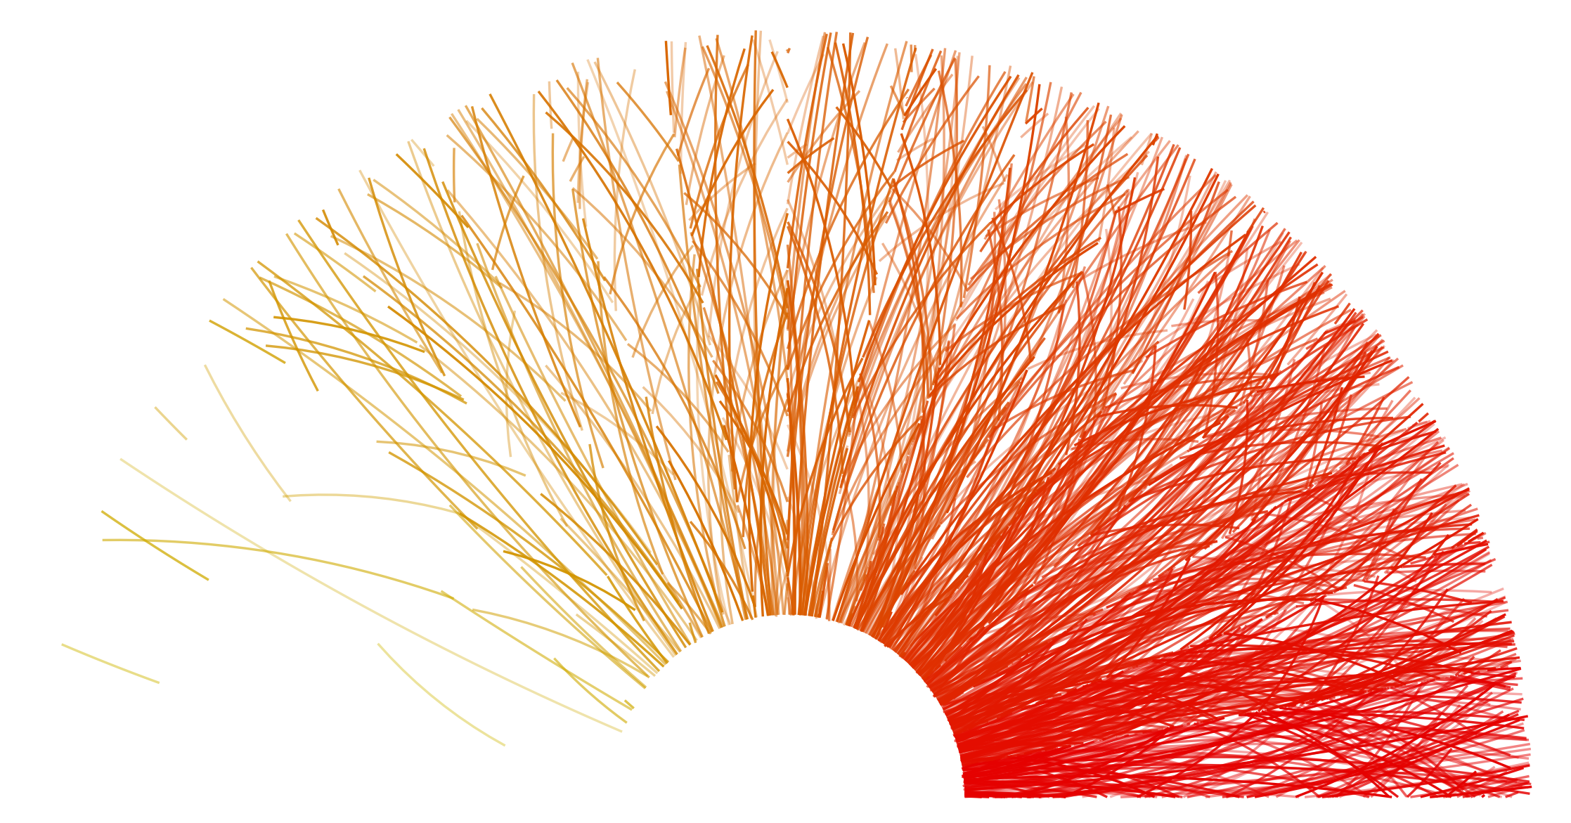
System-size dependence studies at ALICE
Heavy Ion Meeting, 24 May 2019
Beomkyu Kim
INHA Univ. & KoALICE

Slide 2
Multiplicity in different collision systems
p
$$π$$
p
p
$$π$$
$$Λ$$
Particle production in pp collisions
2→2 scattering (LO)
infrared 2->2 scatterings
Multi Parton interactions (MPI)
Initial and Final state radiations
pp collisions

Slide 3
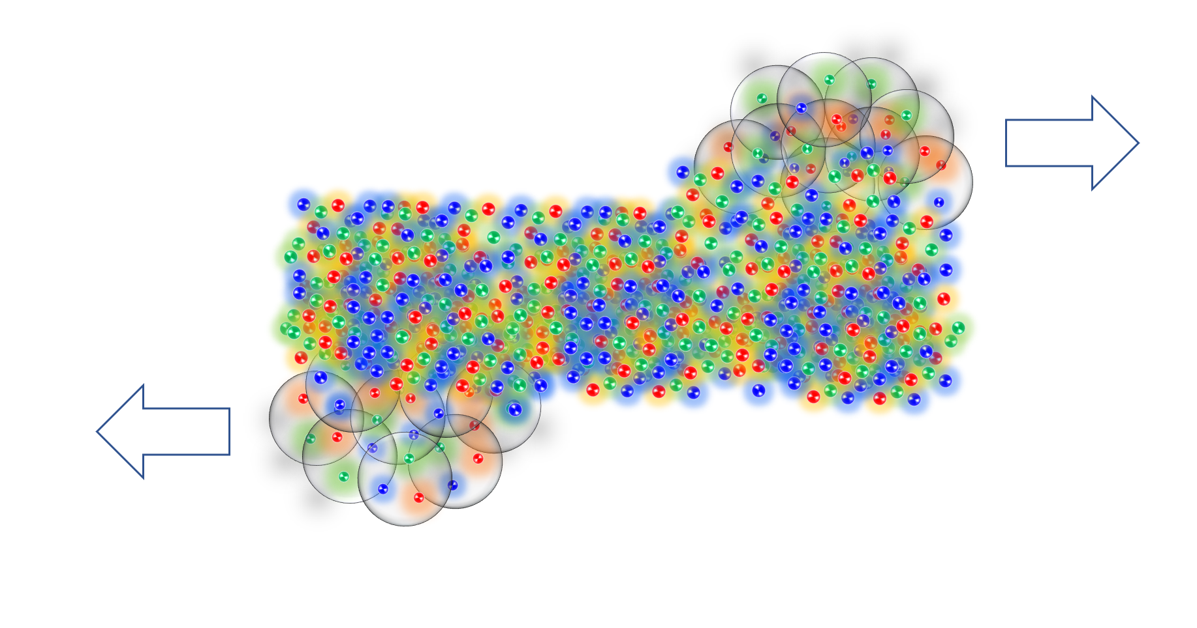
Multiplicity in different system sizes
p
$$π$$
p
p
$$π$$
$$Λ$$
Particle production in pp collisions
2→2 scattering (LO)
infrared 2->2 scatterings
Multi Parton interactions (MPI)
Initial and Final state radiations
Chemically and kinematically equilibrium state
pp collisions
AA collisions

Slide 4
Multiplicity in different system sizes
p
$$π$$
Some threshold?
In-transition?
in between
the two collision systems?
p
p
$$π$$
$$Λ$$
Particle production in pp collisions
2→2 scattering (LO)
infrared 2->2 scatterings
Multi Parton interactions (MPI)
Initial and Final state radiations
Chemically and kinematically equilibrium state
High-multiplicity pp
pA collisions
pp collisions
AA collisions

Slide 5
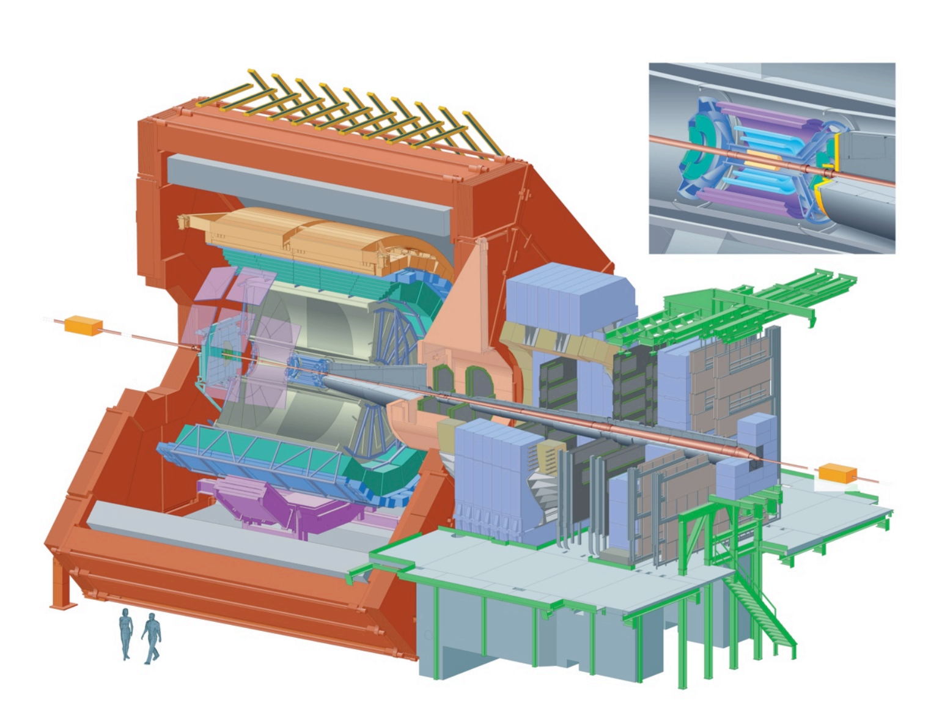
ALICE
Low-momentum tracking and particle identification in a high multiplicity environment

Slide 6
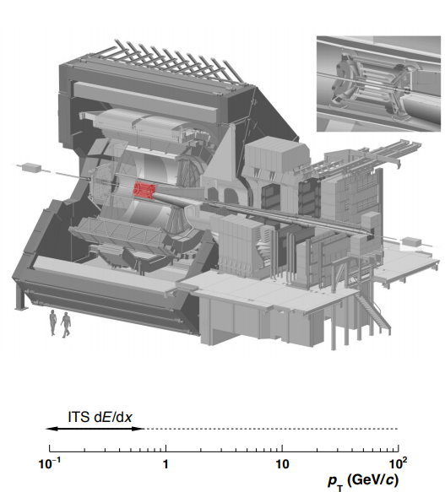
ALICE
ITS ($\left|η\right|<0.9$)
6 layers of Si detector
Trigger, tracking, vertex, PID

Slide 7
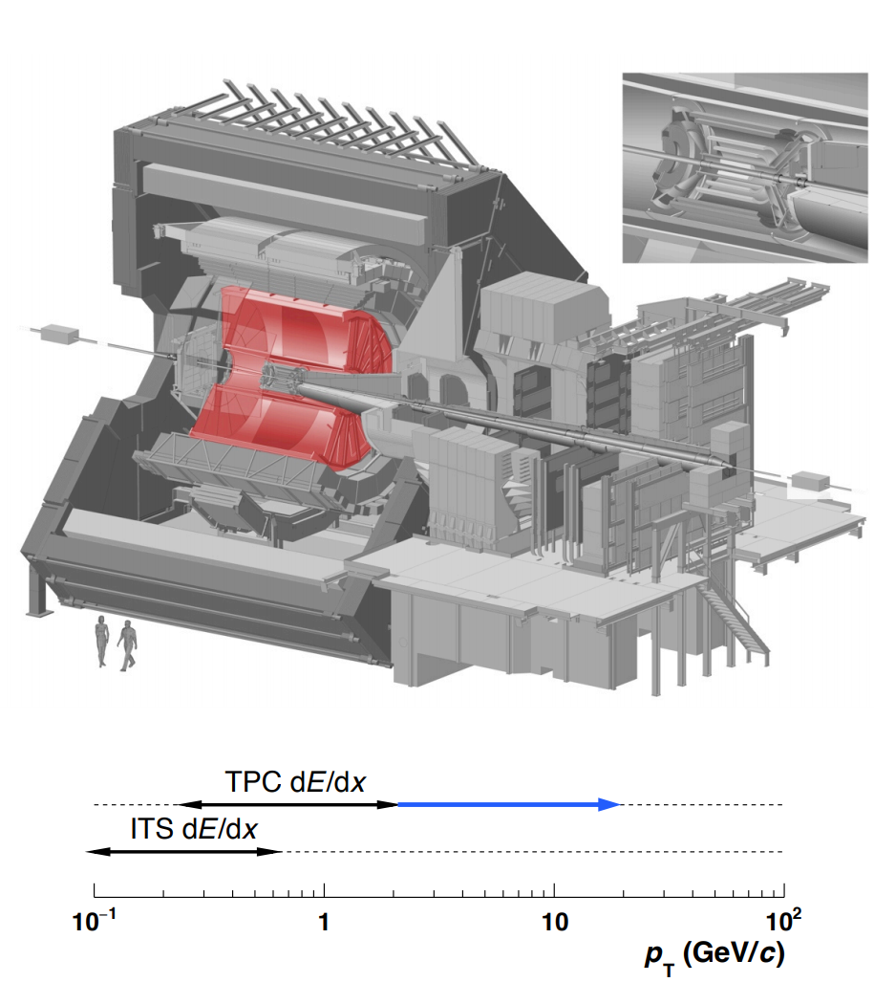
ALICE
ITS ($\left|η\right|<0.9$)
6 layers of Si detector
Trigger, tracking, vertex, PID
TPC ($\left|η\right|<0.9$)
Gas detector
Tracking, vertex, PID

Slide 8
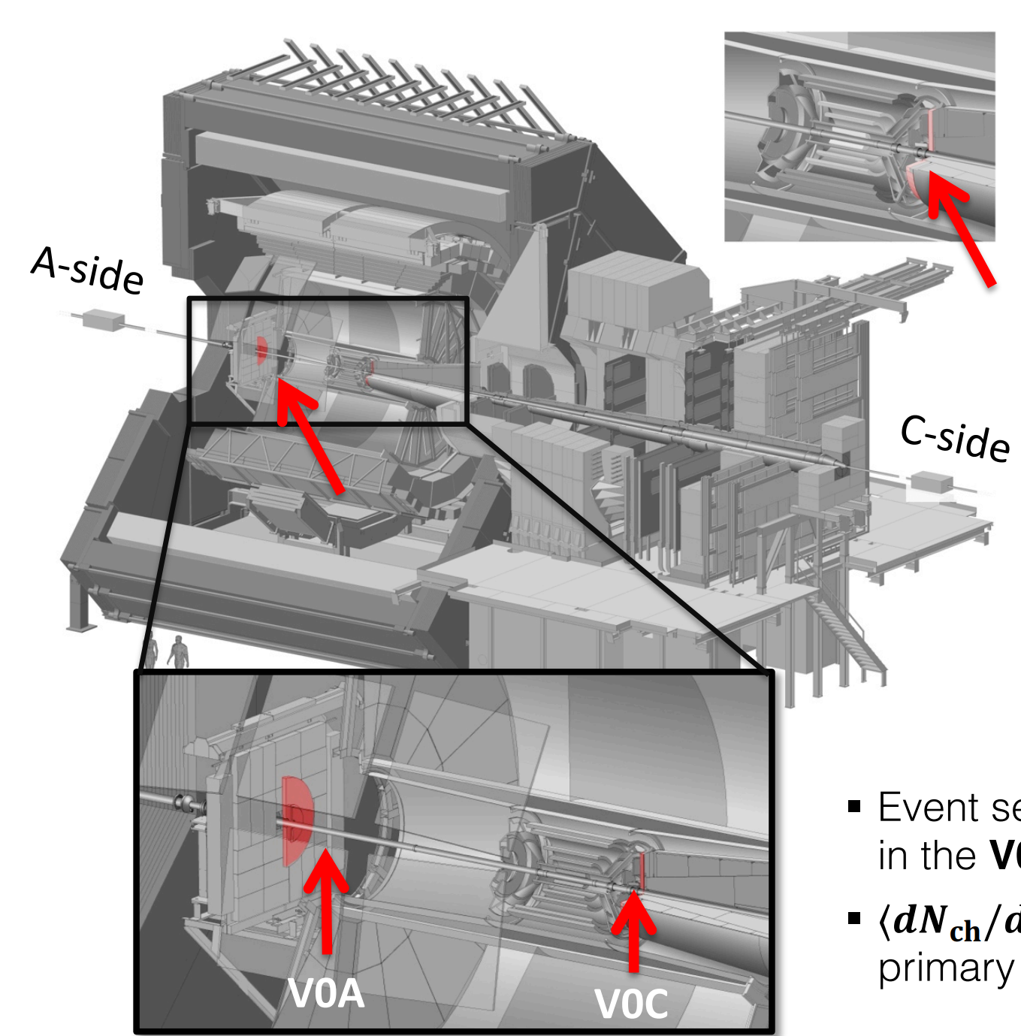
ALICE
ITS ($\left|η\right|<0.9$)
6 layers of Si detector
Trigger, tracking, vertex, PID
TPC ($\left|η\right|<0.9$)
Gas detector
Tracking, vertex, PID
V0 ($2.8<η<5.1, −3.7<η<−1.7$)
Forward arrays of Scintillator
Trigger, beam gas rejection
Multiplicity estimator

Slide 9
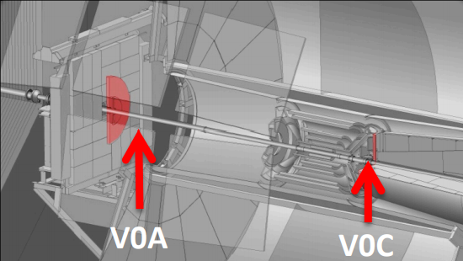
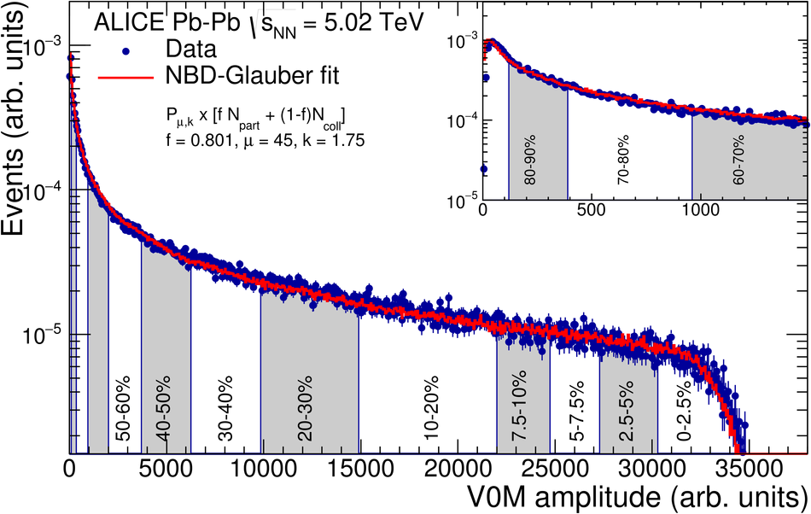
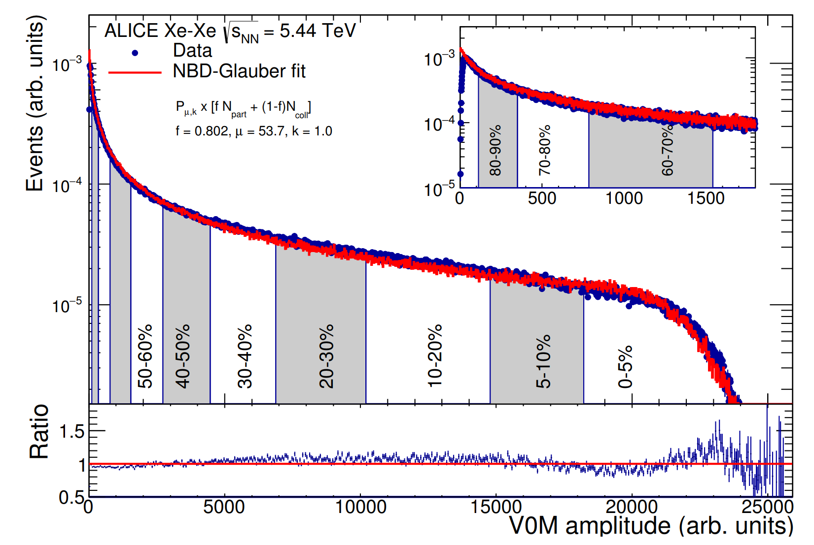
Multiplicity (and centrality) estimation
V0 detector
Centrality estimation in AA collisions
V0M is the energy deposited in V0A & V0C
V0M multiplicity fitted with MC-Glauber
Pb—Pb
Xe—Xe
ALICE-PUBLIC-2018-003
ALICE-PUBLIC-2018-003

Slide 10
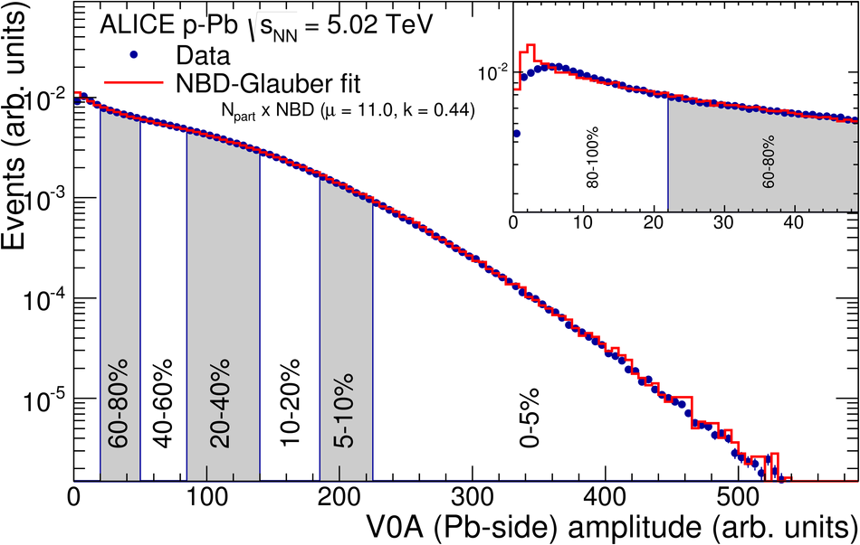
Multiplicity (and centrality) estimation
V0 detector
Centrality estimation in AA collisions
V0M amplitude fitted with MC-Glauber
Centrality estimation in p—Pb collisions
Pb-outgoing side V0 (V0A) amplitude fitted with MC Glauber
p—Pb
Phys. Rev. C 91 (2015) 064905

Slide 11
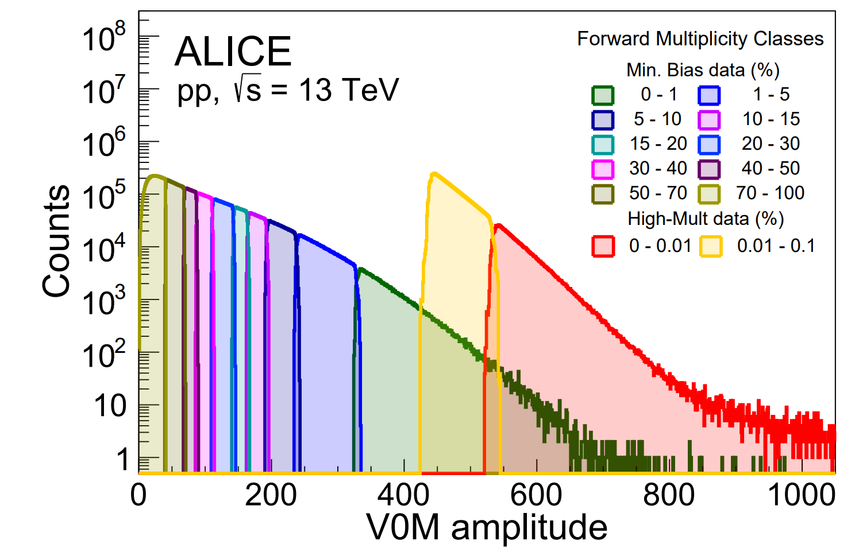
Multiplicity (and centrality) estimation
V0 detector
Centrality estimation in AA collisions
V0M amplitude fitted with MC-Glauber
Centrality estimation in p—Pb collisions
Pb-outgoing side V0 (V0A) amplitude fitted with MC Glauber
Multiplicity percentile estimation in pp collisions
Raw V0M amplitude is used

Slide 12
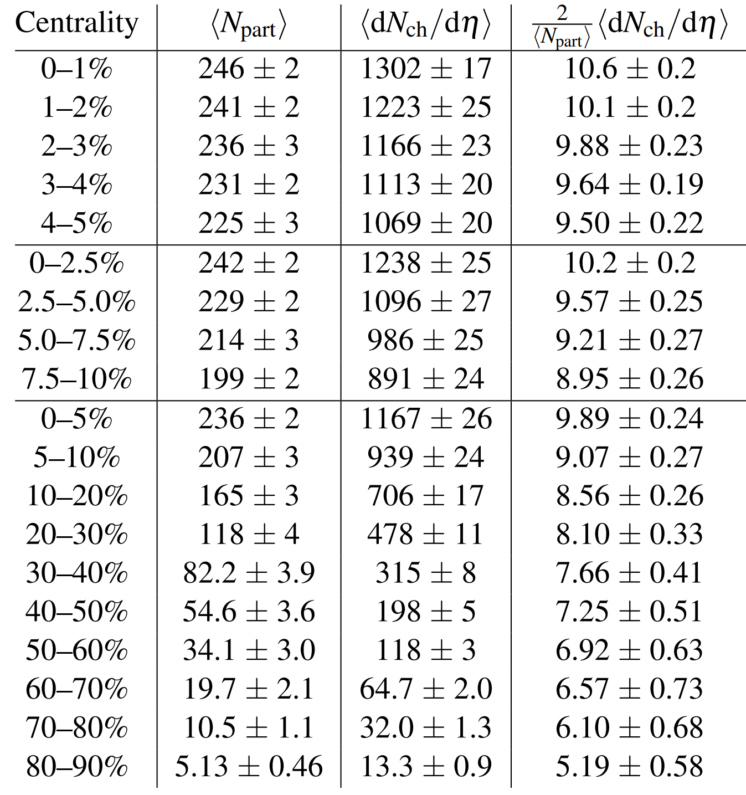
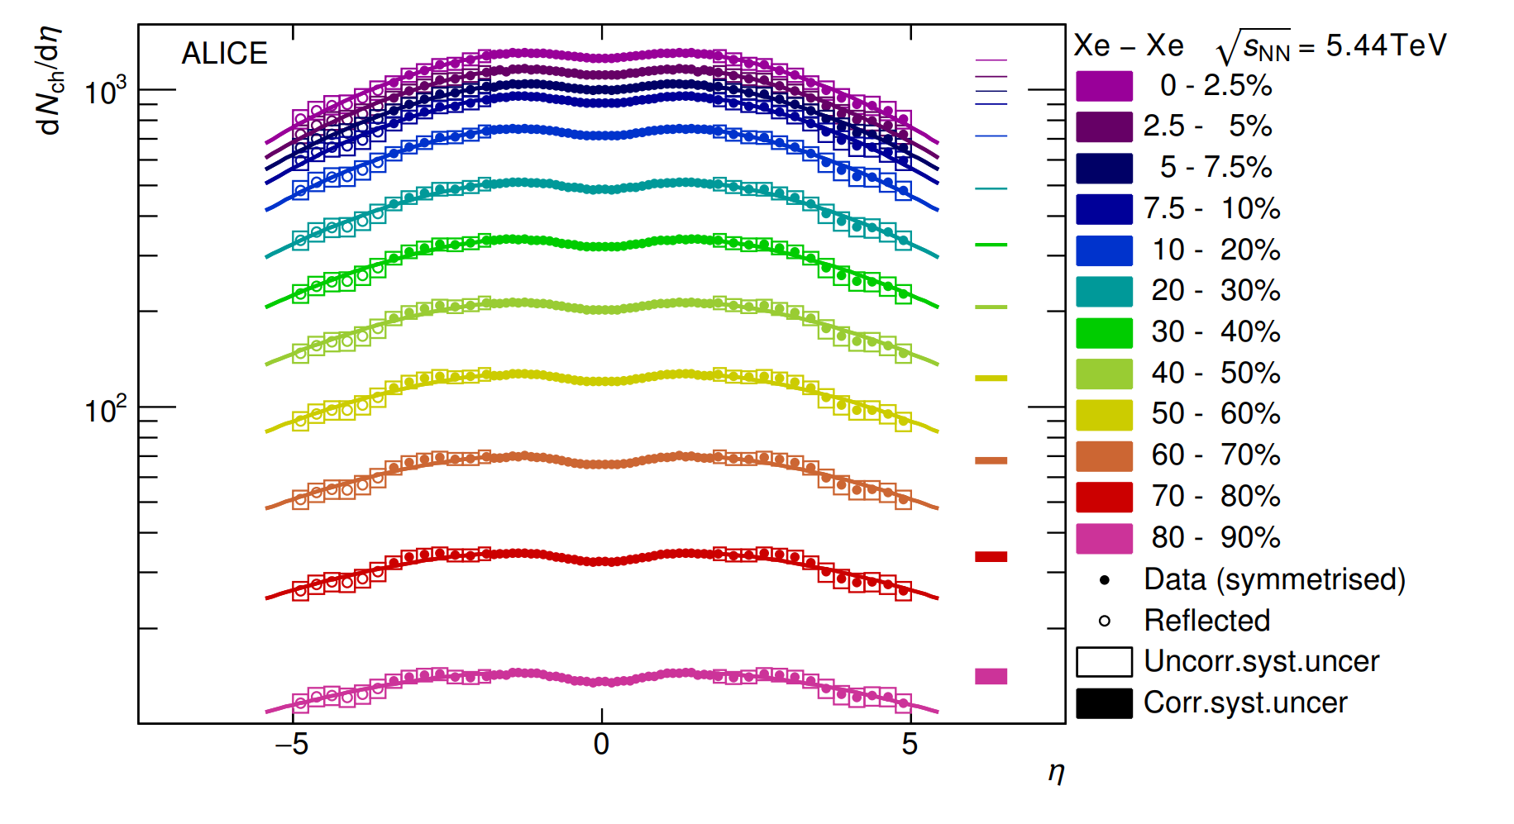
Multiplicity density measurement
Multiplicity density in all systems
SPD : innermost two silicon layers of ITS
Track counting : A short track segment reconstructed with two hits on the SPD that can be extendable to the primary vertex
Phys. Lett. B 790 (2019) 35-48

Slide 13
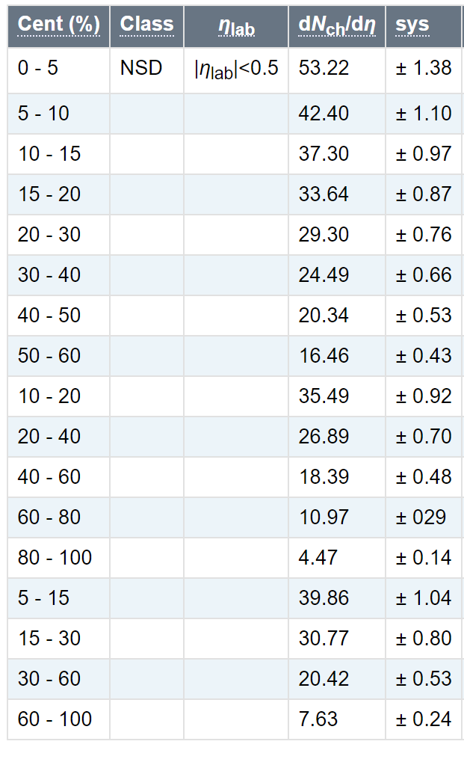
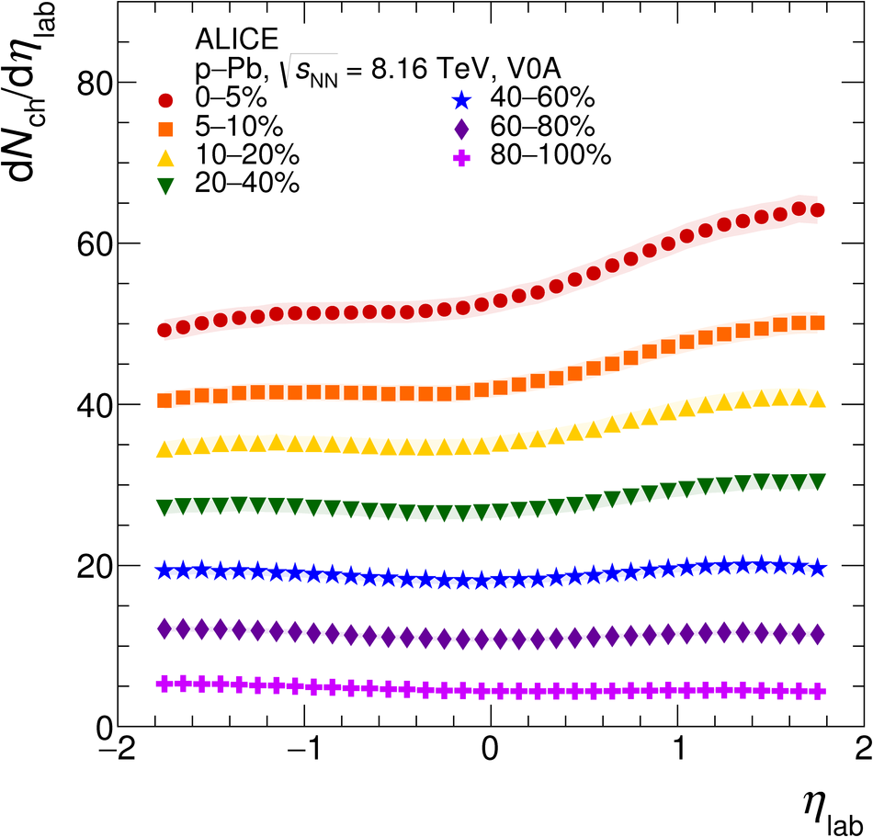
Multiplicity density measurement
Multiplicity density in all systems
SPD : innermost two silicon layers of ITS
Track counting : A short track segment reconstructed with two hits on the SPD that can be extendable to the primary vertex
Eur. Phys. J. C (2019) 79: 307

Slide 14
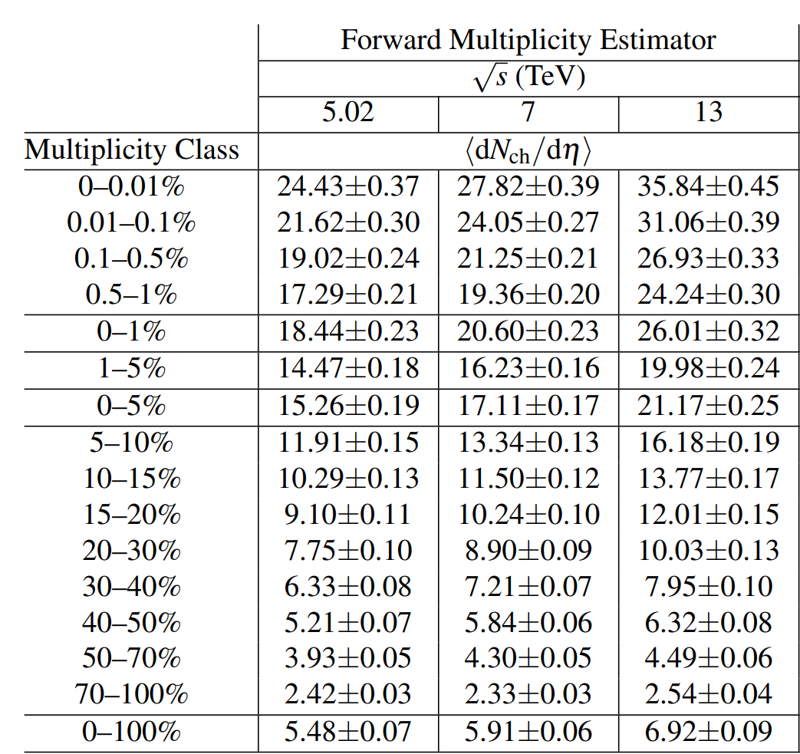
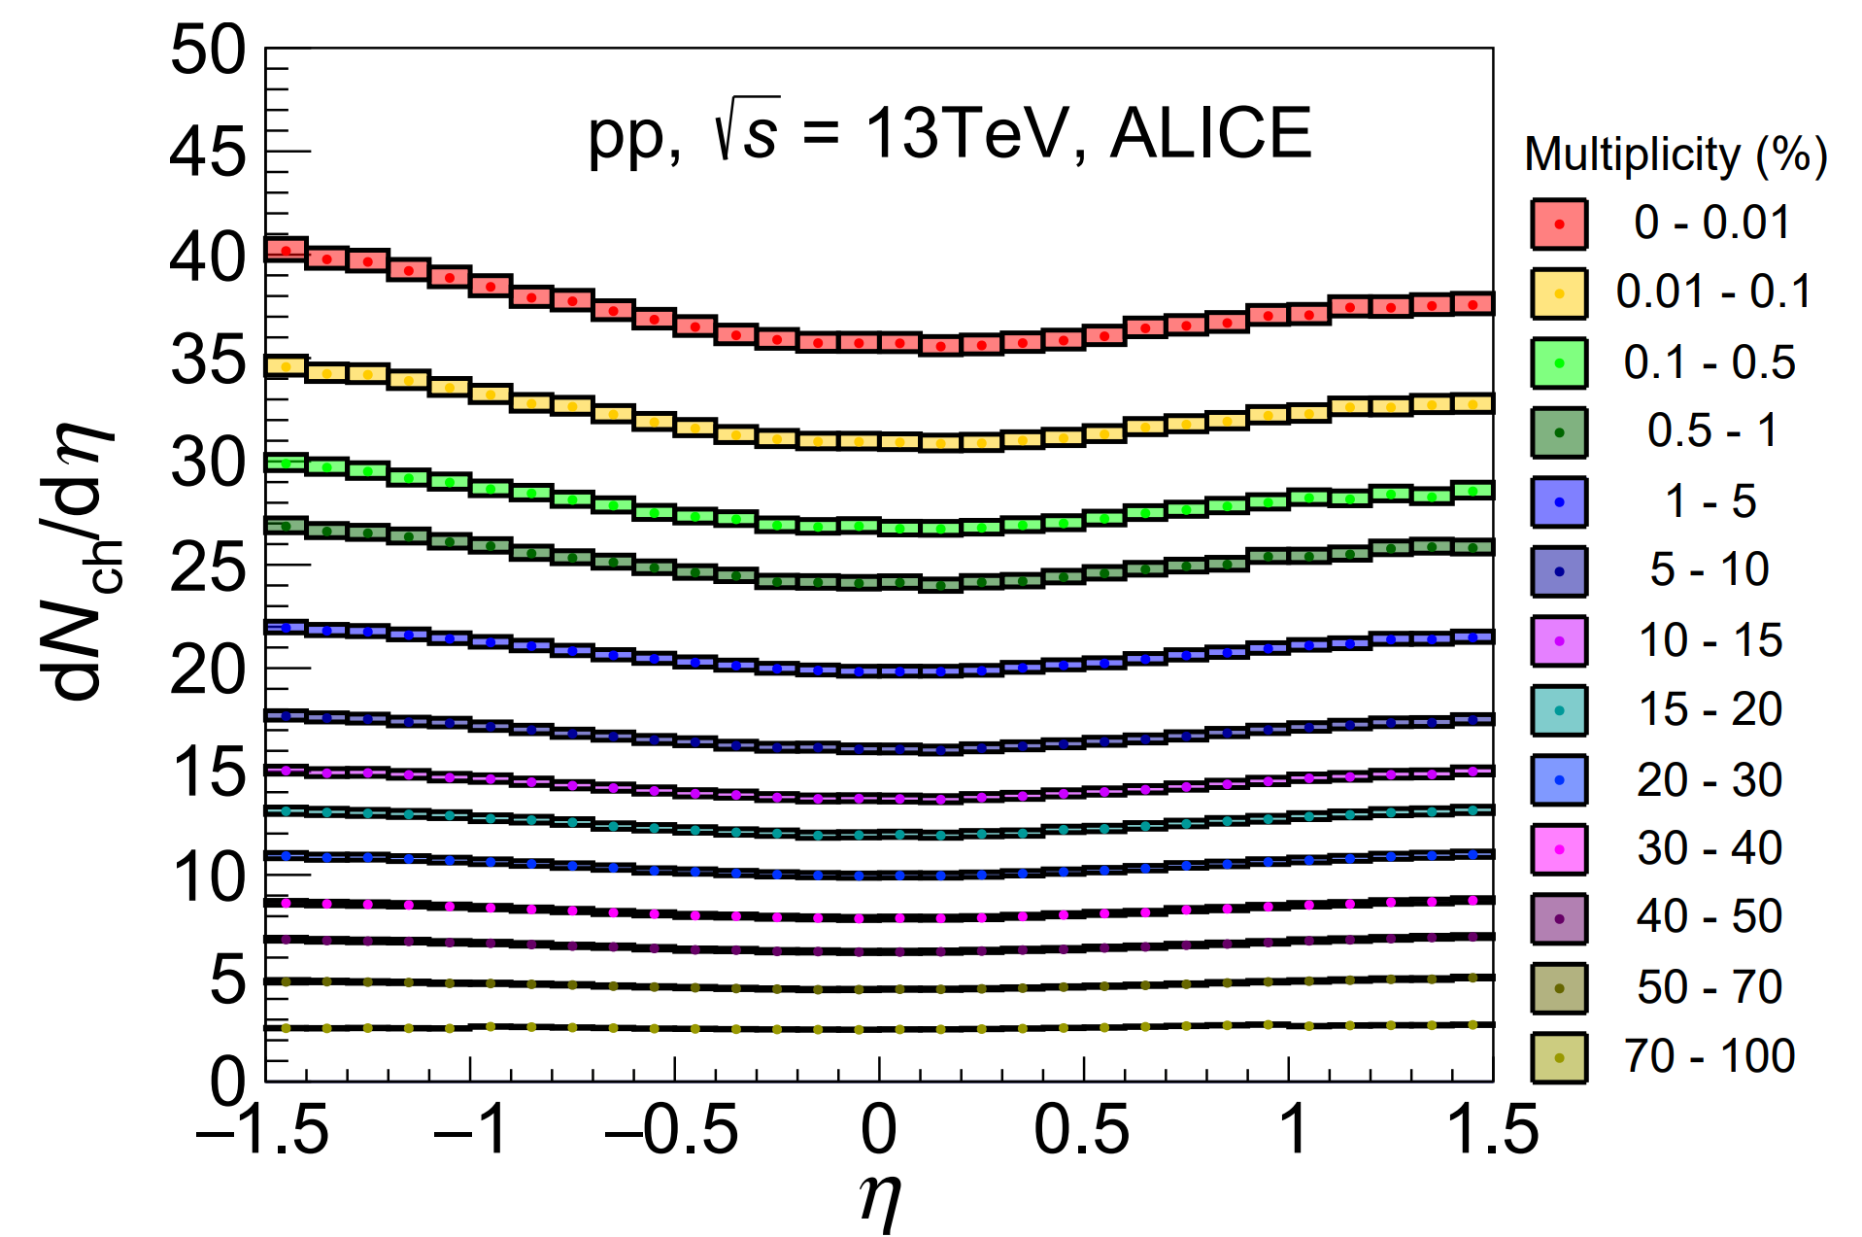
Multiplicity density measurement
Multiplicity density in all systems
SPD : innermost two silicon layers of ITS
Track counting : A short track segment reconstructed with two hits on the SPD that can be extendable to the primary vertex

Slide 15
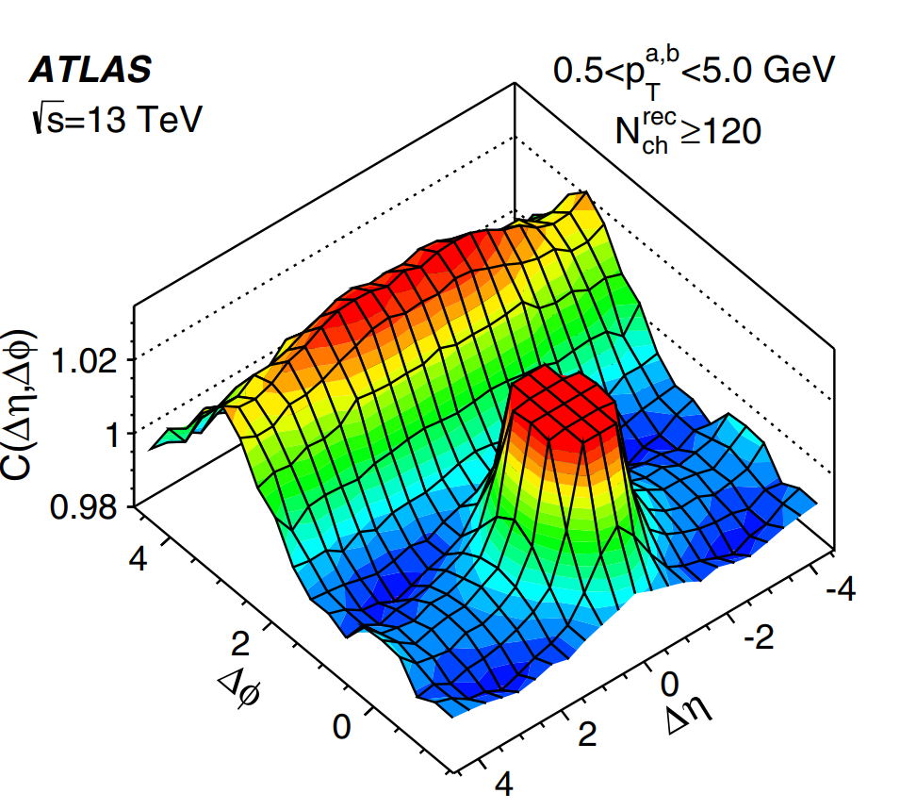
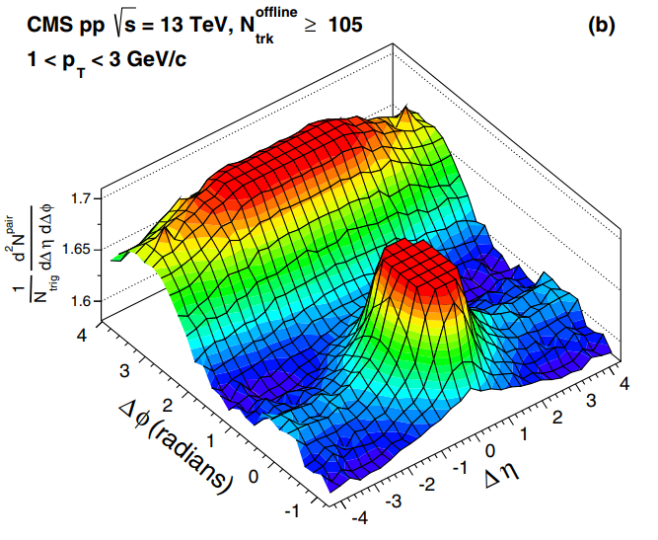
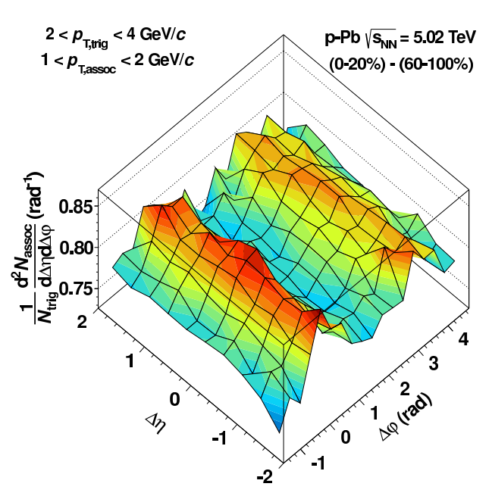
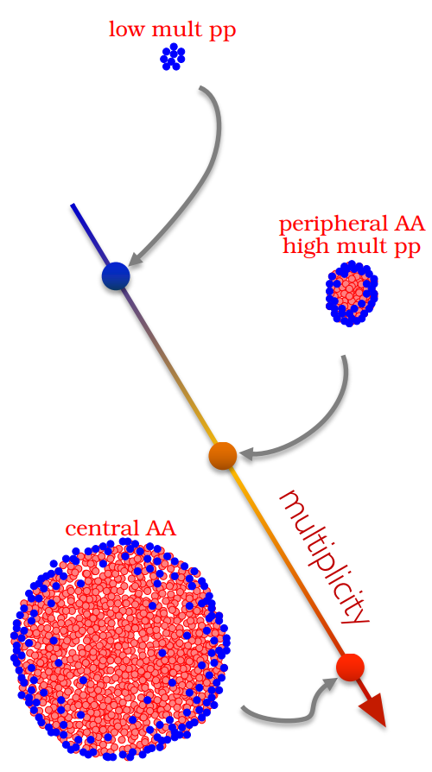
QGP-like effects in small systems
High-Multiplicity (HM) pp collisions
p—Pb collisions
ATLAS, $\sqrt{s}=13$ TeV
PRL 116, 172301 (2016)
CMS, $\sqrt{s}=13$ TeV
PRL 116, 172302 (2016)
ALICE, $\sqrt{s_{NN} }=5.02$ TeV
PRL 116, 172302 (2016)
Color Reconnection
EPOS LHC, Color flux tube (Core & Corona)
p
p
p
p
Two models introduced recently for the long range correlations in high multiplicity pp collisions by constraining the increased MPI !

Slide 16
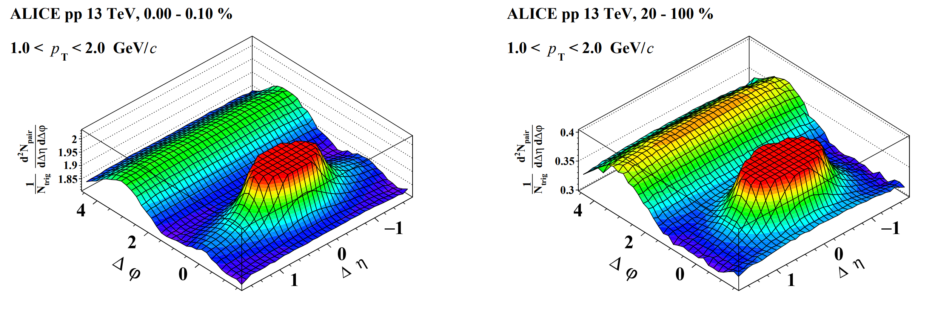
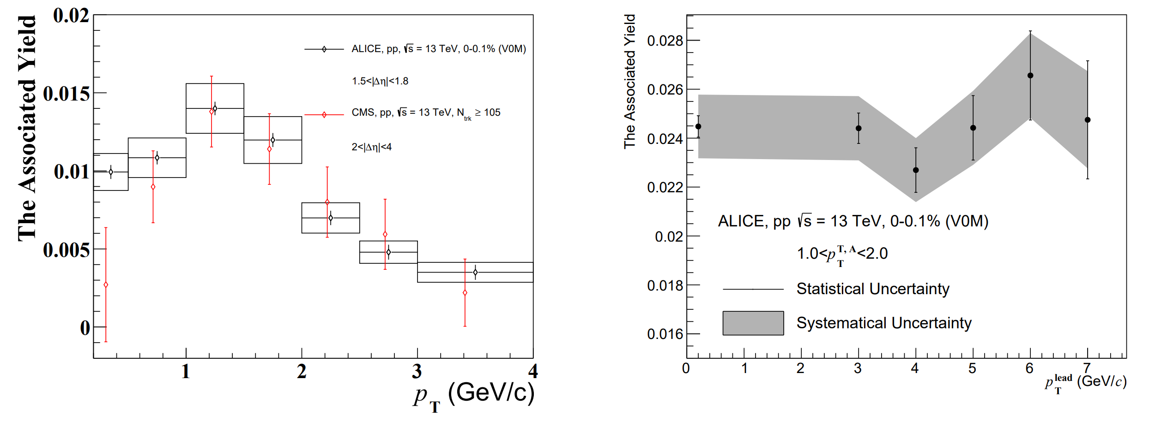
Ridge in pp collisions at ALICE
Junlee Kim, Chonbuk National Univ.

Slide 17
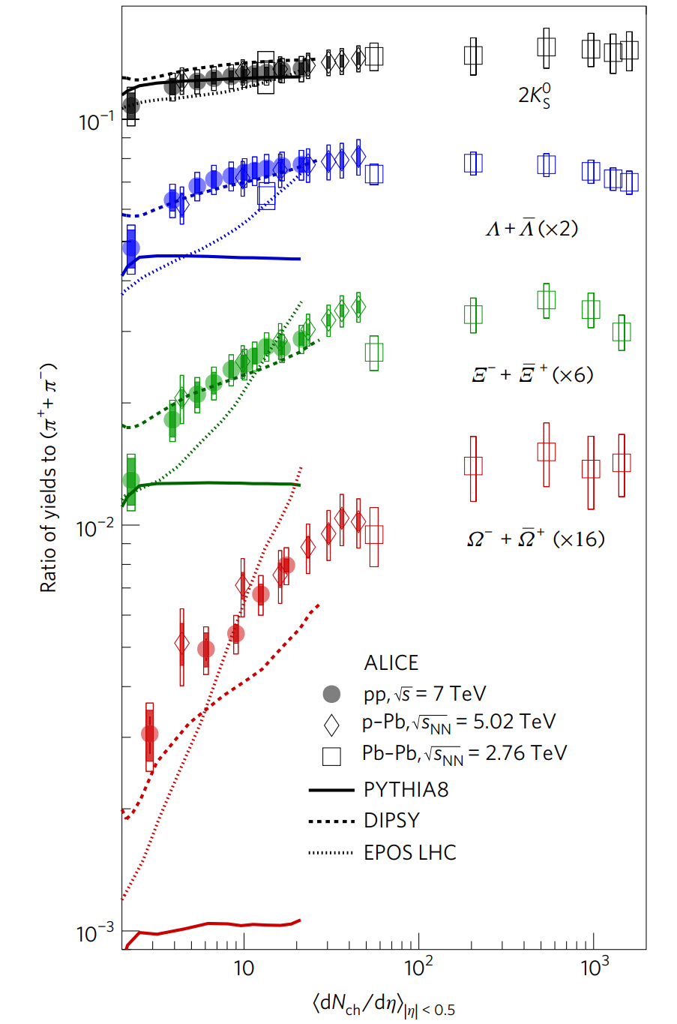
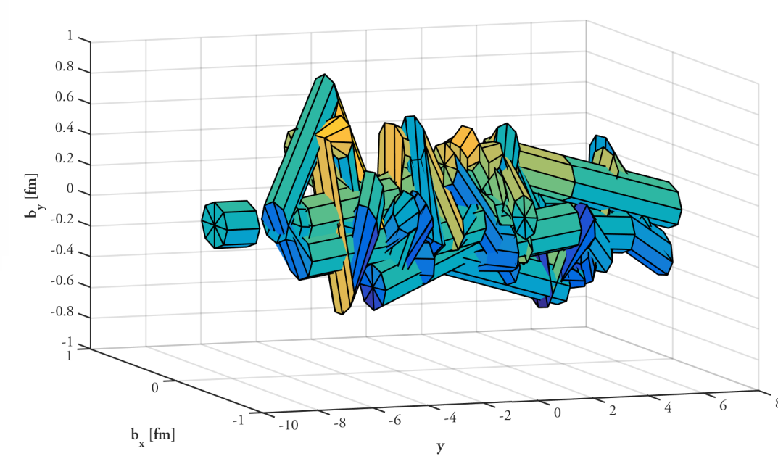
Strangeness enhancement
One of the original traces of the QGP
Thermal production via gluon fusion in a QGP medium
$K_{S}^{0}$, $Λ$, $Ξ$and $Ω$ in Pb-Pb at 5.02 TeV
Production w.r.t to $π$ enhanced
Also studied in p—Pb and pp
Strangeness increases with multiplicity following the universal trend
PYTHIA default
Not describe the enhancement
EPOS LHC
Hydrodynamic treatment
DIPSY (PYTHIA8 + ROPE)
Like the Color Reconnection
strings may overlap to form color ropes
Increased tension → increase strangeness
Nat. Phys. 13 (2017) 535-539

Slide 18
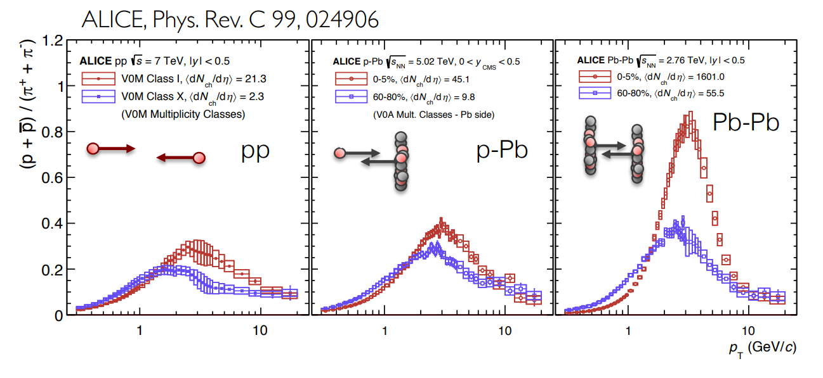
$p/π$
ALICE, Phys. Rev. C 99, 024906
Behavior known from Pb-Pb collisions
Interpreted as radial flow:
p are pushed to higher momenta by a common velocity field
Same behaviors in pp and pA collisions with respect to system size

Slide 19
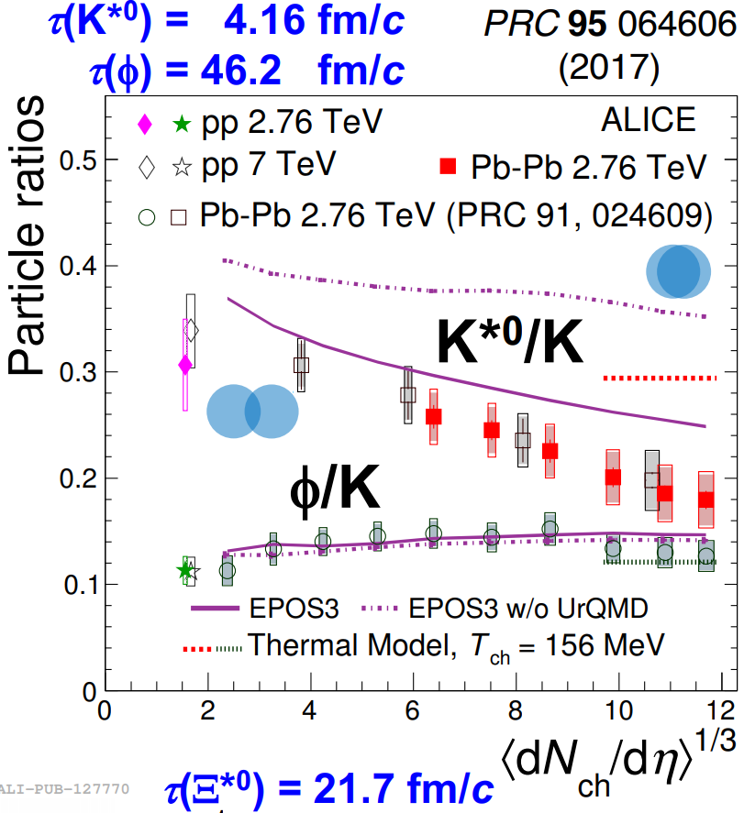
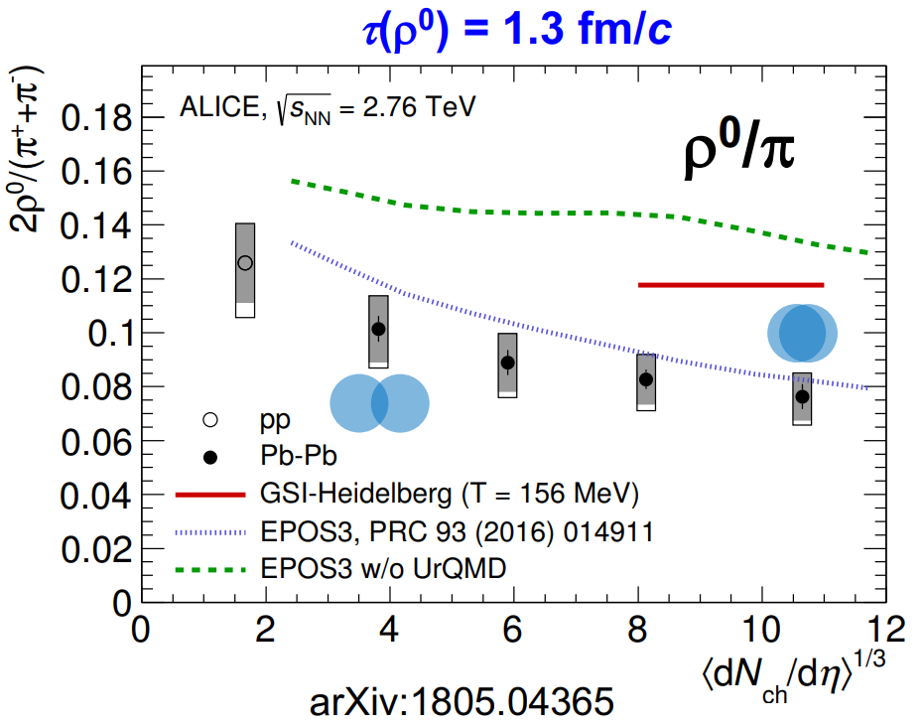
Resonance suppression
Re-scattering of decay products in hadronic medium

Slide 20
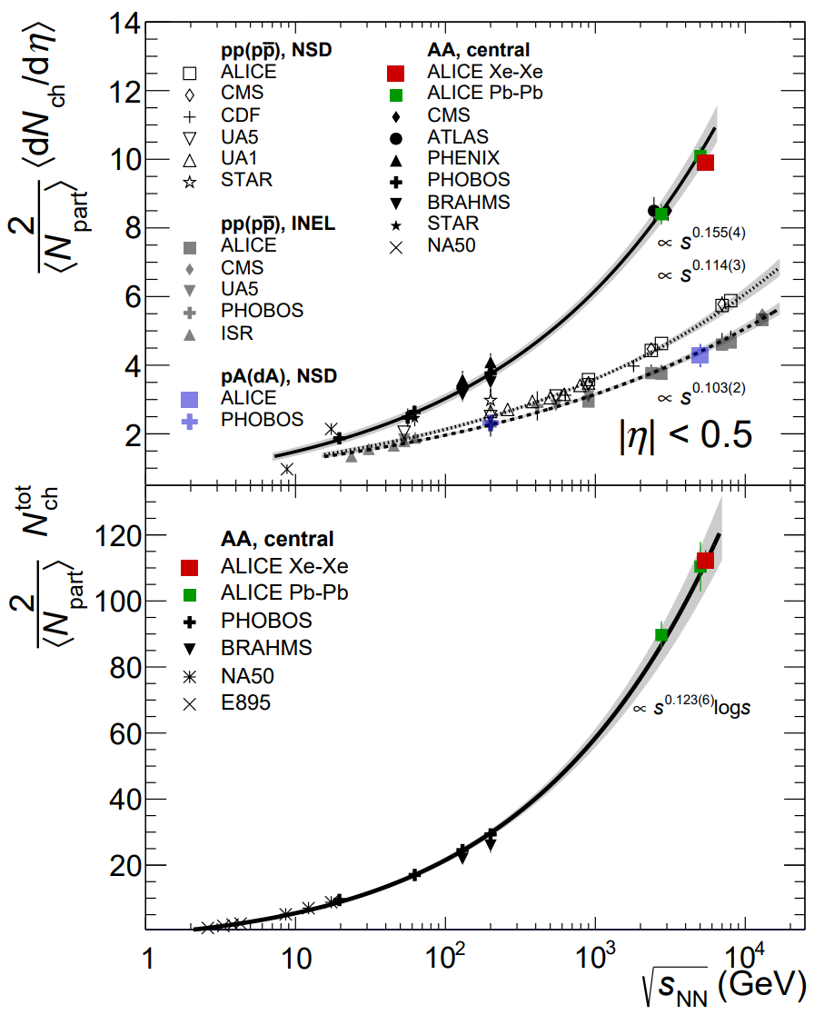
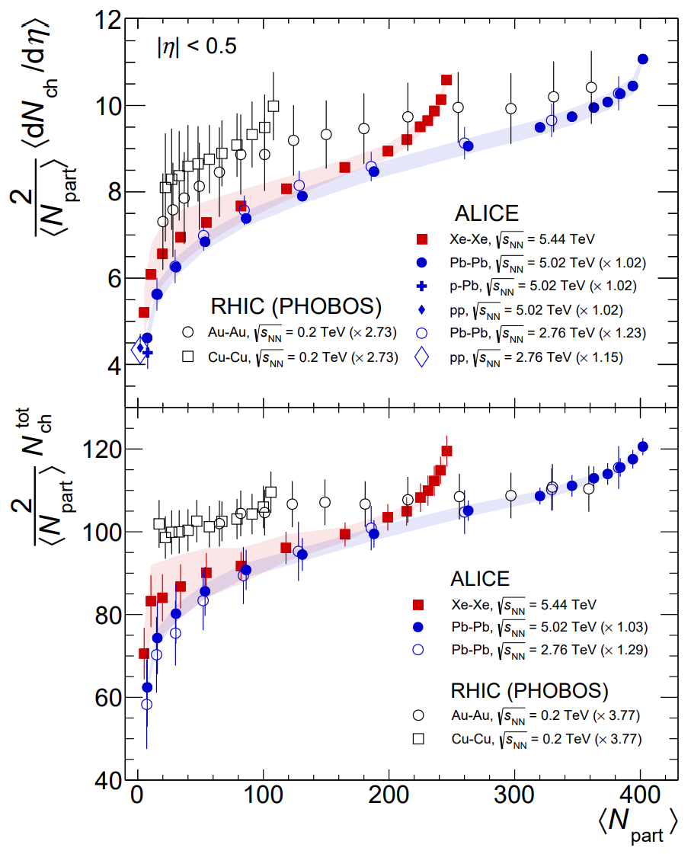
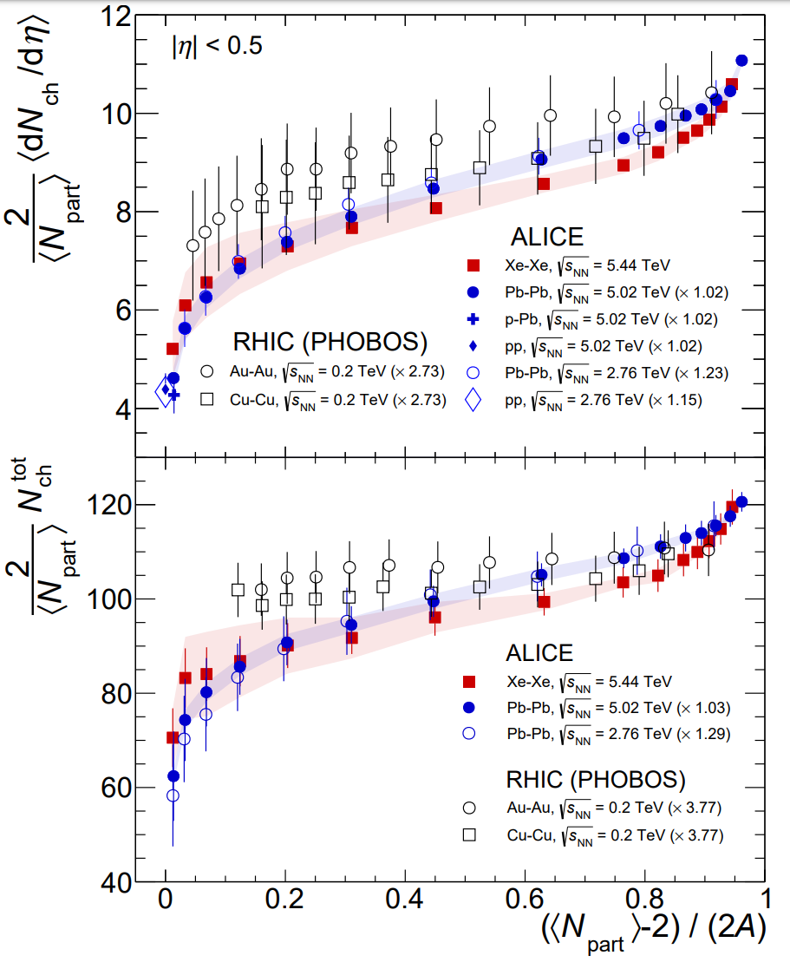
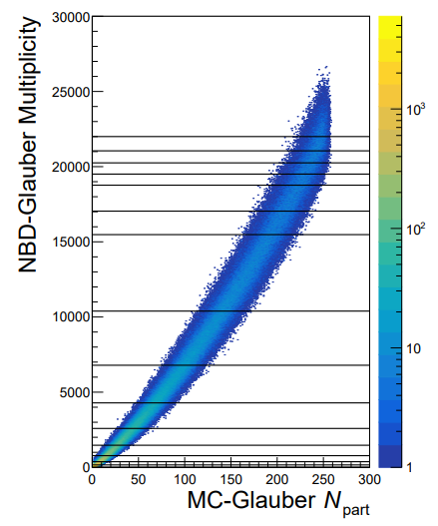
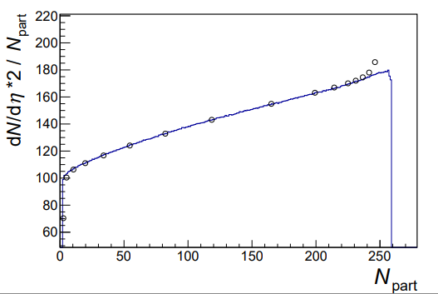
Medium-sized system (Xe—Xe )
Phys. Lett. B 790 (2019) 35-48

Slide 21
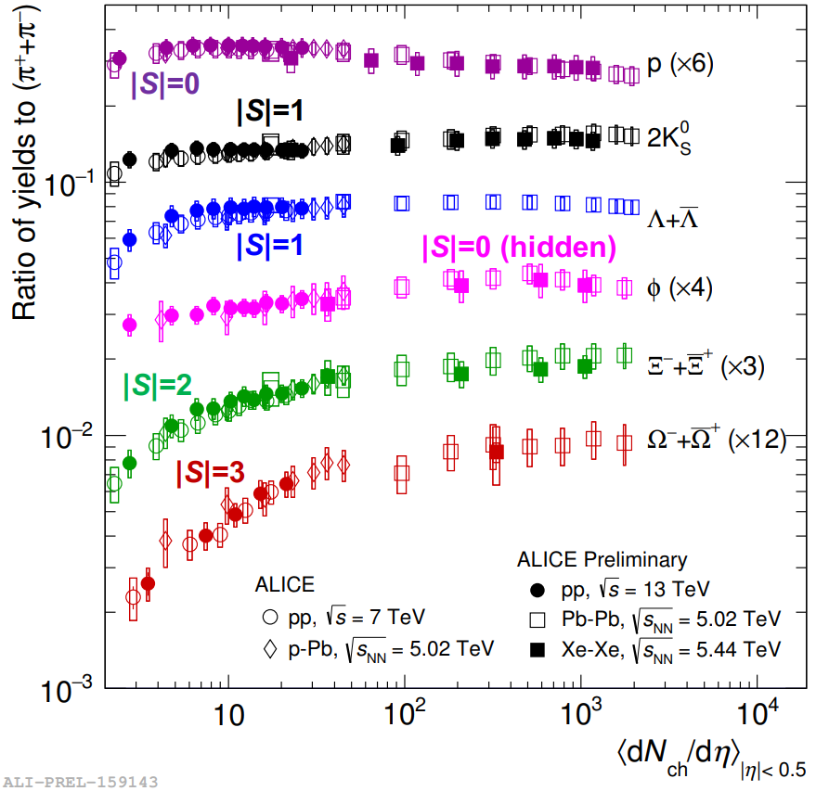
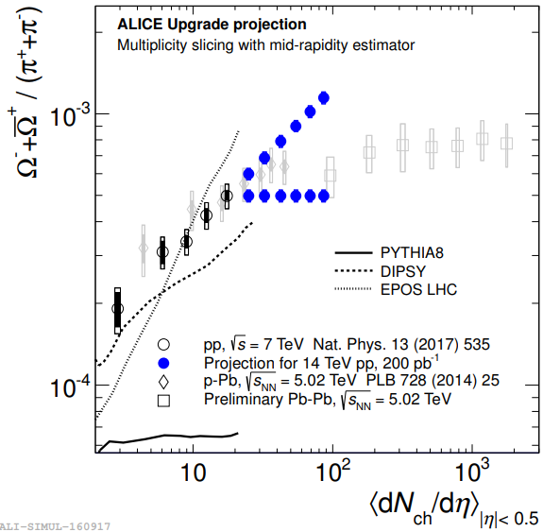
Medium-sized system (Xe—Xe )
Results from Xe—Xe confirm that multiplicity is the key observable for relative particle abundances
No energy dependence
Hadron chemistry is driven by the multiplicity (system size)
or OO collisions in RUN3+4

Slide 22
Summary
Multiplicity
Key variable to connect pp to Pb—Pb collisions via high-multiplicity pp and medium sized AA collisions
Fundamental constraints to theory
PYTHIA Rope, EPOS LHC and Color Reconnection
Re-establishment of observables as a function of system size in Heavy-ion Physics
Providing system-size information to ALICE and involved in various system-size dependent studies

