Slide 1
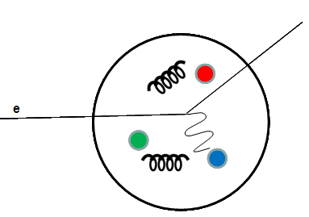
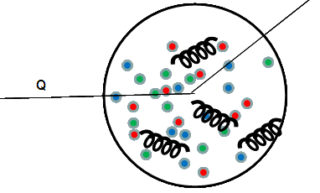
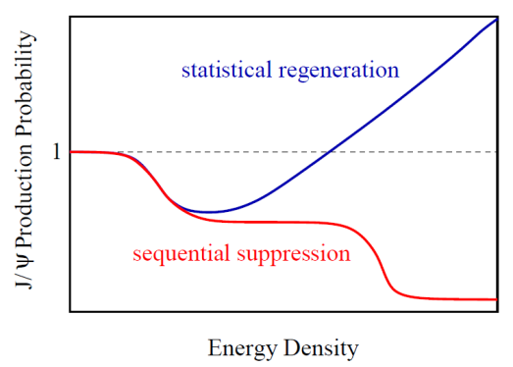
Quarkonia as a Probe of QGP
Pengfei Zhuang Physics Department, Tsinghua University, Beijing
● Why is quarkonium a thermometer of QGP ? Unlike light quarks which can be largely produced in hot medium, 1) heavy quarks are mainly created in the initial impact of the collisions, and 2) the production process is controlled by pQCD. Similar to electrons which are used to probe the QED structure of a nucleon, heavy quarks can signal the QCD structure of the fireball in heavy ion collisions.
electrons and heavy quarks as QED and QCD probes
Zhu, Bleicher, Huang, Schweda, Stoecker, Xu, Zhuang, PLB647 (2007) 366-370
PBM, Stachel, Thews
● Cancellation between suppression and
regeneration
● How to increase the sensitivity of the
thermometer ?
Matsui, Satz

Slide 2
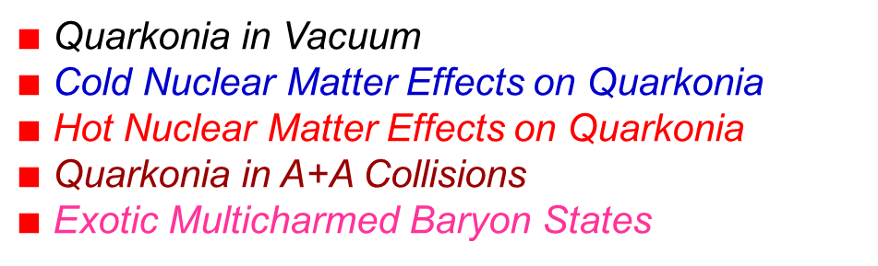
$∎$Quarkonia in Vacuum $∎$Cold Nuclear Matter Effects on Quarkonia $∎$Hot Nuclear Matter Effects on Quarkonia $∎$Quarkonia in A+A Collisions $∎$Exotic Multicharmed Baryon States

Slide 3
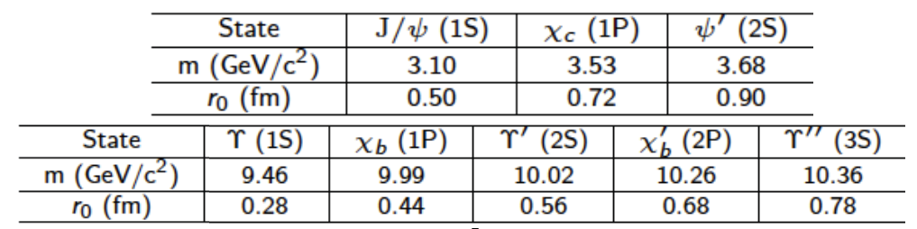
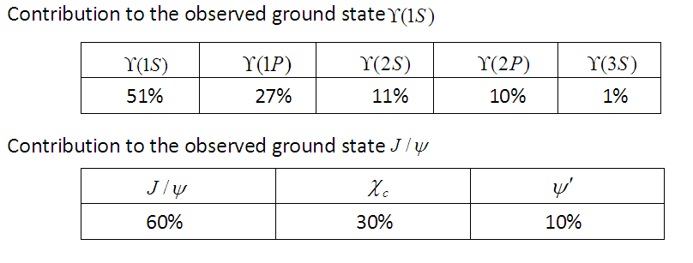
Quarkonium Properties in Vacuum

Slide 4
Potential Model in Vacuum
production:
Quarkonium formation:
radial equation for the relative motion between $Q$ and $\overline{Q}$
three parameters
by fitting the quarkonium masses
Solution: binding energy and radial wave function

Slide 5
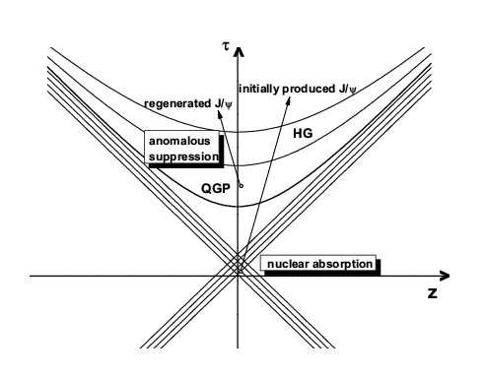
Cold and Hot Nuclear Matter Effects
Hot Nuclear Matter effects: 1)suppression in fireball 2)regeneration in fireball
Cold Nuclear Matter effects: 1)shadowing effect 2)Cronin effect 3)nuclear absorption
from screening to regeneration

Slide 6
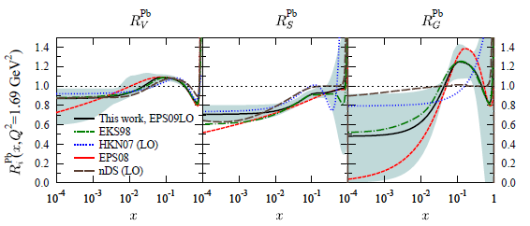


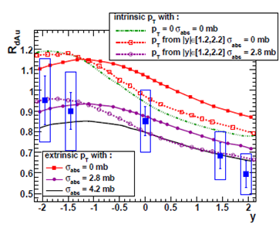
Shadowing Effect
parton distribution function (PDF) in a nucleus is different from a simple superposition (Glauber model) of the PDF in a free nucleon.
R.Vogt, Phys.Rept.310, 197(1999)
shadowing correction factor:
shadowing effect + nuclear absorption can explain the pA data at RHIC.

Slide 7
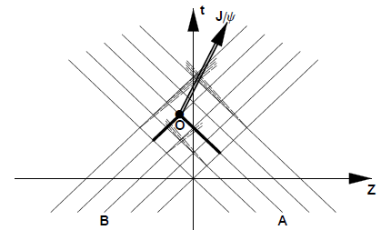
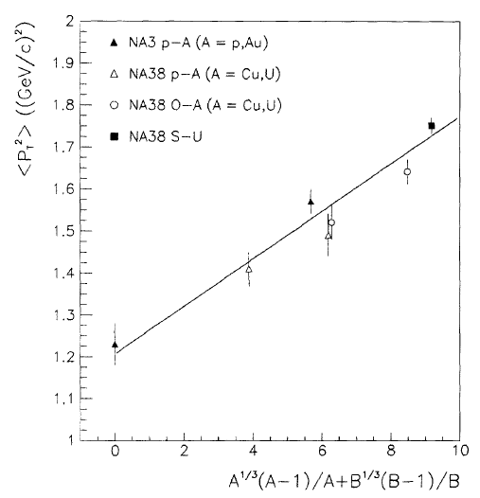
Cronin Effect
transverse momentum broadening due to gluon multiscattering with nucleons before they fuse into a pair of $Q\overline{Q}$ :
Gerschel and Huefner, Ann. Rev. Nucl. Part. Sci. 49, 255(1999)
pA and light nuclear collisions at SPS are controlled by cold medium effects.

Slide 8

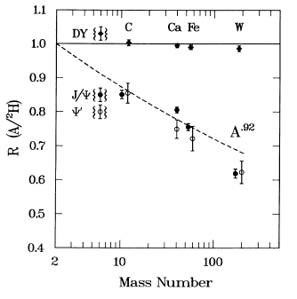
Nuclear Absorption
formed quarkonia are absorbed by the surrounding nucleons before they enter the QGP phase
nuclear absorption can be ignored at high energies (LHC).

Slide 9
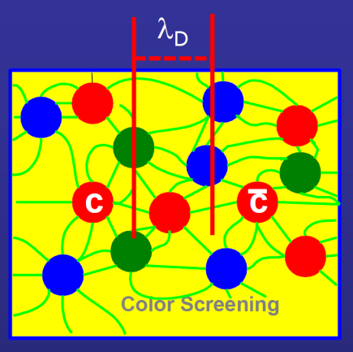
Debye Screening in QGP
medium effects on potential:
1) string tension in deconfinement phase
2) charge rearrangement Debye screening, the charge density seen by Q
becomes small
Coulomb potential Yukawa potential
Debye screening length
Debye screening mass

Slide 10
Estimation of Quarkonium Dissociation Temperature
Hamiltonian of the system at T > T_{c}:
from uncertainty relation
average energy
stability condition
dissociation temperature
from pQCD calculated

Slide 11
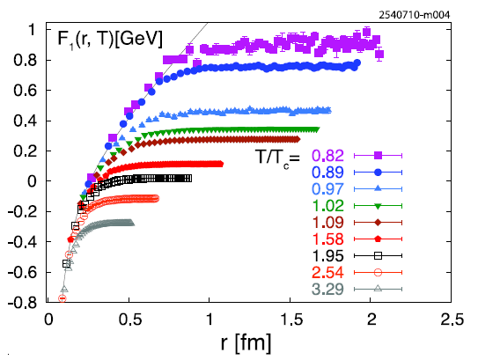
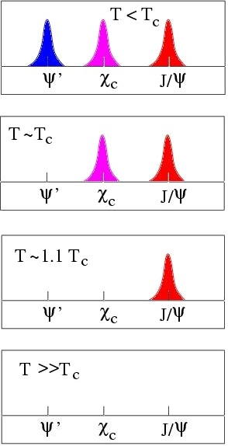


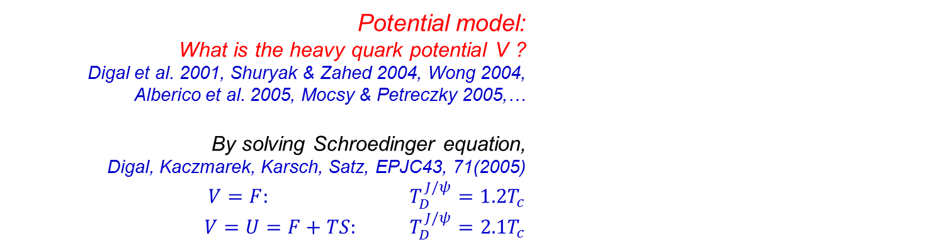
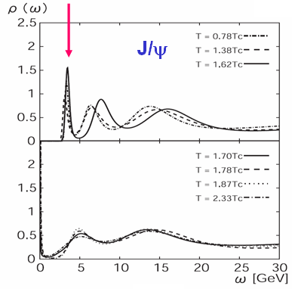
$$V=F or V=U$$
Lattice simulated heavy quark free energy F
Petreczky, JPG37, 094009(2010)
Potential model: What is the heavy quark potential V ? Digal et al. 2001, Shuryak & Zahed 2004, Wong 2004, Alberico et al. 2005, Mocsy & Petreczky 2005,…
By solving Schroedinger equation, Digal, Kaczmarek, Karsch, Satz, EPJC43, 71(2005)
$V=F: T_{D}^{J/ψ}=1.2T_{c}$
$V=U=F+TS: T_{D}^{J/ψ}=2.1T_{c}$
Spectral function
sequential suppression
Liu, Chen, Xu, Zhuang, PLB697, 32(2011)
excited $Υ$ states are sensitive to the potential !
Asakawa and T.Hatsuda, PRL92, 012001(2004)

Slide 12
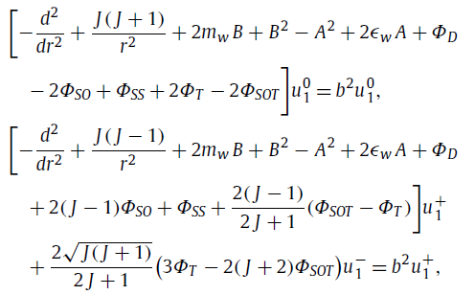
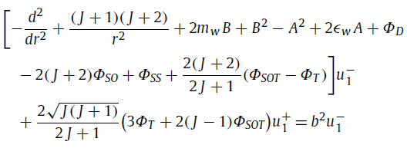
Relativistic Correction
the Dirac equation can be expressed as a group of covariant relativistic Schrodinger equations for the spin triplet $\left(u_{1}^{0},u_{1}^{+},u_{1}^{−}\right)$ and spin singlet $\left(u_{0}\right)$:
H.W.Crater, J.Yoon, and C.Wong, PRD79, 034011(2009
At finite temperature (Guo, Shi and Zhuang, PLB718, 143(2012)):
In comparison with the non-relativistic calculation, the J/ψ $T_{D}$ increases from 1.26Tc to 1.35Tc for V=F and from 2.1Tc to 2.38Tc for V=U.

Slide 13
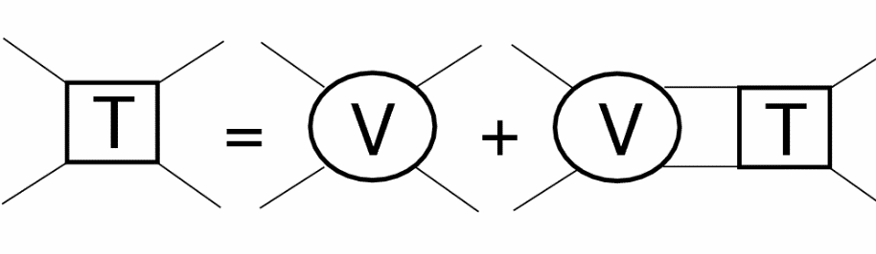
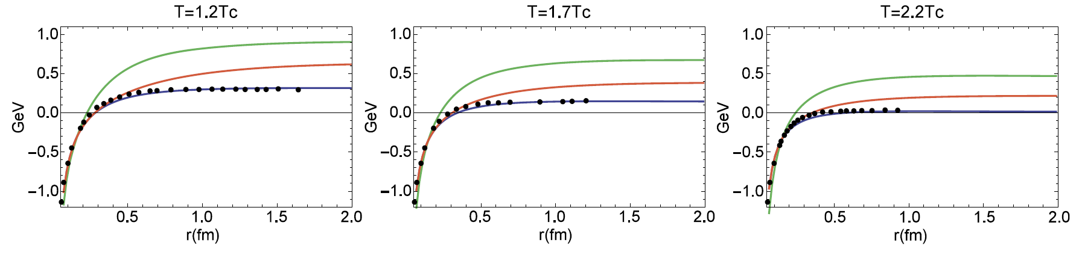
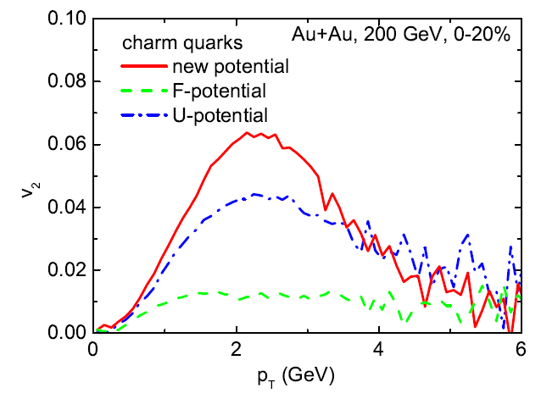
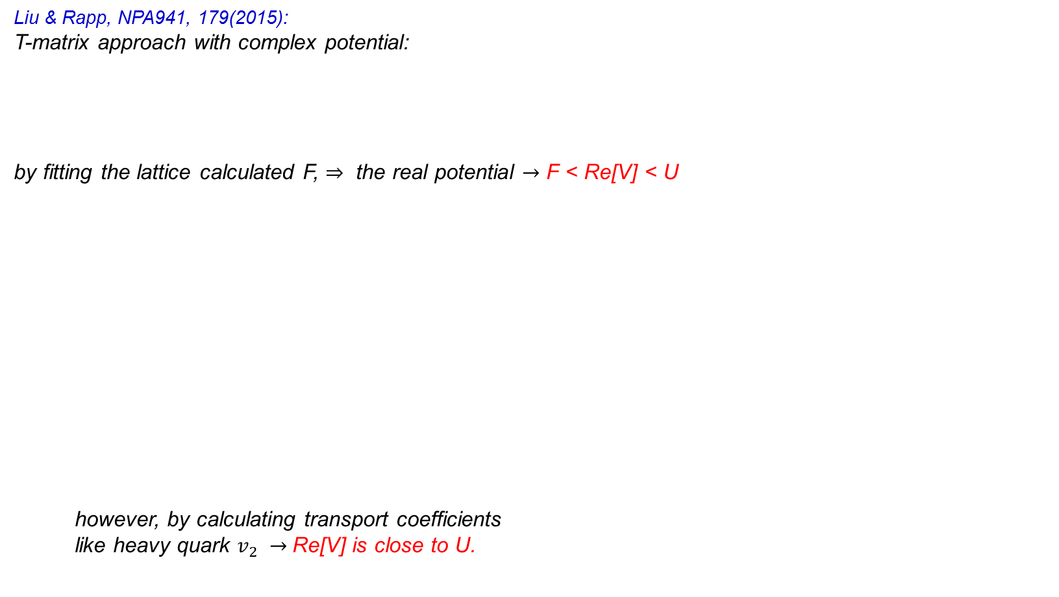
T-matrix Approach
Liu & Rapp, NPA941, 179(2015):
T-matrix approach with complex potential:
by fitting the lattice calculated F, $⇒$ the real potential $→$ F < Re[V] < U
however, by calculating transport coefficients
like heavy quark $v_{2} →$Re[V] is close to U.
[Lipman-Schwinger equation]

Slide 14
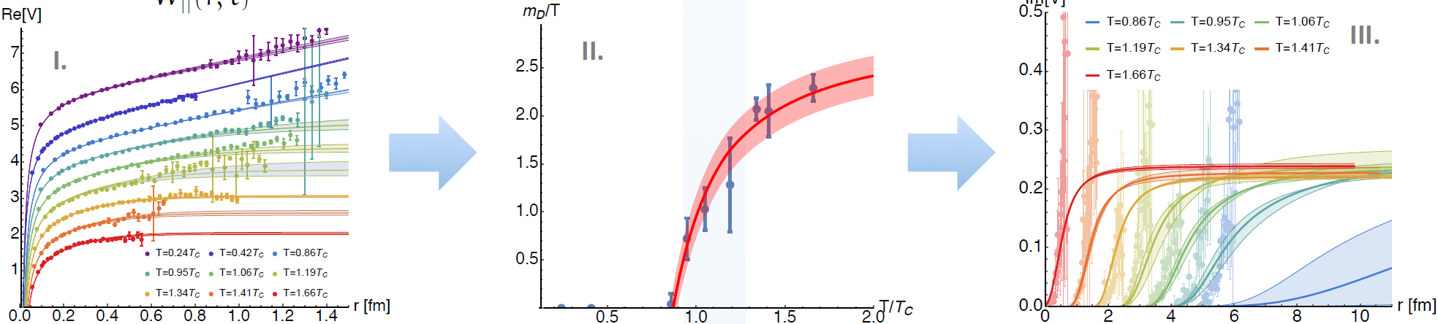


Lattice Simulation
Burnier, Kaczmarek, Rothkopf, JHEP1610, 032(2016): 1) extracting potential V=Re[V] + i Im[V] from lattice simulated spectral function $→$ Re[V] is close to F. 2) parametrization of the potential via an extended Gauss law $→$ Debye screening mass $m_{D}(T)$.
Other lattice simulation (H.Ohno): the limit temperature of J/$ψ$ 1.25 $T_{c}$ supports V=F.
The complex potential is used to describe $Υ$ suppression at LHC (G.Wolschin).

Slide 15
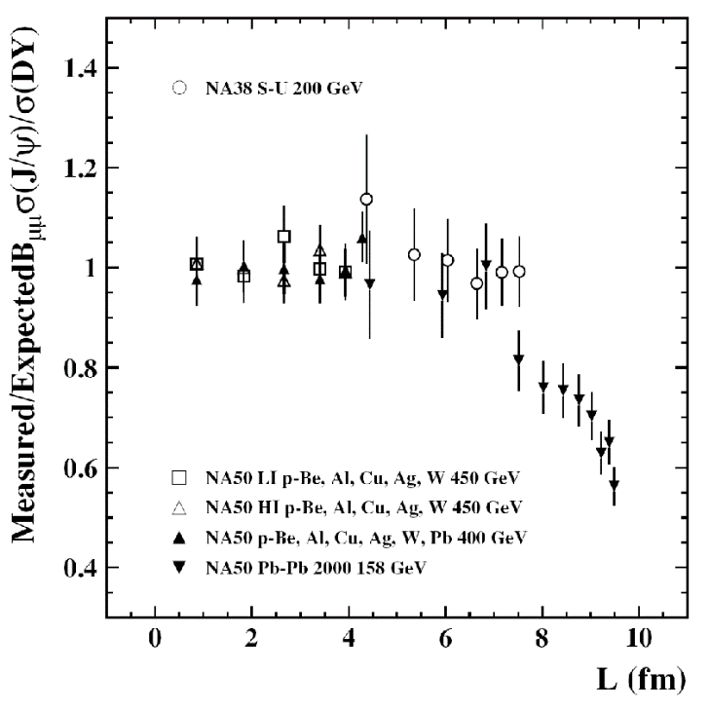

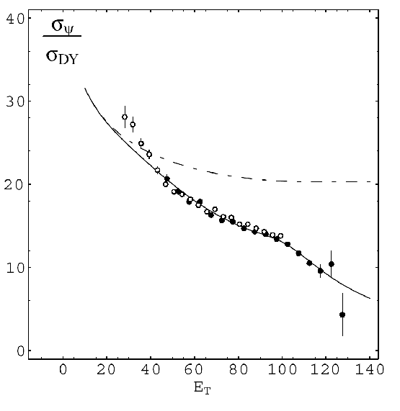
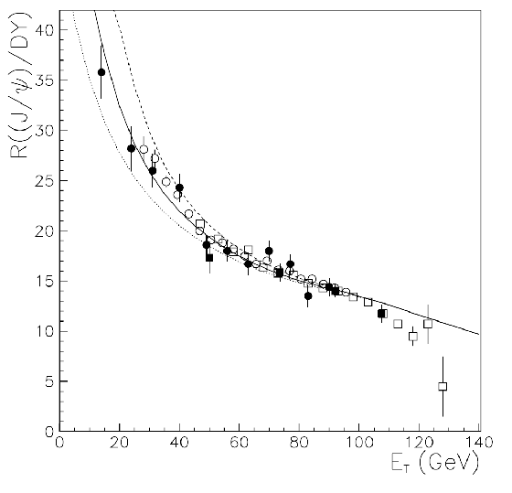

Anomalous Suppression at SPS
anomalous suppression
model 1: Debye screening (Matsui & Satz, 1986)
NA38
model 2: threshold model (Blaizot, Dinh, Ollitrault, PRL85, 4010(2000)
geometric fluctuations
model 3: comover interaction
(Capella, Feireiro, Kaidalov, PRL85, 2080(2000)

Slide 16
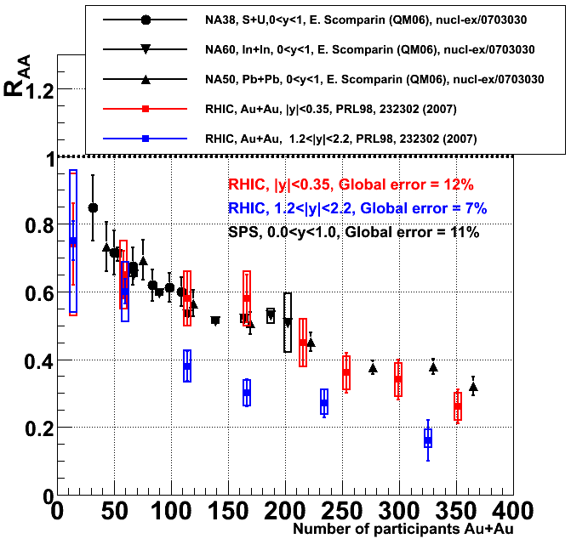
J/ψ Puzzles at RHIC
2 puzzles for J/psi production at RHIC:
R_{AA} (RHIC, |y|<0.35) ≈ R_{AA} (SPS)
R_{AA} (|y|<0.35) > R_{AA} (1.2<|y|<2.2)
The Debye screening picture can not explain the 2 puzzles.
how to explain the puzzles ?

Slide 17
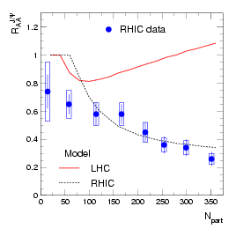
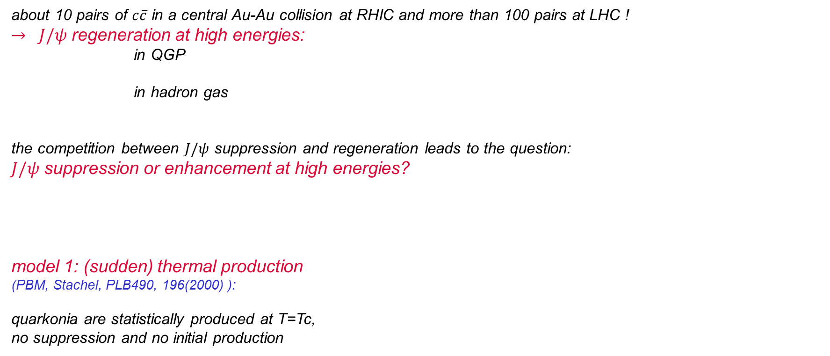
Regeneration at RHIC (I)
about 10 pairs of $c\overline{c}$ in a central Au-Au collision at RHIC and more than 100 pairs at LHC !
$→ J/ψ$ regeneration at high energies:
in QGP
in hadron gas
the competition between $J/ψ$ suppression and regeneration leads to the question: $J/ψ$ suppression or enhancement at high energies?
model 1: (sudden) thermal production (PBM, Stachel, PLB490, 196(2000) ):
quarkonia are statistically produced at T=Tc, no suppression and no initial production
mesons

Slide 18

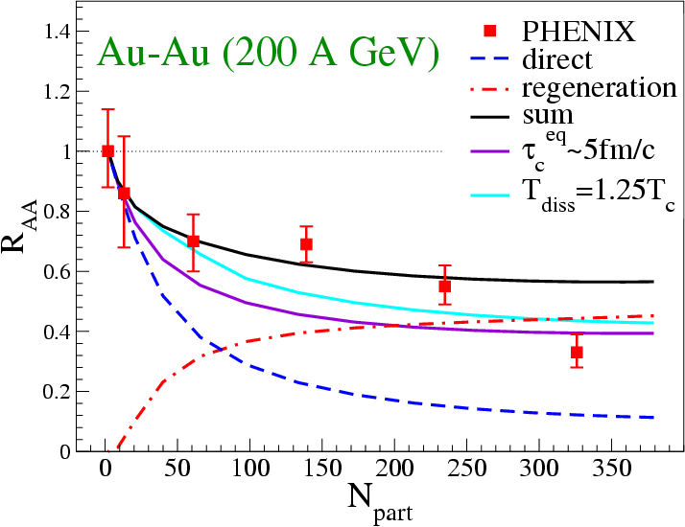

Regeneration at RHIC (II)
model 2: (continuous) production in QGP (Thews, Mangano, PRC73, 014904(2006):
quarkonia are produced in the whole QGP, including anomalous suppression but no initial production
* perturbative calculation with nonrelativistic Coulomb potential (Peskin, Bhanot, NPB156, 365(1979) * detailed balance
model 3: two-component model (Grandchamp, Rapp, Brown, PRL92, 212301(2004):
initial production + regeneration

Slide 19
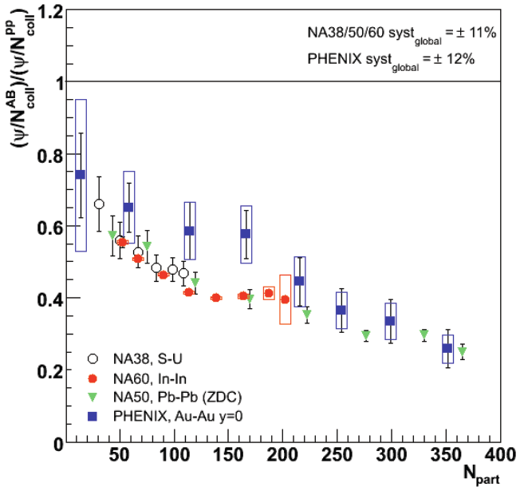
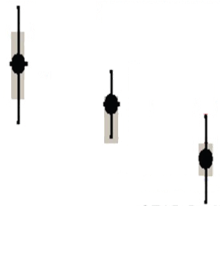

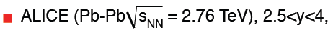
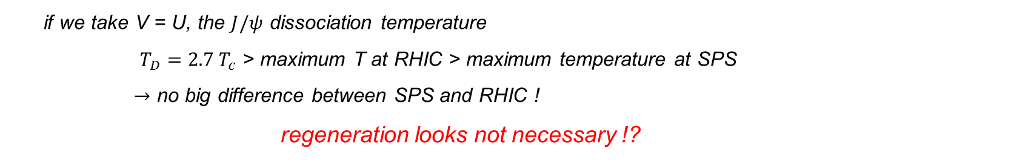
Is Regeneration Necessary ?
SQM2011 summary by K.Safarik: overall suppression of J/ψ is nearly identical between SPS and RHIC !
if we take V = U, the $J/ψ$ dissociation temperature
$T_{D}=2.7 T_{c}$ > maximum T at RHIC > maximum temperature at SPS
$→$ no big difference between SPS and RHIC !
regeneration looks not necessary !?
(Young and Shuryak, PRC79, 034907(2009)

Slide 20
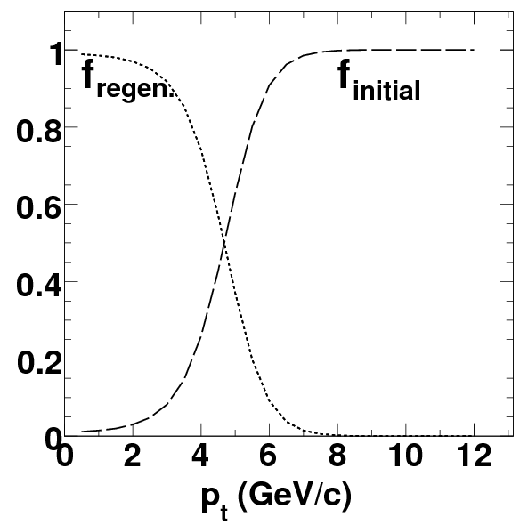
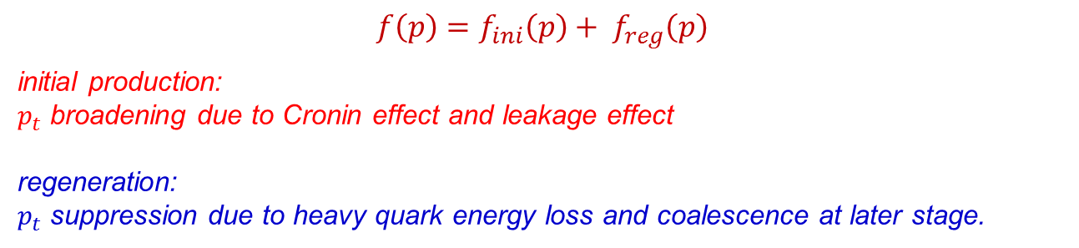
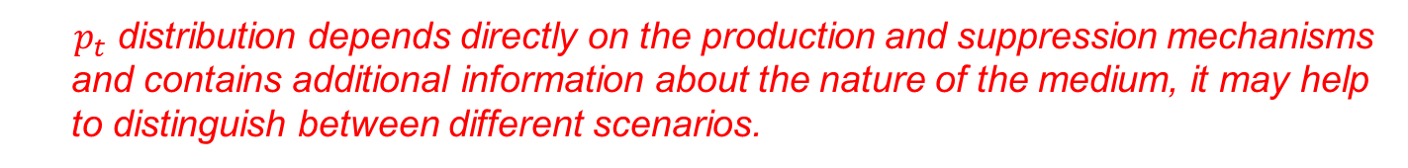

How to distinguish Hot Mediums: Quarkonium $P_{t}$Distribution
$$f\left(p\right)=f_{ini}\left(p\right)+ f_{reg}\left(p\right)$$
initial production: $p_{t}$ broadening due to Cronin effect and leakage effect
regeneration: $p_{t}$ suppression due to heavy quark energy loss and coalescence at later stage.
J/$ψ$ in 5.5TeV central Pb+Pb Liu, Xu, Zhuang, NPA834, 317C(2010).
$p_{t}$ distribution depends directly on the production and suppression mechanisms and contains additional information about the nature of the medium, it may help to distinguish between different scenarios.

Slide 21


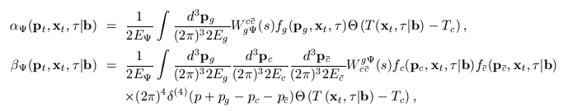
A Transport Approach
Dynamical approaches for quarkonia evolution in QGP: kinetic approach (Rapp et al.), Schroedinger-Langevin approach (Gossiaux), Langevin approach (Blaizot), ……
Zhu, Xu, Zhuang, PLB607, 107(2005), Yan, Nu, Zhuang, PRL97, 232301(2006):
●quarkonium motion
hot nuclear matter effects: gluon dissociation (OPE) and regeneration (detailed balance)
● analytic solution
cold nuclear matter effects: shadowing and Cronin
● QGP evolution
+ Lattice QCD equation of state

Slide 22
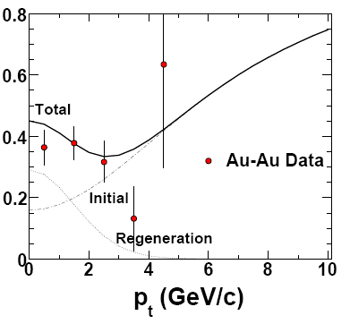
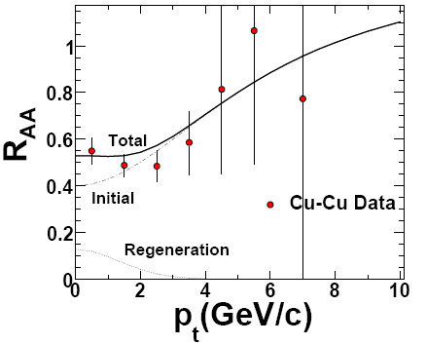
J/ψ R_{AA} ( p_{t} ) at RHIC
Liu, Qu, Xu, Zhuang, PLB2009

Slide 23
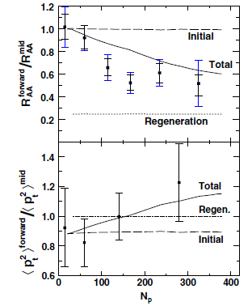
J/ψ Rapidity Dependence at RHIC
Liu, Xu, Zhuang, JPG2010

Slide 24
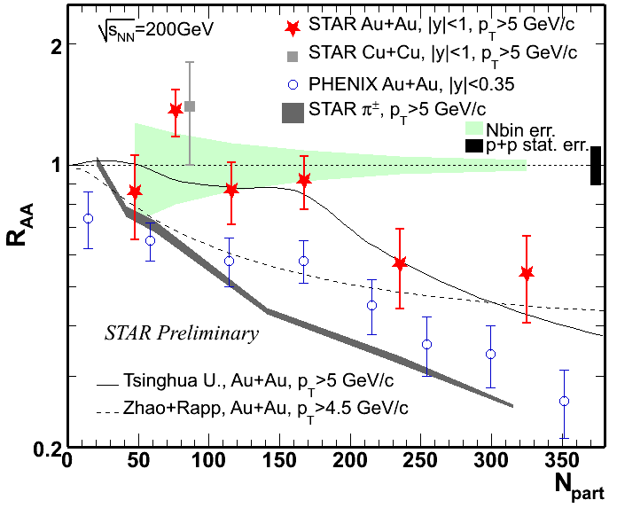
J/ψ R_{AA} ( N_{p} ) at high pt at RHIC

Slide 25
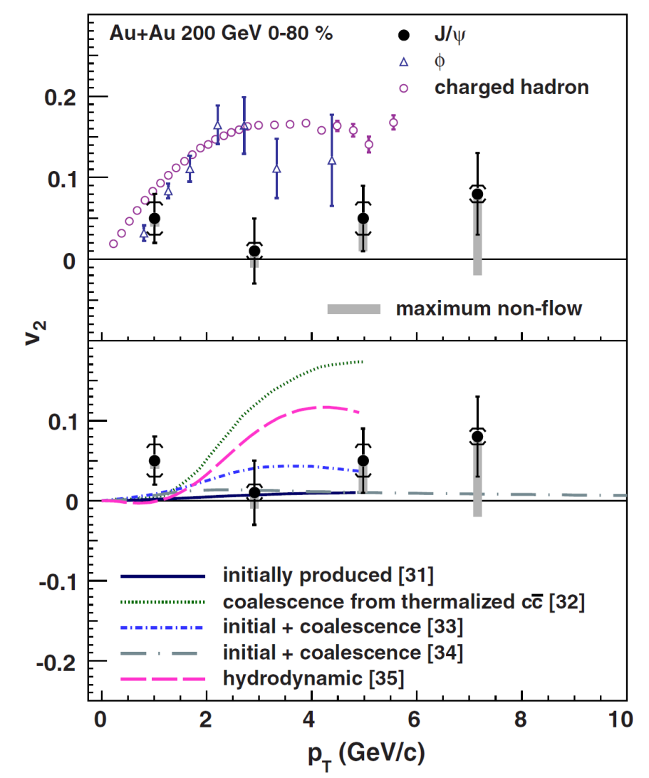
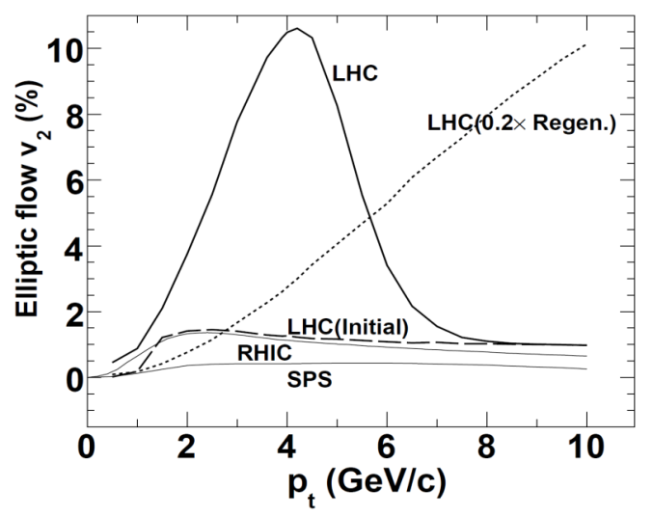
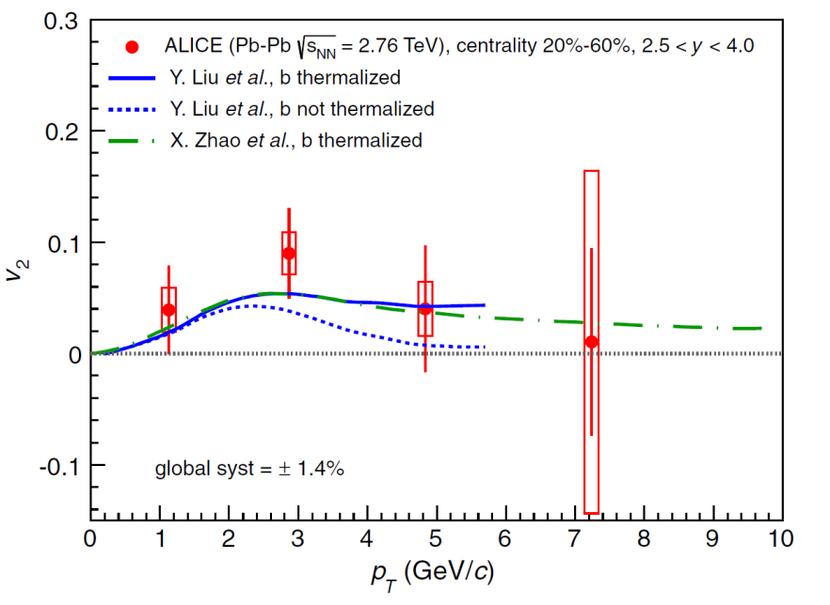
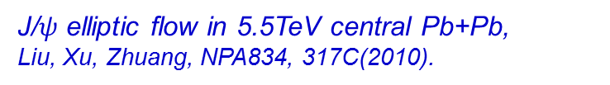
Flow
J/$ψ$ elliptic flow in 5.5TeV central Pb+Pb,
Liu, Xu, Zhuang, NPA834, 317C(2010).
STAR Collaboration, PRL111, 052301(2013)
ALICE Collaboration, PRL111, 162301(2013)

Slide 26
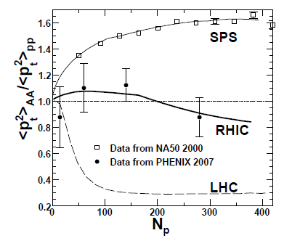
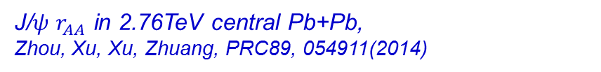


$$r_{AA}=\frac{{\left\langle p_{t}^{2}\right\rangle }_{AA}}{{\left\langle p_{t}^{2}\right\rangle }_{pp}}$$
J/$ψ$ $r_{AA}$ in 5.5TeV central Pb+Pb, Zhou, Xu, Zhuang, NPA834, 249C(2010).
ALICE Collaboration, JHEP1605, 179(2016)
J/$ψ$ $r_{AA}$ in 2.76TeV central Pb+Pb, Zhou, Xu, Xu, Zhuang, PRC89, 054911(2014)

Slide 27




Charmonium Production in Magnetic field
strong magnetic field in heavy ion collisions at RHIC and LHC
(Deng, Huang, PRC85, 044907(2012), Gursoy, Kharzeev, Rajagopal, PRC89, 054905(2014))
Guo, Shi, Xu, Xu, Zhuang, PLB751, 215(2015):
$c\overline{c}$ state evolution: $i\frac{∂}{∂t}$ $|\left.c\overline{c}\right\rangle =\hat{H}\left(B(t)\right)|\left.c\overline{c}\right\rangle$
$\hat{H}(r,R,B(t))=\frac{{\left({\vec{p}}_{c}−q_{c}{\vec{A}}_{c}\right)}^{2}}{2m_{c}}$+$\frac{{\left({\vec{p}}_{\overline{c}}−q_{\overline{c}}{\vec{A}}_{\overline{c}}\right)}^{2}}{2m_{c}}−\frac{{(q}_{c}{\vec{s}}_{c}+q_{\overline{c}}{\vec{s}}_{\overline{c}})∙\overline{B}}{m_{c}}+V_{c\overline{c}}\left(r\right)$
$V_{c\overline{c}}\left(r\right)$=-$\frac{α}{r}+σr+βe^{−γr}{\vec{s}}_{c}∙{\vec{s}}_{\overline{c}}$
$|\left.c\overline{c}\right\rangle$=$\sum_{ψ}{\left\langle ψ | c\overline{c}\right\rangle |\left.ψ\right\rangle }$
the probability for the $c\overline{c}$ to be in the charmonium state $|\left.ψ\right\rangle$: ${|\left\langle ψ | c\overline{c}\right\rangle |}^{2}$
Non-collective $v_{2}$ at high $P_{t}$ created by B field !

Slide 28

Heavy Quark Production at FCC
Heavy quark production in QGP:
Levai, Muller and Wang, PRC51, 3326(1995).
Kaempfer and Pavlenko, PLB391, 185(1997).
Uphoff, Fochler, Xu and Greiner, PRC82, 044906(2010).
Zhang, Ko and Liu, PRC77, 024901(2008),……
initial + thermal production
Charm quark evolution in QGP
Zhou, Chen, Greiner, Zhuang, PLB758, 434(2016)
only initial production
*NLO production cross section
*T-dependent parton mass and coupling
*hydrodynamics for QGP evolution
*detailed balance between loss and gain terms
*shadowing effect on initial distribution (EPS09s NLO)
significant charm enhancement (~80%) at FCC !

Slide 29


Charmonia at FCC
Zhou, Chen, Greiner, Zhuang, PLB758, 434(2016)
without shadowing
significant J/$ψ$ enhancement at low $p_{T}$:
$R_{AA}\left(p_{t}\right)<1 → R_{AA}\left(p_{t}\right)>1$ !
with charm thermal production
without charm thermal production

Slide 30




Motivation to Study Multi-charmed Baryons
1) $Ω_{ccc}$ and $Ξ_{cc}$ are hardly produced in pp collisions,
$σ\left(Ω_{ccc}\right)=\text{0.06\sim 0.13 }\text{nb} \text{at}\text{ 7 }\text{GeV} \text{and}\text{ 0.1\sim 0.2 }\text{nb} \text{at}\text{ 14} \text{GeV}$ (Bjorken 1986 and Chen, 2011)
$σ(Ξ_{cc})$~10 nb at 1.8 TeV (PRL89 (2002) 112001).
SELEX Collaboration claimed the observation of $Ξ_{cc}$, but FOCUS, BaBar, Belle, LHCb failed to reproduce it in elementary collisions.
2) However, coalescence among uncorrelated charm quarks in A+A may significantly enhance the production probability,
$N\left(Ξ_{cc}\right)$ ~ $N_{c}^{2}, N\left(Ω_{ccc}\right)$ ~ $N_{c}^{3}, N_{c}∼100$at LHC !
3) If they are discovered in A+A collisions, it is a unique signal of QGP!
4) Exotic baryon states at quark level ?
1) Borromean rings
2) Efimov states (PLB33, 563(1970)),
discovered in cold atom gas
(T.Kraemer et al., Nature 440, 315(2006)).

Slide 31






Wigner Function
He, Liu, Zhuang, PLB746, 59(2015)
Zhao, He, Zhuang, arXiv:1603.04524
Methods to solve 3-body Schroedinger equation: Hyperspherical method, Separable model, ……
Static properties:
Wigner function:
$\left\langle r_{Ω}\right\rangle =0.5 fm≃\left\langle r_{J/ψ}\right\rangle$
$m_{Ω}=4.75$ GeV (4.8 GeV from LQCD), $ε_{Ω}=900 MeV,$

Slide 32




Significant Enhancement in A+A
He, Liu, Zhuang, PLB746, 59(2015)
Zhao, He, Zhuang, arXiv:1603.04524
$$f\left(\vec{r},\vec{p} \right)=\frac{1}{e^{p^{μ}u_{μ}/T}+1}$$
the coalescence happens on the hadronization hypersurface $Σ$ determined by hydrodynamics.
$σ_{Ω}\sim 3.5×{10}^{4} nb$ for $σ_{pp}=62 mb$in central Pb+Pb at 2.76 TeV
in comparison with
$σ_{Ω}\text{\sim 0.1} \text{nb} \text{in} \text{p}\text{+}\text{p} \text{at}\text{ 7 }T\text{eV}\text{, }$
the $Ω_{ccc}$ production in A+A is enhanced by 6 orders !

Slide 33



Exotic States of $Ω_{ccc}$ at Finite Temperature
Zhao, Zhuang, in progress
short range potential at high T
Borromean rings
$\frac{E_{n}}{E_{n+1}}=e^{2π/s_{0}}=515$, Efimov states
the exotic states might be realized during the cooling down of the fireball in A+A collisions.

Slide 34

Summary
Quarkonium is still a smoking gun in probing QGP, the $p_{t}$ distribution is sensitive to the fireball properties.
Cold medium effects dominate p+A at RHIC, but there is already a sizeable hot medium effect in p+A at LHC.
Quarkonium $v_{2}$, $r_{AA}=\frac{{\left\langle p_{t}^{2}\right\rangle }_{AA}}{{\left\langle p_{t}^{2}\right\rangle }_{pp}}$ and $R_{AA}{(p}_{t})$ can distinguish hot mediums at SPS, RHIC and LHC：from pt enhancement at SPS to pt suppression at LHC !
It is most probable to discover $Ω_{ccc}$ and $Ξ_{cc}$ in A+A, and the discovery is a unique signal of QGP formation.
There are exotic baryon states at quark level, which might be realized during the cooling down of the fireball in heavy ion collisions.
There are still some puzzles, like double ratio $\frac{ψ′}{J/ψ}$, $J/ψ$ enhancement in p+A, and excess of low $p_{t}$ J/$ψ$.

Slide 35
Backup

Slide 36

decay modes of $Ω_{ccc}$
Decay through weak interaction, for instance
nonleptonic cascade decay mode (Chen 2011):
semileptonic decay mode (Bjorken, 1986):

