Slide 1


Directed flow in Ni+Ni and Au+Au collisions and the QMD simulation
Kyungil Kim
Nov. 25th , 2016, HIM

Slide 2
Contents
Motivation
Introduction to QMD
Directed flow in Ni+Ni and Au+Au
Summary and Outlook

Slide 3
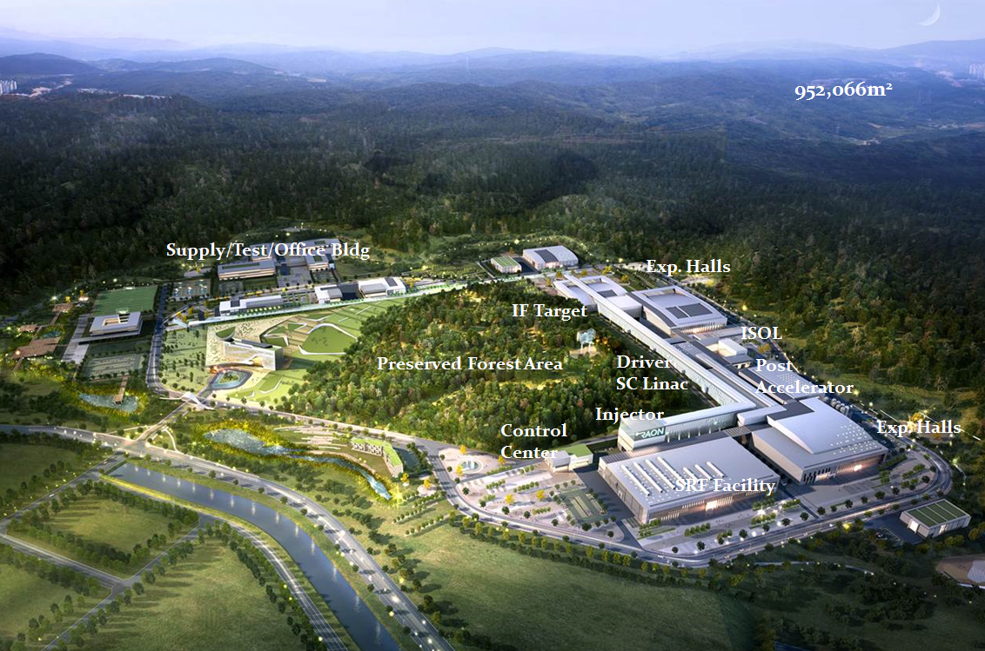
RAON and LAMPS
Bird’s-eye view
RAON
Basic design was finished in Dec. 2015
A construction company was selected in Sept. 6, 2016. i
from Y.J.Kim’s slide

Slide 4
Nuclear Equation of State
ref. A.W.Steiner et al. Phys.Rep. 411,325

Slide 5
Nuclear Equation of State
ref. B.-A.Li et al. Phys.Rep. 464,113

Slide 6
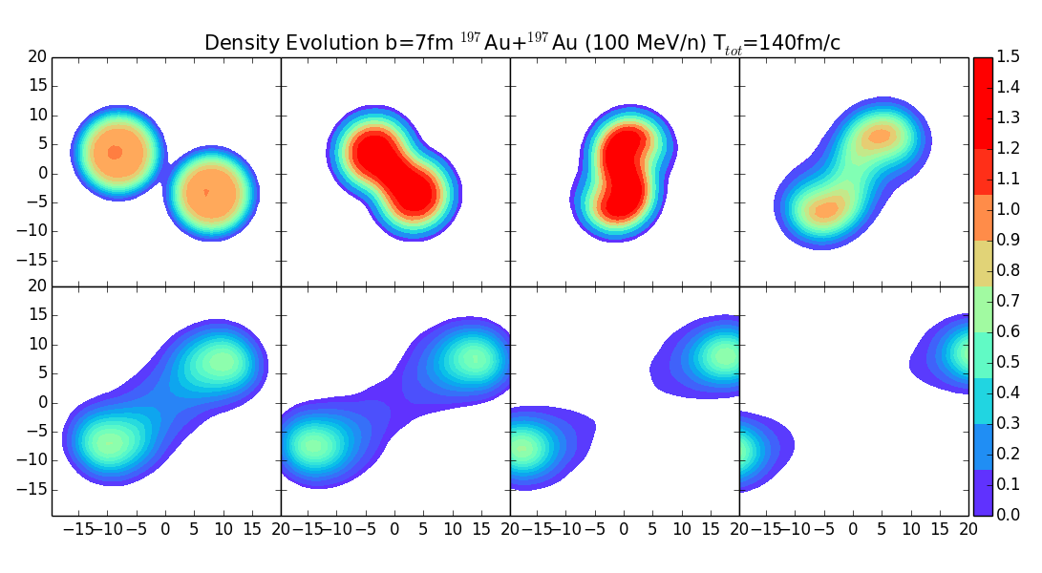
Au (100 MeV/n)+Au at b=7fm

Slide 7
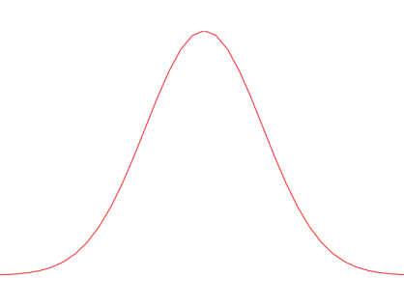

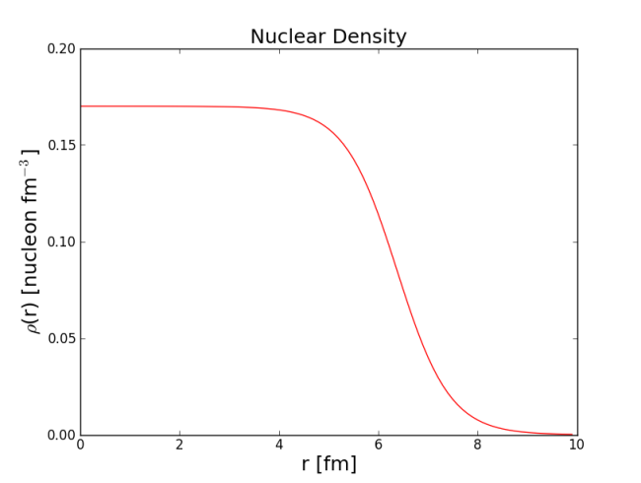

Initialization
<Gaussian distribution>
d > 1.5 fm
<Density distribution>
- Wood-Saxon function

Slide 8
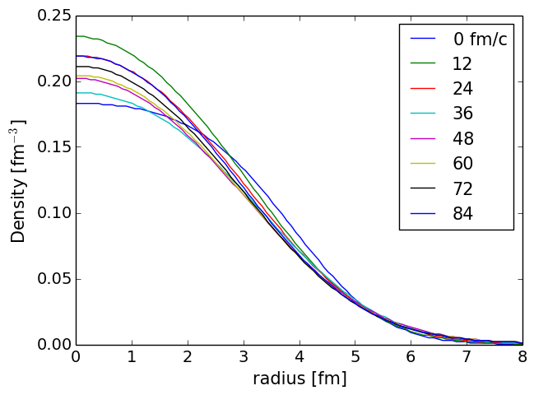
Stability of Ni Nucleus

Slide 9

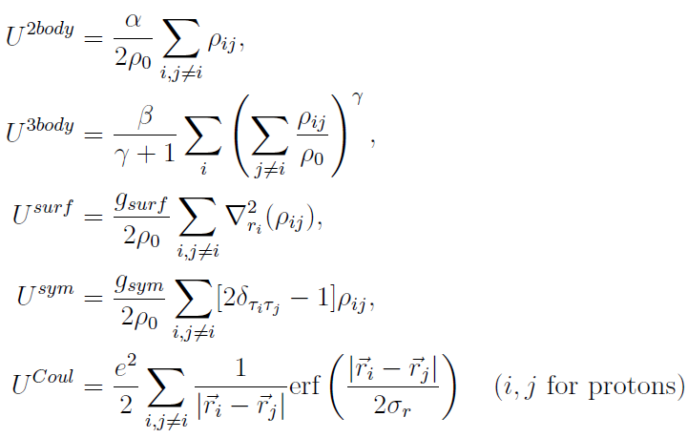
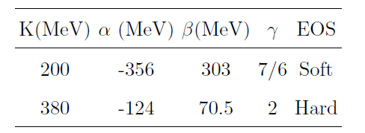


Propagation
Skyrme parametrization for NN potential
Ref.) M. Papa PRC 64(2010)024612
<Equation of Motion>

Slide 10




N-N Collision
In classical scattering,
r₁
b
r₂
$$b<r_{1}+r_{2}$$
Two particles are always scattered.
$$σ={π\left(r_{1}+r_{2}\right)}^{2}$$
In our model,
If a distance, d, between two nucleons is smaller than b, d<b, a collision is always tried.
Here, $σ_{tot}$ is in-medium cross-section.

Slide 11
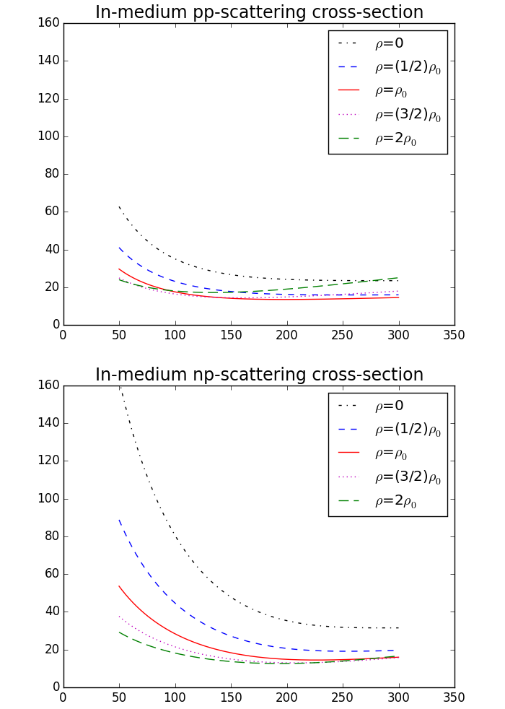

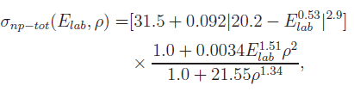
N-N Collision
Ref.) G.Li and R.Machleidt PRC 48, 1702, PRC 49, 566

Slide 12



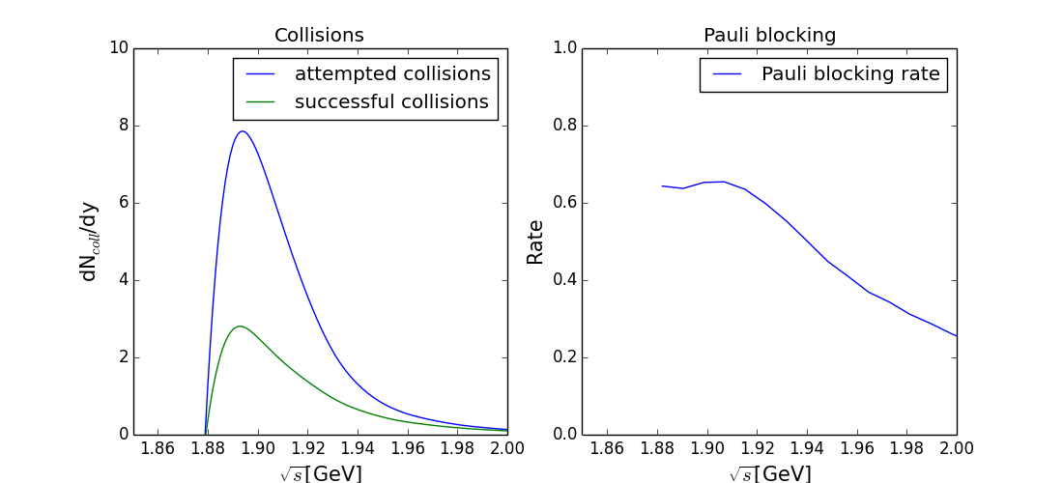
Pauli blocking
<x-space>
<p-space>
<Phase space density for i th particle>
Occupation number

Slide 13
Cluster Recognition
<Minimum Spanning Tree (MST)>
Disconnected if a length is larger than 3.5 fm.

Slide 14
Differential Flow
p_{x}
p_{x}
p_{y}
p_{y}
Z(beam direction)

Slide 15
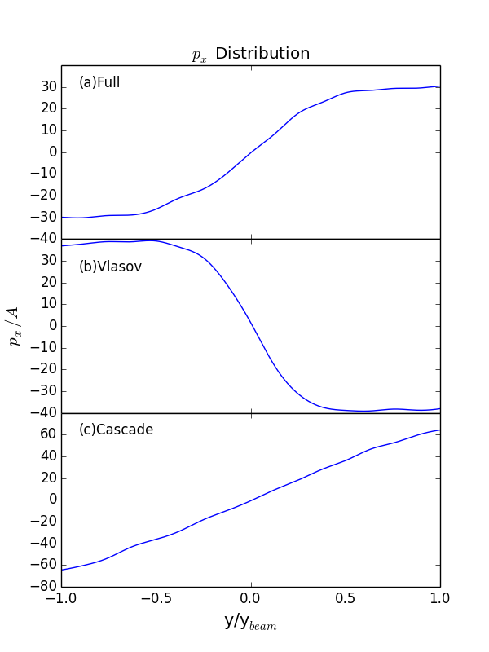
p_{x} distribution
Potential + Collisions
Potential only
Collisions only

Slide 16
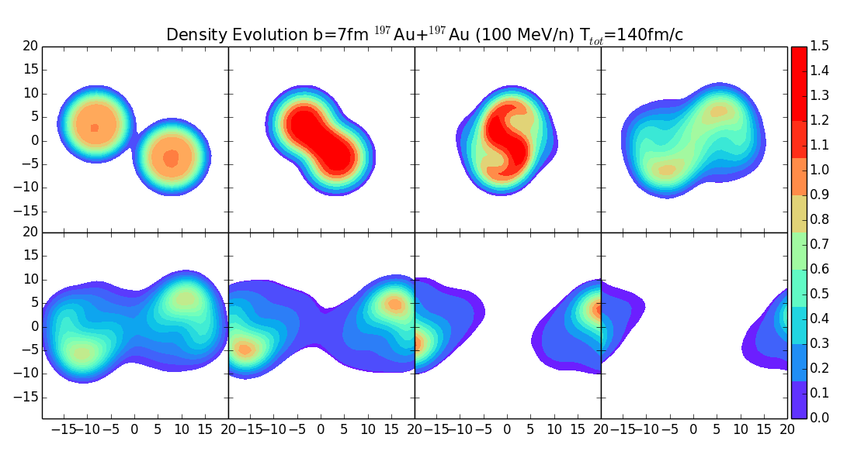
Role of NN Collision
w/o collisions
w/ collisions

Slide 17
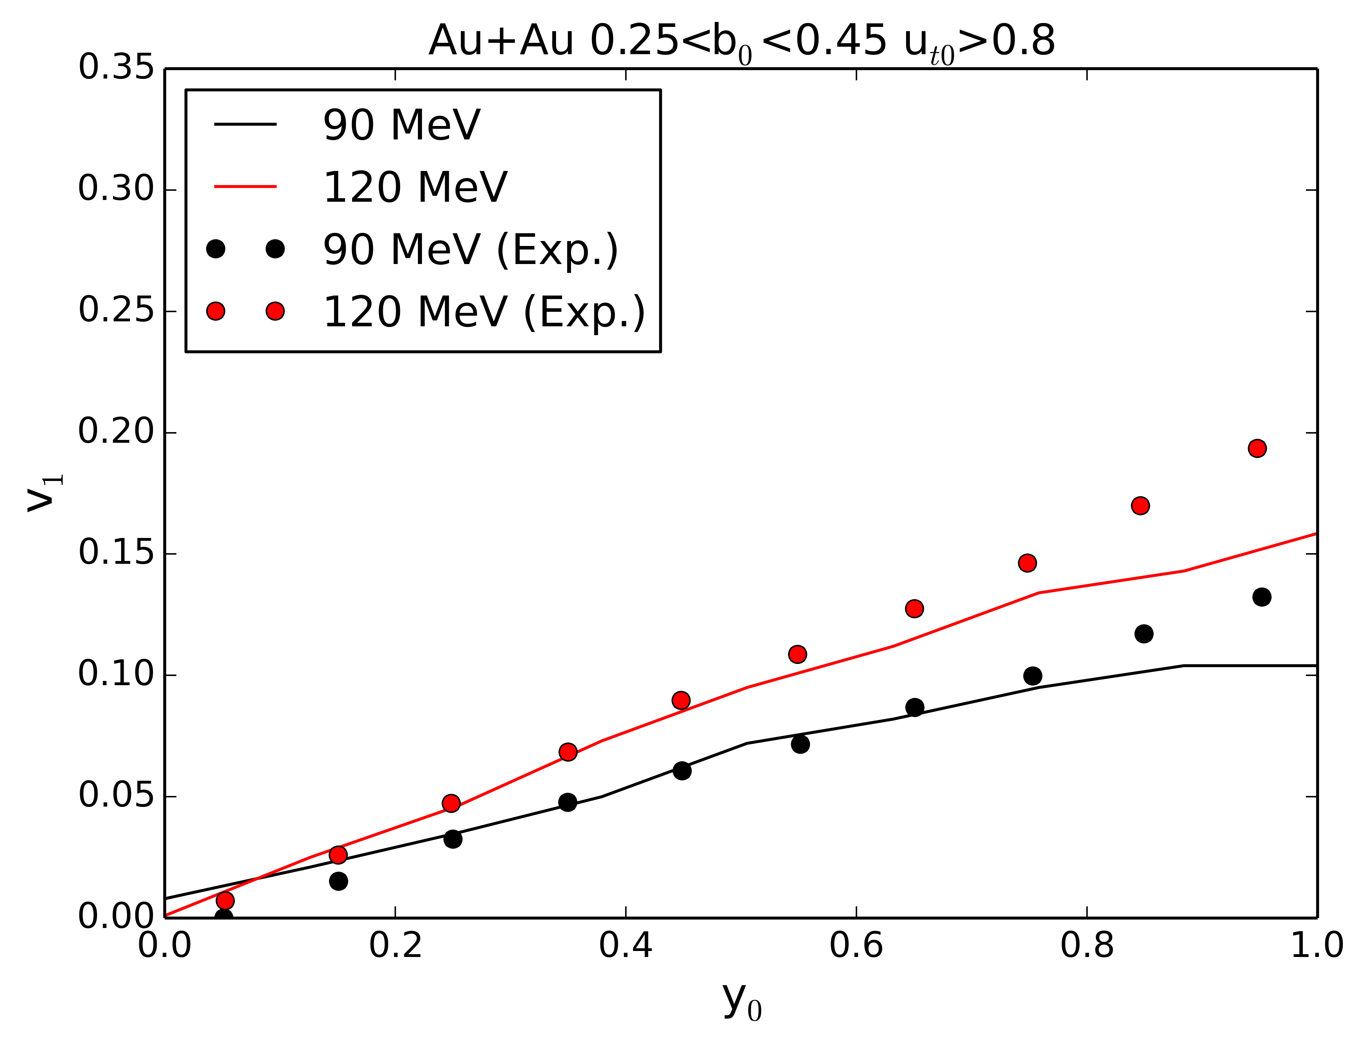
Comparison with FOPI data

Slide 18
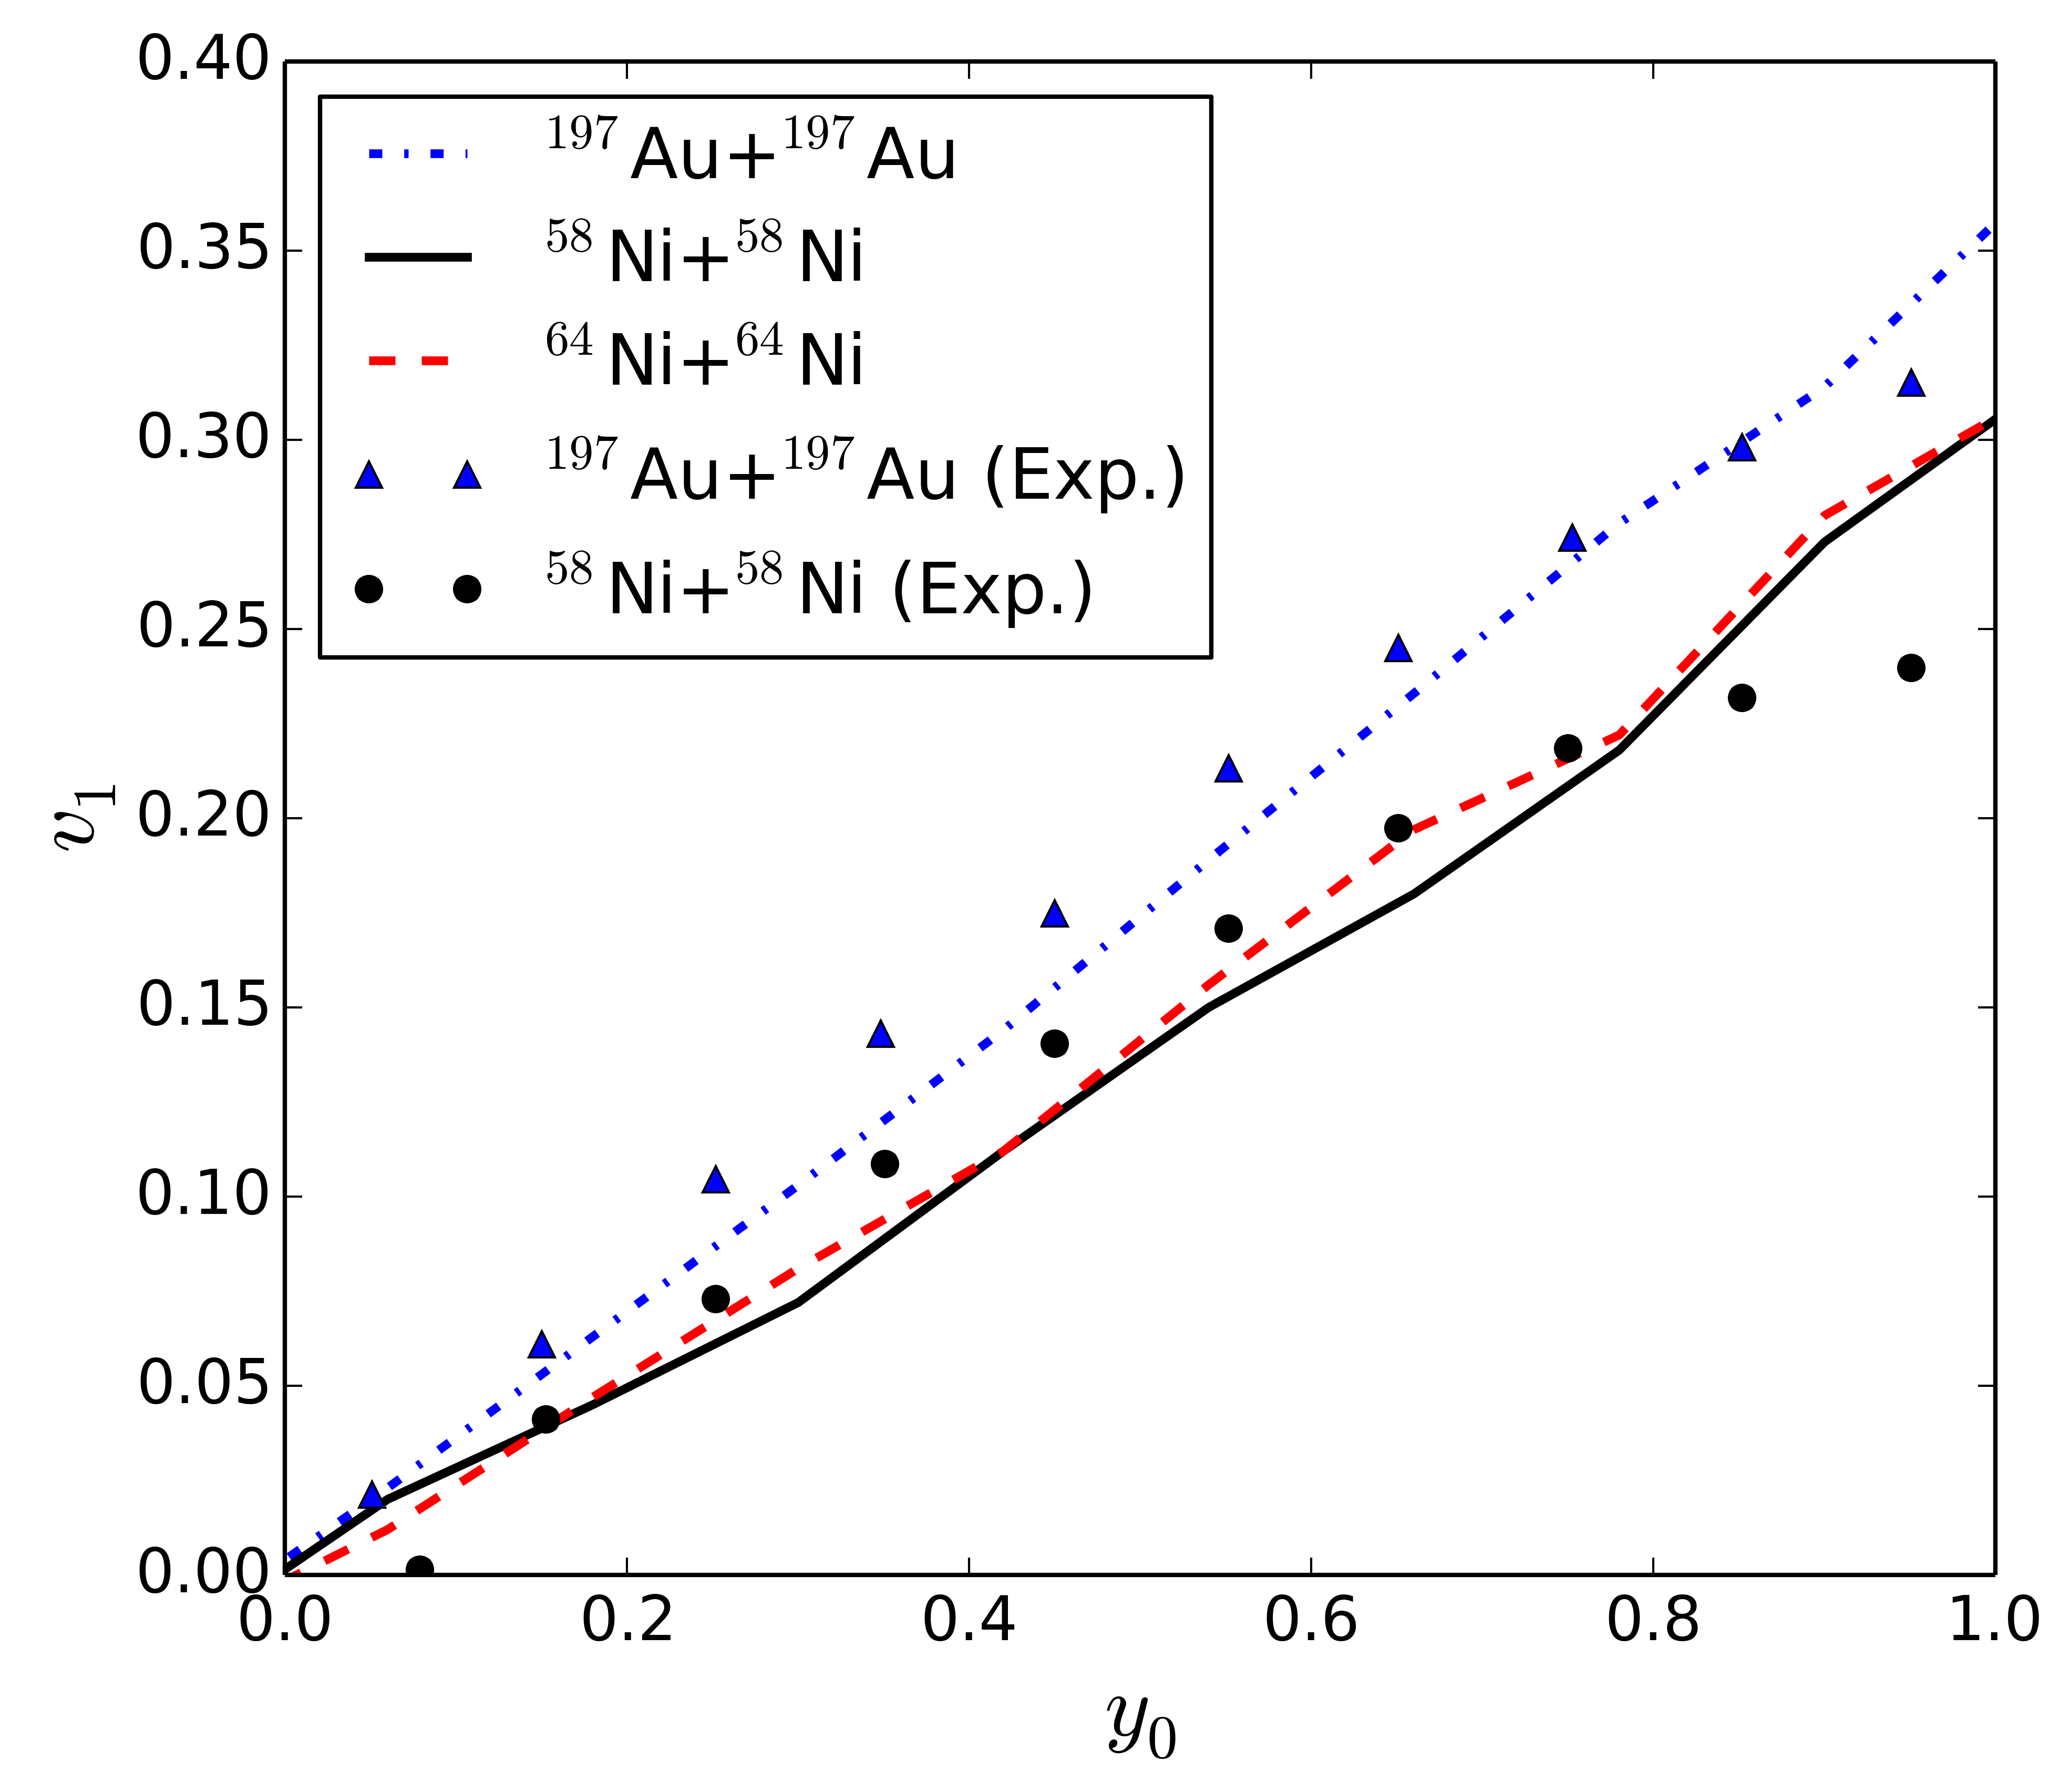
v₁ of Ni+Ni and Au+Au

Slide 19
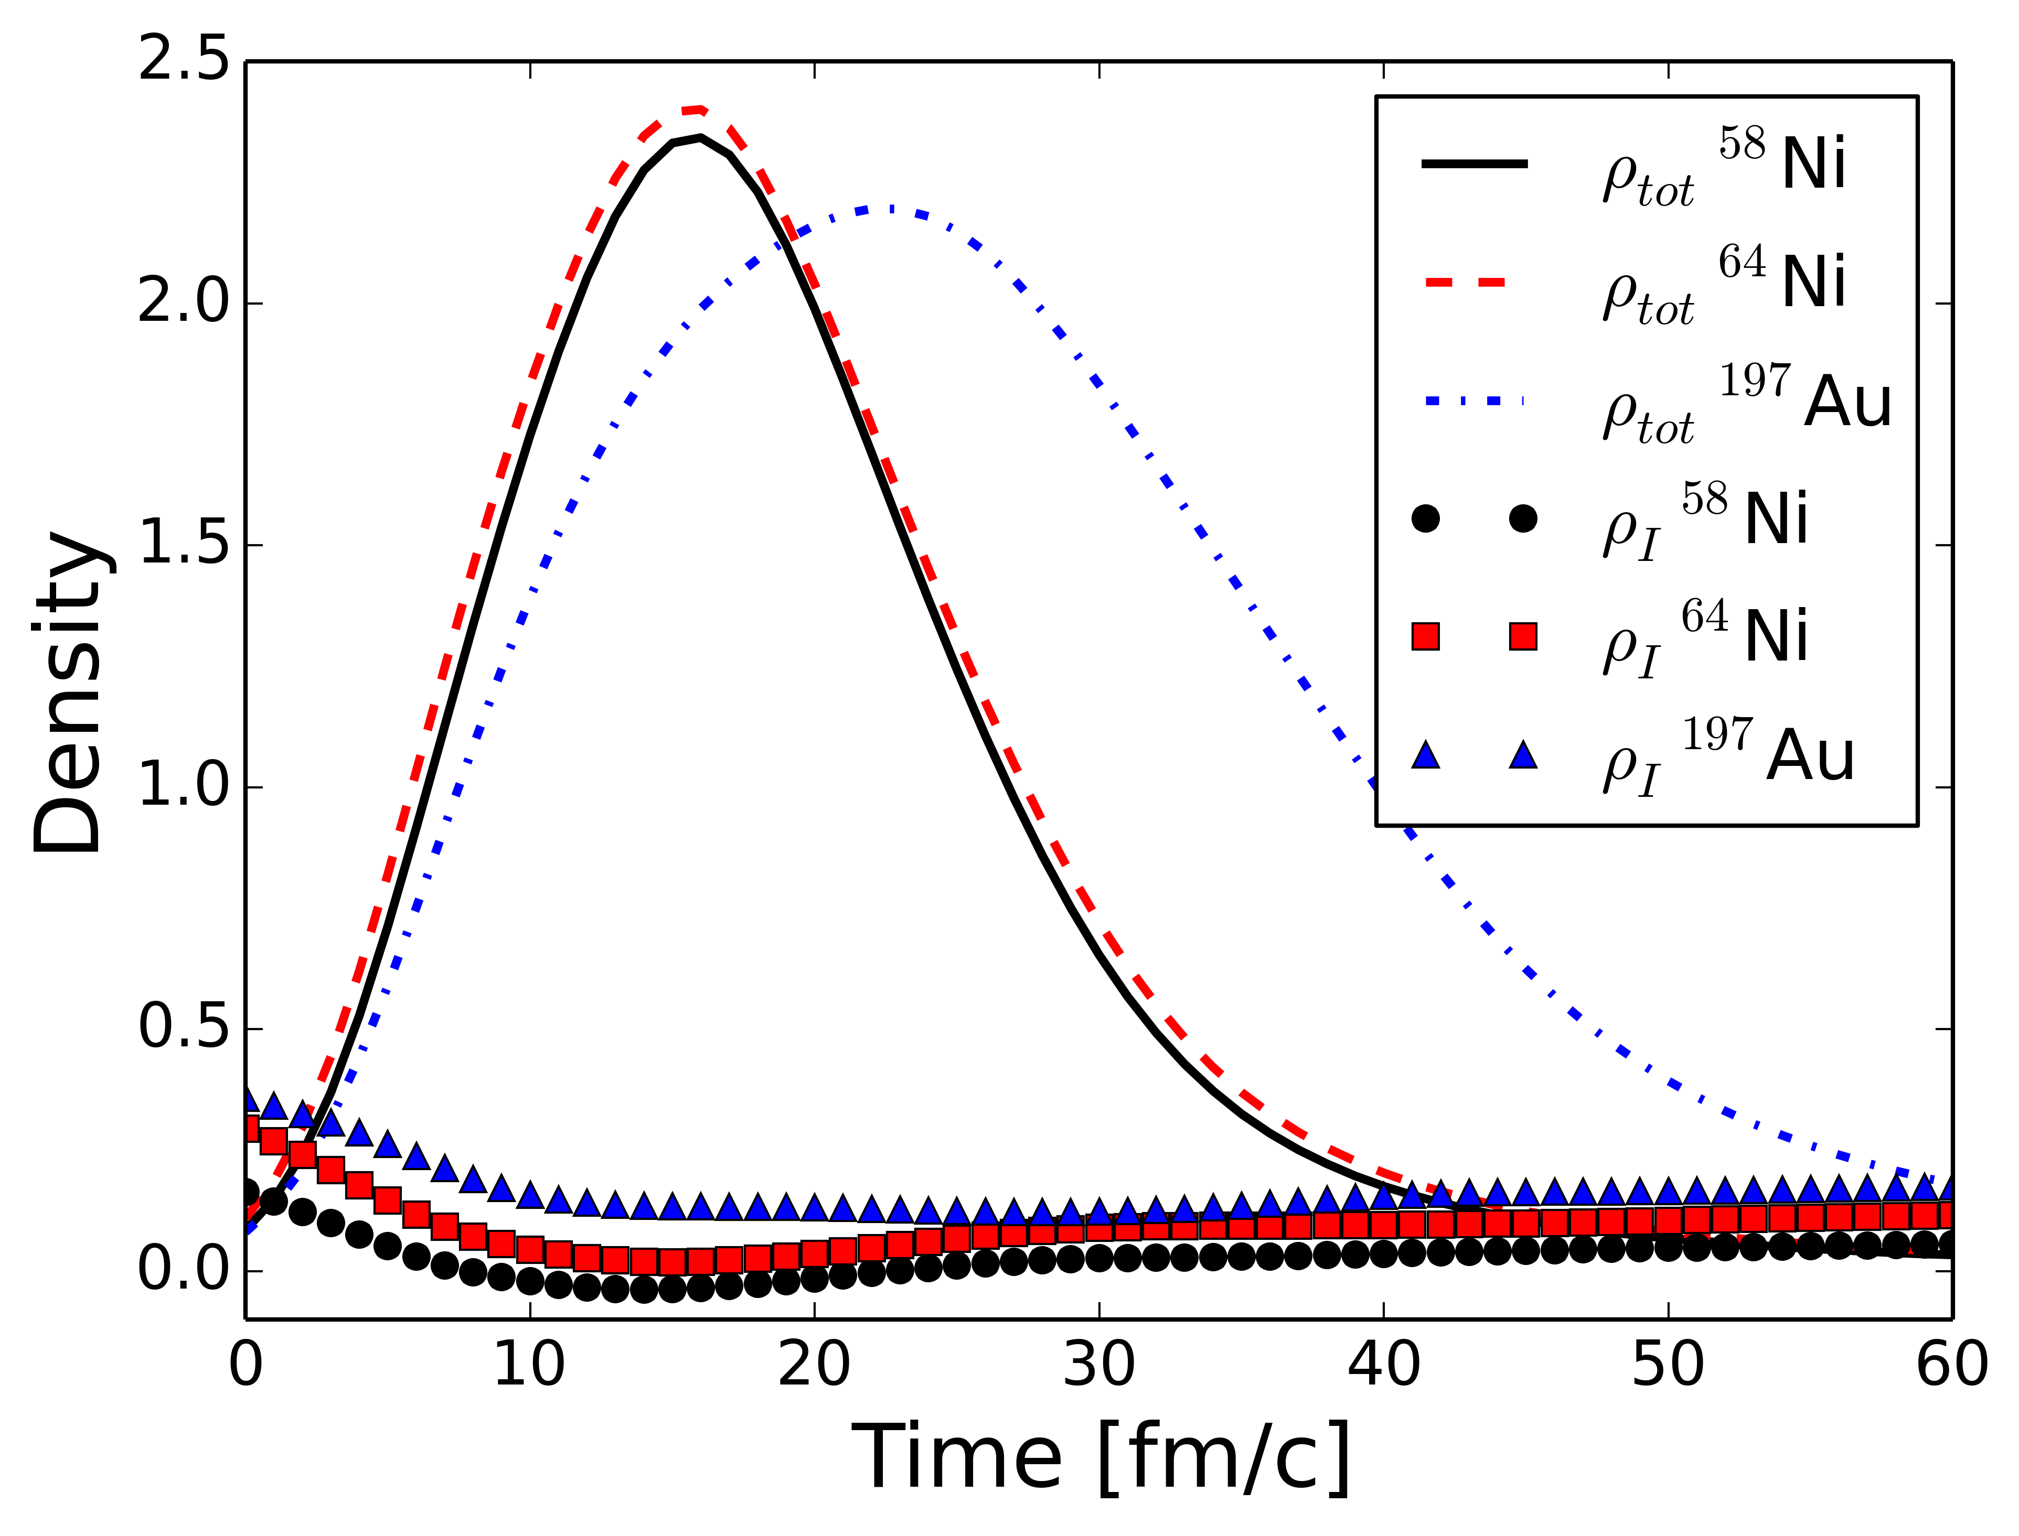
Density at Collision Center

Slide 20
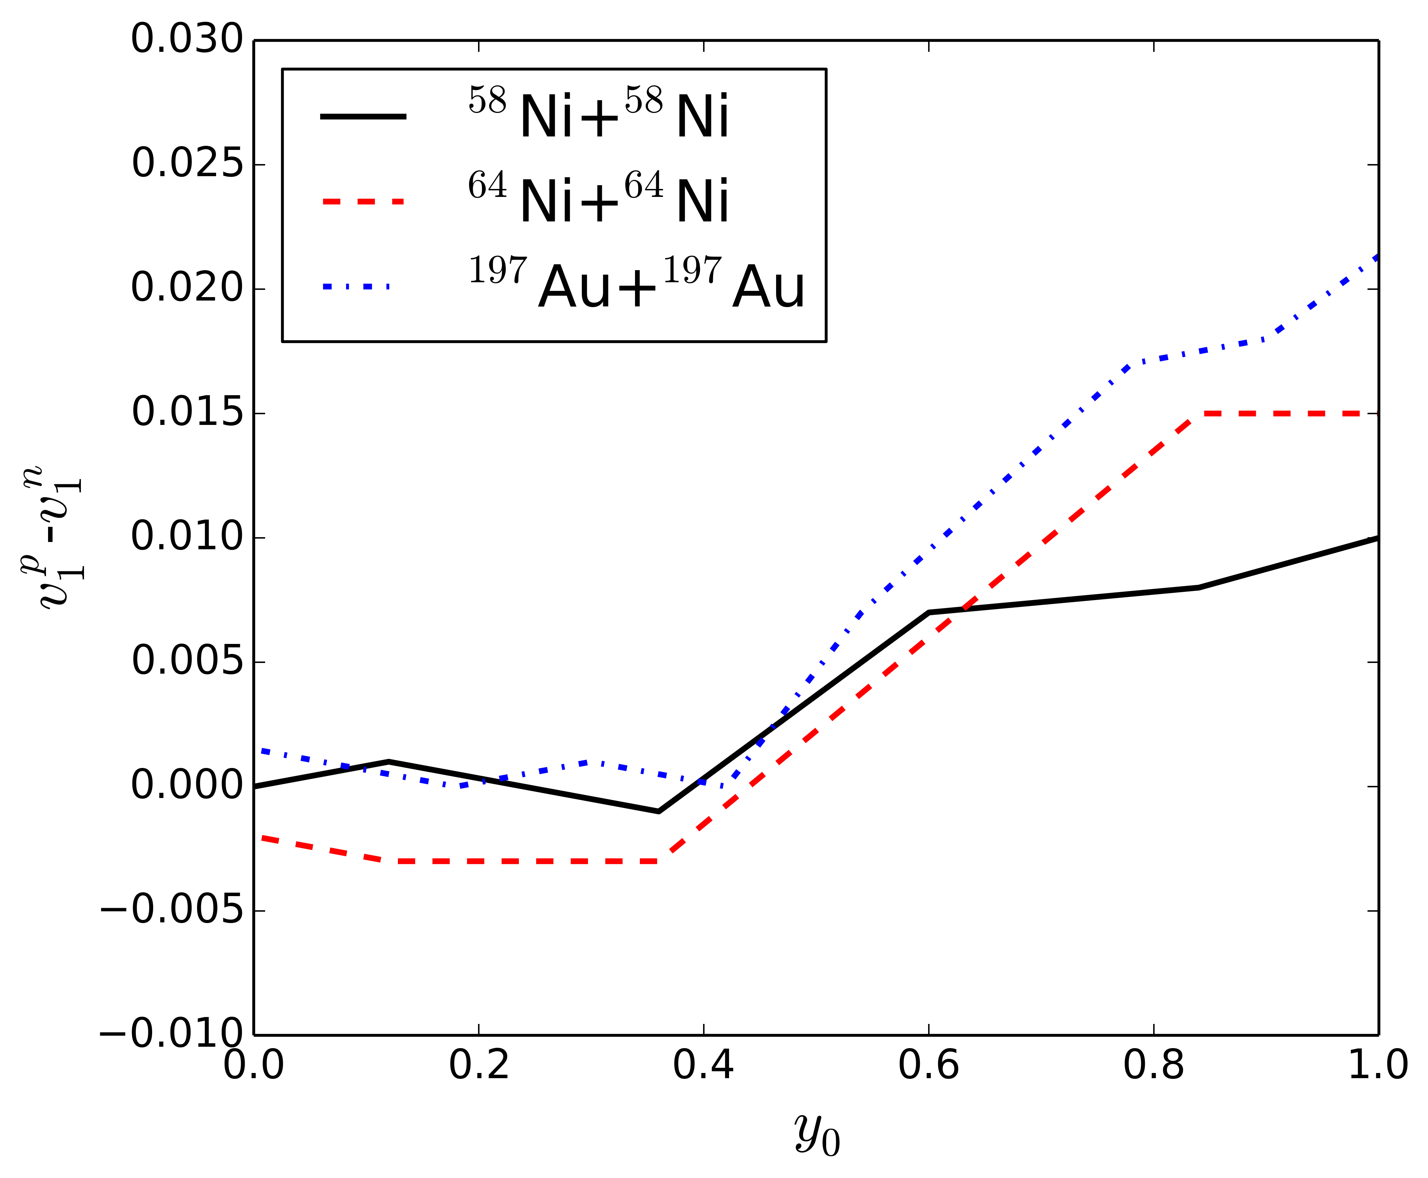
Difference between proton and neutron

Slide 21
Summary and Outlook
RAON facility will provide opportunities to study isospin asymmetric matters and exotic nuclei by heavy-ion collisions induced by neutron-rich beams.
As a reliable theoretical tools, we need a transport model.
Differential flow is one of the probes for the symmetry potential study.
We need more study to find an observable which is sensitive to the change of the curvature of symmetry potential.

Slide 22
Thank you for your attention!!

Slide 23
Backup Slides

Slide 24
Transport model

