Slide 1



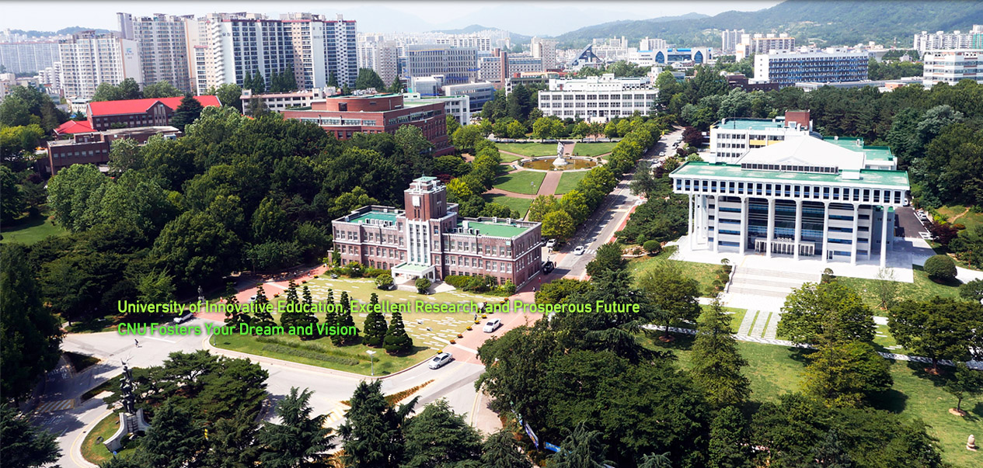



Two heatedly debated topics in relativistic heavy ion collisions
Fuqiang Wang
Purdue University, Huzhou University

Slide 2
Two heatedly debated topics
Anisotropies, hydrodynamic descriptions, nearly perfect fluidity
  Is azimuthal anisotropy all from hydro?
  How can we address the question?
  Is quantum uncertainty principle at all relevant?
Chiral magnetic effect, chiral magnetic wave, chiral vortical effect
  Have we experimentalists exercised sufficient self-criticality?
Charges from Iky
  Where we are, on the way to look for the QGP?
  Where to go, for more concrete conclusion on QGP?
  What fundamental knowledge will we contribute?
I will be critical.

Slide 3
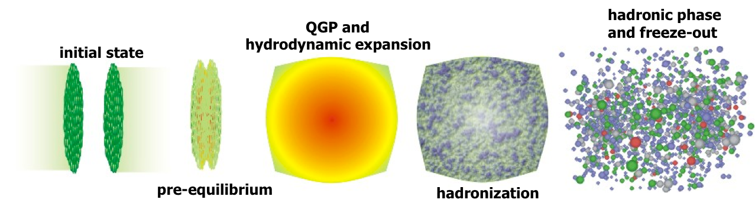
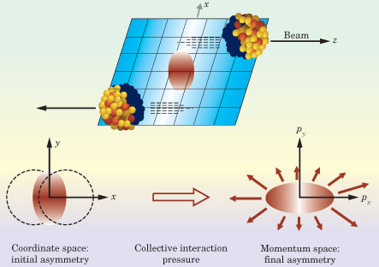
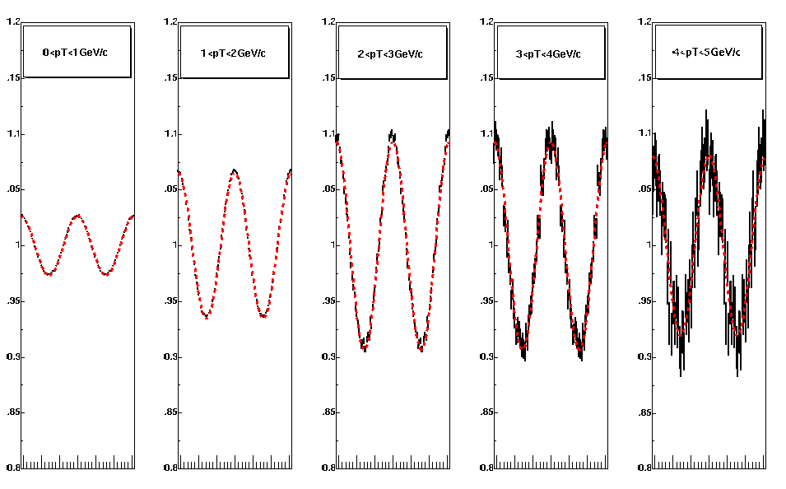
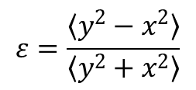
Azimuthal Anisotropy
4v₂
−π 0 π
$$ε=\frac{〈y^{2}−x^{2}〉}{〈y^{2}+x^{2}〉}$$

Slide 4
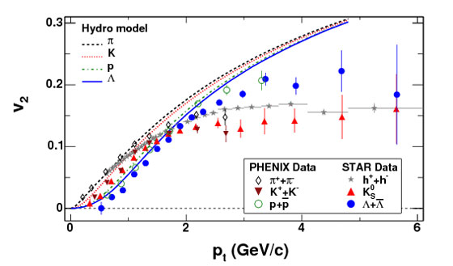
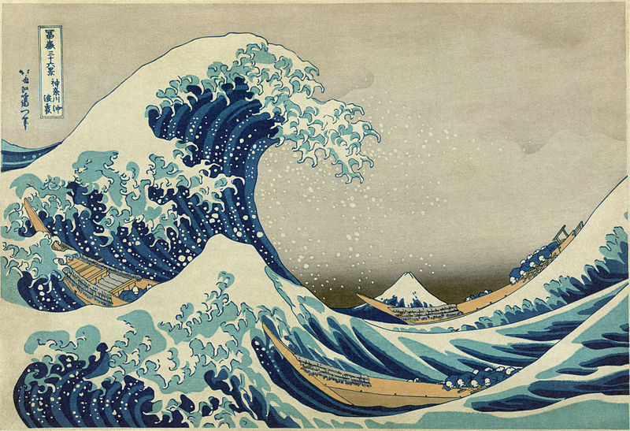
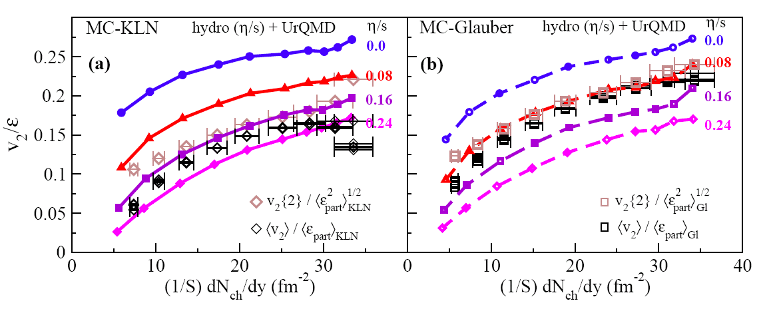
Elliptic flow measurements
RHIC
4v₂
1+2v₂cos2φ
Hydro
➔ Small value of specific viscosity over entropy η/s
Model: Song et al. arXiv:1011.2783

Slide 5
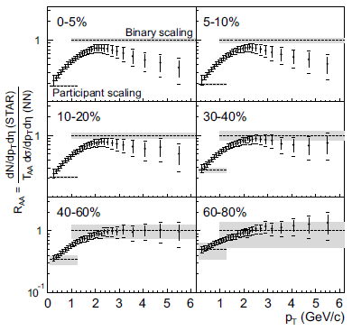
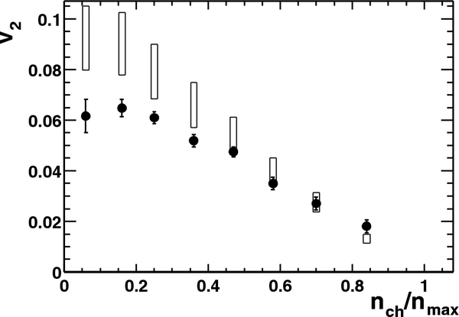
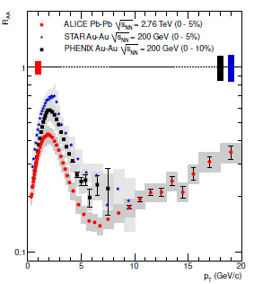
Large flow, large energy loss
Au+Au 130 GeV
STAR, PRL89 (2002) 202301
STAR, PRL86 (2001) 402
Hydro
expectations
data

Slide 6
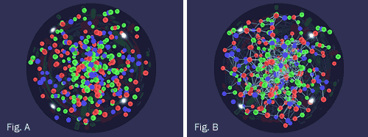
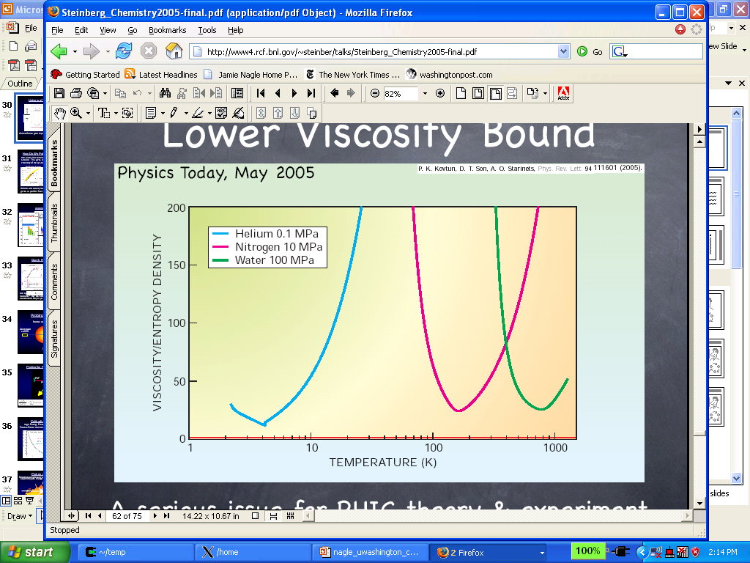
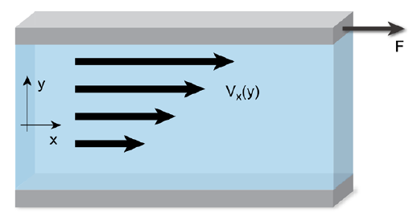



BNL press release 2005
RHIC Scientists Serve Up "Perfect" Liquid
New state of matter more remarkable than predicted -- raising many new questions
http://www.bnl.gov/newsroom/news.php?a=1303
Infinite viscosity
Very low viscosity
η/s ≈ (1-2)/4π
Viscosity quantum limit:
RHIC results

Slide 7
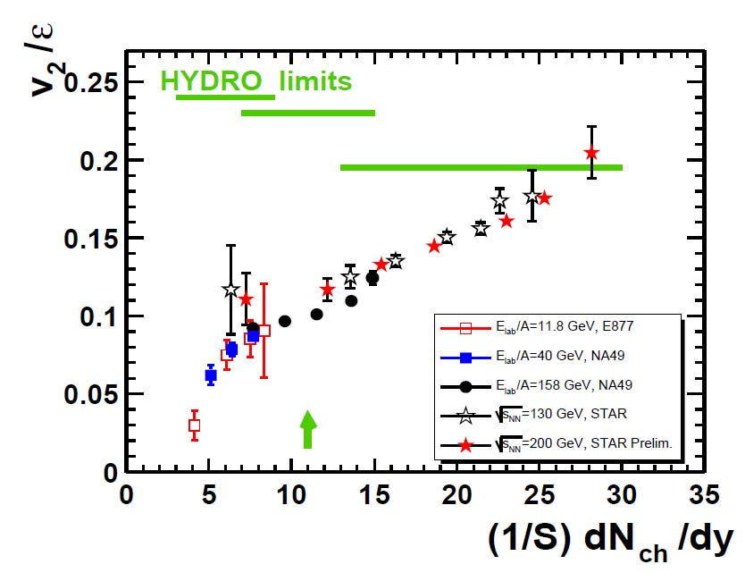
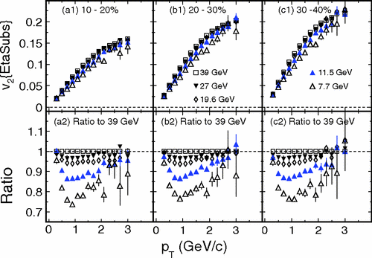
Very little energy dependence
circa 2005
circa 2013

Slide 8
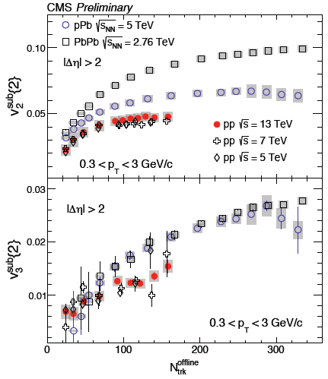

Small systems…
proton
LEAD
Yeah…pPb, even pp creates a QGP!
Maybe we need to rethink about the whole paradigm…

Slide 9
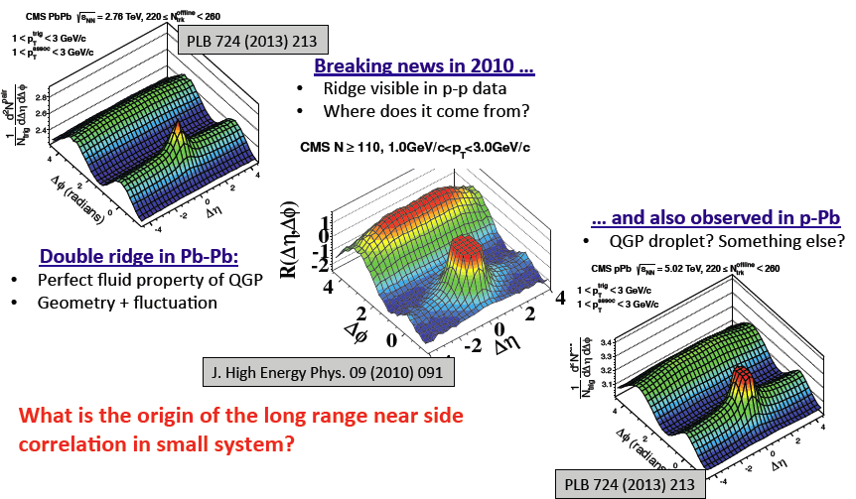
A bit of history…

Slide 10
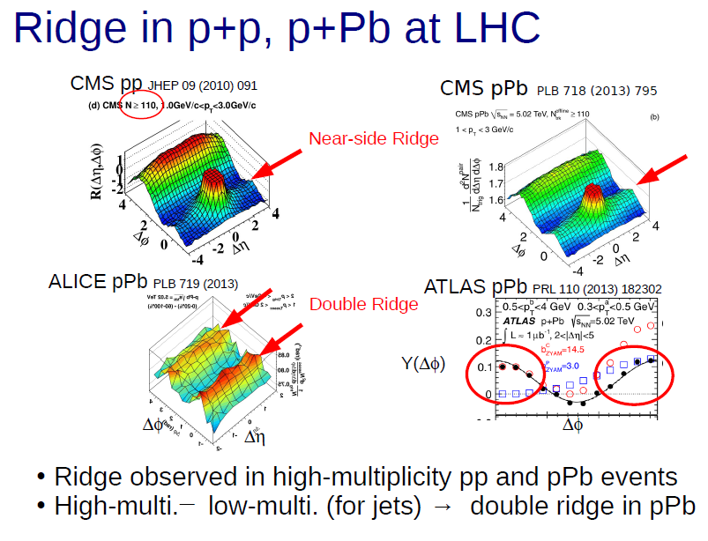
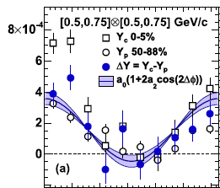
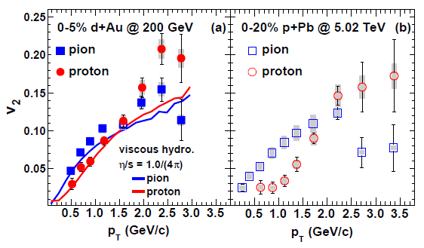
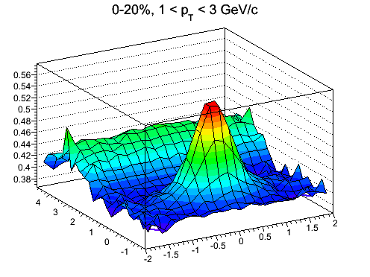
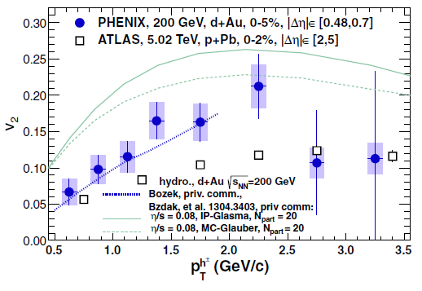
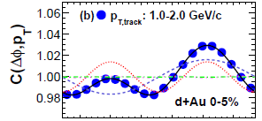
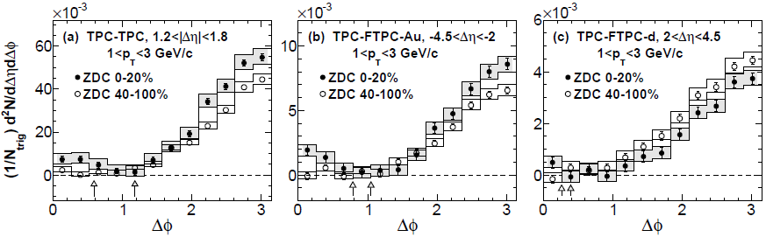
“flow” in small systems, and everywhere
ATLAS
ALICE
PHENIX dAu
STAR dAu
PHENIX
ALICE
Δη ∼ 3
PHENIX dAu
STAR

Slide 11
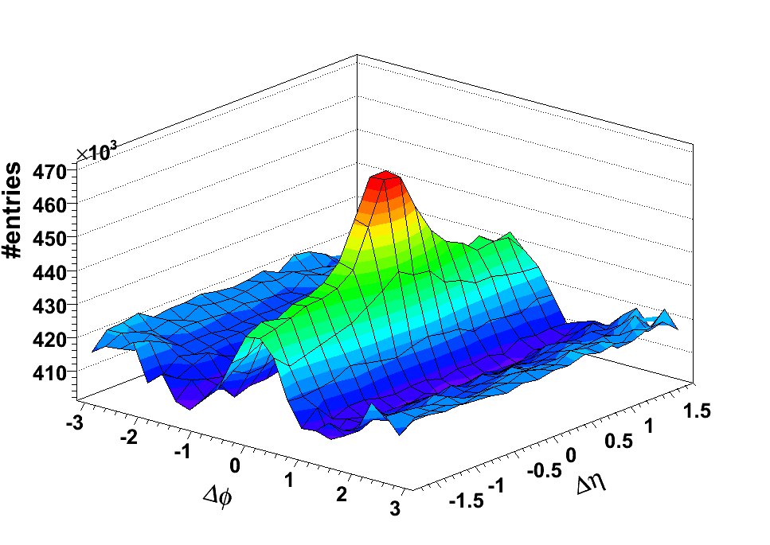
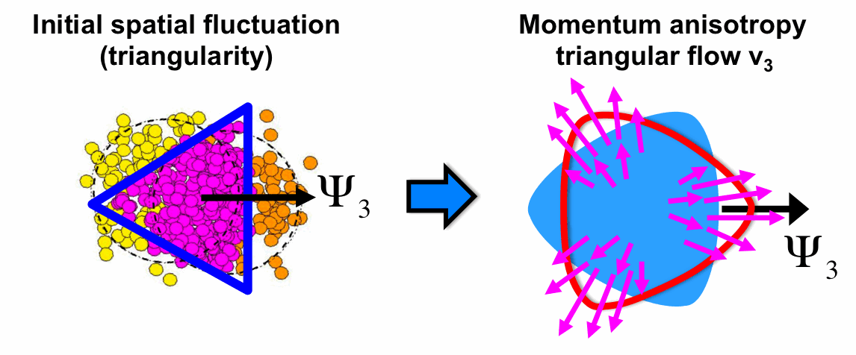
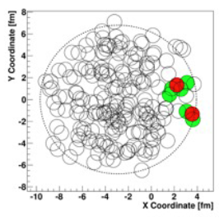
The Ridge
Two-particle
angular correlations
dN/dφ ∼ 1 + 2v₂cos2(φ−ψ₂) + 2v₃cos2(φ−ψ₃)
dN/dΔφ ∼ 1 + 2v₂²cos2Δφ + 2v₃²cos2Δφ
STAR, PRC 80 (2009)
Au+Au
ridge
Δφ
Δη
Elliptic flow subtracted
Above uniform pedestal

Slide 12
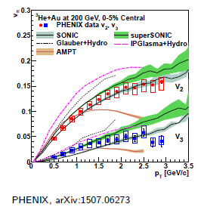
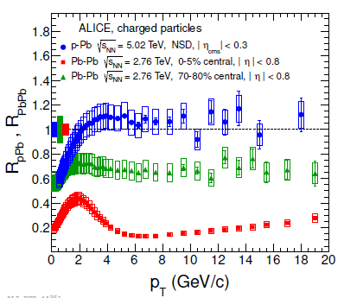
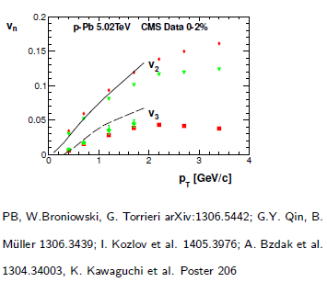
Strong anisotropy, but no energy loss

Slide 13

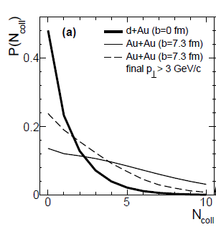
Is it really hydro?
?
Mean free path: L_{mfp} = 1/ρσ
Prob. = exp(−L/L_{mfp}) = exp(−ρσL)
Opacity = L/L_{mfp} = ρσL
Low opacity in QGP modeled by AMPT
AMPT
Hydro questionable

Slide 14
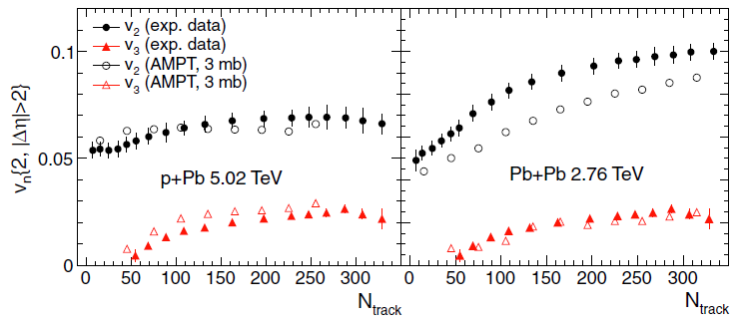
AMPT can describe the data too…
AMPT: A Multi-Phase Transport (string melting turned on)
Partons (quarks) liberated from nucleons and strings
Parton cascading: elastic scattering with 3 mb cross-section
Partons cease to interact: freeze-out, coalescence into hadrons
A. Bzdak, G.L. Ma, PRL 113, 252301 (2014)

Slide 15
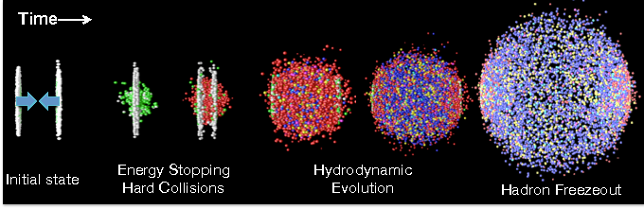
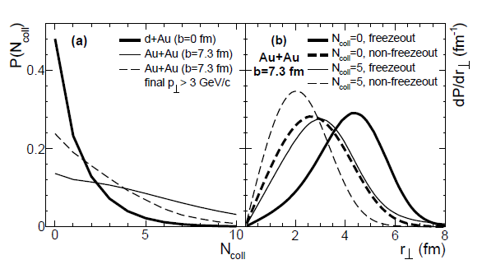
Parton cascade history
Get into transport code
Follow cascading history, microscopic interactions
Investigate how parton v_{n} is generated
Low opacity in QGP modeled by AMPT

Slide 16
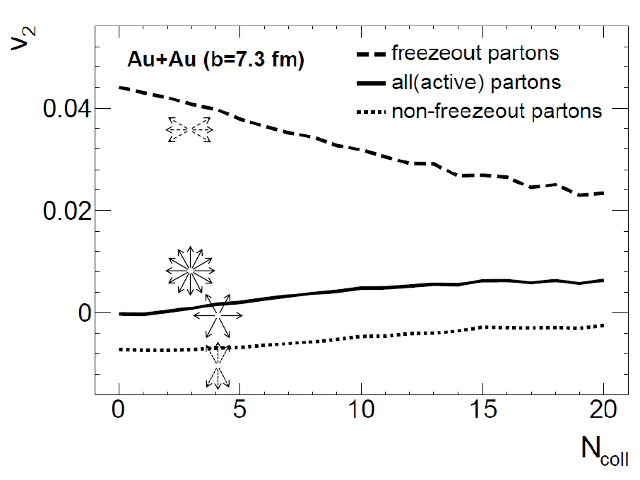
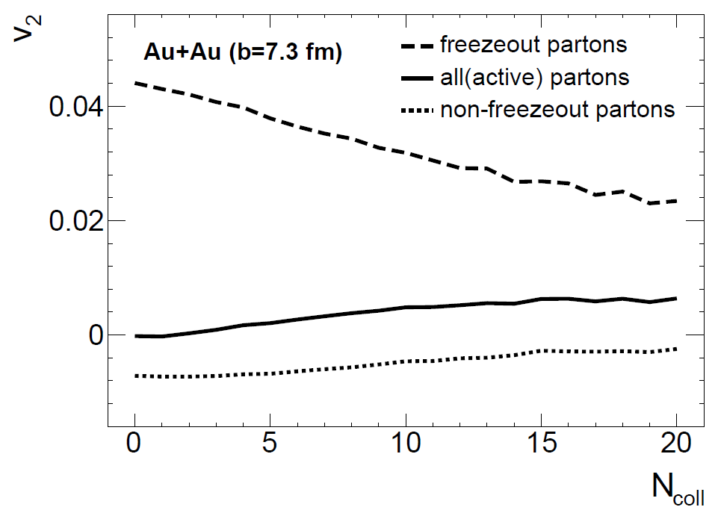
How is anisotropy developed in AMPT?
L. He, T. Edmonds, Z.-W. Lin, F. Liu, D. Molnar, FW, arXiv:1502.05572
Parton v₂
Partons freeze out with large positive v₂, even when they do not interact at all.
This is due to larger escape probability along x than y.
Remaining partons start off with negative v₂, and become ∼isotropic (v₂∼0) after one more collision.
Process repeats itself.
Similar for v₃.
Similar for d+Au collisions.

Slide 17
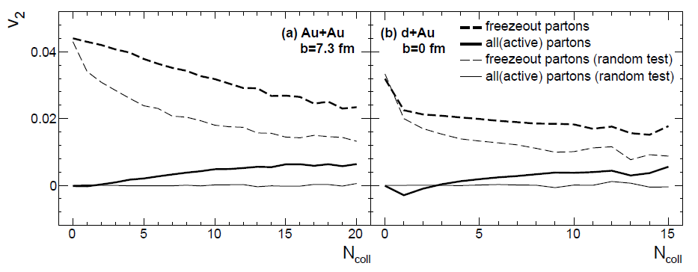
Majority anisotropy from escape
Normal AMPT
p randomized
Normal AMPT
p randomized
Majority of anisotropy comes from the final-step “escape” mechanism.
Escape yields a slightly larger v₂ in normal AMPT than in random case. The escape probability (parton sees) differs in these two cases.
The partons start with small v₂ before escape (freezeout).
This small v₂ is due to dynamics, result of hydrodynamic pressure push. It is this flow that is most relevant. However it plays a minor role.

Slide 18
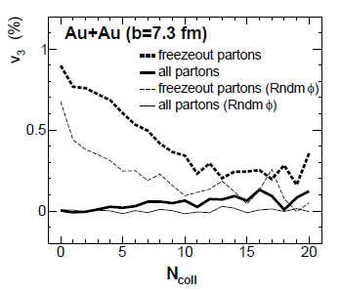
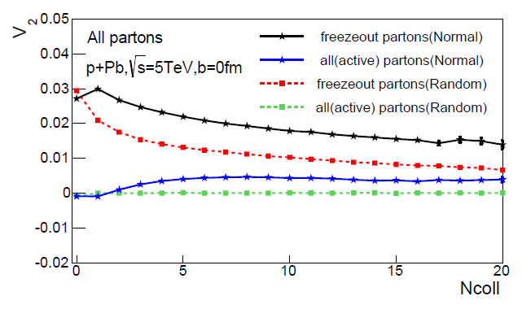
Similar for v₃ & LHC p+Pb

Slide 19
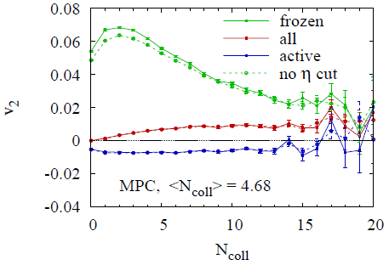
Is it general? AMPT vs MPC
AMPT
Yes, it is general to transport.

Slide 20
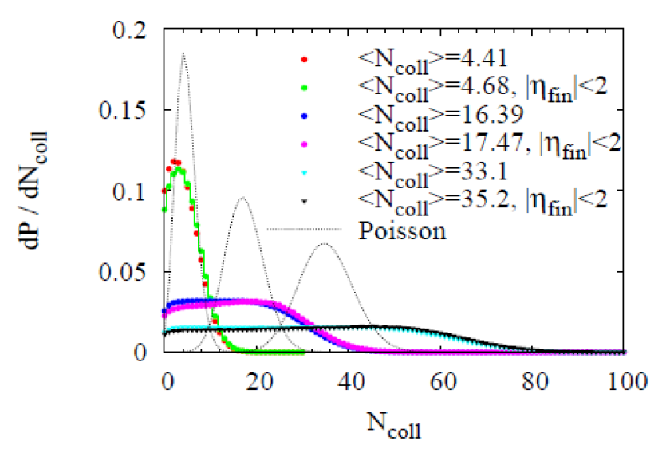
Increasing x-section → hydro?
MPC
AMPT
3mb
3mb
20mb
40mb

Slide 21
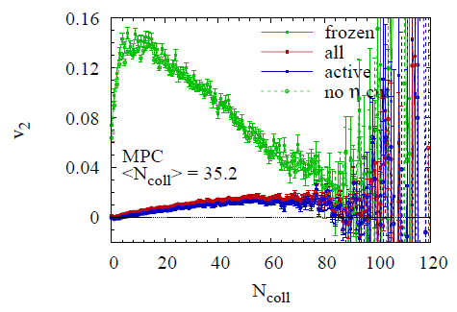
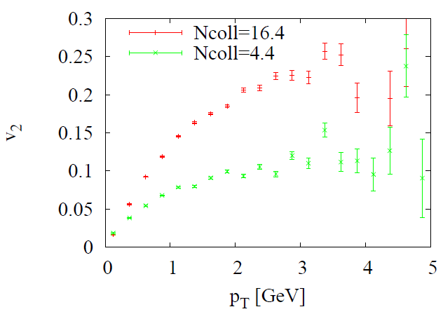
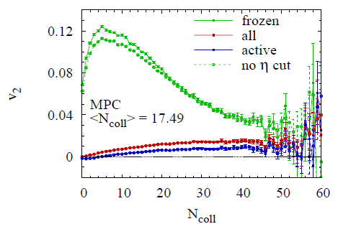
40mb
MPC
20mb
3mb
20mb
3mb

Slide 22
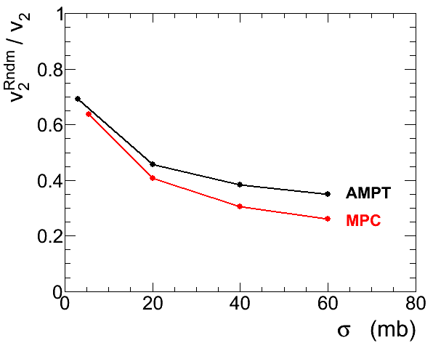
Relative escape contribution
N_{coll} ≈
5 20 35 50
Escape contribution still sizeable even at x10 larger x-sections.

Slide 23
Anisotropy mechanism
?
DATA
4v₂
−π 0 π
No expansion
Expansion, flow

Slide 24
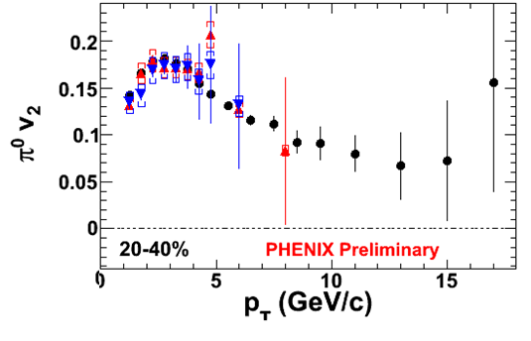
Our flow paradigm?
hydro
??
pathlength-dep.
energy loss

Slide 25
Our Paradigm
ca 2005
T, ε, p
Local equilibrium??
Collective velocity
field??
Ncoll ∼ a few:
Already enough to equilibrate and generate large hydrodynamic flow?
Might there be another mechanism to generate large anisotropy?

Slide 26
Many open questions
Many interesting features in small and large systems.
Can hydro describe them all?
Is hydro simply a model with many parameters too?
Are we really right that the majority of the measured anisotropy is indeed hydro flow?
Transport models say no.
Is the “nearly perfect liquid” actually far from perfect?
…

Slide 27
Which is real?
Hydrodynamics have pressure driven evolution only.
Energy-momentum cell freeze-out controlled by local T, ε.
The escape mechanism is not obviously present in hydro.
Escape anisotropy has all characteristics of “flow” so multi-particle correlations etc. It’s just not hydro flow.
Hydrodynamics describe data well. AMPT also describes data well.
Majority v₂ in AMPT is from escape. Are data v_{n} from hydro?
Which is more real? How to distinguish?
  Pressure push generates radial flow
  Escape mechanism does not generate radial flow

Slide 28
Heavy ion collisions
Low density/opacity
Mundane physics
Perfect liquid
Hydrodynamics
Need experimental test!

Slide 29
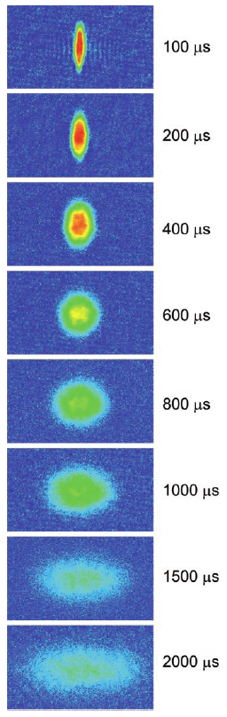
Cold Atom System
Opacity: ρσL
a ≈ 5×10⁻⁵ cm
σ_{int} ≈ 10⁻⁸ cm²
ρ ≈ 5×10¹³ /cm³
L_{mfp} ≈ 2×10⁻⁶ cm
L ≈ 2×10⁻³ cm
L/L_{mfp} ≈ 1000
K. M. O’Hara et al., Science 298, 2179 (2002)
AMPT
X10⁻³
0-1
Low opacity in QGP modeled by AMPT
Very high opacity for the cold atom system
low
Indeed hydro!
To emulate QGP with cold atoms
ρσ_{int}L: reduce opacity by 10³
1000 → 1

Slide 30
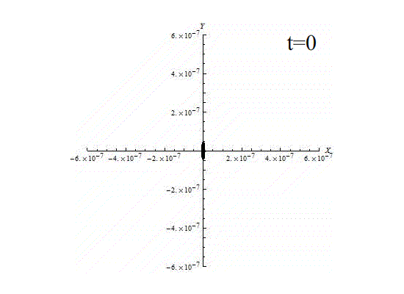
Anisotropic ion trap is also viable
Coulomb interactions
Can change trap size and anisotropy, and ion density

Slide 31
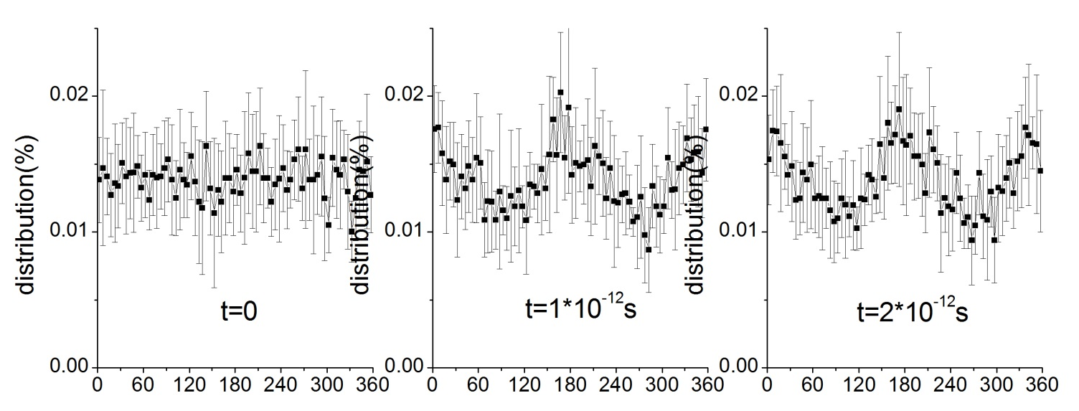

Ion trap: Coulomb
Lx=10nm
Ly=80nm
Lz=100nm
Number of ions =1000
Initial thermal velocity 2000m/s

Slide 32





Ion trap: Coulomb with hard core
ρσ_{int}L ∼ 1

Slide 33
Hot QGP vs Cold Atoms
  Is quantum uncertainty principle at all relevant?

Slide 34


T = 10⁴ K
Quantum Mechanical?
Classical?

Slide 35




Is QGP classical?
?
K. M. O’Hara et al., Science 298, 2179 (2002)
Li: M∼6000 MeV
T∼1μK∼10⁻¹⁶MeV
x∼20μm, y∼100μm
p∼(TM)^{1/2}∼10⁻⁶MeV
p quan∼1/r∼10⁻⁸MeV
E quan∼1/(mr²)∼10⁻²⁰MeV
Negligible!
Cold atoms are hot,
“classical” w.r.t. trap size.
q,g: M∼0 MeV
T∼200 MeV
x∼3fm, y∼4fm
p∼200MeV
p quan∼1/r∼200MeV
E quan∼200 MeV
Comparable!
QGP is cold,
quantum mechanical.
Kolb, Heinz, nucl-th/0305084; Lisa et al. New J. Phys. 13 (2011) 065006

Slide 36
QM uncertainty principle
y
x

Slide 37
Infinite square well
b
a
1 fm
Single state anisotropy

Slide 38

Harmonic oscillator

Slide 39


Thermal probability
x, y at same Fermi energy, so different number of filled energy levels.
At high temperature, classical limit, sum is approximated by integral:
then it’s independent of potential.
It’s isotropic at all temperature because K=(p_{x}²+p_{y}²)/2m is isotropic.
Because
This is classical physics limit.

Slide 40








Thermal probability weight
D. Molnar, FW, and C.H. Greene, arXiv:1404.4119

Slide 41


Quantum physics anisotropy
D. Molnar, FW, and C.H. Greene, arXiv:1404.4119

Slide 42

Relativistic quantum mechanical calculation
Much harder calculation. The last two years were spent on it.
Use of polar coord. and wise choice of base functions.
Converges with ~200 eigenstates.
Effect is ~1% at T=140 MeV and 0.5% at T=200 MeV.

Slide 43
Cold atoms
Strong elliptic anisotropy
K. M. O’Hara et al., Science 298, 2179 (2002).
Lithium atoms M ~ 6000 MeV
Temperature T ~ 1 μK ~ 10⁻¹⁶ MeV
Trap size x ~ 20 μm, y ~ 100 μm
Typical momentum (TM)^{1/2} ~ 10⁻⁶ MeV
Intrinsic momentum quantum ~ 1/r ~ 10⁻⁸ MeV, negligible.
Typical energy ~ T ~ 10⁻¹⁶ MeV
Intrinsic energy quantum 1/(mr²) ~ 10⁻²⁰ MeV, negligible.
Cold Lithium atoms are actually “hotter” than the hot QGP.
~ 10⁻⁵
The observed large v₂ is indeed due to strong interactions.

Slide 44
Is quantum v₂ real in QGP?
It should be… but need experiment to verify (cold atom experiment)
Cold atoms are “classical.”
Make it Quantum Mechanical.
Would be neat to verify QM and uncertainty principle
K. M. O’Hara et al., Science 298, 2179 (2002)
Li: M∼6000 MeV
T∼1μK∼10⁻¹⁶MeV
x∼20μm, y∼100μm
p∼(TM)^{1/2}∼10⁻⁶MeV
p quan∼1/r∼10⁻⁸MeV
E quan∼1/(mr²)∼10⁻²⁰MeV
Negligible!
Cold atoms are hot,
classical.
q,g: M∼0 MeV
T∼200 MeV
x∼3fm,y∼4fm
p∼200MeV
p quan∼1/r∼200MeV
E quan∼200 MeV
Comparable!
QGP is cold,
quantum mechanical.
Kolb, Heinz, nucl-th/0305084; Lisa et al. New J. Phys. 13 (2011) 065006
x10⁻⁴
X10⁻²

Slide 45
Remarks
Hydrodynamics is only an assumption.
Is initial QM v₂ important after hydro evolution?
When does hydro set in and take over?
Will the initial QM v₂ be washed out by hydro?
Current hydro implementation is classical.
Need to incorporate QM into hydro: quantum hydrodynamics.

Slide 46
Chiral magnetic effect

Slide 47

Symmetries and conservation laws
Slide stolen from Jinfeng Liao

Slide 48

Chiral Anomaly
Slide stolen from Jinfeng Liao

Slide 49






Chiral Magnetic Effect (CME)
D. Kharzeev, et al. NPA 803, 227(2008)
non-conservation of axial currents. Axial Ward-identity
Peak magnetic field ~ 10¹⁵ T !
Electric charge separation alone the B field
Notes:
QCD真空存在比较丰富的结构，可以用拓扑电荷来量化各种态之间的变化，由于涨落的原因，在重离子碰撞中形成的QGP里，存在一些局域的非零的拓扑电荷，这些拓扑电荷的存在会产生一个非零的轴矢量流，导致净的手征荷的变化，比如说左手粒子变为右手粒子，粒子手征性的变化可以通过改变自旋方向或者动量方向，考虑到在非对心的重离子碰撞中，可能会形成非常强的磁场，自旋和磁场的耦合能量大于粒子的动能，因此在这种情况下，更容易通过改变运动方向来改变手征性，最终的结果就会导致u或d夸克朝同一个方向跑，就会产生一个电荷分离的效应，这个就是手征磁效应。

Slide 50

Three-particle correlator observable
Kharzeev, PLB633:260 (2006)
Kharzeev, McLerran, Warringa, NPA803:227 (2008)
CME + P-odd domain → charge separation across RP
A direct measurement of the P-odd “a” should yield zero
S. Voloshin, PRC 70 (2004) 057901
Directed flow: known to be small expected to be the same for SS and OS
P-even quantity: what we’re looking for; still sensitive to charge separation
Non-flow/non-parity effects: The hope was that these cancel out

Slide 51

Charge “Separation” Signal
STAR collaboration, PRL 103(2009)251601; PRC 81(2010)54908; PRC 88 (2013) 64911
Correlator indicates charge separation signal
Confirmed with 1st-order EP (from spectator neutron v1)

Slide 52
Beam Energy Scan data
ALICE, arXiv:1207.0900
STAR, PRL 113 (2014) 052302
From 2.76 TeV to 7.7 GeV, changes start to show from the peripheral collisions.

Slide 53
Consider OS-SS to be signal...
ALICE, arXiv:1207.0900
The signal seems to be disappearing at 7.7 GeV, but the statistical errors are large.

Slide 54


Slide 55

Elliptic flow driven background
As pointed out at the same time of the STAR publications, the backgrounds may not be negligible: [2009~2010] Wang; Bzdak, Koch, Liao; Pratt; …
Y
π⁻
π⁺
π⁺
ρ
π⁺
ρ
π⁻
X
ψ_{RP}
ρ
π⁺
π⁻
π⁻

Slide 56

Suppressing flow-driven background
Clearly there are flow driven background contributions:
need to develop ways to suppress such backgrounds!

Slide 57

The imfamous kappa parameter

Slide 58
LPV in UU
A dedicated trigger selected events with 0-1% spectator neutrons.
With the magnetic field suppressed, the charge separation signal disappears (while v₂ is still ~ 2.5%).
70-80%
0-5%
Logic: With finite v₂, there should be no background, but signal is zero → v₂-bkgd model is wrong → signal=0 is actually expected from CME picture → the finite signals in non-central collisions likely come from CME because v₂-bkgd model can be wrong there too.
What I think is going on: v₂ is v₂{2}, dominated by fluctuations in ultracentral collisions. The bkgd source v₂ is likely uncorrelated with the v₂{2} from final-state particles.

Slide 59


Small systems
Jie Zhao for STAR, ISMD2016
STAR preliminary
STAR preliminary
At same multiplicity d+Au and Au+Au show similar charge separation
More data needed for d+Au collisions.

Slide 60



LHC/CMS results
CMS, arXiv:1610.00263

Slide 61


Resonances and Jets effect
F. Wang, “Effects of cluster particle correlations on local
parity violation observables”, Phys.Rev.C 81 (2010) 064902
Y
π⁺
π⁻
ρ, resonance, jet…
X (defined ψ_{R})
ϒ -> α + β
Flow -> might be dominant source of background for CME signals
Flowing clusters produce CME like signal

Slide 62

Event shape selection method does not completely eliminate background
Wang, Zhao, arXiv:1608.06610

Slide 63
Resonances decay simulation
 | dN/dy | B.R.
ρ -> π⁺+π⁻ | ~16.7 | ~100%
η -> π⁺+π⁻+π⁰ | ~7.86 | ~22.9%
η -> π⁺+π⁻+γ | ~7.86 | ~4.2%
ω -> π⁺+π⁻+π⁰ | ~9.87 | ~89.2%
ω -> π⁺+π⁻ | ~9.87 | ~1.5%
STAR, Phys. Rev. C 92, 024912 (2015)
ρ/inclusive π ratio from STAR 40-80% ~0.169 for all centrality,
fixed ρ/η, ρ/ω ratio from the MB data.
consider ρ, η and ω to π contributions, fixed ρ/η, ρ/ω ratio.
total resonance/”direct” π ~0.39

Slide 64
Resonances decay simulation
Single π and ρ -> π⁺+π⁻, η -> π⁺+π⁻+π⁰, η -> π⁺+π⁻+γ,
ω-> π⁺+π⁻+π⁰ , ω-> π⁺+π⁻.
two-body/three-body phase space decay,
Breit-Wigner mass fun for η, ω, ρ .
π pt from PHENIX. ρ pt from STAR 40-80%, for all centrality.
η and ω same pt as ρ for all centrality, v₂ from the excepted NCQ fitted data.
π v₂ from STAR low pt + PHENIX high pt (only upto 50-60%, take same for 60-70%and 70-80%).
particle mult. for each centrality sampled by Poisson accord. to dN/dy, Flat rapidity (+/-1.5) (STAR acc. with pt>0.2 and |eta|<1).
ρ/π ratio from STAR 40-80% ~0.169 for all centrality, consider ρ, η and ω to π contributions, fixed ρ/η, ρ/ω ratio. total resonance/’direct” π ~0.39

Slide 65




Pion p_{T} spectra
modified Hagedorn function
Bose-Einstein distribution
Inclusive pion dN/dy fixed from PHENIX data, while the pt shape use the Bose-Einstein distribution.
In our simulation input single pion mainly the direct pion, resonance decay pion dominate at low pt, so I use the Bose-Einstein distribution.
STAR acc. cut will remove ~25-35% low pT pions, and also for resonances.

Slide 66


Rho p_{T} spectra
exponential mT fit
m₀)/T_{exp}
(m₀+T_{exp})
rho pt from STAR 40-80%, for all centrality. same shape for eta and oemga.
With fixed rho/inclusive pion =0.169, fixed eta/rho, omega/rho.

Slide 67



Input v₂
PHENIX, PRL 105, 142301 (2010); STAR, PRC 72, 014904 (2005)
1 + exp(-((m_{T} - m₀)/n – b)/c)
X. Dong et al., Phys. Lett. B597, 328 (2004)
NCQ scaling fitted pion data, predict for rho, eta, omega

Slide 68



Resonances decay simulation
Fuqiang Wang, Jie Zhao, arXiv:1608.06610

Slide 69



Jet effects with Hijing simulation
Hijing with b: 9-14fm
Final state pi, k, p reconstructed event plane,
or impact parameter direction as event plane (ψ₂=0).
afterburner flow with respect to the
event plane
Liang Zhang, Feng Liu, Fuqiang Wang, Phys. Rev. C 92, 054906 (2015)
ψ₂=0
recon. ψ₂

Slide 70



Jet effects with Hijing simulation
Jie Zhao, Fuqiang Wang (Hard Probes 2016)
The charge separation signal is zero with default Hijing and the ture event plane.
The charge separation signal with reconstructed event plane in Hijing is comparable to experimental data.
STAR preliminary

Slide 71


Jet effects with Hijing simulation
afterburner flow effect
Jie Zhao, Fuqiang Wang (Hard Probes 2016)
With flow afterburner, the charge separation signal increases.
The results indicate that jets can mimic a CME signal.

Slide 72
Final remarks
The more I think, the more skeptical I am about our established paradigm.
What have we learned from heavy ion collisions?
Spontaneously, I can give you a long list of findings.
What fundamental physics have we learned?
I cannot give you a clear answer.
We must be self critical. We must ask hard questions.
We must think out of the box.

Slide 73
Where we are?
Where we are, on the way to look for the QGP?
Where to go, for more concrete conclusion on QGP?
What fundamental knowledge will we contribute?

Slide 74



Fundamental physics we can contribute
Artist’s view of heavy ion collision
Gold
P. W. Anderson
Gold
More is different!
High energy nuclear physics
nucleus-nucleus collision
Many body physics
Nuclear Matter
High energy Nuclear Physics: Condensed Matter physics of QCD

