Slide 1
Equation of state of neutron stars: Consistency with observation
Deagu University
Chang Ho Hyun
HaPhy-HIM joint workshop
IBS, Daejeon, August 29, 2015

Slide 2
Contents
Observables and current status
Model: Skyrme force and RMF
Cooling curve
Summary
Special thanks to:
Chang-Hwan Lee (PNU),
Kyujin Kwak (UNIST),
Yeunhwan Lim (RISP/IBS) and
Youngman Kim (RISP/IBS)

Slide 3
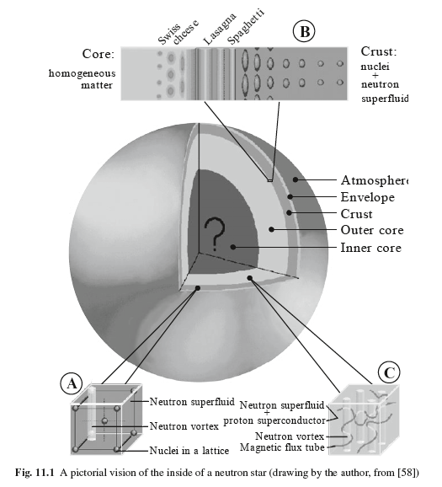

Slide 4
Observables and current status
Mass and radius: binary systems
X-ray/optical binaries
Double neutron stars
White dwarf/neutron stars
About 70 systems have been observed
Temperature: isolated neutron stars
Cooling curve: temperature + age
About 20 objects have been measured

Slide 5
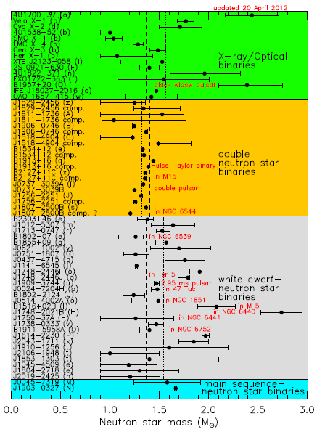
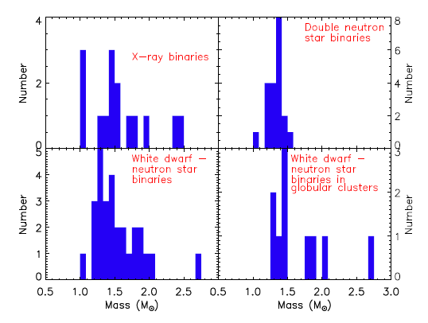
Mass and radius
Key ingredients: equation of state (EoS)
Mass distribution (J. Lattimer, Ann. Rev. Nucl. Part., 2012)
PSR J1614-2230: (1.97±0.04)M⊙
PSR J0348+0432: (2.01±0.04)M⊙

Slide 6
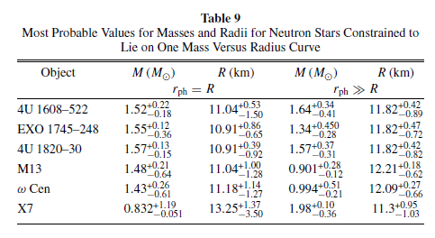
Mass-radius (A. Steiner, J. Lattimer, E. Brown, ApJ, 2010): Determine EoS from data set of six neutron stars. Markov chain Monte Carlo algorithm within a Bayesian framework
For M = 1.4 M⊙, R = 11 – 12 km
Maximum mass: (1.9 – 2.2)M⊙

Slide 7
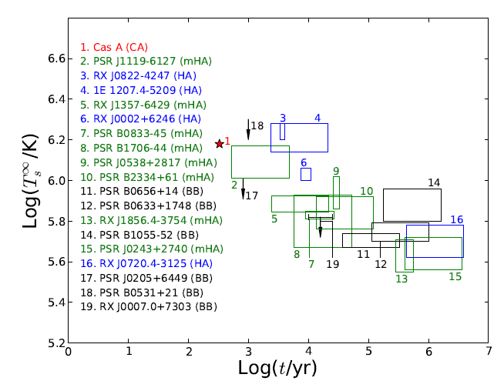
Temperature
Key ingredients: EoS (particle fraction), Elements in the envelop, Nuclear superfluidity
Cas A: Observed about 300 yrs ago
Age group
young: less than 10⁴ yrs
middle: 10⁴ – 10⁵ yrs
old: more than 10⁵ yrs
Slow-quick-slow cooling

Slide 8
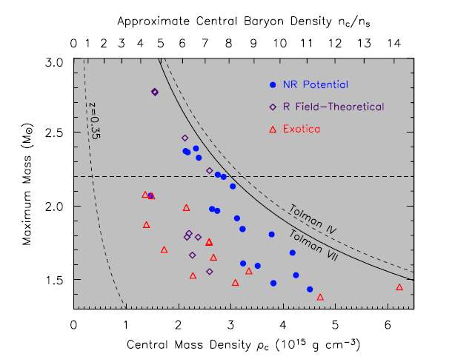
Model
Theories

Slide 9
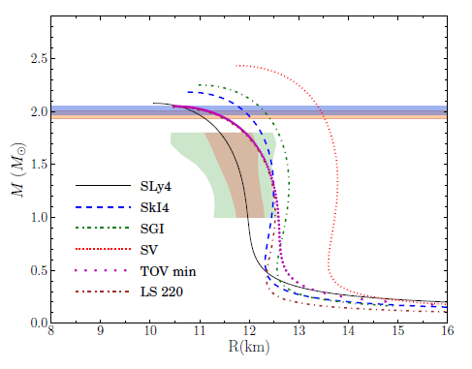
Skyrme force
General form
Mass-radius relation

Slide 10
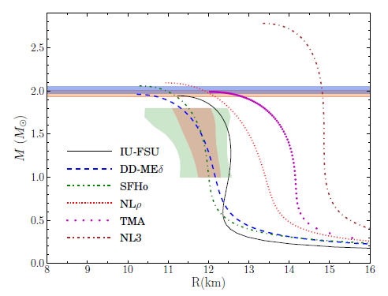
RMF
General form
Mass-radius relation

Slide 11
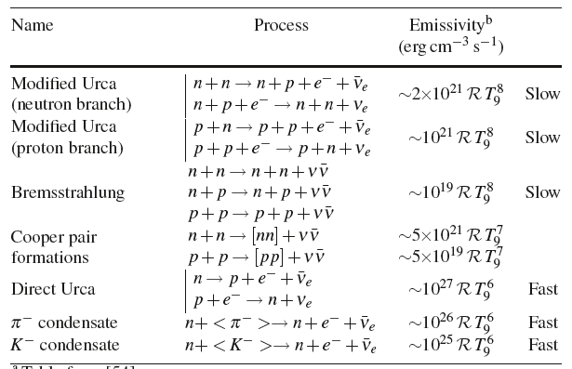
Cooling curve
Cooling mechanism
Photon emission: mostly on the surface
Neutrino emission: entire region, major energy loss

Slide 12
Standard cooling
Direct Urca, Modified Urca, Pair bremsstrahlung
We do not know the mass of observed stars
Probably mass of the stars lie in the canonical range (1.2 – 1.6)M⊙

Slide 13
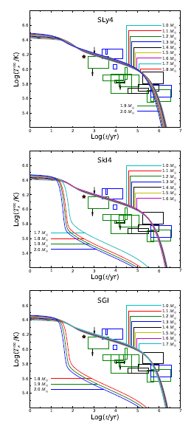
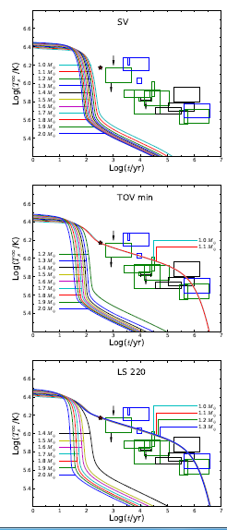
Skyrme force
Mass in the range of (1.0 – 2.0)M⊙
Abrupt drop: ingnition of direct Urca
SLy4: do direct Urca
Stiffer EoS allows early direct Urca
No model can explain middle-age data
Good: SLy4, SkI4, SGI
TOV-min: fitted to neutron star mass, but does not satisfy cooling

Slide 14
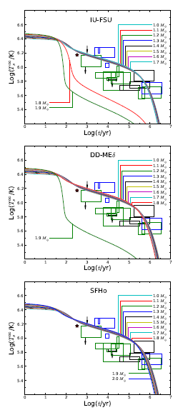
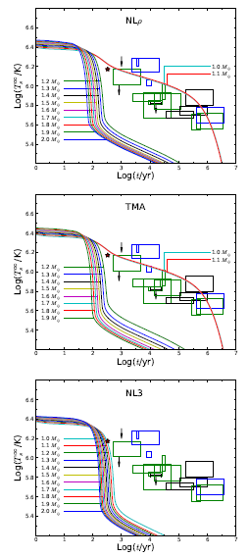
RMF
Mass in the range of (1.0 – 2.0)M⊙
Abrupt drop: ingnition of direct Urca
SFHo: do direct Urca
No model can explain middle-age data
Good: IU-FSU, DD-Meδ, SFHo

Slide 15
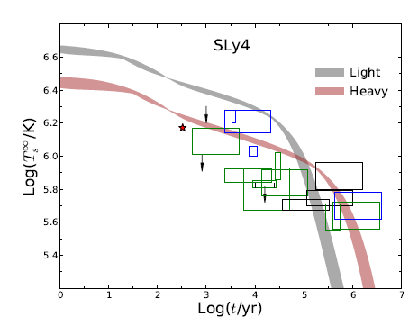
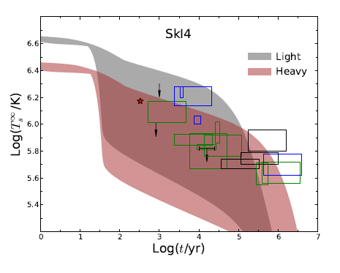
Effect of envelop element
Mass range: (1.2 – 2.0)M⊙
Heavy dependence on model

Slide 16
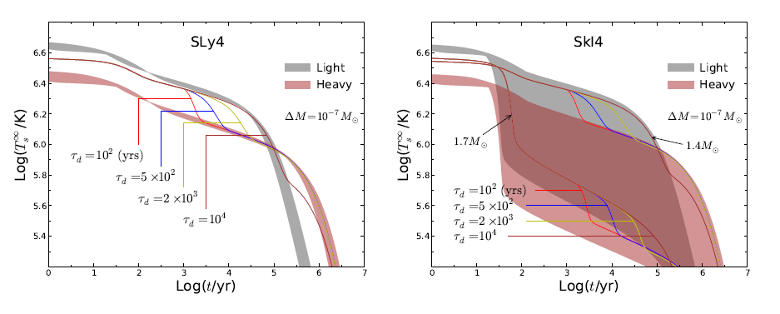
Dependence on the light element life time

Slide 17
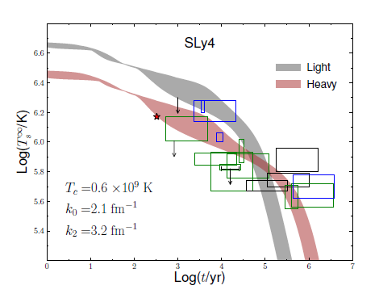
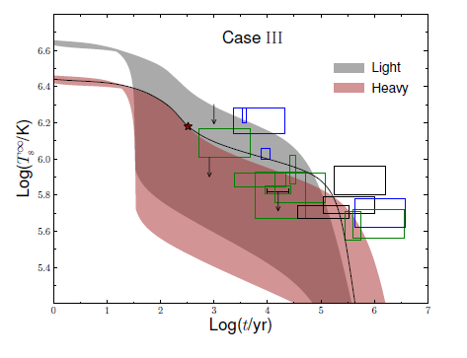
Effect of nuclear superfluidity

Slide 18
Summary
Mass-radius and temperature data: experimental constraints
Nuclear models: Skyrme force, RMF
Could distinguish better models: Good for mass-radius is also good for temperature evolution
Proper combination of envelop elements and nuclear superfluidity: prediction within the data
More to consider
Strangeness
- hyperon puzzle
- kaon condensation (Y. Lim, K. Kwak, CHH, C.-H. Lee, PRC, 2014)

Slide 19
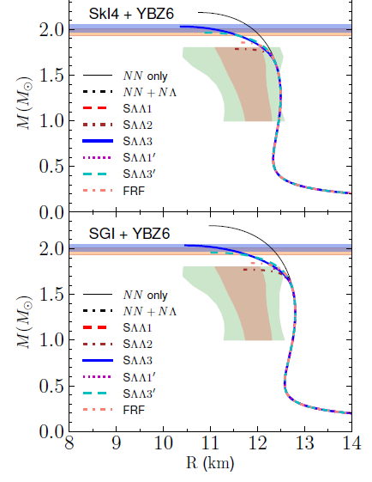
Y. Lim, CHH, K. Kwak, C.-H. Lee, arXiv: 1412.5722, submitted to NPA
Cooling curve with strangeness: in progress
Improve models: systematic way to determine the EoS at high densities

Slide 20
새로운 현상 발견
새로운 핵모형 개발
핵력의 체계적 이해
계산 기술의 발전
별의 진화와 원소의 생성 원리 이해, 초신성 폭발의 원인 규명, 고밀도 핵물질의 상태방정식 이해
RIA를 가동 또는 건설 중인 나라: 미국, 캐나다, 독일, 프랑스, 러시아, 중국, 일본, 한국 등
RAON: 한국 최초의 핵물리 연구용 가속기
우리의 배를 타고 미지의 세계를 탐험할 수 있는 멋있는 여행

