Slide 1
1. Introduction (J-PARC)
2. Baryon spectroscopy (J-PARC E45)
3. Future heavy-ion experiment at J-PARC (J-PARC HI)
4. Summary
Baryon spectroscopy and
Studies of extremely dense matter
at J-PARC
Hiroyuki Sako (ASRC/J-PARC, JAEA)
for J-PARC E45 and J-PARC HI Collaboration
2015 HaPhy-HIM Joint Meeting: Experimental and Theoretical Nuclear Physics (28 Aug 2015)

Slide 2
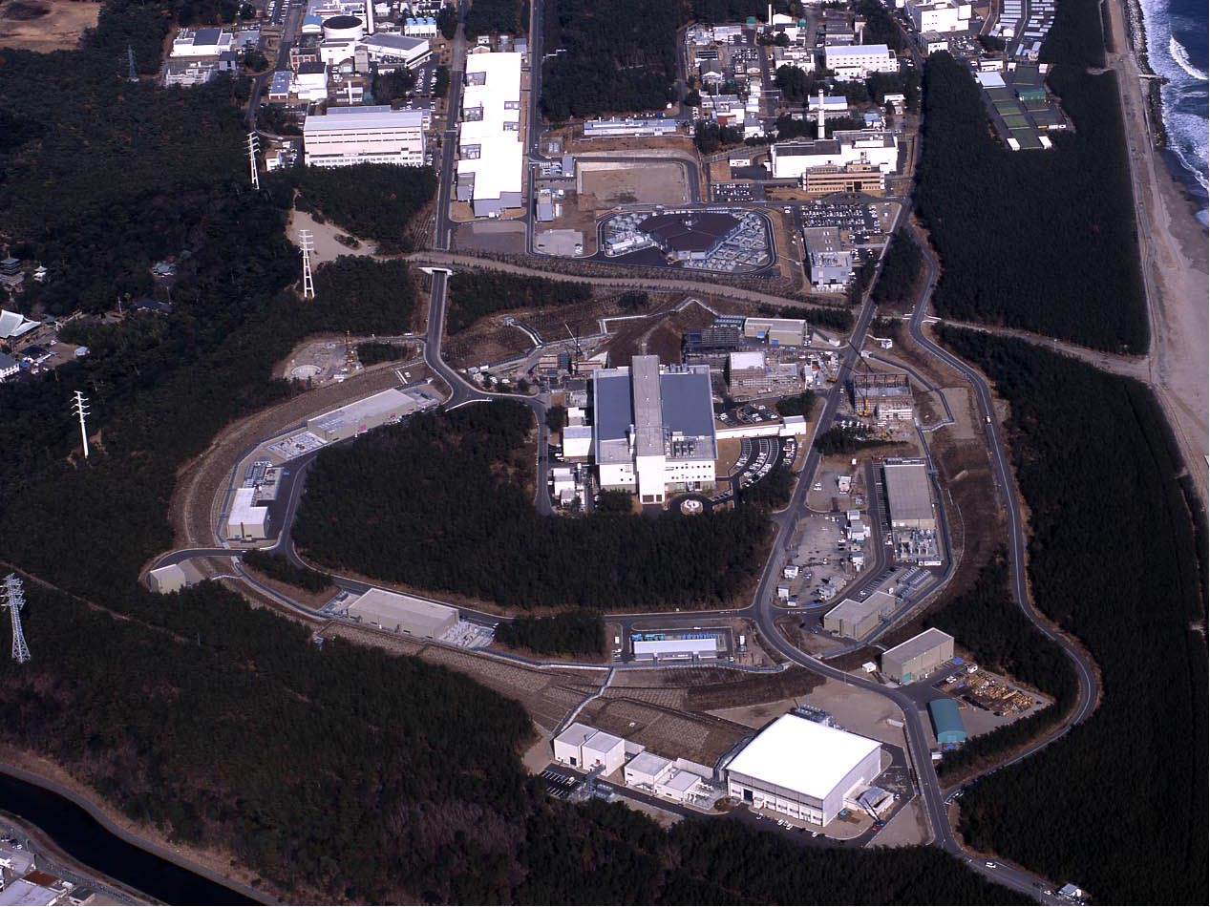
400 MeV LINAC
3 GeV Synchrotron
Neutrino Beams (T2K experiment)
Materials and Life Experimental Facility
5
MR Synchrotron (30 GeV)
Bird’s eye photo in January of 2008
Hadron Exp. Facility
J-PARC (MW proton synchrotron)

Slide 3
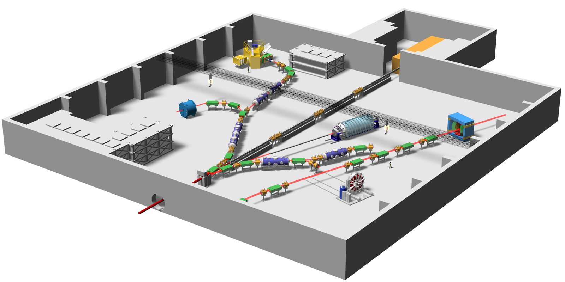
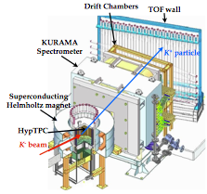
Hadron Experimental Facility
10¹⁴/spill p beams
10⁸/spill π beams
10⁶/spill K beams
Hyperon spectrometer (E42/E45)
K1.8
High p
K1.8BR
KL
K1.1
Production
Au target
K1.1BR
Proton Beam
Notes:
On the other hand, the hadron experimental hall looks like this.
● Proton beam comes here and various kaon beam lines are prepared, where K=1.8 means kaons with momentum of 1.8 GeV/c.
● At SKS, hypernuclear spectroscopy will be performed for a variety of nuclei. ● In particular, searches for double hypernucleus and pentaquark are the highlights in here.
● In this beamline, kaon implantation is planned. When kaon is implanted inside the nucleus, there is a possibility that high density matter is created. ● Kaonic atom and kaonic nucleus will be studied.
● This beam line is the neutral kaon line to study CP violation, and ● this line is for T-violation experiment.
● Finally, this line, which is not yet completed, is dedicated to the study of chiral symmetry, namely, the mass generation mechanism of bound quarks.
3

Slide 4
J-PARC E45
Studies of baryon resonances in (π,2π) reactions
Precise measurements of baryon resonance properties
  Many resonances have not been established experimentally
  ππΝ has strong coupling to high mass resonances
  Not enough (π,2π) experimental data since 1970’s
Deeper understanding of non-perturbative QCD
Search for new baryon states
  e.g. hybrid baryons (qqqg)
π
π
π
N*
N
N
Notes:
J-PARC P45実験はバリオン共鳴を(π、2π）反応で測定する実験ですが、目的としては、以下のような３つのものがあります。
まず、バリオン共鳴の性質を正確に測定することです。
依然として実験的に確立されていない共鳴状態が多く残っており、
また（π、2π）反応は1970年代に測定されて以来データが不足してこの実験が重要です。
次に、理論との比較により非摂動QCDのより深い理解につながり
また、ハイブリッドバリオン等の新たなバリオン状態の探索も行いたいと思っております。

Slide 5
E45 collaboration list
K. H. Hicks, S. Chandavar, J. Goetz, W. Tang (Ohio University, USA)
H. Sako, K. Imai, S. Hasegawa, S. Sato, S.H. Hwang, K. Hosomi, H. Sugimura, Y. Ichikawa, Y. C. Han, H. Ekawa, S. Hayakawa, Y. Nakada, S. Kinbara
(Japan Atomic Energy Agency, Japan)
K. Nakazawa, J. Yoshida (Gifu University)
J.K. Ahn, J. W. Lee, S. H. Kim, J. B. Park, M. H. Kim, W. S. Jung, J. L. Kim (Korea University, Korea)
K. Tanida, J. Y. Lee (Seoul National University, Korea)
H. S. Lee (RISP, Korea)
J.H. Park, K. Y. Baek (Pusan National University, Korea)
H. Fujioka, S. Nakamura, M. Niiyama (Kyoto University, Japan)
K. Ozawa (KEK, Japan)
B. Bassalleck, Y. Han (University of New Mexico, USA)
K. Joo, N. Markov, N. Harrison, T. O’Connell, E. Seder (University of Connecticut, USA)
B. Briscoe, F. Klein, I. Strakovsky, R. Workman (George Washington University, USA)
R. Schumacher (Carnegie Melon University, USA)
D. M. Manley (Kent State University, USA)
L. Guo (Florida International University, USA)
P. Cole , A. Forest, D. McNulty (Idaho State University, USA)
T.S.-H. Lee (Argonne National Lab, USA)
T. Sato, H. Kamano (Osaka University, Japan)
H. Kamano, K. Shirotori, S.Y. Ryu (RCNP, Osaka University, Japan)
Y. Azimov (Petersburg Nuclear Physics Institute, Russia)
V. Shklyar (University of Giessen, Germany)
A. Svarc (Ruder Boskovic Institute, Hungary)
S. Ceci (RBI-Zagreb, Hungary)
M. Hadzimehmedovic, H. Osmanovic (University of Tulza, Bosnia/Herzegovina)
From USA, Japan, Korea, and Europe

Slide 6
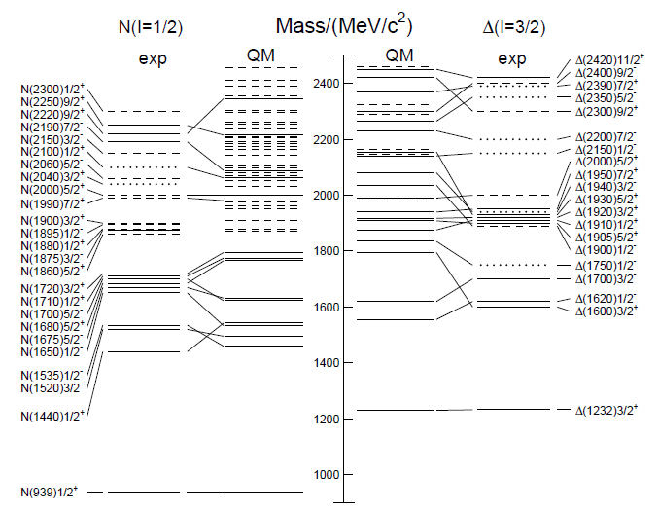
Baryon mass: Exp vs QM (PDG)
Missing baryons
Quark model does not describe well N* mass levels.
****
established
***
Orders of mass levels
are different
* **
Most of the N*s so far were
Measured from
PDG 2014
Notes:
6

Slide 7



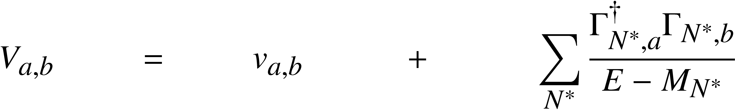
Dynamical coupled-channels model (ANL-Osaka)
For details see Matsuyama, Sato, Lee, Phys. Rep. 439,193 (2007)
Kamano’s talk (Apr 14)
Partial wave (LSJ) amplitude of a → b reaction:
Reaction channels:
Transition potentials:
Physical N*s will be a “mixture” of the two pictures:
baryon
a→c→b
meson cloud
a→b
coupled-channels
meson
core
exchange potentials
of ground state
mesons and baryons
bare N* states

Slide 8
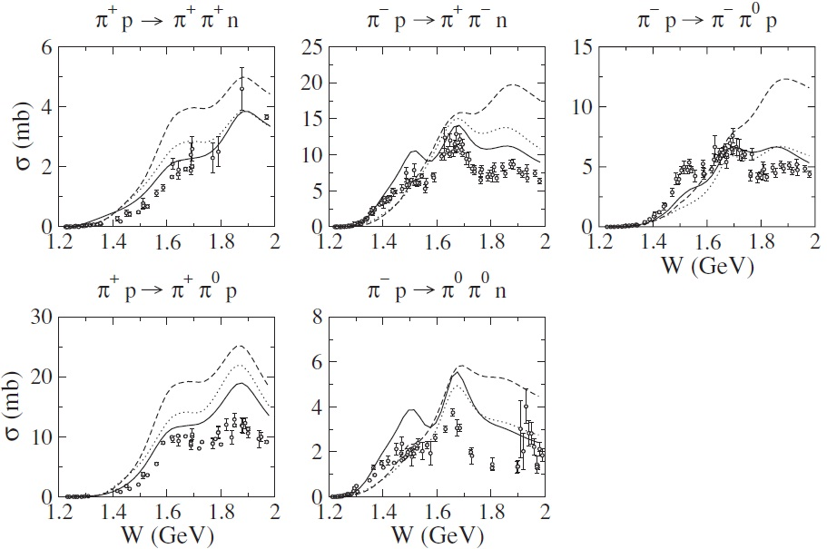
World’s πN→ππN data
Only 240K bubble chamber data in 1970’s
No channel
coupling
With channel
coupling
ππN center of mass energy
H. Kamano et al., PRC 79, 025206 (2009).
Notes:
8

Slide 9
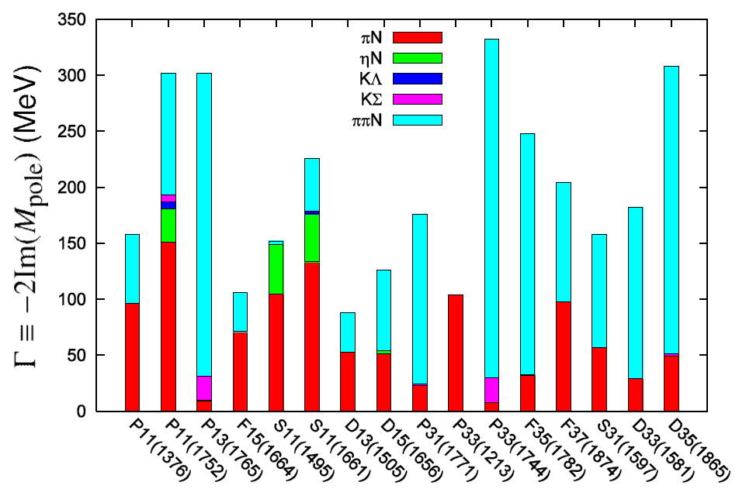
Importance of Nππ Decay
H. Kamano, et al. PRC 79 025206 (2009)
Notes:
9

Slide 10
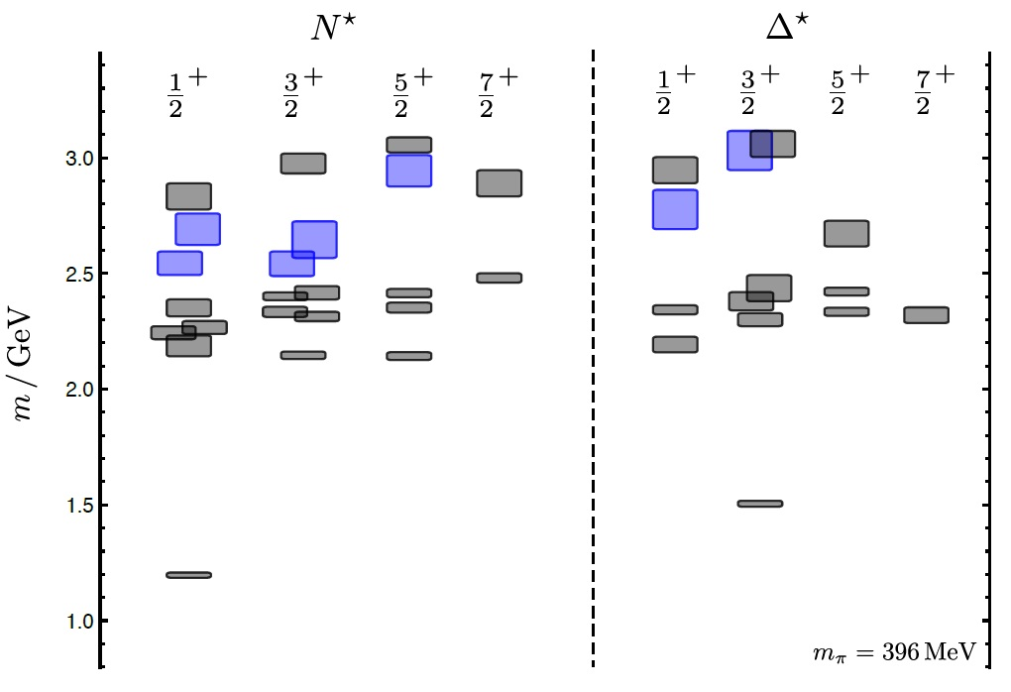
Recent Lattice QCD calculations
J. Dudek et al., PRD85 (2012) 054016
Note: Not real mass!
Hybrid baryons
(qqqg)
N(939)
Notes:
10

Slide 11
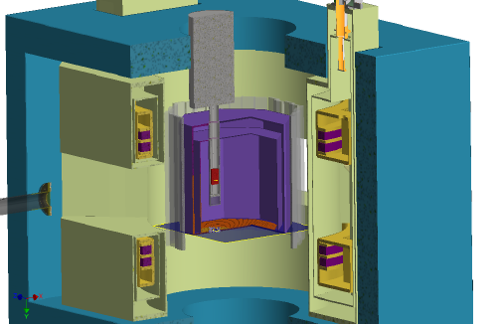
E45 HypTPC Spectrometer
Measure (π,2π) in large acceptance TPC in dipole magnetic field
π⁻p→π⁺π⁻n, π⁰π⁻p 2 charged particles + 1 neutral particle
π⁺p→π⁰π⁺p, π⁺π⁺n →missing mass technique
πN→KY (2-body reaction)
π⁻p→K⁰Λ,
π⁺p→K⁺Σ⁺ (I=3/2, Δ*)
π⁺⁻ beam on liquid-H target
(p= 0.73 – 2.0 GeV/c
W=1.5-2.15 GeV)
Trigger with hodoscope
LH target
π beam
Superconducting Helmholtz
Dipole magnet
Hyp-TPC

Slide 12
HypTPC
Gas vessel
Field cage (sensitive volume)
Large acceptance
H-target inside TPC
High-rate capable TPC
Gating Grid
GEM(Gas Electron Multiplier)
  Suppression of positive-ion backflow causing position distortions
Good position resolution with magnetic field and fine-segmented pads
π/K/p separation
dE/dx vs p
70φ
500φ
P-10 gas
Target holder
E=180V/cm
π⁺
ionization
~550
π⁻ beam
n
e-
π⁻
B=1.5T
Liquid H target
Electron
drift
Gating grid wires
GEM (e amplification)
Pad plane

Slide 13
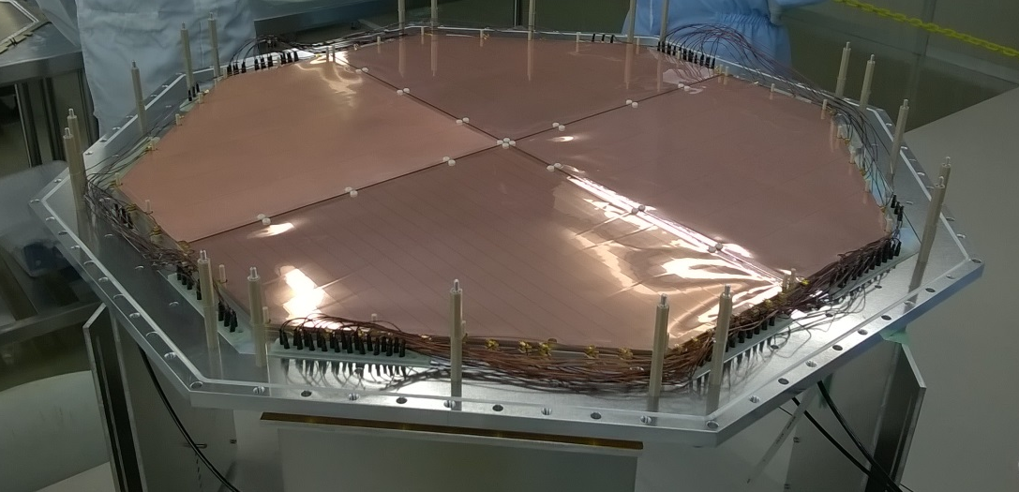
GEM (Gas Electron Multiplier)
544
・4 GEM (250mmx250mm) sheets
・3-GEM stack
50μm + 50μm +100μm thickness
・Gain ~ 10⁴
Target
position
Hit distribution (GEANT)
544
130
Segmented electrodes
・reduce discharge rate / electrode
・minimize acceptance loss in case an electrode is broken

Slide 14
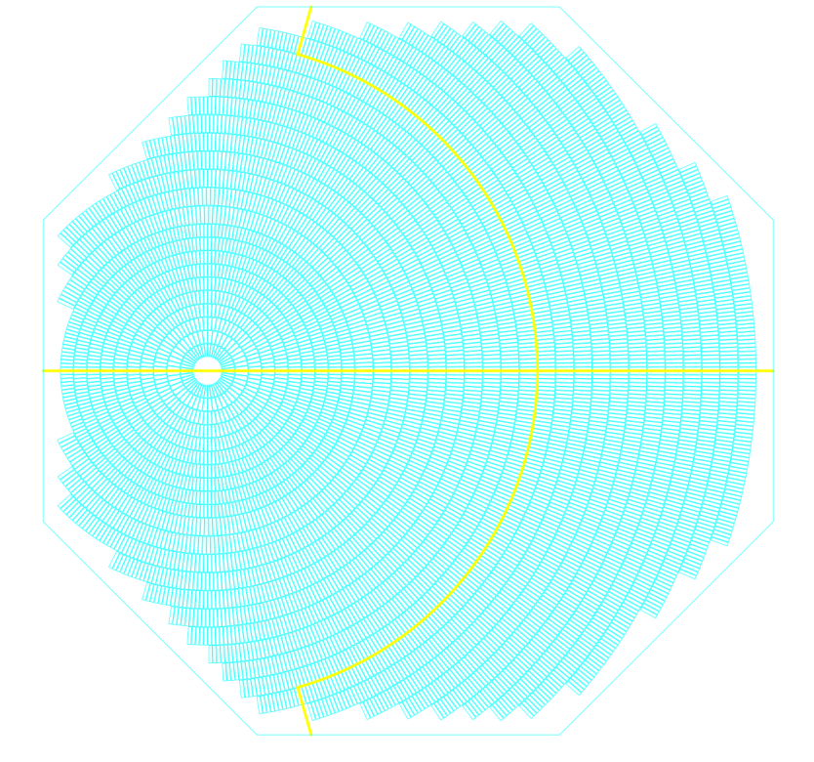
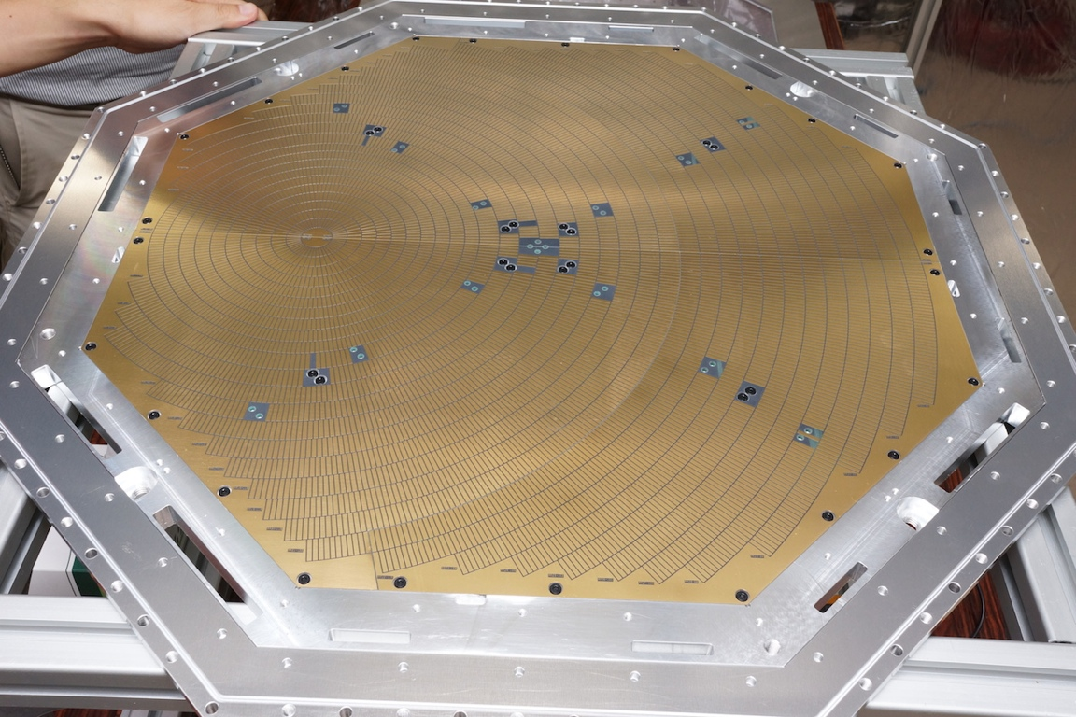
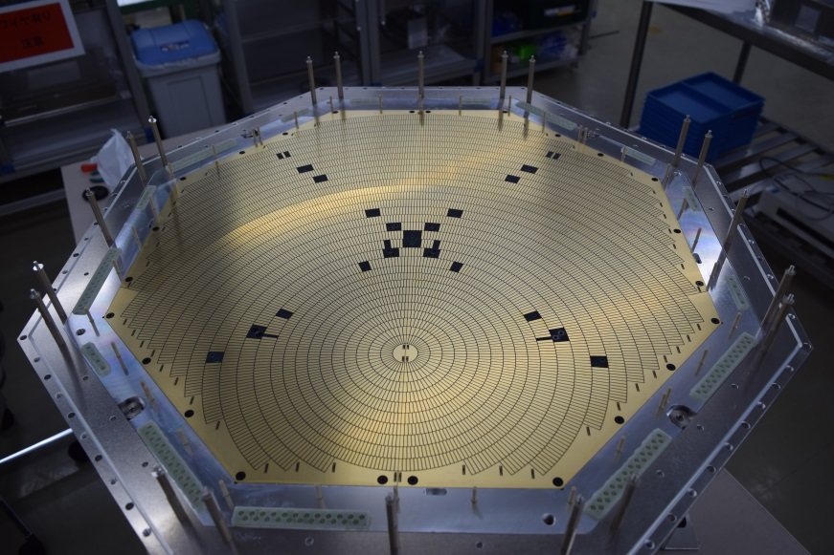
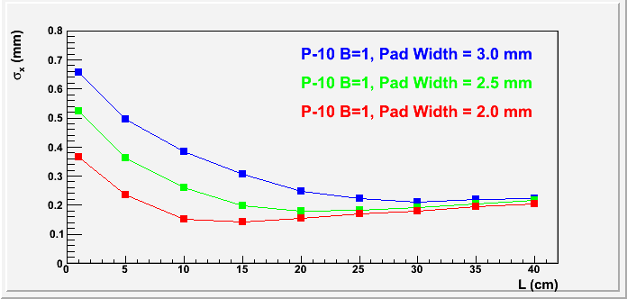
Readout pads
Pad size
2.4 x 9 mm² (inner layer)
2.4 x 13 mm² (outer layer)
32 pad rows (rings)
No. of pads = 5768
520
520
Position resolution <300μm
(L>10cm)
Δp/p=1-3% (π,p)
215

Slide 15
Particle identification with TPC
E45
p
π⁻
K⁺
π⁺
Courtesy of S.H. Hwang
π/K : p<=0.5 GeV/c
π/p : p<=1.1 GeV/c

Slide 16
Data statistics
・ (π,2π) cross section : ~2 mb
・π beam rate : ~10⁶ / cycle (6s)
・Liquid H target : 5cm length
・TPC acceptance : 40%
160 events / cycle
Dominant background: elastic scattering
(σ_{total}= 40 mb → trigger rate = 3200 events / cycle
~ 800 Hz in maximum (4s flat top))
・Energy range : 1.50 – 2.15 GeV
・No. of bins (1000) π⁻ beam : 24 (energy) x 20 (angle)
π⁺ beam : 23 (energy) x 20 (angle)
・No. of events / bin : 32 K
30M events in 15 days
Increase world’s ππN data (240K) by factor of 130
Notes:
16

Slide 17
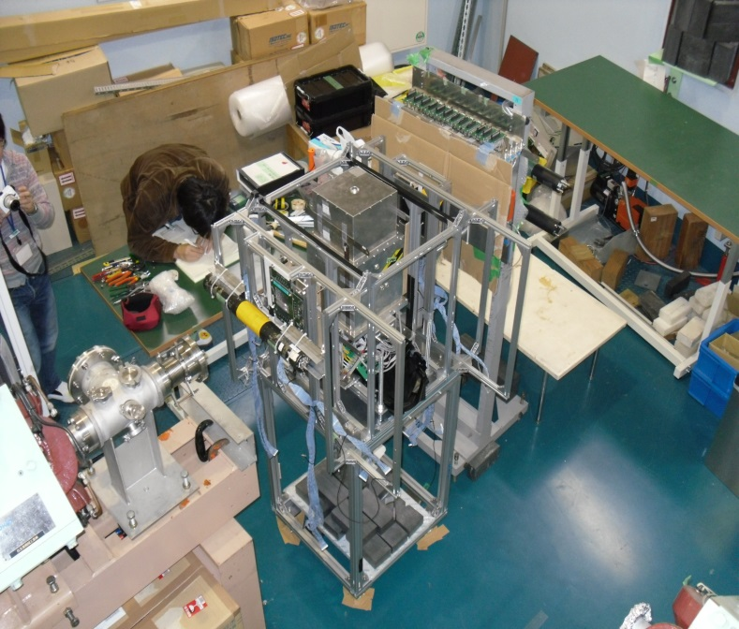
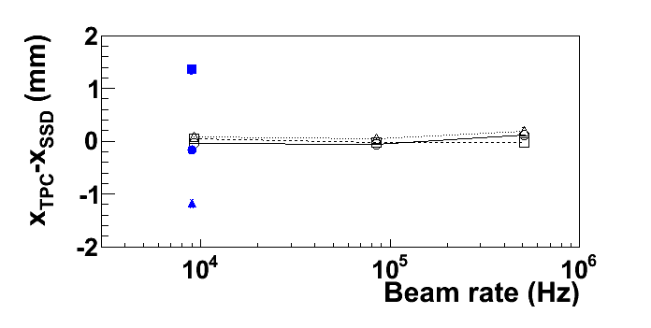
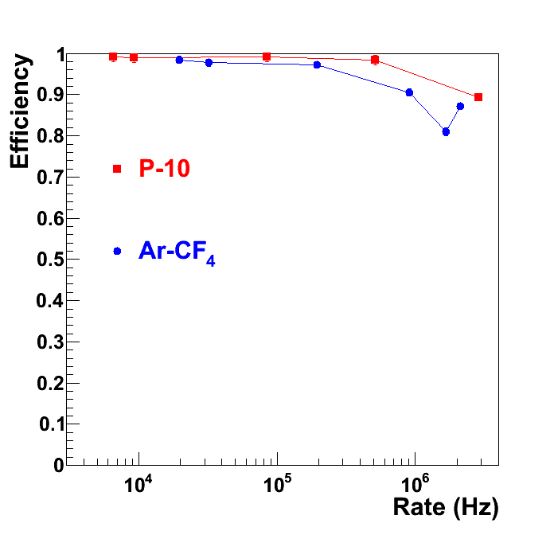
TPC prototype test
NIMA763(2014)65-81
TPC
3m
Beam test at RCNP
  Proton beam at 400 MeV
  Beam rate up to 10⁶ Hz /cm²
Proton
beam
SSD
Hit position distortion <0.1mm
Efficiency vs rate
Ion backflow ~ 5% (bench test)

Slide 18
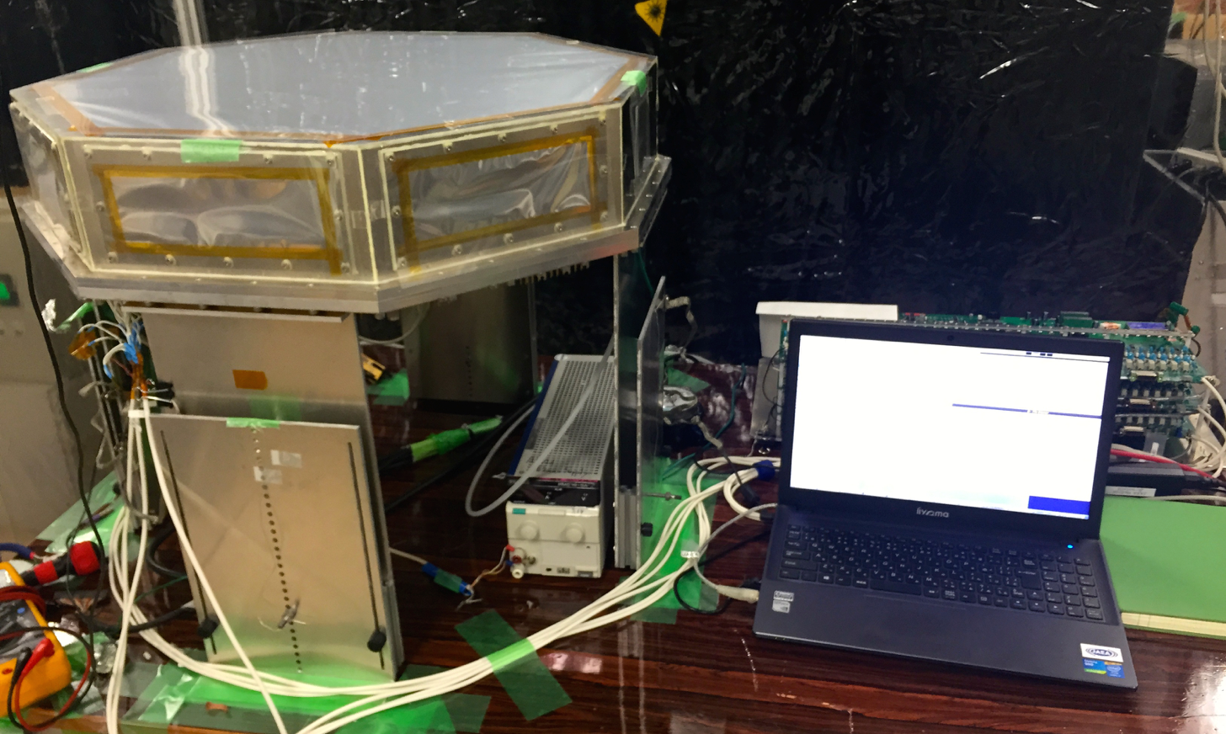
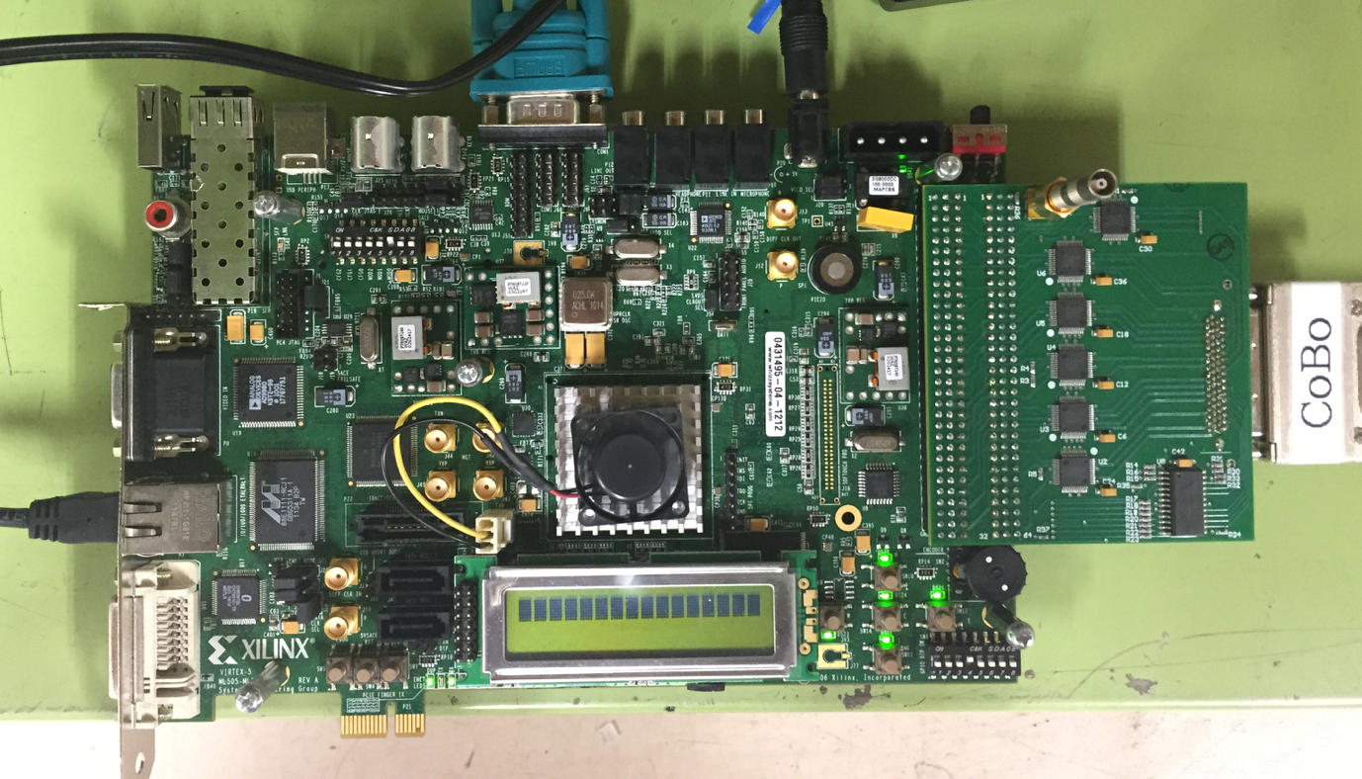
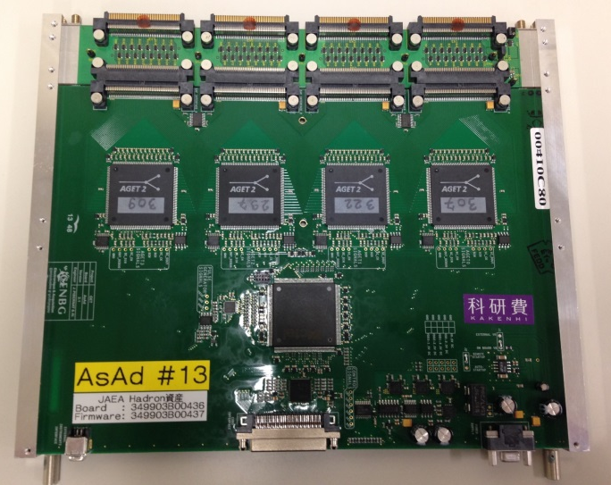
HypTPC test
Source tests with GET(General Electronics for TPC) readout system
Mar 2015
HypTPC
r-CoBo
(data collector)
ZAP
(Discharge
protection)
AsAd
(amplifier/ADC)

Slide 19
Physics possibilities with HypTPC
H-dibaryon (E42) : K⁻C→K⁺Η X, H→ΛΛ,Λπ⁻p
Λ(1405) : π⁻p→K⁰Λ(1405)
Λ(1405)→Λγ (KN compositeness, T. Sekihara, PRC89 (2014) 025202)
K⁻pp : π⁺d→K⁺K⁻pp
  K⁻pp→Λp,Σ⁰p,Λπ⁰p,Σ⁰π⁰p
Ξ excited states:
    K⁻p → K⁺Ξ⁻*, Ξ^{−∗} ◊ ΛΚ⁻, Σ⁰Κ⁻, Σ⁻Κ⁰, Ξ⁻π⁰, Ξ⁰π⁻, Ξ⁻γ
    K⁻p → K⁰Ξ^{0∗}, Ξ^{0∗} ◊ ΛΚ⁰, Σ⁰Κ⁰, Σ⁺Κ⁻, Ξ⁻π⁺
Ξ-C atom (E42) :K⁻C→K⁺Ξ⁻X, Ξ⁻ capture in C
X-ray detection in TPC (Ar gas)
πN→πηN
Λ*, Σ* studies in K⁻p reactions

Slide 20
Summary : J-PARC E45
We proposed J-PARC-E45 to study baryon excited states in (π,2π) reactions, which will improve previous data statistics by two orders of magnitude.
We have developed a large acceptance TPC for high rate beams and a superconducting Helmholtz magnet
  They will be ready for beams in 2016
Partial wave analysis with dynamical coupled channels model in collaboration with theorists (H. Kamano, T. Sato,..)

Slide 21
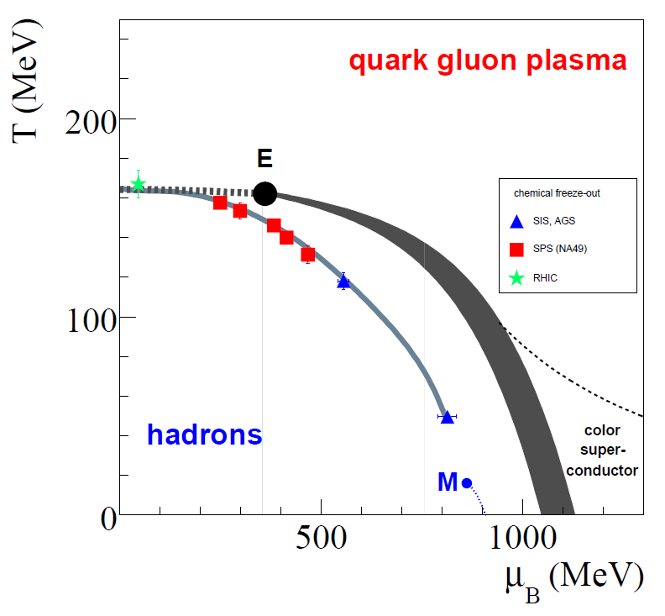
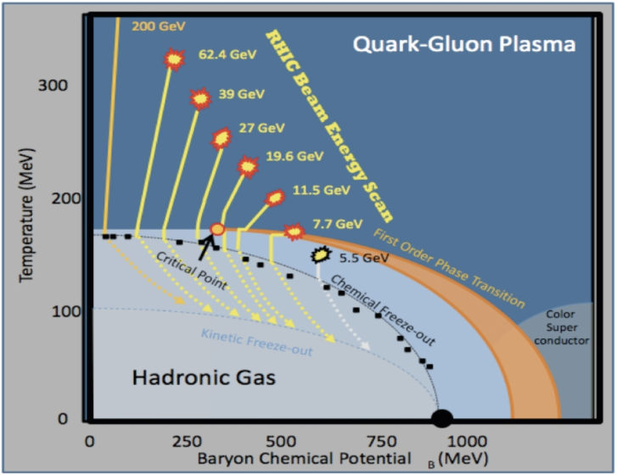
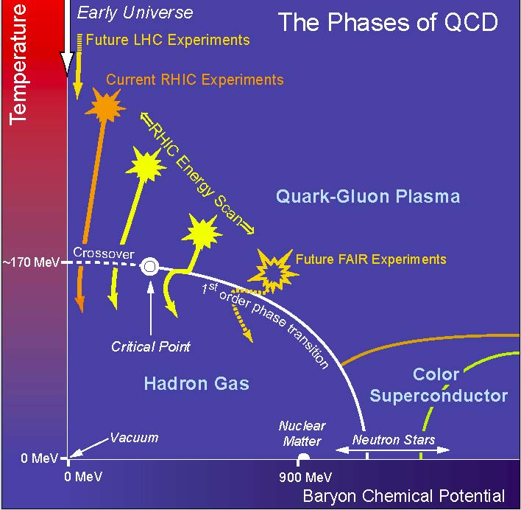
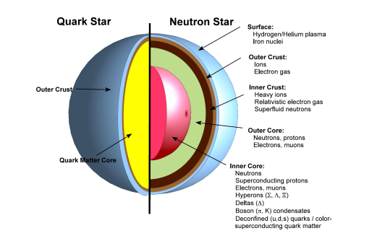
Future J-PARC Heavy-ion Program
In A+A collisions at RHIC and LHC, QGP has been discovered at high T and low ρ, but the phase transition is smooth cross over[1]
  High p_{T} hadron suppression[2]
  Thermal photon radiation[3]
At J-PARC, we aim at studies of QCD phase structures (critical point and phase boundary) in high density regime (~neutron star)
high statistics data with world’s highest intensity HI beams
LHC
RHIC
J-PARC
GSI-SIS
[1] Y. Aoki et al, Nature 443 (2006) 675
[2] K. Adcox et al, PRL 89 (2002) 022301
[3] A. Adare et al, PRL 104 132301
μ_{B}

Slide 22
J-PARC HI Collaboration
Nuclear Experimentalists and Accelerator Physicists
S. Nagamiya (JAEA/KEK/RIKEN)
H. Sako, K. Imai, K. Nishio, S. Sato, S. Hasegawa, K. Tanida, S. H. Hwang, H. Sugimura, Y. Ichikawa (ASRC/JAEA)
H. Harada, P. K. Saha, M. Kinsho, J. Tamura (J-PARC/JAEA)
K. Ozawa, K. Itakura, Y. Liu (J-PARC/KEK)
T. Sakaguchi, M. Okamura (BNL)
K. Shigaki (Hiroshima Univ.)
M. Kitazawa, A. Sakaguchi (Osaka Univ.)
T. Chujo, S. Esumi, B. C. Kim (Univ. of Tsukuba)
T. Gunji (CNS, Univ. of Tokyo)
H. Tamura, M. Kaneta (Tohoku Univ.)
K. Oyama (Nagasaki Institute of Applied Science)
H. Masui (Wuhan Univ.)

Slide 23
Heavy-ion programs in the world
Accelerator | Type | Beam energy (AGeV) | C.M. energy √s(AGeV) | Beam rate / Luminosity | Interaction rate (sec⁻¹) | Year of experiment
RHIC Beam Energy Scan (BNL) | Collider |  | 7.7-62 | 10²⁶ -10²⁷cm⁻²s⁻¹ (√s=20AGeV) | 600~6000 (√s=20AeV) (σ_{total}=6b) | 2004-2010 2018-2019 (e-cooling)
NICA (JINR) | Collider Fixed target | 0.6-4.5 | 4-11 1.9-2.4 | 10²⁷ cm⁻²s⁻¹ (√s=9AGeV Au+Au) | ~6000 (σ_{total}=6b) | 2019- 2017-
FAIR SIS100 (CBM) | Fixed target | 2-11(Au) | 2-4.7 | 1.5x10¹⁰ cycle⁻¹ (10s cycle,U⁹²⁺) | 10⁵-10⁷ (detector) | 2021-2024
J-PARC | Fixed target | 1-19(U) | 1.9-6.2 | 10¹⁰ -10¹¹ cycle⁻¹ (~6s cycle) | 10⁷-10⁸ ? ^{(0.1% target)} | ?
References
RHIC: A. Fedotov, LEReC Review, 2013
FAIR: FAIR Baseline Technical Review, C. Strum, INPC2013, Firenze, Italy; S. Seddiki, FAIRNESS-2013, C. Hoehne, CPOD2014
NICA : A. Kovalenko, Joint US-CERN-Japan-Russia Accelerator School, Shizuoka, Japan, 2013, A. Sorin, CPOD2014
Notes:
Au+Au total cross section 6.424 barn

Slide 24
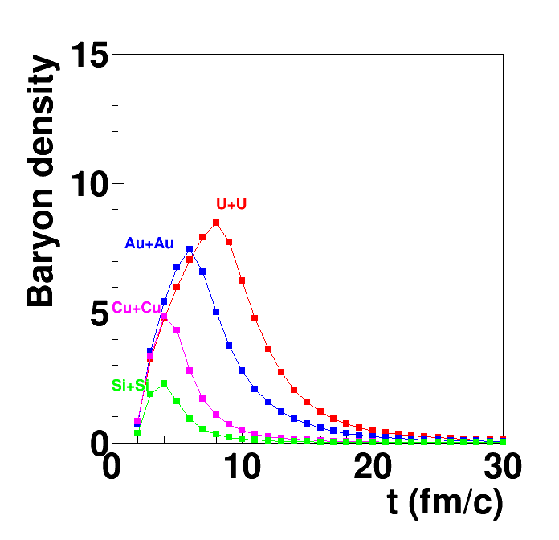
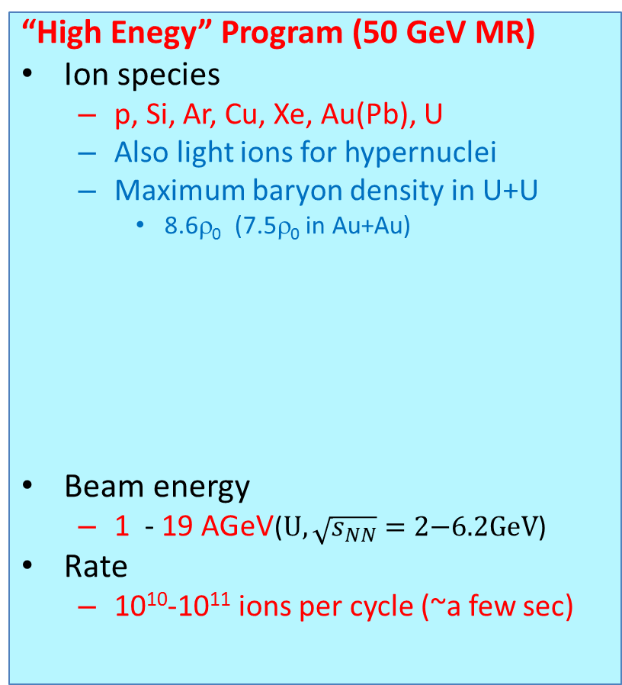
Low and High energy programs
“Low energy” program (Linac)
for unstable nuclei research
Ion species
  Ne, Ar, Fe, Ni, Kr, Xe,…,U
Beam energy
  1 - 10 AMeV (U)
Beam current
  10-30 pμA
  10ms, 25Hz
“High Enegy” Program (50 GeV MR)
Ion species
  p, Si, Ar, Cu, Xe, Au(Pb), U
  Also light ions for hypernuclei
  Maximum baryon density in U+U
    8.6ρ₀ (7.5ρ₀ in Au+Au)
Beam energy
  1 - 19 AGeV($U, \sqrt{s_{NN}}=\text{2−}\text{6.2}\text{GeV}$)
Rate
  10¹⁰-10¹¹ ions per cycle (~a few sec)
ρ/ρ₀
    JAM model, Y. Nara, Phys. Rev. C61,024901(1999)
Au+Au
U+U

Slide 25
Advantages/limitation of RCS/MR for HI beam
Existing 3 GeV and 50 GeV synchrotrons
HI injector and injection section in RCS should be added
Proven performance for high-rate proton beam for RCS and MR
  Slowly extracted proton beams
  2.5x10¹³/cycle →1.3x10¹⁴ /cycle (2017)
Parallel RCS operations for MR(HI) and MLF(proton) are a must
  (similarly to current proton operation)
Limited freedom in RCS for operation parameters
  (magnets, RF cavity…)
  → The injector must be designed to fit to RCS

Slide 26
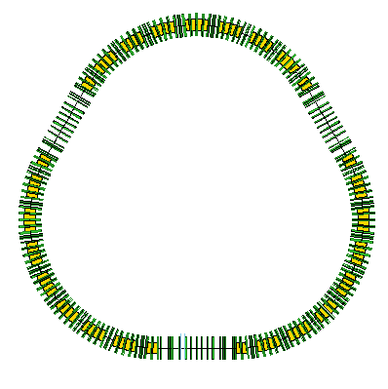
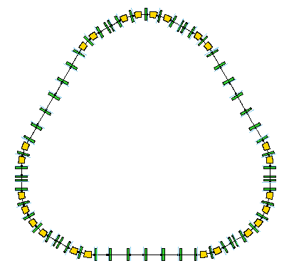

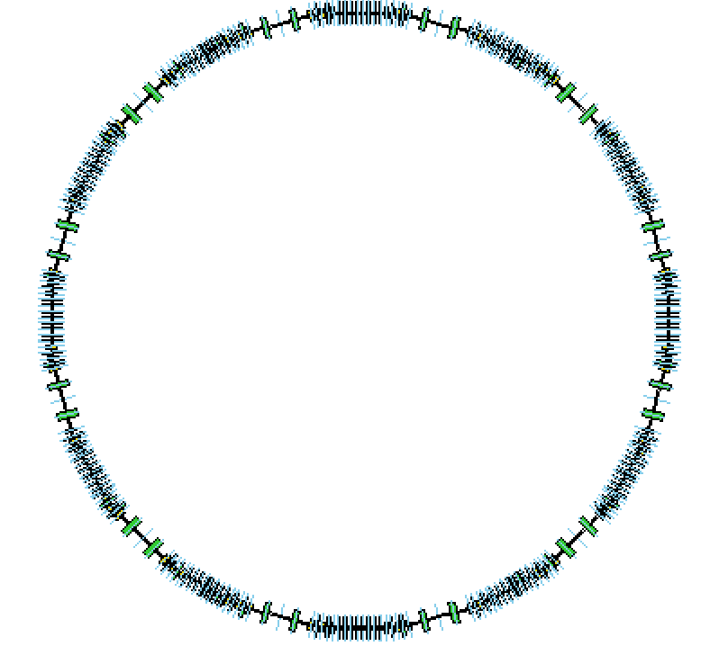
J-PARC HI Accelerator scheme
(H. Harada, J-PARC)
U³⁵⁺→U⁵⁵⁺
20.0→19.86
AMeV
U⁶⁶⁺→U⁸⁶⁺
67.0→62.34
AMeV
U⁸⁶⁺→U⁹²⁺
735.21→727.0
AMeV
stripping
stripping
stripping
HI LINAC
HI booster
RCS
MR
stripping
U³⁵⁺
20.0AMeV
U⁵⁵⁺→U⁶⁶⁺
19.86→67.0
AMeV
U⁸⁶⁺
62.34→735.2
AMeV
U⁹²⁺
727.0AMeV/u→11.15
AGeV
(30GeV for p)

Slide 27
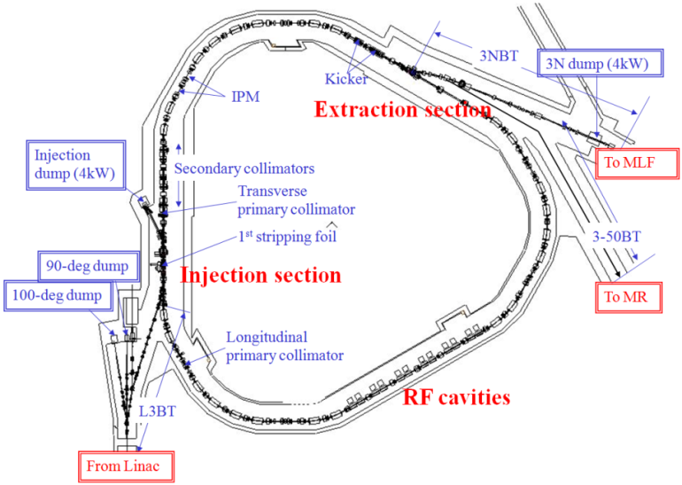
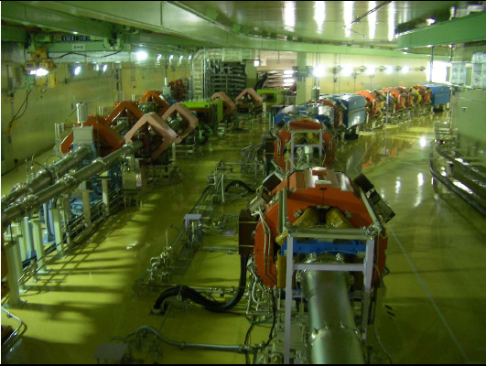
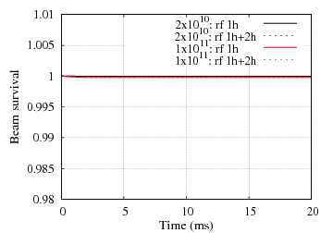
HI injection and acceleration at RCS
HI Injection candidate: end of extraction straight section
Extraction
section
P. K. Saha, J-PARC
to MLF
Beam transport lines
HI Injection?
Only kicker magnets
to MR
RCS
H- stripping
Injection
1st foil
H⁻ → H⁺
H⁻
RF section
  Only injection kicker magnets necessary
Beam survival probability
at 2×10¹⁰ ~1×10¹¹/bunch
>= 99.97%
Loss point: Collimator (100%)
[ For 1 MW proton : ~99.8%, beam loss mainly due to foil scattering]

Slide 28
Physics goals
Dileptons (dielectron and dimuon)
Systematic and high statistics hadron measurements
  Strange meson and baryons
  Event-by-event fluctuations
  Two particle correlations
  (YN, YY correlations in high baryon density)
  Collective flow (related to EOS?)
Rare probes
  Hypernuclei
  Exotic hadrons
    Λ(1405)
    Dibaryon (H-dibaryon, ΩN, ΔΔ,…)
    Kaonic nucleus (K⁻pp,…)
  Charm
    J/ψ, D, charmed baryons
Photons
  Thermal radiation from QGP
J-PARC E16 p+A
Onset of QGP
Search for critical point
Properties of
Dense matter
J-PARC π/K beams

Slide 29
Dileptons at J-PARC energy
  Penetrating probes of dense matter
Low Mass Range
  in-medium modification of vector mesons (link to chiral symmetry restoration)
Intermediate Mass Range
  DD is suppressed
  Sensitive to QGP thermal radiation?
Axel Drees
T. Sakaguchi, JHI2014

Slide 30
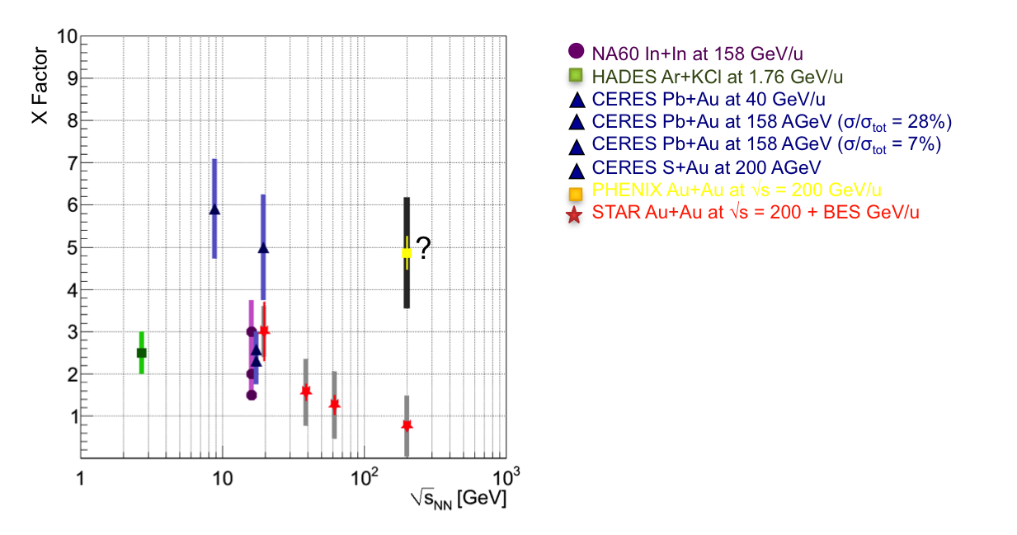
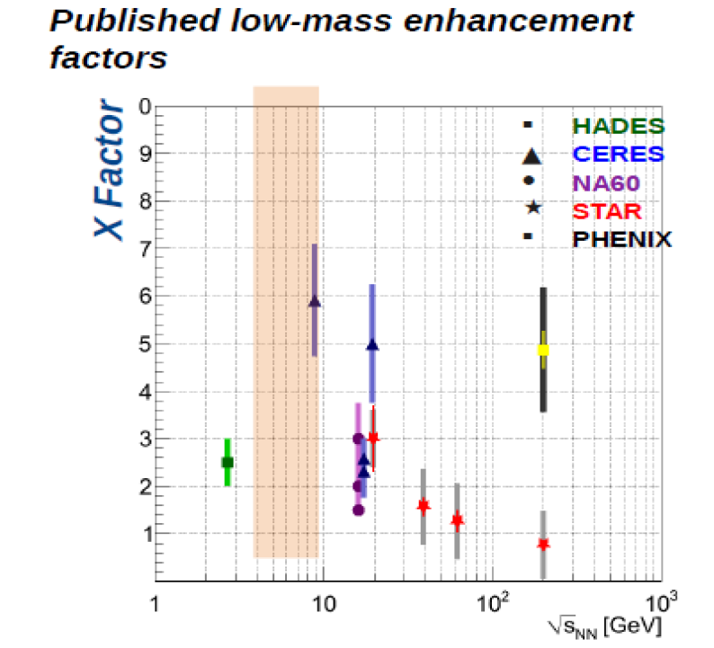

Low-mass dileptons
NA60 In+In, 158AGeV/c
HADES Ar+KCl 1.76AGeV/c
CERES Pb+Au 40AGeV/c
CERES Pb+Au 158AGeV/c
CERES S+Au 200 AGeV
PHENIX Au+Au 200 AGeV
Low-mass dilepton enhancement factor
Measured / cocktail in m=0.2-0.8 GeV/c²
(PRC81,034911(2010)
Maximum low mass enhancement around J-PARC energies?
High statistics at J-PARC
  Moment analysis→direct comparison to spectrum functions by theories
Dielectron
  low p_{T}, lower m
  γ conversion at low m
Dimuon
  high p_{T}, higher m
  π,K → μ decay background
  Utilize highest beam intensity
J-PARC
$$\int{dm_{ee}N\left(m_{ee}\right){m_{ee}}^{n}}$$
Highest baryon density ~ 8GeV
(Randrup, PRC74(2006)047901)
T. Galatyuk, EM probes of Strongly Interacting Matter, ECT*, Trento 2007

Slide 31
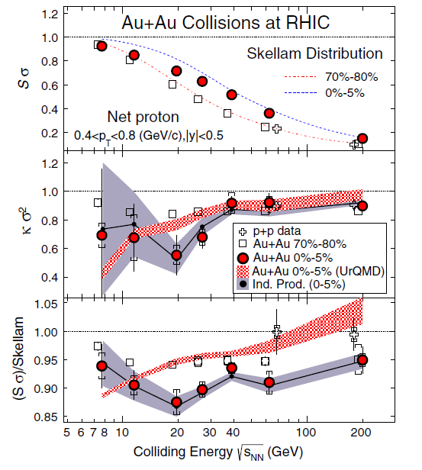


Event-by-event fluctuations
Search for the critical point
and phase boundary
w/ 3rd and 4th-order fluctuations
Direct comparison to lattice-QCD may be possible
Net-charge
Net-proton (baryon)
Strangeness
High statistics in J-PARC
Wide y-p_{T} acceptance required
STAR PRL112 (2014) 032302
S$σ≅\frac{χ_{B}^{3}}{χ_{B}^{2}}$
${κσ}^{2}≅\frac{χ_{B}^{4}}{χ_{B}^{2}}$
J-PARC

Slide 32
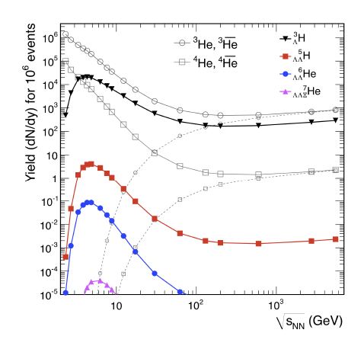
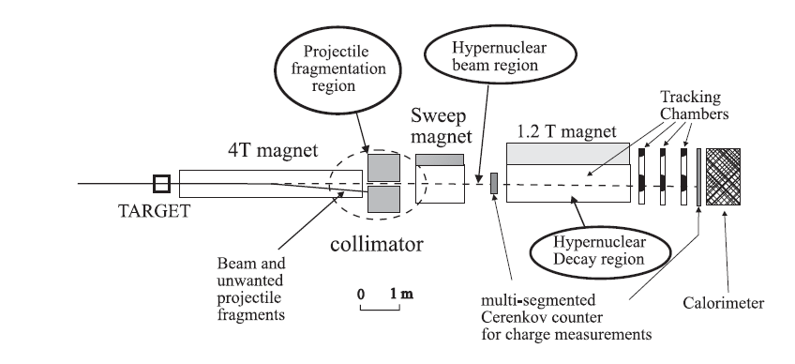
Hypernuclei
Maximum yield at J-PARC
Coalescence of high-density baryons
S=-3 Hypernuclei
Precise secondary vertex reconstruction (mid rapidity)
Closed geometry setup (beam rapidity)
  Full intensity beam
  Magnetic moment
J-PARC
A. Andronic, PLB697 (2011) 203
KEK Report 2000-11
Expression of Interest for Nuclear/Hadron Physics Experiments at the 50-GeV Proton Synchrotron

Slide 33
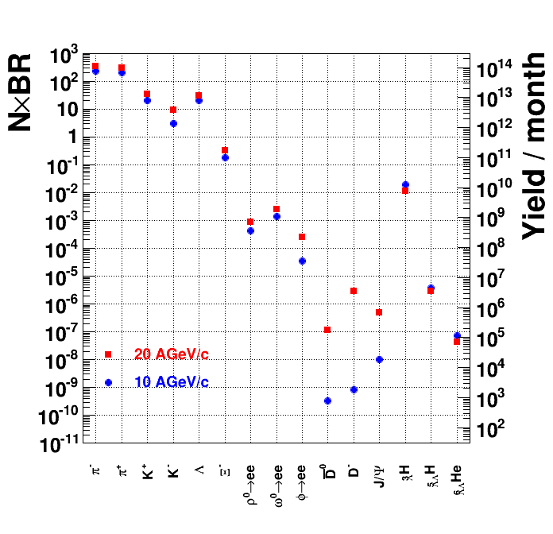
Particle production rates
Beam : 10¹⁰ Hz
0.1% target
→ Interaction rate 10⁷ Hz
Centrality trigger 1%
→ DAQ rate = 100kHz
In 1 month experiment:
ρ,ω,φ→ee 10⁷-10⁹
D,J/Ψ 10⁵-10⁶ (20AGeV)
(10³ -10⁴(10AGeV))
Hypernuclei 10⁵ -10¹⁰
AGS
Hypernuclei
Dilepton
Charm
Ref: HSD calculations in FAIR Baseline Technical Report (Mar 2006)
A. Andronic, PLB697 (2011) 203

Slide 34
Experimental challenges
High rate capability
  Fast detectors
    Silicon trackers, GEM trackers, …
  Extremely fast DAQ → triggerless DAQ
    >= 100kHz
High granularity
  Pixel size < 3x3mm²
  (at 1m from the target, θ<2deg, 10% occupancy)
Large acceptance (~4π)
  Coverage for low beam energies (CBM<30º , beam energy>=8AGeV/c)
  Maximum multiplicity for e-b-e fluctuations
  Backward physics (target fragment region)
Electron measurement
  Field free region for RICH close to the target
Toroidal magnet setup

Slide 35
Toroidal
Muon Tracker
HCAL
Beam View
EMCAL
12-fold Toroid coils
(Coils : dead area)
RICH
Better Bφ uniformity
with a larger number
of coils
With 12 coils
variations ~+-20%

Slide 36
Toroidal
Muon Tracker
Top
View
3.2m
HCAL
0.9m
EMCAL (e,γ ID)
PbWO_{4,} 15X₀
EMCAL
HCAL (n ID)
Pb-scintillator, 4λ_{ιnt}
Toroid
TOF
0.65m
e-π separation
1.9m
RICH
C₅F₁₂ radiator
p<3.4GeV/c
0.7m
0.4m
μ - π separation
p>1.5 GeV/c
Fe absorbers + Trackers
0.5m
5m
ZCAL
R=1m
Beam
ZCAL
1.4m
SVD
4m
0.25m
Multiplicity
counter
0.14m
Centrality
MC + ZCAL

Slide 37
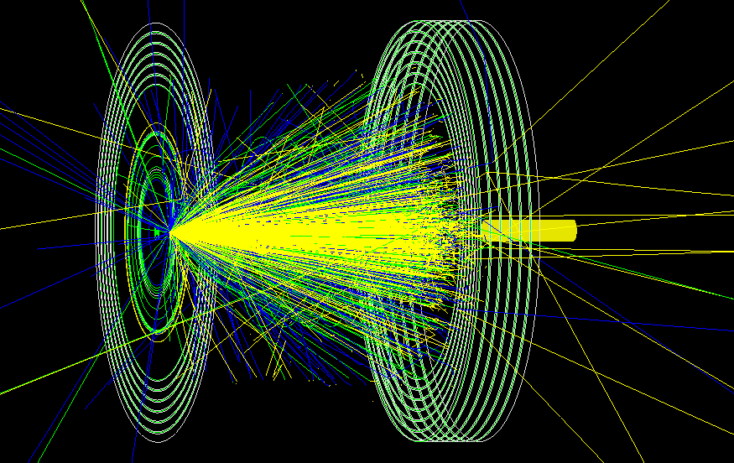
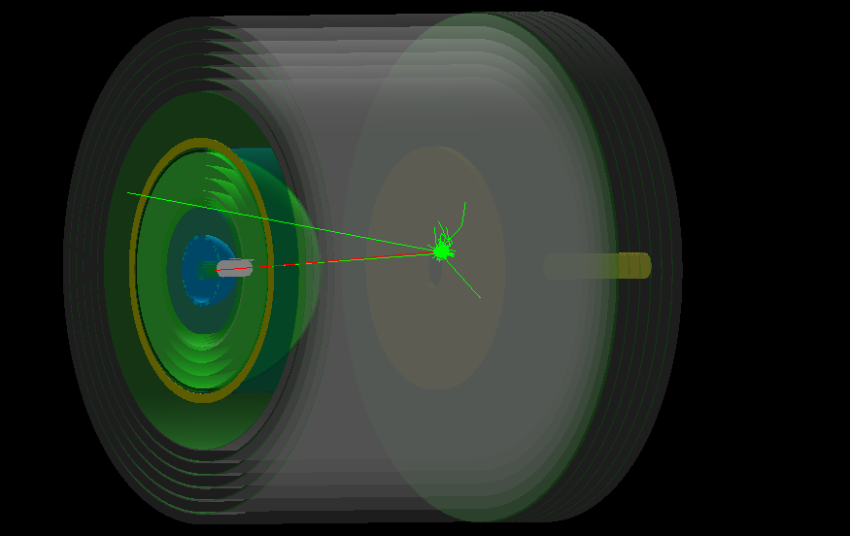
GEANT4 (Toroidal) setup
U+U at 10AGeV/c with JAM
Assumption for simplicity
  Half-spherical toroidal shape
  Uniform B_{φ} field
  No dead area due to coils
H. Sako, B.C. Kim

Slide 38
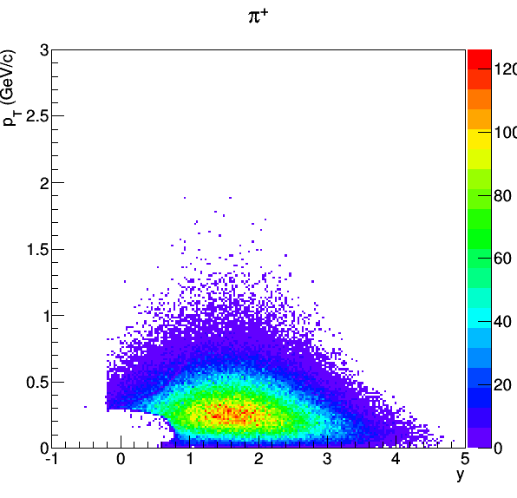
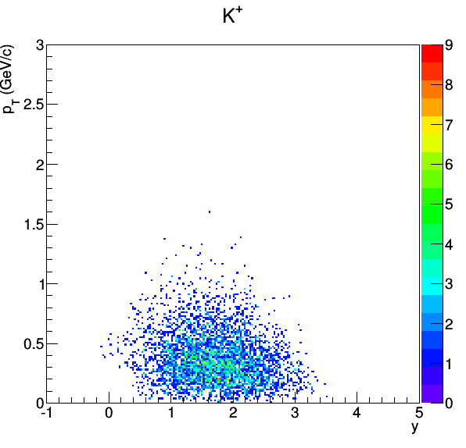
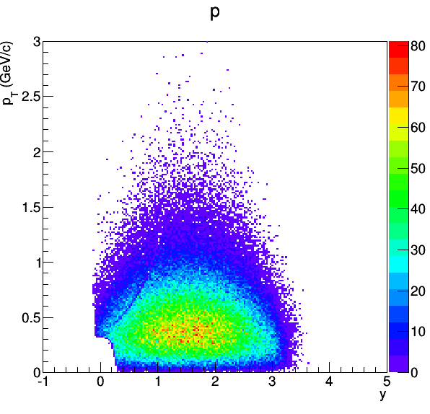
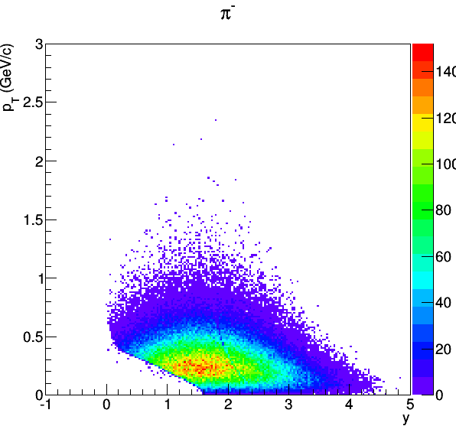
Acceptance
Acceptance = 64.2%
Acceptance = 77.5%
Acceptance = 95.0%
TOF hits are required
Acceptance includes decay loss
Acceptance = 70.9%

Slide 39
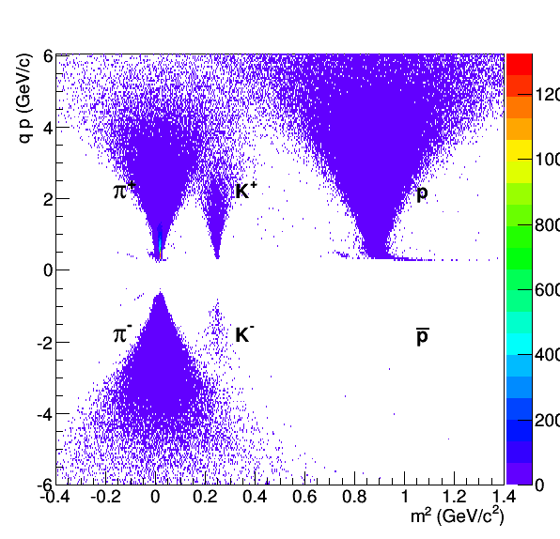
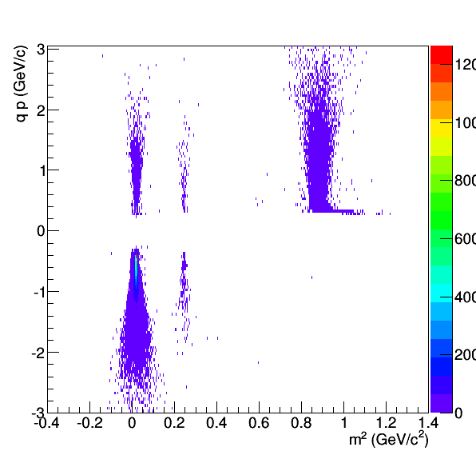
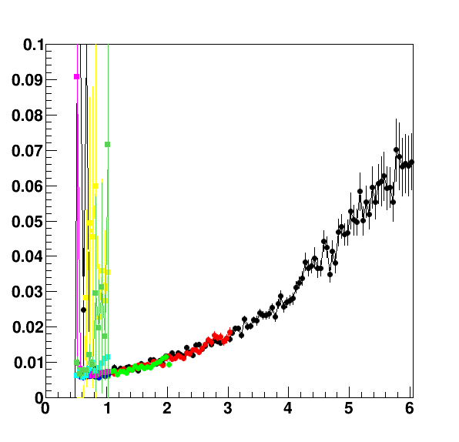
PID and momentum resolution
Forward
Barrel
Δp/p
TOF resolution 50ps
π/K separation 2.5GeV/c (2.5σ)
Δp/p = 0.7% - 5% (0.5-5GeV/c)
p(GeV/c)

Slide 40
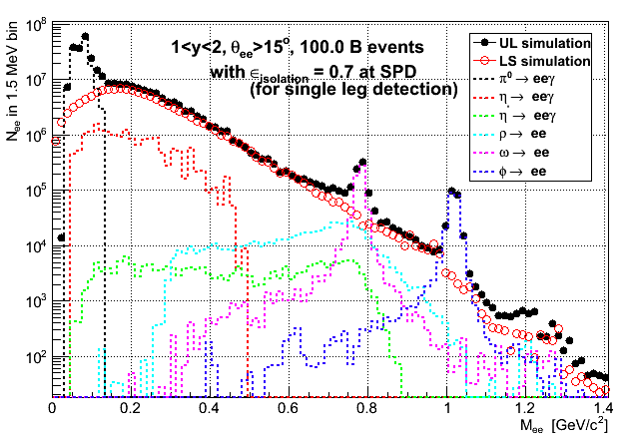
Simulated di-electron spectrum
(preliminary)
π⁰
Based on π⁰ spectra of JAM
Other hadrons m_{T}-scaled
b<1fm (0.25% centrality)
Momentum resolution 2%
Electron efficiency 50%
(No detector response)
10¹¹ events
⇔100 kHz
x 1 month running
ε_{isolation} = rejection efficiency of close opening angle Dalitz pair
ω
ρ
φ
Calculations by T. Gunji and T. Sakaguchi
Solenoid+Dipole setup

Slide 41
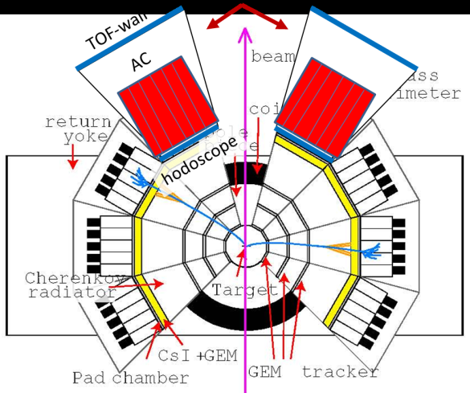
Summary : J-PARC HI
A heavy-ion program at J-PARC is being designed to study dense matter
  Acceleration schemes with RCS and MR
  Near-4π HI spectrometer with Toroidal to measure dileptons and hadrons
Prospects
R&D
  MRPC-TOF (Tsukuba, JAEA, KEK) in J-PARC E16 (p+A) for hadron measurements
  DAQ (JAEA,NIAS)
→A conceptual design report (white paper) in this year
International collaboration is very important for success of the project
  We welcome Korean collaborators!
  Reimei workshop at JAEA (Jan 18 – 20, 2016)
  Prof. Hyun-Chul Kim (Inha University), Makoto Oka, H. Sako (JAEA)
  Heavy-flavor hadron physics and heavy-ion physics
  J-PARC Heavy-ion collaboration meeting (Jan 21)

Slide 42
Backup

Slide 43
comments on s=-3 nuclei
Smallest triple Λ nuclei will be ¹⁴C_{ΛΛΛ}, since 3rd Λ should be in p-shell which is only bound larger than A=11 (¹³C_{Λ}) .
Possible smaller s=-3 nuclei can be;
⁴He+ΛΛ+Ξ⁰ system ~10⁻⁷
A. J. Baltz, C. B. Dover et al, PLB325 (1994) 7

Slide 44
Muon Tracker
Side
View
1.3m
HCAL
EMCAL
Barrel
trackers
0.65m
RICH
Toroidal coil
0.66m
0.4m
R=1m
5m
1.90m
0.2m
0.5m
Beam
ZCAL
4m
Forward
trackers
Troidal
trackers
B=2T
gap=0.65
BL=1.3Tm
4.15m
6.36m

Slide 45


HypTPC test with ⁵⁵Fe (X-ray) source
Amplifier gain : 120fC, Shaping T: 70ns, V_{GEM}.: 315 V
2.7 keV peak
5.9 keV peak
Cluster size (mm)
ΔE/E :14.3 ± 0.2 %
Cluster size : 1.87 ± 0.02 mm
cf. prototype TPC (5 - 10 cm)
: 1.7 ~ 2.0 mm
Discharge rate < 1 min⁻¹
Gain ~ 10⁴

Slide 46




Magnetic field
Front (x-y) view
Side (z-y) view
B_{T}/B < 3%
in most of the volume
Courtesy of J.K. Ahn

Slide 47


Detector simulation (GEANT)
Elastic scattering
(Same trigger condition)
p
p3
coplanarity
=cosine of angle
Between p1 and
(p2xp3)
p1
π-
p2
3-body reaction
π-
π⁻p → π⁻ π⁰p reaction
MM²(π±p)
Rejected events by coplanarity cut
Cut on coplanarity cut.
Only 3-body reaction can be survived.

Slide 48


Trigger efficiency
2-charged particle trigger
(inefficiency due to double hit)
80 cm
Proposed hodoscope with 32 segments.

Slide 49


Acceptance
π⁺p → π⁺π⁰p reaction
Momentum of Proton > 300 MeV/c (large energy loss in target)

Slide 50














仮想光子の半分くらいは、
真空中のメソン崩壊で生成する
ハドロン状態の寿命
約20fm
π, η, φの寿命はハドロン状態の寿命と比べはるかに長い。
これらの粒子崩壊への媒質効果は、基本的に無視できる。
ρメソンのみが、例外！

Slide 51

X. Luo, CPOD2014

Slide 52


Slide 53

Y. Nara, Heavy Ion Pub
2015/07/14

Slide 54

Y. Nara, Heavy Ion Pub
2015/07/14

Slide 55
Hypernuclei measurements
(Closed geometry setup)
Setup proposed for J-PARC
Asakawa et al (JHF)
Select near-neutral fragments
With 1st dipole magnet/collimator
Measure spin precession of polarized hypernuclei in dipole magnet by weak decay of hypernuclei
25AGeV, C or Li beams (10¹⁰-10¹² Hz)

Slide 56

R&D Plan
MRPC-TOF (Tsukuba, KEK, JAEA)
  Prototype MRPC-TOF achieved 40 ps timing resolution (Univ. Tsukuba)
  Large size MRPC-TOFs (60x60cm²) to be developed and installed in J-PARC E16 for hadron measurements
    φ→K⁺K⁻, hypernuclei at target rapidity...
DAQ
  Design based on ALICE-DAQ
  (NIAS,JAEA)
Candidate positions
For MRPC-TOF

Slide 57

Charmed particles
c-c produced in the early stage of collisions
  D,J/ψ may be modified
  Probe of high density state
  J-PARC energies close to the production thresholds
  D (5.07 AGeV),J/ψ (4.77 AGeV)
  May be possible with increased beam energy 12 →19 AGeV/c
  √s= 4.9→6.2GeV (U)
  Enhancement due to multi-step processes in A+A?
CBM Physics Book,
W. Cassing, E. L. Bratkovskaya and
A. Sibirtsev, Nucl. Phys. A 691 (2001) 753

Slide 58


RICH
Design based on HADES-RICH
Target shifted to downstream of RICH center
  Slightly small theta acceptance (<80deg)
  But rings detected at photon detector at larger theta (avoid overlap with high density charged track at the photon detector
Radiator C₅F₁₂ radiator (n=1.002)
  π rejection p<3.4 GeV/c
1m
RICH
0.5m
R=1m
0.25m
1.8m
Photon
detector

Slide 59
Detectors
Silicon vertex trackers
  4 end cap, 4 barrel layers
    Pad size : 40-80um
Spherical (toroid) GEM trackers
  3 before toroid, 4 in toroid, 4 after toroid
Forward trackers (5 planes)
  FTOF (3.9m)
Barrel trackers (3 planes)
  BTOF (2.0m)
EMCAL (e,γ ID)
  PbWO₄ 15X₀
HCAL
  Pb-Scintillator, 3.8λ_{int}
  Neutron ID → baryon number fluctuations
Muon tracker
EMCAL+HCAL+Fe absorbers (~7λ_{int})+GEM trackers
  π rejection = 2-4 x 10⁻³
  μ efficiency ～ 70%
  Rejection of μ from weak decay with track matching
  Punch through π / μ (π decay) = 0.16

Slide 60
Preliminary setup
TOF (5m from target)
Top View
TOF
RICH
Dipole
(BL=1.5Tm)
RICH
Muon
tracker
Solenoid (BL=1Tm)
30º
Silicon pixel/strip
trackers
2m
target
GEM trackers
1.5m
0.3m
2m
1m
hadron-ID (θ<110º)
e-ID : θ<30º
μ-ID : θ<30º
20º = y_{mid} at 10AGeV/c
1m
GEM Trackers
EMCAL

Slide 61
Status of J-PARC HI Program
  White paper for conceptual design of accelerators and the experiment in JFY 2015
  After this, proceed with the proposal to J-PARC
  …
  After approval, construction of accelerators and detectors within 10 years ?

Slide 62
Detectors
Silicon vertex trackers
  4 end cap layers
    Pad size : 40,40,80,80um, resolution = pad size/sqrt(12)
  4 barrel layers
    Pad size : 40,40,80,80um, resolution = pad size/sqrt(12)
Spherical (toroid) trackers
  3 before toroid, 4 in toroid, 4 after toroid
Forward trackers
  5 planes, FTOF (3.9m)
  Pad size = z/1000 (m), Resolution = pad size/10 mm
Barrel trackers
  3 layers, BTOF (2.0m)
  Pad size = r/1000 (m), Resolution = pad size/10 mm

Slide 63
Exotic particles in HI collisions
Dibaryon
  H→ΛΛ→π-pπ-p
  d*(2380)→dπ+π-
Kaonic nucleus
  K-pp→Λp→π-pp
Resonances
  K*(892)→πK
  Δ(1232)→pπ
  Σ(1385)→Λp
  Λ(1520)→pK-
  Ξ(1530)→Ξπ
  Ω◊ΛΚ−
  Ξ−◊Λπ−
Penta quarks
  Θ+(uudd sbar)→pKs
  Θ+++(uuuu sbar)→pπ+π+
  Θ0(uddd sbar)→pK-
  Ns(uudd ubar)→ΛK
  Σ5(udds ubar)→Λπ
  Σ5→(uuds dbar)pK0bar
  …

Slide 64

Separation of hypernuclear beams
Separation of beams depending on Z/A
Hypernucleus / fragments = 10⁻⁵-10⁻⁶

Slide 65


QCD和則とスペクトル関数
comment by 初田さん
International Conference on Soft Dilepton Production
LBNL, 1997
http://macdls.lbl.gov/DLS_WWW_Files/DLSWorkshop/proceedings.html
スペクトル自身よりも、積分値の方がより直接的に実験とQCD凝縮を比較できる
See also, Hatsuda, Hayano, RMP82, 2949
※実験的に積分値を出すのは誤差との戦いか？

Slide 66

Strange meson/baryons
Systematic energy scan below the “horn” at ~8 GeV
There is almost no Ξ, Ω measurements
J-PARC
A. Andronic et al, Nucl. Phys. A 837 (2010) 65

Slide 67
Possible accelerator schemes
at J-PARC
P=10⁻⁶Pa
(current value)
Au⁷⁷⁺
E_{inj}=72AMeV
(same rigidity as proton)
New Ring
A
New LINAC
3GeV
RCS
50 GeV
MR
B
New LINAC
P=10⁻⁹Pa
(improvement required)
Au³²⁺
E_{inj}=13AMeV

Slide 68

Experimental challenges
C. Hoehne, CPOD2014

Slide 69





Toroid (12 coil configuration)
Increasing number of coils improves phi uniformity
12 coil configuration is good
CLAS12
z=250mm, R at coil center
z=750mm
z=1300mm
B(T)
rφ(mm)

Slide 70


Muon ID performance(preliminary)
EMCAL (~1λ_{int} )+Fe absorber (~1λ_{int})x6
+GEM trackers （7 layers）
・Goal π suppression：1/10 of π→μ decay probability (5m,2GeV/c):4.4x10⁻³
π, μ rejection performance by simulation
π suppression = 2-4 x 10⁻³
μ detection eff ~70%
punch through π / μ (π decay) = 0.16
Decay rejection by track matching
  P (80%), K (95%)
π+
survival probability
μ+
Survival probability
π⁺ and decayed μ+
before/after muon absorbers
π⁺
μ⁺
p (GeV/c)
p (GeV/c)
p (GeV/c)

Slide 71
Hypernuclear physics with HI
Goals
Discovery of new hypernuclei and extension of hypernuclear chart
  S=-1,-2,-3 hypernuclei
  Proton-rich and Neutron-rich hypernuclei
  Can be done in mid-rapidity or beam/target rapidity
  Identification with weak decay to a (light) nucleus + π-
Study of weak decays at beam rapidity
  With meson beams, due to short decay length these measurements are difficult
  life time measurement
  Mesonic decay e.g. ⁴_{Λ}H→ π⁻+⁴He (⁴He ground state)
    standard way to identify a hypernucleus
  Non-mesonic weak decay
    Λp → pn (p,n : high momentum) the rest nucleus is exited state, and will break.
    Measurements of residues
  magnetic moment
    never measured!
    sensitive to hyperon wave function inside hypernucleus
    Spin and angular momentum structure
    Spin-dependent YN interaction
Special closed-geometry setup is required
We could utilize full 10¹⁰ Hz beam?
Simulation study necessary

Slide 72
Introduction
Hypernuclear production in heavy-ion collisions
HI collision : Spectator-participant picture
K+
beam nucleus
beam fragments
spectators
Λ
Λ absorption in
fragments
π+
Λ
participants
Λ
p
n
target nucleus
target fragments
coalescence
rapidity

Slide 73
Separation of hypernuclear beams
Separation of beams depending on Z/A
Hypernucleus / fragments = 10⁻⁵-10⁻⁶

Slide 74

How to measure the magnetic moment
For Λ case
  Polarization is transverse to the reaction plane
    p+p→Λ+K⁺+p, reaction plane : a plane with p(beam)+Λ
    Polarization : perpendicular to the reaction plane
    So measure direction of Λ→p+π⁻ plane w.r.t. the reaction plane
Precise measurement of
Λ magnetic moment
L. Schachinger et al
PRL 41 (1978) 1348

Slide 75



Λ magnetic moment
Polarization measurement
(from p asymmetry w.r.t the reaction plane)
Precession angle vs BdL
■:B=0
●:B in y+ direction
〇:B in y- direction

Slide 76

HypHI at GSI
⁶Li beam 3x 10⁶ /s
3.5-day experiment
¹²C graphite target
8.84g/cm²→interaction prob 10%
B=0.75T
TR0-TR2 : SciFi
BDC, SDC: drift chambers
π-
Positive
particle
fragments
Reconstructed decays
Vertex cut required!

Slide 77

HypHI Results
Comparison of the absolute yields (dN/dy)
  ⁶Li+¹²C minimum-bias cross section : σ_{total} =0.667b
  N(Λ) = 2.6x10⁻³
  N(³_{Λ}H)= σ(³_{Λ}H)/σ_{total} = 3.9x10⁻⁶/0.667= 5.8x10⁻⁶
  N(⁴_{Λ}H)= σ(⁴_{Λ}H)/σ_{total} = 3.1x10⁻⁶/0.667= 4.6x10⁻⁶
~3x10⁻⁶ in p+C
at E16?
p+C/Li+C~1/6
Energy cor=3

Slide 78

Kaonic nuclei production in HIC
Andronic, PBM, et al, NPA 765 (2006) 211–225
J-PARC
J-PARC
Evidence of K⁻pp state at J-PARC (E27) (π⁺+d → K⁺+K⁻pp), but no other states yet
Statistical thermal model calculation
Maximum yields at J-PARC energy range

Slide 79

Exotic hadrons in HIC
ExHIC collab (A. Ohnishi, et al)
Yields depend on the system size assuming a coalescence model (RHIC or LHC)
J-PARC?
Λ(1405) is KbarN or 5-quark state?

Slide 80

Support beam/piping

Slide 81
Hypernuclear physics with HI
Goals
Discovery of new hypernuclei and extension of hypernuclear chart
  S=-1,-2,-3 hypernuclei
  Proton-rich and Neutron-rich hypernuclei
  Can be done in mid-rapidity or beam/target rapidity
  Identification with weak decay to a (light) nucleus + π-
Study of weak decays at beam rapidity
  With meson beams, due to short decay length these measurements are difficult
  life time measurement
  Mesonic decay e.g. ⁴_{Λ}H→ π⁻+⁴He (⁴He ground state)
    standard way to identify a hypernucleus
  Non-mesonic weak decay
    Λp → pn (p,n : high momentum) the rest nucleus is exited state, and will break.
    Measurements of residues
  magnetic moment
    never measured!
    sensitive to hyperon wave function inside hypernucleus
    Spin and angular momentum structure
    Spin-dependent YN interaction
Special closed-geometry setup is required
We could utilize full 10¹⁰ Hz beam?
Simulation study necessary

Slide 82


(T , μ_{B} ) and √s_{NN}
A. Andronic, et al, NPA837 (2010) 65-86
Focusing effect toward the critical point in the system evolution
We can measure (T,μ_{B}) as a function of √s with fine steps (almost continuously) and systemactically with the same spectrometer
Signature for the critical point = step structure?
?
?
Higher √s
M. Stephanov PRL81(1998)4816

Slide 83
How about beam demand for space development in Japan?
Comments by Toru Tamagawa (RIKEN)
宇宙関連では、重イオン照射に一定のニーズがある。特に低エネルギー側でICやセンサーへの照射は、半永久的にニーズが絶えないと思われます。これから CubeSat などの超小型衛星が大学レベルで開発が進むので、自前で放射線耐性を 確認したいというニーズも増えるのではないか。
現在最も良く用いられているのは HIMAC (800AMeV)。ユーザーサポート体制が整っている。
最近理研もユーザーサポートを強化している。RCNP(200AGeV) でも、衛星搭載用の CCD chip に 陽子を照射する実験を行っているグループがある。
地球周回軌道（科学衛星の大半）では、主に低エネルギー側(<1 AGeV)が効く。 低エネルギーなので、ある程度シールドすることが可能。電子機器の single event upset (SEU) などを研究する人は、低エネルギーを希望 する。
銀河宇宙線の場合は、高エネルギー(>1-10AGeV)なので、シールドできるほど十分な物質 を宇宙に上げられません。宇宙に人が長期滞在する時や、月とか火星に行く 場合は、こちらのほうが効く。
もしJ-PARCで行う場合は、低エネルギーも高エネルギーも、MRを使用する必要がある。(70AMeV-10AGeV)

Slide 84





EOS from flow
To measure EOS is one of the ultimate goals of nuclear experiments
Flow as a function of sqrt(s) may have important information of EOS
  Danielewicz et al., Science 298 (2002) 1592

Slide 85




Vertex resolution
Barrel xca
Forward xca
Xca,zca
Closed approach
Of the track
To the target
Position
Good resolution
With 4 layer
40umx40um
and
80umx80um
pixels
σ=51um
σ=45um
Barrel zca
Forward zca
σ=54um
σ=62um

Slide 86

μ/π separation with RICH
P<0.8GeV/c
TOF (MRPD)
3σ separation
σ_{t}=30ps , L=5m
0.8<p<1.5GeV/c
RICH(aerogel)
P>1.5 GeV/c
Fe absorbers
+trackers

Slide 87
An U+U event

Slide 88



GEANT4 simulation
JAM model
U+U collisions
(10AGeV)

Slide 89



U+U at 10 AGeV (Preliminary)
Acceptance
(including decay loss)
p | 97.5%
K | 72.3%
π | 87.1%

Slide 90




PID and momentum (Preliminary)
Momentum vs m² (with TOF)
Dipole
Solenoid
p
Charge*P (GeV/c)
π+
K+
TOF resolution 50 ps
2σ π-K separation
p<2.8 GeV/c
(dipole)
π-
K-
pbar
M² (GeV/c²)
M² (GeV/c²)
Δp/p
Proton (θ<30º)
Momentum resolution
Proton (θ>30º)
Silicon trackers : 14-23 μm
GEM trackers: 0.2-0.4 mm
Position resolution
Δp/p
~ 0.4% x p (GeV/c) (dipole)
~ 1.5% (solenoid)
P(GeV/c)
P(GeV/c)

Slide 91

Search for Super-Heavy Nuclei
²³⁸U + ²⁴⁸Cm
( 6MeV/u )
Neutrons
²⁴⁸Cm
²³⁸U
by V. Zagrebaev (FLNR)
Protons

Slide 92

Low Energy Program
Search for Heaviest N=Z Nuclei
Search for Super-heavy Nuclei
Search for Heaviest N=126 Nuclei
SHE
β-stability line
150
N=126
120
114
100
184
N=Z
82
Z
50
50
126
28
82
20
50
28
50
100
150
200
N

Slide 93
Search for Heaviest N=126 Nuclei
126
α
²²⁶Fm
Proton Drip Line
Fm
100
EC/ β⁺
Es
β－
Cf
98
sf
Bk
T_{1/2} > 1μs
Cm
96
Am
Pu
α
Protons
²²⁰Pu
94
Np
U
U
α
92
Pa
⁸²Kr + ¹⁴⁰Ce → ²²²Pu* → ²²⁰Pu
⁸²Kr + ¹⁴⁴Nd → ²²⁴Cm* → ²²²Cm
⁸²Kr + ¹⁴⁴Sm → ²²⁶Cf* → ²²⁴Cf
Th
Th
α
90
Ac
88
120
125
130
135
140
Neutrons
New Region Predicted by H. Koura, ASRC/JAEA

Slide 94

Search for Heaviest N = Z Nuclei
¹¹⁴Ce
N=Z
¹¹²Ba
¹¹⁶Ba
α
N < Z Region
¹⁰⁸Xe
¹¹²Xe
α
¹⁰⁴Te
α
⁵⁸Ni + ⁵⁸Ni → ¹¹⁶Ba* → ¹¹²Ba

Slide 95
Beam request for low energy HI experiments
• Ion Species
Ne, Ar, Fe, Ni, Kr, Xe…, U
• Energy
up to 10 MeV/u
• Beam current (Super-conducting ECR)
10 pμA (Au,U), 30 pμA (Ni, Kr) or more
• Beam structure
25 Hz beam more than 25% duty factor (pulse width 10ms or more)
20 ms
10 ms
10 pμA for U
30 pμA for Ni, Kr
40 ms

Slide 96
J-PARC
(JAEA & KEK)
400 MeV H⁻ Linac
3 GeV Rapid Cycling Synchrotron (RCS)
1 MW
50 GeV Main Ring Synchrotron (MR) [30 GeV at present]
0.75 MW
JFY 2006 / 2007
JFY 2008
Hadron Experimental Hall (HD)
JFY 2009

Slide 97
An acceleration scheme
13AMeV
190AMeV
11.5AGeV
SC-ECR
Ion source
¹⁹⁷Au³²⁺
¹⁹⁷Au³²⁺
¹⁹⁷Au⁷⁹⁺
Linac
stripping
RFQ
7 x IH-DTL
Short Cavities
RCS
MR
  Multi-turn injection
2 bunch
8 bunch
Chopping=60%
Efficiency=100%
Au³²⁺, 10pμA CW
25Hz, 0.5ms
3.1x10¹⁰/pulse
1.0x10¹⁰/bunch
8.0x10¹⁰/MR cycle
(upper limit)
Y. Liu, J-PARC HI Meeting

Slide 98

Measured particle multiplicity in Au+Au(Pb+Pb)
Ω,Ξ⁺,Δ at STAR BES at 7.7GeV
π⁰, p, Pbar, K_{s}, d, t, ³He measured at AGS
π⁰,η at 1.2AGeV
CBM report 2012-1, C. Blume J. Phys. G31 (2005) S57

Slide 99



U+U at 5 AGeV/c

Slide 100


U+U at 1 AGeV/c

Slide 101
Baryon density from light to heavy ions
ρ/ρ₀
10 AGeV/c
Au+Au→U+U
  Baryon density
    7.5ρ₀ → 8.6ρ₀
  Duration at ρ>5ρ₀
    4 → 7 fm/c
U beam is necessary
at J-PARC!
JAM model
Y. Nara, et al, Phys. Rev. C61,024901(1999)

Slide 102

J. Randrup et al., PRC 74, 047901 (2006)

Slide 103


Exceeding phase boundary at J-PARC
System evolution trajectories
(t=1fm/c step)
Mixed phase
Critical point
Au+Au→U+U
  Baryon density
    7.5ρ₀ → 8.6ρ₀
  Duration at ρ>5ρ₀
    4 → 7 fm/c
U beam is necessary
at J-PARC!
Au+Au(t=5fm/c)
t=6fm/c
QGP
t=1fm/c
hadron
ρ/ρ₀
Unstable
region
J. Randrup
PRC82 (2010) 034902
Talk by J. Randrup
Phase boundary ρ=5-10ρ₀
Density of neutron stars ρ=6-10ρ₀
JAM model
Y. Nara, et al, Phys. Rev. C61,024901(1999)

Slide 104

Muon identification (absorber+tracker)
PbWO₄ 14cm (~1λ_{int} )+Fe absorber 15cm (~1λ_{int})x6
Pion suppression = 2-4 x 10⁻³
Muon efficiency = 70%, cut off p>1.4 GeV/c
Survived π / μ decayed from π = 0.16
π decay rejection by track matching ~85%
K decay rejection by track matching ~95%

Slide 105






Rapidity and p_{T} distributions
10AGeV/c
5AGeV/c
1AGeV/c

Slide 106


SPS results on low mass dileptons
Excess in low mass region (LMR) is well confirmed by CERES dielectrons and NA60 dimuon results
Consistently explained by Ralf-Wambach scenario
  Hadron multi-body scattering + thermal radiation + in-medium ρ modification
cocktail
Vac ρ
RW
ΒΡ
NA60, PRL 96, 162302 (2006)

Slide 107



Centrality determination
ZCAL theta<1.5deg
(Fe(1cm)+Pl scinti(0.3cm)) X 136 layers (=AGS-E866)
Multiplicity Counter (4<theta<14deg)

Slide 108


Centrality Trigger
Narrow centrality cut taking advantage of high rate beams
  Ultra-central
  Many narrow
  centrality ranges
Impact parameter resolution
~0.62 fm

Slide 109


Slide 110


Slide 111


Slide 112

KenIchi Imai, J-PARC HI meeting (2013/4/24)

Slide 113


Photon basics
Production Process
  Compton and annihilation (LO, direct)
  Fragmentation (NLO)
  Escape the system unscathed
Carry dynamical information of the state
Temperature, Degrees of freedom
  Immune from hadronization (fragmentation) process at leading order
  Initial state nuclear effect
    Cronin effect (k_{T} broardening)
Photon Production: Yield ∝ αα_{s}
e⁺
e⁻
γ∗
γ

Slide 114

Photon feasibility study
0.1 T events 1<y<2, b<1fm
Blue: pi0, Black: eta, Red: decay photons from pi0 and eta
Direct photon signal is assumed to be 2% of background photons
Statistical error only
No hadron contamination, photon efficiency is taken into account.

Slide 115
Electron feasibility study
Huge background is a problem
Very small jet-originated background
  No cross-pair
  No charm contribution
Based on pi0 spectra obtained from JAM event generator
  Other hadrons m_{T}-scaled
1<y<2 (in lab), b<1fm (0.25% centrality)
0.1T events (by one month running)
e⁻
γ
e⁺
π⁰
e⁺
e⁺
π⁰
e⁻
π⁰
γ
e⁻
γ

Slide 116


Beam Energy Scan of dielectrons
LMR excess observed for all energies
systematic measurement of excess
Model calculations appear to provide robust description from RHIC down to SPS energies
Measurements consistent with in-medium ρ broadening
  expected to depend on total baryon density

Slide 117

Photon calculation
Using UrQMD, low p_{T} photons are calculated at FAIR energy
  arxiv:1211.2401
  Bremsstrahlung ππ −> ππγ is dominant
Elliptic flow is estimated of the order of 1-2%

Slide 118
Solenoid spectrometer
Pixel size (<6x6mm² at 1m at θ>10º)
B=2T
Layer | detector | R(cm) | Pixel size(φxz) (mm2) | thickness | material | L/X₀
1 | SPD | 1.5 | 0.05x0.4 | 0.3mm | Polyimide(286mm) | 1.05e-3
2 | SPD | 3 | 0.05x0.4 | 0.3mm |  | 1.05e-3
3 | SSD | 10 | 0.08x1 | 0.3mm |  | 1.05e-3
4 | SSD | 14 | 0.08x1 | 0.3mm |  | 1.05e-3
5 | GEM TR | 30 | 2x10 | 0.025mm 0.050mm 0.027mm | Kapton(286mm) Mylar(285mm) Cu(1.44mm) | 2.32e-3
6 | GEM TR | 50 | 3x15 |  |  | 2.32e-3
7 | GEM TR | 75 | 5x20 |  |  | 2.32e-3
 | He | 75 |  |  | He (568.192m) | 1.30e-3
 | TOF | 85
Total |  |  |  |  |  | 1.25%
pTcut=0.26GeV/c

Slide 119
Dipole spectrometer (new)
Pixel size (<6x6mm² at 1m at θ<10º)
B=1T
Layer | detector | Z(cm) | Pixel size(XxY) (mm²) | thickness | material | L/X₀
1 | SPD | 7.5 | 0.05x0.4 | 0.3mm | Si(0.2mm)+polyimide | 1.4%
2 | SPD | 15 | 0.05x0.4 | 0.3mm |  | 1.4%
3 | SSD | 32 | 0.08x1 | 0.3mm |  | 2.1%
4 | SSD | 44.8 | 0.08x1 | 0.3mm |  | 2.1%
5 | GEM TR | 180 | 2x10 | 0.025mm 0.100mm 0.027mm | Kapton(286mm) Mylar(285mm) Cu(14.35mm) | 2.32e-3
6 | GEM TR | 190 | 3x15 |  |  | 2.32e-3
7 | GEM TR | 360 | 5x20 |  |  | 2.32e-3
8 | GEM TR | 370 | 5x20 |  |  | 2.32e-3
9 | GEM TR | 530
 | RICH | 410
 | EMCAL | 540
 | He | 150 |  |  | He(568.192mm) | 2.64e-3
 | TOF | 520
Total | (mom) |  |  |  |  | 1.57%

Slide 120
Summary of acceptance and pixel size
Acceptance
 | 1AGeV | 5AGeV | 10AGeV
θ<20deg | 23.2% | 47.5% | 57.5%
θ<30deg | 42.9% | 64.7% | 72.7%
θ<40deg | 59.9% | 76.0% | 81.9%
Required pixel size at 10% occupancy at 1m from the target
 | 1AGeV | 5AGeV | 10AGeV
θ<2deg | 17x17mm² | 5x5mm² | 3x3mm²
θ=10deg | 18x18mm² | 7.5x7.5mm² | 6x6mm²
θ=30deg | 25x25mm² | 21x21mm² | 20x20mm²

Slide 121

E19
Search for pentaquark Θ⁺(uudds)
π⁻ +p→ K⁻+Θ⁺

Slide 122


Slide 123


E27
Search for a K⁻pp bound state
No tagging 2p : inclusive measurement
Tagging 2p : exclusive measurement
K⁺
p
π⁺
p
K⁺
π⁺d→ K⁺X
X=K⁻pp→Λp
→Σ⁰p
→Yπp
p
p
π⁺

Slide 124
Missing mass spectrum of d(π⁺, K⁺)
There are a lot of B.G (quasi-free hyperon production).
→It is difficult to identify the K⁻pp from inclusive spectrum.
In the Λ and Σ region, observed spectrum is almost consistent with simulation.
“Puzzling ” Y* peak shift = -32.4 ± 0.8 MeV/c²
Y*N final state interaction might explain it?
Quasi-free B.G.
- Λ, Σ^{+/0},
- Y*: Λ(1405),
Σ(1385)^{+/0},
- Λπ, Σπ

Slide 125




E16 : Goal @ J-PARC
Measurements of φ →e+e- in p+A to study in medium modification of φ (change of QCD dynamical mass)
Momentum Dependence
KEK-E325
Pb
Cu
Proton
e⁺e⁻ invariant mass
Decays inside nucleus
Decays outside nucleus
Large statistics is required

