Slide 1
PNU RICH Detector R&D Status
Pusan National University
Kwangyoung Kim*, Kunsu Oh, KyungEon Choi
Jongsik Eum, Sanguk Won, Jihye Song, Jiyoung Kim, Bong-Hwi Lim, In-Kwon Yoo

Slide 2
Contents
Motivation
Concept of PNU RICH v.2.5
Previous results & Beam Test @PAL
Analysis using time difference
Summary and Outlook

Slide 3
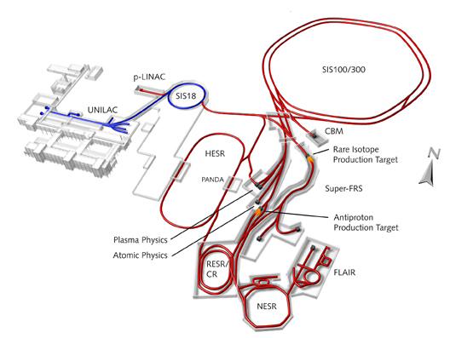
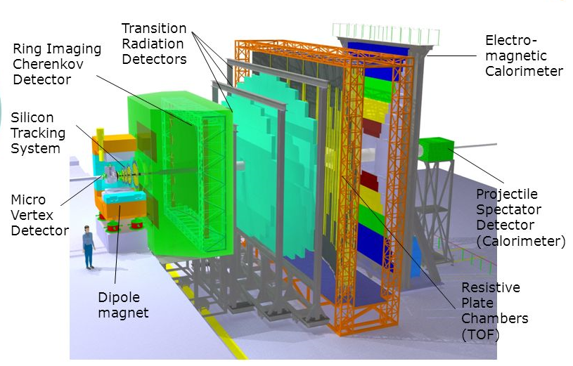
Motivation
Introduction to CBM RICH
CBM interested in QCD phase diagram (deconfinement & chiral PT.)
Prototype of RICH detector is developed in PNU
RICH detector for electron ID (J/Ψ , ρ mesons decay to e+ e-)
Au+Au collision from 2-45 GeV in 2016

Slide 4
Motivation
Cherenkov radiation
Charged particles travelling
in medium(n>1)
+ velocity of particles(v>c/n)
$$\cos{θ_{c}=\frac{1}{βn}}$$
→ Cherenkov radiation
Emission of photon
by varying dipole momentum
$$\frac{d^{2}N}{dEdl}=\frac{αz^{2}}{\overline{h}c}\sin^{2}{θ_{c}}$$
z : electric charge in units of e
$$α=\frac{e^{2}}{\overline{h}c}$$
$$θ_{c}$$
Medium (radiator: CO2)
Neutral Atom
↑ Dipole
charged particle
Image courtesy of [Yi Jungyu]

Slide 5
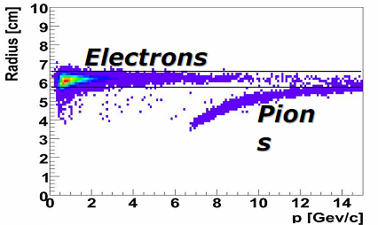
Motivation
Ring Imaging CHerenkov Detector
Image courtesy of [Yi Jungyu]
Result of CBM simulation
Particle ID is possible by measuring a radius of ring
Radius is given by (small angle approximation)
$$r=F\tan{θ_{c}}\sim \frac{R}{2}\sqrt{2−\frac{2}{n}\sqrt{1+\frac{{(mc)}^{2}}{p^{2}}}}$$

Slide 6
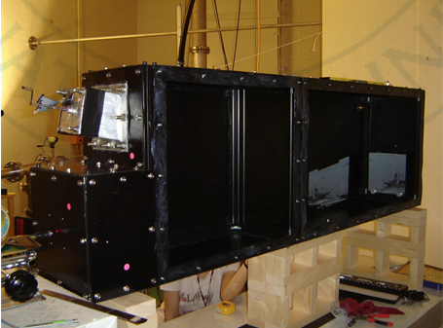
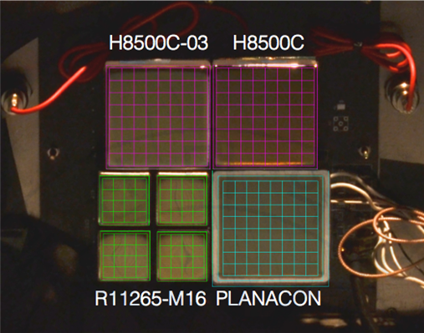
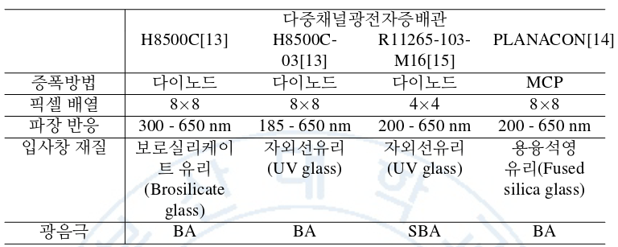
Concept of PNU RICH2.5
Prototype concept
RICH detector is consist of 3 parts : Radiator, Mirror, MAPMT
Parameter | PNU-RICH2.5
Radiator length | 1.76 m
Radiator | N2, CO2
Curvature | 3.2 m
Reflexibility | >85% (λ>200 nm)
Ring radius(60MeV) | 36.61mm, 45.96
From J.S Eum’s thesis

Slide 7
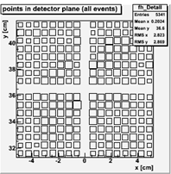
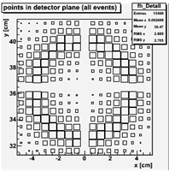
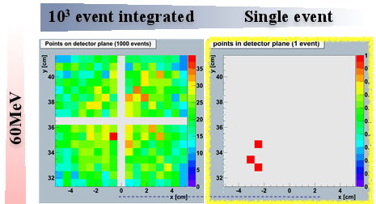
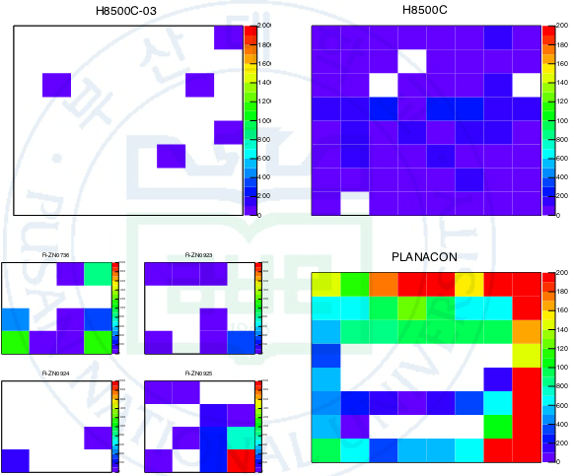
Previous Results
Simulation for PNU RICH(Integrated events)
60MeV
400MeV
Experiment @PAL (Integrated events)
To get high resolution is impossible by inte.
→ To select single event(1 electron) is needed
→ But # of electron ~${10}^{10}$ in 1 bunch of beam
→ Using a time difference to reduce # of electron

Slide 8
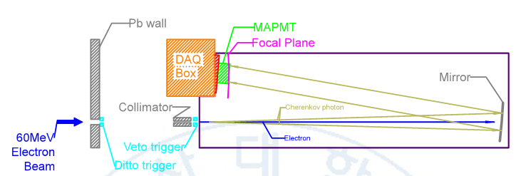
Beam test @ PAL
Setup of PNU RICH2.5
Image courtesy of [Jongsik Eum]
1.76m
DITTO, VETO trigger are coincidence to count beam
Size of beam is about 5.5*7${cm}^{2}$ -> Collimator is needed

Slide 9
Beam test @ PAL
Dataset(CO2)
Position of mirror
Run | Dipole(A) | Mirror
Focus | 13.7 | 5°
Half | 13.7 | half
Unfocus | 14.3 | 0°
H8500 C03
H8500 C
half
5(degree)
R-series
PLANACON
0(degree)
Focus = Background + Cherenkov, UnFocus = Background only
Dipole current change the energy of electron beam
13.7A ->32.6 MeV , 14.3A ->34.0 MeV
The reason using ~30MeV beam is to reduce trigger rate

Slide 10
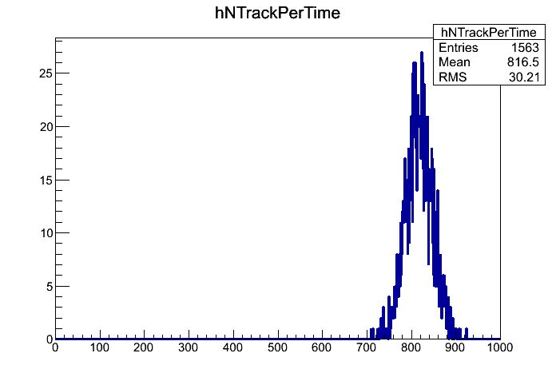
Analysis using time difference
Time difference
Time difference = coincidence time($t_{c}$) – MAPMT hits($t_{p}$)
MAPMTs
-H8500 C03
-H8500 C
-PLANACON
-R-series
Trigger
(Coincidence)
DITTO+VETO
$$t_{c}$$
ROC Board
(Read-Out
Controller)
$$t_{p}$$
Single $t_{c}$ has ~816 time difference
in interval -8000 ~ 8000 ns
→ ~816 MAPMT hits each $t_{c}$ !!!
→ select narrow interval of time difference

Slide 11
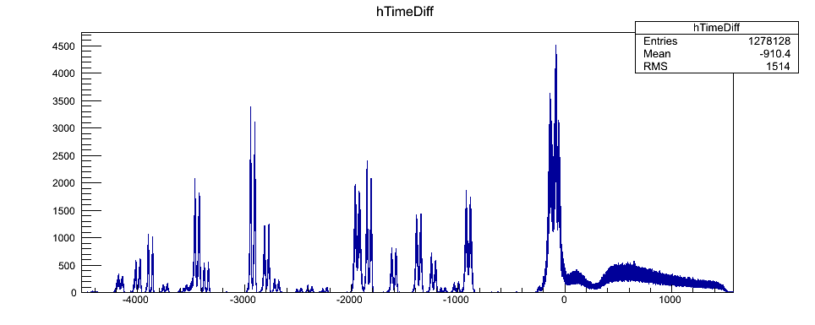
Analysis using time difference
How to separate intervals of time difference
Relatively small peak
also included
These distribution is separated by 47 intervals(all peak)
Size of Intervals are about 40~90 ns
ADC distribution is normalized by total # of coincident time($t_{c}$)

Slide 12
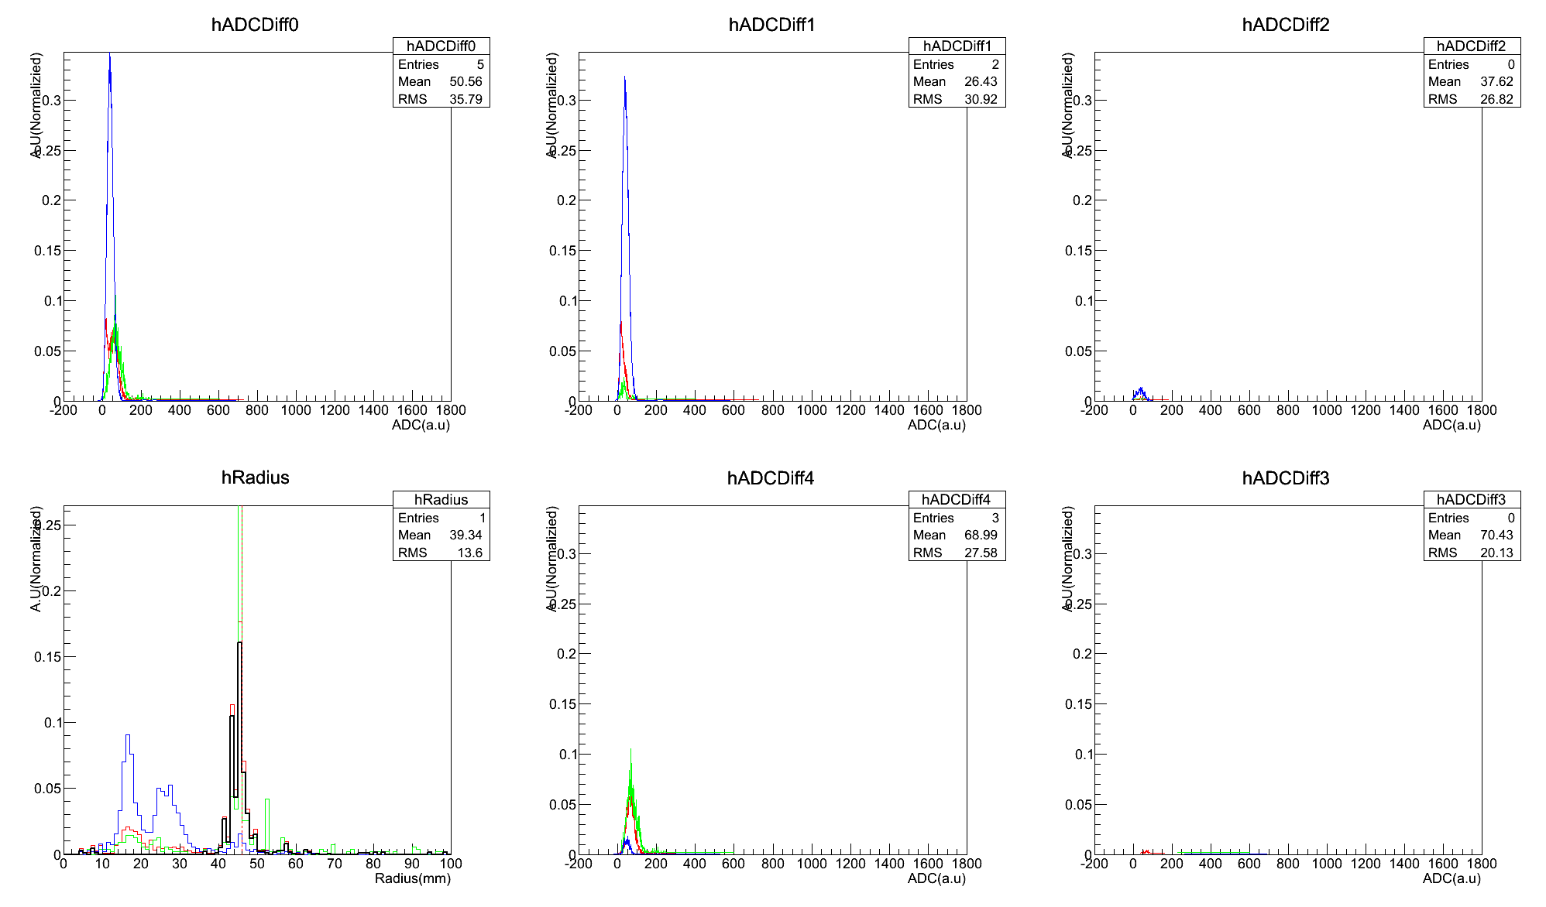
Analysis using time difference
Red:Focus, Green:Half(C03), Blue:Unfocus
Background dominant interval(pedestal only)
All
H8500 C03
H8500 C
Radius
R-series
PLANACON
Black:Focus-Unfocus
Interval(-3555,-3525)

Slide 13
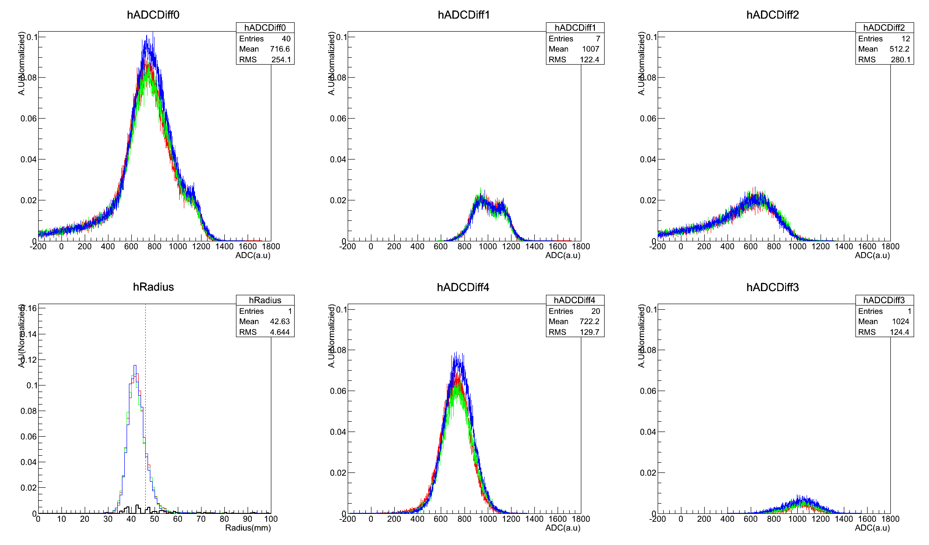
Analysis using time difference
Red:Focus, Green:Half(C03), Blue:Unfocus
Background dominant interval(unfocus>focus)
All
H8500 C03
H8500 C
Radius
R-series
PLANACON
Black:Focus-Unfocus
Interval(-70,-30)

Slide 14
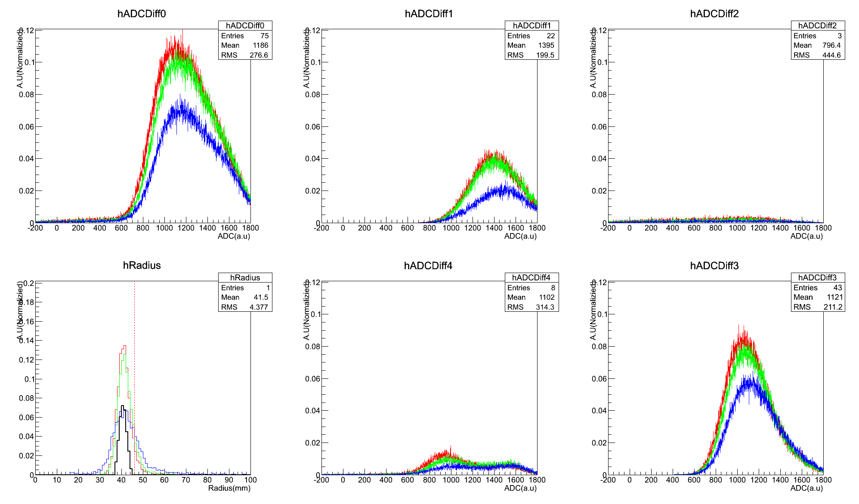
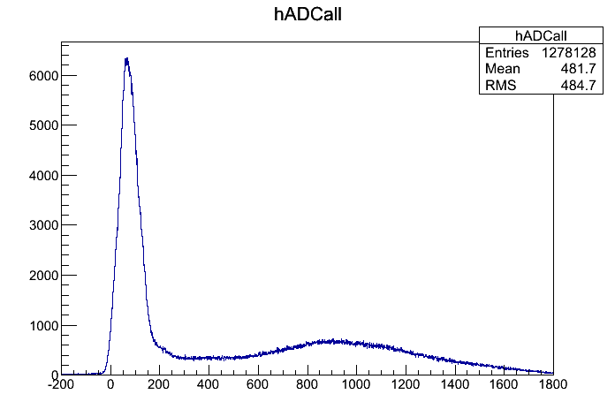
Analysis using time difference
Red:Focus, Green:Half(C03), Blue:Unfocus
Signal Dominant interval(focus>half>unfocus)
All
H8500 C03
H8500 C
Interval(-8000,8000)
All PMT
Remove the Pedestal peak
Radius
R-series
PLANACON
~60MeV
Signal
Dominant ?
Black:Focus-Unfocus
Interval(-200,-110)

Slide 15
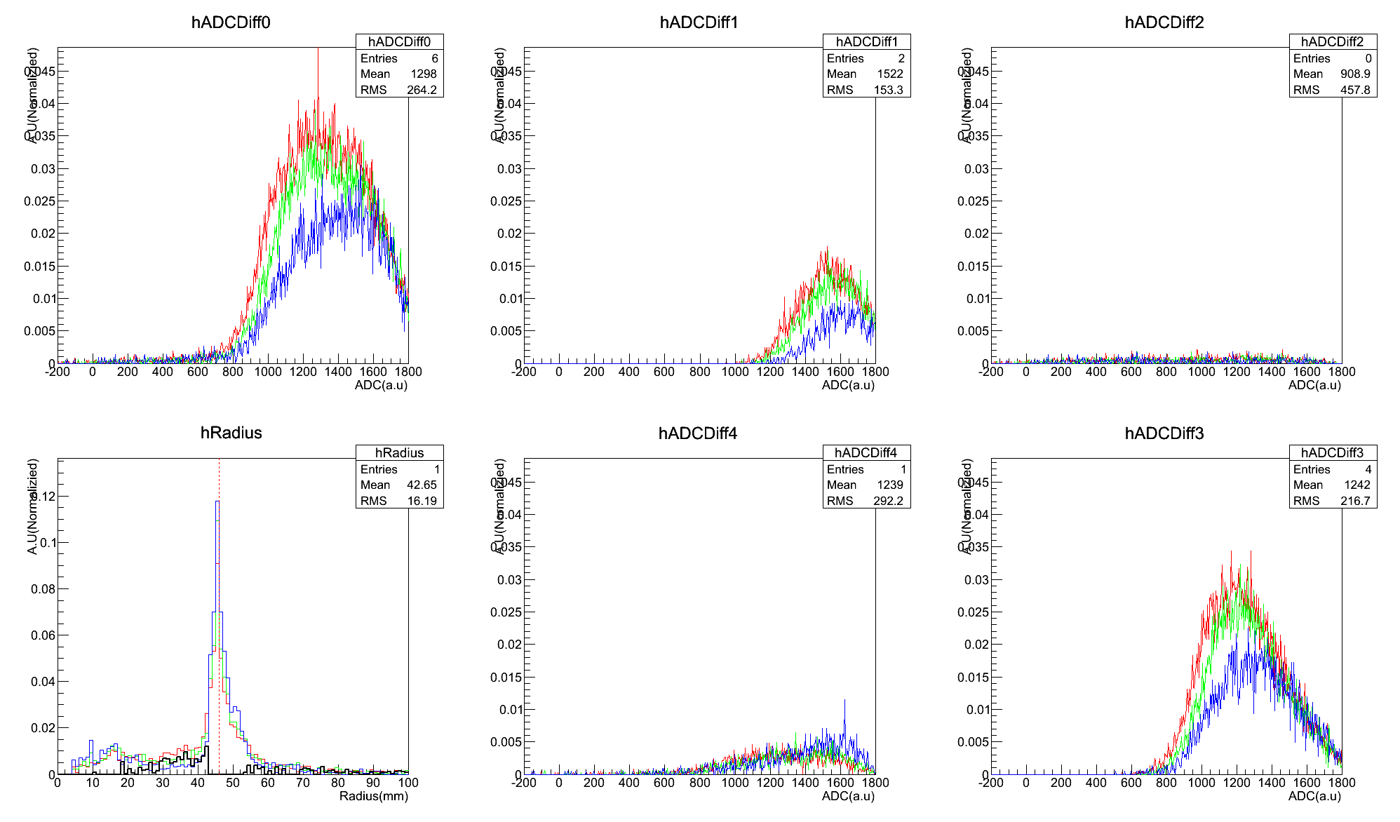
Analysis using time difference
Red:Focus, Green:Half(C03), Blue:Unfocus
Finding specific interval
Expected
Radius
~32MeV
~60MeV
Black:Focus-Unfocus
Interval(-170,-160)

Slide 16
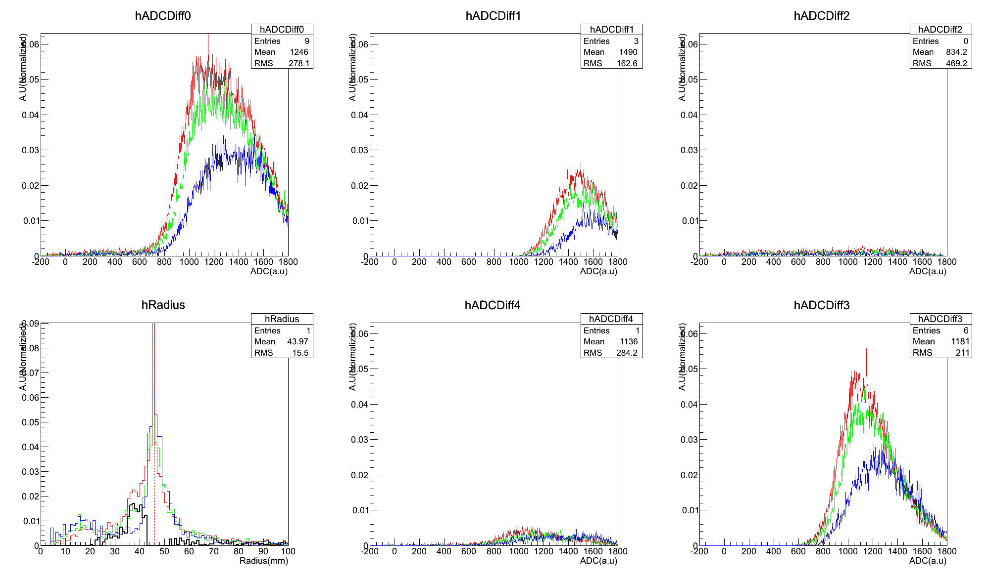
Analysis using time difference
Red:Focus, Green:Half(C03), Blue:Unfocus
Finding specific interval
Expected
Radius
~32MeV
~60MeV
Black:Focus-Unfocus
Interval(-160,-150)

Slide 17
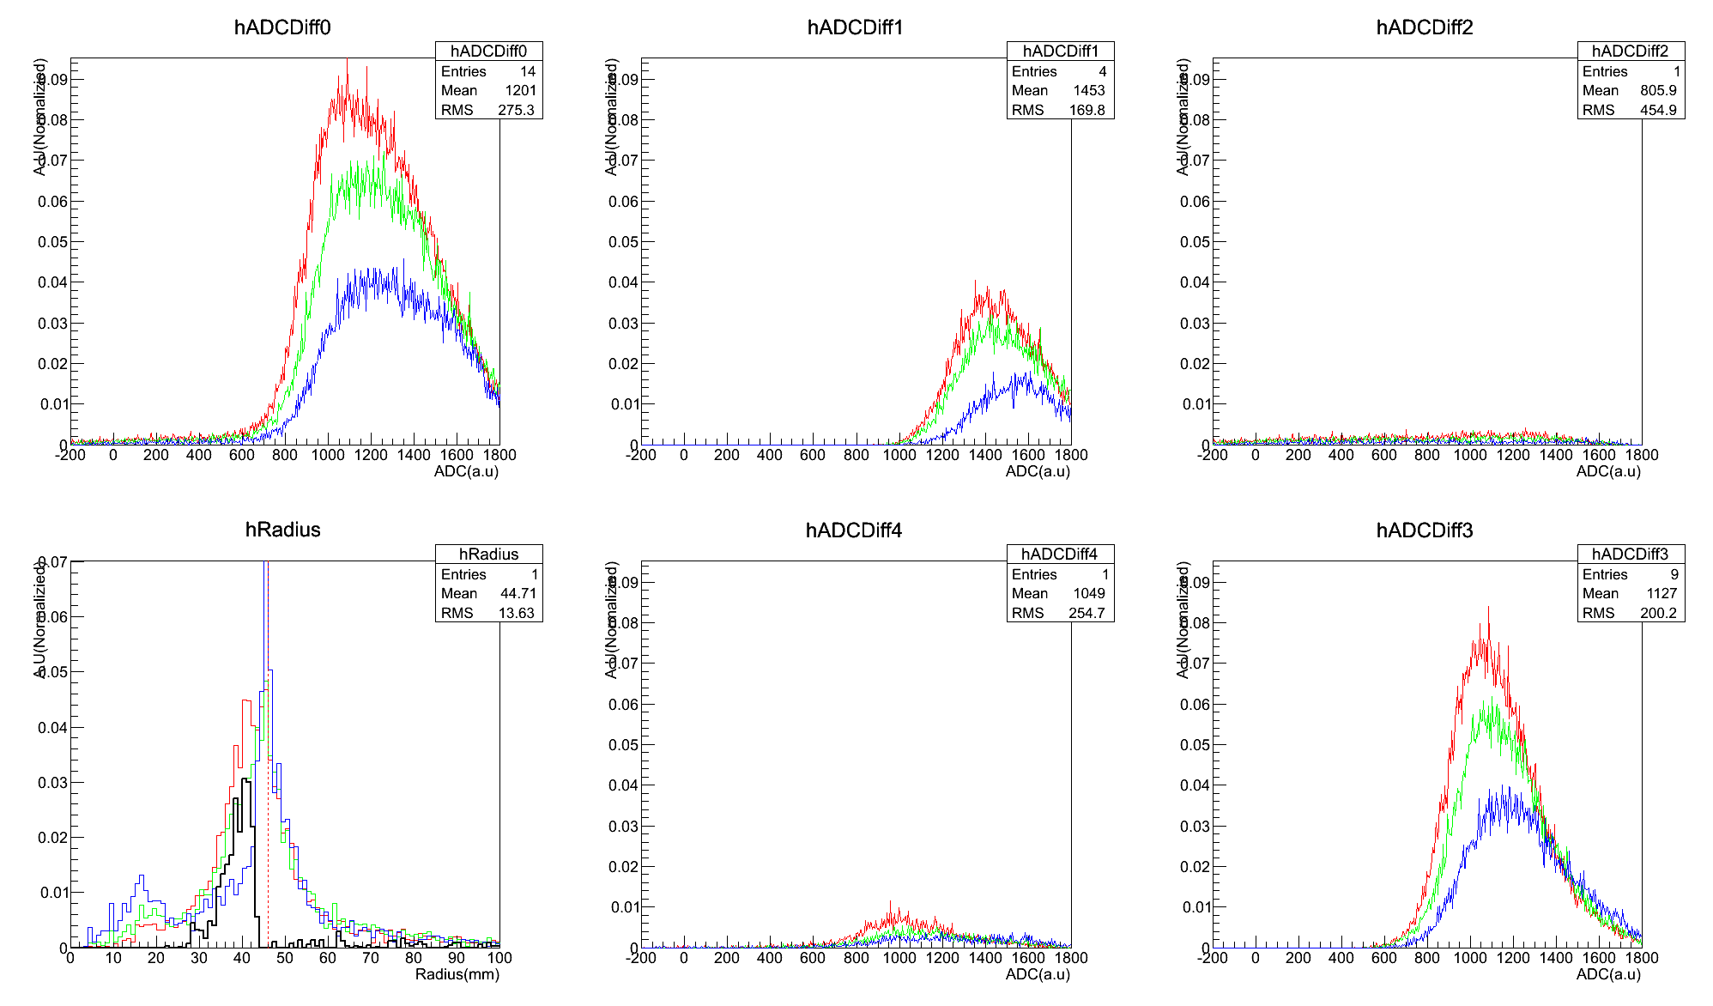
Analysis using time difference
Red:Focus, Green:Half(C03), Blue:Unfocus
Finding specific interval
Expected
Radius
~32MeV
~60MeV
Black:Focus-Unfocus
Interval(-150,-140)

Slide 18
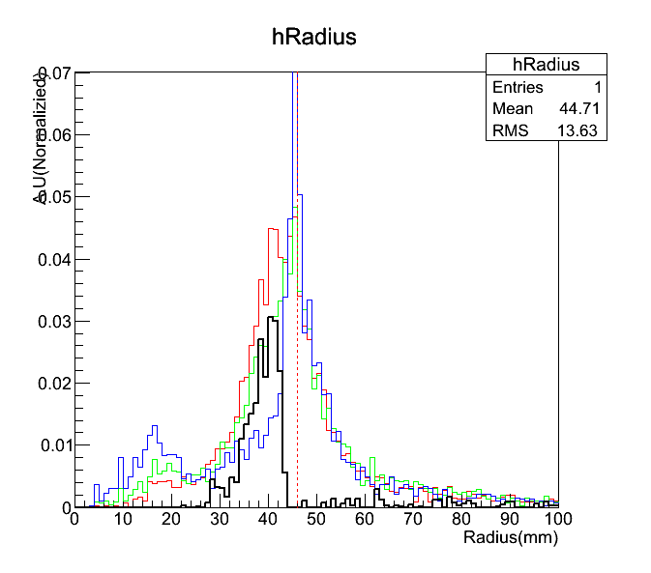
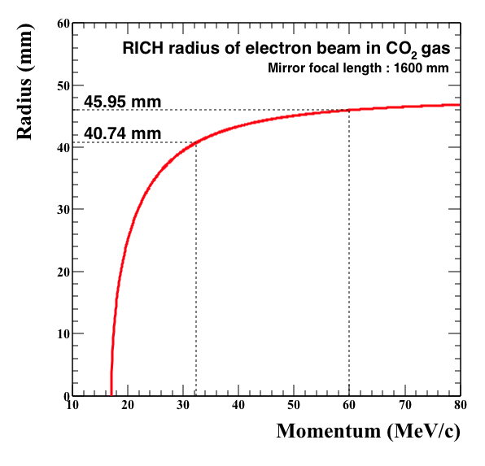
Analysis using time difference
Red:Focus, Green:Half(C03),Blue:Unfocus
Finding specific interval
Expected
Radius
~32MeV
Dipole current
=13.6 ~ 14.3A
~23A
~60MeV
Black:Focus-Unfocus
Interval(-150,-140)

Slide 19
Summary & Outlook
Summary(case of CO2)
In ~32MeV we have to use time difference
Signal dominant interval is (-160,-130)ns
Cherenkov ring will be statistically found
Result of N2 don’t agree with our approach -> more studying
Outlook
Fit Quality cut makes the results more meaningful
Cross-check about N2 & look the ring directly over hundred MeV
→ Confirm the operation of PNU RICH Detector !

Slide 20
Back up

Slide 21
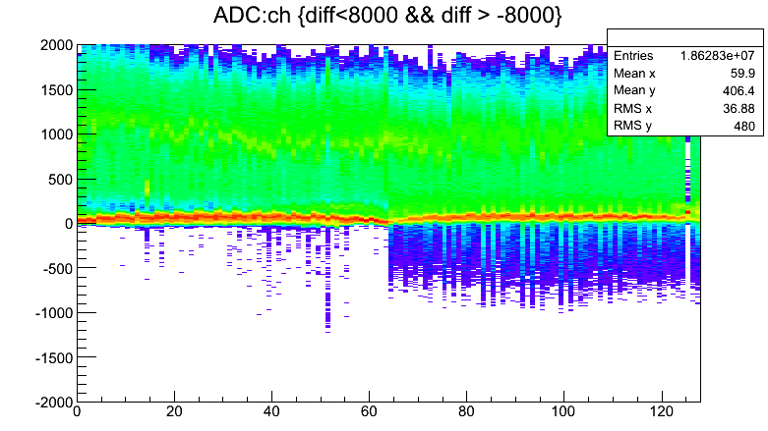
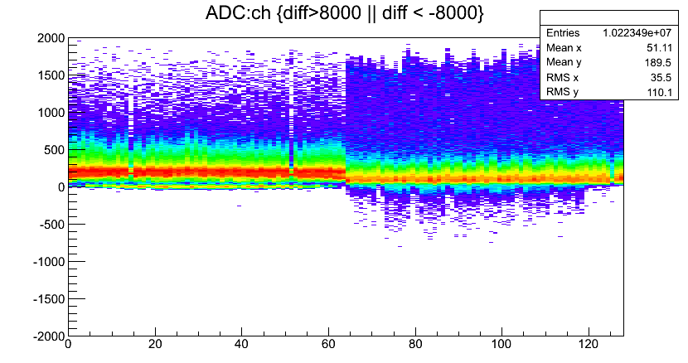
Time difference window

