Slide 1
Nuclear Symmetry Energy in QCD degree of freedom Phys. Rev. C87 (2013) 015204 (arXiv:1209.0080) Eur. Phys. J. A50 (2014) 16 Some preliminary results Heavy Ion Meeting 2014-12 December, 5, 2014
Kie Sang JEONG
Su Houng LEE
Nuclear and Hadron Theory Group
Yonsei University

Slide 2
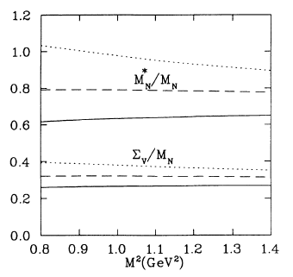
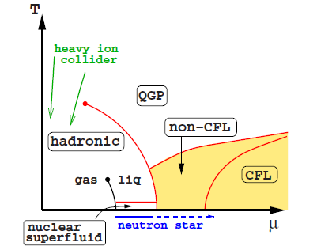
Motivation and Outline
Nuclear phenomenology – QCD sum rule
Extremely high density matter?
– QCD itself is main dynamics
Physical Review C49, 464 (1993)
(Thomas Cohen et al.)
Cold matter Symmetry Energy from
Hard Dense Loop resummation
Color BCS pairing
Rev. Mod. Phys. 80, 1455 (2008) (M. G. Alford et al.)

Slide 3
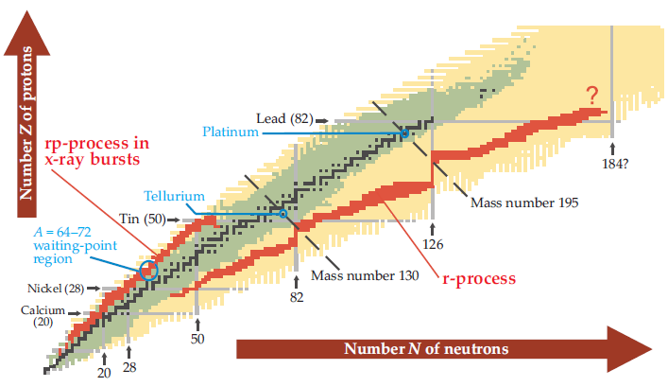
Nuclear Symmetry Energy
From equation of state
RMFT propagator
Quasi-nucleon on the asymmetric Fermi sea
Bethe-Weisaker formula
In continuous matter
(Quoted from Physics Today November 2008)
(Up to linear density order)

Slide 4
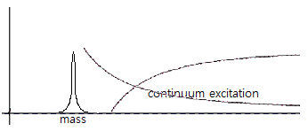
QCD Sum Rule
Correlation function
Energy dispersion relation and OPE
Phenomenological ansatz in hadronic degree of freedom
Weighting - Borel transformation
Ioffe’s interpolating field for proton
Contains all possible hadronic resonance states in QCD degree of freedom
Equating both sides, hadronic quantum number can be expressed in QCD degree of freedom

Slide 5
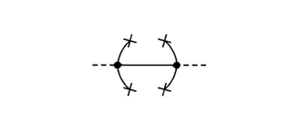
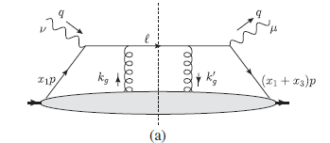
QCD Sum Rule
Operator Product Expansion
In-medium condensate near normal nuclear density
Multi-quark operators (Twist-4)
Non-perturbative contribution
Medium property can be accounted by nucleon expectation value x density
can be estimated from DIS experiments data

Slide 6
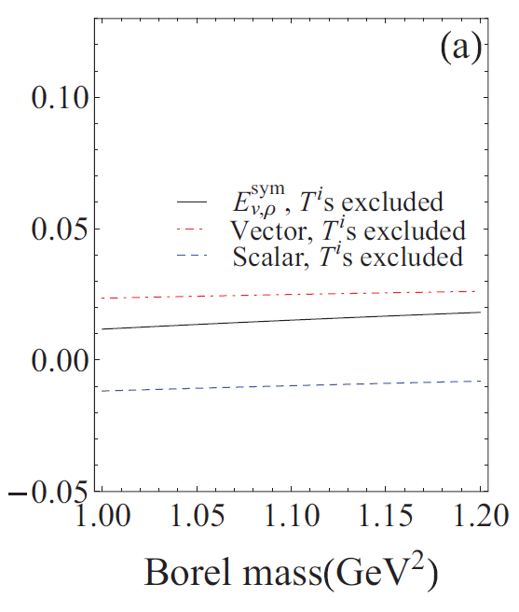
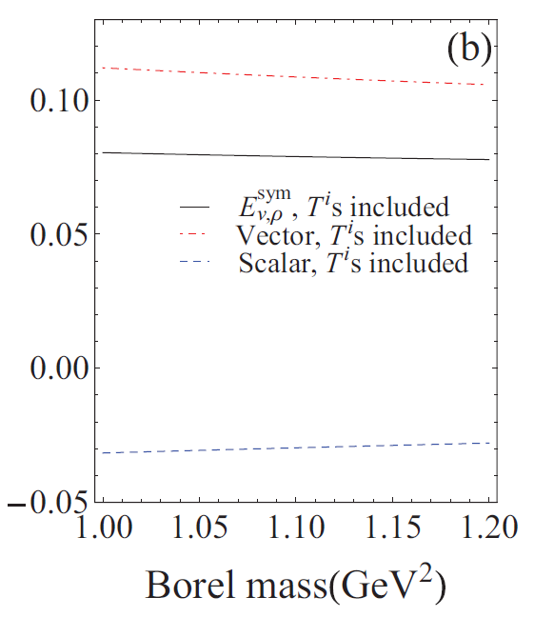
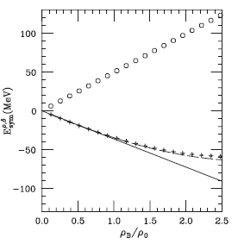
Nuclear Symmetry Energy from QCD SR
Iso-vector scalar / vector decomposition
Comparison with RMFT result
Twist-4 excluded
Twist-4 included
Esym (GeV)
Esym (GeV)
Physics Report, 410, 335 (2005)
(V. Baran et al.)
Iso-vector meson exchange
High density behavior -> high density dependence of condensates

Slide 7
At extremely high density?
QCD phase transition
Euclidean Lagrangian for dense QCD at normal phase
In region, QCD can be immediately applicable
Statistical partition function for dense QCD
Normal QM phase - BCS paired phase
(For fermion)
(For boson)
Continuous energy integration -> Discrete sum over Matsubara frequency

Slide 8
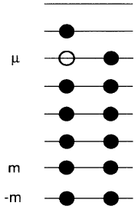
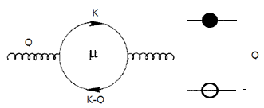
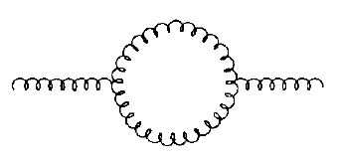
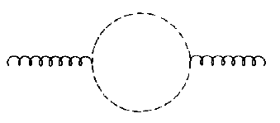
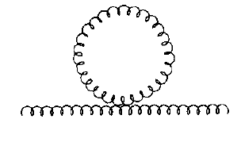
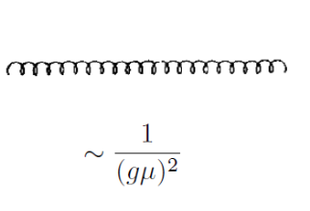
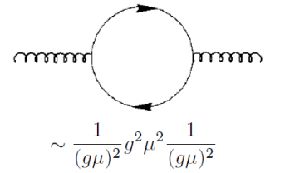
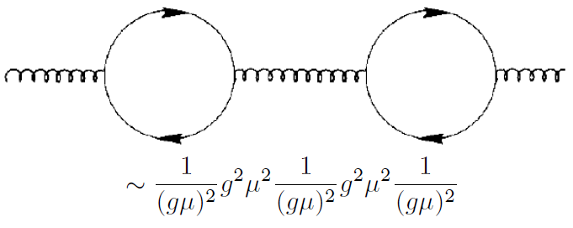
Hard Dense Loop resumation
Quark-hole excitation is dominant (Q~T ≤ gμ )
Gluon self energy in cold matter (Q~T ≤ gμ )
Quark-anti hole contributes to transverse mode
Gluon/Ghost contribution is negligible at Q~T ≤ gμ
~ order
Phys. Rev. D.53.5866 (1996) C. Manuel
Phys. Rev. D.48.1390 (1993) J. P. Blaizot and J. Y. Ollitrault
All equivalent 1PI diagrams should be resumed!

Slide 9
Hard Dense Loop resumation
Projection along polarization
Debye mass and effective Lagrangian
Euclidean propagator
Longitudinal and transverse part
(In w->0 limit)
Effective Lagrangian for soft gluon in cold dense matter
Debye mass from HDL

Slide 10
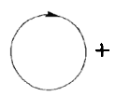
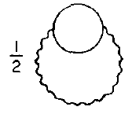
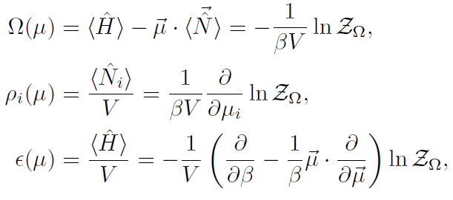
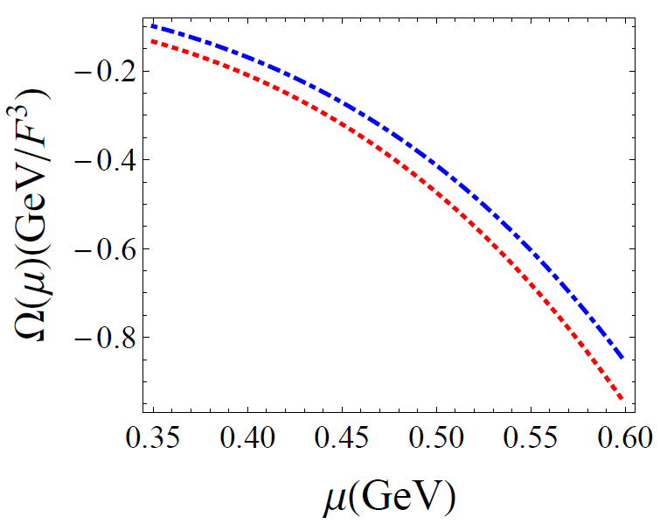
HDL resumed thermodynamic potential
Relevant ring diagrams
Thermodynamic quantities can be obtained from
Where in T ≤ gμ limit
Ideal quark gas
HDL involved

Slide 11
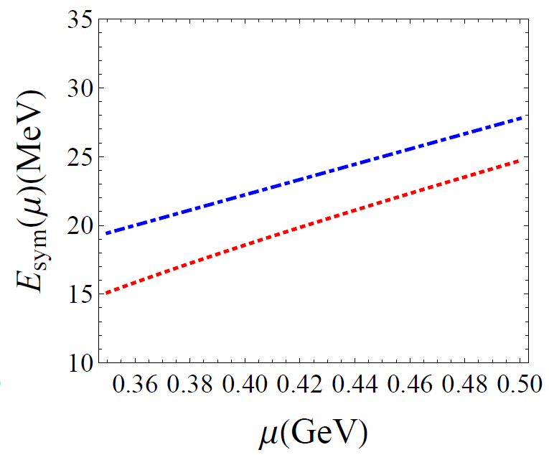
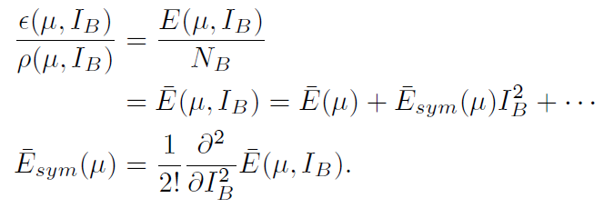
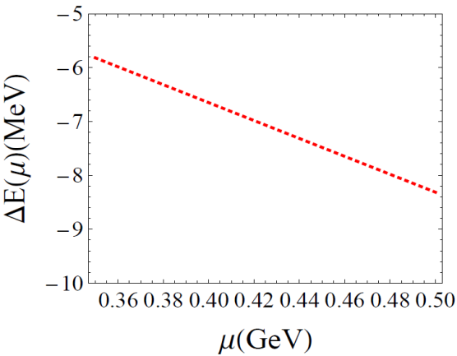
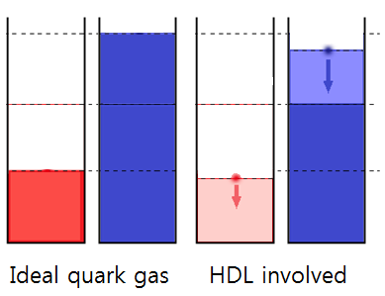
Symmetry Energy at normal phase
Symmetry Energy
HDL correction suppress Quasi-Fermi sea
Ideal quark gas
HDL involved
As density becomes higher, suppression becomes stronger
The difference between quasi-Fermi seas becomes smaller
-> Costs less energy than ideal gas
-> Reduced symmetry energy

Slide 12
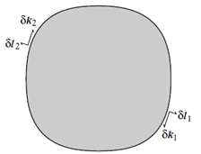
Color Superconductivity
BCS Pairing near Fermi sea
Wilsonian HDET and Nambu-Gorkov formalism
In terms of effective interaction near Fermi sea
is marginal along to Fermi velocity
Fermion – conjugated fermion interaction
When V<0 two states form a condensate (gap)
BCS action as Fermion – conjugated Fermion
HDET Lagrangian - Irrelevant high energy excitation has been integrated out
Diagrammatically described gapped quasi-state
->

Slide 13
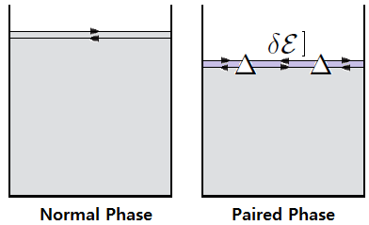
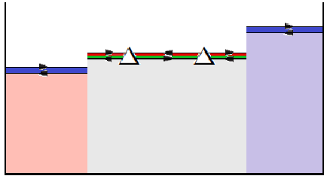
Color BCS paired state
BCS Pairing locks the gapped quasi-states
2 color superconductivity
In QCD, color anti-triplet gluon exchange interaction is attractive (V<0)
In non negligible , 2SC state is favored
In 2SC phase, u-d red-green states are gapped
Only s quarks and u-d blue quarks are liberal
Ms ~ 150 MeV
μ ~ 400 MeV
s quarks d (blue)
s quarks u (blue)
u-d red green
quasi-Fermi sea is locked

Slide 14
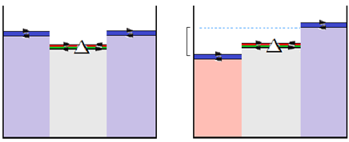
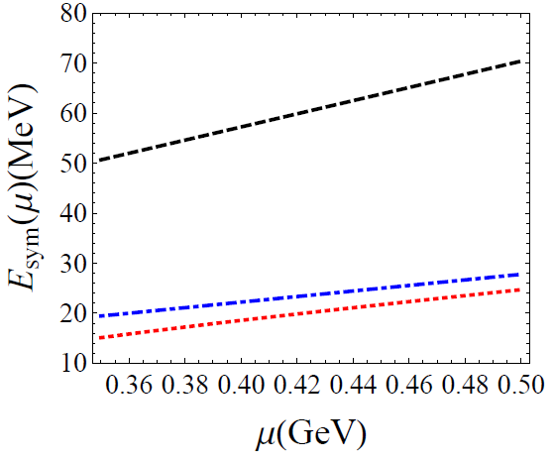
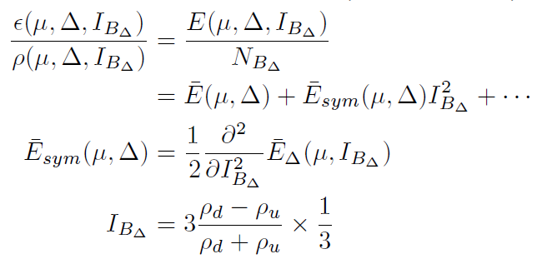
Asymmetrization in 2SC phase
Only Blue state (1/3) can affect iso-spin asymmetry
Symmetry energy
BCS phase remains in
Only u-d blue states can be asymmetrized
The other 4 gapped quasi-states are locked
(Phys. Rev. Lett. 9, 266 (1962) A. M. Clogston )
In HDET formalism
BCS gapped (2SC)
Ideal quark gas
HDL involved

Slide 15
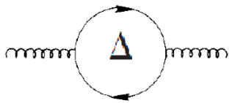
Quasi-fermion state in 2SC phase
Meissner mass effect?
Gapped states and dense loop
Quasi-fermion in gapped state
Fermion in ungapped state
1) If gap size is quite large
-> matter loop do not have hard contribution
-> do not need resummation -> reduction vanish
2) But if gap size is quite small
-> needs resummation -> reduction remains
3) For ungapped quark loop -> reduction remains
~

Slide 16
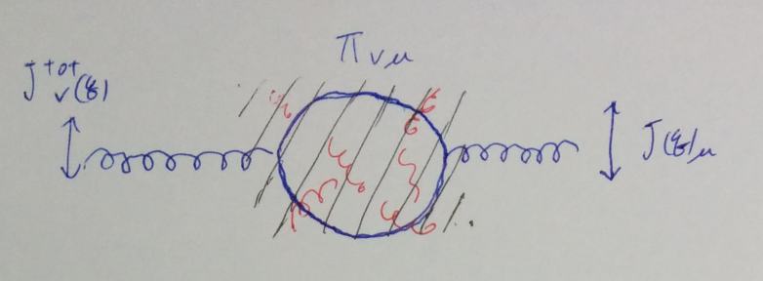
High density effective formalism
2SC description as linear combination of Gellman matrices
Gluon self energy as kernel for linear response
Gapped and un-gapped quasi-state
Effective Lagrangian
+ and – represents Fermi velocity
Determines gluon-quasi Fermion coupling

Slide 17
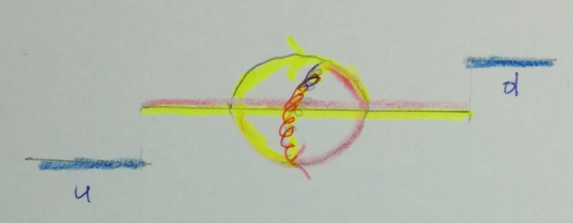
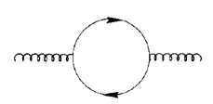
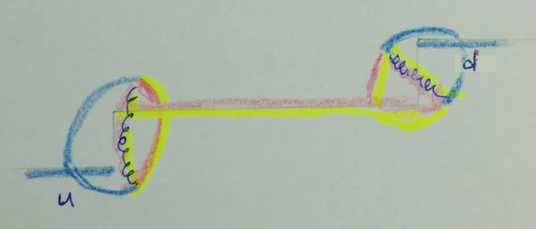
Gluon self energy in 2SC phase
Adjoint color 1,2,3 only couple with gapped states
Adjoint color 4,5,6,7 partially couple with gapped state
In p->0 limit,
Gluons are trapped in gapped state
Symmetry energy do not reduced by HDL
Adjoint 1,2,3 trapped in BCS gap state
In p->0 limit,
Transition from gapped-ungapped state
HDL through asymmetric Fermi sea can contribute reduction of symmetry energy
Adjoint 4,5,6,7 mediate transition between BCS gapped – ungapped state

Slide 18
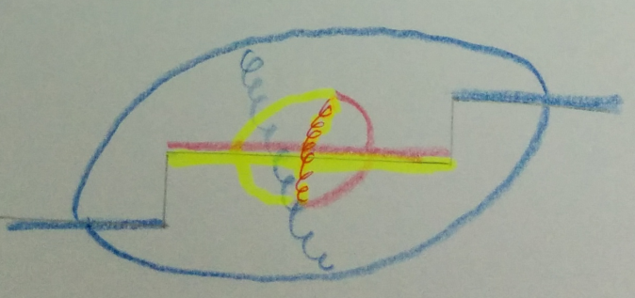
Gluon self energy in 2SC phase
Adjoint color 8
All gapped state can be liberated at
Reduction from HDL significantly dropped
In p->0 limit,
HDL from gapped loop -> locked in symmetric gapped sea
HDL from ungapped loop -> can be asymmetrized as in normal phase
Adjoint 8 has contributions from gapped loop and ungapped loop

Slide 19
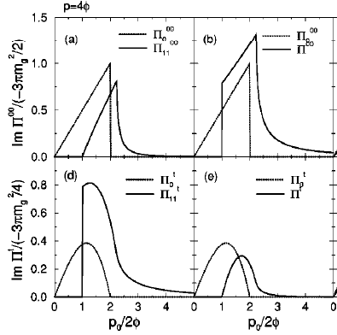
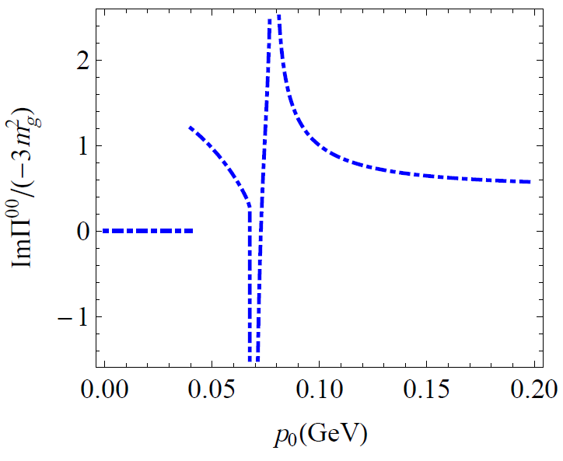
Recent works
Calculation in TFT
Calculation in HDET
(PRD 64, 094003 (2001) Dirk H. Rishke)
Imaginary part of gluon self energy
Two singularities
Irrelevant loop correction needs
Imaginary part of gluon self energy
In 2SC, no gluon mass in static limit (for adjoint 1,2,3)

Slide 20
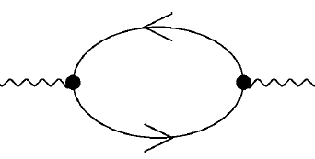
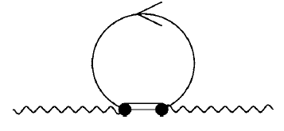
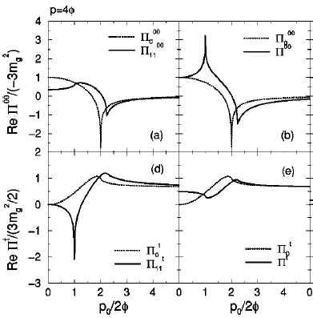
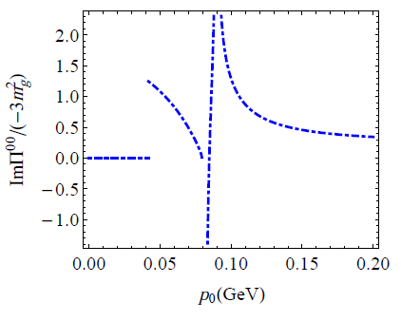
Recent works
Irrelevant loop correction
Real part can be obtained by dispersion relation
+
(PRD 64, 094003 (2001) Dirk H. Rishke)
Real part of gluon self energy
Scale comparison

Slide 21
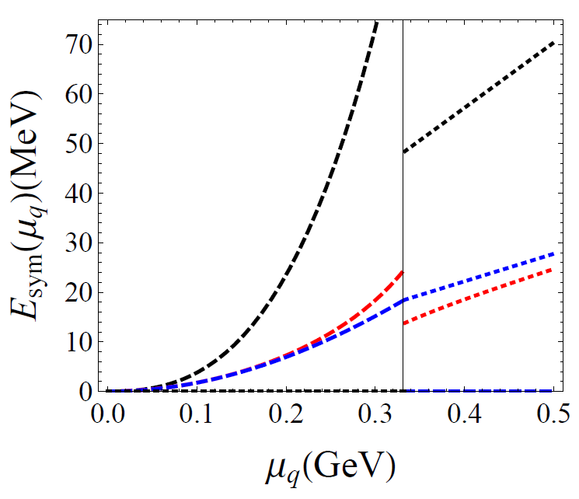
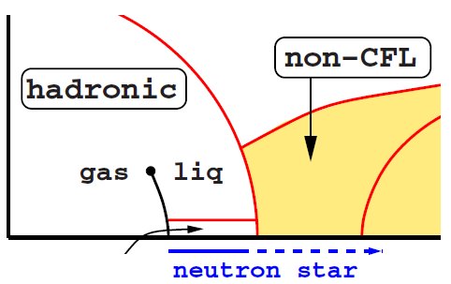
Summary and Future goals
Nuclear Symmetry Energy in hadron and quark phase
Evaluating gluon self energy by analytic calculation
Quark-hadron continuity?
Hadron phase | Quark phase
Cold matter symmetry energy from correct statistics can be obtained
Symmetry Energy from QCD SR
(Kin. + Pot.)
BCS gapped (2SC)
Ideal quark gas
HDL involved
Important quantum numbers?
(e.g. strangeness)
-> High density behavior at hadron phase
Kinetic part (Ideal nucleon gas)
Kinetic part (QCD SR based interaction involved)

