Slide 1

Long-Range Correlations and Implication to Collectivity in pPb & PbPb from CMS
Heavy-Ion Meeting (HIM 2014-12)
Haeundae Grand Hotel, Busan, Korea, 5-6 December, 2014
Byungsik Hong
(Korea University)
for the CMS Collaboration

Slide 2
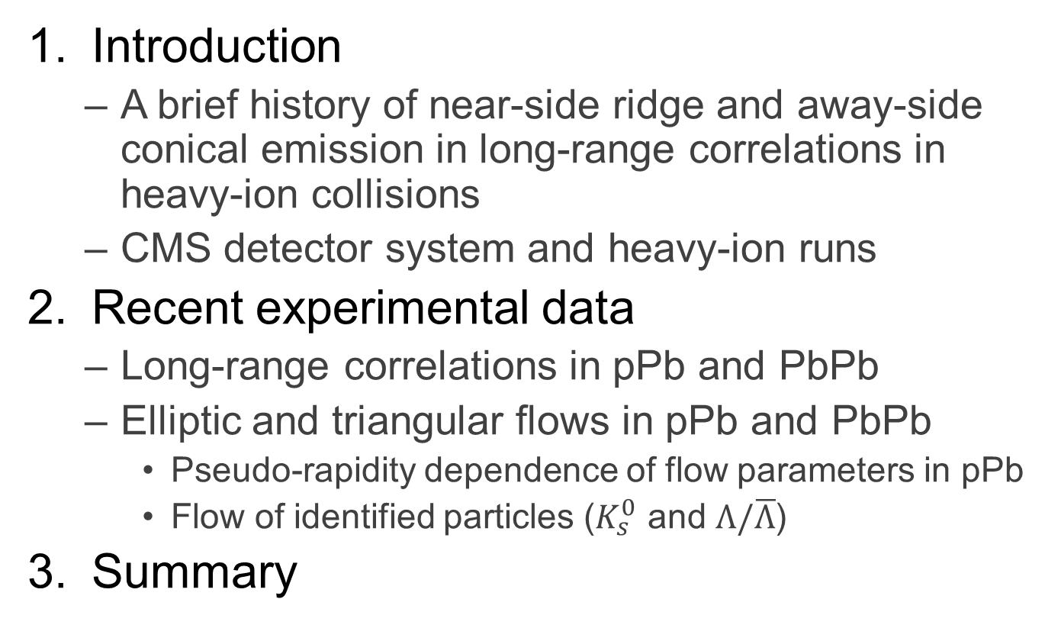
Outline
Introduction
  A brief history of near-side ridge and away-side conical emission in long-range correlations in heavy-ion collisions
  CMS detector system and heavy-ion runs
Recent experimental data
  Long-range correlations in pPb and PbPb
  Elliptic and triangular flows in pPb and PbPb
    Pseudo-rapidity dependence of flow parameters in pPb
    Flow of identified particles ($K_{s}^{0}$ and $Λ/\overline{Λ}$)
Summary

Slide 3
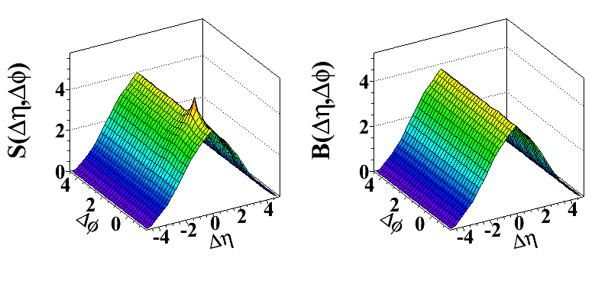
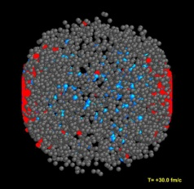
Dihadron Correlation Technique
Signal distribution
Background distribution
Particle 1: Trigger
Particle 2: Associated
Same event pairs
Event #1
Mixed event pairs
Event #2
Associated hadron yield per trigger:
Δη = η^{assoc} – η^{trig}
Δφ = φ^{assoc} – φ^{trig}

Slide 4
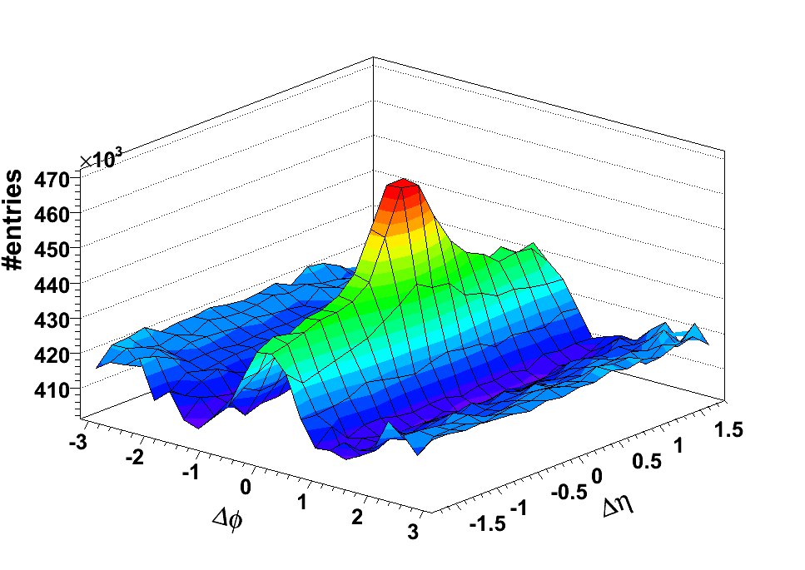
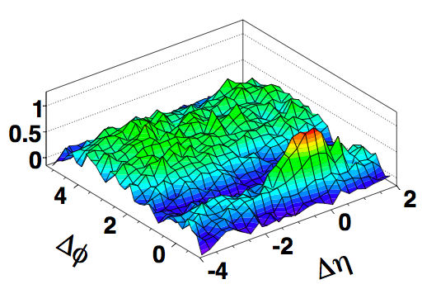
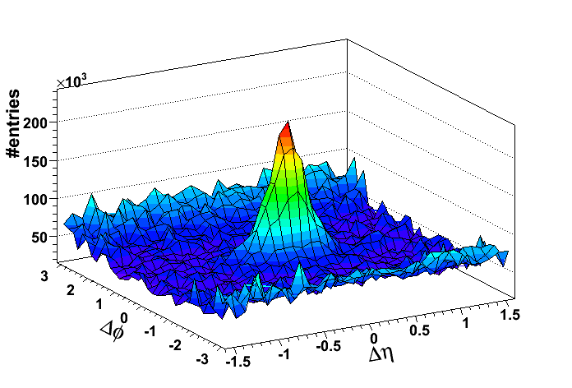
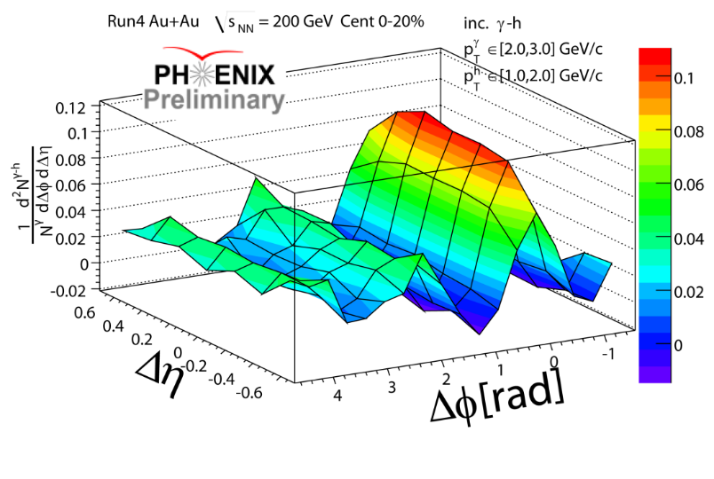
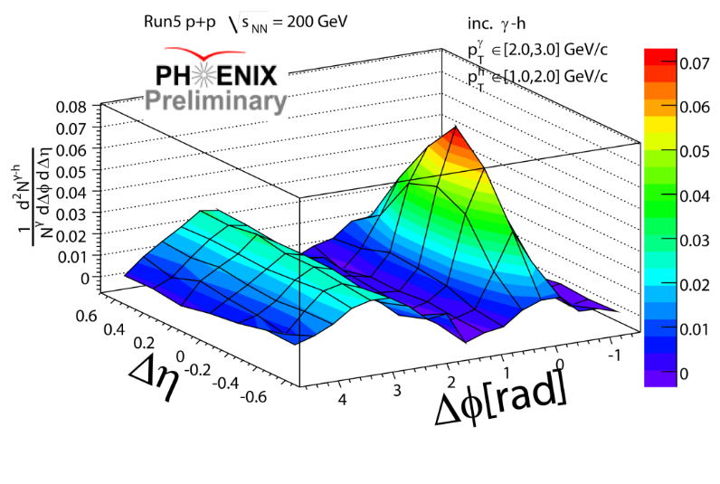
Discovery of Ridge @ RHIC
  First observation of near-side ridge in central Au+Au at 200 GeV in QM2006 in Shanghai by two-particle correlations
Au+Au @ 200 GeV (0-10%)
3<p_{T,trig}<4 GeV, p_{T,assoc.}>2 GeV
Au+Au (0-30%)
PRL 104, 062301 (2010)
d+Au @ 200 GeV (0-10%)
STAR
PHOBOS
STAR
    Ridge was absent in pp and dAu

Slide 5
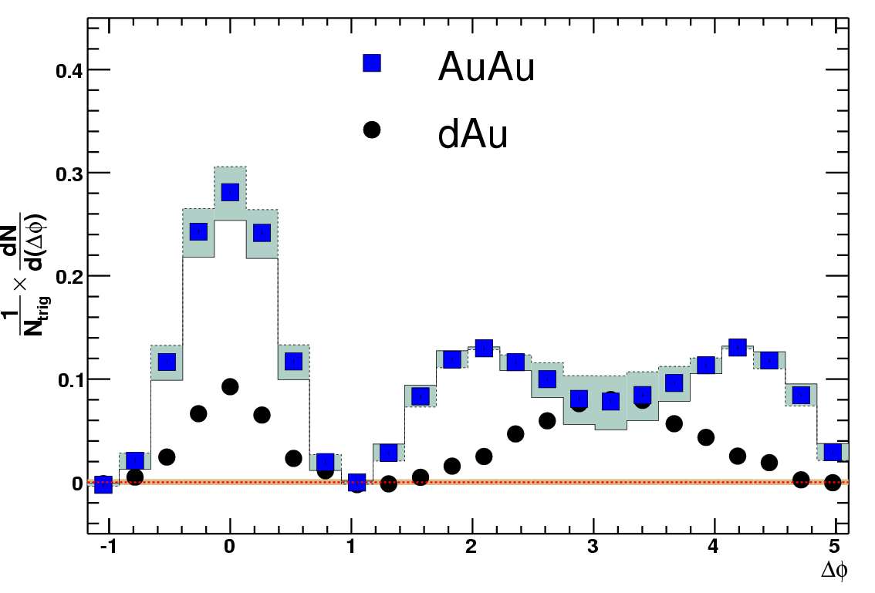
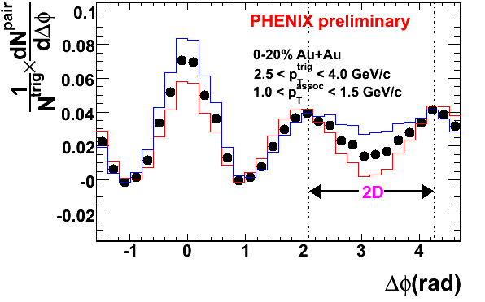
Conical Emission @ RHIC
  First observation of away-side conical emission in central Au+Au at 200 GeV in QM2006 in Shanghai by two-particle correlations
PHENIX
STAR
p_{T}^{trig} = 3.0-4.0 GeV/c
p_{T}^{asso} = 1.0-2.5 GeV/c
By M. Horner
By C. Zhang

Slide 6
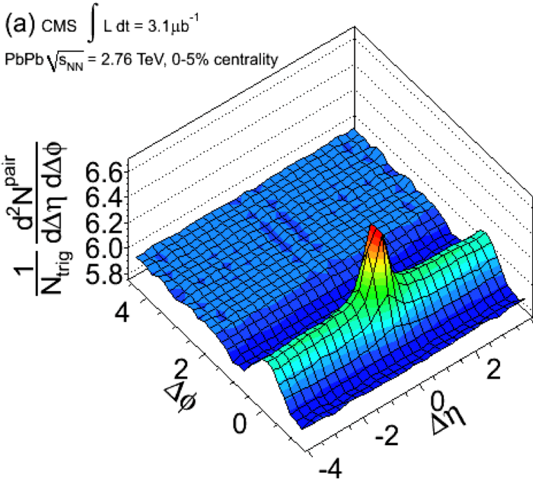
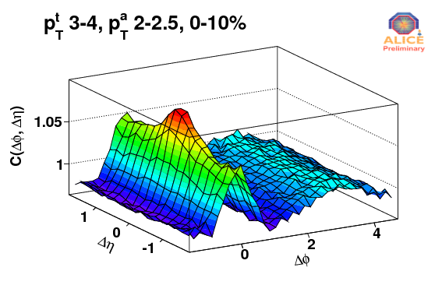

Ridges in PbPb @ LHC
$p_{T}^{trig}=4\sim 6$ GeV/c
$p_{T}^{assoc}=2\sim 4$ GeV/c
  LHC experiments observed near-side ridge and away-side conical emission in central PbPb at 2.76 TeV in QM2011 in Annecy
CMS
ATLAS
ALICE

Slide 7
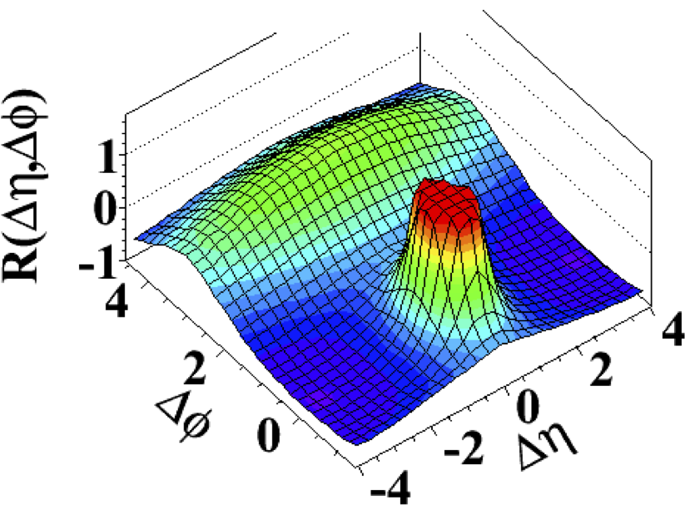
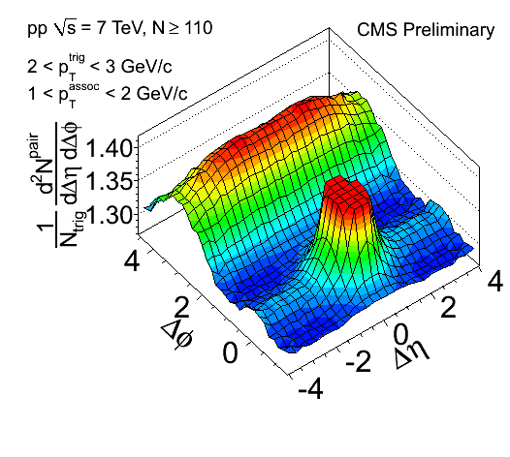
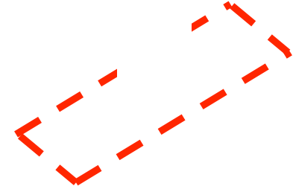
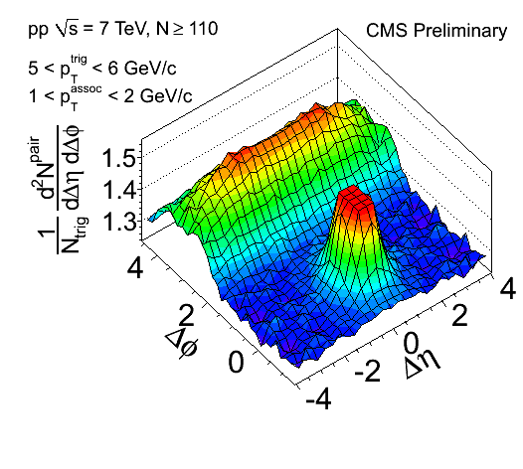

Ridge in pp @ LHC
Striking near-side ridge in high-multiplicity pp events
  Not observed before in either hadron collisions or MC models
Minimum Bias pp (<N>~15)
High-multiplicity events (N>110)
CMS,
JHEP 09, 091 (2010)
PAS HIN-11-006
No ridge when correlating to high $p_{T}$ particles!

Slide 8
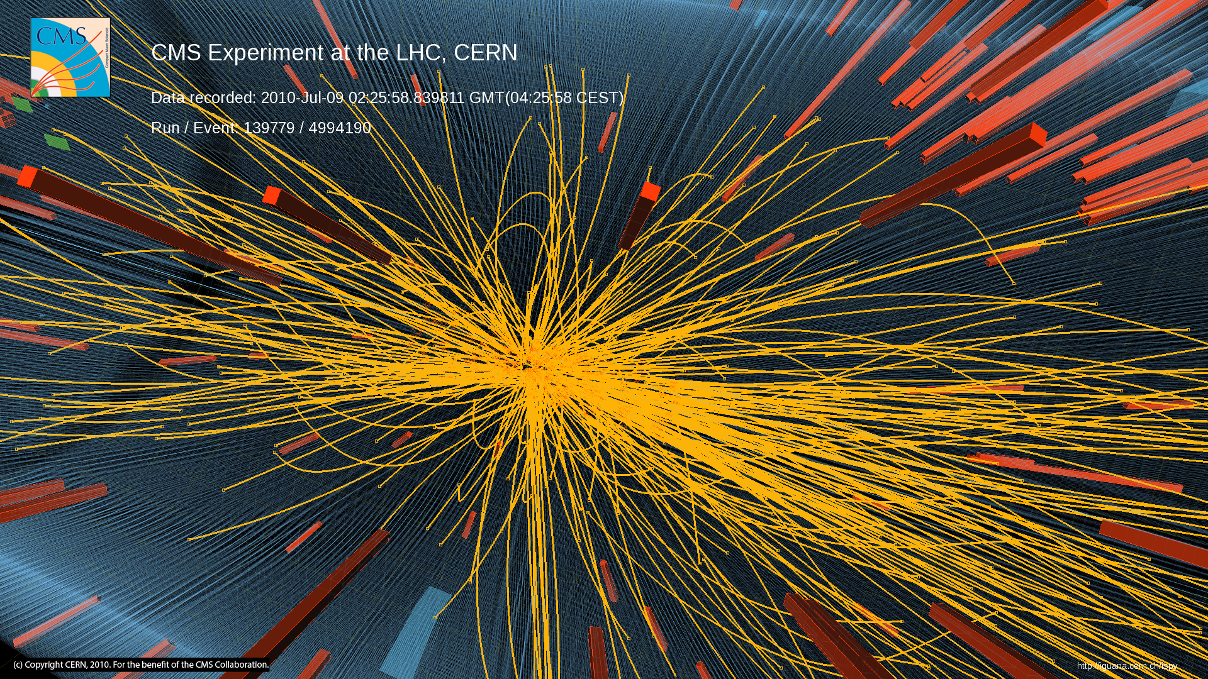
High-Multiplicity pp Event

Slide 9
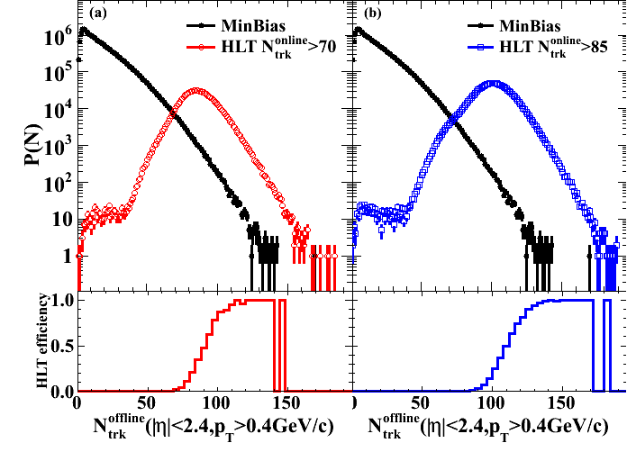
High-Multiplicity pp Events
Very high particle density regime
Is there anything interesting happening?
Dedicated triggers
on high multiplicity
events from a single
collisions (not pileup!)
N^{online} > 85 trigger
un-prescaled for
full 980 nb⁻¹ data set
JHEP 09, 091 (2010)
~350k top multiplicity events (N>110) out of 50 billion collisions!

Slide 10
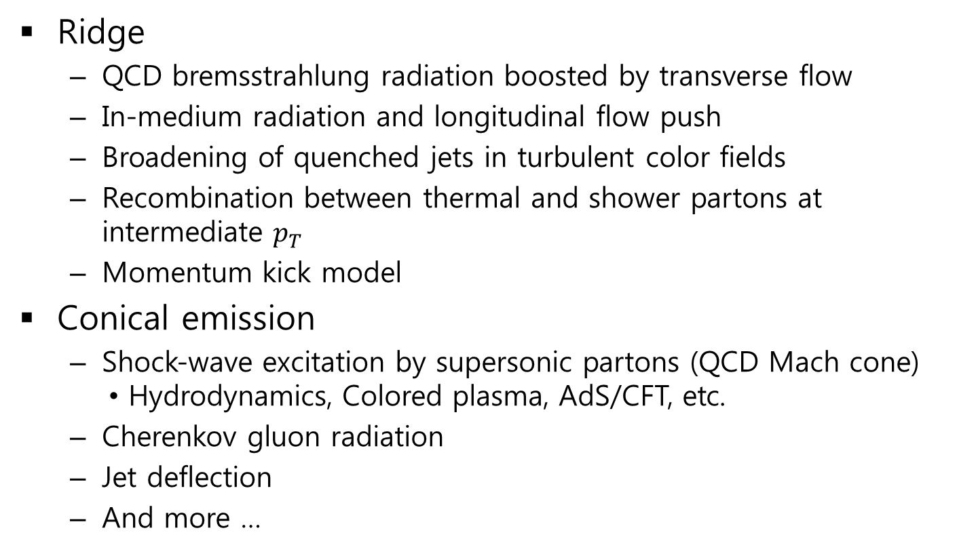
Proposed Interpretations ~06’
Ridge
  QCD bremsstrahlung radiation boosted by transverse flow
  In-medium radiation and longitudinal flow push
  Broadening of quenched jets in turbulent color fields
  Recombination between thermal and shower partons at intermediate $p_{T}$
  Momentum kick model
Conical emission
  Shock-wave excitation by supersonic partons (QCD Mach cone)
      Hydrodynamics, Colored plasma, AdS/CFT, etc.
  Cherenkov gluon radiation
  Jet deflection
  And more …

Slide 11
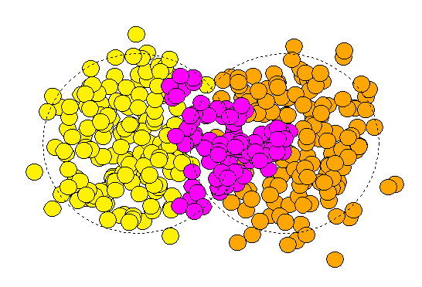
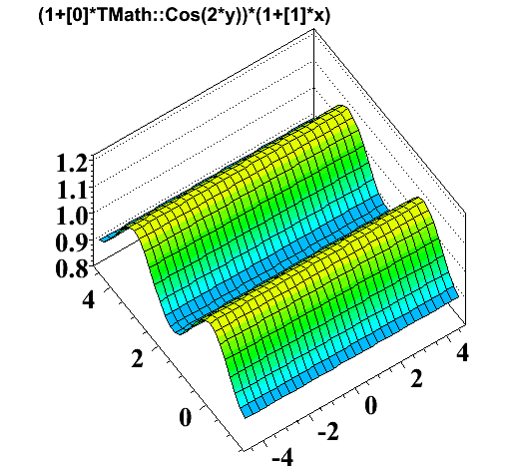
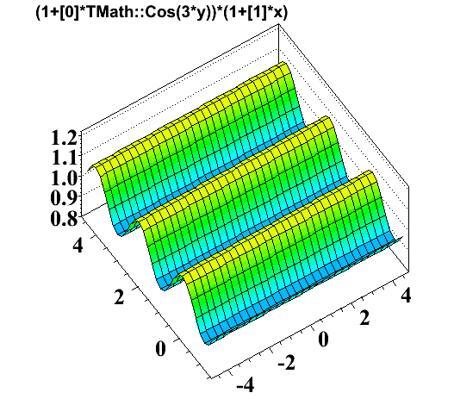
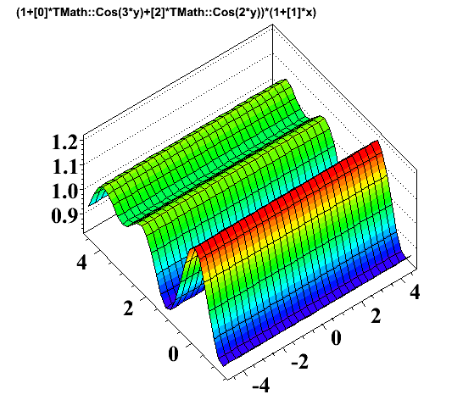




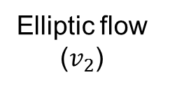





Alternative Interpretation
Fluctuation+Higher-order flow terms ($v_{2}$, $v_{3}$, $v_{4}$, $v_{5}$, …)
Elliptic flow
($v_{2}$)
Triangular flow ($v_{3}$) from
event-by-event fluctuation
Reaction
plane
z
y
B. Alver & G. Roland, Phys. Rev. C 81,
054905 (2010)
x
y
x
Cone
+
=
$$∆φ$$
$$Δφ$$
Ridge
$$Δη$$
$$Δη$$
$$Δφ$$
$$Δη$$
$$\sim v_{2}\cos{(2∆φ)}$$
$$\sim v_{3}\cos{(3∆φ)}$$

Slide 12
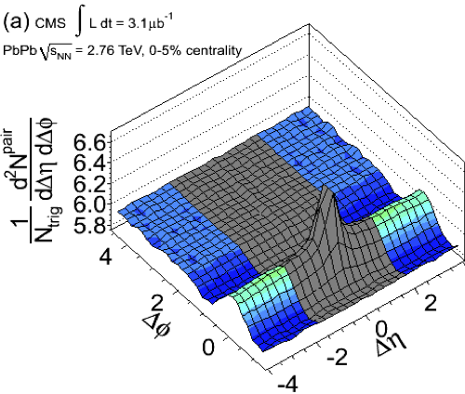
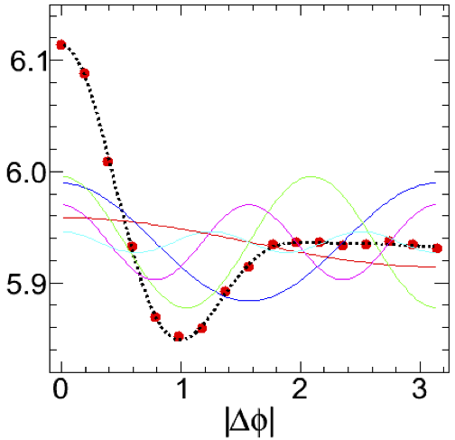


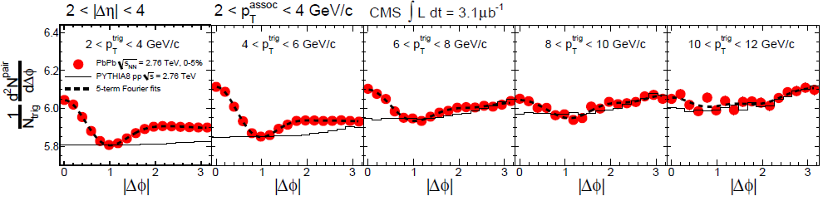

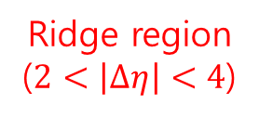
Application to PbPb Data
JHEP07, 076 (2011)
PbPb @ 2.76 TeV (0-5%)
Ridge region
($2<\left|∆η\right|<4$)
2<|Δη|<4
V₂^{f}
V₄^{f}
V₅^{f}
V₁^{f}
V₃^{f}
$$p_{T}$$
Dashed lines: First 5 Fourier terms

Slide 13
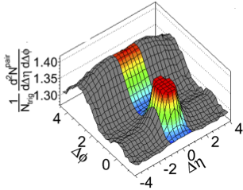
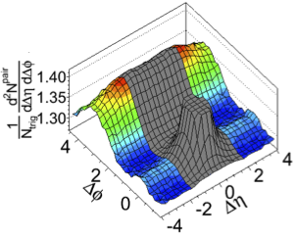
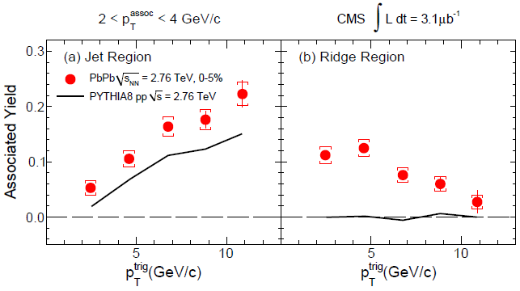
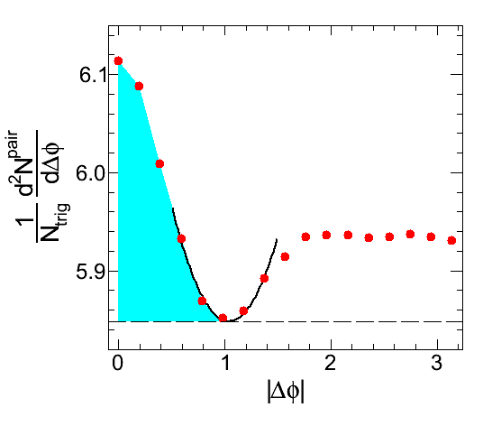
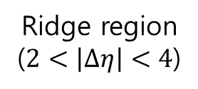
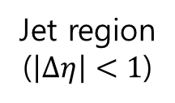
Application to PbPb Data
JHEP07, 076 (2011)
PbPb @ 2.76 TeV (0-5%)
Definition of the associated yield
ZYAM
Ridge region
($2<\left|∆η\right|<4$)
Jet region
($\left|∆η\right|<1$)
v₂ not subtracted
Ridge in PbPb collisions tends to diminish at high $p_{T}$.

Slide 14
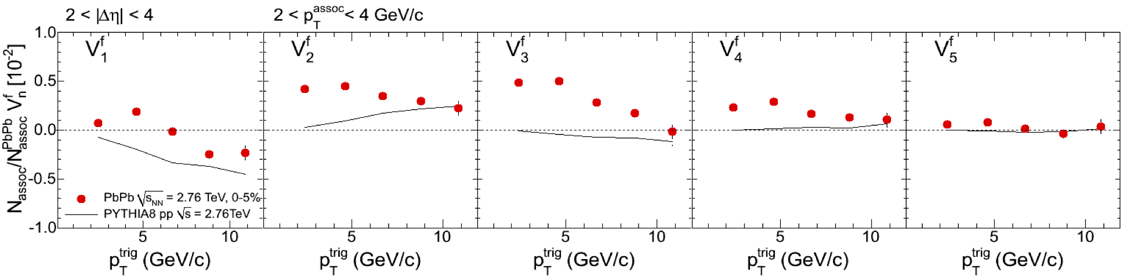

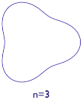
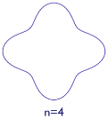

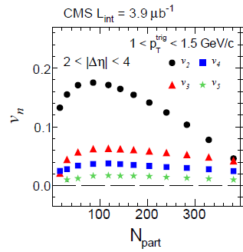
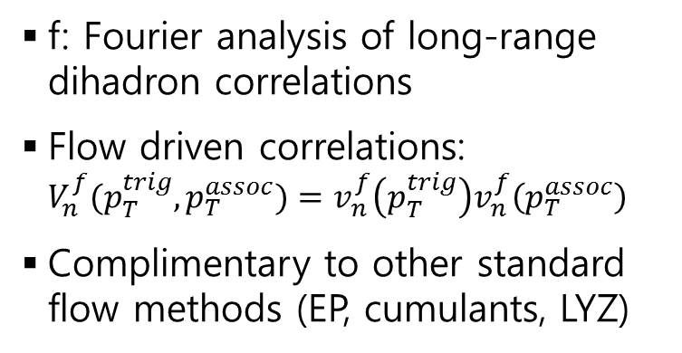

Application to PbPb Data
JHEP07, 076 (2011)
PbPb @ 2.76 TeV (0-5%)
n=2
n=3
n=4
n=5
${1<p}_{T}^{assoc}<3$ GeV/c
f: Fourier analysis of long-range dihadron correlations
Flow driven correlations: $V_{n}^{f}(p_{T}^{trig},p_{T}^{assoc})=v_{n}^{f}\left(p_{T}^{trig}\right)v_{n}^{f}\left(p_{T}^{assoc}\right)$
Complimentary to other standard flow methods (EP, cumulants, LYZ)
EPJC72, 2012 (2012)

Slide 15
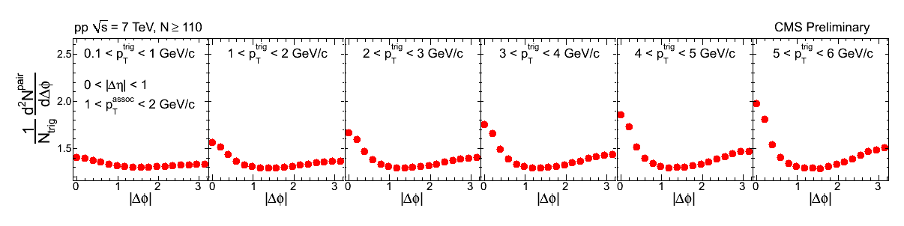
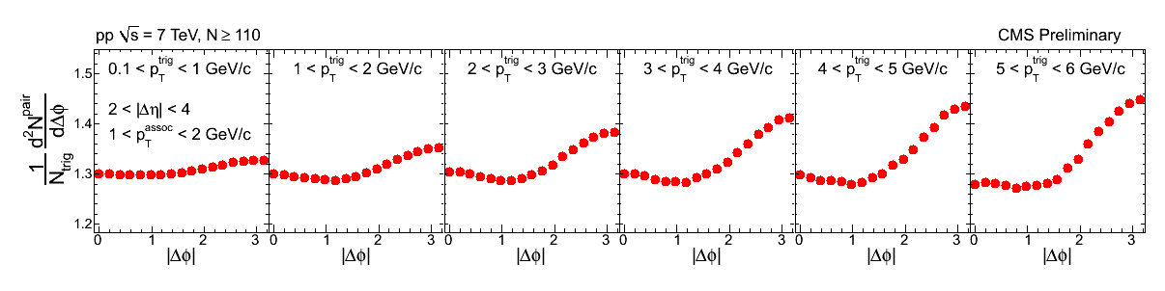
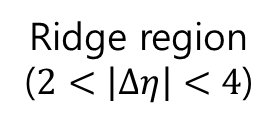
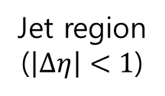
Application to pp Data
PAS HIN-11-006
pp @ 7 TeV, N ≥ 110
Jet region
($\left|∆η\right|<1$)
Ridge region
($2<\left|∆η\right|<4$)

Slide 16
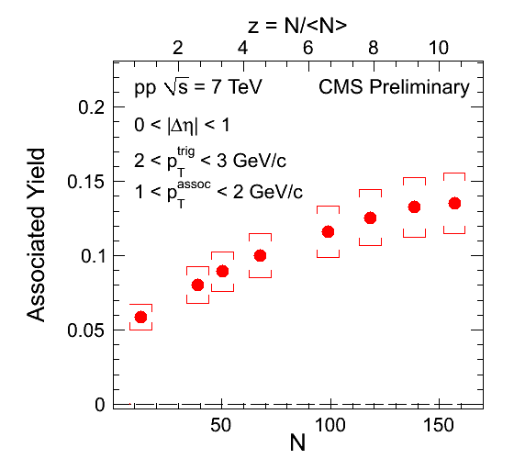
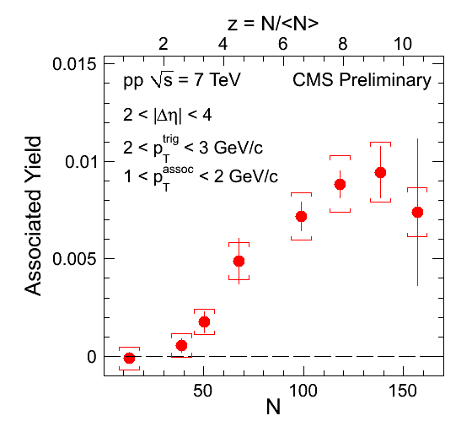
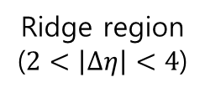
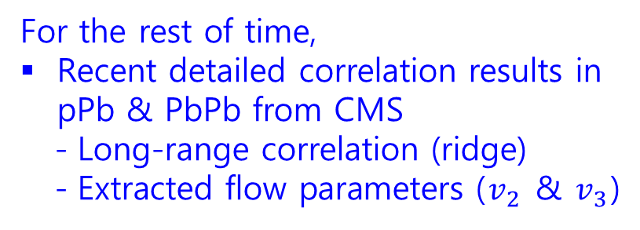
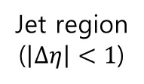
Application to pp Data
PAS HIN-11-006
Jet region
($\left|∆η\right|<1$)
Ridge region
($2<\left|∆η\right|<4$)
For the rest of time,
Recent detailed correlation results in pPb & PbPb from CMS
  Long-range correlation (ridge)
  Extracted flow parameters ($v_{2}$ & $v_{3}$)
Ridge in pp turns on N~50
(<N>~15 for MinBias events)
Origin is not yet clear
  Multi-jet correlation
  Color connection between jets
  Hydrodynamic flow of QGP, etc.

Slide 17
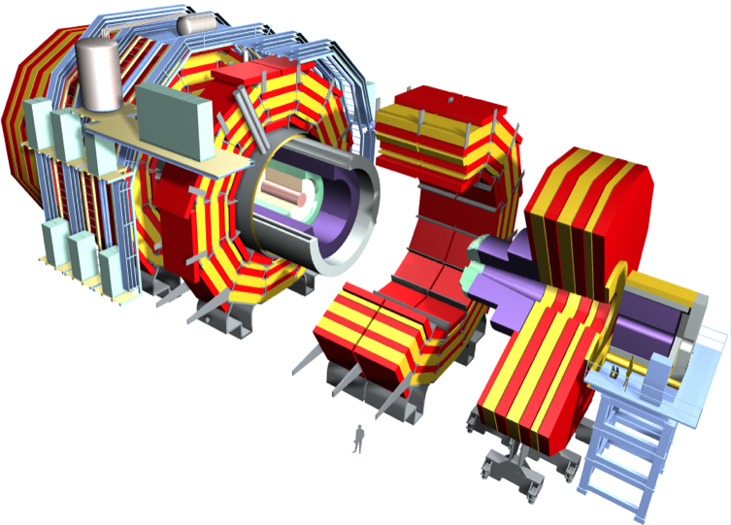
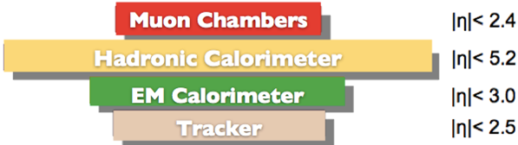
CMS Detector
Superconducting Coil (3.8 T)
CALORIMETERS
ECAL
Weight: 12,500 tons
Diameter: 15 m
Length: 22 m
76k scintillating
PbWO₄ crystals
HCAL
Plastic scintillator/
Brass sandwich
Steel YOKE
BSC
MB trigger
HF
TRACKER
MB trigger
Centrality in HI
Pixels (66M Ch.)
Silicon Microstrips (9.6M Ch.)
220 m² of silicon sensors
MUON ENDCAPS
HF(EM
+HAD)
HF(EM
+HAD)
Cathode Strip Chambers
MUON BARREL
Resistive Plate Chambers
Drift Tube Chambers
Resistive Plate Chambers

Slide 18


CMS Trackers
Large coverage (|Δη| < 2.5)!
η = 0
y
φ
η = 2.5
x
θ
z
Pixels (66M channels) + Silicon Microstrips (9.6M channels)
220 m² of silicon sensors

Slide 19



Heavy-Ion Related Data Samples
Period | System | $\sqrt{s_{NN}}$ (TeV) | Int. L | Comment
Dec. 2010 | Pb+Pb | 2.76 | 7 μb⁻¹
Dec. 2011 | Pb+Pb | 2.76 | 150 μb⁻¹
Mar. 2011 | p+p | 2.76 | 230 nb⁻¹ | Reference
Jan. 2013 | p+Pb | 5.02 | 35 nb⁻¹
Feb. 2013 | p+p | 2.76 | 5.4 pb⁻¹ | Reference
Almost same $N_{coll}$ scaled luminosities for pp, pPb & PbPb
  As many as Z’s and W’s
Recent improvements (compared to QM2012)
  PbPb results updated with 20 times more pp reference data
  New pPb results

Slide 20






Ridges in pPb @ LHC
CMS, PLB 724, 213 (2013)
$p_{T}$ > 0.4 GeV/c, $|η|$ < 2.4
pPb
Same $N_{trk}^{offline}$ range
PbPb
($N_{trk}^{offline}$: Offline track multiplicity)
Ridge structure in pPb was also found by other LHC experiments
  ALICE, PLB 719, 29 (2013)
  ATLAS, PLB 725, 60 (2013)

Slide 21


Relevant Formulae
Cumulants formed from $v_{n}$ moments
$c_{n}\left\{2\right\}=\left\langle \left\langle 2\right\rangle \right\rangle$
$c_{n}\left\{4\right\}=\left\langle \left\langle 4\right\rangle \right\rangle −2{\left\langle \left\langle 2\right\rangle \right\rangle }^{2}$
$c_{n}\left\{6\right\}=\left\langle \left\langle 6\right\rangle \right\rangle −9\left\langle \left\langle 4\right\rangle \right\rangle \left\langle \left\langle 2\right\rangle \right\rangle +12{\left\langle \left\langle 2\right\rangle \right\rangle }^{3}$, etc.
where, for example,
$\left\langle 6\right\rangle ≡\left\langle e^{in\left(φ_{1}+φ_{2}+φ_{3}−φ_{4}−φ_{5}−φ_{6}\right)}\right\rangle$
$≡\frac{1}{P_{M,6}}\sum_{i≠j≠k≠l≠m≠n}^{M}{e^{in\left(φ_{i}+φ_{j}+φ_{k}−φ_{l}−φ_{m}−φ_{n}\right)}}$
and $\left\langle \left\langle ∙\right\rangle \right\rangle$ means the average of over all particles from all events within a given multiplicity range
Flow coefficients from cumulants
$v_{n}\left\{2\right\}=\sqrt{c_{n}\left\{2\right\}}$, $v_{n}\left\{4\right\}=\sqrt[4]{−c_{n}\left\{4\right\}}$, $v_{n}\left\{6\right\}=\sqrt[6]{\frac{1}{4}c_{n}\left\{6\right\}}$,
$v_{n}\left\{8\right\}=\sqrt[8]{−\frac{1}{33}c_{n}\left\{8\right\}}$, etc.
A. Bilandzic, et al.,
Phys. Rev. C 83, 044913 (2011)

Slide 22




Elliptic Flow: PbPb vs. pPb
CMS, PLB 724, 213 (2013)
$$v_{2}$$
Relative fluctuation
N. Borghini, P. M. Dinh, J.-Y. Ollitrault, arXiv:nucl-ex/0110016
$$F\left(v_{2}\right)$$
Fourier expansion also works well for the long-range correlations in pPb.
$v_{2}\left\{2\right\}$ contains some non-flow components.

Slide 23


Elliptic Flow: PbPb vs. pPb
PAS HIN-14-006
6- & 8-particle cumulants: Insensitive to non-flow contributions
Lee-Yang Zeros (LYZ): All particle correlations
PLB 724, 213 (2013)
$v_{2}\left\{4\right\}$, $v_{2}\left\{6\right\}$, $v_{2}\left\{8\right\}$ and $v_{2}\left\{LYZ\right\}$ are in good agreement within $±$10%
True collectivity observed in pPb!

Slide 24


Elliptic Flow: PbPb vs. pPb
PAS HIN-14-006
Fluctuation-driven initial-state eccentricity in hydrodynamics in pPb
  A. Bzdak, P. Bozek, and L. McLerran, arXiv: 1311.7325
  L. Yan and J.-Y. Ollitrault, PRL 112, 082301 (2014)
0.6 0.7 0.8 0.9
$$v_{2}\left\{4\right\}/v_{2}\left\{2\right\}$$

Slide 25



Triangular Flow: PbPb vs. pPb
CMS, PLB 724, 213 (2013)
Remarkable similarity in the $v_{3}$ signal as a function of multiplicity in pPb and PbPb

Slide 26









η-Dependence of $v_{n}$ in pPb
${−2.4<η}_{trig}<2.0$ (Pb-going trigger)
${2.0<η}_{trig}<2.4$ (p-going trigger)
η_{trig}
η_{assoc}
η_{assoc}
η_{trig}
$S\left(∆η,Δφ\right)=\frac{1}{N_{trig}}$ $\frac{d^{2}N^{same}}{dΔηΔφ}$
Near-side jet
Near-side ridge
Shape~dN/dη
PAS HIN-14-008

Slide 27






η-Dependence of $v_{n}$ in pPb
η_{trig}
η_{assoc}
η_{assoc}
η_{trig}
Pb-going
trigger
p-going
trigger
Jet region
$$(0<\left|∆η\right|<0.2)$$
Ridge region
$$(2.8<|∆η|<3.0)$$
PAS HIN-14-008

Slide 28



η-Dependence of $v_{n}$ in pPb
Comparison of the near-side ridge yields for both direction triggers
η_{trig}
η_{assoc}
η_{assoc}
η_{trig}
Pb-going
p-going
After jet subtraction
PAS HIN-14-008
Shifted to single particle
Near-side ridge yields show different $η$ dependences for both triggers.

Slide 29



η-Dependence of $v_{n}$ in pPb
PAS HIN-14-008
Pb-going
p-going
Red symbols: Low-multiplicity subtraction to minimize jet contribution
[CMS, PLB 724, 213 (2013)]
Long range data used for single $v_{n}(η_{assoc})/v_{n}(0)$
Extract $V_{2}$ and $V_{3}$ from the Fourier decomposition
Assuming factorization, $V_{n}\left(η_{trig},η_{assoc}\right)=v_{n}(η_{trig})v_{n}(η_{assoc})$
Self-normalized single particle flow parameter $v_{n}(η_{assoc})/v_{n}(0)$
Practically, $v_{n}(η_{assoc})/{ v}_{n}\left(0\right)$ = $V_{n}\left(η_{trig},η_{assoc}\right)$/$V_{n}\left(η_{trig},0 \right)$

Slide 30






η-Dependence of $v_{n}$ in pPb
$$v_{2}(η)/v_{2}(0)$$
PAS HIN-14-008
$$v_{3}(η)/v_{3}(0)$$
Lab frame
mid-rapidity
$v_{2}$ is η dependent: Larger $v_{2}$ with higher particle density
$v_{2}$ from low-multiplicity subtraction: asymmetric about mid-rapidity
With large errors, we cannot draw any conclusion yet for $v_{3}$.

Slide 31








Elliptic Flow of Identified Particles
PAS HIN-14-002
Preliminary
Preliminary
$$K_{s}^{0}$$
$$Λ/\overline{Λ}$$
Candidates/0.0005 GeV
Candidates/0.0005 GeV
$m_{inv}(π^{+}π^{−})$ (GeV)
$m_{inv}(pπ^{−}+\overline{p}π^{+})$ (GeV)
Clean signal of $K_{s}^{0}$ and $Λ$ reconstructed over a wide range of $p_{T}$ and $η$.
Masses are very close to PDG values.

Slide 32


Elliptic Flow of Identified Particles
PAS HIN-14-002
Two-particle correlation functions are constructed for
  $K_{s}^{0}−h^{±}$ : $K_{s}^{0}$ as trigger, the charged hadrons as associated
  $Λ−h^{±}$ : $Λ$ as trigger, the charged hadrons as associated

Slide 33




Elliptic Flow of Identified Particles
Two-particle long-range correlation functions projected
Fitted by the Fourier series function to extract $V_{n}$
Extracted single particle $v_{n}$, assuming factorization:
  $v_{n}^{K_{s}^{0}}=V_{n}^{K_{s}^{0}−h}/v_{n}^{h}$, $v_{n}^{Λ}=V_{n}^{Λ−h}/v_{n}^{h}$
($\left|Δη\right|>2.0$)
Ridge region
PAS HIN-14-002
($\left|Δη\right|<1.0$)
Jet region

Slide 34






Elliptic Flow of Identified Particles
(Minbias events)
$$N_{trk}^{offline}$$
PAS HIN-14-002
$v_{2}$ patterns almost the same for $K_{s}^{0}$ & $Λ$ at low multiplicity in both collision systems
Crossing over at $p_{T}$~2 GeV/c for ${60≤N}_{trk}^{offline}<120$

Slide 35



Elliptic Flow of Identified Particles
PAS HIN-14-002
$$N_{trk}^{offline}$$
Mass ordering in $p_{T}$ < 2 GeV/c and crossover in $p_{T}$ > 2 GeV/c

Slide 36





Mass Ordering & Crossover
Also observed by other RHIC and LHC experiments
PLB 726, 164 (2013)
PLB 726, 164 (2013)
d+Au
STAR
Au+Au, 0-80%
QM2014
Preliminary
0 1 2 3
$p_{T}$ (GeV/c)

Slide 37



NCQ Scaling in High-Mult. Events
$N_{trk}^{offline}$:
(120, 150)
(150, 185)
(185, 220)
(220, 260)
PAS HIN-14-002
Constituent quark scaling works better in pPb.
Azimuthal anisotropy develops at the partonic level in pPb?

Slide 38



$v_{3}$ of $K_{s}^{0}$ and $Λ$
PAS HIN-14-002
Mass ordering and crossover also exist for $v_{3}$ at $p_{T}$ ~ 2 GeV/c.

Slide 39

Summary
Long-range correlation
  Near-side ridge structures exist in high-multiplicity pp, pPb and PbPb at LHC.
  Ridges can be caused by the initial-state geometry fluctuations in pPb as well as PbPb.
    What about pp?
Flow
  Strong elliptic and triangular flows exist in pPb and PbPb
  Elliptic flow depends on pseudo-rapidity $η$ in pPb:
    No conclusion yet on the triangular flow due to large errors.
  Mass ordering and crossover were observed in $v_{2}$ and $v_{3}$ for identified hadrons.
High-multiplicity pPb events show collectivity!
  Are these results in pPb related to hydrodynamic flow as in PbPb?

