Slide 1
Experimental data on collective flow and correlations
Ju Hwan Kang
(Yonsei University)
Heavy Ion Meeting 2014-06
20 June 2014

Slide 2
ALICE Results
Extracted from the following talks.
“Long-range angular correlations at the LHC with ALICE” by Leonardo Milano
“Elliptic flow of identified particles in Pb-Pb collisions at the LHC” by A. Dobrin
“Searchs for azimuthal flow in pp, p-Pb and Pb-Pb collisions” by Anthony Timmins

Slide 3
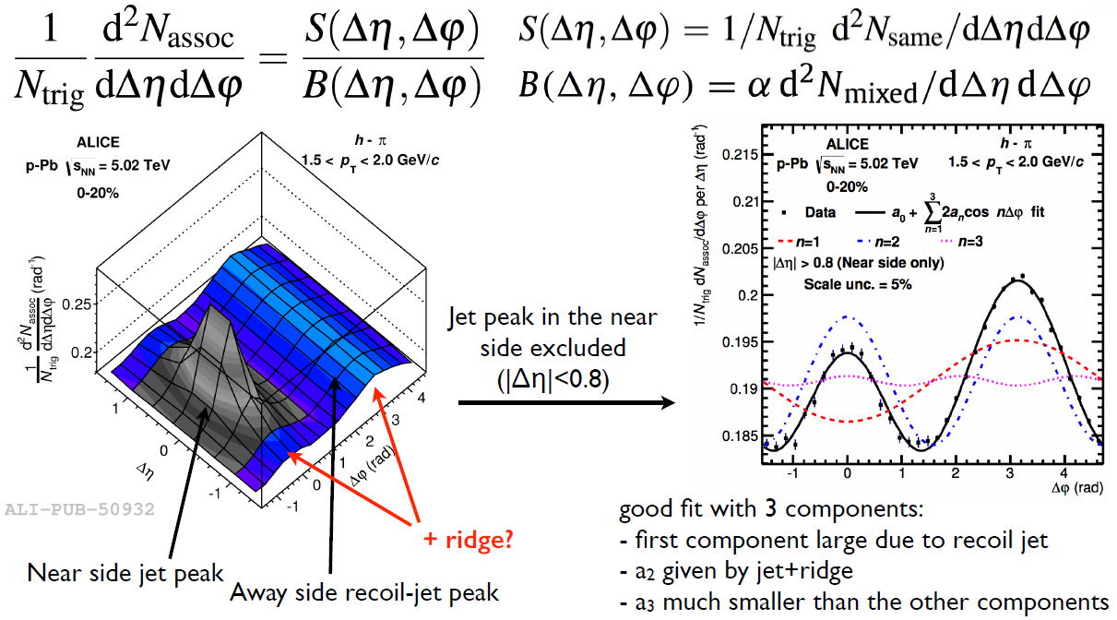
Associated yield per trigger particle

Slide 4
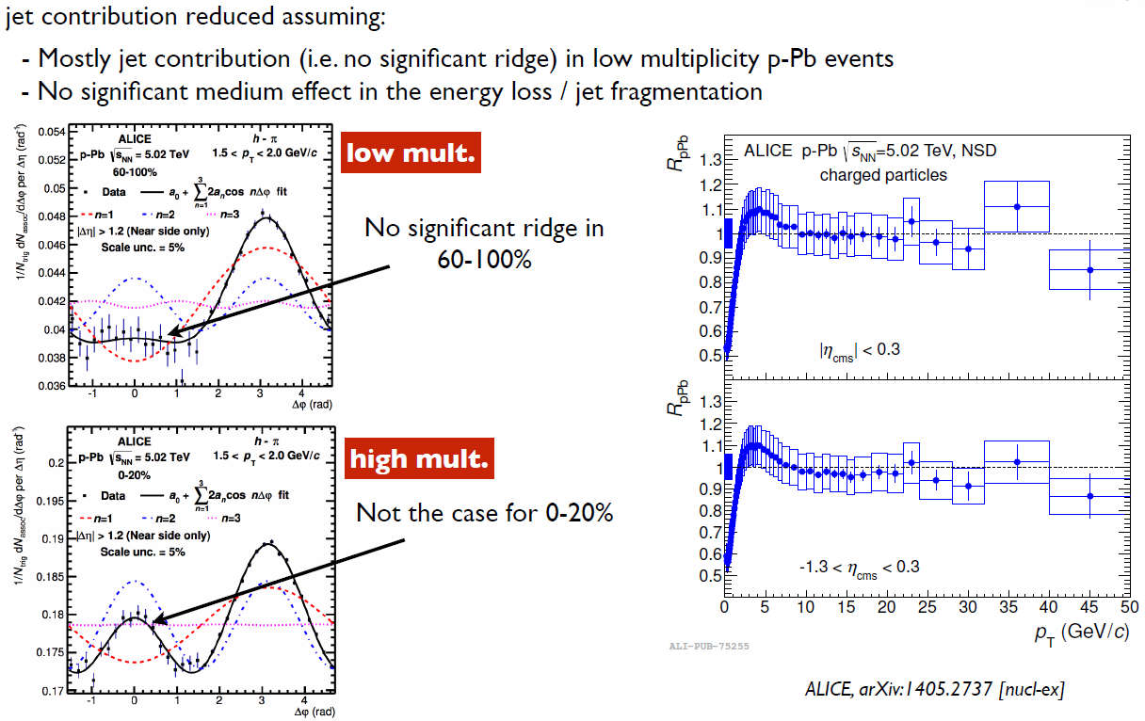
The subtraction procedure

Slide 5
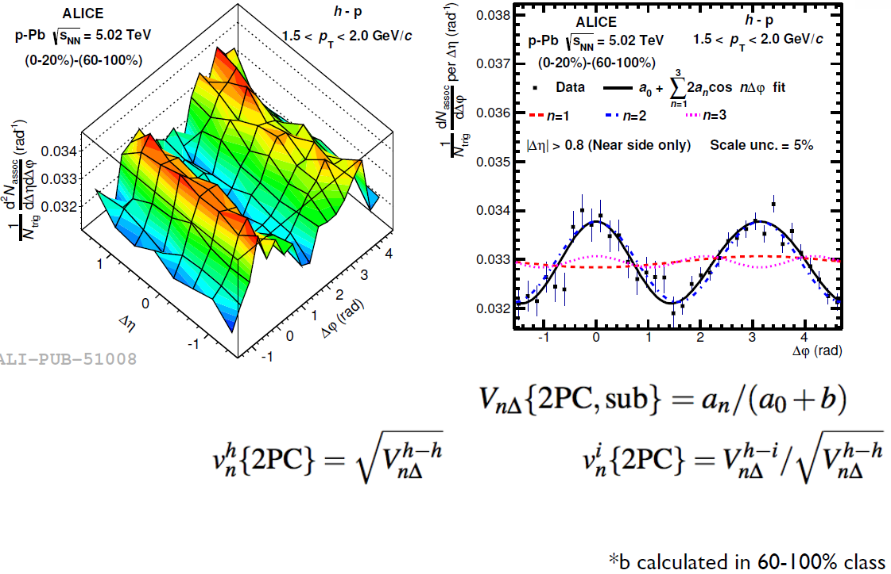
The subtraction procedure
(When each of the particles is correlated with a common plane)

Slide 6
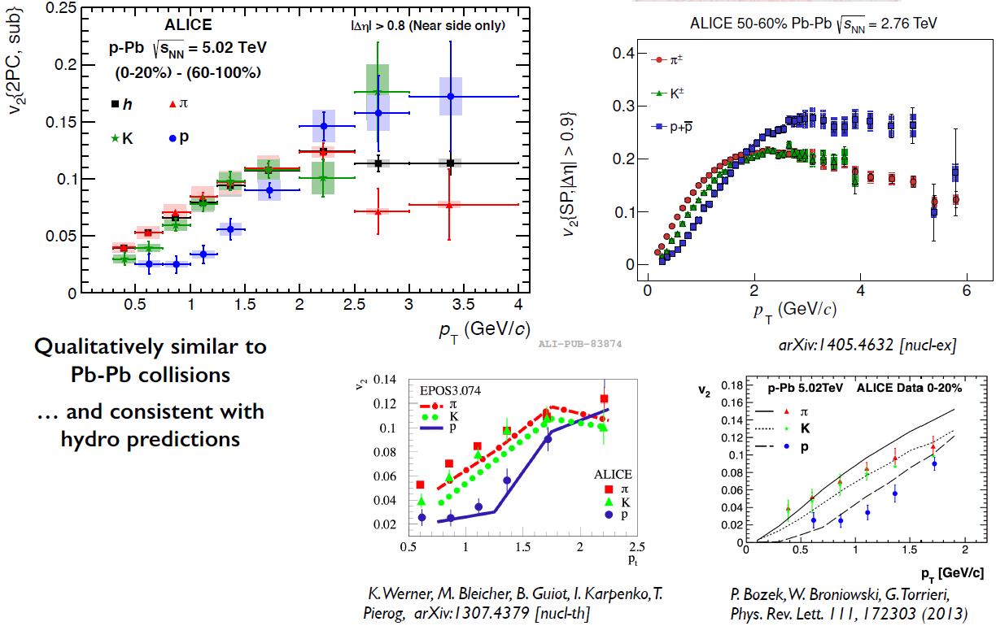
v2 of π, K, p in high-multiplicity p-Pb

Slide 7
Conclusions
experimental observations are highly suggestive of collective effects in high-multiplicity p-Pb collisions
mass ordering of the second order coefficients of the double ridge

Slide 8
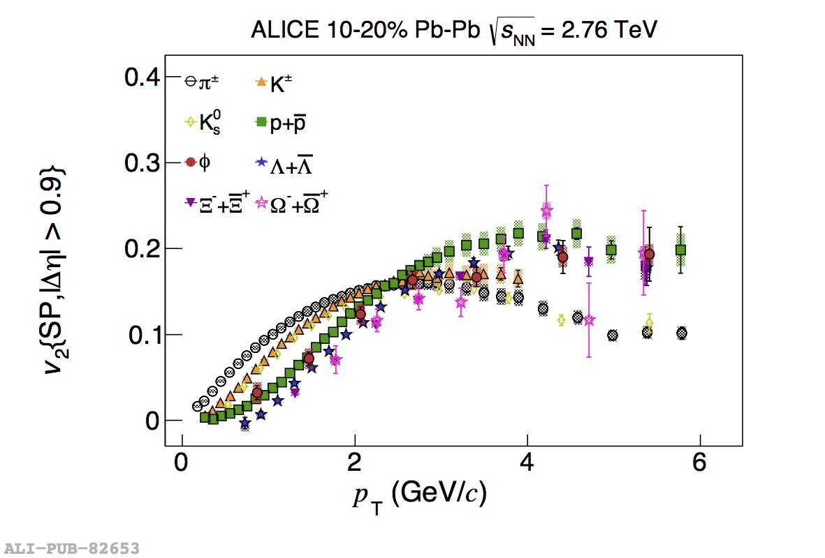
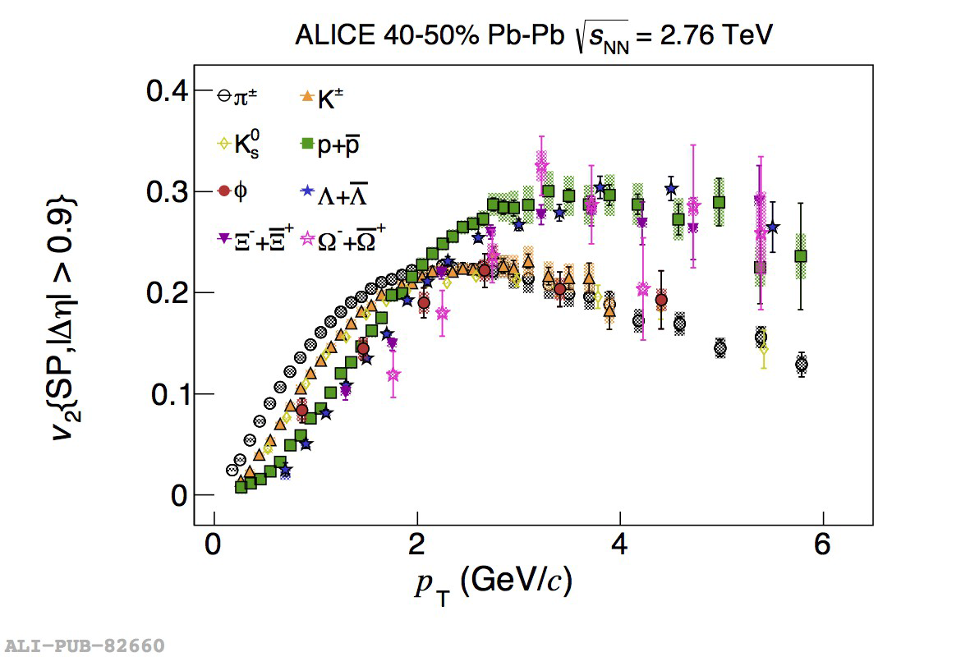
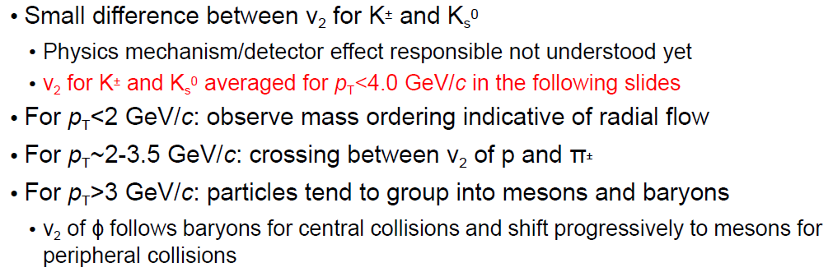
Identified particle v2

Slide 9
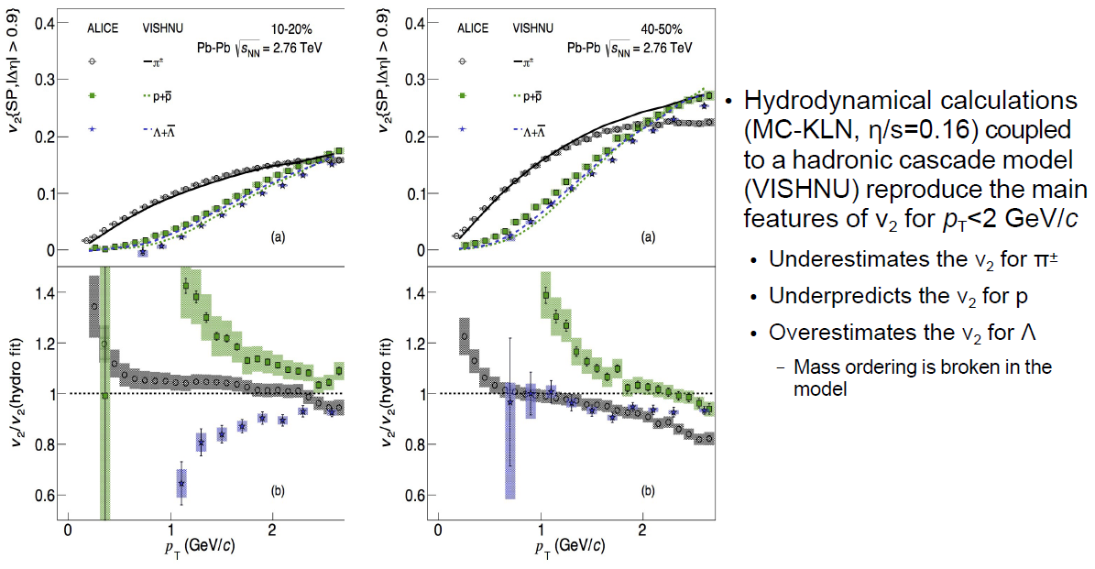
Comparison with hydrodynamical calculations (π±, p, Λ)

Slide 10
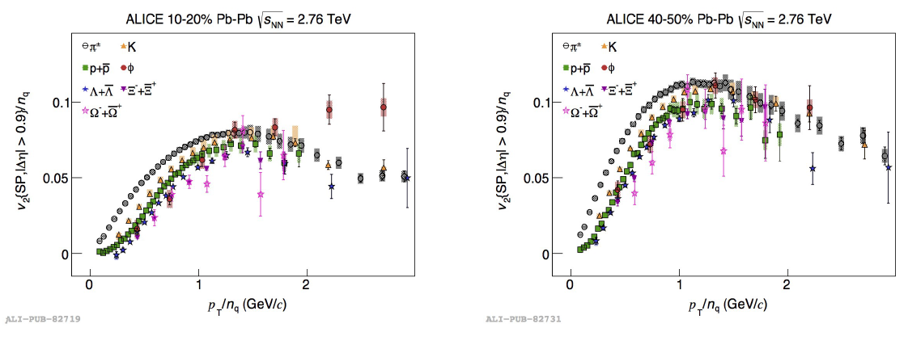
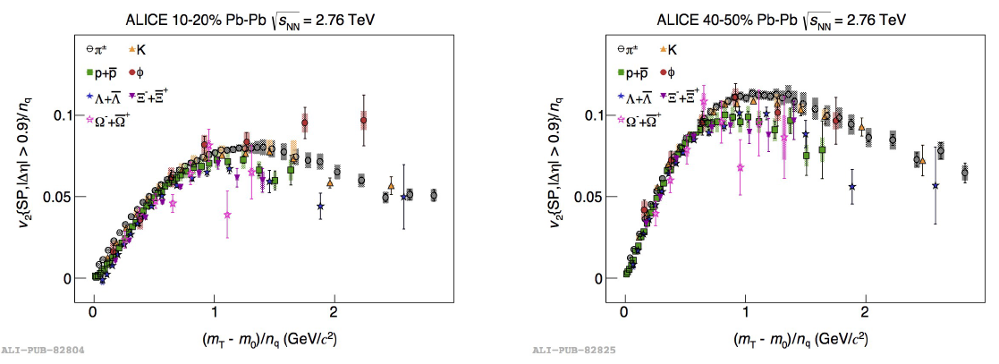
pT/nq or KET/nq scaling?

Slide 11
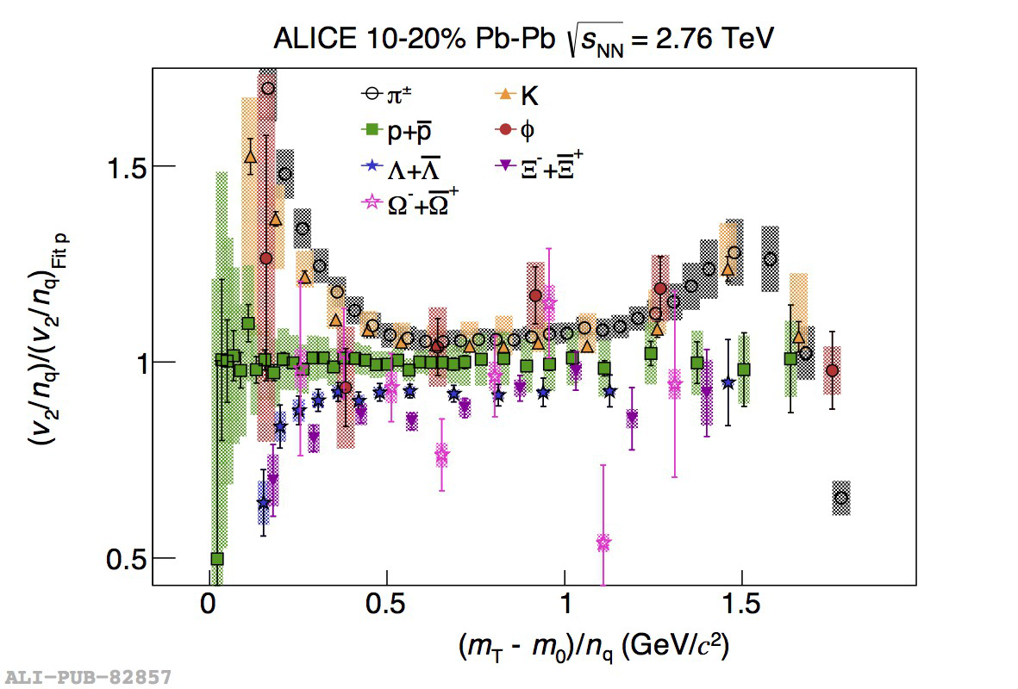
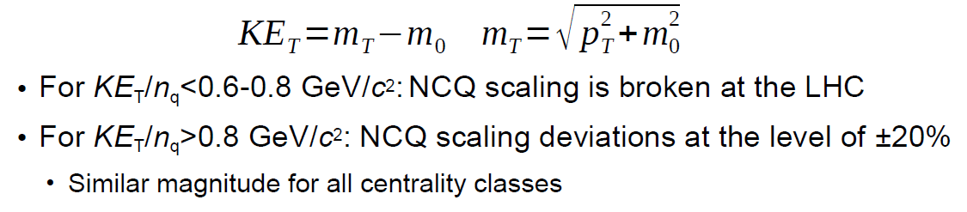
KET/nq scaling?

Slide 12
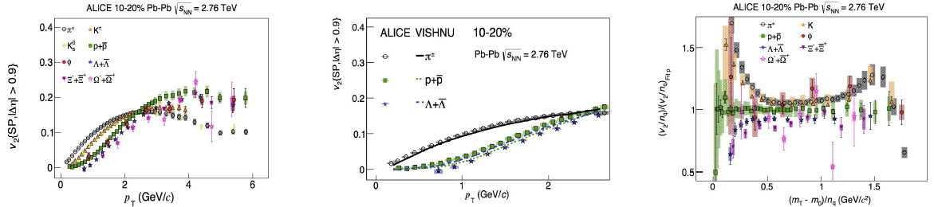
Summary

Slide 13
Motivation
Double ridge observed in p-Pb collisions
  Few or many particle correlations?
Flow cumulants sensitive to multi-particle correlations
  How do they compare to Pb-Pb at same multiplicity?
Mass dependence of v2 observed in Pb-Pb collisions
  Interplay of radial and elliptic flow
  What happens in pp and p-Pb collisions?
Phys. Lett. B726 (2014) 164
ALICE PID flow paper just submitted to arivx
p-Pb and Pb-Pb results to be submitted this week

Slide 14

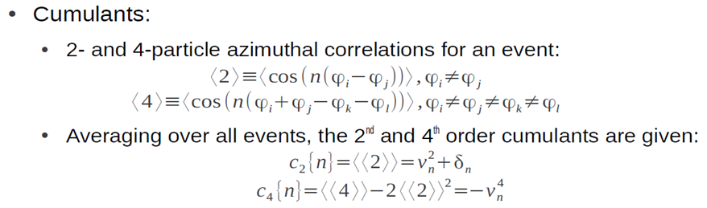
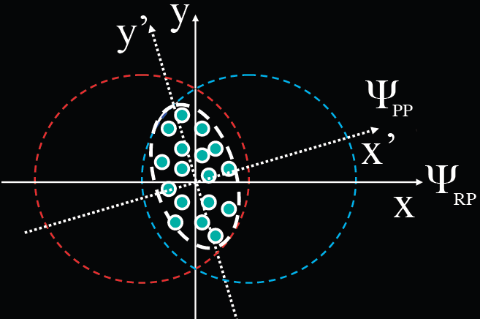
Flow cumulants and coefficients
Cumulants formed from vn moments. Moments from multi-particle correlations (n=flow harmonic, <vn>^{m} = <m>).
Flow coefficients formed from cumulants
Methods have different sensitivity to flow fluctuations and non-flow
v2 {2} and v2{4} have different sensitivity to flow fluctuations (σn) and non-flow (δ)
Plane of symmetry (ΨPP) fluctuate event-by-event around reaction plane (ΨRP) => flow fluctuation (σn)

Slide 15
c₂{2} in p-Pb and Pb-Pb
p-Pb c2{2} rises for large Δη gap. Inconsistent with naïve expectations of non-flow
Pb-Pb c2{2} values bigger at same Nch.
  ε2 (Pb-Pb) RMS driven by geometry & fluctuations.
  ε2 (p-Pb) RMS by just fluctuations?
.
.

Slide 16
c₂{4} in p-Pb and Pb-Pb
p-Pb c2{4} switches from pos. to neg. at high Nch. (v2{4} becomes real).
Pb-Pb c2{4} values more neg. at same Nch after Nch > 100

Slide 17
v₂{2} and v₂{4} in p-Pb
v2{2} > v2{4} in p-Pb -> Indicative of flow fluctuations? Contributions from non-flow?
R2 approximates σv2/<v2>. Fluctuations larger in p-Pb compared to Pb-Pb.

Slide 18
Third harmonic in p-Pb and Pb-Pb collisions
Large dependence on Δη gap for c3{2}. Increases with Nch for large Δη
v3{2} consistent with Pb-Pb at same Nch
  ε3(p-Pb)RMS ~ ε3(Pb-Pb) RMS and driven by fluctuations?

Slide 19
v₂{SP} and v₂{2PC} in p-Pb
Both v2{SP} and v2{2PC} equivalent for current pT selections
“Centrality” characterized via multiplicity in V0 (Pb side)
Mass ordering at high multiplicity
  Different to pp
  v2(p) < v2(K)
  v2(π) ~ v2(K)
  Hint of cross over in high mult. classes
2PC = di-hadron correlations

Slide 20
v₂{2PC, sub} in p-Pb
See ALICE talks by Alex Dobrin and Leonardo Milano for more details
v2{2PC, sub}: Obtained via central yields – peripheral associated yields
  Aims to subtract non-flow
  Mass dependence more pronounced.
  Cross over of v2(π) & v2(p)
Qualitatively more similar to Pb-Pb.

Slide 21
Summary
Experimental observations highly suggestive of collective effects in high mult. p-Pb collisions
Integrated h± vn measurements
  c2{2} rises in p-Pb with Nch for large |Δη|. Naively inconsistent with non-flow.
  c2{4} in p-Pb transitions from pos. to neg. values. v2{4} becomes real.
  c2{m} higher in Pb-Pb compared to p-Pb at same Nch.
  v3{2} in p-Pb and Pb-Pb similar at same Nch.
Differential PID v2 measurements
  Different mass ordering in minbias pp and high mult. p-Pb.
  Mass ordering in high mult. p-Pb more pronounced after non-flow subtraction.
  Qualitative similar features to Pb-Pb collisions.

Slide 22
CMS Results
Extracted from the following talks.
“Long range two-particle correlations with K0^{S} and Λ in pPb and PbPb collisions” by Monika Sharma
“Pseudorapidity dependence of long-range two-particle correlations in pPb collision at CMS” by Lingshan Xu
“Azimuthal Anisotropy of Charged Particles from Multiparticle Correlations in pPb and PbPb Collisions” by Quan Wang

Slide 23
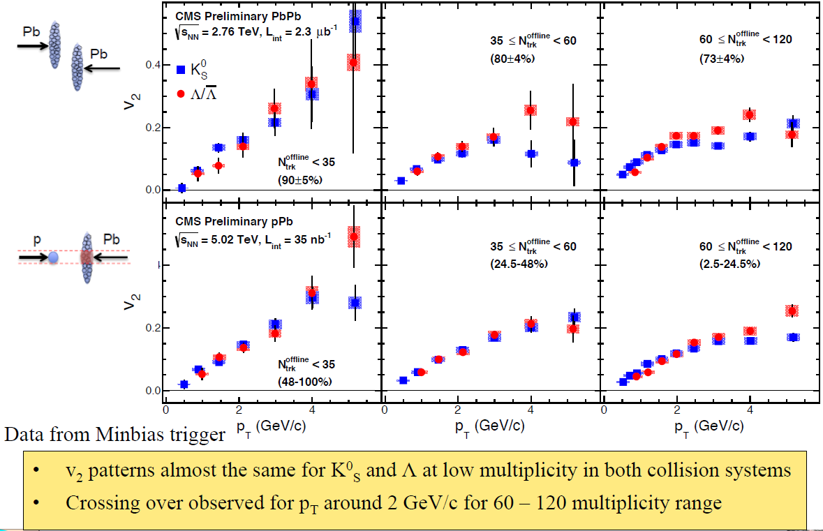
Low multiplicity: pPb and PbPb collisions

Slide 24
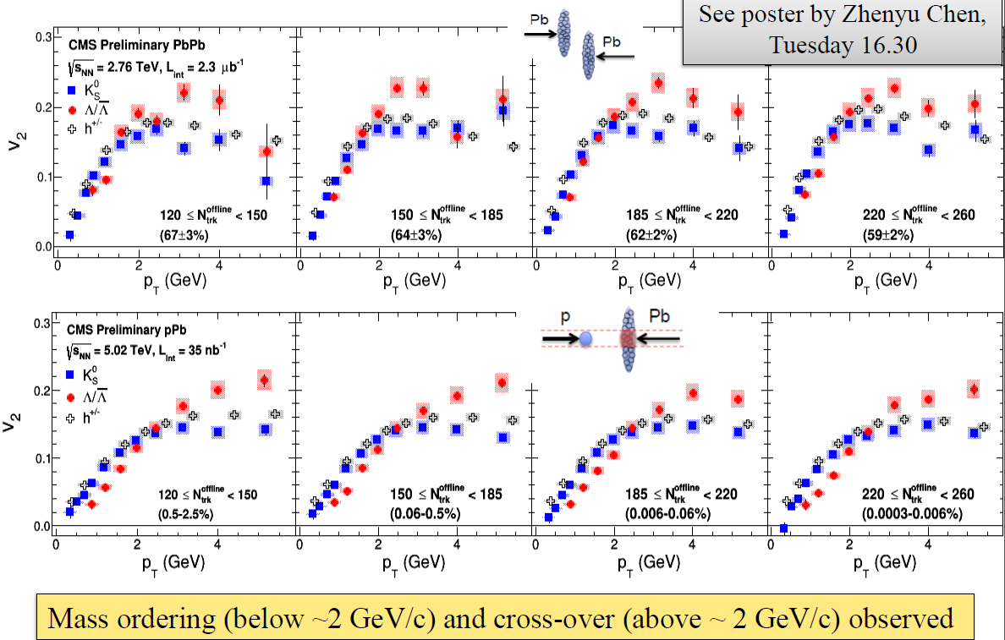
Higher multiplicity class: pPb and PbPb collisions

Slide 25
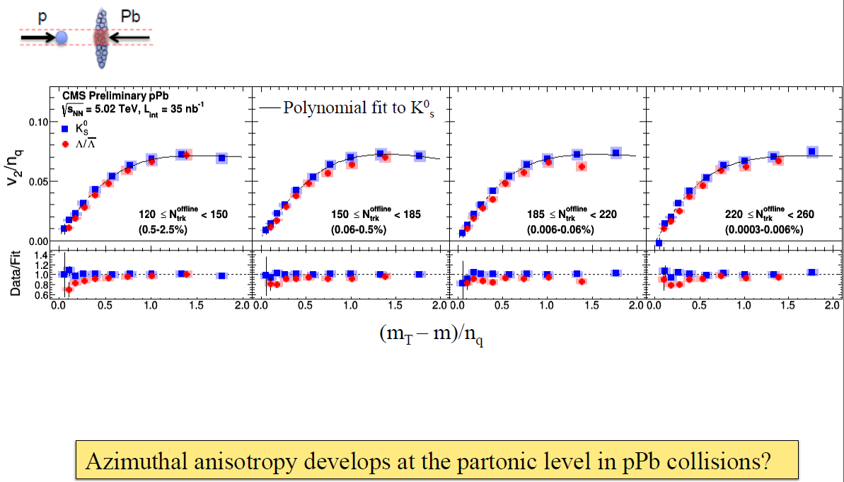
NCQ scaling in high multiplicity pPb collisions

Slide 26
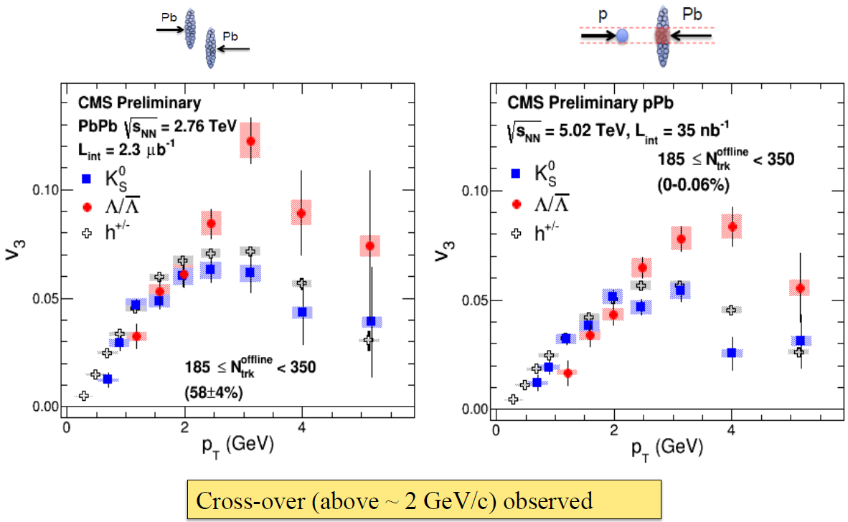
v3 in higher multiplicity

Slide 27
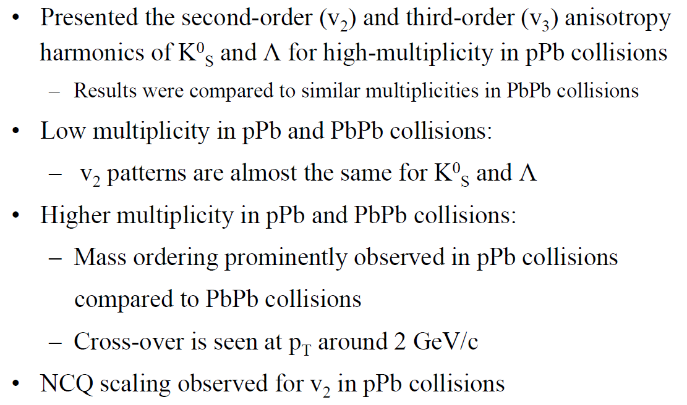
Conclusions

Slide 28
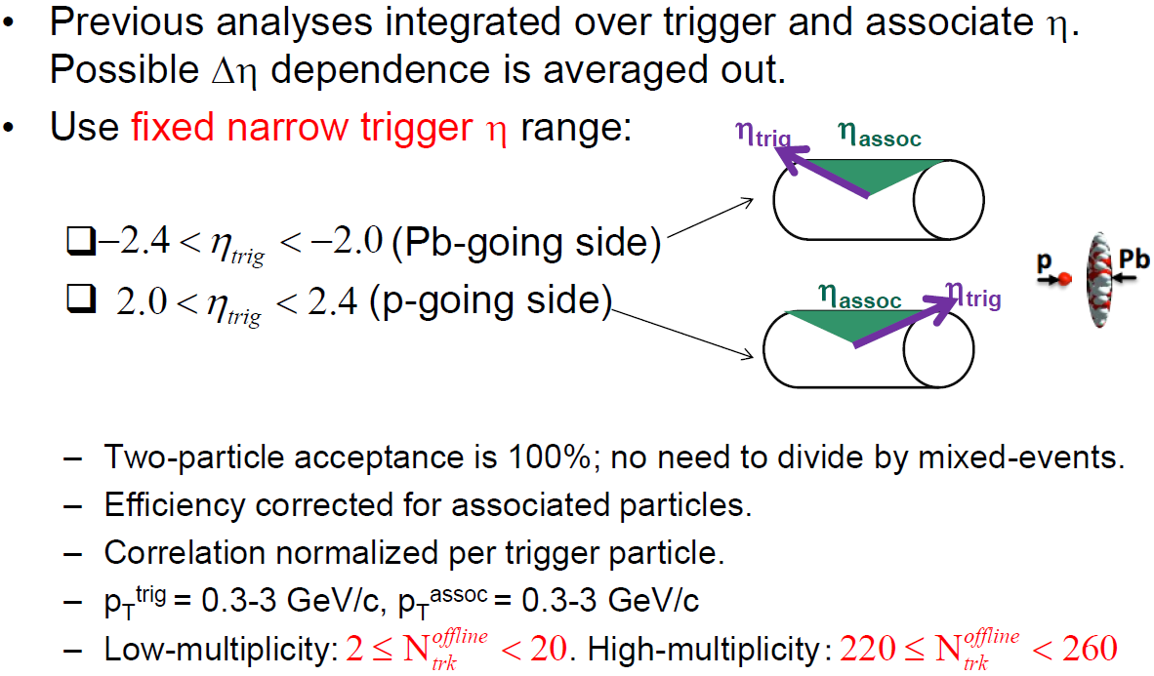
Analysis procedure

Slide 29
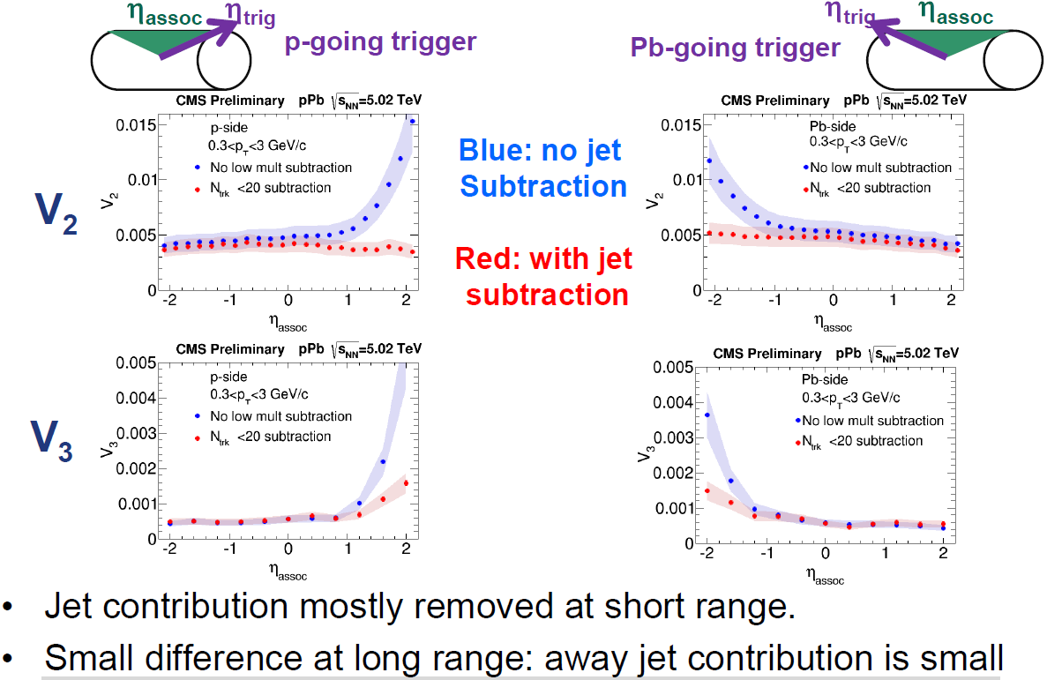
Fourier coefficients Vn from dihadron correlation

Slide 30
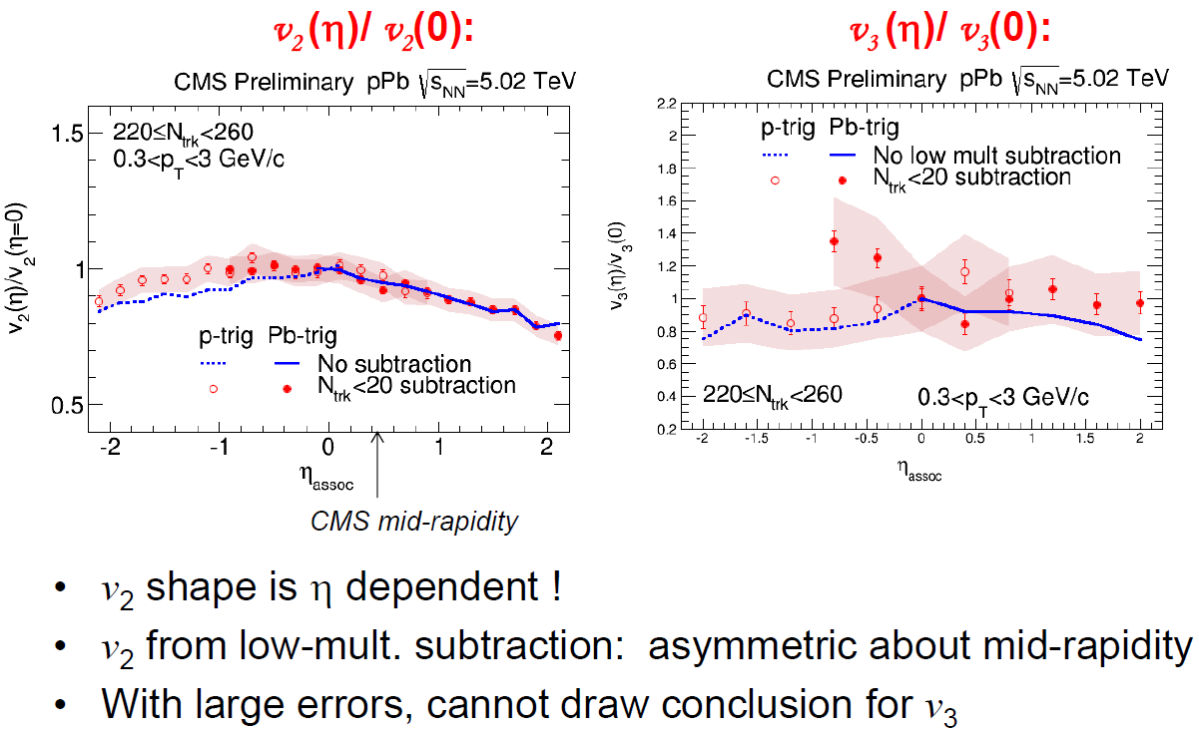
Extract vn(η)/ vn(0) from Fourier coefficient

Slide 31
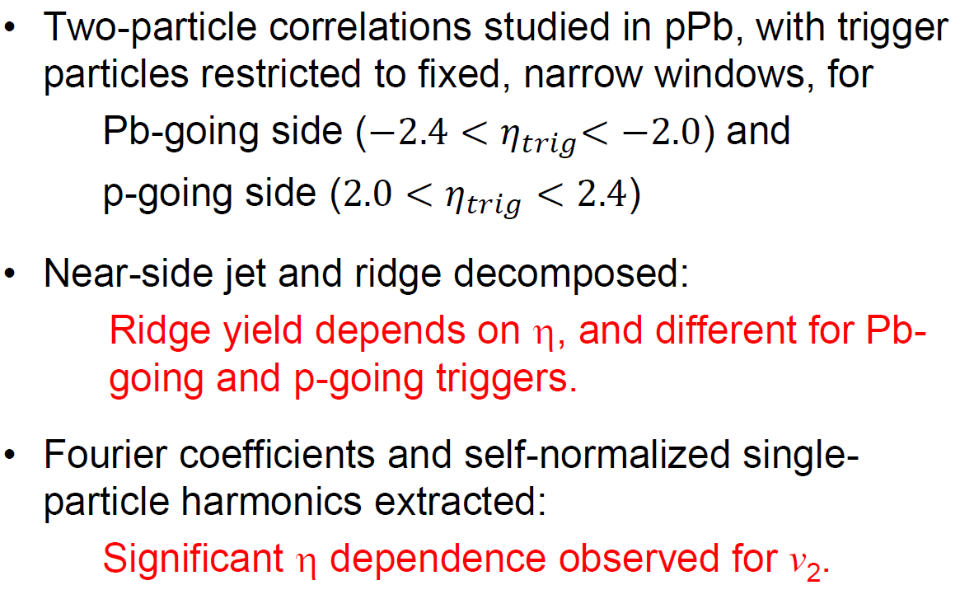
Conclusions

Slide 32
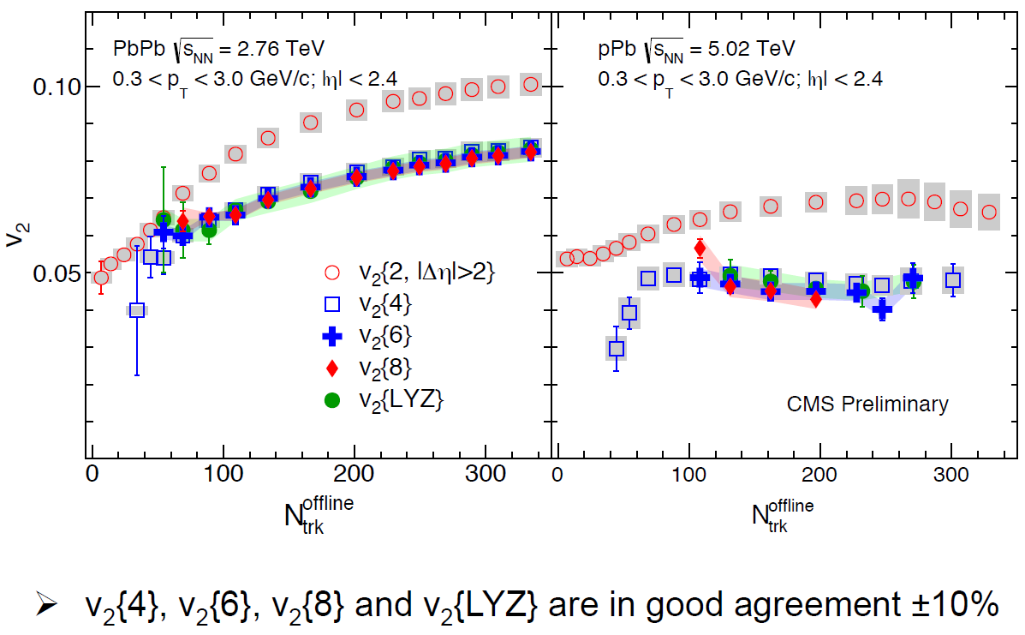
Results – v2
“Lee-Yang Zeros”
all-particle correlation

Slide 33
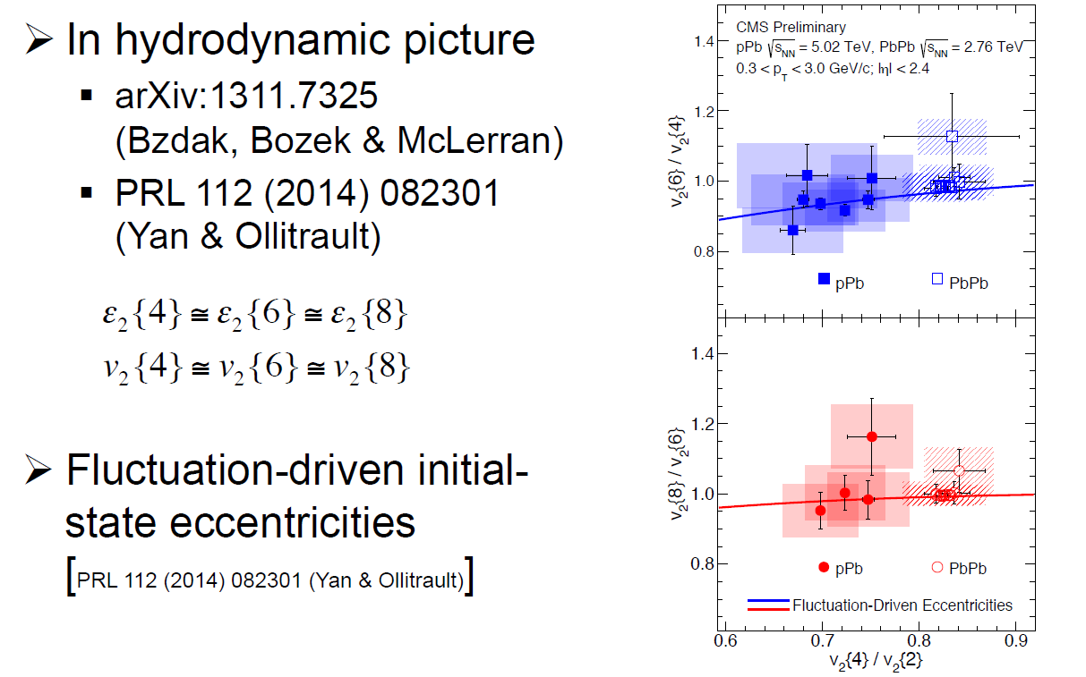
Result – Cumulant v2 ratios

Slide 34
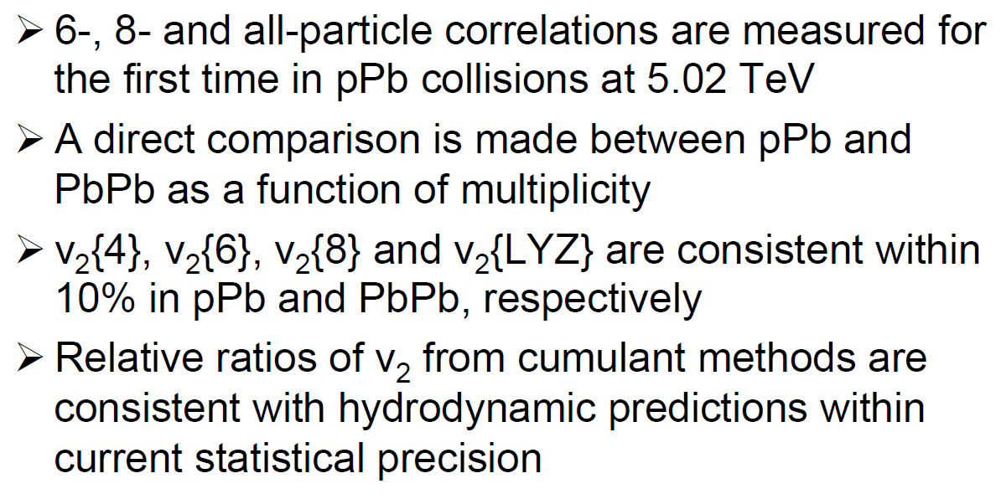
Summary

Slide 35
ATLAS Results
Extracted from the following talks.
“Measurement of the long-range pseudorapidity correlations and azimuthal harmonics in √𝑠=5.02 TeV proton-lead collisions with the ATLAS detector” by Sooraj Radhakrishnan
“Flow harmonics in Pb+Pb collisions at energy of √𝑠NN = 2.76 TeV with the ATLAS detector” by Dominik Derendarz

Slide 36
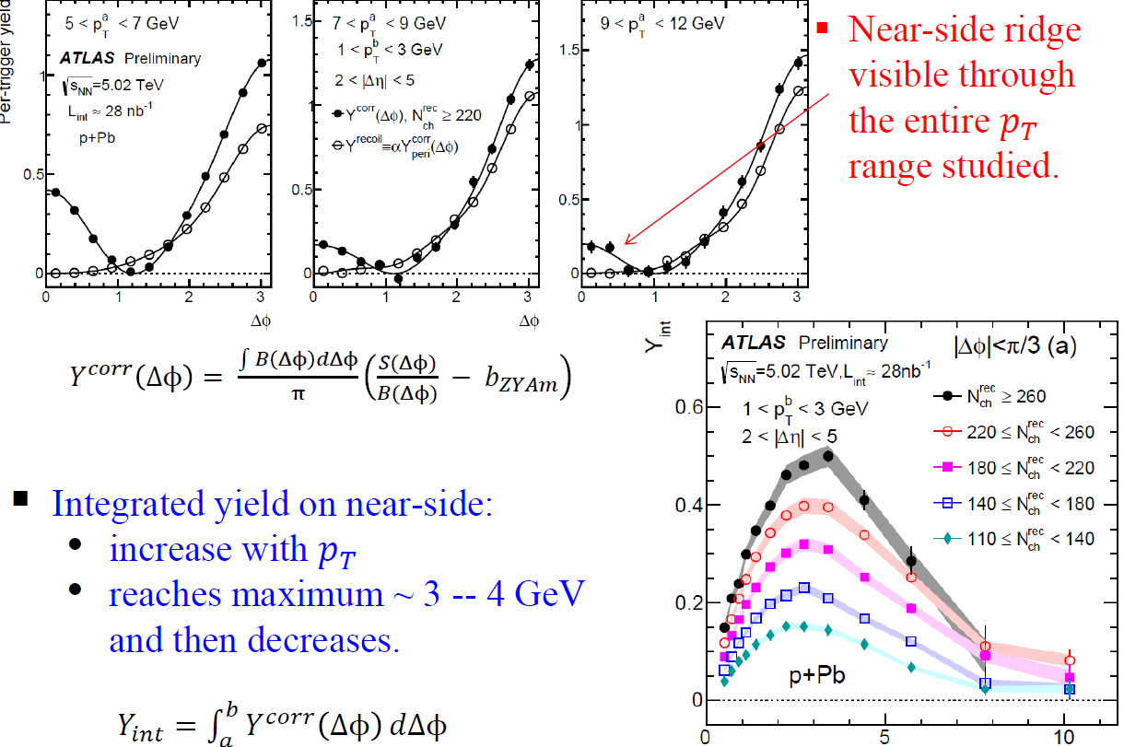

Ridge at higher 𝑝𝑇

Slide 37
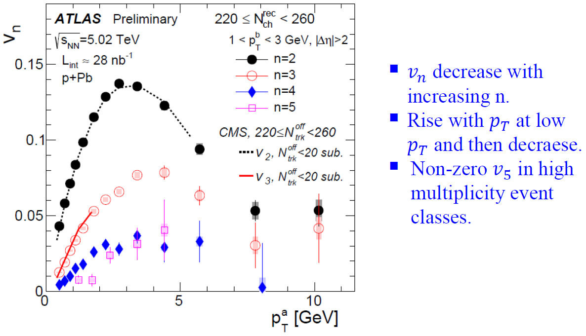
𝑣𝑛 vs 𝑝𝑇 for different n

Slide 38
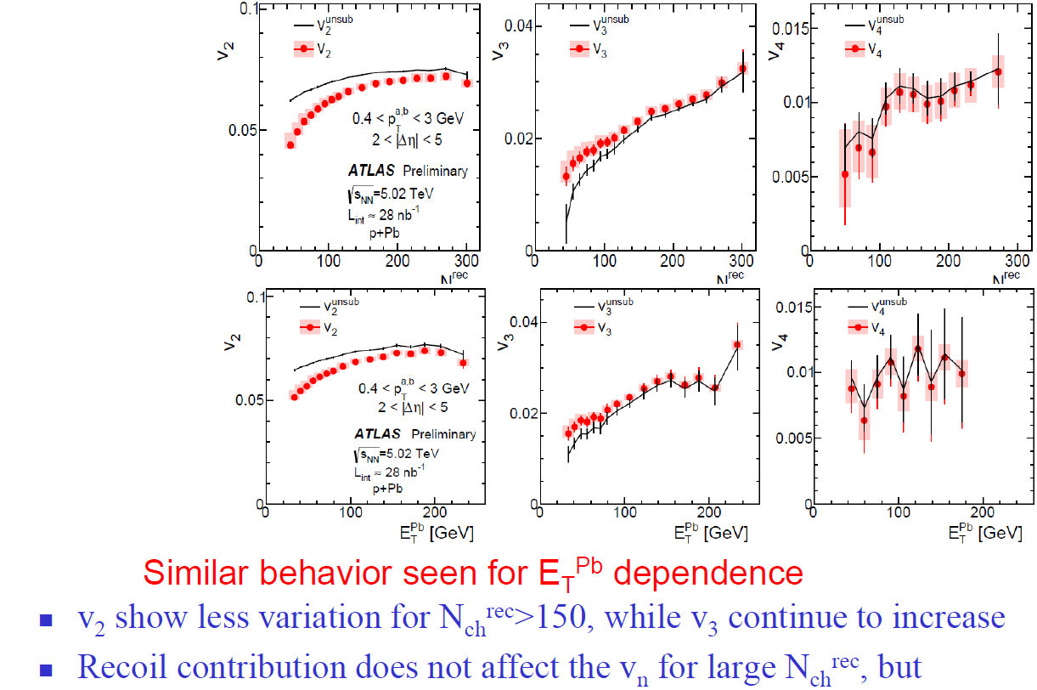
vn: Event activity dependence

Slide 39
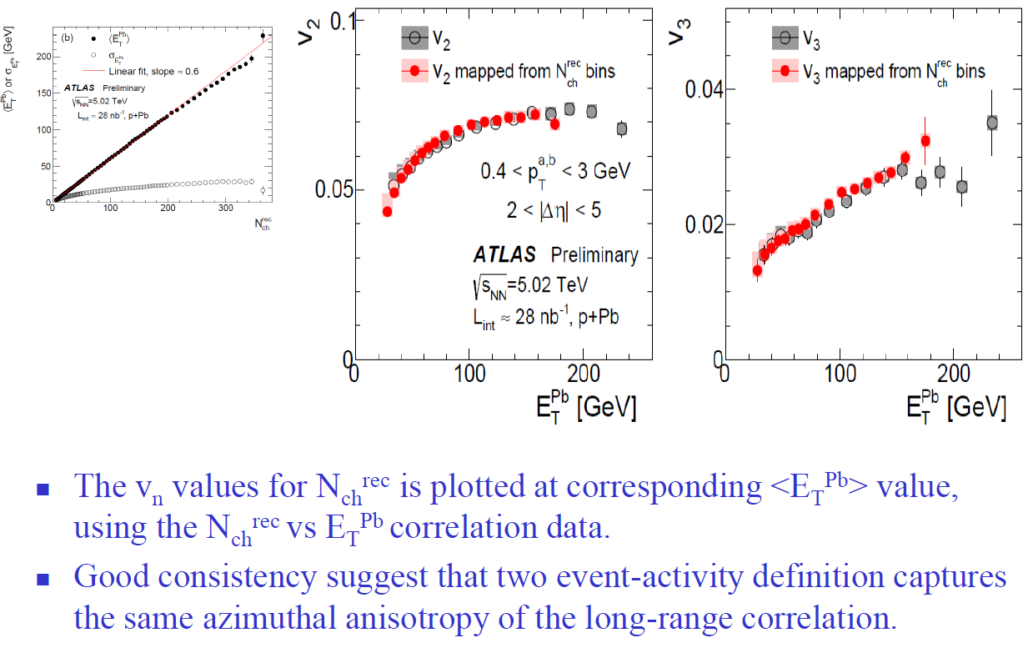
Mapping Nch^{rec} - dependence to ET^{Pb} dependence

Slide 40
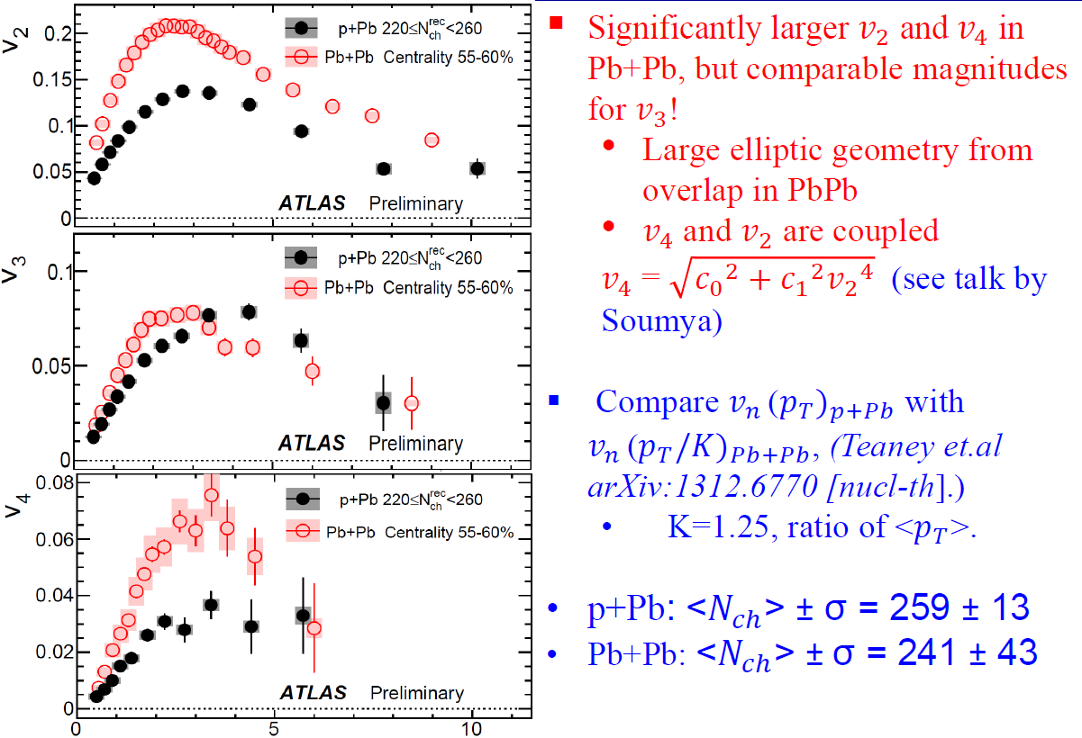


Comparison of 𝑣𝑛 in p+Pb and peripheral Pb+Pb
They both emerge from a collective response to the geometry dictated by
L is the transverse size of the high multiplicity events

Slide 41
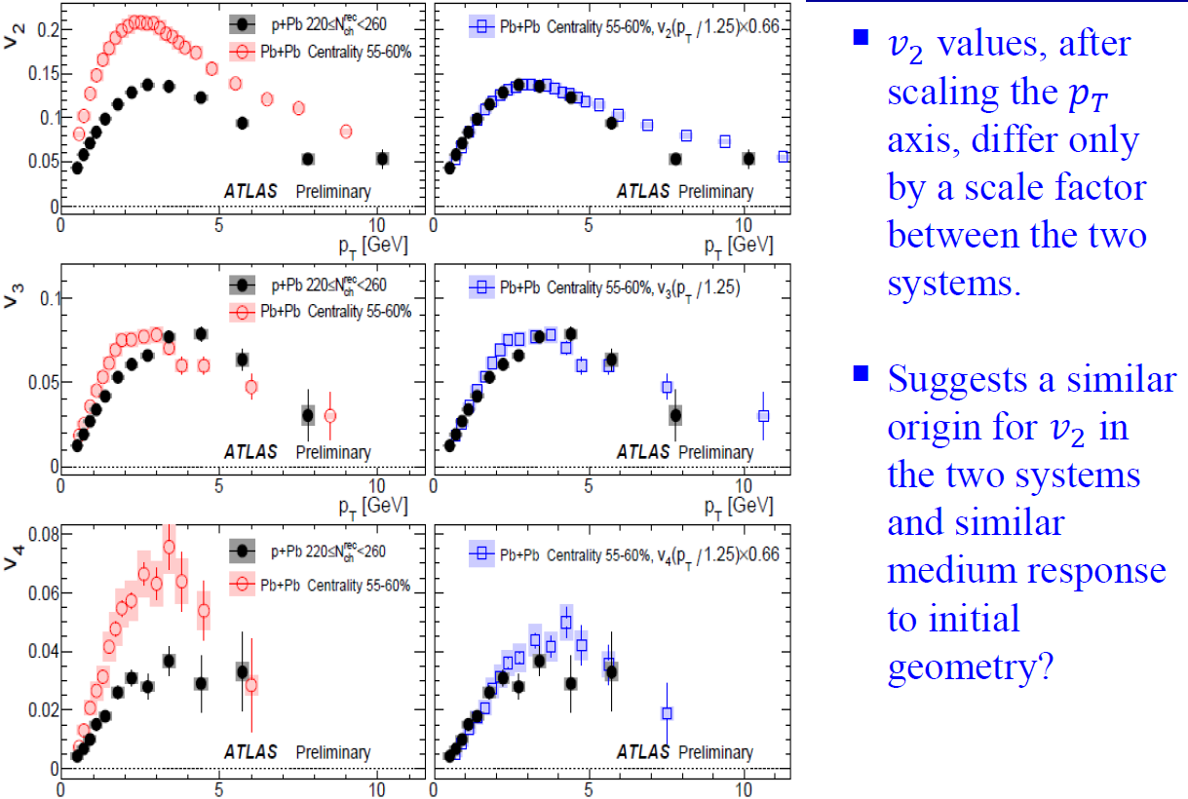
𝑣𝑛 scaling between the p+Pb and Pb+Pb systems

Slide 42
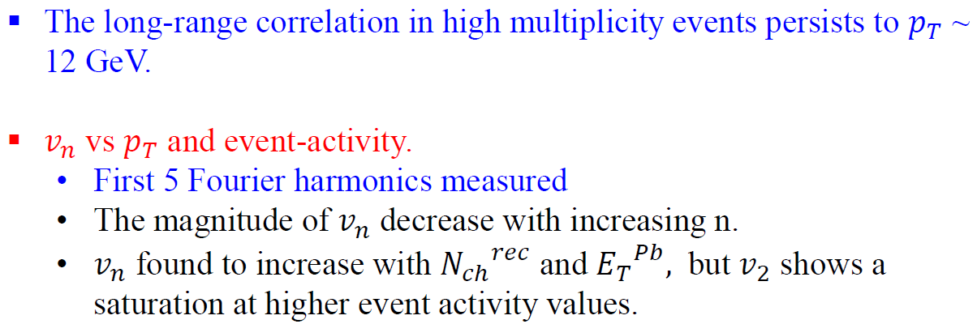
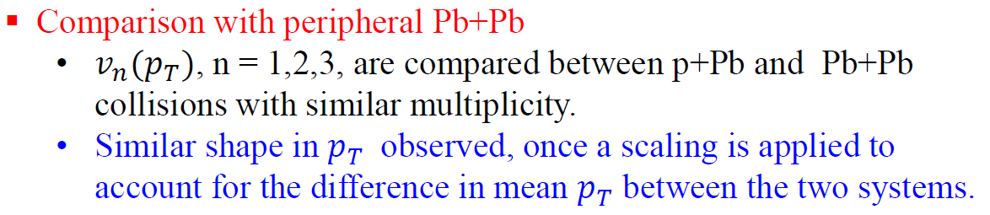
Summary and Conclusions
“Based on an independent cluster model and a simple conformal scaling argument, where the ratio of the mean free path to the system size stays constant at fixed multiplicity, we argue that flow in p+A emerges as a collective response to the fluctuations in the position of clusters, just like in A + A collisions.”
(arXiv:1312.6770)

Slide 43
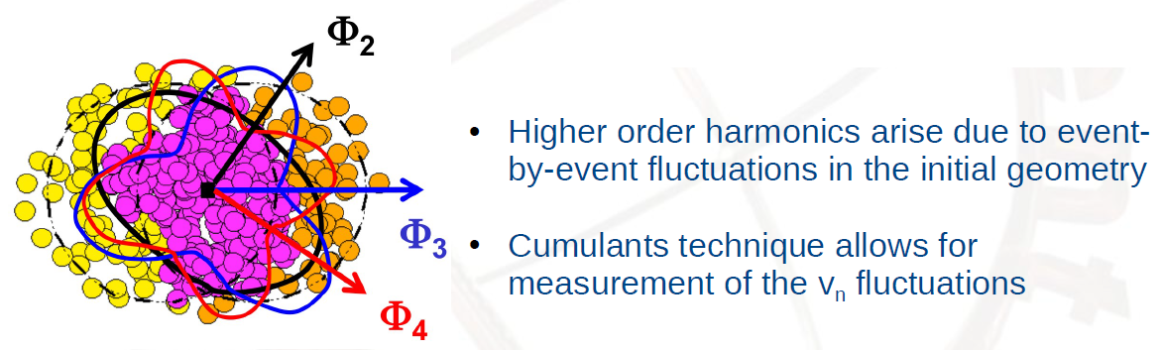
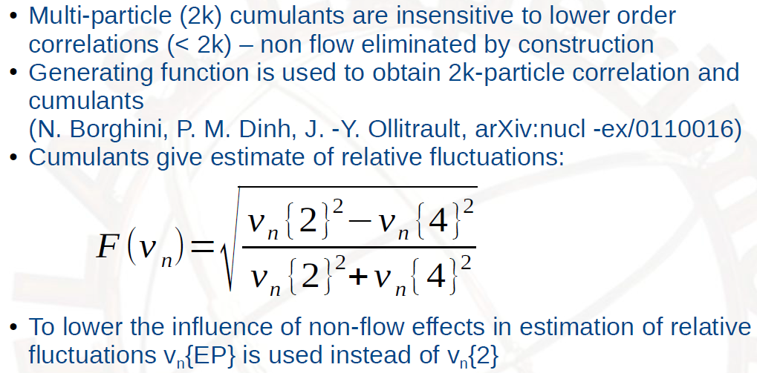
Cumulant method

Slide 44
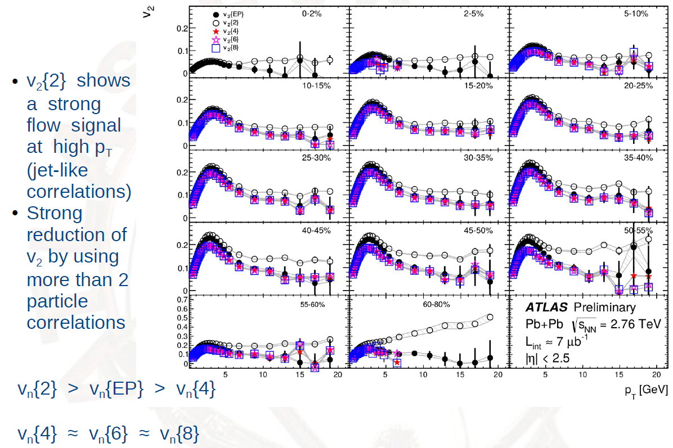
Transverse momentum dependence of v2

Slide 45
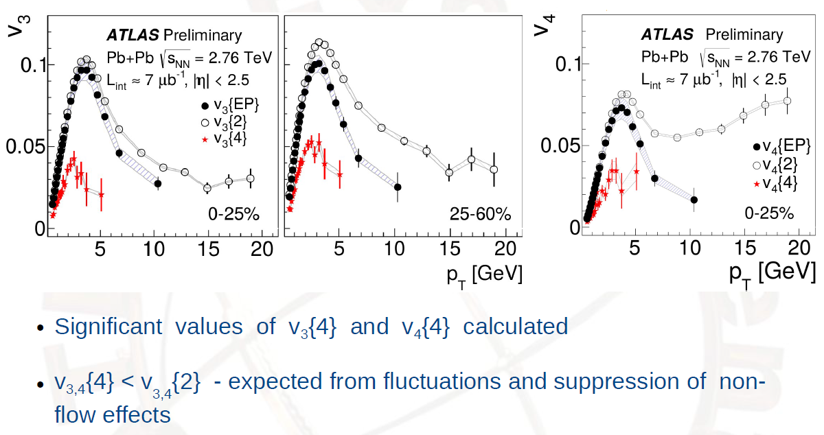
Transverse momentum dependence of v3 and v4

Slide 46
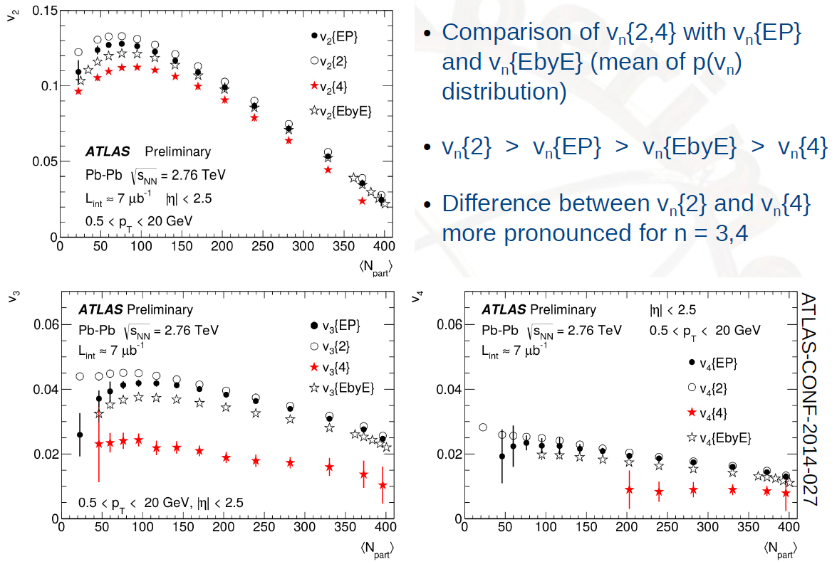
Centrality dependence of vn harmonics

Slide 47
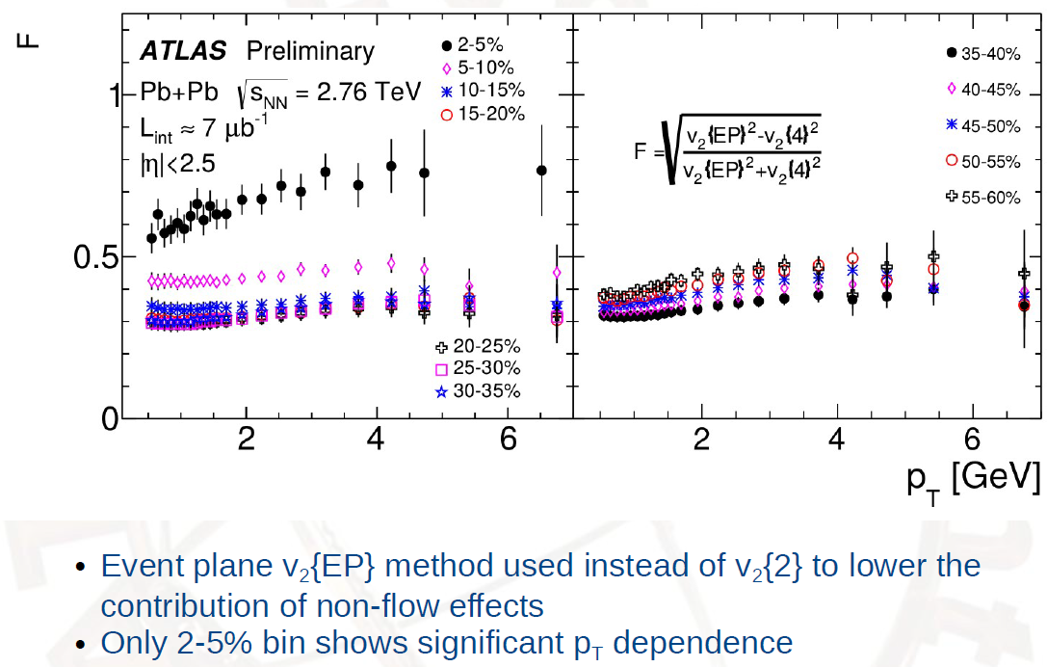
Elliptic flow fluctuations pT dependence

Slide 48
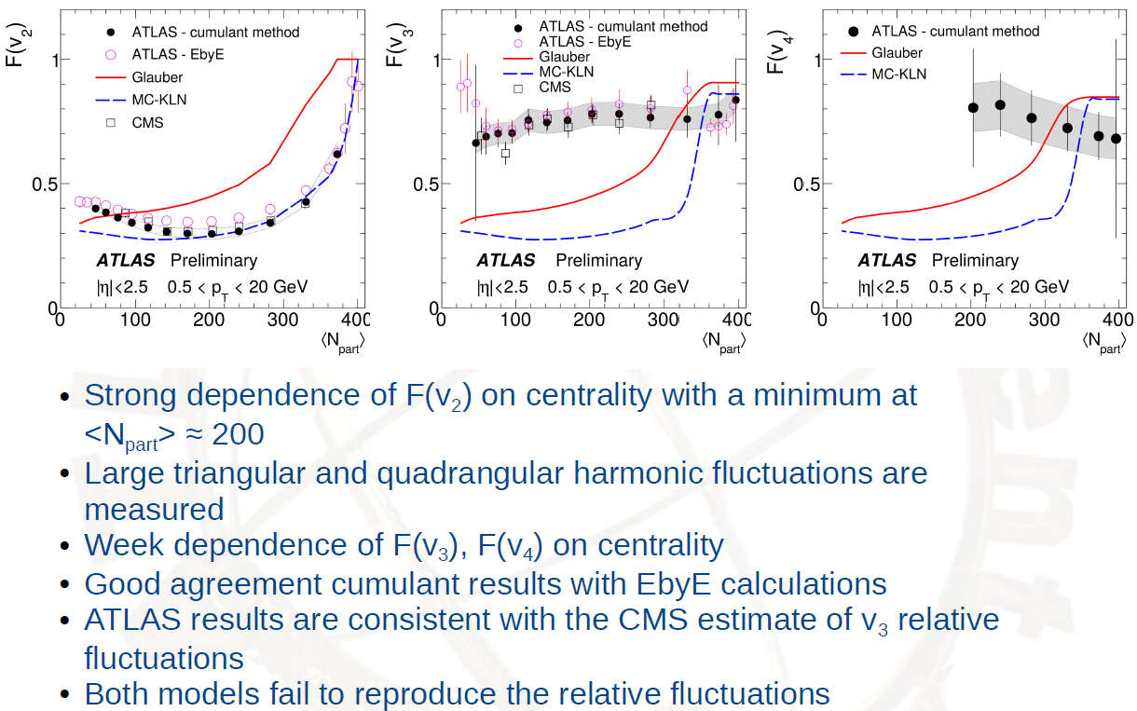
Fluctuations of vn <Npart> dependence

Slide 49
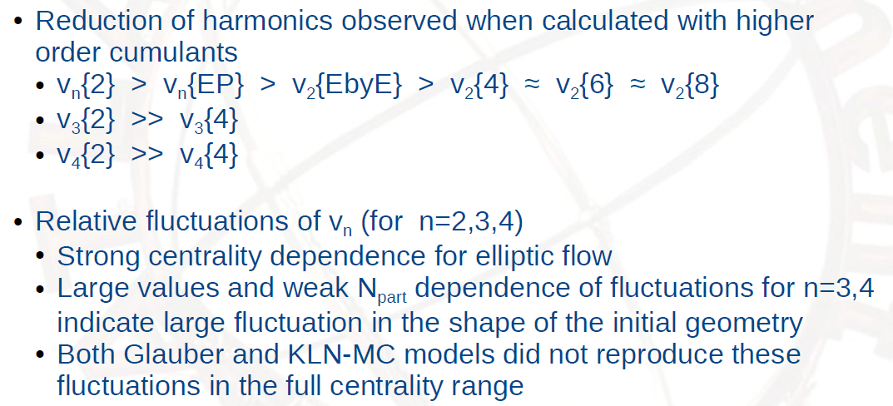
Conclusions

Slide 50
PHENIX Results
Extracted from the following talks.
“Measurements of long-range angular correlation and identified particle v2 in 200 GeV d+Au collisions from PHENIX” by Shengli Huang

Slide 51
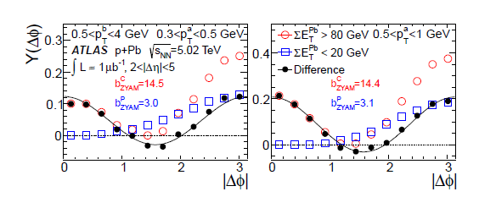
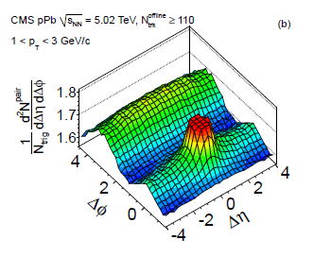
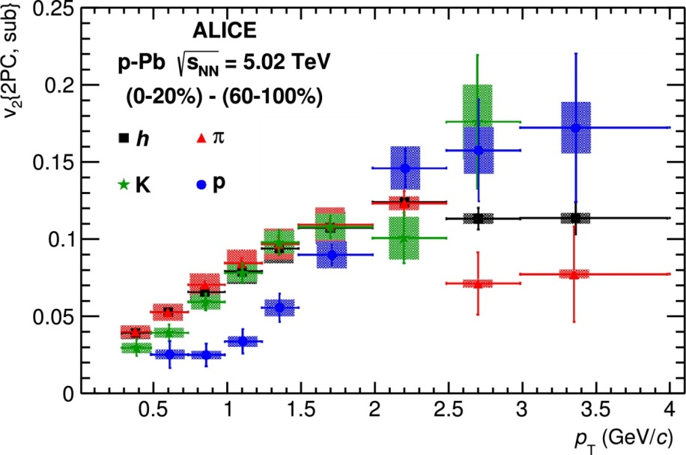
“Ridge” and ”v₂” in p+Pb@5.02 TeV
ALICE: Physics Letters B 726 (2013)
ATLAS: Phys. Rev. Lett. 110(2013)
CMS: Phys. Lett. B 7198(2013
A “ridge” is observed in the central p + Pb@5.02 TeV
The Δφ distribution shows a cos(2Δφ) structure
The identified particle v2 shows a mass ordering

Slide 52
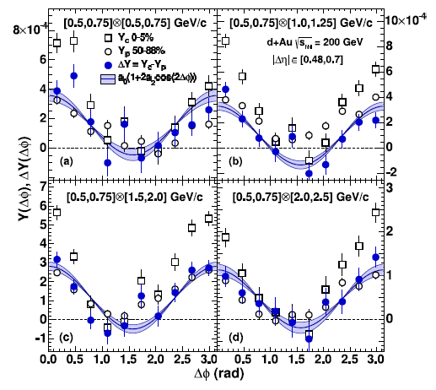
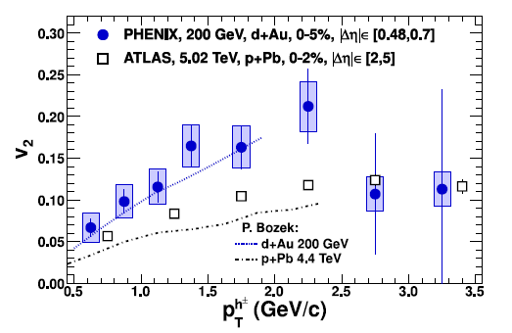
V₂ in d+Au@ 200 GeV
PHENIX: Phys. Rev. Lett. 111, 212301 (2013)
The cos(2Δφ) structure is also seen in 0-5% d+Au. The cut of |Δη|>0.48 is the limit of our central arm acceptance
The v2 in 0-5% d+Au is higher than that in 0-2% p+Pb collisions, which is consistent with hydro calculation
The measurement with large |Δη| is required!

Slide 53
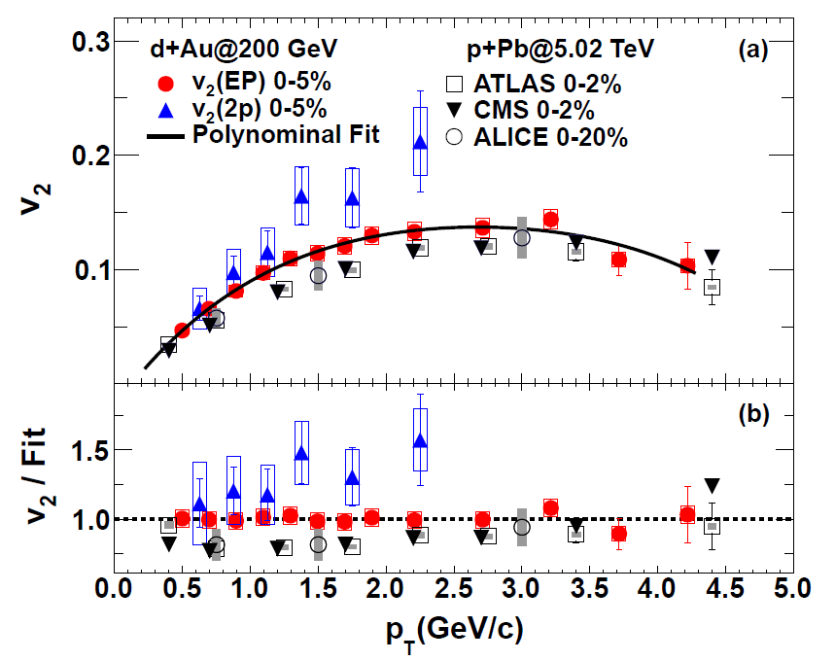
V₂(EP) of charged hadron in 0-5% d+Au
arXiv:1404.7461
The charged hadron v2 measured by the event plane method in central dAu is similar to that in central pPb

Slide 54
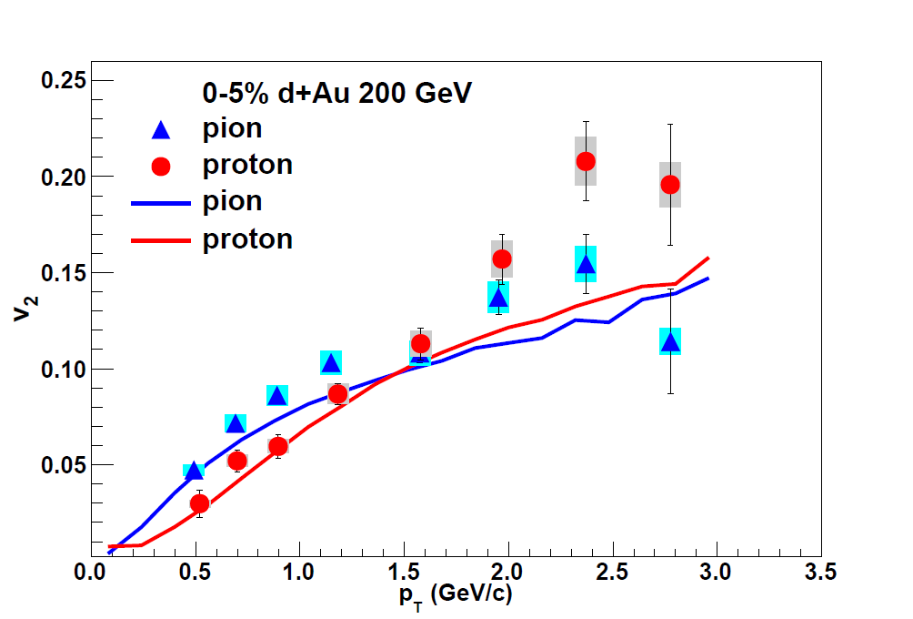
Identified particles’ v2 from EP methods
arXiv:1404.7461
Hydro: P. Romatschke, private communication.
J. Nagle et al., arXiv:1312.4565.
Mass ordering is observed in 0-5% d+Au
This ordering can be reproduced in hydro calculation from P. Romatschke et al.

Slide 55

Weaker radial flow in dAu?
Subtract method
The magnitude of mass ordering in p+Pb is larger than that in d+Au
Weaker radial flow in d+Au?

Slide 56
Summary
Is there “ridge” in dAu collisions?
How about the difference between the v2 in dAu and pPb?
Is there mass ordering for identified particle v2 in dAu?
There is “Ridge” in dAu even with |Δη|>6.0
v2 in central dAu is similar to that in central pPb, while hydro calculation show a significant difference
The mass ordering is observed in central dAu , while it is smaller
comparing with central pPb, it may be due to a weaker radial flow
in dAu
The input from CGC model calculation is expected for the further understanding the physics of “ridge” and “v2” in small collision system

Slide 57
STAR Results
Extracted from the following talks.
“The centrality and energy dependence of the elliptic flow of light nuclei and hadrons in STAR” by Rihan Haque

Slide 58

Measurement of nuclei v2

Slide 59

Mass ordering of v2

Slide 60

Centrality dependence of nuclei v2

Slide 61

NCQ scaling of hadron v2

Slide 62

Precision measurement of v2 of ϕ and Ω

Slide 63

Mass number scaling of v2

Slide 64

v2 of particles and anti-particles

Slide 65

Summary
“with large Δv2”

Slide 66
Backups

Slide 67


Slide 68




The flow vector
The original idea behind the event-plane method is that the direction Ψn of the flow vector in a reference detector provides an estimate of the corresponding angle Φn in the underlying probability distribution. Because a finite sample of particles is used, statistical fluctuations cause Ψn to differ from Φn.
The nonlinear dependence of the resolution on the underlying flow is the origin of the difficulties of the event plane method, which arise when flow fluctuations are considered. A simpler quantity is the projection of the flow vector onto the underlying direction Φn, which directly gives the underlying flow:

Slide 69


Slide 70


Experimental methods
φ
ΨRP
y
z
x
v2 {2} and v2{4} have different sensitivity to flow fluctuations (σn) and non-flow (δ)

Slide 71



Elliptic Flow v₂
Non-Flow corrections
v2 no eta gap between particles
v2 |η|>1 to reduce non-flow such as jets
both v2 corrected for remaining non-flow
using Hijing or scaled pp
With this, we can remove most of non-flow (δ)
v2 Fluctuations
Plane of symmetry (ΨPP) fluctuate event-by-event around reaction plane (ΨRP) => flow fluctuation (σn)

Slide 72

Analysis Techniques

Slide 73

Multiparticle Cumulant

Slide 74

Lee-Yang Zeros Method

