Slide 1

Review of recent development in hydro
Heavy Ion Meeting 2013-10,
Inha Univ., Korea, Nov.2, 2013
Tetsufumi Hirano
Sophia Univ.
K.Murase, TH, arXiv:1304.3243
Y.Tachibana, TH, Nucl.Phys.A904-905(2013)1023c
Y.Tachibana, talk at Hard Probes 2013
M.Hongo, Y.Hirono, TH, arXiv:1309.2823

Slide 2
Outline
Introduction
Relativistic fluctuating hydrodynamics
Medium response to jet propagation
Anomalous hydrodynamics and chiral magnetic effect
Summary

Slide 3
Introduction
Approach
“Form” of matter
4. Relativistic kinetic theory
time
4. Hadron gas
3. Relativistic
hydrodynamics
3. QGP fluid
2. Non-equilibrium
statistical physics
2. Glasma
collision axis
0
1. QCD aspects of nuclear structure
1. Color glass condensate
Hydrodynamics as a central framework of heavy ion collisions

Slide 4
Relativistic Fluctuating Hydrodynamics

Slide 5
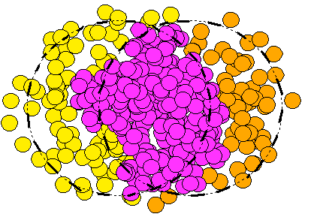
Higher Harmonics is Finite!
Figures adapted from talk
by J.Jia (ATLAS) at QM2011
Two particle correlation function is composed solely of higher harmonics
See talks by Y.-S.Kim and M.-J. Kweon

Slide 6
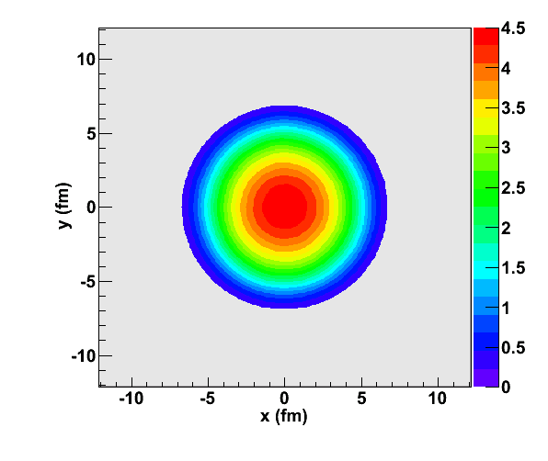
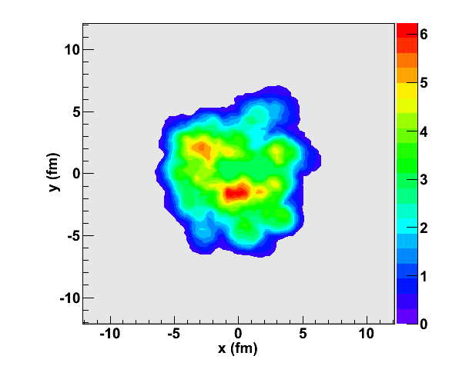


Impact of Finite Higher Harmonics
coarse
graining
size
Most of the people did not believe hydro description of the QGP (~ 1995)
Hydro at work to describe elliptic flow (~ 2001)
E-by-e hydro at work to describe higher harmonics (~ 2010)
initial
profile
$$d≲5 fm$$
$$d≲1 fm$$
Is fluctuation important
in such a small system?

Slide 7
Thermal Fluctuation
Conventional hydro describes space-time evolution of (coarse-gained) thermodynamic quantities.
Some of microscopic information must be lost through coarse-graining process.
Does the lost information play an important role in dynamics on an e-by-e basis?
  → Thermal (Hydrodynamic) fluctuation!
J.Kapusta, B.Muller, M.Stephanov, PRC85(2012)054906.
J.Kapusta, J.M.Torres-Rincon, PRC86(2012)054911.
P.Kovtun, G.D.Moore, P.Romatschke, PRD84(2011)025006.
J.Peralta-Ramos, E.Calzetta, JHEP1202(2012)085.

Slide 8
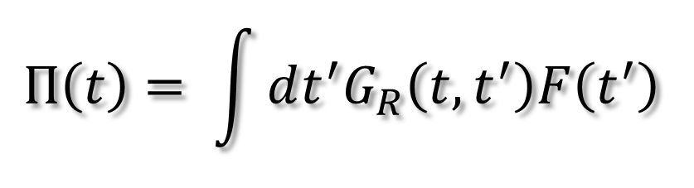
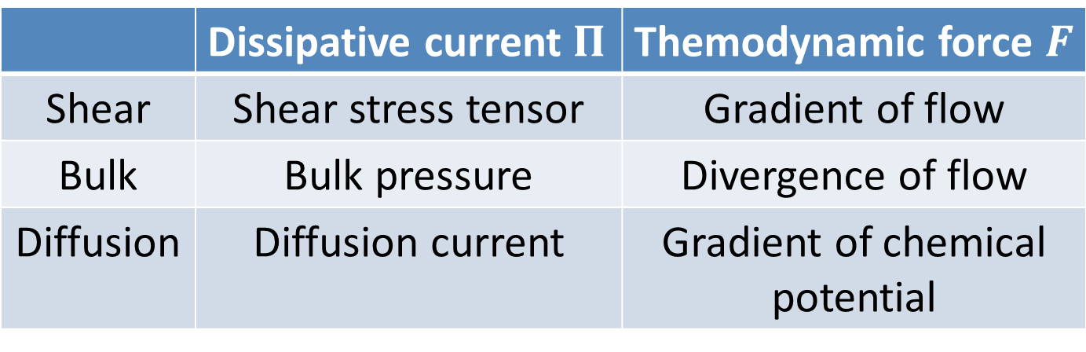
Causal Hydrodynamics
Linear response to thermodynamic force
$$Π\left(t\right)= \int{dt^{′}G_{R}\left(t,t^{′}\right)F\left(t^{′}\right) }$$
 | Dissipative current $Π$ | Themodynamic force $F$
Shear | Shear stress tensor | Gradient of flow
Bulk | Bulk pressure | Divergence of flow
Diffusion | Diffusion current | Gradient of chemical potential

Slide 9
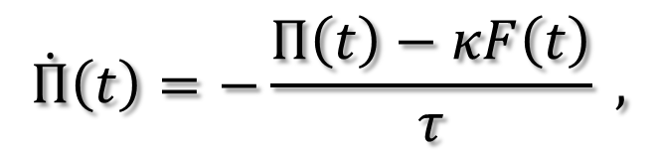
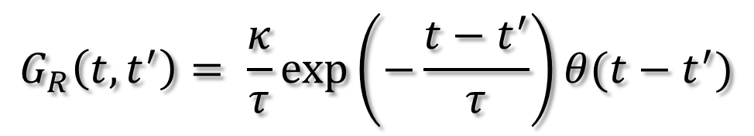
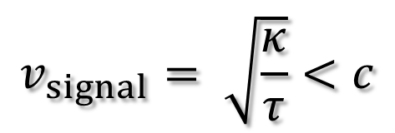
Causal Hydrodynamics (contd.)
1. Delta function (acausal, 1st order hydro)
$$G_{R}\left(t,t^{′}\right)=κδ\left(t−t′\right) → Π\left(t\right)=κF\left(t\right)$$
2. Retarded Green function (causal, 2nd order hydro)
$$G_{R}\left(t,t^{′}\right)= \frac{κ}{τ}exp\left(−\frac{t−t^{′}}{τ}\right)θ(t−t^{′})$$
Differential form
$$\dot{Π}\left(t\right)=−\frac{Π\left(t\right)−κF\left(t\right)}{τ} ,$$
$$v_{signal}= \sqrt{\frac{κ}{τ}}<c$$
Maxwell-Cattaneo Eq. (simplified Israel-Stewart Eq.)

Slide 10
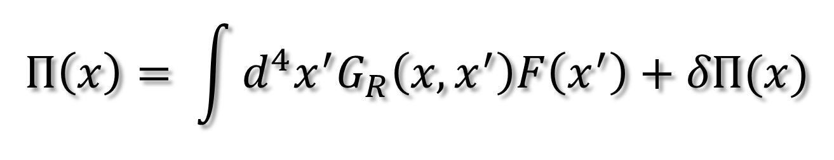


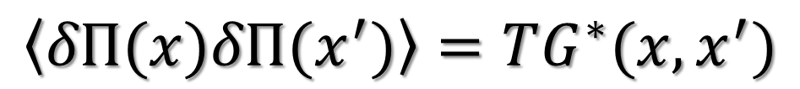
Relativistic Fluctuating Hydrodynamics (RFH)
K.Murase and TH, arXiv:1304.3243[nucl-th]
Generalized Langevin Eq. for fields
$$Π\left(x\right)= \int{d^{4}x^{′}G_{R}\left(x,x^{′}\right)F\left(x^{′}\right)+δΠ(x)}$$
Fluctuation-Dissipation Relation (FDR)
$$\left\langle δΠ(x)δΠ(x^{′})\right\rangle =TG^{∗}(x,x^{′})$$
$$G^{∗}$$
: Symmetrized correlation function
$$δΠ$$
: Hydrodynamic fluctuation
For non-relativistic case, see Landau-Lifshitz, Fluid Mechanics

Slide 11
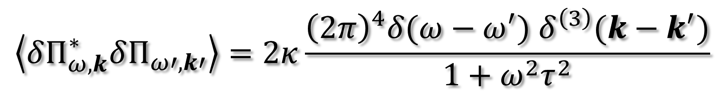
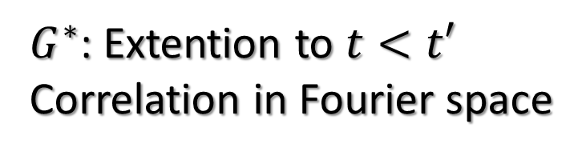
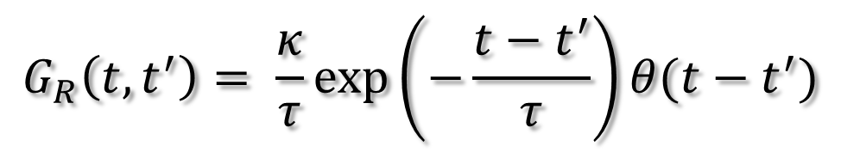
Colored Noise in Relativistic System
K.Murase and TH, arXiv:1304.3243[nucl-th]
$$G_{R}\left(t,t^{′}\right)= \frac{κ}{τ}exp\left(−\frac{t−t^{′}}{τ}\right)θ(t−t^{′})$$
$G^{∗}$: Extention to $t<t′$
Correlation in Fourier space
$$\left\langle δΠ_{ω,k}^{∗}δΠ_{ω′,k′}\right\rangle =2κ\frac{{\left(2π\right)}^{4}δ(ω−ω^{′}) δ^{\left(3\right)}(k−k^{′})}{1+ω^{2}τ^{2}}$$
Colored noise!
As a consequence of causality
Note: white noise in differential form
cf.) C. Young, arXiv:1306.0472

Slide 12
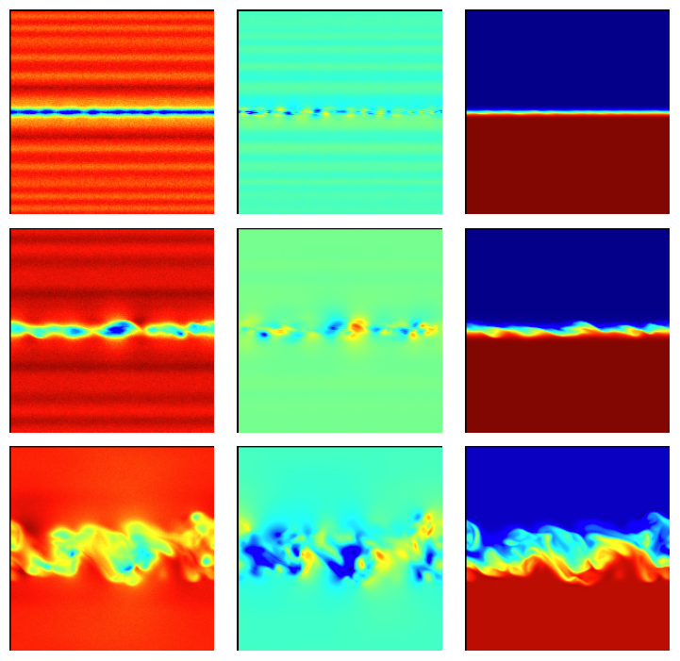
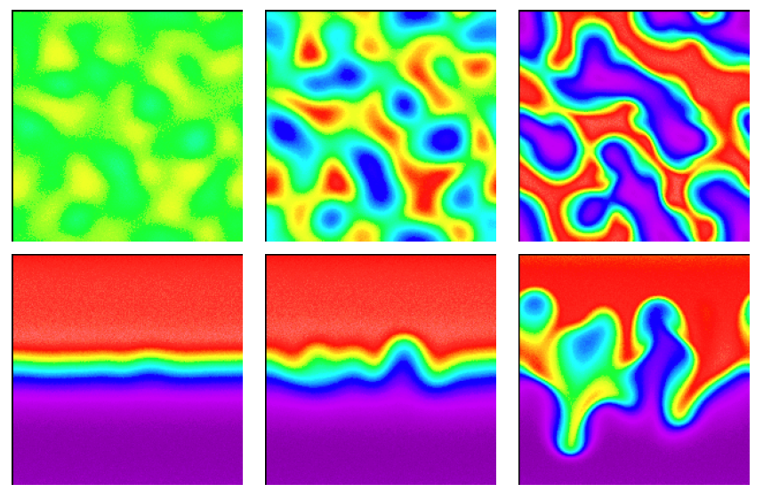
Fluctuation in Non-Linear Equation
Figures from J.B.Bell et al., ESAIM 44-5 (2010)1085
Ex.) Seeds for instabilities
Rayleigh-Taylor instability
Kelvin-Helmhortz instability
Need numerical implementation of fluctuating hydro

Slide 13
Medium Response to
Jet Propagation

Slide 14
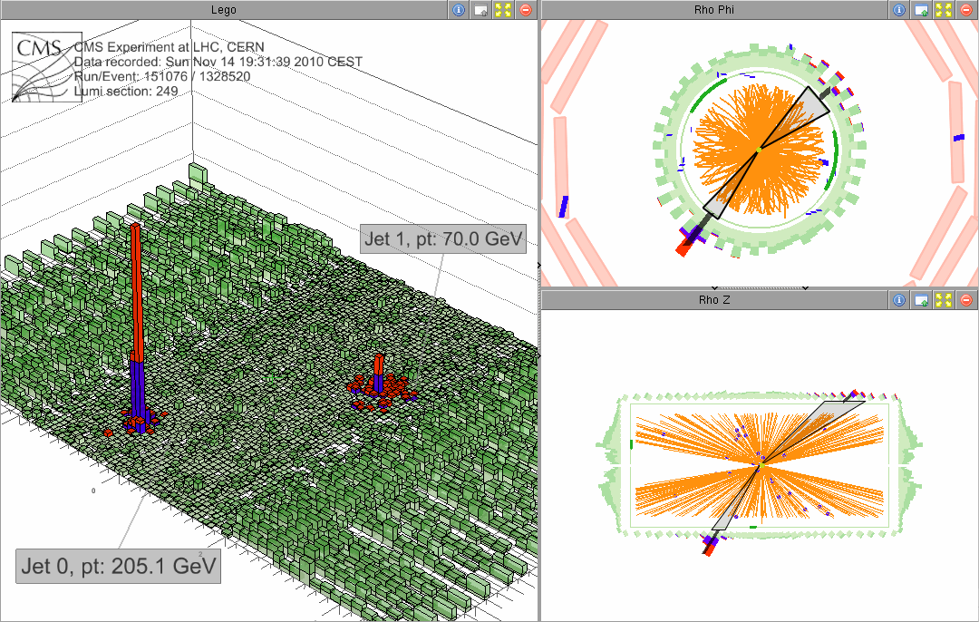
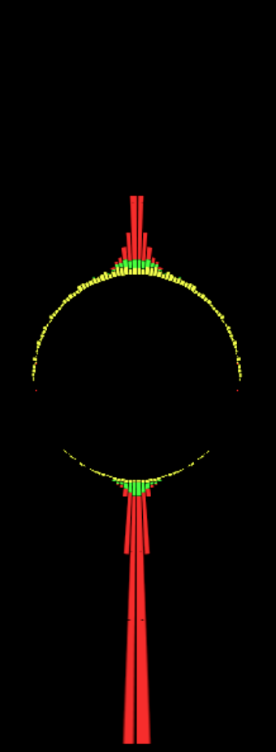
Jet Quenching as Missing p_{T}
Figures adapted from talk
by C.Roland (CMS) at QM2011
in-cone
out-of-
cone
Jet momentum balanced by low p_{T} hadrons
outside the jet cone!
→ Medium response?
See talk by Y.-S. Kim

Slide 15
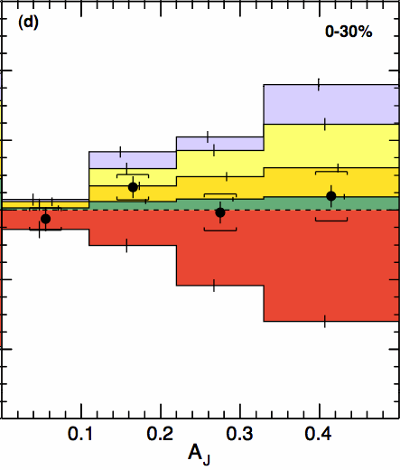
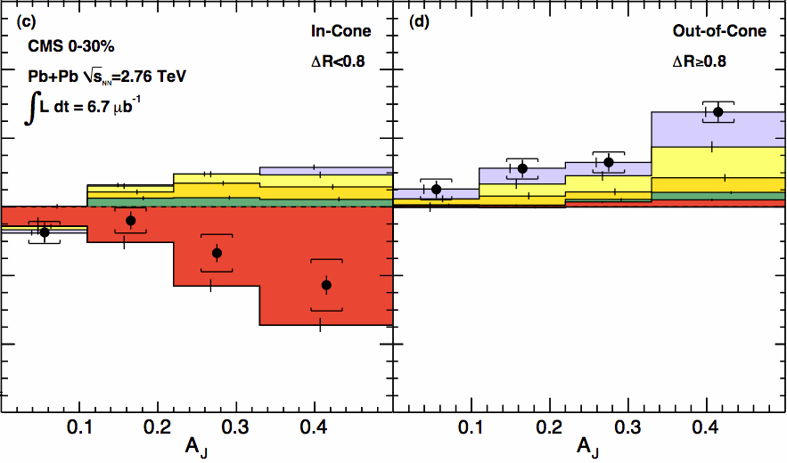
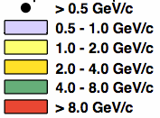
Momentum Balance Restored
Figure adapted from talk
by C.Roland (CMS) at QM2011
Horizontal: Jet asymmetry
Vertical: Transverse momenta (anti-)parallel to jet axis
Lost energy → low p_{T} particles at large angle

Slide 16
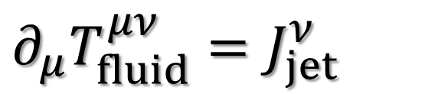
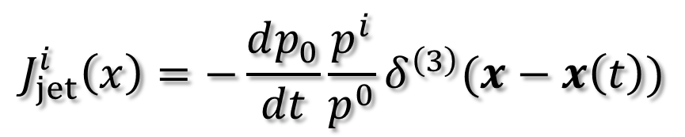
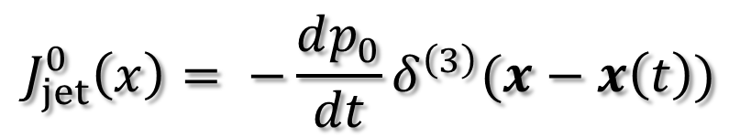
Energy and Momentum Flowing into QGP
Jet quenching could affect QGP expansion at LHC (and even at RHIC?)
Relativistic hydrodynamics with a source term due to propagation of jets
$$∂_{μ}T_{fluid}^{μν}=J_{jet}^{ν}$$
$$J_{jet}^{0}\left(x\right)= −\frac{dp_{0}}{dt}δ^{\left(3\right)}(x−x\left(t\right))$$
$$J_{jet}^{i}\left(x\right)=−\frac{dp_{0}}{dt}\frac{p^{i}}{p^{0}}δ^{\left(3\right)}(x−x\left(t\right))$$

Slide 17
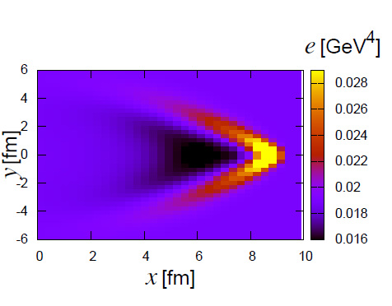
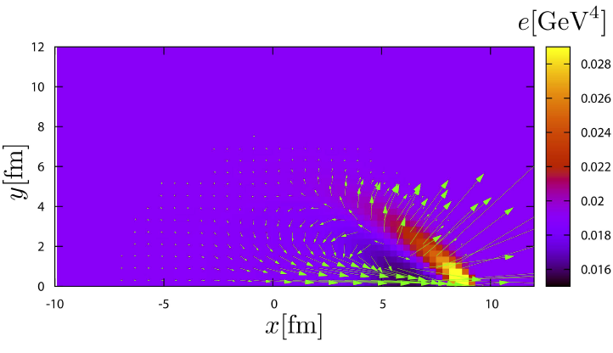
QGP Wake by Jet
Y.Tachibana and TH, Nucl.Phys.A904-905(2013)1023c
A 50 GeV jet traverses a
background with T=0.5 GeV
→ Mach-cone like structure
Vortex ring behind a jet

Slide 18
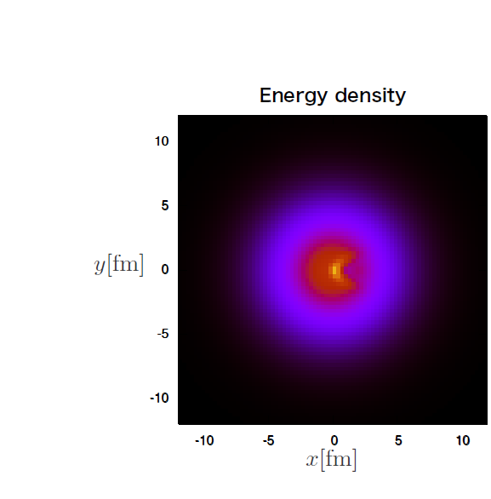
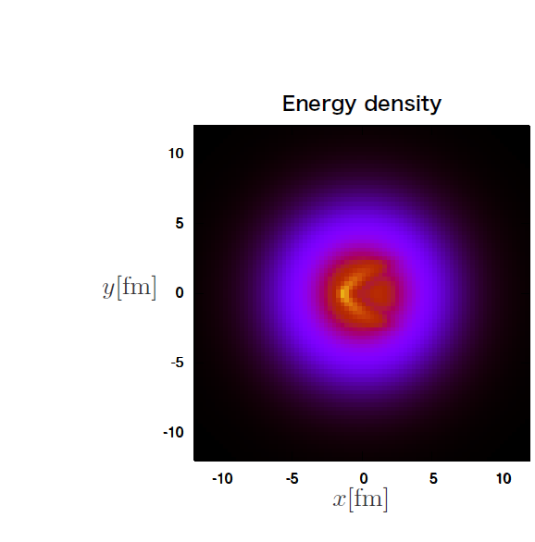
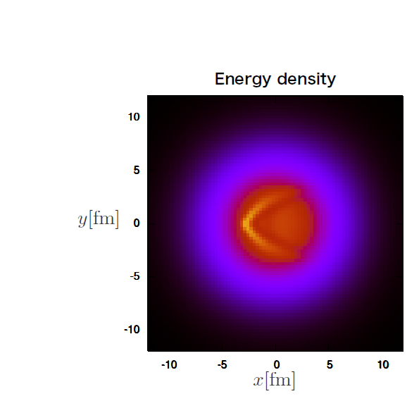
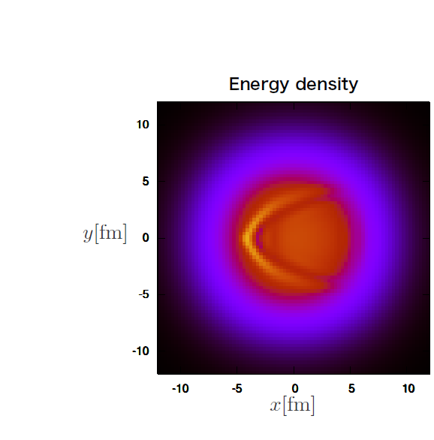

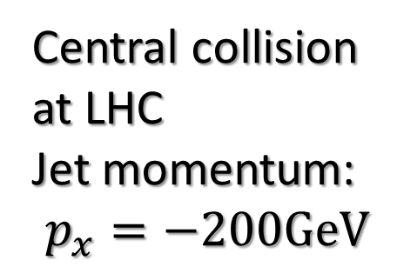
QGP Mach Cone Induced by a Jet
Y.Tachibana and TH, Nucl.Phys.A904-905(2013)1023c
Central collision
at LHC
Jet momentum:
$$p_{x}=−200GeV$$
Fully non-linear and fully 3D hydro
simulation of Mach cone

Slide 19
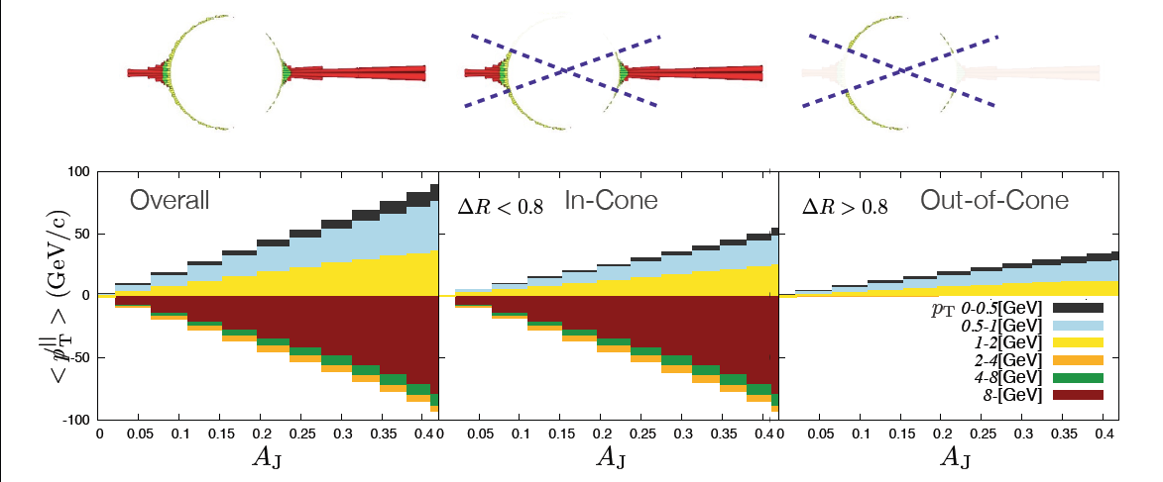
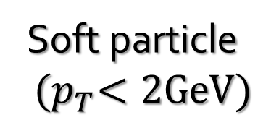
Energy Balance in and out-of
Jet Cone in Hydro + Jet Model
Soft particle
$${(p}_{T}<2GeV)$$
Energy balance
Leading jet
Qualitatively consistent with CMS results

Slide 20
Another Channel to Constrain Shear Viscosity?
Y.Tachibana and TH, Nucl.Phys.A904-905 (2013)1023c
Jet propagation induces large flow velocity along jet axis.
How much momentum diffuses perp. to jet axis?
Momentum diffusion

Slide 21
ANOMALOUS HYDRODYNAMICS AND CHIRAL MAGNETIC EFFECT

Slide 22
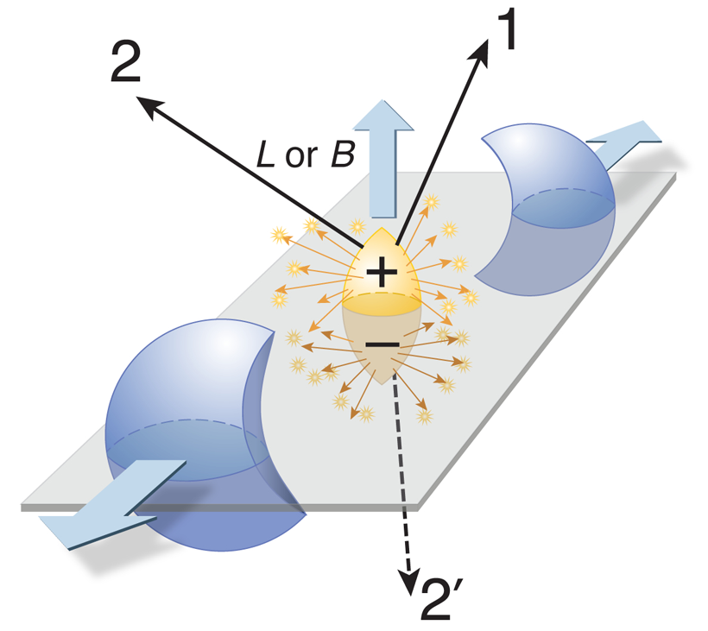
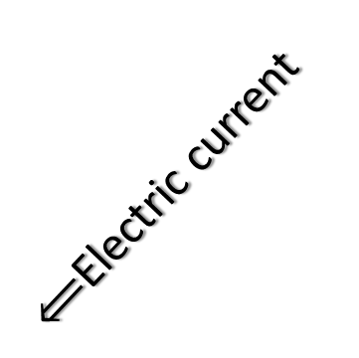
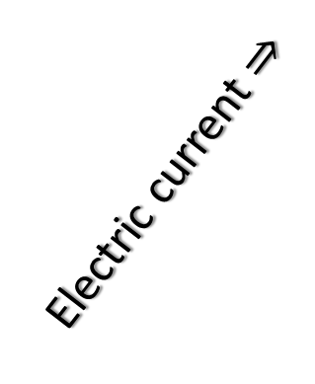
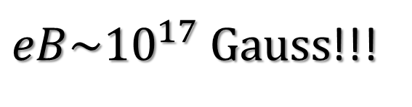
Strong EM fields in Heavy Ion Collisions
Positively charged
heavy ion as a source of
electro magnetic field
→ Ampere’s law
Magnetic field
Electric current $⇒$
$⟸$Electric current
$eB\sim {10}^{17} Gauss$!!!
Figure taken from http://physics.aps.org/articles/v2/104

Slide 23
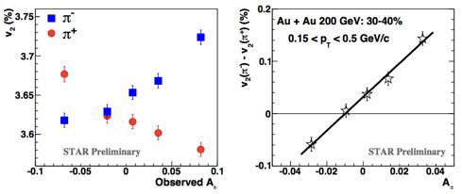
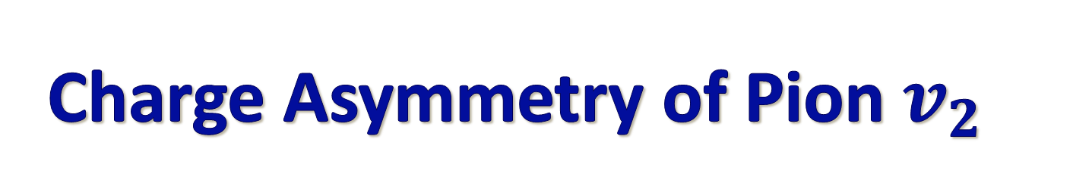
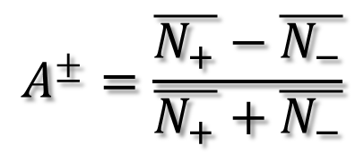
Charge Asymmetry of Pion $v_{2}$
G.Wang (STAR), arXiv:1210.5498
$$A^{±}=\frac{\overline{N_{+}}−\overline{N_{−}}}{\overline{N_{+}}+\overline{N_{−}}}$$
Charge asymmetic results indicate existence
of electromagnetic effects of transport?

Slide 24
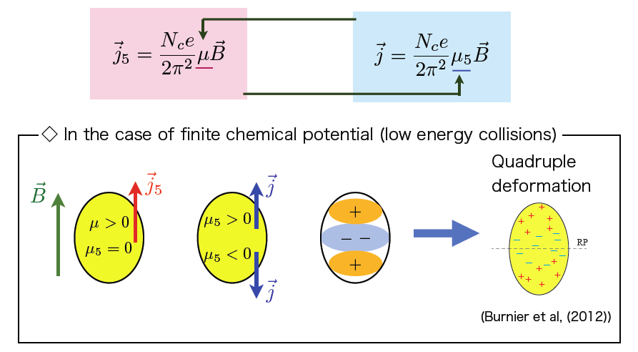
Chiral Magnetic Wave
chiral
separation
effect
chiral
magnetic
effect
D.Kharzeev and H.U.Yee(2011);Y.Burnier et al.(2011)
Slide taken from a seminar talk by M.Hongo at BNL (2013)
For introduction of CME and CSE, see K.Fukushima, arXiv:1209.5064

Slide 25
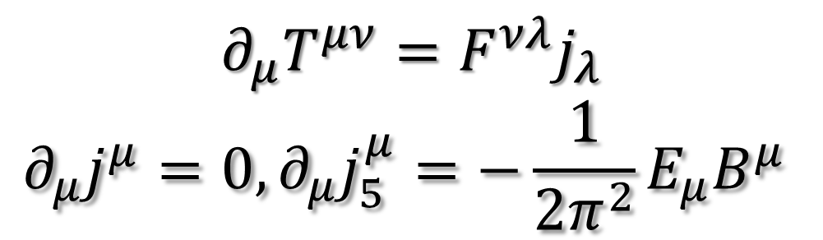
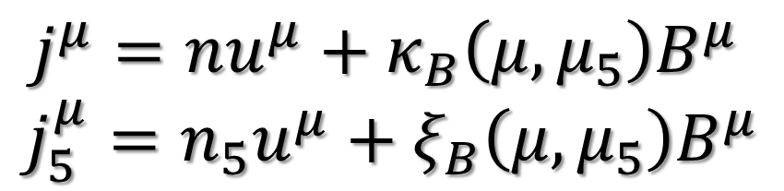
Anomalous Hydro
Hydrodynamic eqs. under EM fields + anomaly
$$∂_{μ}T^{μν}=F^{νλ}j_{λ}$$
$$∂_{μ}j^{μ}=0, ∂_{μ}j_{5}^{μ}=−\frac{1}{2π^{2}}E_{μ}B^{μ}$$
Constitutive eqs. incl. CME and CSE
$j^{μ}=nu^{μ}+κ_{B}\left(μ, μ_{5}\right)B^{μ}$
$$j_{5}^{μ}=n_{5}u^{μ}+ξ_{B}\left(μ, μ_{5}\right)B^{μ}$$
D.T.Son and P.Surowka,PRL103(2009)191601

Slide 26
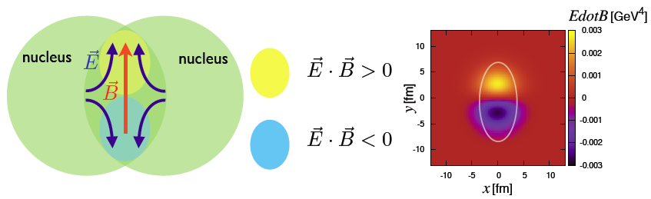
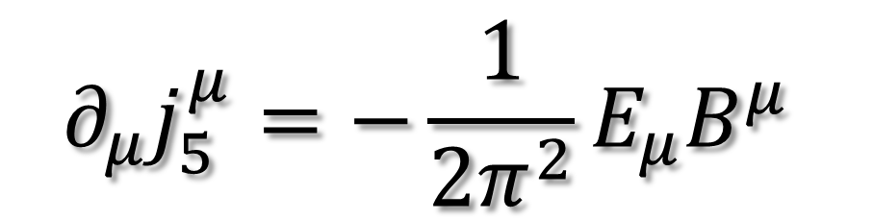
Source of Axial Charge
$$∂_{μ}j_{5}^{μ}=−\frac{1}{2π^{2}}E_{μ}B^{μ}$$
→ Quantum anomaly term

Slide 27
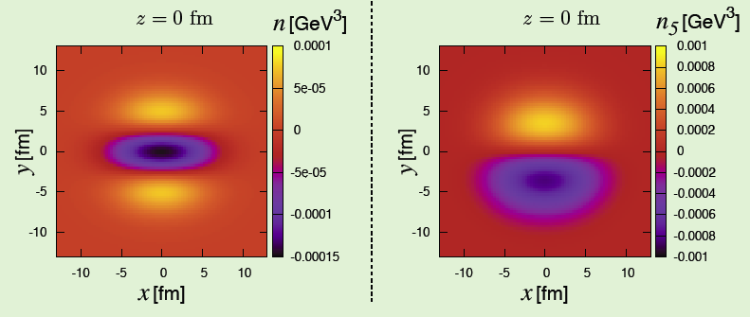

Charge and Axial Charge in Expanding Case
M.Hongo, Y.Hirono, TH, arXiv:1309.2823
Charge density and axial charge density in the
transverse plane at
$$t=6fm/c$$

Slide 28
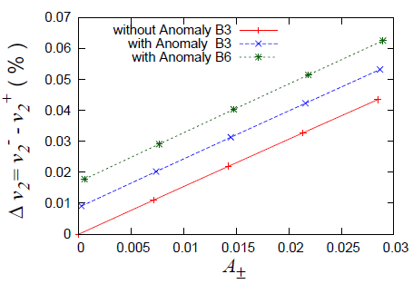

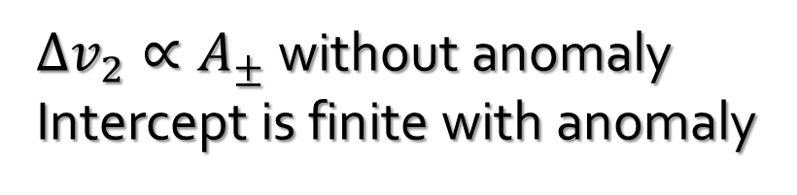
Difference of $v_{2}$ btw. Positive and Negative pions
M.Hongo, Y.Hirono, TH, arXiv:1309.2823
STAR data
$∆v_{2}∝A_{±}$ without anomaly
Intercept is finite with anomaly
Need more quantitative analysis of anomalous hydro

Slide 29
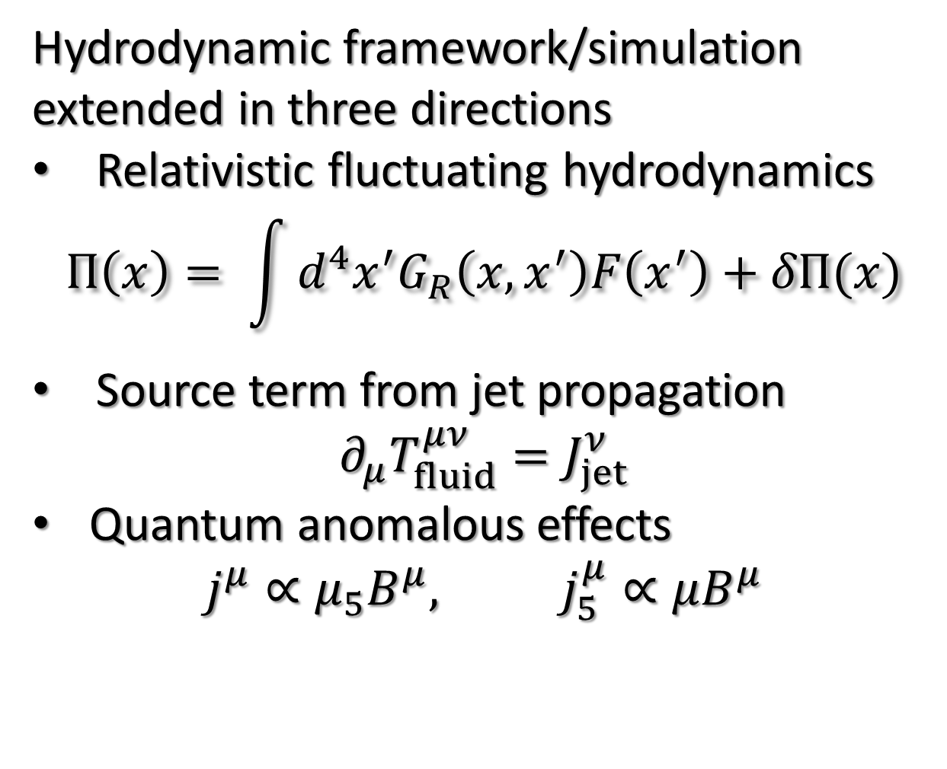
Summary
Hydrodynamic framework/simulation extended in three directions
Relativistic fluctuating hydrodynamics
$$Π\left(x\right)= \int{d^{4}x^{′}G_{R}\left(x,x^{′}\right)F\left(x^{′}\right)+δΠ(x)}$$
Source term from jet propagation
$$∂_{μ}T_{fluid}^{μν}=J_{jet}^{ν}$$
Quantum anomalous effects
$$j^{μ}∝μ_{5}B^{μ}, j_{5}^{μ}∝μB^{μ}$$

Slide 30
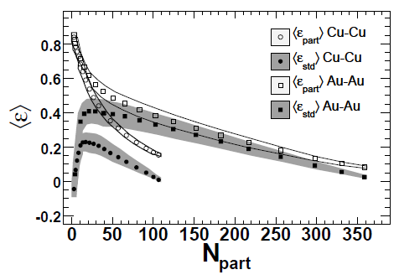
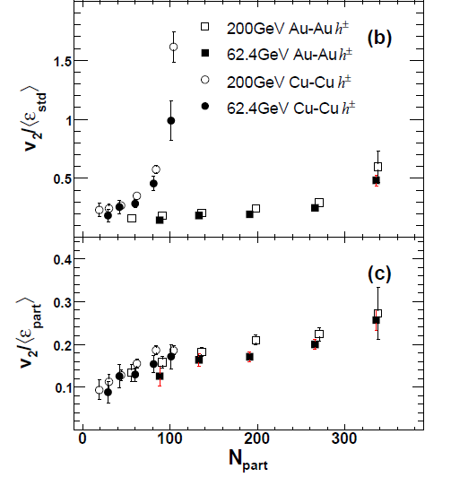

Eccentricity Fluctuation in Small System
$$ε_{part}>ε_{std}$$
PHOBOS,
Phys. Rev. Lett. 98, 242302 (2007)

Slide 31



Fluctuation in Initial Conditions
$$ε_{n}=\frac{\left\langle r^{2}e^{inφ}\right\rangle }{\left\langle r^{2}\right\rangle }$$
$$ε_{n,std}=ℜε_{n}$$
$$ε_{n,part}=\left|ε_{n}\right|$$
B.Alver et al.,
Phys. Rev. C 77, 014906 (2008)

Slide 32
Fluctuation Appears Everywhere
Finite number of hadrons
Propagation of jets
Hydrodynamic fluctuation
Initial fluctuation and
particle production
time
collision axis
0

Slide 33


Green-Kubo Formula
$$η=\lim_{ω→0}\lim_{q→0}{\frac{1}{2ω}\int{dtdx}e^{i(ωt−qx)}}$$
$$×\left\langle \left[T_{xy}\left(t,x\right),T_{xy}(0,0)\right]\right\rangle$$
Slow dynamics → How slow?
  Macroscopic time scale ~ $1/ω$ ← $t_{"macro"}$
  Microscopic time scale ~ $τ$
cf.) Long tail problem (liquid in 2D, glassy system, super-cooling, etc. )

Slide 34





Relaxation and Causality
Constitutive equations at Navier-Stokes level
Instantaneous response violates causality
Critical issue in relativistic theory
Relaxation plays an essential role
$$π^{μν}=2η∂^{<μ}u^{ν>},$$
$$Π=−ς∂_{μ}u^{μ},$$
…
thermodynamics force
$$F or R/κ$$
Realistic response
$$t$$
$$t_{0}$$
$$τ$$

Slide 35







Coarse-Graining in Time
$$G_{R}$$
$$G_{R}$$
Non-Markovian
Markovian
$$G_{R}=\frac{κ}{τ}e^{−\frac{t}{τ}}$$
coarse
graining
???
$$G_{R}≈κδ\left(t′\right)$$
Maxwell-Cattaneo
Navier Stokes
→ causality
$$t→t′$$
$$t$$
$$t′$$
Existence of upper bound in coarse-graining time
(or lower bound of frequency) in relativistic theory???

Slide 36
Outlook for RFH
Numerical implementation in full hydro equation (not linearized one) and its consequences in observables
Langevin simulation in constrained system?
Dynamic critical phenomena
  → Need further formulation of RFH

Slide 37




Large Angle Emission from Expanding Medium
Y.Tachibana and TH, Nucl.Phys.A904-905 (2013)1023c
$$Δ\left(\frac{dp^{∥}}{d\cos{θ}} \right)=\frac{{dp^{∥}}_{w.jet}}{d\cos{θ}}−\frac{{dp^{∥}}_{w.o.jet}}{d\cos{θ}}$$
$$\cos{θ}=−1$$
θ
out-of-cone
$$\cos{θ}=1$$
Jet pair created at
off central position
Enhancement of low
momentum particles at large angle from jet axis

Slide 38
Outlook for Interplay between Soft and Hard
Alternative constraint for shear viscosity
through propagation of jets?
Heat-up due to mini-jets propagation similar to neutrino reheating in Super Nova Explosion?
momentum
transfer perp. to
jet propagation
Jet propagation

Slide 39


Slide 40


Slide 41












Full 3D Anomalous Hydro Simulation
M.Hongo, Y.Hirono and TH, arXiv:1309.2823
$$\vec{B}$$
$$eB_{y}=1.0{GeV}^{2}$$
Background
temperature
$$n=n_{R}+n_{L}$$
$$T=0.5GeV$$
$$n_{L}$$
$$n_{R}$$
“Group velocity” of chiral magnetic wave $\sim 0.58$
CME under expanding background?
Source of charge asymmetric $v_{2}$?

Slide 42


Slide 43


