Slide 1
Future ALICE Physics Perspectives and
ALICE GEM-TPC upgrade
Taku Gunji
Center for Nuclear Study
The University of Tokyo

Slide 2
Outline
Heavy ion physics at LHC energy
Current status of ALICE
Experimental results (inputs for the upgrade)
ALICE upgrade plans
Physics perspectives
GEM-TPC upgrades
Summary and Outlook

Slide 3
Heavy Ion Physics at LHC Energy
To fully exploit scientific potential of the LHC – unique in
  Large cross sections for hard probes
  High initial temperature/long space-time evolution
    Observables are more sensitive to the properties of QGP
  Gluon saturation
    less complexity in initial conditions???
  Strongest (Color) EM field shortly after the collisions
    Key to understand the dynamics just after the collisions
  Collectivity in high multiplicity p-p and p-Pb collisions?
Precision measurement of the QGP parameters at μ_{b}=0
  Quantitative study of QGP in conjunction with RHIC
Experiments need to have the capability to measure:
  Soft probes(PID flow & spectra, correlation)/EM probes (ALICE)
  Hard probes through jets (ATLAS/CMS and ALICE)

Slide 4
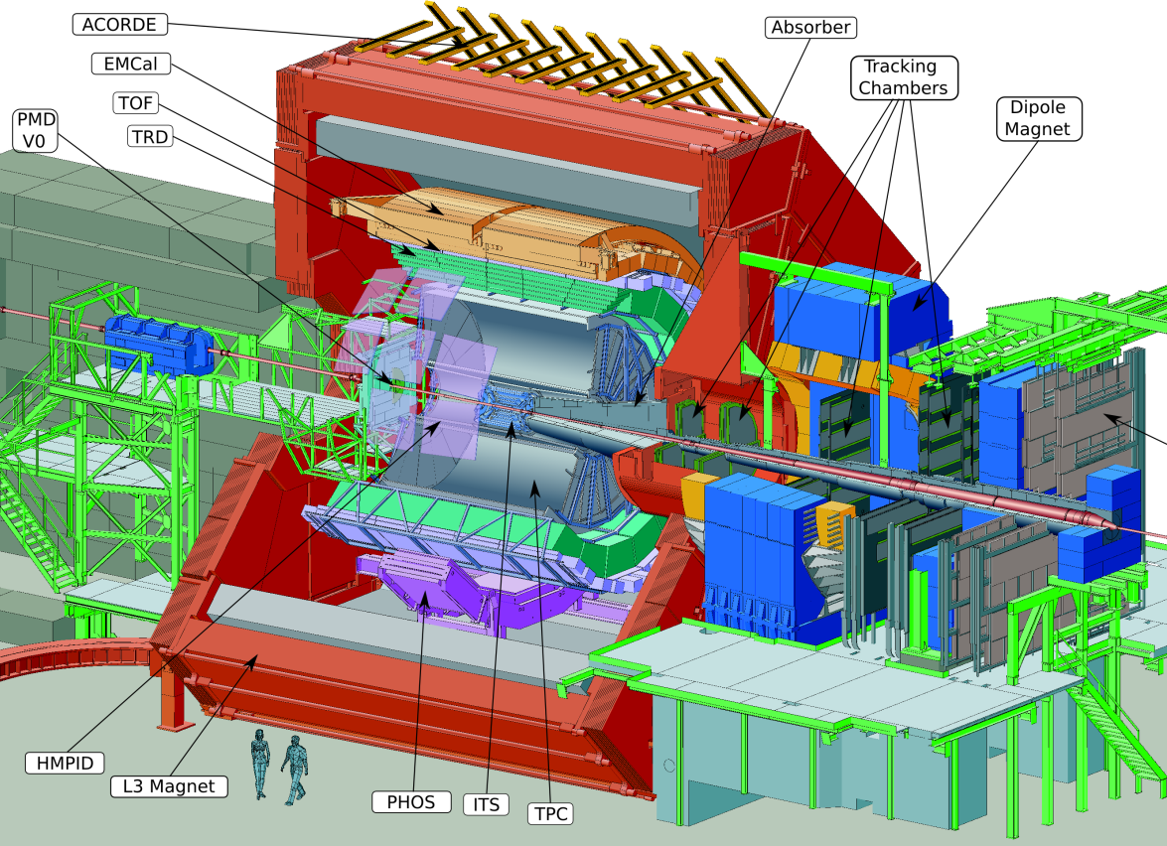
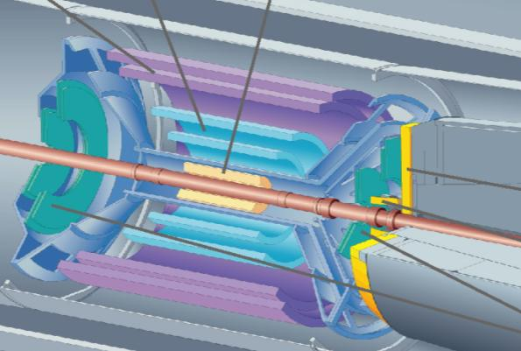
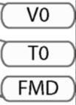
ALICE detector system
17 kinds of detectors
Dedicated to HI collisions
Measure soft~hard probes
and EM probes.

Slide 5
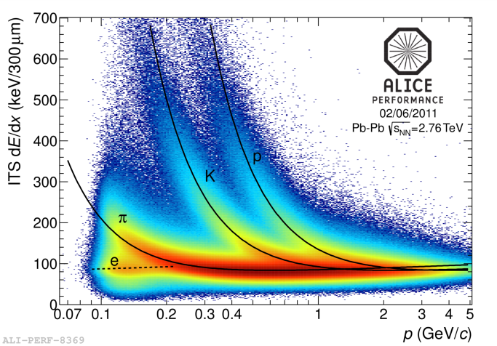
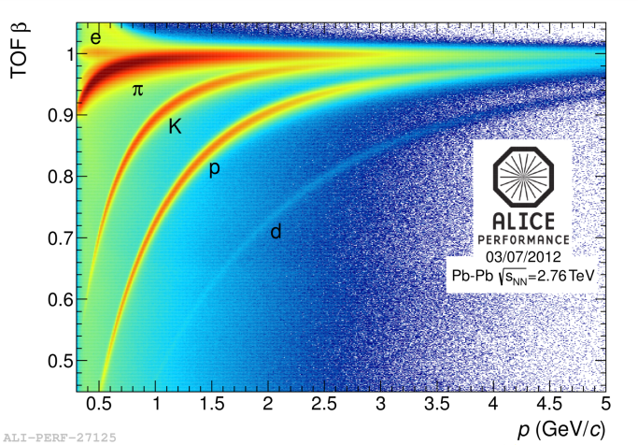
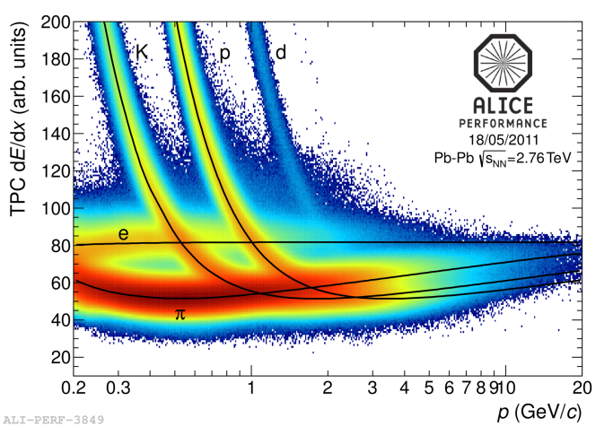
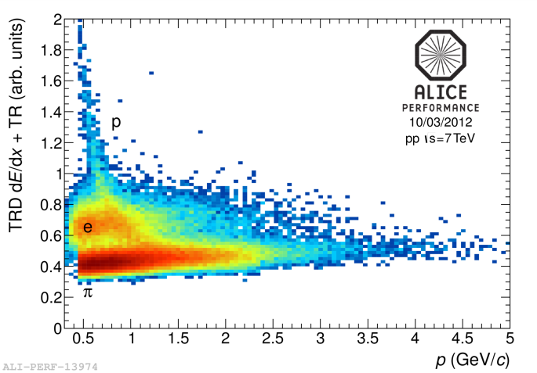
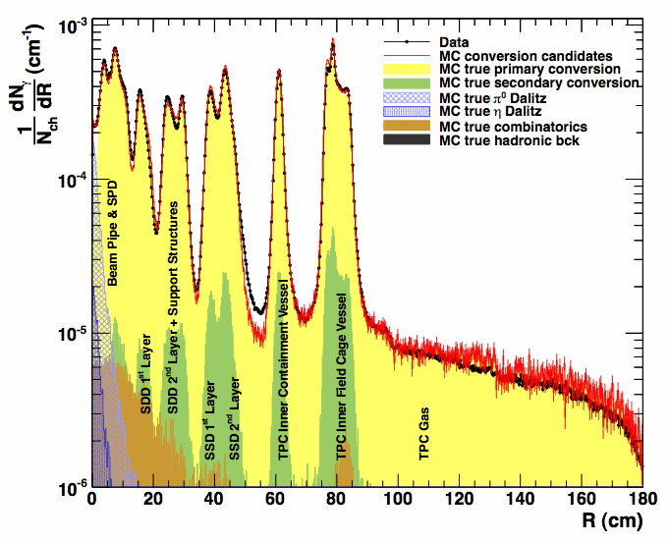
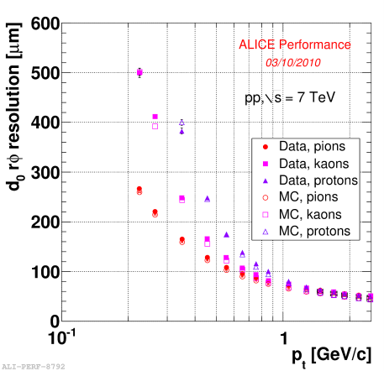
Detector Performance
ITS
TPC
TOF
TRD
vertexing
Particle Identification (pi/K/P/e/mu) for wide p_{T} region
Efficient low-momentum tracking – down to ~ 100MeV/c
Excellent vertexing capability
Low material budget (10% of X₀)
good reconstruction capability of photon conversions

Slide 6
Experimental results (motivate the ALICE upgrades)
Higher order Flow
Event-by-event flow
Heavy flavor measurements
jets
Photon puzzle
Dielectron puzzle and thermal dilepton measurement

Slide 7
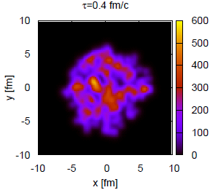
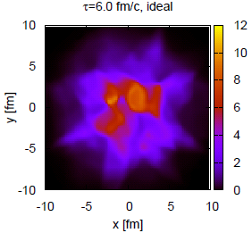
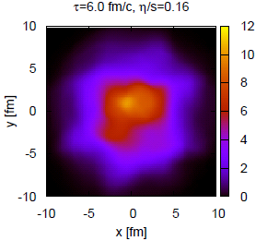
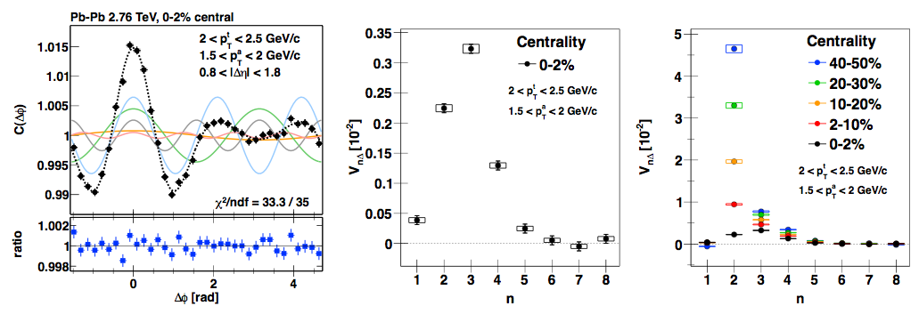
Higher Order Flow
Higher order Flow measurements
  Initial conditions (correlation length, fluctuation), Viscosity

Slide 8
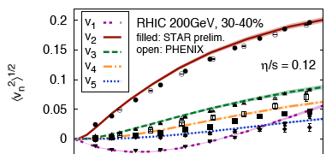
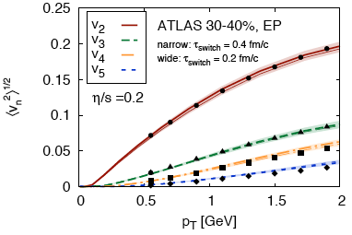

Higher Order Flow
Higher order Flow measurements
  IP-Glasma model (1/Q_{s})
    η/s=0.12(RHIC), 0.2(LHC)
  v_{n}∝ exp(-βn²), β∝η/s
Temperature dependence of η/s???
  Sensitivity to QGP η/s or hadronics η/s??? Can differentiate???
Gale, Jeon, Schenke, Tribedy, Venugopalan,
arXiv:1209.6330

Slide 9
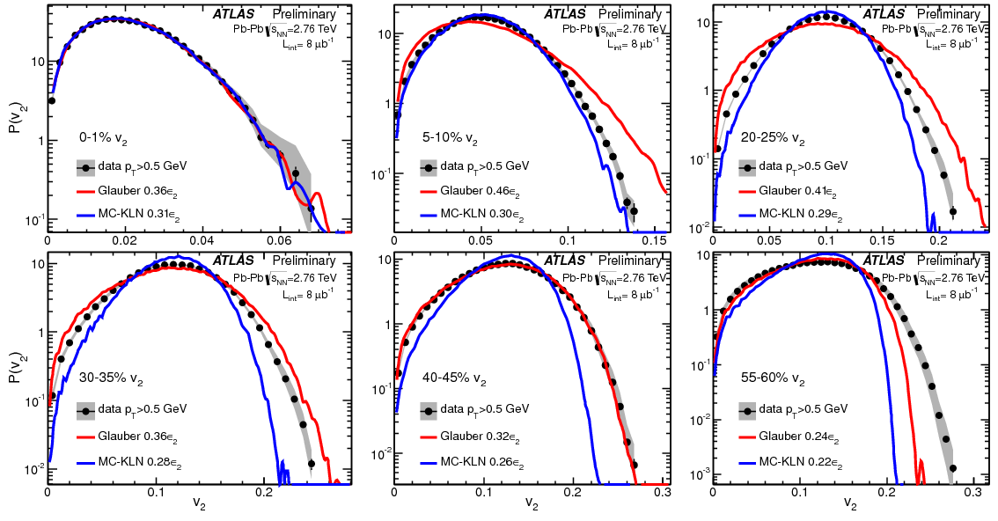
E-by-E Flow
Event-by-event flow
  Better understanding of initial conditions
  Central: MC-KLN, IP-Glasma
  Peripheral: MC-Glauber, IP-Glasma
Firm conclusion??? Another cross-check???
ATLAS-CONF-2012-114

Slide 10
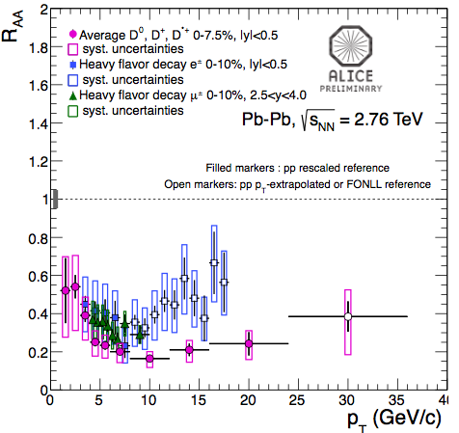
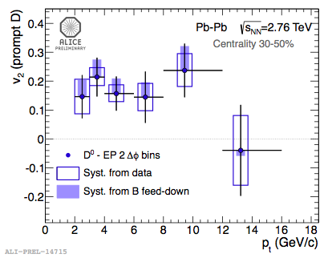
Heavy Quarks
Heavy flavors
  Strong suppression like other hadrons. Hint of R_{AA}(B) > R_{AA}(D)
More precision measurements needed!
  Separation of D/B. Flow of heavy quarks (D, B). v_{n} measurements
  Low p_{T} HQ R_{AA}. Violation of binary scaling??? Wide pT range (→ collisional/Radiative energy loss. → transport properties)

Slide 11
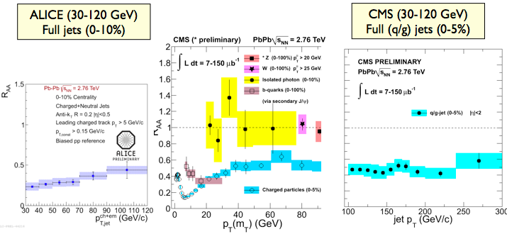
Jet measurements
High pT Jets
Jet energy ←→spatial resolution of the medium
  E-by-E jet analysis(?). Jet-Fluid interaction. Propagation of lost energy in the medium.

Slide 12
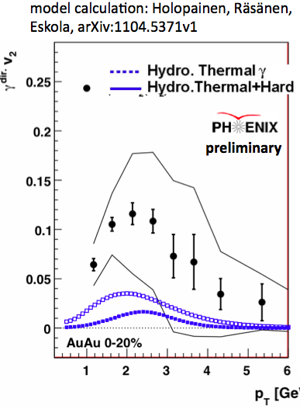
Photons
Enhancement of low pT photon yield
Production is well-understood???
  Origin of large photon v2?
    Hadronic phase? Strong EM field?
  v_{n} of photon production. γ-γ HBT
NLO

Slide 13
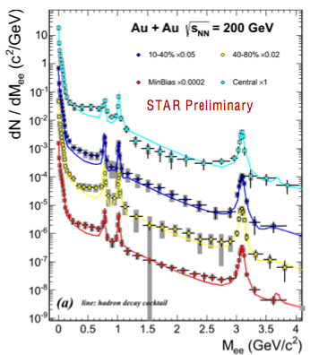
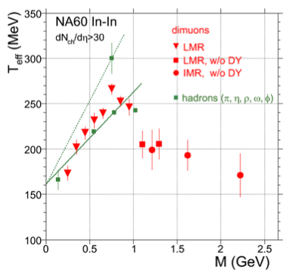
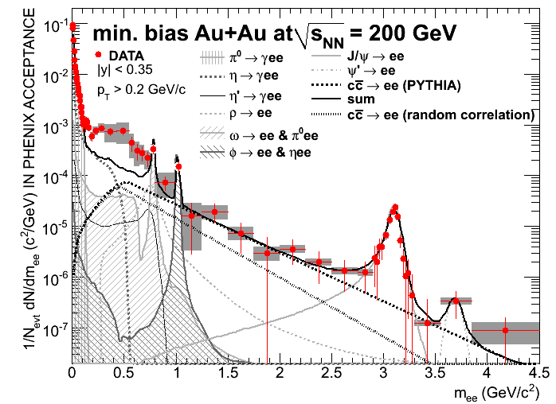
Dileptons
Inconsistent between STAR and PHENIX
ALICE is important!!
  Mass modification of LVM
  Virtual photons, radiation from EM field
  direct thermal dielectrons (M_{ee}, p_{T}, v_{n}).
  Energy loss (angular de-correlation) of HQ

Slide 14
What we have to understand
Initial conditions
  E-by-E, higher order flow not only from soft sectors but also from hard probes, p-p/p-Pb collisions
Temperature dependence of the medium properties
  E-by-E, higher order flow not only from soft sectors but also from hard probes, Leptons & Photons
Thermalization mechanism, Dynamics of non-equilibrium QCD
  Longidudinal correlation, Leptons & Photons, p-p and p-Pb
What we need are:
  High luminosity
  High rate capability (for being able to inspect all MB collisions)
  High performance detectors (jet, HQ, photons, leptons)

Slide 15
ALUCE upgrade plans

Slide 16
ALICE upgrade strategy
Need to accumulate not only soft probes but also wide p_{T} jets, photons, dileptons, heavy quarks
  Some of them = untriggerable
    Require a large event samples on tape
  Increase rate capabilities to inspect all MB heavy-ion collision
    read out all Pb-Pb interactions at a maximum rate of 50~100kHz (i.e. L = 6x10²⁷ cm⁻²s⁻¹), with a minimum bias trigger
    Replace dead-time detectors (TPC, SDD) or detector front-ends (pilepined readout, multi-event buffering)
    DAQ (online tracking, data compression, HLT, event building)
This is ALICE major upgrade in LS2 (2018)
  ALICE upgrade proposal endorsed by LHCC

Slide 17
Core upgrade plans and Motivation
New ITS
  7 layers of Silion Pixel Detector
  Improvement vertex resolution → Heavy Flavor
  Improvement low pT tracking efficiency → Dielectron
TPC upgrade
  Replacing MWPC readout chambers to GEM based readout chambers. No gating Grid operation
  Improve rate capability → Heavy Flavor, Dielectrons, Jets,
Muon Forward Tracker
  4 layers of Silion Pixel detector in front of Muon Absorber at forward rapidity
  Improve secondary vertex and momentum resolution → Heavy Flavors, Quarkonia, Low Mas dimuons

Slide 18
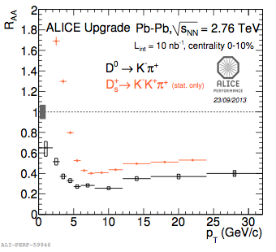
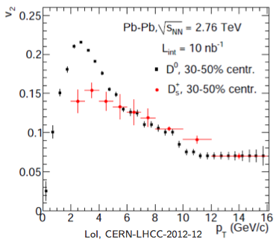
Heavy Flavor Measurements
Improvement of secondary vertex resolution by x2
  Measurement of Λ_{c}, D_{s}, Λ_{b}
  v2 and R_{AA} for wide pT range (down to low pT)

Slide 19
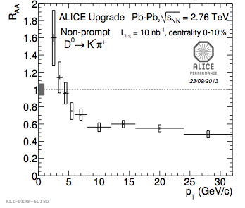
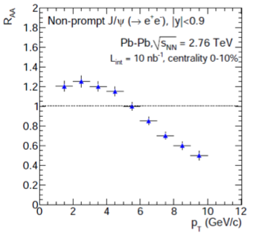
Heavy Flavor Measurements
Improvement of secondary vertex resolution by x2
  Measurement of Λ_{c}, D_{s}, Λ_{b}
  v2 and R_{AA} for wide pT range (down to low pT)
  B measurements (B->D + displaced vertex, B->J/ψ)

Slide 20
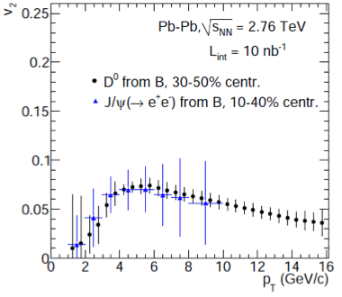
Heavy Flavor Measurements
Improvement of secondary vertex resolution by x2
  Measurement of Λ_{c}, D_{s}, Λ_{b}
  v2 and R_{AA} for wide pT range (down to low pT)
  B measurements (B->D + displaced vertex, B->J/ψ)
  Prevision measurements
  of direct B meson flow!

Slide 21
Di-electron Measurements
Unique Physics and Measurement at the LHC
  Chiral symmetry restoration
  Virtual photons
  Thermal radiation, Radiation from EM field
Need to fight with:
  Conversion/Dalitz
  S/N (combinatorial)
  Charm contributions
    Charm yield
    Correlation of pairs

Slide 22
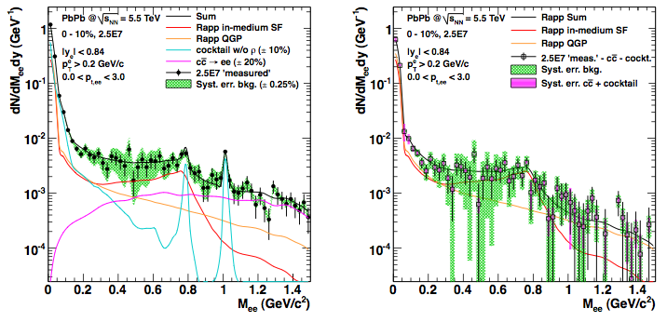
Di-electron Measurements
Current scenario on statistics, tracking and PID capability, but B=0.2 T
Electron ID by TPC/TOF
  High rate TPC required
BG rejection (conversion,
Dalitz, charm pairs)
  New ITS upgrade
  required (especially,
  to suppress conversions and
  systematic uncertainties of
  charm)

Slide 23
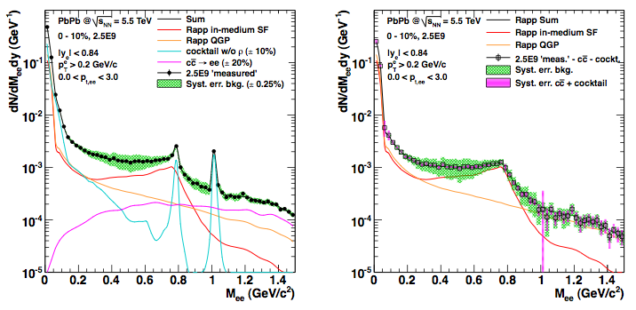
Di-electron Measurements
New ITS + GEM-TPC (keep current tracking & PID capability)
  Improve tracking efficiency, rejection of conversion and Dalitz
50kHz data taking. B=0.2 T
Electron ID by TPC/TOF
  High rate TPC required
BG rejection (conversion,
Dalitz, charm pairs)
  New ITS upgrade
  required (especially,
  to suppress conversions and
  systematic uncertainties of
  charm)

Slide 24
ALICE GEM-TPC upgrade

Slide 25
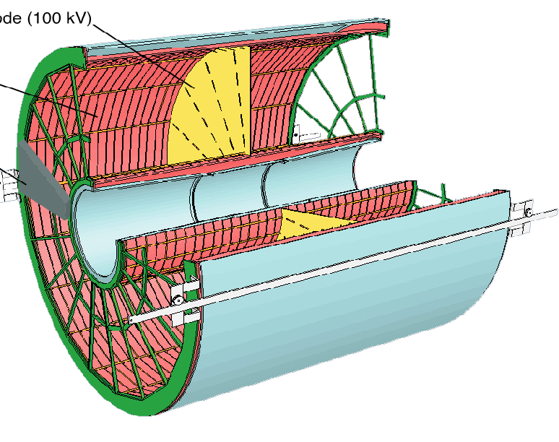
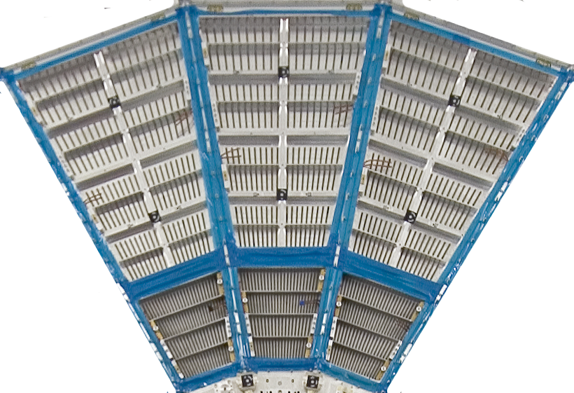
ALCIE TPC - I
Central Electrode (-100kV)
E
E
Diameter: 5.6 m, length: 5.2 m
Acceptance: |η|<0.9, Δφ=2π
Readout Chambers: total = 72
  Outer: 18 x 2, Inner: 18 x 2
  Pad size
    Inner: 4×7.5 mm²
    Outer: 6×10 mm²
  Pad channel number = 557,568
Gas: Ne-CO₂-N₂ (90-10-5)
  at Drift field = 400V/cm
  Diffusion ~0.2mm /1cm
  Drift velocity ~0.8cm/μs
Total drift time: 92μs
5.6 m
5.2 m
Readout chamber
114cm
50cm

Slide 26
Current Rate limitation
Gating Grid operation
  Gating Grid (GG) is used to prevent ion back flow into the drift region
  It takes ~180 μs for the ions generated in the MWPC to reach the GG → unavoidable dead time after each triggered event
  Additional 100 μs for suppression of event pile-up
--> Maximum GG trigger rate is ~3.5 kHz

Slide 27
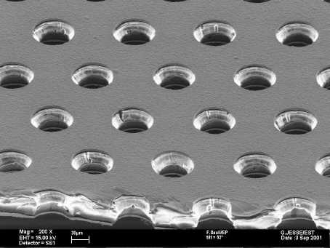
TPC Core Upgrade and strategy
Goal, Requirements
  No gating grid operation but keep small ion back flow capability to avoid a field distortion in the drift space
    0.25-1% of IBF at the gain of 2000 (= 5~20 ions per one seed)
  Maintain the gain stability under 100 kHz/cm² particle rate
    This is not possible with MWPC. Gain decreases by ~20%.
  Keep current PID and tracking capabilities
Strategy
  TPC Continuous readout without gating grid
    No trigger, No deadtime
  Replace MWPC readout by GEM readout
    Efficient to block back-drifting ions
    High rate capability
    Preserve PID and tracking capability

Slide 28
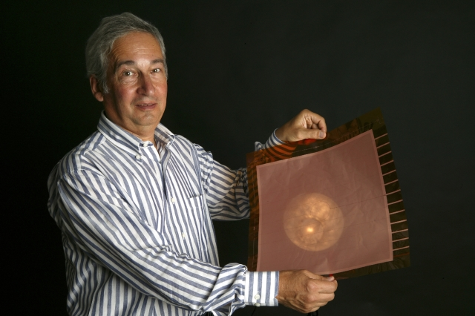
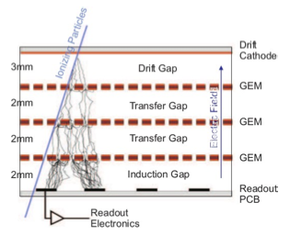
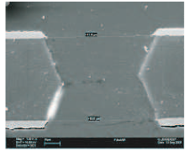
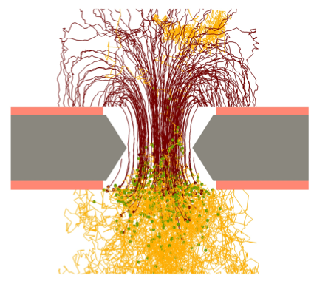
What is GEM?
Invented b F. Sauli (~1997)
Standard GEM foil
  50um thick kapton
  5um Cu electrode
  Pierce the hole
  (by chemical, laser, plasma etching)
Potential between upper and lower electrode
  Avalanche inside of the hole
Merit of the GEM (compared to MWPC)
  Stable operation by stack configuration
  High rate capability
  Good IBF capability with asymmetric field
  No ExB effect

Slide 29
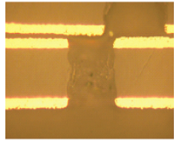
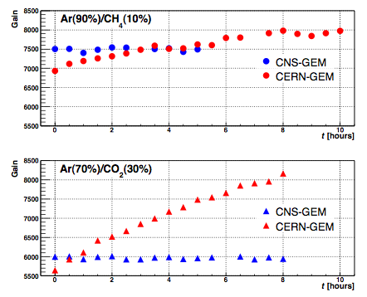
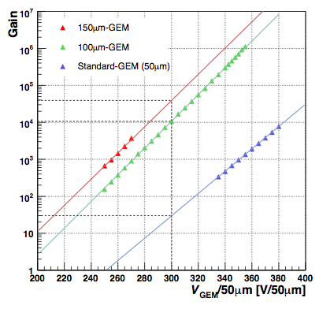
Experience of GEM in CNS
We started GEM R&D since 2002.
Fabrication of GEM in Japan (SciEnergy)
  Plasma + Laser etching
  Cylindrical holes
    No charge up → stable operation
    Thicker GEM (100um, 125um GEM) → stable operation

Slide 30
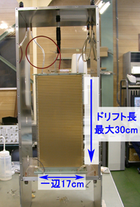
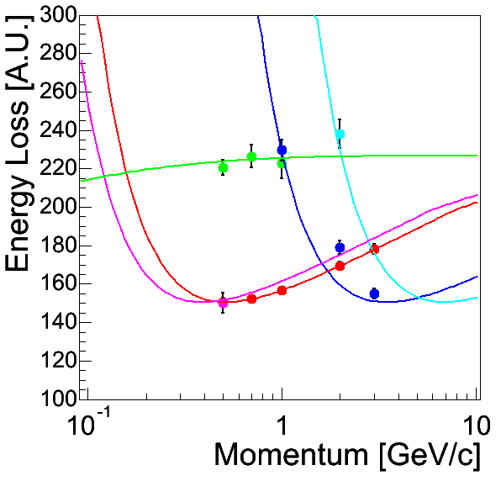
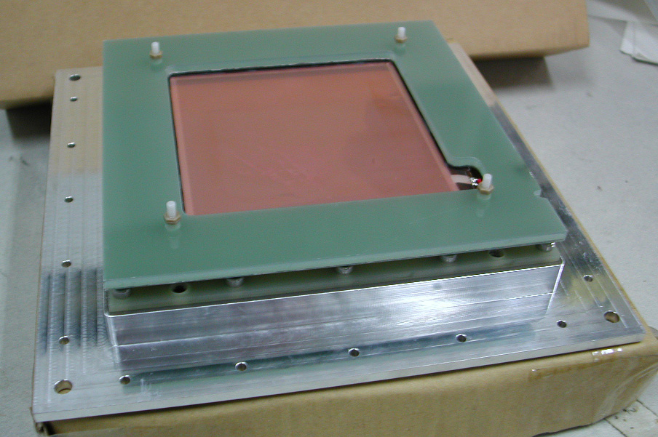
Experience of GEM in CNS
Another type of GEM
  COBRA-GEM for ion feedback suppression
  Glass-GEM (no out gas, no neutron reaction with H, long term stability)
  Telfon GEM (large arc resistance, robust against discharge/spark)
    No short of GEM even after 10⁴ times discharges (at single GEM gain~10⁴)!
Application
  GEM-TPC (CF₄)
  X-ray Imaging

Slide 31
R&D items of GEM-TPC upgrade
Gain stability of GEM under Ne/CO₂
Systematic study of Ion back flow
  3-4 GEM layers (pitch, hole, transfer field dependence)
  Another type of GEM (Cobra GEM)
  Micromegas + 2 GEM systems
  Garfield simulation
Large size foil R&D, IROC Prototype and Beamtest
Electronics R&D
  SAMPA chip, GdSP chip
Performance evaluation, reconstruct strategy

Slide 32
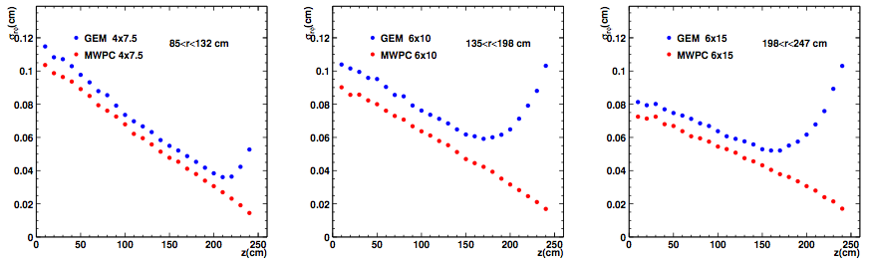
Expected Performance
Position Resolution
  Slightly worse than MWPC due to lack of a Pad Response function in GEMs (narrow spread of signal over pads)
  Near the chamber worse resolution due to low diffusion and narrow PRF

Slide 33
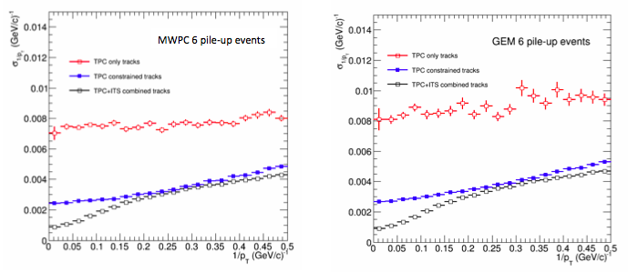
Expected Performance
Momentum Resolution
  Very little deterioration for TPC standalone and 6 pile-up events
    Less merged cluster in case of GEMs: lack of PFR
  No difference between MWPC and GEM in case of ITS vertex +TPC tracking

Slide 34
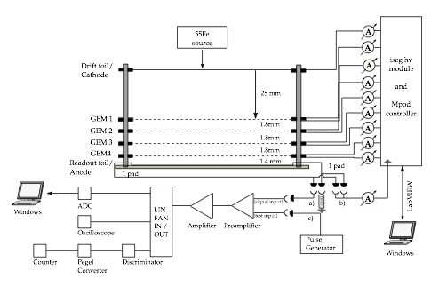
IBF studies
Dedicated test setup at CERN, TUM, FRA, Tokyo
Systematic studies as a function of:
  rate → space-charge effect to the IBF
  Field configuration, number of GEM layers, large pitch foil
Measure the current
at cathode and anode pad.
IBF=(I_{c}-I_{c}⁰)/I_{a}

Slide 35
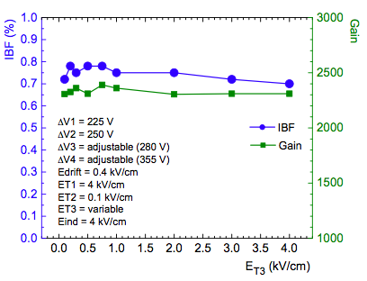
IBF studies
3 standard GEM setups ~ 2% of IBF
4 GEM setup with large pitch foils on GEM1 and GEM3
  LP-S-LP-S: LP=280um pitch (S=140um pitch)
  Reach 0.8% of IBF and secured some flexibility
Further studies are on going
  S-LP-LP-S setup
  Resolution
  Smaller pitch GEM
  Conical GEM
  etc…

Slide 36
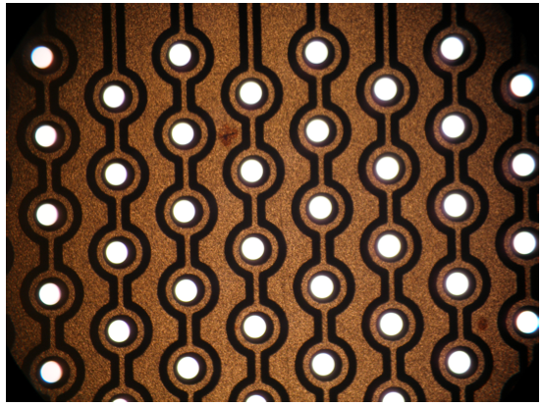
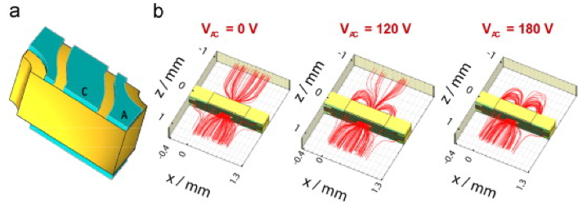
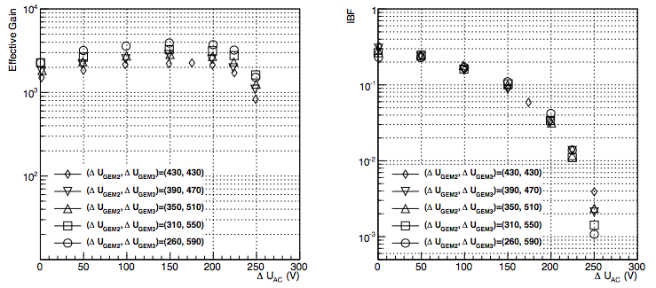
IBF studies
Alternative options = “COBRA” GEMs
  Additional electrode and potential difference to absorb ions
Standard - Cobra – Cobra
IBF<1% is reached!
COBRA-GEM
φ=150um
t=200um
Pitch=400um
Rim=50um

Slide 37

Stability
GEM detector system and wire chamber system in one gas loop system. (common on gas concentration and P/T)
  Wire-chamber is reference. Stability = 0.45%

Slide 38




IROC Prototype and beamtest
Large size GEM by “single” mask technology
  3 GEM layers for IROC size and prototype
  Beamtest at CERN-PS T10 beamine (10-11. 2012)
    PCA16 + ALTRO electronics (from LCTPC) + ALICE DAQ system

Slide 39


IROC Prototype
dE/dx resolution
  Only 46 rows are used.
  Almost equal to the
  expected for MWPC.
  Performance is preserved.

Slide 40



Readout system
Readout system
  Replace existing PASA+ALTRO to SAMPA system
  SAMPA = 32channel PASA (dual polarity) + ALTRO in same die
    10~20MHz ADC capability, DSP, support trigger/continuous readout
  Option = “GdSP” chip being developed at CERN
    40MHz, 128channel input, DSP, high speed data transmission via GBT

Slide 41
Status and Plans
Technical Design Report will be submitted soon.
2013-2014: design and prototyping
2015-2016: production of GEMs (chambers) and FEE
2017-2018: Construction of ROCs, Installation and commissioning
  Depending on shutdown schedule

Slide 42
Summary and Outlook
ALICE upgrades have been proposed to strengthen physics programs for precision QGP studies.
  E-by-E flow, higher order flow for soft~hard probes, lepton, photons
  ALICE is unique in low p_{T} physics, HQ measurements, dielectron measurement
  Inspecting 50kHz of minimum bias Pb-Pb collisions
  Require core upgrades (ITS, TPC, electronics, and DAQ), enhanced rate capabilities , and running beyond LS2/LS3.
    Significant R&D efforts are on-going
  GEM-TPC R&D is ongoing
    To prove the principle, low IBF, space-charge distortion, online-offline corrections, continuous running.

Slide 43
Backup slides

Slide 44
Run at 50 kHz Pb-Pb after LS2
With present MWPC readout, space-charge leads to unbearable distortions (order 1 m) and deterioration of dE/dx (10-20% gain drop)
GEMs offer the possibility to sustain continuous readout under high rates at a lower gain, while efficiently blocking ions to the % level
100 m² of large size foils, long drifts, high rates

Slide 45
Ongoing R&D: Ion Back Flow (IBF)
High rates and long drifts: ‘standard’ GEM operation results in too large distortions (IBF 5-10%).
IBF can be minimised by optimising electric fields, GEM geometry, gain sharing*: for IBF ~ 0.25% distortions stay well below 10 cm, as shown in simulations below
Target value is IBF ~ 0.25% at gain 1000-2000
* M. Killenberg et al. NIM A530, 251 (2004) , B. Ketzer et al. arXiv:1207.0013

Slide 46

Core Detector Upgrades - ITS
6->7 Si layers
  7 pixels or 3(pixel)+4(strip)
  Inner most at R=2.2cm
  Low material 0.3%X₀/lay (←1.14%X₀)
  Hybrid-pixel or MAPS(MIMOSA, LePIX, INMAPS). Extensive R&D.
  Improve vertex resolution by factor of 3
  Improve low pT tracking efficiency

Slide 47


Other upgrades - FOCAL
C.A. Salgado, JPG 38 (2011) 124036
FOCAL(Forward Calorimeter)
  Gluon saturation at small-x
  Early stage dynamics of HI collisions
Unique opportunity for ALICE
  highest eta(>3) with wide p_{T} coverage
  Prompt photon, π⁰, jets, (quarkonia)
  and correlation with rapidity gap
W+Si EM Sampling Calorimeter
  + H-CAL behind under consideration
  Two possibilities on location
    3m (2.5<eta<4.2) from IP
    8m (3.3<eta<5.0) from IP

Slide 48





Other upgrades - FOCAL
FOCAL detector design
  Two combination of the detector
    Low granularity Si-Pad layers
    High granularity Si pixel layers
      Separation of π⁰→2γ and prompt γ
Prototype R&D
  Si-Pad and electronics
  ASIC development (CNS et al.)
  Si-Pixel (MAPS) development
Beamtest of CNS FoCAL (Si-Pad) in 2011
pedestal
Electron
3 GeV
pedestal
Electron
4 GeV
pedestal
Electron
5 GeV

Slide 49
Core Upgrade - DAQ
DAQ upgrade
  Requirements: ~1TByte/s detector readout, 20GB/s in storage
  Strategy:
    Data reduction by (partial) online reconstruction and compression.
    Store only reconstructed data (tight coupling between online and offline)
FTP (Fast Trigger Processor)
CLK/L0/L1, data tagging (ITS/TPC)
DDL/RORC
DDL3(10GB/s)
10-12 DDL3, PCIe GEN3 in RORC3
Network
10/100GBit Ethernet
QDR/FDR Infiniband (42/50GBit)
FLP (First Level Processor)
ZS, data compression/localized
reconstruction
EPN (Event building and Processing Node)
Event building/final data compression
(CPU/GPU)

Slide 50
Single mask GEM
Double mask
Single mask
Same base material
Hole patterning in Cu
Polyimide etch
Bottom electro etch
Second Polyimide Etch
Limited to 40cm x 40cm due to
  Mask precision and alignment
Limited to 2m x 60cm due to
  Base material
  Equipment
R. De Oliveira

Slide 51


Single mask GEM
R. De Oliveira
Similar patterns , similar behavior, same material.
Angles can be adjusted in both structure (Typ. value : 70um copper hole , 50um polyimide hole)
  Steeper angles give lower gain but also reduced charging up ( similar as RIM in THGEM)

Slide 52

Single mask GEM
R. De Oliveira
Similar patterns , similar behavior, same material.
Angles can be adjusted in both structure (Typ. value : 70um copper hole , 50um polyimide hole)
  Steeper angles give lower gain but also reduced charging up ( similar as RIM in THGEM)
WILL BE USED FOR CMS FORWARD MUON TRACKER

Slide 53


Heavy Flavor Measurements
Improvement of secondary vertex resolution by x2
  Measurement of Λ_{c}, D_{s}, Λ_{b}
  v2 and R_{AA} for wide pT range (down to low pT)
  Better feasibility to measure Λ_{c}

Slide 54

ALICE Status with the upgrades

Slide 55

ALCIE TPC - II
Gating wire
  Prevent ions from drifting
  back to the drift space
  Important to avoid field
  distortion
Cathod, anode wire planes
Gas gain ~ 2x10⁴
Multiplication of drift
electrons at anode
Induced current on the readout pad

Slide 56


Current Limitations - II
Current readout capability is worse
  Maximum is ~300 Hz due to TPC readout capability
  LS1 upgrade (RCU upgrade) → 1kHz BW
Rate tolerance of wire amplification. O(10kHz/cm²)

Slide 57


Exotics
10¹⁰ central events. Feasible for these measurements

Slide 58
Future ALICE Program
ALICE heavy-ion program approved for 1~10nb⁻¹:
Possible scenario
  2013–14 Long Shutdown 1 (LS1)
    completion of TRD and installation of Di-jet CAL
  2015 Pb–Pb at √s_{NN} = 5.1 TeV
  2016–17 Pb–Pb at √s_{NN} = 5.5 TeV
  2018 Long Shutdown 2 (LS2)
  2019 Pb-Pb 2.85nb⁻¹
  2020 Pb-Pb 2.85nb⁻¹ (low magnetic field)
  2021 p-p reference run
  2022-2023 Long Shutdown 3 (LS3)
  2024-2026: Pb-Pb/p-Pb run with ALICE upgrade
  (3.5 month/year for HI, 1 month with low B)

Slide 59

Space-charge distortion
Maximum radial and azimuthal distortions for various gas mixtures at IBF=1% and gain=2000
Ne-CO₂-N₂ is baseline gas mixture.
  Online corrections to 0.01% (0.02cm) are required
  Space-charge map, fluctuation map (from Pb-Pb raw data)

Slide 60

IBF studies
3 standard GEM setup
  Measurement at gain = 2000
  Better IBF with high Et1 and low Et2 but IBF=2%! Not enough!

Slide 61

IBF studies
Another option = “2 GEM + Micromegas”
  MMG has good IBF capability.
  With 1000LPI mesh, IBF ~ E₁/E₂ ~ 1%.
  Further IBF suppression with 2 GEMs x 10, IBF~0.1% can be possible.
  On-going
  measurements!

