Slide 1
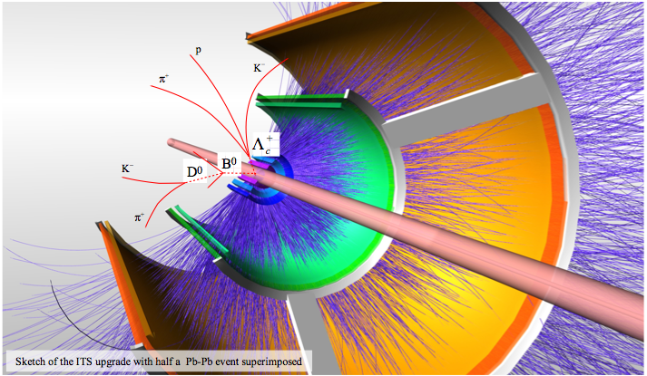


Korean participation in ALICE Upgrade Ⅱ
In-Kwon Yoo
Pusan National University
Heavy Ion Meeting 2013-06

Slide 2
Outline
ALICE & Inner Tracking System
ALICE upgrade Strategy
  ITS Physics Motivation
New ITS design
  Goals
  Upgrade options
Physics Performance Study
Korean contribution

Slide 3
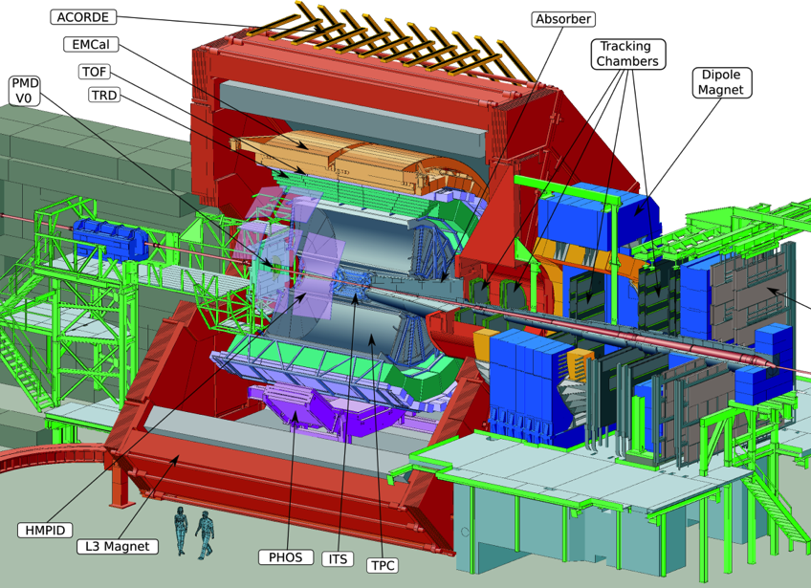
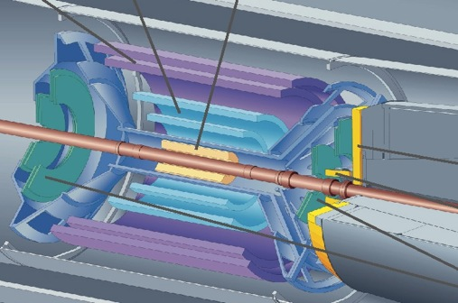

ALICE Detector
Current ITS
6 concentric barrels, 3 different technologies
2 layers of silicon pixel (SPD)
2 layers of silicon drift (SDD)
2 layers of silicon strips (SSD)

Slide 4
ALICE Upgrade Strategy
☐ High precision measurements of rare probes at low p_{T}, which can not be selected with a trigger, require a large sample of events.
Target
Gain a factor 100 in statistics over approved program.
  Pb-Pb recorded luminosity ≥ 10 nb⁻¹ ➔ 8 x 10¹⁰ events
  pp (@5.5 TeV) recorded luminosity ≥ 6 pb⁻¹ ➔ 1.4 x 10¹¹ events
Significant improvement of vertexing & tracking capabilities.
Goals
Upgrade the ALICE readout system & online system
Improve vertexing & tracking at low pT ➔ New ITS

Slide 5
ITS performance - Tracking and vertex determination
ALICE ITS (present detector)
Example: D⁰ meson
Open charm
D⁰ reconstructed
momentum
Particle | Decay Channel | cτ (μm)
D⁰ | K⁻ π⁺ (3.8%) | 123
D⁺ | K⁻ π⁺ π⁺ (9.5%) | 312
 | K⁺ K⁻ π⁺ (5.2%) | 150
 | p K⁻ π⁺ (5.0%) | 60
Pointing
Angle θ
K⁻
π⁺
secondary
vertex
D⁰ flight line
~ 100 μm
Pb
d₀^{π}
Pb
d₀^{k}
Primary vertex
Analysis based on decay topology and invariant mass technique
ALI-PERF-12878

Slide 6
What determines the impact parameter resolution
What determines the impact parameter resolution?
Vertex projection from two points: a simplified approach (telescope equation)
current ITS 
pointing resolution = (13 ⊕ 22GeV/p⋅c) μm
first pixel layer
from
detector
position
error
from
coulomb
scattering
Δx
detector layer 2
θ_{m}
Δx
detector layer 1
For higher Pointing resolution,
Smaller pixel size
less material budget
Add layers
Reduce distance between layers
r₁
r₂
r₁
r₂
perceived
vertex
Δv
true vertex
perceived
vertex
Δv
true vertex

Slide 7
New ITS Design goals
1. Improve impact parameter resolution by a factor of ~3
- Get closer to IP (position of first layer)
: 39mm 22mm
- Reduce material budget (X/X₀ /layer)
: ~1.14%  ~ 0.3% (for inner layers)
- Reduce pixel size
: currently 50mm x 425mm
monolithic pixels  20 mm x 20 mm
hybrid pixels  state-of-the-art , 50 mm x 50 mm
2. Improve tracking efficiency and p_{T} resolution at low p_{T}
- Increase granularity: 6 layers  7 layers , reduce pixel size
- Increase radial extension: 39-430 mm  22– 430 (500) mm
3. Fast readout
readout of Pb-Pb interactions at > 50 kHz and pp interactions at ~ several MHz
4. Fast insertion/removal for yearly maintenance
possibility to replace non functioning detector modules during yearly shutdown

Slide 8

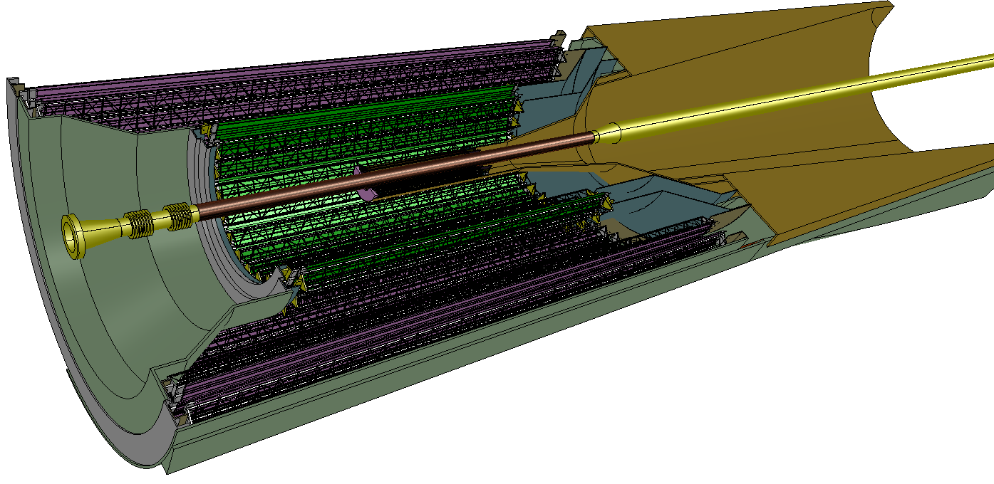
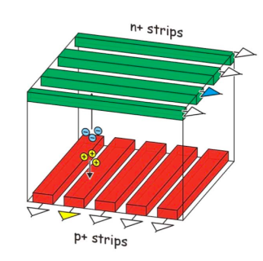
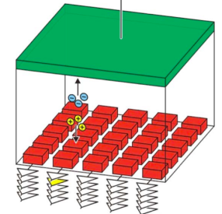
Upgrade options
Two design options have being studied
7 layers of pixel detectors (baseline)
3 inner layers of pixel detectors and 4 outer layers of strip detectors
Option B
4 layers of strips
Option A
7 layers of pixels
3 layers of pixels
Pixels: O(20x20µm² – 50 x 50µm²)
700 krad/ 10¹³ n_{eq}
Includes safety factor ~ 4
Pixels: O( 20x20µm² – 50 x 50µm²)
Strips: 95 µm x 2 cm, double sided

Slide 9

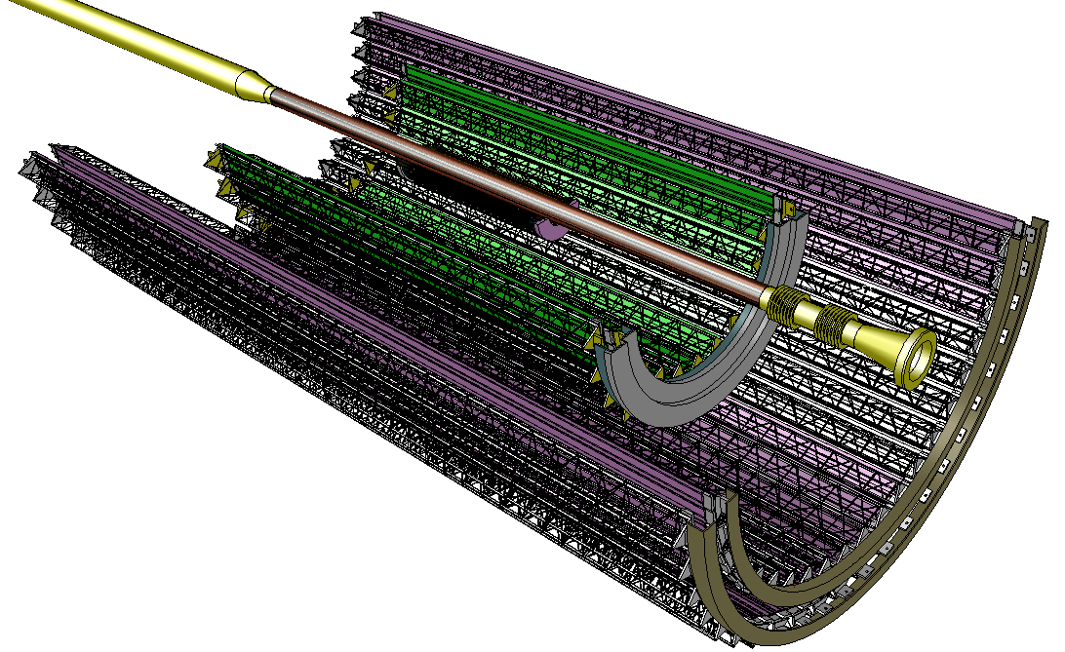
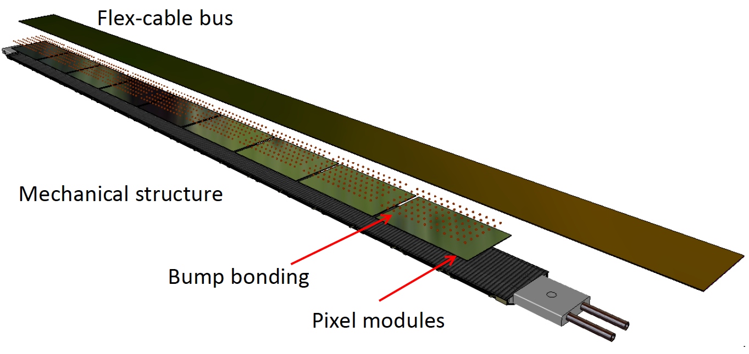
New ITS (baseline)
Inner Barrel: 3 layers
Outer Barrel: 4layers
Detector module (Stave) consists of
Carbon fibber mechanical support
Cooling unit
Polyimide printed circuit board
Silicon chips (CMOS sensors)
25 G-pixel camera, 10 m²
Complementary Metal-Oxide-Semiconductor

Slide 10
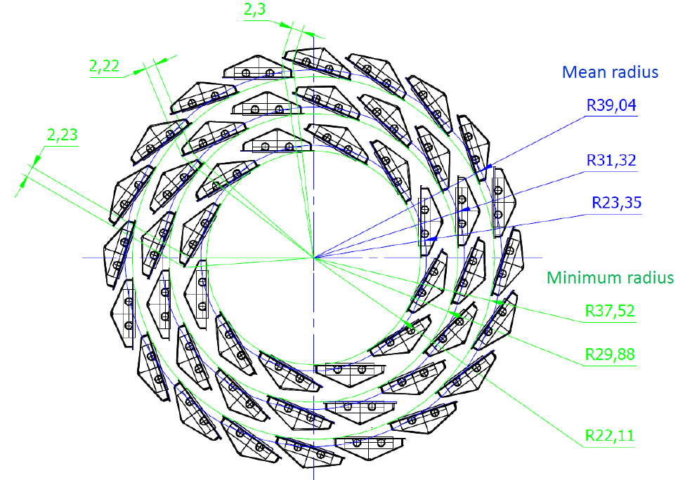
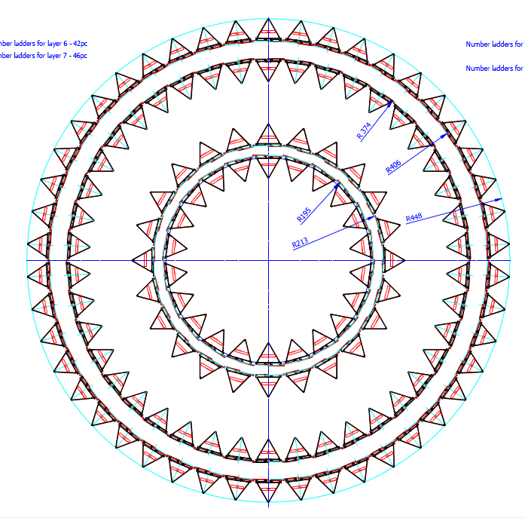
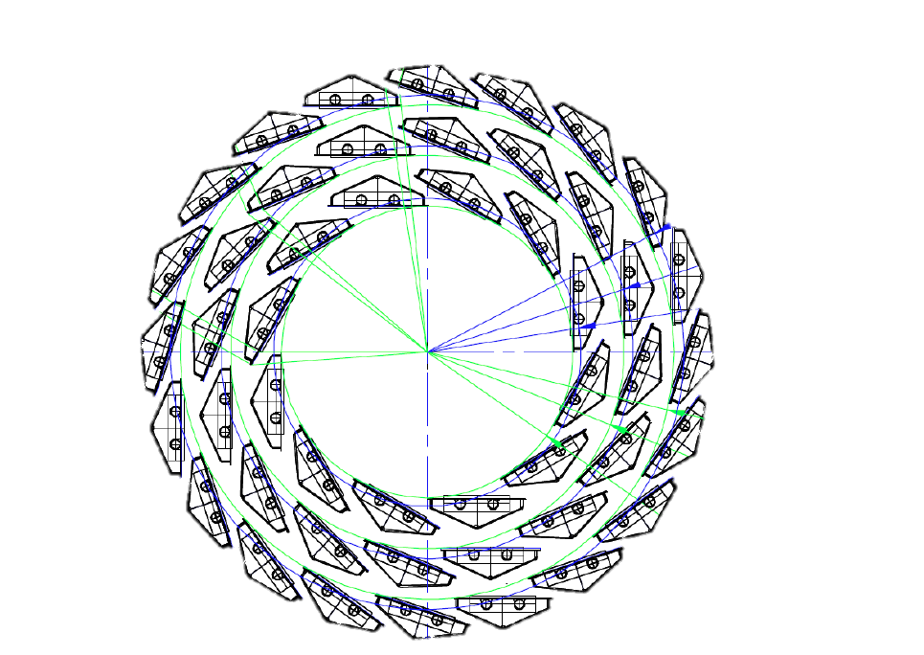
ITS Barrel Layers
Inner Barrel layers
Middle & Outer Barrel layers
3 innermost layers at r= 22, 28 and 36 mm
Same z-length: 27 cm
Assumed chip size: 15 mm x 30 mm
9 chips/module
X/X₀≤ 0.3%
4 outermost layers at r= 48, 52, 96, 102 mm
84 cm < z-length < 150 cm
Double chip rows per module
X/X₀≤ 0.8%
 | Modules | Chips
Layer 1 | 12 | 108
Layer 2 | 16 | 144
Layer 3 | 20 | 180
Total | 48 | 432
 | Modules | Chips
Layer 4 | 48 | 2688
Layer 5 | 52 | 2912
Layer 6 | 96 | 9600
Layer 7 | 102 | 10200
Total | 298 | 25400

Slide 11
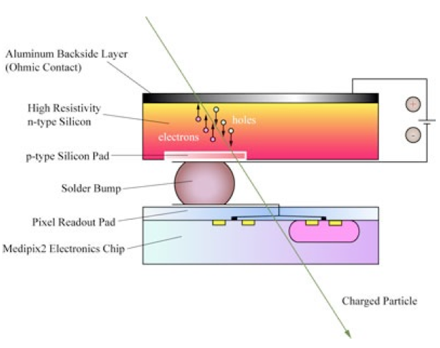
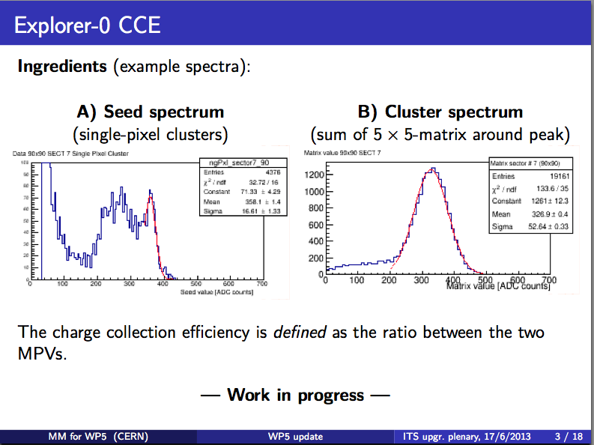
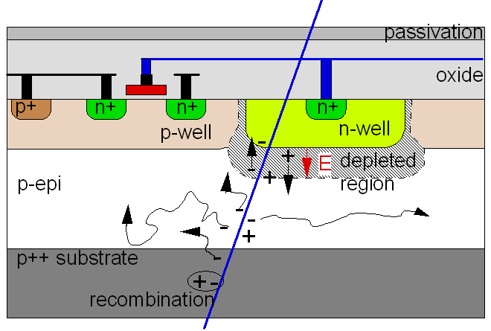
Hybrid Pixel Detector – ‘Expolrer-0/1’
Assembly layout
Hybrid Pixel Layout
Assumed chip size: 15 mm x 30 mm
9 chips/module
X/X0 ≤ 0.3%
CMOS Pixel Sensors
Ionizing Particle

Slide 12
Physics Performance Study
Motivation : Improvement of impact parameter resolution
x 5
x 3
Simulations for two upgrade layouts
Key !!
Option A: 7 pixel layers
Resolutions: s_{rf} = 4 mm, s_{z} = 4 mm for all layers
Material budget: X/X₀ = 0.3% for all layers
Option B: 3 layers of pixels + 4 layers of strips
Resolutions: s_{rf} = 4 mm, s_{z} = 4 mm for pixels s_{rf} = 20 mm, s_{z} = 830 mm for strips
Material budget: X/X₀ = 0.3% for pixels X/X₀ = 0.83% for strips
radial positions (mm): 22, 28, 36, 200, 220, 410, 430
Same for both layouts

Slide 13
Physics Performance Study
An Example : Impact parameter distribution for,
work with Prof. M.Kweon
K.Choi, K,Oh
Dielectron and Dalitz electrons
electrons from B meson
Current
Upgraded
Current
Upgraded
PbPb
pp
Notes:
그림에 대한 간단한 설명을 드리면 앞의 그림은,
- pp와 PbPb 2.76 TeV 충돌에서의 0.8~6.0 GeV의 Dielectron and Dalitz electrons의 impact parameter 분포입니다.
- 그림에서 블루는 업그레이드 전, 레드는 업그레이드 후입니다.
- 총 4개의 그래프가 2개씩 겹쳐 있는데, 위의 그래프 두개가 PbPb 결과이고 아래의 결과가 권민정 교수님께서 하셨던 pp에서의 결과입니다.
- 왼쪽위의 블루 시그마는 업그레이드 전의 PbPb 결과의 가우시간 피팅의 시그마 값이고 레드는 업그레이드 후입니다.
- 그림의 X축은 impact parameter over impact parameter resolution으로 업그레이드 전/후 같은 값이 나오기를 기대하였고, 결과도 그러합니다.
두번째 그림은,
- B 메존에서 붕괴된 전자의 분포입니다.
- 업그레이드 후 피크가 더 브로드 해지길 기대하였고, 그렇게 되는 것을 시물레이션을 통해서 확인하였습니다.

Slide 14
Task Organization of Asian groups
Activity | Participants | Comments
Detector simulation and reconstruction, physics performance | Inha, SUT, CCNU (?) | WP physics (A. Dainese) WP simul. and rec. (M. Masera, J. Belikov)
Design of pixel chip | CCNU, Yonsei, TMEC | WP chip design (W. Snoeys)
Characterization of pixel chip (radioactive source, test beam) | CCNU , Inha, Pusan, SLRI | WP characterization and qualification (M. Mager)
Characterization of pixel chip (laser) | Yonsei | WP characterization and qualification (M. Mager)
Pixel chip mass test | CCNU, Yonsei, TMEC | WP wafer pp and test (P. Riedler)
Assembly and qualification of hybrid structures | CCNU, Pusan, Inha | WP middle/outer layers (other institutes involved: Berkeley/INFN-Nikhef)

Slide 15
Outlook : PNU Task for ITS upgrade
2013/15
: Characterization & Qualification of pixel chips.
  This July/August : Learn Test System (Procedure, Device)
  In advance : Build a Test System in Pusan
: Physics Performance study (with Inha Univ.)
2015/2017 : Assembly and qualification of hybrid structures (pixel chips + kapton printed circuit board)
  Test environment preparation:
    Probing (including mechanical tooling, probe-card design, …)
    Visual inspection system
    Define test areas (clean room)
  Automatisation of test-system: movements, pattern recognition.
  Define Database for test-results
  Component tracking – investigate technical options

Slide 16
Back Up

Slide 17
PROJECT
ORGANIZATION
1. Physics
2. Simulation and Reconstruction
3. Pixel chip design
Institute Board
(PL, DPL, SPL, TC, Team Leaders)
4. Wafers post-processing and testing
5. Characterization and Qualification
UPGRADE
6. Inner Layers Module
Project Coordination
(PL, DPL, SPL, TC, RC,
Upgrade Tasks Coordinators)
7. Middle Layers Module
8. Outer Layers Module
ITS Operation
(RC, PL, DPL, SPL, TC, QAC, CC,
experts)
9. Layers Integration/Commissioning
10.Readout Electronics
11. Mechanics and Cooling
Conveners nominated
12. DCS and Database

Slide 18
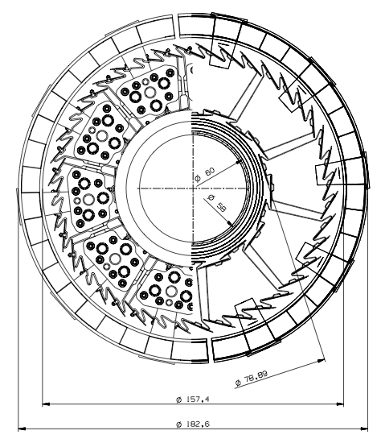
ALICE ITS Upgrade layout
Current Layout (SPD)
Inner Radius
R 50
R 78.89
R 157.4

Slide 19
ALICE ITS Upgrade layout
Current Layout (SPD)
Upgrade Layout (Inner)
Inner Radius
R 50
R 78.89
R 157.4
Mean Radius
R 39.04
R 31.32
R 23.35

Slide 20
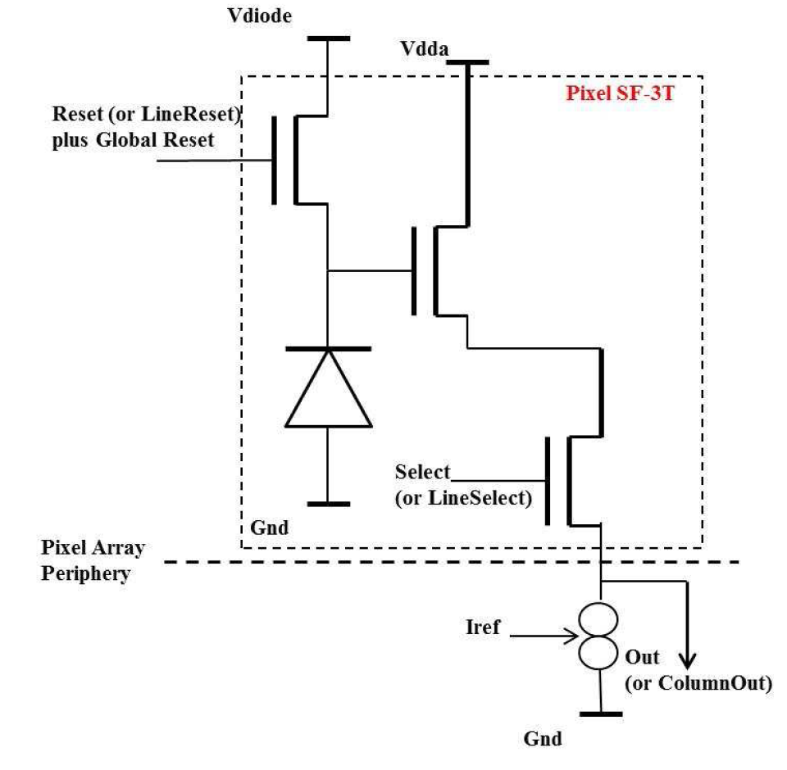
CMOS Pixel Sensors
Ionizing Particle
ROLLING SHUTTER
Pixel Array
Row Address Decoder
Res Addr
COLUMN DISCRIMINATORS
Address
Generator
SCANNER & ENCODER

Slide 21
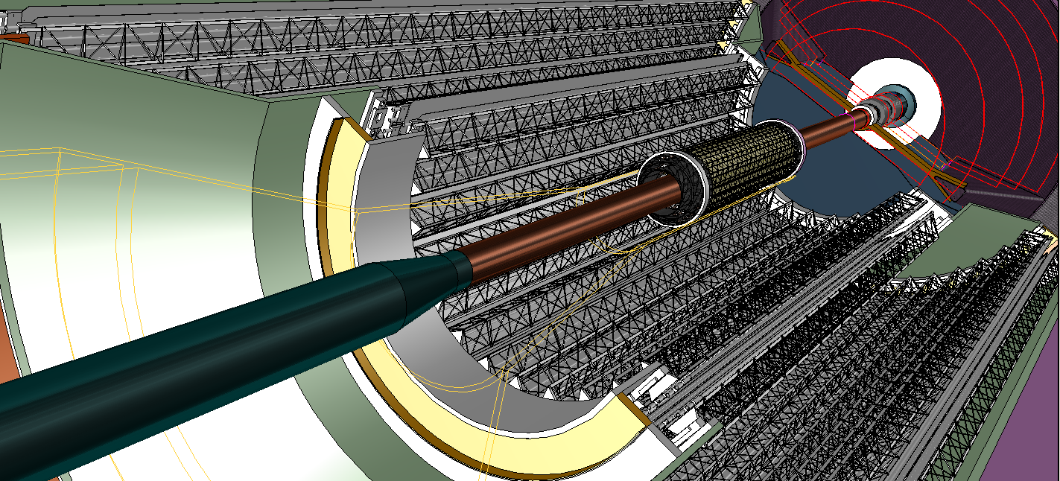
Inner Barrel (IB): 3 layers pixels
Radial position (mm): 22,28,36
Length in z (mm): 270
Nr. of modules: 12, 16, 20
Nr. of chips/module: 9
Nr. of chips/layer: 108, 144, 180
Material thickness: ~ 0.3% X₀
Throughput: < 200 Mbit / sec•cm²
Outer Barrel (OB): 4 layers pixels
Radial position (mm): 200, 220, 410, 430
Length in z (mm): 843, 1475
Nr. of modules: 48, 52, 96, 102
Nr. of chips/module: 56, 56, 98, 98
Nr. of chips/layer: 2688, 2912, 9408, 9996
Material thickness: ~ 0.8% X₀
Throughput: < 6 Mbit / sec•cm²

Slide 22
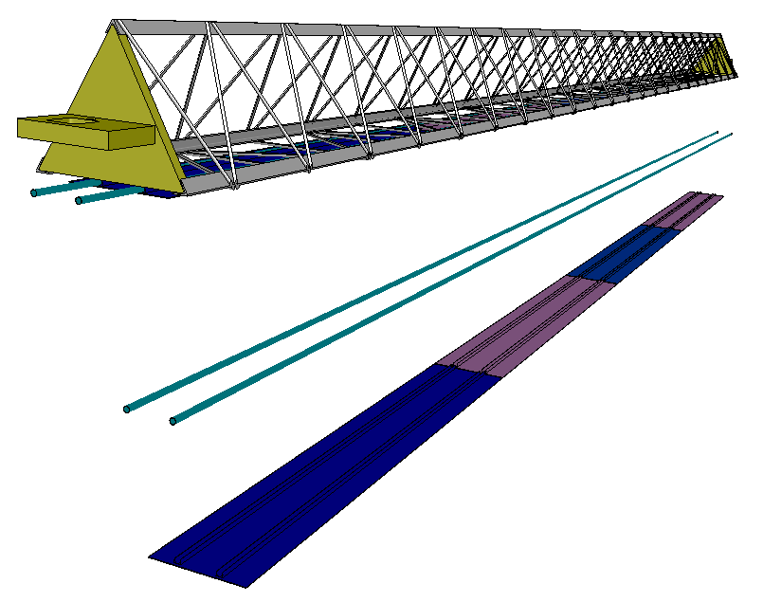
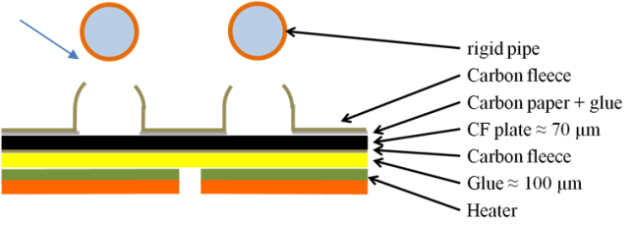
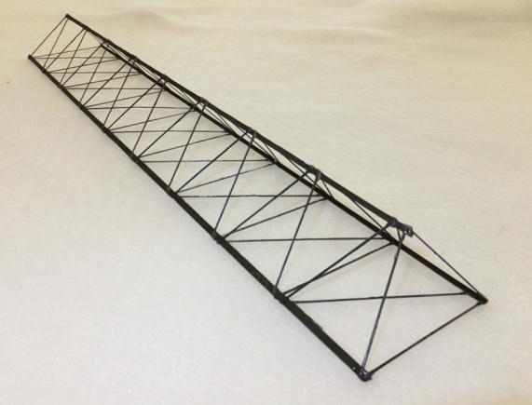
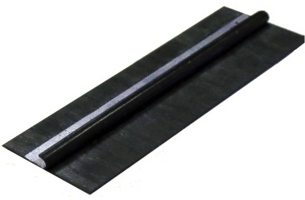
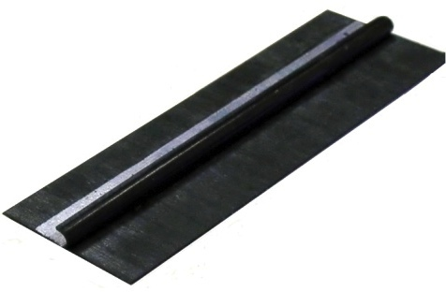

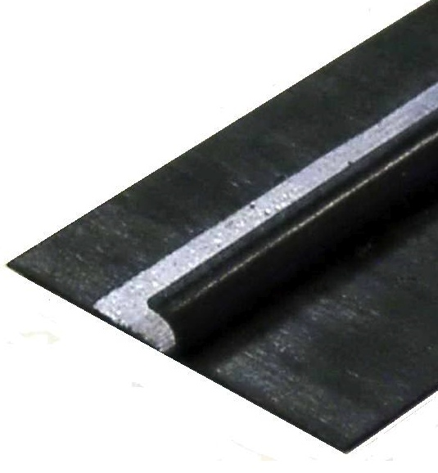
PROTOTYPE
CLAMP
Carbon clamps
Silicon
Bus

Slide 23
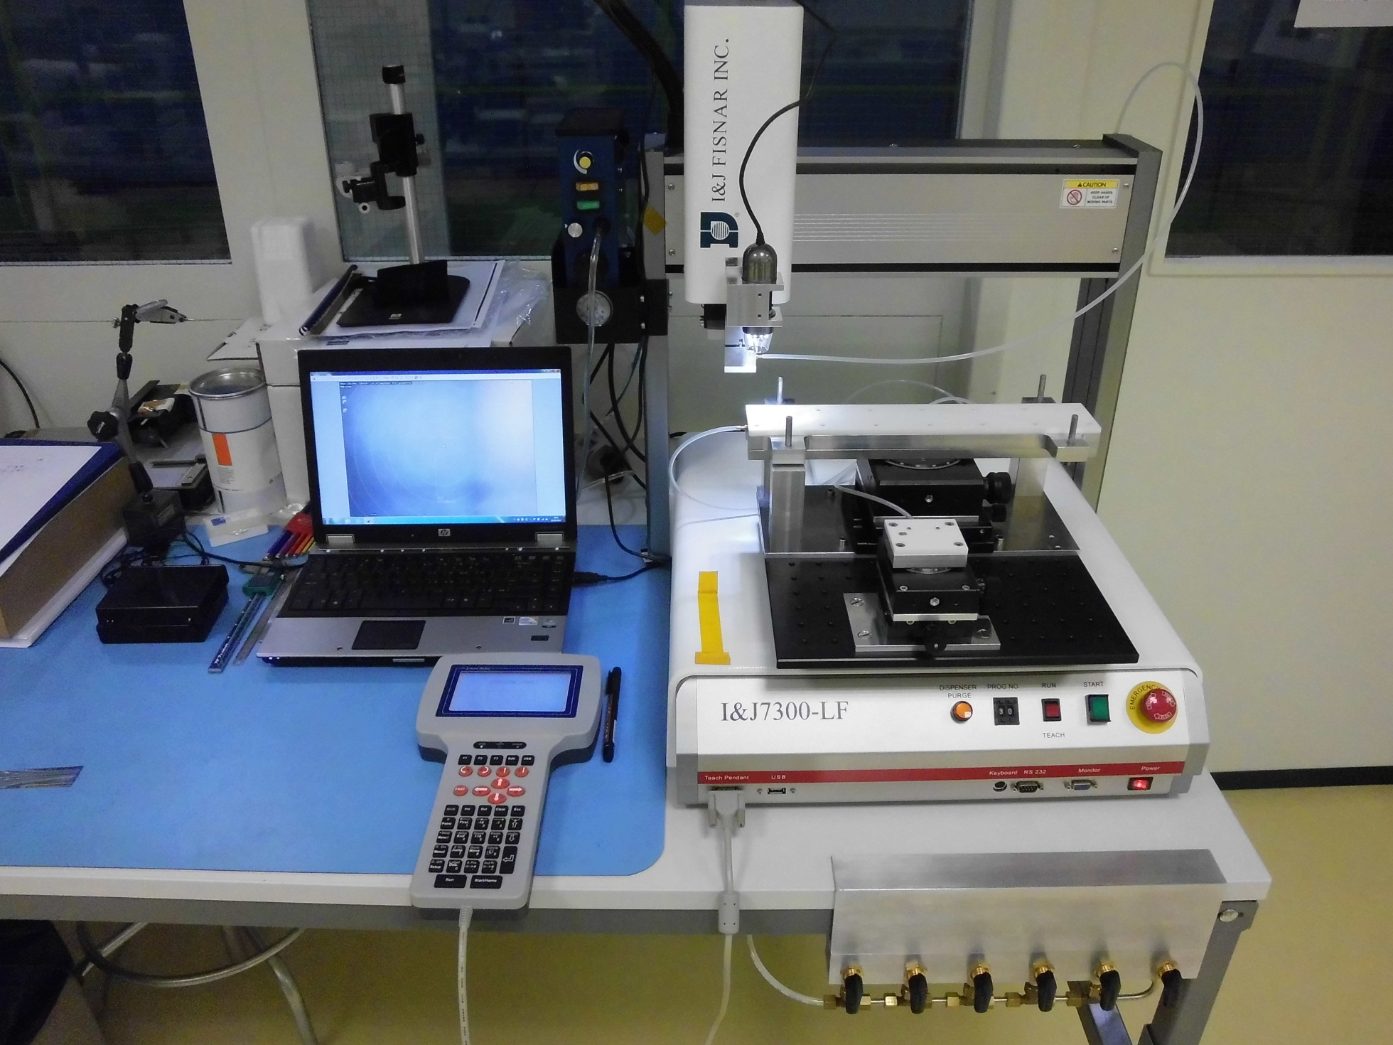
Chip aligner and gluing machine

Slide 24
