Slide 1

The density curvature parameter and high density behavior of the symmetry energy
Lie-Wen Chen (陈列文)
Department of Physics and Astronomy, Shanghai Jiao Tong University
(lwchen@sjtu.edu.cn)
The symmetry energy
Current constraints on the symmetry energy
- n-A elastic scattering and the symmetry potential
- Symmetry energy at 0.11 fm⁻³
- High density behaviors
Density curvature K_{sym} and the high density symmetry energy
Summary and outlook
“Heavy-Ion Meeting”, Korea University, Seoul, May 24, 2013

Slide 2
Outline
The symmetry energy
Current constraints on the symmetry energy
- n-A elastic scattering and the symmetry potential
- Symmetry energy at 0.11 fm⁻³
- High density behaviors
Density curvature K_{sym} and the high density symmetry energy
Summary and outlook

Slide 3
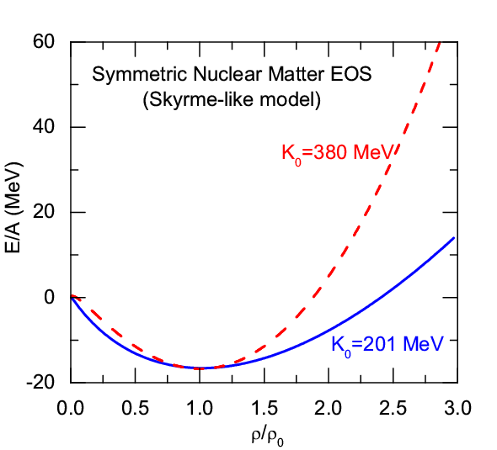
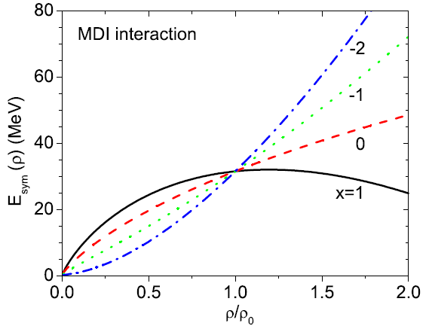
The Symmetry Energy
EOS of Isospin Asymmetric Nuclear Matter
(Parabolic law)
Symmetric Nuclear Matter
(relatively well-determined)
Isospin asymmetry
Symmetry energy term
(poorly known)
The Nuclear Symmetry Energy

Slide 4

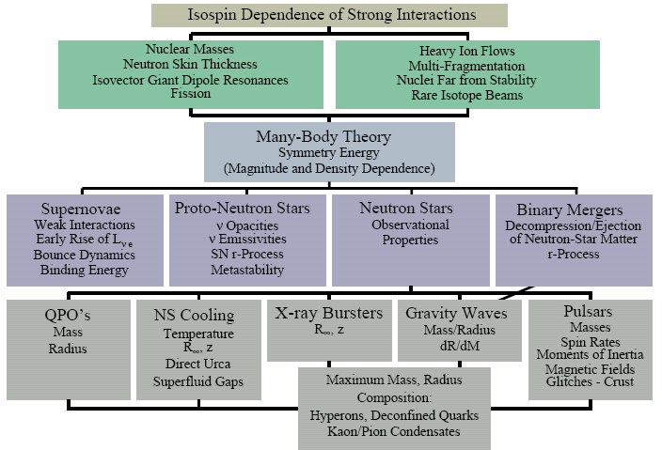
Why Symmetry Energy？
The multifaceted influence of the nuclear symmetry energy
A.W. Steiner, M. Prakash, J.M. Lattimer and P.J. Ellis, Phys. Rep. 411, 325 (2005).
Nuclear Physics
on the Earth
Symmetry Energy
Astrophysics and Cosmology
in Heaven
The symmetry energy is also related to some issues of fundamental physics:
1. The precision tests of the SM through atomic parity violation observables (Sil et al., PRC05)
2. Possible time variation of the gravitational constant (Jofre et al. PRL06; Krastev/Li, PRC07)
3. Non-Newtonian gravity proposed in the grand unified theories (Wen/Li/Chen, PRL09)
4. Dark Matter Direct Detection (Hao Zheng and Lie-Wen Chen, in preparation, 2013)

Slide 5
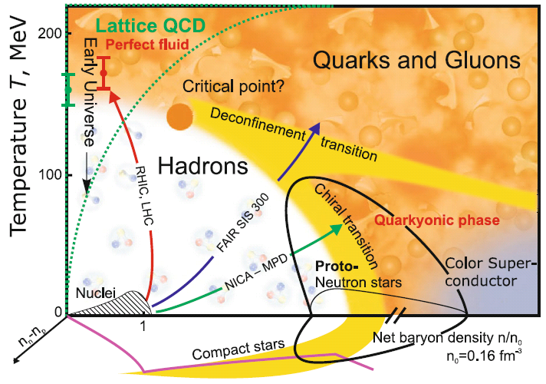

Phase Diagram of Strong Interaction Matter
QCD Phase Diagram in 3D: density, temperature, and isospin
V.E. Fortov, Extreme States of Matter – on Earth and in the Cosmos, Springer-Verlag Berlin Heidelberg 2011
Physics of QGP
Holy Grail of
Nuclear Physics
Isospin Nuclear Physics
Compact Stars
To Understand Strong Interaction Matter at Extreme，especially its EOS
Heavy Ion Collisions (Terrestrial Lab); 2. Compact Stars(In Heaven); …

Slide 6
Facilities of Radioactive Beams
Cooling Storage Ring (CSR) Facility at HIRFL/Lanzhou in China (2008)
up to 500 MeV/A for ²³⁸U
http://www.impcas.ac.cn/zhuye/en/htm/247.htm
Beijing Radioactive Ion Facility (BRIF-II) at CIAE in China (2012)
http://www.ciae.ac.cn/
Radioactive Ion Beam Factory (RIBF) at RIKEN in Japan (2007)
http://www.riken.jp/engn/index.html
Texas A&M Facility for Rare Exotic Beams -T-REX (2013)
http://cyclotron.tamu.edu
Facility for Antiproton and Ion Research (FAIR)/GSI in Germany (2016)
up to 2 GeV/A for ¹³²Sn (NUSTAR - NUclear STructure, Astrophysics and Reactions )
http://www.gsi.de/fair/index_e.html
SPIRAL2/GANIL in France (2013)
http://pro.ganil-spiral2.eu/spiral2
Selective Production of Exotic Species (SPES)/INFN in Italy (2015)
http://web.infn.it/spes
Facility for Rare Isotope Beams (FRIB)/MSU in USA (2018)
up to 400(200) MeV/A for ¹³²Sn
http://www.frib.msu.edu/
The Korean Rare Isotope Accelerator (KoRIA-RAON(RISP Accelerator Complex) (Starting)
up to 250 MeV/A for ¹³²Sn, up to 109 pps
……

Slide 7
Nuclear Matter EOS: Many-Body Approaches
The nuclear EOS cannot be measured experimentally, its determination thus depends on theoretical approaches
Microscopic Many-Body Approaches
Non-relativistic Brueckner-Bethe-Goldstone (BBG) Theory
Relativistic Dirac-Brueckner-Hartree-Fock (DBHF) approach
Self-Consistent Green’s Function (SCGF) Theory
Variational Many-Body (VMB) approach
Green’s Function Monte Carlo Calculation
V_{lowk} + Renormalization Group
Effective Field Theory
Density Functional Theory (DFT)
Chiral Perturbation Theory (ChPT)
QCD-based theory
Phenomenological Approaches
Relativistic mean-field (RMF) theory
Quark Meson Coupling (QMC) Model
Relativistic Hartree-Fock (RHF)
Non-relativistic Hartree-Fock (Skyrme-Hartree-Fock)
Thomas-Fermi (TF) approximations

Slide 8
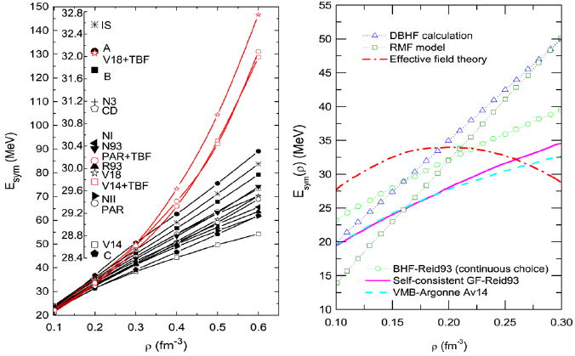
Nuclear Matter Symmetry Energy
Chen/Ko/Li, PRC72, 064309(2005)
Chen/Ko/Li, PRC76, 054316(2007)
Z.H. Li et al., PRC74, 047304(2006)
Dieperink et al., PRC68, 064307(2003)
BHF
Notes:
8

Slide 9

Nuclear Matter EOS: Transport Theory
Transport Models
Ni + Au, E/A = 45 MeV/A
Transport Models for HIC’s at intermediate energies:
N-body approaches
CMD, QMD,IQMD,IDQMD,
ImQMD,ImIQMD,AMD,FMD
One-body approaches
BUU/VUU, BNV, LV, IBL
Relativistic covariant approaches
RVUU/RBUU,RQMD…
Central collisions
Broad applications of transport models
in astrophysics, plasma physics, electron transport in semiconductor and nanostructures, particle and nuclear physics, ……

Slide 10
Transport model for HIC’s
Isospin-dependent BUU (IBUU) model
Solve the Boltzmann equation using test particle method (C.Y. Wong)
Isospin-dependent initialization
Isospin- (momentum-) dependent mean field potential
Isospin-dependent N-N cross sections
a. Experimental free space N-N cross section σ_{exp}
b. In-medium N-N cross section from the Dirac-Brueckner
approach based on Bonn A potential σ_{in-medium}
c. Mean-field consistent cross section due to m*
Isospin-dependent Pauli Blocking
EOS

Slide 11
Outline
The symmetry energy
Current constraints on the symmetry energy
- n-A elastic scattering and the symmetry potential
- Symmetry energy at 0.11 fm⁻³
- High density behaviors
Density curvature K_{sym} and the high density symmetry energy
Summary and outlook

Slide 12
Probes of the Symmetry Energy
Promising Probes of the E_{sym}(ρ)
(an incomplete list !)
Pigmy/Giant resonances
Nucleon optical potential
B.A. Li, L.W. Chen, C.M. Ko
Phys. Rep. 464, 113(2008)

Slide 13
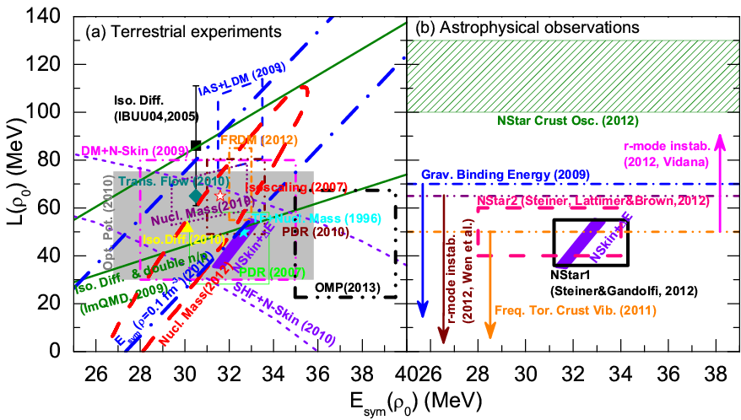
E_{sym}：Around saturation density
Current constraints (totally 24) on E_{sym} (ρ₀) and L from
terrestrial experiments and astrophysical observations
L.W. Chen, arXiv:1212.0284
B.A. Li, L.W. Chen, F.J. Fattoyev,
W.G. Newton, and C. Xu,
arXiv:1212.1178

Slide 14
E_{sym}：Around saturation density
The current constraints on Esym are strongly model dependent, even around saturation density!!!
Is there a general principle at some level, independent of the interaction and many-body theory, telling us what determines the E_{sym}(ρ₀) and L?
If possible, how to constrain separately each component of E_{sym}(ρ₀) and L?
E_{sym}(ρ) and L(ρ) can be decomposed in terms of nucleon potential in asymmetric nuclear matter which can be extracted from Optical Model Potential from N-nucleus scattering
C. Xu, B.A. Li, L.W. Chen and C.M. Ko, NPA 865, 1 (2011)
C. Xu, B.A. Li, and L.W. Chen, PRC82, 054607 (2010)
R. Chen, B.J. Cai. L.W. Chen, B.A. Li, X.H. Li, and C. Xu, PRC85, 024305 (2012)
X.H. Li, B.J. Cai. L.W. Chen, R. Chen, B.A. Li, and C. Xu, PLB721, 101 (2013)

Slide 15
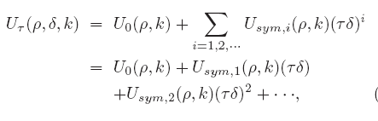
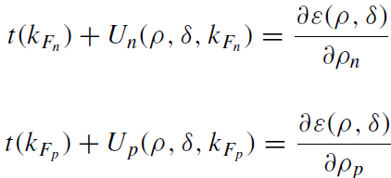

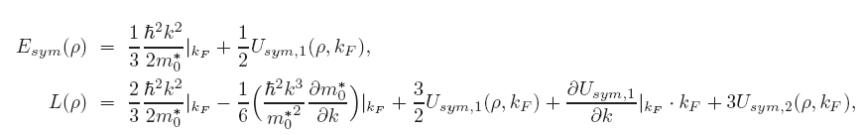

Decomposition of the Esym and L according to the Hugenholtz-Van Hove (HVH) theorem
C. Xu, B.A. Li, L.W. Chen and C.M. Ko, NPA 865, 1 (2011)
C. Xu, B.A. Li, and L.W. Chen, PRC82, 054607 (2010)
R. Chen, B.J. Cai. L.W. Chen, B.A. Li, X.H. Li, and C. Xu, PRC85, 024305 (2012).
The Lane potential (Symmetry potential)
Higher order in isospin asymmetry
K. A. Brueckner and J. Dabrowski,
Phys. Rev. 134, B722 (1964)

Slide 16
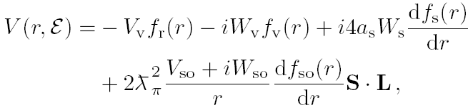
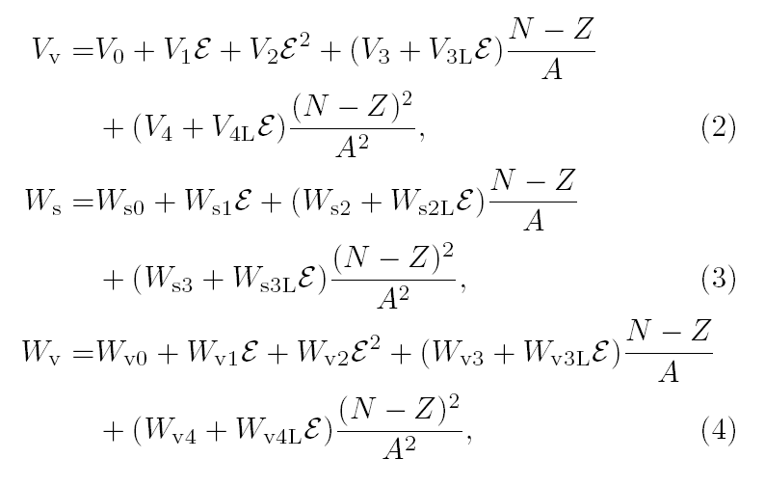
Is the second-order symmetry potential U_{sym,2} (ρ,p) negligibly small compared to the first-order symmetry potential U_{sym,1} (ρ,p) (Lane potential)?
Constraining symmetry potentials from
neutron-nucleus scattering data
X.H. Li, B.J. Cai. L.W. Chen, R. Chen, B.A. Li, and C. Xu, PLB721, 101 (2013)
Both U_{sym,1} (ρ,p) and U_{sym,2} (ρ,p) at saturation density can be extracted from global neutron-nucleus scattering optical potentials

Slide 17
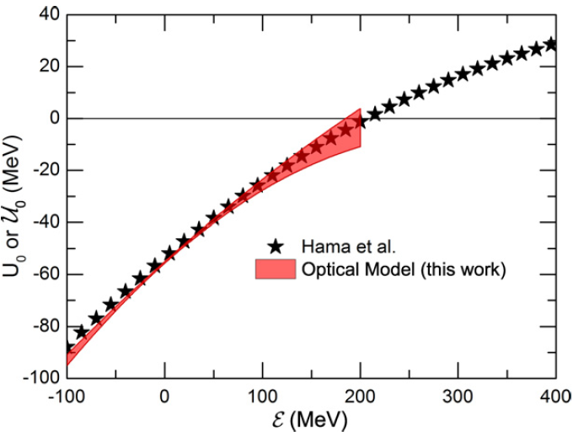
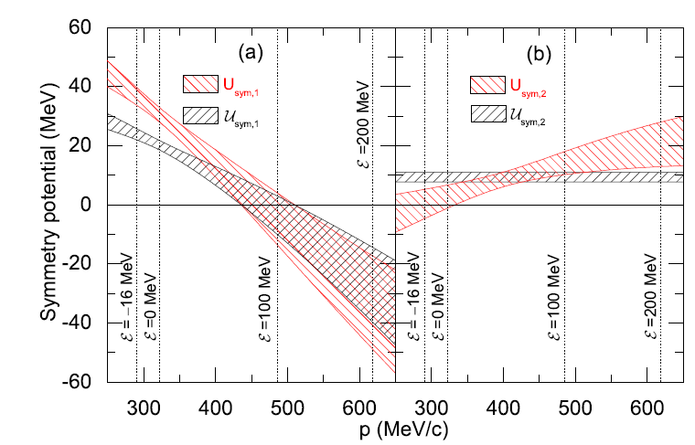
The second-order symmetry potential U_{sym,2} (ρ,p) at saturation density is NOT so small as that we guess originally !
Constraining symmetry potentials from
neutron-nucleus scattering data
X.H. Li, B.J. Cai. L.W. Chen, R. Chen, B.A. Li, and C. Xu, PLB721, 101 (2013)

Slide 18
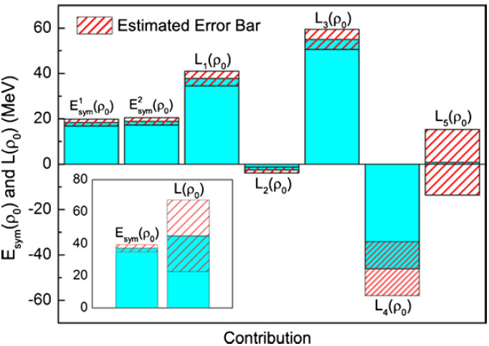
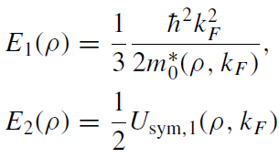
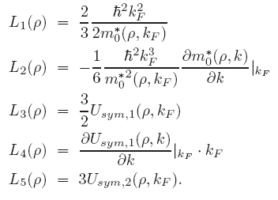

Constraints on L_{n} from n+A elastic scatterings
X.H. Li, B.J. Cai. L.W. Chen, R. Chen, B.A. Li, and C. Xu, PLB721, 101 (2013)
The U_{sym,2} (ρ₀,p) contribution to L is small ! (but with large uncertainty)
Extrapolation to negative energy (-16 MeV) from
scattering state has been made, which may lead to
some uncertainty on E_{sym} (ρ₀) but almost no influence
on L (Dispersive OM may help?)

Slide 19
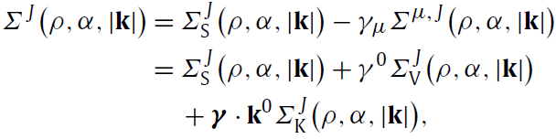



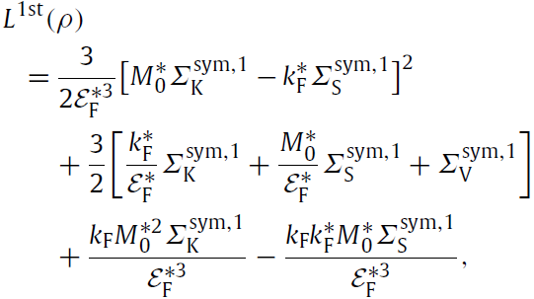
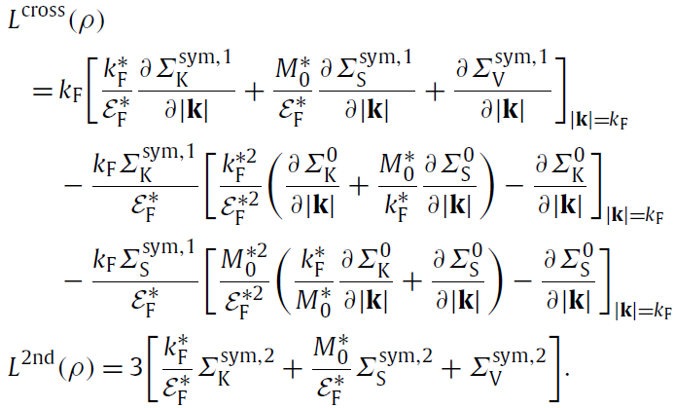
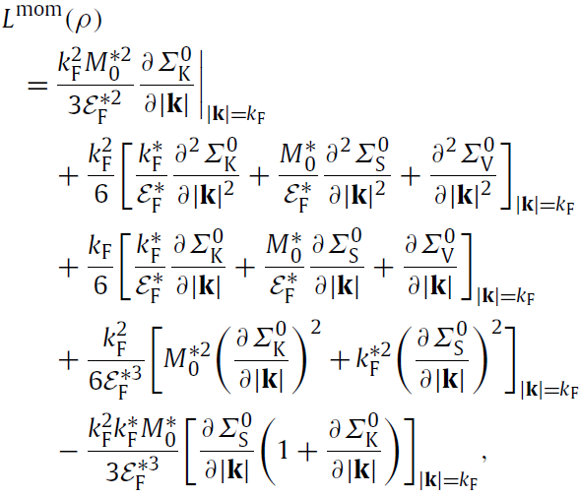
Lorentz Covariant Self-energy Decomposition of the E_{sym} and L
B.J. Cai and L.W. Chen, PLB711, 104 (2012)
Lorentz covariant nucleon self-energy can be obtained from Dirac phenomenology, QCD sum rules (KS Jeoug/SH Lee, EG Drukarev),……

Slide 20
Outline
The symmetry energy
Current constraints on the symmetry energy
- n-A elastic scattering and the symmetry potential
- Symmetry energy at 0.11 fm⁻³
- High density behaviors
Density curvature K_{sym} and the high density symmetry energy
Summary and outlook

Slide 21
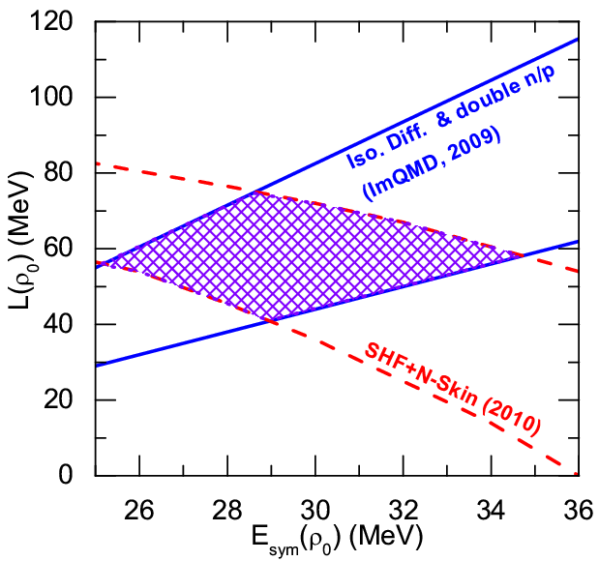
E_{sym}：Around saturation density
Current constraints (totally 24) on E_{sym} (ρ₀) and L from
terrestrial experiments and astrophysical observations
E_{sym}(ρ₀)=30±5 MeV
L=58±18 MeV
Chen/Ko/Li/Xu, PRC82, 024321(2010)
Neutron skin constraint leads to a negative E_{sym}-L correlation!!!
But why???
The nskin is directly correlated with L(0.11 fm⁻³) which leads to a negative
E_{sym}-L correlation (at saturation density)

Slide 22
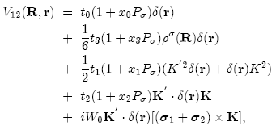
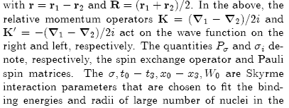
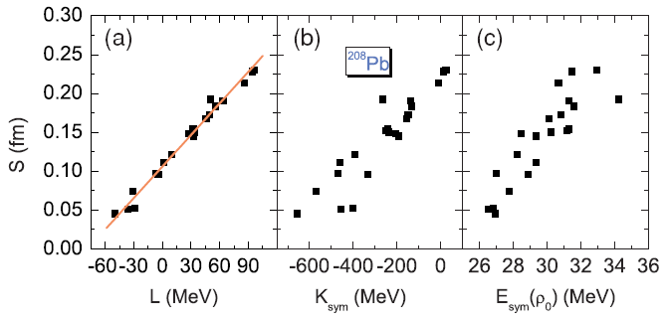

Correlation analysis using macroscopic quantity
input in Nuclear Energy Density Functional
Standard Skyrme Interaction:
There are more than
120 sets of Skyrme-
like Interactions in
the literature
Agrawal/Shlomo/Kim Au
PRC72, 014310 (2005)
Yoshida/Sagawa
PRC73, 044320 (2006)
Chen/Ko/Li/Xu
PRC82, 024321(2010)
_________
9 Skyrme parameters:
9 macroscopic nuclear properties:

Slide 23

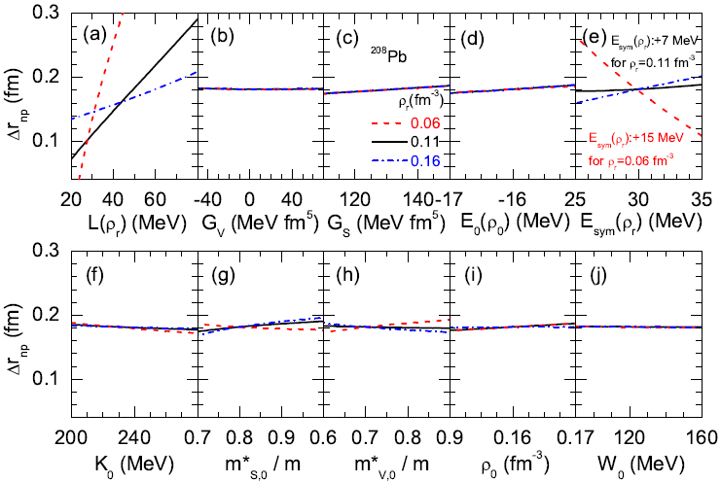
What really determine NSKin?
Zhen Zhang and Lie-Wen Chen ,arXiv:1302.5327
Skyrme HF calculations with MSL0
Neutron skin always increases with L(ρ_{r}) , but it can increase or decrease with E_{sym}(ρ_{r}) depending on ρ_{r}
When ρ_{r} =0.11 fm⁻³, the neutron skin is essentailly only sensitive to L(ρ_{r}) !!!
The neutron skin of heavy nuclei
L(ρ_{r}) at ρ_{r} =0.11 fm⁻³

Slide 24
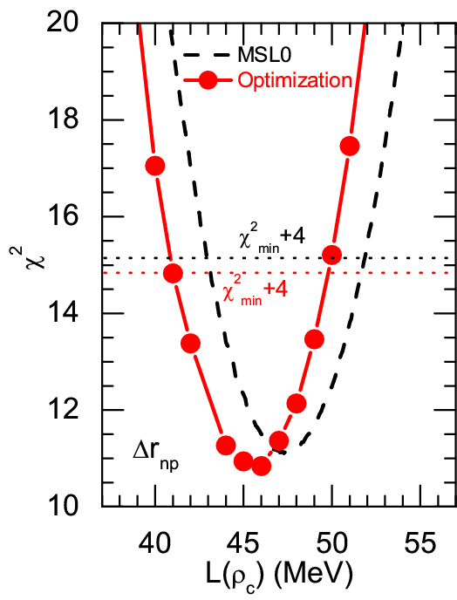
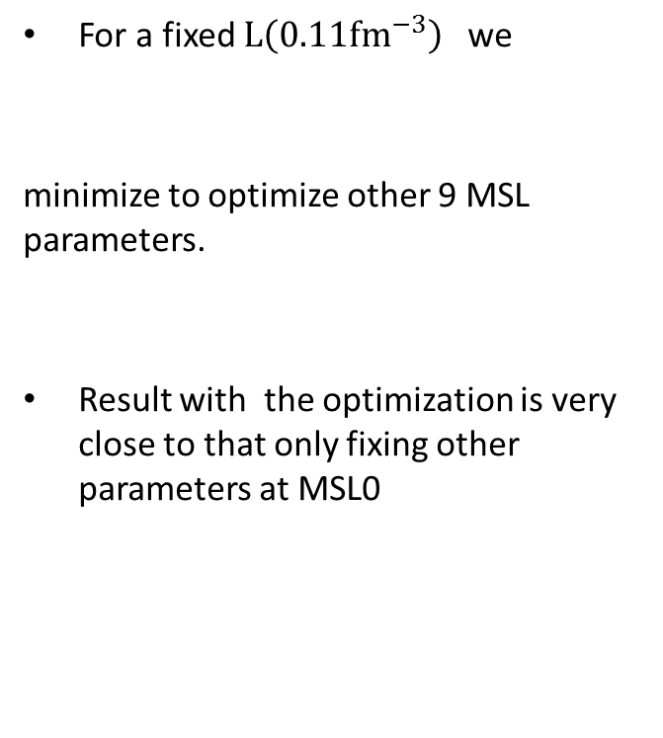
Determine L(0.11 fm⁻³) from NSkin
Zhen Zhang and Lie-Wen Chen ,arXiv:1302.5327
21 data of NSKin of Sn Isotope

Slide 25



What really determine ΔE?
Isotope binding energy difference
(spherical even-even isotope pairs)
(a_{sym}(A): Symmetry energy of finite nuclei)
a_{sym}(A)≈E_{sym}(ρ_{c}) with ρ_{c} ≈0.11 fm⁻³ for heavy nuclei
M. Centelles et al., PRL102, 122502 (2009)
L.W. Chen, PRC83, 044308 (2011)
E_{sym}(ρ_{c}) at ρ_{c} ≈0.11 fm⁻³
Binding energy difference of heavy isotope pair
E_{sym}(ρ_{c}) at ρ_{c} =0.11 fm⁻³

Slide 26
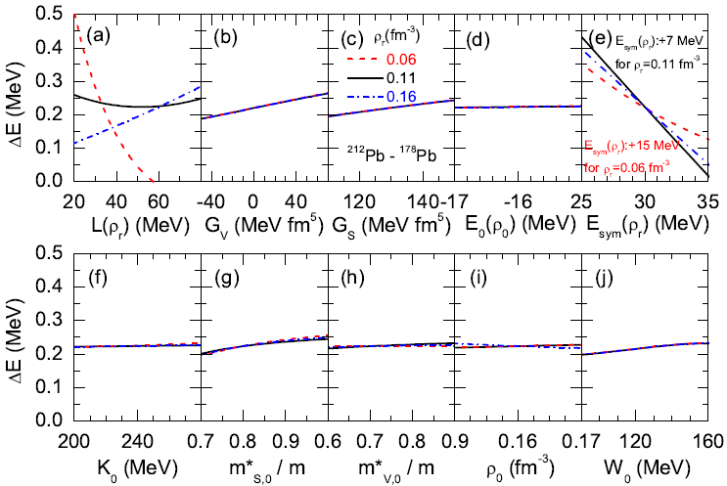
What really determine ΔE?
Zhen Zhang and Lie-Wen Chen ,
arXiv:1302.5327
Skyrme HF calculations with MSL0
ΔE always decreases with E_{sym}(ρ_{r}) , but it can increase or decrease with L(ρ_{r}) depending on ρ_{r}
When ρ_{r} =0.11 fm⁻³, ΔE is mainly sensitive to E_{sym}(ρ_{r}) !!!
Binding energy difference of heavy isotope pair
E_{sym}(ρ_{c}) at ρ_{c} =0.11 fm⁻³

Slide 27
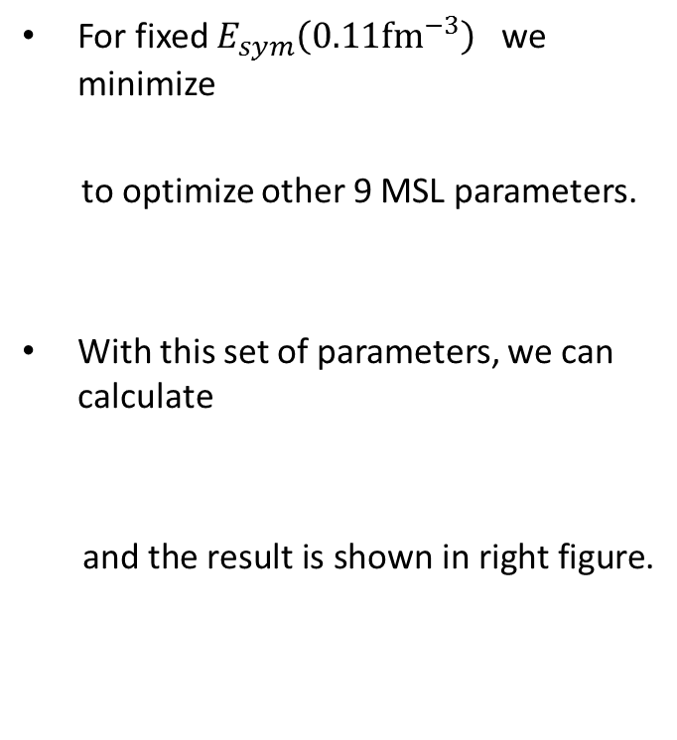
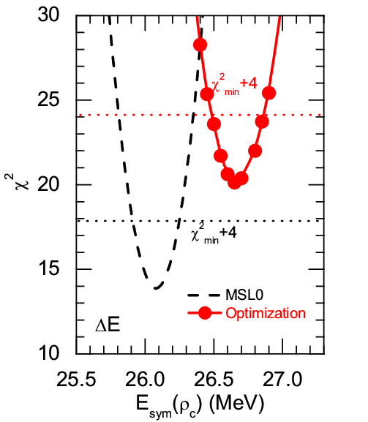
Determine E_{sym}(0.11 fm⁻³) from ΔE
19 data of Heavy Isotope Pairs
(Spherical even-even nuclei)
Zhen Zhang and Lie-Wen Chen ,arXiv:1302.5327

Slide 28
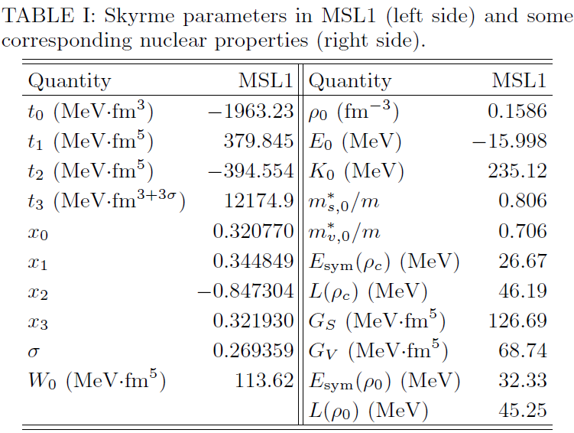
Symmetry energy around 0.11 fm⁻³
The globally optimized parameters (MSL1)
Binding energy difference of heavy isotope pairs
The neutron skin of Sn isotopes
Zhen Zhang and Lie-Wen Chen
arXiv:1302.5327

Slide 29
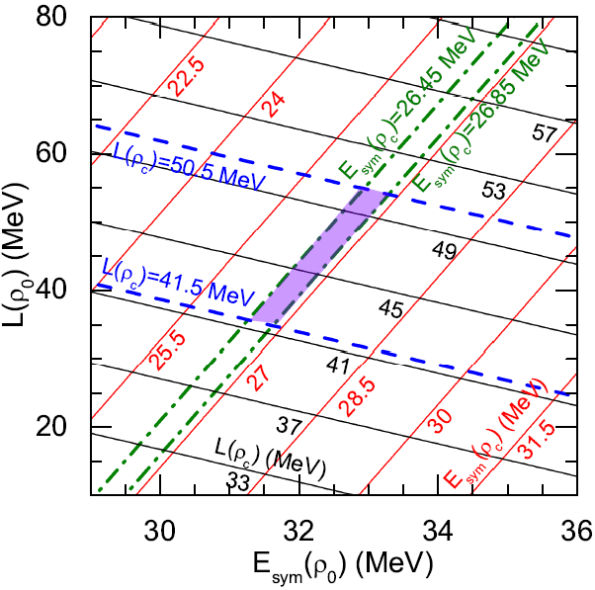
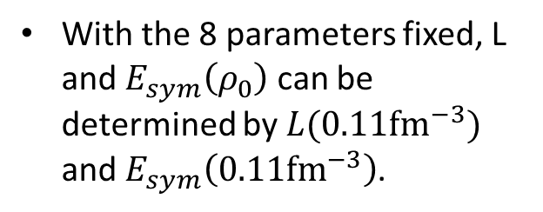
Extrapolation to ρ₀
A fixed value of E_{sym}(ρ_{c}) at ρ_{c} =0.11 fm⁻³ leads to a positive E_{sym}(ρ₀) -L correlation
A fixed value of L(ρ_{c}) at ρ_{c} =0.11 fm⁻³ leads to a negative E_{sym}(ρ₀) -L correlation
Zhen Zhang and Lie-Wen Chen
arXiv:1302.5327
Nicely agree with the constraints from IAS+NSKin by P. Danielewicz; IsospinD+n/p by Y Zhang and ZX Li

Slide 30
Outline
The symmetry energy
Current constraints on the symmetry energy
- n-A elastic scattering and the symmetry potential
- Symmetry energy at 0.11 fm⁻³
- High density behaviors
Density curvature K_{sym} and the high density symmetry energy
Summary and outlook

Slide 31
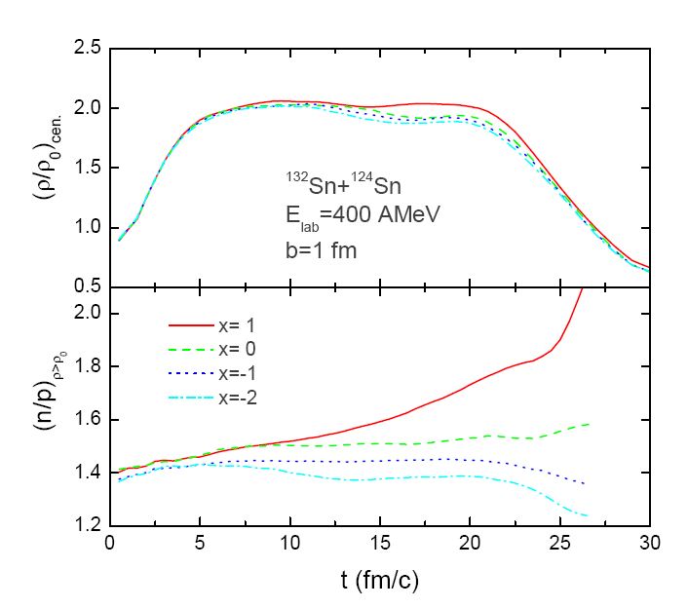


High Density Behaviors of E_{sym}：HIC
IBUU simu.
Heavy-Ion Collisions at Higher Energies
n/p ratio of the high density region
Isospin fractionation!
Xu/Tsang et al. PRL85, 716 (2000)
B.A. Li, PRL88, 192701(2002)

Slide 32
Particle Production in HIC
Besides protons, neutrons, deutrons, tritons, 3He, 4He, and on,
the following particles can be produced in HIC at energies lower
than their production threshold energies in NN collisions:
Particle subthreshold production in HIC provides an important
way to explore nuclear matter EOS and hadron properties in
nuclear medium

Slide 33
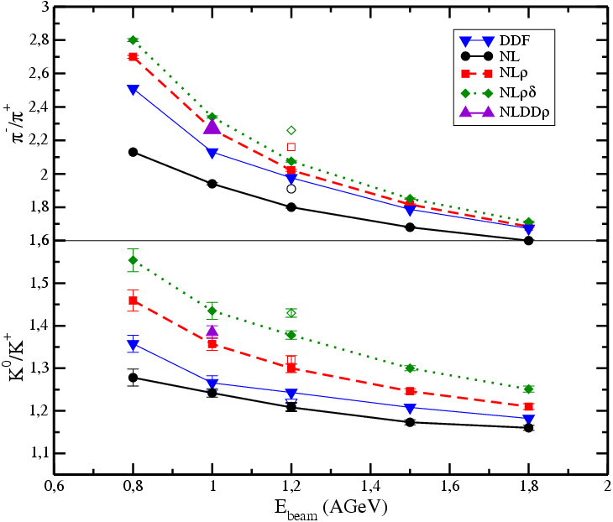
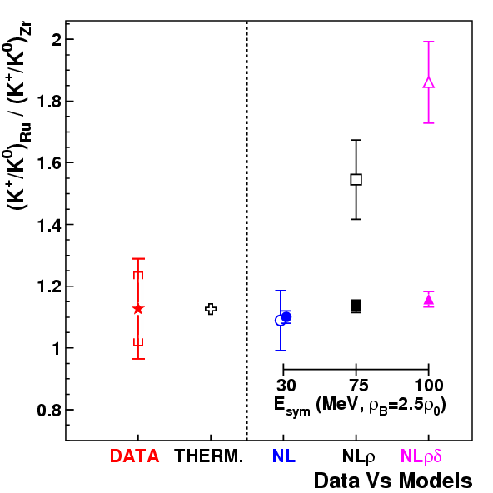
High density E_{sym}: Subthreshold kaon yield
Aichelin/Ko, PRL55, 2661 (1985): Subthreshold kaon yield is a sensitive probe of the EOS of nuclear matter at high densities (Kaons are produced mainly from the high density region and at the early stage of the reaction almost without subsequent reabsorption effects)
Theory: Famiano et al., PRL97, 052701 (2006)
Exp.: Lopez et al. FOPI, PRC75, 011901(R) (2007)
K⁰/K⁺ yield is not so sensitive to
the symmetry energy! Lower energy and more neutron-rich system???
Subthreshold K⁰/K⁺ yield may be a sensitive probe of the symmetry energy at high densities

Slide 34
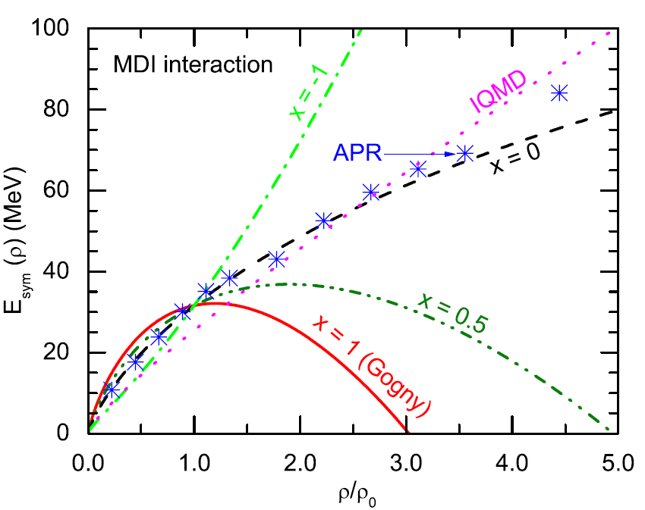
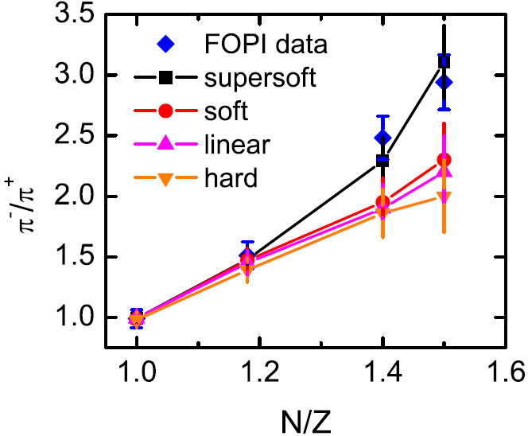
High density E_{sym}: pion ratio
A Quite Soft Esym at supra-saturation densities ???
ImIBLE, Xie/Su/Zhu/Zhang,
PLB718,1510(2013)
IBUU04, Xiao/Li/Chen/Yong/Zhang, PRL102,062502(2009)
Softer
Stiffer
Pion Medium Effects?
Xu/Ko/Oh
PRC81, 024910(2010)
Threshold effects?
Δ resonances?
……
ImIQMD, Feng/Jin, PLB683, 140(2010)

Slide 35
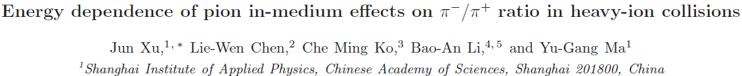
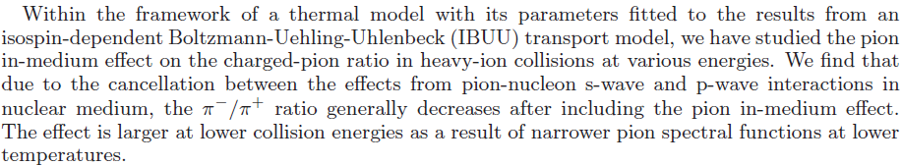
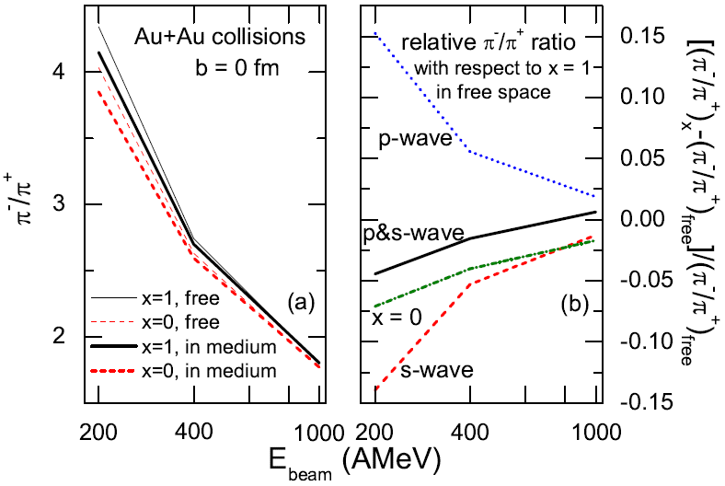
High density E_{sym}: pion ratio
arXiv:1305.0091
PRC, in press
The pion in-meidum effects seem small in the thermal model !!!
But how about in more realistic dynamical model ???
How to self-consistently teat the pion in-medium effects in transport model remains a big challenge !!!

Slide 36
High density E_{sym}: n/p v2
A Soft or Stiff Esym at supra-saturation densities ???
P. Russotto,W. Trauntmann, Q.F. Li et al., PLB697, 471(2011)

Slide 37
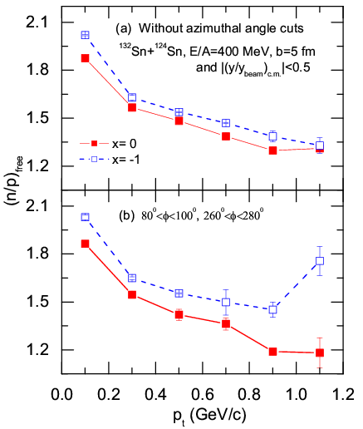
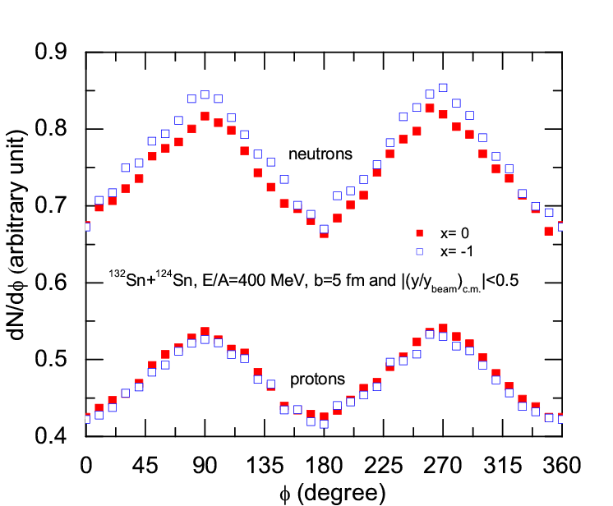
High density E_{sym}: n/p (t/³He) ratio at
squeeze-out direction
In the squeeze-out direction: nucleons emitted from the high density participant region have a better chance to escape without being hindered by the spectators. These nucleons thus carry more direct information about the high density phase of the reaction.
The effect can be 40% at higher p_{T} !
(RAON can make contribution)
Yong/Li/Chen, PLB650, 344 (2007)

Slide 38
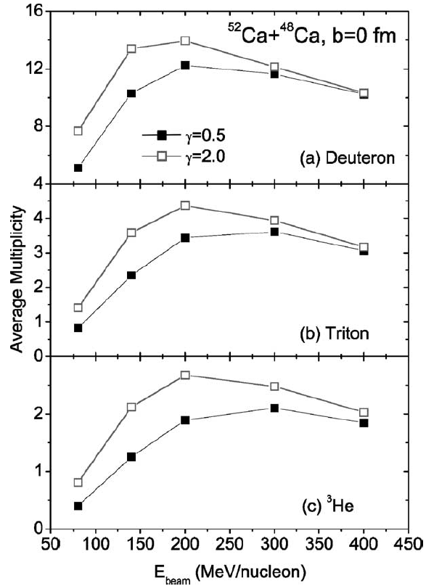
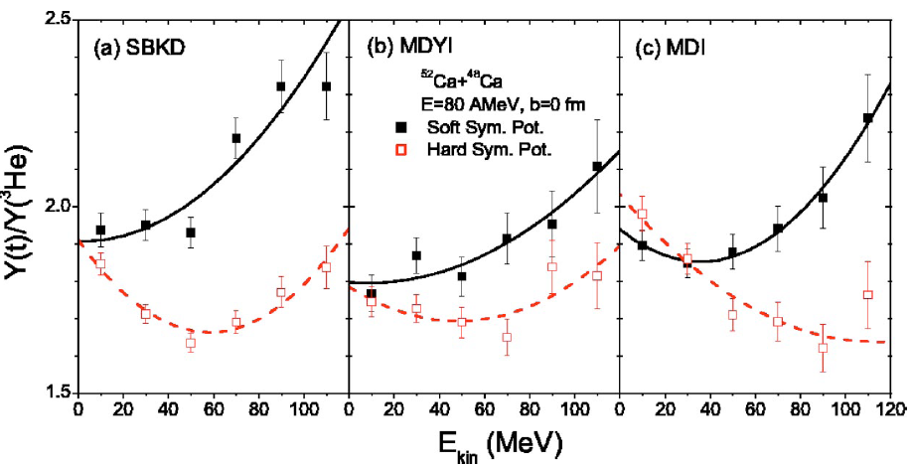
High density E_{sym}: n/p (t/³He) ratio at
squeeze-out direction
IBUU04+Coalescence
Chen/Ko/Li, PRC69, 054606 (2004)
RAON can make contribution!!!
Chen/Ko/Li, NPA729, 809 (2003)

Slide 39
Outline
The symmetry energy
Current constraints on the symmetry energy
- n-A elastic scattering and the symmetry potential
- Symmetry energy at 0.11 fm⁻³
- High density behaviors
Density curvature K_{sym} and the high density symmetry energy
Summary and outlook

Slide 40
High density E_{sym}：other ways?
The high behaviors of Esym are the most elusive properties of asymmetric nuclear matter!!!
While high quality data and reliable models are in progress to constrain the high density Esym, can we find other ways to get some information on high density Esym?
Can we get some information on high density Esym from the knowledge of Esym around saturation density?

Slide 41
High density E_{sym}: K_{sym} parameter？
L.W. Chen, Sci. China Phys. Mech. Astron. 54, suppl. 1, s124 (2011) [arXiv:1101.2384]

Slide 42
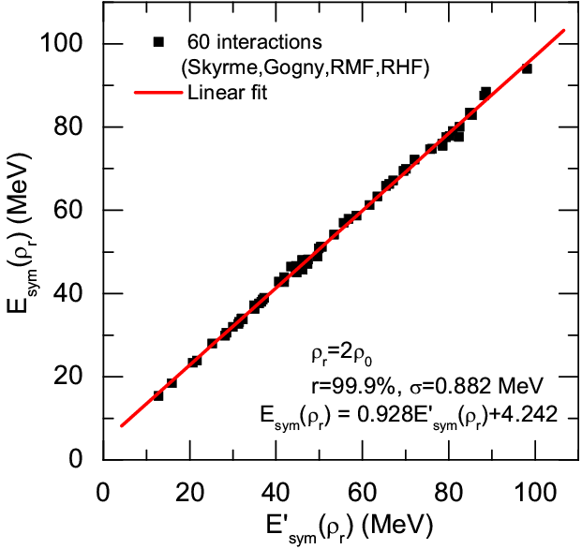
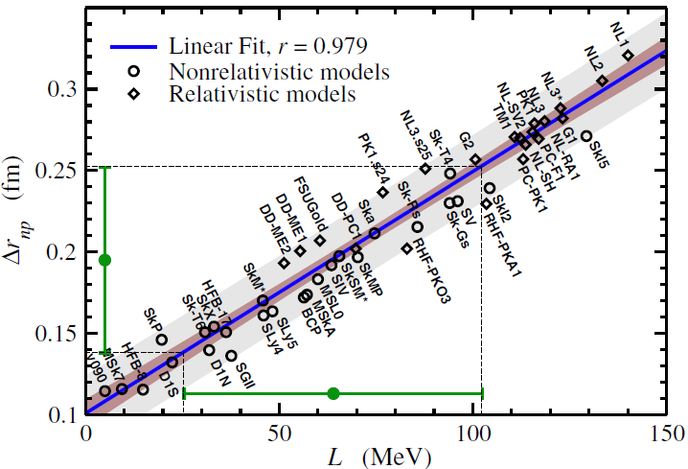
High density E_{sym}: K_{sym} parameter？
Roca-Maza et al., PRL106, 252501 (2011)
46 interactions +BSK18-21+MSL1+SAMi +SV-min+UNEDF0-1+TOV-min+IU-FSU
+BSP+IU-FSU*+TM1*

Slide 43
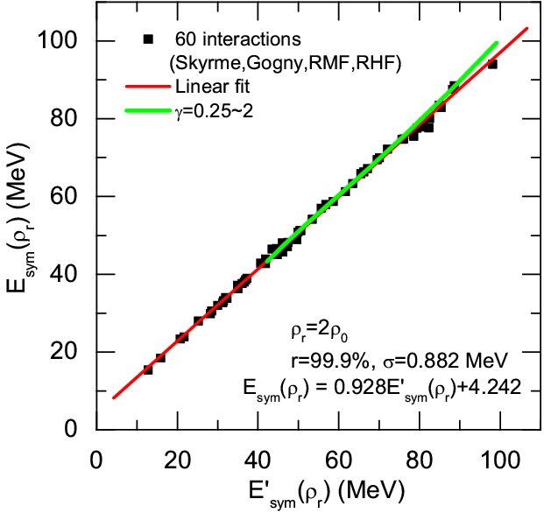
High density E_{sym}: K_{sym} parameter？
L.W. Chen, in preparation

Slide 44
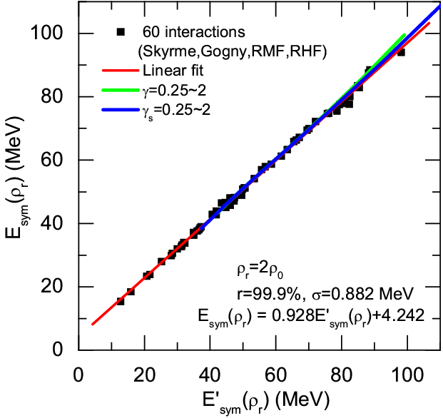
High density E_{sym}: K_{sym} parameter？
L.W. Chen, in preparation

Slide 45
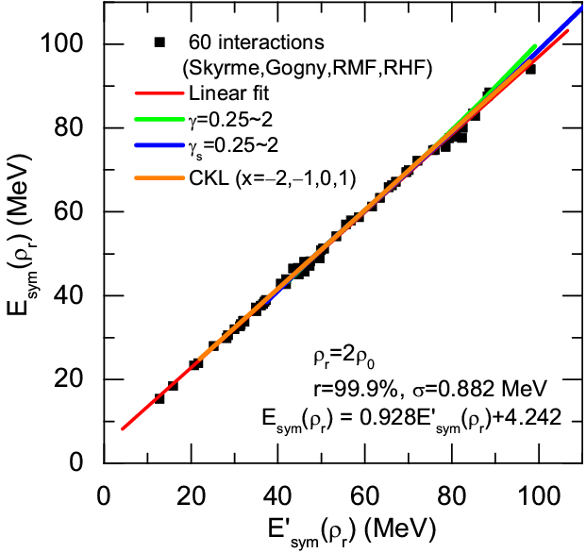
High density E_{sym}: K_{sym} parameter？
L.W. Chen, in preparation
Model independent!

Slide 46


What’s value of K_{sym}？
L.W. Chen,
PRC83, 044308(2011)
Based on SHF !
L.W. Chen, Sci. China Phys. Mech. Astron. 54, suppl. 1, s124 (2011) [arXiv:1101.2384]

Slide 47


K_{sym}: Symmetry energy of finite nuclei
Liquid-drop model
Symmetry energy term
Symmetry energy including surface diffusion effects (y_{s}=S_{v}/S_{s})
W. D. Myers, W.J. Swiatecki, P. Danielewicz, P. Van Isacker, A. E. L. Dieperink,……

Slide 48

K_{sym}: Symmetry energy of finite nuclei
Symmetry energy coefficient of finite nuclei in mass formula
Q: neutron-skin stiffness coefficient in the droplet model, it is also related to
the surface symmetry energy, and can be obtained from asymmetric
semi-infinite nuclear matter (ASINM) calculations
As a good approximation (See, e.g., L.W. Chen, PRC83, 044308 (2011)), we have
M. Liu et al., PRC82, 064306 (2010)

Slide 49

ASINM calculations
Treiner/Krivine, Ann. Phys. 170, 406(86)

Slide 50

k and kʹ parameters
With about 20% uncertainty
Esym of finite nuclei

Slide 51

High density E_{sym} : E_{sym}(2ρ₀)？
Iso. Diff. & double n/p (ImQMD, 2009)
M.B. Tsang et al., PRL102, 122701 (2009)
SHF+N-Skin (2010)
L.W. Chen et al., PRC82, 024321 (2010)
Nucl. Mass+Nskin (2003):
Danielewicz, NPA727, 233 (2003)
IAS (2009):
Danielewicz/Lee, NPA818, 36 (2009)
Nucl. Mass (2010):
M. Liu et al., PRC82, 064306 (2010)
L.W. Chen, in preparation

Slide 52

High density E_{sym} : E_{sym}(2ρ₀)？
L.W. Chen, in preparation
P. Russotto,W. Trauntmann, Q.F. Li et al., PLB697, 471(2011)

Slide 53
Outline
The symmetry energy
Current constraints on the symmetry energy
- n-A elastic scattering and the symmetry potential
- Symmetry energy at 0.11 fm⁻³
- High density behaviors
Density curvature K_{sym} and the high density symmetry energy
Summary and outlook

Slide 54
Summary
Neutron-nucleus scattering data provide new constraints on energy
dependent symmetry potential (Lane potential U_{sym,1} (ρ₀,p) and
U_{sym,2} (ρ₀,p) ), and we find U_{sym,2} (ρ₀,p) is comparable with U_{sym,1} (ρ₀,p) .
Furthermore, we obtain:
E_{sym}(ρ₀) =37.24±2.26 MeV and L=44.98±22.31 MeV
The neutron skin is determined uniquely by L(ρ_{c}) at ρ_{c} =0.11 fm⁻³,
and from the neutron skin of Sn isotopes, we obtain:
L(0.11 fm⁻³) =46.0±4.5 MeV
The binding energy difference of heavy isotope pair is essentially
determined uniquely by E_{sym}(ρ_{c}) at ρ_{c} =0.11 fm⁻³, and from a number
of heavy isotope pairs, we obtain:
E_{sym} (0.11 fm⁻³) =26.65±0.2 MeV
A fixed value of E_{sym}(ρ_{c}) at ρ_{c} =0.11 fm⁻³ leads to a positive E_{sym}(ρ₀)-L
correlation while a fixed value of L(ρ_{c}) at ρ_{c} =0.11 fm⁻³ leads to a
negative E_{sym}(ρ₀)-L correlation. From E_{sym} (0.11 fm⁻³) and L(0.11 fm⁻³),
we obtain:
E_{sym}(ρ₀) =32.3±1.0 MeV and L=45.2±10.0 MeV
E_{sym}(2ρ₀) is essentially determined by E_{sym}(ρ₀) , L, and K_{sym}. From
the surface symmetry energy in finite nuclei, we can obtain
K_{sym}:[-669,213] MeV, and E_{sym}(2ρ₀):[10,65] MeV

Slide 55
Outlook
1. Some promising probes for high density E_{sym} in heavy ion collisions
n/p: spectra, flows, squeeze-out,…
(direct probe to symmetry potential/energy)
t/³He: spectra, flows, ,squeeze-out,…
(Semi-direct probe to symmetry potential/energy through nucleon
coalescence)
π -/π+ ratio:
(Secondary probe to symmetry potential/energy)
K0/K+ ratio:
(Secondary+ probe to symmetry potential/energy, but suffers from
much weak final state interactions compared with pions, ….)
2. Accurate constraints on E_{sym} around saturation density can help to
limit the high density E_{sym}
3. More accurate measurements on M-R of neutron stars ….

Slide 56
谢 谢！
Thanks!

Slide 57

Nuclear Matter EOS

Slide 58

EOS of Symmetric Nuclear Matter
(1) EOS of symmetric matter around the saturation density ρ₀
Giant Monopole Resonance
K₀=231±5 MeV
Yongblood/Clark/Lui, PRL82, 691 (1999)
Recent results:
K₀=240±20 MeV
G. Colo et al.
U. Garg et al.
S. Shlomo et al.
Uncertainty of the extracted K₀ is mainly due to the uncertainty of
L (slope parameter of the symmetry energy) and
m*₀ (isoscalar nucleon effective mass)
(See, e.g., L.W. Chen/J.Z. Gu, JPG39, 035104(2012))

Slide 59

EOS of Symmetric Nuclear Matter
(2) EOS of symmetric matter for 1ρ₀< ρ < 3ρ₀ from K⁺ production in HIC’s
J. Aichelin and C.M. Ko,
PRL55, (1985) 2661
C. Fuchs,
Prog. Part. Nucl. Phys. 56, (2006) 1
C. Fuchs et al,
PRL86, (2001) 1974
Transport calculations indicate that “results for the K⁺ excitation function in Au + Au over C + C reactions as measured by the KaoS Collaboration strongly support the scenario
with a soft EOS.”
See also: C. Hartnack, H. Oeschler,
and J. Aichelin,
PRL96, 012302 (2006)

Slide 60
(3) Present constraints on the EOS of symmetric nuclear matter for 2ρ₀< ρ < 5ρ₀ using flow data from BEVALAC, SIS/GSI and AGS
EOS of Symmetric Nuclear Matter
P. Danielewicz, R. Lacey and W.G. Lynch, Science 298, 1592 (2002)
The highest pressure recorded under
laboratory controlled conditions in
nucleus-nucleus collisions
Use constrained mean fields to predict the EOS for symmetric matter
  Width of pressure domain reflects uncertainties in comparison and of assumed momentum dependence.
High density nuclear matter
2 to 5ρ₀

Slide 61

k parameter: LDM+NSKin
Liquid Drop model + Neutron Skin
Danielewicz, NPA 727, 233 (2003)
Note: Actually, what they constrained are E_{sym}(ρ₀)
and the surface symmetry energy (k), rather than L

Slide 62
k parameter: IAS+LDM
Isobaric Analog States + Liquid Drop model with surface symmetry energy
Danielewicz/Lee, NPA 818, 36 (2009)
Note: Actually, what they constrained are E_{sym}(ρ₀)
and the surface symmetry energy (k), rather than L

Slide 63

k parameter: LDM
Liquid Drop model with surface symmetry energy
Note: Actually, what they constrained are E_{sym}(ρ₀)
and the surface symmetry energy (k), rather than L

Slide 64


Neutron skin of ²⁰⁸Pb
The Lead Radius Experiment ("PREX"),
experiment number E06002, uses the
parity violating weak neutral interaction
to probe the neutron distribution in a heavy nucleus, namely ²⁰⁸Pb, thus measuring the RMS neutron radius to 1% accuracy, which has an important impact on nuclear theory.
Jefferson Lab (JLab):
²⁰⁸Pb Radius EXperiments - PREX

Slide 65
E_{sym} at low densities: Clustering Effects
Horowitz and Schwenk,
Nucl. Phys. A 776 (2006) 55
S. Kowalski, et al.,
PRC 75 (2007) 014601.
Notes:
65

Slide 66

E_{sym} at low densities: Clustering Effects
Notes:
66

Slide 67

E_{sym}：Around saturation density
Constraints on E_{sym} (ρ₀) and L from nuclear reactions and structures
(1) TF+Nucl. Mass (1996)
Myers/Swiatecki, NPA 601, 141 (1996)
(2) Iso. Diff. (IBUU04, 2005)
L.W. Chen et al., PRL94, 032701 (2005);
B.A. Li/L.W. Chen, PRC72, 064611(2005)
(3) Isoscaling (2007)
D. Shetty et al., PRC76, 024606 (2007)
(4) PDR in ^{130,132}Sn (2007) (LAND/GSI)
A. Klimkiewicz et al., PRC76, 051603(R)(2007)
(5) Iso. Diff. & double n/p (ImQMD, 2009)
M.B. Tsang et al., PRL102, 122701 (2009);
(6) IAS+LDM (2009)
Danielewicz/J. Lee, NPA818, 36 (2009)
(7) DM+N-Skin (2009)
M. Centelles et al., PRL102, 122502 (2009);
M. Warda et al., PRC80, 024316 (2009)
(10) Opt. Pot. (2010)
C. Xu et al., PRC82, 054607 (2010)
(8) PDR in ⁶⁸Ni and ¹³²Sn (2010)
A. Carbon et al., PRC81, 041301(R)(2010)
(11) Nucl. Mass (2010)
M. Liu et al., PRC82, 064306 (2010)
(9) SHF+N-Skin (2010)
L.W. Chen et al., PRC82, 024321 (2010)
(12) FRDM (2012)
P. Moller et al., PRL108, 052501 (2012)

Slide 68

Optimization
The simulated annealing method (Agrawal/Shlomo/Kim Au, PRC72, 014310 (2005))
Experimental data
Binding energy per nucleon and charge rms radius of 25 spherical even-even nuclei (G.Audi et al., Nucl.Phy.A729 337(2003), I.Angeli, At.Data.Nucl.Data.Tab 87 185(2004))

Slide 69
Optimization
Constraints:
The neutron 3p_{1/2}-3p_{3/2} splitting in ²⁰⁸Pb lies in the range of 0.8-1.0 MeV
The pressure of symmetric nuclear matter should be consistent with constraints
obtained from flow data in heavy ion collisions
The binding energy of pure neutron matter should be consistent with
constraints obtained the latest chiral effective field theory calculations with
controlled uncertainties
The critical density ρ_{cr}, above which the nuclear matter becomes unstable by
the stability conditions from Landau parameters, should be greater than 2 ρ ₀
The isoscalar nucleon effective mass m*_{s0} should be greater than the isovector
effective mass m*_{v0}, and here we set m*_{s0} − m*_{v0} = 0.1m (m is nucleon mass in
vacuum) to be consistent with the extraction from global nucleon optical
potentials constrained by world data on nucleon-nucleus and (p,n) charge-
exchange reactions and also dispersive optical model for Ca, Ni, Pb
P. Danielewicz, R. Lacey and W.G. Lynch, Science 298, 1592 (2002)
I. Tews, T. Kruger, K. Hebeler, and A. Schwenk, PRL 110, 032504 (2013)
C. Xu, B.A. Li, and L.W. Chen, PRC82, 054607 (2010); Bob Charity, DOM (2011)

Slide 70




Determine E_{sym}(0.11 fm⁻³) from ΔE
19
23%

