Slide 1
Parton Cascade
신기량
안동대학교 물리학과

Slide 2
Contents
1. Introduction
2. Initial Phase Space of HIC
3. Parton cascade
4. Some Results
5. Discussion

Slide 3
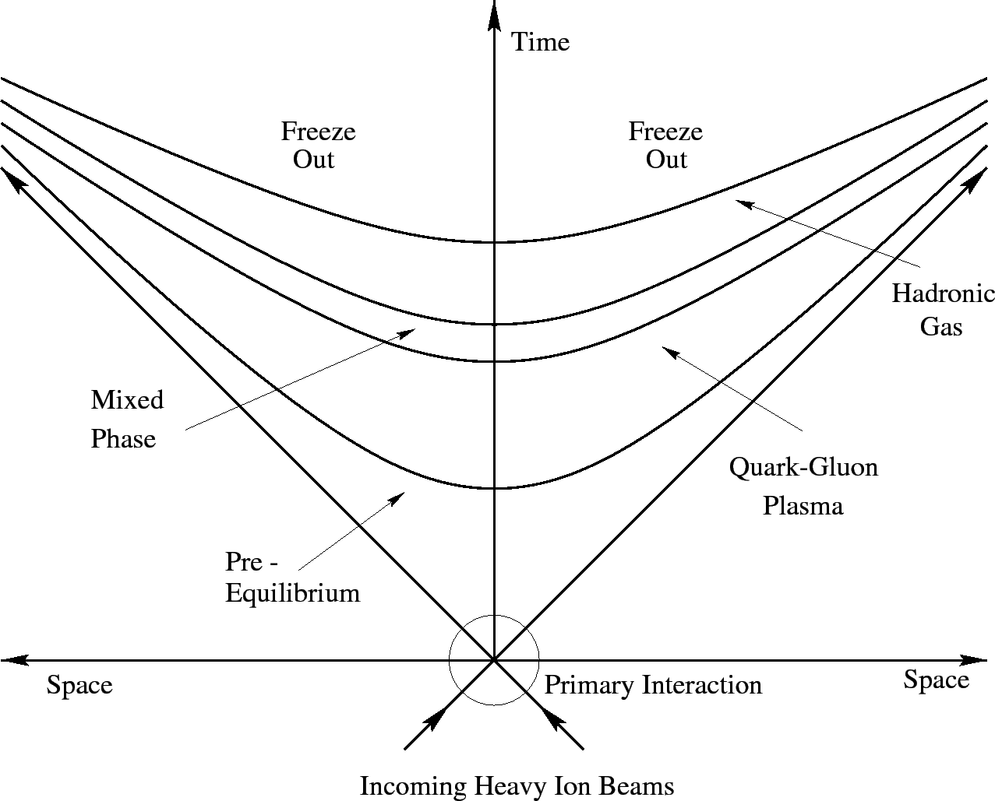
1. Introduction
Ambitious proposals: Understanding from the start to the end of HIC:

Slide 4
The dream we have is to describe all the way from the first contact of two colliding nuclei to hadronic detections
  What is the phase space of incoming nucleus (parton distribution)?
  How does the degree of freedom of nuclei make collisions and be liberated?
    How many?
    What is the virtuality?
    What is the phase space?
  What is the mechanism to thermalize them?
  How the partons evolve(in QGP)?
    What is the color force?
  How do the partons become hadrons?
  How do hadrons make expansion?

Slide 5
2. Initial Phase Space
We make simple:
  Projectile and target nucleus are made of nucleons(protons and neutrons) and nucleons are made of partons (gluons, valance quarks, sea quarks and anti-quarks)
  These quasi-particles (parton) will make collisions while the two nuclei passing through with the assumption of frozen transversal momentum
  If transversal momentum after collision is greater than p_T(min), we assume the quasi-particle is liberated from the mother nucleus and become on-shell particle.

Slide 6
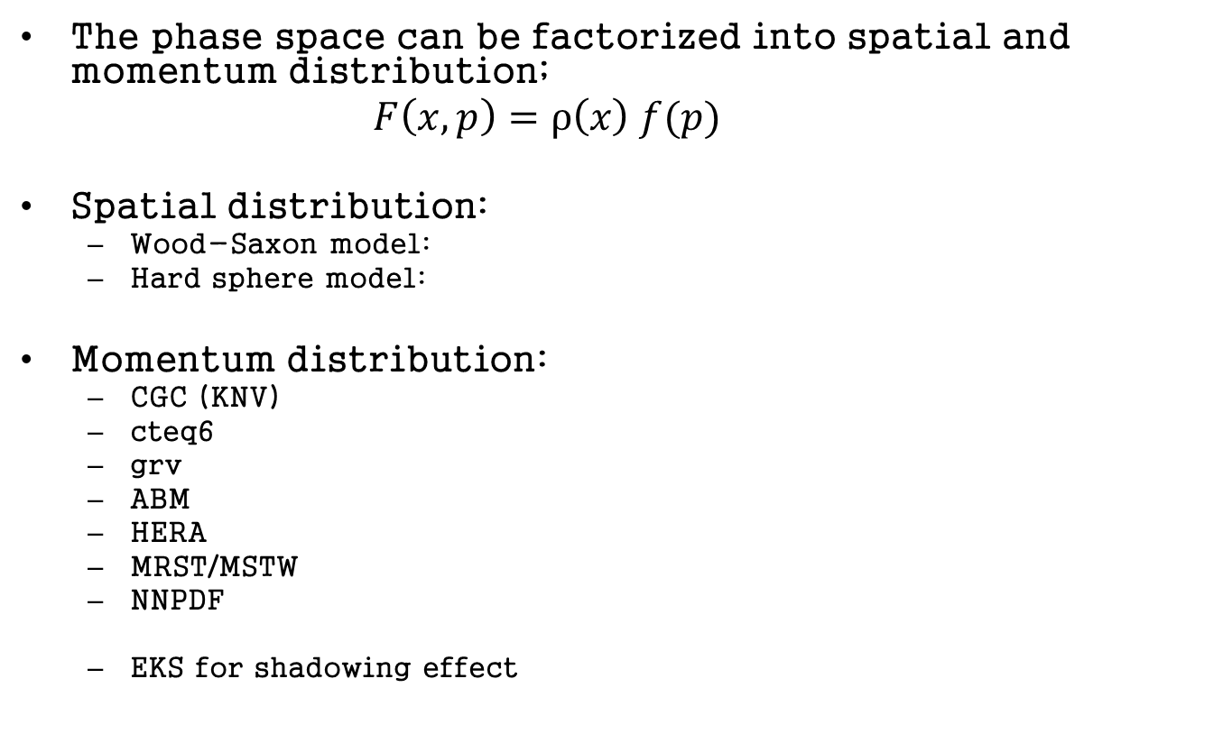
2.1 Nucleus Phase Space
The phase space can be factorized into spatial and momentum distribution;
    $$F\left(x,p\right)=ρ\left(x\right) f(p)$$
Spatial distribution:
  Wood-Saxon model:
  Hard sphere model:
Momentum distribution:
  CGC (KNV)
  cteq6
  grv
  ABM
  HERA
  MRST/MSTW
  NNPDF
  EKS for shadowing effect

Slide 7
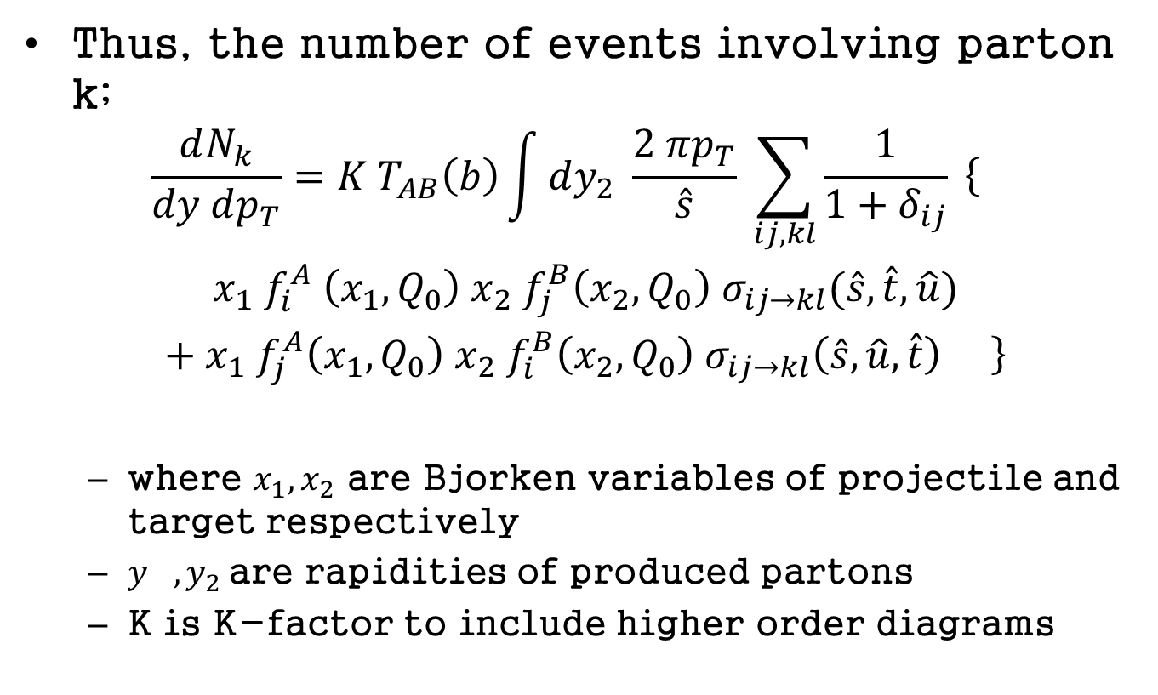
2.2 initial phase space
Thus, the number of events involving parton k;
    $$\begin{matrix}\frac{dN_{k}}{dy dp_{T}}=K T_{AB}\left(b\right)\int{dy_{2} \frac{2 πp_{T}}{\hat{s}} \sum_{ij,kl}{\frac{1}{1+δ_{ij}} \left\{\right.}} \\ x_{1} f_{i}^{A} \left(x_{1}, Q_{0}\right) x_{2} f_{j}^{B}\left(x_{2}, Q_{0}\right) σ_{ij→kl}(\hat{s},\hat{t},\hat{u}) \\ + x_{1} f_{j}^{A}\left(x_{1},Q_{0}\right) x_{2} f_{i}^{B}\left(x_{2},Q_{0}\right) σ_{ij→kl}\left(\hat{s},\hat{u},\hat{t}\right) \left.\right\}\end{matrix}$$
  where $x_{1}, x_{2}$ are Bjorken variables of projectile and target respectively
  $y_{},y_{2}$are rapidities of produced partons
  K is K-factor to include higher order diagrams

Slide 8
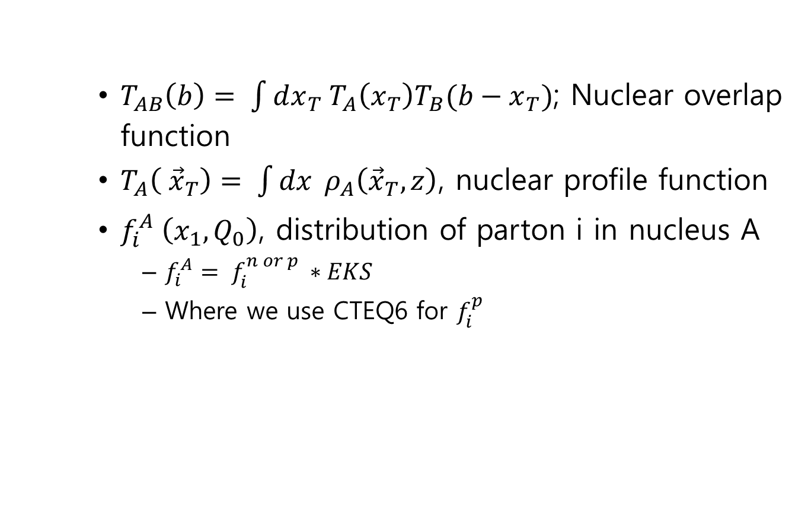

Slide 9
Kinematics and allowed ranges

Slide 10
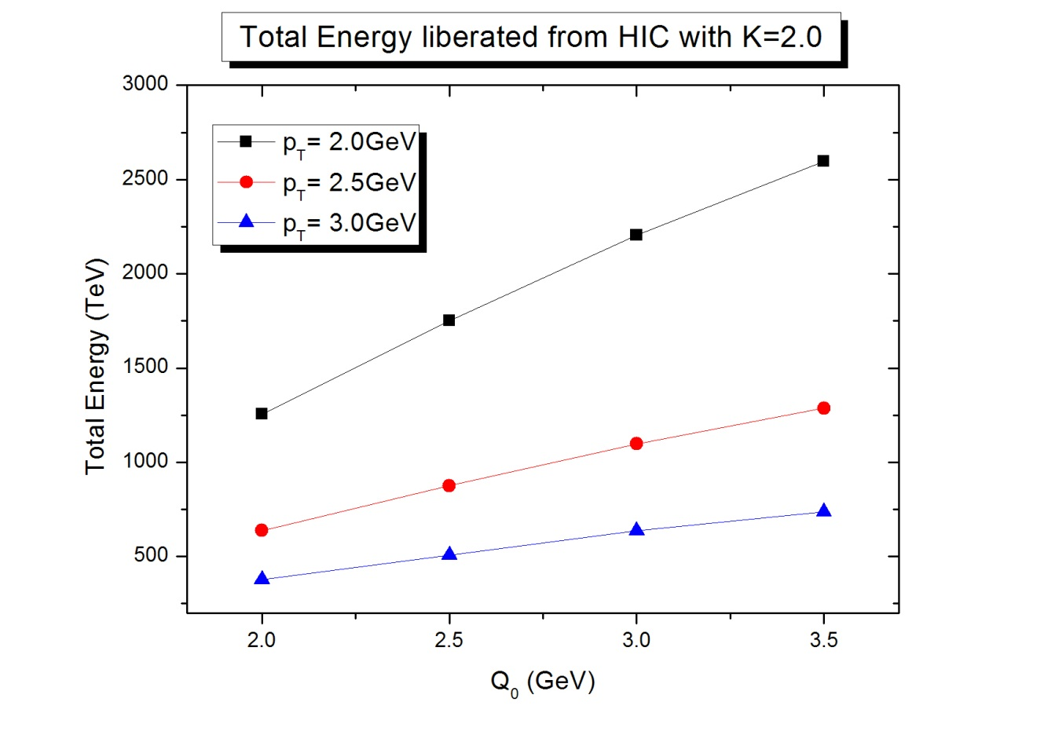
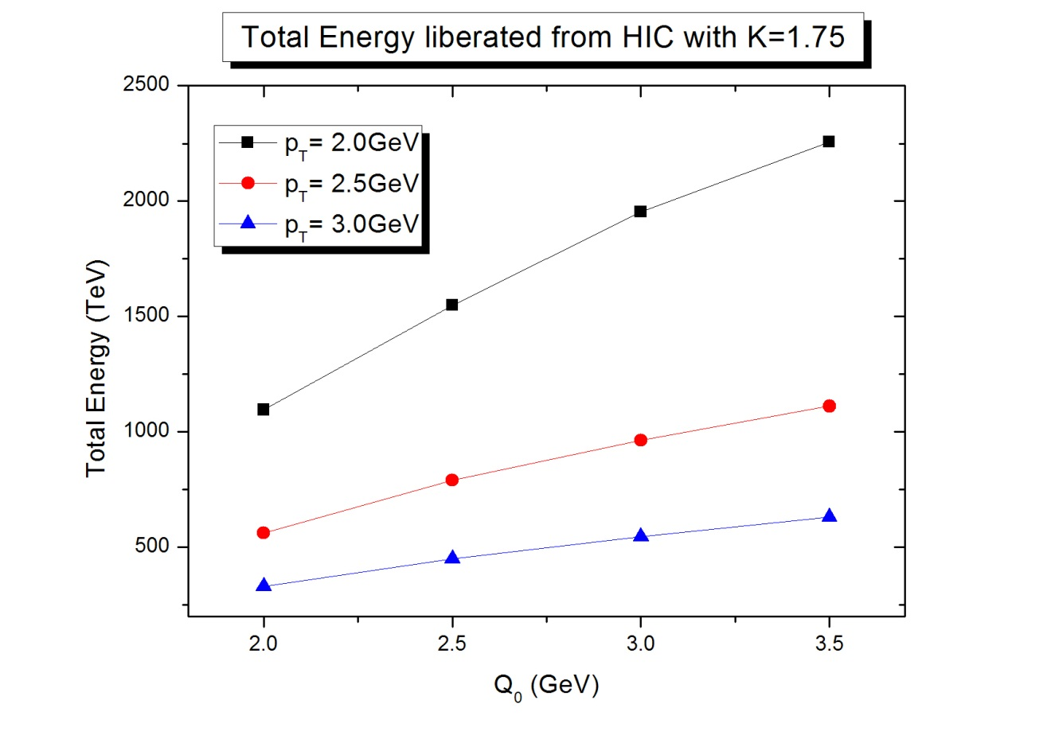
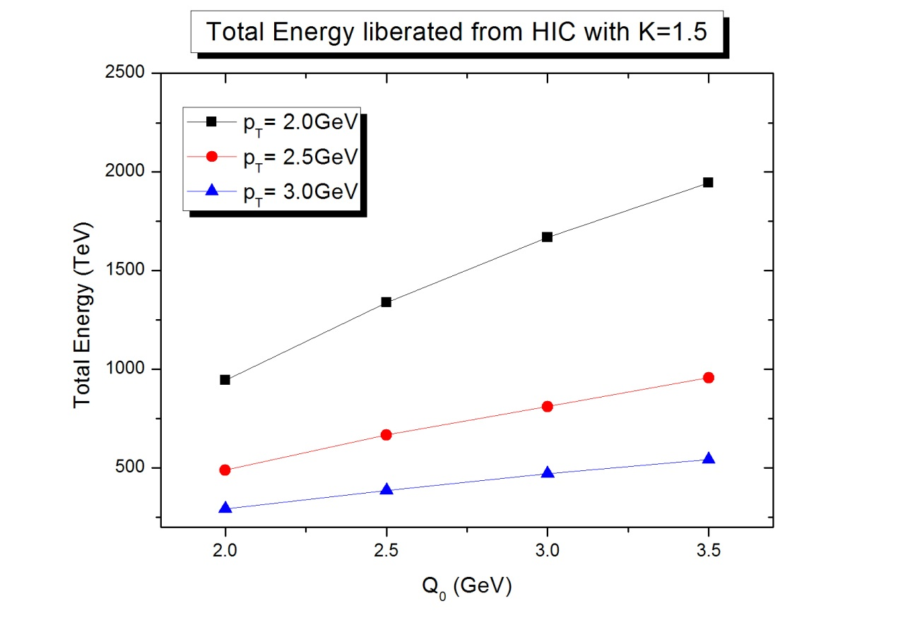
2.3 examples of initial phase space
Total Energy liberated: as a function of Q_0, p_T(cut), K-factor

Slide 11
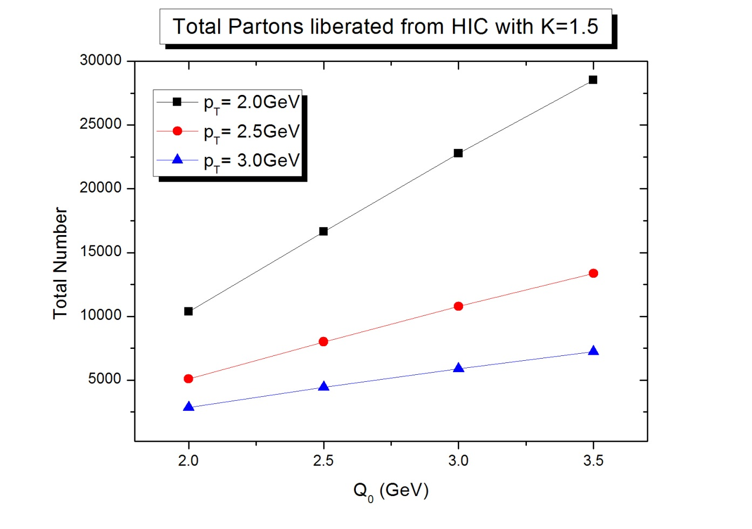
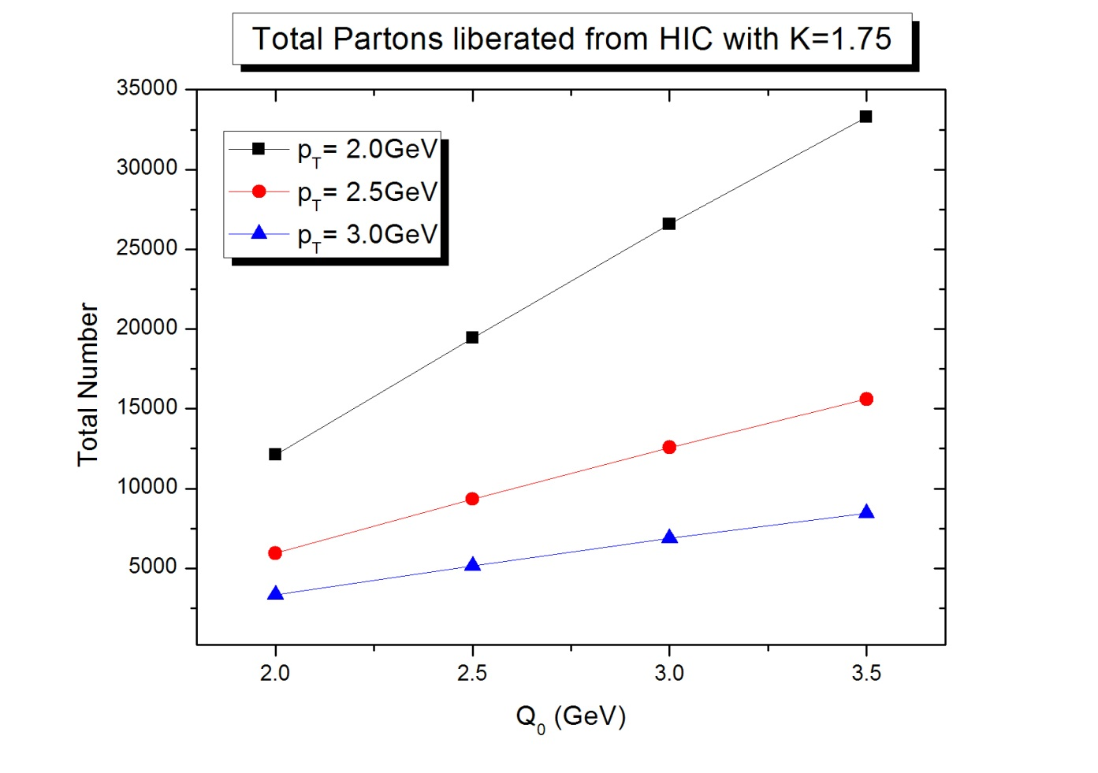
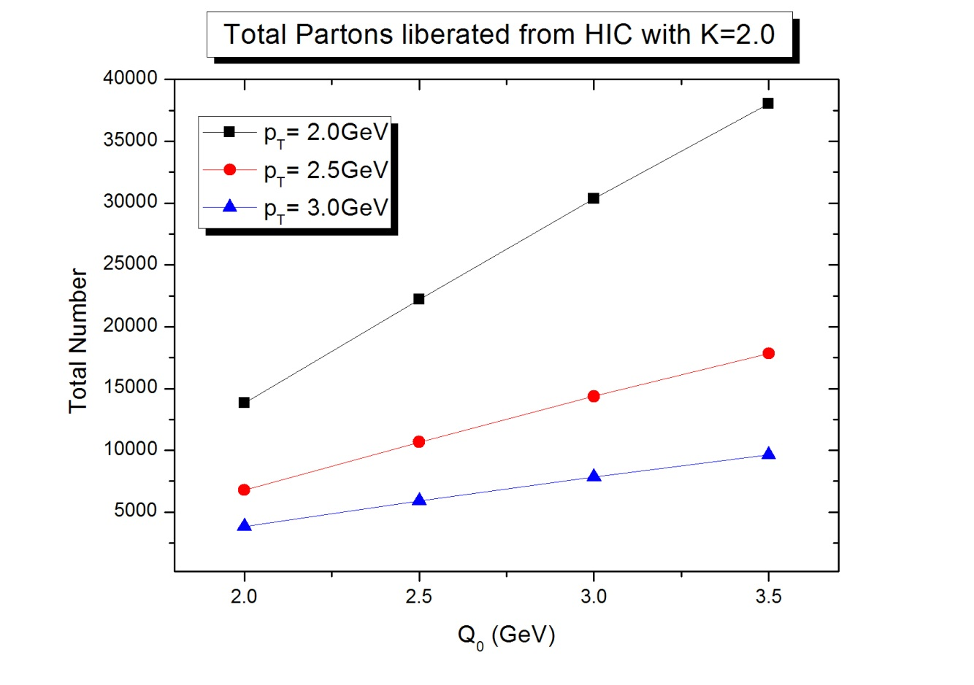
Number of partons:

Slide 12
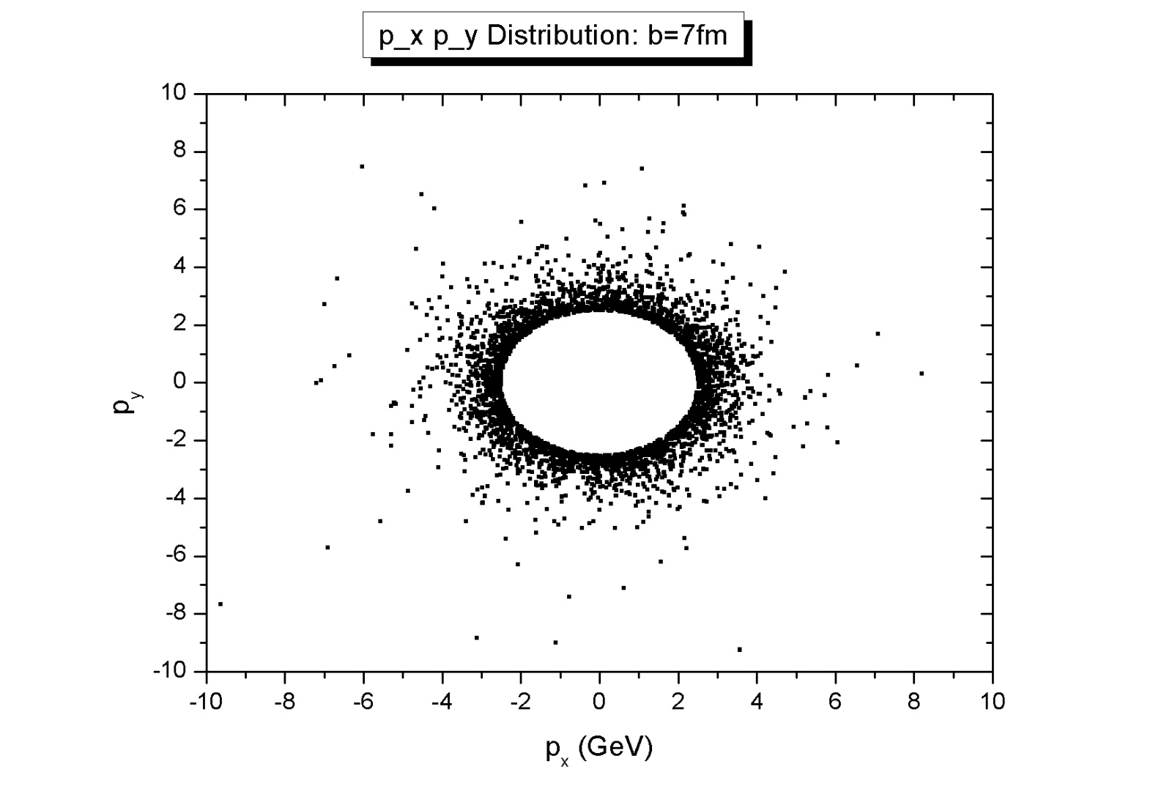
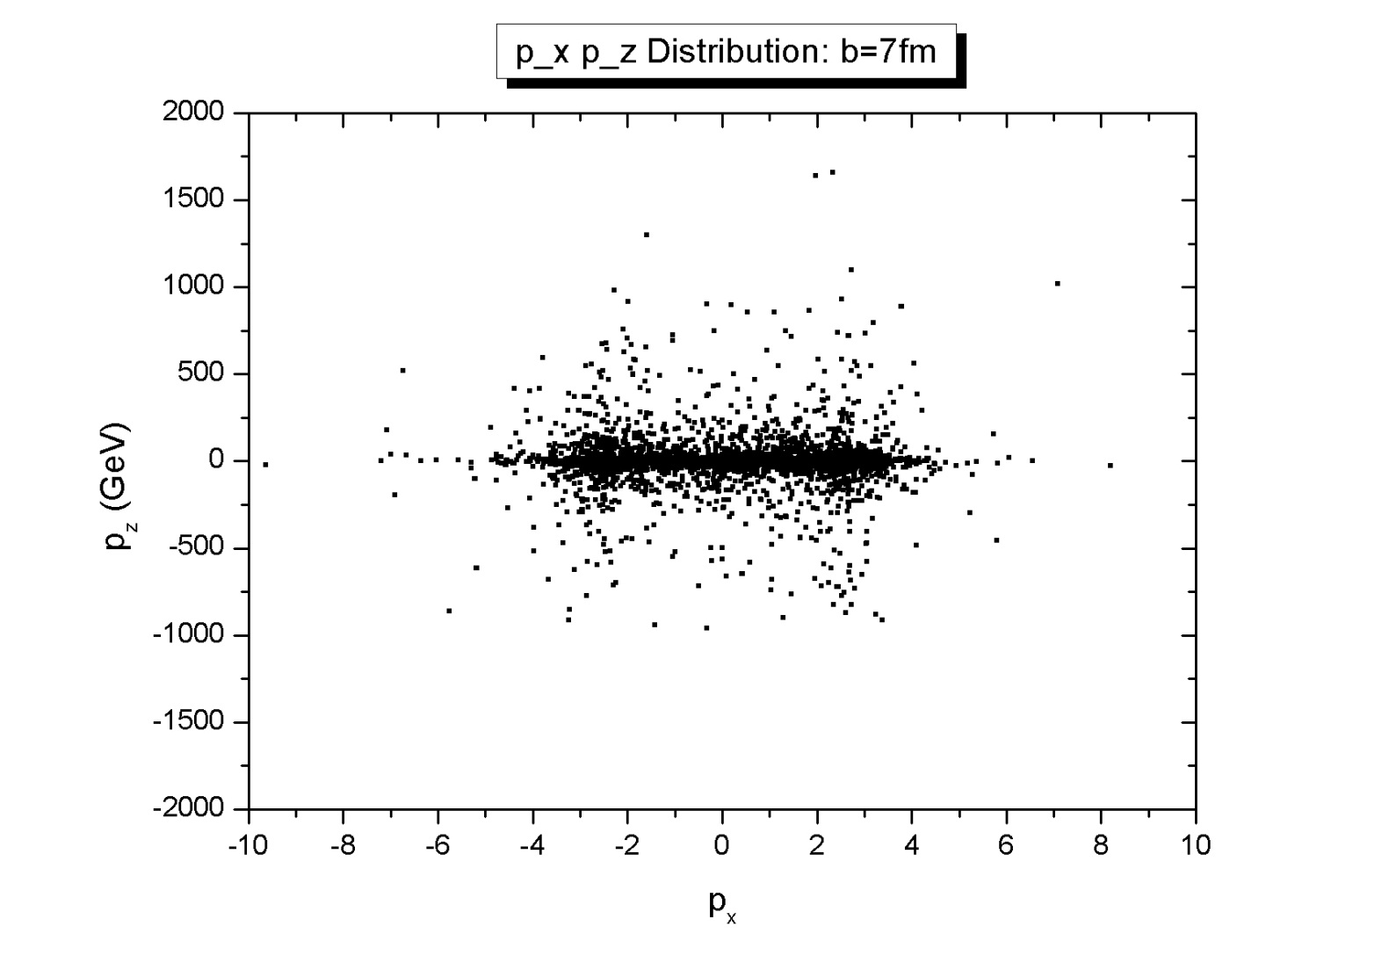
Momentum distribution:

Slide 13
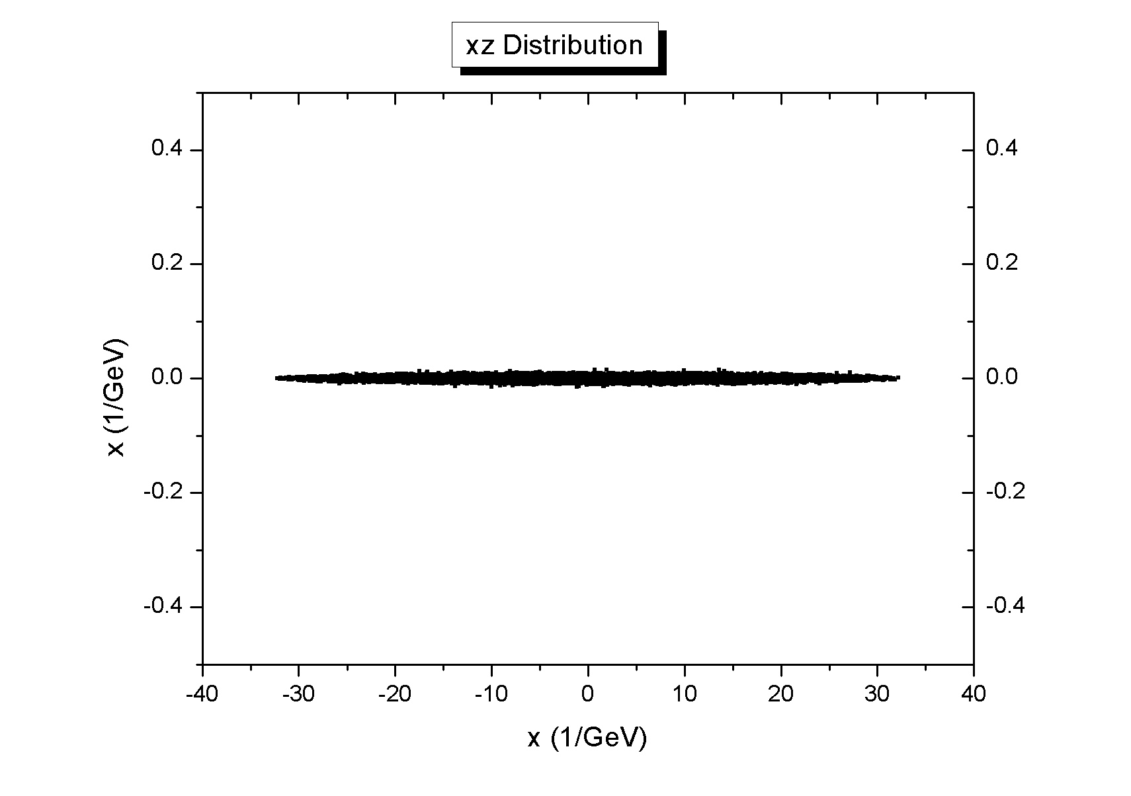
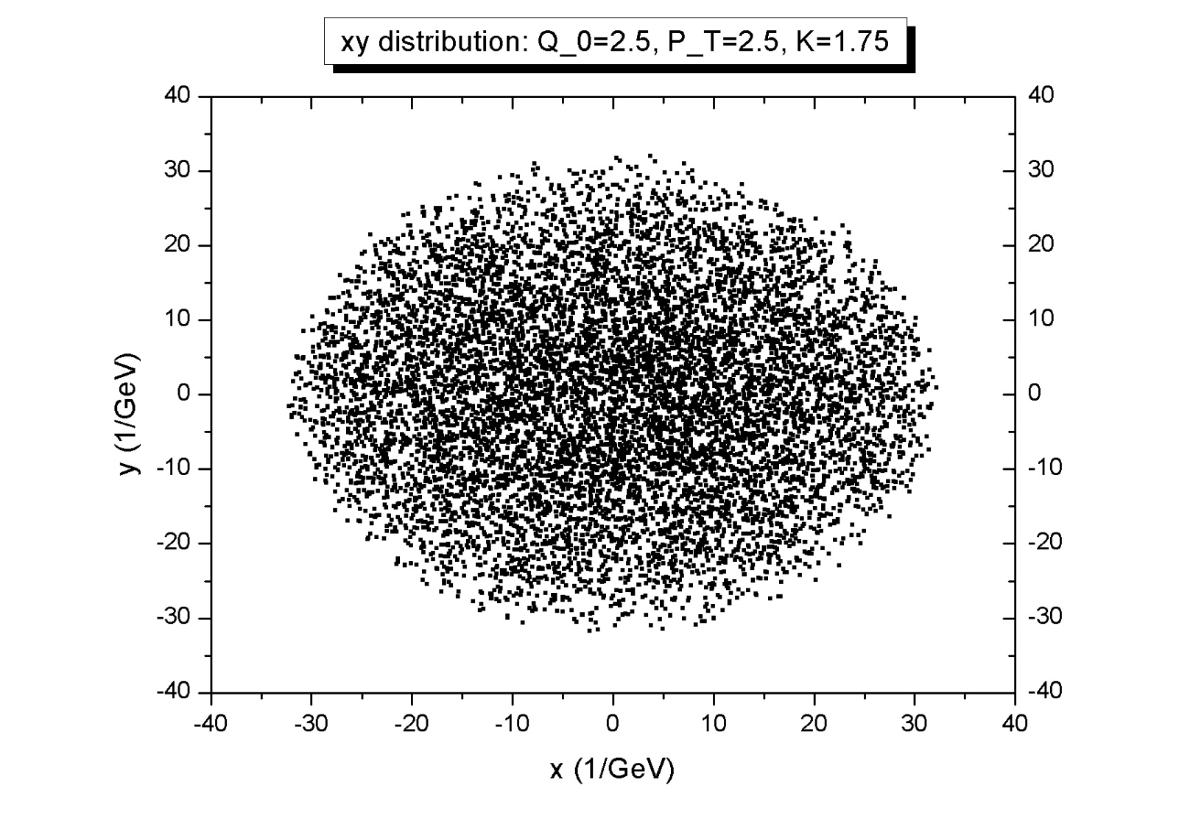
Spatial distribution:

Slide 14
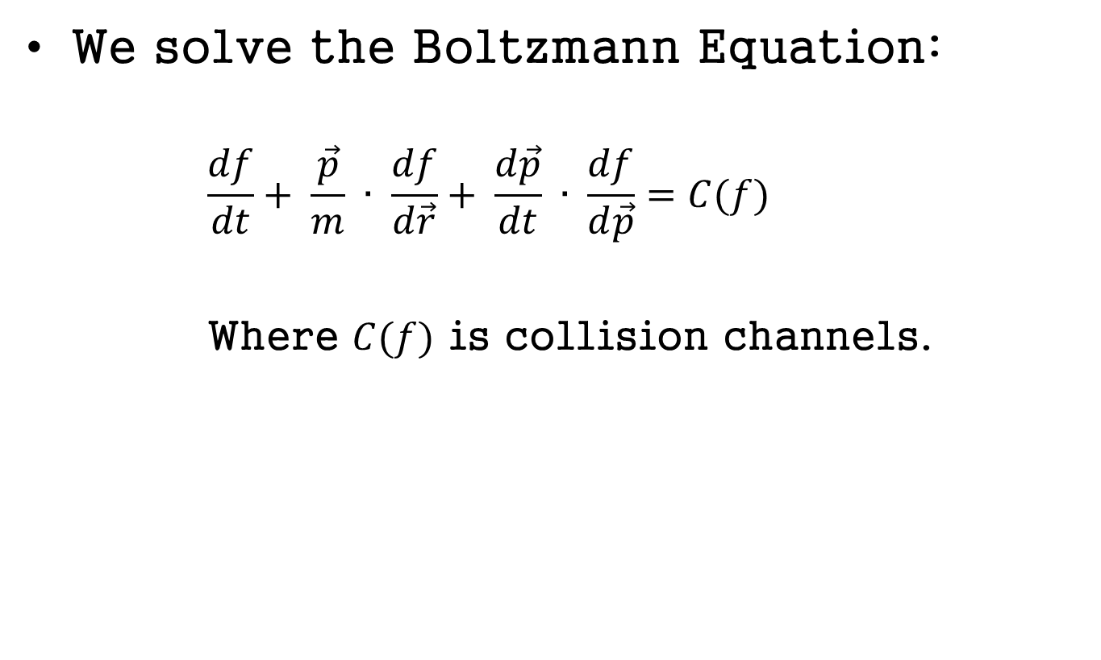
3. Parton Cascade
We solve the Boltzmann Equation:
      $$\frac{df}{dt}+ \frac{\vec{p}}{m} ∙ \frac{df}{d\vec{r}}+ \frac{d\vec{p}}{dt} ∙ \frac{df}{d\vec{p}}=C(f)$$
      Where $C(f)$ is collision channels.

Slide 15
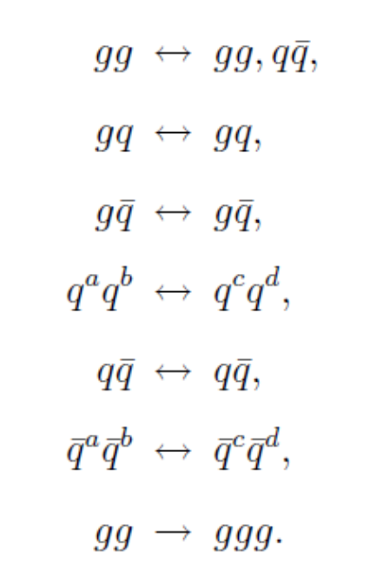
3.1 Collision channels

Slide 16
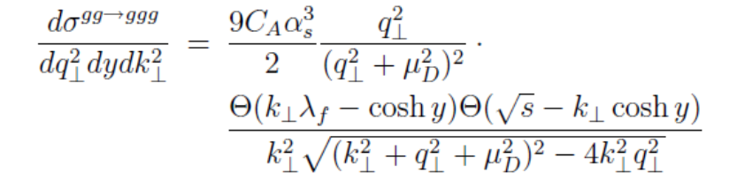
3.2 Cross Section

Slide 17

K-factor = 1.5 ~ 2
Minimum momentum transfer:
  $p_{T}\left(minimum\right)=0.5 GeV$
Coupling constant:
  $α_{s}=0.3$

Slide 18
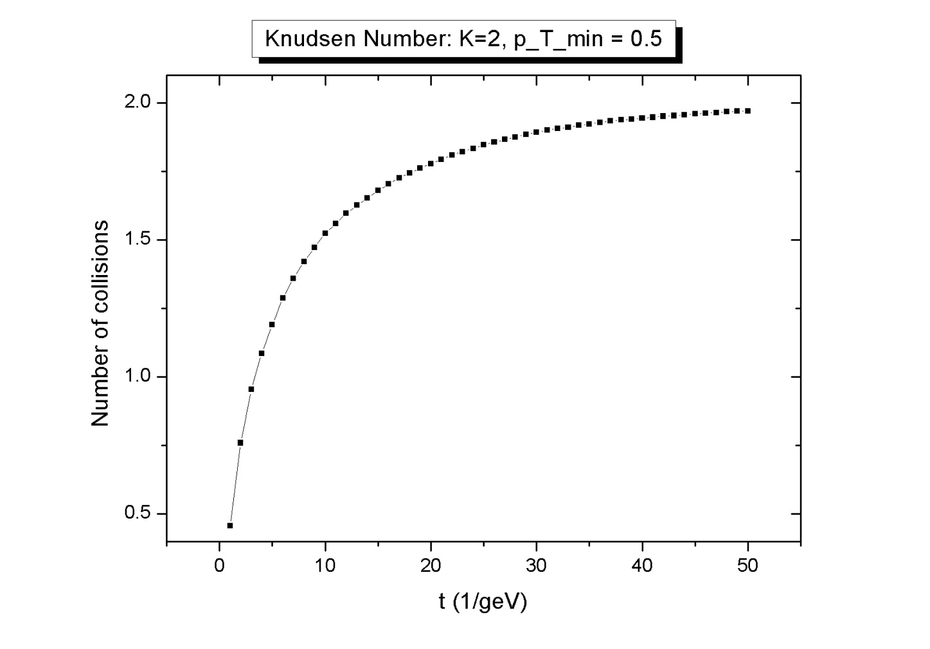
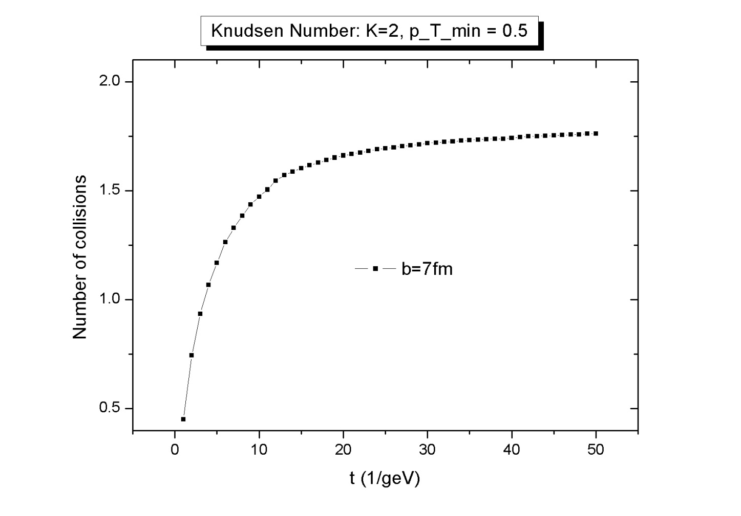
4. Some Results
1) Knudsen Number:

Slide 19

Note that
  We have only 20 runs (pretty bad statistics ; statistical error = $σ_{s}/\sqrt{N−1}$) and almost all of partons are gluons so that flow data should be similar to hadron data).

Slide 20
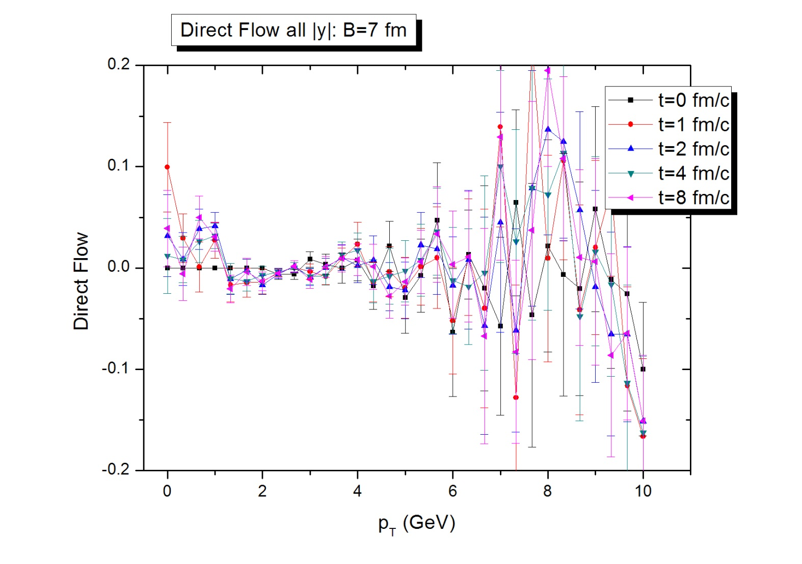
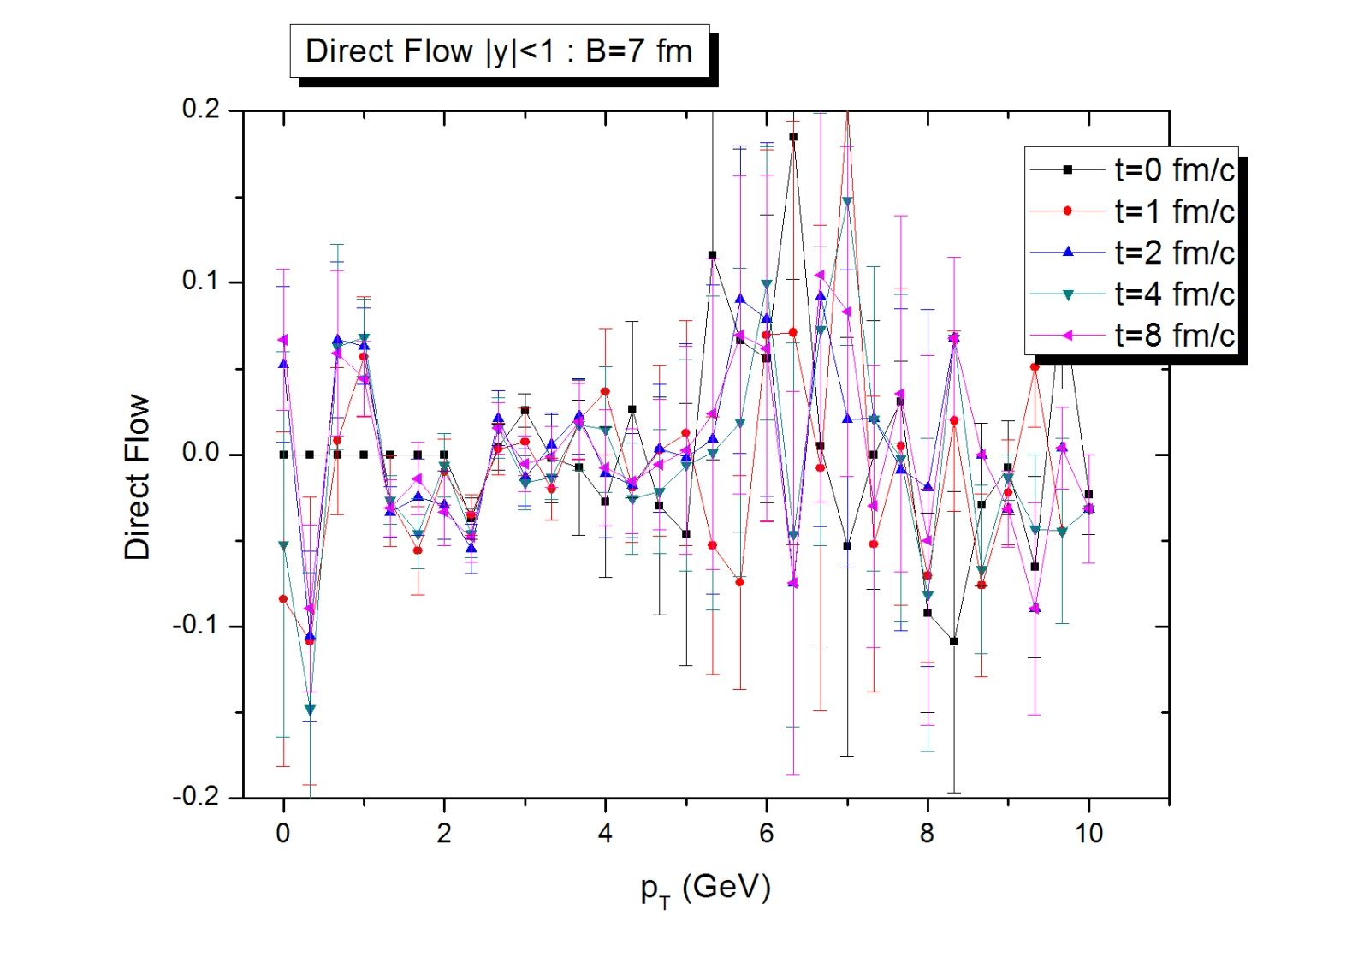
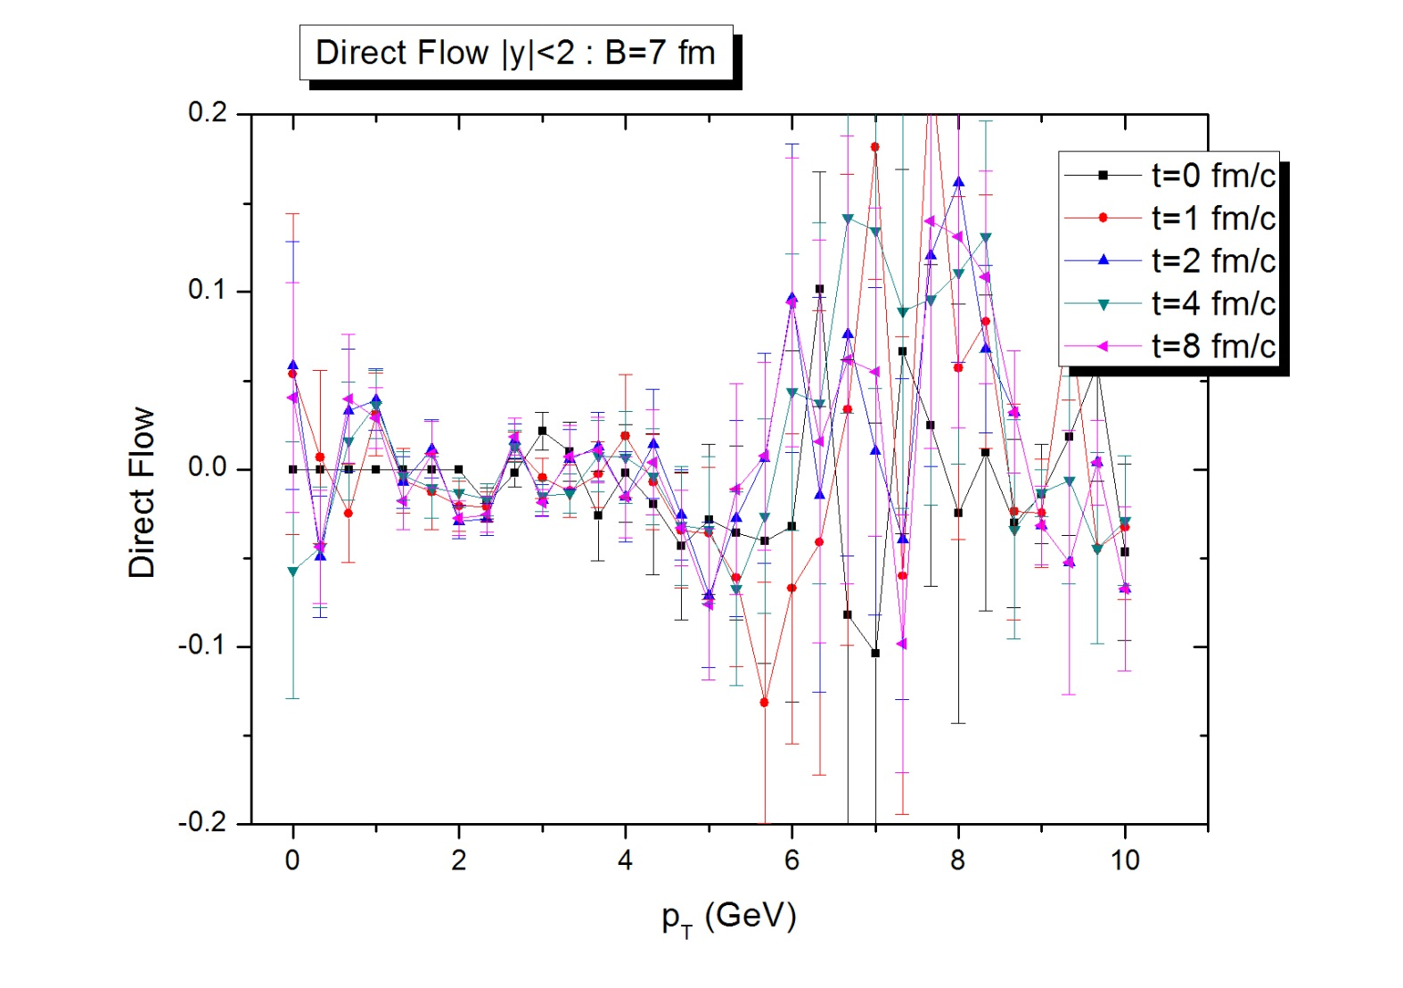
2) Direct Flow:

Slide 21
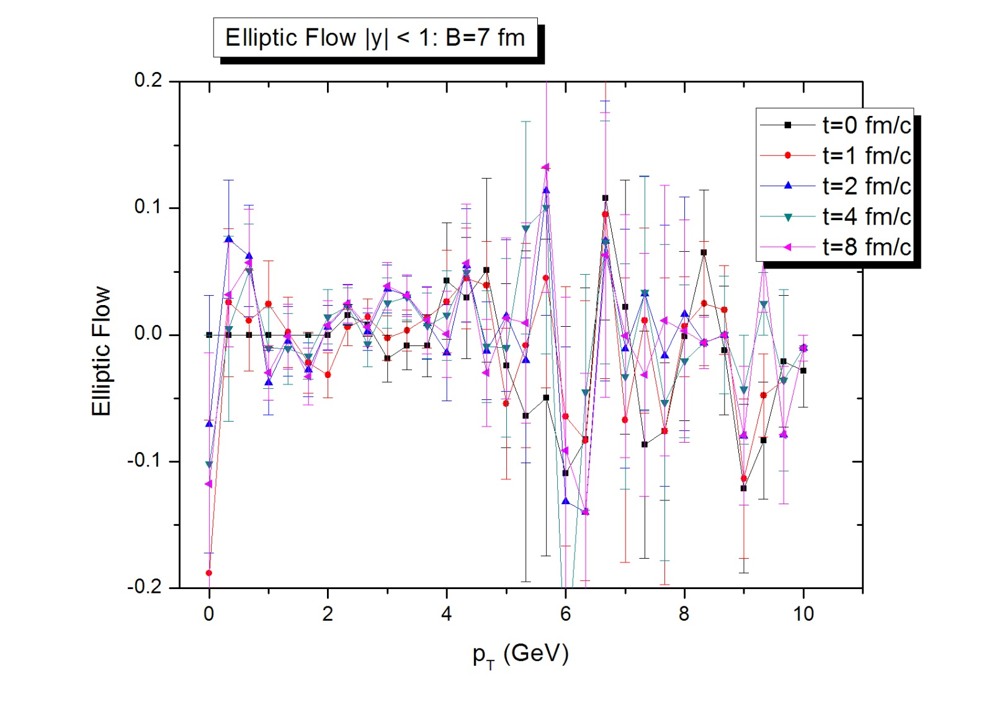
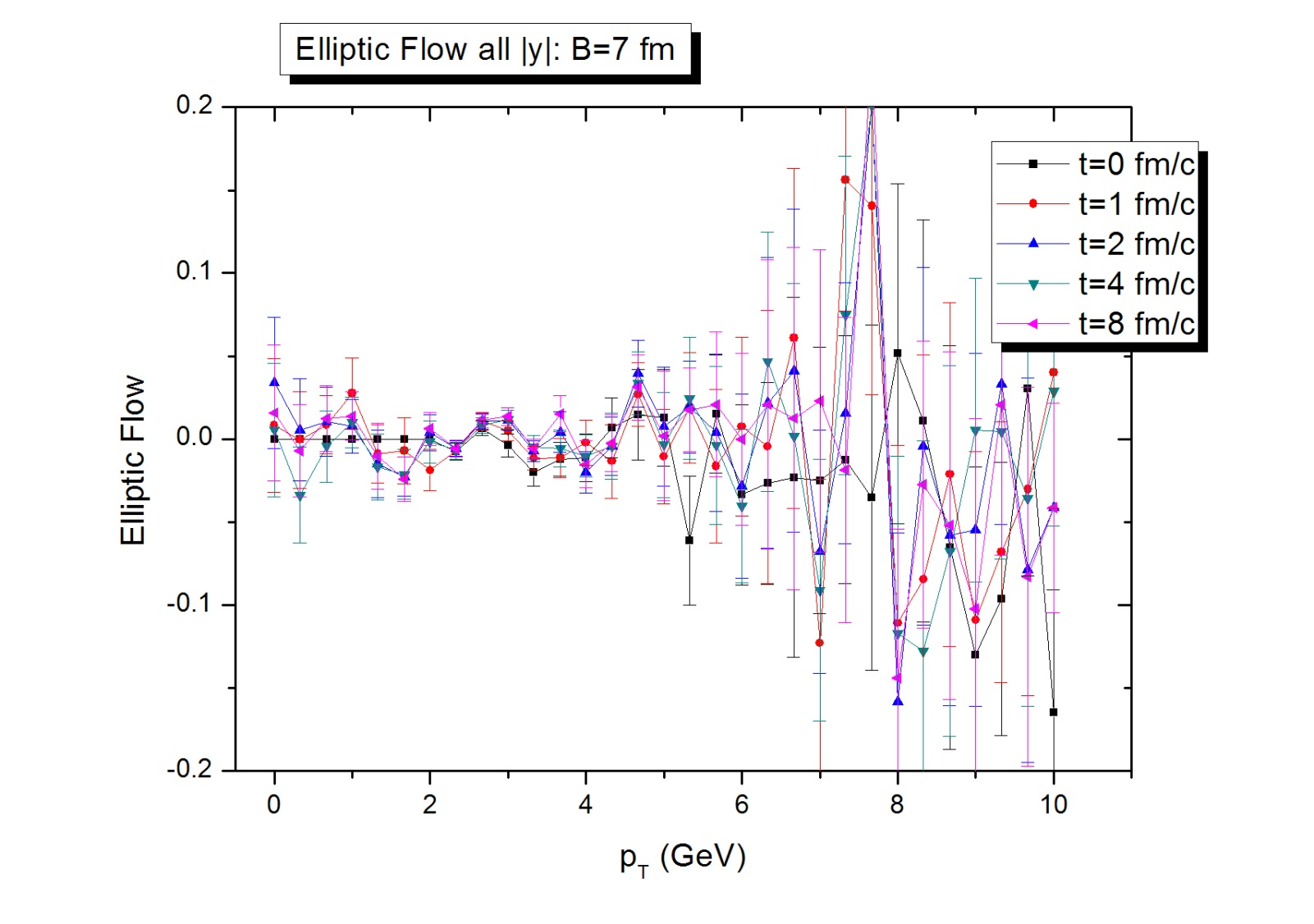
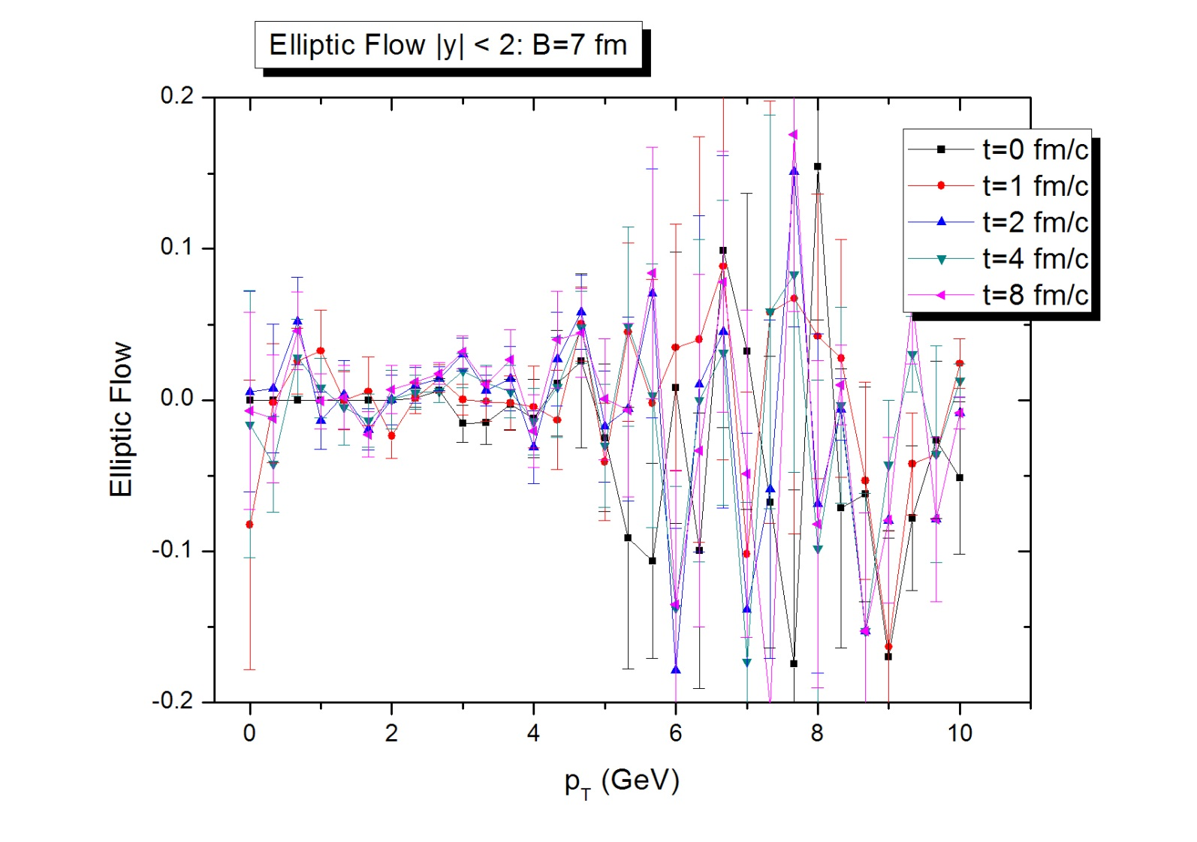
3) Elliptic Flow:

Slide 22
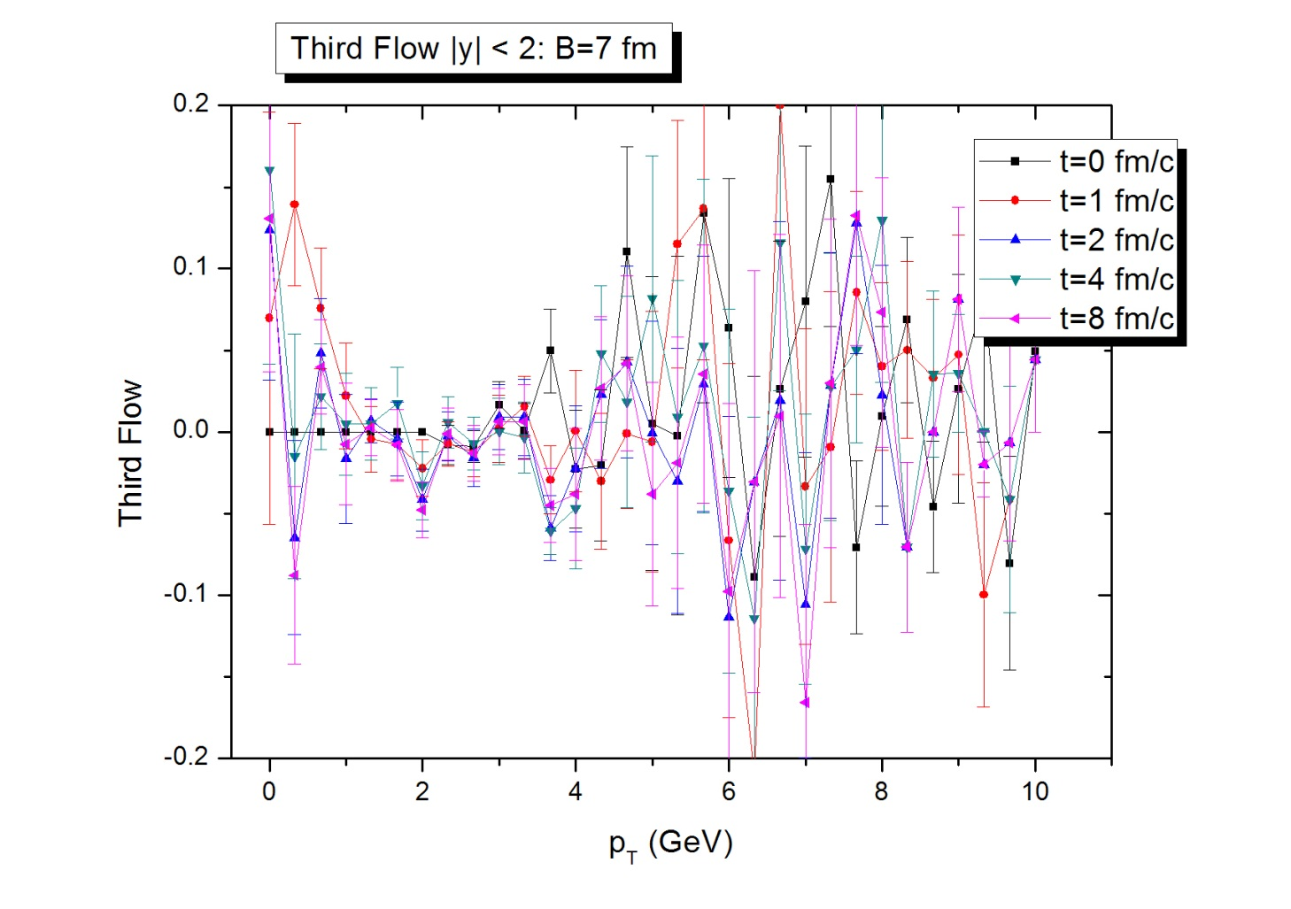
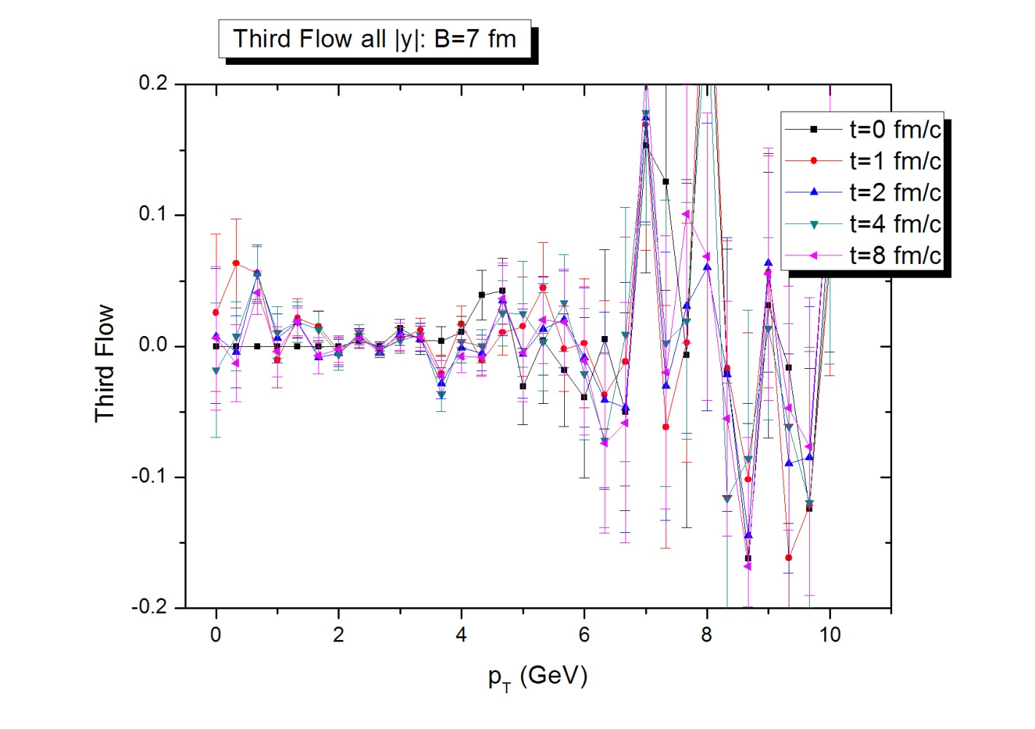
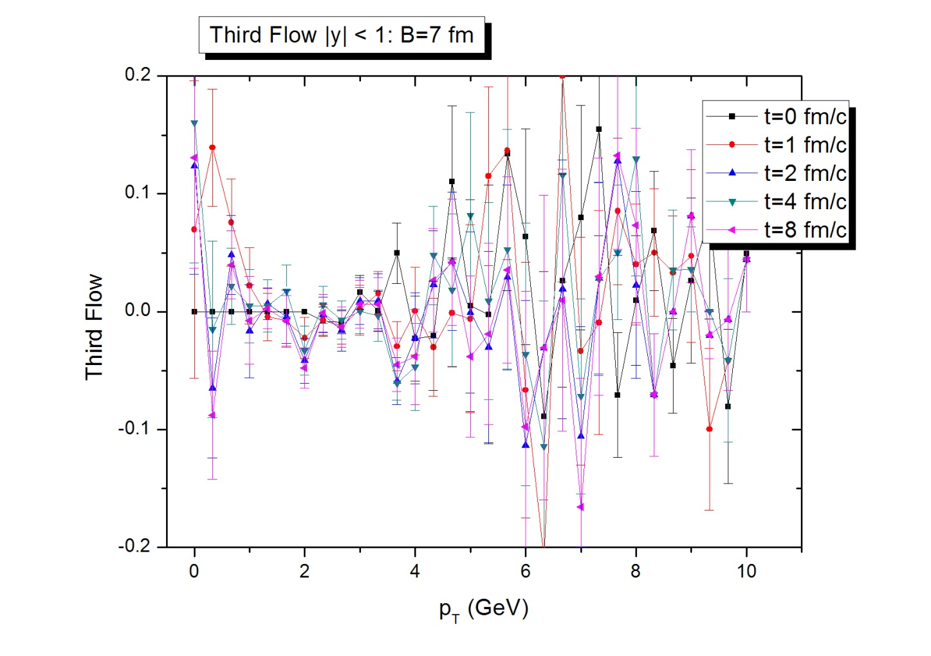
4) Third Flow

Slide 23

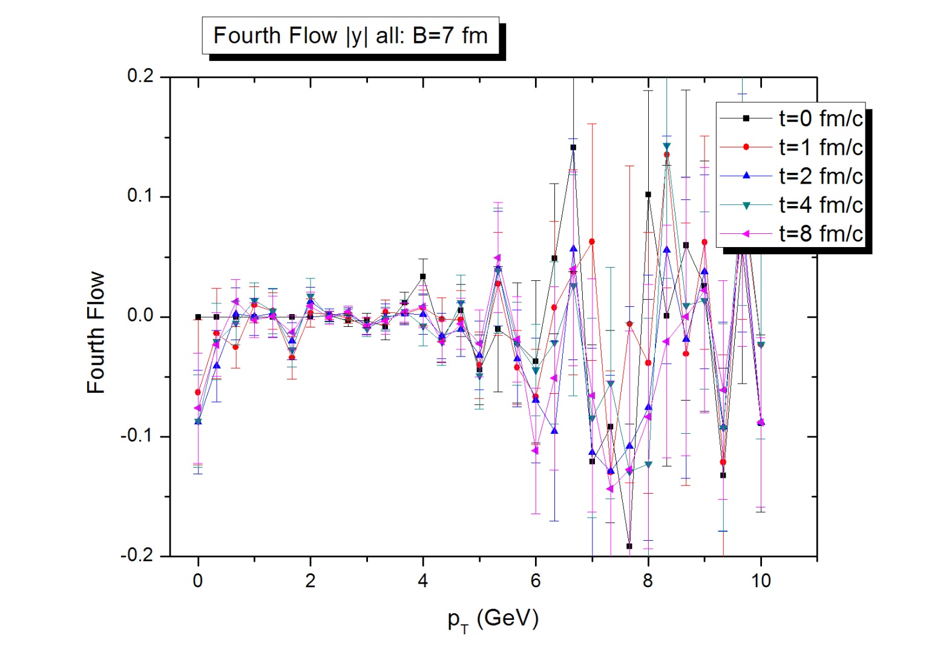
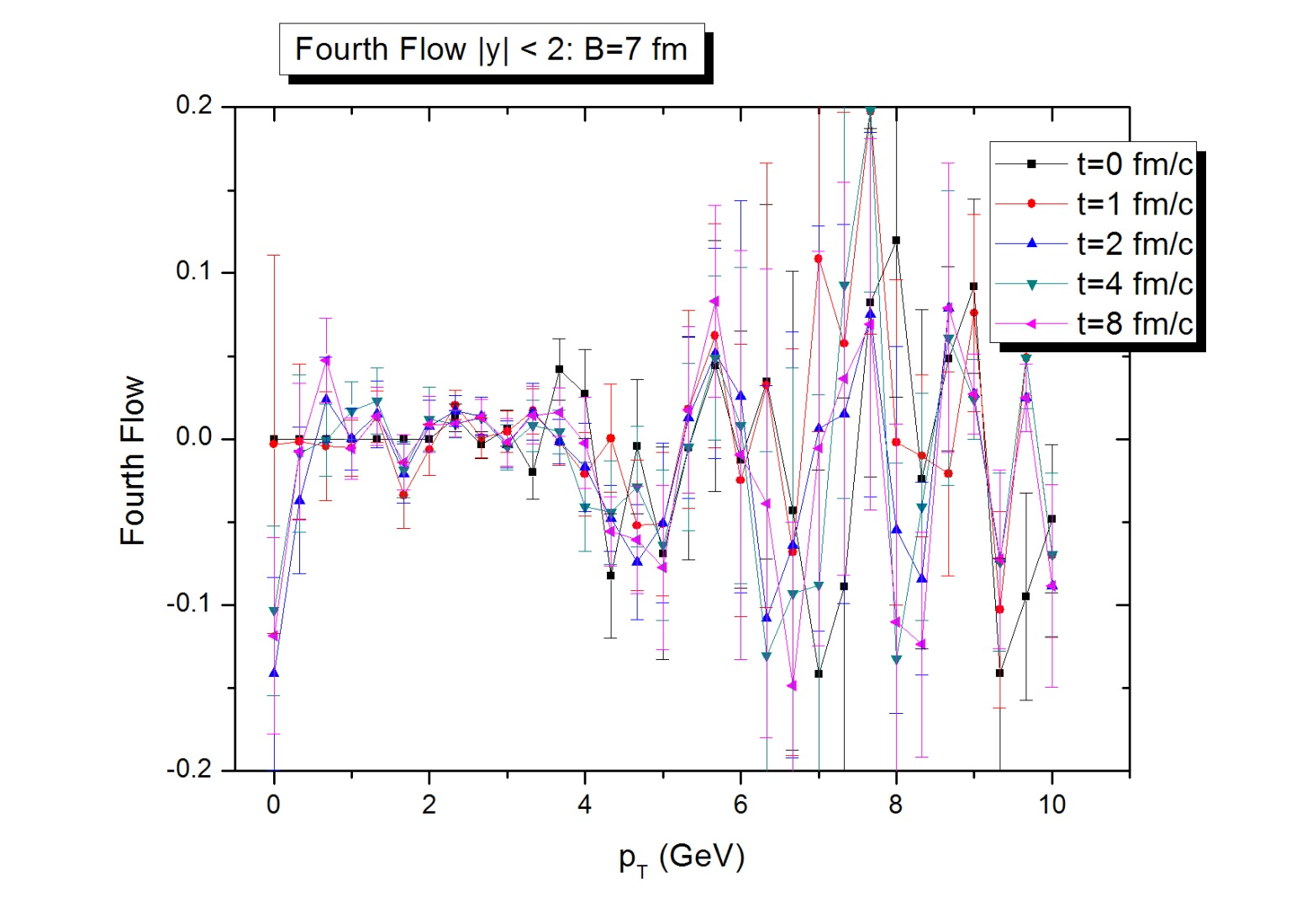
5) Fourth Flow:

Slide 24
5. Discussions
I have seen the elliptic flow at RHIC energy but not at LHC. Why? Partial answer: Those partons at LHC have much higher longitudinal momentum.
How to improve?
  Virtuality
  Better parameters:
    K-factor
    LPM effect: formation time
    parton mass
    coupling constant
    Minimum momentum transfer
  Color Force: MAJOR PROBLEM
Hadronization: to compare to hadron data

Slide 25
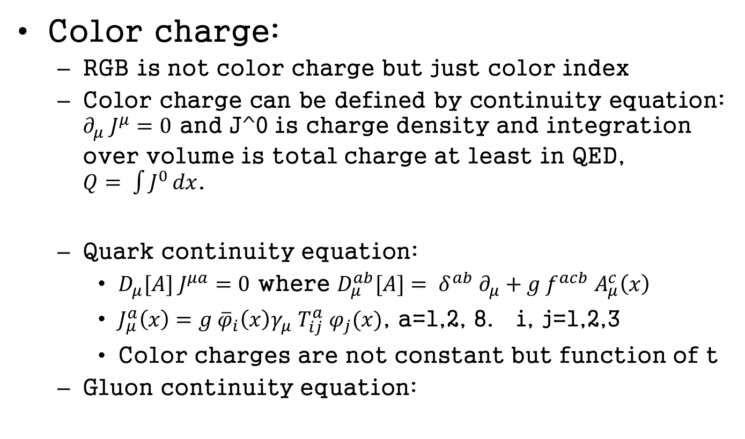
Color force
Color charge:
  RGB is not color charge but just color index
  Color charge can be defined by continuity equation: $∂_{μ} J^{μ}=0$ and J^0 is charge density and integration over volume is total charge at least in QED, $Q= \int{J^{0}}dx$.
  Quark continuity equation:
    $D_{μ}[A] J^{μa}=0$ where $D_{μ}^{ab}[A]= δ_{}^{ab} ∂_{μ}+g f^{acb} A_{μ}^{c}\left(x\right)$
    $J_{μ}^{a}\left(x\right)=g {\overline{φ}}_{i}\left(x\right)γ_{μ} T_{ij}^{a} φ_{j}(x)$, a=1,2, 8. i, j=1,2,3
    Color charges are not constant but function of t
  Gluon continuity equation:

Slide 26
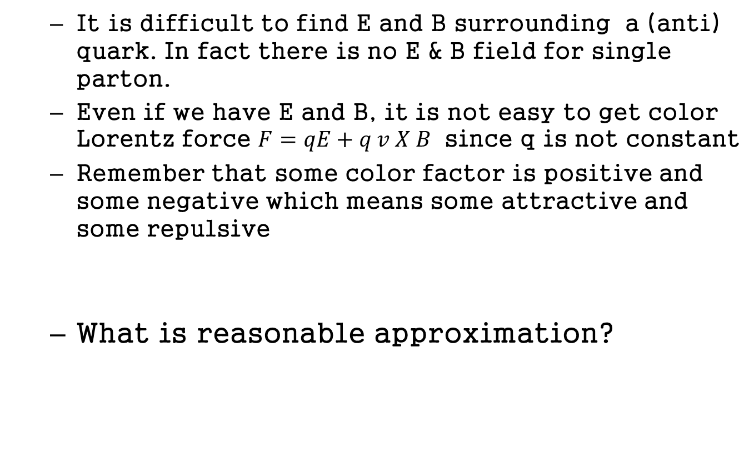
  It is difficult to find E and B surrounding a (anti) quark. In fact there is no E & B field for single parton.
  Even if we have E and B, it is not easy to get color Lorentz force $F=qE+q v X B$ since q is not constant
  Remember that some color factor is positive and some negative which means some attractive and some repulsive
  What is reasonable approximation?

Slide 27
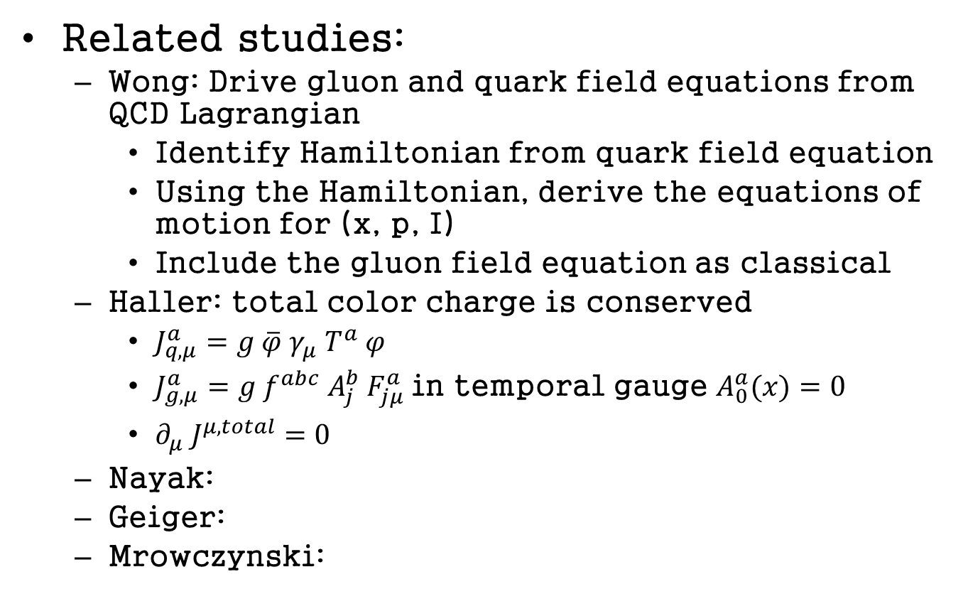
Related studies:
  Wong: Drive gluon and quark field equations from QCD Lagrangian
    Identify Hamiltonian from quark field equation
    Using the Hamiltonian, derive the equations of motion for (x, p, I)
    Include the gluon field equation as classical
  Haller: total color charge is conserved
    $J_{q, μ}^{a}=g \overline{φ} γ_{μ} T_{}^{a} φ$
    $J_{g, μ}^{a}=g f^{abc} A_{j}^{b} F_{jμ}^{a}$in temporal gauge $A_{0}^{a}(x)=0$
    $∂_{μ} J^{μ,total}=0$
  Nayak:
  Geiger:
  Mrowczynski:

Slide 28
Possible answer to the last question:
  We may start from the equation by Haller and separate the gluon field into soft and hard part. Treat the hard part as classical particles and derive their equations of motion, for example, Wong equation, for quark and hard gluon. And solve (soft, abelian, classical) gluon field equation.
  Average over color charge for the given parton
We do not know the answer BUT the NATURE does.

