Slide 1
Pixel sensor for ALICE ITS upgrade & CIS
Y. Kwon
(Yonsei Univ.)

Slide 2

NA
LHC
SPS
ALICE

Slide 3
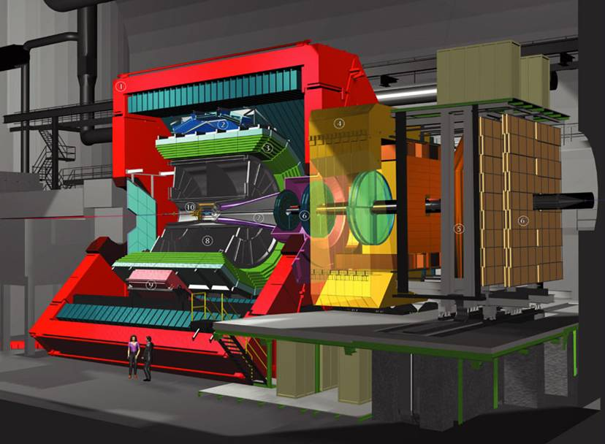
ALICE Set-up
Size: 16 x 26 meters
Weight: 10,000 tons
TOF
TRD
HMPID
ITS
PMD
Muon Arm
PHOS
TPC

Slide 4
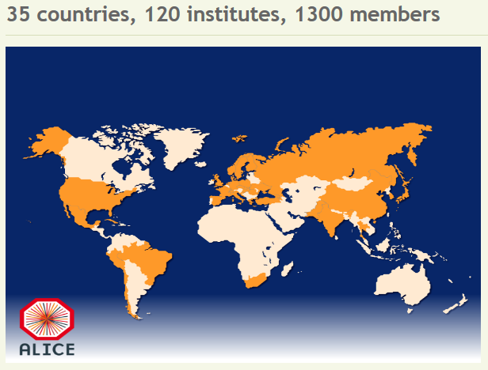
ALICE
(Participation)

Slide 5
A possibility in Korea

Slide 6
Si sensor in general
Mature technology
Reliable performance
Fine granule
Higher energy and time resolution (than gaseous ionization detectors)
Key burden is cost.

Slide 7
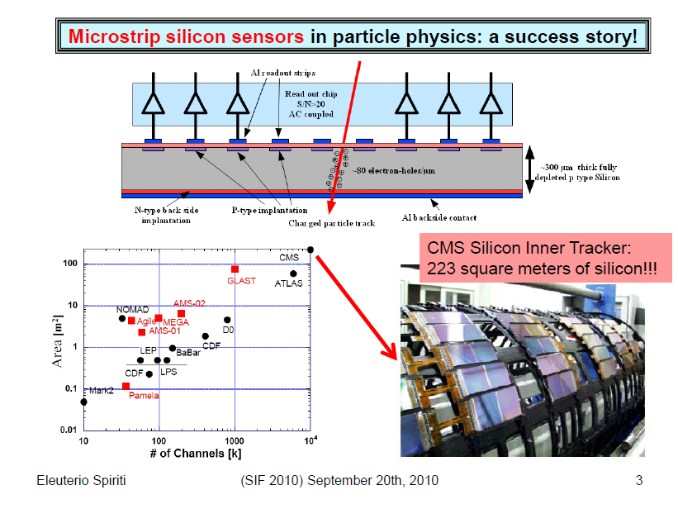

Slide 8
Typical PIN-type Si sensor

Slide 9
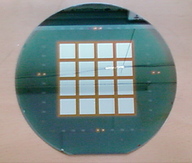
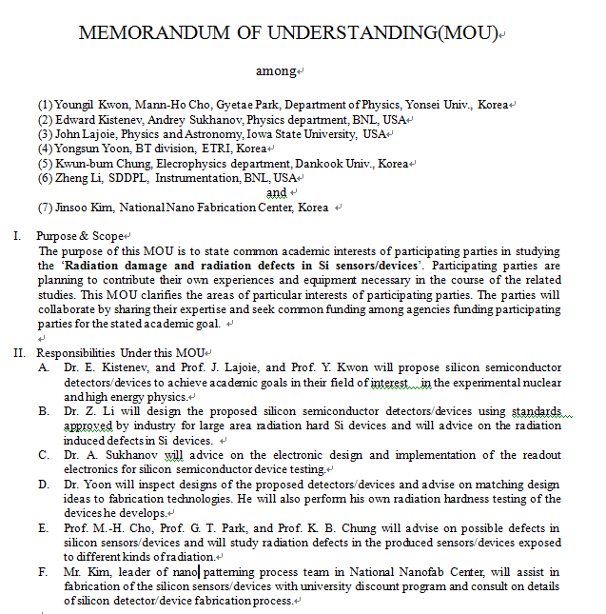

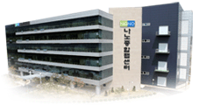
R&D environment
6 inch fabrication line
300 cm² ~ $ 500
8 inch fabrication line

Slide 10
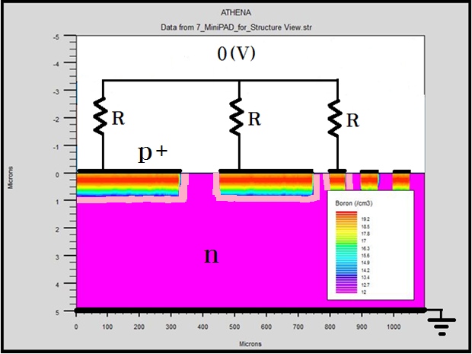
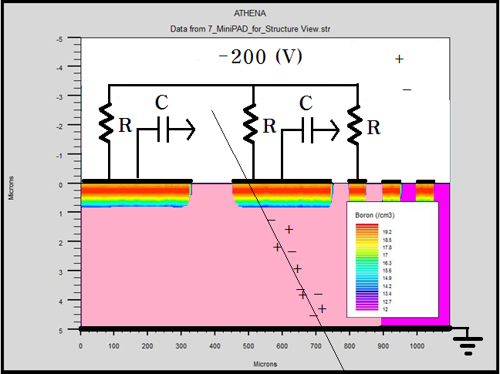
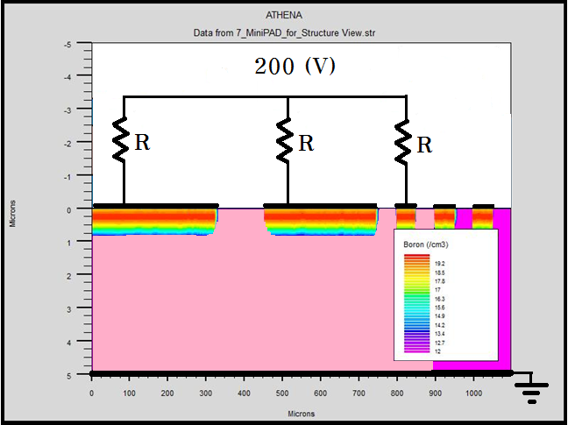
Traditional Si sensor operation
-

Slide 11
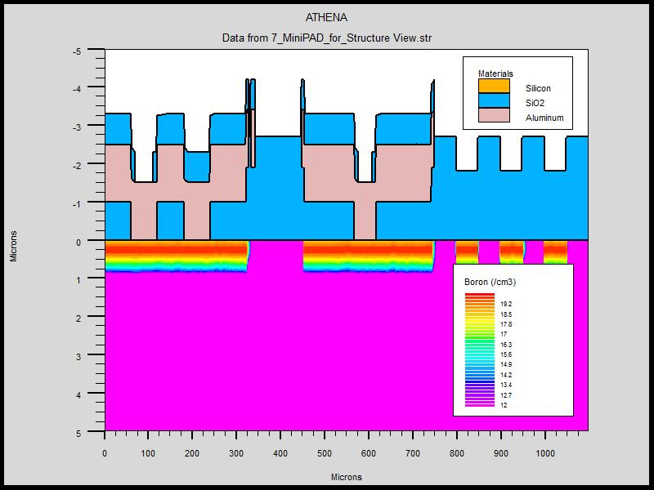
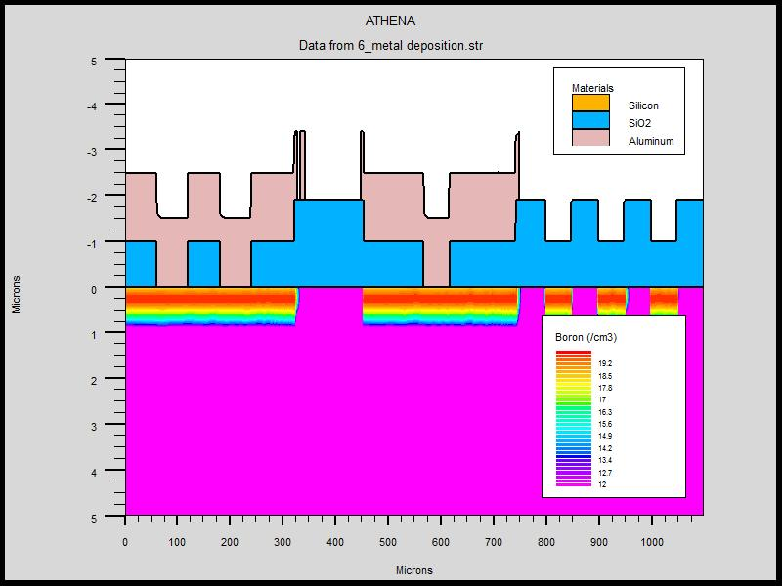
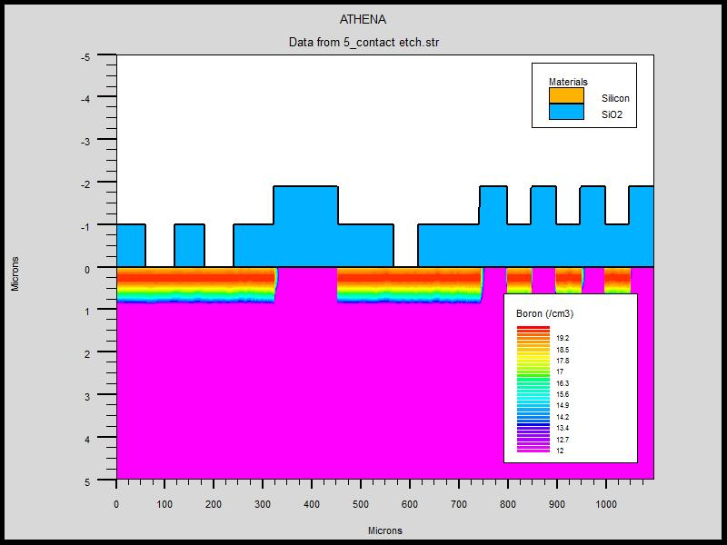
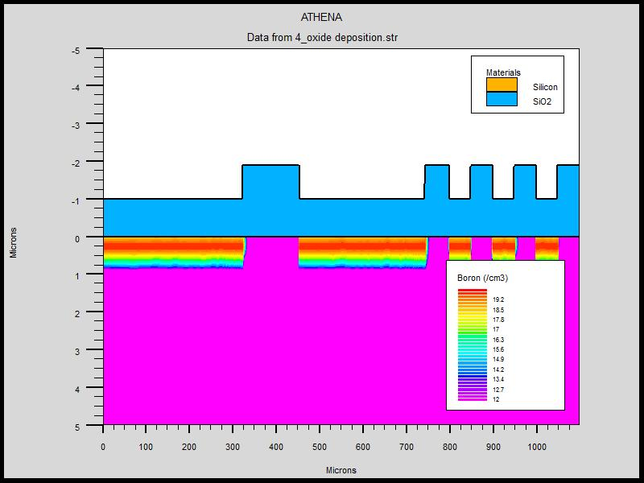
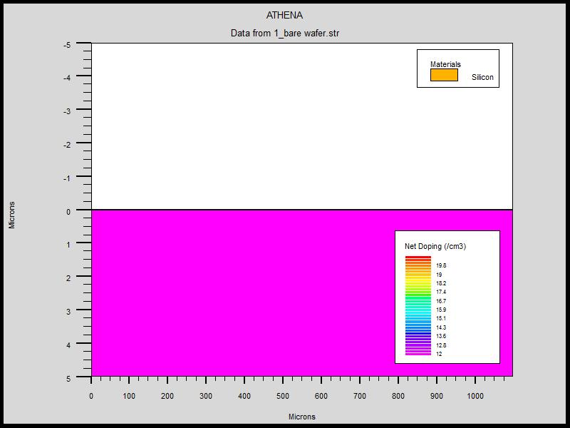
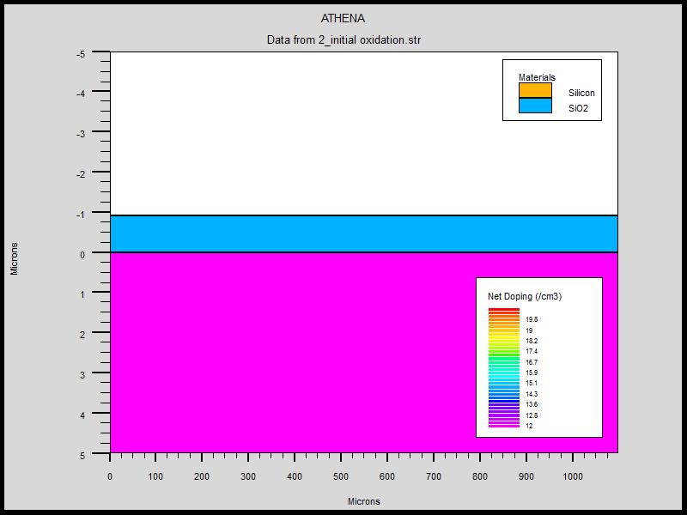
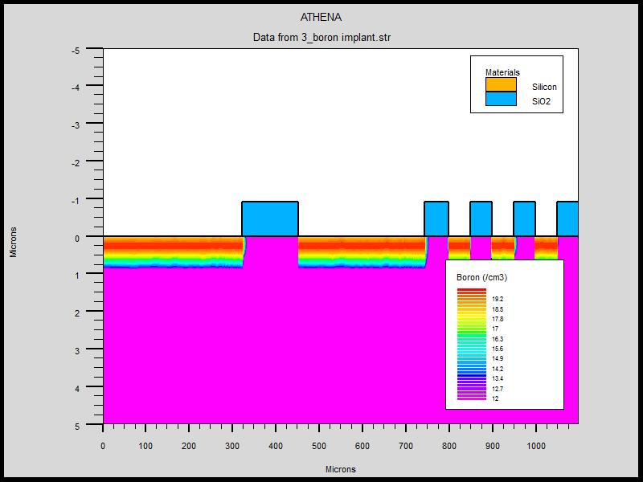
How do we make it?
(CMOS process)
Metal layer deposition
Passivation
Oxide layer deposition
Etch for contact
High purity Si wafer
Oxidation
Ion implant

Slide 12
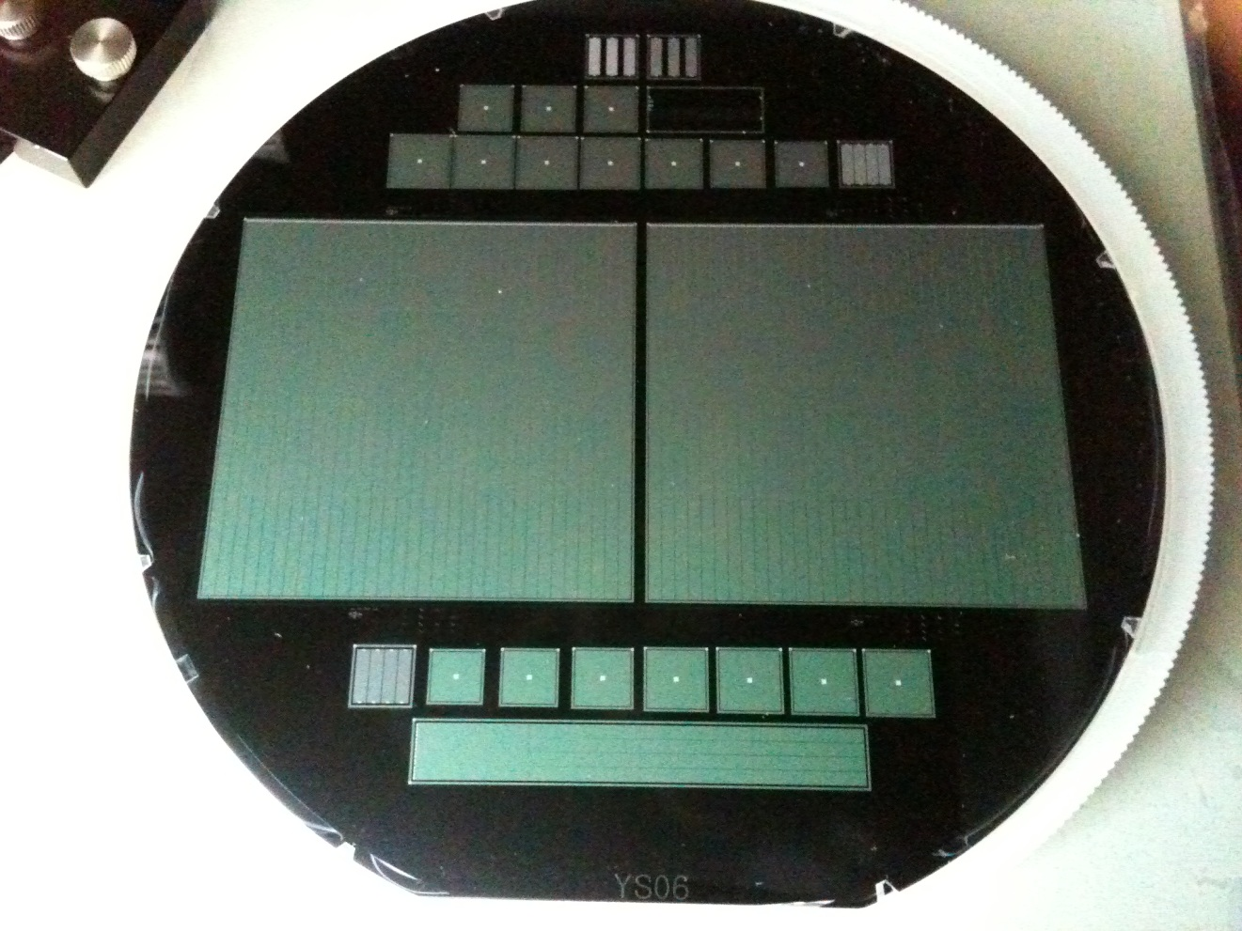
Processed Wafer

Slide 13
New challenge

Slide 14
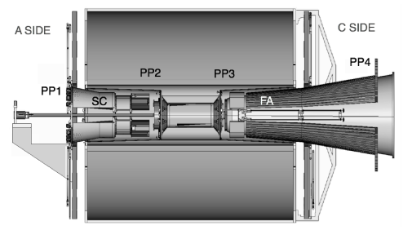
Current ALICE ITS

Slide 15
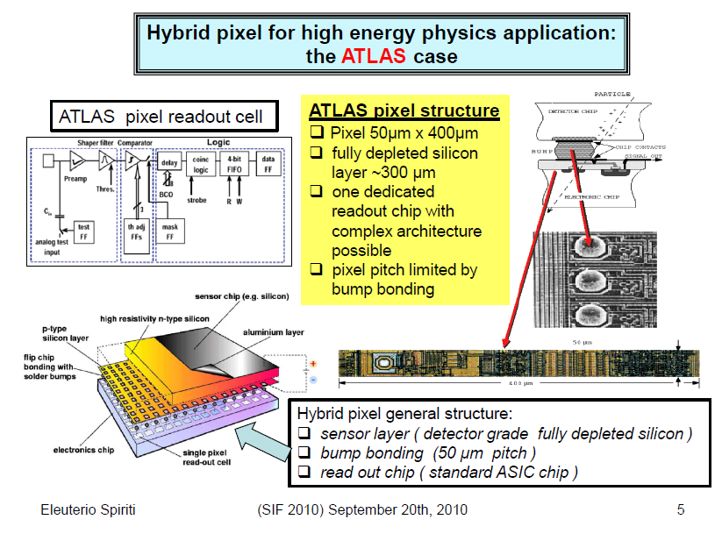

Slide 16
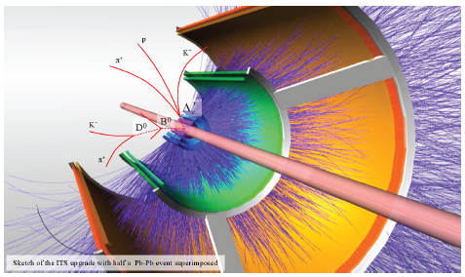
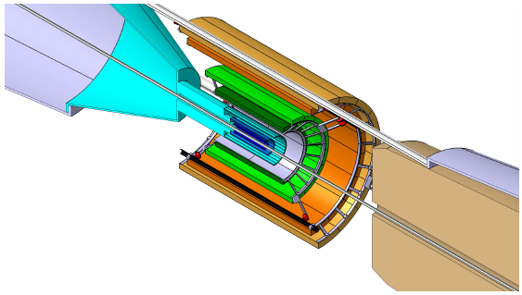
ALICE ITS Upgrade

Slide 17
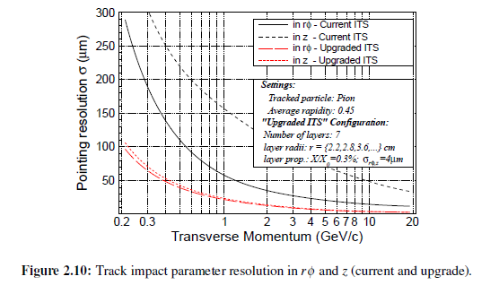
Main Physics Goal
As a function of collision centrality, measure
  Charm spectra down to p_{T}=0
  Beauty
    Displaced J/Ψ production
    Displaced D⁰ → Kπ
  Heavy flavor from single displaced electrons
  Thermal radiation

Slide 18
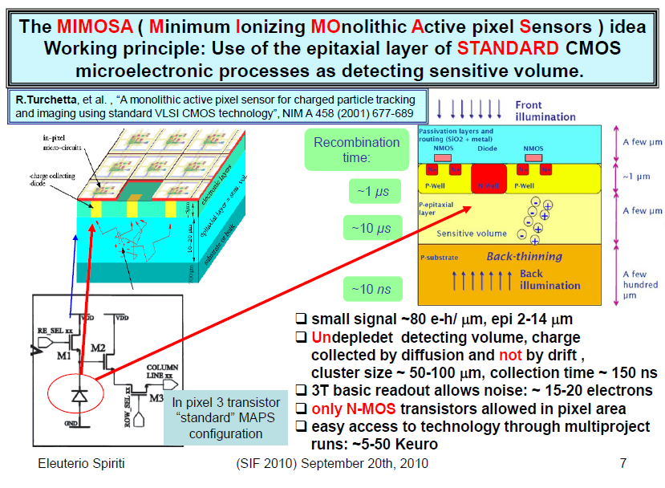

Slide 19
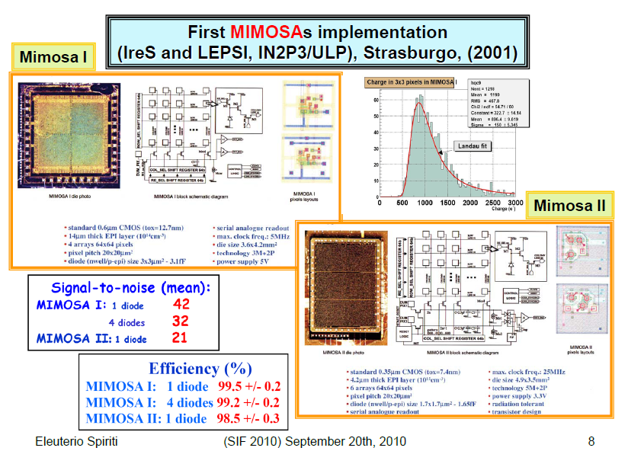

Slide 20
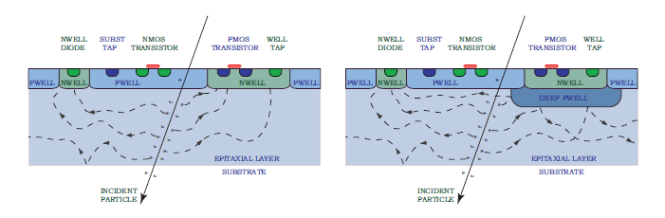
Sensor + Digitization

Slide 21
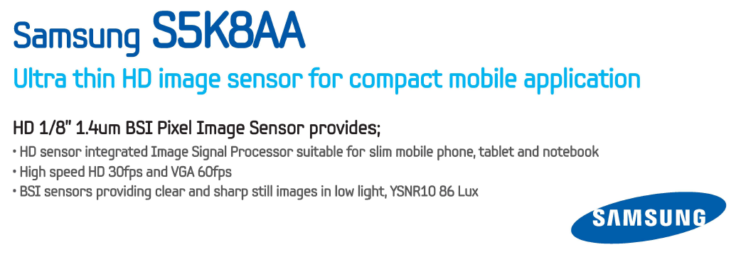

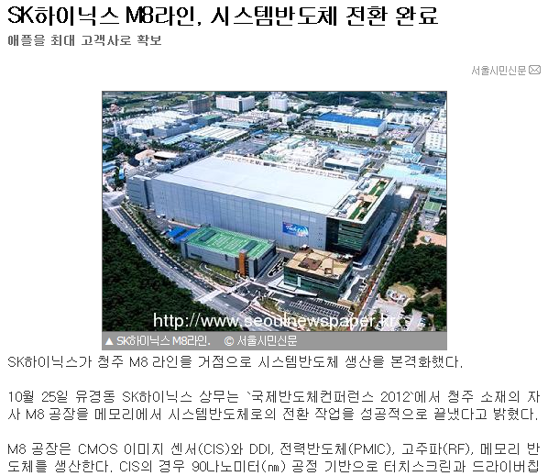

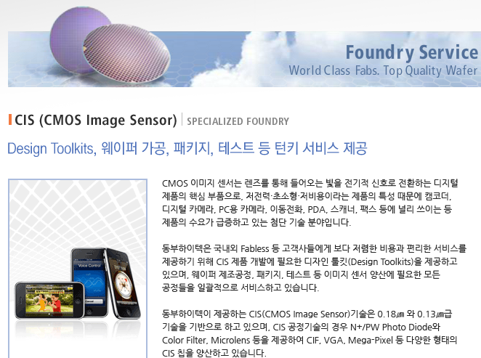

Slide 22
As of now
Would it work?
  In physics?... ITS upgrade is approved and is also top priority.
  Technically?... Probably, R&D might be initiated.
  Financially?
  Politically?

