Slide 1
Nuclear Symmetry Energy from QCD Sum Rule Heavy Ion Meeting 2012-04, April 13, 2012
Kie Sang JEONG
Su Houng LEE
(Theoretical Nuclear and Hadron Physics Group)
Yonsei University

Slide 2
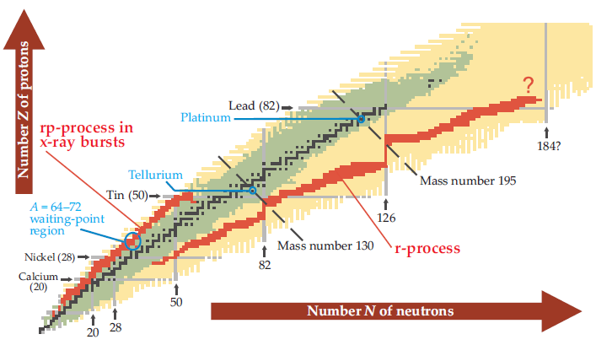
Motivation 1 – KoRIA plan
Rare Isotope Accelerator Plan
(Quoted from Physics Today November 2008)
Nuclear Symmetry Energy plays key role in Rare Isotope and Neutron Star study

Slide 3
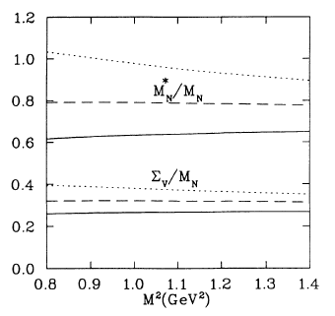
Motivation 2 – RMFT vs QCD SR
Dirac phenomenology of nucleon scattering on nuclear target suggests nucleon potential to consist of strong vector repulsion and scalar attraction
This tendency also comes naturally in RMFT
For symmetric nuclear matter, it is confirmed that this result can be justified with QCD, by Thomas Cohen et al. (1992)
Motivated by these, we applied QCD Sum Rule to asymmetric nuclear matter
Physical Review C 49, 464 (1993)

Slide 4
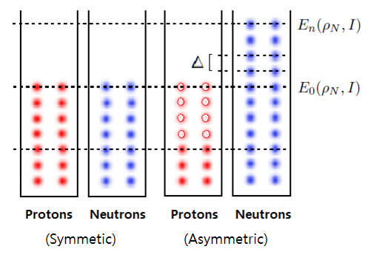
Early attempt for finite nuclei
Liquid drop model
Total shifted energy
Total shifted state number
Nuclear Symmetry Energy
This simple concept can be generalized to infinite matter case

Slide 5
For infinite nuclear matter
Energy per a nucleon
Single nucleon energy
Averaged single nucleon energy
Nuclear Symmetry Energy

Slide 6
Mean field approximation
Quasi-particle on the Fermi sea
Nucleon propagator in nuclear medium
How we can get nucleon self energies in the fundamental principle?
QCD Sum Rule is a well established method for investigating quasi-particle state in medium
(Up to linear density order)

Slide 7
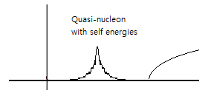
QCD Sum Rule
Correlation function
Vacuum sum rule for nucleon
In-medium sum rule for quasi-nucleon
Contains all possible resonance states
Ioffe’s interpolating field for proton
In-medium vector part

Slide 8
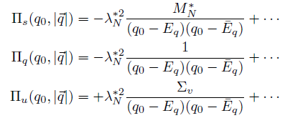
QCD Sum Rule
Phenomenological ansatz
At short distance, Wilson coefficient can be obtained by perturbative calculation
One can find self energies near pole
Kinetic part is excluded
Not be dependent on external momentum
For example,
(These figures are quoted from Ph.D. thesis of Thomas Hilger)

Slide 9
Iso-spin relation for 2-quark condensates
In-medium condensate in asymmetric nuclear matter
Iso-scalar/vector operators in light quark flavor
2-quark condensates
can be estimated with nucleon expectation value and each nucleon density
Can be related with ratio factor
Well known from many previous studies
Each 2 type of condensate need different ratio factor

Slide 10
Iso-spin relation for condensates
Ratio factor for type
Ratio factor for type
Lower lying baryon octet mass relation comes from baryon expectation value of energy-momentum tensor
In medium rest frame
This relation can be estimated from lower lying baryon octet mass relation
Phenomenological description for nucleon mass term

Slide 11
Mass terms
Trace part of QCD energy momentum tensor
For proton
With renormalizing scheme (Trace anomaly)
Heavy quark expansion
(M.A.Shifman, Physics Letters B 78B, 443 (1978))

Slide 12
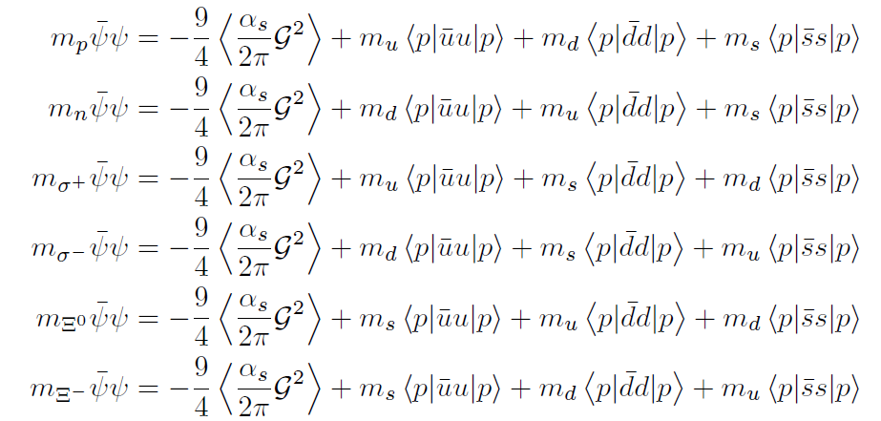
Ratio factor from baryon octet
Lower lying Baryon octet mass relation
(S.H.Choi, Master thesis, Yonsei University. (1991))
With this relation…

Slide 13
Ratio factor from baryon octet
Iso-vector part, can be written as,
Iso-scalar part, comes from pion-nucleon sigma term
Ratio factor for type
Strange quark mass = 150 MeV

Slide 14
4-quark Operator Product Expansion
So far, there was no systematic description for four-quark condensates in the nucleon sum rule
To express four-quark condensates in terms of linear combination of independent operators, one can use Fierz rearrangement
Constraint from `Zero Identity’ for pure quark flavor case which comes from forbidden di-quark structure of quark model for hadron
Simple factorization scheme was used as in the vacuum saturation hypothesis
And with assumed P, T symmetry of medium ground state…

Slide 15
4-quark Operator Product Expansion
4-qaurk OPE of the nucleon sum rule can be expressed with only few condensates as below
Among these, except for , all twist 4 operators can be estimated from experiment (DIS)
Twist 4 (Dimension 6 spin2) | (4 independent Ops.) | (4 independent Ops.)
Dimension 6 scalar
Dimension 6 vector
Can be combined into scalar and vector condensates

Slide 16
Twist 4 operator from DIS data
(SHL et al., Physics Letter B 312 (1993) 351-357)
Where, Ku, Kd are
From these result…

Slide 17
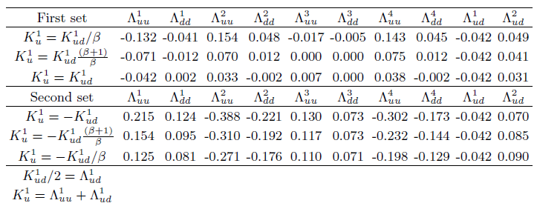
Twist 4 operator from DIS data
Table for twist 4 matrix elements for the nucleon SR
First set and second set give different contribution to Nuclear Symmetry Energy

Slide 18
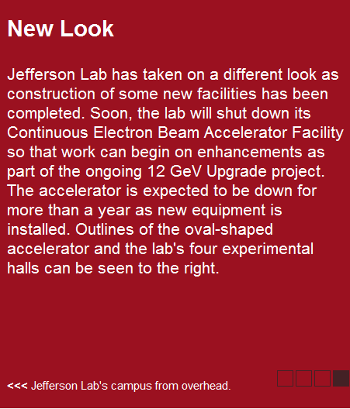
DIS data will be sharpened
Table for twist 4 matrix elements has some ambiguity
Jefferson Lab has a plan for accelerator upgrade
This plan will lead to more precise structure functions for twist 4 matrix elements
We can get more precise twist 4 contributions to the nuclear symmetry energy

Slide 19
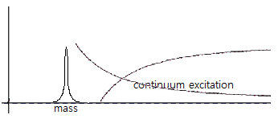
Borel transformation
Borel transformation to exclude quasi-hole and continuum excitation
Differential operator for OPE side
Weight function for phenomenological side
With weight function

Slide 20
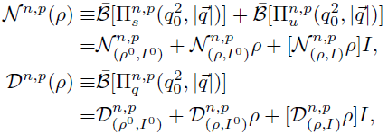
Self energies with OPEs
Self energies can be obtained by taking ratio
New symbols for self energies
To treat self energies in terms of density order and asymmetric factor, self energies need re-arrangement
Numerator of total self energy
Denominator of total self energy
Power of in the first index represents the density power order
Power of I in the second index represents the iso-spin order

Slide 21
QCD sum rule Formula
General expression
Expression up to linear density order
We need both sum rule
In medium condensates are estimated up to linear order
General expression which contains up to 2nd order density is needed to check higher density behavior of Nuclear Symmetry Energy

Slide 22
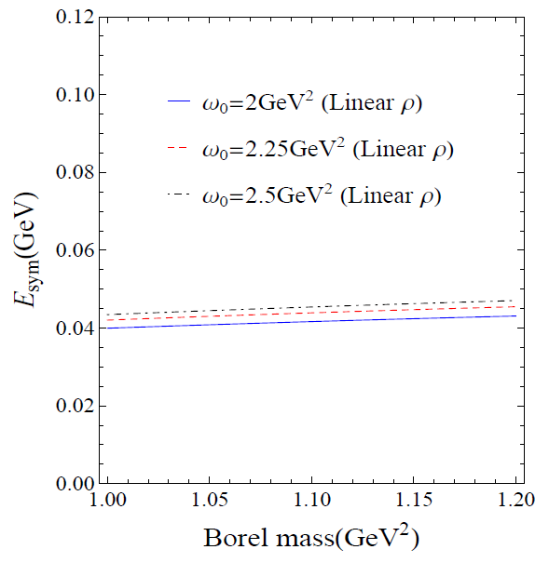
Sum Rule analysis up to dimension 5
Borel window
Nuclear Symmetry Energy
To make pole contribution be more than 50% and
Highest mass dim condensate contribution be less than 50%,
We will see our sum rule in
(B.L.Ioffe and A.V.Smilga, NPB232 (1984),109)
Nuclear Symmetry Energy is ~40 MeV
This result shows consistency with previous Nuclear Symmetry Energy study in order of magnitude

Slide 23
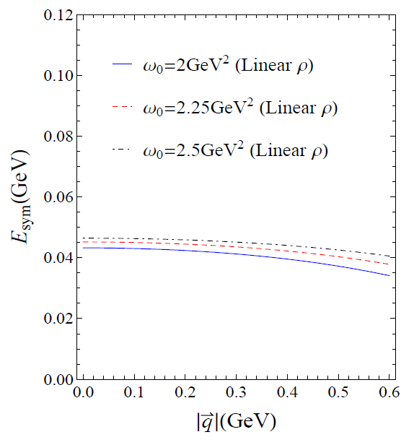
Sum Rule analysis up to dimension 5
Main ingredient?
Nuclear Symmetry Energy do not strongly depend on quasi nucleon three-momentum in 0 ≤ q ≤ 0.5 GeV
Our sum rule result mainly consists of ``Potential like” part
Kinetic part of Nuclear Symmetry Energy is known as
in mean field type calculation
(S.Kubis et al., Physics Letters B 399 (1997) 191-195)

Slide 24
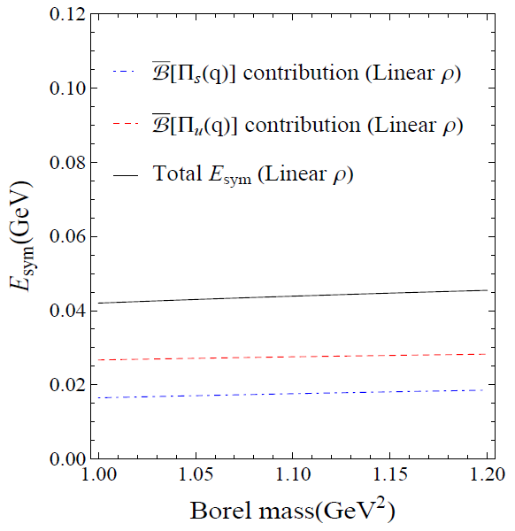
Comparison to RMFT
Scalar/Vector self energy contribution
RMFT result
In our result, both self energies give positive contribution
Which part gives reducing contribution in our sum rule?
Vector meson exchange -> Repulsive
Scalar meson exchange -> Attractive
(V.Baran, et al. Physics Reports 410 (2005) 335–466)

Slide 25
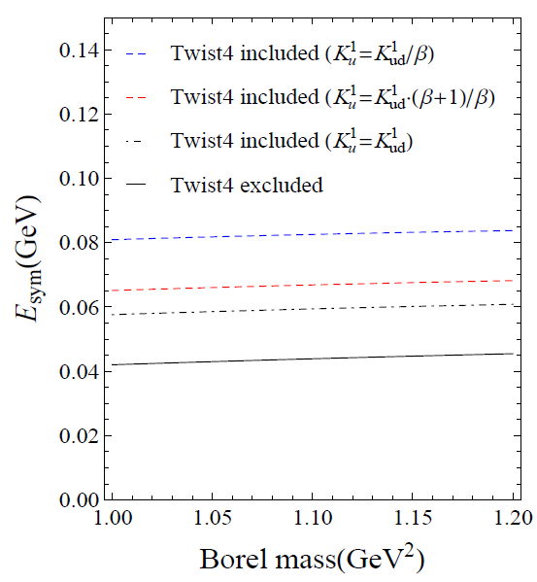
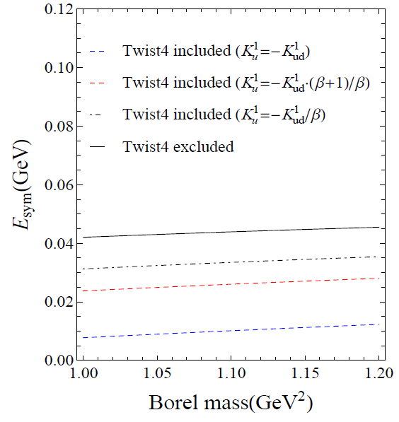
Nuclear Symmetry Energy with twist 4 op.
Contribution from first set
Contribution from second set
Most wanted value for the potential part of the nuclear symmetry energy
20 MeV~40 MeV enhanced
20 MeV~30 MeV reduced

Slide 26
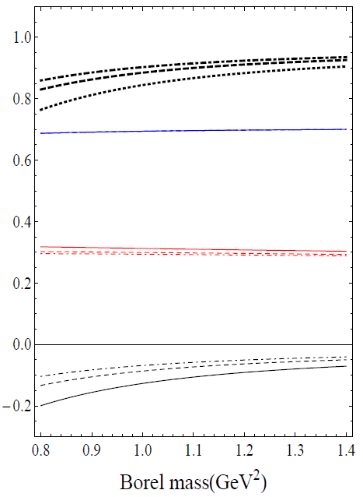
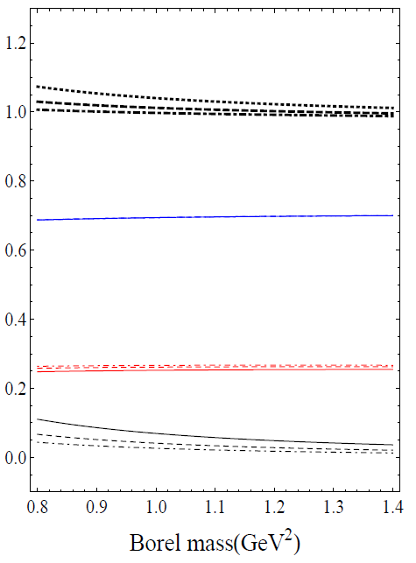
Nuclear Symmetry Energy with twist 4 op.
In-medium nucleon sum rule with twist 4 condensates
Thick black lines are total quasi-nucleon self energy
The first set gives quasi-nucleon energy over than the nucleon mass in vacuum
But the second set gives plausible quasi-nucleon energy, slightly smaller than the nucleon mass in vacuum
So hereafter we conclude that the second set may be more plausible choice
Scalar self energy
Vector self energy
Twist 4 contribution

Slide 27
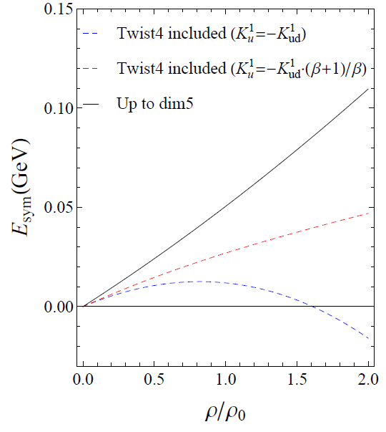
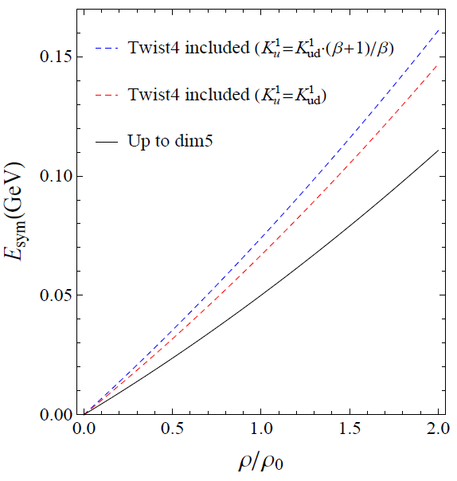
Nuclear Symmetry Energy with twist 4 op.
Density dependence with twist-4 contribution
The result with the first set gives strong enhancement and second set gives strong reduction as nuclear matter becomes higher density
In dense matter, twist-4 condensates determine higher density behavior of the Nuclear Symmetry Energy
Multi-quark operators may determine the asymmetric nuclear bulk properties in dense condition

Slide 28
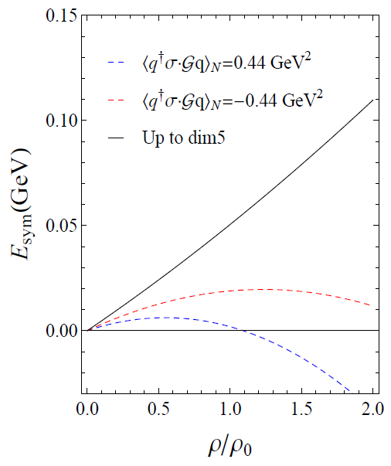
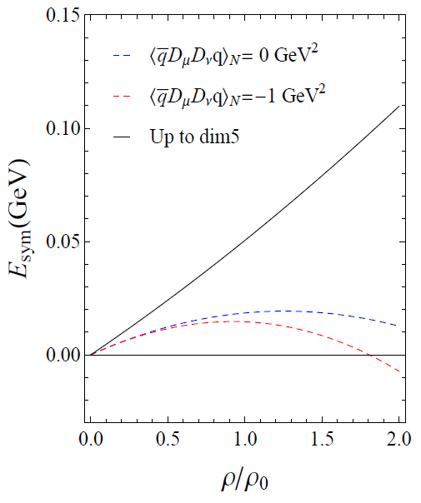
Nuclear Symmetry Energy <-> DIS
Contributions of 2-quark dimension 5 operators
Our sum rule shows that precise measurement of Nuclear Symmetry Energy can give us a meaningful constraint to unknown higher twist operators
From these facts, we can re-write effective expression for Nuclear Symmetry Energy in our sum rule context
Scalar-Vector Cond.=> Enhancing
Pure Tensor Cond. => Reducing

Slide 29
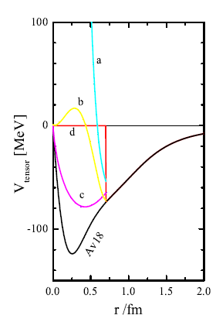
At Extremely high density?
Model prediction with effective nucleon-nucleon-tensor potential
At high density, phase of nuclear matter may become to quark phase, and mean distance between quarks will be shortened
We may make naïve guess that this kind of prediction for dense condition might be justified by QCD via studying twist 4 of multi quark condensates at high density
(Bao An Li: arXiv:1107.0496v1)

Slide 30
Conclusion
We have successfully reproduced numerical value of the Nuclear Symmetry Energy of previous studies and found exact contribution of twist 4 matrix elements to the nucleon sum rule
Twist 4 matrix elements give non-negligible contribution to Nuclear Symmetry Energy. Reducing contribution may be more plausible
Nuclear Symmetry Energy can be understood via QCD, and also constraints for twist-n and multi-quark condensates can be studied from Nuclear Symmetry Energy
Extremely high density behavior remains unclear, but this also might be understood via QCD

Slide 31
Back up slides

Slide 32
4 quark Operator Product Expansion
So far, there was no systematic description for four-quark condensates in the nucleon sum rule
To express four-quark condensates in terms of linear combination of independent operators, one can use Fierz rearrangement
Simple factorization scheme was used as in the vacuum saturation hypothesis
(For pure quark flavor case)
(For mixed quark flavor case)

Slide 33
4 quark Operator Product Expansion
And one may use `zero identity’ for pure quark flavor case which comes from forbidden di-quark structure of quark model for hadron
Finally, with this constraint, one can find that it needs only for 2type of twist-4 condensates and their trace part to express the 4q OPE of the nucleon sum rule (for pure flavor case)
Will be dropped with assumed P, T symmetry of nuclear medium

Slide 34
4 quark Operator Product Expansion
For mixed quark flavor case, with assumed P, T symmetry of nuclear medium ground state, the OPE can be simplified as
So now we have got exact four-quark OPE for the nucleon sum rule with Ioffe current
These four-quark OPE gives important contribution to nucleon in the symmetric/asymmetric nuclear matter

