Slide 1
Prospect for Si sensors in Korea
Y. Kwon
(Yonsei Univ.)

Slide 2
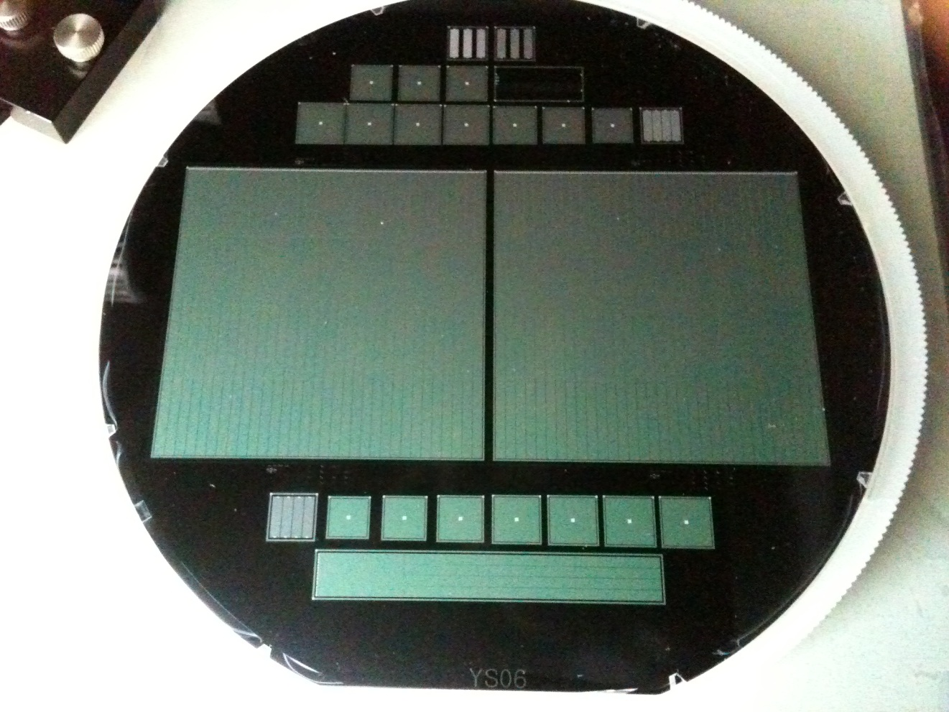
What is Si sensor?
(Sensor on Si wafer)

Slide 3
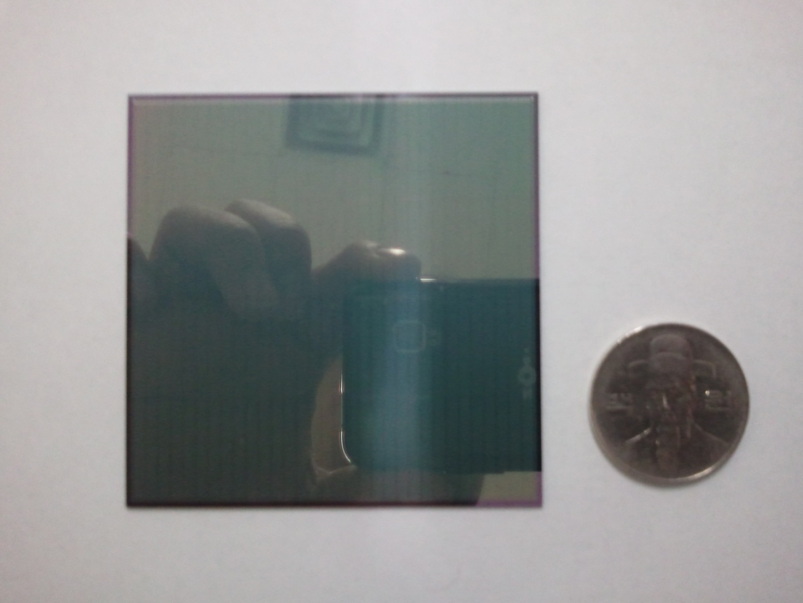
What is Si sensor?
(Diced sensor)

Slide 4
Introduction for student

Slide 5
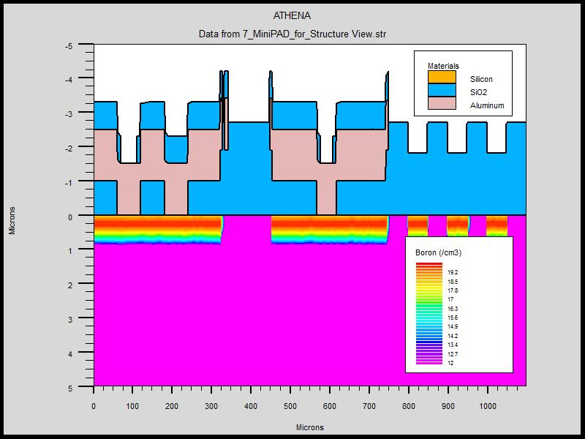
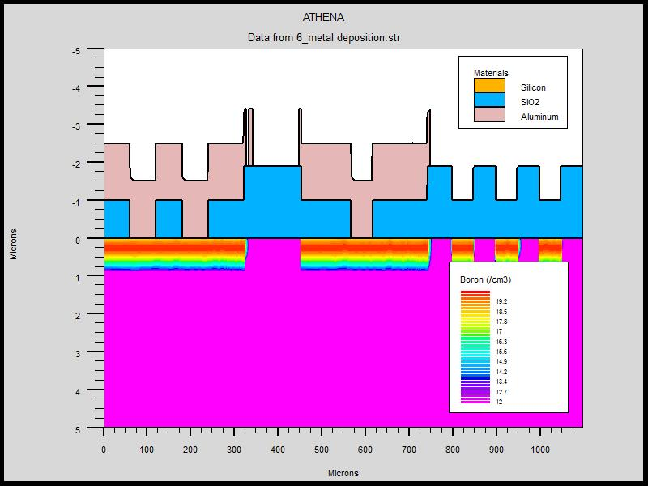
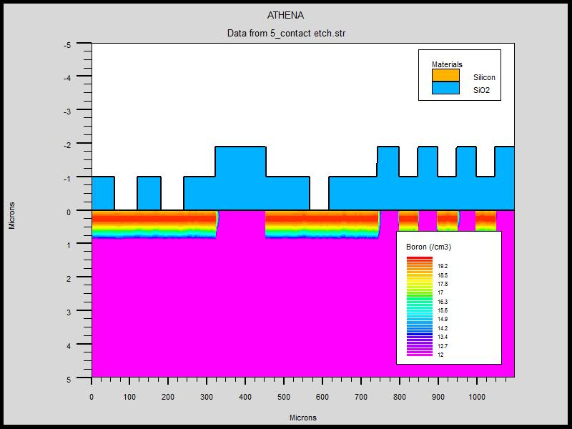
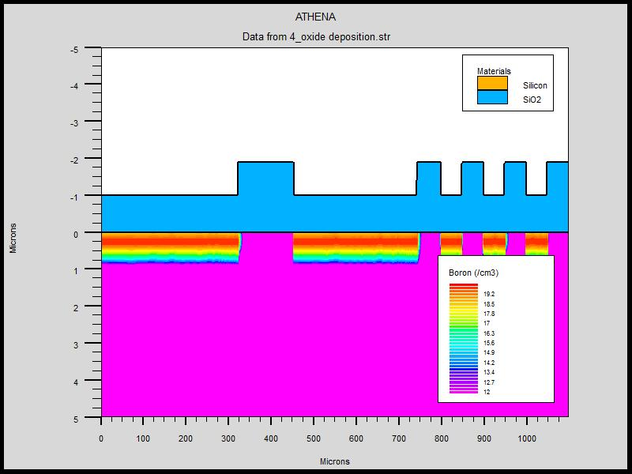
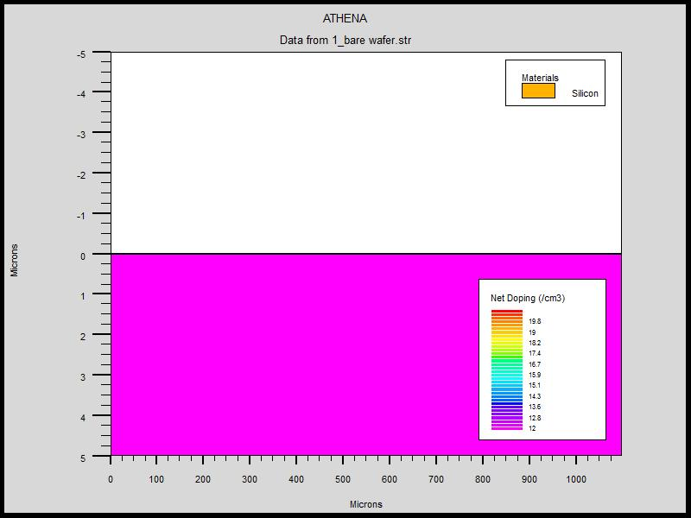
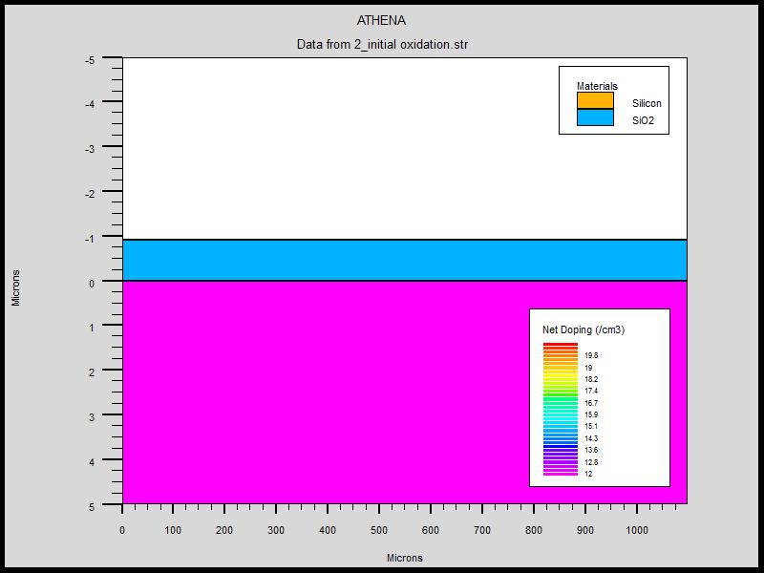
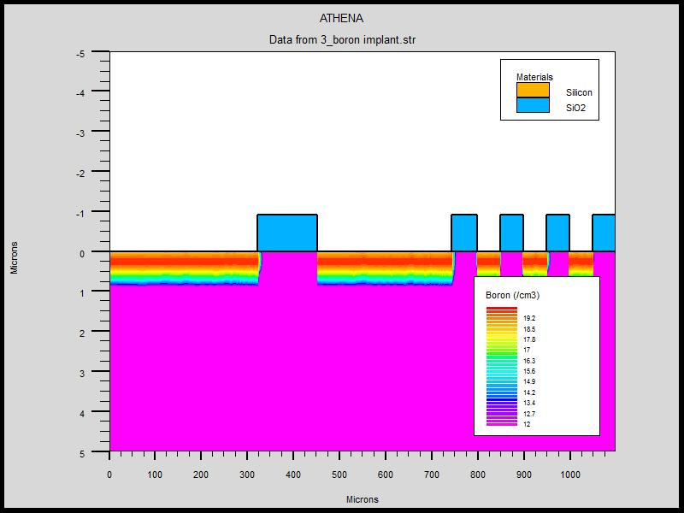
How do we make it?
(CMOS process)
Metal layer deposition
Passivation
Oxide layer deposition
Etch for contact
High purity Si wafer
Oxidation
Ion implant

Slide 6
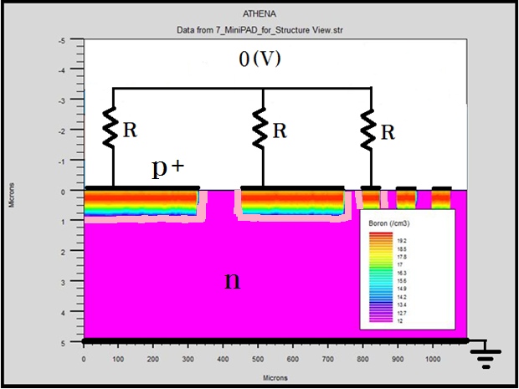
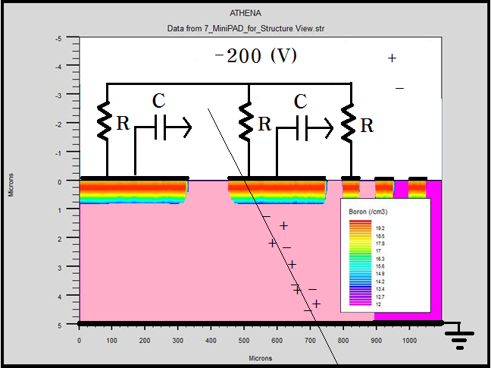
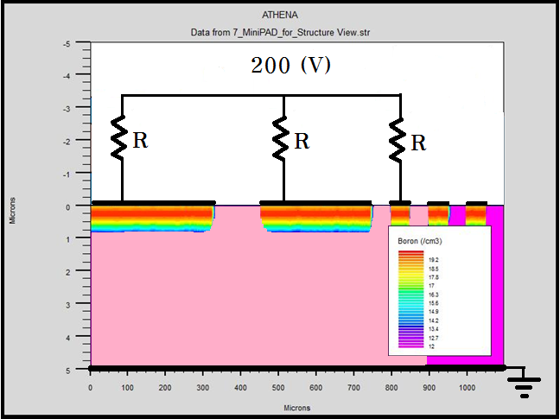
How does it operate?
-

Slide 7
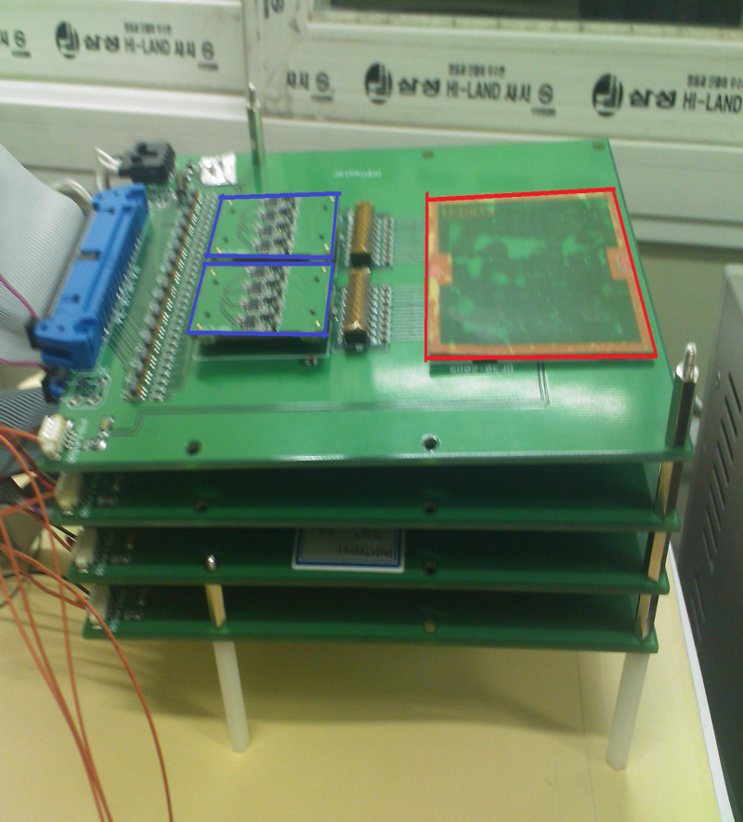
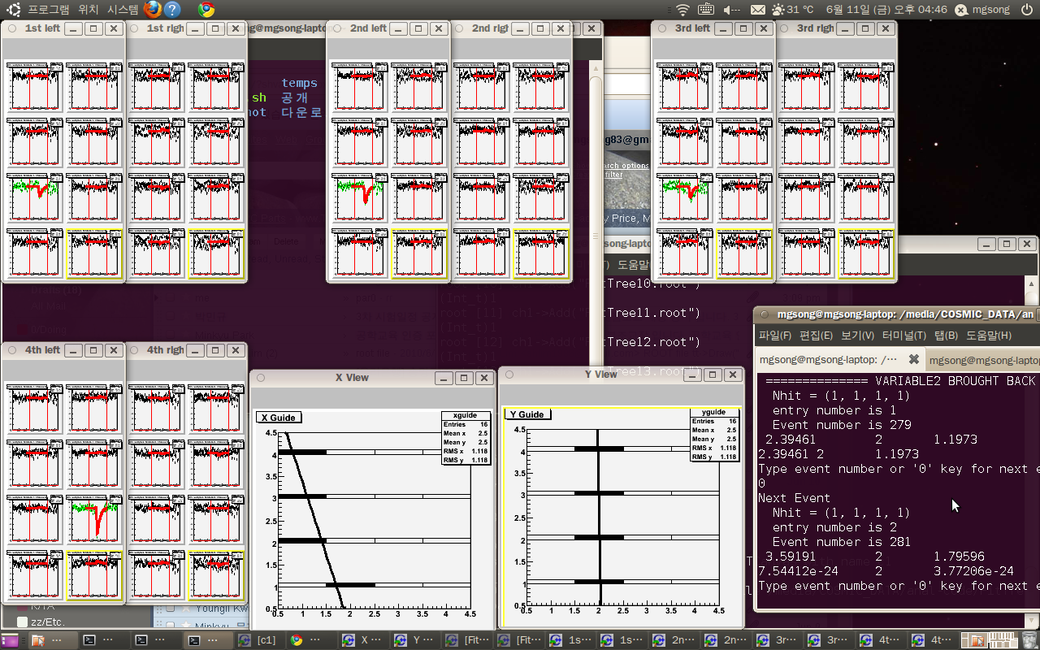
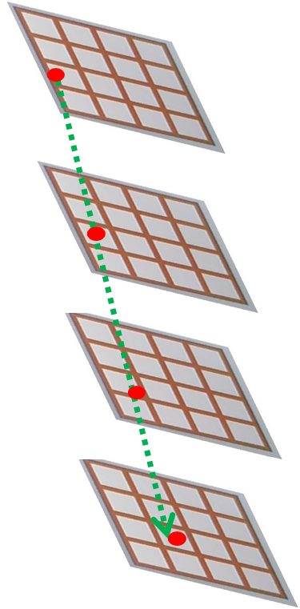
Cosmic muon test
KPS, Fall 2010

Slide 8
Possibility in Korea

Slide 9
Si sensor in general
Mature technology
Reliable performance
Fine granule
Higher energy and time resolution (than gaseous ionization detectors)
Key burden is cost.

Slide 10
Korean Strength
Productivity!
  Large amount of Si sensors produced with the standard CMOS process

Slide 11
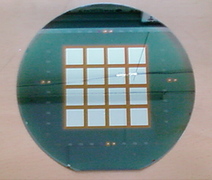
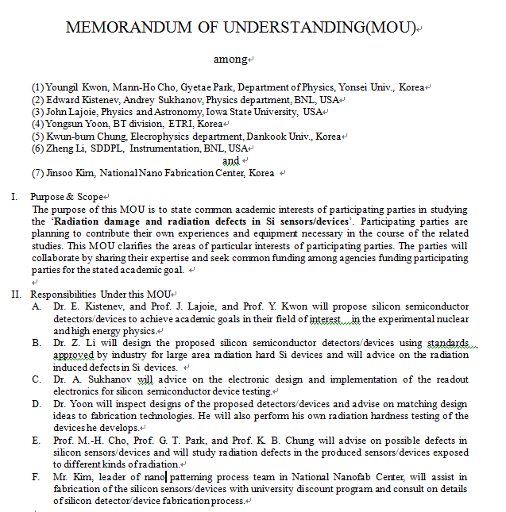


R&D environment
6 inch fabrication line
300 cm² ~ $ 500
8 inch fabrication line

Slide 12
Application

Slide 13
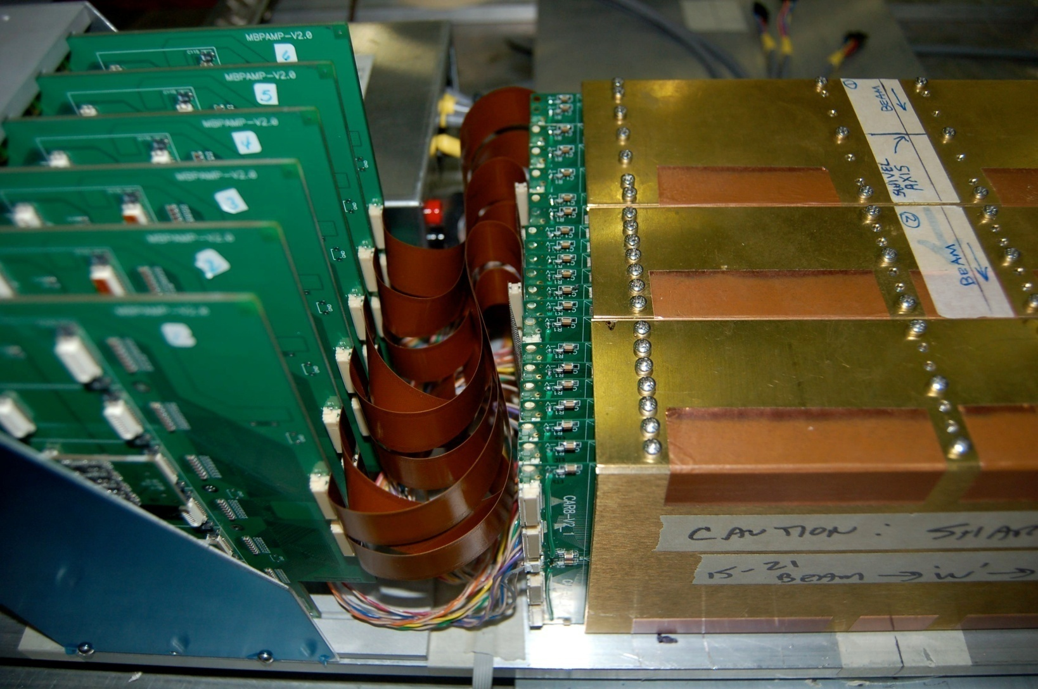
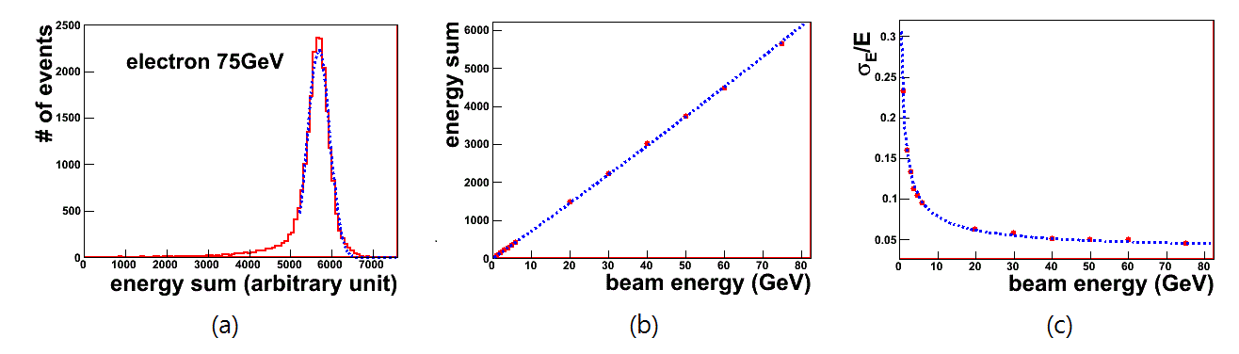
“A” Si/W calorimeter prototype
Large amount of Si sensors needed!

Slide 14
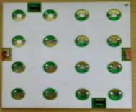

Schematics
8 pad sensors
in one carrier board
15 mm
Lateral
Longitudinal
Segment - 0
Segment - 1
Segment - 2
W, 4mm

Slide 15

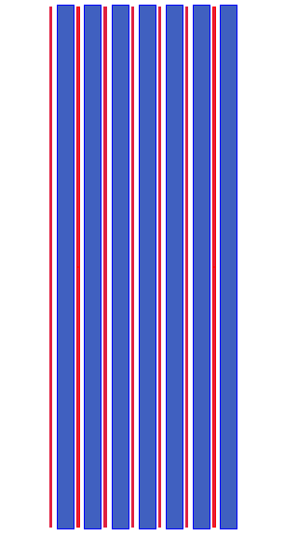
FOCAL - schematic view (y-z view)
~1X₀ x 20
PAD
STRIP
W
SEG0
SEG1
SEG2
-R_{M}<y<R_{M}
(EM Shower by single e)
y
z

Slide 16
Current snapshot

Slide 17
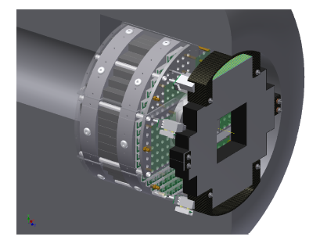
MPC-EX for PHENIX
Application as a pre-shower for EMCal (Electromagnetic calorimeter)

Slide 18
Sensor Design

Slide 19
Segmentation as a pre-shower
6.2 cm
Total # of PADs = 128
# of PADs =32
0.18cm
6.2 cm
1.5cm
# of PADs =4

Slide 20
Fine structure
Edge Rounding
PADs of Sensor
Bonding PADs
Bias Guardring
Floating Guardring
(3 layer structure)

Slide 21
Process monitoring

Slide 22
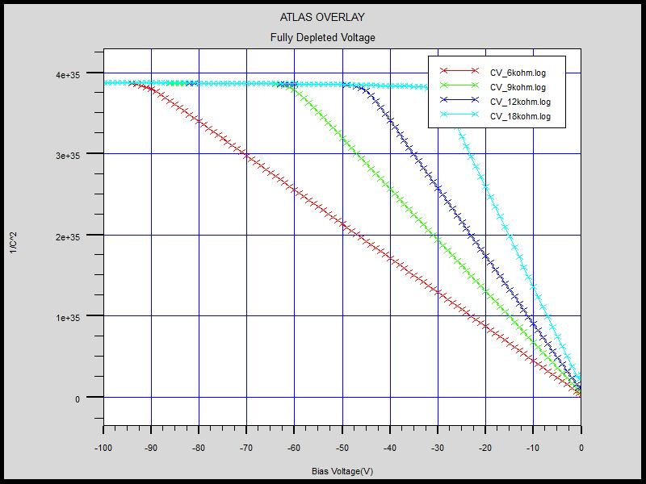
C–V simulation
Substrate specification
  ρ(resistivity) = 6,9,12,18 kΩ∙cm
  thickness = 405μm
  orientation = <100>
Full depletion
  90V(6kΩ∙cm)
  60V(9kΩ∙cm)
  45V(12kΩ∙cm)
  30V(18kΩ∙cm)

Slide 23
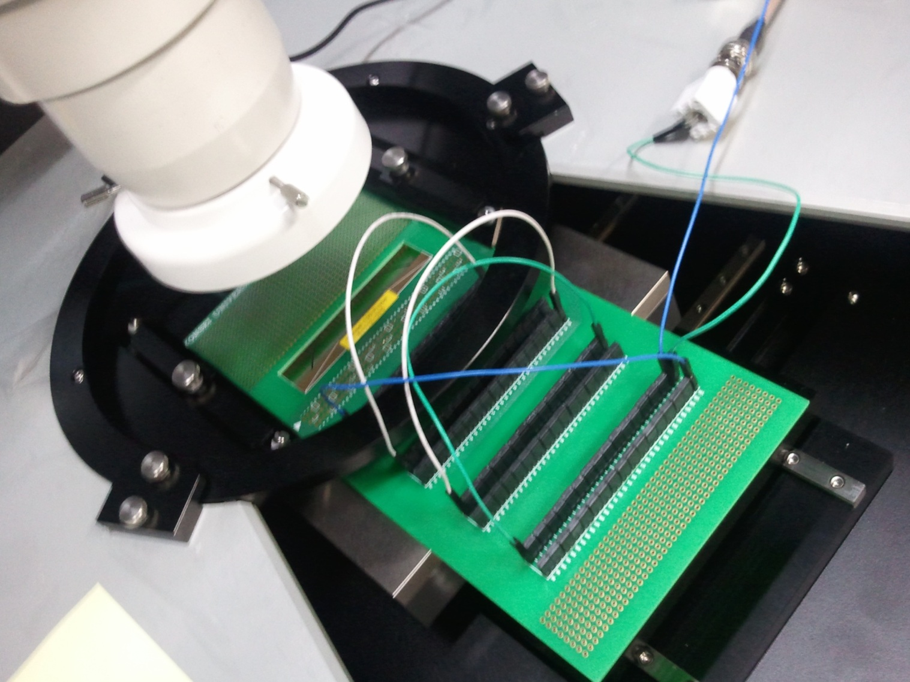
Test system

Slide 24
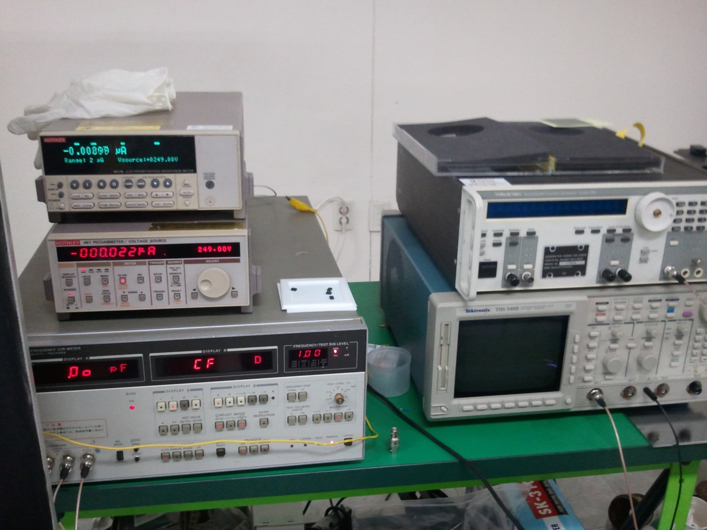
Test electronics

Slide 25
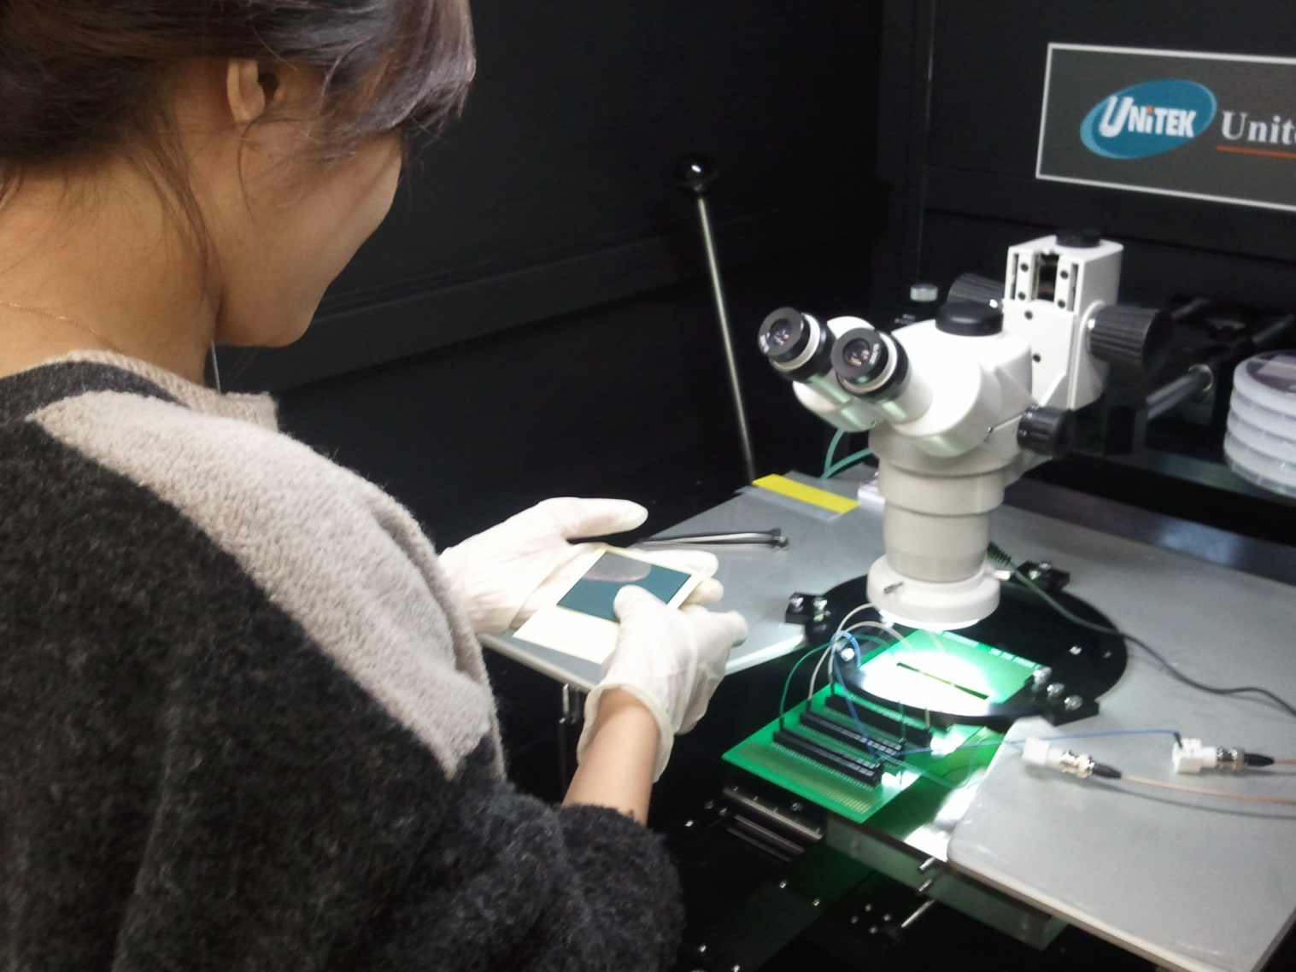
Actual test

Slide 26
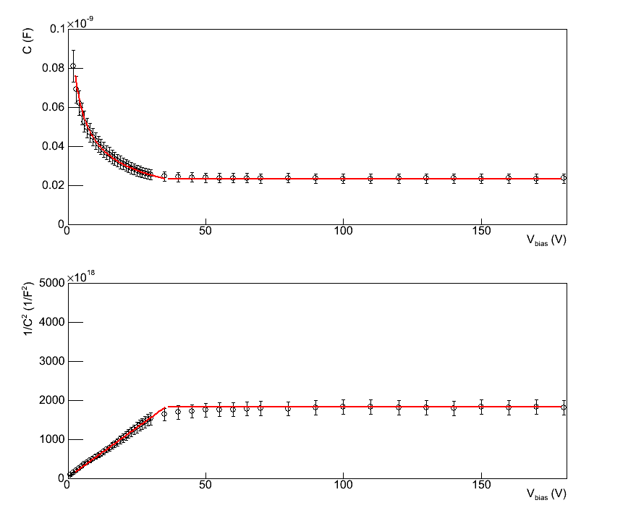
Measurement : Capacitance
Notes:
(CV공식 쓰고 설명하기)
결론 : depletion thickness가 예상대로 형성되고 있다. Guard Ring 포함 면적보다 조금 더 deletion이 형성된다.(>>) 10%차이
Fully Depletion voltage도 강조할것 중요해!!!

Slide 27
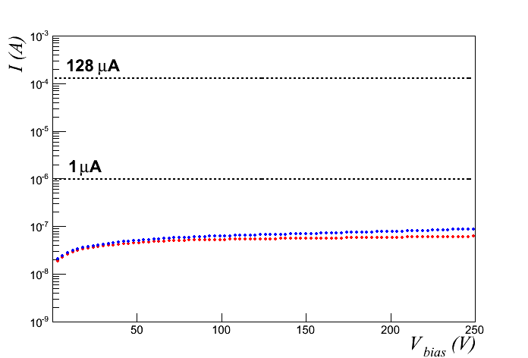
Measurement : Leakage current
< 1 μA for whole sensor!

Slide 28
Electric circuit test
We measured resistance between neighboring channels. Small fraction of them had short. Current yield ~ 30%. Statistics suggest the short is between metal traces. Stringent metal etching process is expected to cure the problem.
6 cm
30 μ
30 μ
3
4
2
1
1.5 cm
1.5 cm
3 cm

Slide 29
Ending comment
Challenges are there…, but bright future is ahead!

