Slide 1
Equations of state and compact stars in gauge/gravity duality
20 -22February 2012
Heavy Ion Meeting 2012, Pyeongchang , Korea
Kyung Kiu Kim(Institute for the Early Universe)
With Youngman Kim(APCTP) and Ik-jae Sin(APCTP)

Slide 2
Outline
Short note for string theory
Short note for AdS/CFT
Motivation
Gravity degrees of freedom in gauge/gravity correspondence
Simple compact stars and TOV equation
The simplest holographic model without matter
Adding the neutral scalar condensation to the model
Summary and discussion

Slide 3
Short note for string theory
Quantum field theories and the gravity theories including super gravity theories are point particle theories.
Point particle theories have UV infinity problem.
In field theory side, we have a method extracting physical quantities, renormalization.
In gravity theory side, we don’t have any way regarding quantum effect(Some Sugra theories, Loop quatum gravity, Horava gravity,…..).
But the point particle theory cannot avoid the UV divergence problem, because the size of particles is zero.
The only way to avoid is eliminating all dimensionful couplings. We have many successful examples in QFT.
We cannot do such a thing in gravity theory, because gravity theories have the famous dimensionful coupling Planck’s constant.

Slide 4
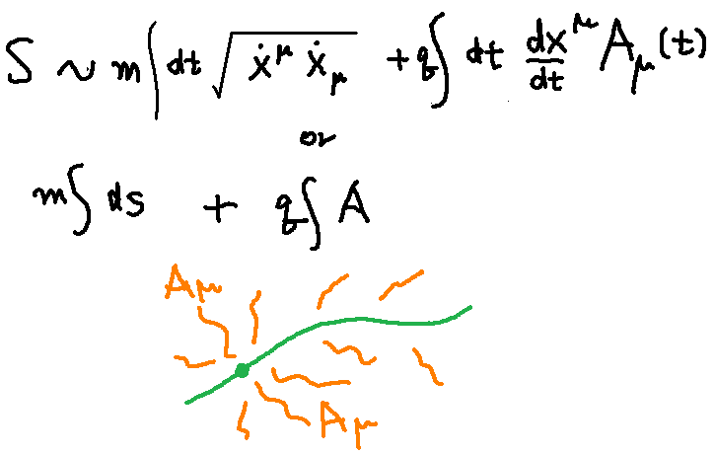
Short note for string theory
So we may take some theory which have the extended objects(string, membrane and so on…..) as fundamental particles.
An example of point particle theory

Slide 5
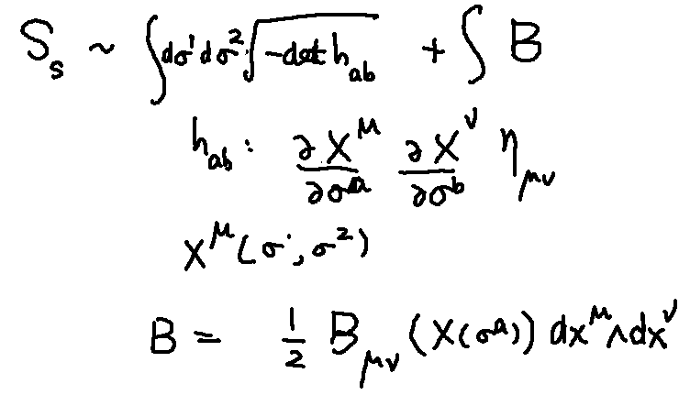
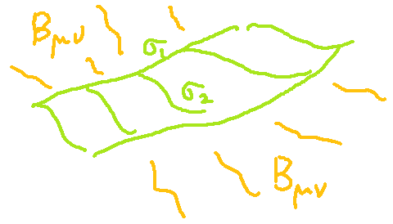
Short note for string theory
String theory

Slide 6
Short note for string theory
Better Action ; Polyakov Action
Quantization

Slide 7
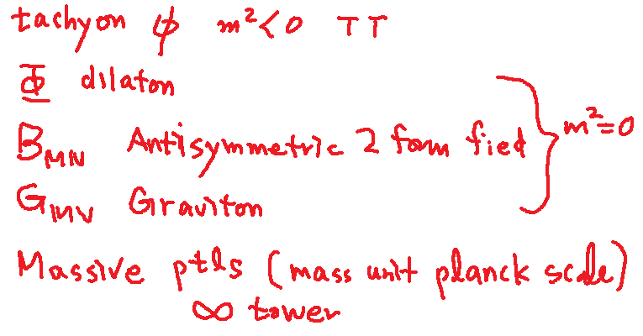
Short note for string theory
Closed string -> periodic boundary condition
Result
D=26

Slide 8
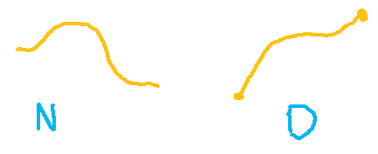
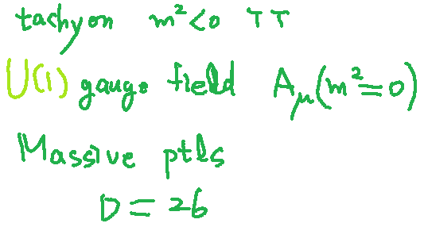
Short note for string theory
Open string ; -Neumann boundary condition -Derichlet Boundary condition
Result( N. B.C)

Slide 9
Short note for string theory
D . B.C -From the wave mechanics, we can see that the physical meaning of such a B.C is related to existence of other object.
If there are some object at the end points of open strings, open string ends can have generalized charges.

Slide 10
Short note for string theory
D . B.C -> Some extended object -> “D-brane”
D(-1) brane world point instantonlike object
D 0 brane world line particle like object
D1 brane world sheet string like object
D2 brame world volume membrane like object
D3 brane 3 dimensional object
It is well known that these object are really dynamical objects.

Slide 11
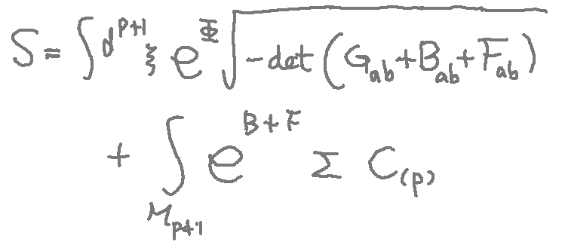
Short note for string theory
What is effective action for D-p brane
Ramond fields: Generalized gauge fields sauced by D branes

Slide 12
Short note for string theory
In order to eliminate tachyons, one may introduce super symmetry.
Results - No tachyon - Consistent theories --type I (D=10) --type IIA (D=10) --type IIB (D=10) --Heterotic E8 X E8 (D= 10+26) --Heterotic SO(32) (D= 10+ 26)

Slide 13
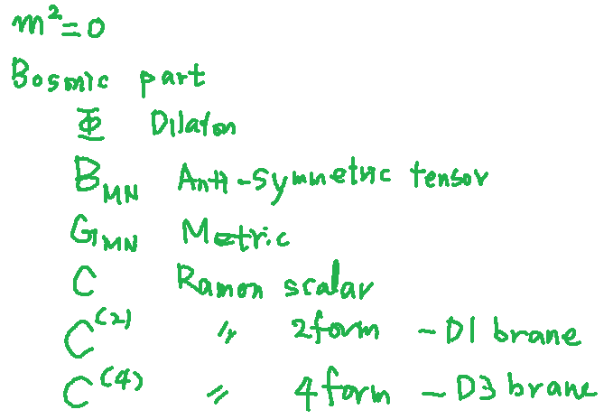
Short note for string theory
One example- type IIB string theory

Slide 14
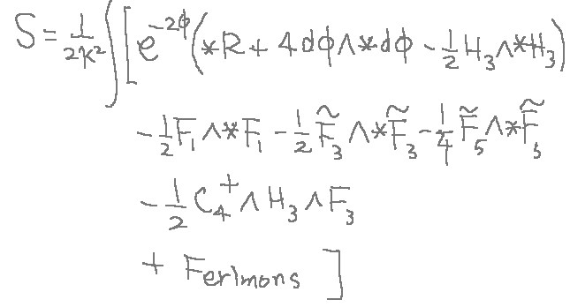
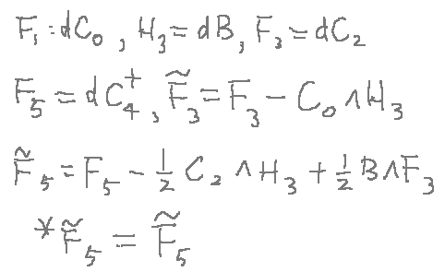
Short note for string theory
Low energy effective field theory. --→ Type IIB super gravity theory

Slide 15
Summary of string theory
One supersymmetric black 3-brane solution
Actually this blackhole-like 3 brane solution is same with D3 brane on end point of open strings. (Polchinski)

Slide 16
Short note for string theory
So this is main difference from usual supergravity. In old supergravity, this black brane solution has nothing to do with fundamental particle.s It is just a soliton solution in the supergravity.
However, the supergravity theory as a low energy effective theory for string theory has exact relation between the black brane soliton solution and fundamental string.

Slide 17
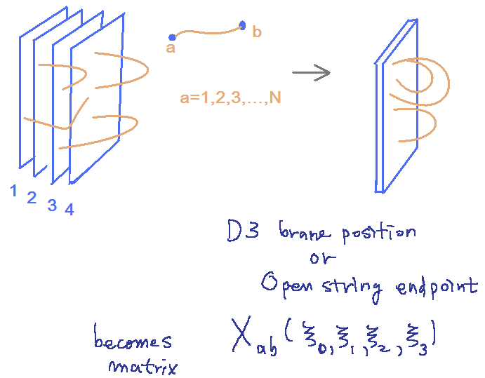
Short note for AdS/CFT
Now we use the fact in the previous short note. Let’s consider N D3-brane. The D-brane has two description, D-brane in string theory and Black brane in supergravity.
D-brane in stringy picture

Slide 18
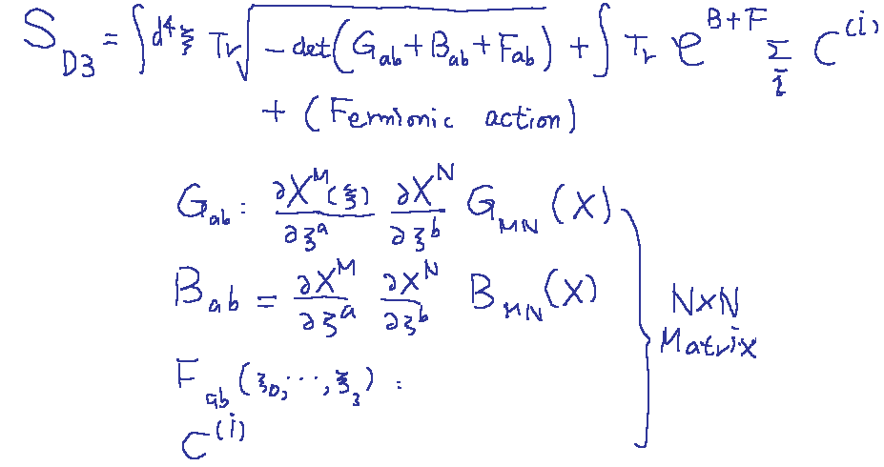
Short note for AdS/CFT
D3 brane action becomes Non-abelian with some presciptions.
The perturbation theory is welll defined, when

Slide 19
Short note for AdS/CFT
The low enegy limit
The higher derivative terms can be ignored.
The Sugra fields are decoupled from Dbrane.
Then the action governing D3 brane turns out to be U(N) Super Yang-Mill theory with 4 super-charges.

Slide 20
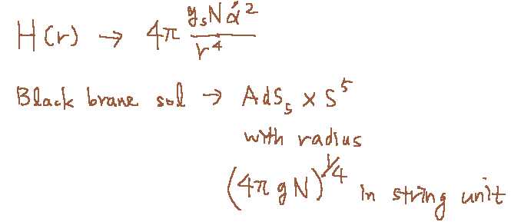
Short note for AdS/CFT
Super gravity point of view
Near horizon limit(r -> 0)
The SUGRA is valid when two following quantities are large.

Slide 21
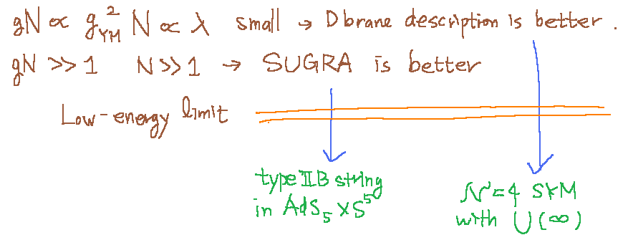
Short note for AdS/CFT
There are two limit for same object N D3 brane
This is the AdS/CFT.

Slide 22
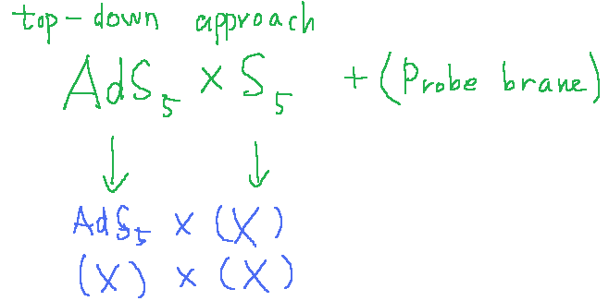
Short note for AdS/CFT
This super conformal YM is very strange theory which is very far from real YM theory QCD. In order to make similar theory to real QCD, we need to deform the conjecture.

Slide 23
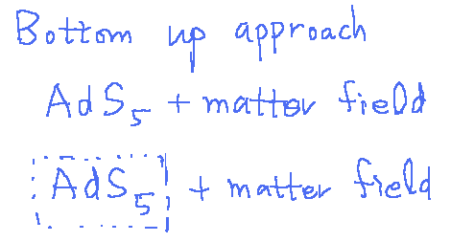
Short note for AdS/CFT
Or we may think phenomenological model

Slide 24
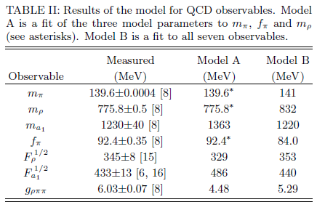
Short note for AdS/CFT
An example ; EKSS(J. Erlich, E. Katz, Dam T. Son and M. A. Stephanov, 05’), model

Slide 25
Motivation
QCD is still mysterious region in physics.
In general, strong coupling behavior, density and temperature make field theory difficult. We have no way to control these situations.
AdS/CFT gave us some possibilities for controlling the situations.
At least, for some super conformal field theories, we can overcome these difficulties.
Although it is not clear whether this way can produce the quantitative explanation for real QCD or not, we may extend the correspondence due to a likelihood of qualitative explanations.

Slide 26
Motivation
The compact star(neutron star, white dwarfs, quark stars, strange stars,…) is another interesting research topic, because they can tell us the equation of state for some region in the phase space of QCD.
There are many interesting observations from neutron stars.
Since these objects are self bound objects with nuclear force and gravity. there are two obstacles, the density and the gravity.
First one is already mentioned. It is well known that we can avoid this problem by introducing bulk gauge field.
For the second one, we have to introduce the gravity degrees of freedom in the boundary of AdS space. This is the source for boundary energy-momentum tensor.
So it is also interesting to realize similar configuration in holographic QCD. This is our motivation.

Slide 27
Gravity degrees of freedom in gauge/gravity correspondence
Randall-Sundrum model was already considered for the gravity degrees of freedom in our brane. The gravity strength is represented by warping factor.
The first work investigating gravity wave functions is given by Gherghetta et al, 05’. In the model, they considered a mass term for IR brane and obtained composite graviton.
Another work is given by Kiritsis and Nitti 06’. They considered massless 4d gravitons in the Asymptotically AdS5 geometries.
Now I want to describe their idea.

Slide 28
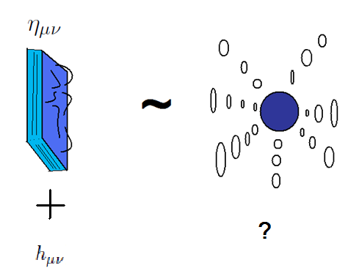
Gravity degrees of freedom in gauge/gravity correspondence
The original AdS/CFT correspondence was about correspondence between two possible descriptions of a same object. One description is a theory decoupled from bulk degrees of freedom, i,e. a field theory on a flat spacetime. The other one is the string theory on a curved geometry, AdS X Sphere.
If we take decoupling limit, there is no way to introduce gravity degrees of freedom in the field theory system. Then the field theory should be defined in a flat space time.

Slide 29
Gravity degrees of freedom in gauge/gravity correspondence
So it is difficult to realize compact stars in usual AdS/CFT correspondence. Because the compact star is a self bound configuration with not only nuclear interaction but also gravity interaction.
In string theory point or view, this configuration is a bound state of open strings(Field theory degrees of freedom) and closed strings degrees of freedom(Gravity degrees of freedom).
We need closed string degrees of freedom for compact star, thus we have to take an extension of usual AdS/CFT into account and we should be very careful of the decoupled limit. It is not easy problem.

Slide 30
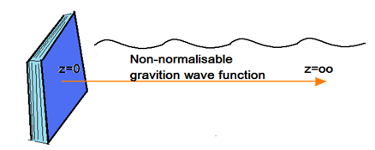
Gravity degrees of freedom in gauge/gravity correspondence
If we introduce the gravity fluctuation in the AdS space with Poincare coordinates.
Solving Einstein equation, this gravity wave function is not a normalizable function., where y is from 0 to infinity.

Slide 31
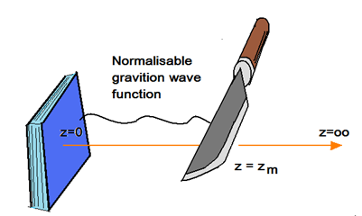
Gravity degrees of freedom in gauge/gravity correspondence
One idea for normalizable wave function is introducing cutoff and suitable boundary condition for gravity wave function.
This make the existence of graviton on the boundary.
So we can have gauge+gravity/gravity correspondence.

Slide 32
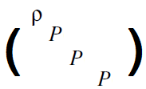
Simple compact stars and TOV equation
Now we know how to construct existence of gravity d.o.f on the boundary of AdS space.
Now we want to describe the compact stars with this construction.
For this, we summarize how the usual 4 dimensional Einstein gravity consider for simplest perfect fluid stars.
Where the energy momentum tensor is perfect fluid energy momentum tensor.

Slide 33
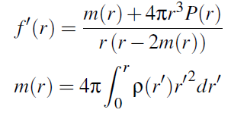
Simple compact stars and TOV equation
The metric is given by
Where
Then Einstein equation gives

Slide 34
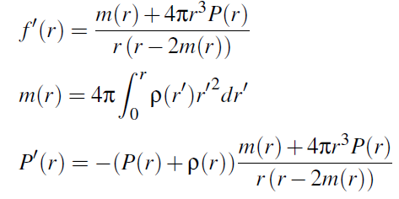
Simple compact stars and TOV equation
If consider hydrostatic equation, we can obtain TOV
Thus we have to solve following tree equations
We have only tree equations for four unknown ftns.

Slide 35
Simple compact stars and TOV equation
Usual study needs one more equation, for example ,the equation of state.
If we know equation of state, we can solve the four equations.
Then we can see full function of mass, pressure and energy density.
From these, we can read the radius and the mass of a compact star.
This computation can be related to observation.
The EOS is from the microscopic nature of the nuclear matter, the radius and mass are from the observation.
Thus the compact stars are good object to understand microscopic physics from observation.
In this usual case, we have to assume or obtain EOS from QCD. But we don’t know yet.

Slide 36
The simplest holographic model without matter
If we believe possibility for existence of gravity degrees of freedom, we may consider holographic model in a curved spacetime.
This is a deformation from the gauge/gravity correspondence.
In order to obtain first intuition, we had better take a simplest toy model. So we are going to consider the Einstein-Hilbert action with negative cosmological constant in 5 dimension.
The general behavior already studied by Skenderis et al(2000).

Slide 37
The simplest holographic model without matter
The summary of their work is as follows.
If we take the Fefferman-Graham coordinates, The general behavior of metric is
The expectation value of energy-momentum tensor is

Slide 38
The simplest holographic model without matter
Again, the bulk metric is
The first term is related to conformal anomaly and scheme dependent term, when we consider holographic renormalization. For simplicity, we assume that this term vanishes.
The second term is interpreted as the metric of boundary system. Usually, this is taken as flat metric. In our case we will put nontrivial non-flat metric into this boundary metric.

Slide 39
The simplest holographic model without matter
Since we will take star object into account, we assume that our metric has rotational symmetry. Then our ansatz for bulk metric is
From this ansatz, we may solve the bulk equation.

Slide 40
The simplest holographic model without matter
Now we take a star metric as the boundary metric.
Then we can solve the bulk Einstein equation order by order in z.
Up to zeroth order equation, g^(2) is given in terms of g^(0).

Slide 41
The simplest holographic model without matter
Up to second order, the metric must satisfy following constraint equation.
In other words, If the boundary metric satisfies this equation, then the full bulk metric is solution of the bulk Einstein equation up to second order.

Slide 42
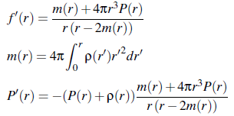
The simplest holographic model without matter
We take one more assumption. If the boundary metric is a perfect fluid star, we have to consider following constraints.
These come from the boundary Einstein equation and TOV equation.
Then previous complicate constraint becomes simple.

Slide 43
The simplest holographic model without matter
If we solve the following equations with initial condition P(0),rho(0) and m(0)=0, then we can obtain pressure and energy density as functions of the radial coordinate.

Slide 44
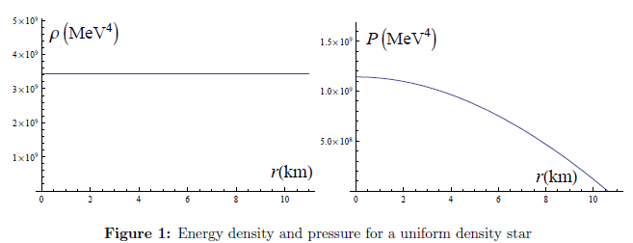
The simplest holographic model without matter
Indeed, these equation can be solved, the solution is well known uniform density solution.
This is a simplest toy model, so we expect that more realistic model can give more realistic equation of state.

Slide 45
The simplest holographic model without matter
Main reason for this determination comes from our rotation symmetry and the bulk Einstein equation. The bulk Einstein equation has more component than the boundary Einstein equation. Such a extra degrees of equation can make following constraint equation.

Slide 46
Adding neutral scalar to the model
Now we move to more realistic configuration.
First one we can think is giving a simplest matter to the system.
So we have to add a neutral scalar bulk field as follows.
Eom for matter fields

Slide 47
Adding neutral scalar and gauge field to the model
The ansatz for the matter field is as follows.
The metric ansatz is same with the previous case.
We can solve the Einstein equation and the equations of motion for matter field near boundary(z=0) of the AdS5 order by order in z.

Slide 48
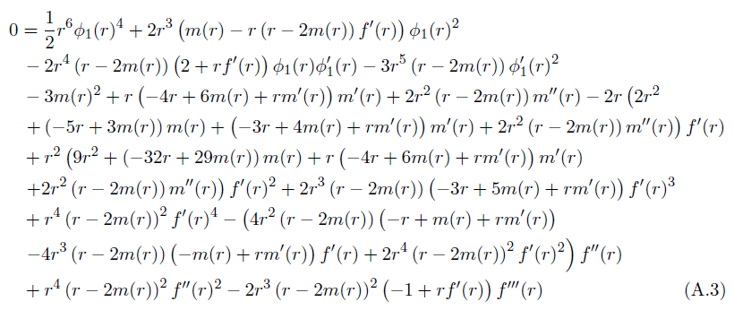
Adding neutral scalar and gauge field to the model
For the matter fields, we can obtain the result
Again a complicate equation for metric

Slide 49
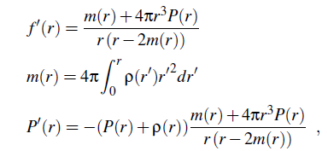
Adding neutral scalar and gauge field to the model
And for the scalar field
If we give perfect fluid metric condition and TOV equation to these solution

Slide 50
Adding neutral scalar and gauge field to the model
The two equations become much simpler

Slide 51
Adding neutral scalar and gauge field to the model
Thus the equations we have to solve are

Slide 52
Adding neutral scalar and gauge field to the model
By regularity condition of the star metric, the relevant parameter for this solution are P(0), rho(0), phi_1(0)
If we give thess parameters, we can obtain holographic star solutions.

Slide 53
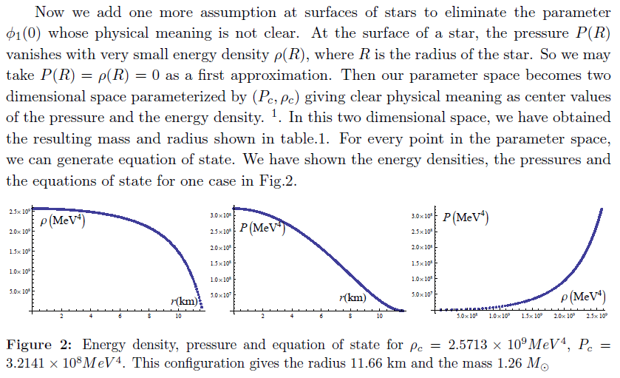
Adding neutral scalar and gauge field to the model

Slide 54
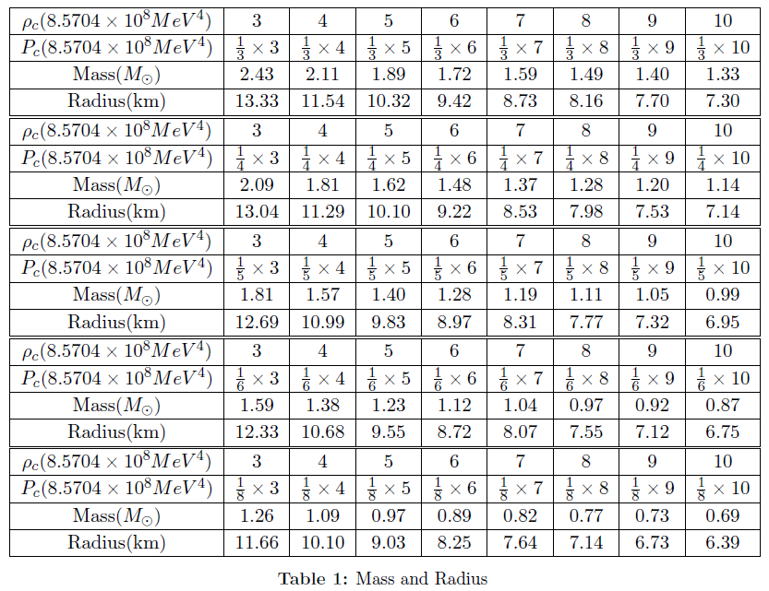
Adding neutral scalar and gauge field to the model

Slide 55
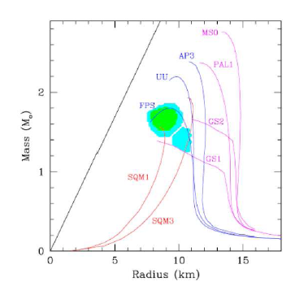
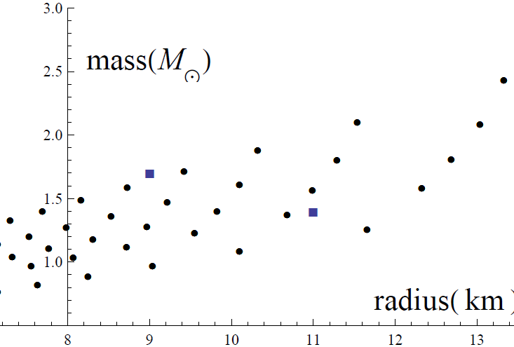
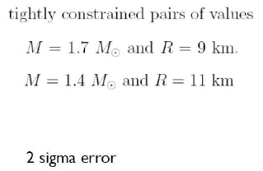
Adding neutral scalar and gauge field to the model

Slide 56
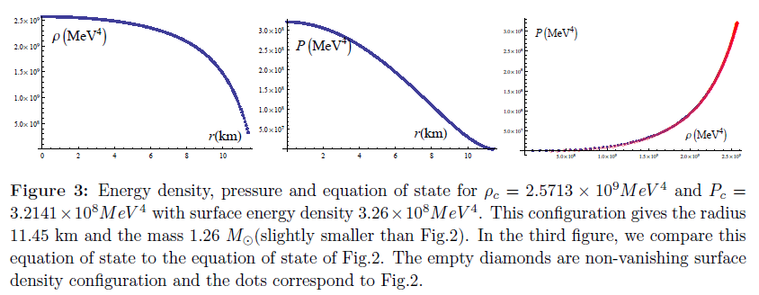
Adding neutral scalar and gauge field to the model
By holography, one can obtained equation of state depending on some paremeters.
The back reactin was included in our construction. But we are still trying to undet stand this point.
And we can make a situation whose surface energy density does not vanish.
In this case, we can interpret the scalar field parameter as a parameter related to surface energy density.

Slide 57
Summary and discussion
In order to consider compact stars, we have deformed boundary metric which is not flat.
To embed the compact star geometry, we have taken rotational symmetry on the metric.
Since the bulk Einstein equation gives more degrees of freedom than the boundary Einstein equation, our system gives one complicate constraint.
By taking perfect fluid star as the boundary metric, the constraint becomes very simple we can solve.
The simplest solution is well-known uniform density star.
We think that this simple structure is from the simplicity of the model.
Thus we introduced other matter fields.
Another toy model gave more realistic configuration.
As a next step, we will study full bulk geometry by solving partial differential equation with boundary metric, then we can understand which IR condition is relevant for this configuration.
Then we can compare the IR condition to the already known cutoff and boundary conditions.

