Slide 1
η‘ at finite temperature
Su Houng Lee
Quark condensate and the η’ mass

Slide 2
1. Quark condensate and the η’ meson
Some introduction
Casher Banks formula
Lee-Hatsuda formula
Witten – Veneziano formula
At finite temperature and density

Slide 3
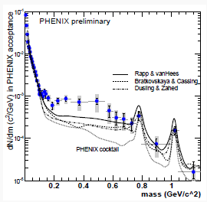
Some introduction
QCD symmetry: SU(N)_{L}x SU(N)_{R} → SU(N)_{V} and U(1)_{A} is always broken by Anomaly
QCD → confinement
Kapusta, Kharzeev, McLerran PRD 96 : Effective U(1)_{A} restoration in medium in SPS data
Rapp, Wambach, van Hees: SPS dilepton data
RHIC dilepton puzzle
Csorgo, Vertesi, Sziklai : Additional contribution from η’ mass reduction
Experimental and theoretical works on η‘ in nuclear medium

Slide 4
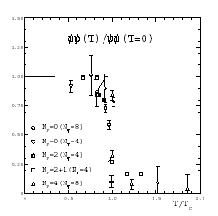
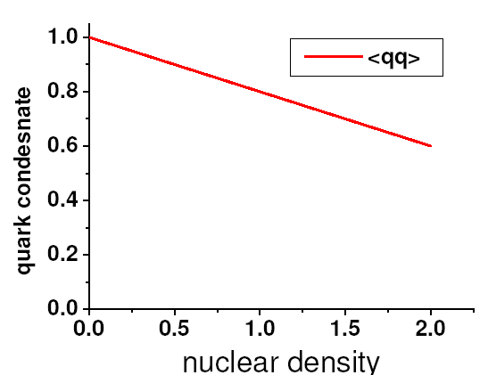
Quark condensate – Chiral order parameter
Finite temperature
Lattice gauge theory
1
T/Tc
Finite density
Linear density approximation
ρ/ρ_{n}

Slide 5
Casher Banks formula - Chiral symmetry breaking (m→0)
Quark condensate
→ Phenomenologically need constituent quark mass
→ Casher Banks formula in the chiral limit

Slide 6
Other order parameters: σ − π correlator (mass difference)
→ Phenomenologically constituent quark mass terms survives
→ Generalized Casher Banks formula in the chiral limit

Slide 7
Correlation function for η ‘ (Lee, Hatsuda 96)
η ‘− π correlator (mass difference)
ν=1
T. Cohen (96)
Lee, Hatsuda (96)
→ U(1) _{A} symmetry will effectively be restored up to quark mass terms in SU(3)

Slide 8
η’ mass? Witten-Veneziano formula - I
Correlation function
Contributions from glue only from low energy theorem
When massless quarks are added
Large Nc argument
Need η‘ meson

Slide 9
Witten-Veneziano formula – II
η‘ meson
Lee, Zahed (01)

Slide 10
Witten-Veneziano formula in medium (Kwon, Morita, Wolf, Lee in prep )
Large Nc counting
LET (Novikov, Shifman, Vainshtein, Zhakarov) at finite temperature for S(k): Ellis, Kapusta, Tang (98)

Slide 11
LET at finite temperature for P(k) : Lee, Zahed (01)
Therefore,

Slide 12
W-V formula at finite temperature:
Smoothes out temperature change because if
Therefore , : → Observable consequences ?

Slide 13
Summary
η’ mass is related to quark condensate and thus should reduce in medium
→
a) Could serve as signature of chiral symmetry restoration
b) Dilepton in Heavy Ion collision
c) Measurements from nuclear targets

Slide 14
Other order parameters: σ − π correlator (mass difference)

