Slide 1
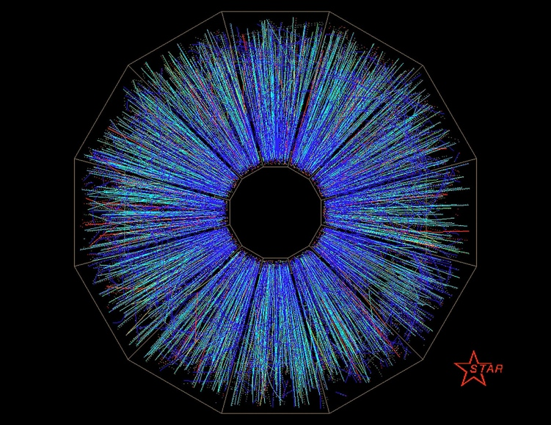

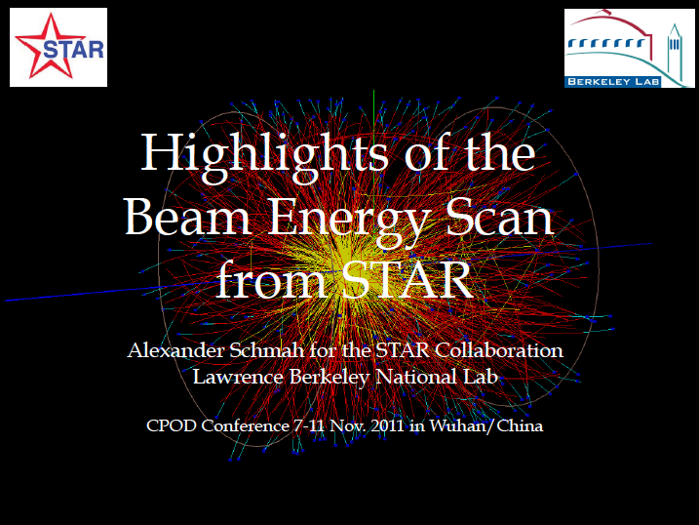
Highlights in 2011 at STAR & ALICE
In-Kwon Yoo

Slide 2
Outline
STAR BES Results
  BES runs and STAR general
  Charged Meson
  Λ and Ξ
  Freeze-out Conditions
  φ
  Flow
  E-by-E
ALICE Recent Results
  ALICE general
  Particle Production
  RHIC vs. LHC
  Freeze-out Volume
  Particle Ratios
  Flow
  Jet Quenching
  Miscellaneous ..

Slide 3
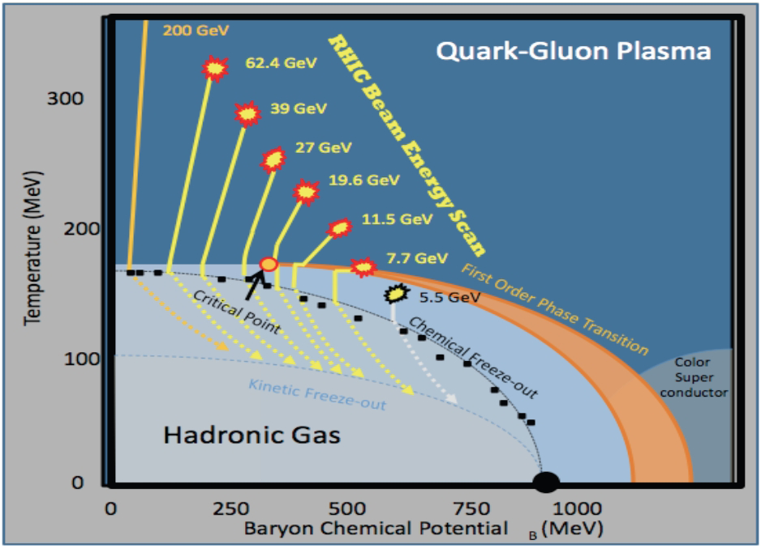
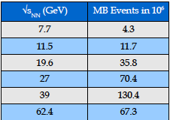
STAR BES
Beam Energy Scan
  Signature of Onset
  Critical Point
T-mB scan
Looking for
  anomalies
  testing theories
  RHIC vs. LHC

Slide 4


Slide 5
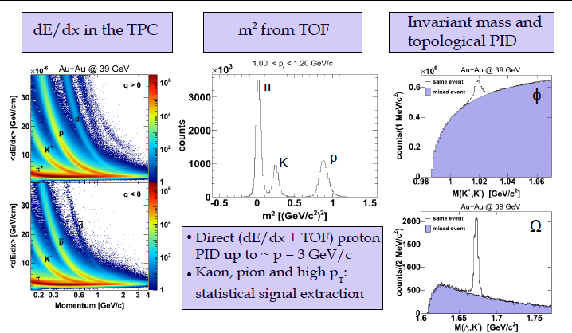
PID at STAR

Slide 6
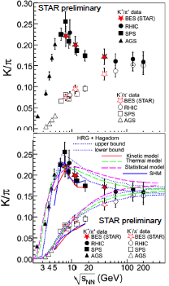
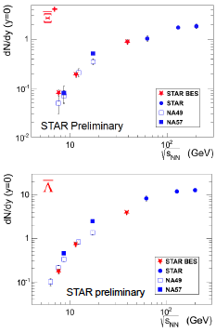
K/π, Λ, Ξ vs. E_{CM}
Excellent agreement with SPS results

Slide 7
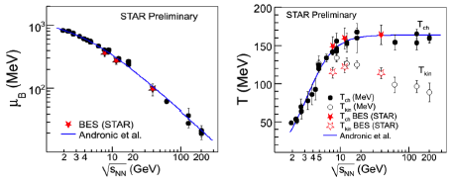
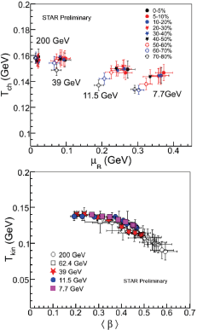
Freeze-Out Conditions
Statistical model fit to π, K, p
Excellent agreements with pub.data
Clear centrality dependence of T

Slide 8
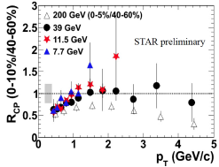
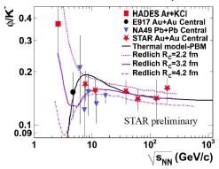
φ → KK
R_{CP} in E_{CM} dependence
φ/K ratio vs. theories

Slide 9
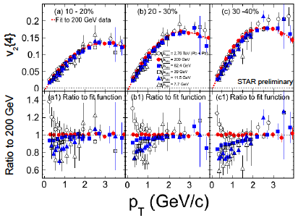
Flow (v₂) of Charged Hadrons

Slide 10
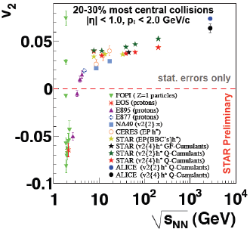
Integrated v₂ vs. E_{CM}
BES results fill gap between NA49 and 200GeV/u

Slide 11
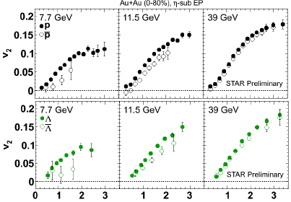
Particle – Antiparticle v2

Slide 12
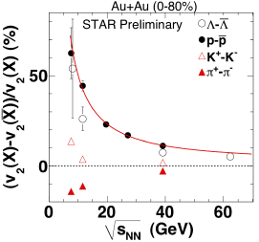
Particle – Antiparticle v2

Slide 13
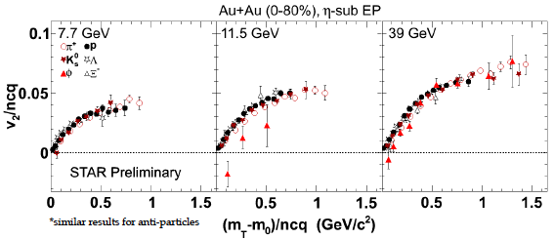
v₂/ncq scaling
ncq-scaling for all particles holds up to 7.7 GeV
φ-meson results deviates from others at 11.5 GeV

Slide 14
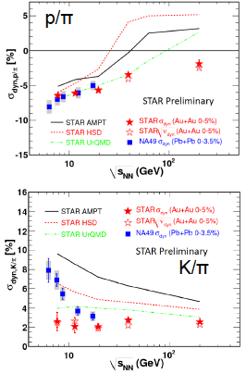
K(p)/π E-by-E fluctuations
σ(p/π): monotonic increase
s(K/p): almost constant ; disagree with NA49

Slide 15
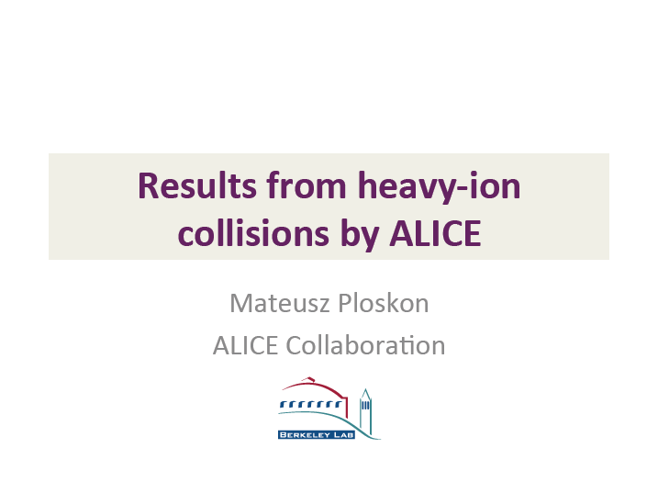


Slide 16
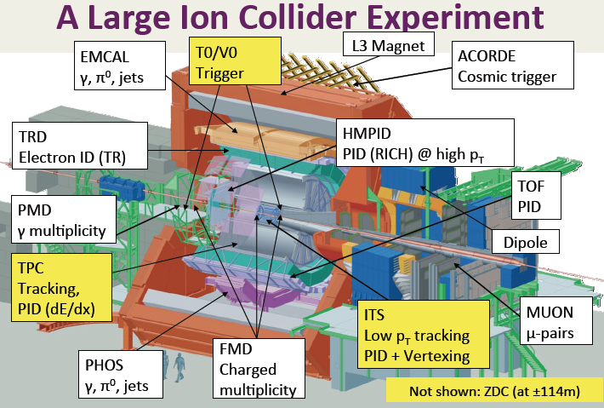

Slide 17
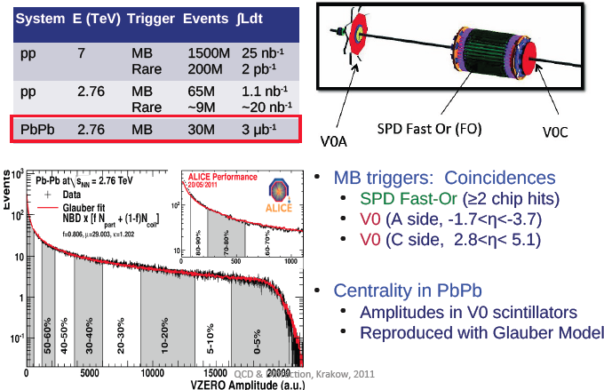
ALICE Data

Slide 18
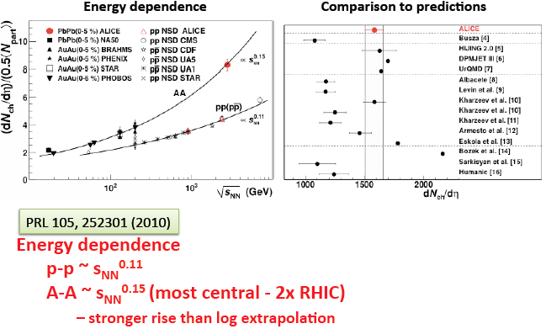
Particle Production in pp/PbPb

Slide 19
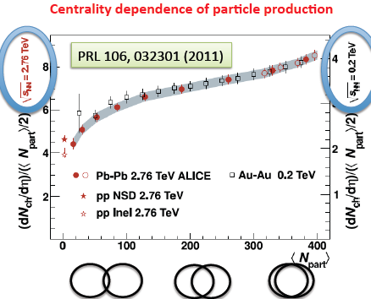
RHIC vs. LHC
The same experiment under vastly different conditions

Slide 20
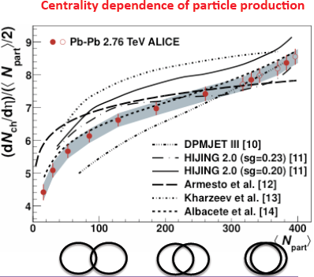
System-size dependence vs. Theories
identical variation of particle production with system-size at RHIC and LHC
Global features of the system : independent on collision Energy

Slide 21
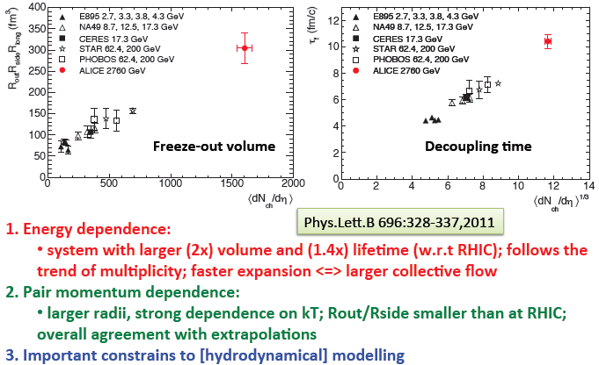
Freeze-out Volume : Source-size

Slide 22
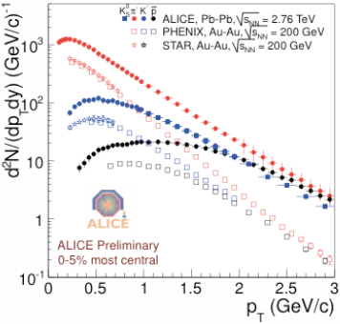
Identified particle spectra
much harder spectra
  inv.slope parameter
  expanding T

Slide 23
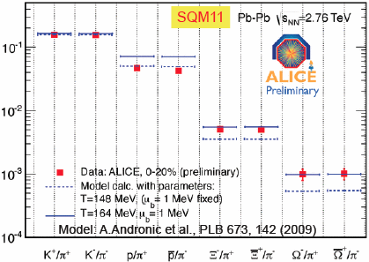
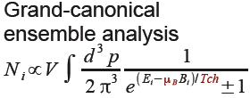
Particle Ratios vs. Thermal model
Similar temperature as at RHIC , T_{CH} ~ 164MeV

Slide 24
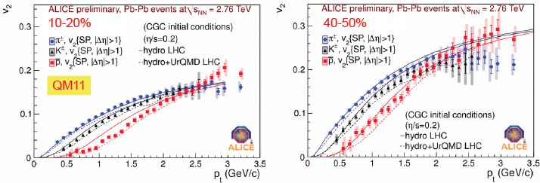
Elliptic flows
mass dependence due to the radial flow
viscous hydro predictions describe the data
similar to RHIC : hydro+UrQMD (rescattering) for antiproton

Slide 25
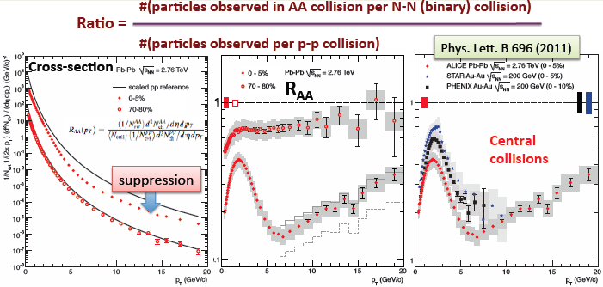
Jet quenching

Slide 26
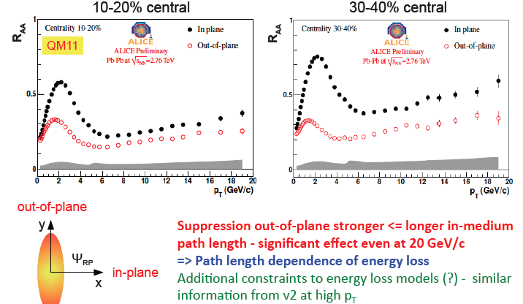
RAA in- vs. out-of-plane

Slide 27
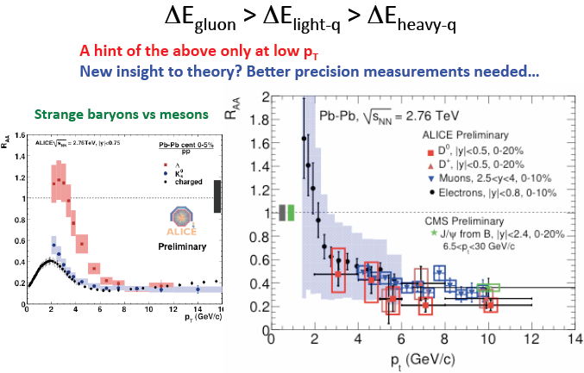
Flavor dependence

Slide 28
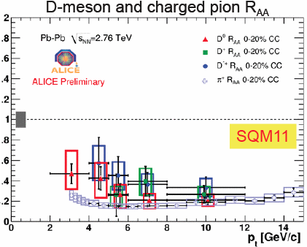
Flavor dependence

Slide 29
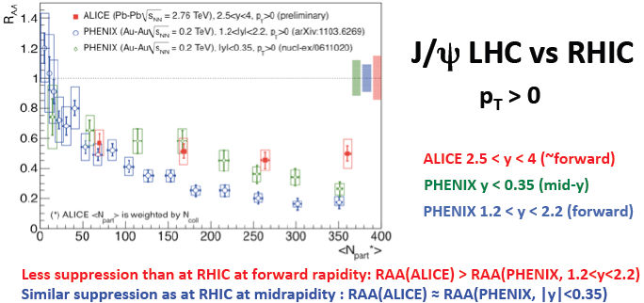
J/Psi RAA
Contribution from B is not substracted ; Cold nuclear matter effect at RHIC vs. LHC ; pA@LHC needed

Slide 30
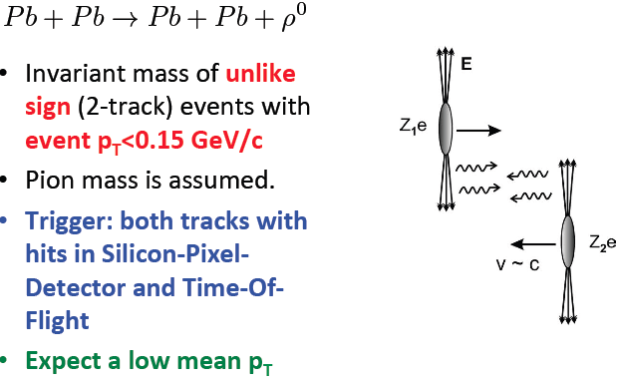
UPC with ALICE

Slide 31
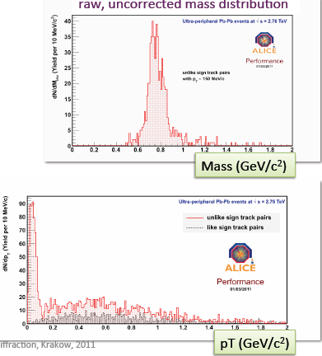
UPC with ALICE

Slide 32
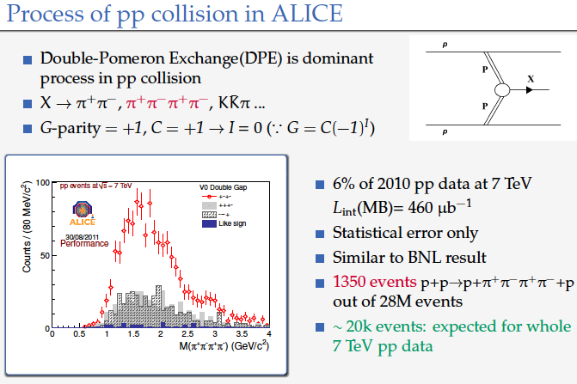
UPC with ALICE

Slide 33
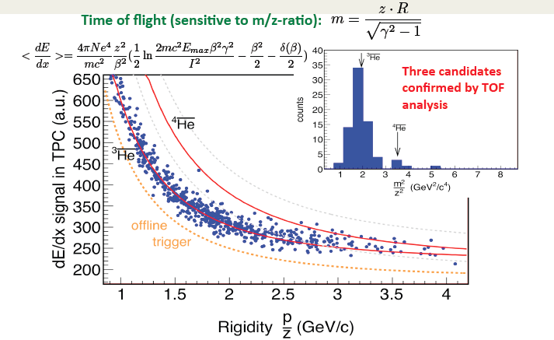
Anti-Alpha with ALICE

Slide 34
Conclusions and Outlook
Excellent agreements of STAR BES results with NA49
Scanning and Filling up the gap between SPS and RHIC
Even more strongly interacting matter at LHC than RHIC?
Rich data with high precisions and PID to be continued
pA program at LHC?
What to be expected at 5.5TeV in 2014?

