Slide 1
RECENT Development
OF HYDRO MODEL
AFTER “Perfect LIQUID”
Heavy Ion Meeting, Yonsei University
Seoul, Dec. 10, 2011
T.H., P.Huovinen, K.Murase, Y.Nara (in preparation)

Slide 2
Outline
Introduction
  Discovery of Perfect fluid
  Importance of initial fluctuation
Hydro-based event generator
  Initial state fluctuation
  Flow analysis
  Results
Conclusion

Slide 3
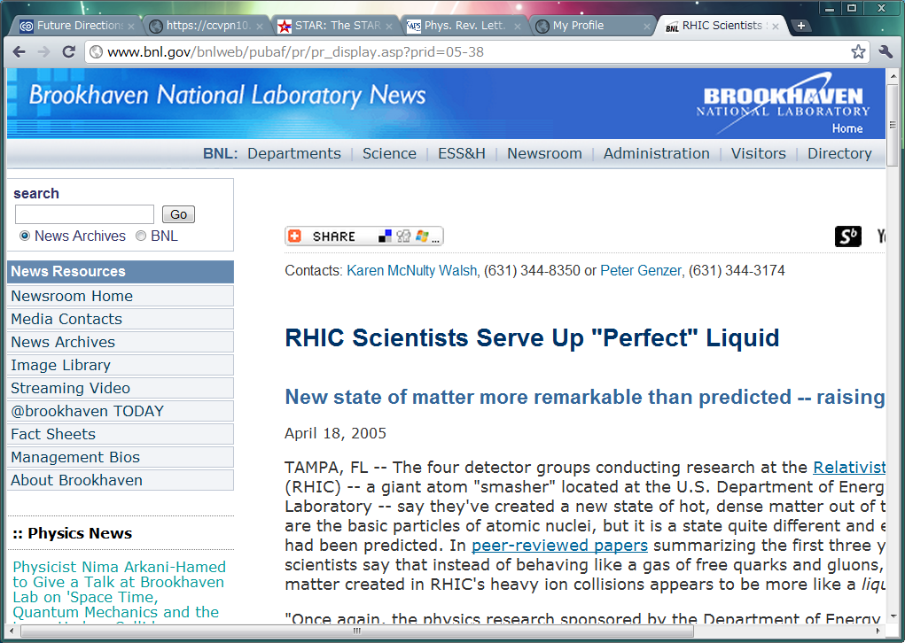
Discovery of “Perfect Liquid”
http://www.bnl.gov/bnlweb/pubaf/pr/pr_display.asp?prid=05-38

Slide 4
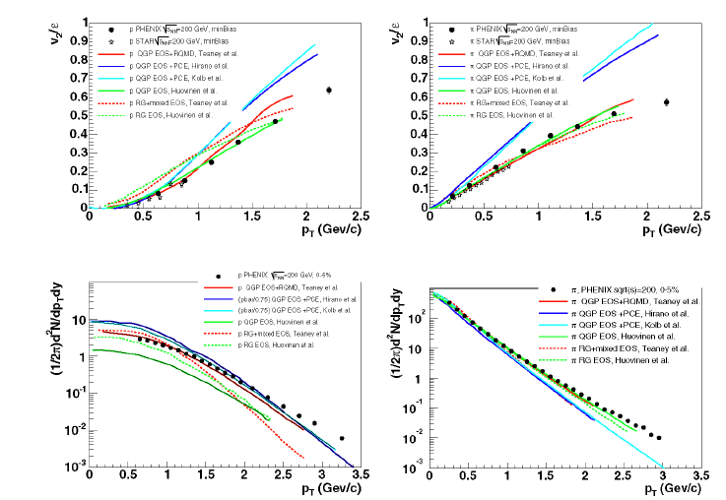
Status as of Press Release
Three pillars of modeling
QGP ideal hydro
hadronic cascade
Glauber type initial conditions
PHENIX, Nucl. Phys. A 757, 184 (2005)

Slide 5
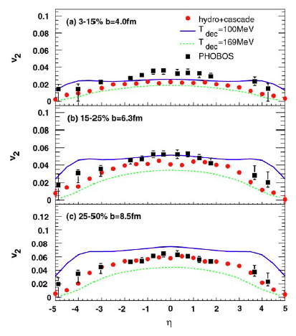
What is missing in central collisions?
Undershoot the data at midrapidity in central collisions
→ Open question
T.Hirano et al., Phys. Lett. B 636, 299 (2006)

Slide 6
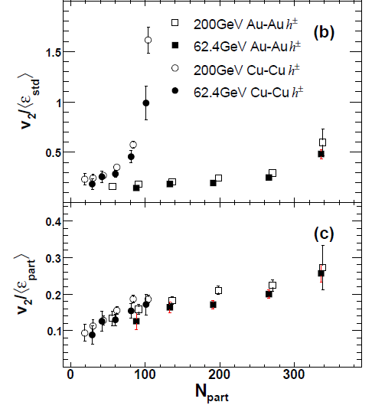
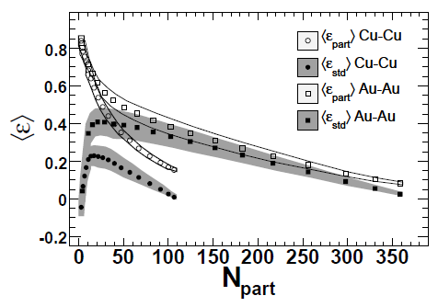
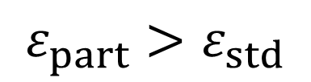
Importance of Fluctuation in Initial Conditions
$$ε_{part}>ε_{std}$$
PHOBOS,
Phys. Rev. Lett. 98, 242302 (2007)

Slide 7
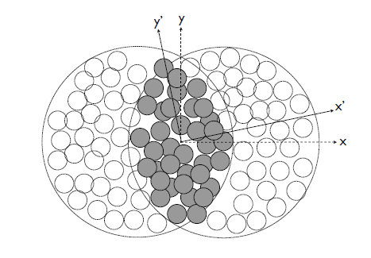
Fluctuation in Initial Conditions
Elliptic flow is generated with respect to
participant plane
(x’-y’ frame)
rather than
reaction plane
(x-y frame).
B.Alver et al.,
Phys. Rev. C 77, 014906 (2008)

Slide 8
Importance of PHOBOS finding
System could (hydrodynamically?) respond to such a fine structure.
  Is local thermalization achieved in such a short length scale (~1 fm)?
  Need event-by-event hydro simulations?
  Higher harmonics?

Slide 9
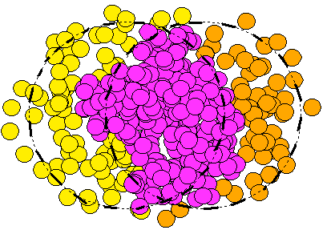
Higher Harmonics is Finite!
Two particle correlation function is composed solely of higher harmonics
Away-side two bumps just from hydrodynamic responses?
Figures adapted from talk
by J.Jia (ATLAS) at QM2011

Slide 10
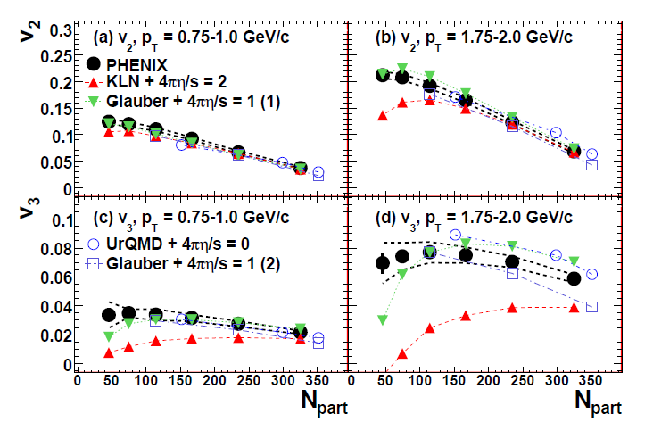
PHENIX v₂ vs. v₃ Argument
Analysis of v₂ and v₃ at once constrains the model
New challenge to hydrodynamic models

Slide 11
Hydro-based event generator

Slide 12
Current Status: E-by-E H2C
hadron gas
time
Hadronic cascade
3D ideal hydro
Monte Carlo I.C.
(MC-KLN)
QGP fluid
collision axis
0
Au
Au

Slide 13
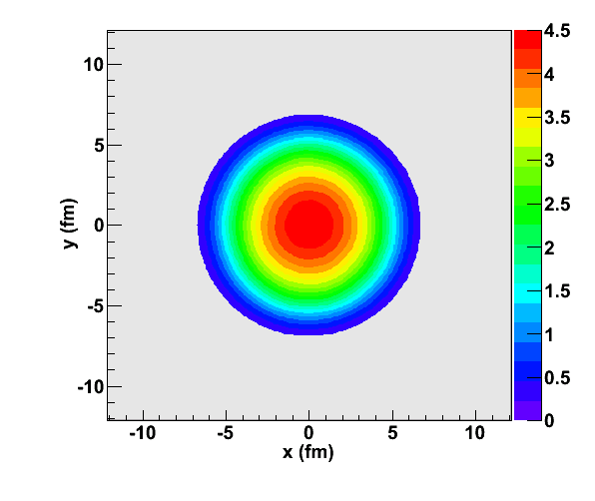
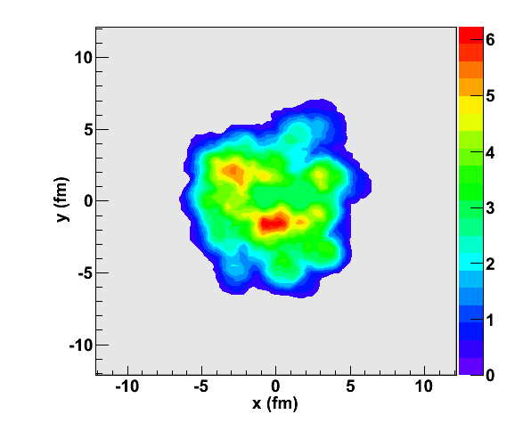

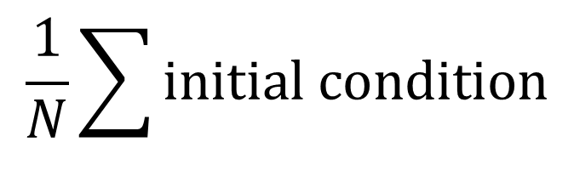
Initial Density Fluctuation
$$\frac{1}{N}\sum{initial condition}$$
$$single initial condition$$
conventional
hydro
event-by-event
hydro

Slide 14

Event-by-event Fluctuation
Actual collision?
Higher order deformation
Ideal, but unrealistic?
OK on average(?)
Figure adapted from talk
by J.Jia (ATLAS) at QM2011

Slide 15
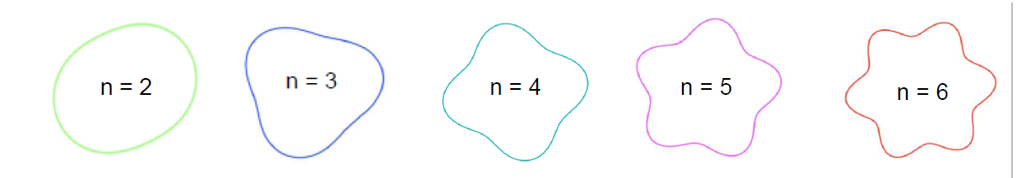
Deformation at Higher Order
Figure adapted from
talk by J.Velkovska at QM11

Slide 16
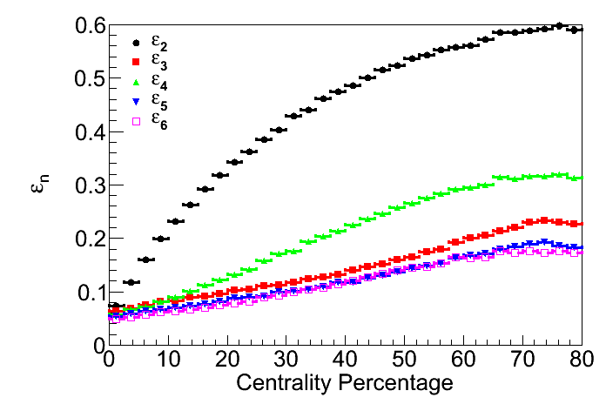
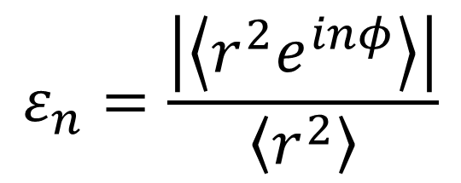
Deformation in Model Calculations
Sample of entropy
density profile in a
plane perpendicular
to collision axis
$$ε_{n}=\frac{\left|\left\langle r^{2}e^{inφ}\right\rangle \right|}{\left\langle r^{2}\right\rangle }$$

Slide 17
v₂{***}
v₂{EP}, v₂{2}, v₂{4}, v₂{6}, v₂{LYZ}, …
Hydro-based event generator
→ Analysis of the outputs almost in the same
way as experimental people do.
Demonstration of v_{n} analysis according to
event plane method by ATLAS setup.
E.g.) Centrality cut using E_{T} in FCal region
ATLAS, arXiv:1108.6018

Slide 18
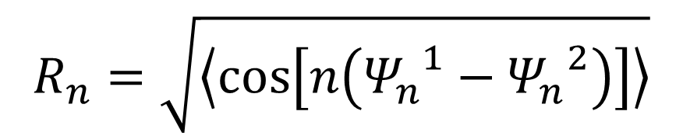
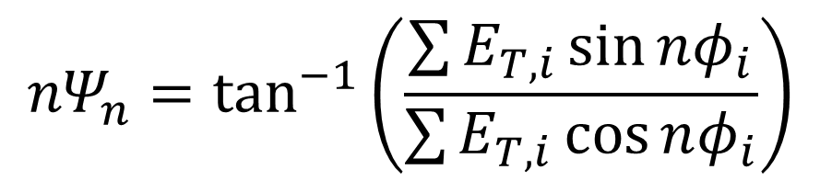
Resolution of Event Plane
Reaction (Event) plane is not known experimentally nor in outputs from E-by-E H2C.
Event plane method
Event plane resolution using two subevents
$$R_{n}=\sqrt{\left\langle \cos\left[n\left({Ψ_{n}^{}}^{1}−{Ψ_{n}}^{2}\right)\right]\right\rangle }$$
$${nΨ}_{n}=\tan^{−1}\left(\frac{\sum{E_{T,i}\sin{nφ_{i}}}}{\sum{E_{T,i}}\cos{nφ_{i}}}\right)$$
c.f.) A.M.Poskanzer and S.Voloshin, Phys. Rev. C 58, 1671 (1998)

Slide 19
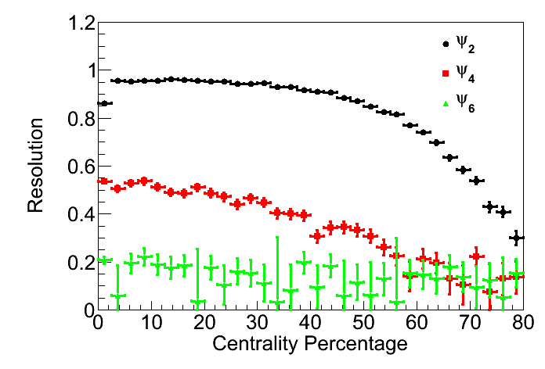
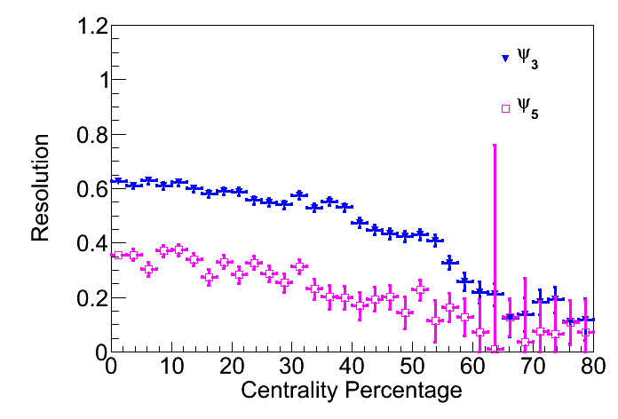
Resolution of Event Plane from E-by-E H2C
Even Harmonics
Odd Harmonics
# of events: 80000 (Remember full 3D hydro+cascade!)
Subevent “N”: charged, -4.8< η < -3.2 (FCal in ATLAS)
Subevent “P”: charged, 3.2< η < 4.8 (FCal in ATLAS)
ATLAS, arXiv:1108.6018

Slide 20
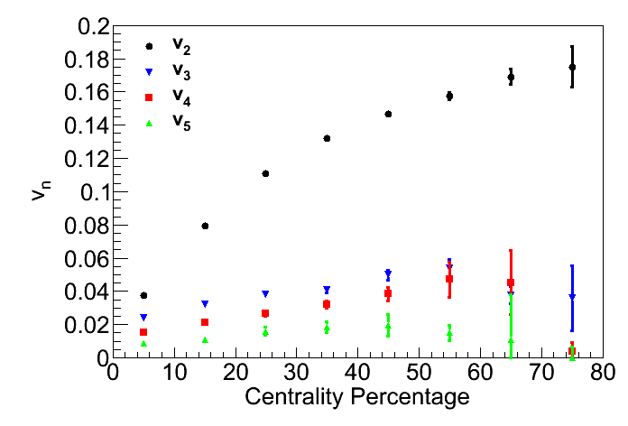

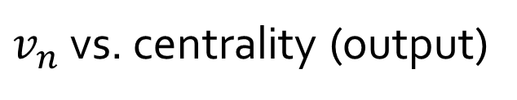
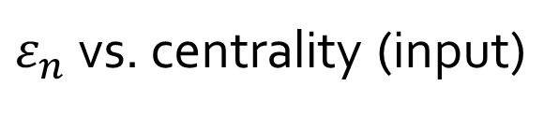
v_{n}{EP}(centrality)
$ε_{n}$ vs. centrality (input)
$v_{n}$ vs. centrality (output)
Response of the QGP to initial deformation
$v_{n}$ roughly scales with $ε_{n}$

Slide 21
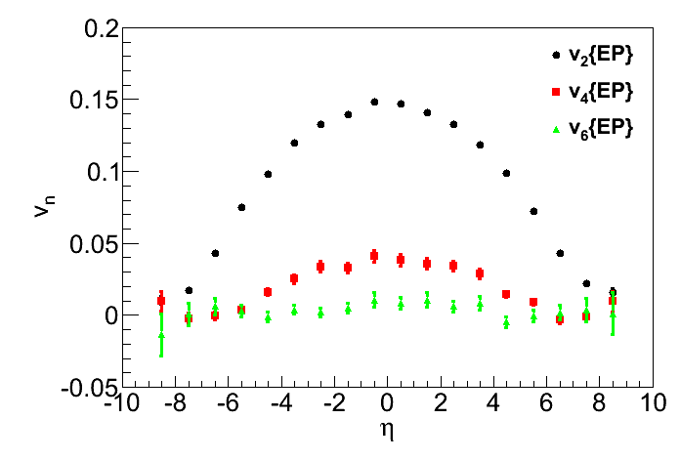
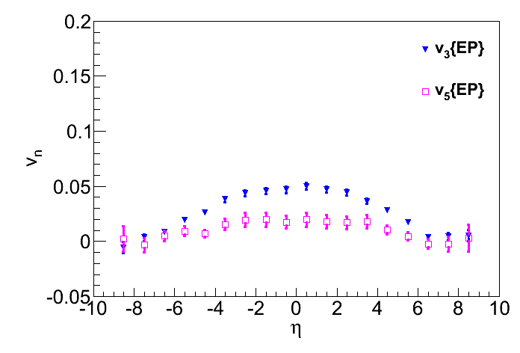
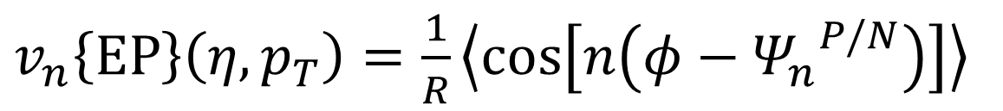
V_{n}{EP}(η)
$v_{n}\left\{EP\right\}\left(η, p_{T}\right)=\frac{1}{R}\left\langle \cos\left[n\left(φ−{Ψ_{n}}^{P/N}\right)\right]\right\rangle$
Even Harmonics
Odd Harmonics
40-50%
40-50%
Not boost inv. ←→almost boost inv. for epsilon

Slide 22
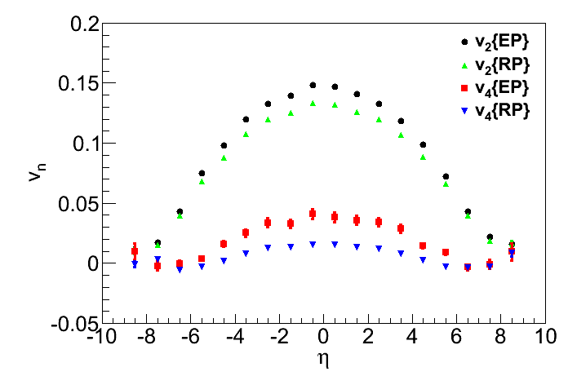
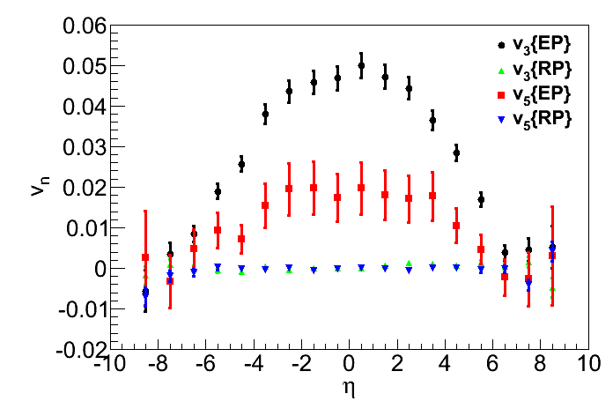
v_{n}{EP} vs. v_{n}{RP}
v_{n}{RP}: v_{n} w.r.t. reaction plane known in theory
Even Harmonics
Odd Harmonics
40-50%
40-50%
v_{even}{EP}>v_{even}{RP}
due to fluctuation
v_{odd}{RP}~0

Slide 23
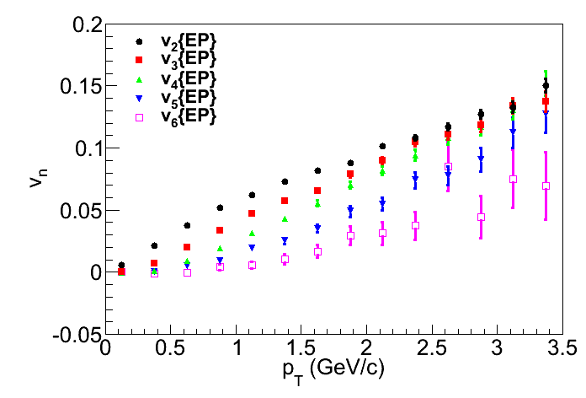
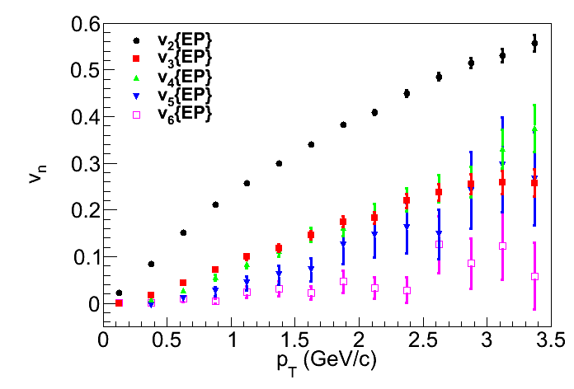


V_{n}{EP}(p_{T})
0-10%
40-50%
$$\left|η\right|<1$$
$$\left|η\right|<1$$
v₂{EP} ≈v₃{EP}
v₂{EP} > v₃{EP}
Note: ε₂>ε₃

Slide 24
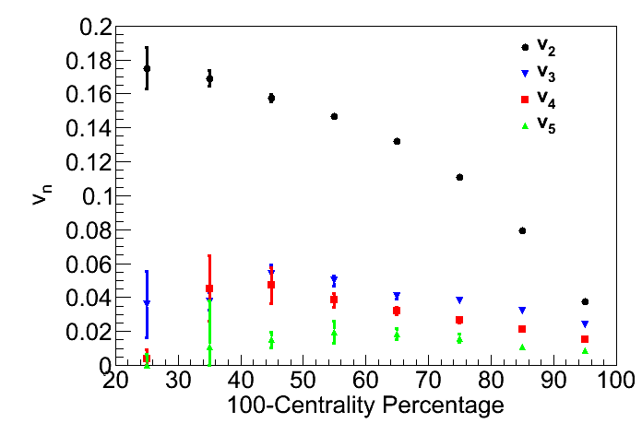
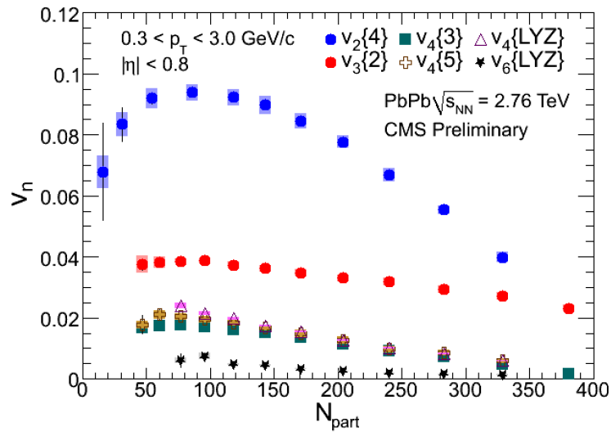
Comparison of v_{n} with Data
Theory
Experiment
Tendency similar to experimental data
Absolute value ←→ Viscosity

Slide 25


Impact of Finite Higher Harmonics
coarse
graining
size
Only few people believed hydro description of the QGP (~ 1995)
Hydro at work to describe elliptic flow (~ 2001)
Hydro at work (?) to describe higher harmonics (~ 2010)
initial
profile
$$d≲5 fm$$
$$d≲1 fm$$

Slide 26
Conclusion
Physics of the quark gluon plasma
Strong coupling nature
Small viscosity
Physics of relativistic heavy ion collisions
Toward precision physics
  2nd order harmonics → Higher order harmonics
  Equilibration/coarse graining in a small system
  Precise determination of transport coefficients

Slide 27
BACKUPS

Slide 28
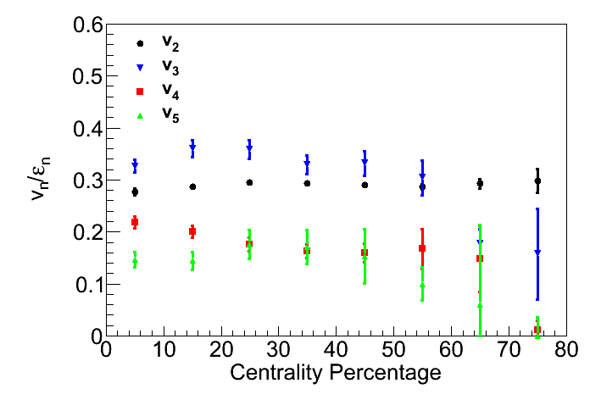
Response to Deformation

Slide 29
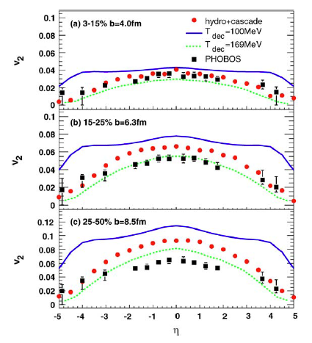
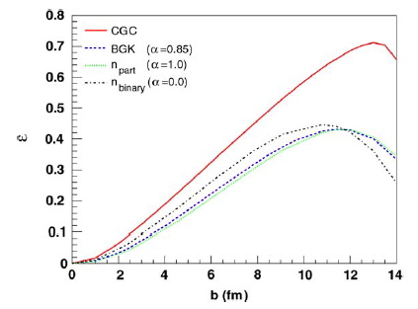
CGC Initial Conditions
CGC and perfect fluid,
are they compatible?
T.Hirano et al., Phys. Lett. B 636, 299 (2006)

