Slide 1
Dihadron Correlations and Flow from CMS
Heavy-Ion Meeting (HIM2011-12)
Yonsei University, Seoul, Korea, 10 December, 2011
Byungsik Hong
(Korea University)
For the CMS Collaboration

Slide 2
Outline
Introduction
Physics motivation
LHC and the CMS detector
First experimental data from CMS
We concentrate only on the correlation and flow results in this presentation.
Correlations in pp at 7 TeV and PbPb at 2.76 TeV
Flow in PbPb at 2.76 TeV
Comparison to Hydro
Summary

Slide 3
Motivation
Correlation is a powerful tool to study
Hadron production mechanism
Jet-medium interactions in heavy-ion collisions
Bulk properties of the produced medium (sQGP)
Flow is a powerful tool to address
Equation-of-state
Viscosity of the medium
Fluctuations and initial conditions

Slide 4
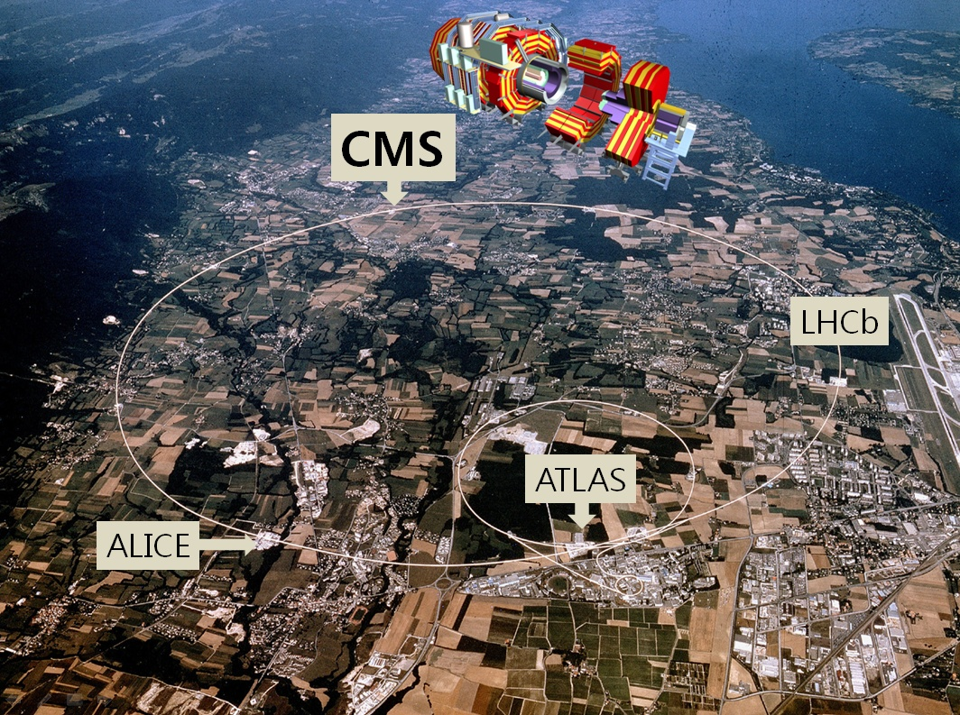
p+p at (√s)_{max} = 14 TeV
Designed L of pp: 10³⁴ cm⁻²s⁻¹
Pb+Pb at (√s_{NN} )_{max} = 5.5 TeV

Slide 5
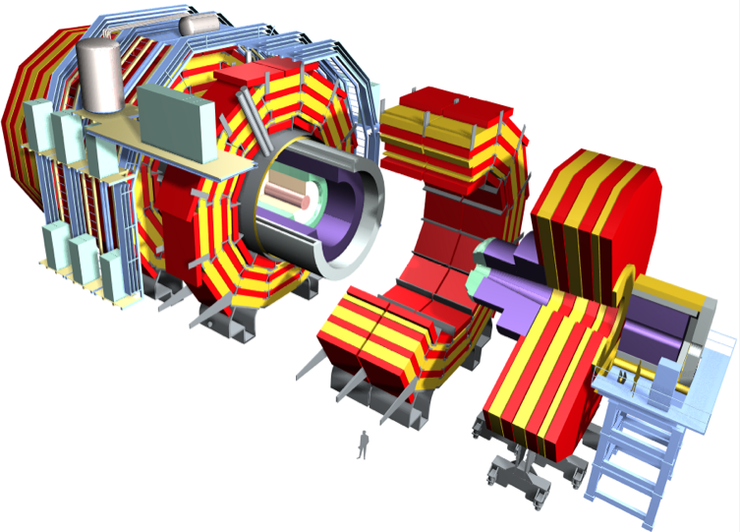
CMS Detector
Superconducting Coil (3.8 T)
CALORIMETERS
ECAL
HCAL
76k scintillating
PbWO₄ crystals
Plastic scintillator/
Brass sandwich
Steel YOKE
HF
HF
Centrality in
heavy-ion events
for 2010 run
Centrality in
heavy-ion events
for 2010 run
TRACKER
TRACKER
Pixels (66M Ch.) Silicon Microstrips (9.6M Ch.)
220 m² of silicon sensors
Pixels (66M Ch.) Silicon microstrips (9.6M Ch.)
220 m² of silicon sensors
Very large coverage (|Δη| < 5.0)!
MUON ENDCAPS
Weight: 12,500 tons
Diameter: 15 m
Length: 22 m
MUON BARREL
Cathode Strip Chambers
Resistive Plate Chambers
Drift Tube Chambers
Resistive Plate Chambers

Slide 6
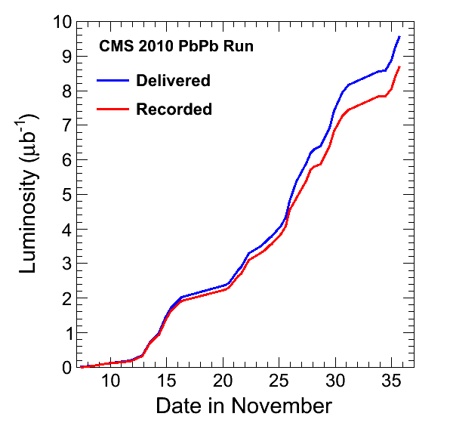
Summary of 2010 PbPb Run
A dedicated heavy-ion mode
Turn off zero suppression
Taking data at up to 220 Hz
12 MB event size
Triggering on minimum bias, jets, muons and photons
ALL rare probes written to tape
~half of minimum bias written
Recorded luminosity
PbPb @ √s_{NN} = 2.76 TeV: 8.7 μb⁻¹
Reference pp data
pp @ √s = 2.76 TeV: 241 nb⁻¹
pp @ √s = 7 TeV: > 5 fb⁻¹
Total volume of PbPb data
~0.89 PetaByte
(Days since Nov. 1, 2010)
Note: luminosities will be rescaled by few % after complete analysis of Van der Meer scans

Slide 7
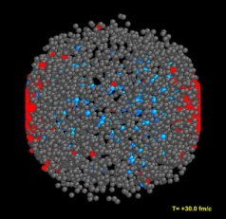
Dihadron Correlation Technique
Same event pairs
1: Trigger particle
2: Associated particle
Mixed event pairs
Event 1
Event 2
Associated hadron yield per trigger
Δη = η^{assoc}– η^{trig}
Δφ = φ^{assoc} – φ^{trig}

Slide 8
High-Multiplicity pp Event

Slide 9
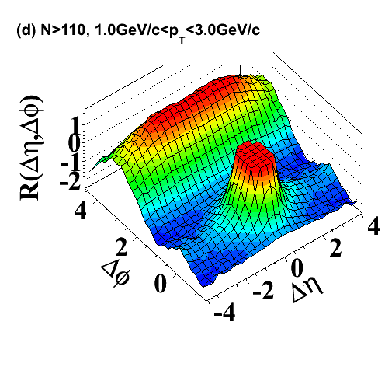
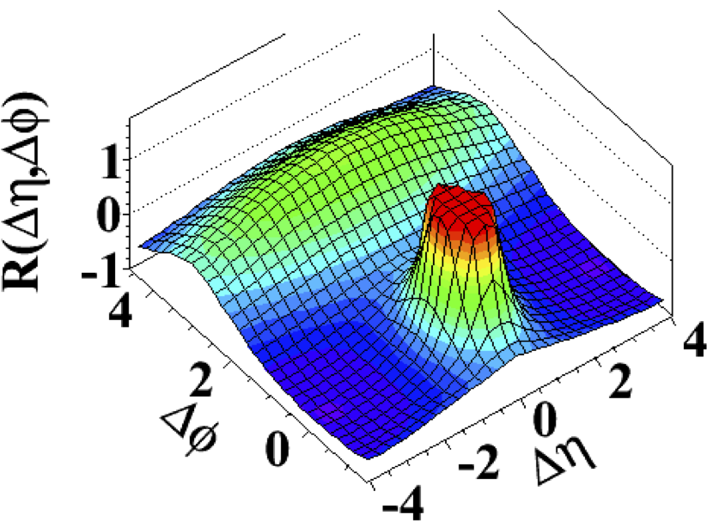
Ridge in High-Multiplicity pp
JHEP09, 091 (2010)
350K top multiplicity events
out of 50 billion collisions
Intermediate p_{T}: 1-3 GeV/c
Minimum bias pp (<N>~15)
High multiplicity pp (N ≥ 110)
Striking “ridge-like” structure
extending over Δη at Δφ ~ 0

Slide 10
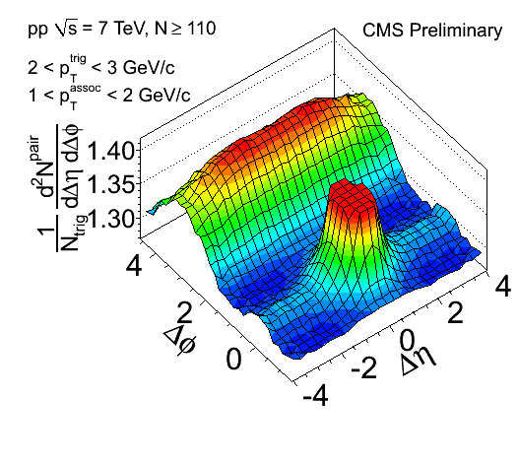
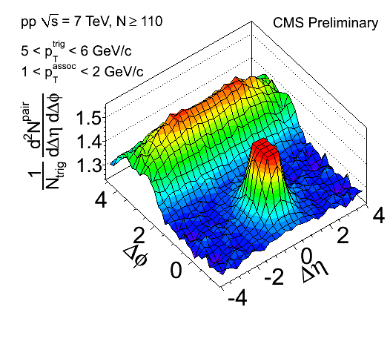
p_{T} Dependence in pp
100 billion (1.78 pb⁻¹) sampled minimum-bias events from high-multiplicity trigger
660K events
No ridge when correlating to high p_{T} particles!

Slide 11
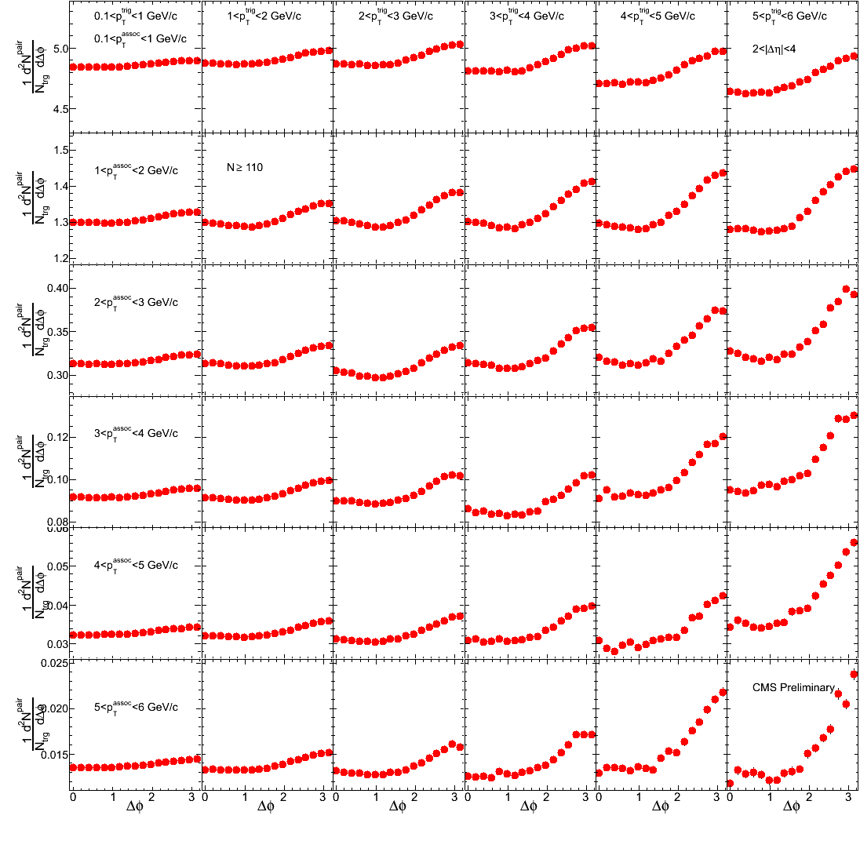
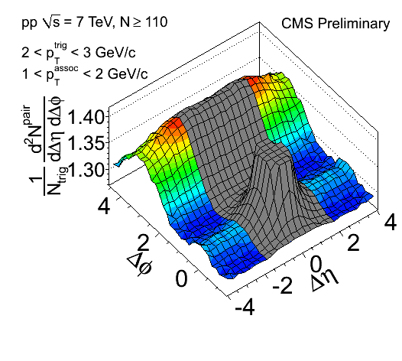
Differential Δφ Projection
CMS Preliminary
p_{T}^{trig}
CMS pp 7 TeV, N ≥ 110
p_{T}^{assoc}
2<|Δη|<4

Slide 12
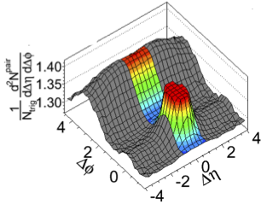
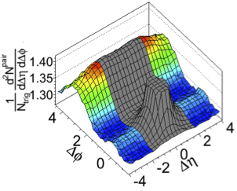
Differential Δφ Projection
CMS pp 7 TeV, N ≥ 110
Jet region (|Δη|<1)
p_{T}^{trig}
Ridge region (2<|Δη|<4)
p_{T}^{trig}

Slide 13
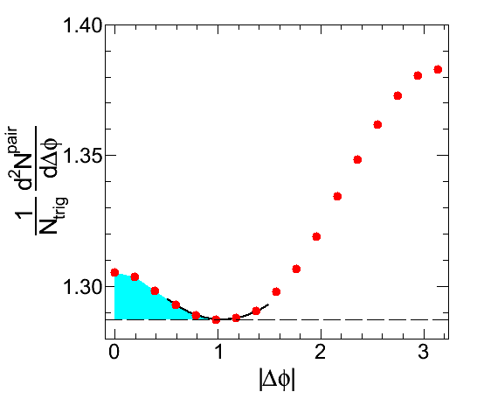
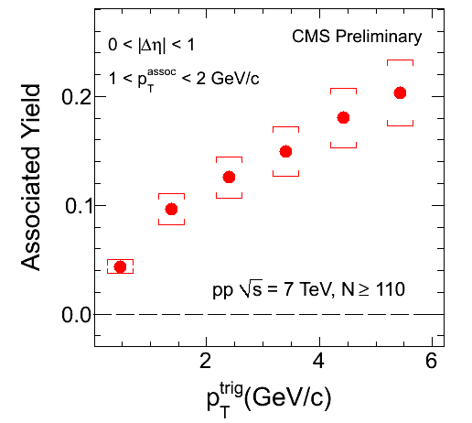
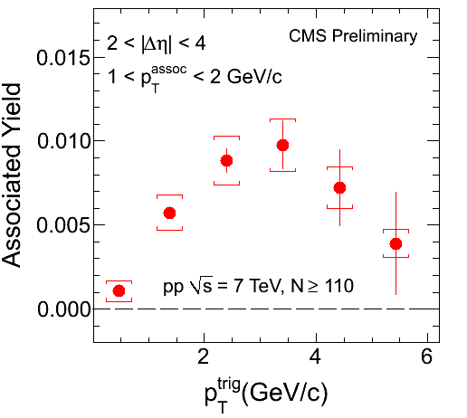
Near-Side Yields for N≥110
Zero-Yield-At-Minimum
(ZYAM)
|Δη|<1
2<|Δη|<4

Slide 14
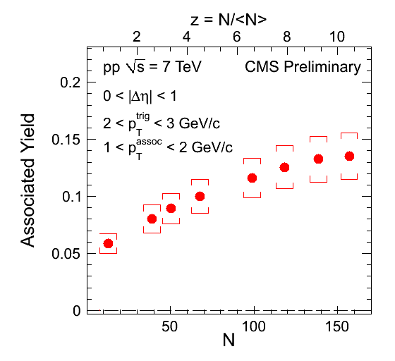
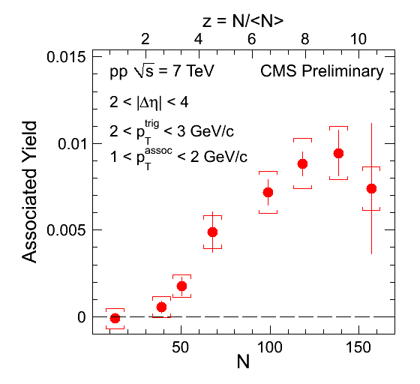
Near-Side Yields for N≥110
|Δη|<1
2<|Δη|<4
Jet yield in pp monotonically increases with N
Ridge in pp turns on around N~50-60 (4XMB) smoothly

Slide 15
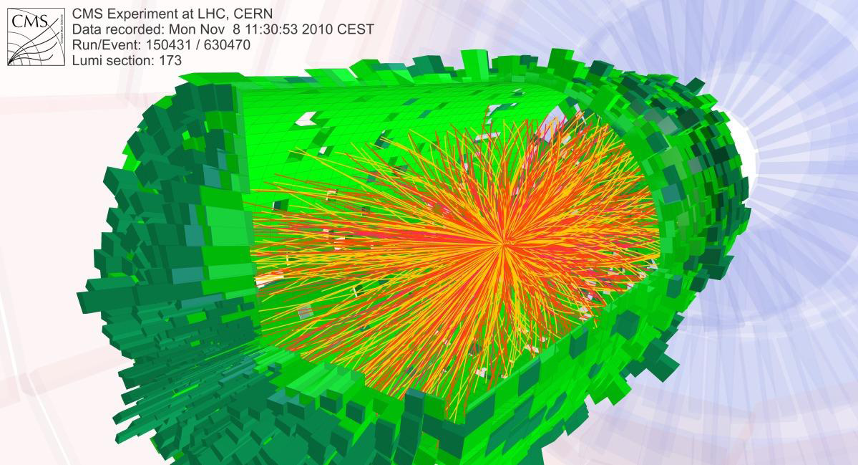
PbPb Event
PbPb at $\sqrt{s_{NN}}$ = 2.76 TeV
(14 X RHIC energy)

Slide 16
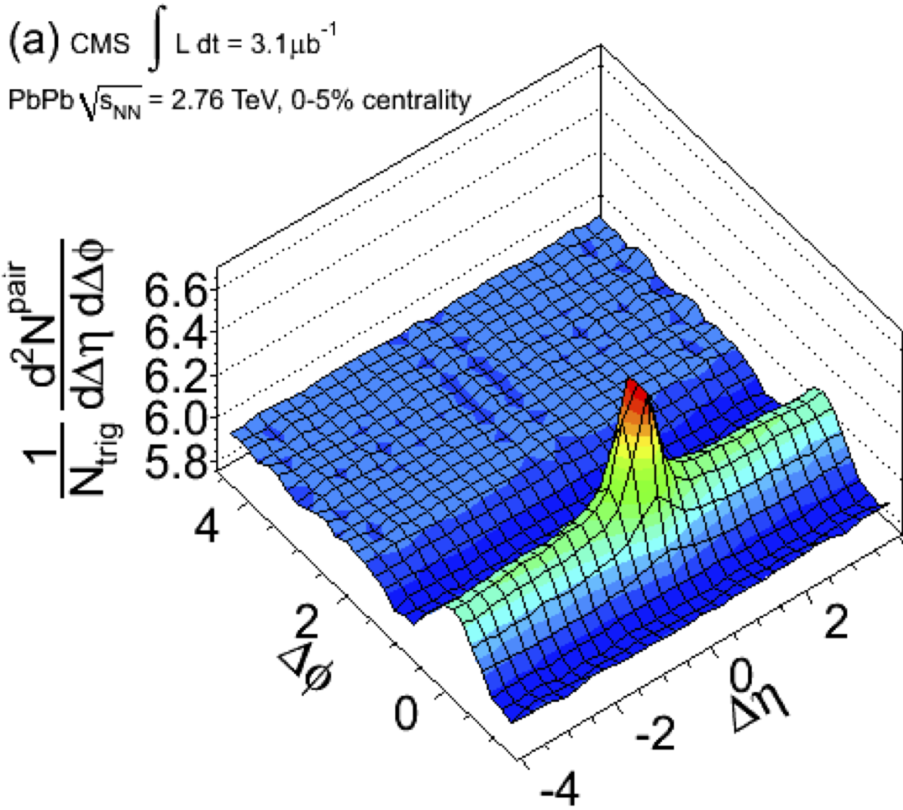
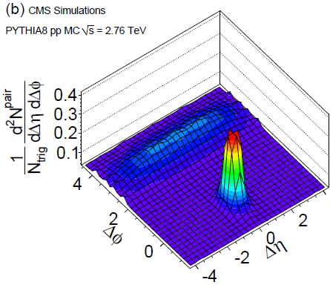
Ridge in Heavy-Ion Collisions
arXiv:1105.2438
Pb
Pb
0-5% most central
= 4 ~ 6 GeV/c
= 2 ~ 4 GeV/c
PYTHIA8 simulation

Slide 17
Differential Δφ Projection
(0-5% most central PbPb)
arXiv:1105.2438
Jet region (|Δη|<1): Short-range correlations
p_{T}^{trig}
Ridge region (2<|Δη|<4): Long-range correlations
p_{T}^{trig}

Slide 18
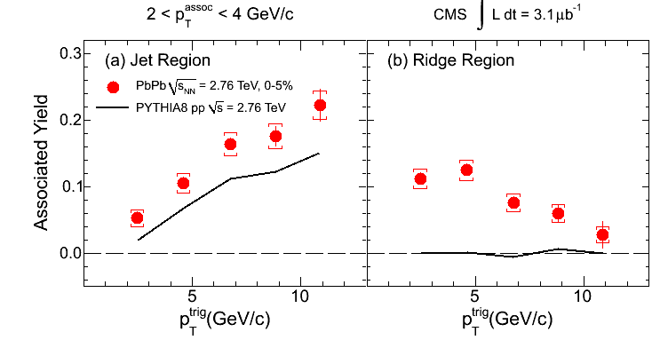
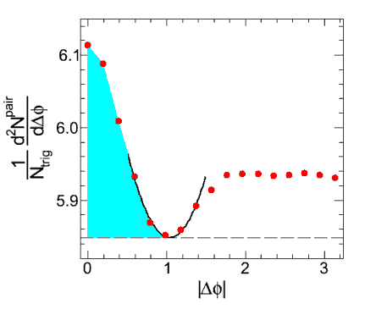
Integrated Associated Yield
(0-5% most central PbPb)
arXiv:1105.2438
ZYAM
v₂ not subtracted: not significant in central collisions
Ridge-region yield: integration of the near-side enhancement
Jet-region yield: sum of the near-side short- & long-range yields
Ridge in PbPb diminishes at high p_{T}

Slide 19
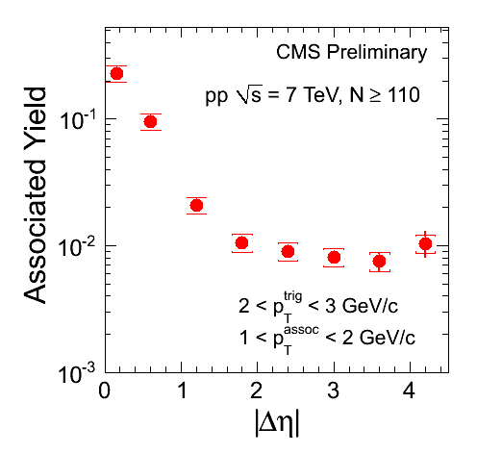
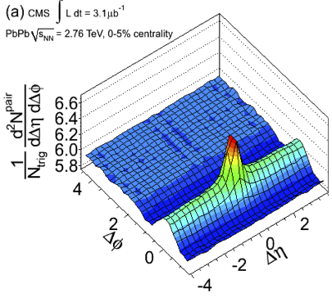
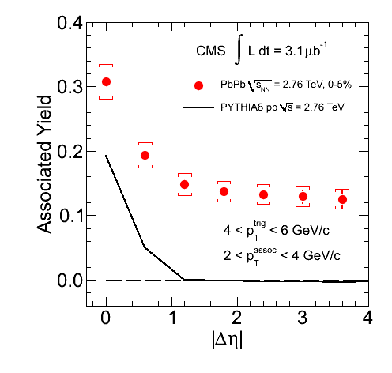
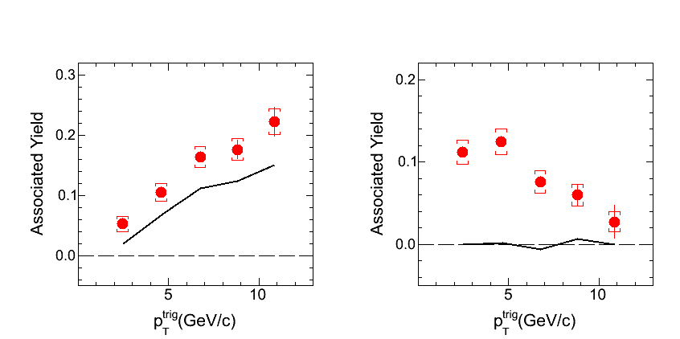
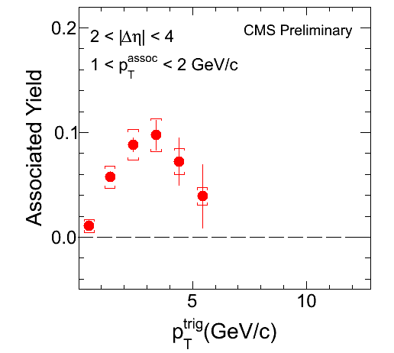
PbPb vs. pp
CMS pp 7 TeV, N ≥ 110
CMS PbPb 2.76 TeV, 0-5%
|Δη| dependence
|Δη| dependence
(X10)
Ridge Region
Ridge Region
x10

Slide 20
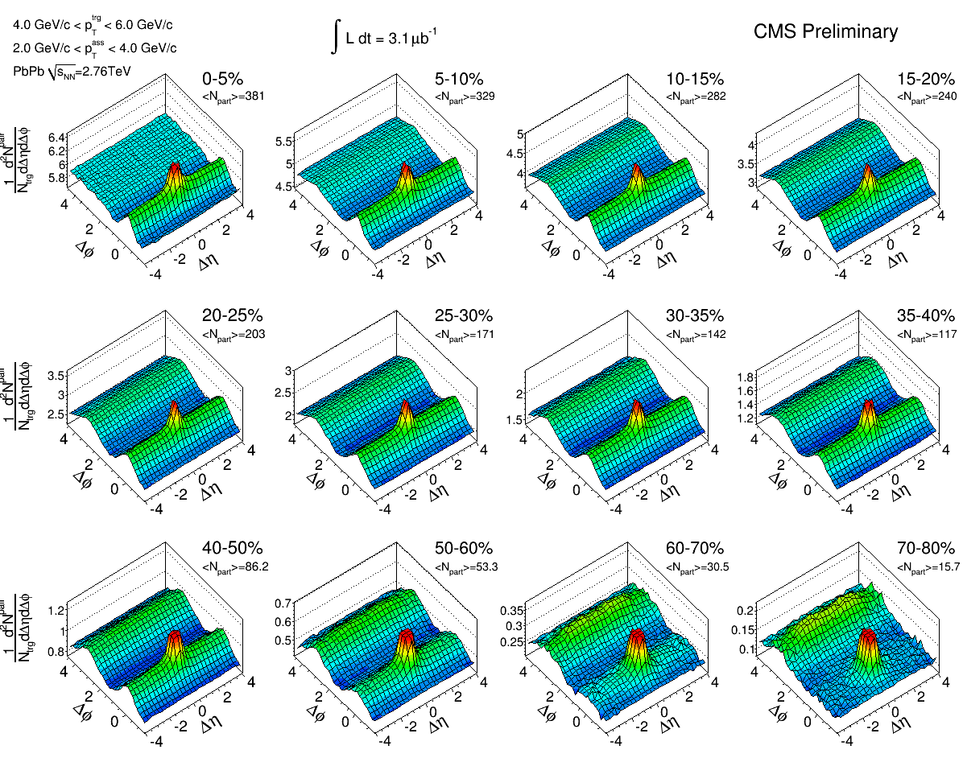
Centrality Dependence in PbPb
: 4 - 6 GeV/c
: 2 - 4 GeV/c
PbPb at 2.76 TeV
Pb
Pb
Pb
Pb
cos(2Δφ)

Slide 21
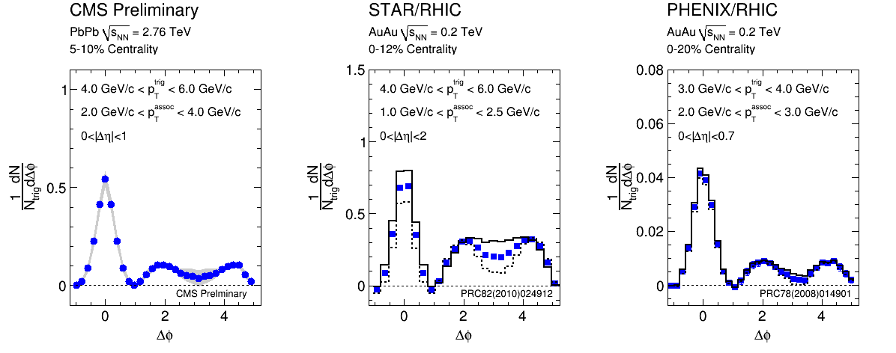
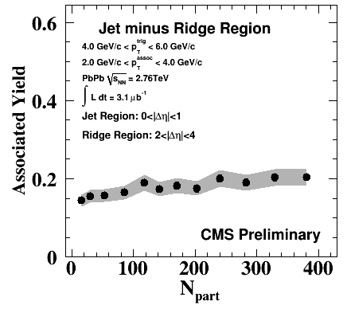
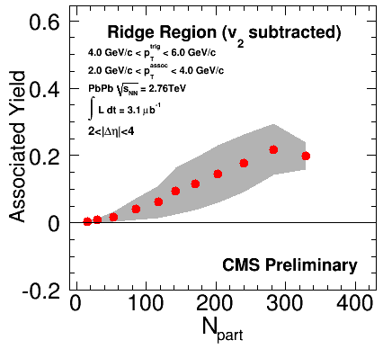
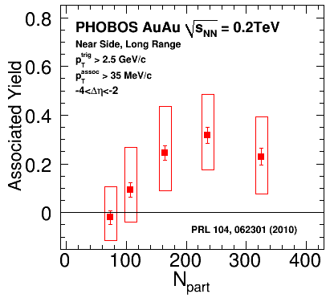
v₂-Subtracted Yields in PbPb
vs. RHIC
Jet region
(|Δη|<1)
Jet minus ridge region
Ridge region (2<|Δη|<4)
Pb
Pb
Pb
Pb
Similar trend in centrality to RHIC results!

Slide 22
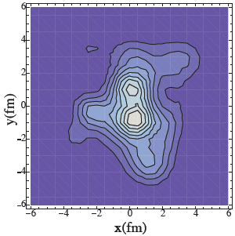
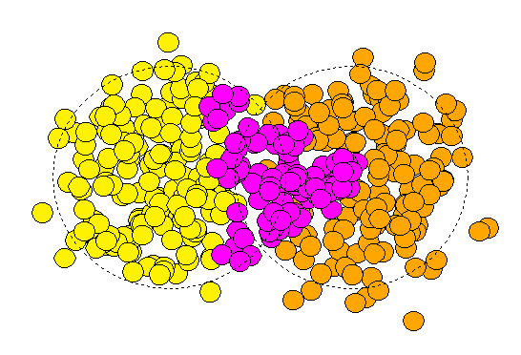
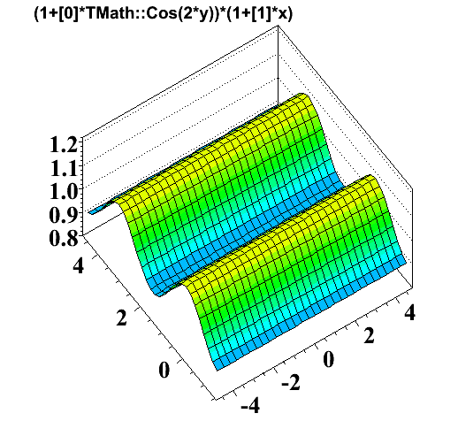
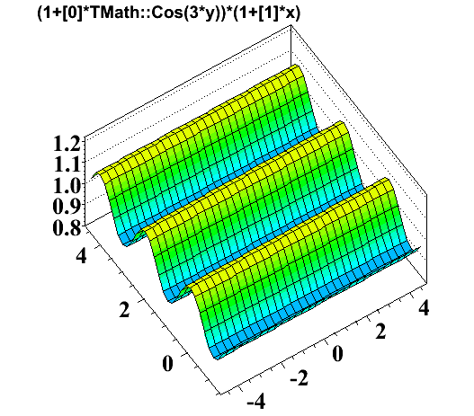
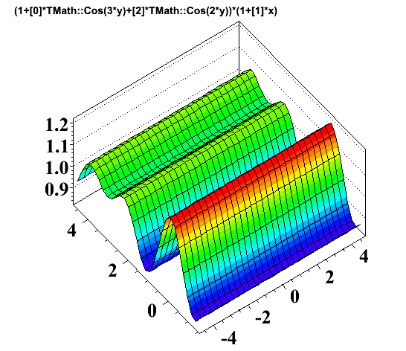
Possible Origin of Ridge
The ridge & Mach-cone like emission may be induced by higher order flow terms!
Triangular flow (v₃) from
event-by-event fluctuation
Elliptic flow (v₂)
y
Reaction
plane
z
Reaction
plane
x
y
G. Qin, H. Peterson
S. Bass, B. Müller
x
PRC81, 054905 (2010)
V₂ + V₃
Mach-cone like
Δφ
Δφ
Δη
Δη
Ridge
Δφ
Δη
~ V₂ cos(2Δφ)
~ V₃ cos(3Δφ)

Slide 23
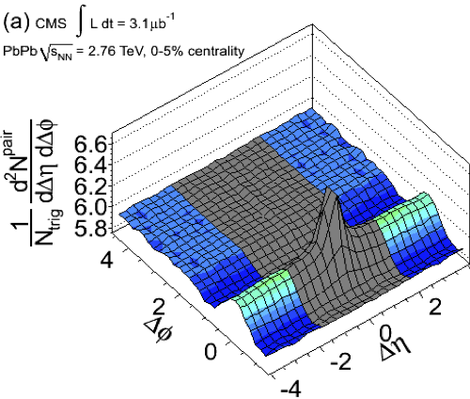
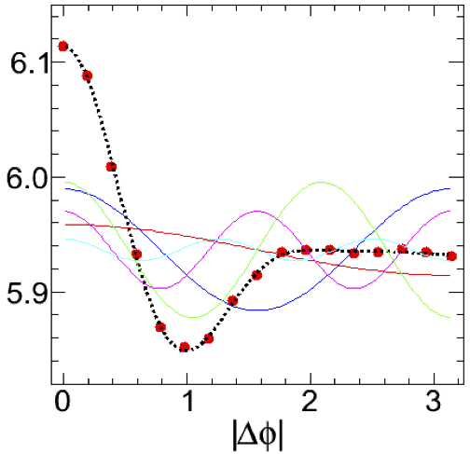
Fourier Decomposition
2<|Δη|<4
2<|Δη|<4
V₂^{f}
V₄^{f}
V₅^{f}
V₁^{f}
V₃^{f}
Fourier analysis of long-range dihadron correlation
Short-range non-flow effects are excluded.
Complementary to standard flow analysis methods
(EP, cumulants, LYZ)

Slide 24
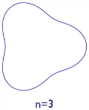
Fourier Decomposition
(0-5% most central PbPb)
arXiv:1105.2438
Ridge region (2<|Δη|<4): Long-range correlations
Dotted lines: Sum of five terms(n=1~5) in the Fourier series
Large $v_{3}$
( )
n=2
n=3
n=4
n=5

Slide 25
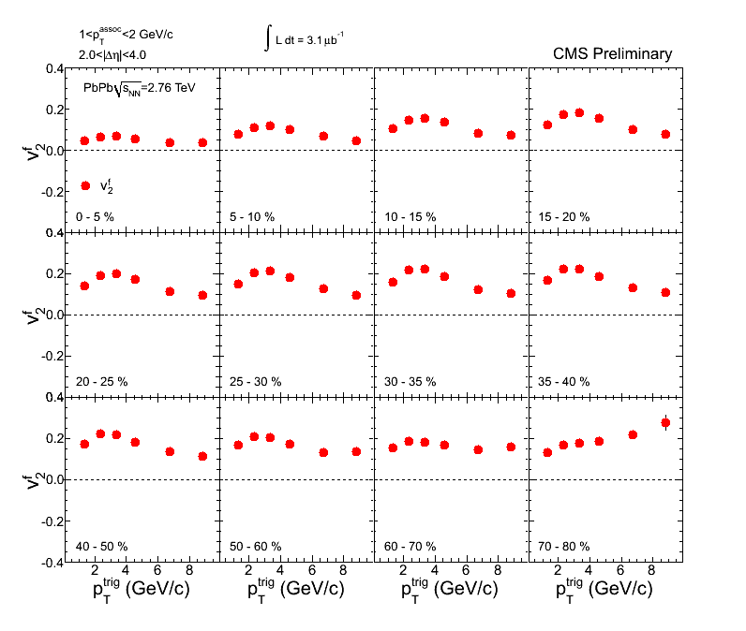
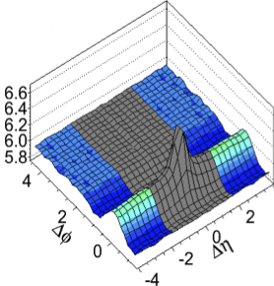
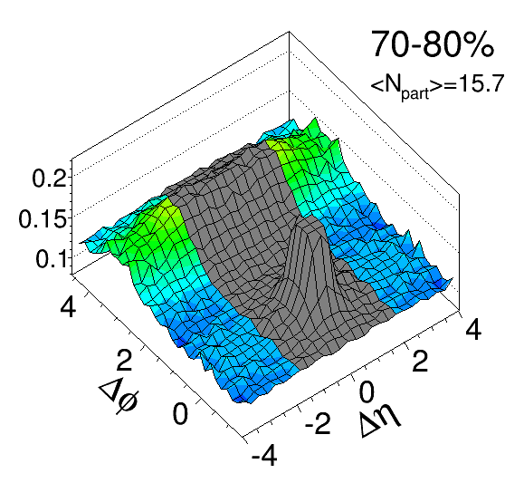
v₂ from Long-Range Correlations
ZPC70, 665 (1996)
PRC81, 054905 (2010)
0-5%
70-80%

Slide 26
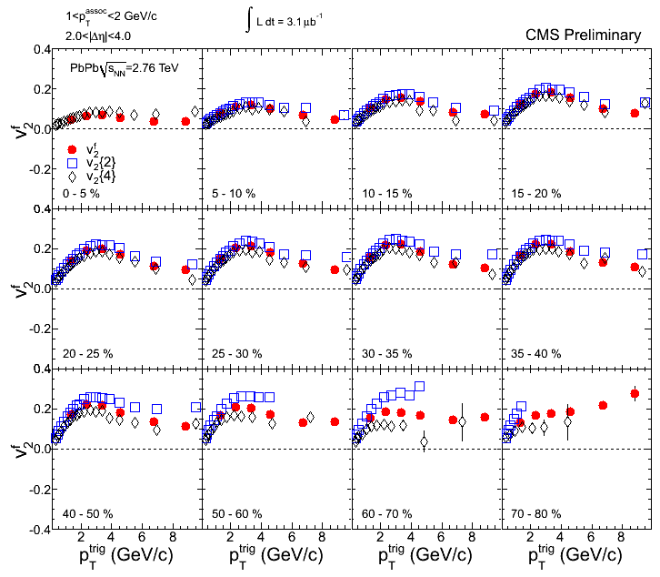
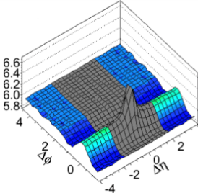
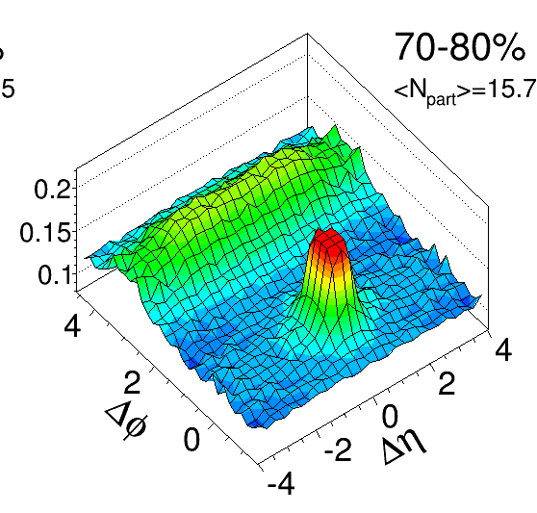
v₂ from Long-Range Correlations
ZPC70, 665 (1996)
PRC81, 054905 (2010)
0-5%
v₂^{f}
v₂{2}
v₂{4}
$$v_{n}^{2}\left\{2\right\}={\overline{v_{n}}}_{}^{2}+{σ_{v}}_{}^{2}$$
$$v_{n}^{2}\left\{4\right\}={\overline{v_{n}}}_{}^{2}−{σ_{v}}_{}^{2}$$
for small fluctuation
Borghini, Dhin, Ollitrault
PRC64, 054901 (2001)
70-80%

Slide 27
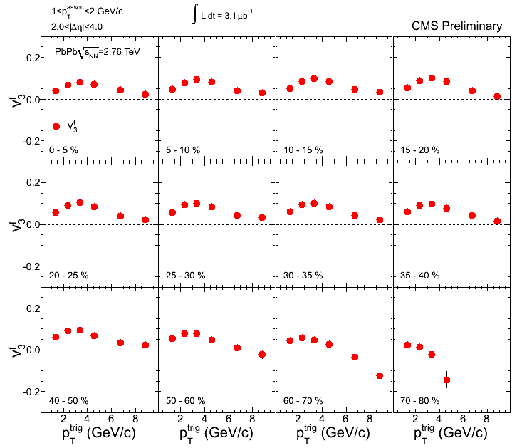
v₃ from Long-Range Correlations
ZPC70, 665 (1996)
PRC81, 054905 (2010)
0-5%
70-80%

Slide 28
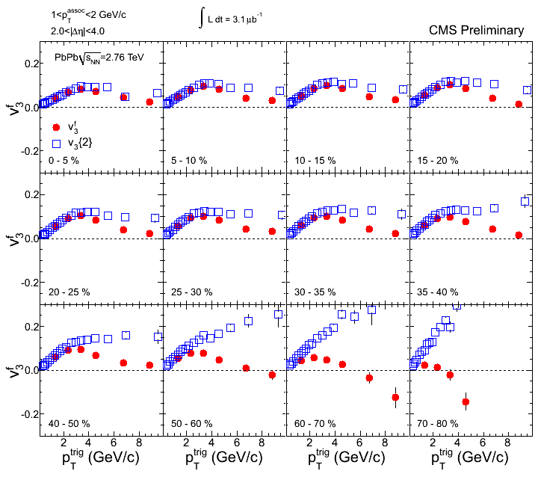
v₃ from Long-Range Correlations
ZPC70, 665 (1996)
PRC81, 054905 (2010)
0-5%
v₃^{f}
v₃{2}
$$v_{n}^{2}\left\{2\right\}={\overline{v_{n}}}_{}^{2}+{σ_{v}}_{}^{2}$$
$$v_{n}^{2}\left\{4\right\}={\overline{v_{n}}}_{}^{2}−{σ_{v}}_{}^{2}$$
for small fluctuation
Borghini, Dhin, Ollitrault
PRC64, 054901 (2001)
70-80%

Slide 29
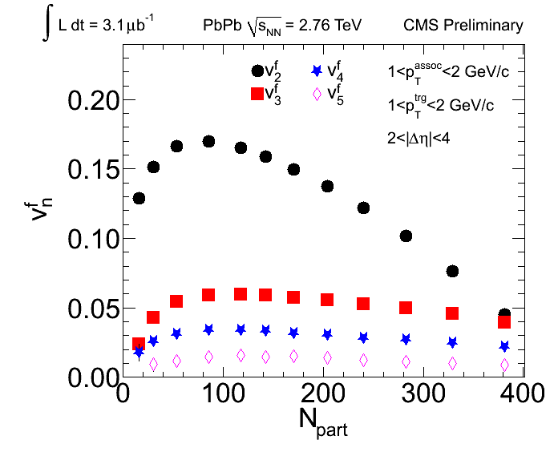
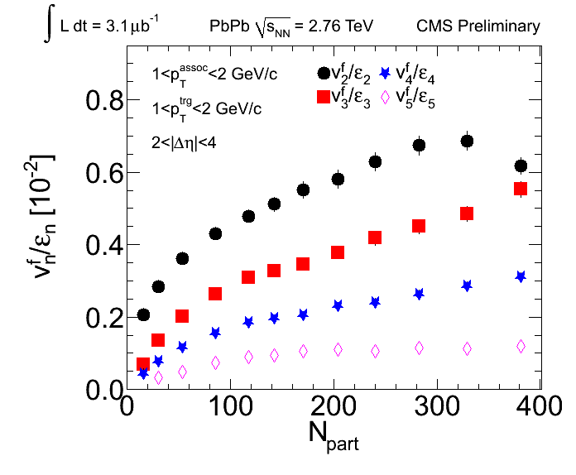
v^{f}_{n} vs. Centrality
Pb
Pb
Pb
Pb
Powerful constraints on the viscosity of the medium
Sensitive to the initial conditions

Slide 30
More on v₂
CMS vs. ALICE ($\left|η\right|<0.8$)
LHC vs. RHIC ($\left|η\right|<0.8$)
CMS and ALICE agree in general
except in most peripheral events
PHENIX > CMS at high p_{T}
for centrality > 30%

Slide 31
Systematics on v₂
Excitation function at mid $η$
$v_{2}/ε_{part}$ scaling
Scaling with transverse density across systems & $\sqrt{s_{NN}}$
Constraint on $η/s$
Smooth increase
from RHIC to LHC by 15-20%

Slide 32
v₄ and v₆
Different methods for $v_{4}$ ($\left|η\right|<0.8$)
$v_{4}$ vs. $v_{6}$ ($\left|η\right|<0.8$) from LYZ
Signals are sizable, reaching ~7%
Compatible $v_{4}\left\{3\right\}$ and $v_{4}\left\{5\right\}$
$v_{6}$ signal is small, but finite,
reaching ~2% at mid-cent.

Slide 33
v₅
Alver et al., PRC82, 034913 (2010)
Prediction for RHIC, 0-5% centrality
$v_{5}$ increases quadratically with p_{T}
in contrast with other flow harmonics.

Slide 34
Full Harmonic Spectra
$v_{n}$ vs N_{part} shows different trends:
Even orders decrease and diminish with increasing N_{part}.
$v_{3}$ depends weakly on centrality & finite for central collisions.

Slide 35
Comparisons to Hydro
For Glauber initial conditions
$v_{2}$ and $v_{3}$ together have better sensitivities on $η/s$.
The centrality dependence adds further constraints.

Slide 36
Initial Conditions & η/s
Different initial conditions add another parameter space
Quantitative comparison requires further tuning
Yet to be determined which set of parameters works best

Slide 37
Summary
Long-range ridge correlations observed in high-multiplicity pp
Ridge yield increases in low p_{T} and vanished at high p_{T}
Systematic study of dihadron correlations in PbPb
In central events, the ridge yield significantly drops at high p_{T}
Extracted flow parameters are consistent with other results done by the cumulant and LYZ methods
Flow parameters
$v_{2}$ is compatible with RHIC data
$v_{3}$ is sizable and weakly depends on the centrality
$(v_{4}/v_{2}^{2}$ is higher than at RHIC)
$v_{5}$ and $v_{6}$ are finite
Important basis for the initial conditions and $η/s$ of sQGP

