Slide 1

HEP Topics for BSI
Dongchul Son (CHEP, KNU)

Slide 2
Outline
BSI’s HEP team?
  Why?
What are current hot issues?
What can we and should we do?
How teams could be organized?
Summary and issues for discussion

Slide 3
BSI’s HEP team? Why?
Short history of Korean HEP
Organizations
Institutions and manpower
HEP teams
Roadmaps (2005, 2009)
Necessity for at least one national organization for HEP

Slide 4
Short history of Korean HEP
¹⁹50 60
70
80
90
²⁰00
10 20
RENO
ILC, Proton Acc, ν studies
Dark Matter, Double beta decay
K2K ν
| T2K ν
AMS & astroparticle | AMS-2
LHC CMS & ALICE | Data taking
Tevatron D0/CDF
ZEUS (ep)
and
CLAS
PHENIX
STAR
SSC
LEP e+e-
L3, ALEPH
TRISTAN e+e-
AMY
KEKB e+e- Super B-factory
Belle Belle 2
Emulsion
Fermilab ν
CERN ν(CHORUS) OPERA
FNAL Donuts
PAL est.

Slide 5
HEP Organizations
(Institutes, Centers, WCU Teams)
CHEP
(2000)
Center of Excellence
Center of Excellence
Kyungpook NU
(host)
CQUeST
(2005)
Sogang U
(host)
WCU
(2009)
KPS
Particles and Fields
Nuclear Physics
Astrophysics
Plasma Physics
WCU-IEU
(2009)
Ewha W U (host)
KHEP: Association of Korean HEP
(2005)
MEMSTEL
(2006)
Korea-CERN
Coop. (2007)
RENO
(2006)
Center of Excellence
KNRC
(2009)
Seoul NU (host)
KODEL
(1997)
WCU
(2009)
Korea U
PAL
(1988)
POSTECH
(host)
Emulsion
Group
DMRC
(2000)
APCTP
(1997)
POSTECH
(host)
GSNU
CTP
(1990)
Seoul NU
(host)
And others (KAERI, etc.)
KIAS
(1996)
KAIST
(host)

Slide 6
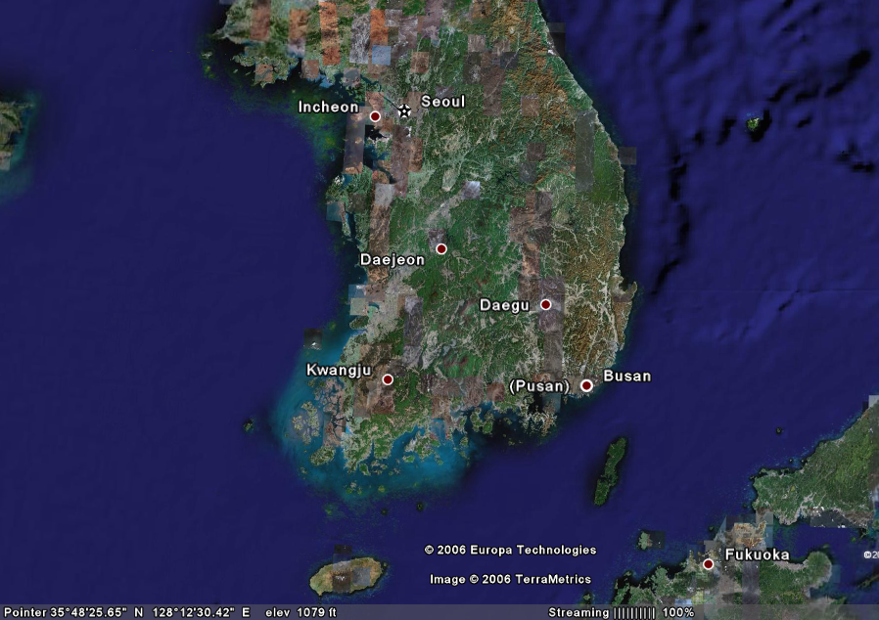
HEP Institutions
~ 57 Institutions
~150 Experimental HE & N Physicists
~ 200 Theoretical HE Physicists
~ 100 Accelerator Experts
Hanyang, Seoul, Korea,
Yonsei, KIAS, Sogang
SKKU, Kyunghee, Konkuk
Sejong, U of Seoul,
Ewha, etc.
Kangnung, Kangwon
Kyungpook CHEP
Andong, Keimyung,
Daegu Catholic,
PAL, APCTP
KAIST, KAERI, KISTI
Chungnam, Chungbuk
Chonbuk
Pusan, Inje, Kyungsung
Chonnam, Dongshin
Gyeongsang
HEP Programs
others
Jeju

Slide 7
HEP teams in Korea
Dongshin U
CMS
Korea U
Kyungpook
NU
Seoul City U
SKKU
Konkuk U
Chonnam NU
Jeju NU
CDF
Seoul NU
Kyungpook
NU
SKKU
Kangwon NU
D0
Seoul NU
Korea U
Belle/Belle II
Seoul NU
Kyungpook
NU
Korea U
Gyeongsang
NU
Hanyang U
Yonsei U
Ewha W U
ILC
Seoul NU
Kyungpook
NU
Korea U
Hanyang U
Ewha W U
KIMS AMORE
Seoul NU
Kyungpook
NU
Sejong U
KRISS
RENO
Seoul NU
Kyungpook
NU
Chonnam NU
Sejong U
SKKU
Dongshin U
Gyeongsang
NU
SuperK/T2K
Seoul NU
Chonnam NU
SKKU
Chonbuk NU
Seokyeong U
Pusan NU
Opera
Gyeongsang
NU
AMS
Kyungpook
NU
Ewha W U
MEMSTEL
Ewha W U
ALICE
Kangnung U
Sejong U
Yonsei U
Pusan NU
PHENIX
Yonsei U
Myongji U
Korea U
Chonbuk NU
Ewha W U
Seoul NU
Accelerator
PAL
Kyungpook
NU
Pusan NU
KAERI
KAPRA

Slide 8
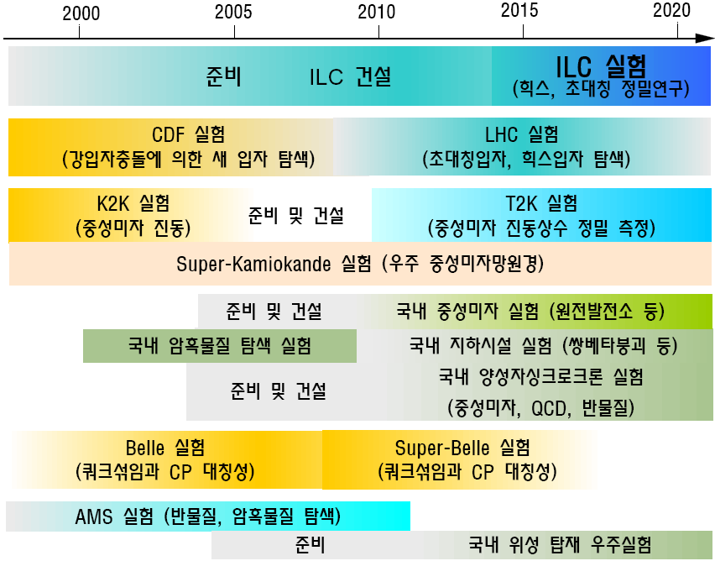
Korean HEP Roadmap (2005)
Domestic Neutrino Programs
Reactor Neutrino Exp. Exp. Long-baseline Osc.
Domestic Dark Matter Search Exp
Double Beta Decay Exp
Proton Accelerator Programs
Domestic Satellite HEP & AstroPP Exp.

Slide 9
Accelerator Based HEP Roadmap
(2009.4, KHEP Association)
2005 2010 2015 2020 2025 2030
PEFP
100 MeV Proton Accelerator
Try to connect the
PEFP, KoRIA, Photon Facotry Programs
with HEP Plans
2nd Phase PEFP or SC of KoRIA
Superconducting Cavity Technology
As first priorit
Smaill e-Linac for Rare Isotope production
by photofission at KoRIA
RCS(1GeV)
Neutron/Muon Source
SC(1GeV)
Proton Drive (8-10 GeV)
High Power PS – neutrino factory, μ Collider
KoRIA (Superconducting)
200 MeV Rare Isotope Accelerator
Options:
After 2015 Proton Drive or ILC
ILC (Superconducting)
500 GeV - 1 TeV e+e- collider
Super Charm
3 GeV e+e- collider
Options considered: ILC or Super Charm, post-ILC
Next ILC
> 3 TeV e+e-
LHC (7+7 TeV)
SLHC
Super KEKB
ILC
J-PARC
FAIR
FRIB
2005 2010 2015 2020 2025 2030
Dongchul Son, July 1-2, 2010, P-ECFA

Slide 10
고에너지물리의 미래를 위해
국립고에너지물리연구소 – 이휘소 연구소(가칭) 필요
  (양성자 가속기)
  여러 창의적인 실험 수행 및 R/D 시설
  모든 사람들이 참여하는 연구소로
국가대형연구시설 (확정, 그러나 예산 미반영)
  CMS Tier 1
  양양지하검출기시설
  차세대중성미자검출시설
  지하고에너지연구시설 : T2KK, 양성자붕괴실험 시설
    여러 가지 연구를 위한 지하연구시설로 활용 가능
국제공동연구의 전초기지
  LHC-CMS, ALICE, Super-B factory, JPARC 등
BSI 사업단으로서의 필요성

Slide 11

What are current hot issues?
Based on Reviews at the most Recent LP11 and ICHEP10
Standard Model’s Mystery
  Where is the Higgs particle ?
Matter-Antimatter Asymmetry ?
  Baryogenesis
Understanding mysterious Neutrinos
  Leptogenesis
Unification of forces
Unknown dark matter and energy
  Controversial results : positive vs negative
Understanding the Universe more deeply
  Ultra HE particle sources
  Propagation of cosmic particles
Other candidates of new physics ?

Slide 12

“Discovery” of Standard Model
‘Yesterday’
Excerpts from
Rolf Heuer’s talk at LP11
At the energy frontier through synergy of
hadron - hadron colliders (e.g. Tevatron)
lepton - hadron colliders (HERA)
lepton - lepton colliders (e.g. LEP, SLC)

Slide 13
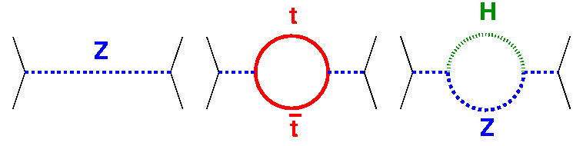
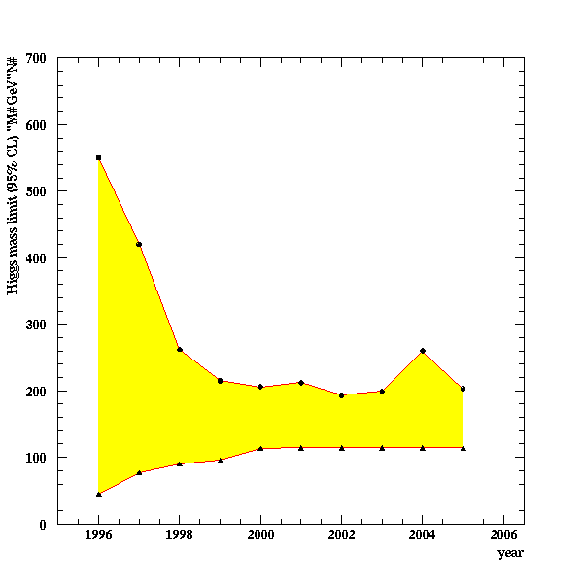
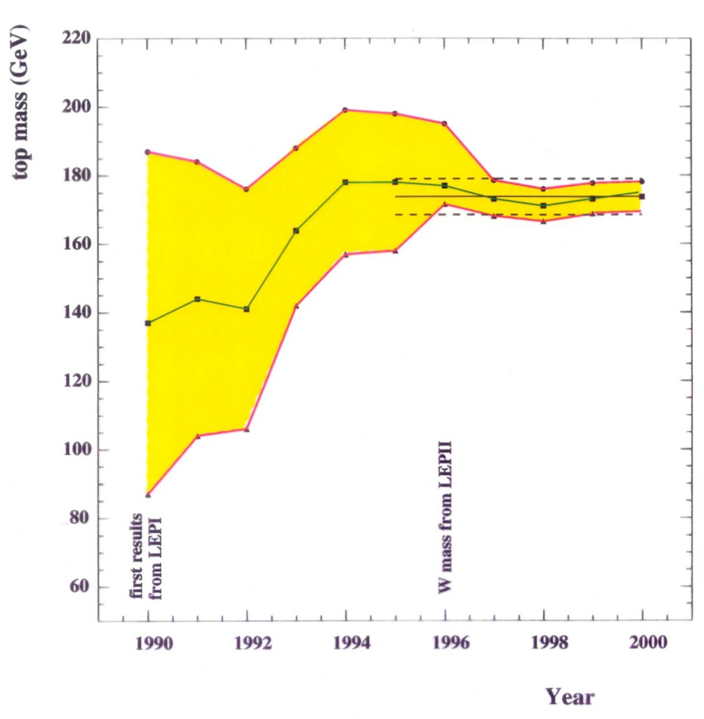
Test of the SM at the Level of Quantum Fluctuations
Excerpts from
Rolf Heuer’s talk at LP11
prediction of the range
for theHiggs mass
indirect determination of the top mass
possible due to • precision measurements • known higher order electroweak corrections
LEP

Slide 14
Exciting Times
‘Today’
Excerpts from
Rolf Heuer’s talk at LP11
At the energy frontier, the LHC brings us
into unexplored territory:
Excellent progress
Accelerator – Experiments – Grid

Slide 15
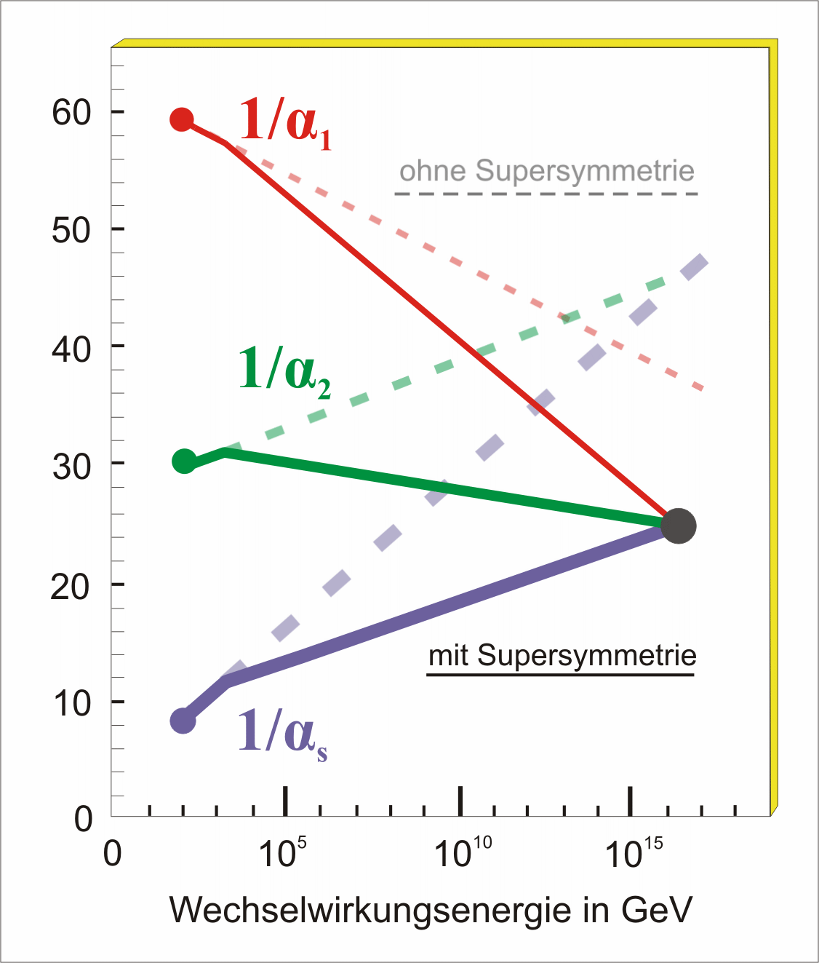
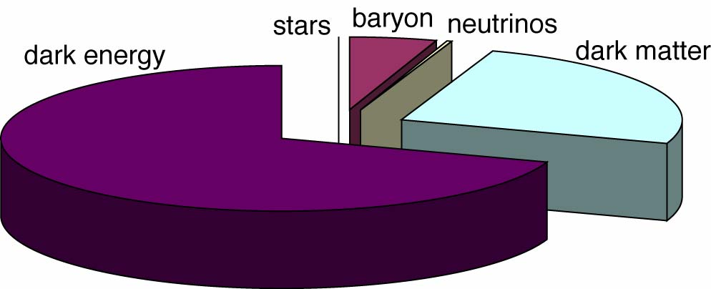
Key Questions of Particle Physics
Excerpts from
Rolf Heuer’s talk at LP11
origin of mass/matter or origin of electroweak symmetry breaking
unification of forces
fundamental symmetry of forces and matter
where is antimatter
unification of quantum physics and general relativity
number of space/time dimensions
what is dark matter
what is dark energy
For most questions:
new particles should appear
at TeV scale or below
→ territory of the LHC

Slide 16
Key message (II)
‘Tomorrow’
Excerpts from
Rolf Heuer’s talk at LP11
There is a 20 years programme at
the energy frontier with the LHC:
7 TeV
14 TeV design luminosity
14 TeV high luminosity (HL-LHC)

Slide 17
?
‘Beyond Tomorrow’
Excerpts from
Rolf Heuer’s talk at LP11
Colliders at the Energy Frontier
beyond LHC

Slide 18
Road beyond Standard Model
Next decades
Excerpts from
Rolf Heuer’s talk at LP11
At the energy frontier through synergy of
hadron - hadron colliders
lepton - hadron colliders
lepton - lepton colliders
LHC results will guide the way at the energy frontier

Slide 19
Linear Colliders: ILC / CLIC
Excerpts from
Rolf Heuer’s talk at LP11
Both projects are global endeavours
Wide range of Physics Topics, e.g.
Higgs (self) couplings
Z, W, Top studies
new physics

Slide 20
Key message (III)
High Priority Items for Linear Collider Projects
ILC and CLIC projects → LC project
Construction Cost
Power Consumption
Value Engineering

Slide 21
Key message (IV)
Excerpts from
Rolf Heuer’s talk at LP11
All projects need continuing accelerator and detector R&D;
All projects need continuing attention concerning a convincing physics case;
close collaboration exp-theo mandatory
so that the right decision can be made when the time comes to identify the next energy frontier accelerator (collider).
Today, we need to keep our choices open.

Slide 22
Excerpts from
Rolf Heuer’s talk at LP11
Past decades saw precision studies of 5 % of
our Universe → Discovery of the Standard Model
…
We are just at the beginning of exploring
95 % of the Universe
exciting prospects

Slide 23
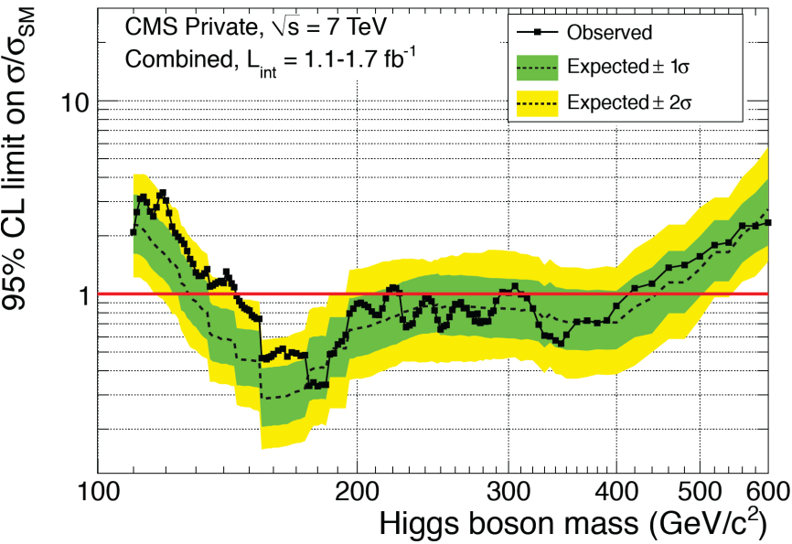
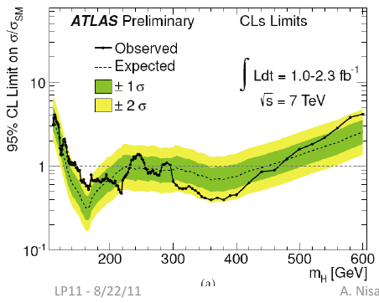
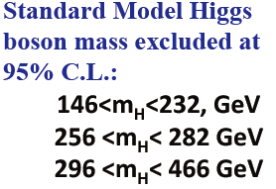
Results of Search for Higgs
… to be continued
Observed exclusion mass range (95% CL)
145-216 GeV
226-288 GeV
310-400 GeV
95% CL is not enough !!!
Need more than 99% CL result for discovery…
Key words:
Higgs or no-Higgs?
More careful analysis is necessary !!!

Slide 24
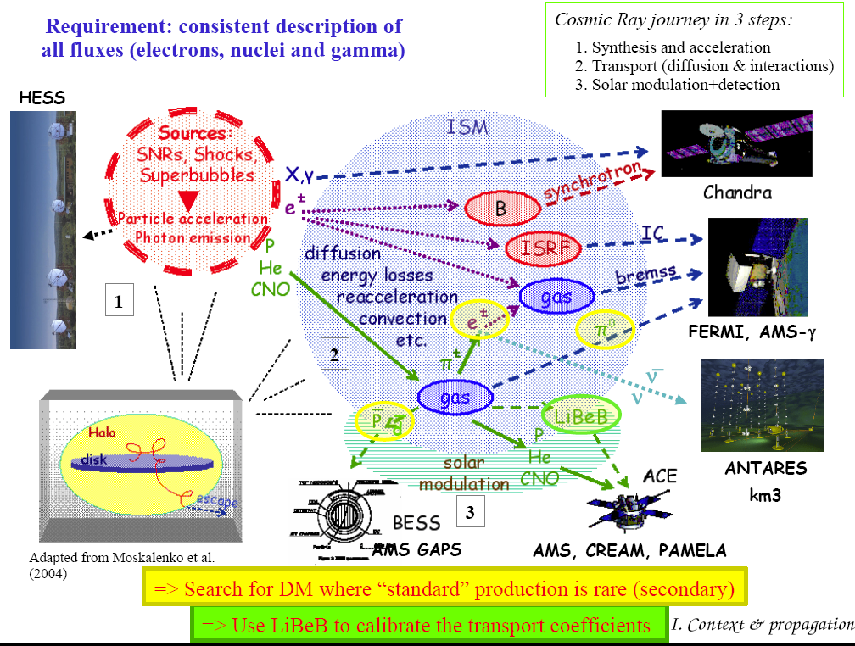
Matter-Antimatter Asymmetry and High Energy Cosmic Particles
Belle and BaBar discovered Asymmetry in B systems
Major CP-violation source would be from the baryon sector
Understanding the baryogensesis is a hot issue
Now PAMELA, Fermi-LAT, AMS2, CREAM, etc. are searching antimatter in the space
Key words: Baryogeneis, Dark Matter
Lots of data are now coming !!!

Slide 25
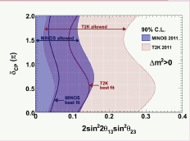
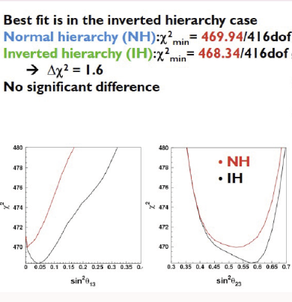
Understanding Neutrinos
Excerpts from J Thompson’s talk at LP11
Reactor experiments + NOVA and T2K will get range of allowed δcp
Assuming θ13 is between 5º and 10º NOνA could get at δcp and the mass hierarchy
The mass hierarchy is the Next Big Thing in neutrino physics
SUPER-K shows a hint of IH (Neutrino 2010)
If IH is correct and 0νββ is not seen in next generation experiments, neutrinos will be Dirac
Key words: Leptogeneis, CP-violation
Connection to Baryogensis → GUT
Long-baseline Nu, Proton decay Exp.!!!

Slide 26
What can we and should we do?
10s of billion events NOW and expect Tera-events in coming 10 yrs
Data analysis work is the most imminent and important
  LHC – CMS/ALICE (7, 14 TeV)
  AMS + CREAM
Preparation for the next 10 years : Detector and Accelerator R/Ds
  Super-KEKB
  Underground Facilities: Double beta decay, Proton Decay, Nu Telescope, etc. ← Indian has just started this.
  Neutrino (Reactor, especially Long-baseline)
  ILC/CLIC
  UHE CR physics
Phenomenology
  Link between Theory and Experiments
  Synergy ← Good example of Real Physics
Key words:
Data Analysis, Preparation (Acc. Detector)
Phenomenology
Tera-scale HEP Research !!!

Slide 27
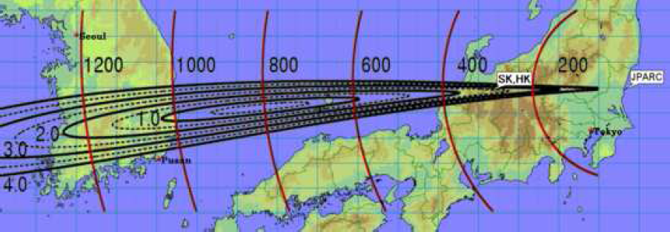

A Vision of Future Korean HEP Facilities
Yangyang Underground Lab (operating)
- Dark matter, Double beta decays
Reactor Neutrino Program
- RENO (started operation)
40~200 GeV Proton accelerator?
ILC ? (working for a proposal)
LCG Tier-2s (CMS, ALICE)
LCG Tier-1 (CMS, proposal stage)
Long baseline neutrino Exp & Proton Decay Exp.
- T2KK (working for a proposal)
Super-K
Tokaimura
East Sea
Japan
J-Parc
Korea
295km
~780 km
neutrinos
neutrinos
neutrinos
~1,050 km
Pacific
Ocean

Slide 28
Major Research Goals
물질을 구성하는 기본입자와 기본 힘의 규명
암흑물질과 암흑에너지의 규명
우주의 생성과 진화에 대한 근원적인 이해
우주의 시공간에 대한 이해
미관측된 새로운 현상 발견 및 정체 규명
In other worlds
  Complete understanding of SM
  Understanding of origins of Dark Matter, Dark Energy
  Search for mechanisms for Unification of Forces
  Establishing Baryogenesis and Leptogenesis
  Search for New Physics BSM

Slide 29
연구 내용
표준모형의 정밀 검증과 힉스 입자의 성질 정밀 규명
초대칭 이론/여분차원 공간 등 새로운 이론에 대한 검증
암흑물질의 탐색과 규명
암흑에너지의 이론적 규명
우주의 물질과 반물질의 대칭성 깨짐과 새로운 물리 연구
무거운 쿼크와 경입자의 성질에 대한 정밀 측정
중성미자의 질량 측정 및 성질 결정
양자색소역학의 연구
새로운 물리현상의 발견
초고에너지 우주선 입자의 탐색과 생성, 전파 연구

Slide 30
Research Teams?
▣ 연구팀 -- Very rough idea but according to the KAHEP
LHC physics team (~20명)
Super-B physics team (~20명)
Neutrino physics and proton decay team (~20명)
Dark matter and double beta decay team (~20명)
Phenomenology team (~20명) : 핵,입자,천체
Accelerator and detector R/D and computing team (~20명)
HE nuclear & astrophysics team (??명)
박사급: 120+명 + 대학원생 100명 이상 + 지원인력

Slide 31
Summary & issues for discussion
Since the last decade we have now very sound and ambitious plans for HEP research
It is a very high time to have a big stride of contributing scientifically to the world for the future , not only individually but also as a strong nation-wide effort
Several really top-class and not-to-miss-in-this-decade opportunities are wide open to us
  Linear Collider, Long baseline neutrino, especially
HEP @ BSI should be a nationwide organized research team
Suggestion of the following issues for discussion
  Research scope and teams ?
  HE nuclear & particle & astro- particle physics together ?
    Suggestion of Physics cases

