Slide 1
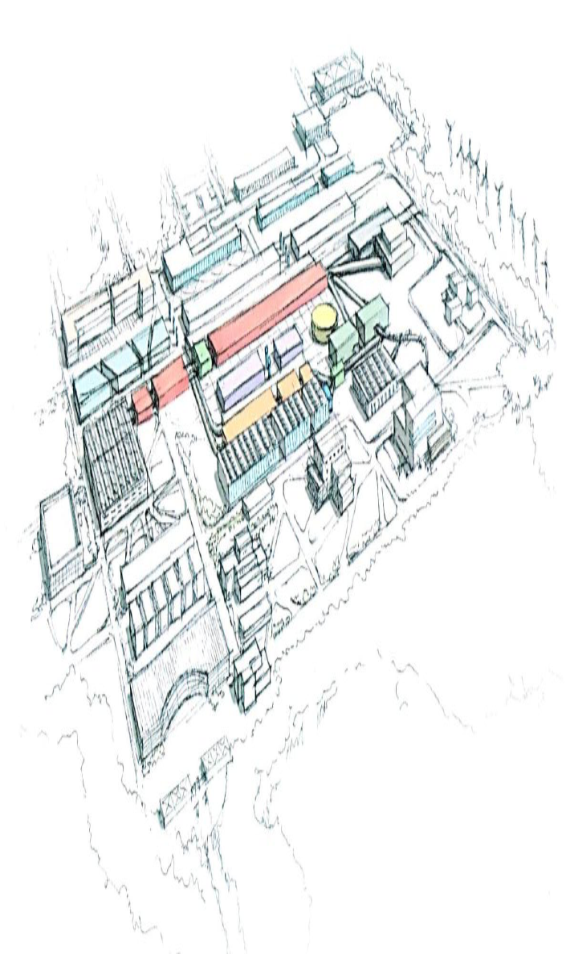
Detector R&D Lab. @ KoRIA
In-Kwon Yoo (Pusan Nat’l University)
HIM-KIAS 2011-09

Slide 2
Outline
Motivation
Requirements
  Beam lines
  Peripherals
Infrastructure
  Gas/Electronic/Mechanic facility
  Cooling/Vacuum system
  Organization
Estimates
Survey of needs

Slide 3
Motivations
No dedicated beam line for Detector Tests
  e-beam at PAL : I~mA..A with d~>10cm, ~<100MeV..1GeV (at beam dump)
  No beam profiler
  n-source from reactor/target : no defined flux
  No spectrometer for specific p-selection
No fundamental infrastructure for Detector R&D
  No (Primitive) mechanic / electronic shop for repair
  No pool for fundamental modules
  No dedicated job position (no well-trained manpower)
No link to industrial application
  No specific enterprise
  Potential : Medical instruments etc.

Slide 4
Requirements
Beam lines
  Primary beam line with p@610MeV, 660pμA - U@200MeV, 8pμA
  Secondary beam line with proper target
  Neutron production at beam dump
Beam line peripherals
  Magnets : Quadro-, Hexa-pole
  Spectrometer : p-selection at downstream of target
  Target system
  Beam profiler
  Trigger system

Slide 5
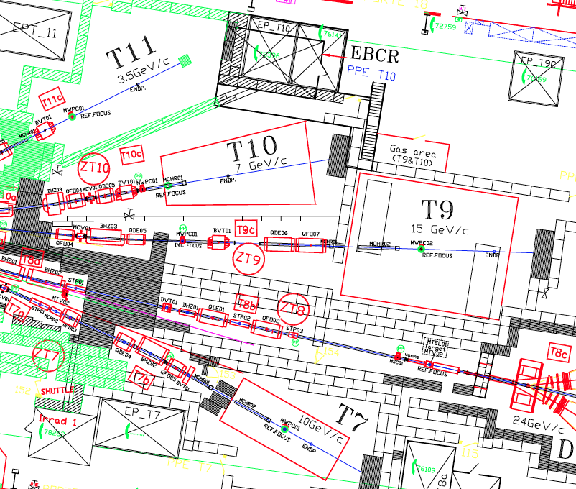
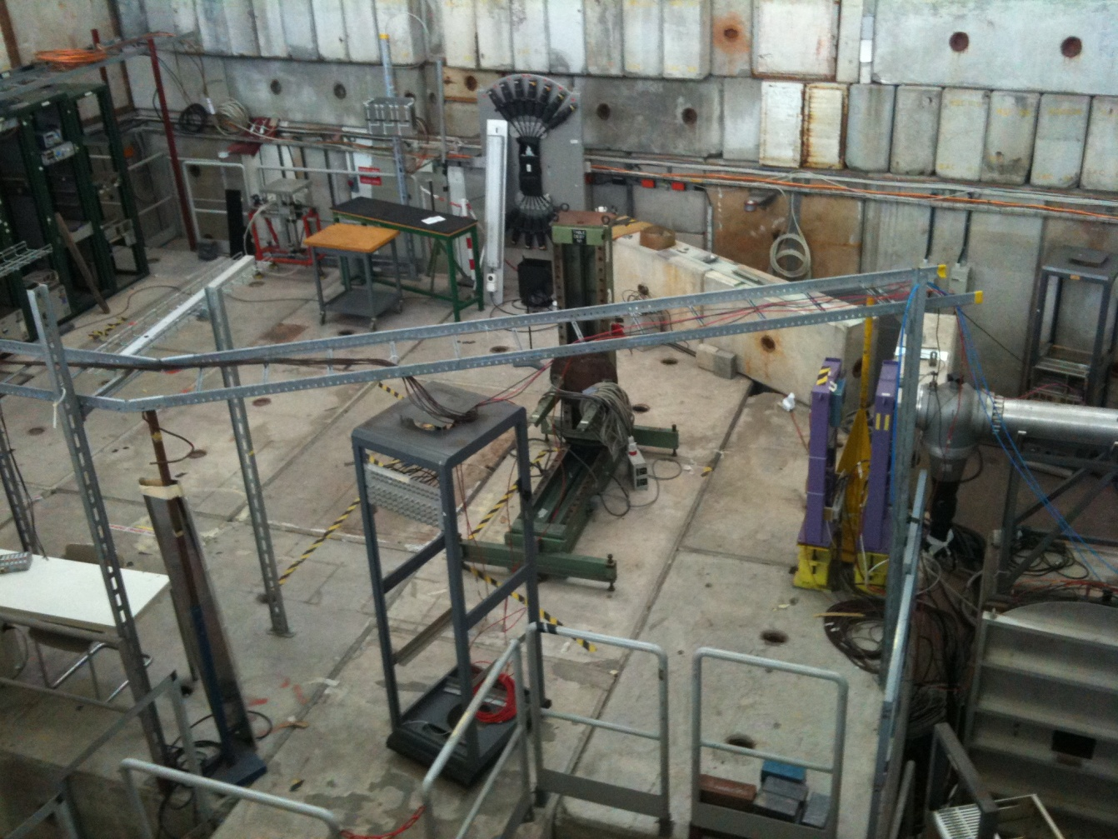
CERN-PS Beam Lines

Slide 6
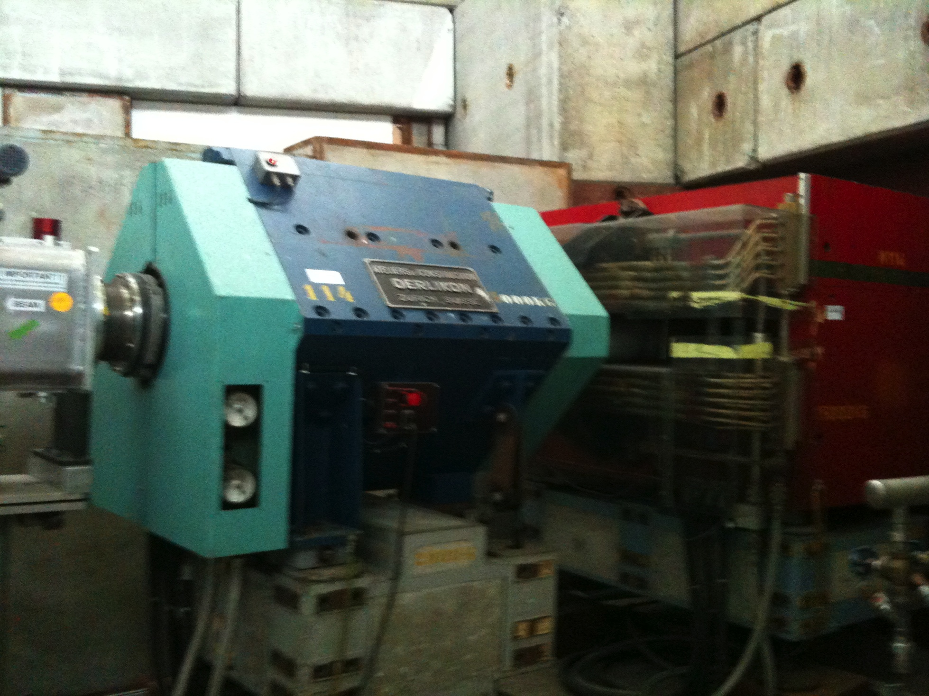
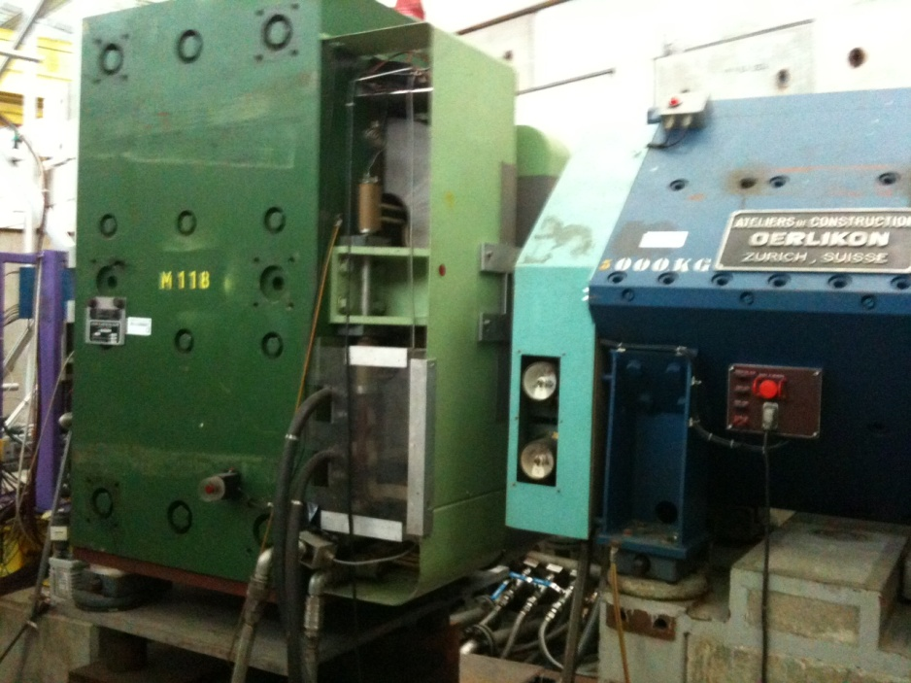
CERN-PS Beam Magnets

Slide 7
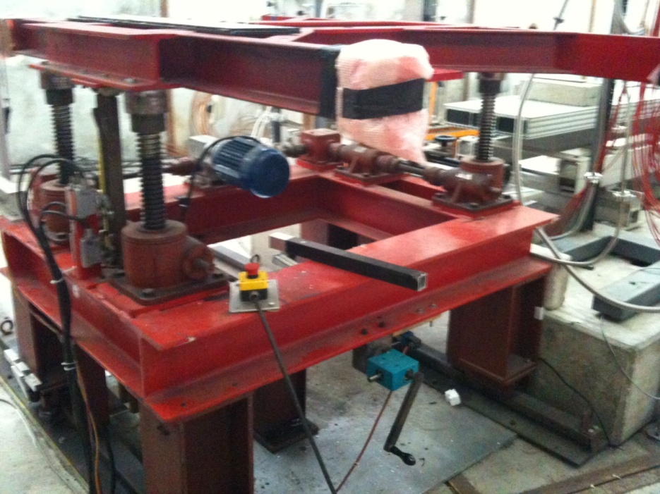
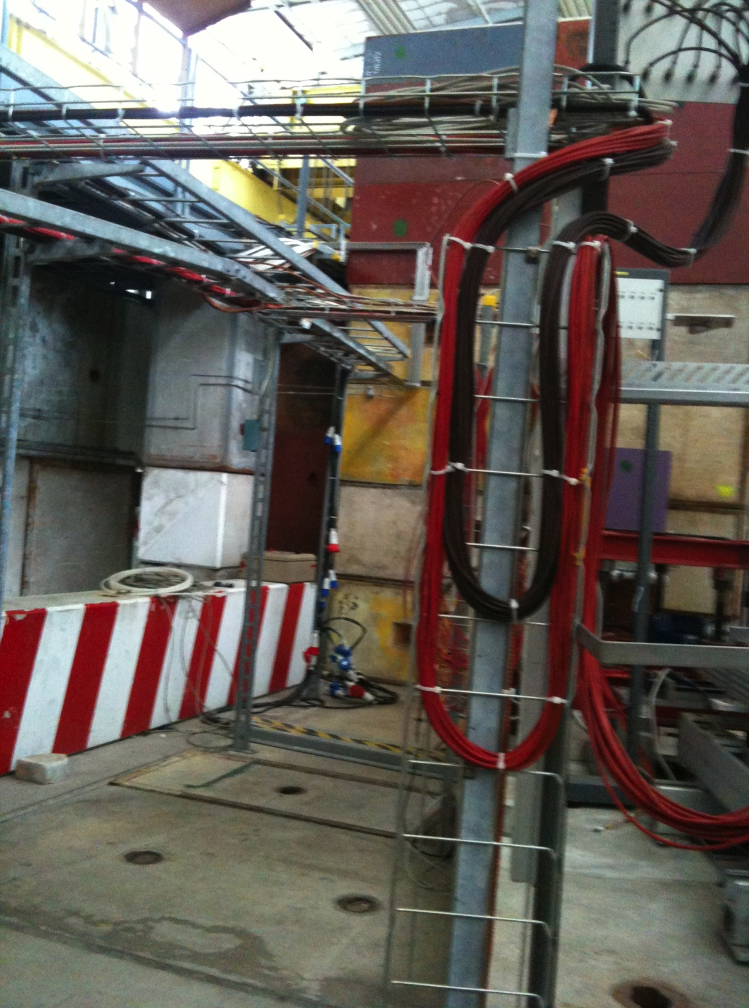
CERN-PS : Detector Bench, Cables

Slide 8
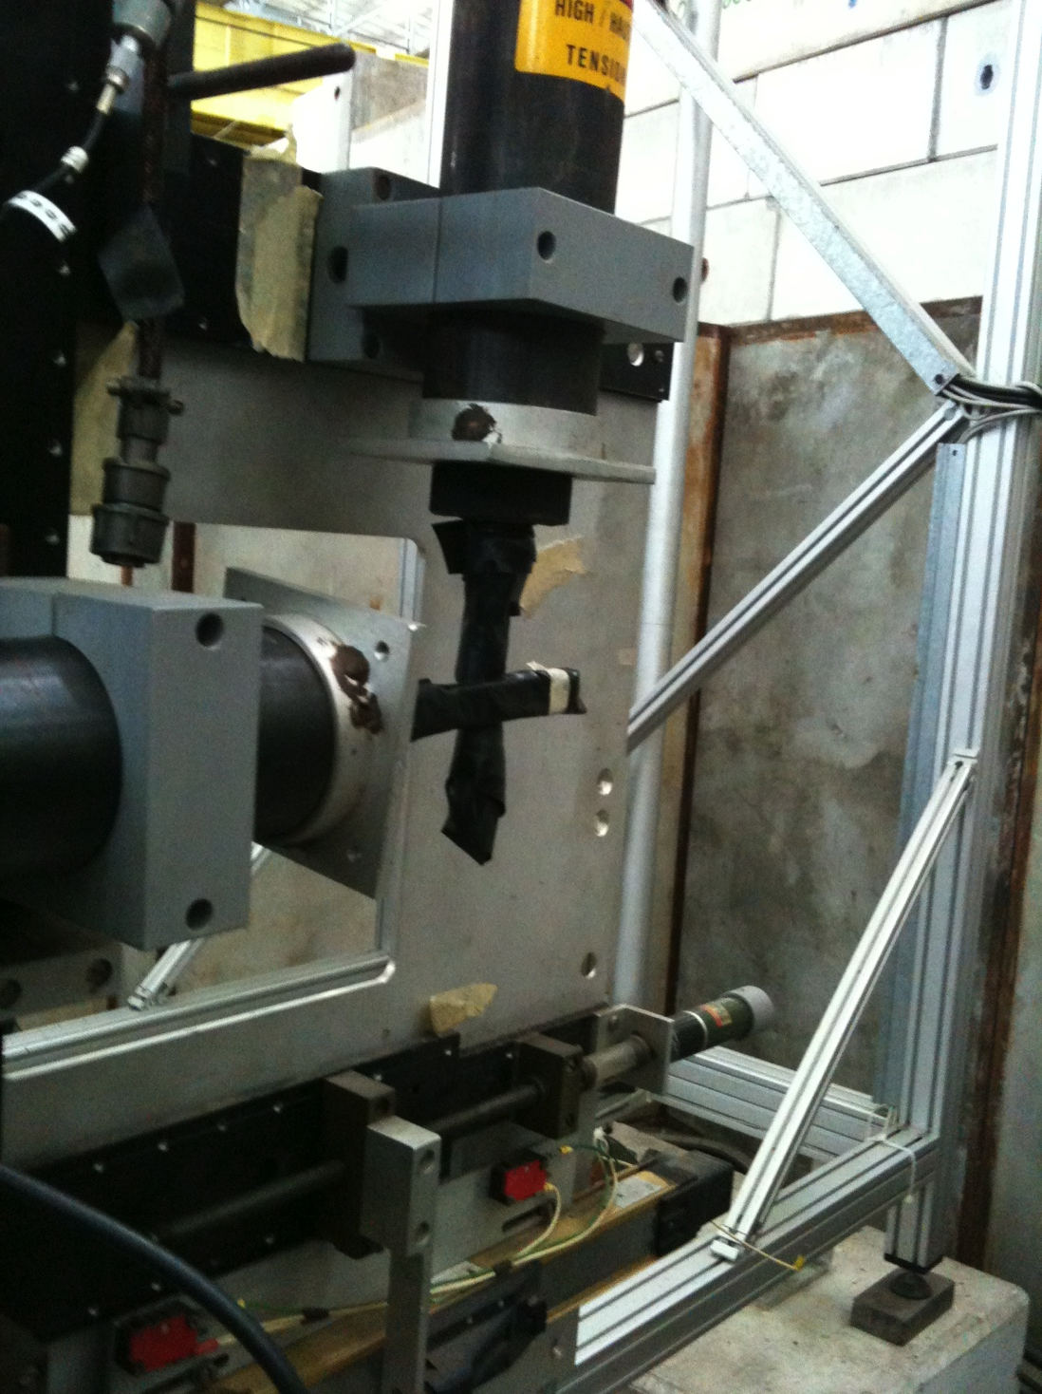
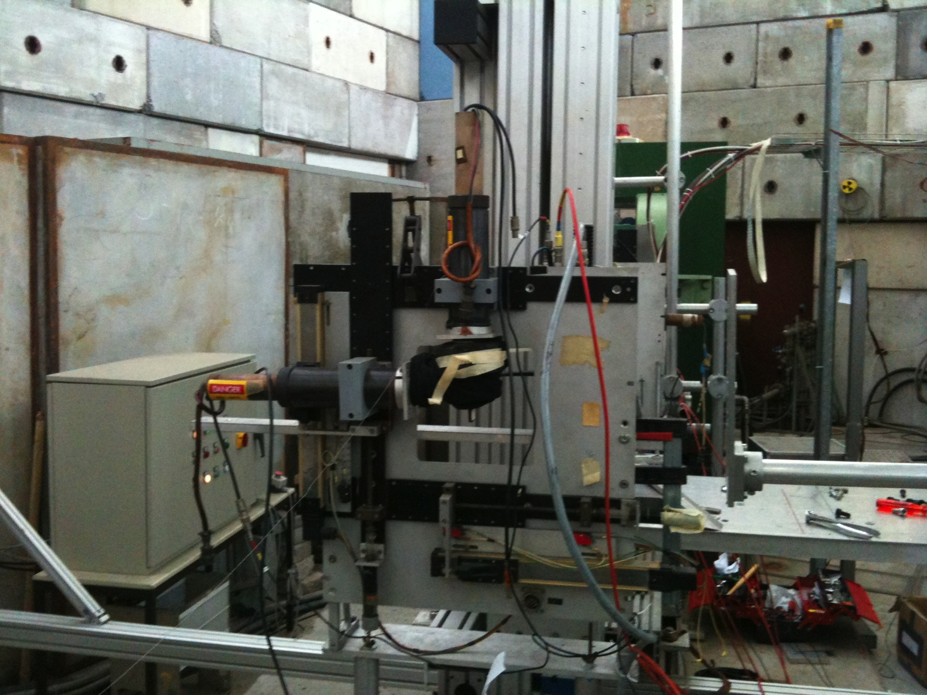
CERN-PS : BPD, Beam Profiler

Slide 9
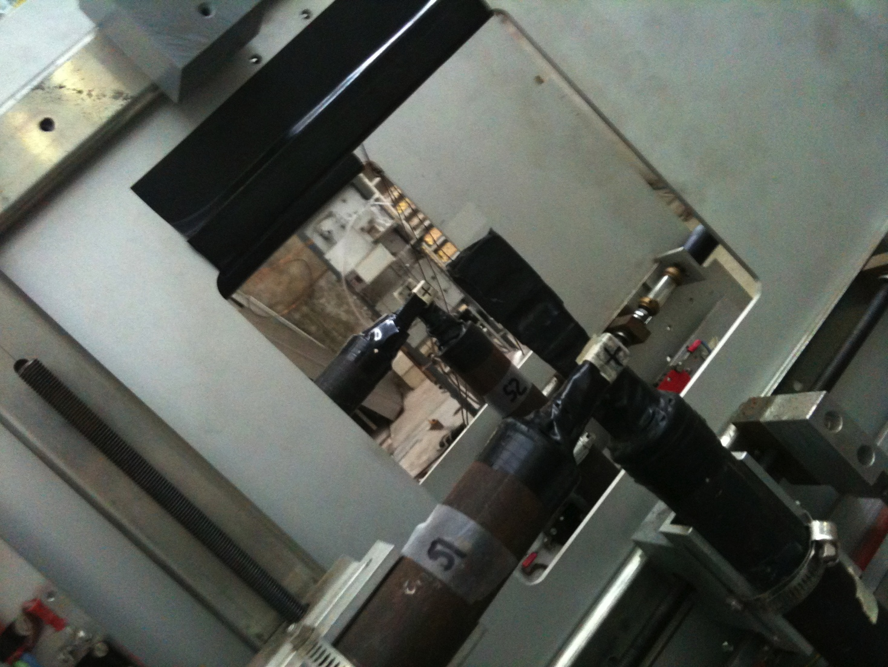
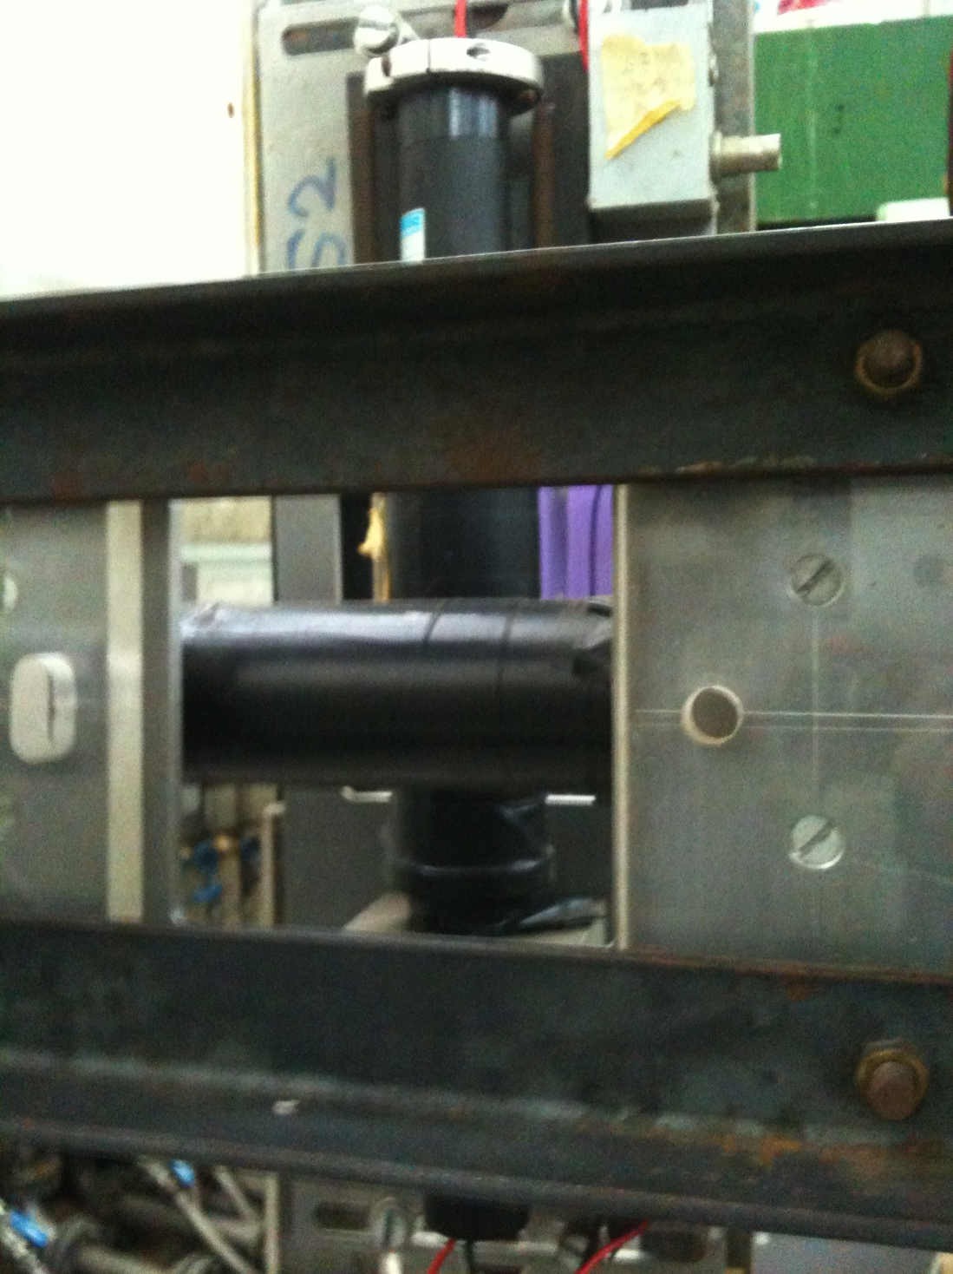
CERN-PS : Trigger System

Slide 10
Infrastructure I
Gas facility
  Gas Warehouse
  Gas Providing/purging/recirculation system
  Monitoring/control system
Electronics
  Cable bins from experimental to counting area
  Grounding / HV/HA system
  Electronic modules : library, repair shop
Mechanics
  Material warehouse
  Mechanic shop : repair, construction
  Self-working room : Cutting, Drilling, Milling etc.

Slide 11
Infrastructure II
Cooling Facility
  Liquid-helium/nitrogen generator
  Gas/Liquid circulation system
  Monitoring/control system (for distribution)
Vacuum facility
  Various vacuum level controller
  Valves, docking system
  Chamber heating/evacuation system
Computing facility
  IT administration
  Storage (backup) / Network / Printing center etc.

Slide 12
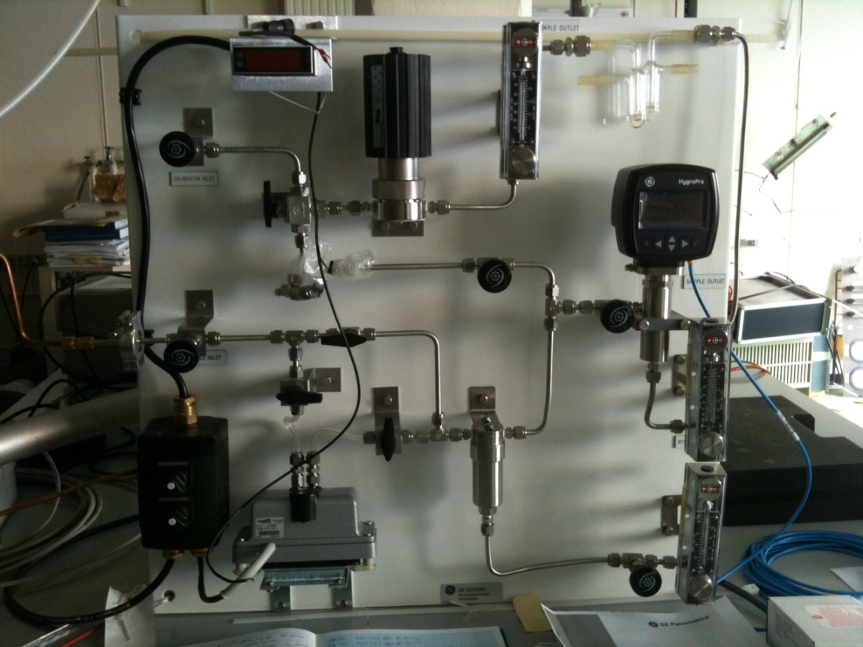
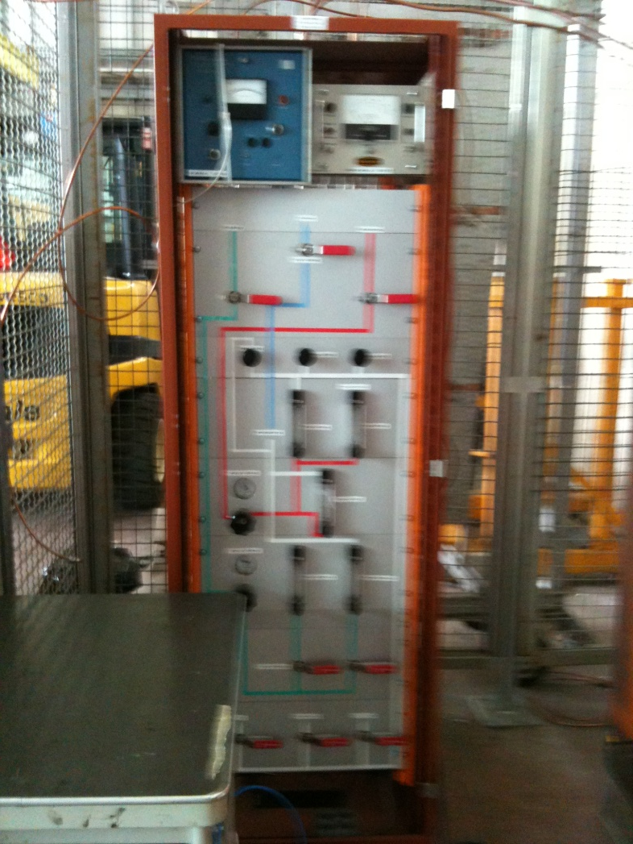
e.g. CERN-Gas Purifier System

Slide 13
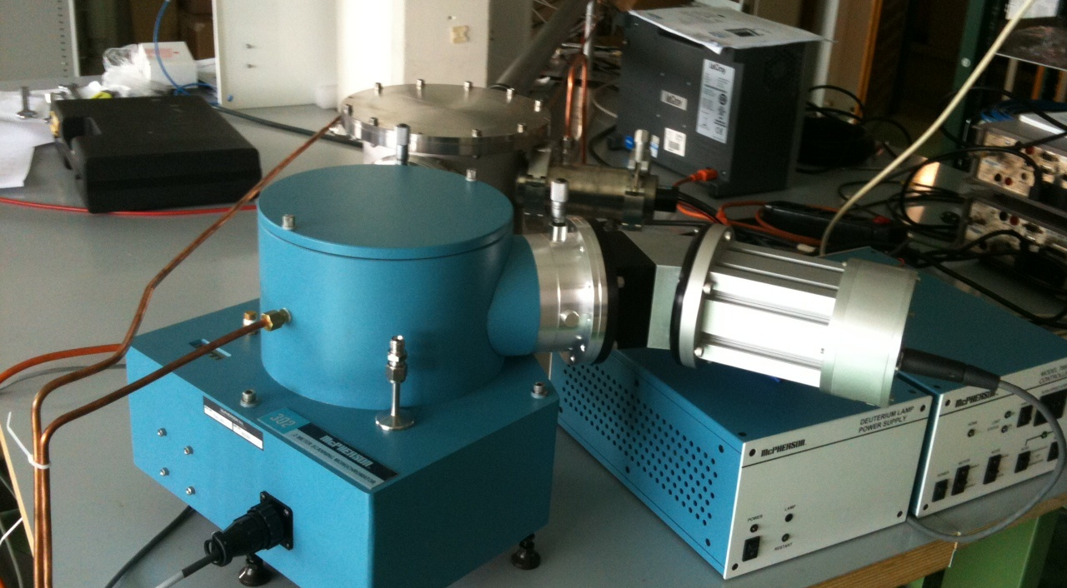
e.g. CERN-Monochrometer

Slide 14
Organization (e.g. GSI)

Slide 15
Technical Div. Esitimates
Manpower : ~ 10 Experts + Trainee + 20 Technician
  Accelerator R&D Lab.
    Beam Line Design Expert
  Detector R&D Lab.
    GAS / Electronics / Vacuum / Mechanical / Safety
  IT Lab.
Budgets
  Setup budget ~ 10BKRW
    Beam line 2 x 1B = 2BKRW
    Facilities 5 x 1B = 5BKRW
  Annual M&O budget ~ 2BKRW/yr
    Labor cost : 1B
    Materials / Travel / Training : 1B

Slide 16
Education and Training
Detector Training Course
Public / Experts
Industrial Linking

Slide 17
Survey of needs
Particle physics
Nuclear physics
Astrophysics
KIRAMS
Radiation Technology
Industry
GSI / CERN / BNL / Fermi Lab / SLAC / KEK etc.

Slide 18
International Front-Ends
2010 2020 2030 2040 2050
LHC : pp, PbPb etc.
CMS Detector Upgrade etc.
Muon Results
ALICE Detector Upgarde etc.
Hadron Results
ILC (new)
New Detectors CDR, TDR, R&D, Construction
New Physics Results
International Collaboration
New Concept of Detectors for New Physics
Korean Facility
Detector Upgrade & New Detector
low-, mid-, high-Energy AA (RI) results
LAMPs Detector CDR, TDR, Construction
RI, UU Results :
Cosmic Nuclear Synthesis
Neutron-rich RI Drip line
Symmetry Energy
KoRIA CDR, TDR, Construction
KoRIA Upgrade : Tevatron Magnets etc.
Accelerator Industry
KoRIA : UU, RI etc.

