Slide 1


Overview of CMS HI Results
- Summary of QM 2011 Presentations -
Byungsik Hong
(Korea University)
for the CMS Collaboration
Disclaimer: The slides are mostly from Bolek Wyslouch’s plenary presentation.
Heavy-Ion Meeting, June 10, 2011, Korea University

Slide 2
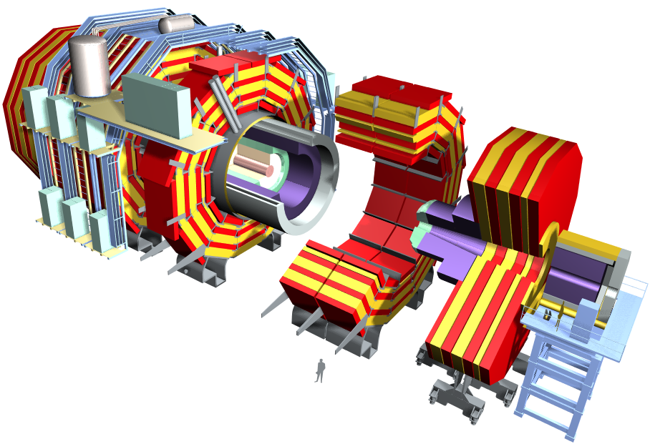
CMS Detector System
EM Calorimeter
Hadron Calorimeter
Beam Scintillator Counters
Forward Calorimeter
CASTOR
Tracker
(Pixels and Strips)
ZDC
Muon Endcaps
Muon Barrel

Slide 3
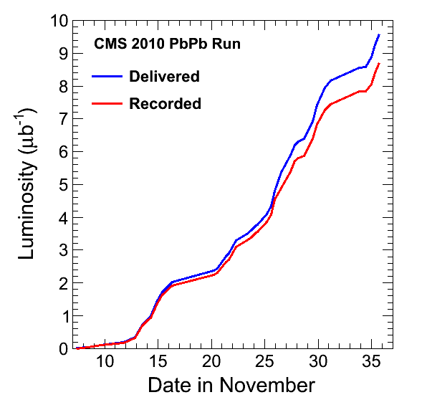
Data taking during PbPb run
CMS configured in a dedicated mode for heavy ions
  Turn off zero suppression
  Taking data at up to 220 Hz
  12 MB event size
Triggering on minimum bias, jets, muons and photons
  ALL rare probes written to tape
  ~half of minimum bias written
Recorded luminosity PbPb 8.7 μb⁻¹
Recorded luminosity pp@2.76 TeV 241 nb⁻¹
Total PbPb data volume ~0.89 PetaByte
Days since Nov 1, 2010
Note: luminosities will be rescaled by few% after complete analysis of Van der Meer scans

Slide 4
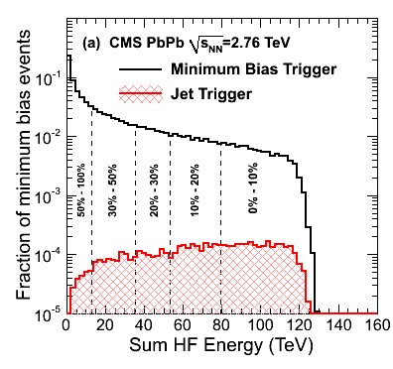
Centrality
Hadron-Forward (HF) calorimeter energy deposits in 3<|η|<5
Notice the increase of the fraction of high-p_{T} triggers with centrality
Pb
Pb
Pb
Pb

Slide 5
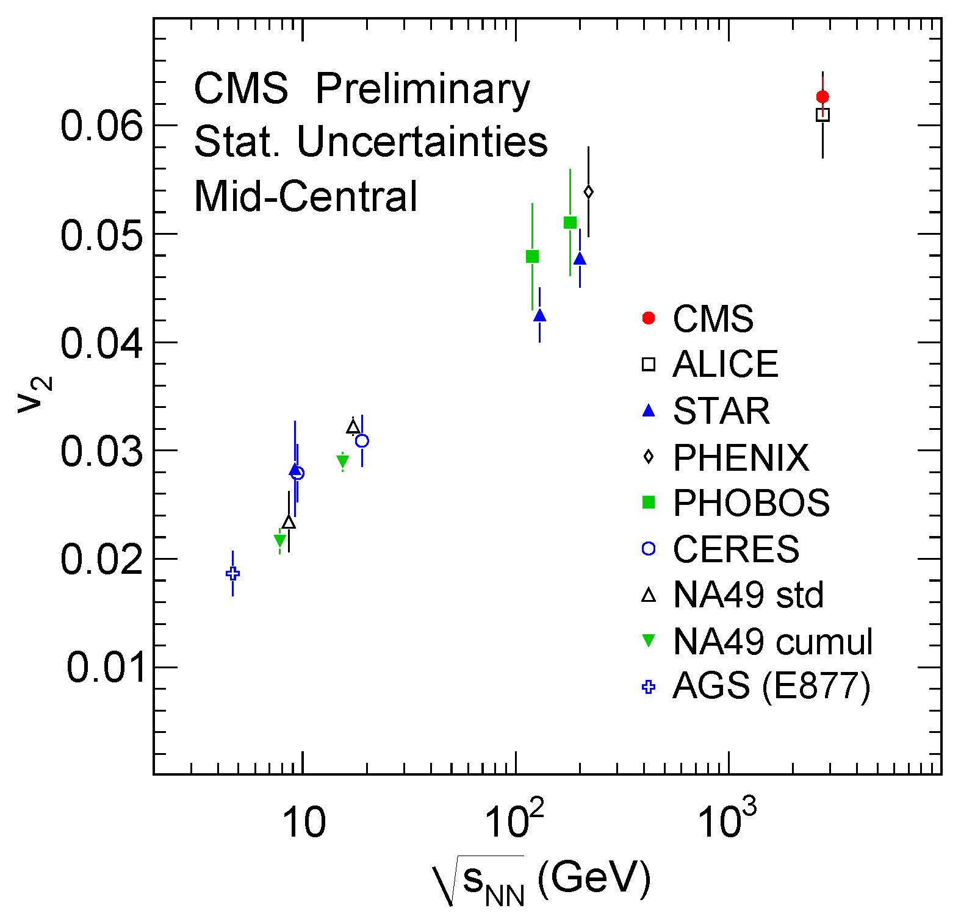
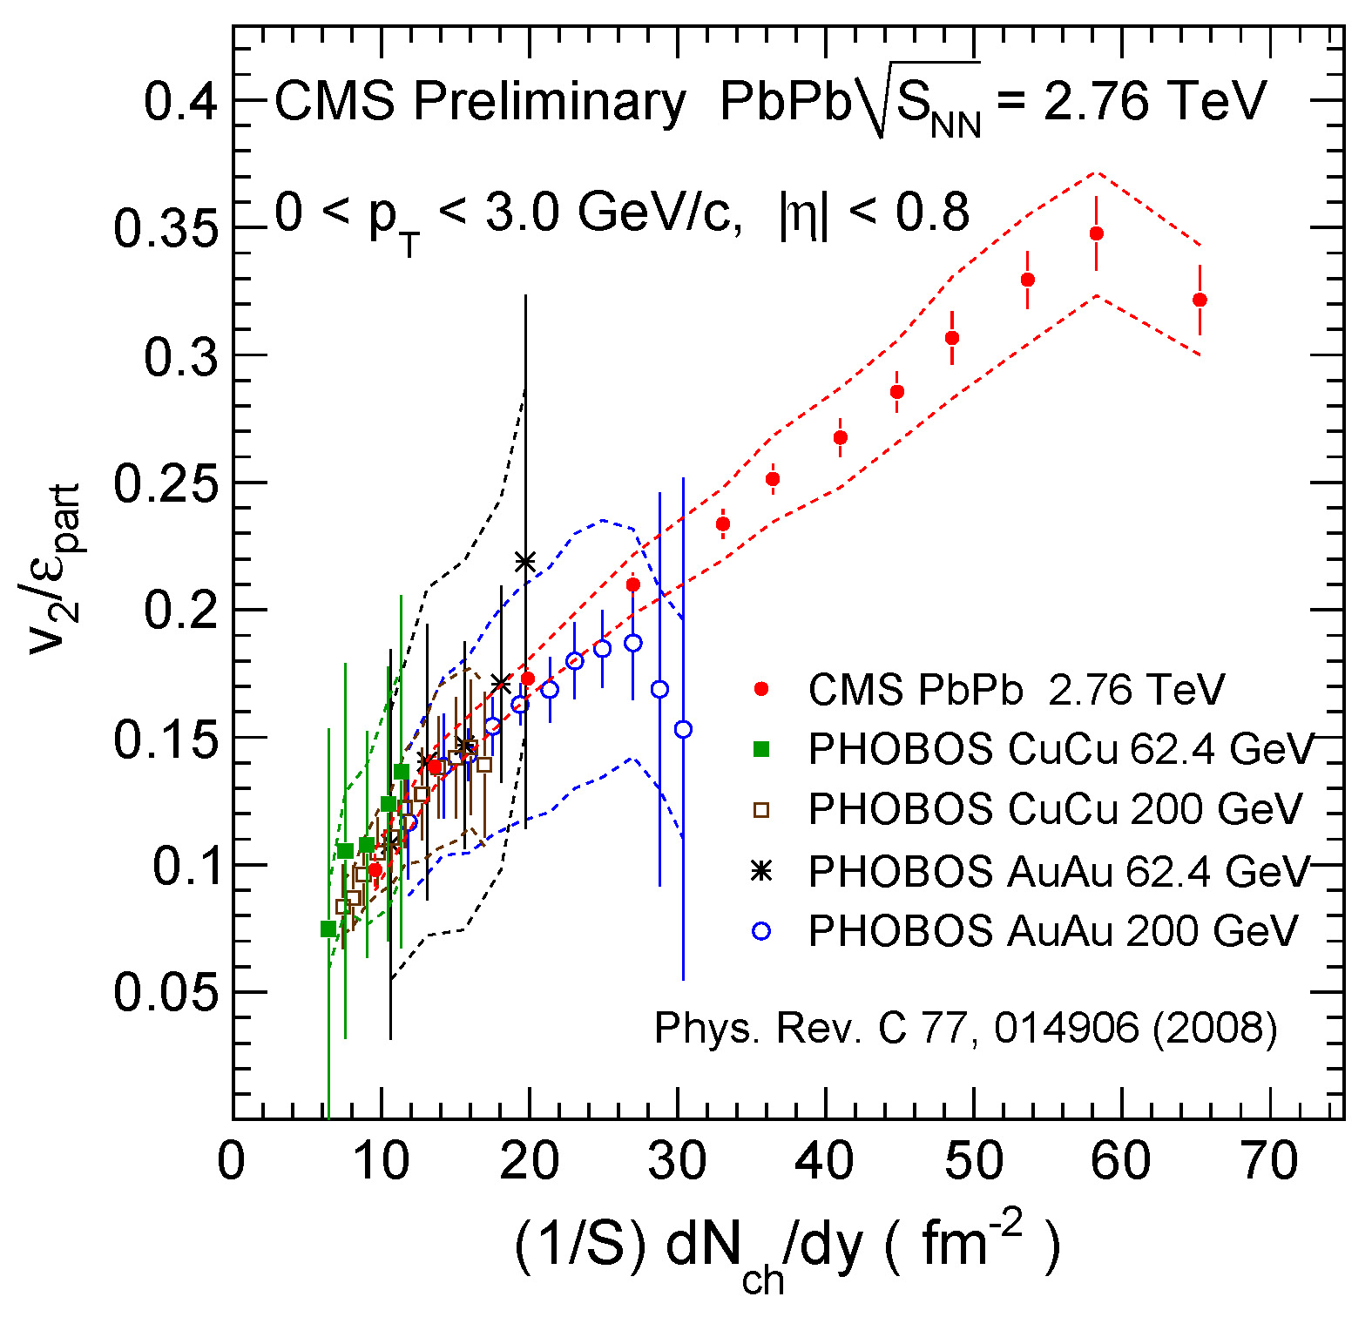
Azimuthal anisotropy: Elliptic flow
Energy Dependence
  CMS: 20-30%, v₂{LYZ}
  Extrapolated to p_{T}=0
Participant eccentricity scaling vs. transverse density

Slide 6
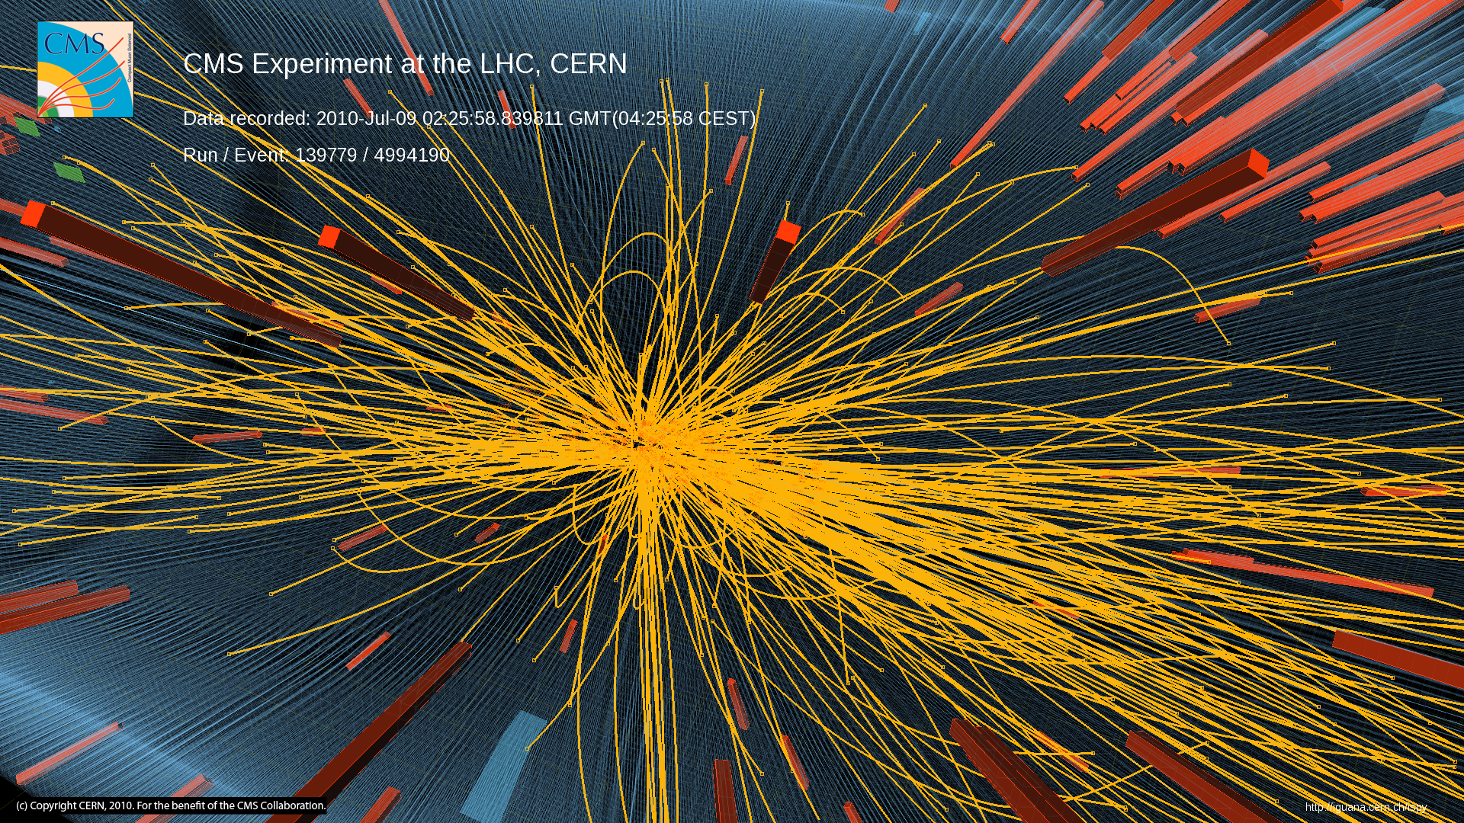
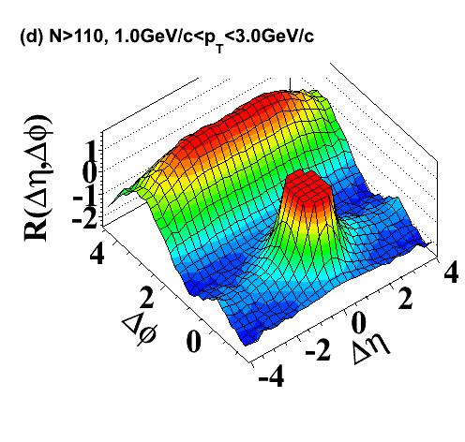
Ridge in high multiplicity pp
Intermediate p_{T}: 1-3 GeV/c
High multiplicity pp (N≥110)
~350k top multiplicity events (N>110) out of 50 billion collisions!
Real-time tracking in High Level Trigger, CPU intensive
Heavy-ion like effect in pp collisions
JHEP 09 (2010) 091
D. Velicanu (TODAY), J. Callner (Tue), Wei Li (Thu)

Slide 7
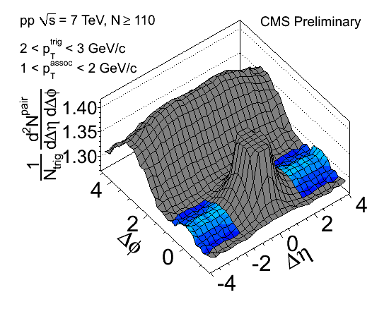
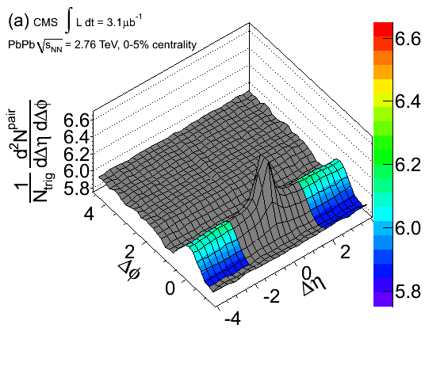
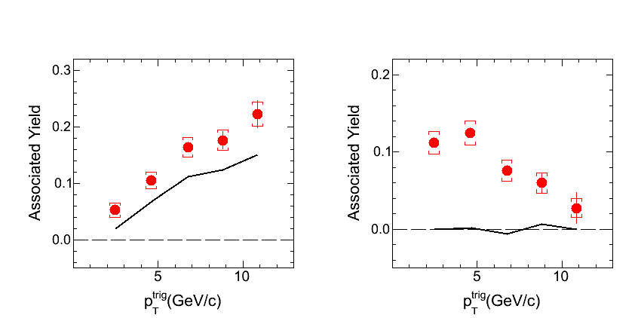
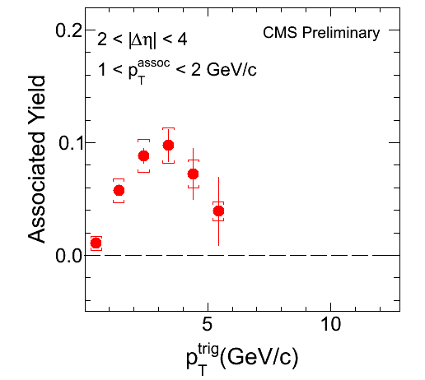
Ridge in pp and PbPb
CMS pp 7 TeV, N ≥ 110
CMS PbPb 2.76 TeV, 0-5%
x10
Ridge Region
Ridge Region
x10
arXiv:1105.2438
D. Velicanu (TODAY), J. Callner (Tue), Wei Li (Thu)

Slide 8
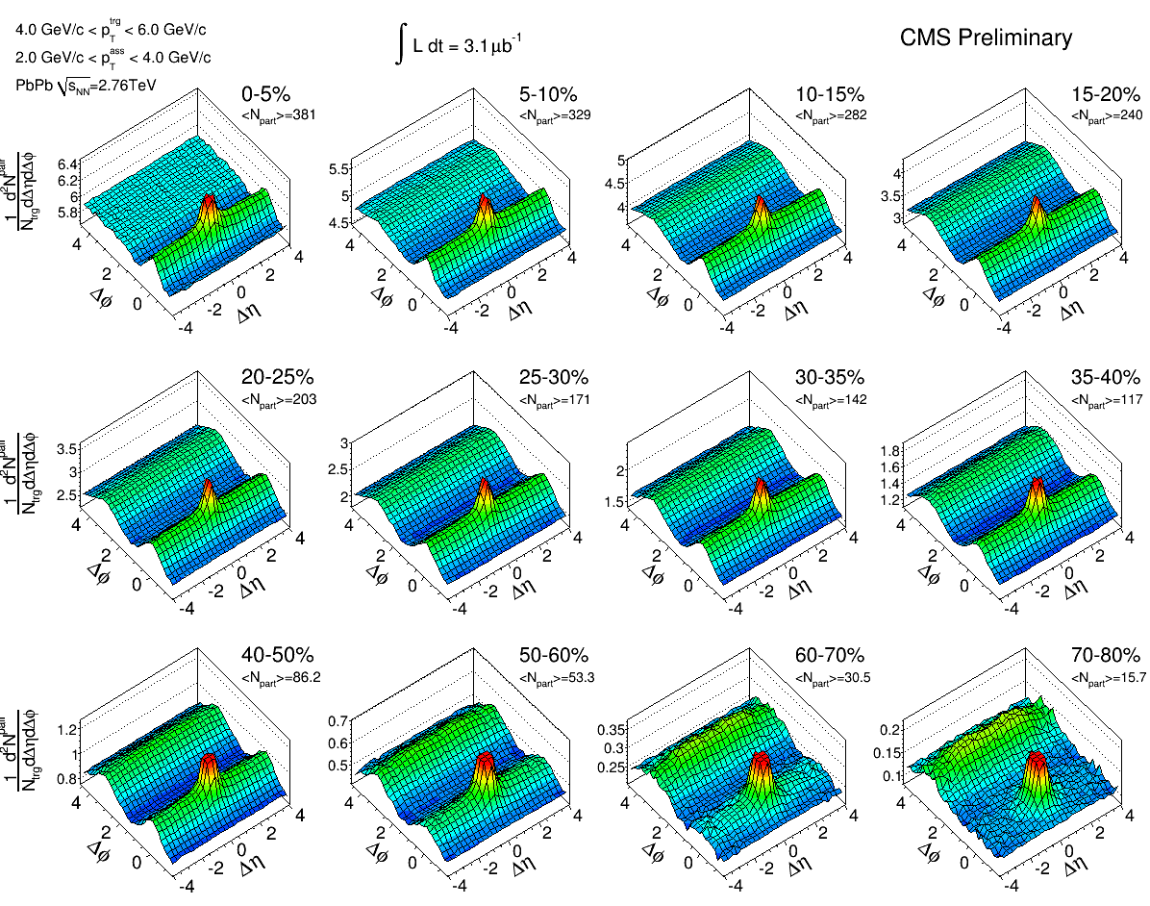
Triggered dihadron centrality dependence in PbPb
: 4 - 6 GeV/c
: 2 - 4 GeV/c
PbPb 2.76 TeV
Pb
Pb
Pb
Pb
cos(2Δφ)
J. Callner (Tue), Wei Li (Thu)

Slide 9
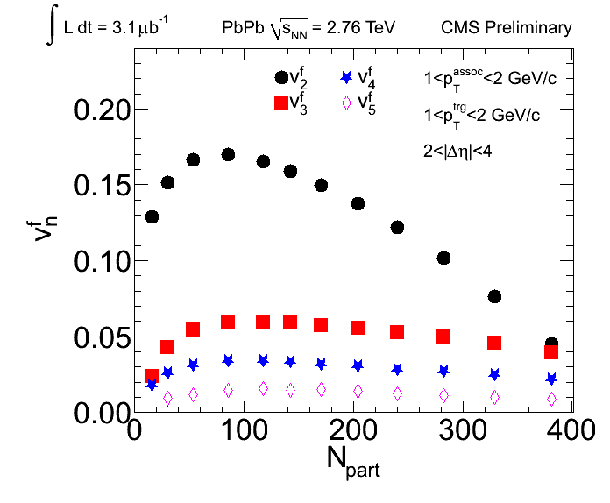
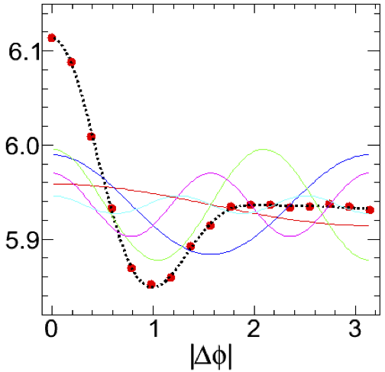

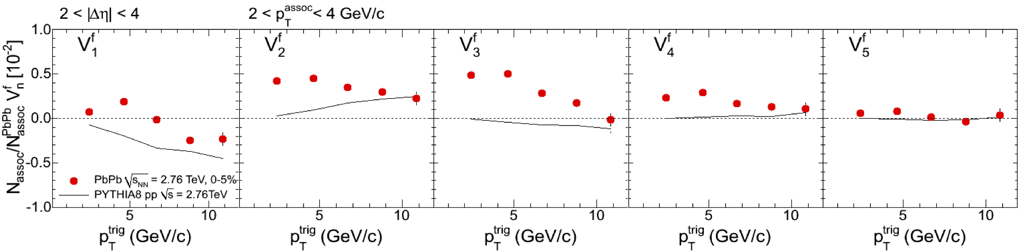



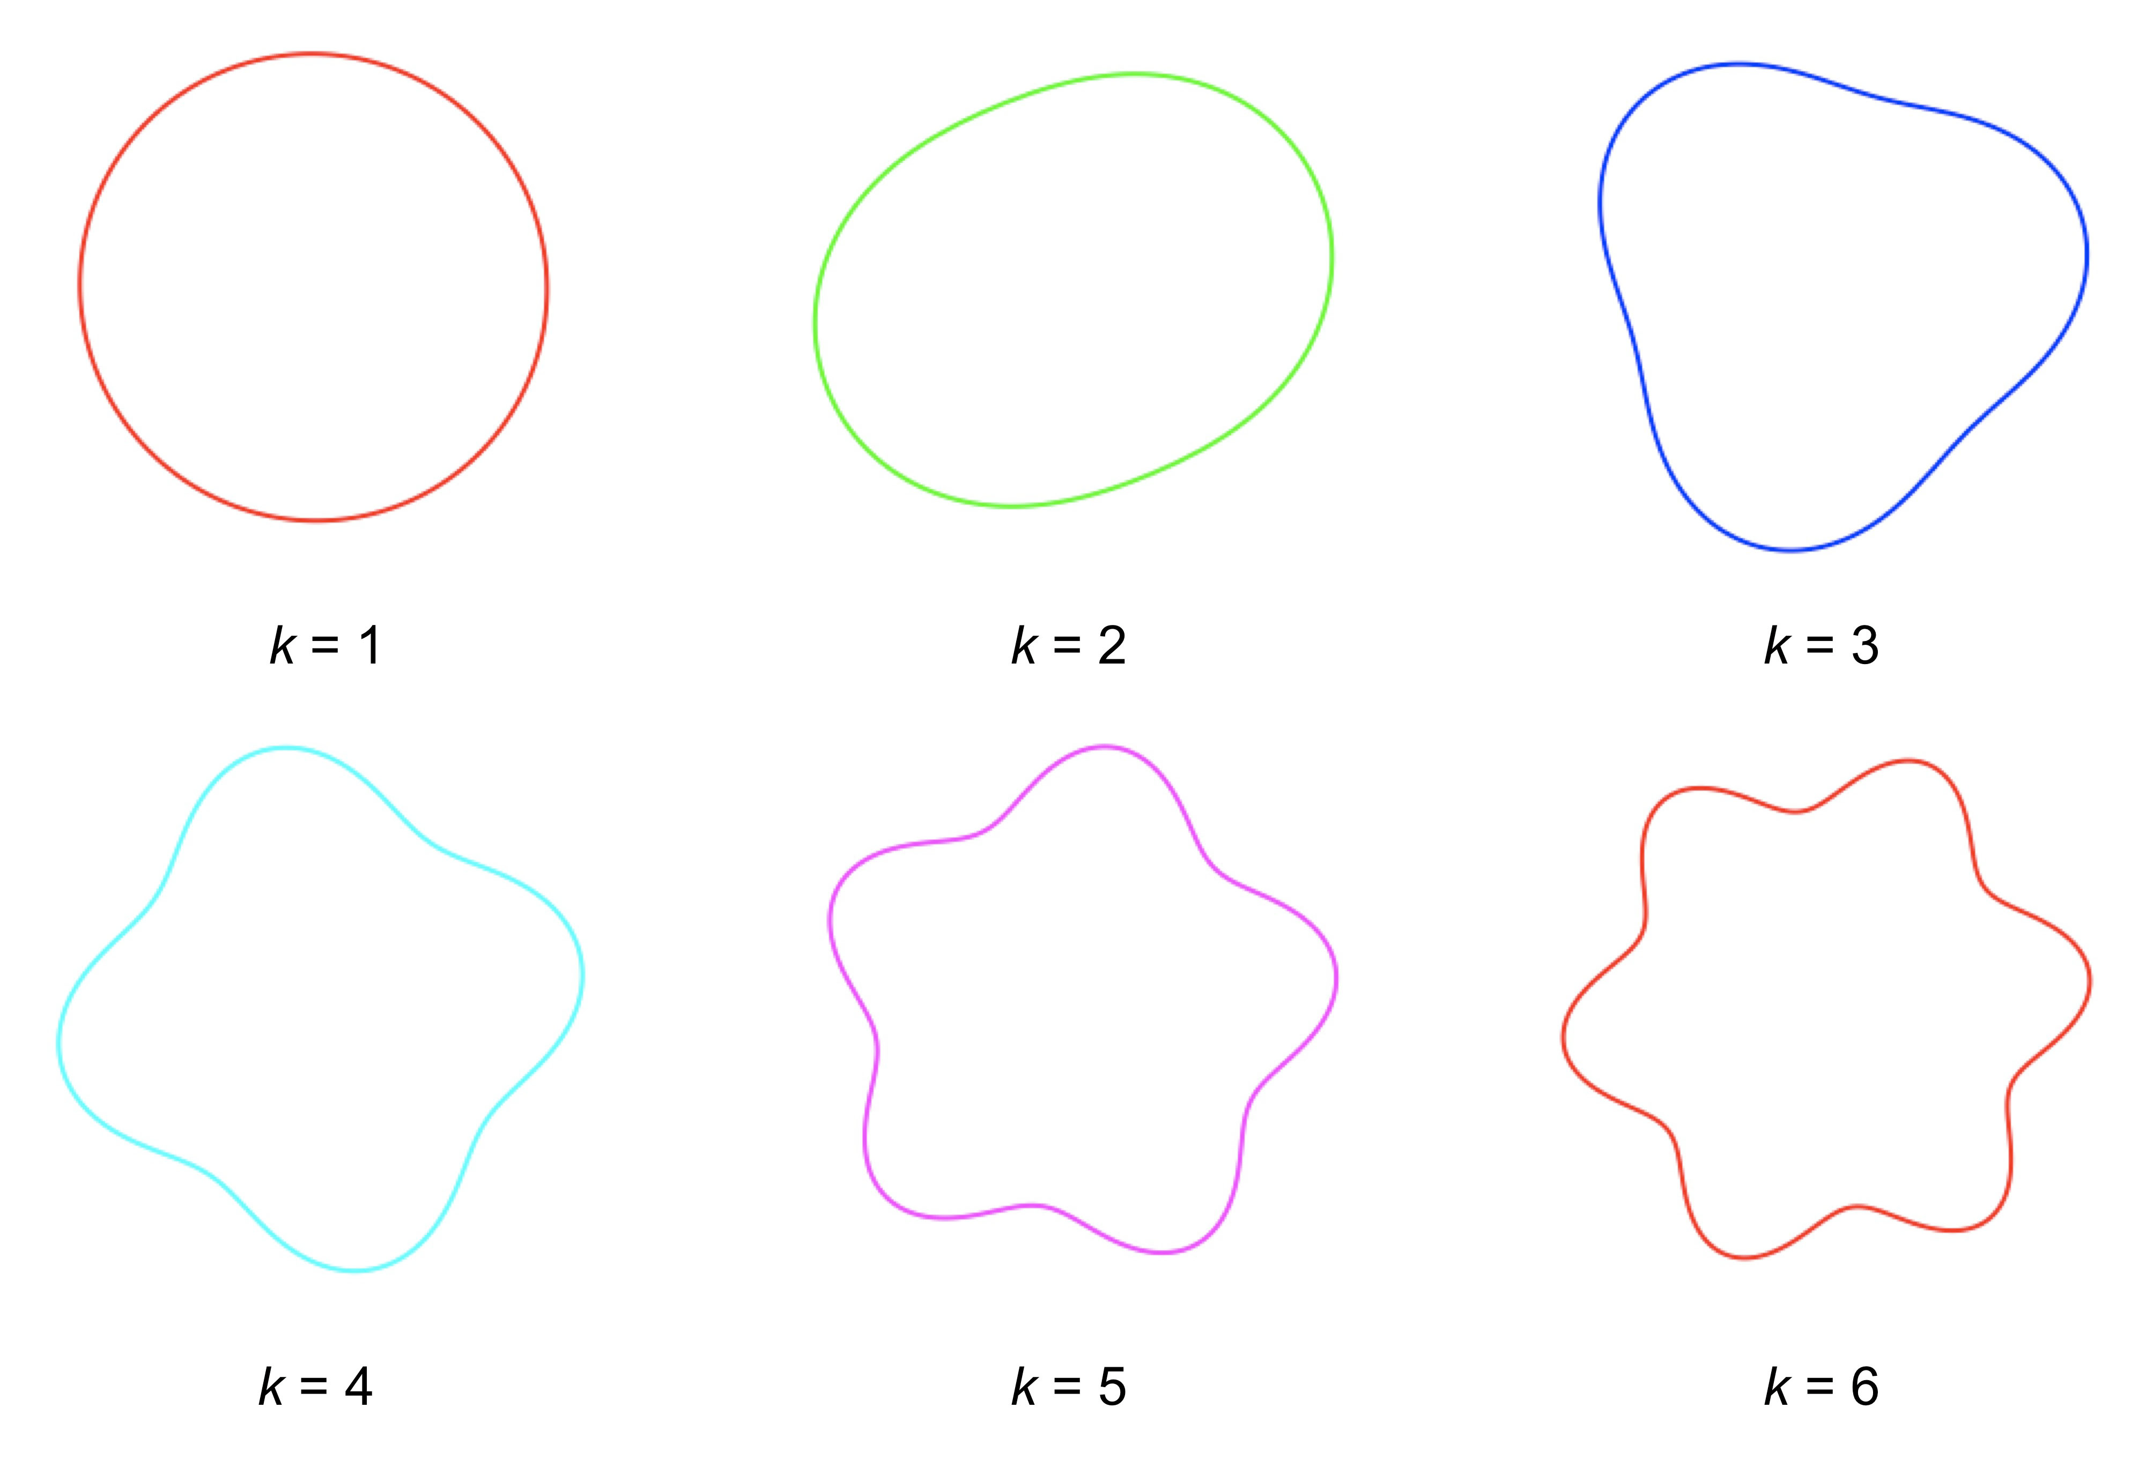
Fourier decomposition of Δφ correlations
2<|Δη|<4
2<|Δη|<4
V₂
V₄
V₅
V₁
V₃
0-5% most central
arXiv:1105.2438
n=2
n=3
n=4
n=5
arXiv:1105.2438
J. Callner (Tue), Wei Li (Thu)

Slide 10
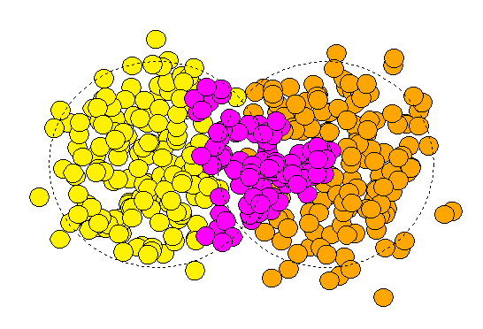
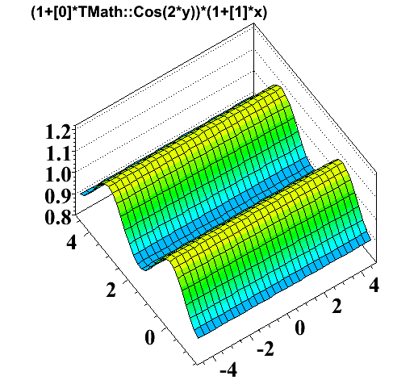
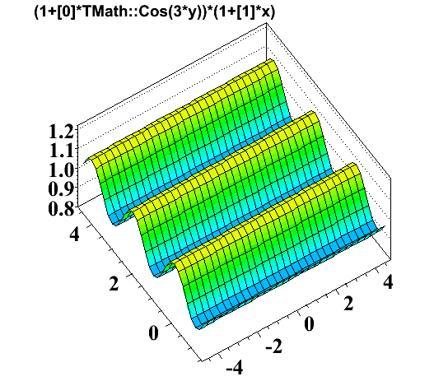
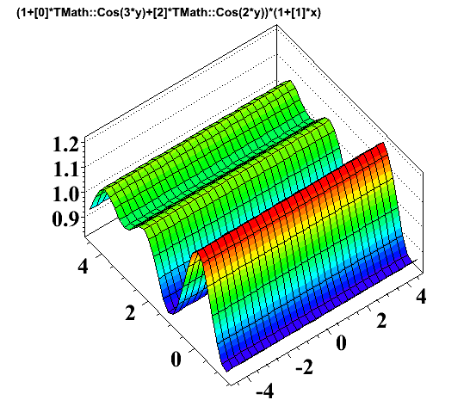
Alternative approach: Fourier analysis
It was recently realized that the ridge may be induced just by higher order flow terms (v₂, v₃, v₄, v₅, …)
Elliptic flow (v₂)
Triangular flow (v₃) from
event-by-event fluctuation
Reaction
plane
z
Reaction
plane
y
x
y
x
Add V₂ and V₃
Phys. Rev. C81:054905, 2010
“Shoulder”?
Δφ
Δφ
Δη
Δη
~ V₂ cos(2Δφ)
~ V₃ cos(3Δφ)
“Ridge”?
Δφ
Δη
Wei Li (MIT) Quark Matter 2011, Annecy
10

Slide 11
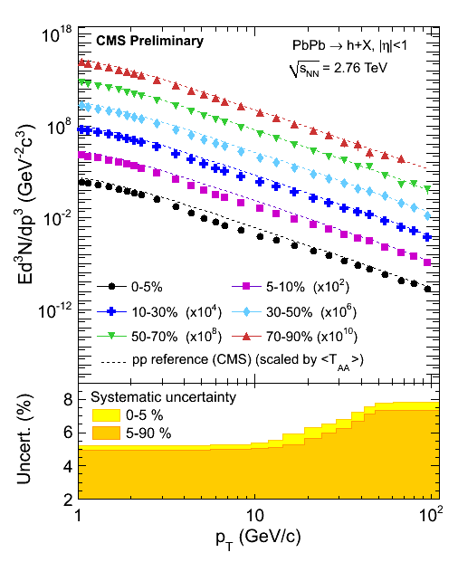
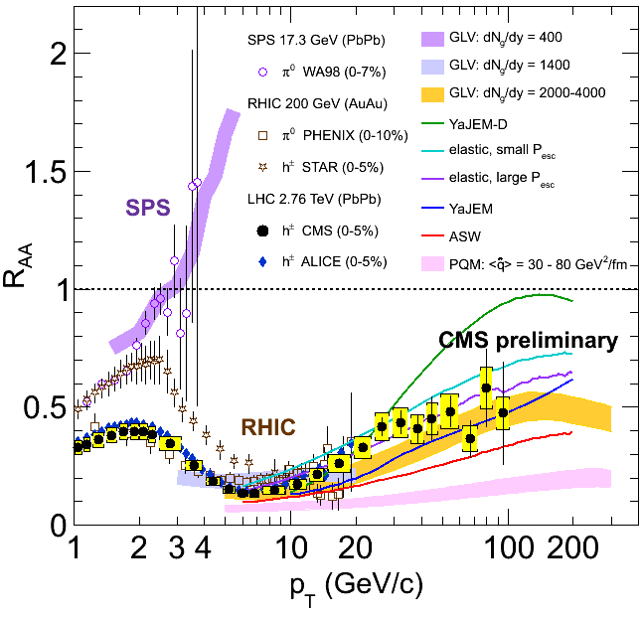
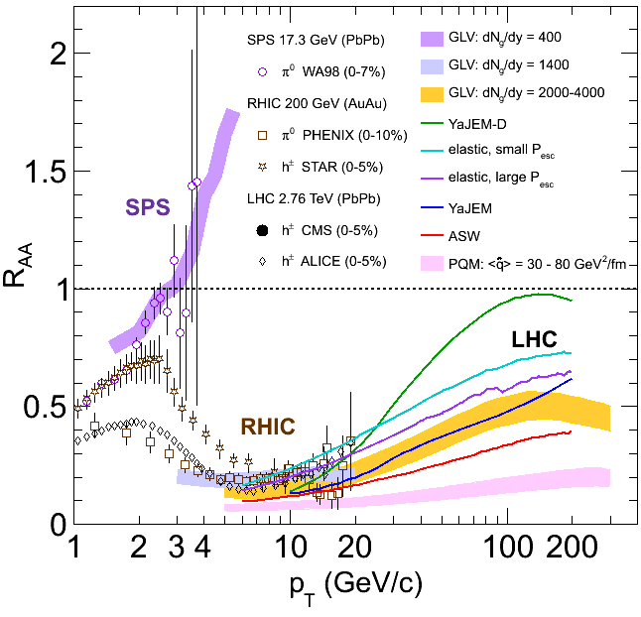
High p_{T} charged hadron suppression
Measuring charged tracks up to p_{T}~100 GeV/c
Using jet triggers to enhance statistics at high p_{T}
Centrality 0-5%
?
Y-J Lee (Wed) A. Yoon (Thu)

Slide 12
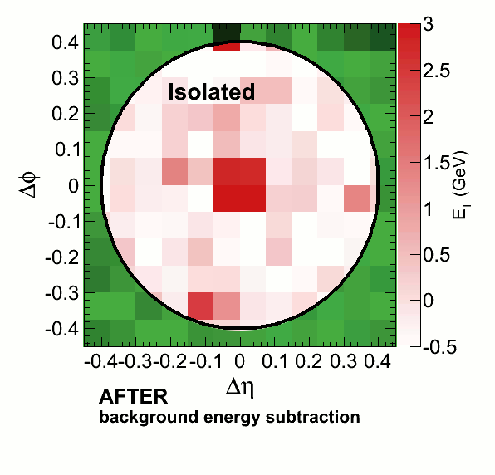
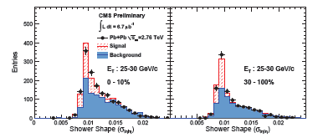

Isolated photons
Colorless probes
  Check suppression
  Nuclear parton distribution function
  Initial state
Photon selection
  Identify isolated electromagnetic clusters
    E_{HCAL}/E_{ECAL} <0.2
    Energy in cone (R<0.4) less than 5 GeV
  Transverse shower shape
Transverse shower shape using high ECAL granularity
π⁰
Smaller width
Larger width
Y-J Lee (Thu), Y Kim (Fri)

Slide 13
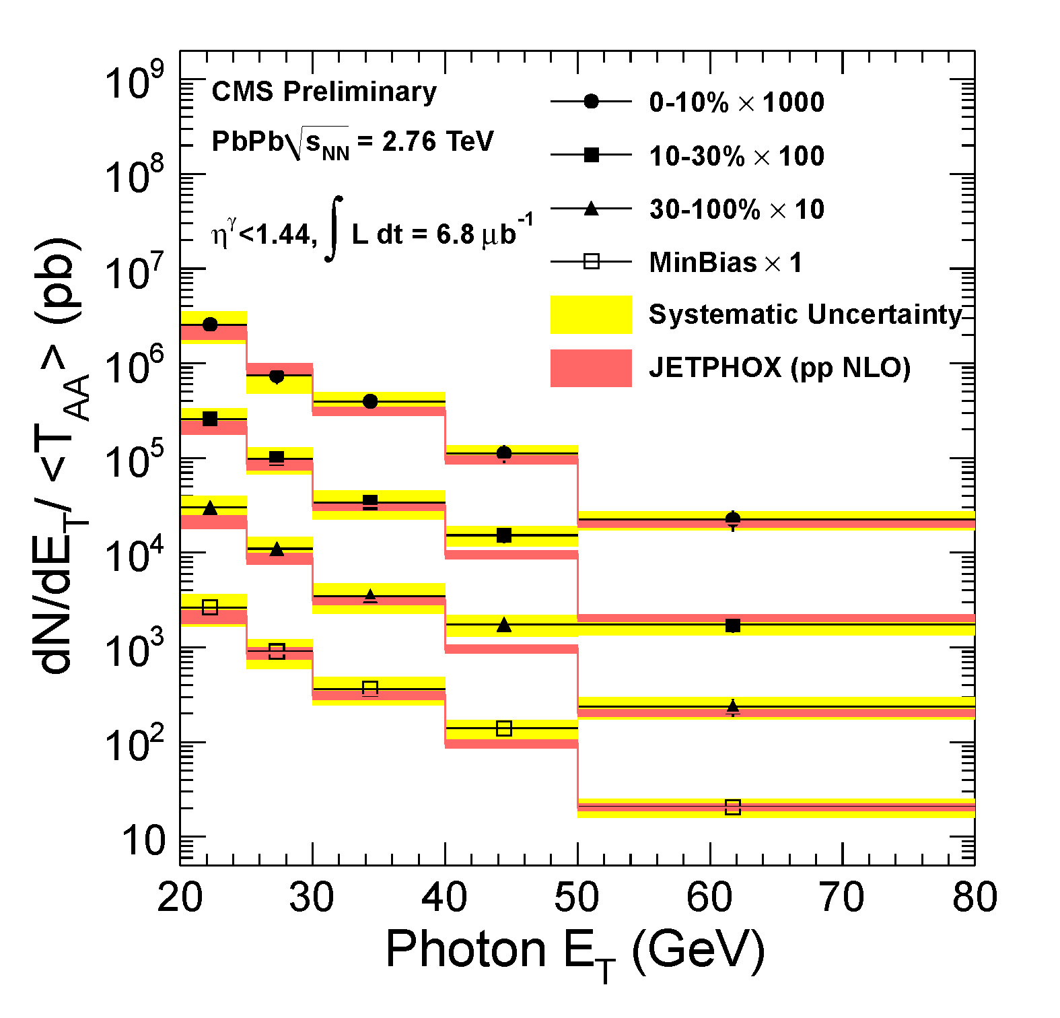
Unsuppressed isolated high p_{T} photons
Confirmation of collisional scaling
No nuclear modifications seen
Y-J Lee (Thu), Y Kim (Fri)

Slide 14
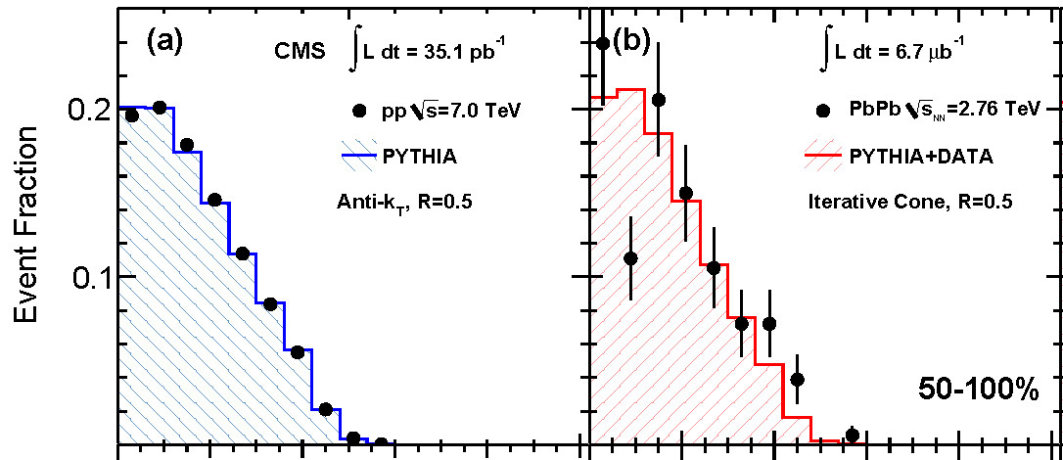
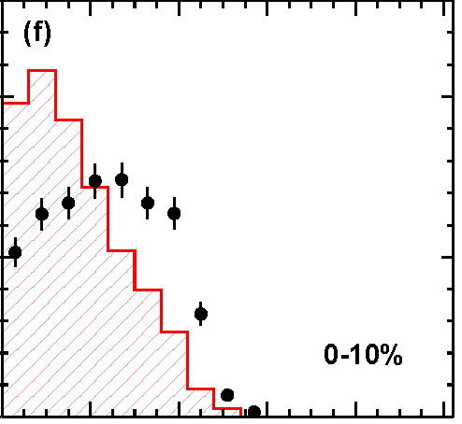
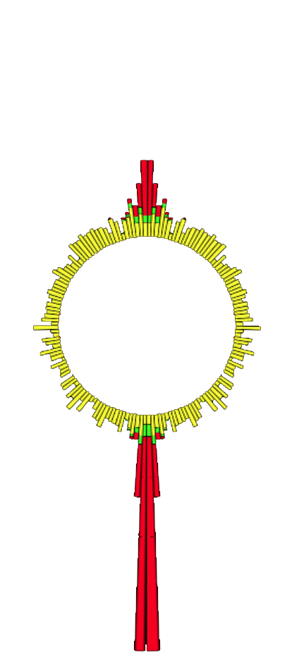


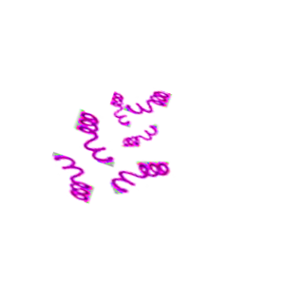

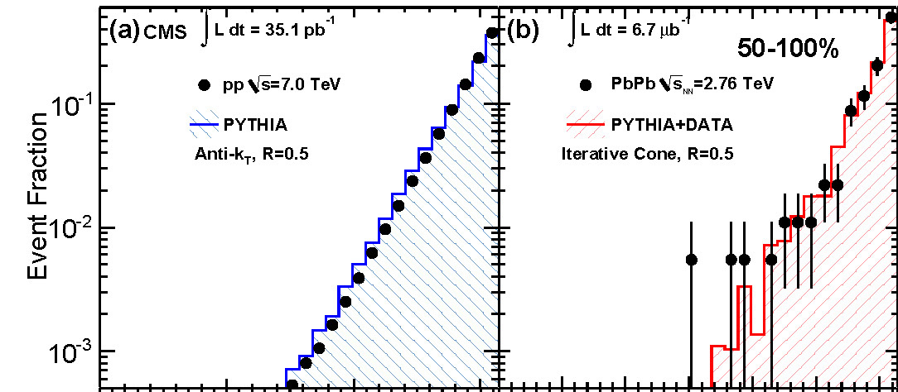
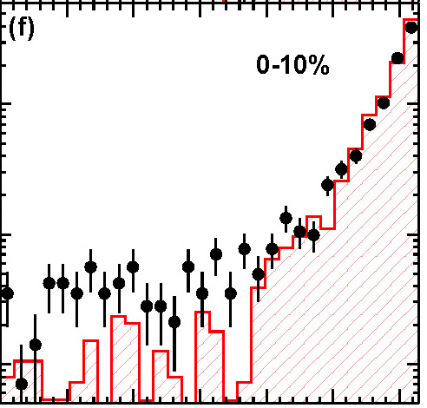
Jet quenching via large dijet energy imbalance
Dijets, calorimeters only
  Leading p_{T}>120 GeV/c
  Sub-leading p_{T}>50 GeV/c
pp PbPb, 50 - 100% PbPb 0 - 10%
Pb
Pb
p_{T} imbalance, increasing with centrality
pp
Pb
Pb
Pb
Pb
Back-to-back Δφ~π for all centralities
pp
Pb
Pb
arXiv:1102.1957
M. Tonjes (Tue), C. Roland (Wed)

Slide 15
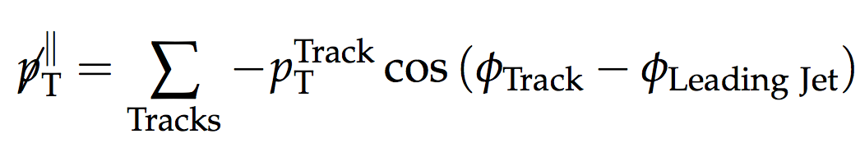

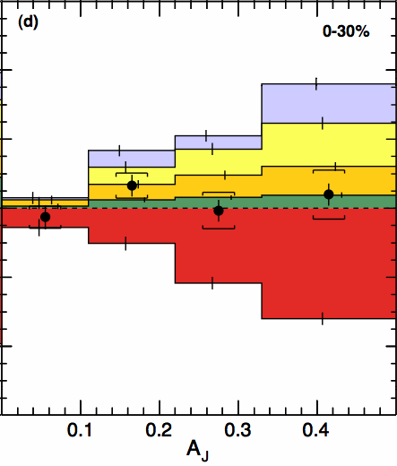
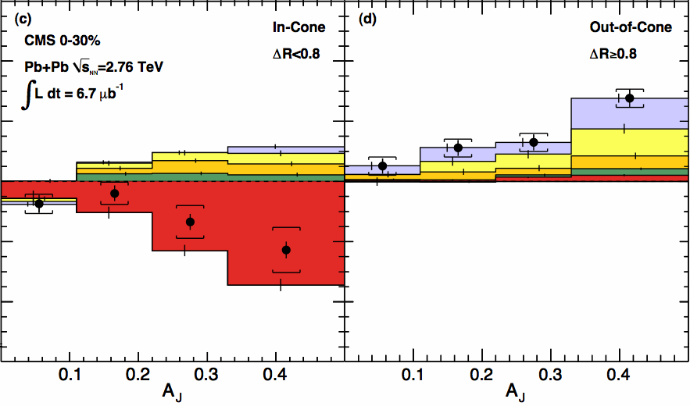
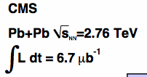
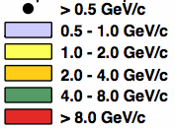
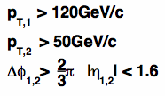
Where is the energy? spread out low p_{T} particles
in-cone
0-30% Central PbPb
out-of-cone
balanced jets
unbalanced jets
Low p_{T}, full acceptance
Momentum is balanced
In-cone large momentum
imbalance at high p_{T}
Consistent with calorimetry
Out-of-cone low p_{T} particles
balance the complete event
The momentum difference in the dijet is balanced by low p_{T} particles at large angles relative to the away side jet axis.
arXiv:1102.1957
M. Tonjes (Tue), C. Roland (Wed)

Slide 16
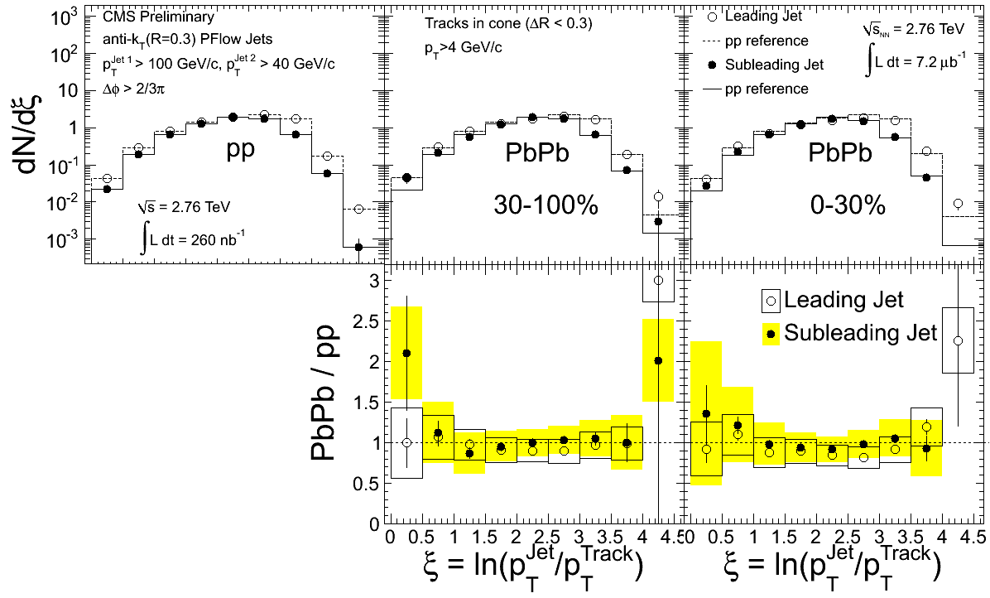
Jet fragmentation function, PbPb ≈ pp
Updated jet algorithm: Particle Flow, Anti-k_{T ,} R=0.3
Charged tracks, >4 GeV/c, jets with =40-300 GeV/c
Compare PbPb to pp
  Fragmentation function similar between PbPb and pp
  Fragmentation pattern independent of energy lost in medium
pp PbPb, 30 - 100% PbPb 0 - 30%
Pb
Pb
Pb
Pb
Y. Yilmaz (Fri), C. Roland (Wed), M. Nguyen (Fri)

Slide 17
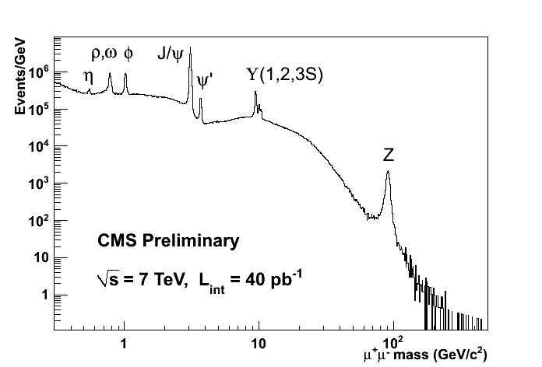
Compact Muon Solenoid: μ⁺μ⁻ invariant mass in pp
pp

Slide 18
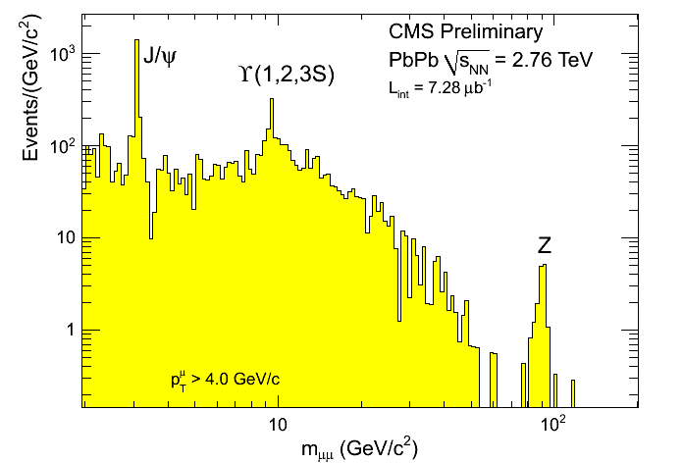
Compact Muon Solenoid: μ⁺μ⁻ invariant mass in PbPb
Z. Hu (TODAY), T. Dahms (Tue), C. Silvestre (Fri), J. Robles (Fri), M. Jo (Poster), D.H.Moon (Poster), H. Kim (Poster)

Slide 19
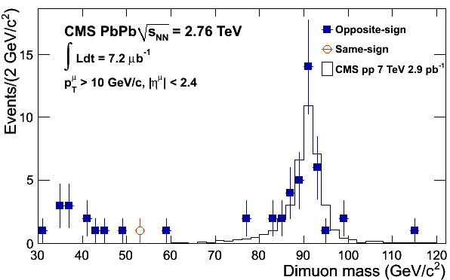
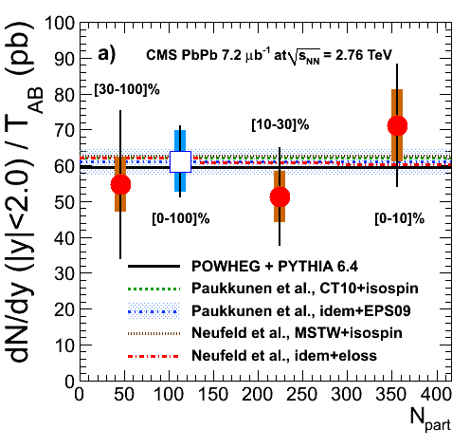
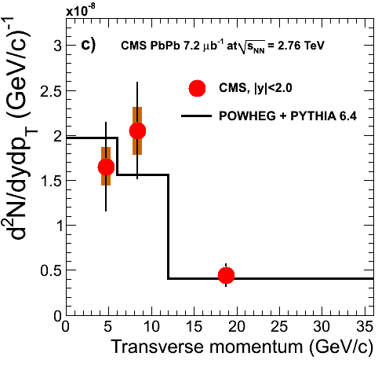
Z bosons show collisional scaling
Z→μ⁺μ⁻
No significant dependence on centrality
p_{T} dependence consistent with pp
arXiv:1102.5435
accepted by PRL
J Robles (Thu)

Slide 20
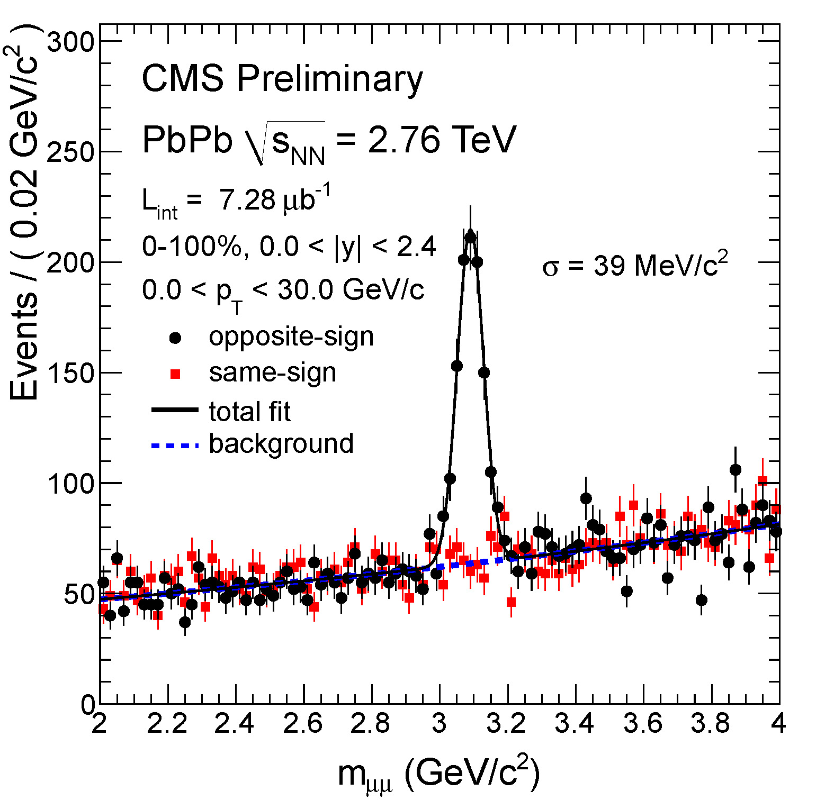
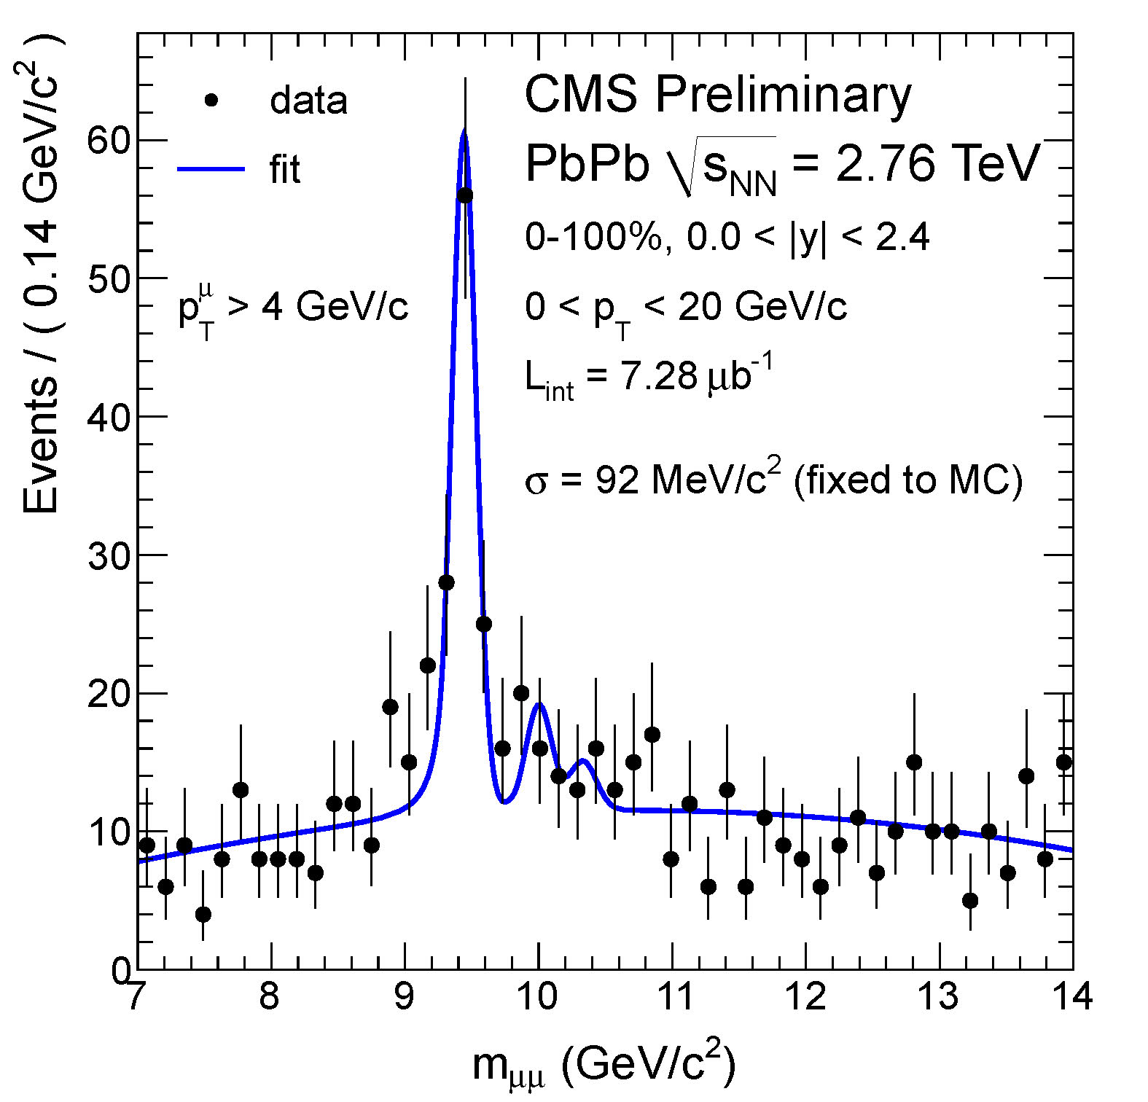
J/ψ and ϒ
J/ψ and ϒ observed in μ⁺μ⁻ channel
CMS muon acceptance |η|<2.4, p_{Tμ}>2-4 GeV/c
Excellent mass resolution ~1%, comparable to pp
N_{J/ψ} =734±54
N_{ϒ} =86±12
J/ψ
ϒ
Z. Hu (TODAY), T. Dahms (Tue), C. Silvestre (Fri)

Slide 21
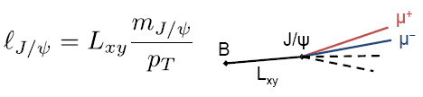
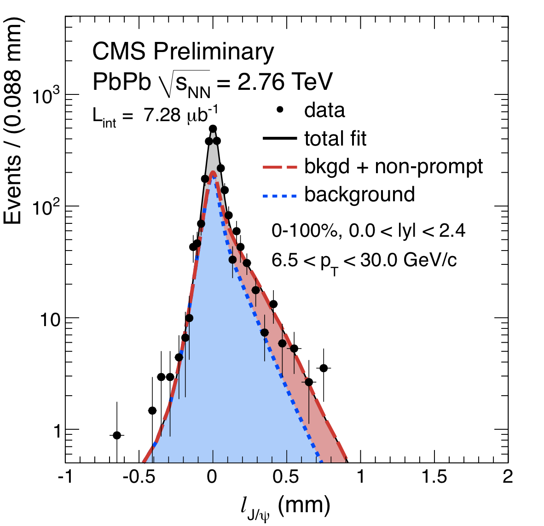
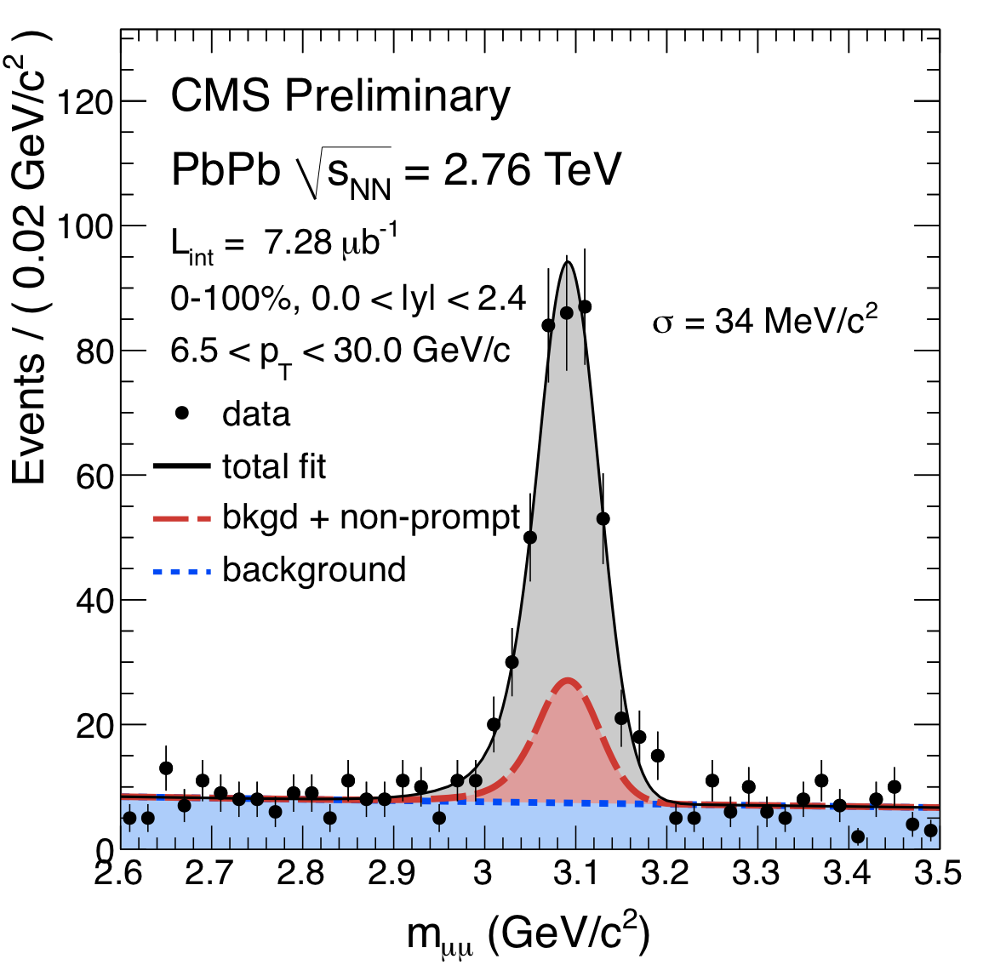
J/ψ: prompt and from B decays
Use separation of primary and μ⁺μ⁻ vertices in plane transverse to beam
Long B decay times lead to displaced vertices
Separate:
  Prompt J/ψ production
  Non-prompt J/ψ from B decays
조미희: Flash Talk에 선정
T. Dahms (Tue), C. Silvestre (Fri)

Slide 22
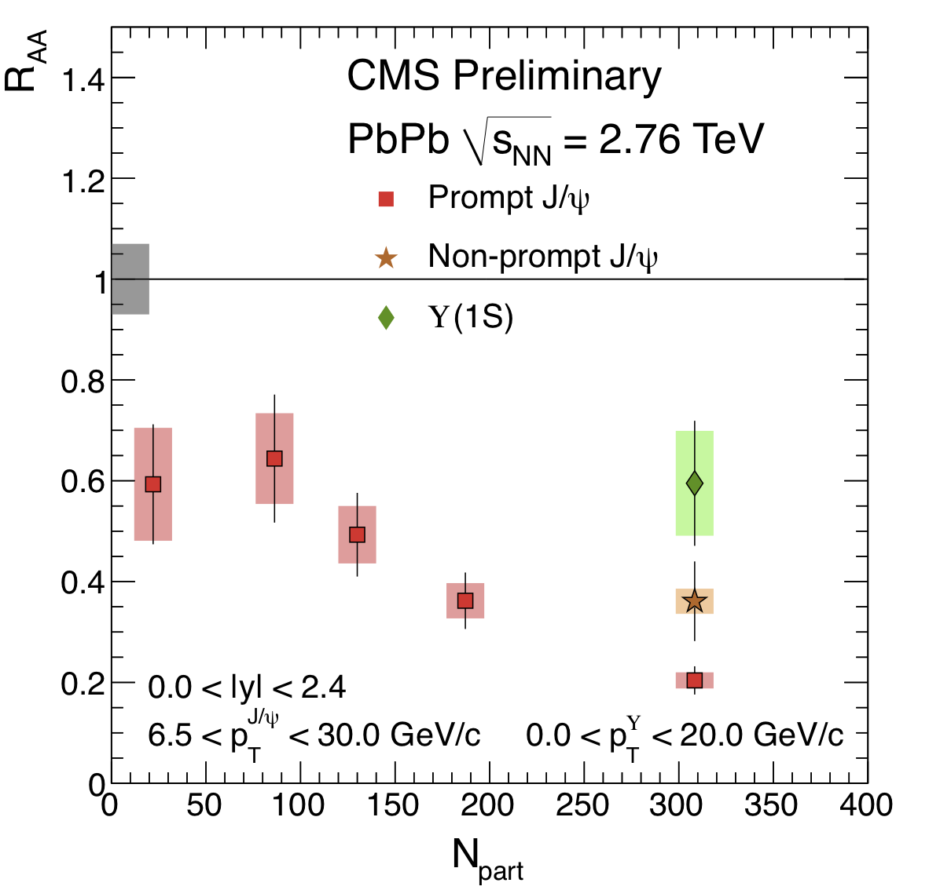
All quarkonia suppressed: R_{AA} vs. centrality
Non-prompt J/ψ suppression is a measure of b-quark quenching
High p_{T} J/ψ is strongly suppressed at the LHC
Inclusive ϒ(1S) is suppressed
0-20%
Z. Hu (TODAY), T. Dahms (Tue), C. Silvestre (Fri)

Slide 23


Suppression of excited ϒ states
pp
PbPb
Excited states ϒ(2S,3S) relative to ϒ(1S) are suppressed
Probability to obtain measured value, or lower, if the real double ratio is unity, has been calculated to be less than 1%
Z. Hu (TODAY), C. Silvestre (Fri)

Slide 24
Summary
CMS experiment performed flawlessly during the 2010 heavy ion run period at LHC
CMS has obtained significant statistics of hard probes
CMS conducted detailed measurements of global properties of medium in PbPb and pp collisions
Our measurements indicate consistent view of the hot and dense medium
  Strong collective effects in the medium
  No quenching of weakly and electromagnetically interacting probes
  Strong quenching of partons, including b-quarks
  Suppression of quarkonia, including excited states of the ϒ
Thanks to CERN for fantastic LHC performance!
For more info click here:
  CMS Heavy Ion Results

