Slide 1
Dilepton production in heavy ion collision
Su Houng Lee
Will talk about heavy quark sector
Thanks to Dr. Kenji Morita(YITP ), Dr. Taesoo Song(Texas A&M)
Sungtae Cho (Yonsei) and present group members

Slide 2
Early work on J/y at finite T (Hashimoto, Miyamura, Hirose, Kanki)
s
String Tension: QCD order parameter
T/Tc
Notes:
I am looking forward to new results from these experiments,
These research topics can also be pursued further at J-parc, but in addition, one can study heavy quark system in nuclear matter, which
have the potentials to answer all the fundamental questions in QCD, such as chiral symmetry restoration and confinement.

Slide 3
J/y suppression in RHIC
Matsui and Satz: J/y will dissolve at Tc due to color screening
Recent works on J/y in QGP
Lattice MEM : Asakawa, Hatsuda, Karsch, Petreczky , Bielefield, Nonaka….
J/y will survive Tc and dissolve at 2 Tc .. Still not settled at QM2011
Potential models (Wong …) : .
Refined Potential models with lattice (Mocsy, Petreczky…)
: J/y will dissolve slightly above Tc
Perturbative approaches: Blaizot et al… Imaginary potential
pNRQCD: N. Brambial et al.
Lattice after zero mode subtraction (WHOT-QCD)
: J/y wave function hardly changes at 2.3 Tc
AdS/QCD (Kim, Lee, Fukushima, Stephanov…. ..)
NRQCD: UK group+ S.Y. Kim
QCD sum rule (Morita, Lee) , QCD sum rule+ MEM (Gluber, Oka, Morita)
Notes:
The previous paper was over shadowed by the seminal paper by Matsui and Satz, which emphasized the disappearance of J/psi as the consequence of color screening in quark-gluon plasma.

Slide 4
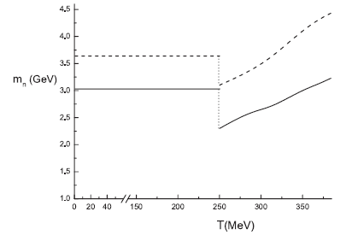
AdS/QCD (Y.Kim, J.P.Lee, SHLee 07)
Y’
Mass (GeV)
J/y
Thermal effect?
Deconfinement

Slide 5
J/y from potential models
Lattice result on singlet potential F(T,r) =V(T,r) -TS(T,r)
V(r) at T=0
Kaczmarek , Zantow hep-lat/0510094
V(T,r) at 1.3 Tc
F(T,r) at 1.3 Tc
r [fm]
Quarkonium dissociation temperature for different potentials
Using F(T,r)
Wong 04
Using V(T,r)
Another model independent approach ?
Notes:
G2 approaches the asymptotic t4 behavior, expected from the stefan Boltzman limit, while the G0 makes an anomalous sudden jumb and then dies out wrt g2.
This behavior is expected to carry the non perturbative change and is maximum at 1.1 Tc.
One can recast this result into

Slide 6
Few things to note about Tc region
Tc region is important in HIC
Au+Au 200 Agev, b=0
T (GeV)
t (fm/c)
Large non-perturbative change at Tc
(e-3p)/T⁴
T/T_{c}
Resumed perturbation fails
Karsch hep-lat/0106019
Notes:
Hydrodynamic calculations suggests that these are the temperature regions where the quark gluon plasma exits from the initial thermalized to the hadronization stage, which could extent to about 4 to 6 fm/c, and due to the tau-1/3 behavior most of that time will be spent near the Tc region
A second point is that in addition to being the critical temperature, most non perturbative change will take place near Tc.
Lastly, it is known that this region can not be accessed by perturbation alone.

Slide 7
A non perturbative method for quarkonium near Tc
K.Morita, SHL: PRL 100, 022301 (08)
K.Morita, SHL: PRC 77, 064904 (08)
SHL, K. Morita: PRD 79, 011501 (09)
Y.Song, SHL, K.Morita: PRC 79, 014907 (09)
Gluon field configurations near Tc

Slide 8
Lattice data on ( e ,p) near Tc
e/T⁴
Sudden increase in e
Slow increase in p
p/T⁴
Lattice result for purge gauge (Boyd et al 96)
Rescaled pressure (Karsch 01)
Karsch hep-lat/0106019
Notes:
G2 approaches the asymptotic t4 behavior, expected from the stefan Boltzman limit, while the G0 makes an anomalous sudden jumb and then dies out wrt g2.
This behavior is expected to carry the non perturbative change and is maximum at 1.1 Tc.
One can recast this result into

Slide 9
Mass and width of J/y near Tc (Morita, Lee 08, M, L & Song 09)
Summary
D
M
Dm from QCD Stark Effect
J
/
y
G
GeV
QCD sum rule limit with DG =0
NLO QCD + confine-model
G =constraint-Dm (Stark effect)
Constraints from Borel sum rule

Slide 10
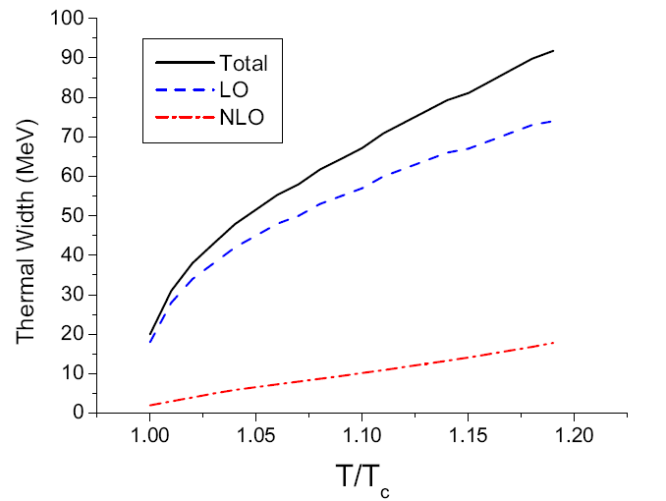
Summary of analysis
Summary
Due to the sudden change of condensate near Tc
G₀
<a/p B² >_{T}
<a/p E² >_{T}
G₂
Abrupt changes for mass and width near Tc

Slide 11
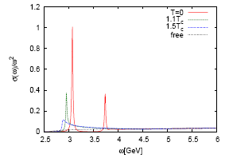
Comparison to other approach
χ_{c} state from lattice
K.Morita, Y. Song, SHL
Mocsy, Petreczky
0.9 T_{c}
Karsch et al.
T=0
0.75T_{c}
400 MeV
1.1T_{c}
1.1T_{c}
1.1T_{c}
1 GeV
χ_{b} state from lattice
K.Morita, Y. Song, SHL
0.9 T_{c}
Karsch et al.
400 MeV
1.5T_{c}
1.5T_{c}
400 MeV
0.9T_{c}

Slide 12
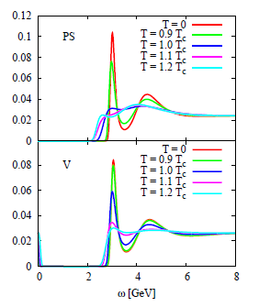
Gubler, Morita, Oka (2011)
QCD OPE + MEM

Slide 13
R_{AA} and v₂ of Charmonium
T. Song, W. Park, SHL : Phys. Rev. C 81, 034914 (2010)
T. Song, C. M. Ko, SHL, Jun Xu : Phys. Rev. C 83, 014914 (2011)
T. Song, C. M. Ko, K. Han, SHL: in preparation

Slide 14
RAA from RHIC (√s=200 GeV y=0 , 2-comp model (Rapp) Song, Park, Lee 10)
Melting of y’ cc
Slope: G_{J/y}
Melting T of J/y
Height: mass of J/y

Slide 15
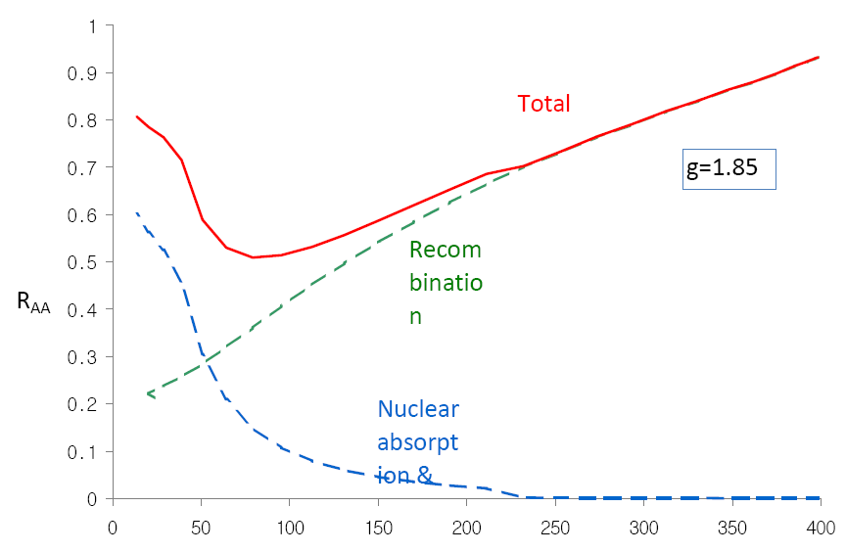
Effects of width and mass
Assumed recombination effect to be the same
Mass shift by -100 MeV
At LHC

Slide 16
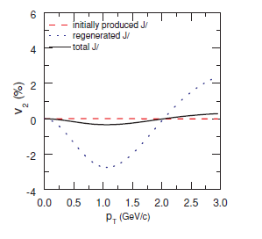
V2 T. Song et al.
Hydro + cc conservation
Thermal + flow

Slide 17
From QM 2011
No analysis yet !!

Slide 18
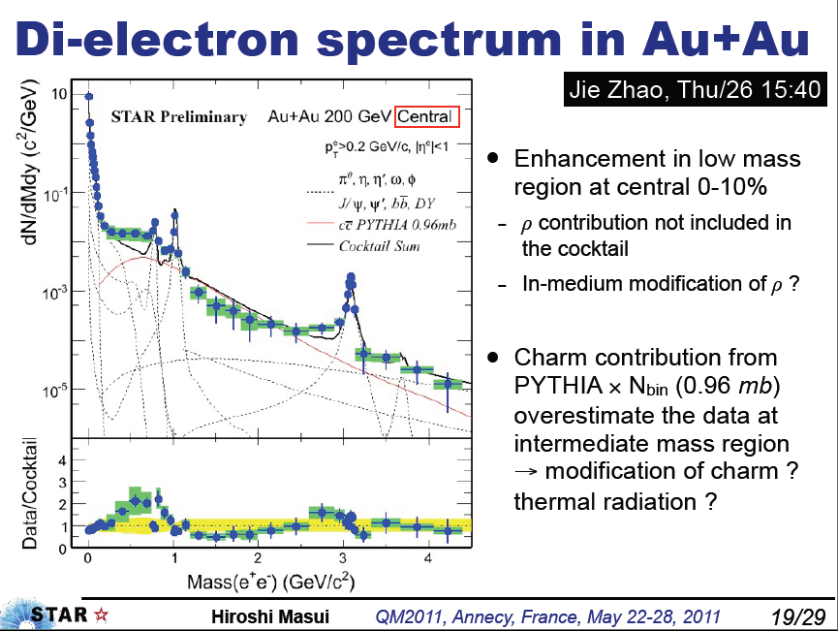

Slide 19
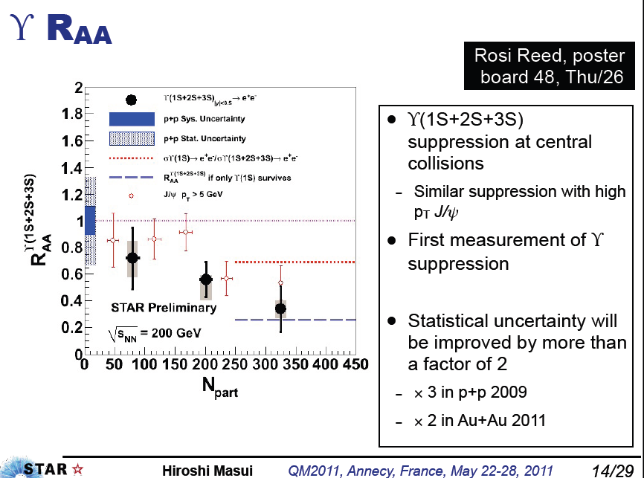

Slide 20
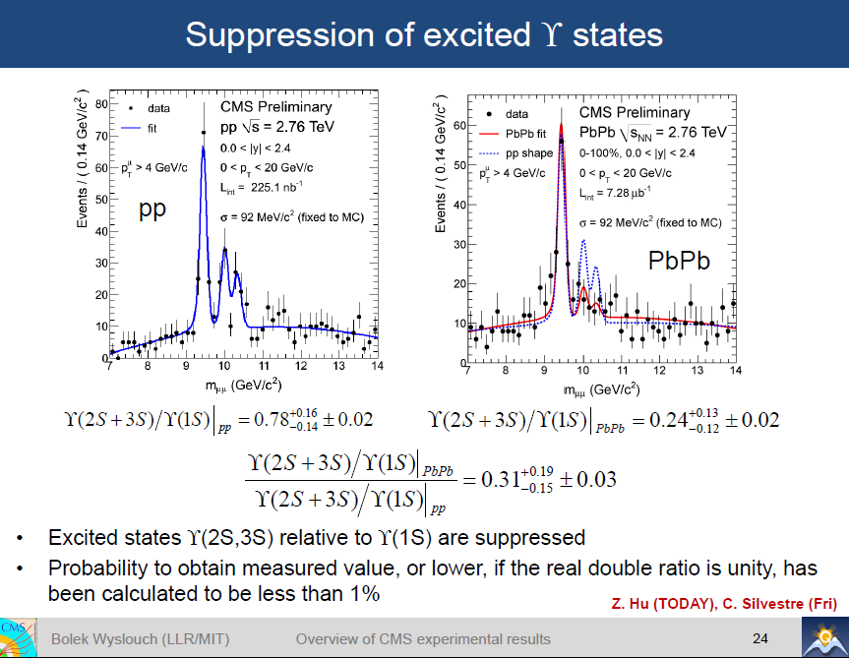

Slide 21
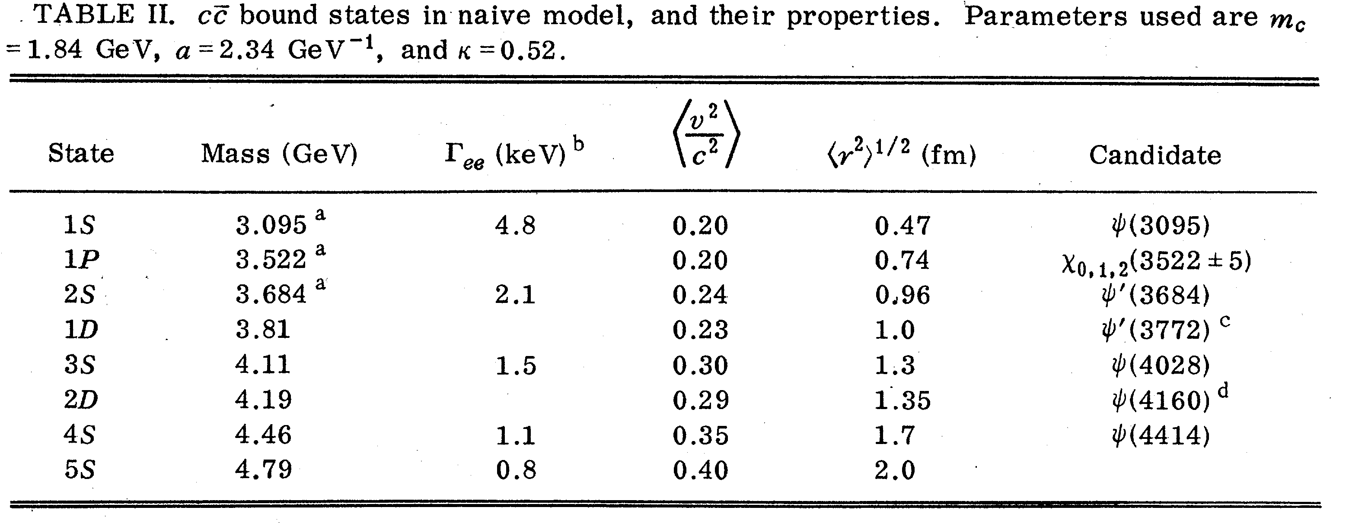
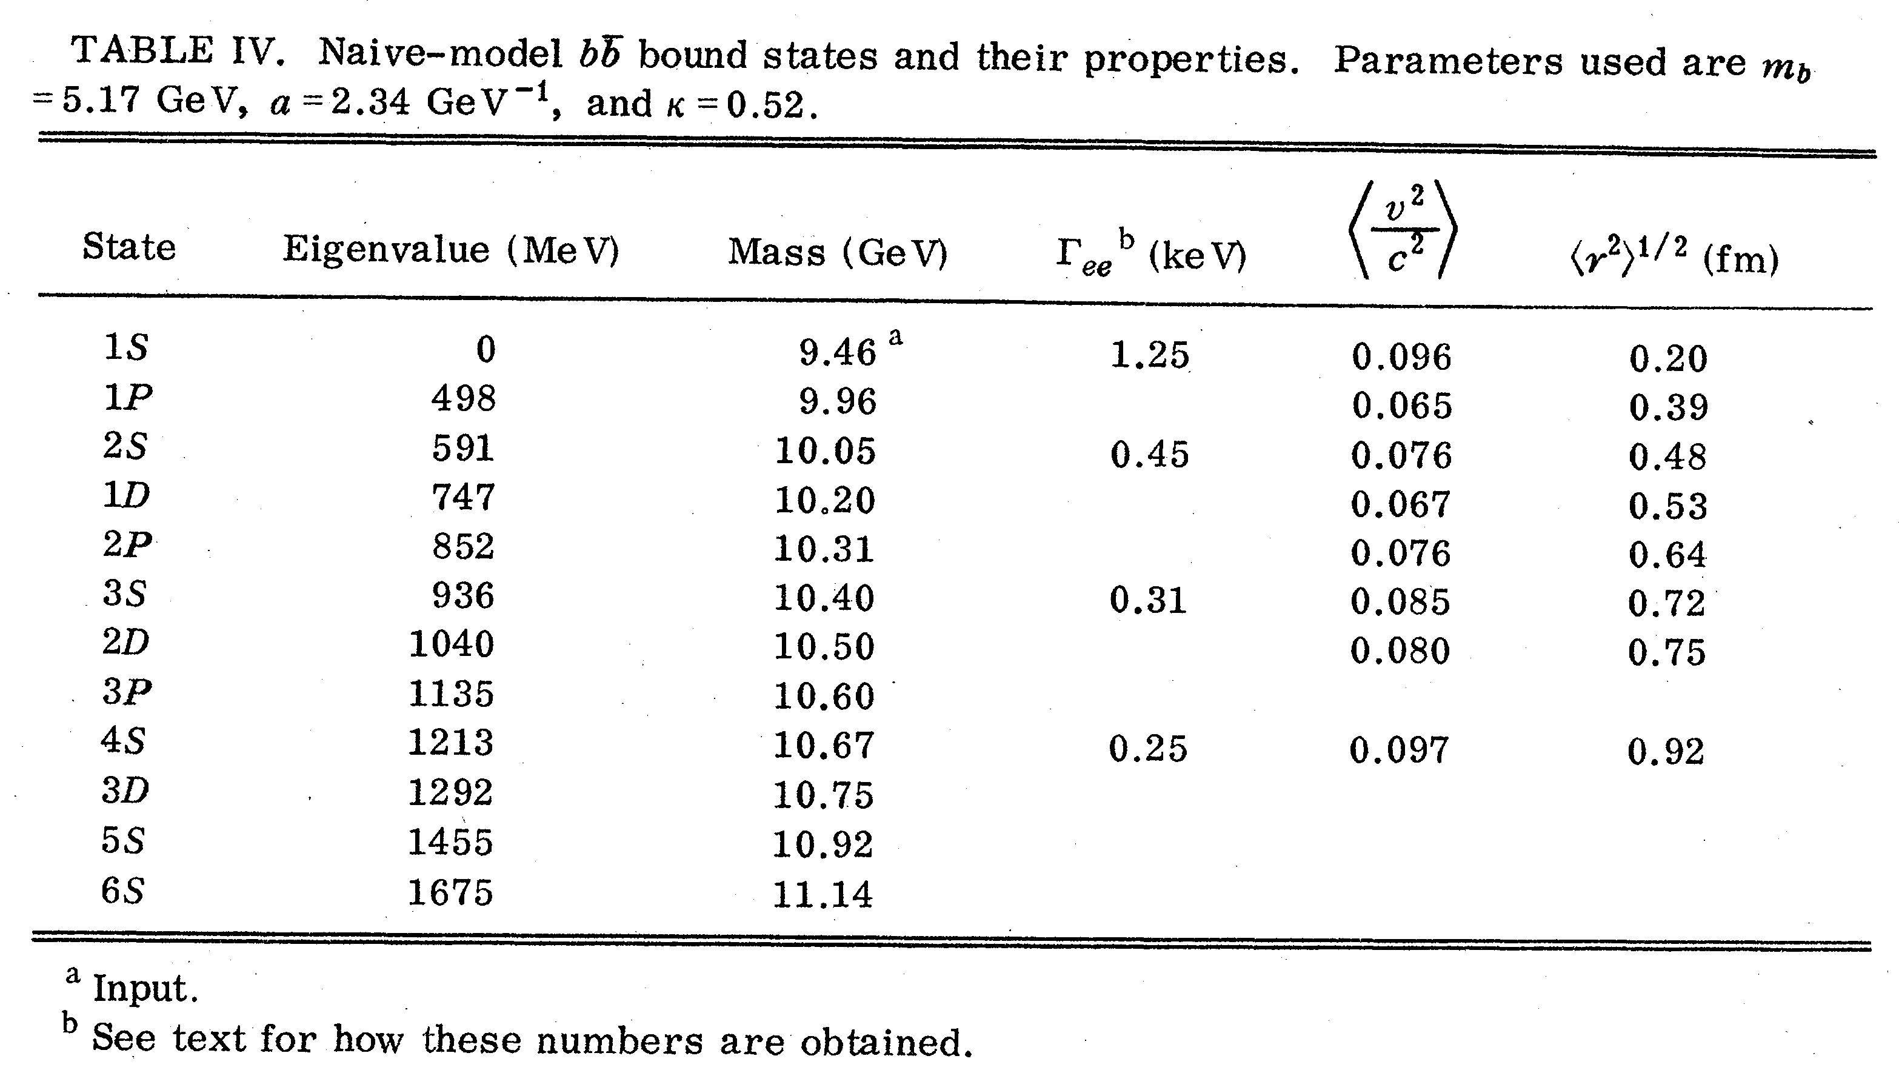
Cornell Potential

Slide 22
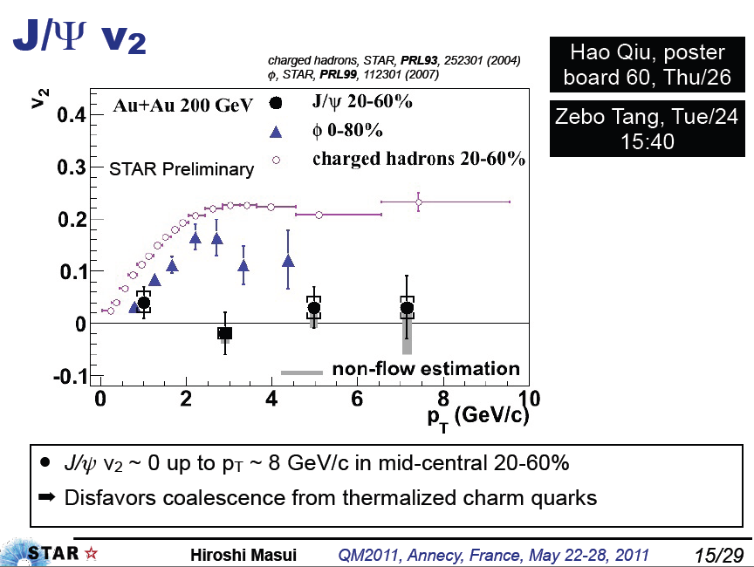
No regeneration
→ too much suppression?
→ mass shift

Slide 23
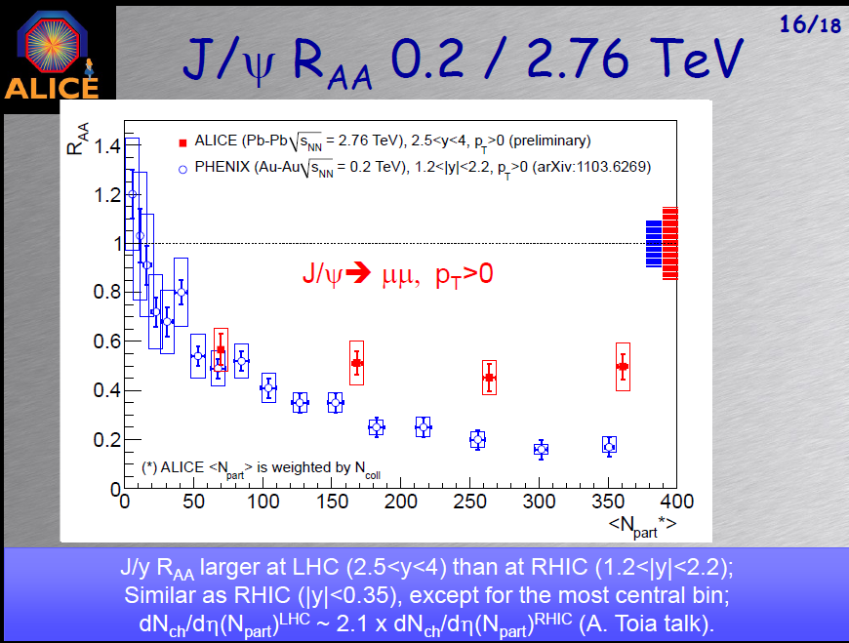

Slide 24
Summary
Deconfinement→ Potential → Quarkonium masses
Abrupt changes for quarkonium masses
Looking forward to Raa, v2 charmonium bottomonium ratio and finer mass resultion from RHIC and LHC
production inside a nuclear at FAIR and

Slide 25

심광숙 선생님, 더욱 건강하시고 계속 뵙기를 바랍니다.

Slide 26
References
Finite temperature lattice: Karsch: arXiv:0711.0661, 0711.0656, 0710.0354, Kaczmarek et al. PRD 70, 074505
Sum rule method at finite T: https://wiki.bnl.gov/qpg/index.php/Sum_rule_approach
J/psi formal: Hashimoto et al. PRL 57,2123 (1986), Matsui and Satz, PLB 178, 416 (1986), Asakawa, Hatsuda PRL 92, 012001 (2004), Morita, Lee, PRL 100,022301, Mocsy, Petreczky, PRL, 99, 211602 (2007)
J/Psi Phenomenology: Gazszicki, Gorenstein, PRL 83, 4009 (1999) , PBM , J. Stachel, PLB490, 196 (2000), Andronic et al. arXiv::nucl-th/0611023, Grandchamp and Rapp, NPA 709, 415 (2002), Yan, Zhuang, Xu, PRL,97,232301 (2006), Song, Park, Lee arXiv: 1002.1884
J/psi in medium, Brodsky et al. PRL 64,1011 (1990) , Lee, nucl-th/0310080,

