Slide 1
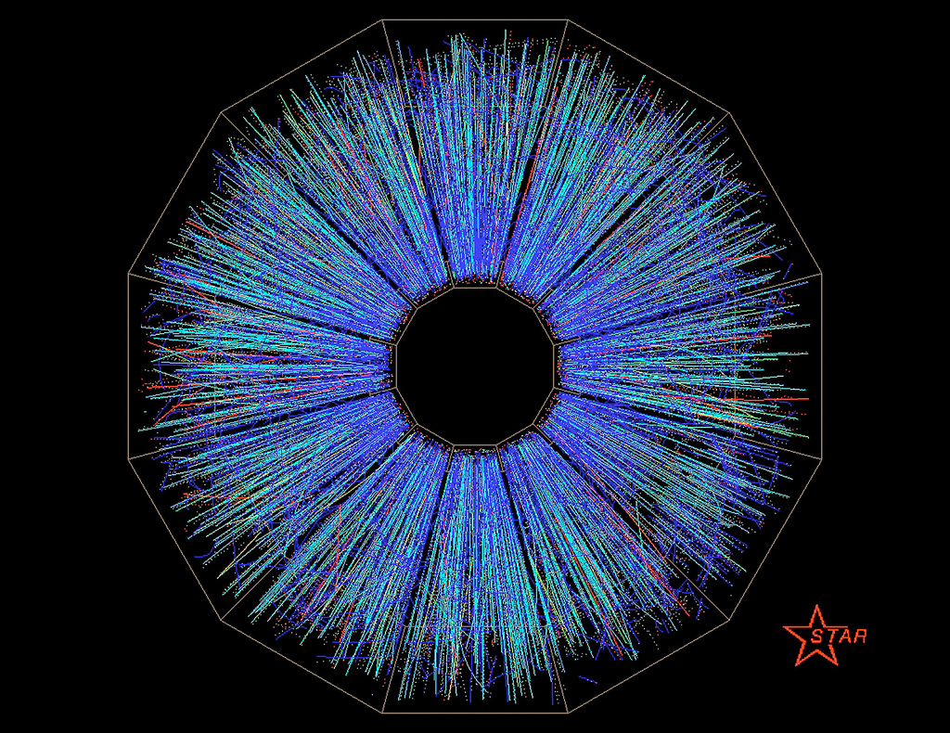
Solenoidal Tracker At Rhic (STAR) with recent Results

Slide 2
Outline
Relativistic Heavy Ion Collision
STAR Experiment at RHIC(ollider) in BNL
Recent Highlights (some updates of QM2011)
A Large Ion Collider Exp. @ LHC

Slide 3
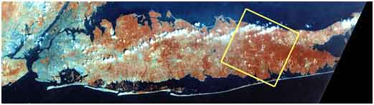
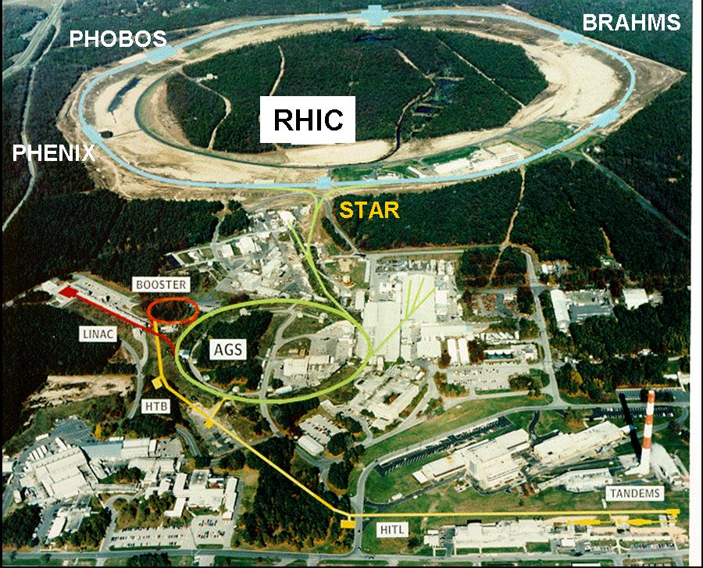
Brookhaven National Lab. (BNL)
Circumference: 3.83 km
First collision: 2000
100A GeV Au+Au(2X10²⁶/cm²/s)
250 GeV p + p (2X10³²/cm²/s)
AuAu @ 19.6, 62, 130, 200 AGeV/u
CuCu @ 200 AGeV/u
dAu @ 200 AGeV/u
polarized pp @ 200 AGeV

Slide 4

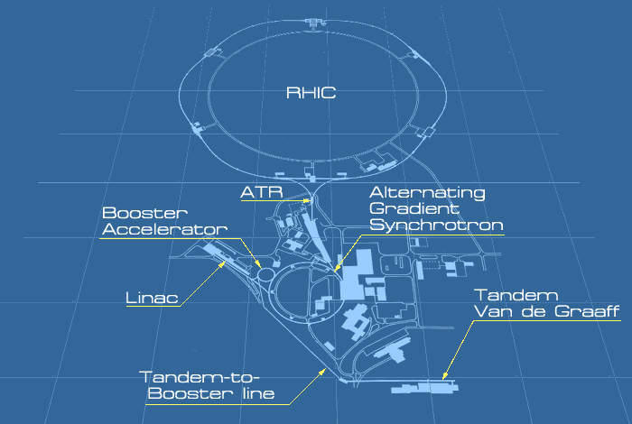
Relativistic Heavy Ion Collider
Since 1947
AGS-To-RHIC (ATR) transfer line. Bunches are directed either left to the clockwise RHIC ring or right to travel counter-clockwise in the second RHIC ring.
The Booster synchrotron
1991 completed. Preacceleration of particles entering the AGS ring.
Alternating Gradient Synchrotron (AGS)
1960. 0.37c → 0.997c 33GeV for protons
11GeV for AuAu
Linear Accelerator (Linac). Protons 200 MeV (300 mA) for pA collisions. Late 1960’s.
Tandem-to-Booster line (TTB)
1986, 700m, 0.05c
Tandem Van de Graaff
1970, 15MV, Ions, 24m

Slide 5
Detectors @ RHIC

Slide 6
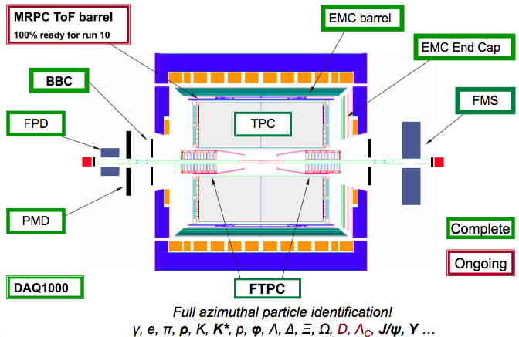
STAR Detector

Slide 7
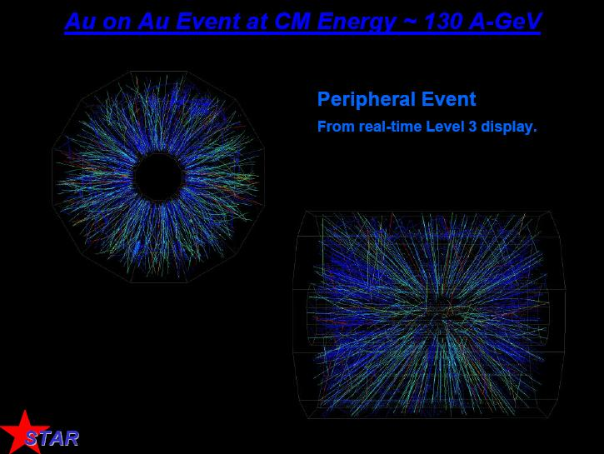
AuAu Collisions @ 130 AGeV

Slide 8
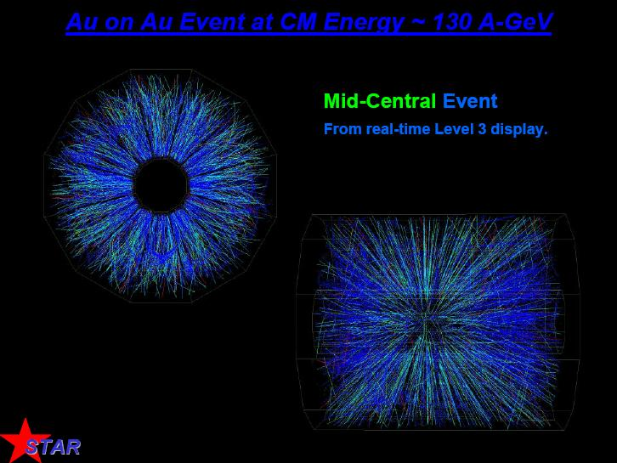
AuAu Collisions @ 130 AGeV

Slide 9
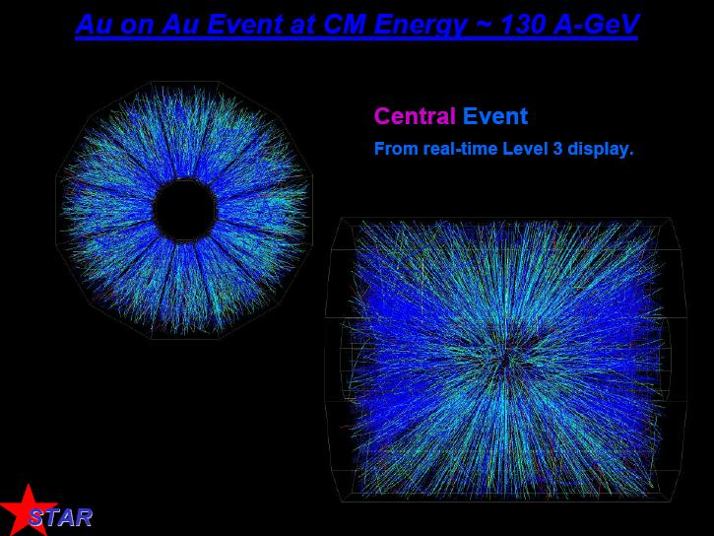
AuAu Collisions @ 130 AGeV

Slide 10
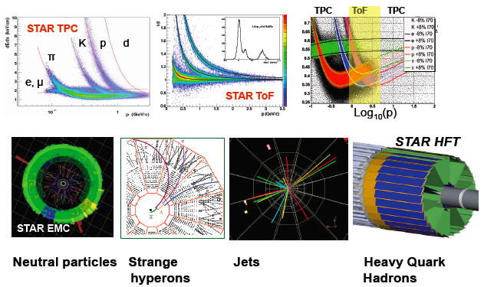
Particle ID @ STAR

Slide 13
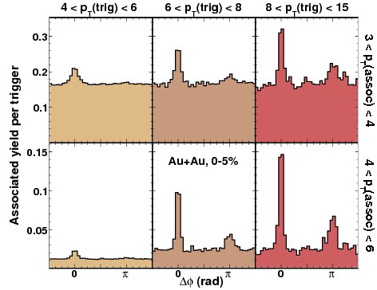
Monojet ? or Dijet?
With increasing the jet energy, back-to-back peaks in central AuAu collisions are reappearing

Slide 14
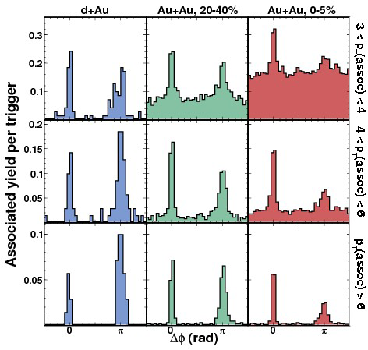
System-size dependence
With increasing system-size, back-to-back peaks are suppressed.

Slide 15
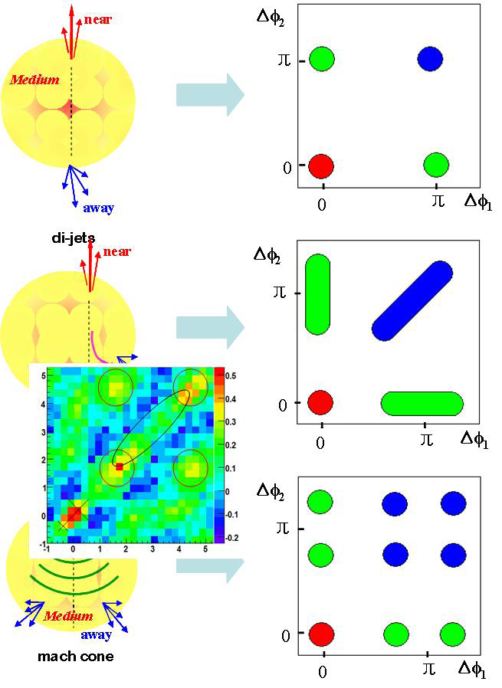
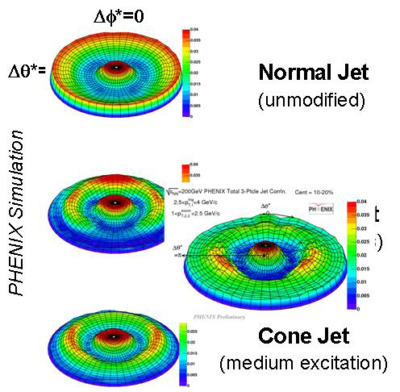
3 particle correlations

Slide 16
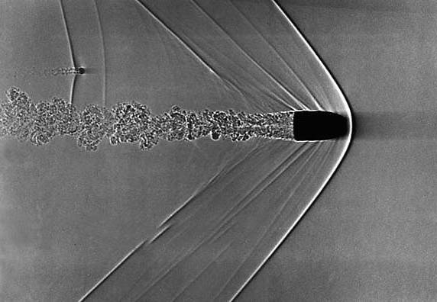
Mach-like Shock Wave
A fast thermalization through dispersing energy into collective modes of shock waves.
near
Medium
away
mach cone

Slide 17
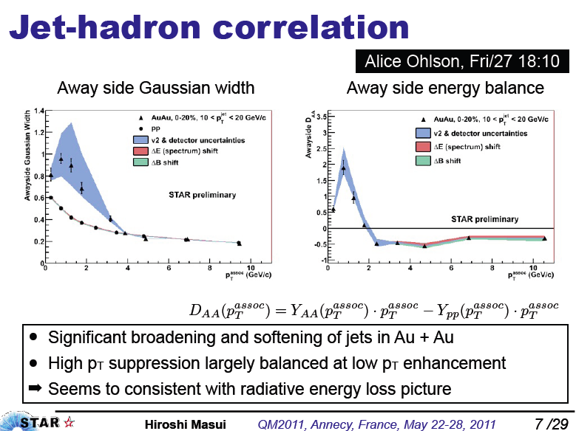

Slide 19
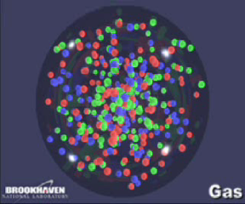
Liquid-like Early Universe

Slide 20
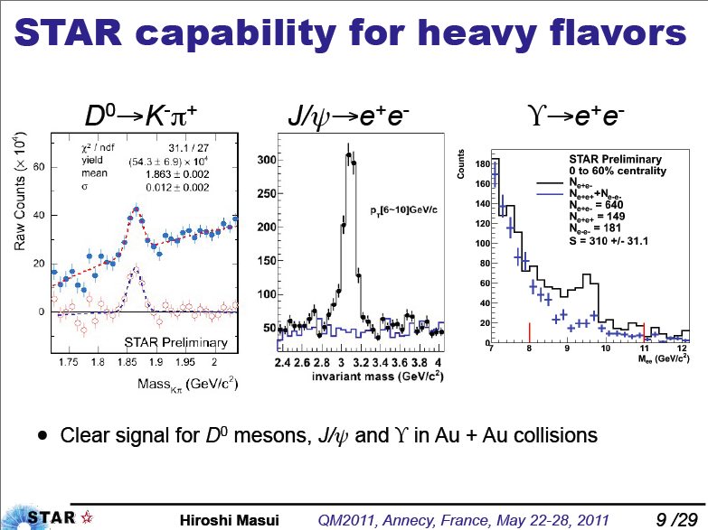

Slide 21
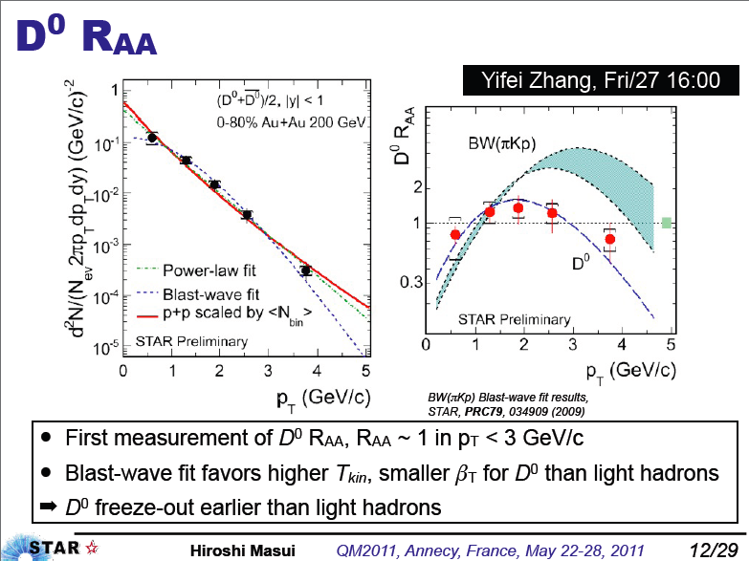

Slide 22
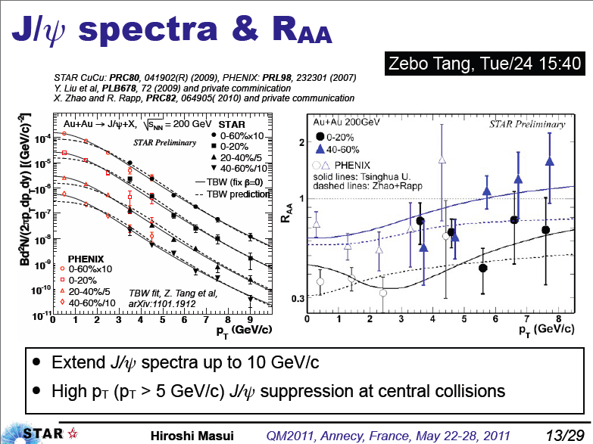

Slide 23
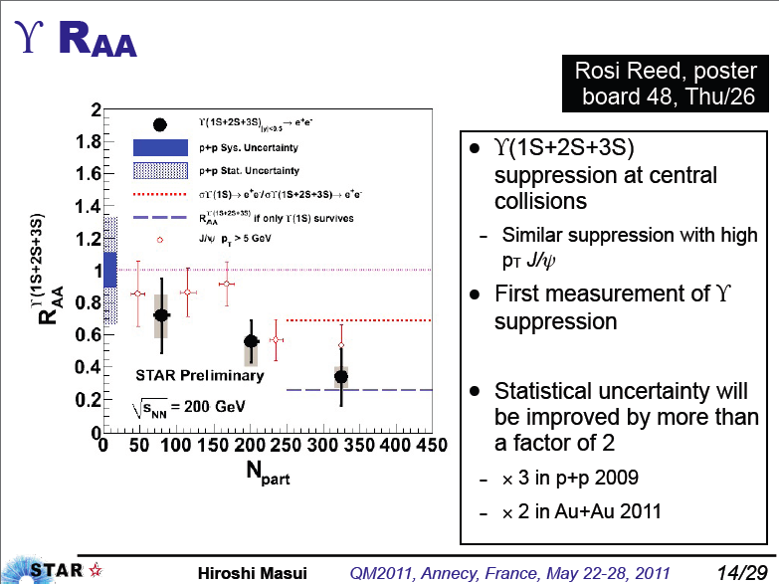

Slide 24
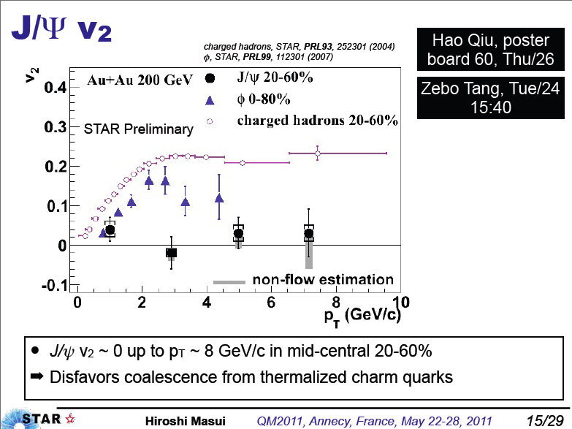

Slide 25
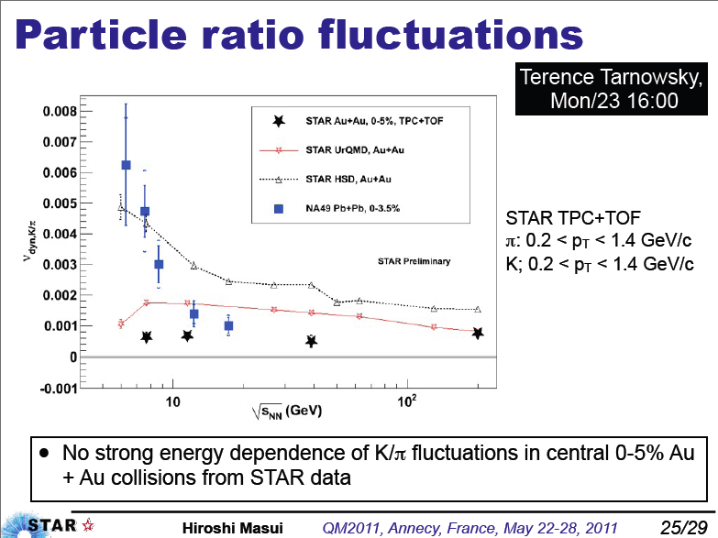
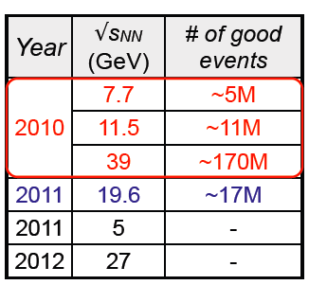

Slide 26
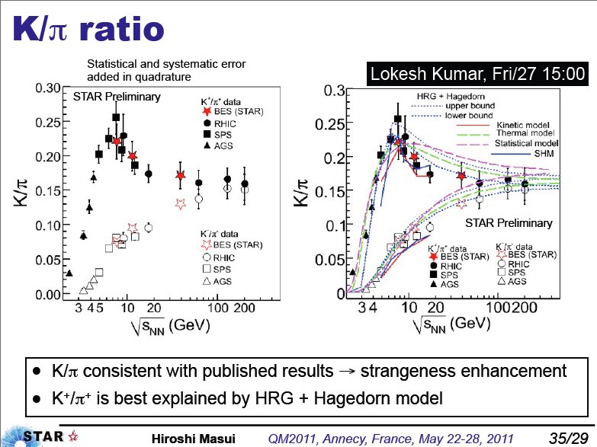

Slide 27
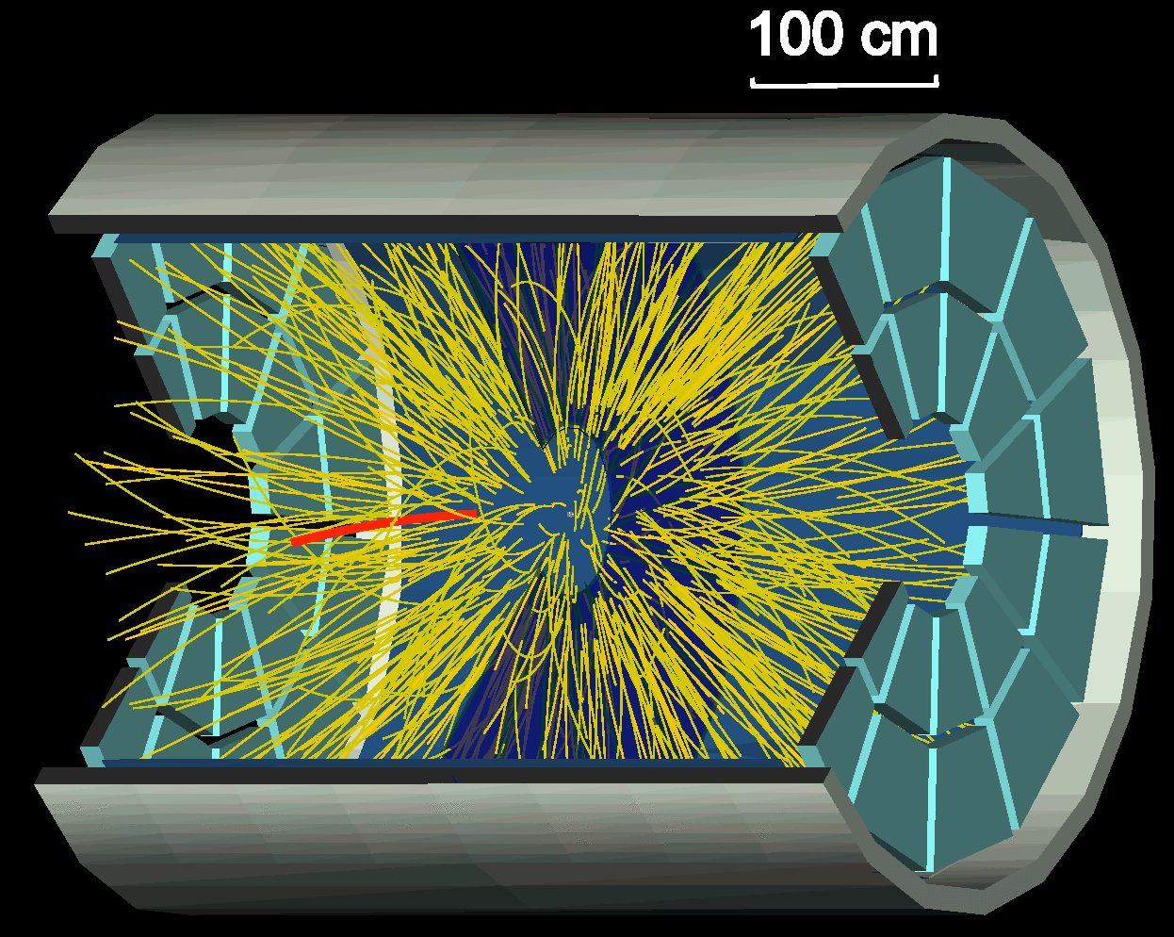
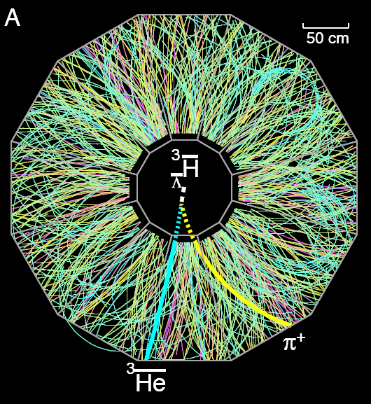


RHIC as Exotic/Antimatter Machine
Science 328, 58 (2010)
Nature 473, 353 (2011)
Latest STAR results for antinuclei

Slide 28

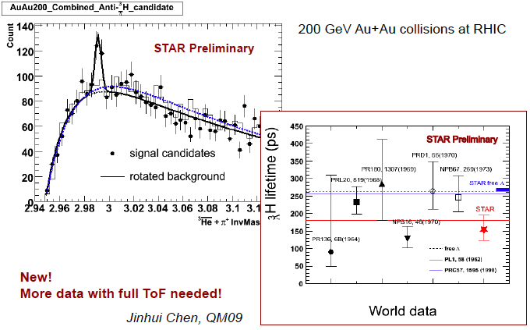
Antimatter Hyper Triton

Slide 29
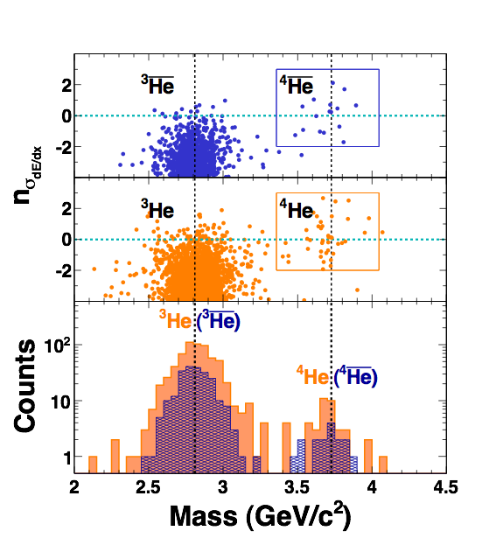
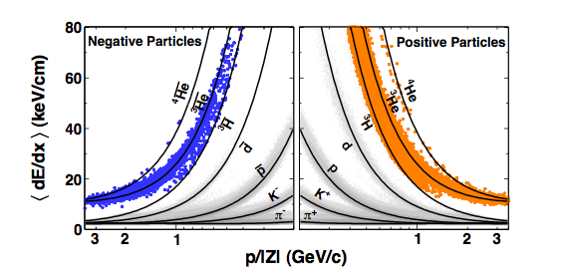
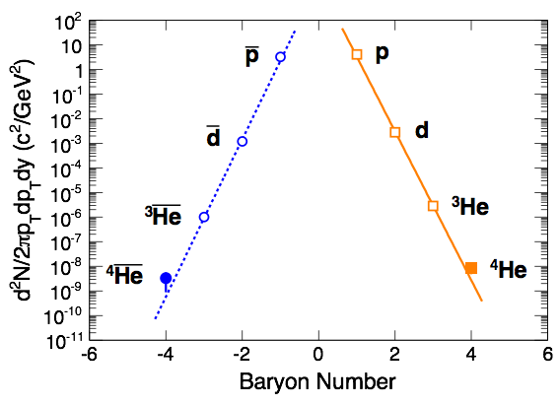
Antimatter Helium

Slide 30
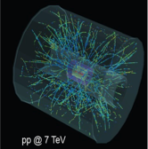
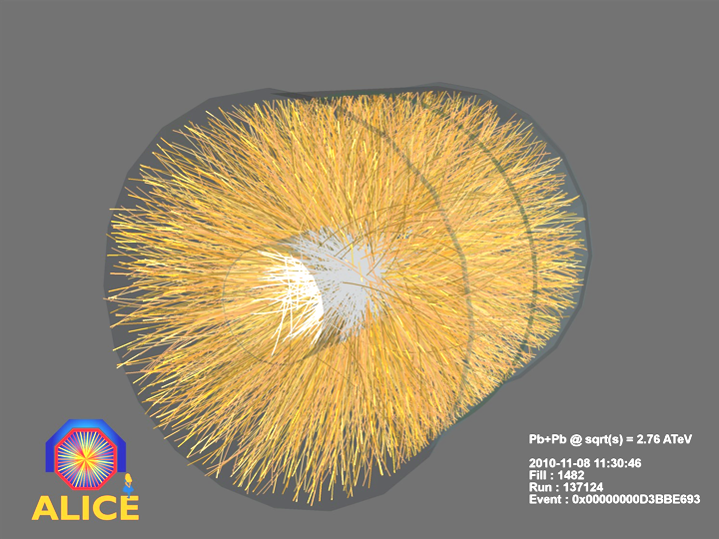
A Large Ion Collider Exp. @ LHC

Slide 31
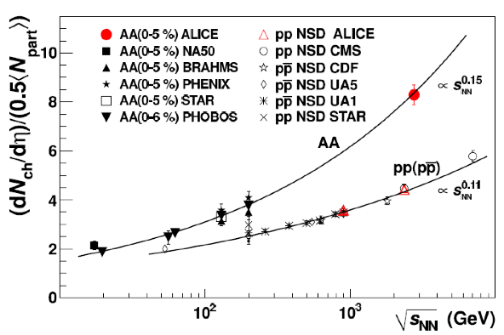
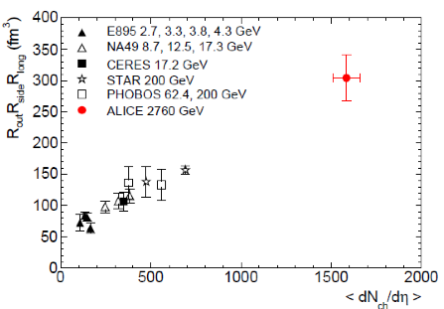
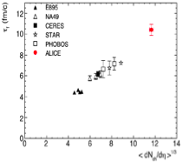


A Large Ion Collider Exp. PbPb@ 2.76TeV
Energy density from dNch/dη
dNch/dη = 1599 ± 4 (stat.) ± 80 (syst.)
constrains / rules out models
100 times cold nuclear matter density
~3 times the density reached at RHIC
(ε ≈ 15 GeV/fm³)
Volume and lifetime from HBT
Freeze-out volume ~ 300 fm³
~ 2 times the volume measured at RHIC (AuAu@200 GeV)
Lifetime until freeze-out ~ 10 fm/c

Slide 32
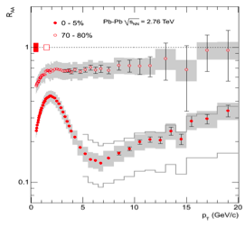
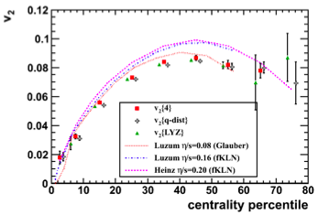
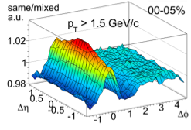
A Large Ion Collider Exp. PbPb@ 2.76TeV
Strong energy loss in hot and dense medium
Quantified by nuclear suppression factor RAA
Maximum suppression RAA ~ 1.5 – 2 x stronger than at RHIC

Slide 33


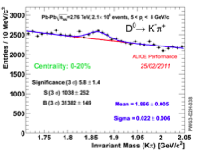
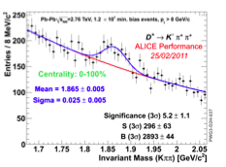
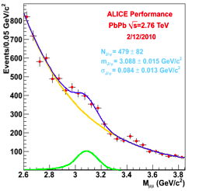
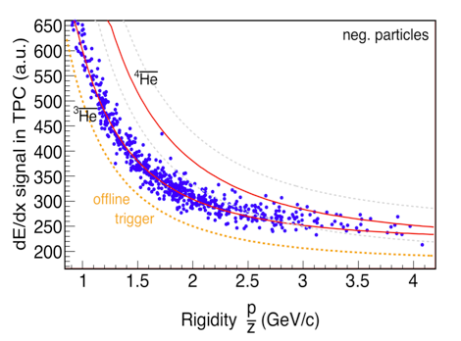
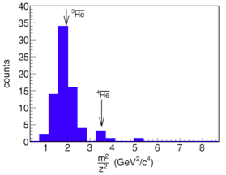
A Large Ion Collider Exp. PbPb@ 2.76TeV

Slide 34
Thanks!
35 Heavy Ion Meetings since 2004-12
290 Talks / avrg. 35 participants
101 foreign invitees
Asian Triangle HI Conferences (ATHIC)
GREAT APPRECIATION TO PROF.SHIM

