Slide 1

Few ideas on Hadronic Physics at RHIC/LHC
Su Houng Lee
1. Λ from pp at ALICE and H dibaryon
2. Exotics from HIC
3. Crypto-exotics from HIC
Acknowledgement: S. Cho, C.M. Ko, S. Yasui + ExHIC collaboration

Slide 2
from p-p ALICE and the
H dibaryon

Slide 3

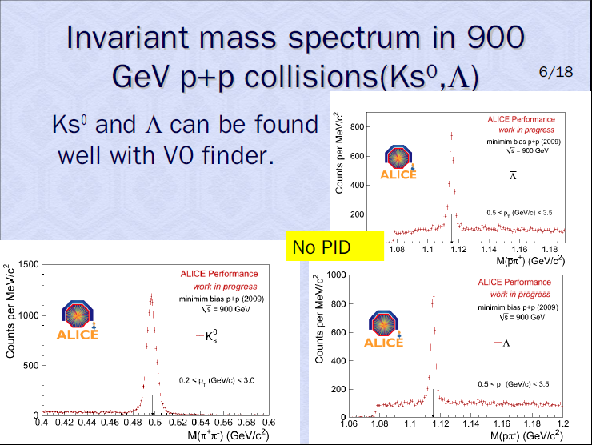
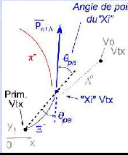

Slide 4
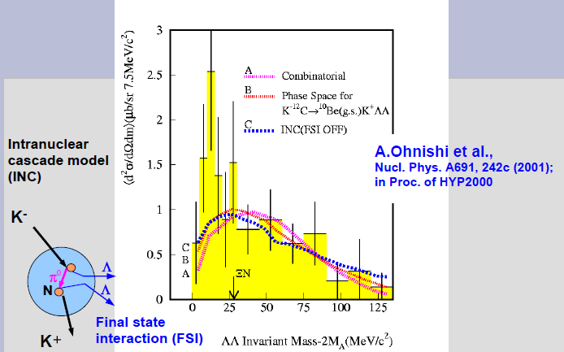
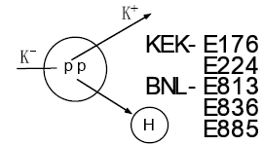
Λ Λ measurement at KEK (안정근 E224, E522)
→ A continued search for H-dibaryon
(K. Imai …)

Slide 5
H –dibaryon Jaffe 77
H di-baryon
u
d
u
s
→
u
d
u
d
0⁺
s
s
d
s
2SC Phase
CFL
Phase of color superconductivity ?
H di-baryon → could be bound
unfortunately not found in so far

Slide 6
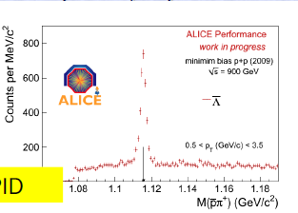
Expectations for H and ΛΛ production in Pb Pb collision at LHC
N_{part} Pb+Pb: X 100
More than
100 H dibaryon
Stat : H/ Λ = 10 ⁻²
If m_{H} < 2 m _{Λ}
If m_{H} > 2 m _{Λ}
π
p
Can be the first observation of real exotic and solution to a 30 year quest
p
Λ
Λ
H
π
Λ

Slide 7
Exotics from HIC
SHL, S. Yasui : EPJC 64 283 (09)
SHL, S. Yasui, W. Liu, CM.Ko : EPJC 54 259 (08)
S. Cho et al. arXiv:1011.0852

Slide 8
Recent Highlights in Hadron Physics – Heavy quark sector
Babar: D_{SJ}(2317) 0+
Puzzle in Constituent Quark Model(2400)
D0 K+ (2358) threshold effect
Chiral partner of (0⁻ 1⁻)
Tetraquark
Molecule ?
D0 | D* | D1
1864 | 2007 | 2420
D0+D* | D*+D* | D+D1 | D1+D*
3871 | 4014 | 4284 | 4427
X(3872) , Y(4260),
Z(4430) → ψ’π
Z(4051),Z(4248)→ χ_{c1}π
Must contain cc ?
Tetraquark ?

Slide 9
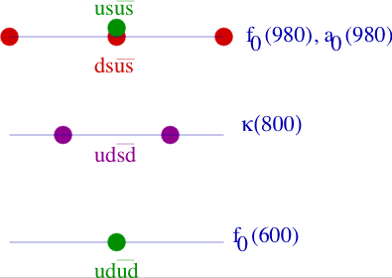
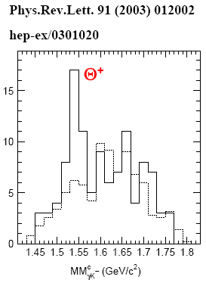
Previous Work on Multiquark hadrons - Light quark sector
Scalar tetraquark (Jaffe 76)
Λ(1405) (Weise, Oset, Jido, Sekihara..)
Crypto-exotic : difficult to prove
N
K
+
Σ
π
Search for H dibaryon
Search for Θ+ pentaquark
Exotic : Not found so far

Slide 10
Multiquark configuration:
Diquark attracation vs quark-antiquark
q₁
q₃
q₂
diquark picture: Yasui, Ko, Liu, Lee,.. (EJP08,EJP09)
 | Type of diquark and its q-q binding
S=C=0 | (ud) → A
S=-1, m_{s}=5/3m_{u} | (us) → 3/5 A | (ds) → 3/5 A
C=1, m_{c}=5m_{u} | (uc) → 1/5 A | (dc) → 1/5 A | (sc) → 3/25 A

Slide 11

Exotics 1: Tetra-quark - configurations
2- light quark 2-light anitquark configuration
Scalar - Tetraquark
π Meson π Meson
0⁺
u
d
d
u
→
0⁻
d
0⁻
u
d
u
2- light quark 2-heavy anitquark configuration
0⁺
u
d
c
b
→
0⁻
c
0⁻
u
d
b
T_{cb}⁰/D > O(10 ⁻⁵ ) at LHC

Slide 12
Axial meson Tcc 2- light quark 2-heavy anitquark
1⁺
u
d
c
c
→
0⁻
c
1⁻
u
d
c
T_{cc}/D > O(10 ⁻⁴ ) at LHC
Vertex detector: FAIR 10⁴ D⁰ /month, LHC 10⁵ D⁰/month

Slide 13
Why Di-bayron
H di-baryon
u
d
u
s
→
u
d
u
d
0⁺
s
s
d
s
H di-baryon → could be bound
unfortunately not found in so far

Slide 14
A new Di-baryon : Hc
H_{c} di-baryon
P
Ξ_{c}
0⁺
u
d
u
s
→
u
d
u
s
u
c
u
c
H_{c}/D > O(10 ⁻³ ) at LHC
Vertex detector: FAIR 10⁴ D⁰ /month, LHC 10⁵ D⁰/month

Slide 15
Crypto Exotics from HIC
(Multiquark configurations )
S. Cho (ExHIC collaboration) arXiv:1011.0852

Slide 16
Normal meson, Tetraquark and Molecule
 | Normal meson | Tetraquark | Molecule
Geometrical configuration
Flavor quantum number | ud | ud | ud
u
u
u
u
u
d
d
u
u
d

Slide 17
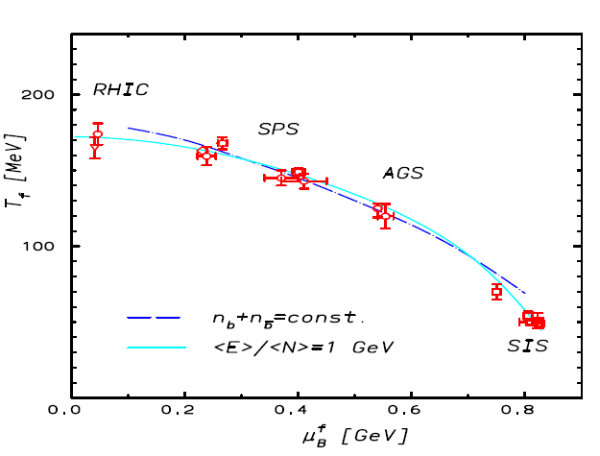
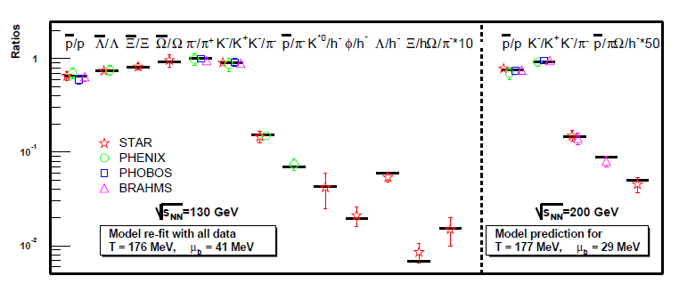
Statistical Model
Freezeout points
Normal hadron yields

Slide 18

Coalescence model : for things with structures
Success of Coalescence model
Coalescence model = Statistical model + overlap
Suppression of p-wave resonance (Muller and Kadana En’yo)
P_{T} dependence of ratio
Quark number scaling of v2
v4
Ko et al
Ko et al
Ko et al

Slide 19
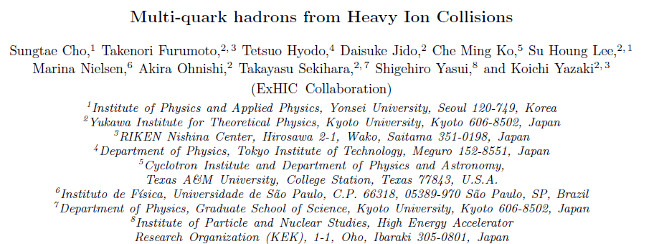
Production of multiquark states from HIC arXiv:1011.0852
Determine Coalescence parameter to yields of normal hadrons at RHIC
Using the coalescence model, calculate the yields of multiquark candidates assuming they are normal hadron, multiquark, molecule

Slide 20
S. Cho
5 x Stat
Fachini [STAR]
0.2 x Stat

Slide 21
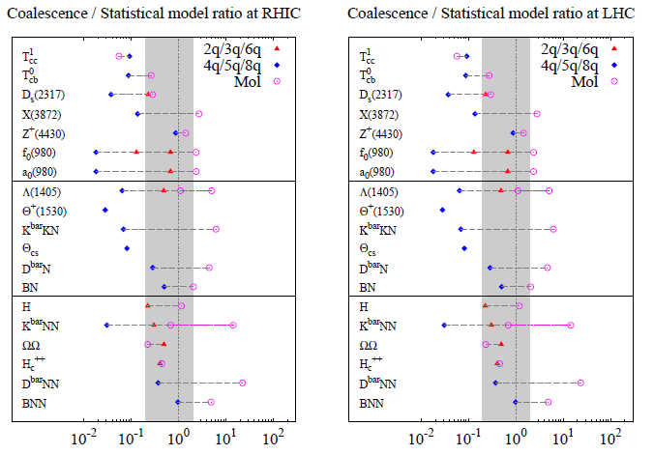
Expectations at RHIC and LHC

Slide 22
Suppression of multi-quark states in HIC
u
c
u
d
D meson production through 2-body coalescence
u
c
s
u
u
d
c
d
d
c
c
s
u
d
c
c
u
s
d
u
d
d
c
d
u
d
d
u
d
d
c
u
u
Tetraquark production through 4-body coalescence
d
u
u
d
s
u
Pentaquark production through 5-body coalescence

Slide 23
Summary
One can search for H dibaryon from pp at LHC in ALICE and later from Pb Pb collisions→ end the 30 year old search.
One could also search for exotic multiquark states: Tcc, Hc, Θc
→ First step towards dense matter and phase diagram of QCD
3. By measuring yields for crypto- exotic states one can identify multiquark configuration
→ finally identify multiquark configuration

Slide 24
Back up slides

Slide 25
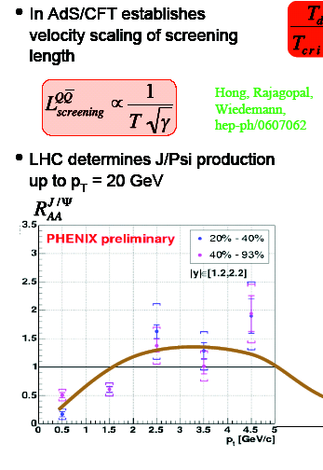
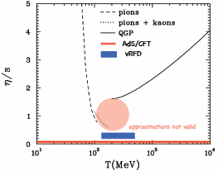
Running conditions at LHC
Collision system | √s_{NN}(TeV) | L₀ (cm⁻²s⁻¹) | Run time (s/year) | σ_{geom} (b)
pp | 14.0 | 10³⁴ * | 10⁷ | 0.07
PbPb | 5.5 | 10²⁷ | 10⁶ ** | 7.7
pPb | 8.8 | 10²⁹ | 10⁶ | 1.9
ArAr | 6.3 | 10²⁹ | 10⁶ | 2.7

Slide 26
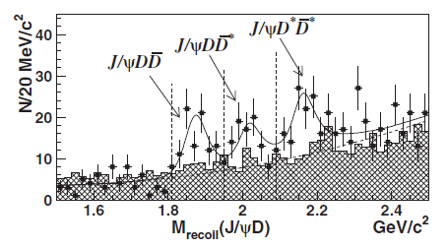
Previous works on Tcc :
Z. Zouzou, B. Silverstre-Brac, C. Gilgnooux, J Richard (86), D. Janc, M. Rosina (04), Y. Cui, S. L. Zhu (07)
QCD sum rules: F Navarra, M. Nielsen, SHLee, PLB 649, 166 (2007)
simple diquark: SHL, S. Yasui, W.Liu, C Ko EPJ C54, 259 (2008), SHL, S. Yasui: EPJ C (09)
Can look for 1⁺ (Tcc)
Belle: PRL 98, 082001 (07)
e+ e- → J/y + X(3904)
→ D D*
e
T_{cc} (3800)
X (3904)
c
c
c
c
e+
SHL, S Yasui, W Liu, C Ko (08)

Slide 27
Production ratios for predicted Multiquarks
Θ_{c} production at RHIC and LHC
Θ_{c}/D > 0.74 x 10 ⁻⁴
Θ_{c}/D_{s} > 0.23 x 10 ⁻³
H_{c} production at RHIC and LHC
H_{c}/D > 0.8 x 10 ⁻⁴
H_{c}/D_{s} > 0.25 x 10 ⁻³
T_{cc} production
T_{cc}/D > 0.34 x 10 ⁻⁴ RHIC
> 0.8 x 10 ⁻⁴ LHC

Slide 28
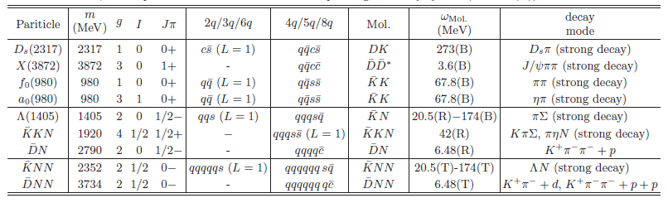
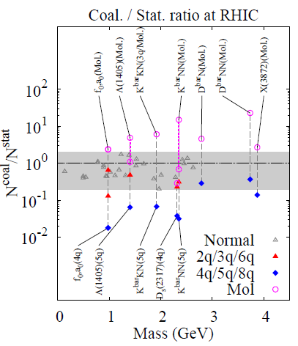
Recent data from RHIC
N^{coal}/N^{stat}

