Slide 1
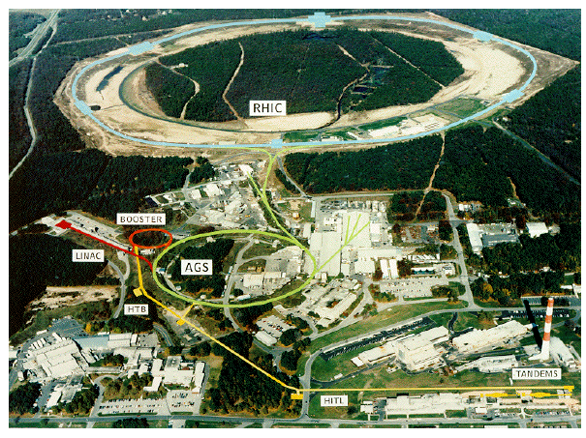
Introduction to Ads/CFT for Nuclear physicists
Sang-Jin Sin (Hanyang U.)
@Muju Resort 2011.02.28

Slide 2
Contents
Why AdS/CFT?
holographic QCD and RG Flow.
Finite Temperature and Confinement 1
History: from QCD string to D-brane
How AdS Emerges
AdS/CFT and its basic structure
Chemical potential
Finite Temperature and Confinement 2
What we can do with it.

Slide 3
1. Why AdS/CFT for Nuclear Physics?
Shear viscosity /entropy density experiment: <0.1 for pQCD: for String Theory : 1/4π =0.09
The method string theory used is AdS/CFT

Slide 4
Plan of the session:
SJS : basic concepts
Y. Kim: Bottom up
Y. Seo: Top down
K. Jo: Two point functions.
Aim of the talk is a communication: what can we do together.
After I show a few pictures,
I will just answer your questions.

Slide 5
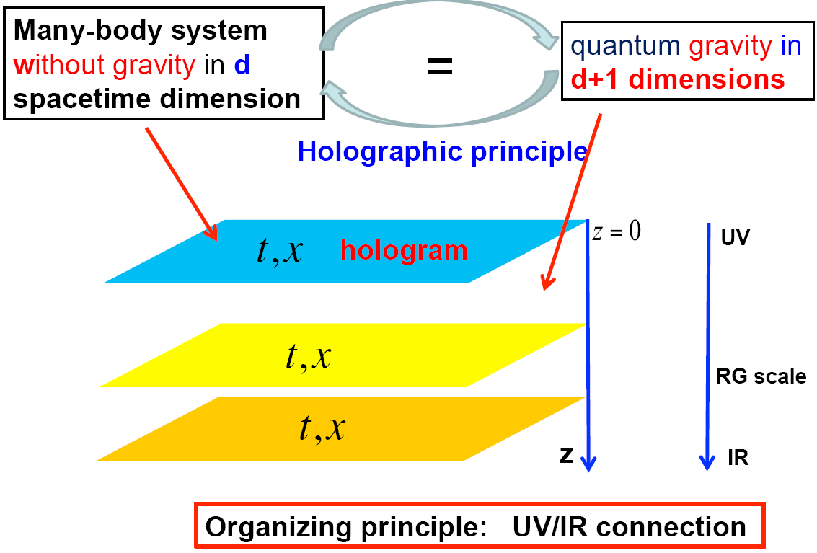
Geometrization of RG flow
One way to view the AdS/CFT

Slide 6
Temperature

Slide 7
Confinement v.s deConfinement

Slide 8
Confinement v.s deConfinement

Slide 9
Confinement v.s deConfinement

Slide 10
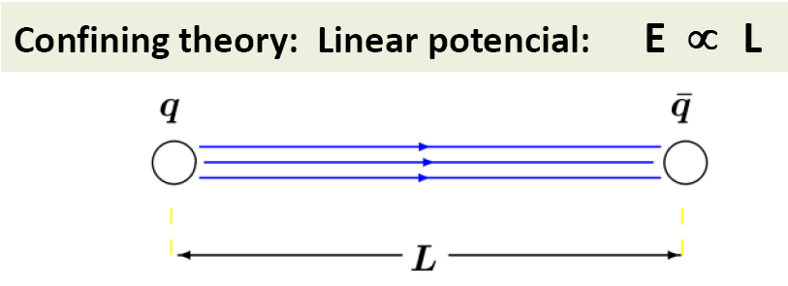
History: from QCD string to D-brane
Confinement → Flux string
QCD string

Slide 11
. QCD string was good for Regge strajectory

Slide 12
Open string theory
Spin 1 is a massless spectrum ➔ photon , gluon?

Slide 13
History
Bad for parton behavior
So QCD string is good for low E and bad for the high energy.
Negative beta function of QCD implied Asymptotic freedom.
QCD string was dead in 1973.

Slide 14
Closed string 1974
Found graviton in Closed string
Paradigm shift : alpha’ is changed from
1GeV to Plank scale.

Slide 15
D-brane
Dirichlett boundary condition
D-brane = black p-brane with charge. (Polchinski) Dp,
Its vibration = open string modes
closed string in warped geometry.
If lambda>>1, gs<<1
Gravity description is valid.
… too much constraint. Let go to board.

Slide 17
Contents
Why AdS/CFT?
holographic QCD and RG Flow.
Finite Temperature and Confinement 1
History: from QCD string to D-brane
How AdS Emerges
AdS/CFT and its basic structure
Chemical potential
Finite Temperature and Confinement 2
What we can do with it.

Slide 19
What can we do with it.
Phase transition, equation of state.
Two point function → Transports. Spectral fct Viscosity conductivity heat cd
Elliptic flow(time dependence)
Dissipation and energy loss. (dragging)
Meson/Baryon spectrum
Symmetry energy
Lepto and Photo emission rate …….

Slide 20
Conclusion
Almost everything can be calculated in terms of ads/cft.
Model dependence and deviation from the real qcd is not controlled yet.
Can we bypass qcd hqcd v.s exp?

