Slide 1
Forward photon measurement and generic detector R&D
Y. Kwon
Yonsei Univ.

Slide 2
Contents
CGC-related γ-physics at forward
Related to RHIC & LHC
Calculable from the 1st principle.
To be addressed 5-10 years down the road.
Relevant generic detector R&D
Si/W sandwich calorimeter
SiPM (Silicon photomultiplier)
무엇보다 한국이 우수한 잠재력을 갖춘 영역에서

Slide 3
CGC-related γ-physics at forward
Application domain
Perturbative QCD : Λ_{QCD} << p_{T}, p_{T} ~ Q_{s}
High parton density at small x : bigger effect at forward/backward
Parton kinematics
Projectile : large x (~valence quarks)
Target : Small x (~gluons → CGC)
Study based on Jamal Jalilian-Marian’s work (PRD66(2002)014021, PRD66(2002)094014,
PRD67(2003)074019, NPA753(2005)307)

Slide 4
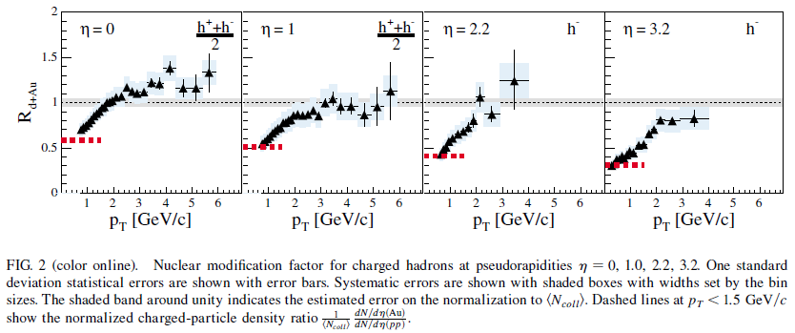
Baseline prediction
Forward hadron suppression
Jet quenching?
Parton coalescence model?

Slide 5
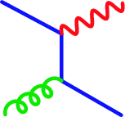
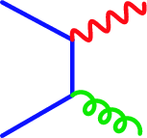
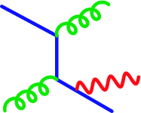
Motivation : Direct γ production
Direct γ production in p+p
→ One of the best known QCD process…
Really?
Leading order diagram
in perturbation theory
Hard photon : Higher order pQCD
Soft photon : Initial/final radiation,
Fragmentation function

Slide 6
Baseline approach
A : Background field, Color Glass Condensate at small x
Using reduction formalism,

Slide 7
U(z_{T}) : a unitary matrix containing the interactions
between the quark and CGC.
in coordinate space and in the “singular” gauge.
L. McLerran and R. Venugopalan, Phys. Rev. D59, 094002(1999)

Slide 9
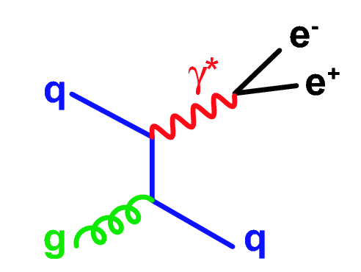
γ*(e⁺e⁻ pair) measurement
Motivation: Low p_{T} : large π⁰, η background
Internal conversion
Any source of real photons also emits virtual photons
Well known example:
π⁰ Dalitz decay
Rate and m_{ee} distribution calculable in QED (Kroll-Wada formula)
Hadron decays: m_{ee}< M_{hadron}
Essentially not such limit for point-like source.
Compton
Improve signal-to-background ratio by measuring e⁺e⁻ pairs with m_{ee} > ~ M_{pion}

Slide 10
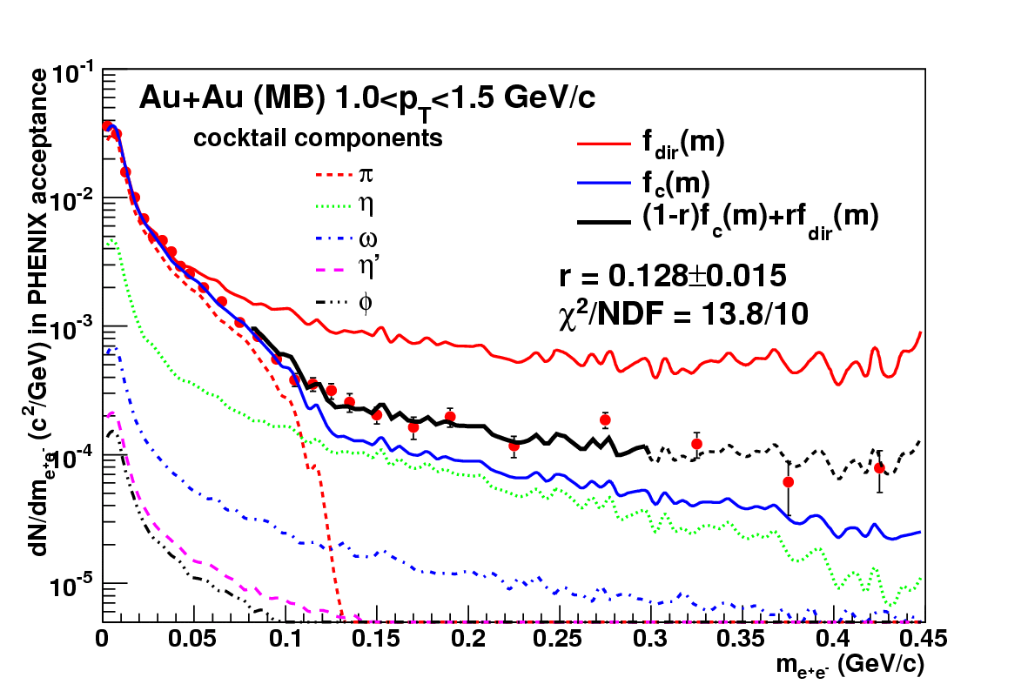
Extraction of γ signal
Separately normalized to data at m_{ee} < 30 MeV
Interpret deviation from hadronic cocktail (π, η, ω, η’, φ) as signal from virtual direct photons
Extract fraction r with two-component fit
Fit yields good χ²/NDF (13.8 / 10)
Fit range: 80 < m_{ee} < 300 MeV

Slide 11
γ Production vs γ* production

Slide 12
Universality (DIS)

Slide 13
Issues…
Phenomenological models for the dipole cross sections…
(baseline JIMWLK equations)
Dipole cross section

Slide 14
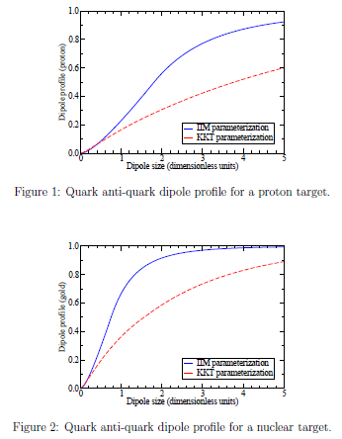
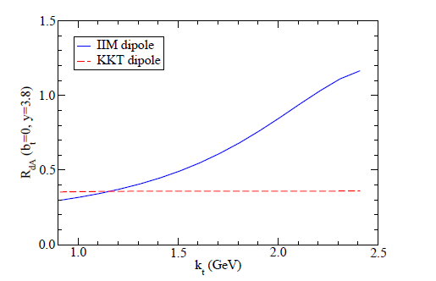
RHIC
J. Jalilian-Marian, NPA753 (2005) p307-315

Slide 15
Summary
Forward γ production at RHIC/LHC
Extension of pQCD possible
Extreme higher twist(large Q_{s}) and CGC.
Universality in dipole cross section (DIS & Forward γ production)
Dipole cross section is not yet calculated from baseline JIMWLK equation, but models for it exist.

Slide 16
Generic detector R&D

Slide 17
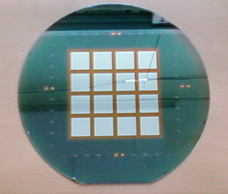
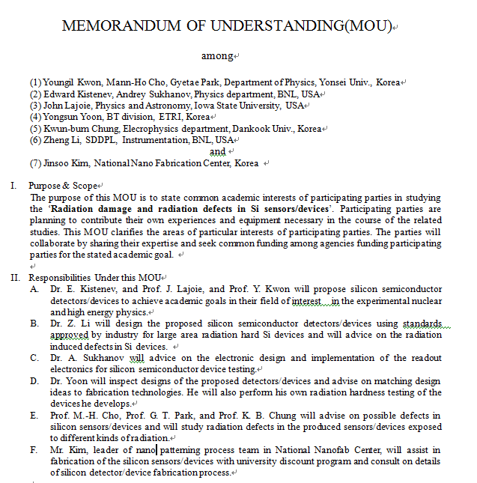
한국의 잠재역량
R&D environment
6 inch fabrication line
300 cm² ~ $ 500
8 inch fabrication line

Slide 18
FOCAL
A compact sampling electromagnetic calorimeter
deals with large particle flux at forward
observes part of the energy deposited by particle for the optimized shower
measures key particles, e, γ and π⁰, within small space
measures energy.

Slide 19
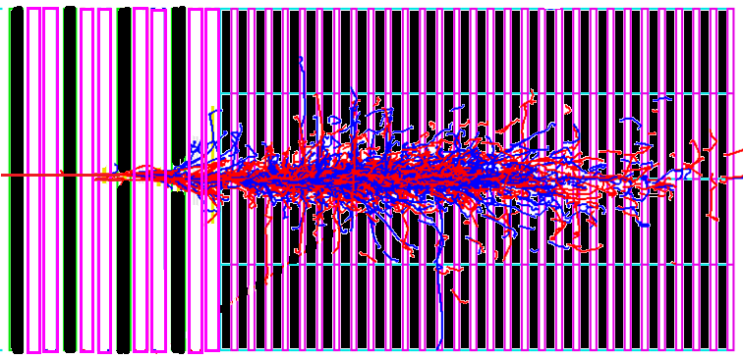
A compact EMCal, Si/W sandwich calorimeter
50 (GeV) electron
1 Moliere radius(~1.5cm)
20 radiation length (4mm W~1 X₀)

Slide 20
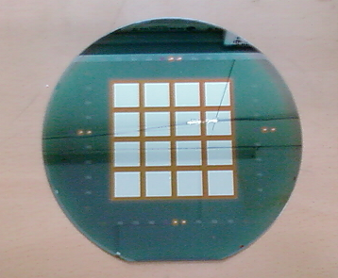
Silicon pad sensor
Basically PN junction diode in reverse bias mode.
N-type substrate and p-type pattern for high energy application => electrons are carriers
16 square(1.5cm×1.5cm) pads in one micro-module
-
ground
Notes:
Here is about silicon pad sensor
The left picture is a side view schematic of pad sensor, and the right picture is a wafer have a sensor for one micro-module.
Basically, pad sensor is a PN junction diode under reverse bias.
As this side view, this part is n type wafer and this part is p type pattern.
So, there will be more electron carriers.
To give reverse bias, ground will be given here and minis voltage will be given here.
In one micromodule sensor there are sixteen square pads.
Each pads are separated from each other.

Slide 21
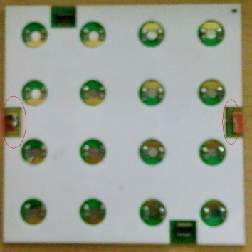
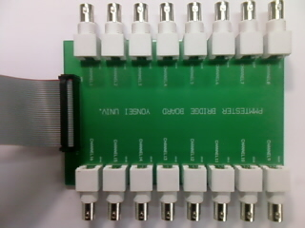
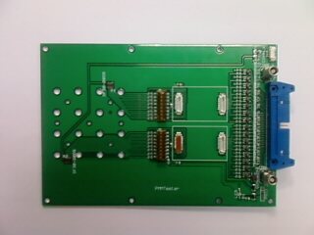
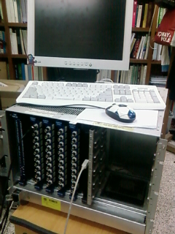

Slide 22
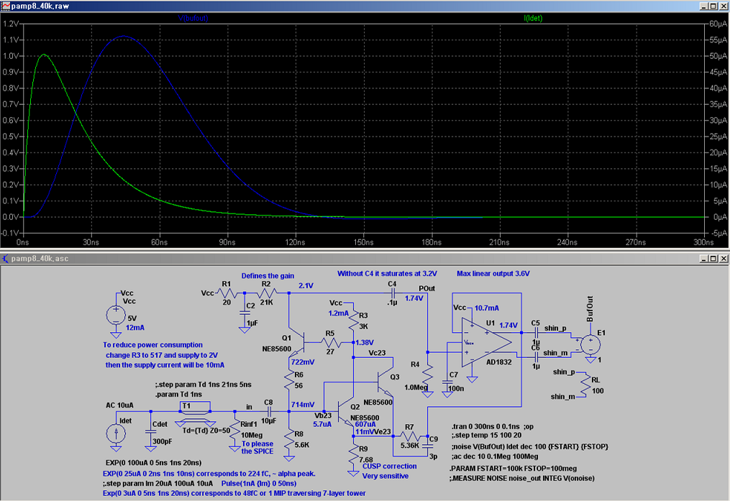
Preamp
Output signal
Injected signal

Slide 23
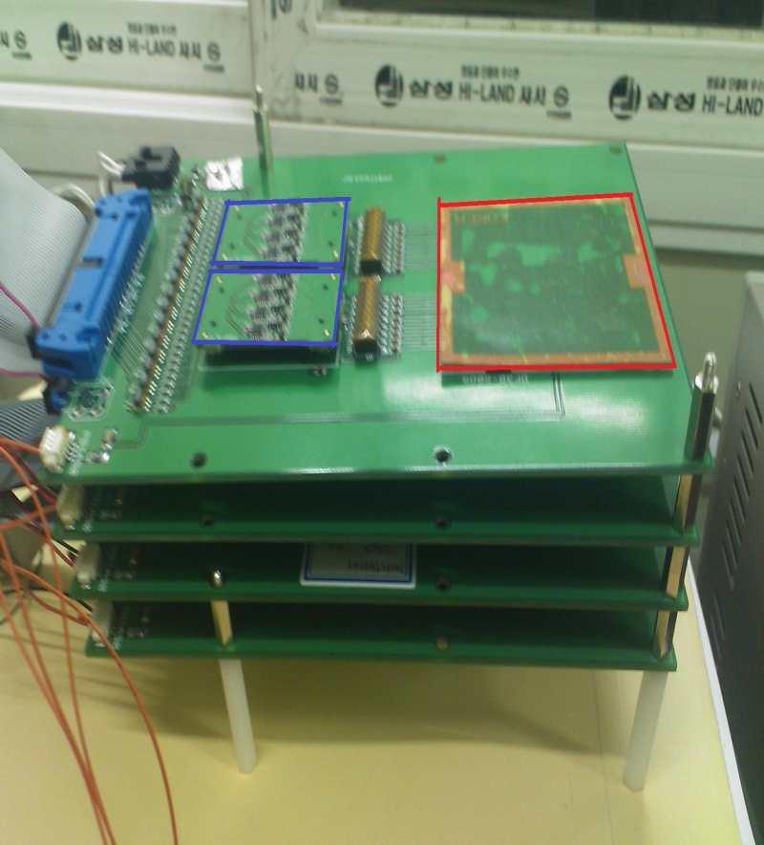
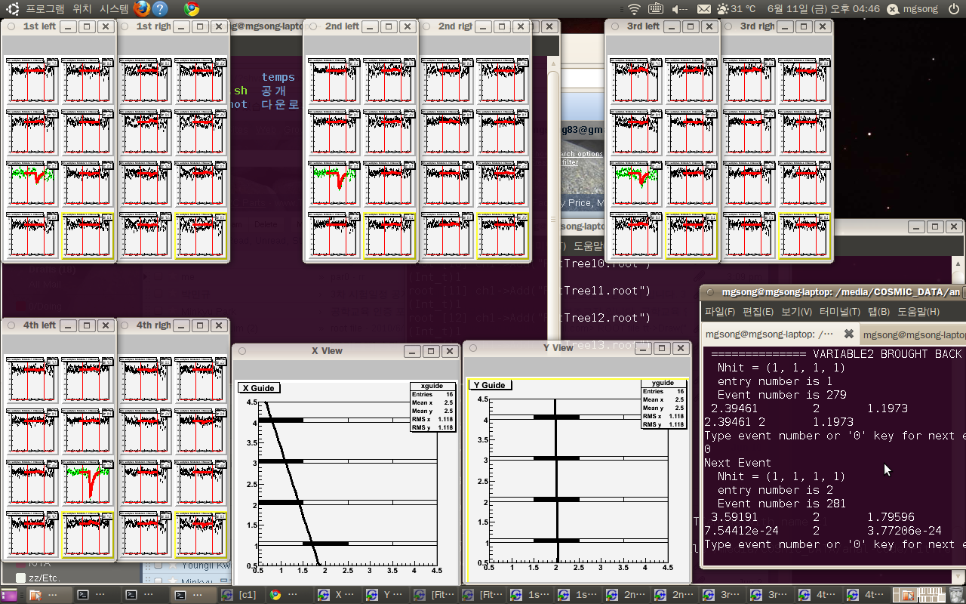
Cosmic muon test

Slide 24
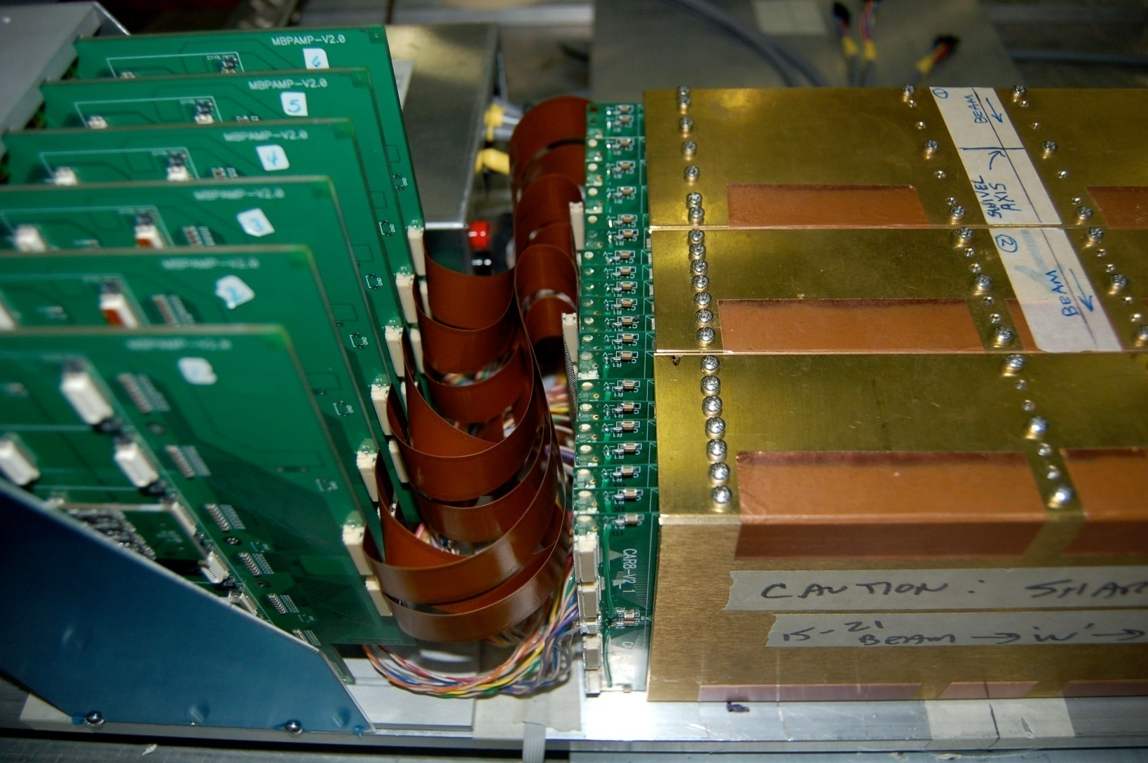
“A” Si/W calorimeter prototype
KPS, Fall 2010

Slide 25
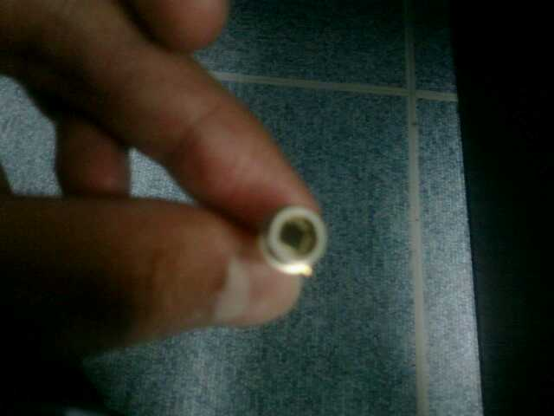
High sensitivity photon sensor (SiPM)
~ 10⁵-10⁶ electrons for a photon in visible range

Slide 26
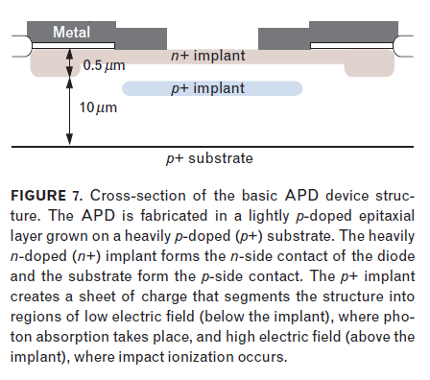
구조와 동작
V_{bias}
+++++++
- - - - - - -

Slide 27
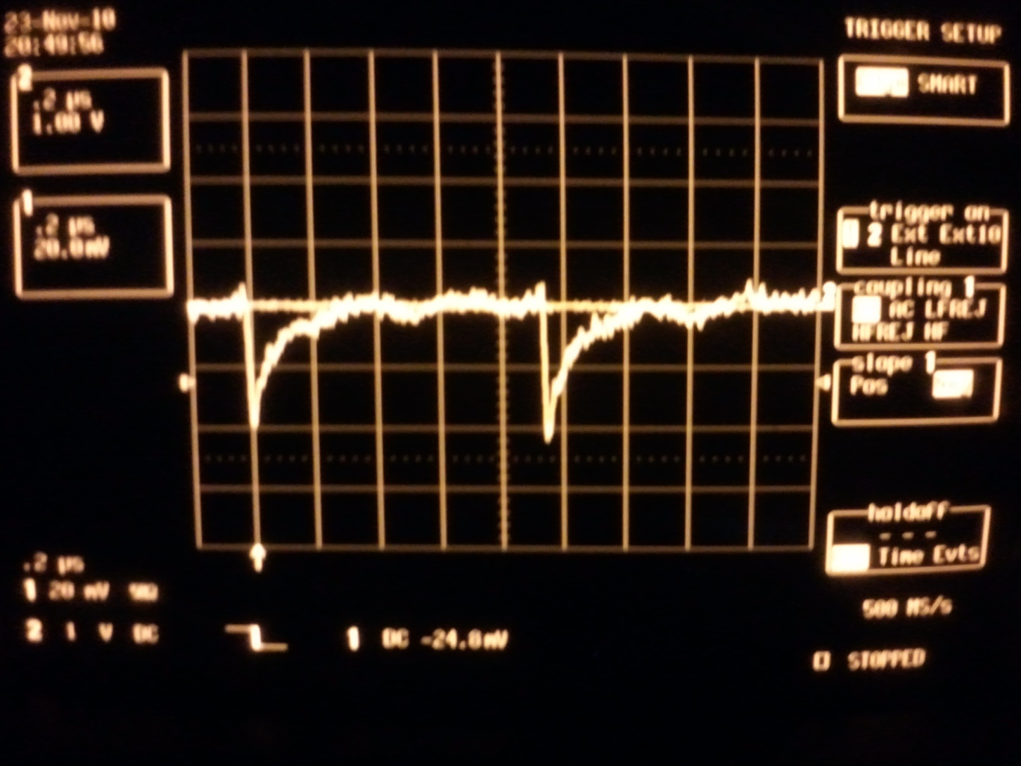
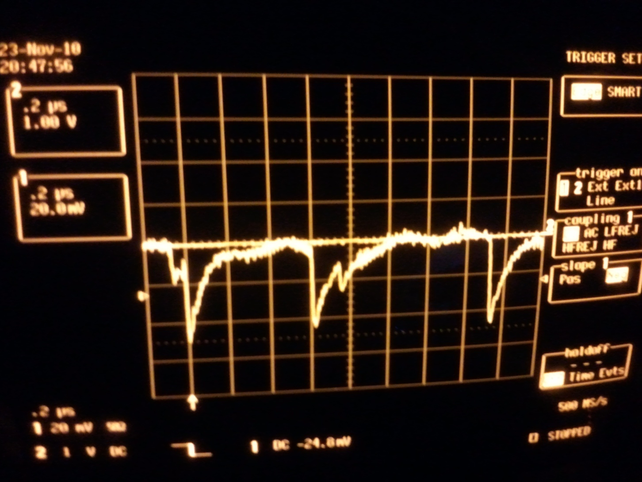
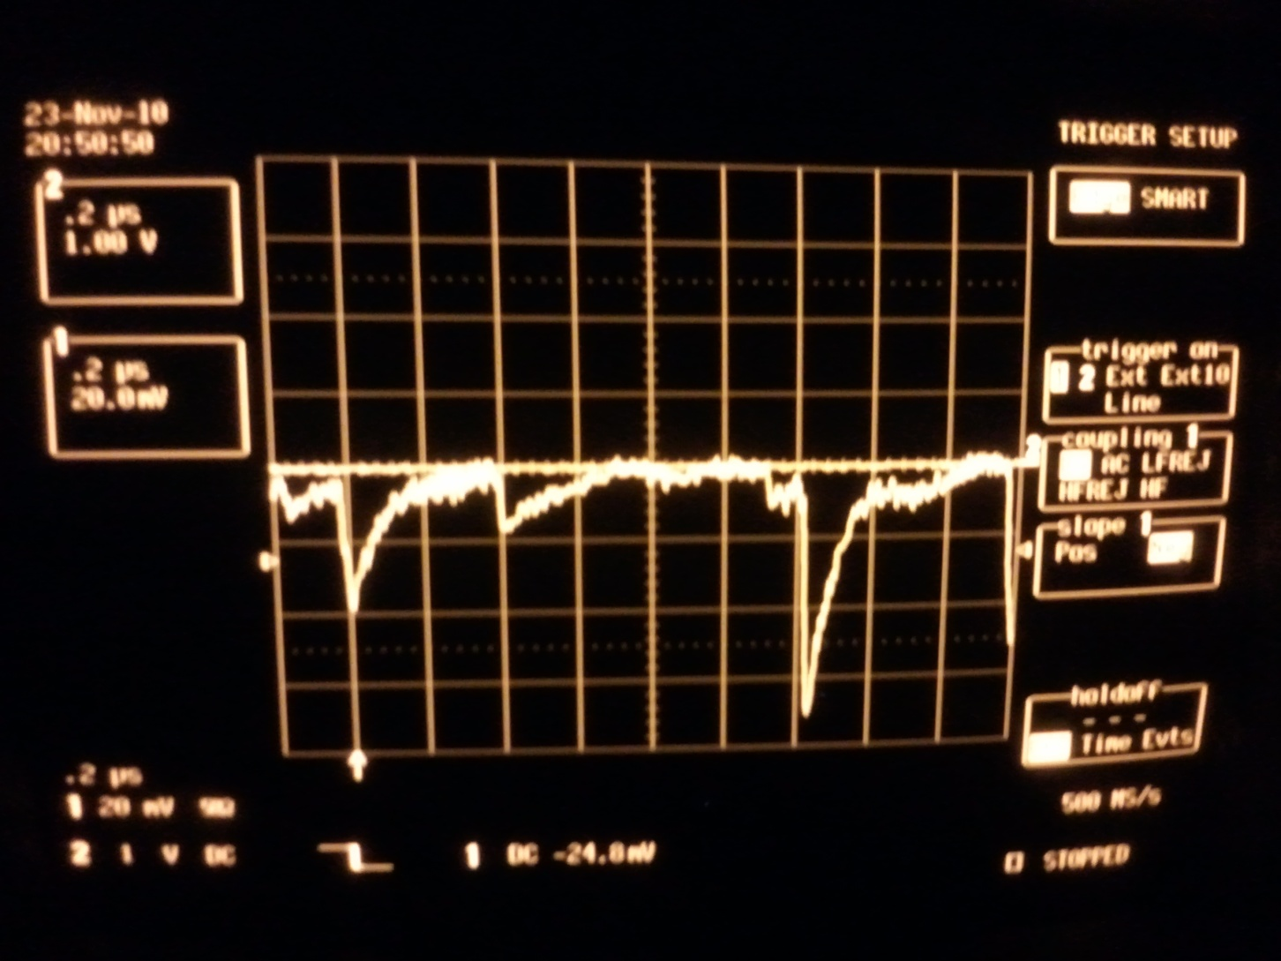
Noise signal

Slide 28
24.5 (V) : Under breakdown

Slide 29
25.5 (V) : Breakdown
~18 (mV)

Slide 30
27.0 (V) : Over breakdown
~31 (mV)
Cross talk?

