Slide 1
Quark Number Susceptibility in Deformed AdS
Kyung-il Kim
December 10~11, 2010, Heavy Ion Meeting

Slide 2
Contents
Introduction
Quark number susceptibility
AdS/QCD at finite temperature
Hydrodynamics
AdS/CFT approaches to hydrodynamics
Deformed AdS space
Quark number susceptibility in AdS/QCD
Summary and Outlook
2010 Dec. 10~11 Heavy Ion Meeting
2/24

Slide 3
Quark Number Susceptibility
Ref. Larry Mclerran PRD 36 (1987) 3291
If the effective mass of baryons in the quark-gluon plasma is small compared to what it is in the hadron gas, then the baryon number concentrates in the region of quark-gluon plasma.
The baryon number density near zero chemical potential
In large N_c limit,
2010 Dec. 10~11 Heavy Ion Meeting
3/24

Slide 4
Quark Number Susceptibility
Ref. Cheng et al. PRD 79, 074505 (2009)
<The pressure>
= Grand potential
<The definition of susceptibility for various charge>
Under conditions met in RHIC and LHC the net baryon number is small and QCD at vanishing chemical potential provides a good approximation.
2010 Dec. 10~11 Heavy Ion Meeting
4/24

Slide 5
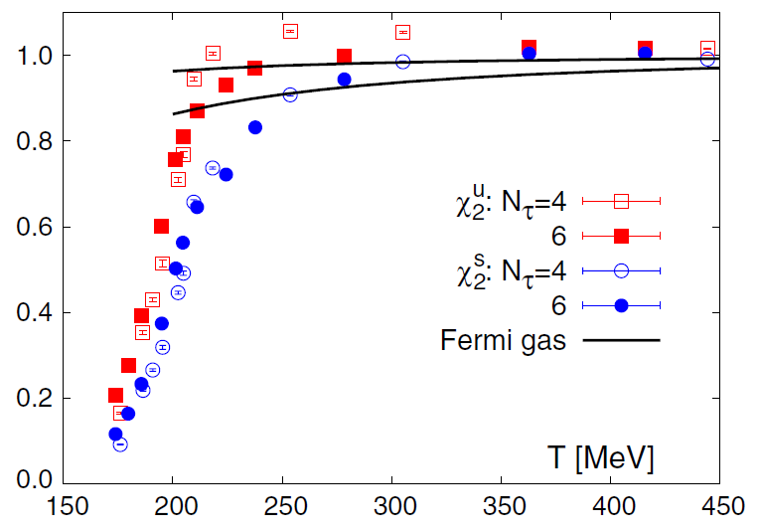
Quark Number Susceptibility
Lattice Results
2010 Dec. 10~11 Heavy Ion Meeting
5/24

Slide 6
AdS/QCD at finite temperature
Geometry
Confinement phase
Thermal AdS
Deconfinement phase
AdS Black Hole
The periodicity
The Hawking temperature
The black hole horizon
The Euclidean gravitational action
2010 Dec. 10~11 Heavy Ion Meeting
6/24

Slide 7
Hydrodynamics
The long-distance, low-frequency behavior of any interacting theory at finite temperature must be described by hydrodynamics.
<The retarded thermal Green’s function>
where,
This function determines the response of the system on a small external source coupled to the current.
When omega and q are small, the external perturbation varies slowly in space and time, and a macroscopic hydrodynamic description for its evolution is possible.
2010 Dec. 10~11 Heavy Ion Meeting
7/24

Slide 8
Hydrodynamics in AdS/QCD
<The gravity/gauge theory duality>
<The method to obtain the retarded Green’s function>
i) From classical action,
ii) With incoming-wave boundary condition at horizon,
=1 at u=0 by definition of mode eq.
iii) The retarded thermal Green’s function is
2010 Dec. 10~11 Heavy Ion Meeting
8/24

Slide 9
Hydrodynamics in AdS/QCD
Ref. G.Policastro, D.T.Son and O.Starinets JHEP 09 (2002) 043
How do we calculate the retarded Green’s function in AdS?
<The metric and action>
<The equation of motion for gauge field>
2010 Dec. 10~11 Heavy Ion Meeting
9/24

Slide 10
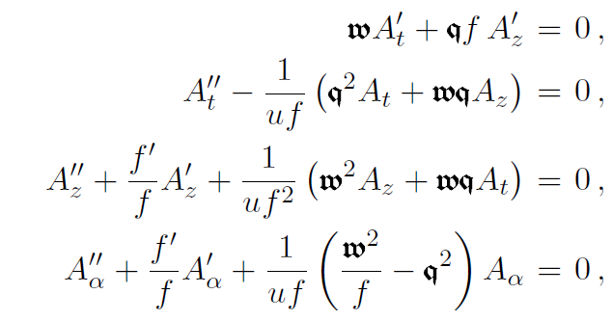
Hydrodynamics in AdS/QCD
<The Fourier decomposition>
We choose,
dimensionless quantities,
The e.o.m can be written as,
2010 Dec. 10~11 Heavy Ion Meeting
10/24

Slide 11
Hydrodynamics in AdS/QCD
The equation for time component
We substitute,
then, we obtain with incoming-wave condition,
The equation for F(u)
2010 Dec. 10~11 Heavy Ion Meeting
11/24

Slide 12
Deformed AdS Space
Ref. Y.Kim, T.Misumi, and I.j.Shin [arxiv 0911.3205]
5D action for scalar field
Scalar field solution for
Thermal AdS :
AdS BH :
σ=0 is assumed in AdS BH since this background corresponds to high temperature deconfined phase.
2010 Dec. 10~11 Heavy Ion Meeting
12/24

Slide 13
Deformed AdS Space
The deformed AdS Black Hole
<The back-reacted metric>
where,
<The Hawking temperature for black-hole>
where,
2010 Dec. 10~11 Heavy Ion Meeting
13/24

Slide 14
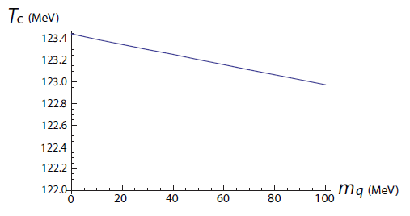
Deformed AdS Space
<Change of critical temperature by quark mass>
If we consider only the effect of back-reacted quark mass, the change of critical temperature is small.
(Here the change of scale is not considered.)
2010 Dec. 10~11 Heavy Ion Meeting
14/24

Slide 15
Deformed AdS Space
< A dimensionless coordinate>
: u=1 is horizon and u=0 is boundary.
The metric rewritten as
where,
2010 Dec. 10~11 Heavy Ion Meeting
15/24

Slide 16
Quark Number Susceptibility
<The 5D action for U(1) gauge field>
with gauge choice,
5D gauge coupling constant
The Fourier decomposition
<The equation of motion for A_t>
2010 Dec. 10~11 Heavy Ion Meeting
16/24

Slide 17
Quark Number Susceptibility
<The equation of motion for time component>
We substitue,
A solution as,
2010 Dec. 10~11 Heavy Ion Meeting
17/24

Slide 18
Quark Number Susceptibility
The small parameter expansion of F(u)
The solution is obtained as following,
2010 Dec. 10~11 Heavy Ion Meeting
18/24

Slide 19
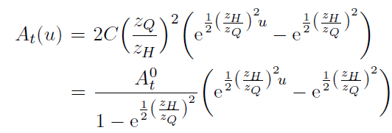
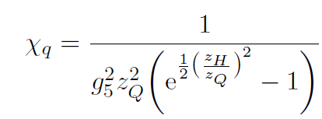
Quark Number Susceptibility
The solution of A_t
<The quark susceptibility from the on-shell action>
2010 Dec. 10~11 Heavy Ion Meeting
19/24

Slide 20
Quark Number Susceptibility
Thermodynamic analysis
<The grand potential>
The 5D bulk action on-shell action in Euclidean spacetime
Solution of time-component of gauge field,
when chemical potential is defined as,
2010 Dec. 10~11 Heavy Ion Meeting
20/24

Slide 21
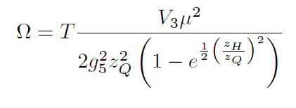
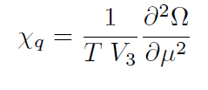
Quark Number Susceptibility
<The grand potential>
<The quark number susceptibility>
2010 Dec. 10~11 Heavy Ion Meeting
21/24

Slide 22
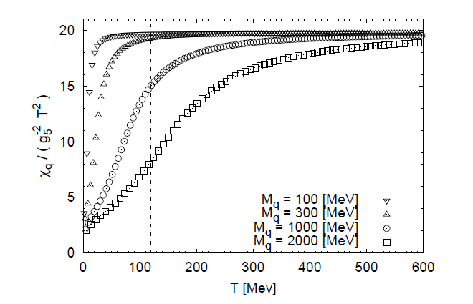
Quark Number Susceptibility
<The quark number susceptibility in deformed AdS>
2010 Dec. 10~11 Heavy Ion Meeting
22/24

Slide 23
Summary and Outlook
The quark number susceptibility has a feature that it is suppressed by quark mass.
Using hydrodynamic and thermodynamic approaches to AdS/QCD, we can obtain same result in quark number susceptibility.
Using D3/D7 model, in top-down approach we can obtain quark number susceptibility.
2010 Dec. 10~11 Heavy Ion Meeting
23/24

Slide 24
Thank you!

