Slide 1
A wake of color medium by a fast parton
Ghi R Shin
With S. Bass and B. Mueller
(J. Phys. G: G/359606/PAP/24069)

Slide 2
Predictions of upcoming winners for Nobel Prize In Physics
For discovering accelerating cosmological expansion: Adam Riess, Saul Perlmutter, Brian Schmitt
For formulating chaos theory: Mitch Feigenbaum, Edward Ott, James Yorke, and Celso Grebogi, Harry Swinney, Benoit Mandelbrot
For the discovery and study of extrasolar planets: Alexsander Wolszczan, Dale Frail, Paul Butler, Geoffrey Marcy, Michael Mayor, Didier Queloz, David Lathan
For discovering and developing carbon nanotubes: Sumio Iijima, Cees Dekker, Phaeton Avouris, Charles Lieber, Thomas Ebbeson
For synthesizing superheavy elements: Peter Armbruster, Yhuri Oganessian, Sigurd Hofmann
For formulating inflationary cosmology: Alan Guth, Paul Steinhardt, Andrei Linde
For predicting, discovering, and developing negative-index metamaterials: Victor Veselago, John Pendry, David Smith, Xiang Zhang, Sheldon Schultz, Ulf Leonhardt
For discovering and developing photonic crystals: Eli Yablonovitch, Shawn Lin, John Joannopoulis
For discovering graphene: Andre Geim and Kostya Novoselov
For studies on quantum nonlocality, entanglement, decoherence, and atom optics: Alan Aspect, Serge Harouche, Anton Zeilinger, Charles Bennett, Anton Zurek, David Pritchard, Joerg Schmiedmayer, David Wineland, Peter Zoller
For achieving stopped light and electromagnetically induced transparency: Lene Hau, Ronald Walsworth, Mikhail Lukin, Stephen Harris, and Marlon Scully
For predicting and demonstrating quark-gluon plasma: Miklos Gyulassy, Bill Zajc, Berndt Mueller
For the development of the LED laser, Nick Holonyak; Shuji Nakamura, blue laser; Robert Hall, first semiconductor laser
For the discovery of the top quark: Paul Grannis, Mel Schocket, William Carruthers
Show repliesNone of the above... I think this will win (please specify)

Slide 3
Problems with PCC: heavy ion collisions
Unknown parton distributions of nuclei: CTEQ, GRV & EKS, CGC
So many unknown parameters: coupling constant, minimum momentum transfer, density, temperature, ….
Unknown equations of motions: Elze and Heinz, Geiger, Jeon, …
NEEDS a simple and understandable scheme which has minimal unknowns

Slide 4
BRICK problem
Thermalized system of gluons, quarks and antiquarks, or quarks and gluons
Well defined temperature or entropy
Thermal cross section: much less controversal – natural cutoff for the minimal momentum transfer
Might important in QGP or Heavy Ion Collisions

Slide 5




1. Initial distribution
Gluon:
(Anti)Quark:

Slide 6





2. Cross Sections(thermal)
gg->gg:
gg->qq:
gq->gq:
qq->qq:
qq->gg:
gg->ggg:

Slide 7
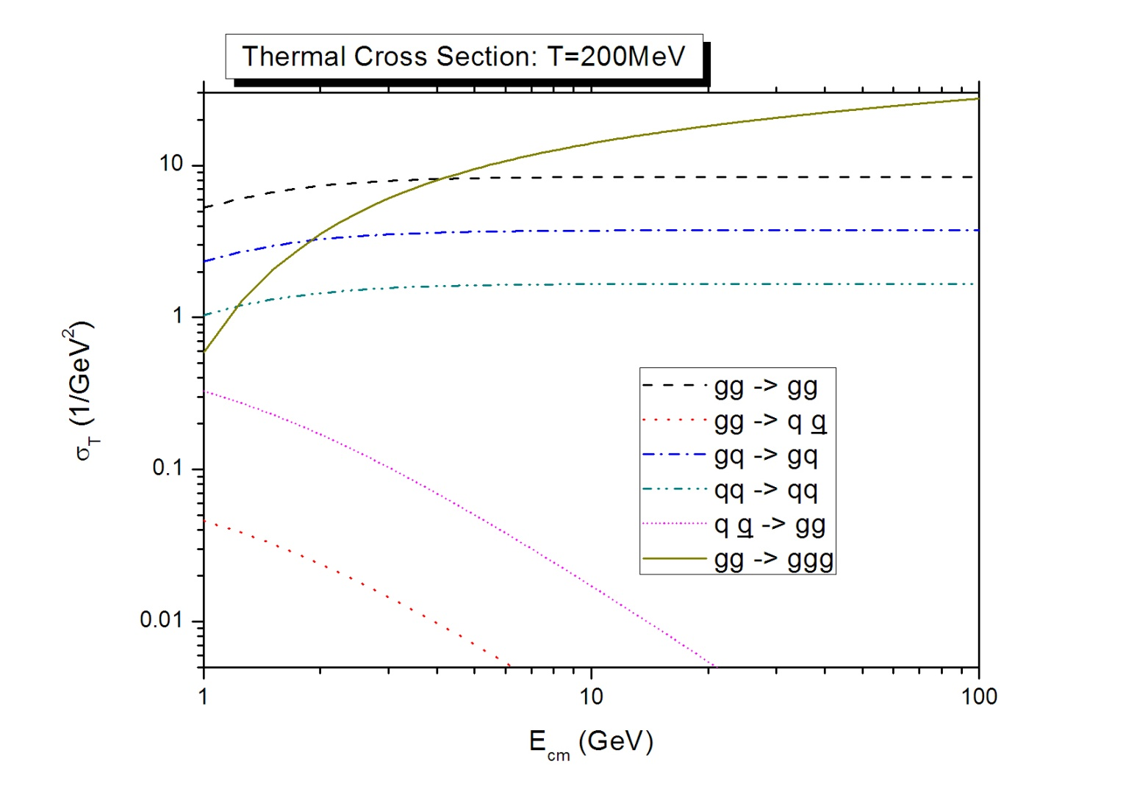

Slide 8
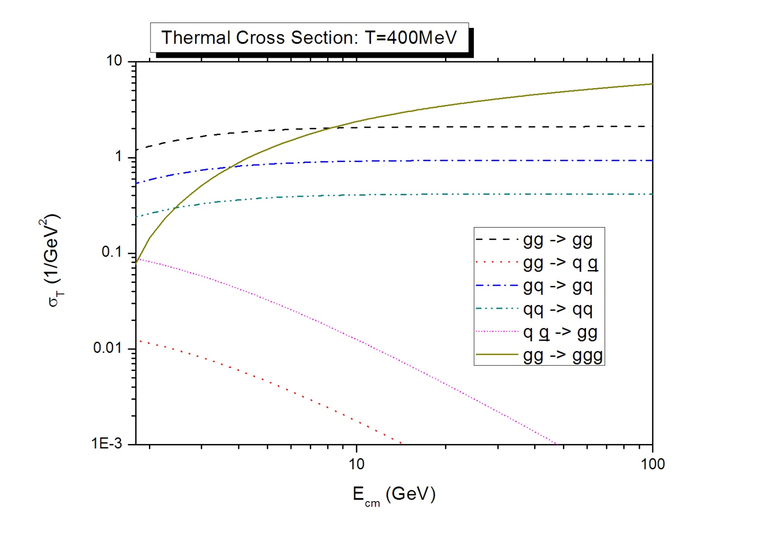

Slide 9
3. PCC
NOT smart way but WORKS OK

Slide 10
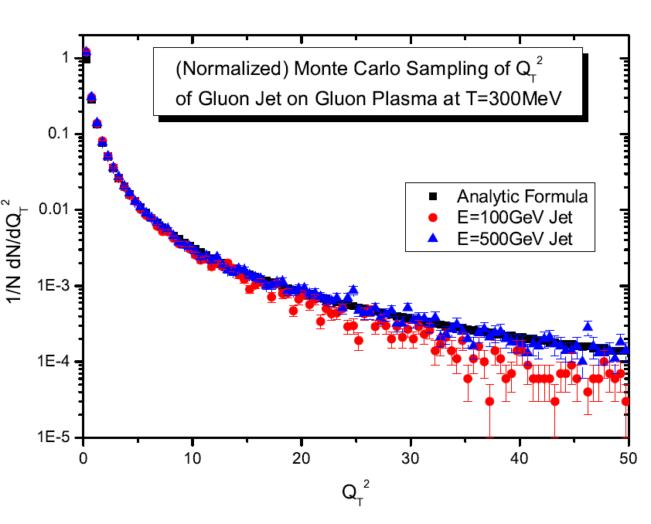
4. Results I: Fast Parton
Monte Carlo sampling:

Slide 11
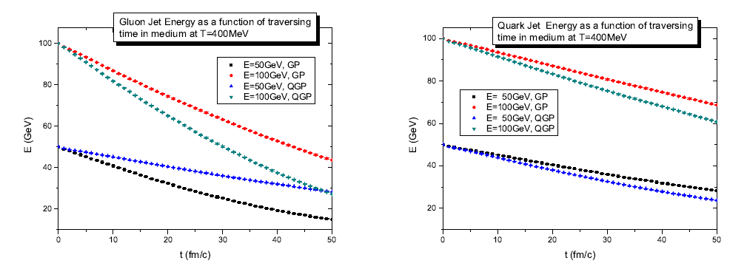
Energy Loss:

Slide 12

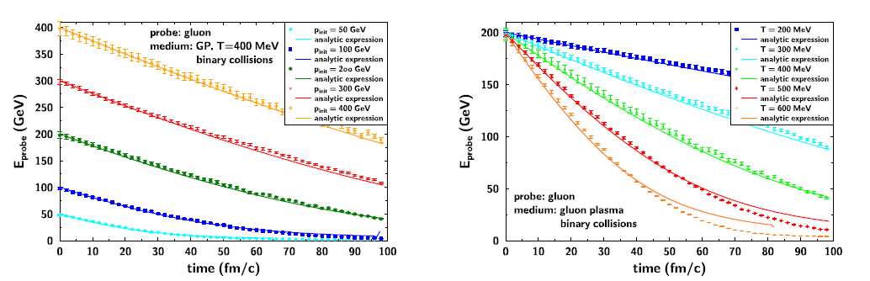

Slide 13

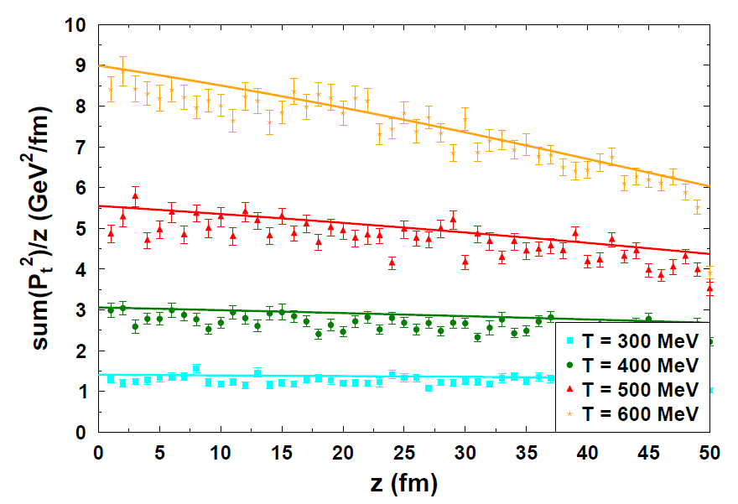
Q_hat:

Slide 15
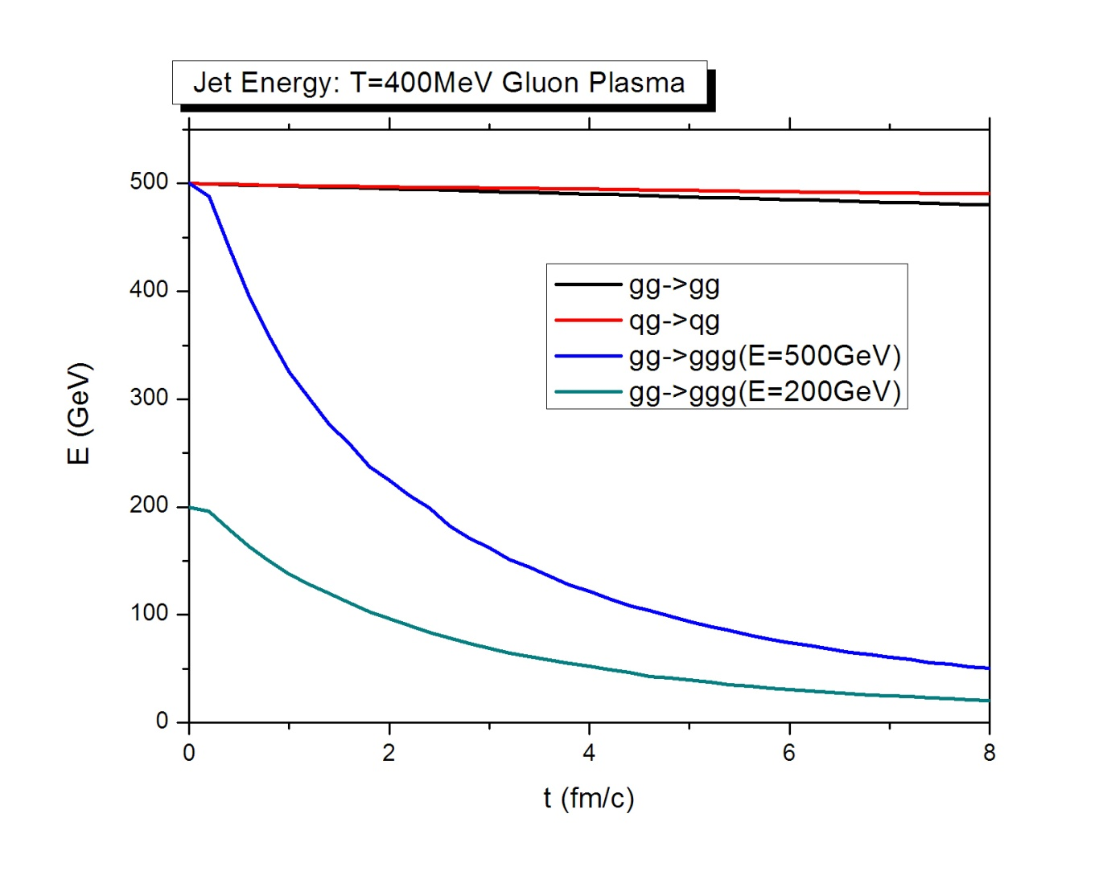
5. Results II: Medium Response

Slide 16
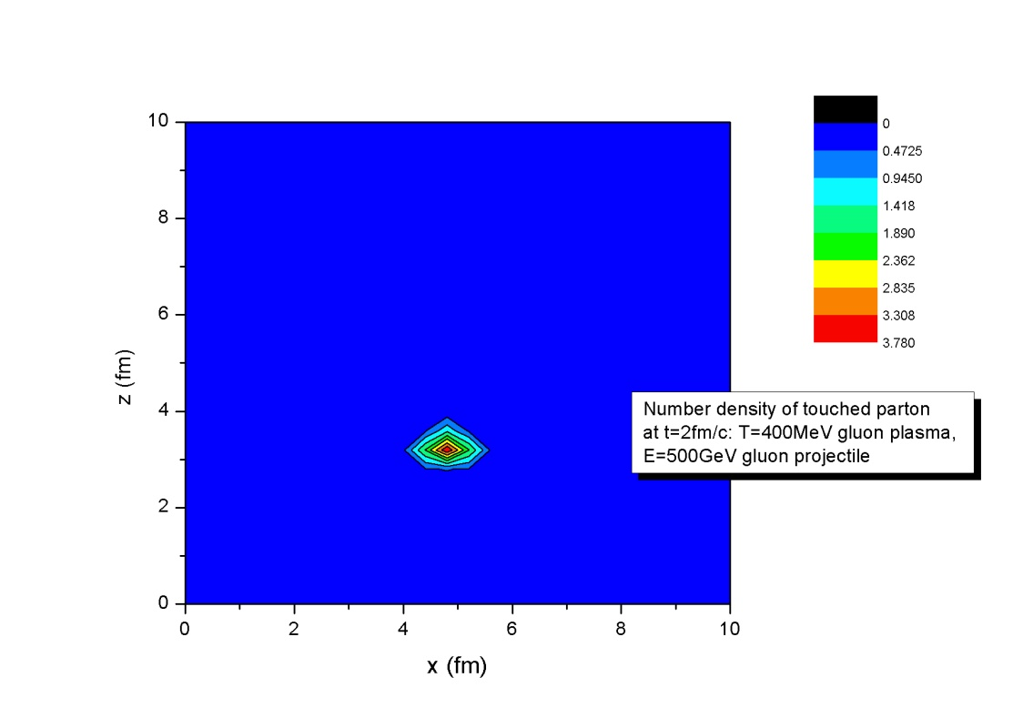
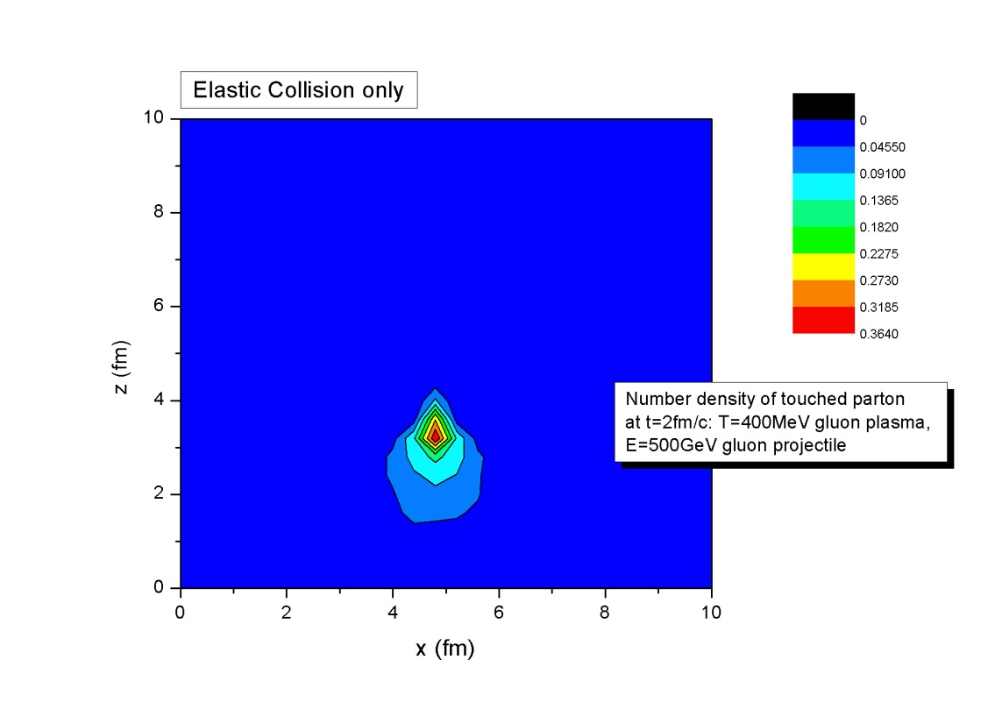
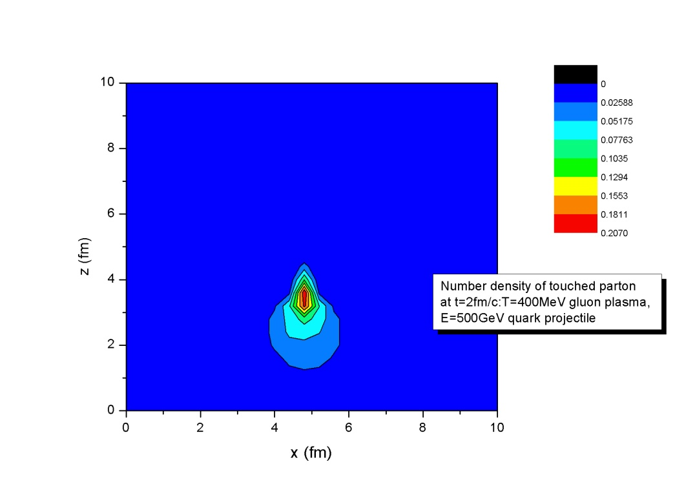
Number density:

Slide 17
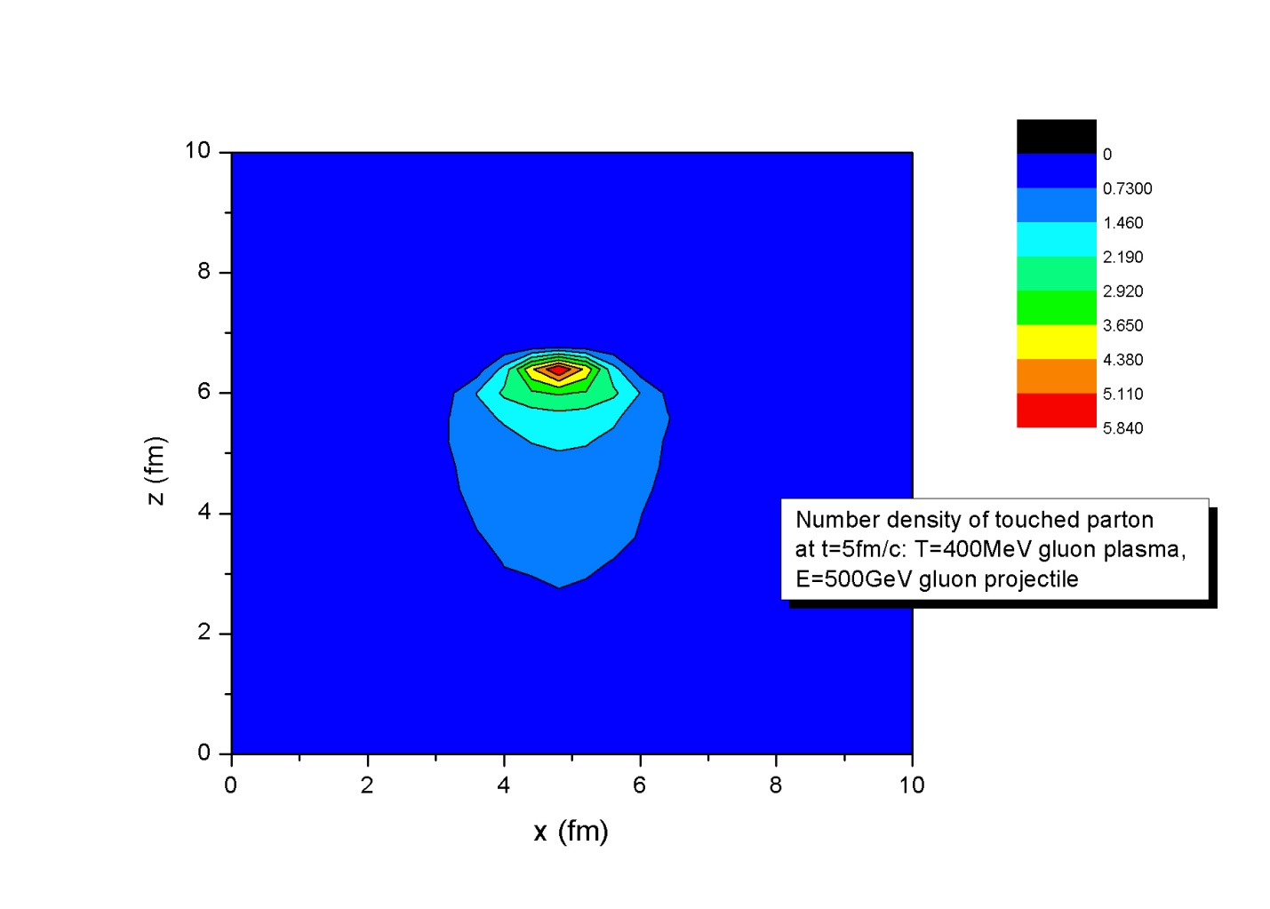
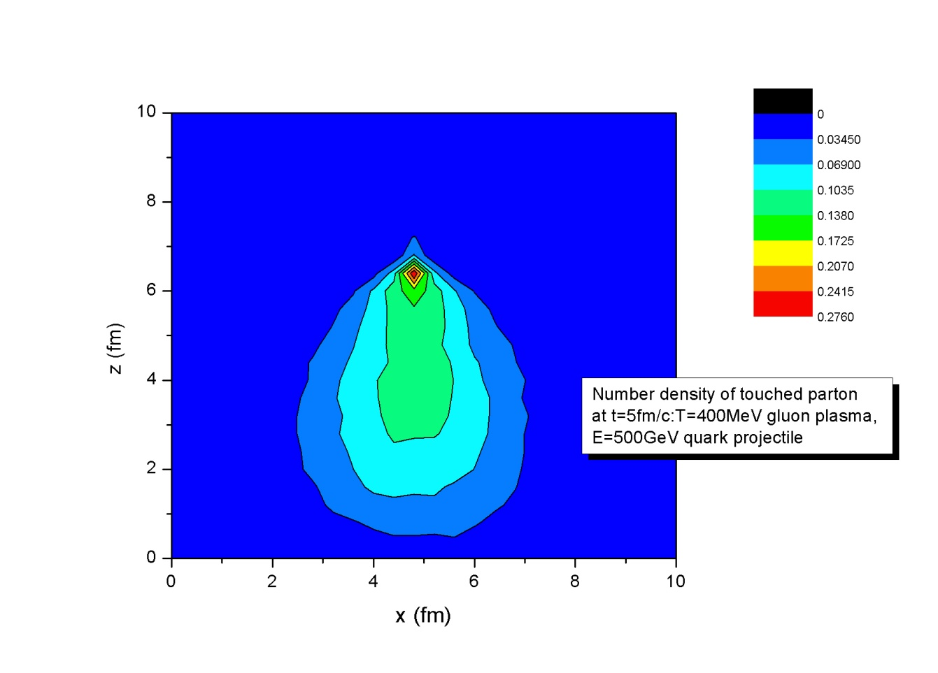
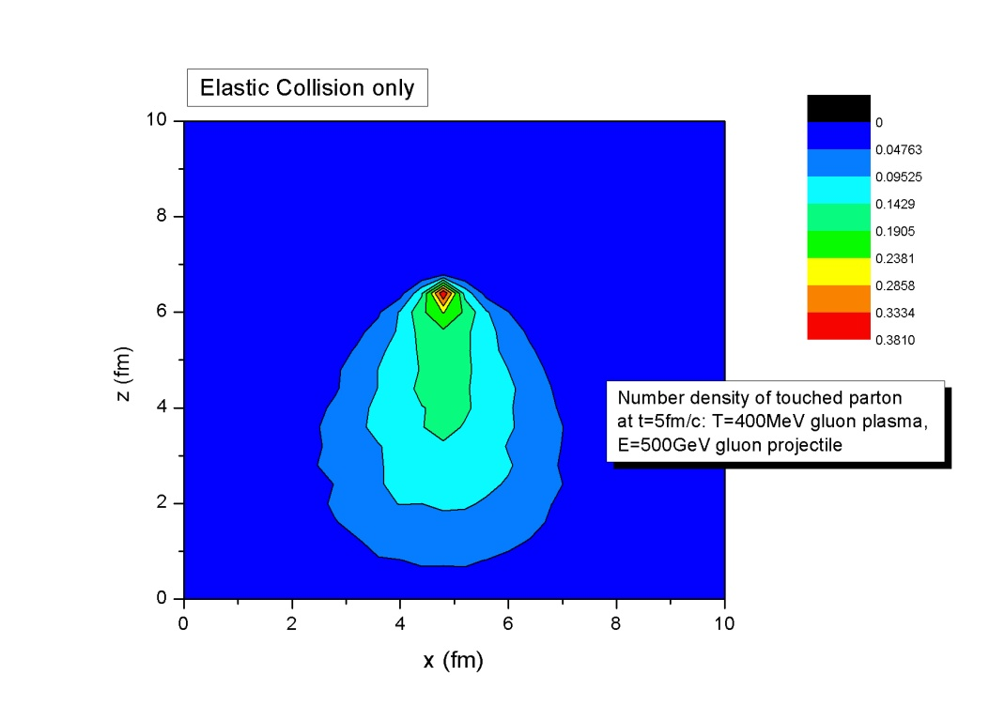

Slide 18
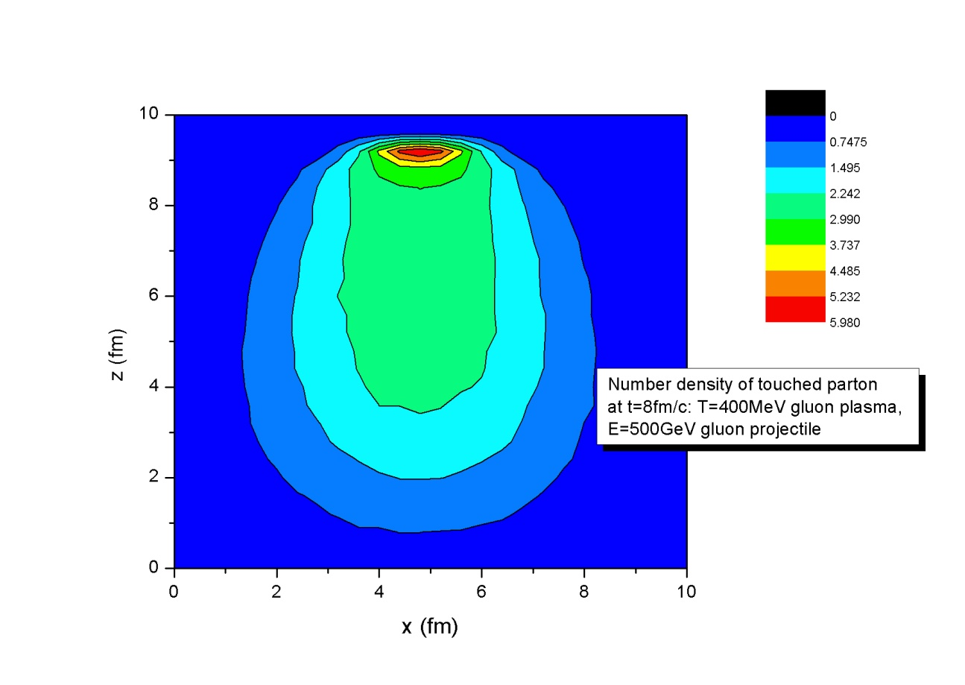
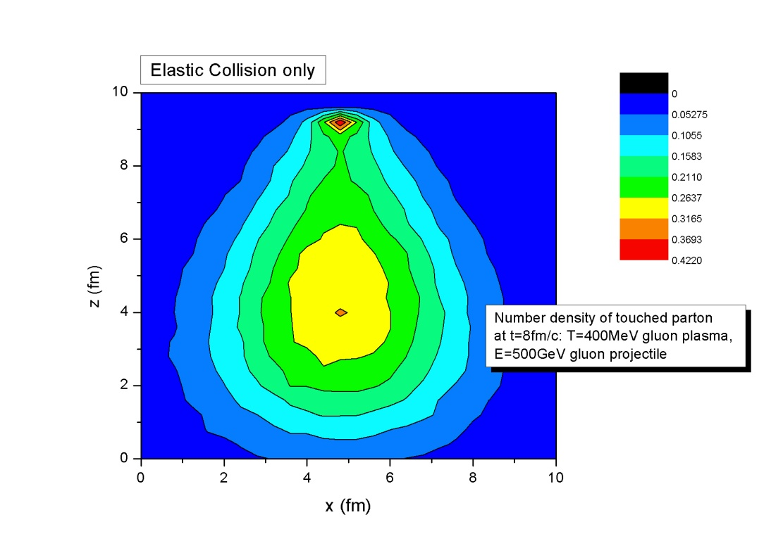
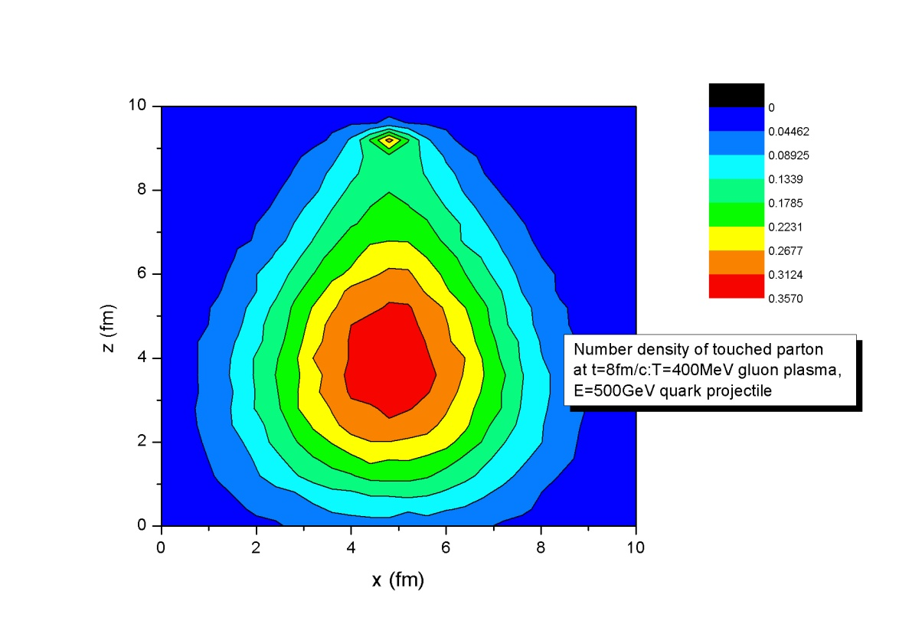

Slide 19
6. Concluding Remarks
Good agreement with analytic formula in elastic scattering
The medium responds differently with different temperature and projectile
Do we see Mach cone or what are the angles?

