Slide 1
Performance of the X-ray PSD based on the MWPC
Position sensitive detector (PSD)
Multi-wire proportional chamber (MWPC)
Ryu Min Sang
Neutron Science Division
Korea Atomic Energy Research Institute (KAERI)
2010.02.25-27 Heavy Ion Meeting
Yongpyong resort, Pyungchang

Slide 2
Contents
Introduction
X-ray diffraction
Small angle X-ray scattering (SAXS)
Position sensitive detector (PSD)
Detector construction
DAQ and test setup
Experimental results
Fabricated PSD at KAERI
Summary

Slide 3
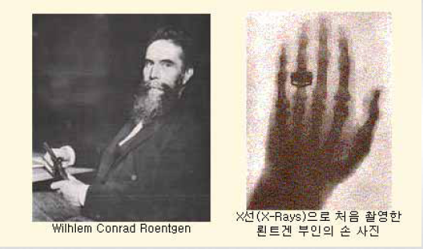
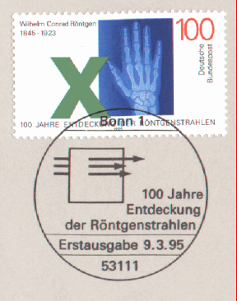
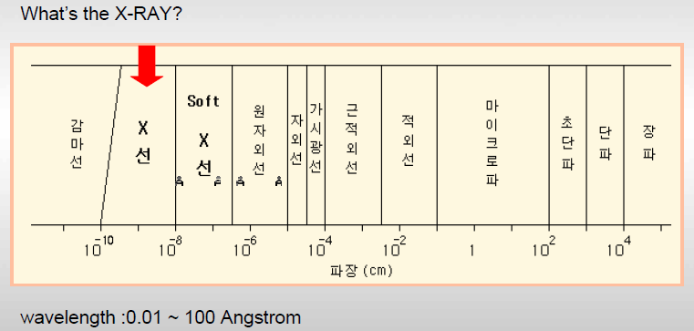
Introduction – X-ray
In 1895, Wilhelm Conrad Roentgen (GE) discovered the X-ray.
< general properties >
X-ray detection method
Imaging
Fluorescence (ZnS, CdS, NaI)
Ionization
Light speed in vacuum
Diffraction like particle
Reflection index ~ 1
(impossible to focus the X-ray)
medical imaging & material experiment due to the high transparency

Slide 4
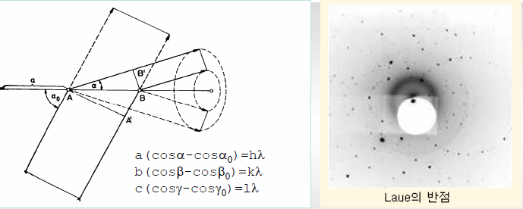
Introduction – X-ray diffraction
In 1912, Laue (GE) succeeded the X-ray diffraction experiment .
X-ray diffracts when its wavelength is same as the distance in between atoms.
In 1913, Bragg (UK) makes Laue’s diffraction formula more simply.
Constructive interference: n = integer
d: distance between the interface of atoms
λ : wavelength
θ : incidence angle

Slide 5
Introduction - SAXS
Small angle X-ray scattering (SAXS):
- research the shape and size of the high molecular materials.
- role of PSD: to measure the scattered pattern.
http://mrl.uscb.edu/~safinyaweb/XRD.htm
q: scattering vector
d: distance between the surface of atoms
λ : wavelength
2θ : scattering angle

Slide 6
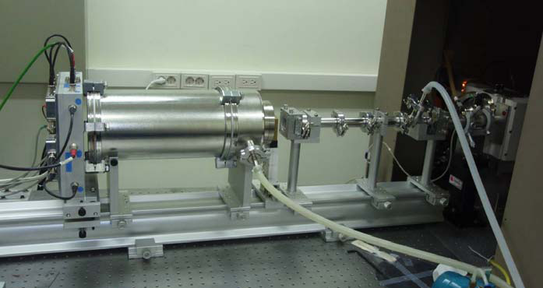
SAXS at Hannam University
Energy range of photon for diffraction and scattering experiment: 5 ~ 30 keV
Photo-electric effect
Wavelength of X-ray: 1.54 Å at 8.04 keV
Vacuum pipe
Focusing mirror
2D MWPC
slit1
MWPC FEE
X-ray generator
slit2
sample
< X-ray generator >
Rigaku rotating anode
3 kW filament
40 kV, 70 mA
< Focusing mirror >
Osmic
Confocal Max-Flux
Source-focus distance: 1200 mm

Slide 7
Introduction - PSD
Why is MWPC attracted than the semiconductor detector?
Multi-wire proportional chamber (MWPC)
- single counting method
<strength>
- high X-ray detection efficiency
- good position linearity
- geometrical flexibility
- fast DAQ
- low production cost
<weakness>
- relatively poor position resolution compared to SDAD.
- poor rate capability
Silicon diode array detector (SDAD) or charge-coupled device (CCD)
- charge accumulation method
<strength>
- good rate capability
- good position resolution
<weakness>
- high background
- narrow dynamic range
- poor time resolution
- slow DAQ

Slide 8
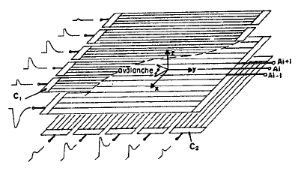
Operation of X-ray PSD
Energy range of photon for diffraction and scattering experiment: 5 ~ 30 keV
Photo-electrical effect creates the photo-electron or Auger electron.
Average ionization energy of noble gas (Ar, Kr, Xe): ~ 30 eV
- number of produced electron-ion pairs: ~160 at 5 keV
~267 at 8 keV
~1000 at 30 keV
<MWPC>
G. Charpak et al., Nucl. Instr. and Meth. 62 262 (1968)
G. Charpak and F. Sauli, Nucl. Instr. and Meth. 162 405 (1979)
Incident X-ray
Photo-electric effect
Electron avalanche occurs toward the anode.
Collect the electrons on the anode.
Positive ion drifts toward the cathode.
Induced signal on the cathode.

Slide 9
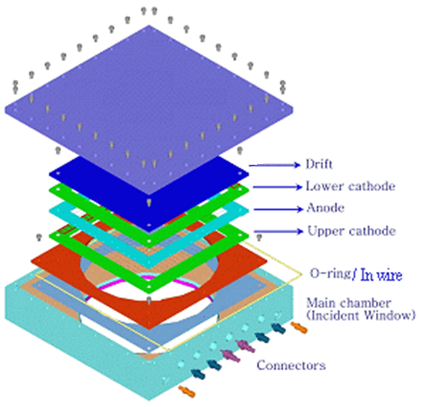
Detector configuration
230 mm
Effective area : 120 x 120 mm
230 mm
0.4 mm aluminized carbon fiber
~80 % transmittance at 8 keV (1.54 Å)
Ø150 mm
Drift
Anode: Ø10 ㎛, 1.25 mm spacing.
(Ø30 ㎛ used for 1st and 2nd wires at both end side.)
Dual Cathode: Ø30 ㎛, 1.25 mm spacing
Drift plate
Anode-Cathode gap: 3.2 mm
Drift-Cathode gap: 3.2 mm
Cathode (Y1, Y2)
Anode
Cathode (X1, X2)
Aluminized carbon fiber

Slide 10
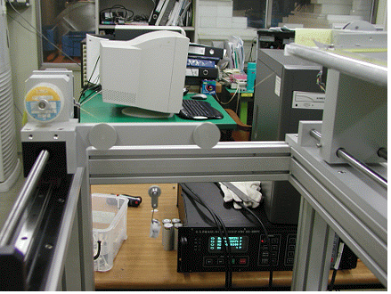
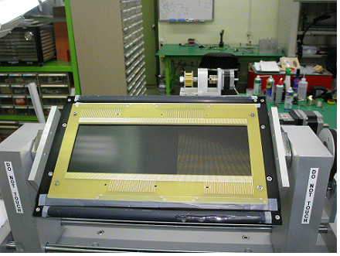
Winding Machine
M2
M3
M3
M1
M1
M2
Motor controller
Weight (wire tension control)
M2
Wire
M3
Wire frame (PCB)
Fixed pulley
*M means a stepping motor
M1 : Wire step control with linear translator
M2 : Wire frame rotator
M3 : Wire length control
M1
Movable pulley
Linear translator
(wire step control)
CERN report 77-09(1977)
Weight (wire tension control)

Slide 11
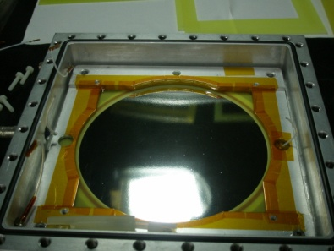
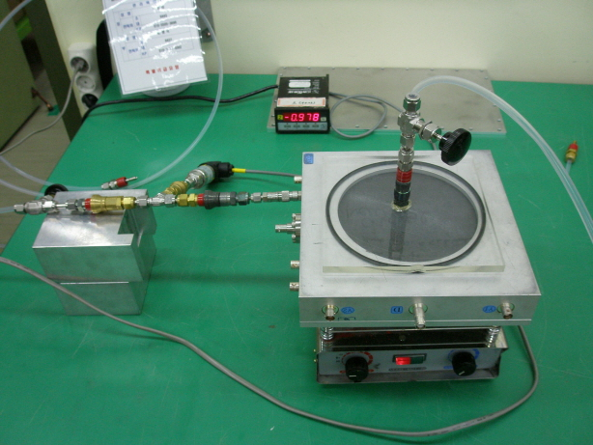
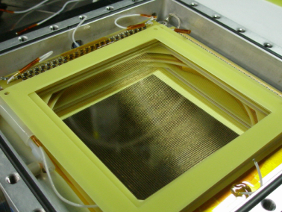
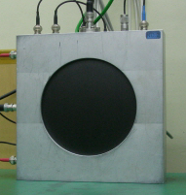
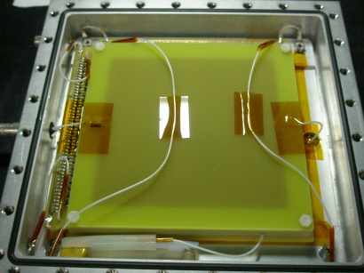
Picture of X-ray PSD
pursing

Slide 12
Data acquisition
Delay-line readout method
Anode wire
Avalanche
Charge
Inductor (145 nH) & capacitor (56 pF)
Total delay time: 170 ns
cathode wire
or
electrode
delay
delay
Constant
CABLE
Position
Fraction
DELAY
ATDC
TDC gate time
Sensitive
Discriminator
Detector
X
-
Left
IN
Detector delay time
PA
OUT
X1
X2
Anode
X
-
Right
PA
IN
Y1
X1
OUT
Y2
TDC delay
Y
-
Left
IN
COM
X2
PA
EXT
ΔX
OUT
count
Y
-
Right
PA
Y1
IN
EXT
OUT
triger
TDC delay
Anode
Y2
PA
IN
USB
ΔY
OUT

Slide 13
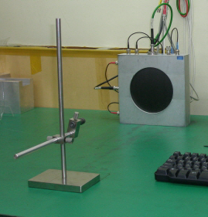
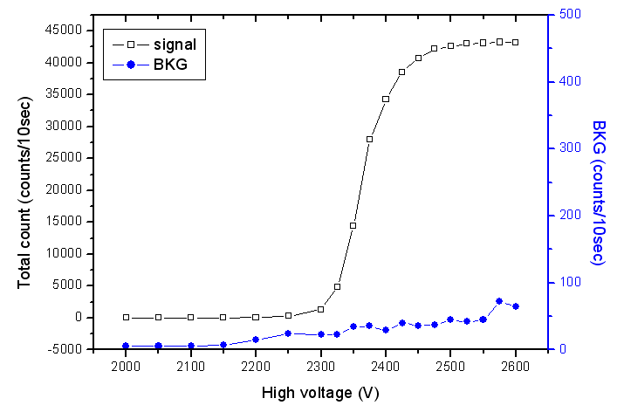
Operational region
Ar + C₂H₆ + CF₄ at 1.5 atm
Drift voltage: -1200 V
Fe-55: 6.4 keV, 10 mCi
(half life time : 2.744 y)
Source to PSD: 45 cm
+2475 ~ 2575V

Slide 14
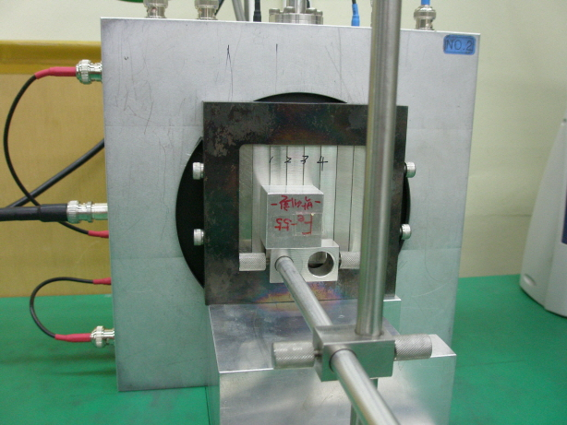
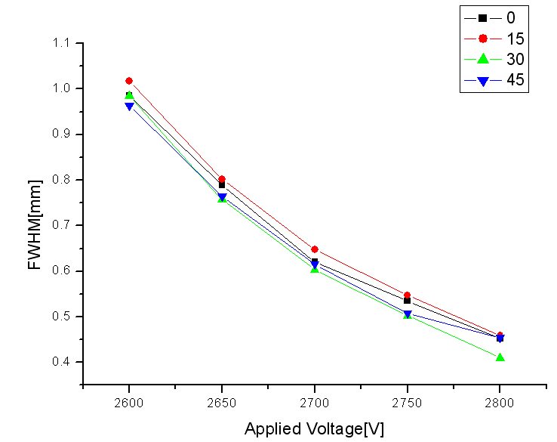
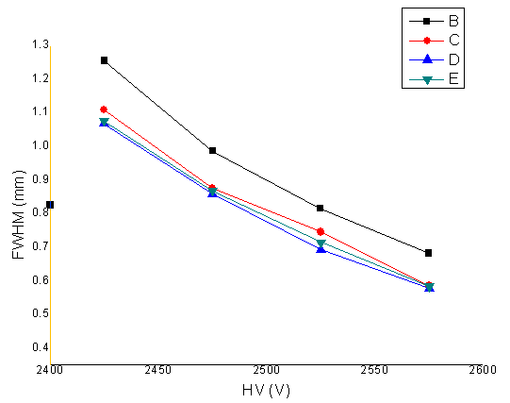
Position resolution
Ar 1.5 atm
Drift voltage: -1200 V
High voltage: +2425 ~ 2575 V
Voltage step: +50 V
Fe-55 (KAERI)
OLD
NEW
+2525 ~ 2575V

Slide 15
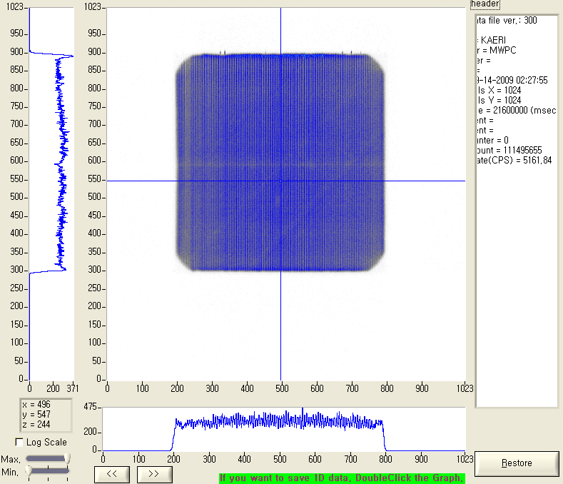
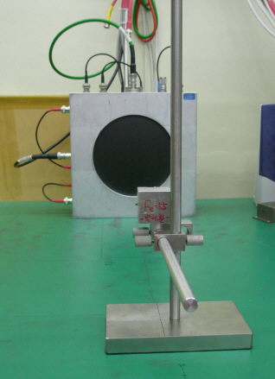
Uniformity
Ar 1.5 atm
Drift voltage: -1200 V
High voltage: +2525 V
Fe-55 (KAERI)
Source to PSD: 45 cm
Time: 21600 sec (6 hours)

Slide 16
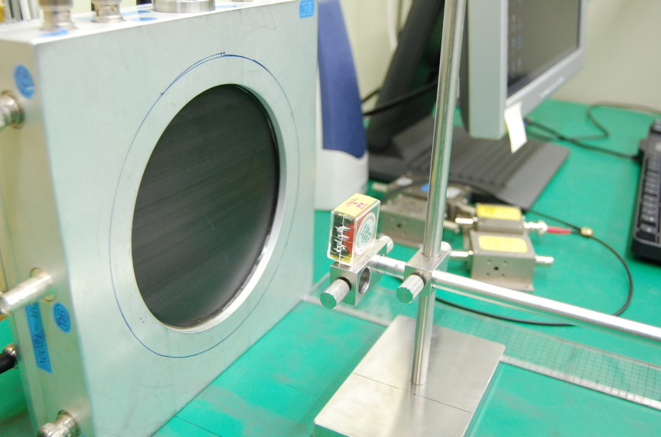
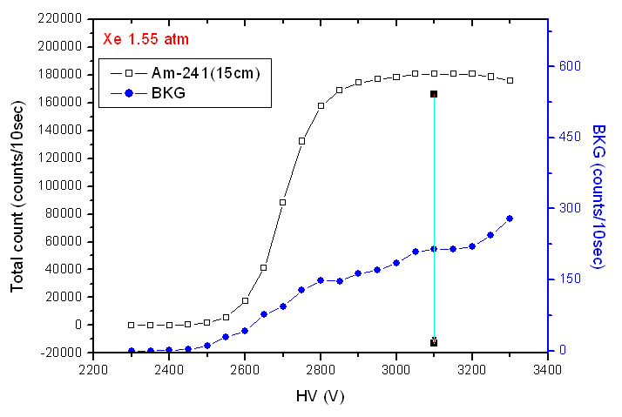
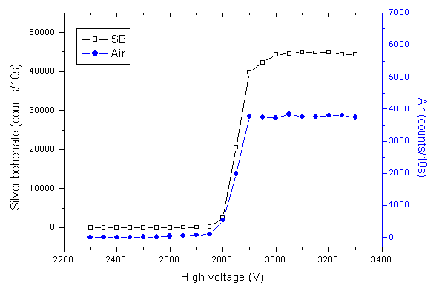
Operational region
Xe + C₂H₆ + CF₄ at 1.55 atm
Silver behenate (SB): standard sample for SAXS
Am-241(103.4 uCi): ~14 keV (KAERI)
X-ray: 8.04 keV (Hannam Univ.)
(half life time : 432.6 y)
+3100 V
Two plots are shown the equivalent trend.
BKG rate has decreased and has been stable.

Slide 17
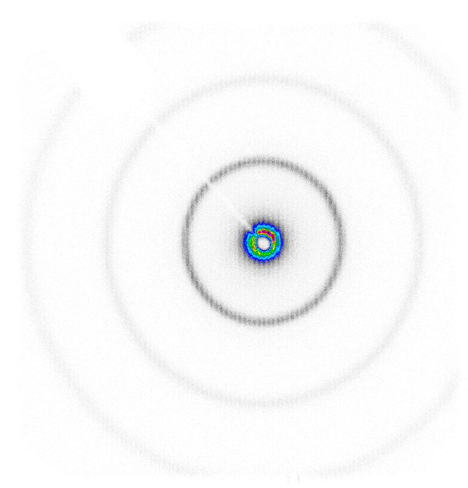
BKG & SB at SAXS
Xe 1.55 atm
Drift voltage: -1200 V
HV: +3050 V
18 cps at the beginning.
14 cps after 24 hours.
11 cps after 72 hours.
BKG rate has decreased.
3600 sec
11.1 cps (BKG)
Silver behenate (SB)

Slide 18
Comparison
Aug. 6 (OLD)
Drift voltage: -1200 V
High voltage: +2750 V
Oct. 7 (NEW)
Xe 1.55 atm
Drift voltage: -1200 V
High voltage: +3050 V
linear
Log
The first peaks can be different due to beam focusing and fluctuation of beam flux.
The second and third peaks correspond to the old data.

Slide 19
X-ray fluctuation
Xe 1.55 atm
Drift voltage: -1200 V
360 trial
Total time: ~ 5040 sec (84 min)
High voltage: +3050 V
sample: LDPE
Cooler on/off
Counting rate (cps)
Cooler
Counting rate (cps)
Time (1bin=14sec)
Counting rate shows not only some coincidence with the on/off of the cooler but also it presents unmatched period.

Slide 20
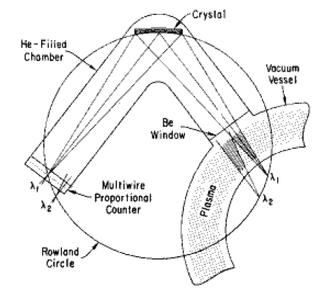
Introduction - XICS
X-ray imaging crystal spectrometer (XICS)
- to measure ion temperatures in the tokamak device.
Doppler-broadening
Movement of the center wavelength (spherically bent crystal)
Ar is injected in the tokamak.
Johann configuration
He-like Ar (Ar XVII, Ar¹⁶⁺) has only two electrons due to the high energy plasma.
Ar¹⁶⁺ and plasma thermally equilibrated.
Ar¹⁶⁺ emits the X-ray.
λ₀ : center wavelength of the spectrum
k : Boltzmann constant
Phys. Rev. Lett. 42 304 (1979) M. Bitter et al.
Rev. Sci. Instrum. 70, 1 (1999) M. Bitter et al.
J. K. Cheon, Ph.D. thesis, Kyungpook national university, (2008)
Doppler-Broadening: the spectral lines are broaden caused by a distribution of velocities of atoms or molecules.

Slide 21
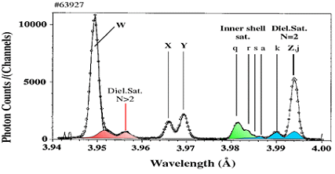
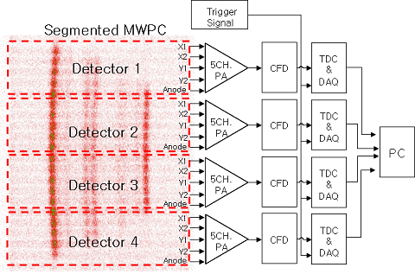
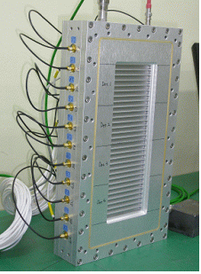
4 segment PSD for XICS
X-ray spectrum of He-like Ar
Ar¹⁶⁺ emits the X-ray (3.9494 ~ 3.9944 Å).
PSD requirements
Photon counting
Enough rate capability
- Large area
Fast DAQ
position resolution (< 0.5 mm)
- Radiation hardened (fast neutron)
3.9494 Å
3.9944 Å

Slide 22
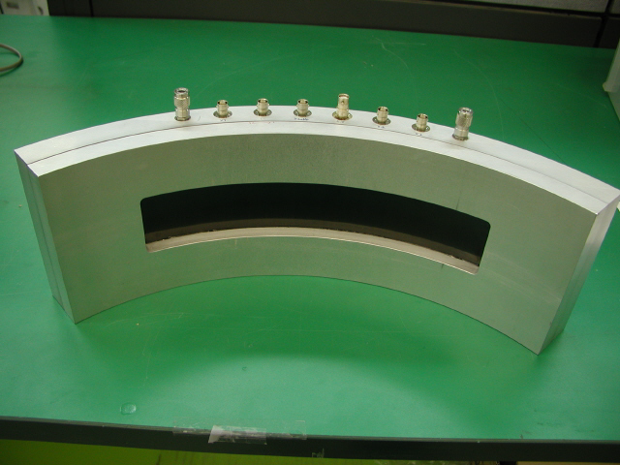
Fabricated PSD at KAERI: part I
1D & 2D X-ray PSD
2D curved X-ray PSD

Slide 23
Fabricated PSD at KAERI: part II
1D Neutron PSD
2D Large Neutron PSD for SANS
Neutron Monitor

Slide 24
Summary
Many kinds of PSD have been producing at KAERI.
Small angle X-ray scattering (SAXS)
X-ray imaging crystal spectrometer (XICS)
Neutron monitor
Neutron diffraction
Small angle neutron scattering (SANS)
PSD
Low production cost
Large effective area
Geometrical flexibility
Fast DAQ
Good position resolution
Sensitivity depending on gas and energy

