Slide 1
Heavy Ion Collision Experiments & Data Analysis Tutorial for Heavy Ion Experiment
In-Kwon Yoo
Pusan National University

Slide 2
Outline
Collision Experiment
Accelerators
Detectors
Electronics
Data Acquisitions
Data Analysis

Slide 3
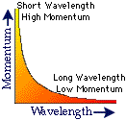
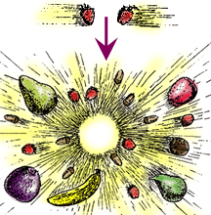
1. Collision Experiments since Rutherford
Why High Energy Collisions?
Resolution
Massive Particle Production
Extreme Conditions (Phase Transition)
What to collide?
Electron
Hadron (Pion, Kaon, Proton)
Heavy Ions
Radioactive Isotope
T(MeV)
Early Universe
(RHIC)
Quark-Gluon Plasma
~150
Phase Transition
Hadron Gas
Color Superconductor
Neutron Star
Atomic Nuclei
~10
Density(n₀)

Slide 4
Collision Energies
Collision System : Center of Mass Energy s^{1/2}
In Target Experiment :
In Collider Experiment :
Possible heaviest producible particle :

Slide 5
1. Collision Experiments since Rutherford
How to collide?
Fixed Target Experiment
Collider Experiment
 | Fixed Target | Collider
Energy | inefficient | efficient
X section | efficient | inefficient
Detector | Large acceptance for designed collision system | Effective acceptance for variable collision system

Slide 6
2. Accelerators
What to accelerate : charged particle only
Source :
How to accelerate : Electric Field
Electrostatic Accelerator
Radio-Frequency Accelerator :
What shape
Linear Accelerator
Cyclotron
Synchrotron

Slide 7
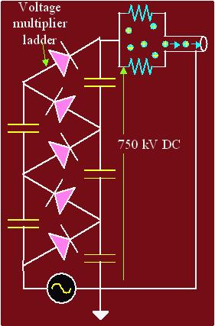
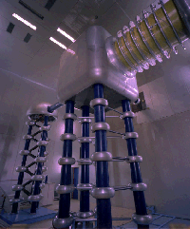
Electrostatic Accelerators
Cockcraft-Walton

Slide 8
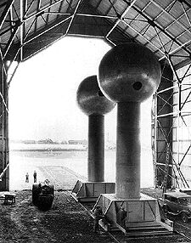
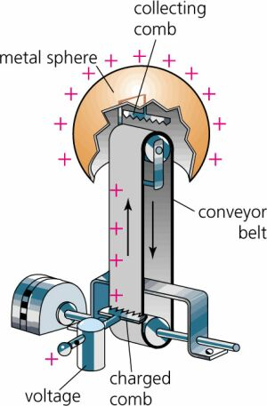
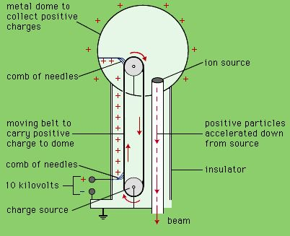
Van de Graaff

Slide 9
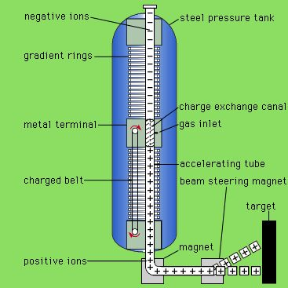
Tandem Van de Graaff

Slide 10
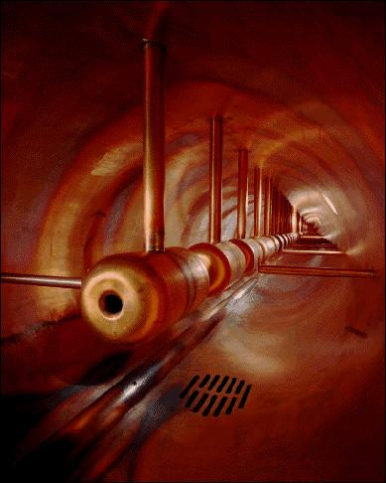
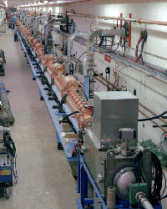
Radio-frequency LINAC

Slide 11
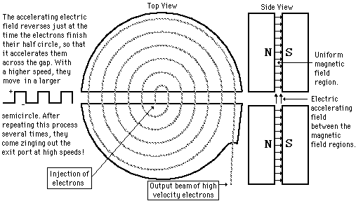
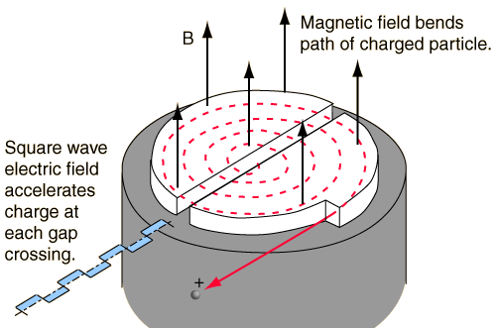
Cyclotron http://www.phy.ntnu.edu.tw/java/cyclotron/cyclotron.html
qvB = mv²/r ; r = mv/qB
f = v/2πr = qB/2πm ;

Slide 12
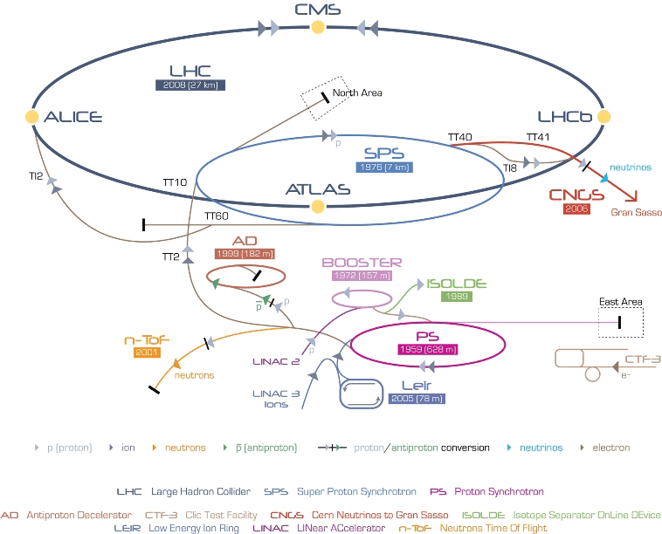
CERN
European Organization for Nuclear Research
Complex

Slide 13
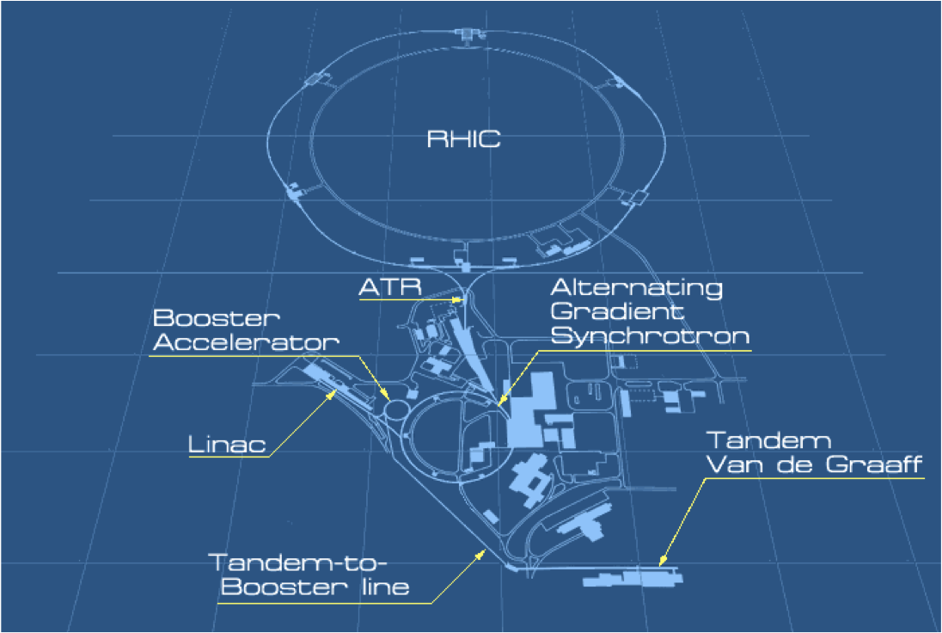
BNL
Brookhaven National Lab.
Complex

Slide 14
C.Y.Wong : Introduction to High-Energy Heavy-Ion Collisions : P1
An Example
Pb+Pb@160 AGeV
Geometry :
r_{Pb} = 1.2fm A^{1/3} = 7.1fm
r_{T} = 7.1fm, r_{ll} = 7.1fm/γ = 0.76 fm
E_{CMS} = s^{1/2} = 17.4 AGeV
βγ = pc/m₀c² ~ 8.7 GeV/0.938 = 9.38
E_{tot,CMS} = 208.17.4 =3619 GeV
Volume = Vol/γ =159.75fm³
Energy Density = ε = 22.6 GeV/fm³
Normal energy density in nucleus ~ 208 GeV/4.7.1³ ~ 0.14 GeV/fm³

Slide 15
C.Y.Wong : Introduction to High-Energy Heavy-Ion Collisions : P1
An Example : continued
Pb+Pb@160 AGeV
Geometry :
Energy Density = ε = 22.6 GeV/fm³ incl. 2Pb rest-Energy
Normal energy density in nucleus ~ 0.14 GeV/fm³
E_{tot} / E_{T} = 4/π
E_{max} = 208.17.4 GeV – 2.208.0.938 GeV = 3.22 TeV
E_{T,max} = π/4.3.22 TeV = 2.53 TeV
Stopping power ~ 57%
→ Converted Energy in PbPb @ 160 GeV ~ 1.46 TeV

Slide 16
C.Y.Wong : Introduction to High-Energy Heavy-Ion Collisions : P1
An Example : continued
Deposit Energy Density
Differential Calculation (Bjorken Formula)
Measurable

Slide 17
C.Y.Wong : Introduction to High-Energy Heavy-Ion Collisions : P1
An Example : continued
Energy-Density meaning
Compare to proton
ρ(r) = ρ₀e^{-αr} , α = 4.27 fm⁻¹

Slide 18
3. Detector System for HEP
What to do for the ‘detection’ ?
Particle Detection (any signal)
Energy deposit necessary for any signal
Momentum determination (kinematics)
Identification with physical properties
Detection of particles
Charged particles :
Neutral particles :

Slide 19
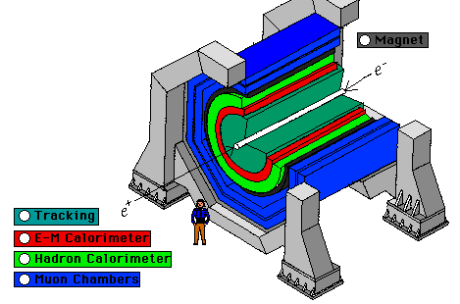
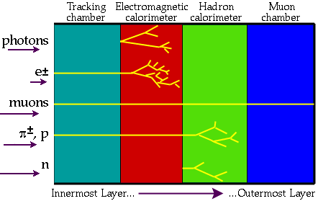
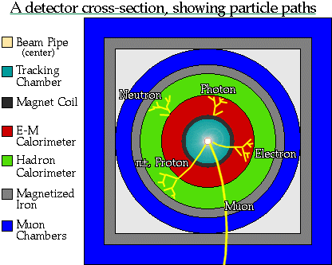
Modern Detector System

Slide 20
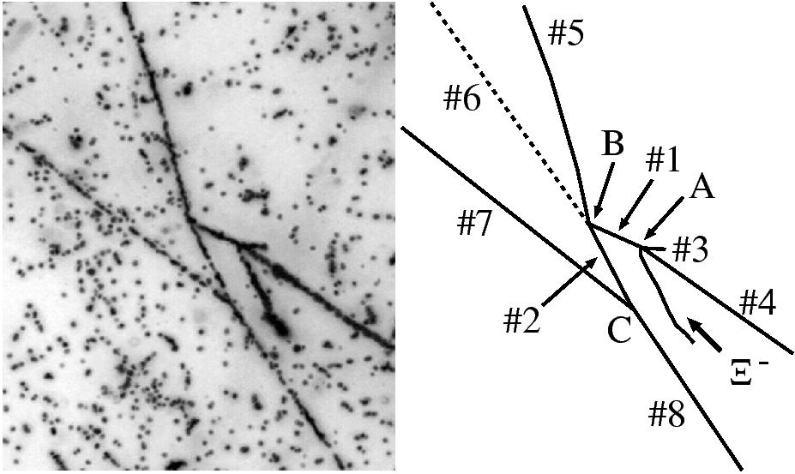
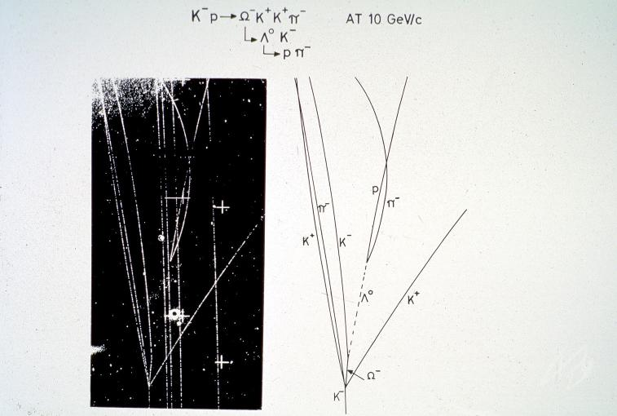
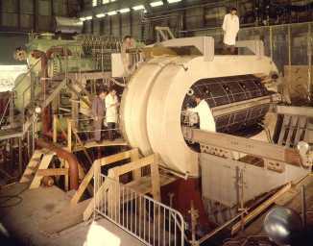
Emulsion plate Image
3.1 Tracking detector
‘visual’ detector
Emulsion detector
Bubble chamber
Spark chamber
Streamer chamber
Bubble chamber and its image

Slide 21
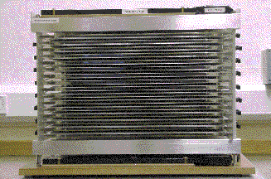
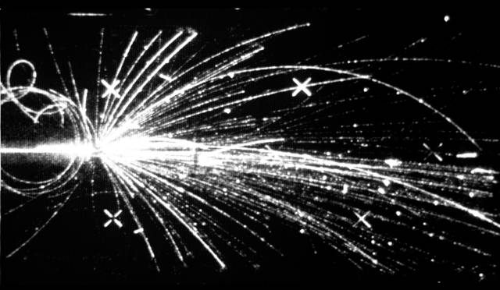
Spark chamber and its image
3.1 Tracking detector
‘visual’ detector
Emulsion detector
Bubble chamber
Spark chamber
Streamer chamber
Streamer Chamber

Slide 22
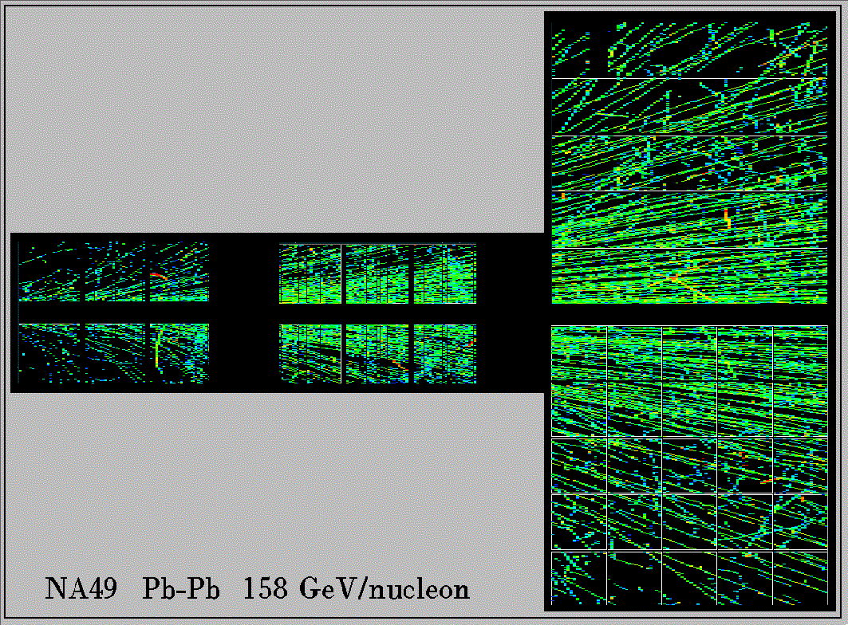
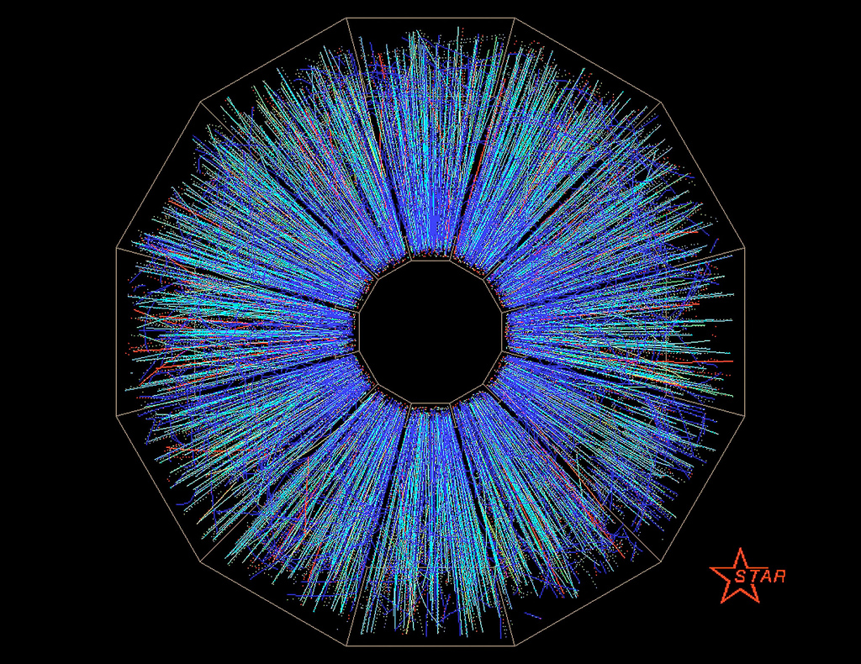
‘electronic’ detector
Time Projection chamber (TPC)
Semiconductor detector
Scintillation detector

Slide 23
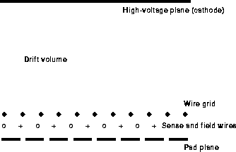
TPC
Drift velocity vs. Electric field strength
Drift velocity vs. Gas mixture
Ionization potential vs. Gas mixture

Slide 24
3.2 Energy loss dE/dx of charged particle in matter
Bethe-Bloch Function : dE/dx = q²f(v) = q²g(βγ)
➔ βγ = pc/m₀c² ➔ dE/dx = q²h(p)
Energy loss && momentum measurement
Minimal ionization dE/d(ρx) ~ 2 MeV/gcm² : MIP
When a minimal ionization particle goes through 5cm long Ar-gas chamber (ionization energy = 26 eV, r = 1.8 g/cm³), how many electron-ion pairs will be produced ?

Slide 25
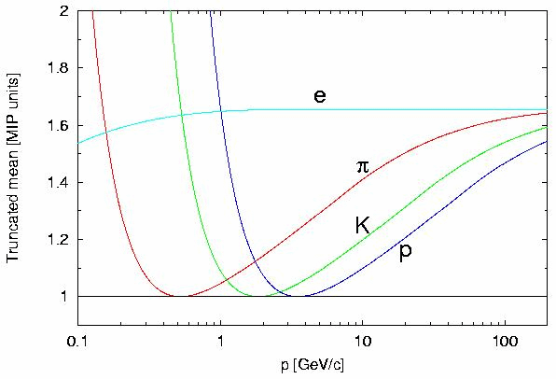
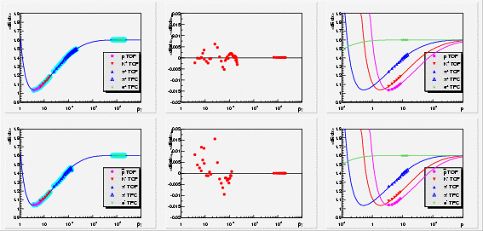
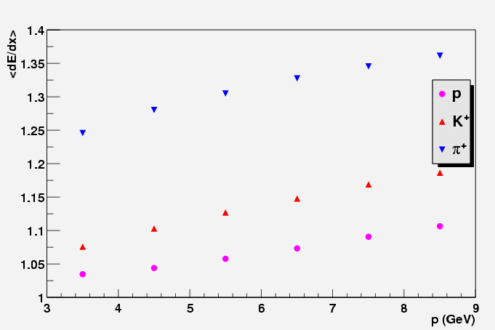

Slide 26
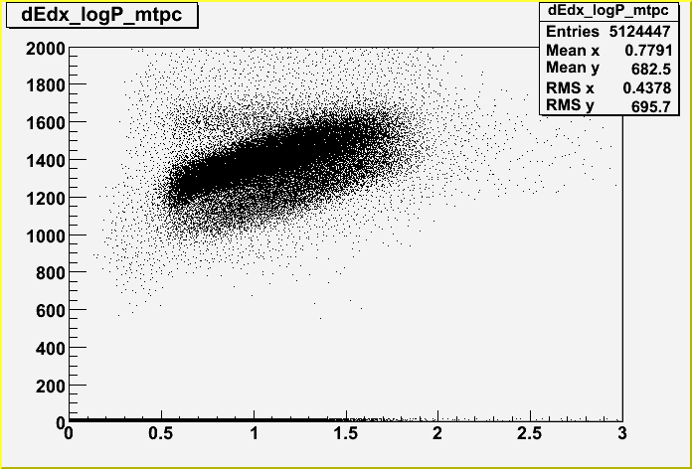
2.2 Particle Identification
Parameterization : dEdx vs. log(p)
Slicing w.r.t p → Filling TH1F (dEdx)
root/01I/param/macro/dedx_p_01Ixx.C

Slide 27
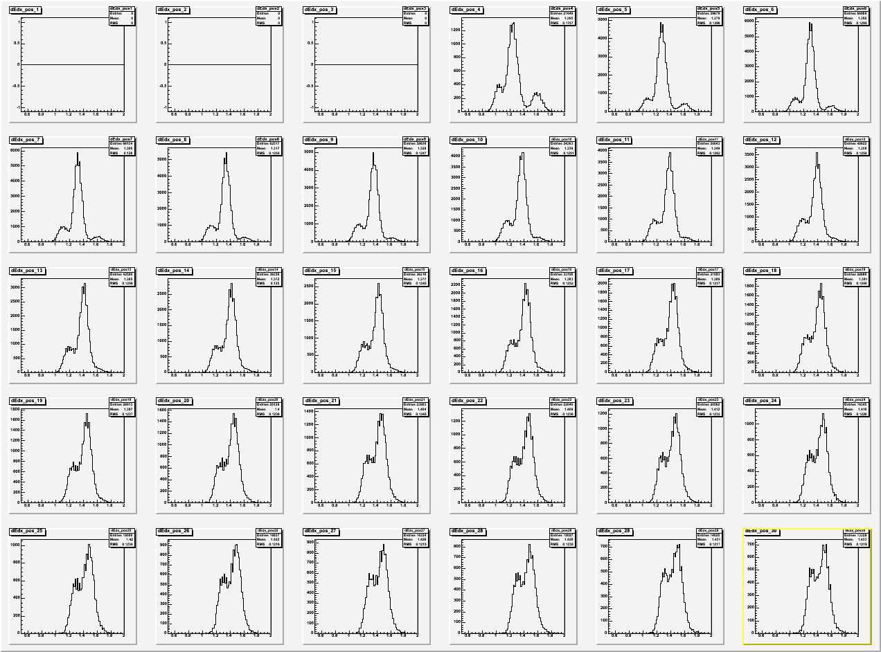
2.2 Particle Identification

Slide 28
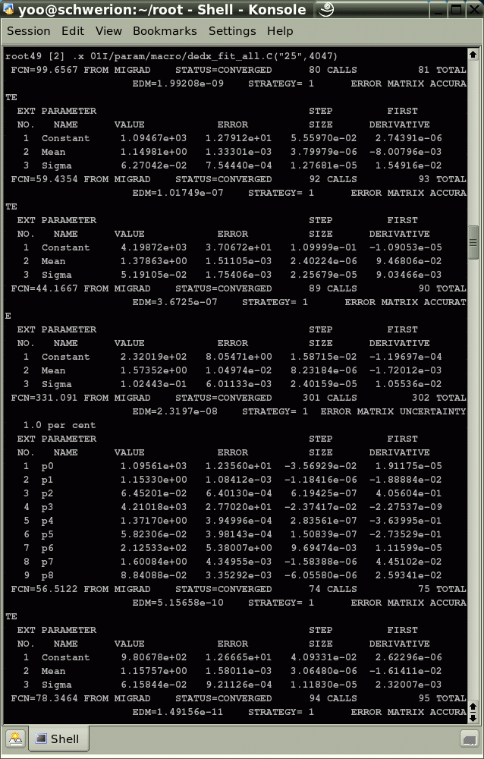
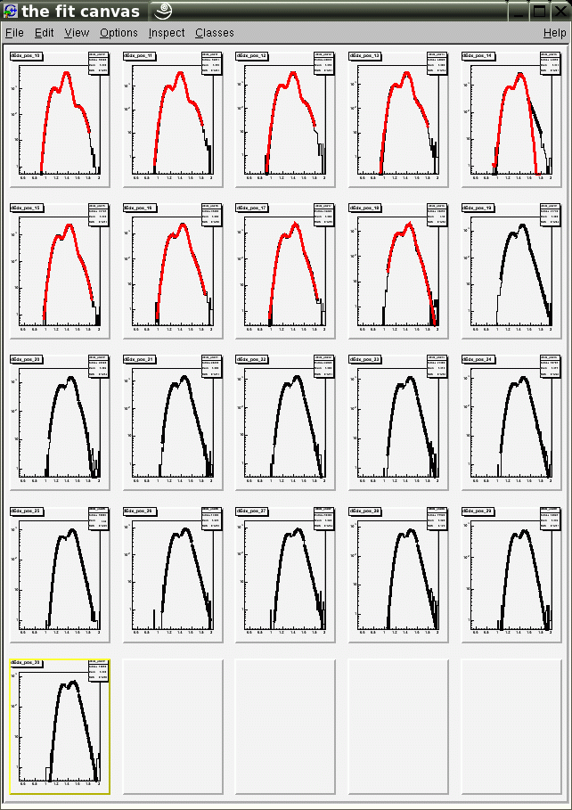
2.2 Particle Identification

Slide 29
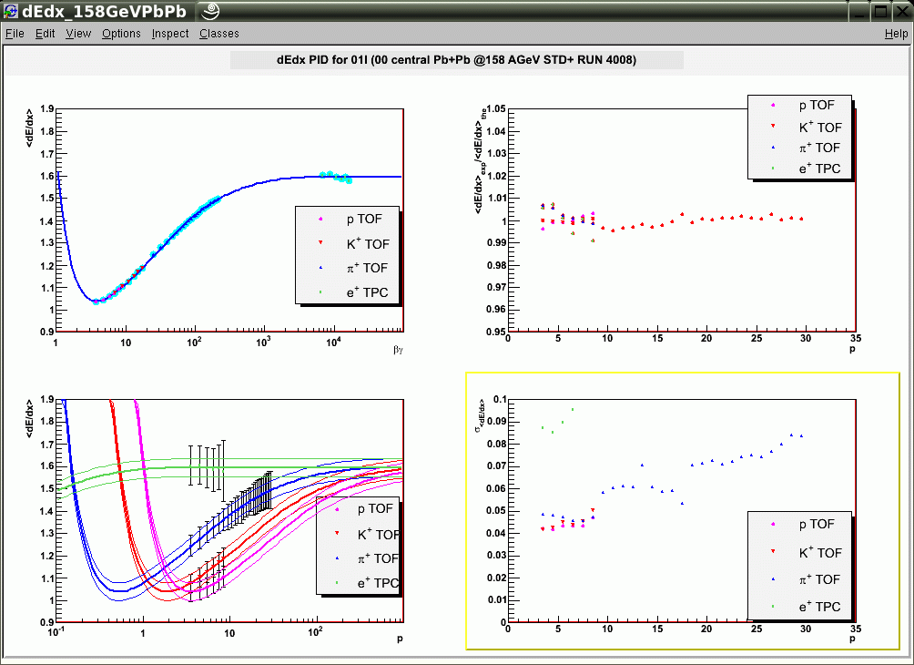
2.2 Particle Identification

Slide 30
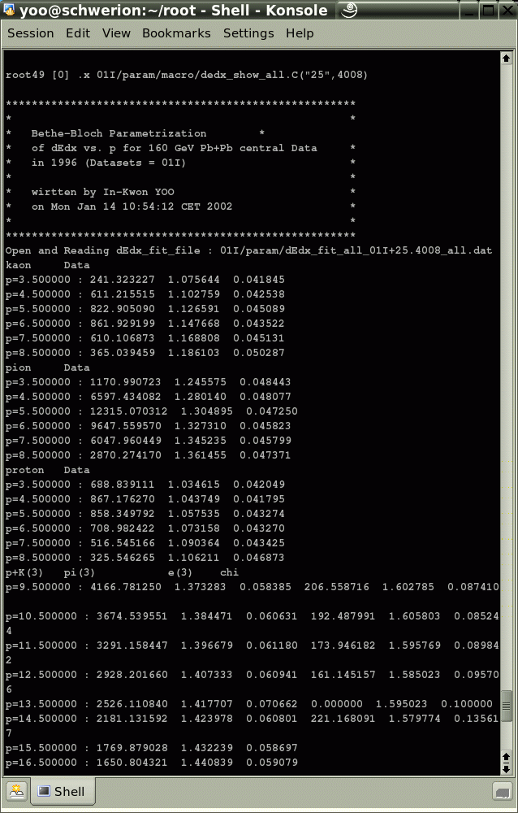
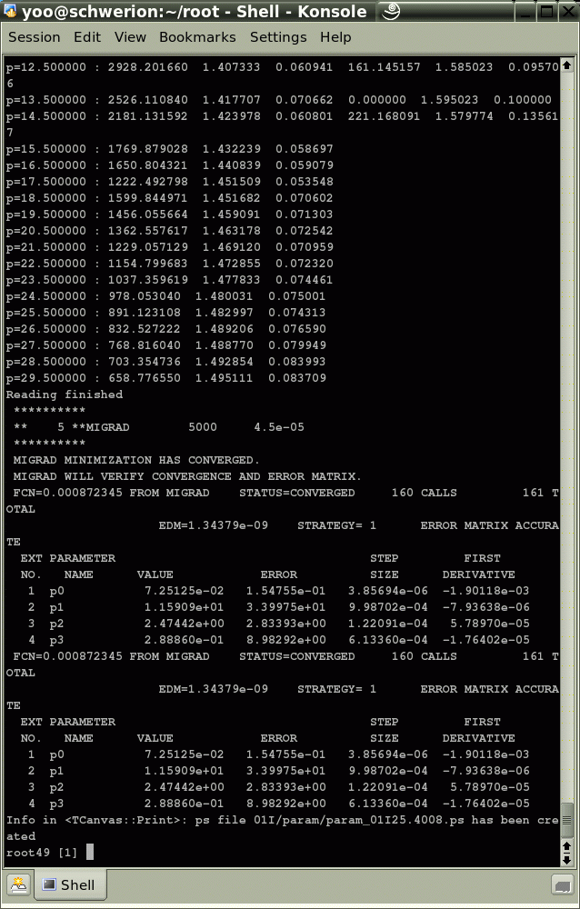
2.2 Particle Identification

Slide 31
3.3 Time-Of-Flight Measurement
With known Track (length) + Time-Of-Flight Measurement ➔ determine β
Error in 1/β
Plastic Scintillator / RPC → σ_{t} ~ 100 ps

Slide 32
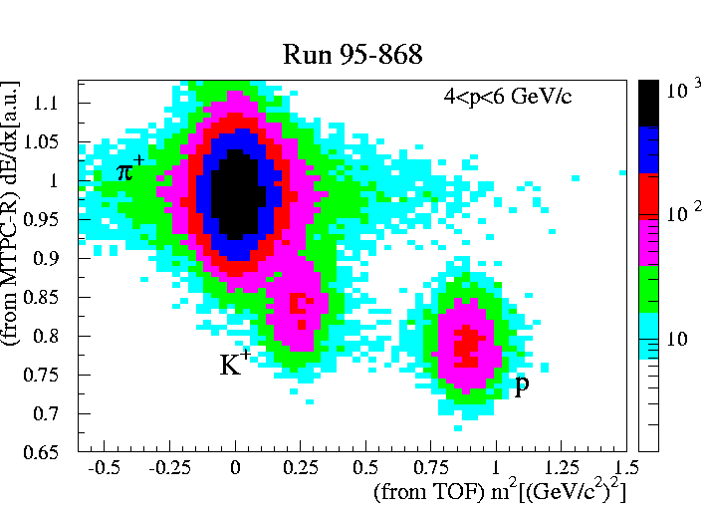
3.3 Time-Of-Flight Measurement
(m₀c²)² = (pc)²(1-β²)/β² : mass determination
Error in (m₀c²)²

Slide 33
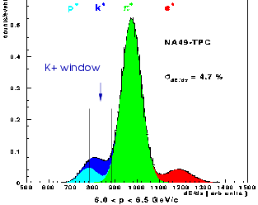
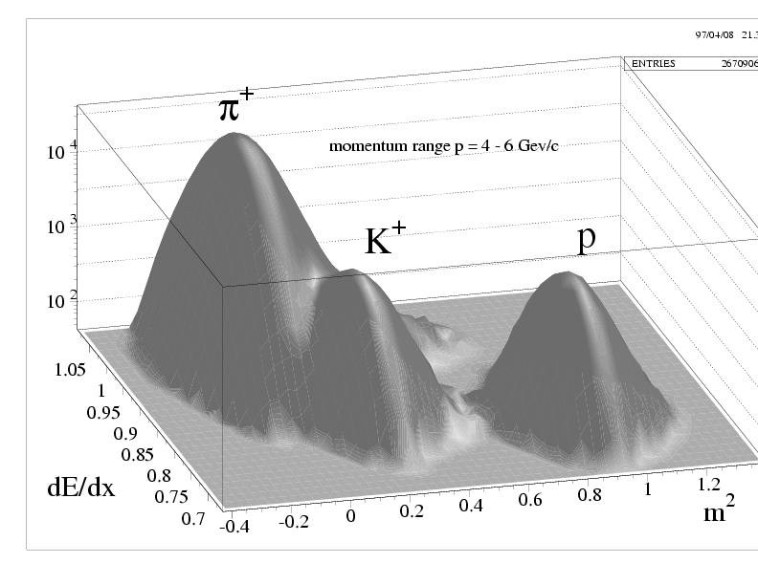
3.2 Particle Identification
Decomposition : Proton-Kaon-Pion-Electron-peaks
4 gaussian with 12 parameters
In function of p
Difficult to separate K-p
TOF Information needed
dEdx-m2 Histogram
Separation of K-p
For limited p <10GeV
Fix dEdx_K, dEdx_p for the limited p
dEdx vs. p/m = βγ
Fit with Bethe-Bloch

Slide 34
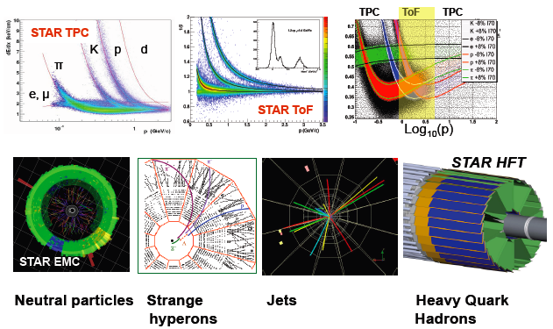
Particle Identification at STAR

Slide 35
Where we are & will go
Electric Signals
Digital Data
Off-line
Detector System
Signal Processing
Data Acquisition
Data Analysis
Tracking
Beam On/Off
Time-Of-Flight
Amplifying / Discrimination
TDC / QDC
Data Reconstruction
Ev / Track Selection
Central Acquisition
Physics Analysis
Event Builder
HV / LV system
Trigger System

Slide 36
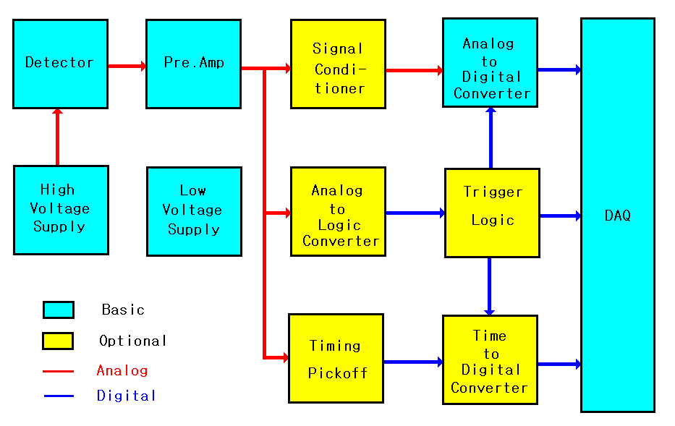
4. Typical electronics setup for HEP experiment
신호의 크기를 조절하는 것이 아니라 Charge를
Vlotage로 변환하는 기능을 담당한다.
(우리의 AMP와는 다른 것)
Detestor에 반드시 Voltage Supply를 걸어주어야 함
여기서 Logic은 NIM, TTL, ECL을 통칭함
06/28/2009
핵물리학교 2009

Slide 37
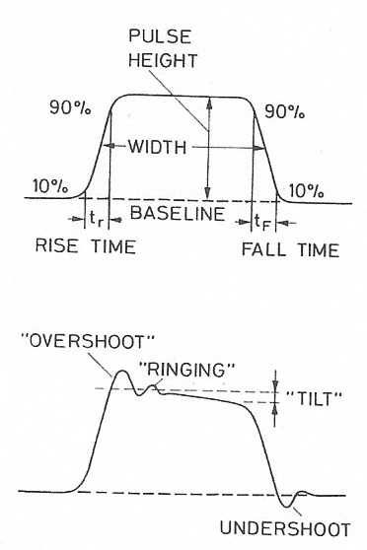
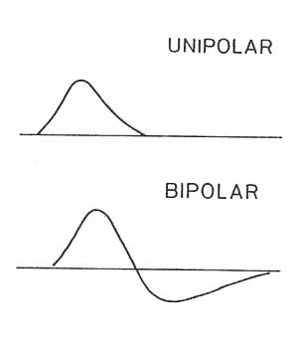
Introduction
Signal Processing
RACK
Cables
Modules
Converter
BUS System
Logic Units
POWER Control
Pulse Signal
Analog vs. Digital
Fast vs. Slow
06/28/2009
핵물리학교 2009

Slide 38
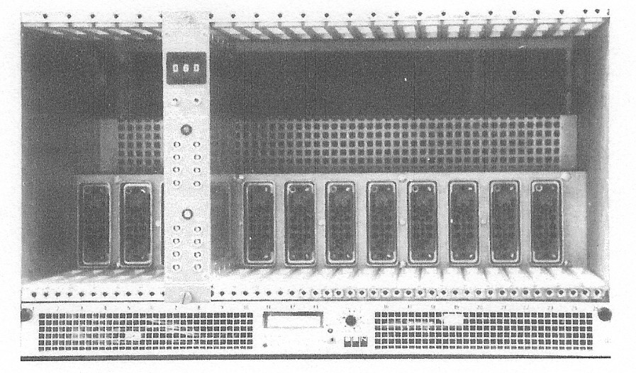
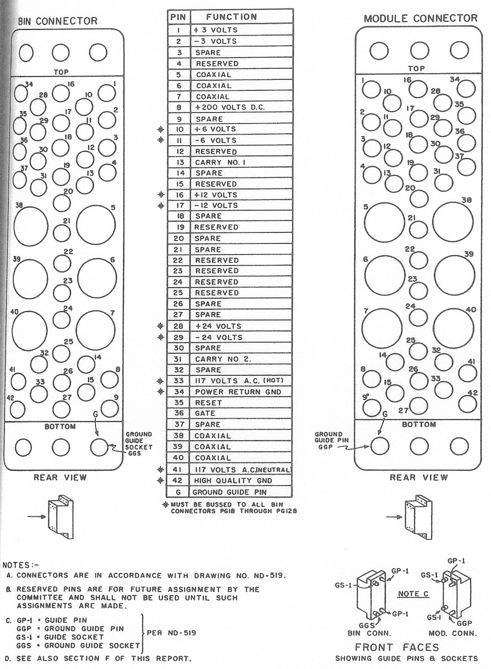
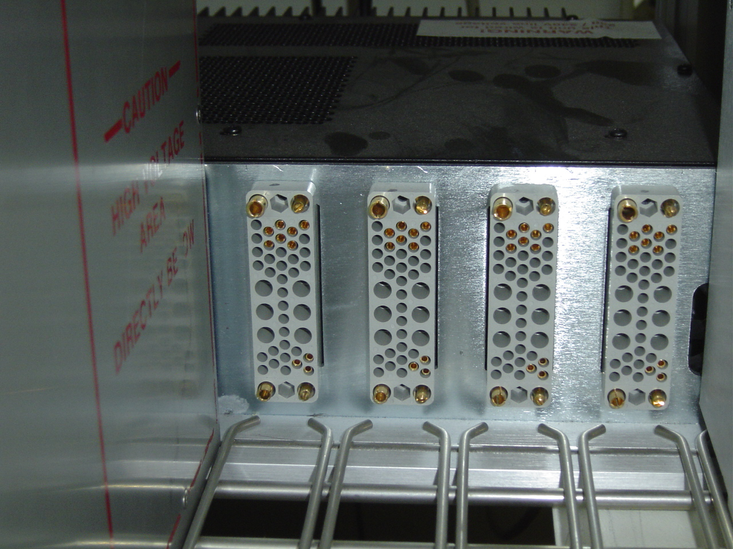
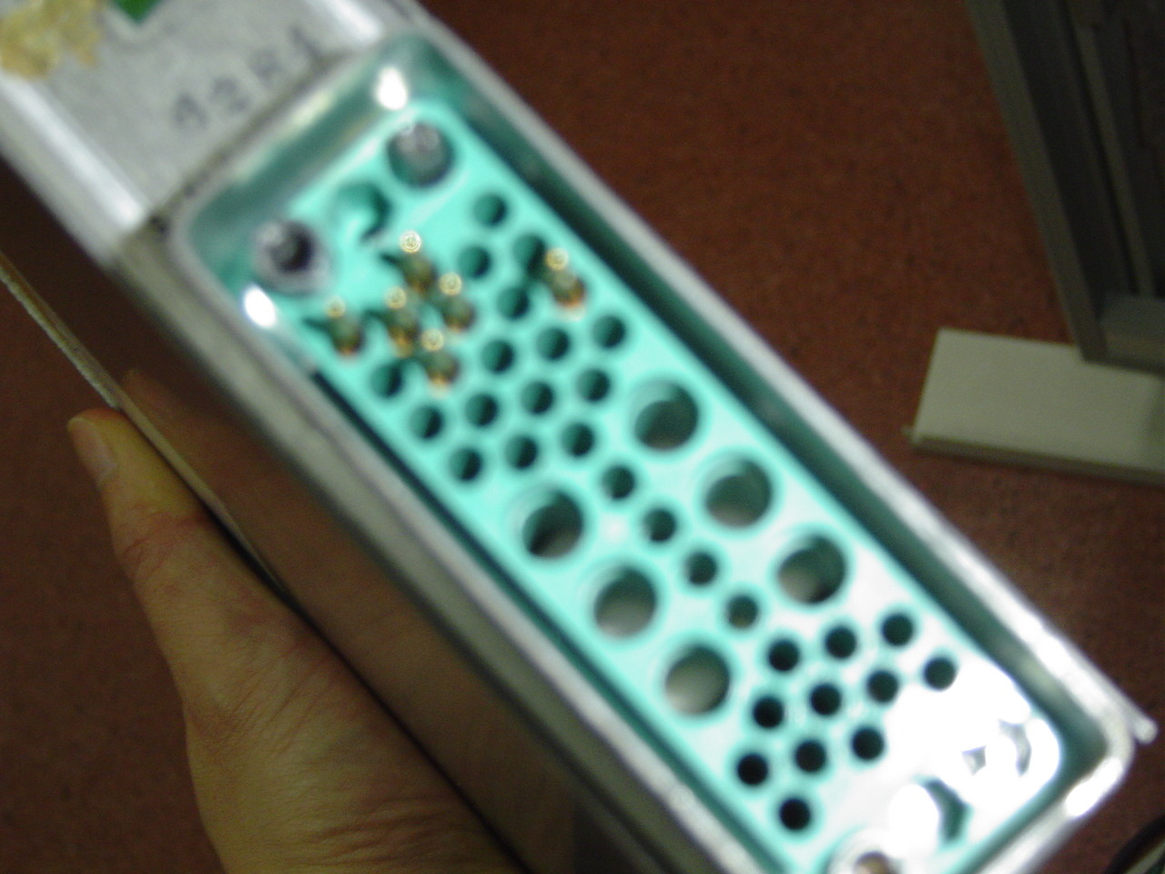
2. The NIM Standard
NIM bin : Power Supply to each module : -24, -12, -6, -3, 0, +3, +6, +12, +24V
06/28/2009
핵물리학교 2009

Slide 39
Logic Signals
NIM, TTL, ECL Logic Signals
Slow / Fast Logic Signals
Positive / Negative Signals
Noise immunity / no loss of bandwidth / minimize ground loop
Twisted pair cable / flat ribbon cable
Converter needed
 | slow pos. NIM | fast neg. NIM | TTL | ECL
Yes, 1 | +3 ~ +12V | -0.7 ~ -0.9V | 2 ~ 5V | -1.75V
No, 0 | +1 ~ - 2V | +0.05 ~ - 0.05V | 0 ~ 0.8V | -0.9V
06/28/2009
핵물리학교 2009

Slide 40
3. Signal Transmission
Commonly used Coaxial cables and Characteristics
NAME | RG-58/U RG-58C/U | RG-174/U | RG-62/U | RG-59/U
Z (impedance) | 50 Ohm | 50 Ohm | 93 Ohm | 73 - 75 Ohm
Delay (ns/m) | 5.14 / 5.06 | 5.14 | 4.0 | 5.14
Diameter (cm) | 0.307 / 0.295 | 0.152 | 0.635 | 0.381
Capacitance (pF/m) | 93.5 | 98.4 | 44.3 | 68.9 – 67.3
Max.op. Voltage (kV) | 1.9 | 1.5 | 0.75 | 2.3
Use | Fast Signal Trans. | Fast Signal Trans. | Slow Signal Trans. | HV power
 | BNC | Lemo | BNC | HV
Single and double braided, high temperature use etc.
06/28/2009
핵물리학교 2009

Slide 41
3. Signal Transmission
Coaxial Cable :
two concentric cylindrical conductors
signal / ground
electromagnetic shielding
self-capacitance and inductance
ideal lossless cable
06/28/2009
핵물리학교 2009

Slide 42
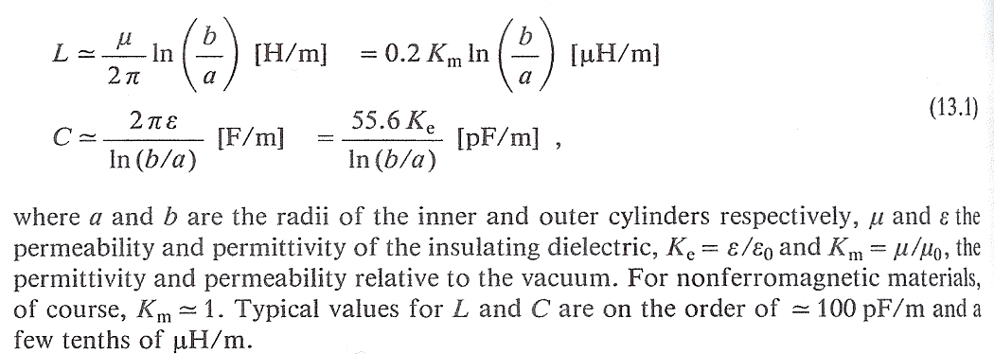
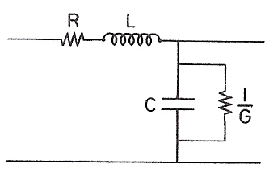
3. Signal Transmission
Coaxial Cable : self-capacitance and inductance
06/28/2009
핵물리학교 2009

Slide 43
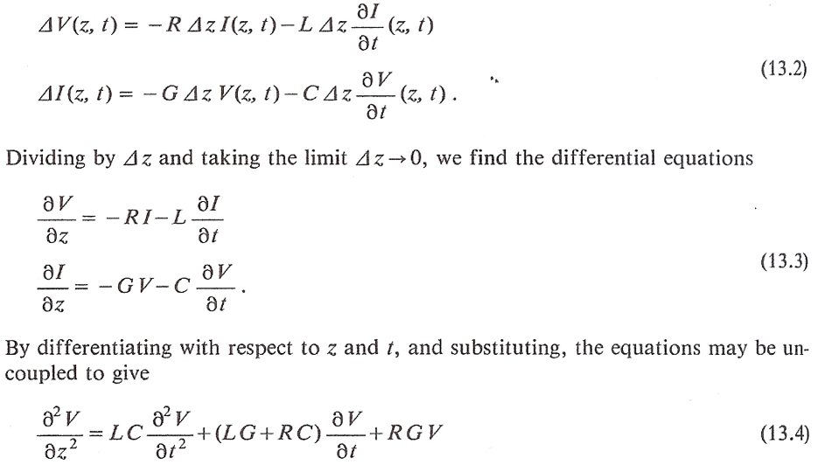
3. Signal Transmission
Ideal lossless cable :
06/28/2009
핵물리학교 2009

Slide 44
3. Signal Transmission
Ideal lossless cable :
for an input signal of
solution :
with
signal propagation :
delay ~ 5ns/m
characteristic impedance :
06/28/2009
핵물리학교 2009

Slide 45
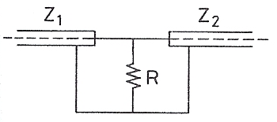
3. Signal Transmission
Impedance Matching
Z1 < Z2
Z1 > Z2
1/Z1 = 1/R + 1/Z2
R = Z1Z2/(Z2-Z1)
Z1 = Z2 + R
R = Z1 - Z2
06/28/2009
핵물리학교 2009

Slide 46
4. Electronics for Pulse Signal Processing
Preamplifier (PA)
Amplifier (AMP)
Pulse Shaping
Biased Amplifier (BA)
Pulse Stretcher (PS)
Linear Gate (LG)
Delay (DELAY)
Discriminator (DISCR.)
Single Channel Analyzer (SCA)
Analog-to-Digital Converter (ADC)
Multichannel Analyzer (MCA)
Time-to-Amplitude Converters (TAC)
Scaler
Coincidence Units
06/28/2009
핵물리학교 2009

Slide 47
4. Electronics for Pulse Signal Processing
Preamplifier
06/28/2009
핵물리학교 2009

Slide 48
흔히 쓰이는 두 종류의 프리엠프
out
out
축전지에 Charge가 Full로 차고 나면,
current가 저항 Rf로 흘러간다.
Detector에는 전압을 걸어주기 때문에 항상 축전지가 걸려 있는 것과 같다.
06/28/2009
핵물리학교 2009

Slide 49
4. Electronics for Pulse Signal Processing
BA
SCA
Pulse Stretcher
TAC
Discriminator
COIN
06/28/2009
핵물리학교 2009

Slide 50
5. Pulse Height Selection and Coincidence Techniques
A Simple Counting System
DET
PA
AMP
DISC.
SCALER
HV
A Simple Counting System for pulse height selection
DET
PA
AMP
SCA
SCALER
HV
06/28/2009
핵물리학교 2009

Slide 51
5. Pulse Height Selection and Coincidence Techniques
Basic Coincidence Technique
HV
DET
PA
AMP
DISC.
DELAY
SCALER
COIN
DET
PA
AMP
DISC.
DELAY
HV
IN1
IN2
OUT
06/28/2009
핵물리학교 2009

Slide 52
5. Pulse Height Selection and Coincidence Techniques
Pulse Shape Discrimination (PSD)
06/28/2009
핵물리학교 2009

Slide 53
5. Pulse Height Selection and Coincidence Techniques
Pulse Shape Discrimination (PSD)
06/28/2009
핵물리학교 2009

Slide 54
6. Electronic Logic for Experiments
One-Body Scattering
Two-Body Scattering
06/28/2009
핵물리학교 2009

Slide 55
6. Electronic Logic for Experiments
Measurement of the Muon Lifetime
06/28/2009
핵물리학교 2009

Slide 56
7. Timing Methods and Systems
WALK
JITTER
Zero-crossing
Constant fraction Discriminator
06/28/2009
핵물리학교 2009

Slide 57
7. Timing Methods and Systems
Calibration the Timing System
06/28/2009
핵물리학교 2009

Slide 58
흔히 쓰이는 세 종류의 ADC
Signal의 최고점에 이르는 순간 a부터는
신호가 끝날 때까지 일정하게 유지함
Siganl의 면적을 적분함
ground와 gate와의 차이 값을 적분하여 나옴
06/28/2009
핵물리학교 2009

Slide 59
Data AcQuisition System 데이터 수집 장치
06/28/2009
핵물리학교 2009

Slide 60
Data Acquisition(DAQ)란?
ADC나 TDC등에 의해 digitize된 신호를 버스를
통해 읽고, 기록여부를 판단하여 기록장치에
기록하는 일련의 과정을 지칭한다.
Bus란?
Address, Data와 Strobe들로 구성된 신호의 다발
흔히 사용되는 버스
PCI, USB, IDE…(PC에서), VME, CAMAC…(핵물리)
정확하게 DAQ가 무엇이라고 규정하지는 않지만,
DAQ라고 하면 대개 이렇게 얘기함
06/28/2009
(주)노티스에서 VME를 자체 제작 가능함
핵물리학교 2009

Slide 61
암흑물질탐색연구단의 flash ADC DAQ
VME
USB2-VME controller의
신호모습(~24MB/s전송)
06/28/2009
핵물리학교 2009

Slide 62
8. Compute Automated Measurement And Control System
Computer Controlled Electronics
06/28/2009
핵물리학교 2009

Slide 63
CAMAC DAQ System
(장점) 모듈이 엄청 퍼져있다.
(장점) 버스구조가 간단하다(안정적이다).
(장점) 배우기 쉽다.
(단점) 전송속도가 다소 느리다(최대 3MB/s).
(단점) 핵.입자물리 이외 사람들이 사용 안 한다(비싸다).
(단점) 메이저 생산업체가 망했다.
06/28/2009
핵물리학교 2009

Slide 64
8. CAMAC System
N
L
N
L
06/28/2009
핵물리학교 2009

Slide 65
Read를 주관하는 부분
signal이 들어왔으므로 받으라는 명령을 내림
Writer를 주관하는 부분
CAMAC bus특징
- Read와 Write데이터 선이 따로 있다.
- Acknowledge가 없는 동기(synchronous)버스이다.
- N과 L 신호가 슬롯 각각에 1대 1연결된다.
controller를 기준으로 Read와 Writer로 나눔
06/28/2009
핵물리학교 2009

Slide 66
Controller -> Module
- W1-24 : 24bit의 데이터 쓰기 신호
- N1-24 : 각 슬롯의 모듈을 access하기 위한 address
- B : Busy = 현재 CAMAC cycle중이다.
- F1,2,4,8,16 : 모듈이 수행할 function을 설정한다.
- A1,2,4,8 : 모듈 안에서 채널을 구분한다.
- S1,2 : CAMAC cycle의 시간관계 신호
- I : Inhibit = CAMAC 명령수행을 금지한다.
- C : Clear = 일부 register를 클리어한다.(모듈마다 다름)
- Z : initialiZe = 모든 register를 클리어한다.
06/28/2009
핵물리학교 2009

Slide 67
Module -> Controller
- R1-24 : 24bit의 데이터 읽기 신호
- L1-24 : LAM(Look At Me)신호로 각각의 모듈에서 controller로 연결된다. 특정한 상황 발생 시 설정된다.(조건은 모듈마다 다르다.)
- X : accepted = CAMAC명령이 유효할 때 발생
- Q : response = 특정 CAMAC명령에 대해 특정한 상황일 때 발생된다. (모듈마다 다르다.)
(예, test LAM시 ADC변환 완료됐다 – LeCroy2249A)
06/28/2009
핵물리학교 2009

Slide 68
이 만큼의 시간간격을 줘서 이 안에 신호가 오면 인식을 함
CAMAC의 모든 신호는
TTL active low이다.
(0.8V이하 = 1,
2.0V이상 = 0)
S1 : N신호 후 이 신호
(약 500ns)이전까지
R, X, Q신호가
설정되어야 한다.
S2 : N이후(약 1us)
이 신호에서
cycle이 종료된다.
06/28/2009
핵물리학교 2009
68

Slide 69
자주 쓰이는 CAMAC명령어(모듈마다 다를 수도 있음)
- F(0) = 데이터 레지스터 읽기
- F(8) = LAM상태 읽기
- F(9) = 모듈 클리어
- F(16) = 레지스터 쓰기
- F(24) = disable LAM
- F(26) = enable LAM
06/28/2009
핵물리학교 2009

Slide 70
CAMAC controller란?
- DAQ를 구성하기 위해서는 PC와의 연결이 필요하다.
- PC에서는 CAMAC bus를 지원하지 않는다
- PC의 PCI 또는 USB, 기타 등등 과의 link가 필요하다.
- 일반적인 PC bus의 신호를 CAMAC신호로 바꾸는
회로를 CAMAC controller라 한다.
CAMAC을 프로그래밍한다는 것은?
- 결국 PC의 PCI나 USB를 프로그래밍하는 것이다.
- controller마다 주어진 protocol이 존재한다.
06/28/2009
핵물리학교 2009

Slide 71
int main(void)
{
unsigned long data;
data = CAMAC(5, 0, 0); // read latch register
data = CAMAC(5, 0, 9); // clear latch register
return 0;
}
unsigned long CAMAC(int N, int A, int F)
{
unsigned long addr, data;
addr = (N << 11) | (A << 7) | (F <<2);
data = VMEread(A32D32, 10, addr); // VME명령어 이다.
return data;
}
데이터 레지스터를 읽어라는 명령어
클리어 하라는 명령
06/28/2009
핵물리학교 2009
71

Slide 72
HIPEx CAMAC DAQ System
TOYO / CAEN Controller
setup -> Station, Channel number
call run_daq.c -> save to ASCII
call d2root.c macro -> convert to a root file
online monitoring of DAQ -> current entry
06/28/2009
핵물리학교 2009

Slide 73
흔히 쓰이는 로직신호들
TTL(positive NIM은 TTL과 구분없이 사용)
1 = 2.0 ~ 5.0V 0 = 0 ~ 0.8V
2. ECL
1 = -1.03 ~ -0.88V 0 = -1.81 ~ -1.62V
3. Negative NIM
1 = ~ -16mA 0 = ~ 0mA
50ohm termination 하면
1 = ~ -800mV 0 = ~ 0V
신호의 조건을 맞춰서 넣지 않으면, 결과가 않나옴.
ECL Cable은 110ohm을 가진 선을 사용하여야 함.
06/28/2009
핵물리학교 2009

Slide 74
NIM -> TTL converter
06/28/2009
핵물리학교 2009

Slide 75
TTL -> NIM converter
06/28/2009
핵물리학교 2009

Slide 76
9. Versa Module Eurocard DAQ System
06/28/2009
핵물리학교 2009

Slide 77
HIPEx VME DAQ System
Notice (주) Controller 8 channel x 8 mod.
Amp - Shaper - FADC 100 MHz 일체형
Setup -> Station, Channel number
call run_daq.c -> save to ASCII / Pulse shape
call a macro to convert to QDC value
06/28/2009
핵물리학교 2009

Slide 78
100ns
10ns
VME
Oscilloscope

Slide 79
9.2us
9.2us
VME
Oscilloscope

Slide 81
6. Data Analysis Practice / Researches
Data Handling
Working Scheme
Macro & Data Structure
Particle Identification
dE/dx PID
TOF PID
Single Particle Production
Kaons in pT, y (CWSon), Protons (HSCho)
Resonance Reconstruction
φ → K⁺K⁻ (EJLee)
Λ1520 → pK⁻ (YMKim)
K* → Kπ (KSOh)
Recent Topics
Charge Transfer Fluctuation

Slide 82
6.1 Data Handling
Experimental Data Handling
RAW Data on Storage ← DAQ
DSTs : Reconstructed Data Set
Analysis Tools (Database Analysis Tools)
Physics Analysis Workstation (PAW) : based on Fortran
Ntuples : Track Informations with Event Number
iev, px, py, pz, …
Histograms, Functions, Graphs, Pictures
ROOT : C++ Interpreter
Trees ~ Ntuples → miniDSTs, mDSTs,..
Simulations
Geometrical / Detector Efficiency
Reconstruction Efficiency

Slide 83
6.1 Data Handling
ROOT
ROOT : An Object Oriented Data Analysis Framework http://root.cern.ch
developed by Rene Brun & Fons Rademakers (CERN)
Tutorials (Demos)
ROOT49 / Root4Star / cbmroot
Own predefined Classes
Own Analysis Tools
DST Interface Classes
Example Macros :
Batch Farm
Sequential jobs for every data file
parallel/cluster computing with hundreds of CPUs

Slide 84
Working Scheme
Old Style (SPS etc.)
Data Production on dedicated computing farm
Macro test on local machine
Job submission onto computing farm
Enhanced Style (RHIC)
Data Production on distributed system
Local access and Job submission onto distributed system
Newest Style (LHC)
Tier Structure
GRID computing : computing over world somewhere

Slide 85
6.1.1 Working Scheme
CERN LINUX Farm
Flowchart
Shell script2
run1
out1
Script for bsub of the jobs
Shell script1
Macro.C (1,4)
run2
out2
Shell script2
run3
out3
run4
out4
Shell script3
run5
out5
Macro.C (5,8)
run6
out6
run7
out7
run8
out8
Programming
Local computer
Summation & Results

Slide 86
LHC Computing Model
Uni x
Lab m
Uni a
CERN Tier 1
HI??
UK
USA
Tier 1
France
Tier3
physics
department
Tier2
Uni n
Italy
CERN Tier 0
……….
Desktop
γ
……….
Germany
Lab b
Lab c
β
Uni y
Uni b
α

Slide 87
LHC Computing Grid
In-Kwon YOO
Yonsei Colloquium 2009-06-03

Slide 88
6.3 Simulations
Particle Production in (y, p_{T}, φ)-bin
PID → Particle Selection
p_{T} (m_{T} = sqrt(m₀²+p_{T}²) ) -Distribution
Rapidity-Distribution
Correction ← Simulation
Simulation Environment – brief version

Slide 89
6.3 Simulations
Simulation Input : Event Generator (e.g. simple ← from known distributions, VENUS, UrQMD, FRITIOF etc.)
GEANT : the transport of particles through a detector apparatus e.g. NA49 → GNA49
The event is defined by a list of particles at the target vertex and their initial momentum vectors. Interactions with detector material, decays of unstable particles, and the production of secondary particles are all accounted for by Monte Carlo techniques. The NA49 GEANT (GNA49) models nearly every component of the NA49 apparatus. The magnetic field is based on the same map used by the reconstruction software.
MTSIM : The TPC simulation program, MTSIM, reads in the GNA49 output and creates data in the form of digitized output of the TPC electronics.

Slide 90
6.3 Simulations
(Embedding) : A simulated event can be superimposed on an actual experimental event with GTEMBED. This provides a realistic background so that the embedded event appears to the reconstruction software as being practially identical to the experimental data. The process of track embedding requires adding ADC signals in each pad-timeslice pixel from both data sets.
Reconstruction : It is operated in a manner identical to that of the experimental event reconstruction and the performance of the reconstruction program should be the same in both cases.
Matching : The reconstructed data, in the form of TPC points and tracks, are compared to the GEANT MC data with an evaluation tool called GTEVAL. The user can then examine the simulation results to determine which of the originally generated MC particles were actually reconstructed. The matching procedure starts with point matching, which is based on the spatial proximity of the GNA49 point to the reconstructed point. Then the track information associated with each point is compiled to make a list of possible matches between tracks. Specialized data arrays are used by GTEVAL to record the point and track matches, which may not necessarily be one-to-one.

Slide 91
2.3 Single Particle Spectrum
~yoo/root/VENUS/sim/ : simple (physics.off) example
generate_kstar.C → ROOT macro : generates particles with variables (px,py,pz)
data/xx.d (real data ASCII file)
data/xx.root (just for review of the distributions)
sim_kstar → script for running GEANT
data/xx.d (ASCII data)
Setup_... Script : GEANT Env. Creating link etc.
Set_keys… script : definitions of keys
*.gcards : Definitions of GEANT variables
/castor/../xx.ds (RAW data)
rec_kstar → mtsim, reconstruction from xx.ds
/castor/../xx.ds
Setup script : predefinitions, keys etc.
Padxx : TPC pad conditions
/castor/../rec_xx.ds (reconstructed RAW data)
copy_MC.C : mini DST
/castor/../rec_xx.ds
/castor/../rec_xx.root

Slide 92
6.4 (An Example) Resonance Production
PID → Particle Selection for each Event
Combination of (possible) daughter particle-pairs in the given Event
Other Physical Conditions : Decay Angle, Vertices etc.
E_{i} = sqrt(m₀² + p²)
Background Construction
(surely) uncorrelated pairs
Particle1 ← Event1 & Particle2 ← Event 2
Normalization : Background Shape
Phase Space Dependency
y- / pt- bins
Multiplicity Distributions
Corrections → Corrected Yields
m_{inv} = [(E₁+E₂)²-(p₁+p₂)²]^{1/2}

Slide 93
6.4 Particle Identification
Save Bethe-Bloch parameter
Save Sigma
Use the parameters for cuts.
Example for φ → K+K-

Slide 94
Resonance Reconstruction
Prologue
Experiment
Outlook
m_{inv} = [(E₁+E₂)²-(p₁+p₂)²]^{1/2}
Identify secondary vertices
Examples in Pb+Pb@158AGeV
Notes:
Lambda Lifetime .. !
Background
WHAT DO WE HAVE NOW ?
Pion, Kaon, proton, Lambda, Omega, Phi,..

Slide 95
Conclusion
Nothing simple!
Many uncertainty sources
Understanding Errors
Reduction of Error range
Better Experimental Ideas / Techniques
Specialize!

