Slide 1
Plan for Korea Rare Isotope Accelerator (KoRIA*)
* Tentative
Byungsik Hong (Korea University)
Outline
Introduction
Physics topics
Experimental observables
Summary

Slide 2
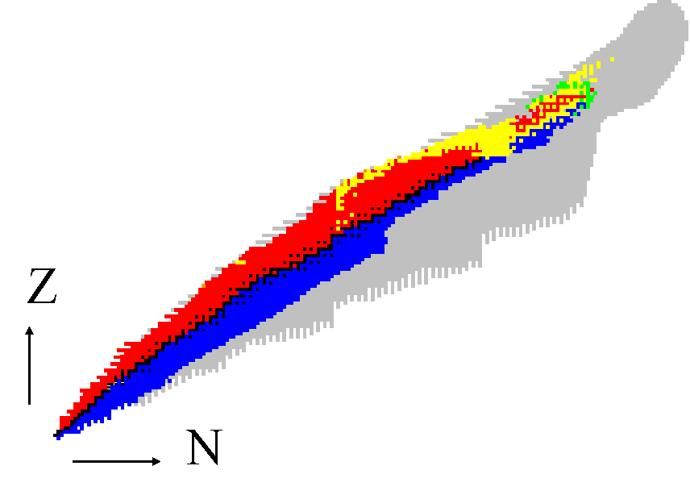
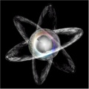



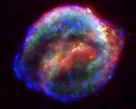
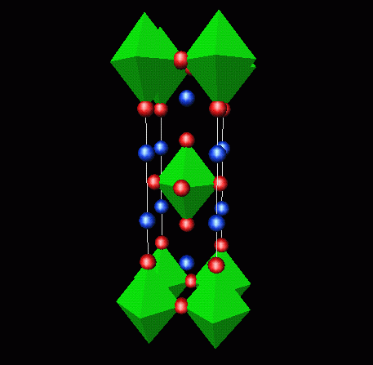
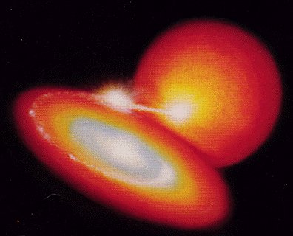

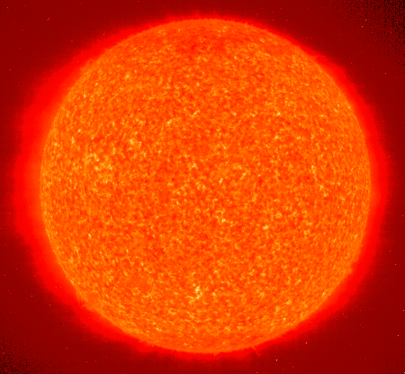
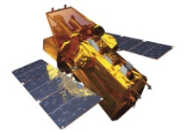
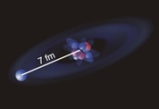
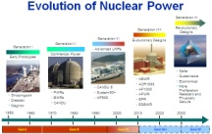

Fundamental Symmetry
in Universe
Research Topics with RIB
Super Heavy
Element
Nuclear mass of heavy nuclei
Spintronics
82
DNA research
Mystery of
High T_{c} Superconductor
r process
50
rp process
How gold is produced?
126
Gateway to
rp process
82
Nuclear Structure of
Double Magic Nuclei
28
20
50
Cancer Therapy
8
28
Next generation Gamma Camera
IR Camera
2
20
Nuclear Synthesis in Red Giant
2
8
Gen-IV nuclear reactor
Nuclear radius of Halo nuclei
Lithium Film Battery

Slide 3
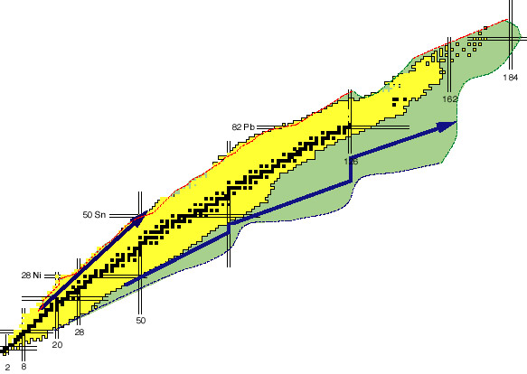
Nuclear Chart for Nuclear Physics
Stable Nuclei ≈ 300
Unstable nuclei observed so far ≈ 2700
Drip-lines (limit of existence)
by theoretical predictions ≈ 6000
Superheavy nuclei
r-process
(Novae & Supernovae)
s-process
(Red giants)
rp-process
Drip lines are determined by interplay among
  n-p symmetry
  Coulomb force
  Shell structure
  NN correlation
Terra incógnita
Z
Neutron halo and skin
Reorganization of the nuclear shell structure
Deformation at drip lines
N

Slide 4
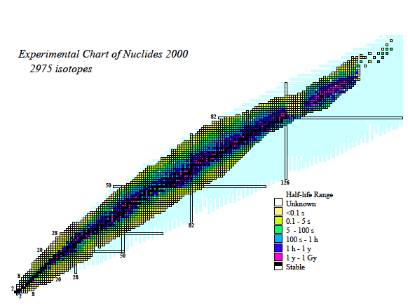
Landscape of Neutron Drip Line?
From T. Nakamura
Where is the neutron drip line?
Shell property at drip line?
Collectivity, deformation at drip line?
Halo nuclei– abundant? universal?
How halo is formed towards heavier region?
82
50
Giant Halo?¹²⁸Zr: 6n halo?
J. Meng and P. Ring,
PRL80, 460 (1998)
n
⁹Li
n
?
¹¹Li
28
20
¹²²Zr
50
8
Halo found in p-shell, sd-shell
28
2n-halo(3body):⁶He,¹¹Li,¹⁴Be,^{17,19}B
1n-halo(2body):¹¹Be,¹⁹C
2
20
2
8
¹²⁸Zr

Slide 5
More neutron halo’s along the drip line?
From T. Nakamura
K
Ar
Cl
S
P
Si
Al
Mg
³²Mg
Halo?
Na
Ne
N=28
F
Island of inversion
O
N=20
N
³¹Ne [S_{n}=0.29(1.64) MeV]
C
B
Jurado et al. PLB649,43(2007)
Be
N=16
Li
1n-halo known
He
N=8
H
2n halo known
N=2
¹⁹C
4n halo (skin)
²²C [S_{2n*}=0.42(94) MeV]
* Estimated value by Audi & Wapstra
Notes:
5

Slide 6
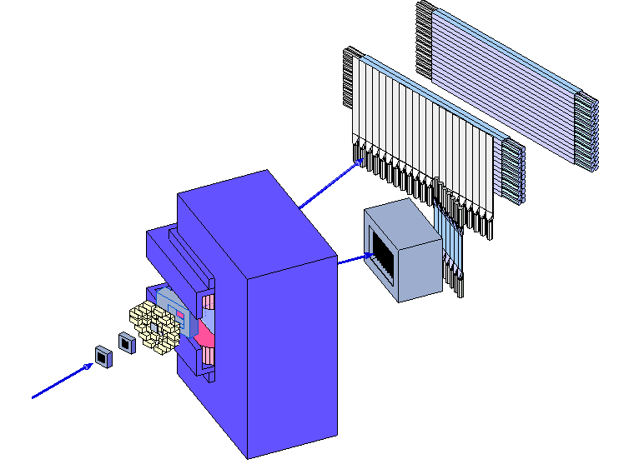
RIPS @ RIKEN
2n breakup of halo nuclei, e.g. ¹¹Li
NEUT
BOMAG
DALI
56 NaI(Tl)
n
n
Target
HOD
⁹Li
DC
RIB
¹¹Li
From T. Nakamura

Slide 7
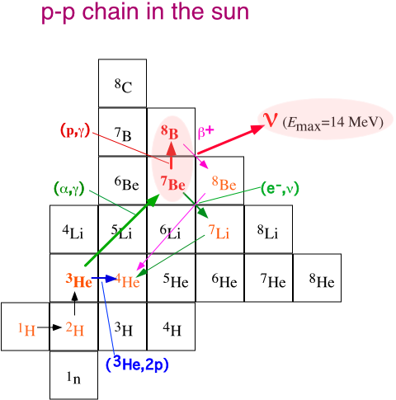
Nuclear Astrophysics
⁷Be(p,γ)⁸B
From T. Motobayashi
We can measure ⁸B
Coulomb dissociation
with RIB
Virtual photons
⁷Be
⁸B
p
²⁰⁸Pb

Slide 8
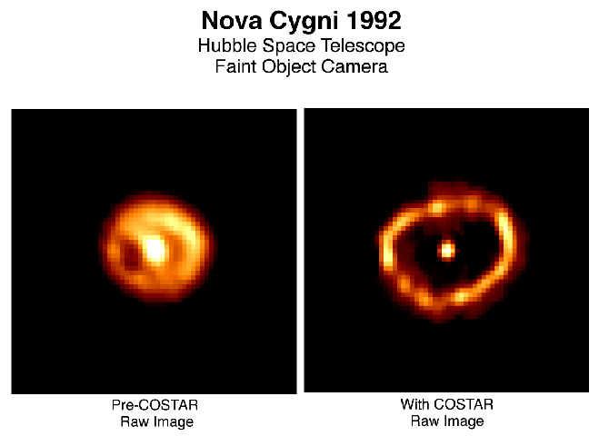
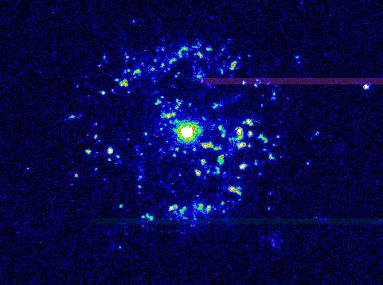
Nova Models
rp process
²⁴Al
²⁵Al
CNO cycle : T₉ < 0.2
HCNO cycle: 0.2 < T₉ < 0.5
rp process : T₉ > 0.5
²¹Mg
²²Mg
²³Mg
²⁴Mg
²⁰Na
²¹Na
²²Na
²³Na
¹⁸Ne
¹⁹Ne
²⁰Ne
²¹Ne
²²Ne
Nova Cygni
(α, γ)
(α, γ)
¹⁷F
¹⁸F
¹⁹F
Stable
(α, p)
Unstable
¹⁴O
¹⁵O
¹⁶O
¹⁷O
¹⁸O
Nova Persei
¹³N
¹⁴N
¹⁵N
CNO cycle
HCNO cycle
¹²C
¹³C

Slide 9
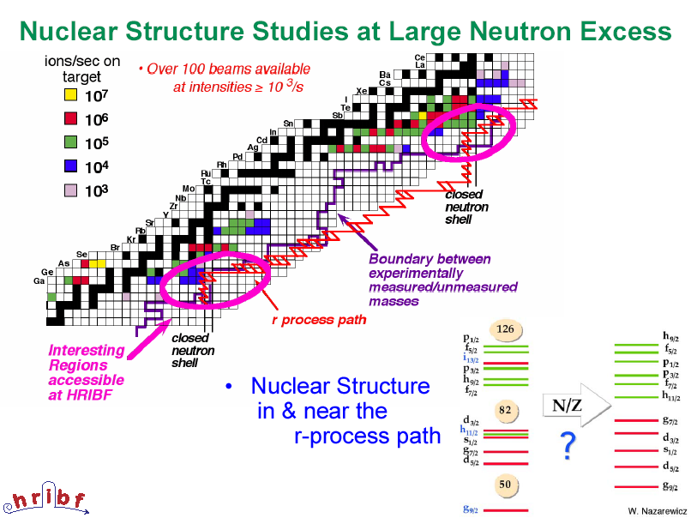

Slide 10
Superheavy Nuclei: Current Status
118
294
117
176
116
290
291
292
293
115
287
288
114
286
287
288
289
113
277
278
283
284
112
277
282
283
284
285
Rg
272
279
280
172
Ds
269
270
271
273
279
281
Mt
266
268
275
276
170
Hs
264
265
266
267
269
Bh
Sg
α
Db
Rf
SF
162
β+ or EC
Lr
No
152

Slide 11
Reactions Tried at GSI in 2007-2008
⁶⁴Ni+²³⁸U → ³⁰²120*
²³⁸U(⁶⁴Ni,2-4n)³⁰⁰⁻²⁹⁸120
122
121
120
³⁰²120*
119
118
294
176
116
290
291
292
293
115
287
288
114
286
287
288
289
113
277
278
283
284
112
277
282
283
284
285

Slide 12
Reactions Could be Studied
²³⁸U(⁷⁰Zn,3n)³⁰⁵122
²³⁸U(⁶⁷Zn,3n)³⁰²122
²³⁸U(⁶⁸Zn,3n)³⁰³122
²³⁸U(⁶⁴Ni,4n)²⁹⁸120
122
121
182
120
119
118
294
176
116
290
291
292
293
115
287
288
114
286
287
288
289
113
277
278
283
284
112
277
282
283
284
285
From Y.H. Chung, Hallym Univ.

Slide 13
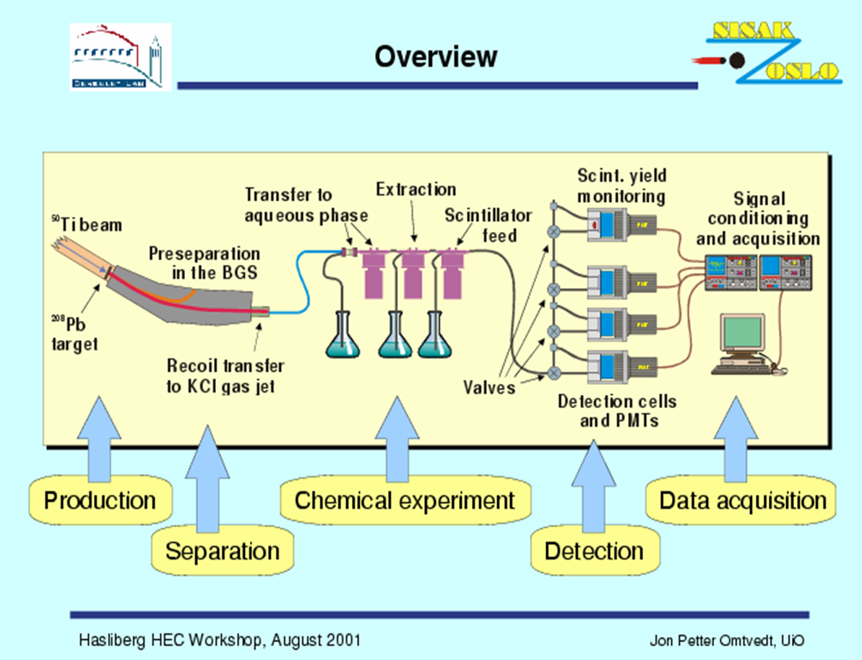
Required Detector System
Gas-filled recoil separator
Focal plane detectors
Rotating wheel system
Automated rapid chemistry apparatus – MG wheel
On-line gas chromatographic apparatus
Something like SISAK in Oslo

Slide 14
Spin Structure of Unstable Nuclei
From W.Y. Kim, Kyungbook Nat. Univ.
Spin-dependent interactions
  Origin of fundamental properties of nuclei
  Modification in neutron rich nuclei
Spin-orbit couplings and potentials
  Localized at the nuclear surface
  Will be modified in neutron rich nuclei
  Should be composed of two parts localized at different positions if p and n have different ρ (r)
  Would have extended shape if n has an extended distribution in skin or halo nuclei
Need polarized p, d, and ³He targets

Slide 15
Present Status at RIKEN
S.Sakaguchi Ph.D. Thesis, University of Tokyo (2008)
⁶He
⁸He
⁴He
⁴He
valence n
Di-neutron structure
  → Large recoil motion of α-core
  → Large charge radius (2.068 fm)
Two valence neutrons
  → Small matter radius (2.45 fm)
Isotropically distributed neutrons
  → Small recoil motion of α-core
  → Small charge radius (1.929 fm)
Four valence neutrons
  → Large matter radius (2.53 fm)

Slide 16
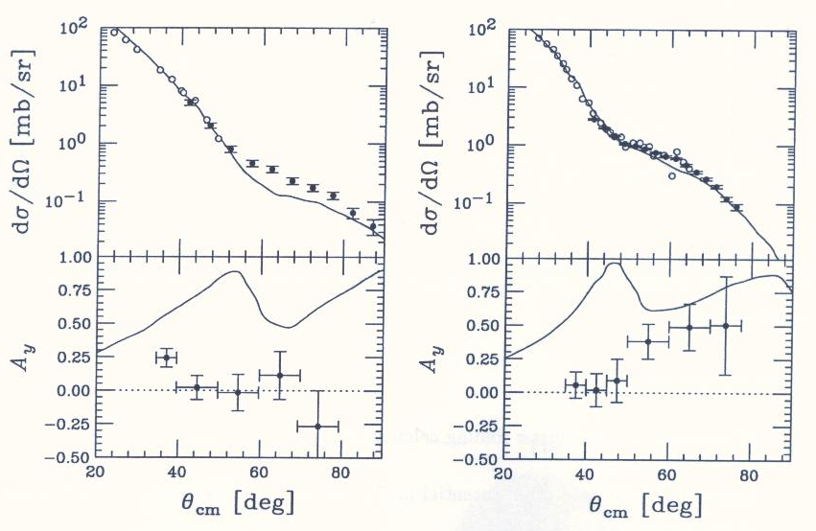
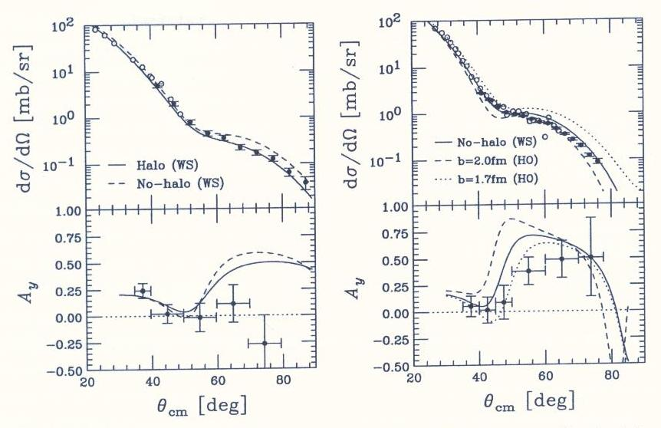
Present Status at RIKEN
S.Sakaguchi (2008)
t-matrix folding calculation
Non-local g-matrix folding calculation

Slide 17
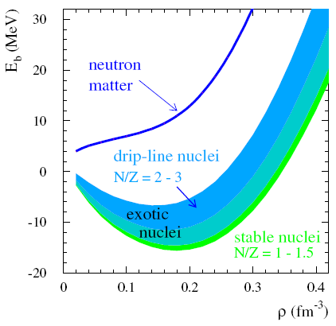
Nuclear Equation of State
B.-A. Li, L.-W. Chen
& C.M. Ko
Physics Report,
464, 113 (2008)
18
E/A (MeV)
Symmetric
nuclear matter
(ρ_{n}=ρ_{p})
CDR, FAIR (2001)
Isospin
asymmetry
0
ρ
Nucleon
density
δ
F. de Jong & H. Lenske, RPC 57, 3099 (1998)
F. Hofman, C.M. Keil & H. Lenske, PRC 64, 034314 (2001)
ρ (fm⁻³)

Slide 18
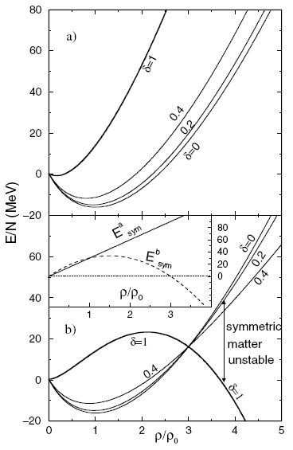
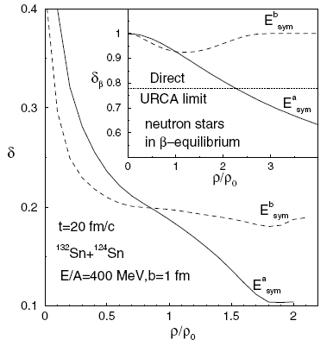
Nuclear Equation of State
Bao-An Li, PRL 88, 192701 (2002)
High (Low) density matter is more neutron rich with soft (stiff) symmetry energy

Slide 19
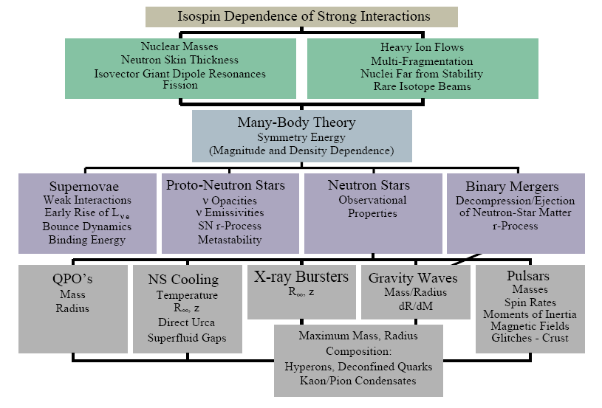
Importance of Symmetry Energy
RIB can provide crucial input.
Effective field theory, QCD
π⁻/π⁺
K⁺/K⁰
n/p +
³H/³He
γ
isodiffusion
isotransport
+ isocorrelation
isofractionation
isoscaling
A.W. Steiner, M. Prakash, J.M. Lattimer and P.J. Ellis, Physics Report 411, 325 (2005)
Red boxes: added by B.-A. Li

Slide 20
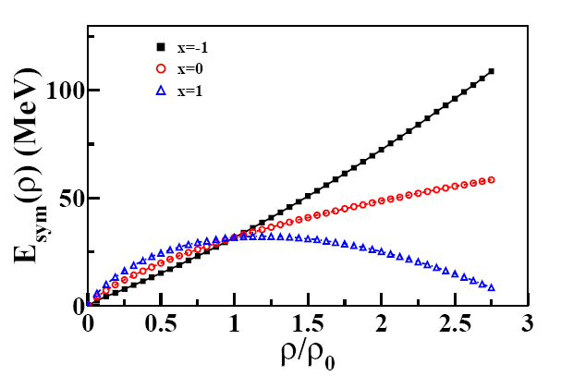
Uncertainty in E_{sym} at high ρ
Kinetic Isoscalar Isovector

Slide 21
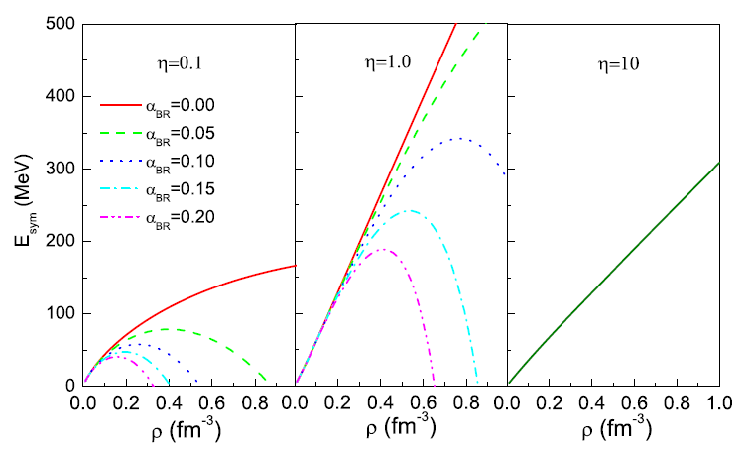
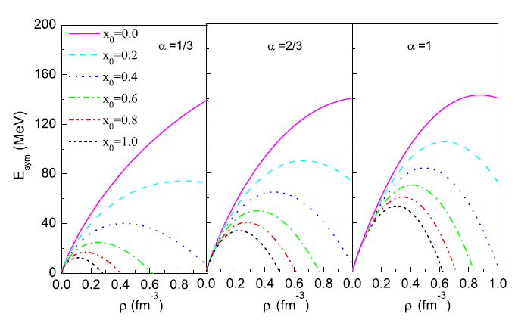
Possible Effects on E_{sym}
Brown-Rho Scaling
G.E. Brown and M. Rho,
PRL 66, 2720 (1991);
Phys. Rep. 396, 1 (2004)
3-Body Force

Slide 22
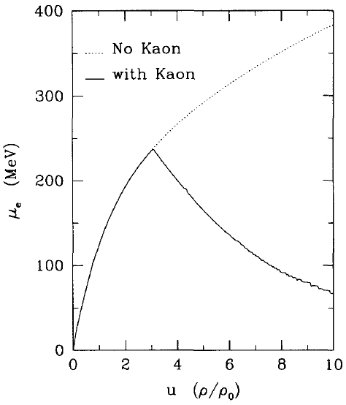
Is NS Stable with a Super Soft E_{sym}?
If the symmetry energy is too soft, then a mechanical instability will occur
when dP/dρ<0, neutron stars will, then, collapse while they exist in nature.
Gravity
?
TOV equation: a condition at
hydrodynamical equilibrium
Nuclear pressure
For npe matter,
G.Q. Li, C.-H. Lee & G.E. Brown
Nucl. Phys. A 625, 372 (1997)
dP/dρ<0, if E’_{sym} is big and negative (super-soft)

Slide 23
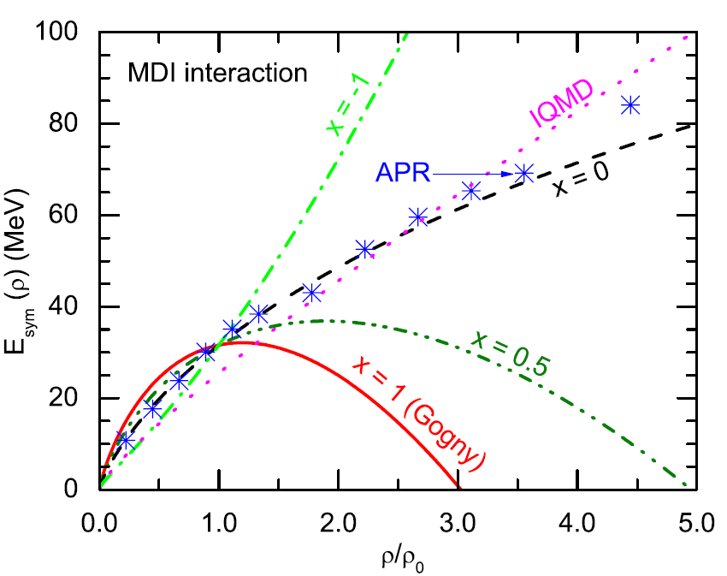
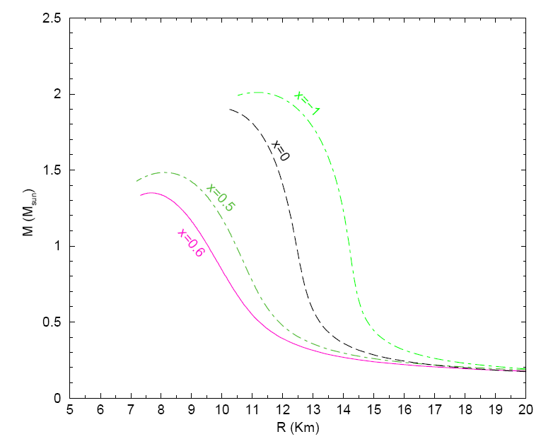
Astrophysical Implication
K₀=211 MeV is used for this calculation; higher incompressibility
for symmetric matter will lead to higher masses, systematically.
The softest symmetry energy that the TOV is still stable is x = 0.93,
giving M_{max} = 0.11 M⊙ and R ≥ 28 km.

Slide 24
Experimental Principles
Range of density in HIC by
  incident energy
  impact parameter
Types of particles formed
  emission time & density
  n & p are emitted throughout
  Fragments (Z=3-20) at sub-saturation densities
Change N/Z of nuclei
  larger N/Z ratio is preferable
π, n, p
fragments

Slide 25
Experimental Observables
Signals at sub-saturation densities
  Sizes of n-skins for unstable nuclei
  n/p ratio of fast, pre-equilibrium nucleons
  ³H/³He ratio
  Isospin fractionation and isoscaling in nuclear multufragmentation
  Isospin diffusion (transport)
  Differential collective flows (v₁ & v₂) of n and p
  Correlation function of n and p
Signals at supra-saturation densities
  π⁻/π⁺ ratio
  K⁺/K⁰ ratio
  Differential collective flows (v₁ & v₂) of n and p
  Azimuthal angle dependence of n/p ratio with respect to the R.P.
Correlation of various observables
Simultaneous measurement of neutrons and charged particles

Slide 26
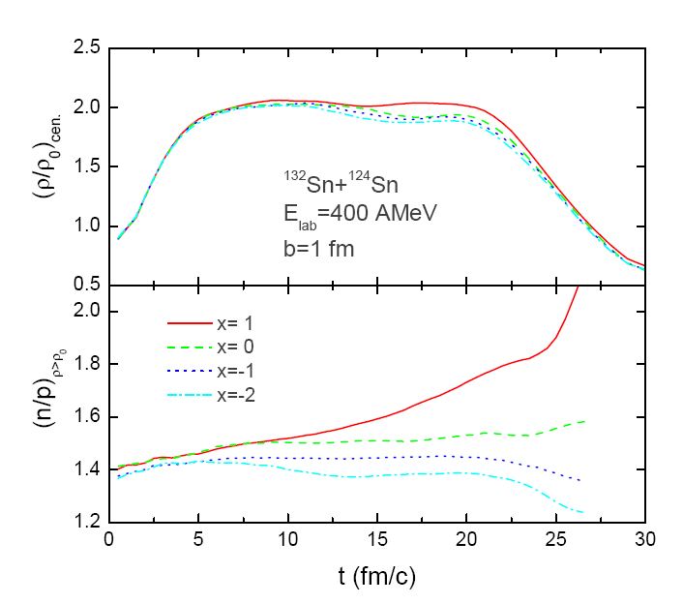
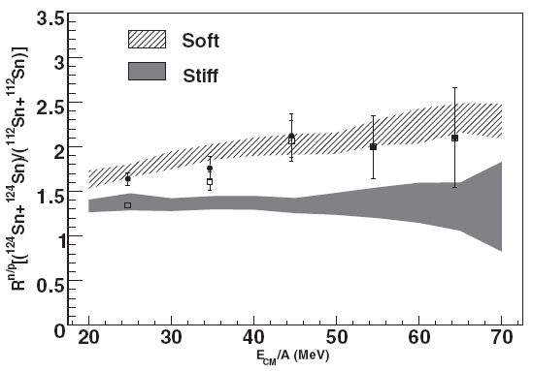
Yield Ratio
Central density
E_{sym}(ρ)=12.7(ρ/ρ₀)^{2/3}+17.6(ρ/ρ₀)^{γi}
Soft E_{sym}
ImQMD
Stiff E_{sym}
Y(n)/Y(p)
Double ratio: min. systematic error
More neutrons are emitted from the n-rich system and softer symmetry energies.
n/p
³H/³He
M. A. Famiano et al.
RPL 97, 052701 (2006)

Slide 27
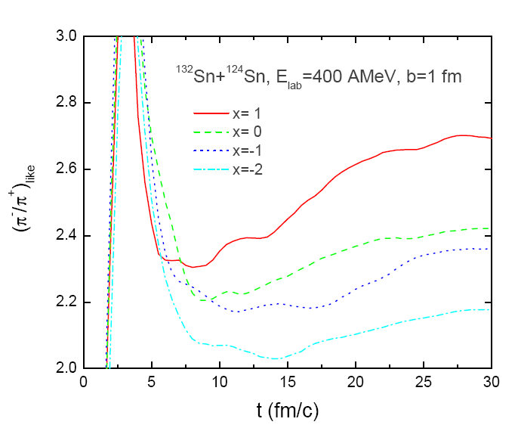
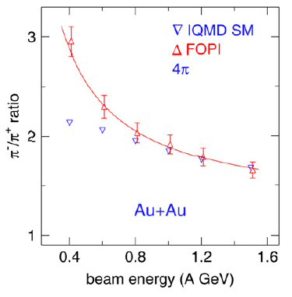
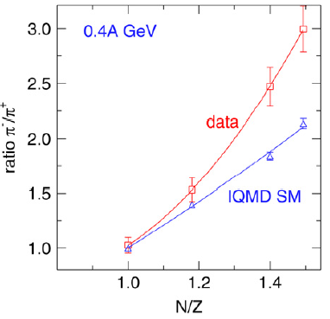

Yield Ratio (π⁻/π⁺)
Data: FOPI Collaboration, Nucl. Phys. A 781, 459 (2007)
IQMD: Eur. Phys. J. A 1, 151 (1998)
Need a symmetry energy softer than
the above to make the pion production
region more neutron-rich!

Slide 28
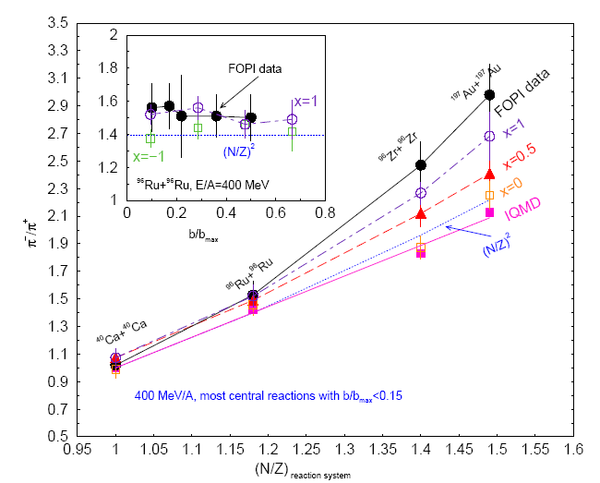
π⁻/π⁺ Ratio
Soft E_{sym}
KoRIA
π⁻/π⁺
Stiff E_{sym}
(N/Z) _{reaction system}

Slide 29
Isospin Diffusion Parameter
Isospin diffusion occurs only in asymmetric systems A+B
R_{i} = 0 for
complete mixing
No isospin diffusion between symmetric systems
124
112
Non-isospin diffusion effects
are the same for A in A+B & A+A
and also for B in B+A & B+B
R_{i} = -1
124
112
124
112
R_{i} = +1
F. Rami et al., FOPI, PRL 84, 1120 (2000)
B. Hong et al., FOPI, PRC 66, 034901 (2002)
Y.-J. Kim & B. Hong, in preparation

Slide 30
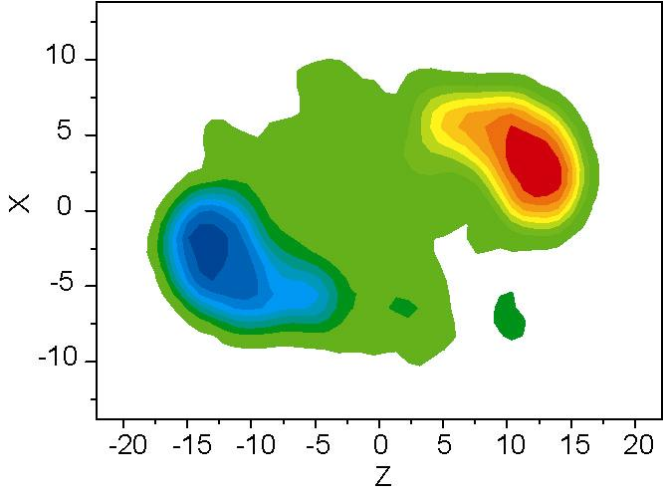
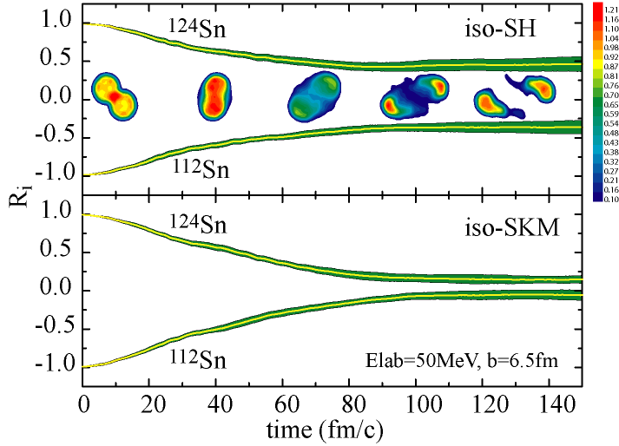
Isospin Diffusion Parameter
Projectile
¹²⁴Sn
stiff
soft
¹¹²Sn
Target
Symmetry energy drives system towards equilibrium
  stiff EOS : small diffusion (|R_{i}| ≫ 0)
  soft EOS : large diffusion & fast equilibrium (R_{i} → 0)
M.B. Tsang et al., PRL 92, 062701 (2004)

Slide 31
Isospin Diffusion Parameter
M.B. Tsang et al., PRL 92, 062701 (2004)
L.W. Chen et al., PRL 94, 032701 (2005)
E_{sym}(ρ)=12.7(ρ/ρ_{o})^{2/3}+12.5(ρ/ρ_{o})^{γi}
IBUU04: E_{sym}(ρ)~31.6(ρ/ρ_{o})^{γ}
pBUU
γ_{i}~2
0.69 ≤ γ ≤ 1.05
0.69≤γ ≤1.05
stiff
soft
stiff
soft
Observable in HIC is sensitive to the ρ dependence of E_{sym} and should provide constraints to the symmetry energy.

Slide 32
Isospin Diffusion Parameter
NSCL/MSU Data at Low Energy
E_{sym}(ρ)=12.5(ρ/ρ₀)^{2/3}+17.6 (ρ/ρ₀)^{γi}
0.4≤γ_{i} ≤1
0.4≤γ_{i} ≤1
R_{i}(f)
R_{i}(α)

Slide 33
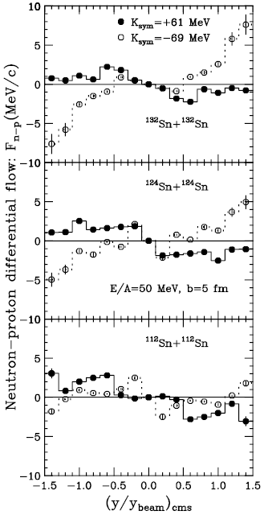
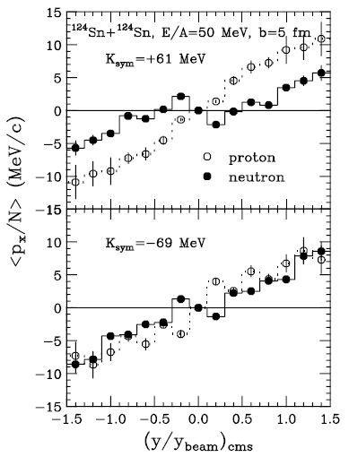
Collective Flow
Large
N/Z
B.-A. Li,
PRL 85, 4221
(2000)
Stiff
Also known as v₁
Super
Soft
Small
N/Z

Slide 34
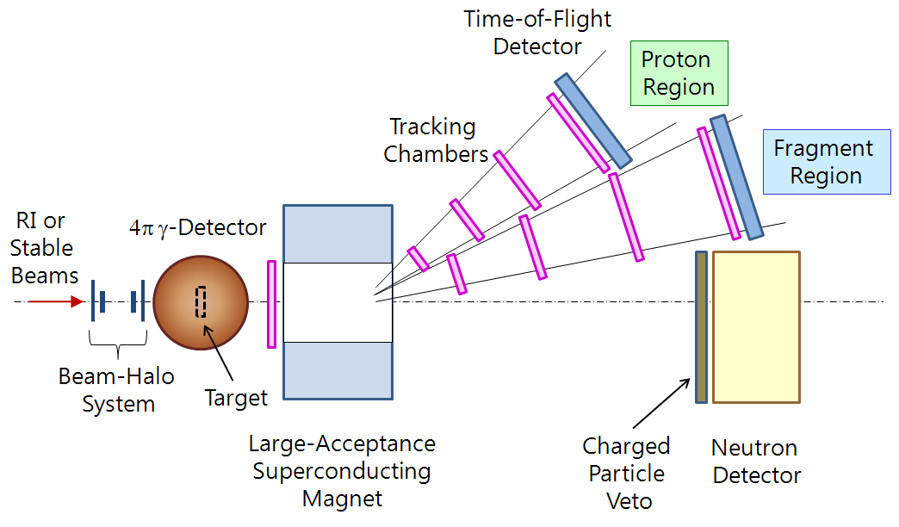
Multi-Purpose Detector

Slide 35
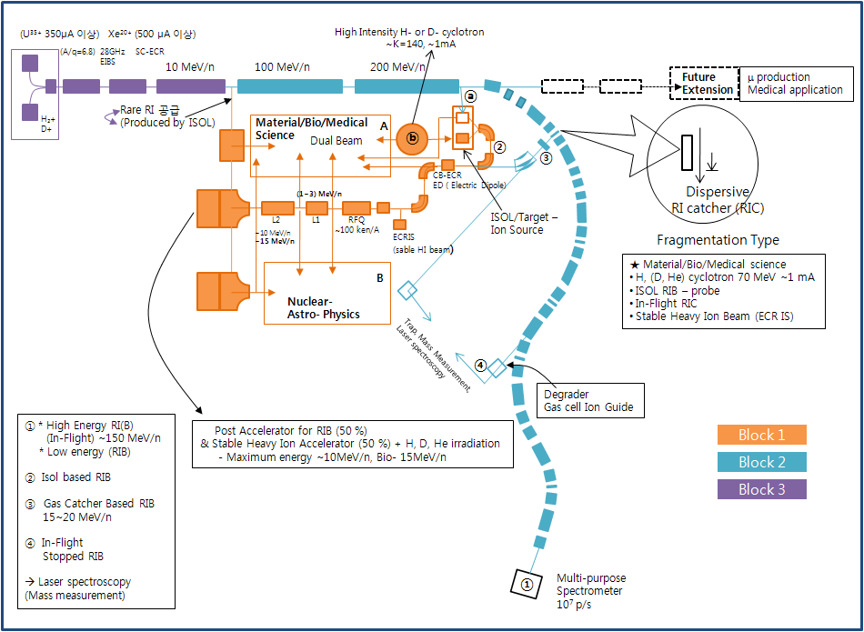
Tentative design
under discussion

Slide 36
Summary
Rich physics with RI beams
  Neutron & proton drip lines
  Neutron halo & skin structures
  Nuclear Astrophysics
  Super-heavy elements
  Fundamental symmetries
  Nuclear symmetry energy
    Long-standing problem in nuclear physics
    Crucial to understand the neutron matter
    Crucial to understand the astrophysical objects
KoRIA
  First large scale accelerator for basic science in Korea
  We need your help & participation!

