Slide 1
To be or not to be,
BR-scaling in hQCD
Sang-Jin Sin (HYU)
@him-wcu 09.10
With
Y. Seo, J.P. Shock, D. Zoakos(0911.xxxx)
CY.Park, KH. Jo, BH Lee(0909.3914 )

Slide 2
Introduction: Dynamical mass*
A good way summarizing the effect of the interaction.
Brown and Rho: m* goes lower.
Based on tendency near chiral restoration.
C14 and other remarkable applications.
Yet. No observable support.
Lattice calculation with density is still difficult.
So, need new idea.

Slide 3
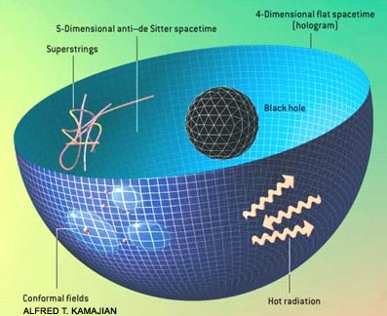
AdS/CFT

Slide 4
Bottom Up Approach
Gluon dynamics is replaced by AdS5.
Flavor dyn. By space filling branes.
Meson=fluctuation of branes.

Slide 5


Baryon Chemical potential
AdS/CFT
Global symmetry
Boundary
gauge symmetry
Bulk
Local charge

Slide 6



Coupling of (metric + vector)
Q=given baryon charge,
q=parameter of RN BH
relation of q & Q?

Slide 7
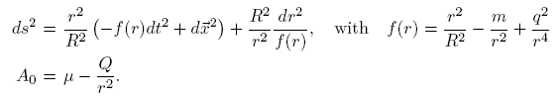
Result: AdS charged black hole
Chamblin et.al hep-th/9902170: with Q asR charge
Here It is consequence of the back reaction and
Q=baryon charge
Remark: this is for deconfined phase.

Slide 8
Hardwall and confinement
Dual to MIT bag-Model
In/Out is switched in ads/cft
Cut off r >r_m
Use z=1/r

Slide 9
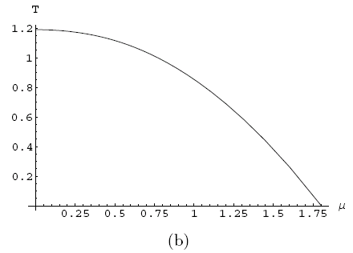
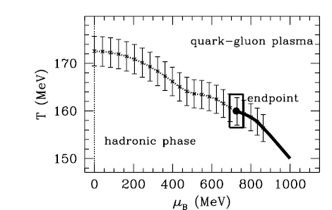
Phase diagram: fixed chemical potential
Z. Fodor, S.D. Katz
(hep-lat/0106002)

Slide 10
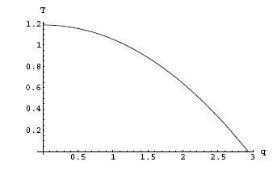
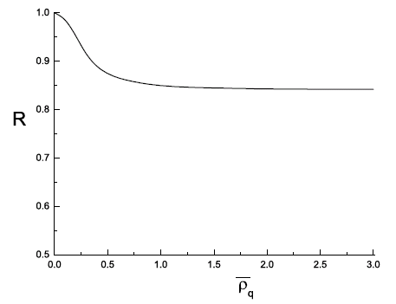

Phase diagram (fixed density)
With back reaction v.s Without
Main change is attributed to the def. change of T.

Slide 11
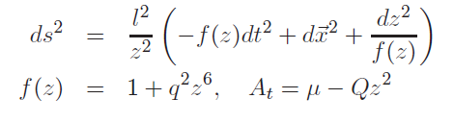


Confining Phase with Baryon charge

Slide 12
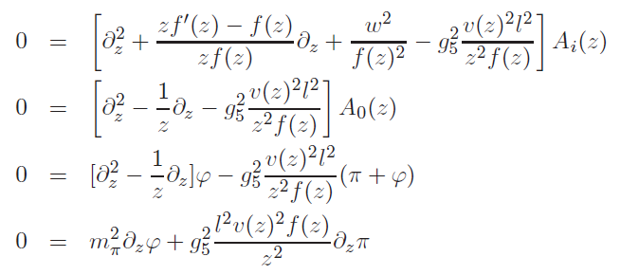


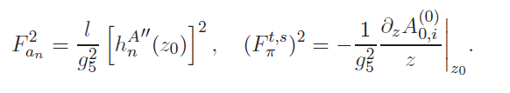
Eq.of M & B.C
Decay constants

Slide 13

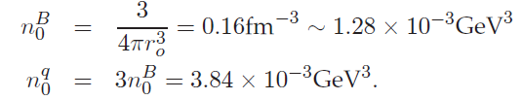
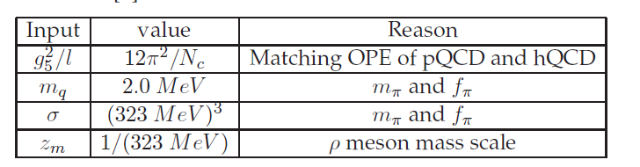





Slide 14
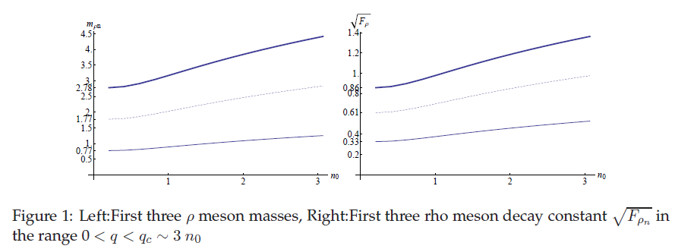
Vector meson in medium

Slide 15
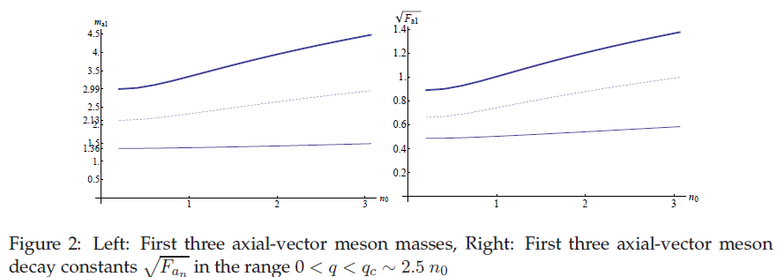
a1 vs density

Slide 16
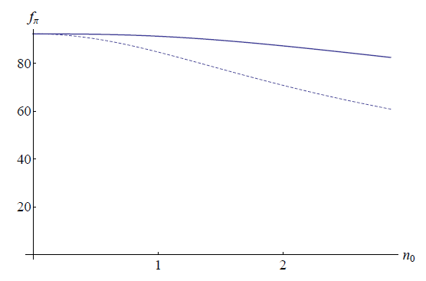

Pion decay constant

Slide 17
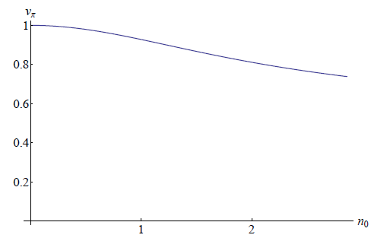
Pion velocity vs density

Slide 18
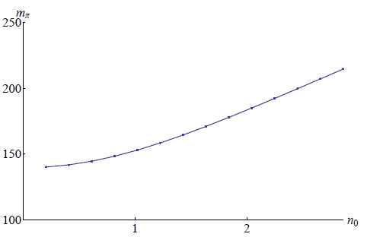
Pion mass vs density

Slide 19

Summary: Bottom up. I
Pion mass | rho mass
BR-scaling is not there in bottom up approach.
Caveat: coupling to the metric fluctuation is not included.

Slide 20




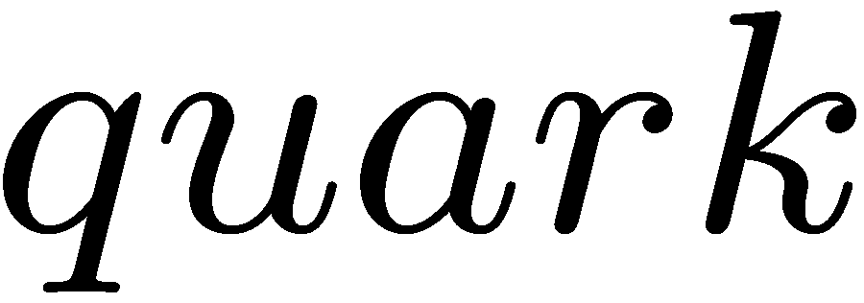



Top Down Approach
Matter with probe brane

Slide 21
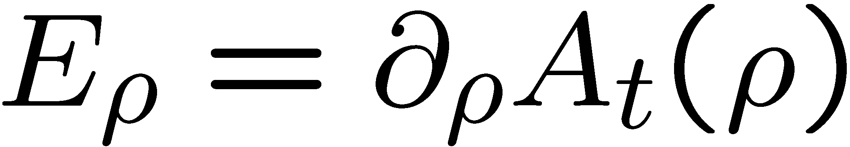
Chemical potential with quark
quark
Black D3

Slide 22
Chemical potential with Baryon
How mesons behave on this configuration?

Slide 23
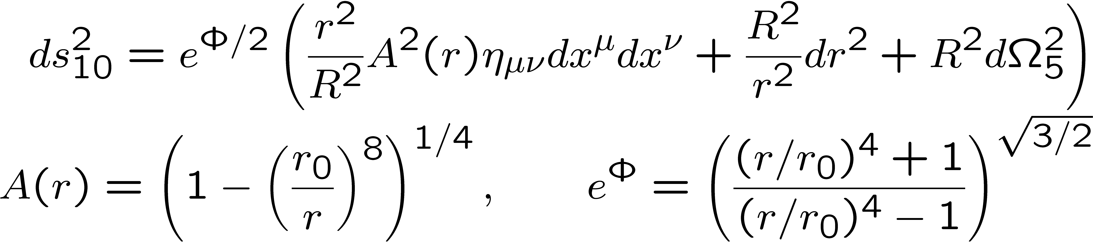
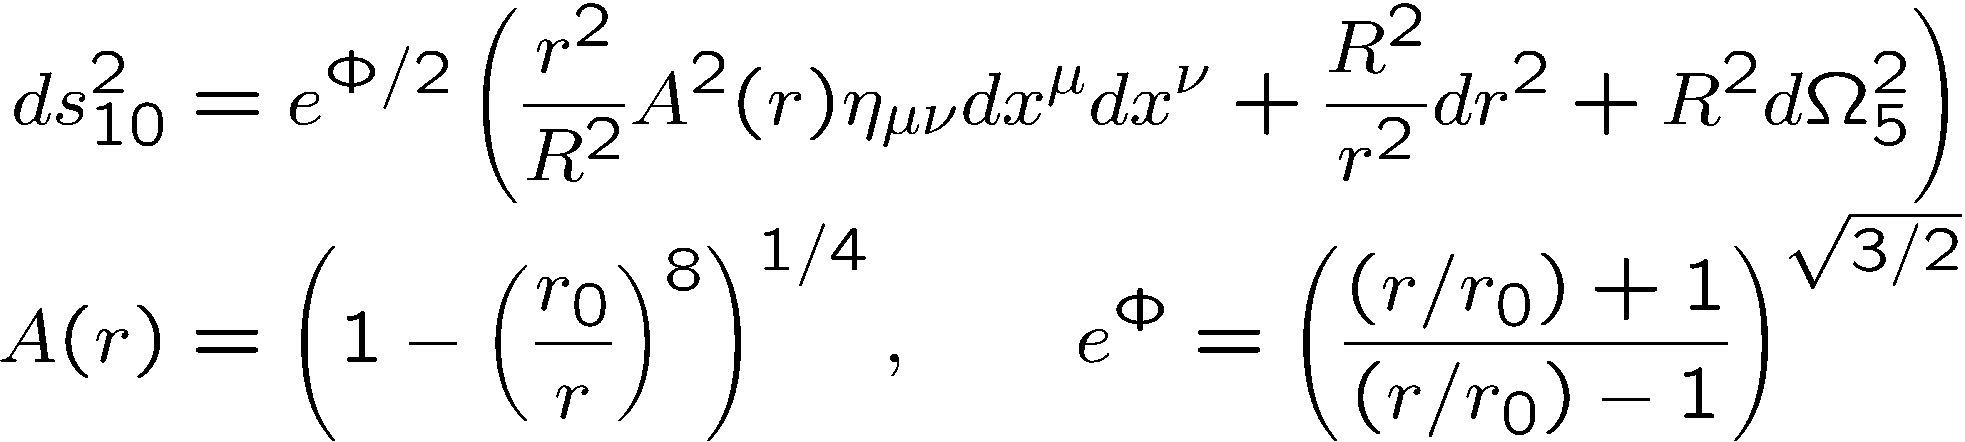
Background geometry
Gubser’s background
Non supersymetric extension of D3-D(-1) bound system
Supersymmetry and chiral symmetry is broken
r0 is proportional to the gluon condensation in gauge theory
This geometry support confining phase

Slide 24
Hardwares: DBI action
Theoretical equipments are
actions and eq. of M
How D-branes vibrate : DBI

Slide 25
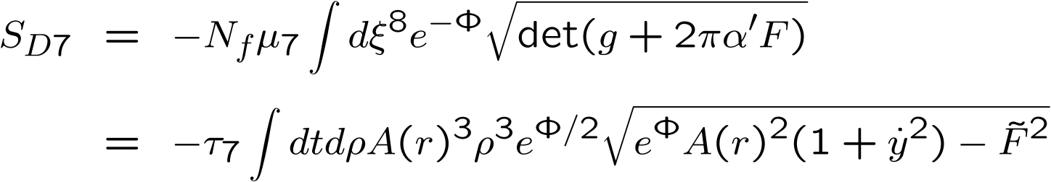
Probe D7 brane: action
We consider D7 brane as a probe brane where the other end point of fundamental strings are attached
End point can be regarded as point source on D7 brane
Induced metric on D7 brane
DBI action

Slide 26

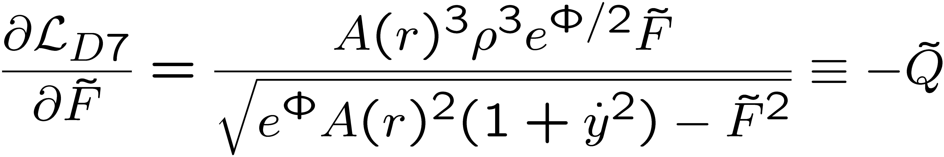
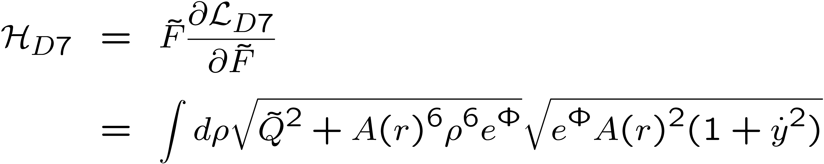
D7: first integral and Ruthian
Equation of motion for
Legendre transformed Hamiltonian

Slide 27
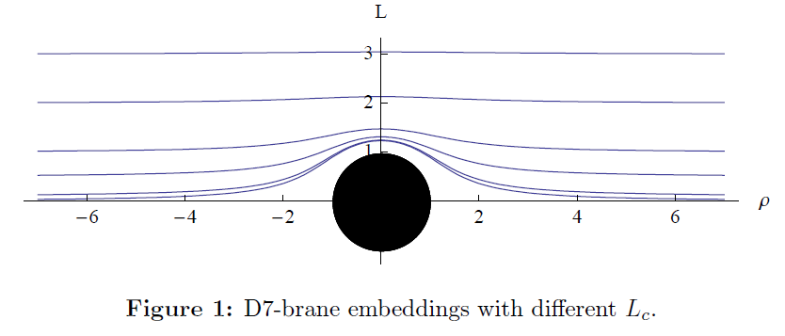
D7 embedding

Slide 28
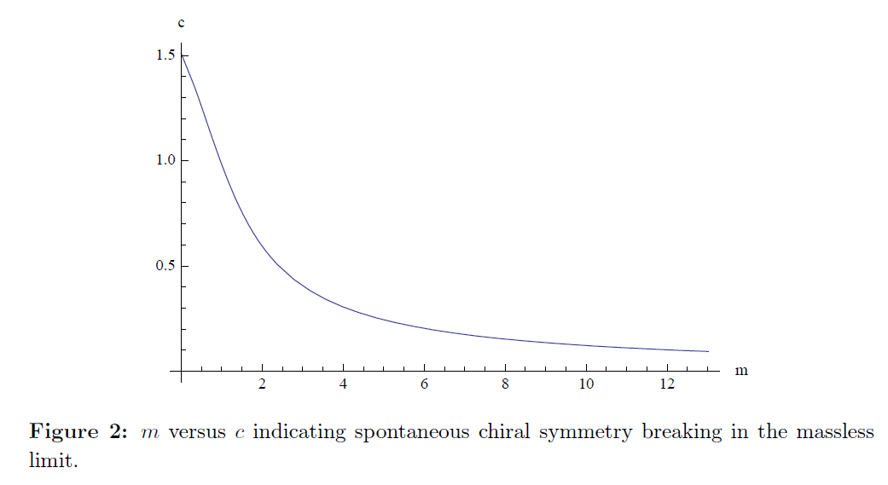
Ex: Chiral condensation and m_q

Slide 29
D5
For dense matter we need D5.
Add baryon vertices in uniform fashion along
D3 direction (spacial direction).
Remark:
For single or non-uniform density distribution
It is difficult.

Slide 30
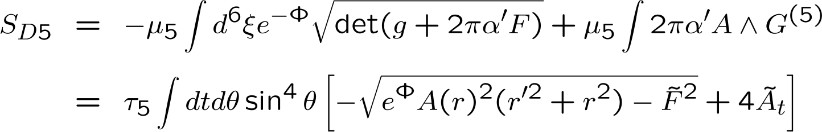
DBI for D5 (Baryon vertex)
Baryons : D5 brane wrapped on an S⁵ on which N_{c} F1’s terminate
The background 5-form field strength can couple to the world volume U(1) gauge field via Chern-Simons term
Induced metric on D5 brane
DBI action for single D5 brane with Nc F1’s

Slide 31
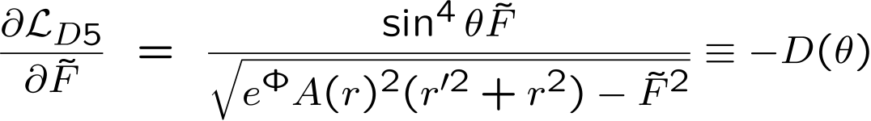
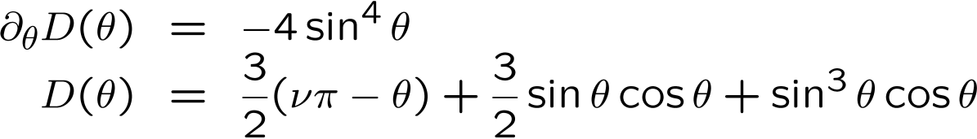
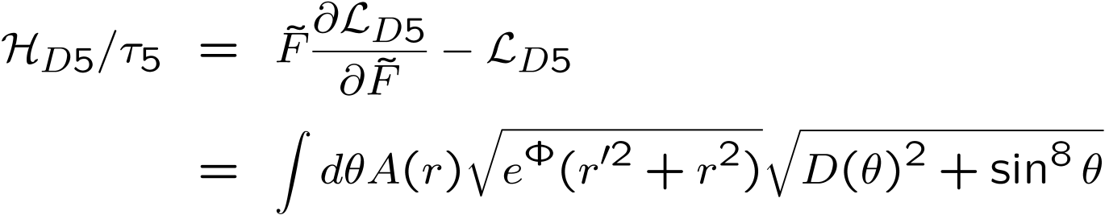
Eq. of M for D5
Dimensionless Displacement
Equation of motion and solution
ν Nc F1’s are attached at south pole and (1- ν)Nc F1’s at north pole
Legendre transformed Hamiltonian

Slide 32
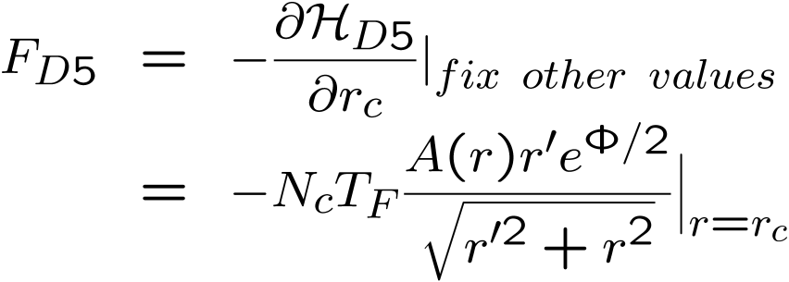
Shape of Baryon vertex
D5 brane solution
D4/D6(D3/D5)
YS, S Sin, JHEP 0804:010, 2008
Force at cusp

Slide 33
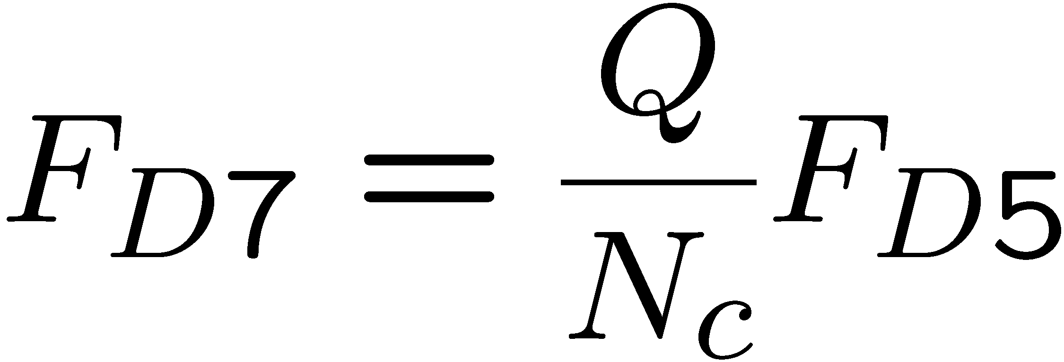
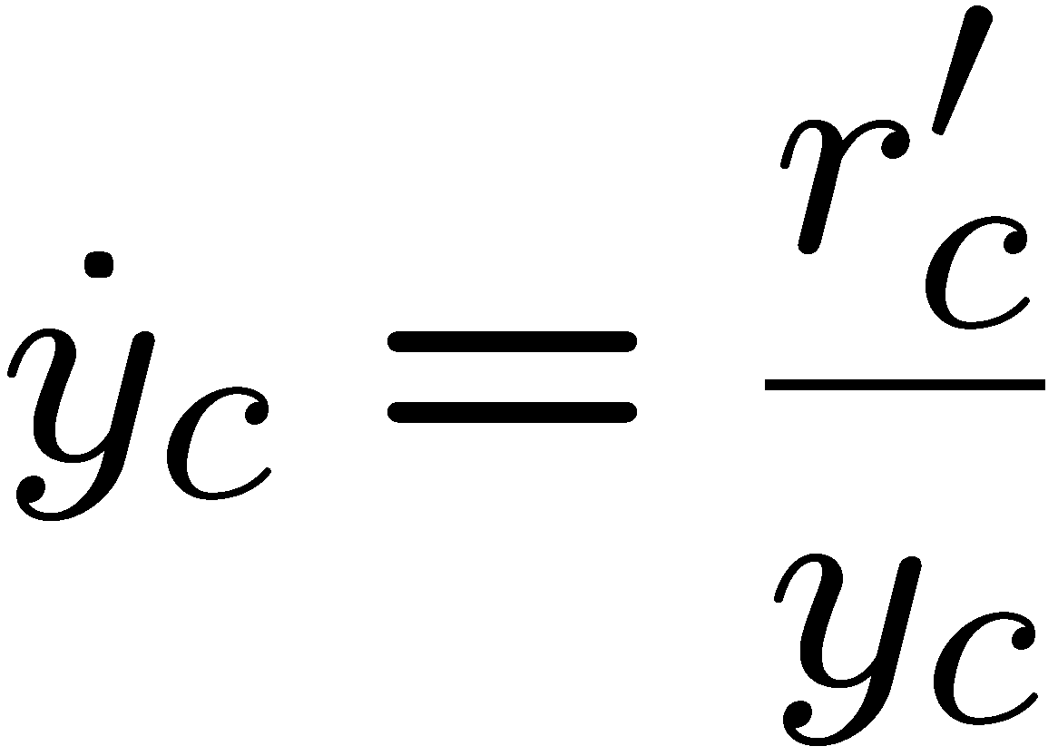
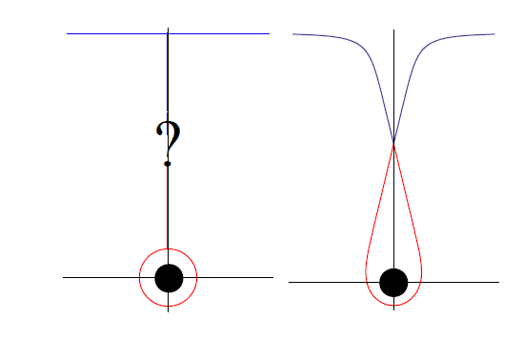
Interaction of D7-D5: force balance with Baryon vertex
Total configuration(Baryon D5 + F1’s +probe D7) can be stationary if there is force balance condition
Force balance condition

Slide 34

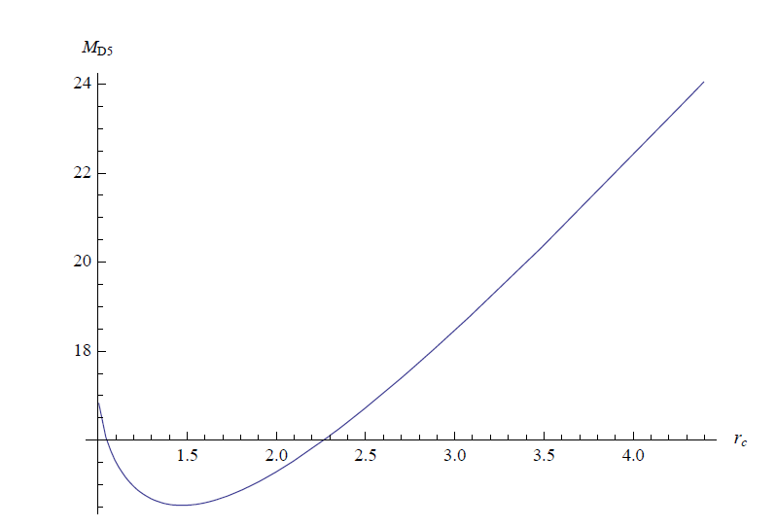

Slide 35
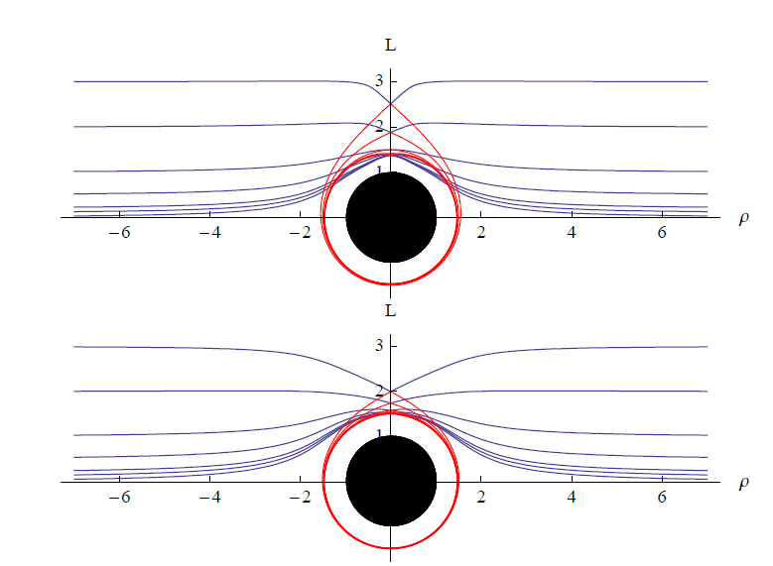
Fixed Q, varing m_q

Slide 36
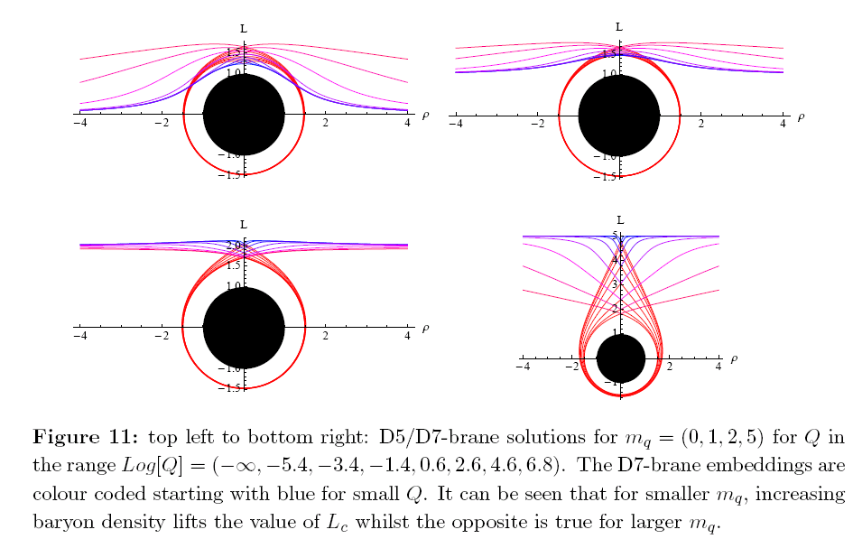

Slide 37
Baryon mass with density
Deformation of D-brane
Deformation of D5 brane
Baryon mass
Deformation of D7 brane
Baryon-baryon interaction
Density dependence of baryon mass
D4/D6(D3/D5)
YS, S Sin, JHEP 0804:010, 2008
mq = 1.5
mq = 1
mq =0

Slide 38
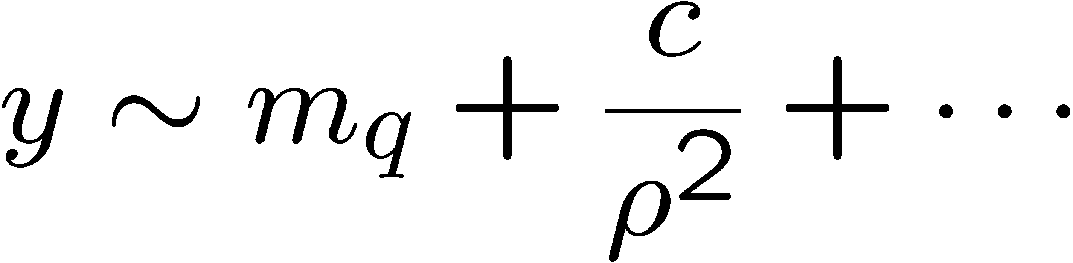
Chiral condensation in Medium
Asymptotic behavior of D7 brane
Chiral condensation

Slide 39
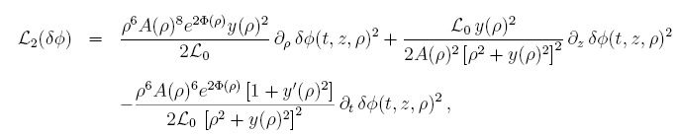
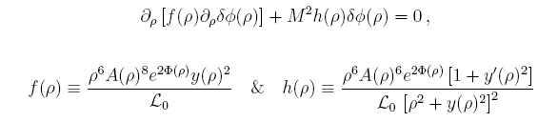
Meson: Fluctuation on D7 brane
Scalar fluctuation
Second order Lagranian with quardratic terms for fluctuation
Equation of motion for fluctuation

Slide 40
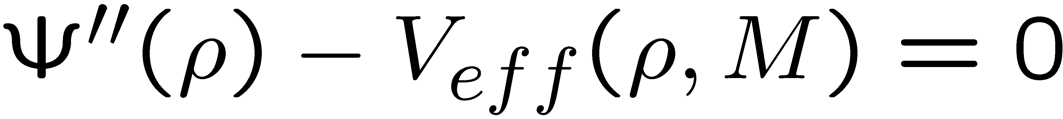
Fluctuation on D7 brane
Effective potential

Slide 41
Fluctuation on D7 brane
By using shooting method, we can calculate mass spectrum of fluctuation, which is meson.
For large enough quark mass, meson mass decreases!
In such case BR-scaling exist.

Slide 42
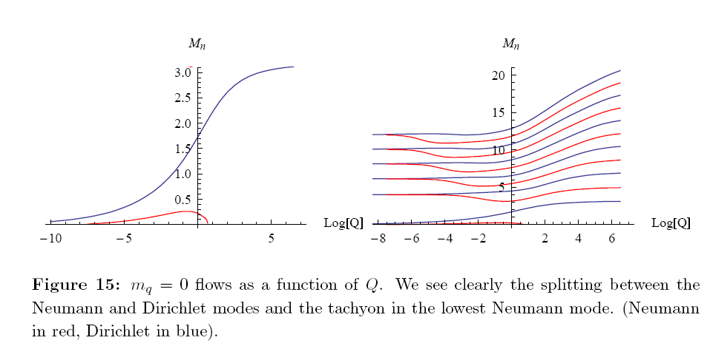
For very small m_q:

Slide 43
Summary
BR scaling is possible for some model for appreciable quark mass,
while it is not there in some of the model.
Remark: So are we are still in pion mode.
Vector mode will be reported in future.
(Rho Seo SJS)

Slide 44
Conclusion: What next?
Here, we studied Density dependences.
Following objects are calculable in hqcd:
0.Phase diagram (not critical point/crossover).
1. equation of state.
2. all Thermodnamic quantities.
3. condensations (chiral , gluon, meson … )
4. susceptiblities. compressibility
5. spectral functions.
6. Symmetry energies.
7. Differnet models and Different modes.
Etc …….

