Slide 1
Half-Skyrmion Matter
&
Quarkionic Matter
HIM-WCU workshop
Hanyang U.
Oct. 31, 2009
Byung-Yoon Park
(Chungnam Nat’l Univ.)

Slide 2
Collaborators
M. Rho(Saclay, Hanyang Univ.)
V. Vento(Valencia Univ.)
D.-P. Min(Seoul National Univ.)
H.-J. Lee(Chungbuk National Univ.)

Slide 3
Contents
Skyrme Model ?
2. Dense Skyrmion Matter
3. Dense & Hot Skyrmion Matter
4. Summary

Slide 4
1. Skyrme Model?

Slide 5



Skyrmion Model
1960, T. H. R. Skyrme
U(x) : mapping from R³-{ }=S³ to SU(2)=S³
8
topological soliton
R ~ 1 f m
M ~ 1.5 GeV
BARYON ?

Slide 6
Hadronic World
(Skyrmionist’s Viewpoint)
1919 Rutherford
1932 Chadwick
1935 Yukawa
1960 Skyrme
pion
pion
proton
neutron
proton
neutron
Notes:
The following is the chronicle of hadronic world in the viewpoint of a skyrmionist.
First there were nucleons.
Then, the pion is introduced by Yukawa. At that time it was just a messenger, mediating the nuclear force among nucleons.
Now, there are only pions in the hadronic world, because pions can produce the nucleons in the form of soliton.

Slide 7
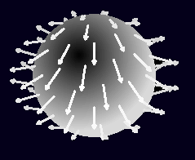
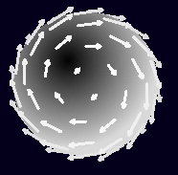
SU(2) Collective
Coord. Quantization
N, Δ
SU(3) collective
Coordinate
Quatization
Ν, Σ, Ξ,
Δ, Σ*, Ξ∗,Ω

Slide 8
Hedgehog Soliton
Ν, Σ, Ξ,
Δ, Σ*, Ξ∗,Ω
SU(2) collective
Coordinate
Quatization
bound kaon

Slide 9
Hedgehog Soliton
Ν, Σ, Ξ_{c},
Δ, Σ*, Ξ*,Ω_{c}
_{c}
_{c}
SU(2) collective
Coordinate
Quatization
bound D,D*

Slide 10
Multi-Skyrmion system
B=2 Torus
B=3 Tetrahedron
B=4 Cube
B=5 with D_{d2} sym
B=6 with D_{d4} sym
B=7 Dodecahedron

Slide 11
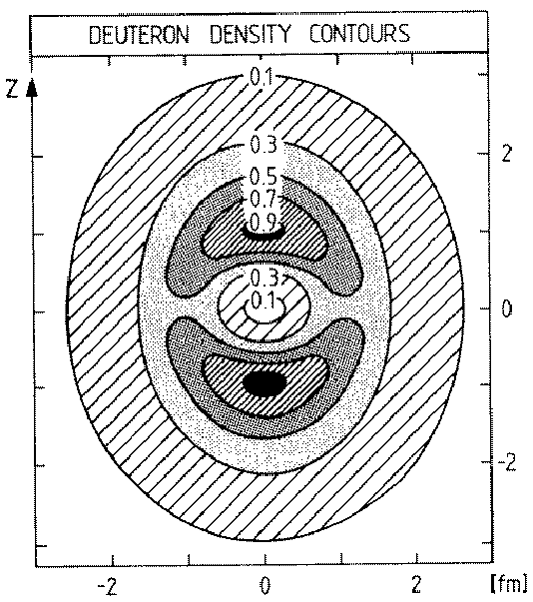
Toroidal B=2 skyrmion
1988, Braaten & Carson,
1995, Leese, Manton & Schroers

Slide 12
2. Dense Skyrmion Matter

Slide 13
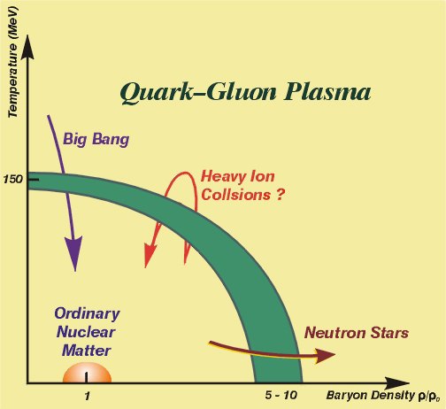
2. Dense Skyrmion matter

Slide 14
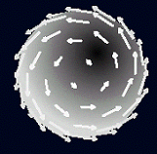
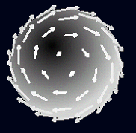
Two skyrmions in the most attractive configuration.
2. Dense Skyrmion matter

Slide 15
Simple Cubic Skyrmion Crystal
1985, I. Klebanov
Y
U(x+L_{C},y,z)
=τ_{y} U(x,y,z) τ_{y}
x
z
x
L_{C}
y
o
y
X
x
z
x
(E/B)_{min}=1.078
at L_{C}=5.56
2. Dense Skyrmion matter

Slide 16
Half-Skyrmion Crystal
1987, A. S. Goldhaber & N. S. Manton
U(x+L_{C},y,z)
=τ_{y}U(x,y,z)τ_{y}
z
x
L_{C}
+ additional
Symmetry
w.r.t.
σ → -σ
0
y
X
σ=-1
(E/B)_{min}=1.076
at L_{C}=5.56
σ=+1
(L_{b}/2 above)
2. Dense Skyrmion matter

Slide 17
Half-skyrmion?
U =-1
.
π
^
U = exp(i F(r)τ r )
F (r )
r
2. Dense Skyrmion matter

Slide 18
U =-1
U =-1
U =+1
2. Dense Skyrmion matter

Slide 19
U =+1
U =-1
U =-1
2. Dense Skyrmion matter

Slide 20
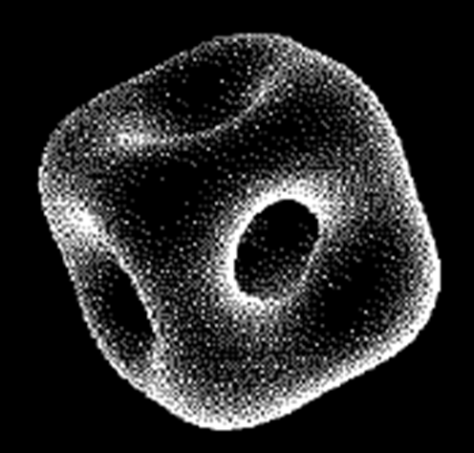
B=4 skyrmion
2. Dense Skyrmion matter

Slide 21
FCC Skyrmion Crystal
1989, L. Castellejo et al. & M. Kulger et al.
Y
Y
z
z
x
L_{F}
o
X
y
y
X
z
z
x
z=0 plane
z=L_{F}/2 plane
2. Dense Skyrmion matter

Slide 22
Half-Skyrmion CC
Y
Y
z
z
x
L_{F}
o
X
y
y
X
z
z
x
(E/B)_{min}=1.038 at L_{f}=4.72
2. Dense Skyrmion matter

Slide 23
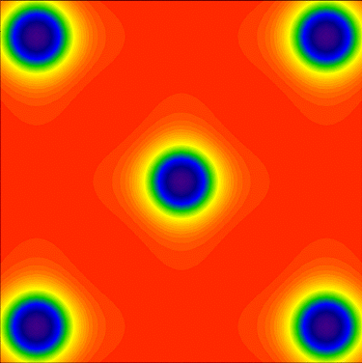
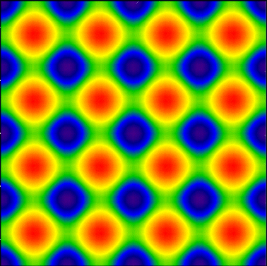
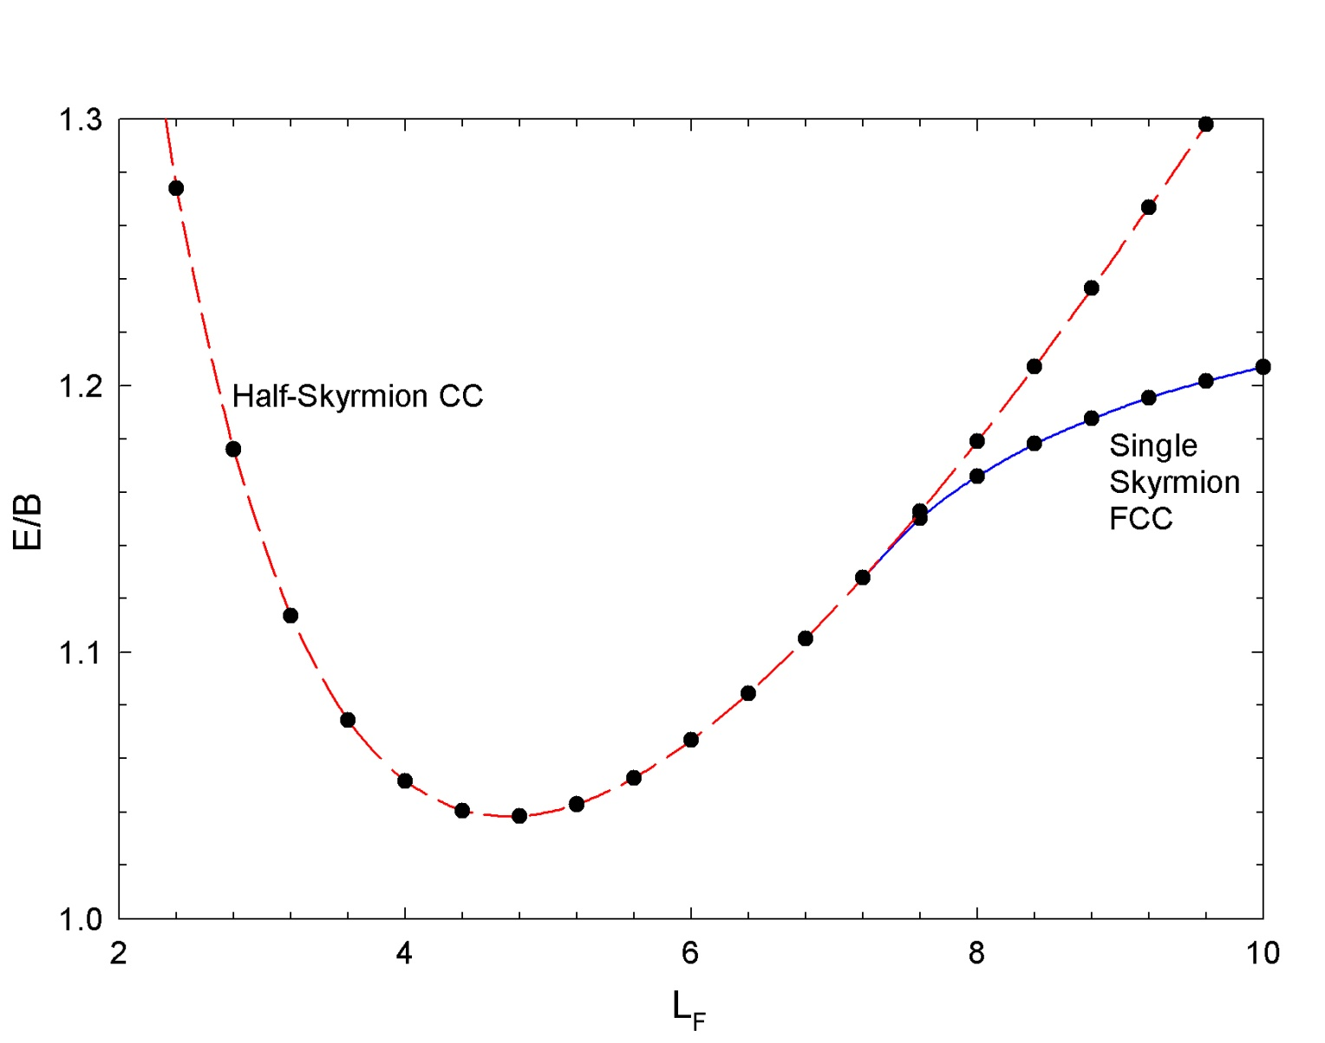
E/B vs. L_{F}
2. Dense Skyrmion matter

Slide 24
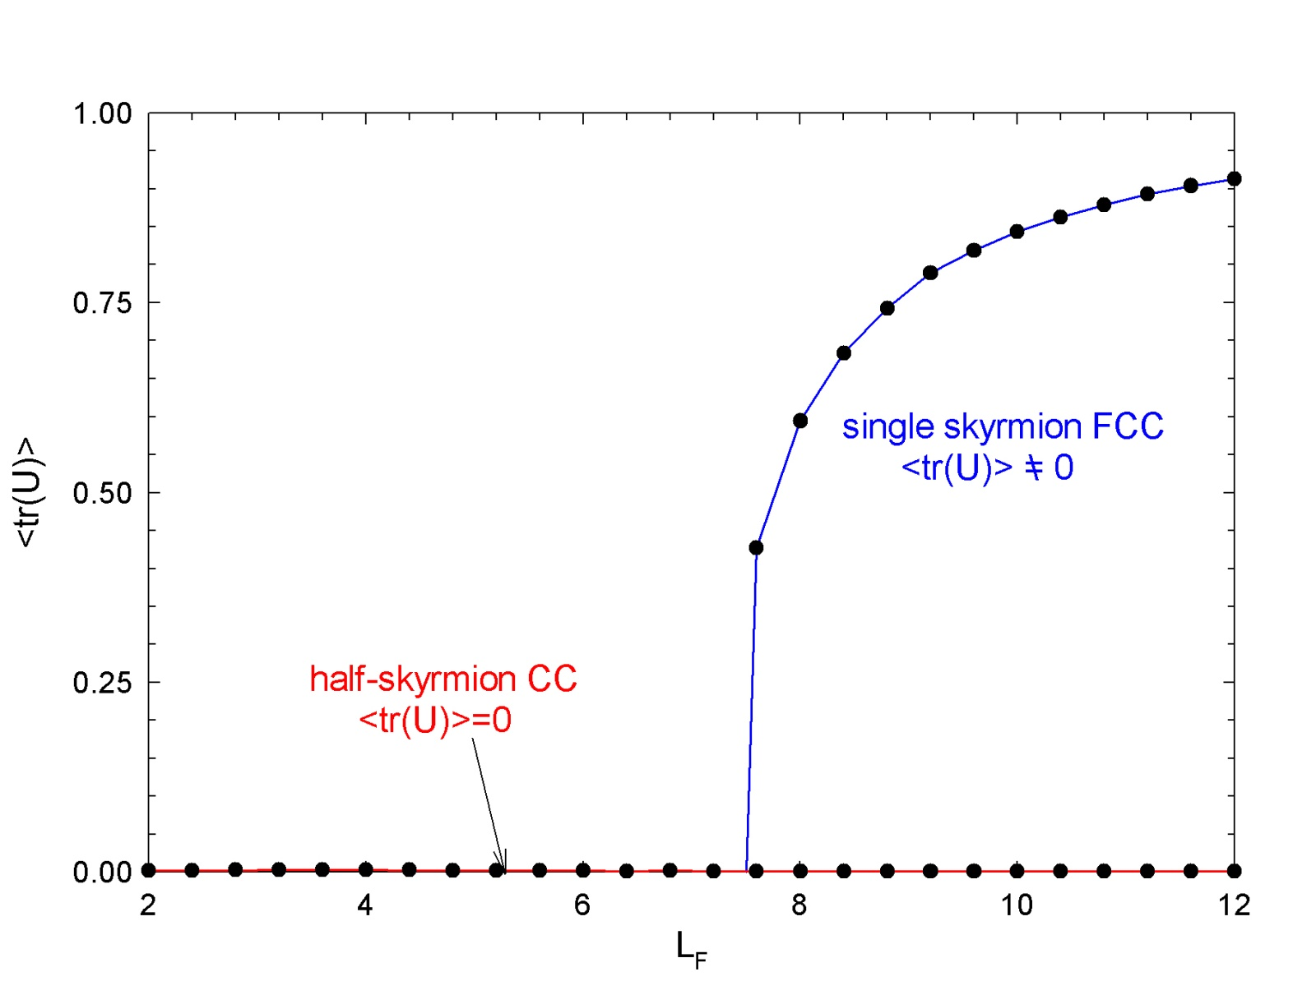
<U>=<σ>
Chiral symmetry
restoration
in dense matter?
2. Dense Skyrmion matter

Slide 25
classical
dense matter
config.
static
soliton
config.
fluctuating
pions
Pion in the dense
baryonic matter?
2. Dense Skyrmion matter

Slide 26
Skyrme Model(m_{π}=0)
\
Pion fluctuation
in ρ_{B}=0 space
Vacuum : U=1
2. Dense Skyrmion matter

Slide 27
π dynamics(ρ=0)
\
Skyrmion matter
Pion fluctuations
on top of the
skyrmion matter
+ π-skyrmion matter
interactions
2. Dense Skyrmion matter

Slide 28
π dynamics(ρ=0)
\
2. Dense Skyrmion matter

Slide 29
π dynamics(ρ=0)
\
2. Dense Skyrmion matter

Slide 30
π dynamics(ρ=0)
\
In-Medium
pion decay
constant ?
In-Medium
pion mass ?
2. Dense Skyrmion matter

Slide 31
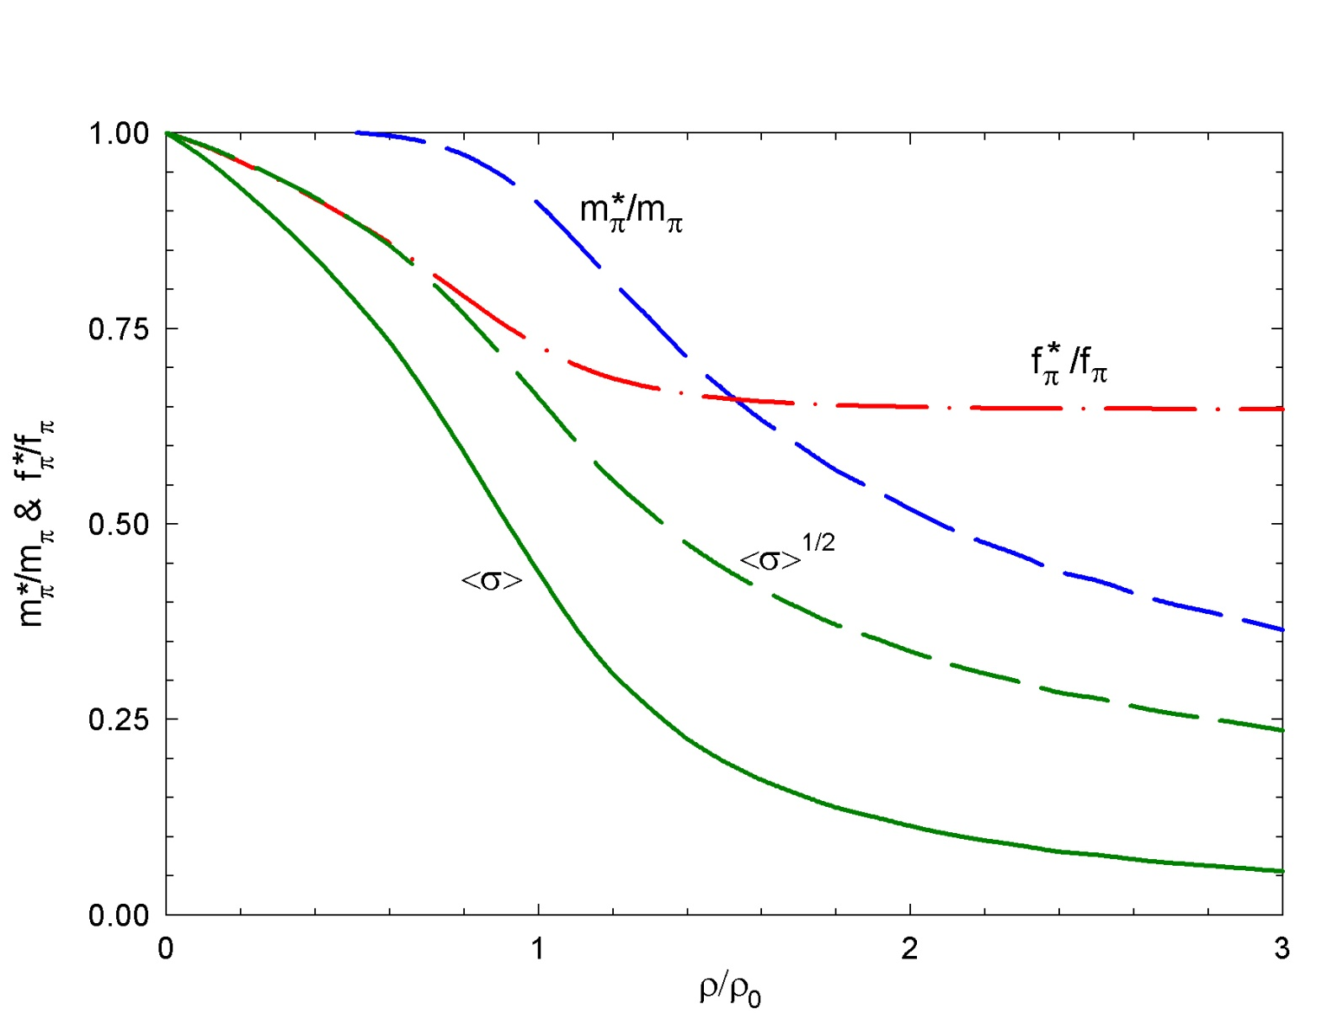
pion effective mass
!
H.-J. Lee, B.-Y. Park, D.-P. Min, M. Rho, V. Vento, Nucl. Phys. A (2003)
2. Dense Skyrmion matter

Slide 32
Pseudogap?
π
f_{π}
σ
U still remains
on the Chiral Circle
But <U>=0
Chiral Symmetry
Restoration
Zarembo, hep-ph/0104305
2. Dense Skyrmion matter

Slide 33
Skyrme Lagrangian
Trace Anomaly
of QCD
2. Dense Skyrmion matter

Slide 34
Skyrme Lagrangian
Ellis & Lanik, PLB(1985)
Brown-Rho scaling, PRL(1992)
m_{χ} ~ 720 MeV, f_{χ}~240 MeV
2. Dense Skyrmion matter

Slide 35
π
U χU
f_{π}
σ
V(χ)
<U>
<χ>
Vacuum (ρ=0)
U=1
χ=f_{χ}
χ
f_{χ}
2. Dense Skyrmion matter

Slide 36
Naive Estimation
E/B=M₂(L)χ²+M₄(L) +M_{m}(L) χ³+V(χ)L³
2. Dense Skyrmion matter

Slide 37
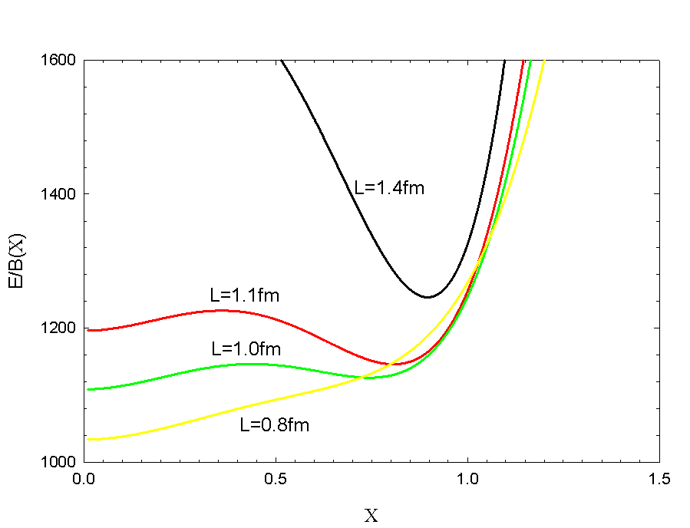
Naive Estimation
2. Dense Skyrmion matter

Slide 38
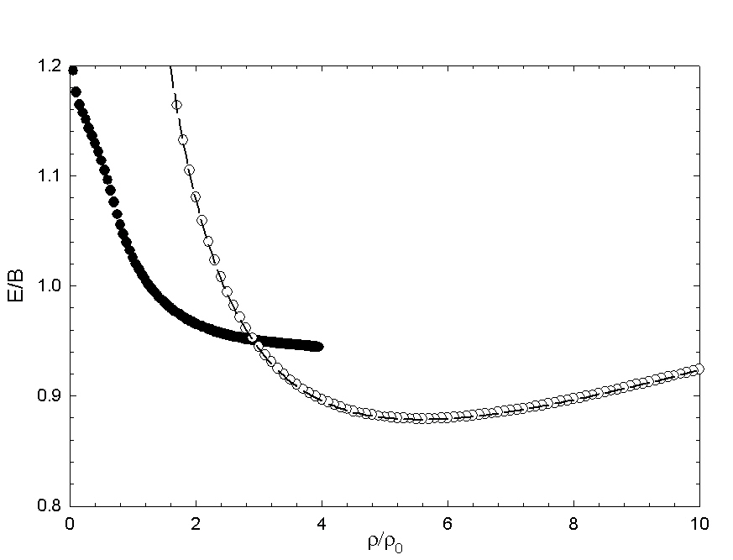
E/B
Chiral phase transition
<χ>=0 phase
<χ>=0 phase
/
2. Dense Skyrmion matter

Slide 39
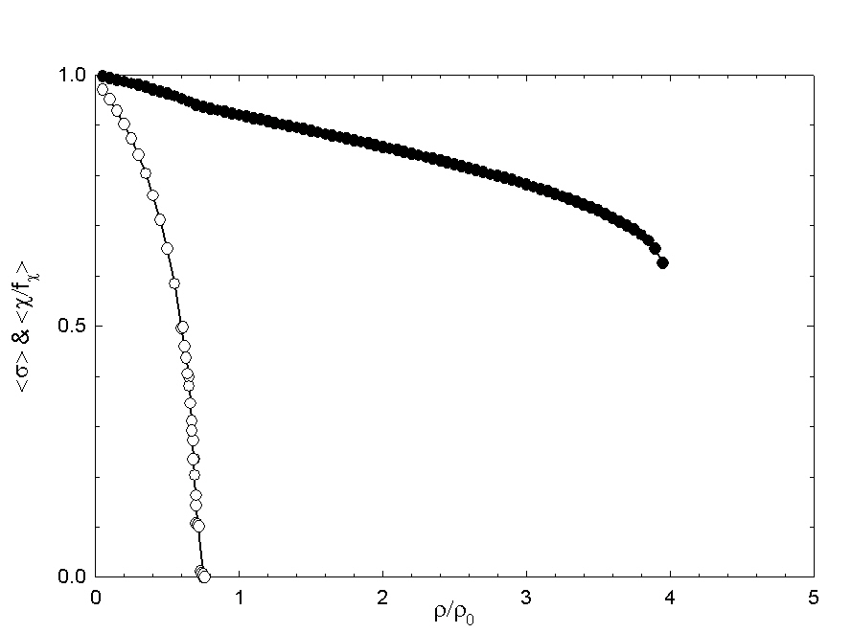
<χ> & <U>
m_{π}=0
<χ>
<σ>
χSB
Phase
Pseudogap
Phase?
χS
Phase
2. Dense Skyrmion matter

Slide 40
Pseudogap still remains?
π
*
Pseudogap
Phase
f_{π}
π
*
σ
f_{π}
χS
Phase
π
σ
χSB
Phase
σ
2. Dense Skyrmion matter

Slide 41
3. Hot & Dense
Skyrmion Matter

Slide 42
?
2. Hot & Dense Skyrmion matter

Slide 43


Skyrmion Soup
Main ingredients : pions
Condiments :
dilaton
vector mesons
Heat
B.-Y. Park, H.-J. Lee, V. Vento, Phys. Rev. D80 (2009)
2. Hot & Dense Skyrme matter

Slide 44
Skyrmion from Instanton
1989, M. F. Atiyah & N. S. Manton
time component of SU(2) gauge
potential for the instanton field
of charge N
time-ordering
constant matrix to make
U approaches 1 at infinity
constant rotation matrix
2. Hot & Dense Skyrmion matter

Slide 45
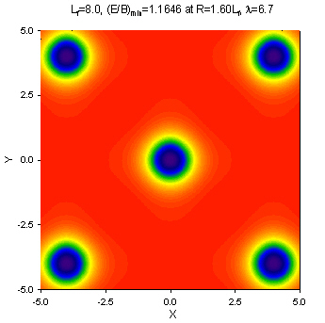
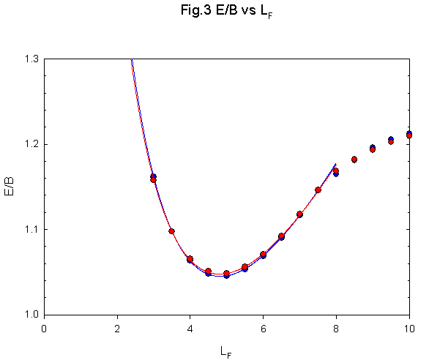
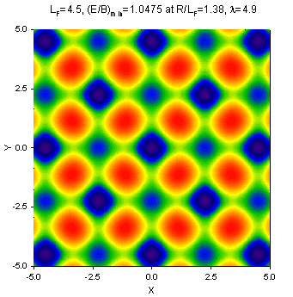
E/B vs. L_{F}
2. Hot & Dense Skyrmion matter

Slide 46
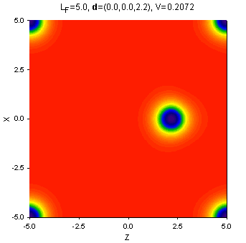
B.-Y. Park, D.-P. Min, V. Vento & M. Rho,
Nucl. Phys. A707(2002) 381
2. Hot & Dense Skyrmion matter

Slide 47
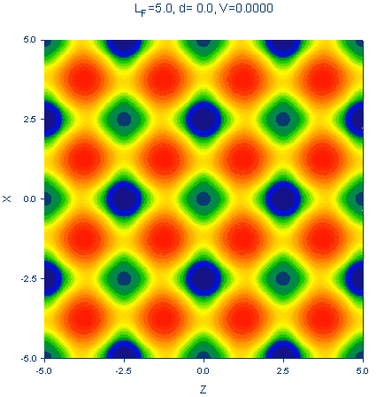
B.-Y. Park, D.-P. Min, V. Vento & M. Rho,
Nucl. Phys. A707(2002) 381
2. Hot & Dense Skyrmion matter

Slide 48
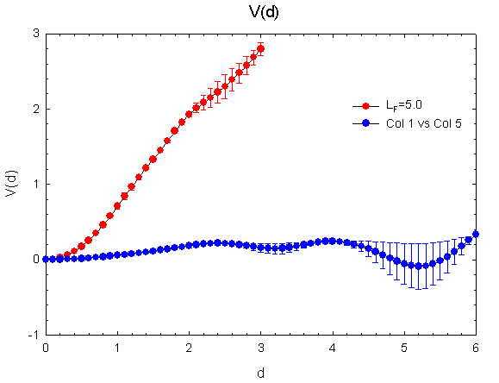
2. Hot & Dense Skyrmion matter

Slide 49
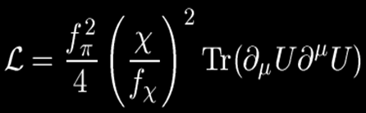
Pion Gas!
π²
30
P = T⁴
E/B = 3PV
E/B=(M₂(ρ)+3PV)χ²+M₄(ρ) +V(χ)/ρ ^{1/3}
2. Hot & Dense Skyrmion matter

Slide 50
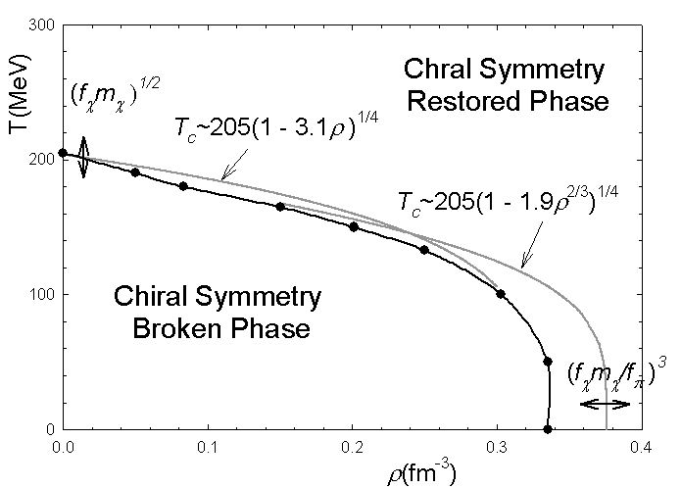
Conclusion
2. Hot & Dense Skyrmion matter

Slide 51
Summary
Skyrme Model can be applied to study
dense hadronic matter
hadron properties in dense
matter
4. Summary

Slide 52
Thank You!

