Slide 1
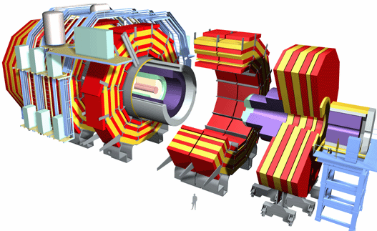
Low-p_{T} dimuon triggering for quarkonia measurements in p+p collisions in CMS
Ji Hyun Kim
Korea University

Slide 2
Contents
Introduction
Results of Trigger Study
Event generation
Trigger efficiency
Trigger rates and Statistics

Slide 3
Introduction

Slide 4
Motivation
Quarkonia physics in CMS at LHC
Pb+Pb collisions will create high-density partonic matter at very high temperature where the phase transition to the QGP is expected.
Heavy quarkonia (J/ψ, Y) suppression is an ideal signature of the QGP.
We need p+p data as a reference.

Slide 5
LHC2010 – very draft
CMS Physics Week, Bologna, Sep. 7-11 2009
pp and HI group should discuss a lot about their physics goal and necessities.
Notes:
.

Slide 6
Goal of Trigger Study
Why is the trigger important?
No trigger means No data!
p+p and heavy-ion trigger menu is different.
Identical, or at least similar trigger setting as in HI is needed for p_{T} spectrum of quarkonia(extended to low-p_{T} region) in p+p for R_{AA}.
CMS Trigger Strategy for 2009
For 2009 physics data taking in p+p, new compact trigger menu was developed and focus on specific luminosity scenarios(L=8E29, 1E31) by trigger review procedure.

Slide 7
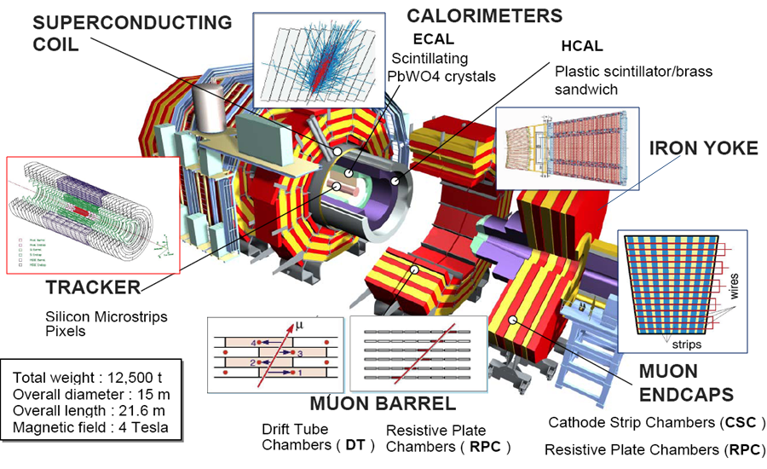
CMS Muon Detectors

Slide 8
CMS Muon Trigger
L1 Muon Trigger
L2 Muon Trigger (StandAloneMuon)
• Seeded by Level-1 muon.
Kalman filtering technique.
• Fit track with beam constraint.
Filter : p_{T}, invariant mass, etc.
L3 Muon Trigger (GlobalMuon)
Track reconstruction and matching with track in muon chamber and inner tracker.
Finding vertex.
Filter : p_{T}, invariant mass, etc.
Finally up to 4 highest p_{T} muons are transmitted to the GT among at most 16 muons candidates.

Slide 9
Default Setting of CMS dimuon trigger
Descriptions of HLT_DoubleMu3 for p+p run
A double muon trigger, based on the Level 3 (combined muon system and tracker) HLT muon reconstruction.
At least two L1(L2/L3) muons with p_{T} > 3 GeV/c are required at corresponding higher trigger level.

Slide 10
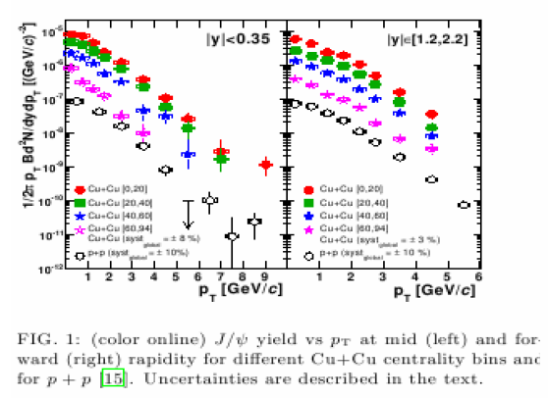
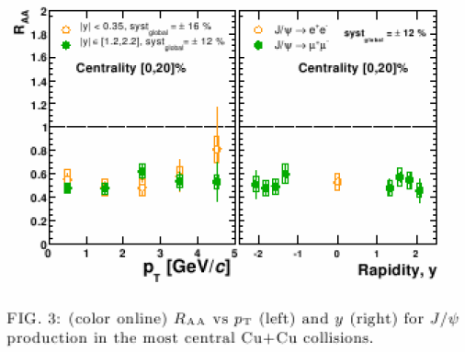
Suggestion : Remove p_{T} cut
Several reasons to remove the low-p_{T} cut in CMS default dimuon trigger
All measurements “in-medium”(HI) are in comparison with “vacuum”(pp)
CMS detector can measure muons down to ~1 GeV/c in the forward region.
Shape of p_{T} distribution is the essential tool to differentiate production models.
RHIC measurements are limited at low p_{T} region.

Slide 11
CMS Default vs. New setting
Trigger Structure
HLT_DoubleMu3
Similar to HI dimuon trigger
HLT_DoubleMu0
Low track quality and without p_{T} threshold
Notes:
.

Slide 12
Trigger Study
Notes:
Now it’s turn to show comparison between two different trigger path. Before, I will explain about Monte-Carlo signal sample that we used.

Slide 13
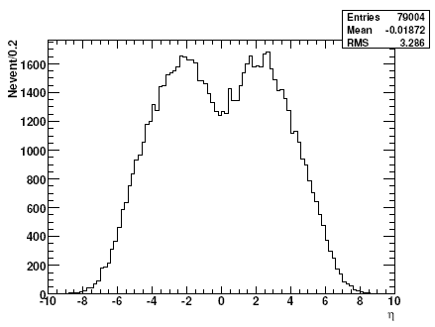
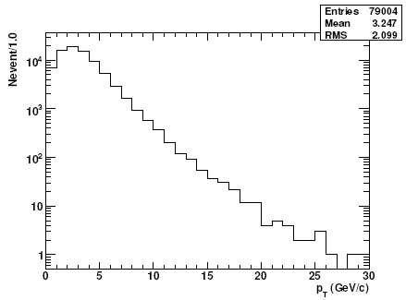
η & p_{T} Specra : J/ψ
MC signal sample
PYTHIA 6.416, √s = 10 TeV
79,004 J/ψs which are forced to decay to μ+μ-
J/ψ
J/ψ
Notes:
We got 79k J/psis which are decayed to dimuons. Plots show J/psi eta and pt.

Slide 14
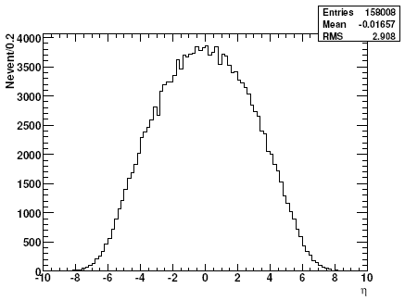
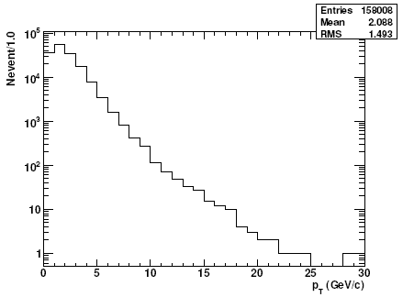
η & p_{T} Spectra : μ+μ-
MC signal sample
PYTHIA 6.416, √s = 10 TeV
158,008 muons from J/ψ decay
μ+μ-
μ+μ-
Notes:
These shows eta and pt spectra of muons decayed from J/psis of the previous slide.

Slide 15
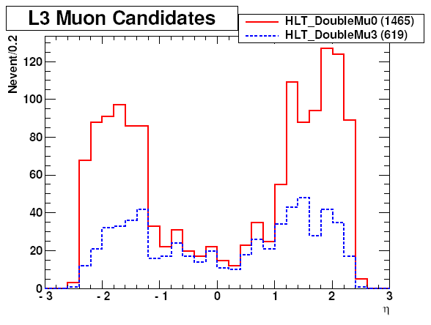
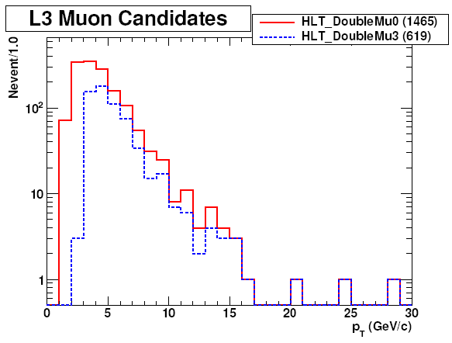
Triggered Muons
CMS default (HLT_DoubleMu3) vs. new setting (HLT_DoubleMu0)
Low p_{T} muons can be survived!!
Muons in the forward region can be survived more!!

Slide 16
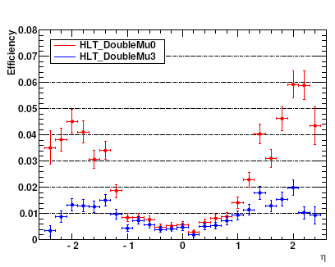
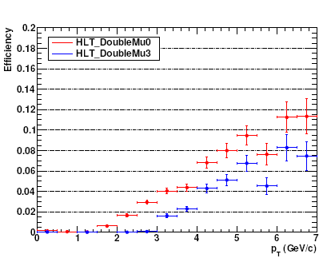
Trigger Eff. : Muon
L3 Muons
L3 Muons

Slide 17
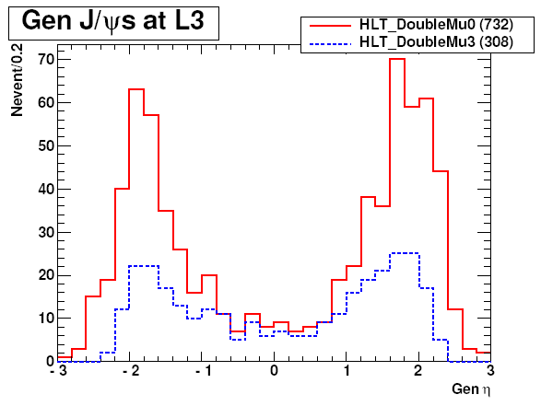
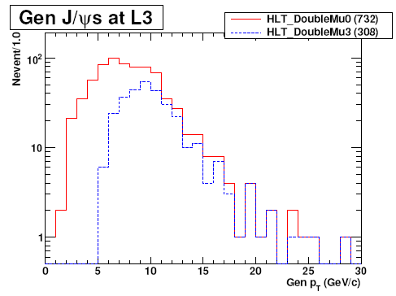
Triggered J/ψs
CMS default (HLT_DoubleMu3) vs. new setting (HLT_DoubleMu0)
We expect low-p_{T} J/ψs (< 7 GeV/c) will be triggered by using HLT_DoubleMu0.

Slide 18
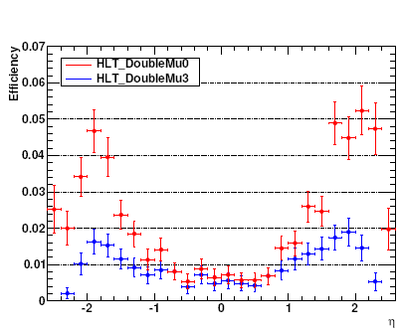
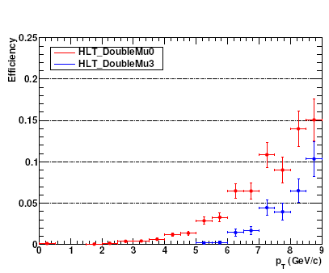
Trigger Eff. : J/ψ
J/Psi
J/Psi

Slide 19
Trigger Rates and Statistics

Slide 20
Pb+Pb vs. p+p Trigger
Level 1 Trigger
Uses custom hardware
Muon chamber + calorimeter information
Level-1 | Pb+Pb(5 TeV) | p+p(14 TeV)
Collision rate | 3kHz(8kHz peak) | 1GHz
Event rate | 3kHz(8kHz peak) | 40MHz
Output bandwidth | 100 GByte/sec | 100 GByte/sec
Rejection | none | 99.7%
High Level Trigger
Full event information available
Run “offline” algorithms
High Level Trigger | Pb+Pb(5 TeV) | p+p (14 TeV)
Input event rate | 3kHz(8kHz peak) | 100kHz
Output bandwidth | 225 MByte/sec | 225 MByte/sec
Output rate | 10-100Hz | 150Hz
Rejection | 97-99.7% | 99.85%
Notes:
First, I would like to compare PbPb and pp trigger rate. You can see that L1 trigger doesn’t reject PbPb data. This optimism is
based on the fact that the maximal collision rate for Pb+Pb is just about 8 kHz in the beginning of storage at the
designed luminosity, L = E27, and that it is much smaller than the input rate for HLT in p + p, which
is about 100 kHz. According to CMS NOTE of PbPb hlt, the average event size of Pb+Pb is less than about factor of ten larger than that of p + p even though considering an uncertainty of predictions and an underestimation by simulation. This implies that
all heavy-ion collision events can be sent to the heavy-ion HLT with minimum bias condition. On the other hand, for pp collisions, 99.7% events are rejected at L1 and 99.85% at HLT. Because HLT output bandwidth is 225MByte/sec and storage cannot register all pp events. In sum, not only raising the trigger efficiency but also maintaining reasonable trigger rate is important.

Slide 21
Muon Trig. Menu (8E29)

Slide 22
Muon Trig. Menu (1E31)

Slide 23
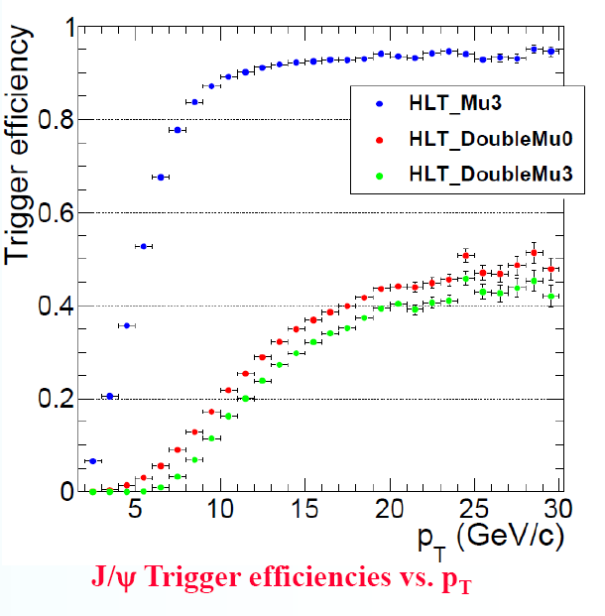
J/ψ Triggger Efficiency
HLT_DoubleMu0 is available since CMSSW_3_X_X:
Without p_{T} requirement on muons.
Comparing to DoubleMu3, DoubleMu0 could highly enlarge the statistics at low-p_{T}.
No prescale for 8E29 and 1E31.
Quarkonia Workshop, Sep. 12-13 2009

Slide 24
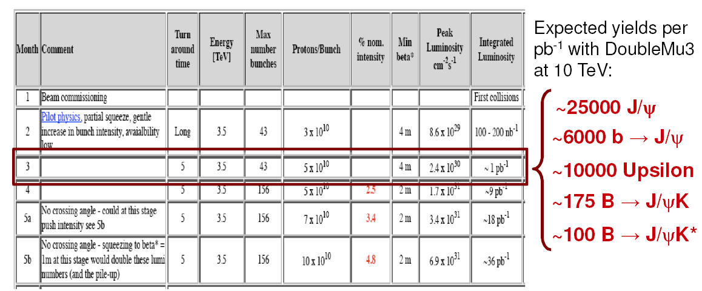
Expected Statistics in p+p
“With an instantaneous luminosity of just ~1e30, in one month CMS will trigger and reconstruct tens of thousands of quarkonia events and hundreds of exclusive B decays.”
CMS Physics Week, Bologna, Sep. 7-11 2009

Slide 25
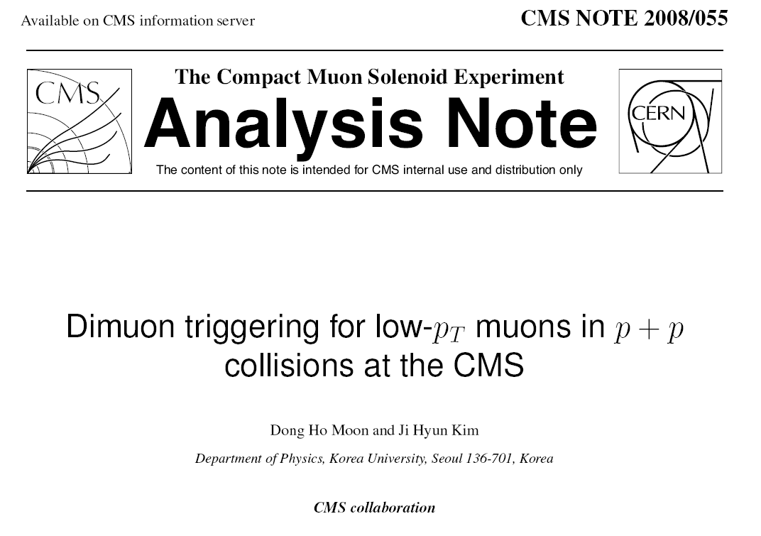
Conclusion
Removing p_{T} cut certainly shows better performance for triggering low-p_{T} muons than default dimuon trigger setting .
New setting of dimuon trigger algorithm was designed for HI collisions, but will be also used in p+p.
Estimated trigger rate is acceptable level for p+p startup run.

Slide 26
Backup Slides

Slide 27
PYTHIA Conditions : J/ψ
Version : 6.416
√s = 10 TeV
Some essential parameters
MSEL = 61 : Quarkonium production via color-singlet and color-octet mechanism of NRQCD
MSTP(51) = 10042 : PDF CTEQ6L1
MSTP(142) = 2 : Quarkonia cross section damping for reweighting
PARP(82) = 1.8387 : p_{T} cutoff for multiparton interactions
PARP(141) ~ PARP(150) : Tuning NRQCD matrix elements from the CDF data
BRAT(859) = 1.000 : J/psi->mu+mu-
Notes:
We used prompt J/psi signal sample generated by PYTHIA at 10 TeV. Some essential parameters are shown here. By MSEL 61, quarkonium production via color-singlet and color-octet mechanism based on NRQCD. And Branching ratio J/psi to mumu is 1.

Slide 28
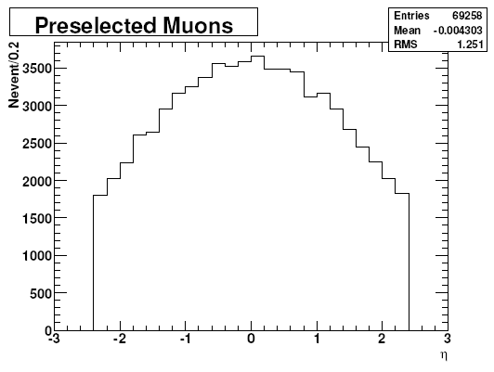
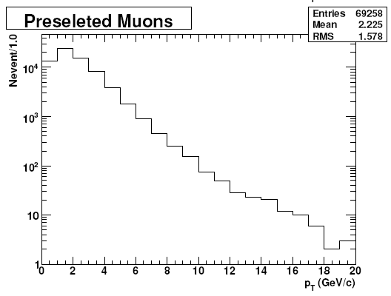
Dimuon η Acceptance
Preselected μ+μ- from J/ψ decay (|η^{μ}| < 2.4)
Notes:
We generated J/psi sample in full phase-space to get geometrical acceptance. When both muons from J/psi decay are in muon chamber region, from -2.4 to 2.4, they are preselected. Eta acceptance was 44%.

Slide 29
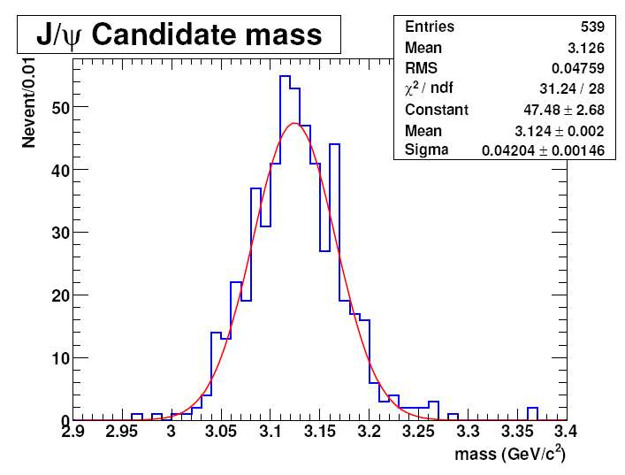
Dimuon Mass Spectrum
By using MuonTrackAssociatorbyHits.
Matching muon SimTrack and RecTrack with Purity = 1.
Ensuring 2 reconstructed muons have decayed from the same vertex.
Notes:
This is invariant mass spectrum of dimuon for the J/psi candidates determined by L3. Two L3 muons are combined by four-vector. Before combining, we checked reconstructed L3 muons ard fake or not by using MuonTrackAssociatorbyHits. This mached muon simTrack and Rectrack with purity parameter. Purity is defined as ration of the number of shared his between the reconstructed tracks and the simulated tracks to the number of valid hits in the RecTracks. We take only reco muons with purity 1 and check both muons were came from same mother vertax.

