Slide 1
Production and test of Si sensors for W-Si sandwich calorimeter
M.G.Song, M.W.Kim, J.H.Kang, Y.Kwon
( Yonsei Univ. ALICE Group)
together with PHENIX FOCAL efforts

Slide 2
Contents
Introduction to W-Si sandwich calorimeter
Sensor production
Design
Fabrication
Packaging
Signal conditioning
Sensor test
Cosmic test
Beam test
Summary

Slide 3
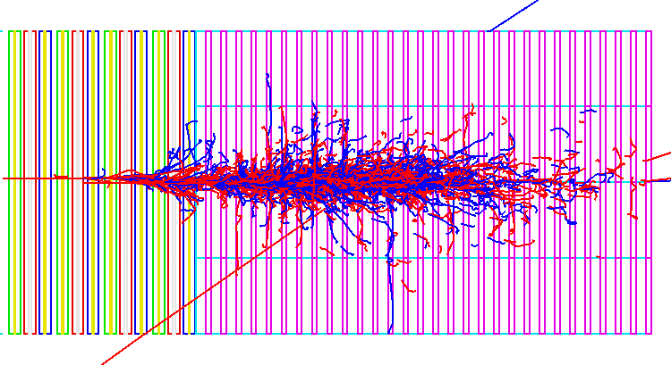
W-Si sandwich calorimeter, Basics
EM Shower in a typical prototype
15mm, ∼R_{M}
∼20cm, ∼ 20X₀, ∼ 1λ

Slide 4
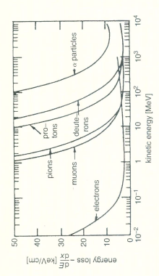
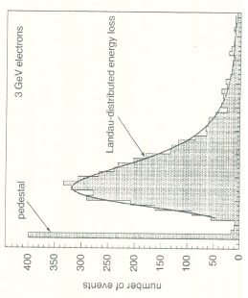
W-Si sandwich calorimeter, Basics
EM Shower in a typical prototype

Slide 5
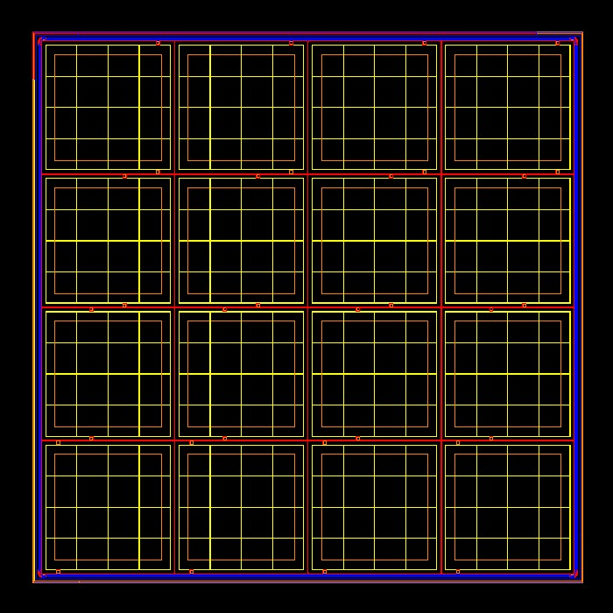
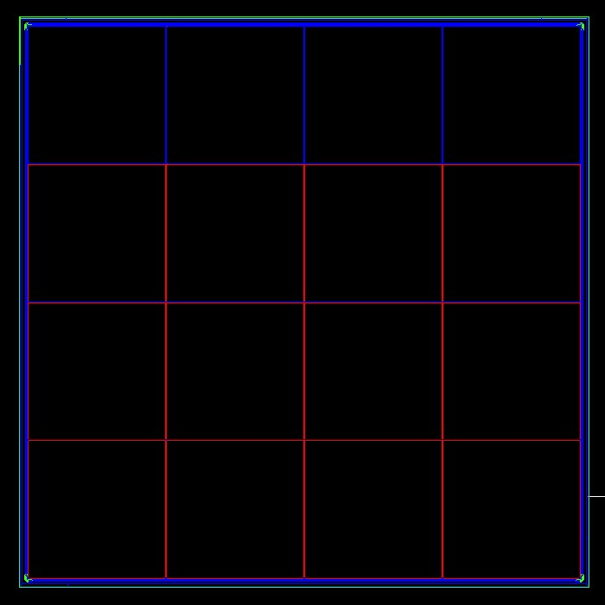
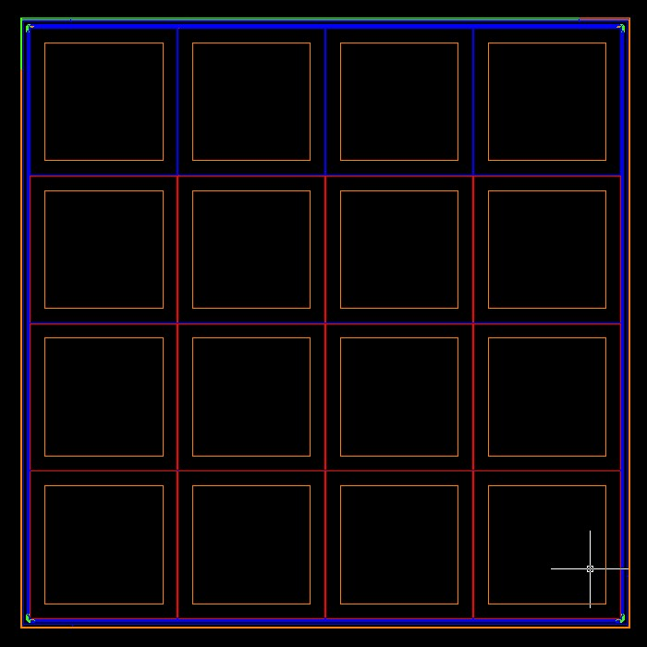
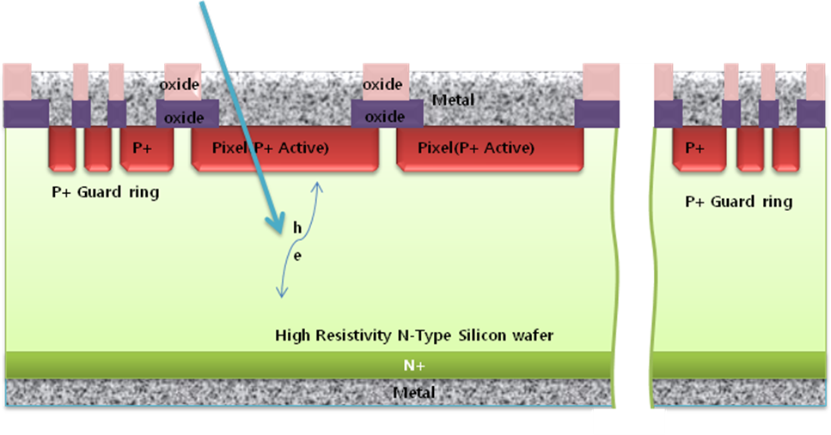
Detector schematics

Slide 6
W-Si sandwich calorimeter, Basics
Ideal for EM signal (γ, e, π⁰) under forward high multiplicity
Compact EM shower inside calorimeter (W)
3D tracking under large background possible though Si layers (Si)
Easy adjustment of the detector granule (Si)
Good energy resolution (W-Si)
Expensive (Si), but we(Korea) can do well.

Slide 7
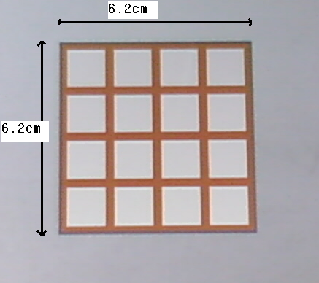
Sensor production
Sensor production
6.2 cm x 6.2 cm n type wafer substrate and p type pattern
4 x 4 (1.5cm each) pad : 16 channel per sensor

Slide 8
Fabrication
Mask production
Optical
Electron lithography
ETRI Production
Lithography
Developing
Implantation
Etching

Slide 9
Packaging
Micro module production
Ceramic spacer
INTC(Inter connect) board
Silicon Sensor
Cu foil
epoxy plate

Slide 10
Components for micro-module
Ceramic spacer
Protection from warping and heat
INTC(Inter connect) board
Electrical connection to sensor
Silicon Sensor
Cu foil
Connection of sensor back plane to ground
Epoxy plate
Electrical and physical protection
Notes:
These are components for micro-module.
This one is a silicon sensor which is the most important part of a micro-module.
On the front of sensor, INTC board is attached.
In this board, there are some RC components to connect to sensor electrically.
Below the sensor, Cu foil is used to connect sensor back plane with ground.
Cu foil INTC board are used for electrical connection.
Ceramic spacer and Epoxy plate are used for electrical and physical protection.
Especically, ceramic spacer locates between INCT board and carrier board, so it protect both boards from electrical connection and heat.

Slide 11
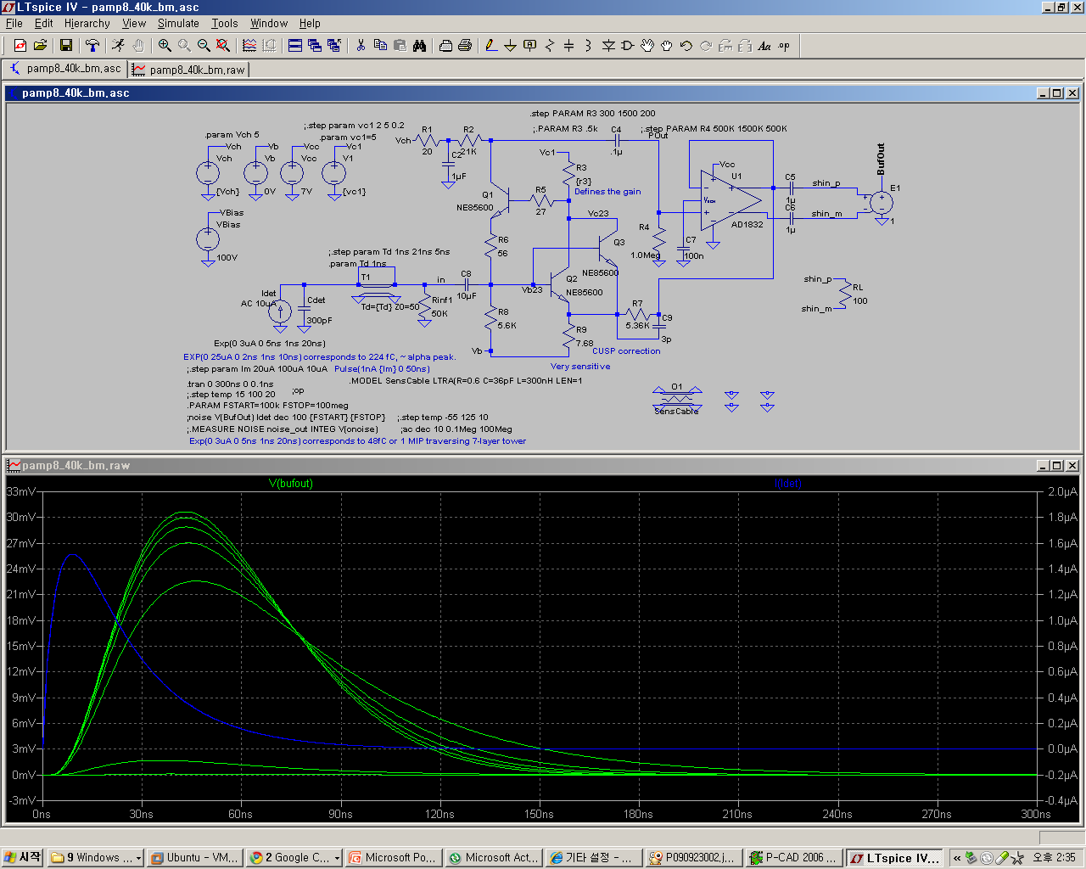
Signal conditioning

Slide 12
Cosmic muon test
Most electrons passing a sensor layer are MIPs, which deposit minimum ionization energy as like cosmic muon.
Cosmic test requires a setup of test electronics made up of silicon sensor, preamp hybrid card, test board, and bridge board.

Slide 13
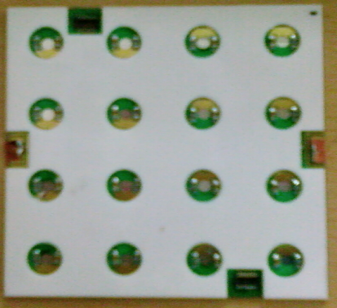
Cosmic muon test

Slide 14
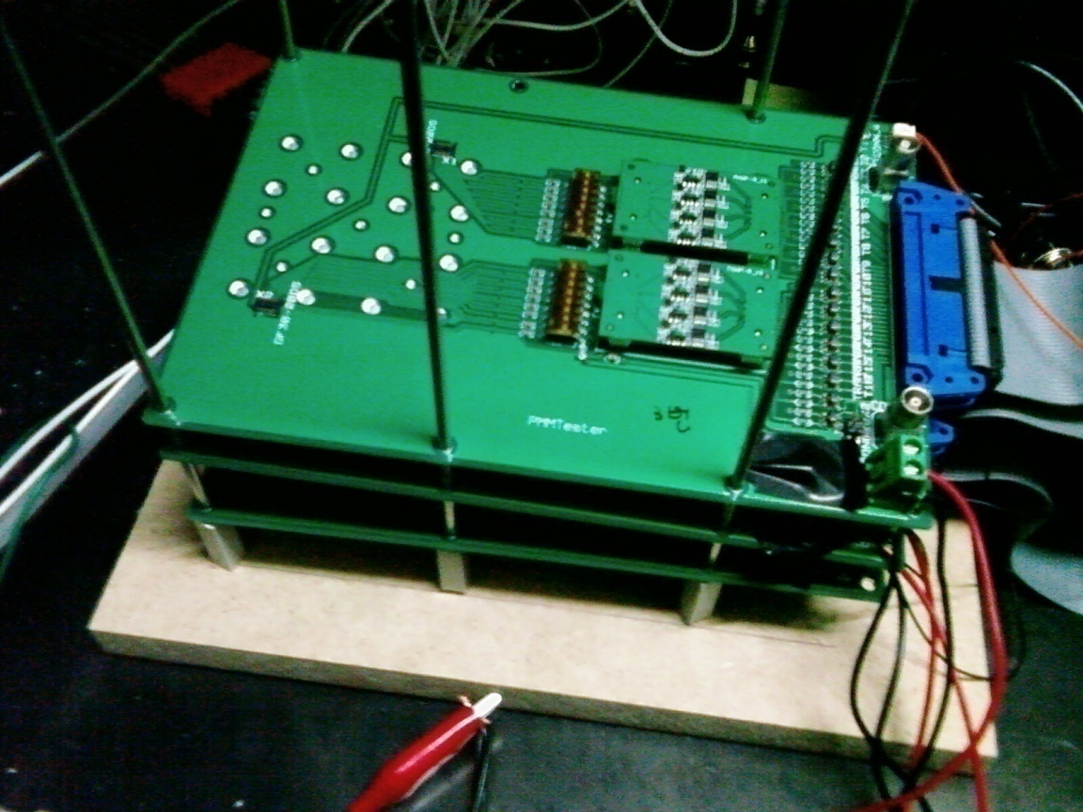
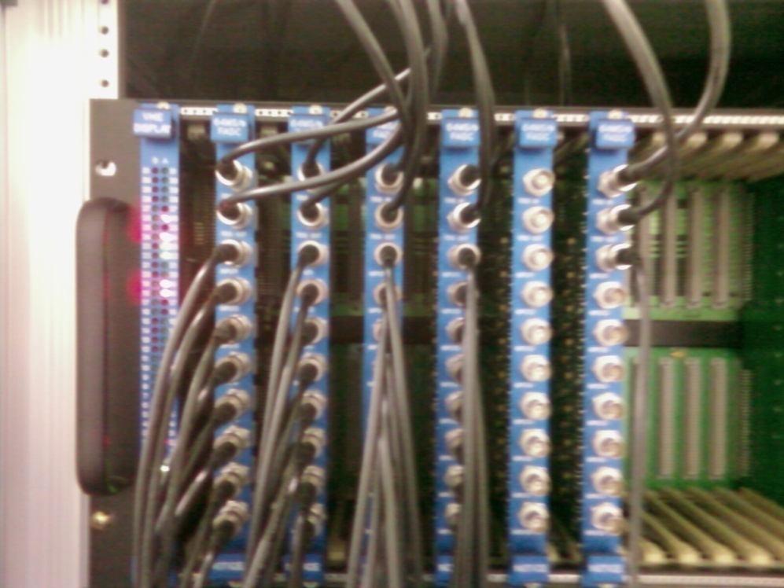
Cosmic muon test

Slide 15
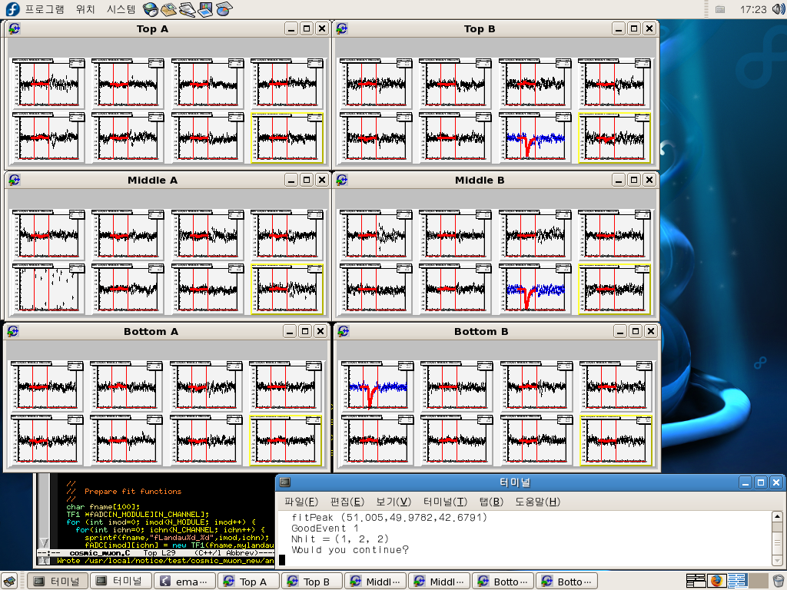

Slide 16
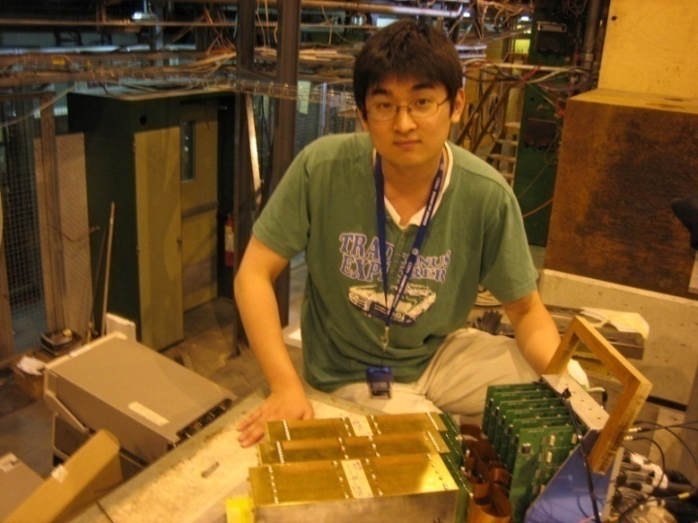
Beam test at CERN
Beam test had been taken 09.06.22~29 at PS and SPS
4 Sensor were used for each layer, and a super module had 7 W-Si layers.

Slide 17
Beam test setup

Slide 19
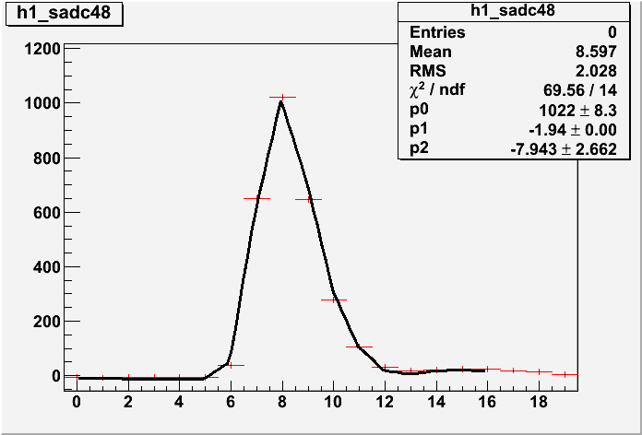

Slide 20
Summary
W-Si calorimeter can effectively measure EM signal under large multiplicity
Si sensor plays a key roll in the function
We are conducting production & test of the Si sensors and see a good prospect

