Slide 1
Direct photon measurement at LHC and Korean strength
Y. Kwon, J. H. Kang
(Yonsei University)

Slide 2
Contents
Motivation --- Why direct γ?
Part I
  Photon measurements at LHC & Challenge --- π⁰, jet
  A new approach, virtual photon, and possibility in ALICE --- e⁺e⁻ pairs
  Related activity by Yonsei Univ. group
Part II
  W/Si calorimeter and Korean strength --- Si-sensor
  Related activity by Yonsei Univ. group

Slide 3
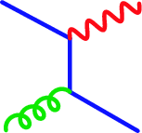
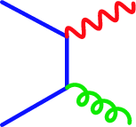
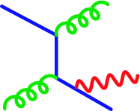
Motivation : Direct γ production
Direct γ production in p+p
    → One of the best known QCD process…
Really?
Leading order diagram
in perturbation theory
Hard photon : Higher order pQCD
Soft photon : Initial radiation,
Fragmentation function

Slide 4
Multiple collision in factorization theorem? Higher twist!

Slide 5
Raw truth spectra
}
PYTHIA
INCNLL γ/h * PYTHIA hadrons
ATLAS Preliminary
Substantial background from jet+jet

Slide 6
Spectra before & after cuts
}
PYTHIA
PYTHIA+GEANT
PYTHIA+INCNLL
Pythia+INCNLL+GEANT
ATLAS Preliminary
Combined cuts suppress background

Slide 7
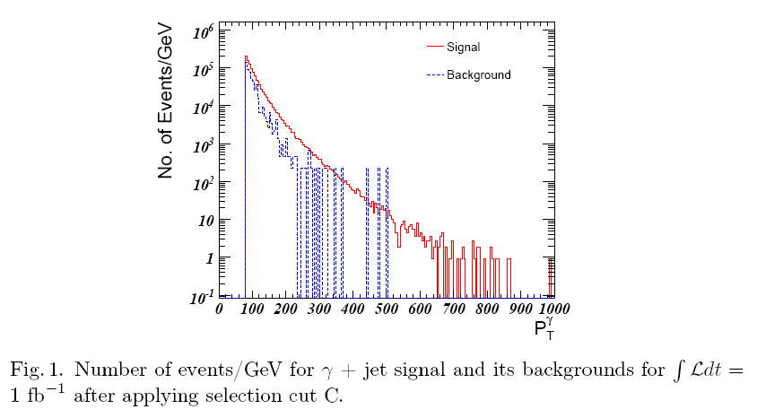
CMS --- what I “could” find as public
Acta Physica Polonica B Proceeding Supplement, Vol. 1, p389 (2008)

Slide 8
Possible approaches to the measurement
Direct method
  Nontrivial errors on inclusive photon measurement, inclusive neutral hadron measurement, and theoretical assumptions entering the background calculations
Indirect method
  γ → γ* → e⁺e⁻ , R H Dalitz 1951 Proc. Phys. Soc. A 64 667-669
  AND we can avoid π⁰ background!
e⁻
e⁺

Slide 9
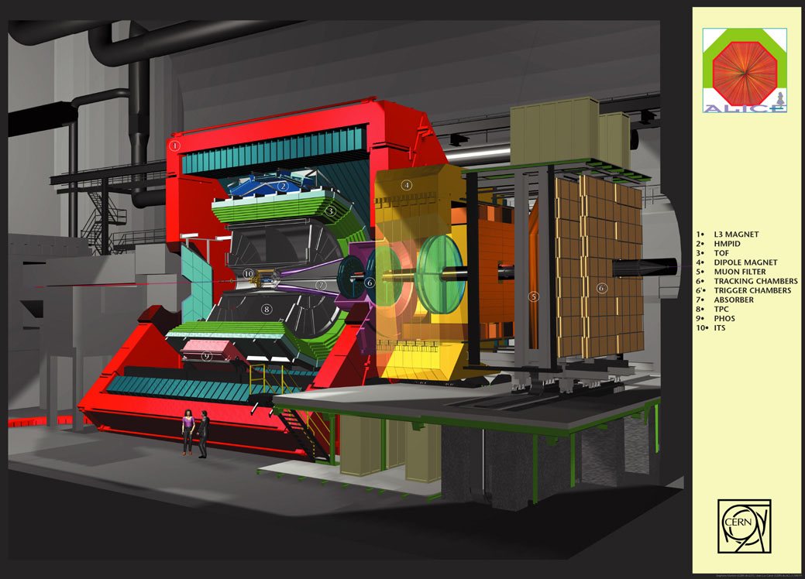
Detector ALICE
web pages created by Pier-Luigi Barberis for ALICE Experiment

Slide 10
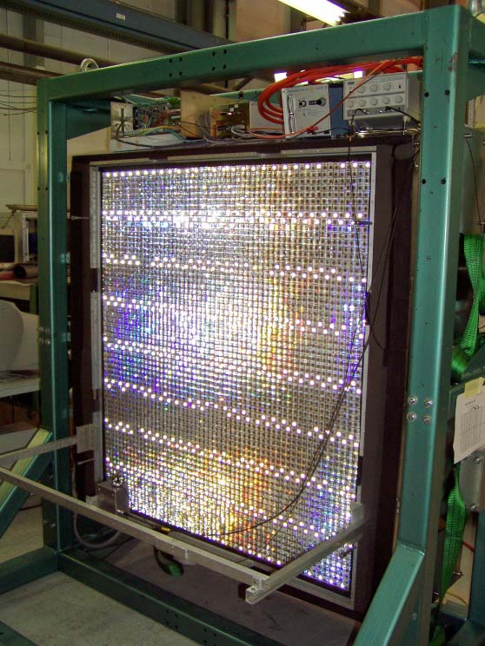
PHOS (PHOton Spectrometer)
Has 17 280 detection channels of lead-tungstate crystals, PbWO₄ (PWO), of 2.2×2.2×18 cm3 dimensions, coupled to large-area PIN-diodes with low-noise preamplifiers.
Covers −0.12 ≤ η ≤ 0.12, and 100◦ in azimuthal angle.
Optimized for measuring photons (of ~0.5–10 GeV/c),
π⁰’s (of ~1–10 GeV/c) and η mesons (of ~2–10 GeV/c).

Slide 11
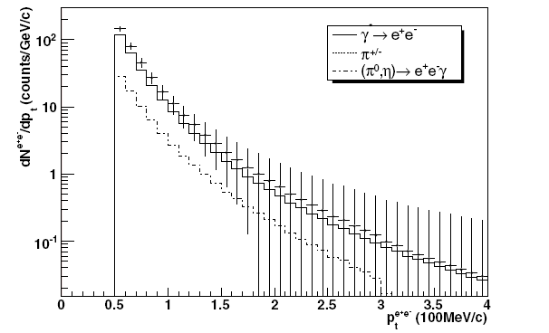
Possible approaches to the measurement
One standard year of data taking

Slide 12
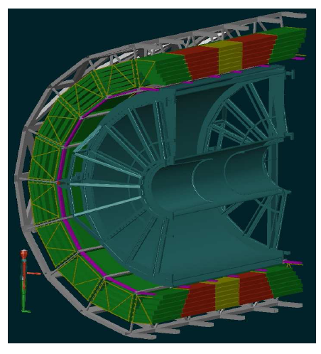
TRD (Transition Radiation Detector)
• |η|<0.9, 45°<θ<135°
• 18 supermodules in Φ sector
• 6 Radial layers
• 5 z-longitudinal stack
→ total 540 chambers
→ 750m² active area
→ 28m³ of gas
• In total 1.18 million read-out
channels

Slide 13
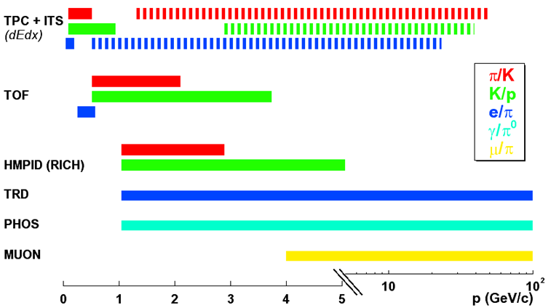
Particle Identification
stable hadrons (π, K, p):
  dE/dx in silicon (ITS) and gas (TPC) + Time-of-Flight (TOF) + Cerenkov (HMPID)
leptons (e, μ)
  transition radiation (TRD), muon spectrometer
photons, η,π⁰
  e.m calorimeters (PHOS, EMCAL)
decay topology (K⁰, K⁺, K⁻, Λ, D⁺, ..), secondary vertices (c,b)
PID
from ~ 100 MeV
to above 50 GeV
Alice uses ~ all
known techniques!

Slide 14
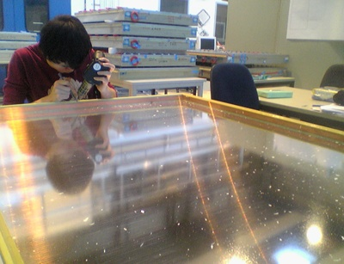

Slide 15
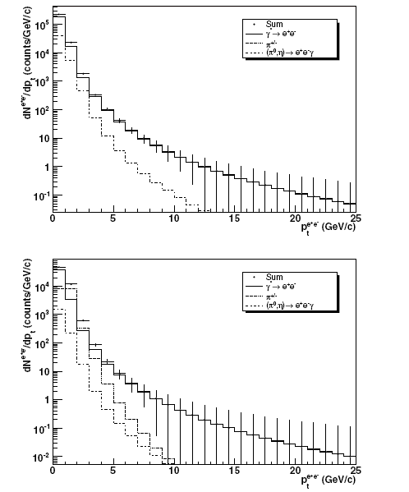
Possible approach to the measurement : indirect method
p+p
One standard year of data taking
Pb+Pb

Slide 16
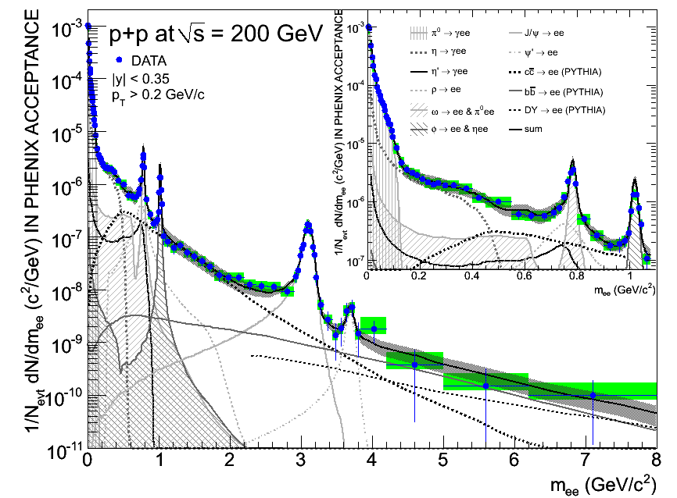
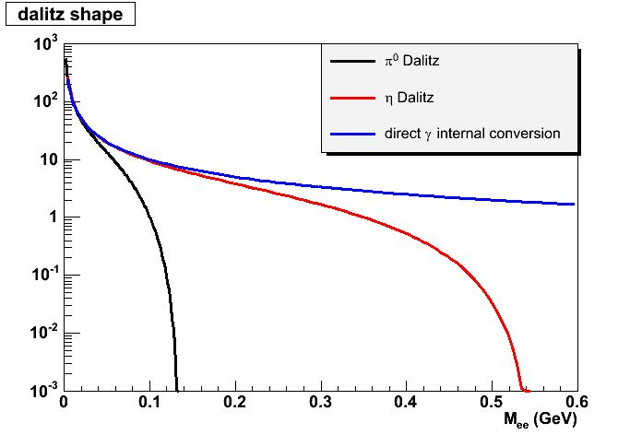
e⁺e⁻ pair mass distribution
invariant mass of Dalitz pair
invariant mass of Dalitz pair
invariant mass of virtual photon
invariant mass of virtual photon
form factor
form factor
phase space factor
phase space factor
Notes:
16

Slide 17
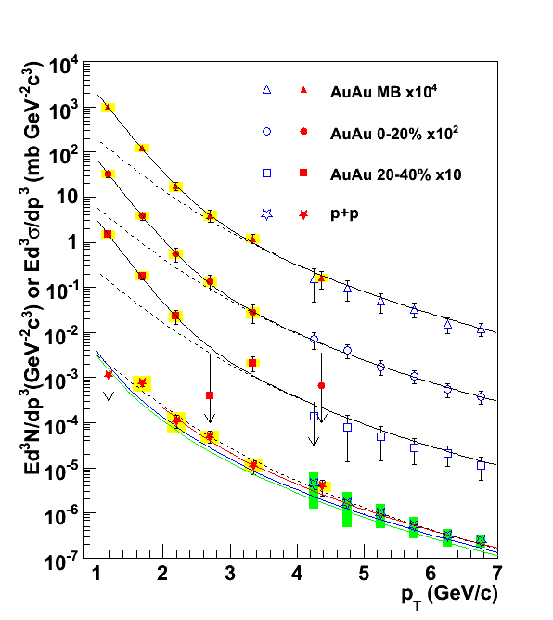
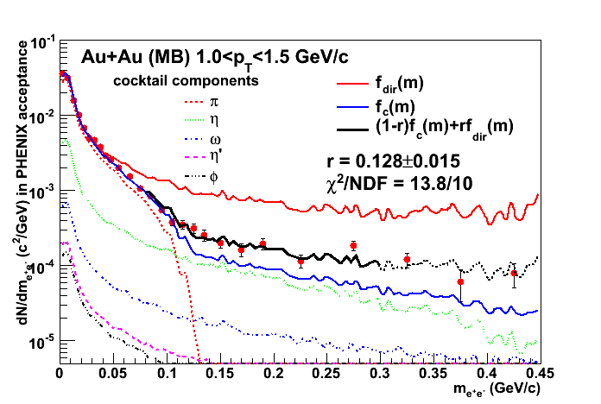
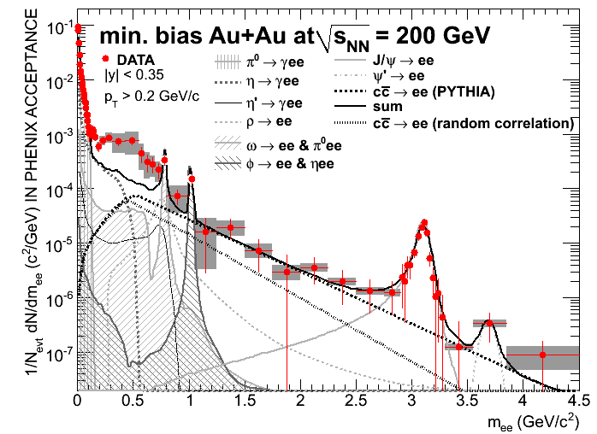
Publication from PHENIX

Slide 18
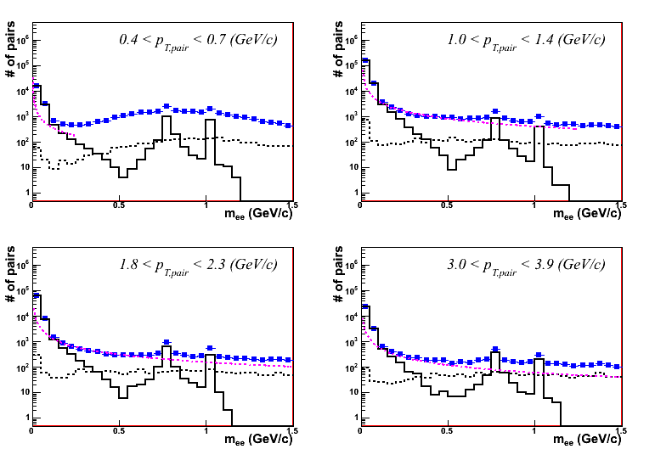
A piece of detail :
Reality & Combinatorial background
Real Pair
-> e₁⁺e₁⁻, e₂⁺e₂⁻
Reconstructed Pair
-> e₁⁺e₁^{-,} e₂⁺e₂^{-,} e₁⁺e₂^{-,} e₂⁺e₁⁻
e₁⁺e₂^{-,} e₂⁺e₁⁻
-> Combinatorial Background
Background estimate
-> mixed event, like-sign pairs
e₁⁺
e₁⁻
e₂⁺
e₂⁻

Slide 19
Korean strength

Slide 20
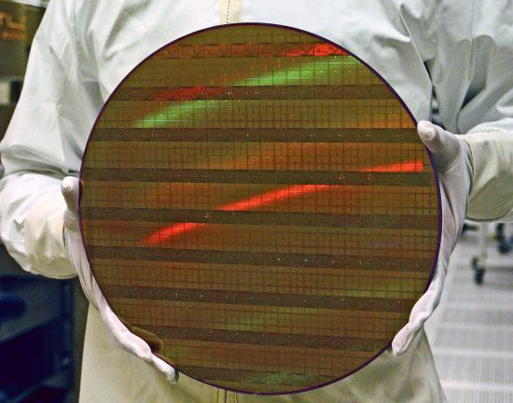
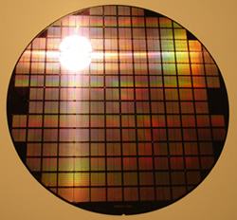
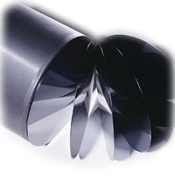
D-Ram? CPU? Si-detector?

Slide 21
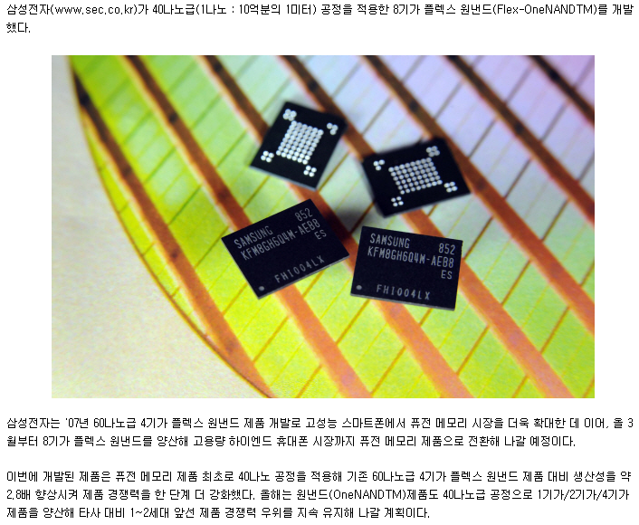

Slide 22
PHENIX FOCAL

Slide 23
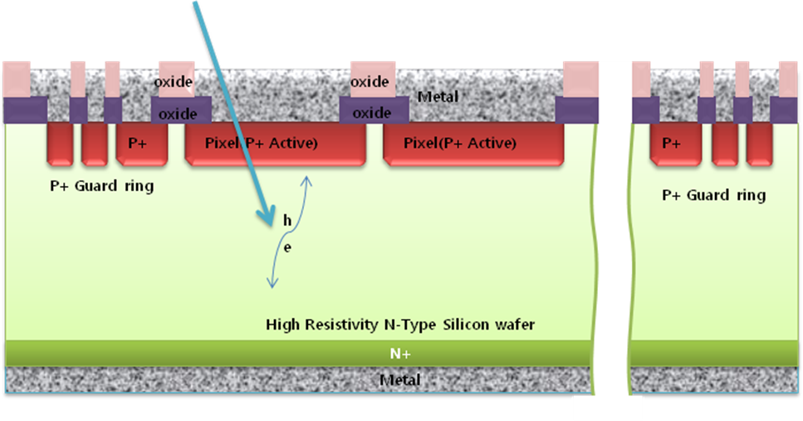
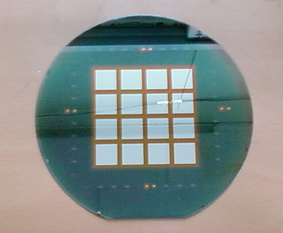
Silicon sensor
Basically PN junction diode in reverse bias mode.
  N-type substrate and p-type pattern for high energy application => electrons are carriers
-
ground
Notes:
Here is about silicon pad sensor
The left picture is a side view schematic of pad sensor, and the right picture is a wafer have a sensor for one micro-module.
Basically, pad sensor is a PN junction diode under reverse bias.
As this side view, this part is n type wafer and this part is p type pattern.
So, there will be more electron carriers.
To give reverse bias, ground will be given here and minis voltage will be given here.
In one micromodule sensor there are sixteen square pads.
Each pads are separated from each other.

Slide 24
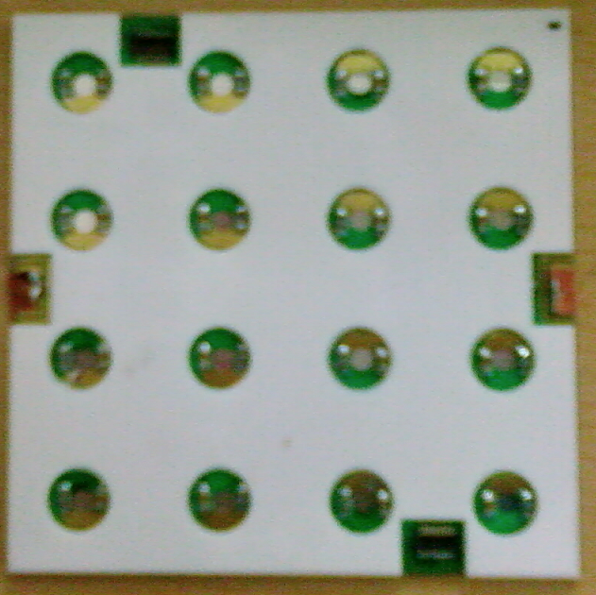
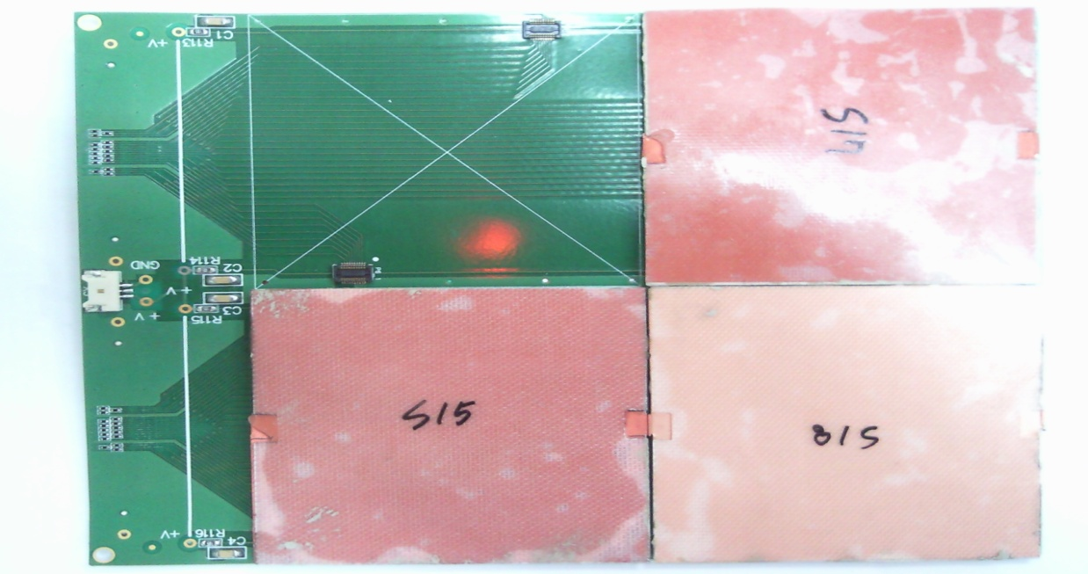
Production results
4 sample micro-module production has completed.
Mechanical and electrical issues have been checked
Notes:
The left picture is a macro-module after production.
And to check mechanical issues, I connect 3 micro-module to carrier board together.
There was no problem on connection.
To check electrical issues, I measure IV characteristics again.
The results are on the next page.

Slide 25


General operation
PAD
STRIP
W
SEG0
SEG1
SEG2
γ
e
y
z
Each tungsten layer : ~1 radiation length.
R_{M} ~ 1.5 cm

Slide 26
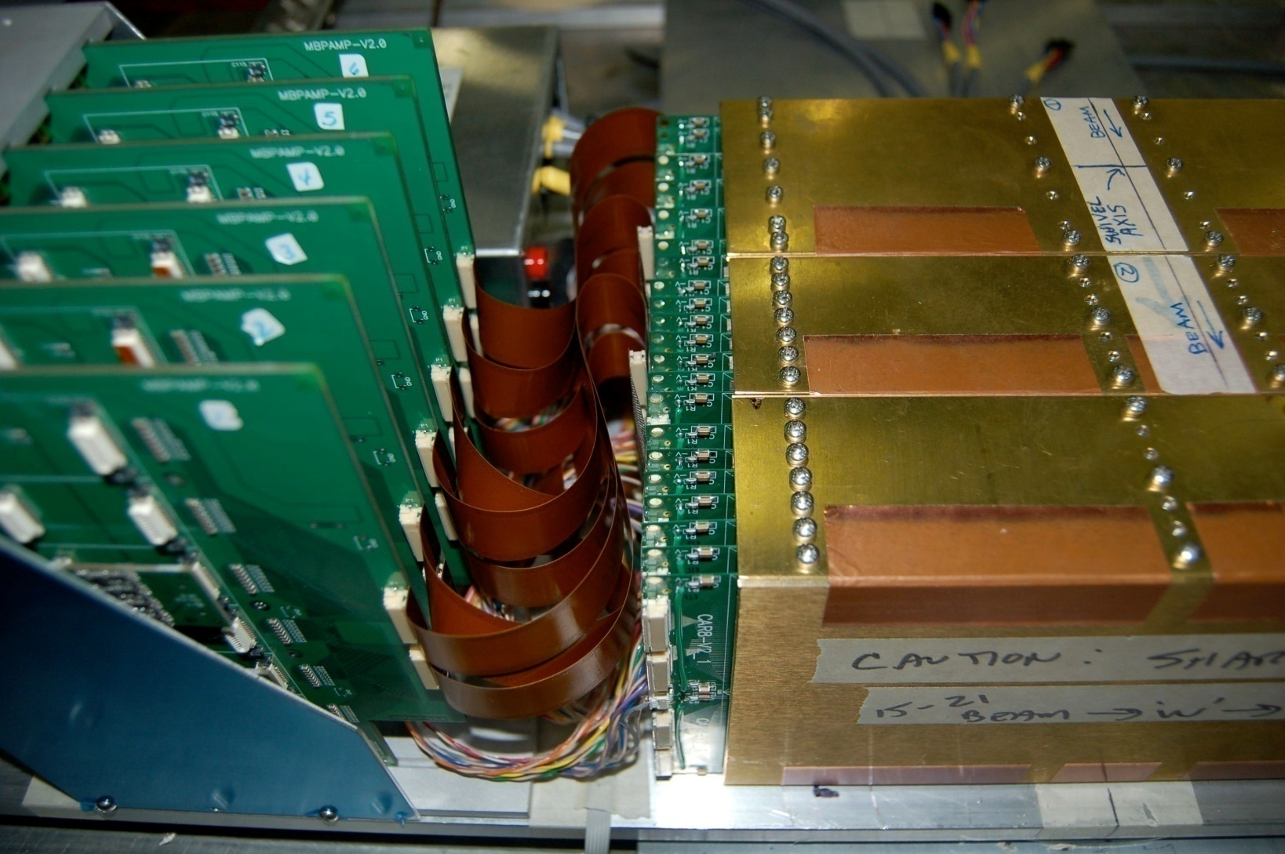
Readout configuration
7 vertical channels grouped (cost issue)
8 pad sensors
in one carrier board
Preamp hybrid

Slide 27
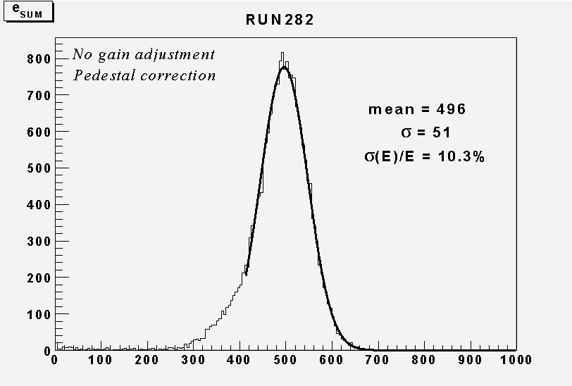
Result obtained while in beam test

Slide 28

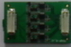
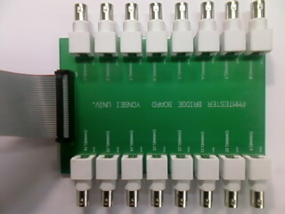
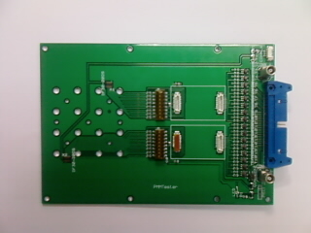
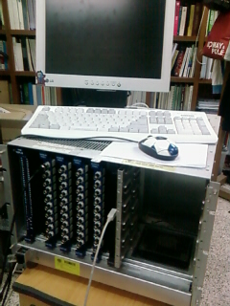
Details in Cp-III-032

Slide 30
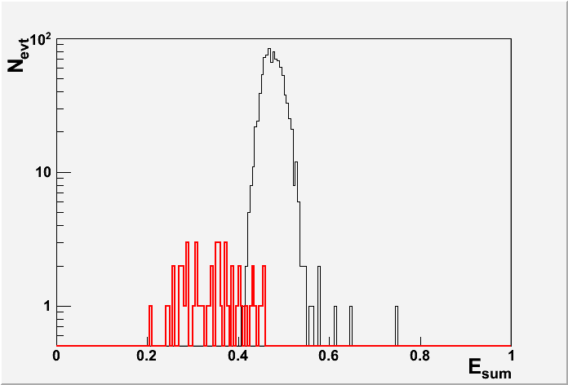
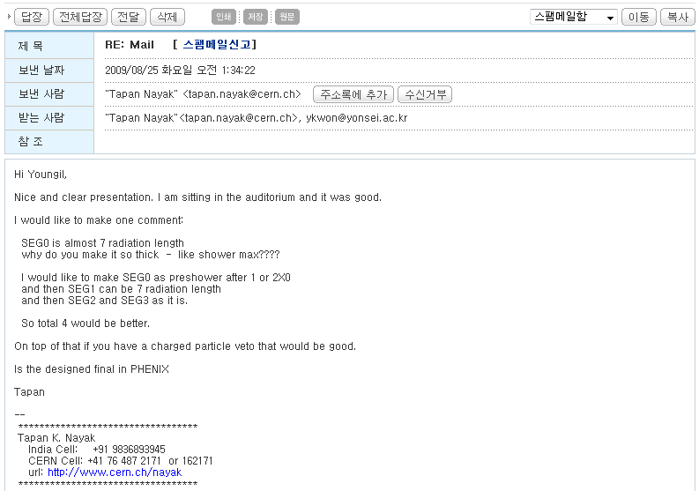
E_{sum} for π⁺ and e⁻ surviving selection
p_{T} = 10 GeV/c, Rejection factor of 200 with ε_{γ}=95%

Slide 31
Conclusion
The π⁰ particle is an important background to the measurement of direct γ.
ALICE can deal with the problem through the low mass e⁺e⁻ pairs.
Korea possesses great potential in Si processing.
We will pursue W/Si sandwich calorimeter in ALICE.

