Slide 1
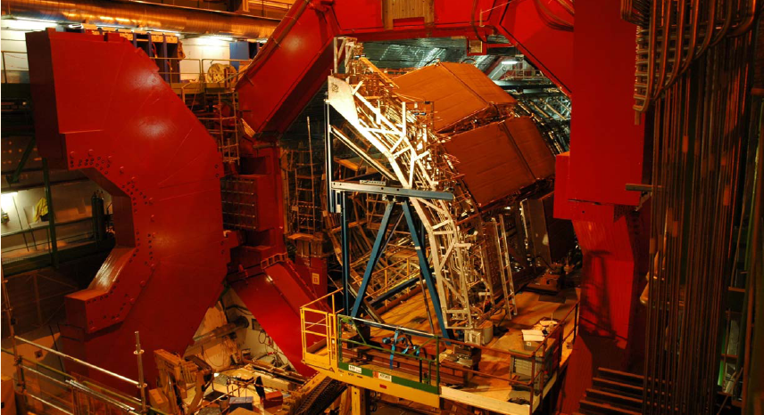
High Momentum Particle IDentification (HMPID) in ALICE
Pusan National University
In-Kwon Yoo
For ALICE / HMPID Collaboration

Slide 2
Outline
Why HMPID ?
  Pre-ALICE RHIC Physics
  Physics of the HMPID
  PID in ALICE
HMPID RICH Detector
  Concept of Design
  HMPID Layout
Cosmic Test Results
VHMPID Project
  Motivation
  Outlook

Slide 3
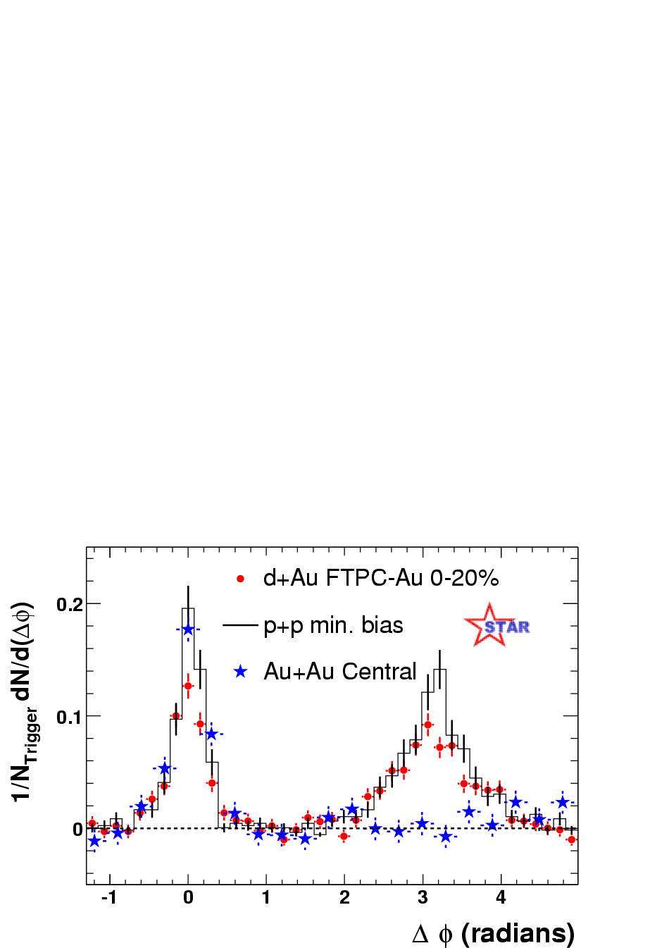
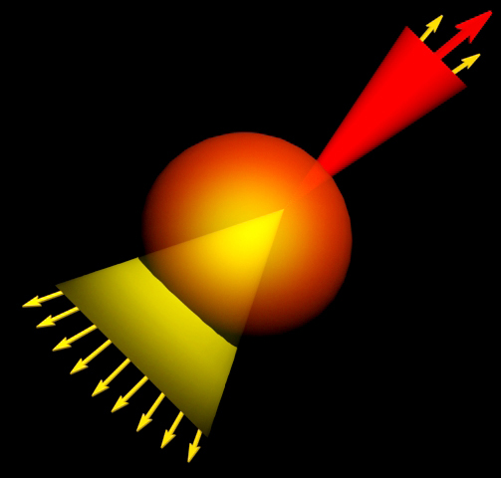
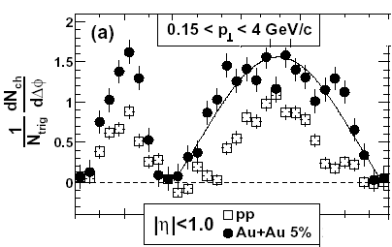
Why HMPID?
Pre-ALICE RHIC Physics
Jet Quenching
p_{T}(assoc) > 2 GeV/c
  Hard associated particles → suppression
4 < p_{T}(trig) < 6 GeV/c
p_{T}(assoc) > 0.15 GeV/c
  Soft associated particles → enhancement

Slide 4
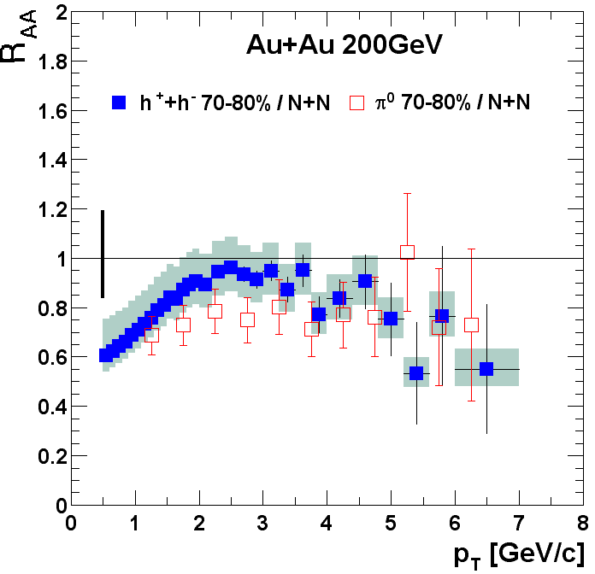
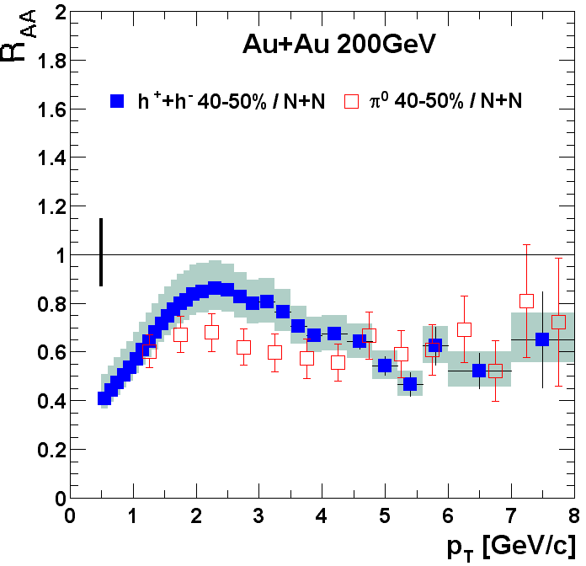
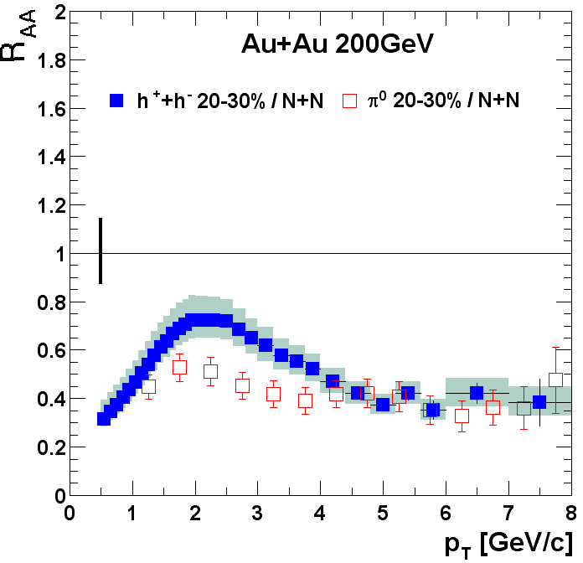
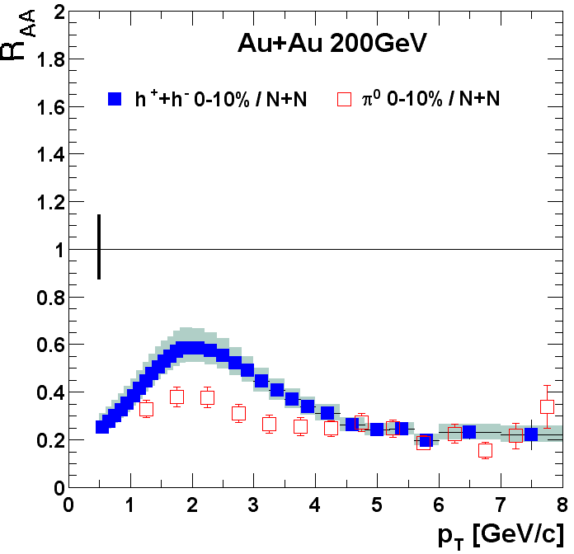
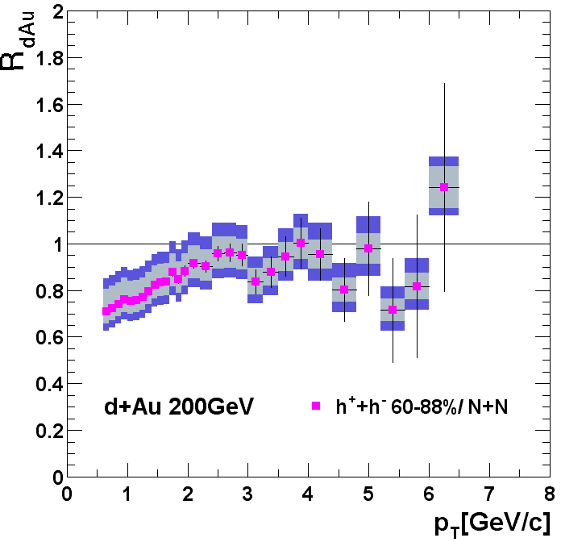
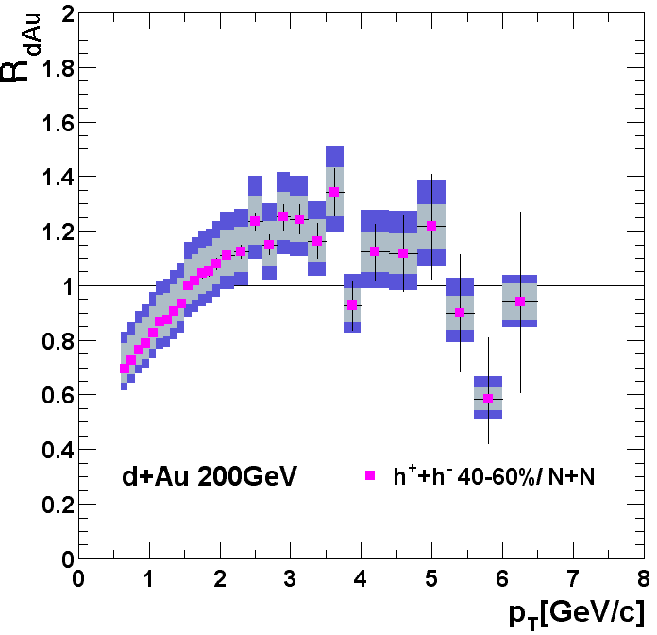
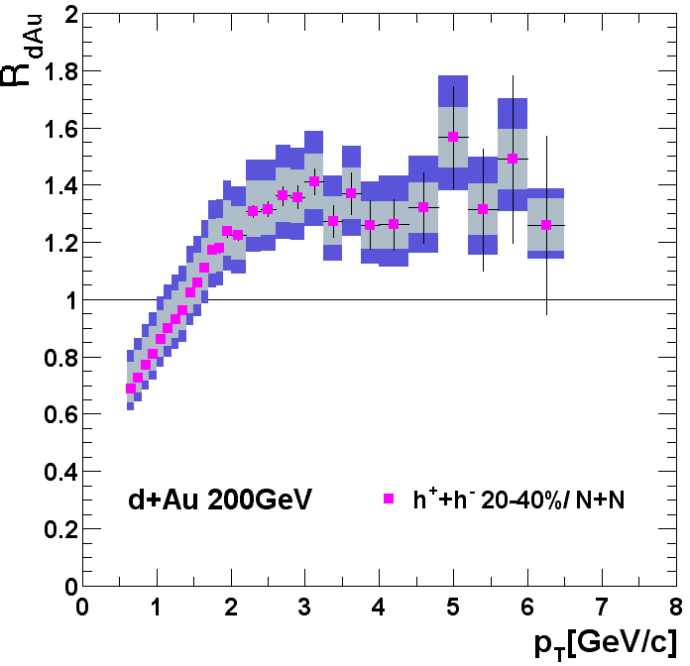
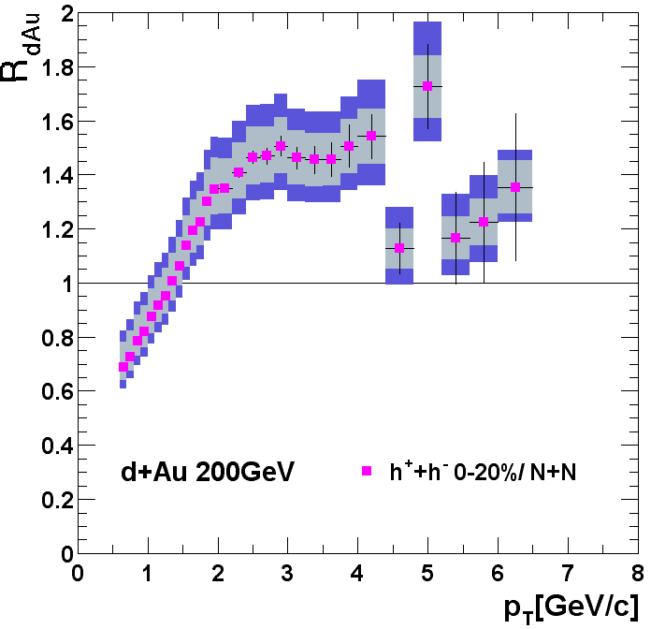

Why HMPID?
Pre-ALICE RHIC Physics
High p_{T} suppression
Final Data
Preliminary Data

Slide 5
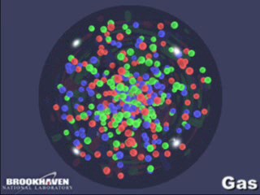
Why HMPID?
Pre-ALICE RHIC Physics

Slide 6
Why HMPID?
Physics of the HMPID
Low p_{T} particle spectra (< 1 GeV/c) → Temperature of the formed medium, via thermal particle emission
High p_{T} particle production ← hard processes (perturbative QCD)
Density of the formed medium in AA collisions ← energy loss of high-energy partons traversing the medium

Slide 7
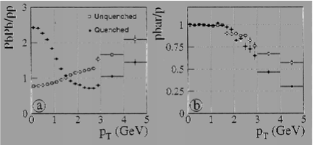
Why HMPID?
Physics of the HMPID
Large E_{T} jet suppression → high p_{T} particle suppression.
Comparison of high p_{T} spectra in AA and pp
Comparison of proton and antiproton spectra → quark jets vs. gluon jets [PRL68, 1480] → tagging quark vs. gluon jets
Gluons with more colors lose more energy in a dense medium than quarks → suppressing pbar at high p_{T}

Slide 8
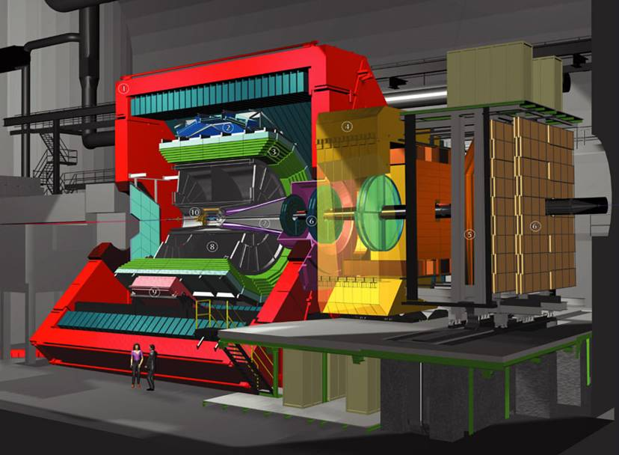
Why HMPID?
PID in ALICE
Cosmic rays trigger
ALICE: the dedicated HI experiment
Solenoid magnet 0.5 T
Forward detectors:
  PMD
  FMD, T0, V0, ZDC
Full azimuthal coverage : ITS, TPC, ToF
ITS, TPC upto p ~ 600 MeV/c
ToF upto ~ 1.2 – 1.4 GeV/c
Single-arm detector : HMPID for 1 – 5 GeV/c
Specialized detectors:
  HMPID
  PHOS
Central tracking system:
  ITS
  TPC
  TRD
  TOF
MUON Spectrometer:
  absorbers
  tracking stations
  trigger chambers
  dipole

Slide 9
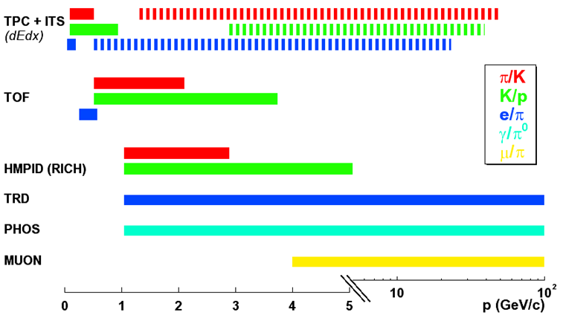
Why HMPID?
PID in ALICE

Slide 10
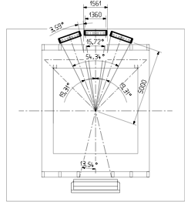
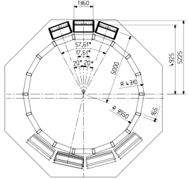
Why HMPID?
PID in ALICE

Slide 11
HMPID RICH
Concept of Design
Ring Imaging Cherenkov (RICH) Detector : Momentum limit = choice of radiator medium
Track-by-track PID
π, K, p with 1-5 GeV/c : liquid radiator
Cherenkov photon (λ ≤ 200 nm) transmittance → C₆F₁₄
Particle density, space, photon absorbtion etc → ‘proximity focusing’
Surface, price, CsI photocathode + MWPC

Slide 12
HMPID RICH
HMPID Layout
RADIATOR
15 mm liquid C₆F₁₄, n ~ 1.2989 @ 175nm, (βγ)_{h} = 1.21
PHOTON CONVERTER
Reflective layer of CsI QE ~ 25% @ 175 nm.
PHOTOELECTRON DETECTOR
- MWPC with CH₄ at atmospheric pressure (4 mm gap) HV = 2050 V.
- Analogue pad readout

Slide 13
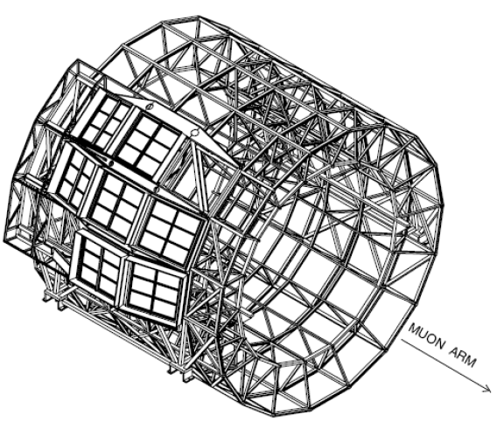
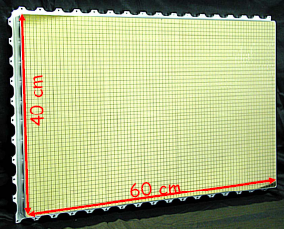
HMPID RICH
HMPID Layout
Six photo-cathodes per module
CsI photo-cathode is segmented in 0.8x0.84 cm pads
Total number of pads per chamber = 161280
photons
MIP

Slide 14
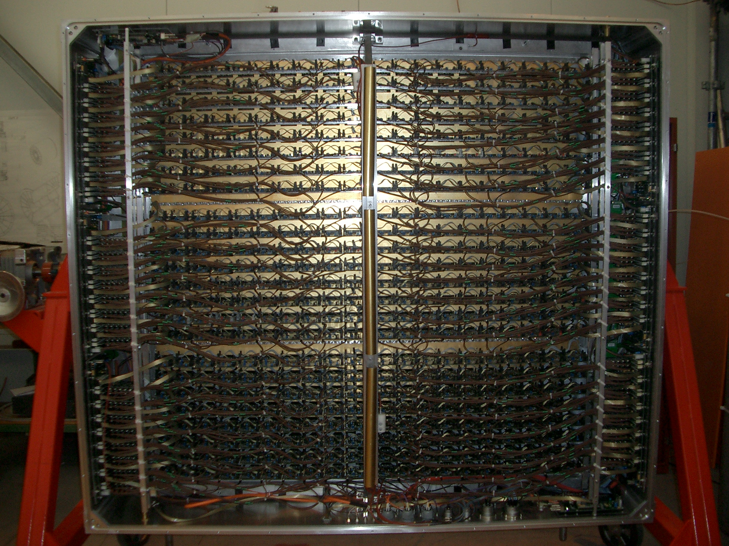
HMPID RICH
HMPID Layout

Slide 15
HMPID is installed in the ALICE magnet since September 2006
Since July 2007, fully powered (LV & HV);
Since July 2007, HMPID is controlled via the Detector Control System;
Since May 2008 the radiator liquid circulation system is completed;
HMPID is ready to take data!!

Slide 16
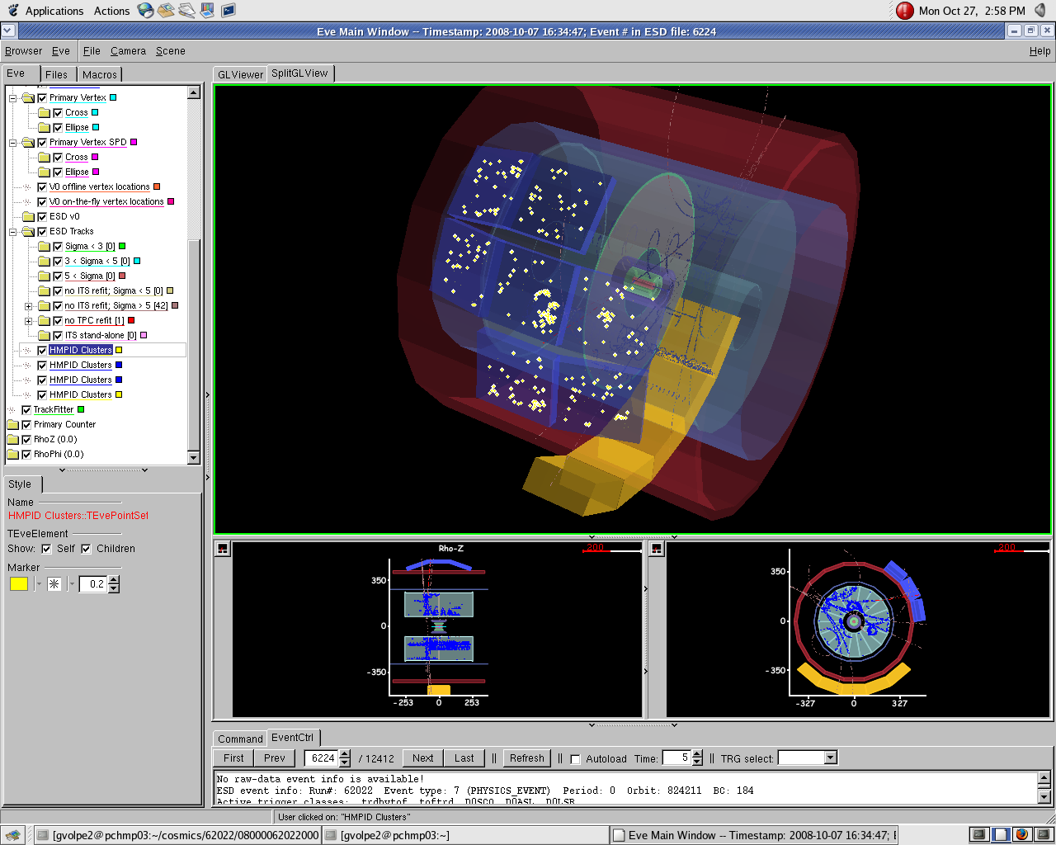
Test HMPID
Cosmic Test Results (G. Volpe, QM09)

Slide 17
Test HMPID
Cosmic Test Results (G. Volpe, QM09)
Matching with tracks reconstructed in the TPC

Slide 18
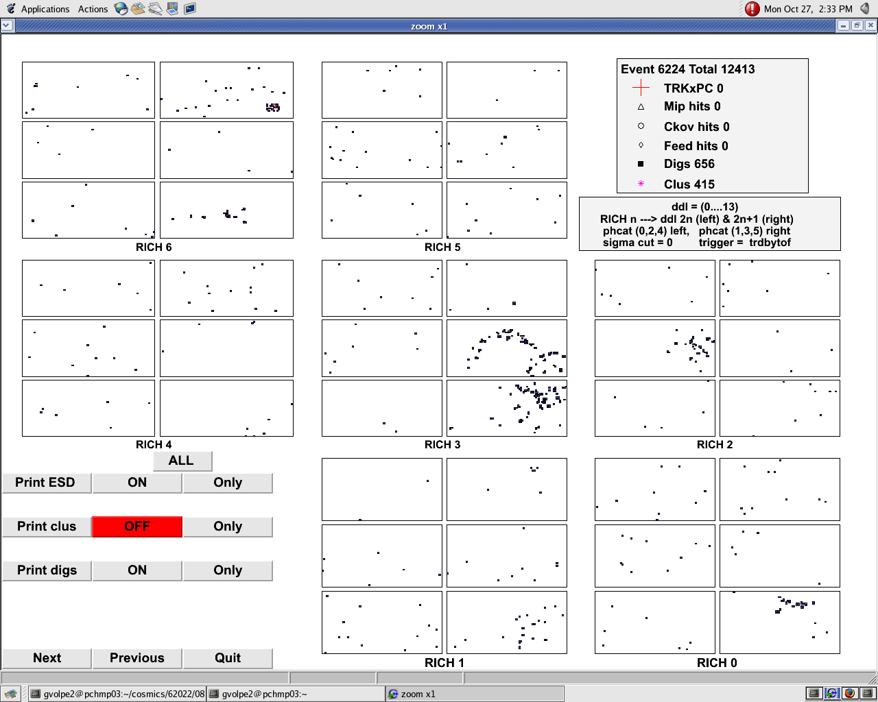
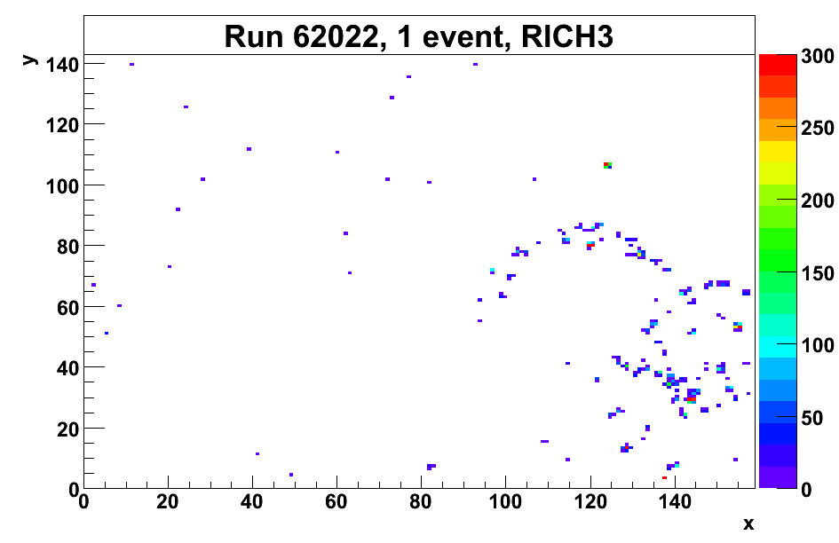
Test HMPID
Cosmic Test Results (G. Volpe, QM09)

Slide 19
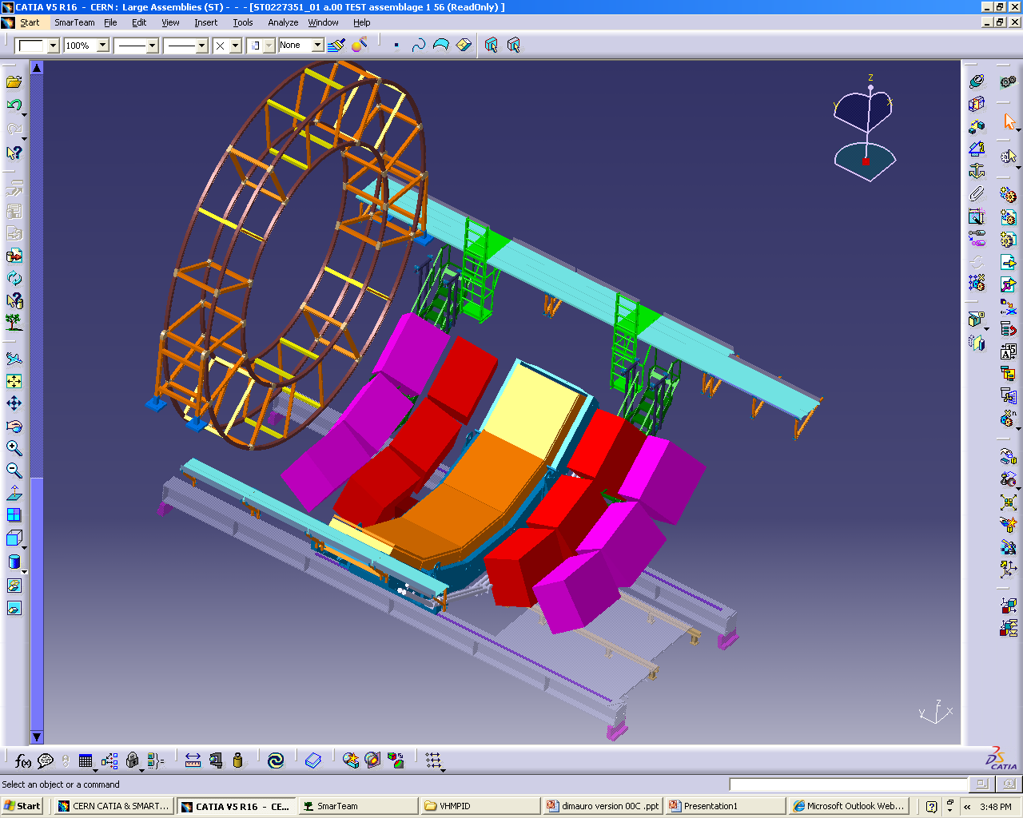
VHMPID Project
Motivation
ALICE detectors were designed in the mid-1990’s
RHIC results → the need for VHMPID
10 GeV/c < pT < 25 GeV/c → the gaseous radiator
Near-side jet-cone analysis && Away-side jet-cone analysis

Slide 20
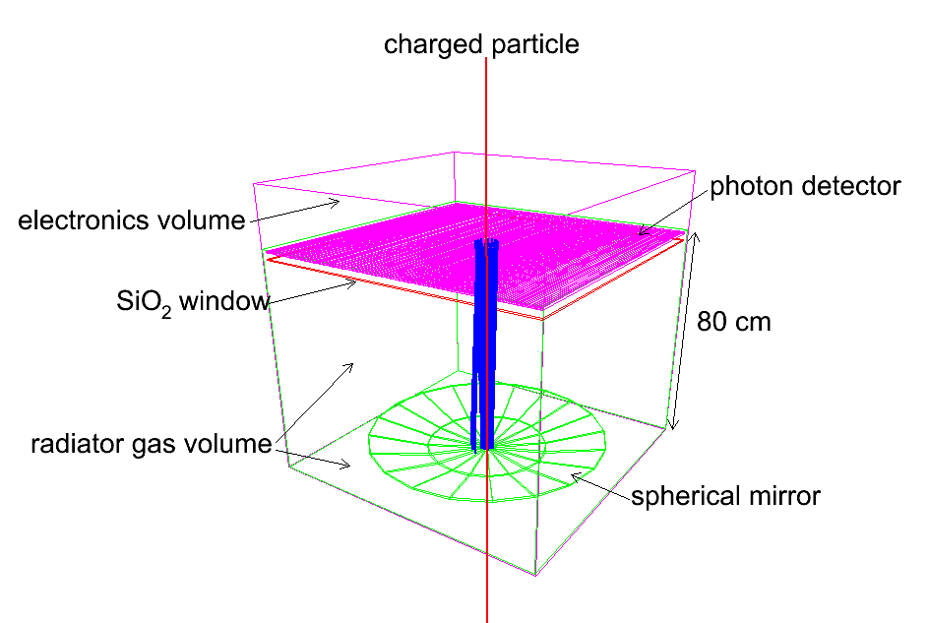
VHMPID Project
Ongoing R&D (A. Di Mauro)
HMPID-like photon detector (MWPC + CsI pad cathode)
Readout FEE: GASSIPLEX + DILOGIC (same as HMPID)
C₄F₁₀ radiator, 80-100 cm long
5 mm Suprasil (SiO₂) window

Slide 21
ALICE VHMPID Collaboration
Instituto de Ciencias Nucleares Universidad Nacional Autonoma de Mexico, Mexico, Mexico : E. Cuautle, A. Ortiz, G. Paic, V. Peskov, P. Podesta, O. Sokolov
Instituto de Fisica Universidad Nacional Autonoma de Mexico, Mexico, Mexico : R. Alfaro
Universita’ degli Studi di Bari, Dipartimento Interateneo di Fisica "M. Merlin " & INFN Sezione di Bari, Bari, Italy : G. De Cataldo, D. Di Bari, A. Mastroserio, E. Nappi, G. Volpe
CERN, Geneva, Switzerland : A. Di Mauro, P. Martinengo, D. Perini, F. Piuz
MTA KFKI RMKI, Research Institute for Particle and Nuclear Physics, Budapest, Hungary : A. Agocs, G.G. Barnafoldi, L. Boldizsar, Z. Fodor, E. Futo, G. Hamar, P. Levai, L. Molnar
Eotvos University, Budapest, Hungary : D. Varga
Chicago State University, Chicago, IL, USA : E. Garcia
Yale University, New Haven, USA : N. Smirnov, J. Harris
Pusan National University, Pusan, Korea : I.-K.Yoo, J. Yi, C.W. Son

Slide 22
Korea-ALICE Institutions
Total : 28 Participants (11 PhDs, 7 PhD St., 10 MA St.)
  Kangnung National University* : 5 PhDs, 4 PhD St., 3 MA St.
  Pusan National University : 2 PhDs, 1 PhD St., 2 MA St.
  Sejong University : 2 PhDs, 1 PhD St., 1 MA St.
  Yonsei University : 2 PhDs, 1 PhD St., 4 MA St.
Residents at CERN : 5 PhDs, 1 PhD St., 3 MA St.
Residents at Korea : 6 PhDs, 6 PhD St., 7 MA St.
2 PhDs + 1 PhD St. + 1 MA St. increased (17%)
22

Slide 23
Korea-ALICE Budget
2008 Total : 225 kCHF
  KICOS -> CERN : 215 k
    common : 50 k (completed)
    stay at CERN : 109k
    visitor : 56k
  local at KNU : 10k
2009 Total : 500 M KRW
  KICOS -> CERN : 410 M
    stay at CERN : 297 M
    visitor : 103 M
  local at PNU : 90 M
    salary : 54 M
    local travel : 5 M
    overhead : 20 M
    admin. : 11 M
23

Slide 24
Korea-ALICE Steering Committee
Steering Committee : 4 Representatives from 4 Institutions
  Bylaw established
  assign a new Team Leader : IKYoo
  assign resident coordinator : Dr. Suh-Urk CHUNG (BNL)
  budget estimate for 2009
  M&O-A list : open competition
http://him.phys.pusan.ac.kr/~alice
24

Slide 25
Korea-ALICE Activities
Goal : Discovery and Study on Quark Matter under Extreme Conditions
  Detector R&D and Operation of ALICE
  Data Analysis using Grid Computing : Test of theoretical expectations
  Brainstorming of new physics ideas : HIM
Kangnung National University
  ALICE-ToF R&D, installation and operation
  ALICE-EM Calorimeter (Muon Detector) operation
  Particle Reconstruction Algorithm Development
25

Slide 26
Korea-ALICE Activities (contin.)
Pusan National University
  ALICE-HMPID R&D and Operation
  Gas System Control System R&D using ALICE-DCS
  Charm Production Study (ΛC/D)
Sejong University
  ALICE Computing GRID Operation
  Theoretical Calculation on Hadron Phenomena at LHC (pp and PbPb collisions)
Yonsei University
  ALICE-TRD Installation and Operation
  Direct Photon Measurement Study
26

