Slide 1
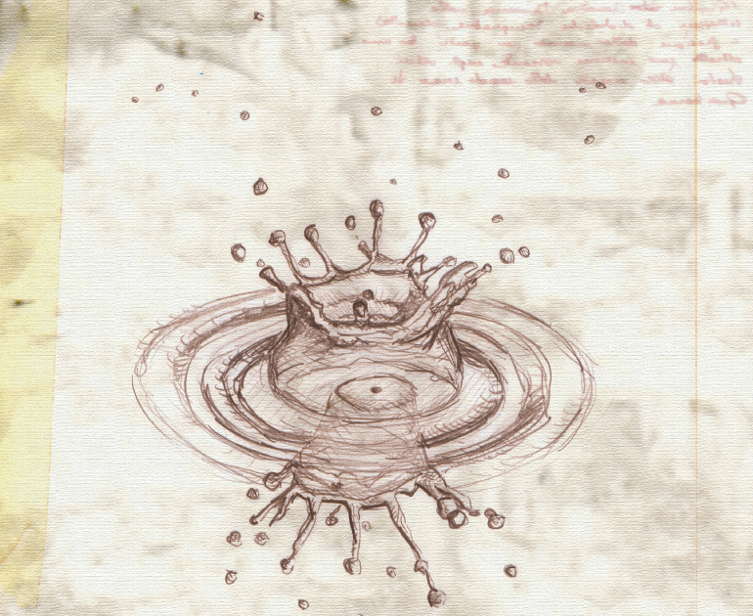

Overview of
Heavy-Ion Physics Program in CMS
Heavy-Ion Meeting, APCTP, Pohang, Korea
September 25-26, 2009
Byungsik Hong (Korea University)
for the Collaboration

Slide 2
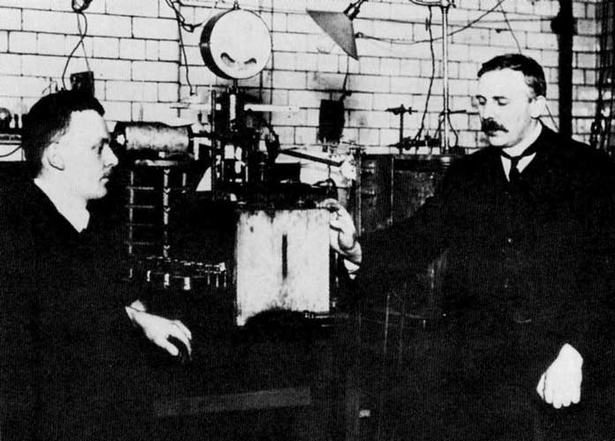
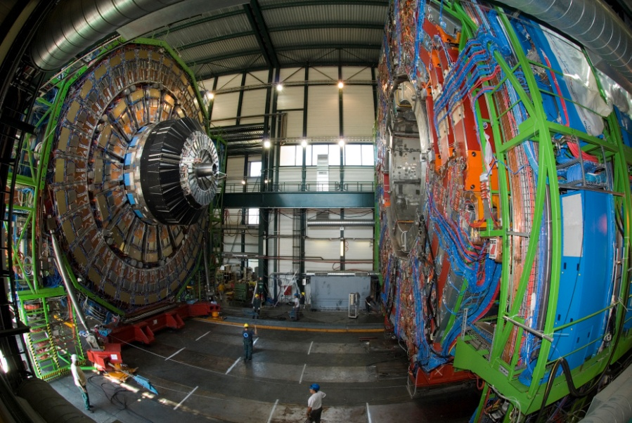
Historical Remark
2009 : A centennial Anniversary of Ion-Ion Collisions
1909 Rutherford gold foil experiment
2009 LHC experiments
Beam: 5 MeV α + fixed Au (√s_{NN}~1 GeV) ⇒ 5.5 TeV (X5,000)
# of collaborators: 3 (+Geiger+Marsden) ⇒ ~3,500 (X1,000)
Construction cost: (X∞)

Slide 3
Outline
Motivation
  Importance & challenges
CMS Detector
  Acceptance
  High-level trigger
  Plan for the first Pb+Pb run
Heavy-Ion Physics Capability of CMS
  Soft probes
  Hard probes
  Ultra-peripheral collisions
Summary

Slide 4
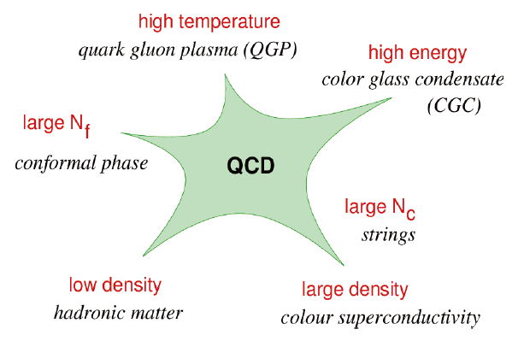
Many Facets of QCD
Quantum Field Theory with rich dynamical content
  asymptotic freedom, confinement, spontaneous broken chiral symmetry & its restoration at high density, non-trivial vacuum, etc.
Standard Model of the collective behavior becomes important
  phase transition, thermalization, flow, etc.
Very diverse many-body phenomenology at various limits:

Slide 5
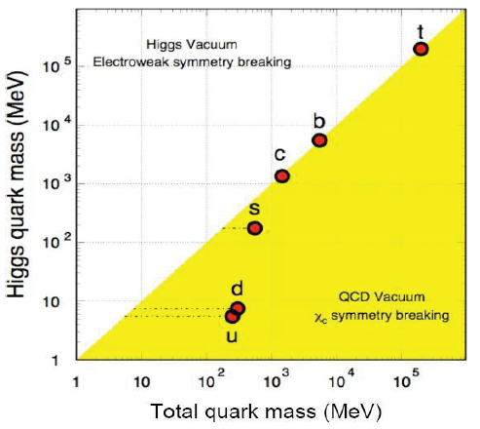
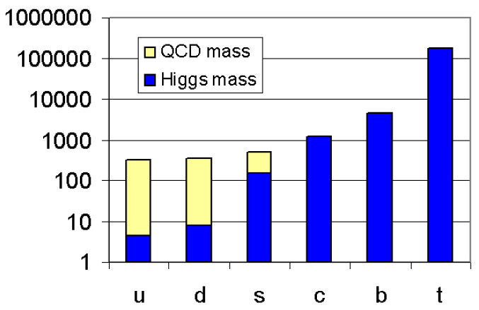
Origin of Visible Mass
QCD (i.e. χ-sym. breaking), not Higgs (i.e. EW-sym. breaking), is truly responsible for the “origin of the visible (baryonic) mass”
About 98% of the (light quark) mass generated dynamically (gluons) in the QCD confining potential
B. Müller, arXiv:nucl_th/0404015
Connection between QCD & HI
Role of CMS for the detailed investigation of QCD

Slide 6
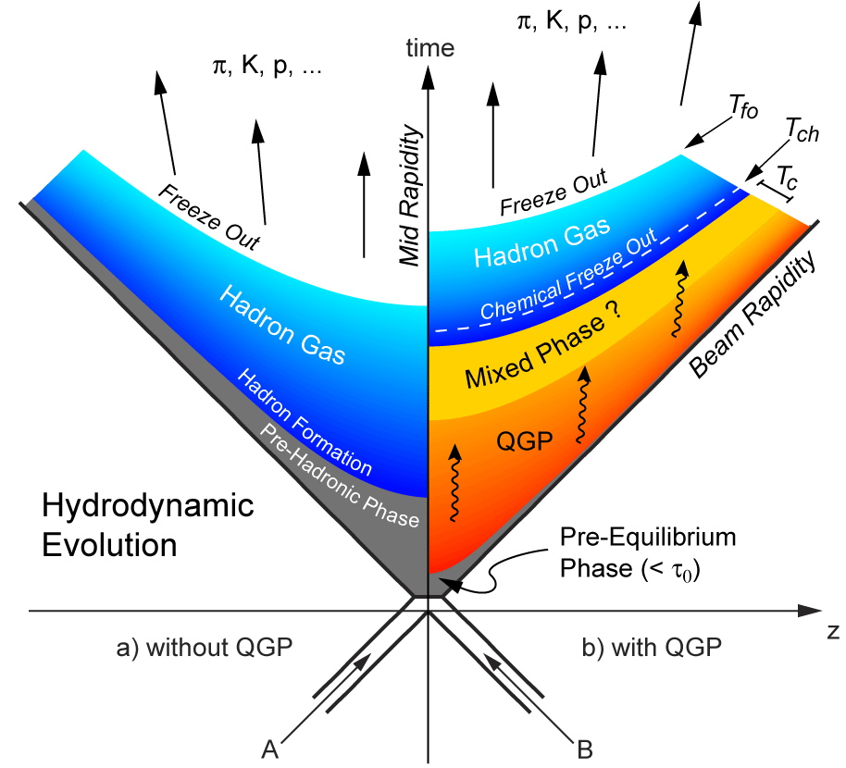
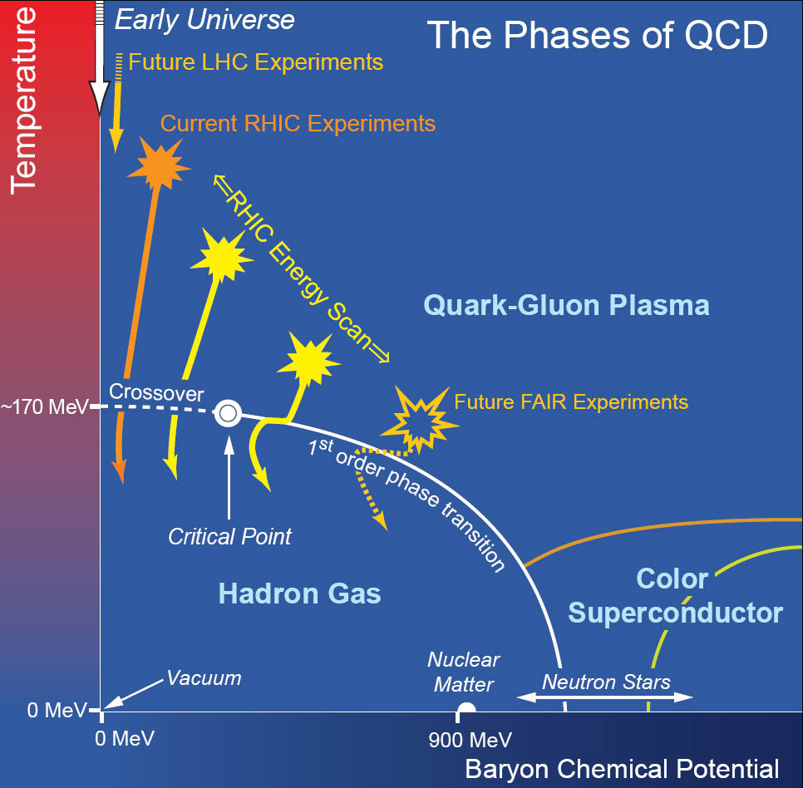
Motivation
Characterizing the early stage by hard probes
    Color charge density, Transport coefficient, QCD ε_{c} & T_{c} , Tomography, …
    High p_{T} spectra, Jets, γ(or γ*, Z⁰)-jet correlations, Quarkonia, …
Characterizing the later stage by soft probes
    Hydrodynamics, QCD EoS, Medium viscosity, ...
    dN_{ch}/dη, Low p_{T} spectra, Elliptic flow, Thermal photons, …

Slide 7
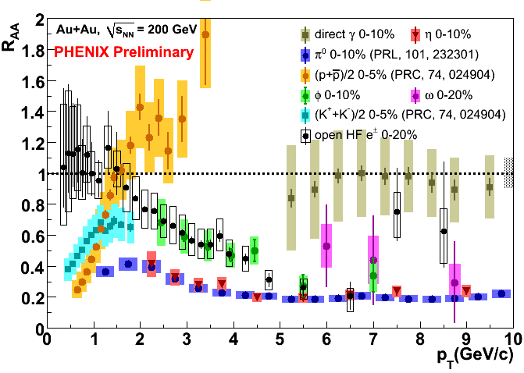
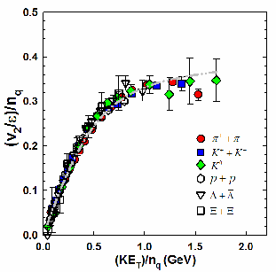
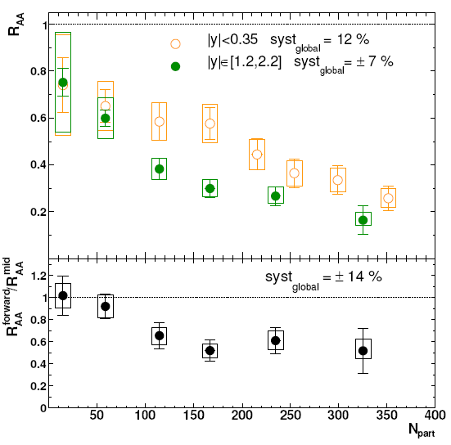
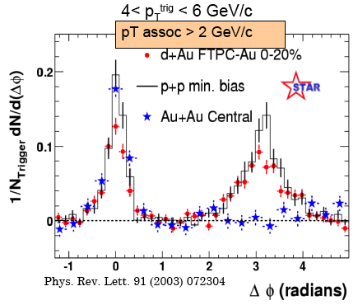
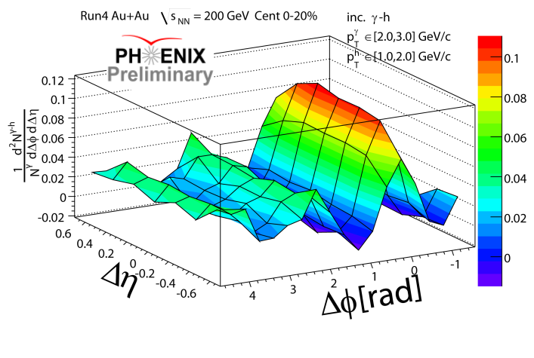
Initial Evidence at RHIC
Strongly coupled matter is hot & dense!
Jet quenching: strong interaction of
high-p_{T} hadrons with dense medium
Flow & NQ scaling:
quark recombination & low η/s
J/ψ suppression: SPS≈RHIC, larger at forward (CGC?)
Jets are modified in medium.

Slide 8
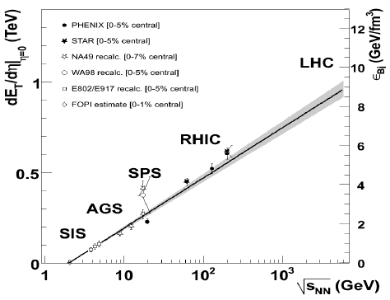
What is New at LHC?
 | AGS | SPS | RHIC | LHC
√s_{NN} (GeV) | 5 | 20 | 200 | 5500
Increasing factor |  | x4 | x10 | x28
η range | ±1.6 | ±3.0 | ±5.3 | ±8.6
LHC energies are far exceeding previous heavy-ion accelerators
  A hotter, denser, and longer lived partonic matter
~
~

Slide 9
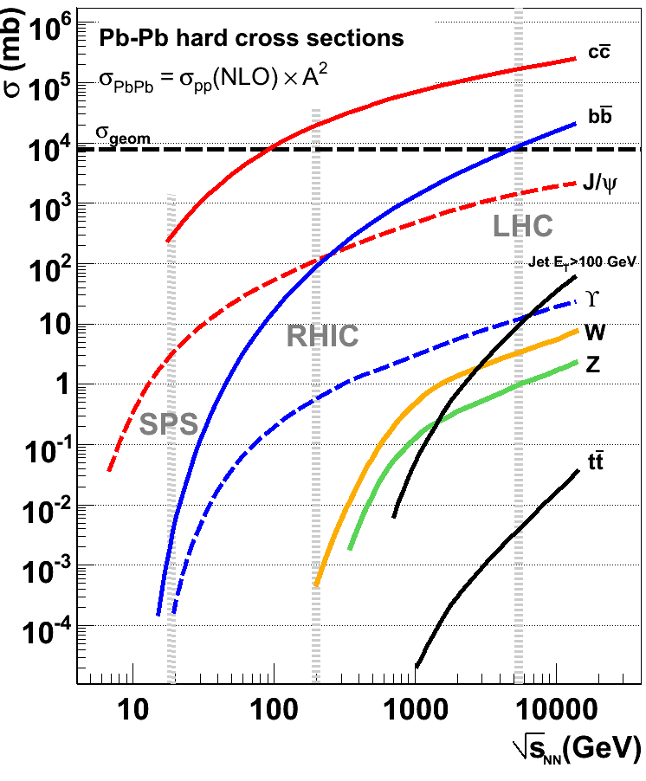
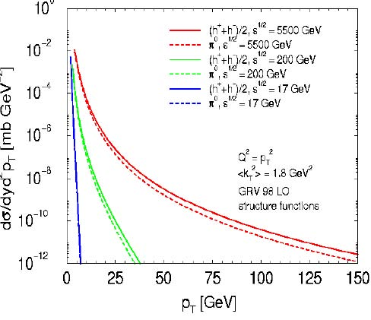
Production Rate at LHC
  Large rates of various hard probes over a larger kinematic range
  Plenty of heavy quarks (b & c)
  Weakly interacting probes are available (W± & Z⁰)
d³σ/dyd²p_{T} [mb GeV⁻²]
LHC
RHIC
SPS
p_{T} [GeV]

Slide 10
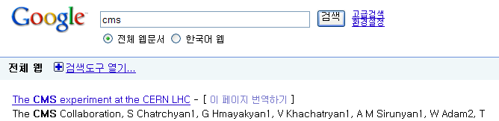

CMS Stands for
Content Management System
Creative Marketing Solutions
Centers for Medicare & Medicaid Services
Convention on Migratory Species
Cash Management Service
Church Missionary Society
College Music Society
Cryptographic Message Syntax
Canadian Mathematical Society
Classic Motorcycle Supplies
Common Management System
Credit Management Solutions
Conceptual Models for Services
…
Compact Muon Solenoid

Slide 11
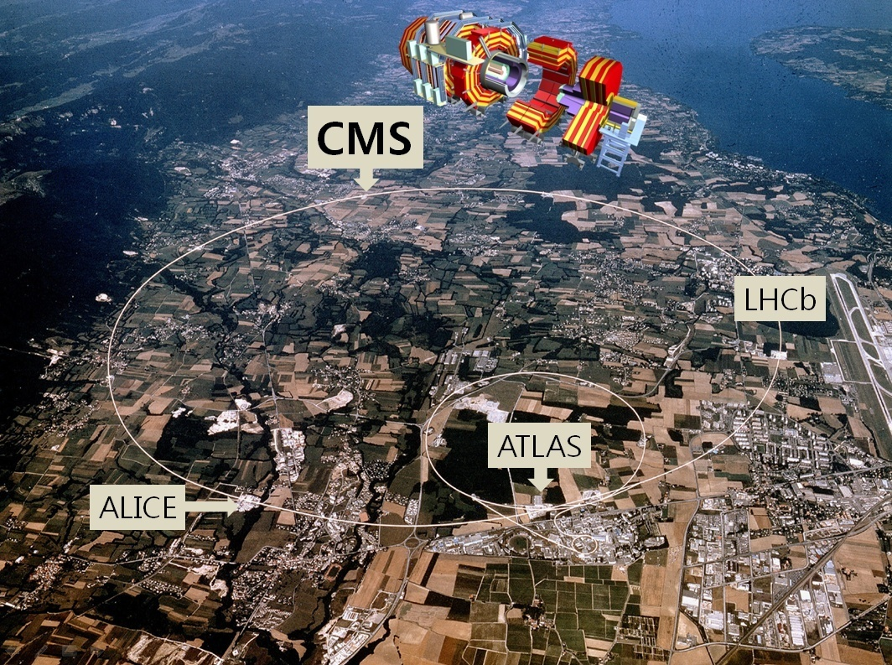

Slide 12
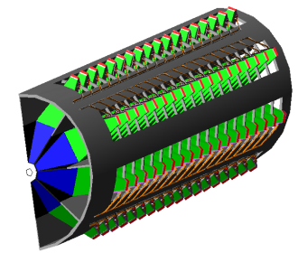
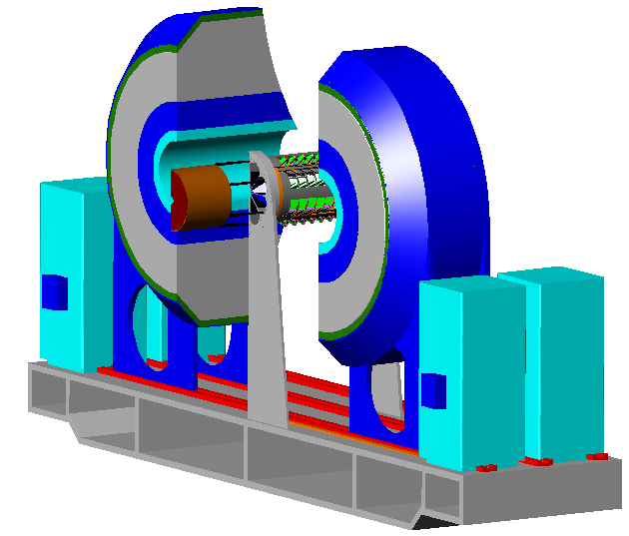
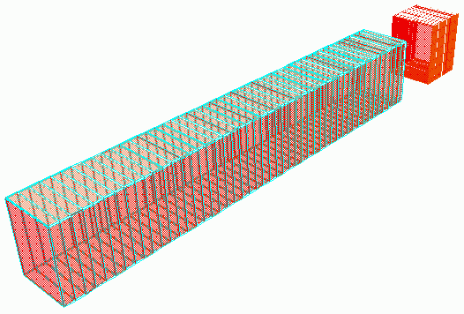
CMS Detector
SUPERCONDUCTING
COILS
ECAL
PbWO₄ Crystals
HCAL
Cu-Scintillator
Sampling
Forward Detectors
CASTOR
(5.2 < η < 6.6)
IRON YOKE
TOTEM
Collar
shielding
(5.3 < η < 6.7)
T2
TRACKER
Si Pixels & Strips
Δp/p ≈1-2%
Occupancy < 2%
for central Pb+Pb
ZDC
(z = ±140 m)
EM
MUON BARREL
Drift Tubes & RPCs
σ_{m}≈50 MeV
at 10 GeV/c²
HAD
Total weight : 12,500 t
MUON ENDCAPS
Cathode Strip Chambers & Resistive Plate Chambers (RPCs)
Overall diameter : 15 m
Overall length : 21.6 m
Magnetic field : 4 Tesla
Beams

Slide 13
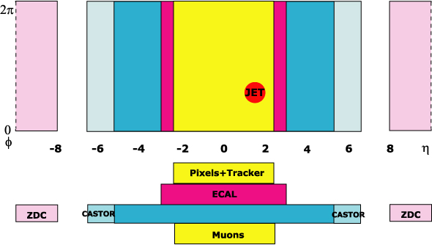
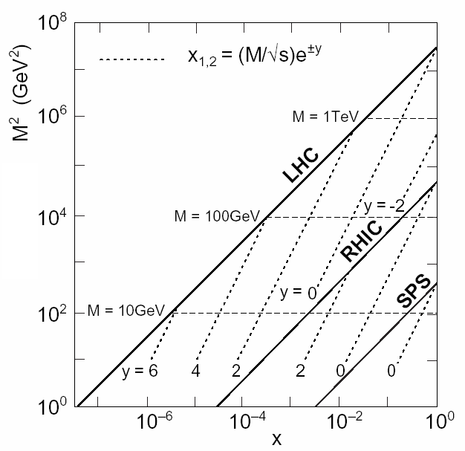



CMS Acceptance
HCAL (Barrel+Endcap+Forward)
Large Range of Hermetic Coverage
Silicon and μ Tracker | ⏐η⏐≤ 2.4
ECAL | ⏐η⏐≤ 3.0
HCAL | ⏐η⏐≤ 5.2
CASTOR | 5.2 ≤⏐η⏐≤ 6.6
ZDC | ⏐η⏐≥ 8.3 for neutrals
  Extended kinematic reach
x~(1/40) of RHIC
<10⁻⁴ measurable

Slide 14
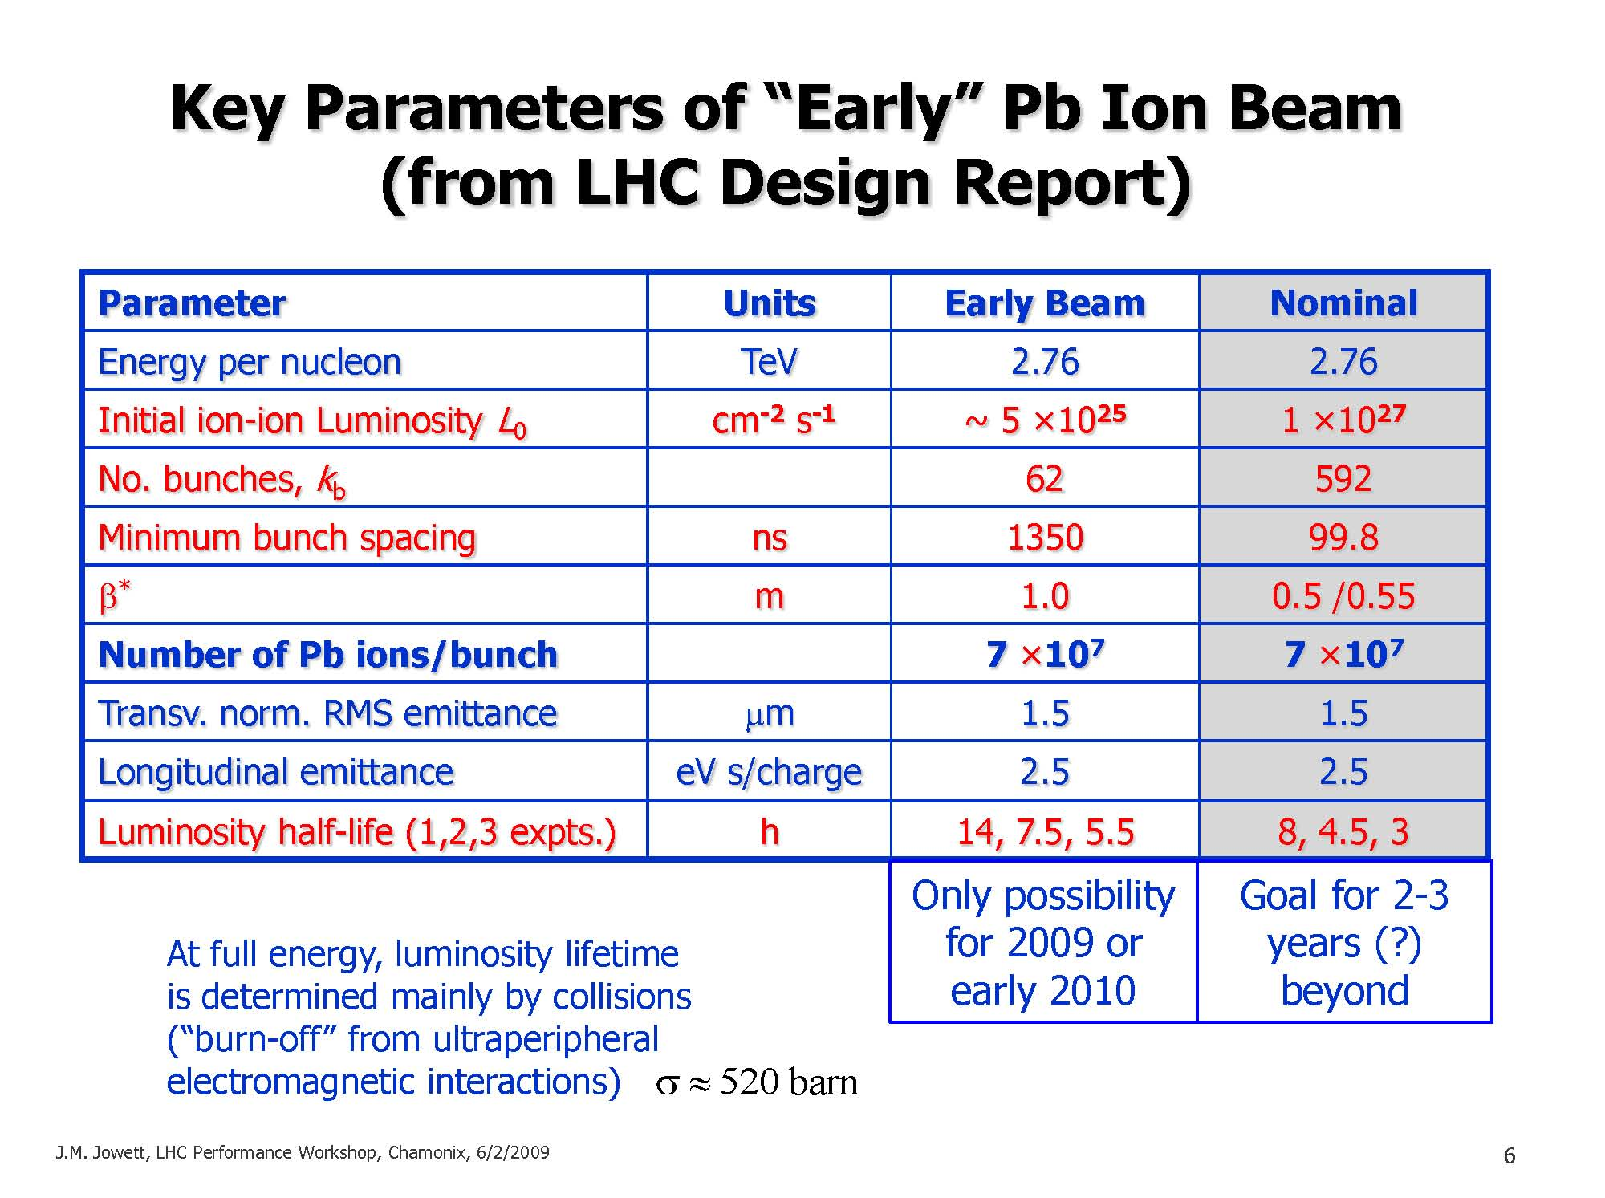
Plan for the First Pb+Pb Coll.
Note from the Chamonix meeting:
Early Pb Beam will have lower beam energy ⇒ 10 TeV in pp corresponds to 4 TeV in Pb+Pb.
→2
Pb+Pb | √s_{NN} | Collision Rate (Max.) | Collision Rate (Avg.)
Year-1 (2010) | 4 TeV | ~150 Hz | ~100 Hz
Nominal (2012) | 5.5 TeV | ~8 kHz | ~3 kHz
Low collision rate in Year-1 allows us to write all min. bias events to mass storage.
Fully functional high-level trigger (HLT) is needed at nominal luminosity.

Slide 15
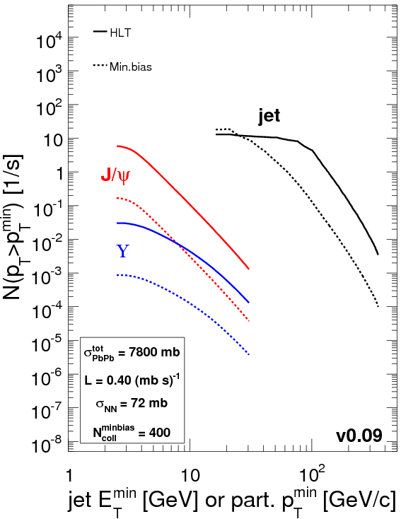
CMS High-Level Trigger
Level 1 (Muon Chambers+Calorimeters)
Level 1 | Pb+Pb | p+p
Collision Rate | 3 kHz (8 kHz peak) | 1 GHz
Event Rate | 3 kHz (8 kHz peak) | 40 MHz
L1 Accept Rate | 3 kHz (8 kHz peak) | 100 kHz
Output Bandwidth | 100 GByte/sec | 100 GByte/sec
Pb+Pb at 5.5 TeV
Nominal luminosity
E_{T} reach x2
jets
High-Level Triggers (high E_{T}-jet, γ, e, μ)
Large computing farm
(Start up with 7.2k CPU cores)
Run “offline algorithm” on every Pb+Pb events
Significantly enhanced statistics
for hard processes (see the right figure)
ϒ
High-Level Trigger | Pb+Pb | p+p
Input Rate | 3 kHz (8 kHz peak) | 100 kHz
Output Bandwidth | 225 MByte/sec | 225 MByte/sec
Output Rate | 10 – 100 Hz | 150 Hz
Rejection | 97-99.7% | 99.85%

Slide 16
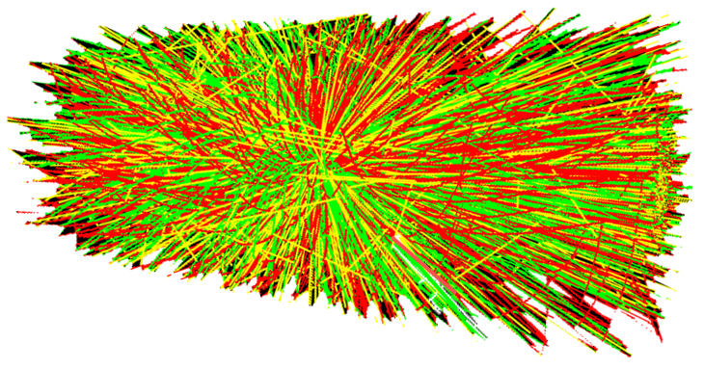
Soft Probes of
QCD Matter in CMS

Slide 17
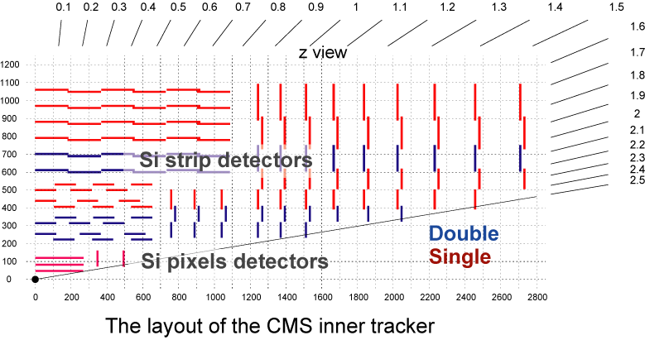
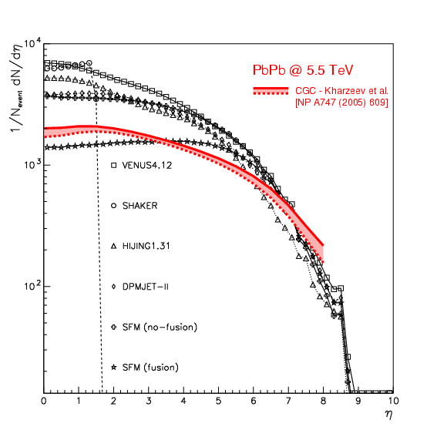


Charged Particle Multiplicity
Total 66M Si Pixels
Occupancy<2% at dN_{ch} /dη ≈ 3500
Cluster shape or tracklet methods
Needs only a few thousand events
dN_{ch} /dη
dN_{ch} /dη
η
Estimation of the Gluon Density Gluon Saturation
Color Glass Condensate (CGC)
η

Slide 18
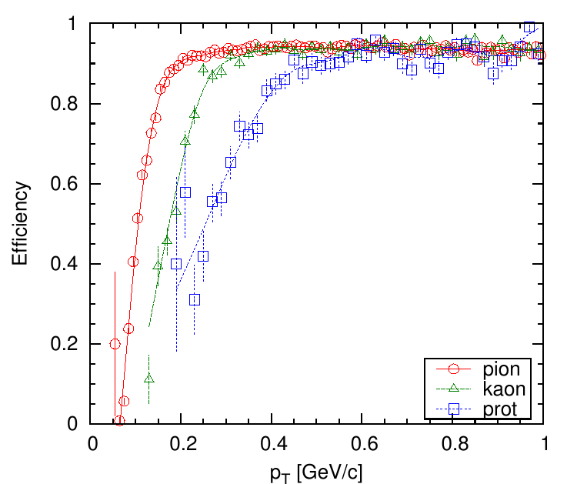
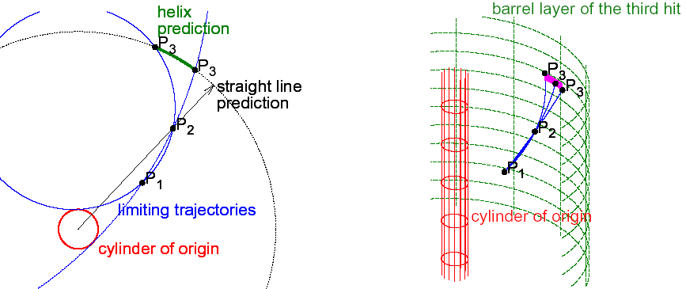
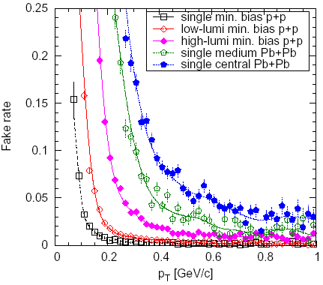
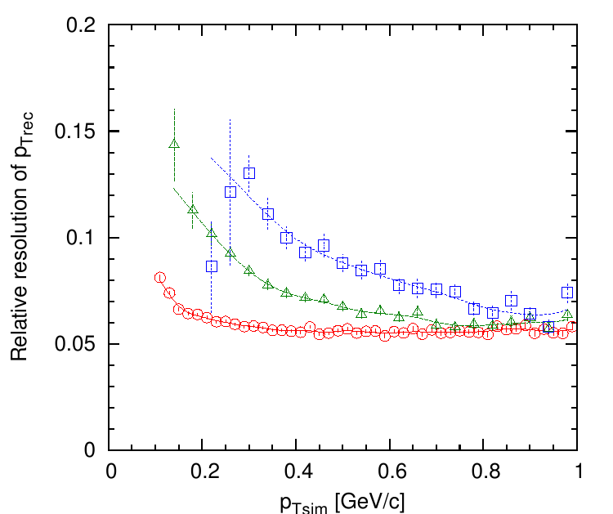
Hadron Spectra at Low p_{T}
Tracking: Pixel-Triplet Algorithm
Efficiency
p_{T} [GeV/c]
Fake Rate
Relative resolution
of p_{Trec}
|η|<1
p_{T} [GeV/c]
p_{Tsim} [GeV/c]

Slide 19
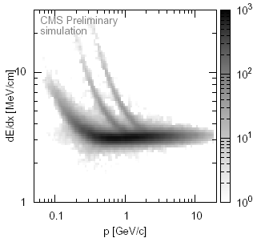
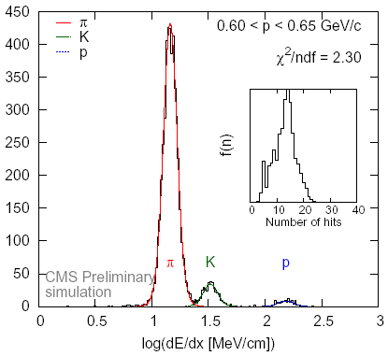
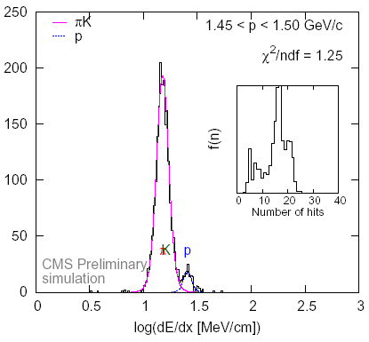
Hadron Spectra at Low p_{T}
PID using the Gaussian unfolding method for dE/dx
Pixels+Strips
dN/dp_{T} [c/GeV]
dE/dx [MeV/cm]
p [GeV/c]
p_{T} [GeV/c]
p_{T} [GeV/c]
Hadron Chemistry
Expansion Dynamics
Equation-of-State
Strangeness Production
log(dE/dx [MeV/cm])
log(dE/dx [MeV/cm])

Slide 20
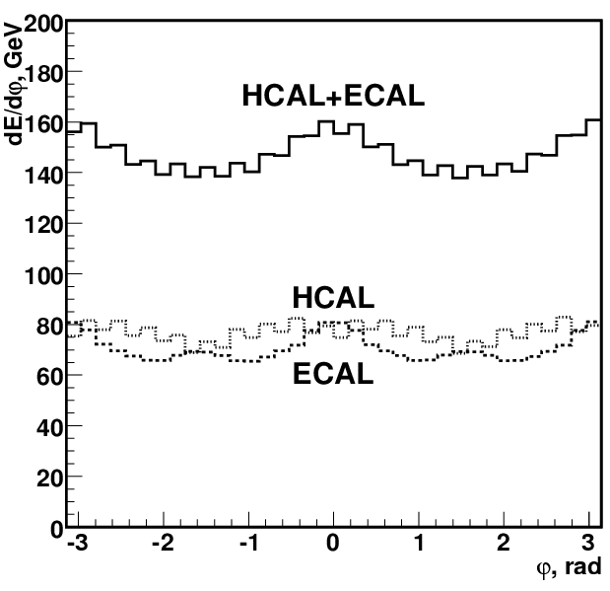
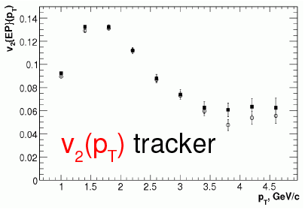
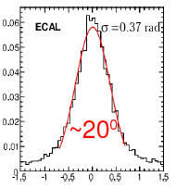
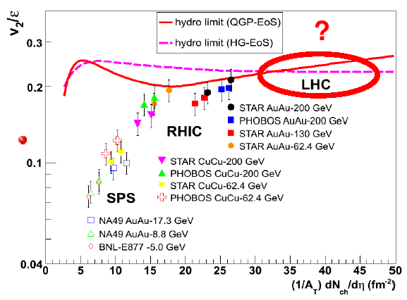
Elliptic Flow
Reaction Plane
Resolution
dE/dφ [GeV]
v₂ (p_{T})
dN/dΔφ
φ
Δφ
p_{T} [GeV/c]
Open symbols: Simulated events
Close symbols: Reconstructed events
Hydrodynamic Behavior
QCD Equation-of-State
Viscosity of Fluid

Slide 21
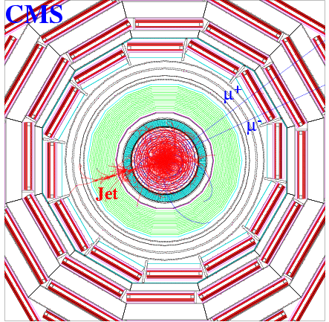
Hard Probes of
QCD Matter in CMS

Slide 22
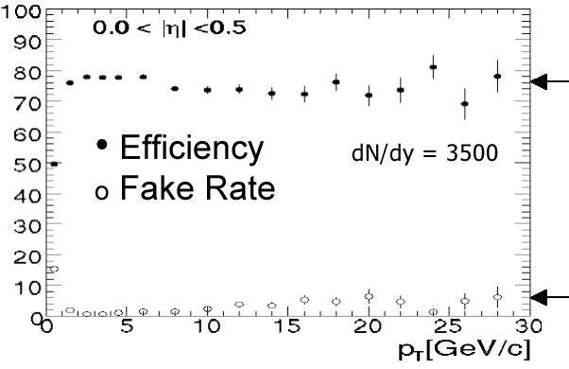
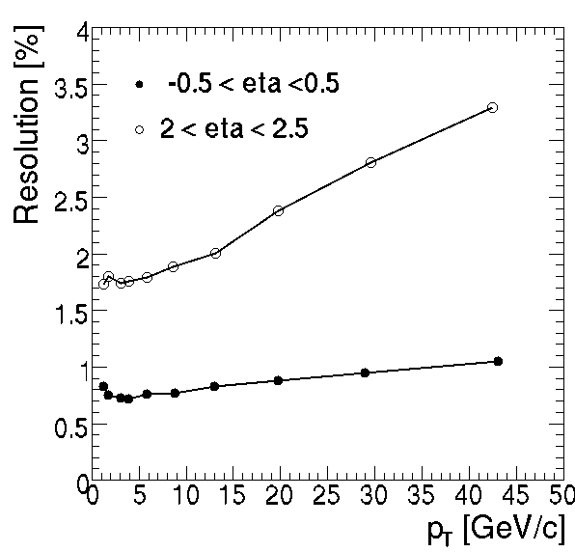
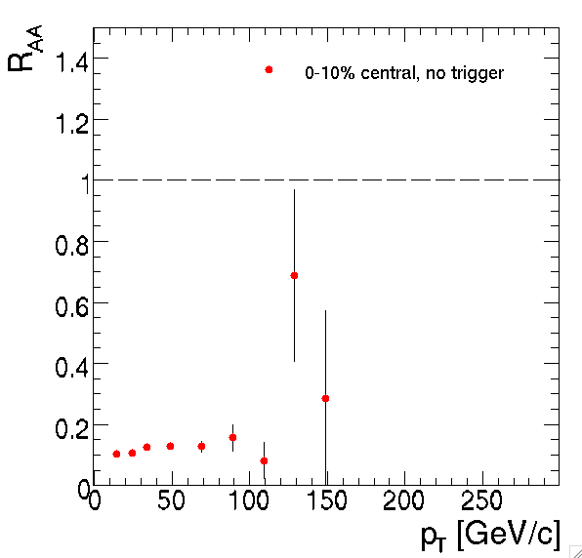
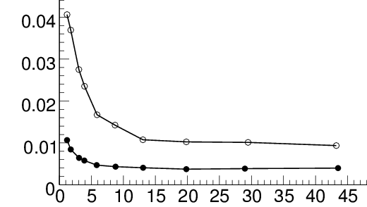
Spectra at High p_{T}
Good
Efficiency
Percentage [%]
Low
Fake Rate
σp_{T}/p_{T} [%]
  dN_{ch}/dη|_{η=0} ≈3500
No trigger
Important for the
secondary vertex
σz [cm]
p_{T} [GeV/c]
p_{T} [GeV/c]

Slide 23
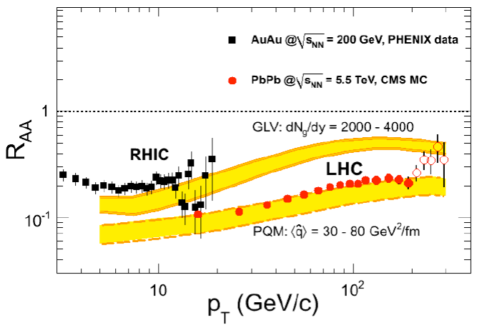
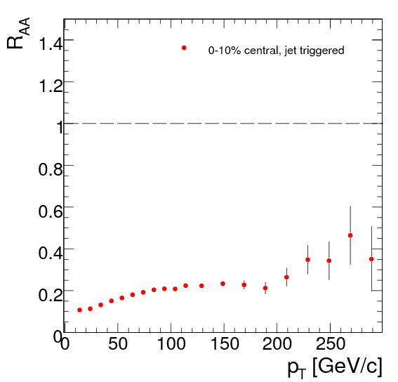
Spectra at High p_{T}
With high-E_{T} HLT
charged particle spectra can be measured up to p_{T} ~300 GeV/c.
Medium Density
R_{AA}
10% Central
Transport Coefficient
p_{T} [GeV/c]

Slide 24
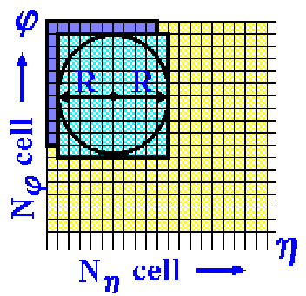
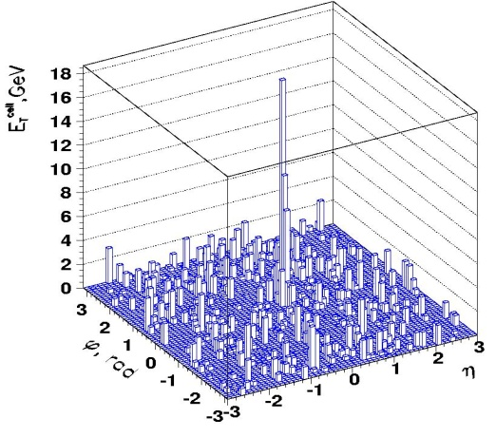
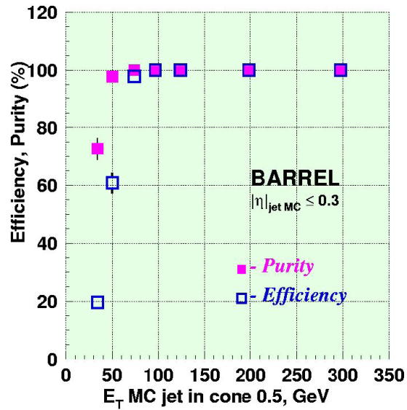
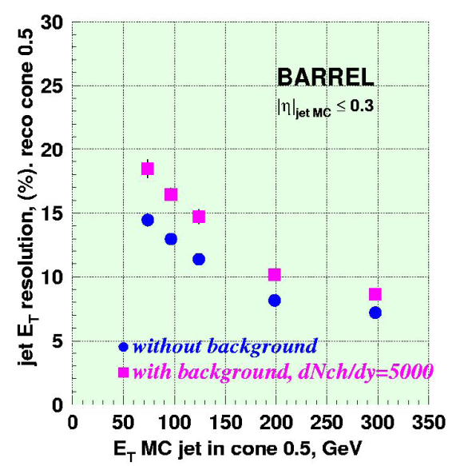
Jet Recon. in Calorimeters
Iterative cone algorithm (R=0.5) with background subtraction
Spatial resolution
  σφ = 0.032, ση = 0.028
  which is smaller than
  the calorimeter tower size 0.087ⅹ0.087
100 GeV jet in
a Pb+Pb event,
after the background subtraction
  High efficiency
  and purity
  for E_{T}>50 GeV
  Good energy
  resolution
  for E_{T}>100 GeV

Slide 25


Jet Spectra
Jet Energy Reconstruction
    Pb+Pb (0.5 nb⁻¹)
      N_{jet}~6ⅹ10⁶
Reconstructed E_{T} (GeV)
MC E_{T} (GeV)
  With high-E_{T} jet HLT
  jet spectra can be measured up to E_{T} ~500 GeV for 1 year running @ nominal luminosity.
Min. Bias
HLT
CMS can use true jets to study parton energy loss.

Slide 26





Photon-Tagged Jets
γ* (or Z⁰) →μ⁺μ⁻ is being also studied
γ
Tagging parton energy
g (q)
g (q)
g (q)
jet
associated hadrons
How is the energy loss distributed in the jet fragmentation cone?
Compton
Bremsstrahlung
Annihilation
Fragmentation
Signal (LO)
Background (NLO, Frag., Decay)

Slide 27


Photon-Tagged Jets
ECAL cluster distributions in the most central 10% Pb+Pb
Before cuts: S/B=0.3
After cuts: S/B=45
Photons
  - Cluster shape variable is used to differentiate isolated photons from mostly non-isolated hadrons (S/B was improved by factor ~15).
  - E_{T}(γ) > 70 GeV

Slide 28



Photon-Tagged Jets
PYQUEN p+p
embedded in
Pb+Pb event at 5.5 TeV
Require the back-to-back γ-jet correlation by Δφ(γ,jet) > 3 rad. with E_{T}(jet)>30 GeV
Reco. FF = MC FF
Depletion at high p_{T}
Enhancement at low p_{T}

Slide 29


Heavy Flavor (J/ψ)
dN_{ch} /dη|_{η=0} =2500
    Pb+Pb (0.5 nb⁻¹)
BARREL+
Endcaps
Events/0.4 GeV/c
p_{T} [GeV/c]
The J/ψ spectra can be measured beyond 40 GeV/c using HLT.
σ _{J/Ψ} =35 MeV/c² for |η|<2.4
S/B~5 for |η|<0.8
N_{J/ψ}~1.8ⅹ10⁵ for 0.5 nb⁻¹
Regeneration vs. Screening
J/ψ may survive up to 2T_{C} (?)

Slide 30

Heavy Flavor (ϒ)
dN_{ch} /dη|_{η=0} =2500
    Pb+Pb (0.5 nb⁻¹)
Events/0.4 GeV/c
p_{T} [GeV/c]
σ _{ϒ} =54 MeV/c² for |η|<0.8
σ _{ϒ} =90 MeV/c² for |η|<2.4
S/B~1 for |η|<0.8
N_{ϒ}~2.6ⅹ10⁴ for 0.5 nb⁻¹
Suppression of ϒ(1S) at LHC?

Slide 31



ϒ Production in UPC
Strong E&M fields due to the coherent action of 82 protons (Ε_{γ}^{max}~80 GeV)
Entries/60 MeV/c²
Entries/60 MeV/c²
M_{ee} [GeV/c²]
M_{μμ} [GeV/c²]
~500 ϒ’s/0.5nb⁻¹
Unexplored xG(x,Q²) region

Slide 32
Summary
The CMS detector is versatile not only for pp, but also for heavy-ion collisions.
The CMS high-resolution trackers, calorimeters, and muon chambers cover almost 4π phase space.
The CMS detector can measure various hard probes with the best resolution at the LHC.
The CMS detector can also measure soft hadrons for p_{T}>200 MeV/c with good particle identification.

