Slide 1

Pion properties from the instanton vacuum
in free space and at finite density
Hyun-Chul Kim
Department of Physics,
Inha University

Slide 2
Outline
Quantum Chromodynamics
Instanton vacuum
QCD vacuum
chiral symmetry &
its spontaneous br.
Effective Chiral Action
Chiral Quark-(Soliton) Model
Structure of hadrons
Confronting with experiments

Slide 3
Experiments & Theories
Elastic scattering Form factors
DI scattering Parton distributions
DVCS & HEMP GPDs
Hadronic reactions Coupling constants
Weak decays Weak coupling consts.
New spectroscopy Quantum Nr.& masses
Accelerators: Spring-8, JLAB, MAMI, ELSA,
GSI (FAIR: PANDA), COSY, J-PARC, LHC……

Slide 4
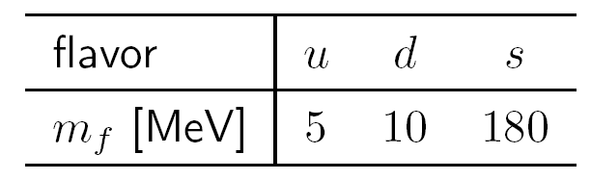
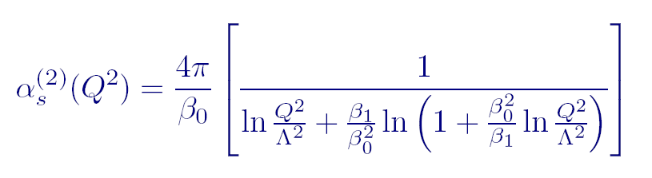
From QCD to An effective theory
QCD Lagrangian
50-100 MeV from ChPT
Running coupling constant
Non-perturbative in low-energy regime

Slide 5
From QCD to An effective theory
Light quark systems: QCD in the Chiral limit, i.e. Quark masses → 0
Global Symmetries:

Slide 6
From QCD to An effective theory
Light quark systems: QCD in the Chiral limit, i.e. Quark masses → 0
Global Symmetries:
Requires all current quark masses to be equal in order to be exactly fulfilled
Requires all current quark masses to be zero in order to be exactly fulfilled

Slide 7
From QCD to An effective theory
General wisdom about QCD
Irred. Representations
Octet
Decuplet
Antidecuplet...
Chiral symmetry
No multiplets
Spontaneous breakdown of chiral symmetry
dynamically generated quark mass m→M
dynamical mass M~(350-400) MeV
Massless Goldstone Bosons (pions)
Chiral quark condensate

Slide 8

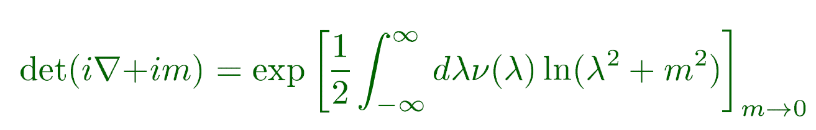
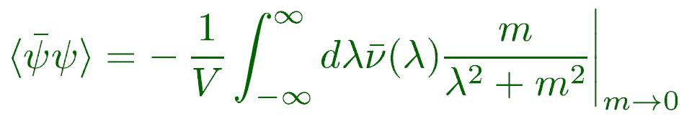
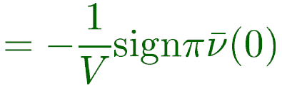
From QCD to An effective theory
Chiral symmetry and its spontaneous breaking
Banks-Casher theorem
Zero-mode spectrum
This zero mode can be realized
from the instanton vacuum

Slide 9
Simplest effective chiral Lagrangian
Does not work
Does work
Chiral Quark Model (ChQM):
Any model that has SCSB must have this kind of a form!!!

Slide 10
Eff. Chiral Action from the instanton vacuum
Derivation of ChQM from QCD via Instantons by Diakonov and Petrov
Extended by
M.Musakhanov,HChK, M.Siddikov
Dynamical quark mass
(Constituent quark mass)
Model-dependent,
gauge-dependent

Slide 11
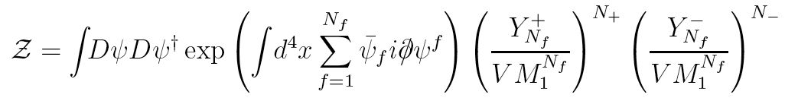
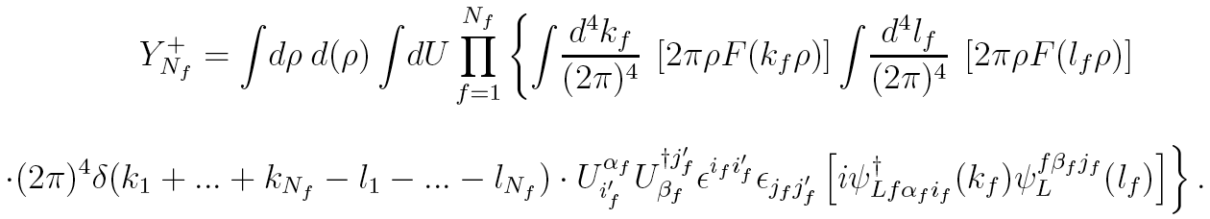
Eff. Chiral Action from the instanton vacuum
Effective QCD action via instanton
Instanton induced partition function (instanton ensemble)
t’Hooft 2Nf-interaction
d(ρ): instanton distribution, U: Color orientation, x: coordinate

Slide 12
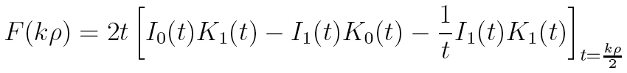
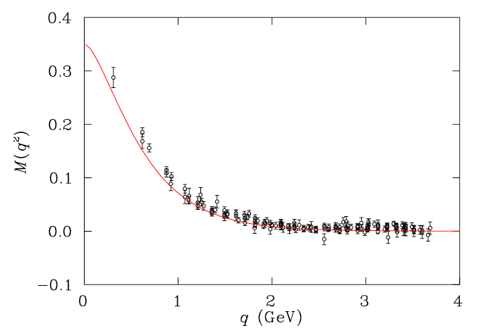
Eff. Chiral Action from the instanton vacuum
Momentum-dependent quark mass
M(k) induced via quark-instaton
Fourier transform of the zero mode solution → F(k) Diakonov & Petrov
Lattice data from
P.O. Bowman et al., Nucl. Phys. Proc. Suppl.
128, 23 (2004)

Slide 13
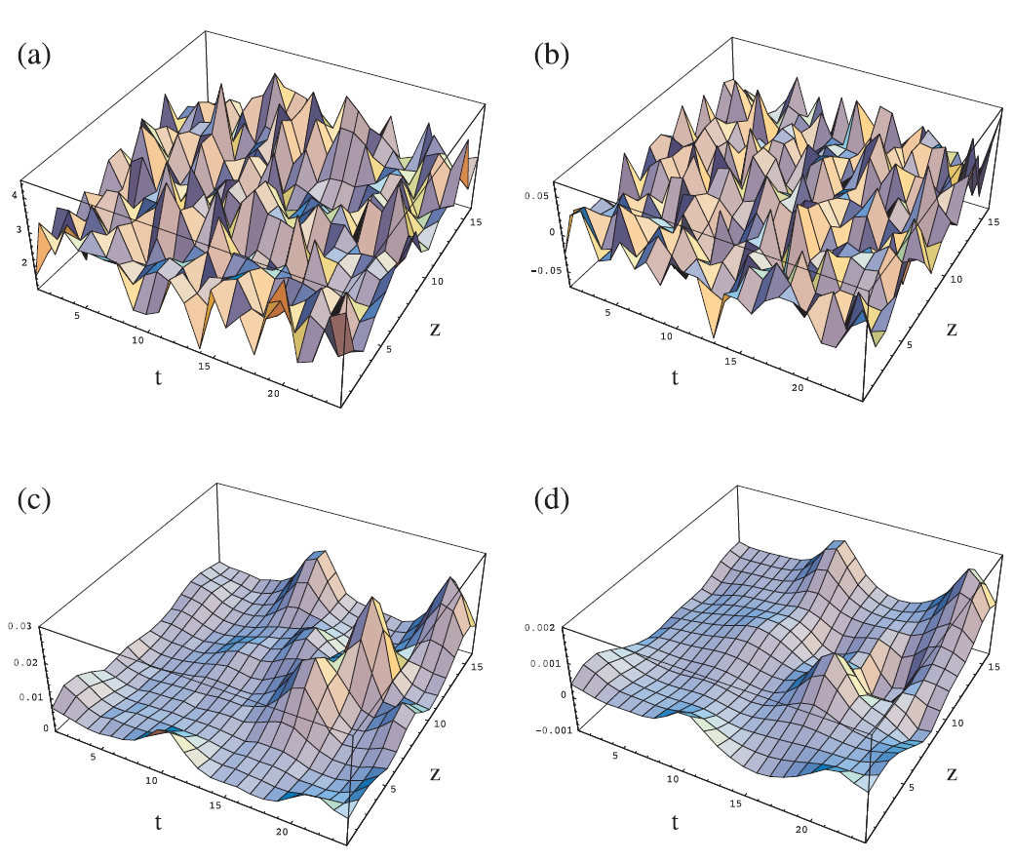
From lattice QCD: After cooling
Chu et al., PRL 70, 225 (1993)
Instantons
Anti-instantons

Slide 14
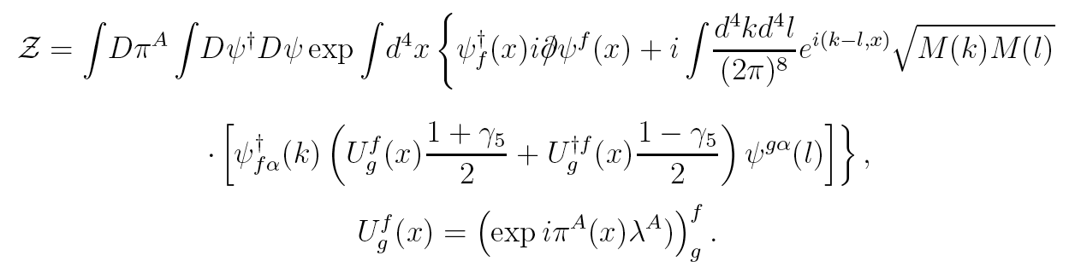
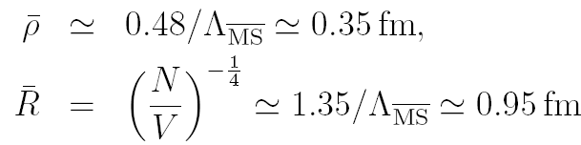
Low-energy effective QCD partition function
Effective Low-energy Partition function from the instanton vacuum
This partition function is our starting point!
There is basically no free parameter:
Λ QCD=280 MeV
ρ/R = 1/3

Slide 15
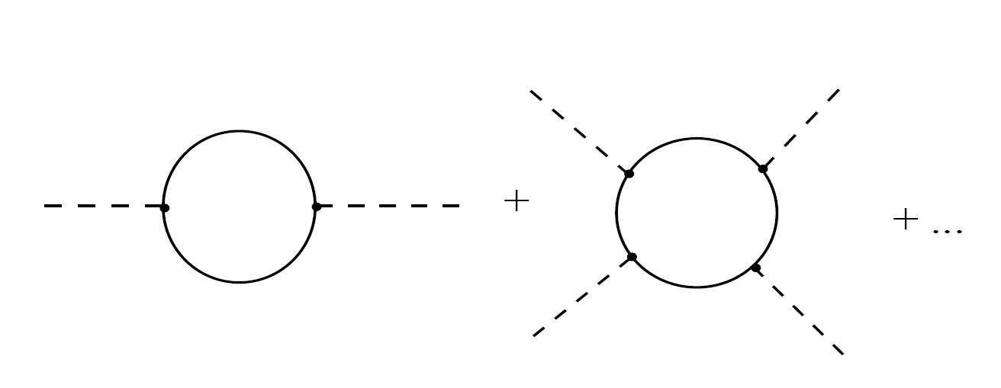
Effective chiral action
Effective Chiral Lagrangian and LECs
Derivative expansions
Weinberg term
Gasser-Leutwyler terms
H.A. Choi and HChK, PRD 69, 054004 (2004)

Slide 16
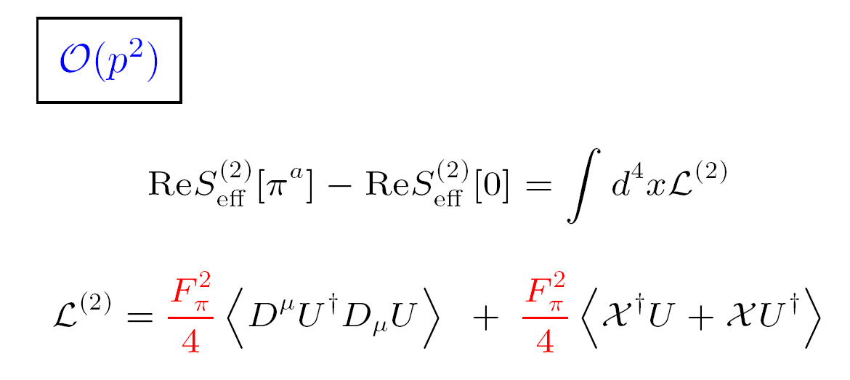
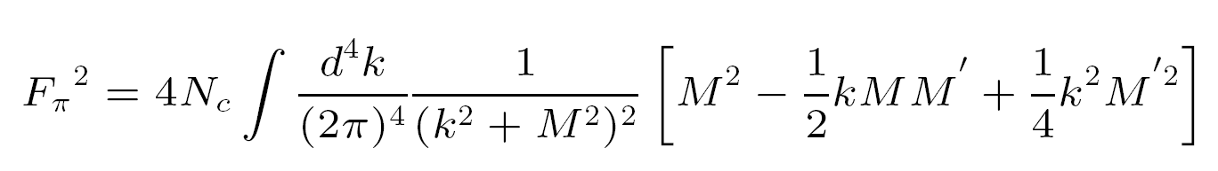
Effective chiral action
Weinberg Lagrangian
H.A. Choi and HChK, PRD 69, 054004 (2004)

Slide 17
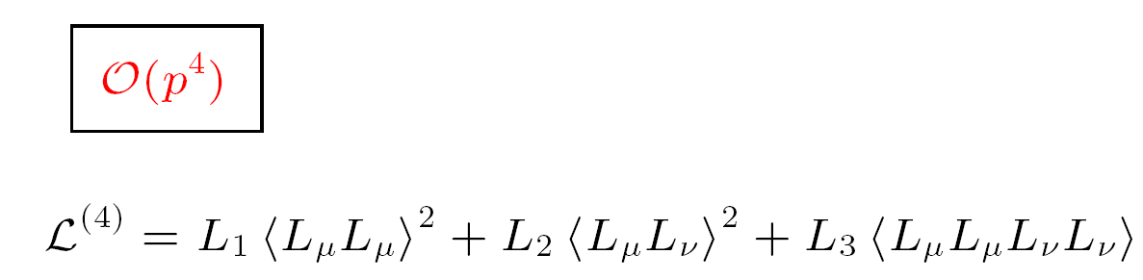
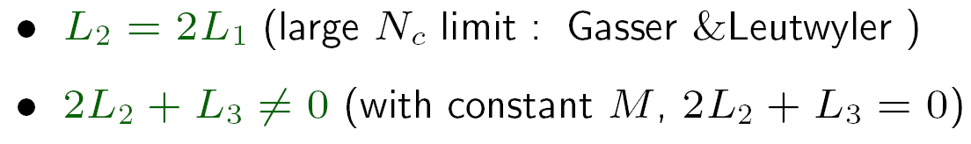
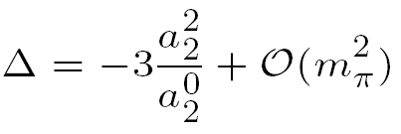
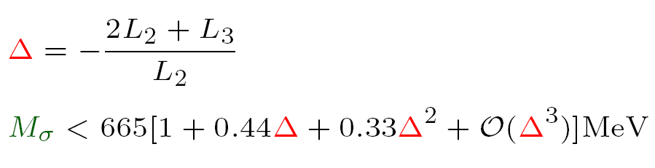
Effective chiral action
Gasser-Leutwyler Lagrangian
M.Polyakov and Vereshagin,
Hep-ph/0104287
H.A. Choi and HChK, PRD 69, 054004 (2004)

Slide 18
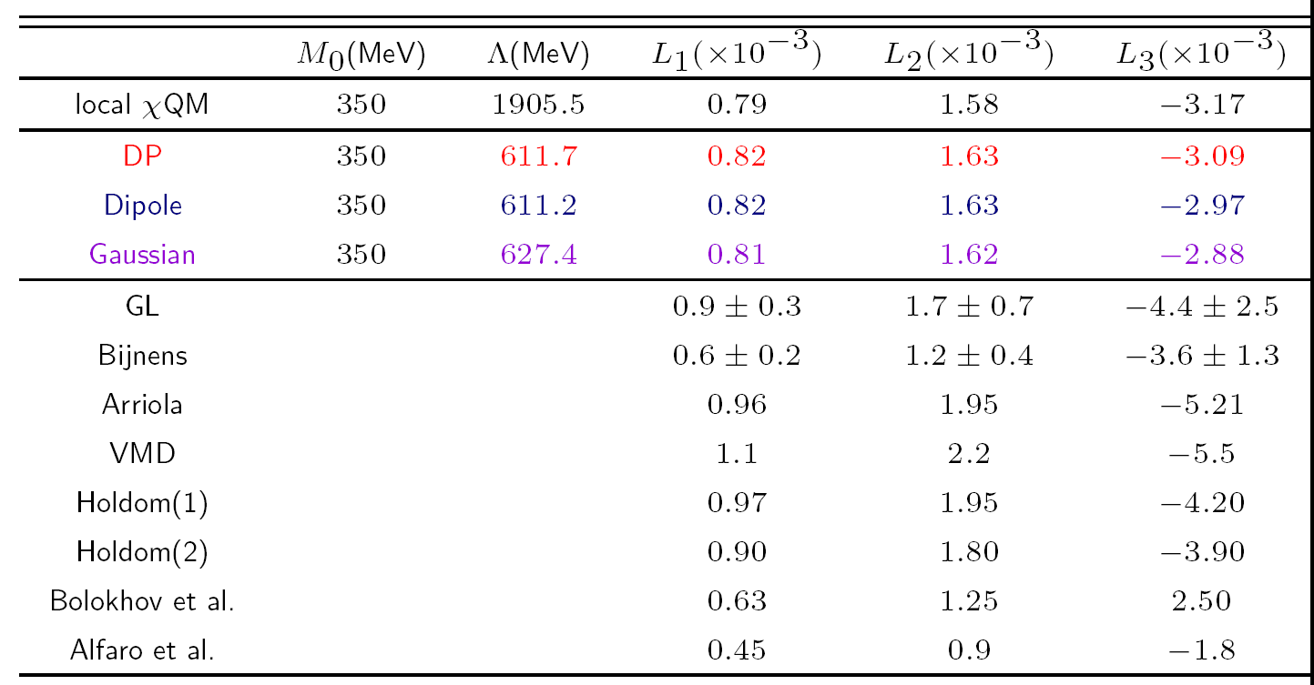
Effective chiral action
Gasser-Leutwyler Lagrangian
H.A. Choi and HChK, PRD 69, 054004 (2004)

Slide 19
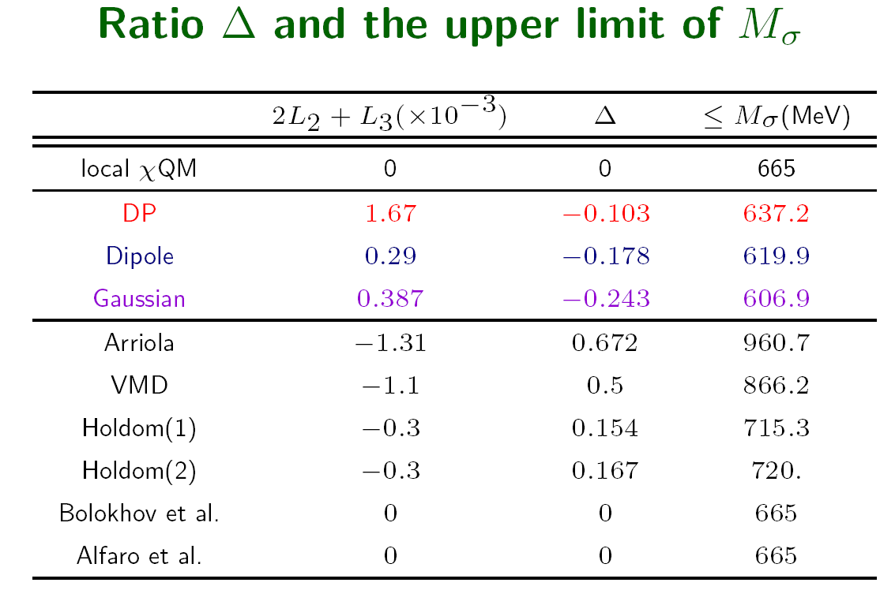

Effective chiral action
Gasser-Leutwyler Lagrangian
H.A. Choi and HChK, PRD 69, 054004 (2004)

Slide 20
Effective chiral action
We also derived the effective weak
chiral Lagrangians ( ΔS=0,1,2)
M. Franz, HChK, K. Goeke, Nucl. Phys. B 562, 213 (1999)
M. Franz, HChK, K. Goeke, Nucl. Phys. A 699, 541 (2002)
H.J. Lee, C.H. Hyun, C.H. Lee, HChK, EPJC45, 451(2006)

Slide 21
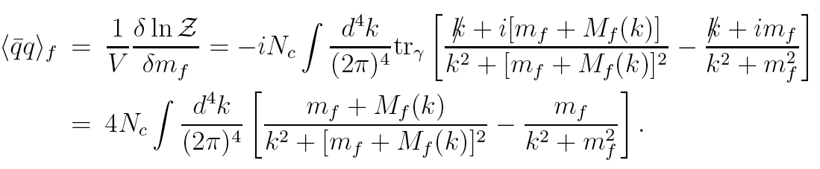
QCD vacuum properties
Quark condensates
Order parameter for spontaneous chiral symmetry breaking ⟨iq⁺q⟩
S.i.Nam and HChK, Phys.Lett. B 647, 145 (2007)

Slide 22


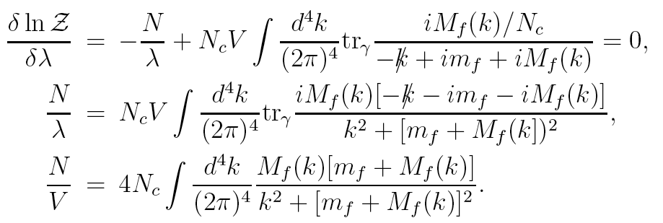
QCD vacuum properties
Gluon condensate
Nonzero due to nonperturbative vacuum fluctuation
Saddle-point (self-consistent) equation
From this constraint, M_{f}(0)=M₀=350 MeV in the chiral limit
S.i.Nam and HChK, Phys.Lett. B 647, 145 (2007)

Slide 23
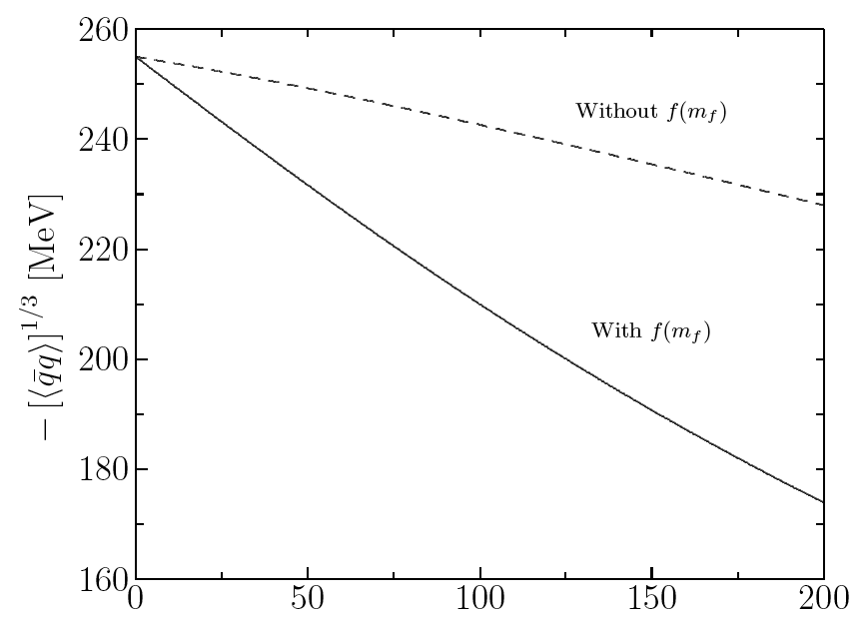
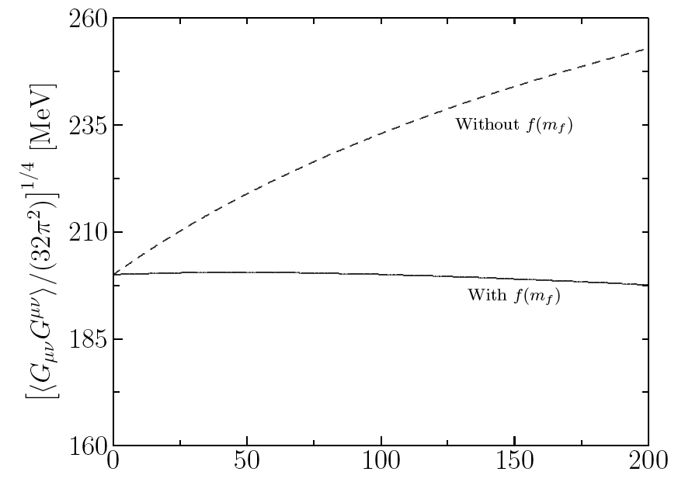
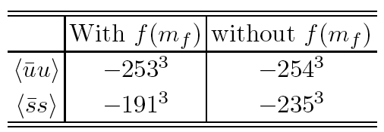
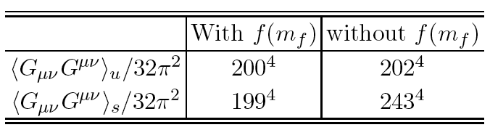
QCD vacuum properties
Numerical results
Quark condensate
Gluon condensate
S.i.Nam and HChK, Phys.Lett. B 647, 145 (2007)

Slide 24


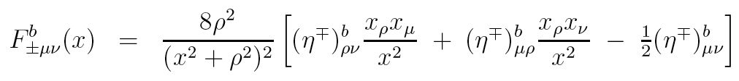

QCD vacuum properties
Quark-gluon mixed condensate
Another order parameter:
Related to ⟨k⊥⟩ of the pseudoscalar meson wf.
Color-flavor matrix convoluted with single instanton (singular gauge)
Gluon field strength in terms of quark and instanton
Quark-gluon Yukawa vertex → instanton-quark
S.i.Nam and HChK, Phys.Lett. B 647, 145 (2007)

Slide 25
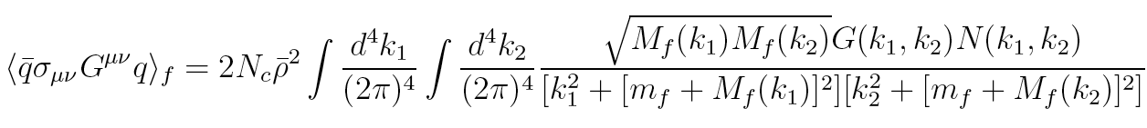
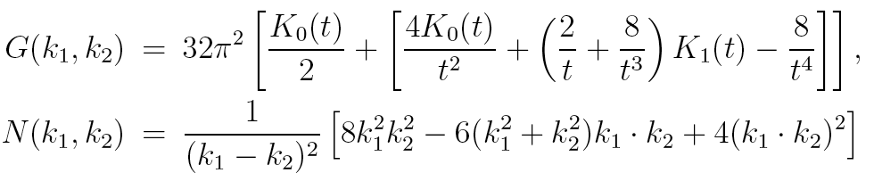
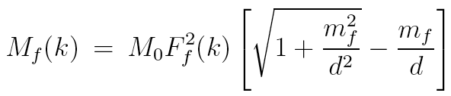
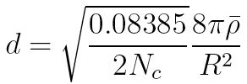

QCD vacuum properties
Quark-gluon mixed condensate
S.i.Nam and HChK, Phys.Lett. B 647, 145 (2007)

Slide 26
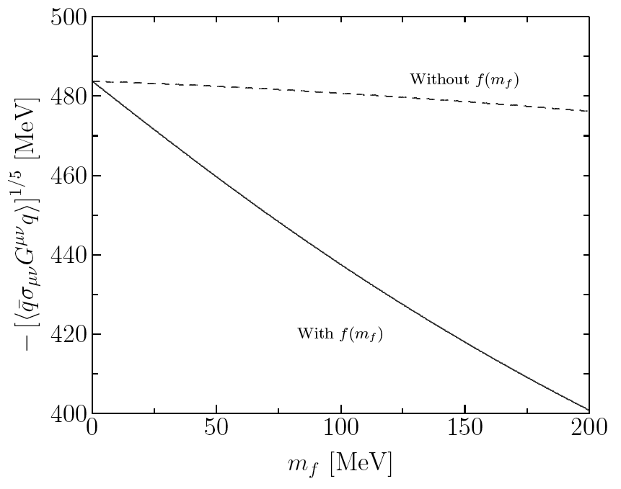
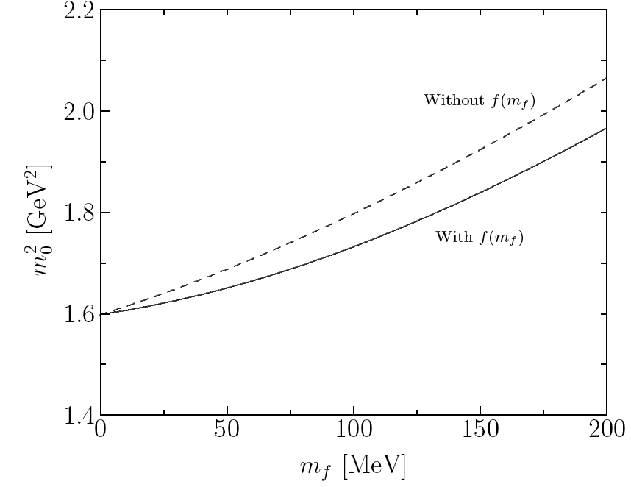

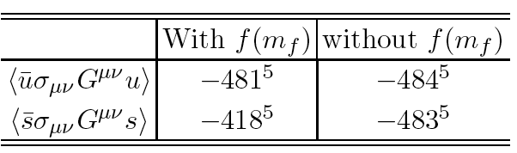
QCD vacuum properties
Numerical results
Mixed condensate
Ratio of condensates
S.i.Nam and HChK, Phys.Lett. B 647, 145 (2007)

Slide 27
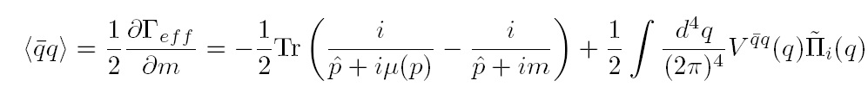
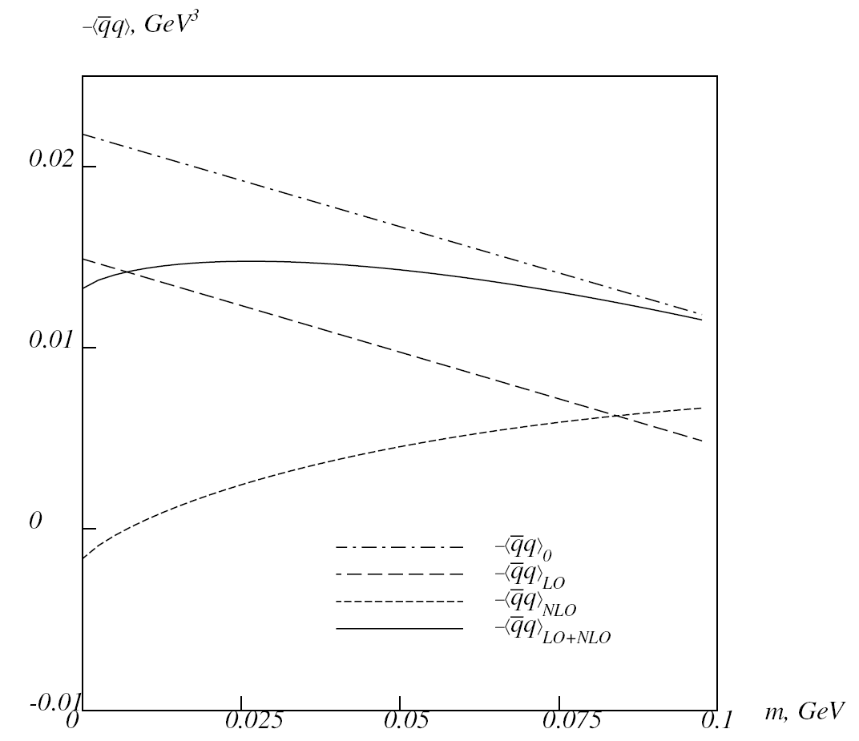
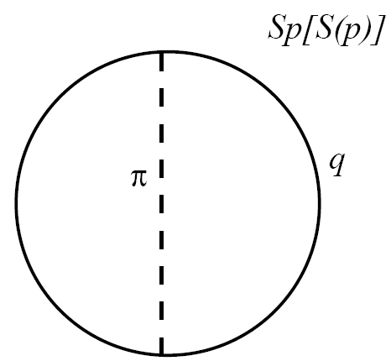
QCD vacuum properties
Quark condensate with meson-loop corrections
With meson-loop corrections
HChK, M.Musakhanov, M.Siddikov, PLB 633, 701 (2006)

Slide 28
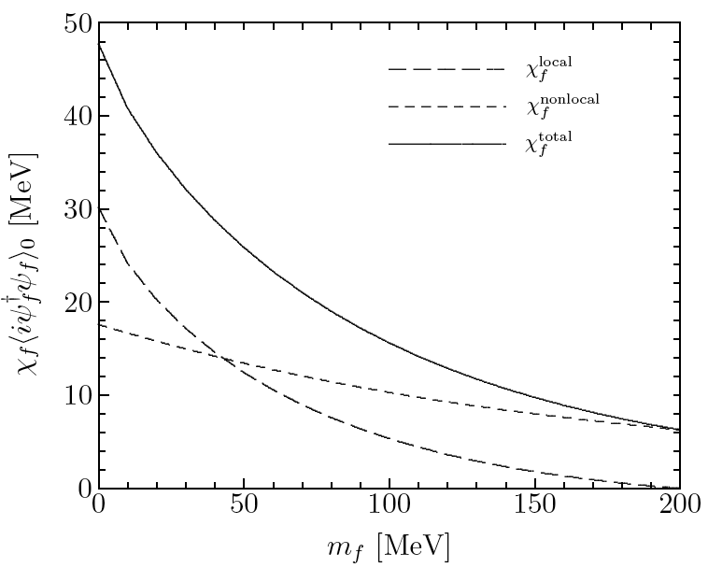
QCD vacuum properties
Magnetic susceptibility of QCD vacuum
Magnetic response of the QCD vacuum to the external EM field
Related to the normalization of photon light-cone W.F.
HChK, M.Musakhanov, M.Siddikov, PLB 608, 95 (2005)

Slide 29
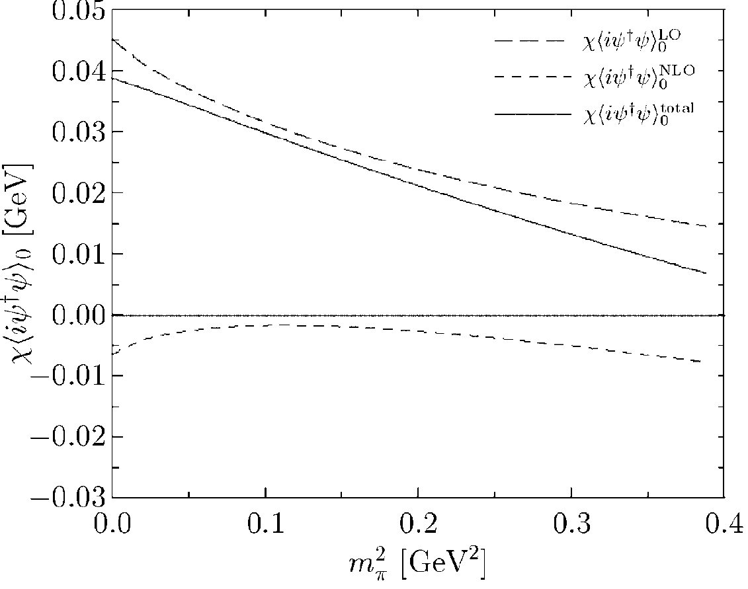
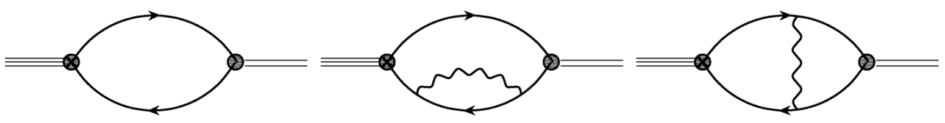
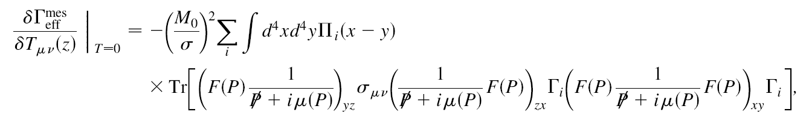
QCD vacuum properties
Magnetic susceptibility of QCD vacuum
with meson-loop corrections
Almost linearly decreased
with meson-loop corrections
Goeke, Siddikov, Musakhanov, HChK, PRD, 76, 116007 (2007)

Slide 30

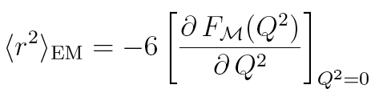
Mesonic properties
Meson electromagnetic form factors
Important physical quantity for understanding meson structure
EM current for the pseudoscalar meson
Charge radius for the pseudoscalar meson
SiNam and HChK, PRD 77, 094014 (2008)

Slide 31
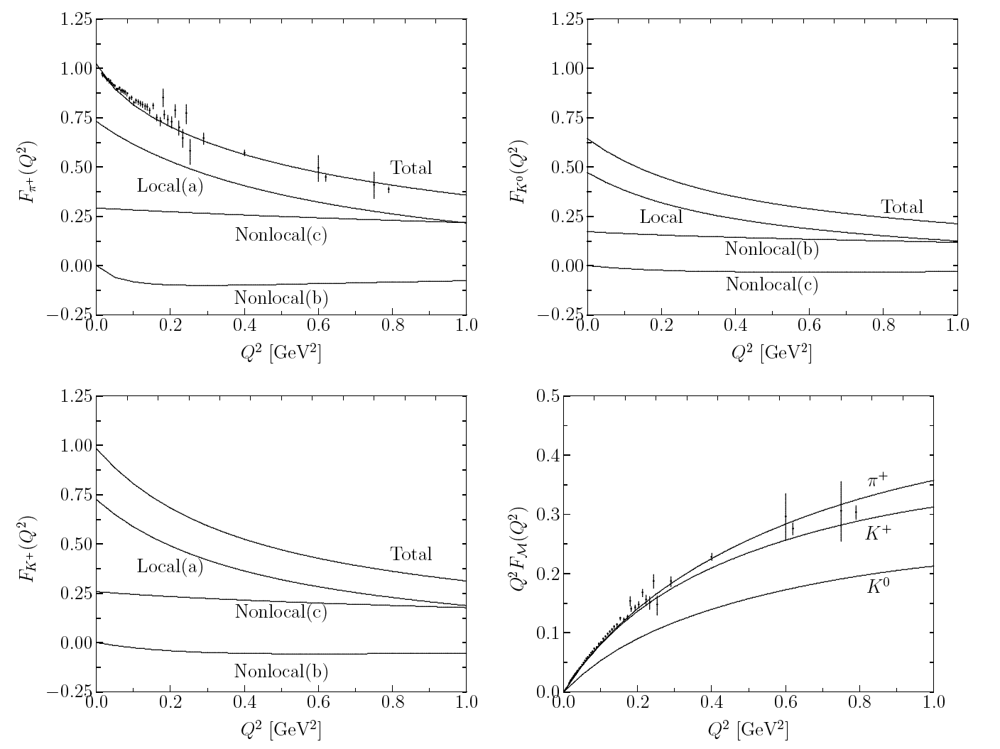
Mesonic properties
Meson electromagnetic form factors
Numerical results for π⁺, Κ⁺ and Κ⁰
SiNam and HChK, PRD 77, 094014 (2008)

Slide 32
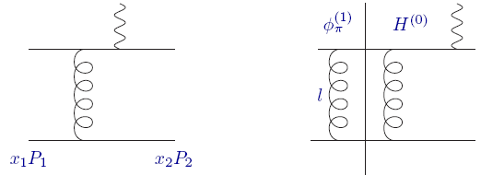
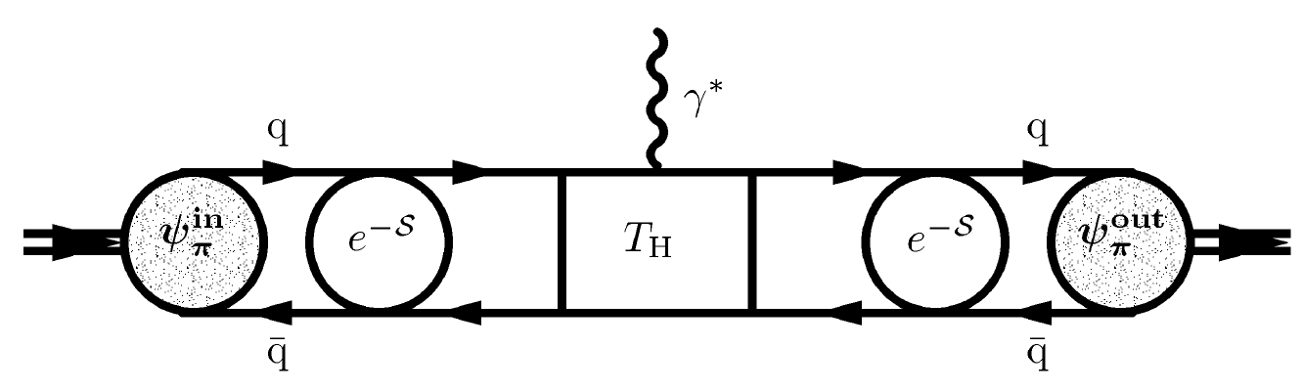
Pion EM form factor
Sudakov FF
Hard Part
Soft part: pion WF

Slide 33
Mesonic properties
How the quark and antiquark
carry the momentum fraction
of the mesons in
q
q
Leading-twist meson DAs

Slide 34
Mesonic properties
Leading-twist meson DAs
Two-particle twist-three meson DAs

Slide 35
Mesonic properties
Pion DA
Kaon DA
SiNam, HChK, A.Hosaka, M.Musakhanov,
Phys.Rev.D74,014019 (2006)

Slide 36
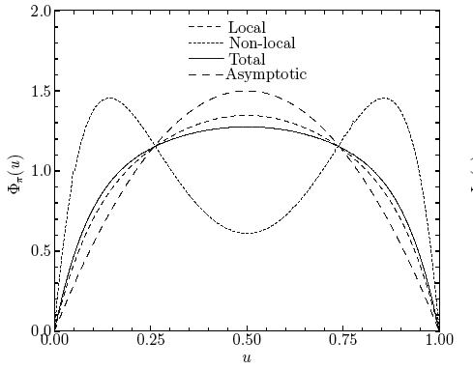
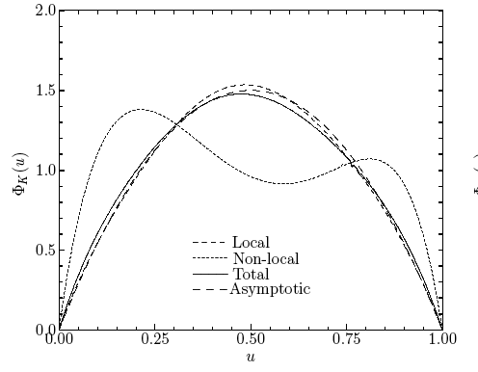
Mesonic properties
Pion
Kaon
SiNam and H.-Ch.Kim, Phys.Rev.D74, 076005 (2006)

Slide 37
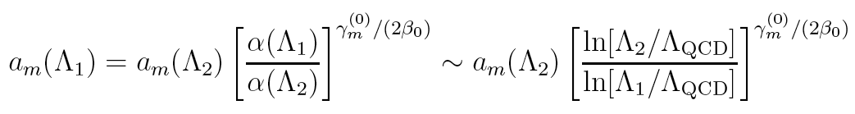
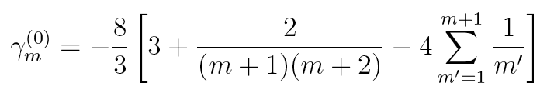
1-loop QCD evolution equation
Mesonic properties
Schmedding and Yakovlev scale: at 2.4 GeV
CLEO Experiment: PRD 57, 33 (1998)
SiNam and H.-Ch.Kim, Phys.Rev.D74, 076005 (2006)

Slide 38

Mesonic properties
2s
ellipsis
SiNam and H.-Ch.Kim, Phys.Rev.D74, 076005 (2006)

Slide 39


Mesonic properties
Kaon Semileptonic decay (K_{l3})
Decay process in terms of electroweak interaction
Flavor changing process for SU(3) symmetry breaking (s→d,u)
Useful in testing validity of models concerning low energy theorems
Decay amplitude defined by
Cabbibo-Maskawa-Kobayashi (CMK) matrix element ~ sinθ_{c}
SiNam and HChK, PRD 75, 094011 (2007)

Slide 40


Mesonic properties
Vector and scalar form factors for decay (K_{l3})
Weak current and Flavor changing matrix element
where t indicates the momentum transfer by W-boson
Decay form factor in terms of scalar and vector form factors
where the scalar form factor is defined by
SiNam and HChK, PRD 75, 094011 (2007)

Slide 41

Mesonic properties
Low energy constants related to K_{l3}
SiNam and HChK, PRD 75, 094011 (2007)

Slide 42


Mesonic properties
Low energy constants related to K_{l3}
Low energy constant L₅ in the large N_{c} limit
Low energy constant L₉ in the large N_{c} limit ~ Callam-Treiman Theorem
L₅ = 1.6~2.0×10⁻³ (exp)
L₉ = 6.7~7.4×10⁻³ (exp)
SiNam and HChK, PRD 75, 094011 (2007)

Slide 43

Mesonic properties
Ratio of f₊(t)/f₊(0) for K_{l3}
Almost linear
Well consistent with data
λ₊ = 0.0303 (0.0296 by PDG)
SiNam and HChK, PRD 75, 094011 (2007)

Slide 44

Mesonic properties
Test of the low energy theorems
Ademollo-Gatto theorem
F_{K}/F_{π} =1.08 (1.22 exp)
L₅ = 7.67×10⁻⁴ (1.45×10⁻³) !!!
L₉ = 6.78×10⁻³ (6.9 ~ 7.4×10⁻³)
SiNam and HChK, PRD 75, 094011 (2007)

Slide 45
Instanton at finite density (μ)
Considerable successes in the application of the instanton vacuum
Extension of the instanton model to a system at finite ρ and T
QCD phase structure: nontrivial QCD vacuum: instanton
at finite density
· Simple extension to the quark matter:
· Breakdown of the Lorentz invariance at finite temperature
Future work!
· Instanton at finite temperature: Caloron with Polyakov line
· Very phenomenological approach such as the pNJL
· Using periodic conditions (Matsubara sum)
Focus on the basic QCD properties at finite quark-chemical potential, μ

Slide 46






Instanton at finite density (μ)
Modified Dirac equation with μ
Instanton solution (singular gauge)
Assumption:
No modification from μ
Zero-mode equation

Slide 47




Instanton at finite density (μ)
Quark propagator with the Fourier transformed zero-mode solution,

Slide 48





Instanton at finite density (μ)
Schwinger-Dyson-Gorkov equation (N_{f}=2, N_{c}=3)
G.W.Carter and D.Diakonov,PRD60,016004 (1999)

Slide 49


M₀, Δ, and <iq⁺q> (N_{f}=2)
1st order phase transition occurred at μ ~ 320 MeV
Metastable state (mixing of σ and Δ) ignored for simplicity here
chiral condensate with μ
NG
phase
CSC
phase
CSC
phase
NG
phase

Slide 50


Magnetic susceptibility at finite μ
QCD magnetic susceptibility with externally induced EM field
Only for the NG phase!!
Magnetic phase transition of the QCD vacuum
Effective chiral action with tensor source field T
Evaluation of the matrix element
SiNam. HYRyu, MMusakhanov and HChK, arXiv:0804.0056 [hep-ph]

Slide 51



Magnetic susceptibility at finite μ
NG
phase
CSC
phase
CSC
phase
Magnetic
phase transition
NG
phase
1st order magnetic phase transition at μ_{c}

Slide 52



Pion weak decay constant at finite μ
Pion-to-vacuum transition matrix element
Separation for the time and space components
Effective chiral action with μ
Renormalized auxiliary pion field corresponding to the physical one
SiNam and HChK, PLB 666, 324 (2008)

Slide 53

Pion weak decay constant at finite μ
Effective chiral action with axial-vector source
Using the LSZ (Lehmann-Symanzik-Zimmermann) reduction formula

Slide 54


Pion weak decay constant at finite μ
Analytic expression for the pion weak decay constant

Slide 55



Pion weak decay constant at finite μ
Local contributions
Nonlocal contributions
When the density switched off,

Slide 56


Pion weak decay constant at finite μ
Time component > Space component

Slide 57



Pion weak decay constant at finite μ
Comparison with the in-medium ChPT
K.Kirchbach and A.Wirzba, NPA616, 648 (1997)
F ^{s} / F ^{t} < 0.5
Critical p-wave contribution
Comparison with the QCD sum rules
(H.c.Kim and M.Oka, NPA720, 386 (2003))

Slide 58



Pion weak decay constant at finite μ
GOR relation satisfied
within the present framework
Changes of the pion properties with μ

Slide 59


Pion EM form factor at finite μ

Slide 60

Pion EM form factor at finite μ
At finite density

Slide 61





Pion EM form factor at finite μ
Charge radius of the pion
Pion form factor with VMD
: Modification of the rho meson mass

Slide 62


Pion EM form factor at finite μ
Charge radius of the pion
More than two times
increased

Slide 63

Pion EM form factor at finite μ
Coupling constant C*
Almost two times
increased

Slide 64



ρ meson mass dropping at finite μ
Modification of the Width
has not been considered!
Slightly smaller than
Hatsuda & Lee, PRC 46, 34 (1992)

Slide 65
Summary and outlook
The nonlocal chiral quark model from the instanton vacuum is shown to be very successful in describing low-energy properties of mesons and
(baryons).
We extended the model to study the QCD vacuum and pion properties at finite μ :
QCD magnetic susceptibility: 1st-order magnetic phase transition
Pion weak decay constant at finite density: p-wave contribution?
Pion EM form factors and ρ meson mass dropping (not complete!)
Perspectives
Systematic studies for nonperturbative hadron properties with μ
Several works (effective chiral Lagrangian, LEC..) under progress
Extension to the finite T (Dyon with nontrivial holonomy, Caloron)

Slide 66
Though this be madness, yet there is method in it.
Hamlet Act 2, Scene 2
Thank you very much!

