Slide 1
Study of plastic scintillators for fast neutron measurements
Mihee Jo*, B. Hong, R. J. Hu, C. Kim, K. S. Lee
Nuclear Physics Laboratory
Korea University

Slide 2
Contents
Introduction & motivation
Experimental setup
Pulse analysis
GEANT4 simulation
Potential application to the neutron camera
Conclusions

Slide 3
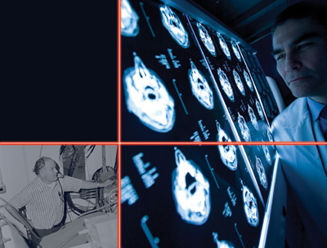
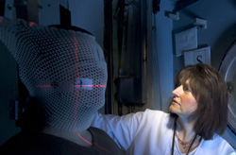
Introduction & motivation
Fast neutrons are applied for the treatment of the human cancers, material science and biology.
Neutrons have a higher biological effectiveness than both photons and protons.
Neutrons are especially effective against advanced tumors like head, neck and prostate cancer.
Notes:
왼쪽 아래 : 1975 년에 Fermilab에서 Linac을 만든 Don young 이라는 과학자의 모습.
오른쪽 : Fermilab의 neutron therapy facility에서 치료를 위해 뇌 영상을 관찰하는 모습. Northern lllinois 대학의 medical director.

Slide 4
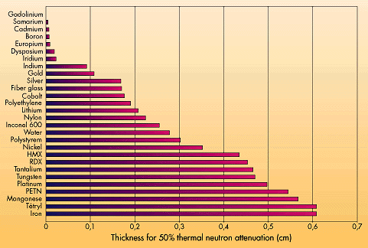
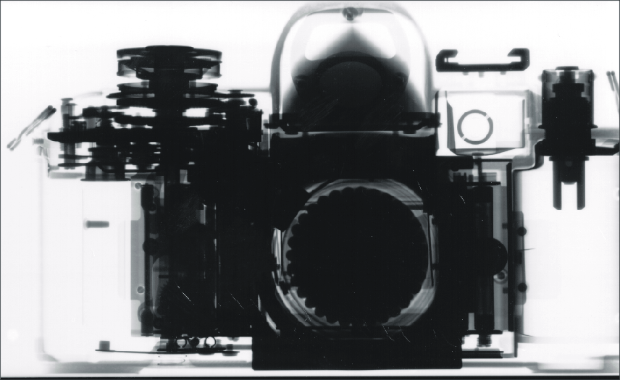
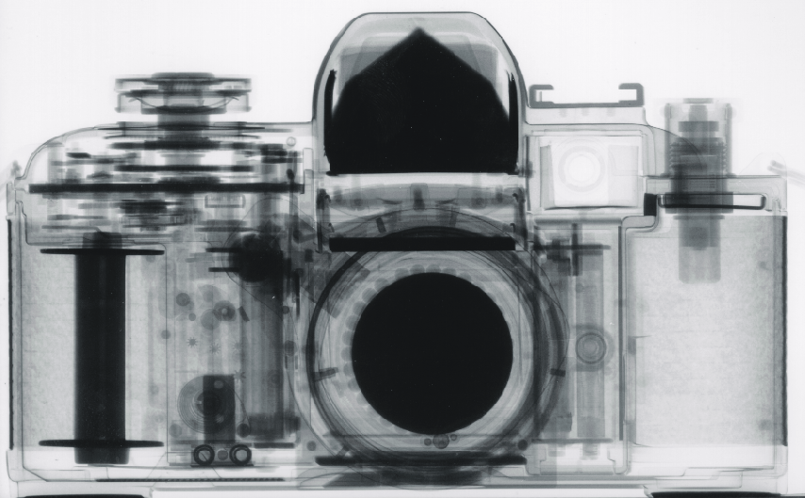
Introduction & motivation
Neutron radiography is used to find out slight defect in materials.
Comparison of X-Ray and Neutron Radiography
Notes:
X-ray는 널리 사용되어왔지만, 크기 감쇄정도가 밀도가 높은 물질일수록 커지고, x-ray가 통과 가능한 얇은 물질에 대해서만 사용될 수 있었다. 중성자는 꽤 두꺼운 금속 물질들도 쉽게 통과할 수 있다. 그래서 사진으로 찍으면 그냥 통과한 부분은 어둡고, 다른 가벼운 원자로 만들어진 물질들이 통과한 부분은 밝게 찍힌다.

Slide 5
Introduction & motivation
Fast neutron – proton elastic scattering can be applied to reconstruction of the neutron tracks emitted from sources.
Elastic scattering produces an energetic proton, which can be measured by proton-rich organic scintillators.
It will be important to diagnose the characteristics of the plastic scintillators for the measurement of fast neutrons.

Slide 6
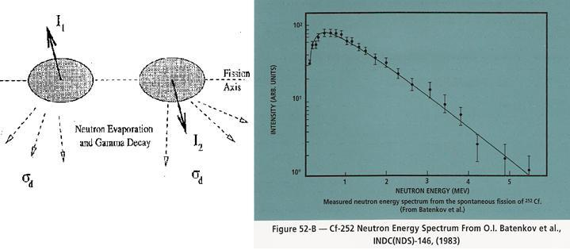
Experimental setup
A 5μCi ²⁵²Cf was used for the energy measurements.
Branching ratio for fission = 0.0309
Branching ratio for α-decays = 0.969
The fission decay was triggered by either neutron or γ-ray emitted from the fission fragments.
Notes:
Fission이 일어난 후 두 개의 fragment에서 평균 3.78개의 고속중성자와 2개의 감마선이 방출됨.
직선 화살표 : 스핀, 점선 화살표 : 중성자 방출

Slide 7
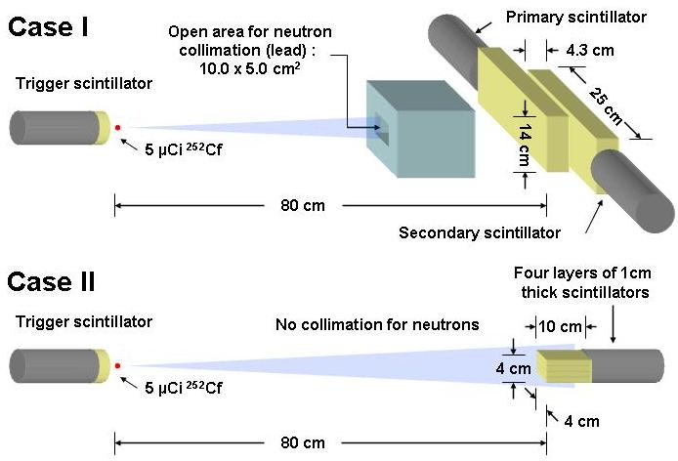
Experimental setup
Case Ⅰ
2 scintillators were used for full absorption.
Neutron events were triggered by trigger scintillator & primary scintillator.
Case Ⅱ
4 layered scintillator with 1-cm-thick plate were used for high efficiency and resolution.
Because of small detectable range, no collimator in front of the 4 layered scintillators.
60 cm

Slide 8
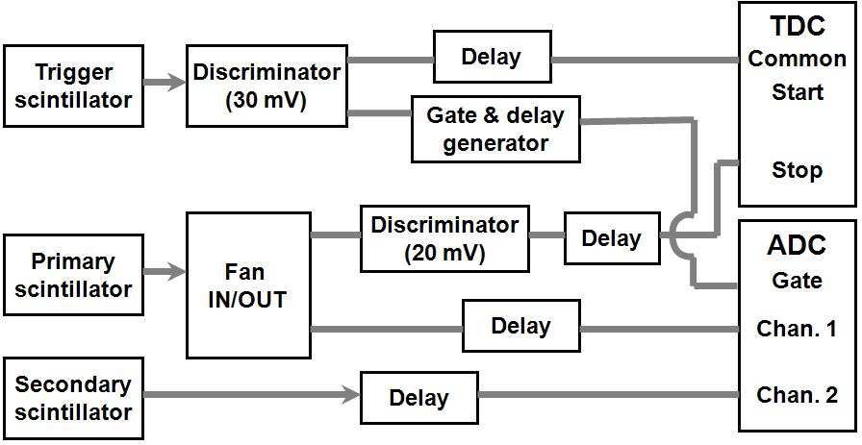
Experimental setup
Neutron energy measured by the TOF
T=Arrival time of neutron
L=Distance between the source and the neutron detector
T_{s}=Conversion factor of TDC (0.2651 ns/ch)
T₀=Time offset
Uncertainties for the neutron energy measurement
Uncertainty of the flight distance caused by the finite thickness of the detectors.
Uncertainty of the flight-time caused by finite time resolution of the test system.
Notes:
A가 calibration factor 인데, 실험을 통해서 얻은 값인지, 문헌에서 찾은 값인지?
T_{s} : Scale factor of TDC
T₀ : trigger, primary 검출기 사이에 선원을 놓고 바짝 붙여서 측정한 절대적인 시간차이

Slide 9
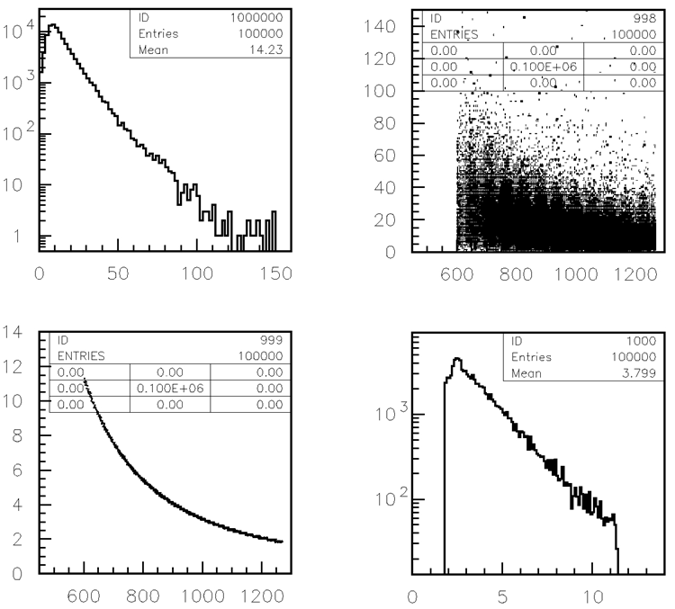
Experimental setup
Selection of the neutron energy : 2 < E_{n}< 7.5 MeV
E_{n} > 7.5 MeV : the contamination of the gamma rays emitted from α and fission decays.
E_{n} < 2 MeV : excluded to minimize the perversion in the neutron-energy spectra due to the threshold on the pulse height (30 mV).
Counts
ADC channel
γ removed
ADC channel
TDC channel
Neutron energy (MeV)
Counts
TDC channel
Neutron Energy (MeV)
Notes:
삭제된 감마선은 primary 검출기에 감마선이 검출된 경우에 대한 것.
(중성자보다 빨리 검출기에 도착한다)

Slide 10
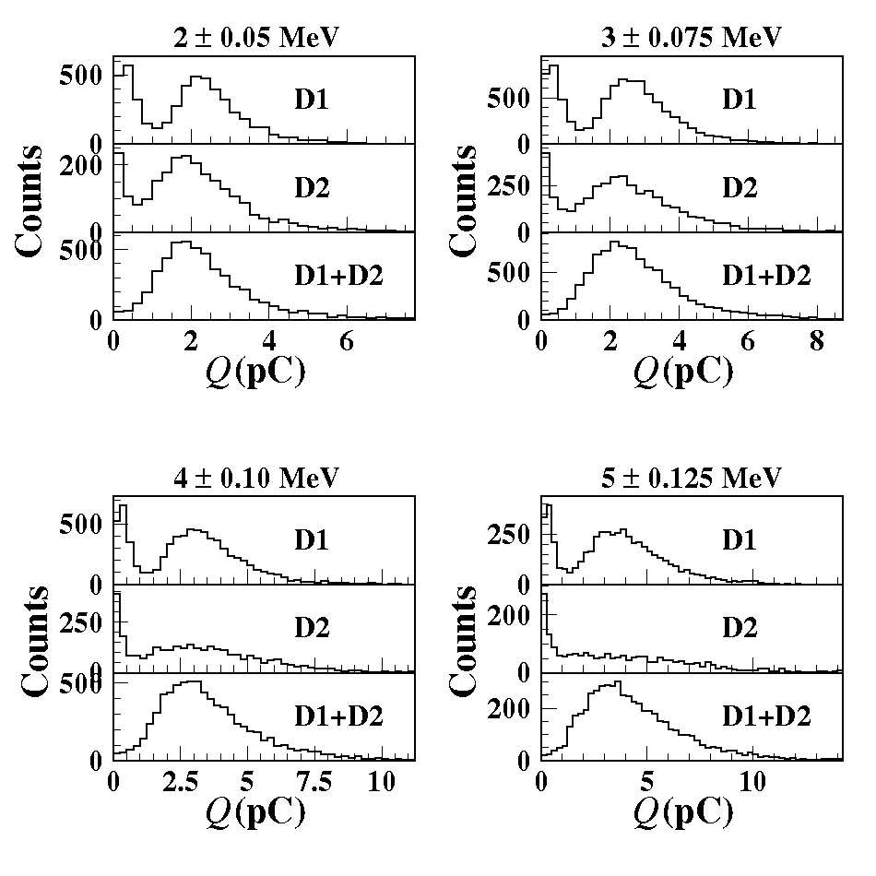
Pulse analysis
Pulse spectra of the fast neutrons (Case Ⅰ)
Energy distribution of primary detector
Energy is deposited partially.
Energy distribution of secondary detector
The rest energy is fully absorbed.
Total energy distribution
At higher neutron energies, energy resolution is worse, and distribution is broader.

Slide 11
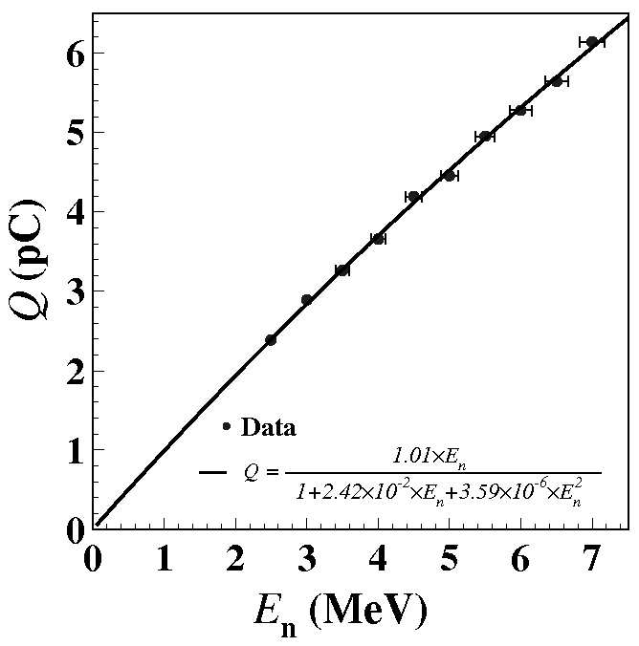
Pulse analysis
Neutron energy dependence of total light output (Case Ⅰ)
Birk’s formula
dL/dx : (light output) / (unit length)
A : absolute scintillation efficiency
kB, B : parameter relating the density of ionization centers to dE/dx
Approximately linear, but small amount of non-linearity exist.
Notes:
Birk 식의 상수값들이 어떻게 계산된 값인지 알아보기.
(다른 책에서 본 것과 단위가 다른 것 같음..)
Astroparticle physics 논문의 proton scattering에 의한 값하고는 어떻게 비교할 수 있는건지?
그래프는 정확한 birk 식이 아님.
E_{n}의 의미는 입사된 중성자의 에너지. Primary에 입사된 중성자의 에너지에 따른 신호의 세기를 보려고 한 것.

Slide 12
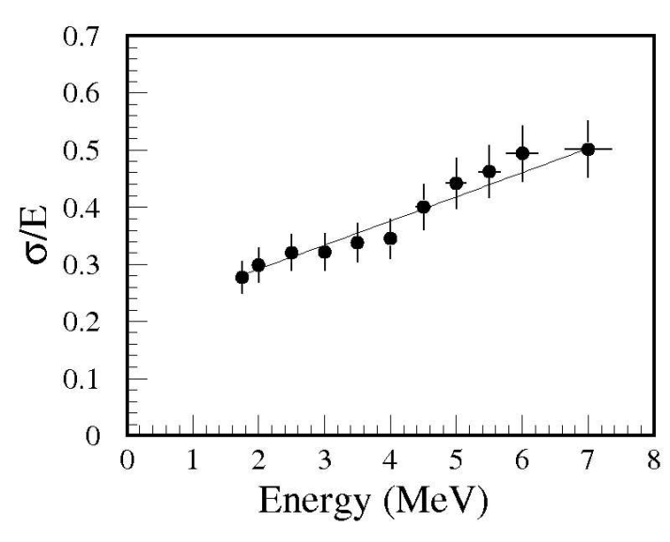
Pulse analysis
Energy resolution of the D1 (Case Ⅰ)
At higher neutron energies, poorer resolutions occur.
The number of fully absorbed neutron decreases.
Light collection efficiency decreases as multiple scattering increases.
Any other reasons?
Probably, other scattering processes affect the light yield.

Slide 13
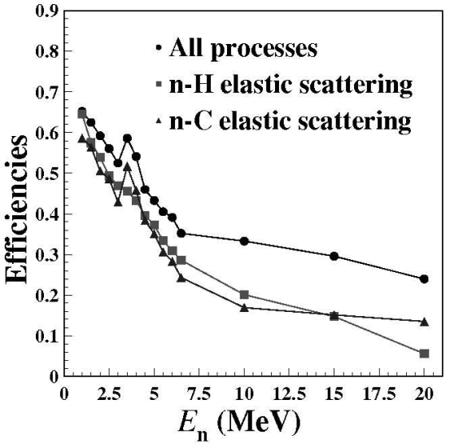
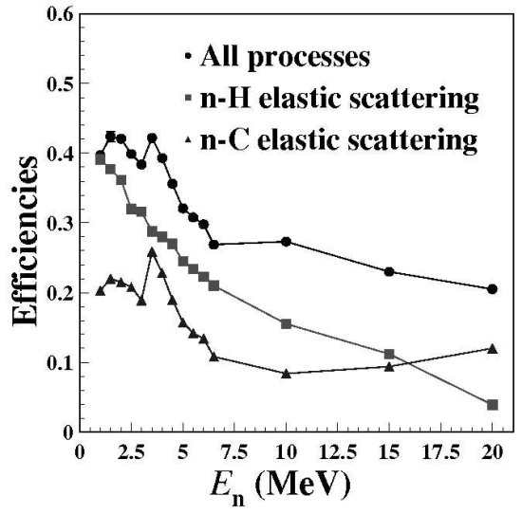
GEANT4 simulation
Sensitivities was predicted as a function of the neutron energy
At higher neutron energies, n-¹²C scattering occurs more frequently.
Total light yield can be reduced because the kB value for n-¹²C scattering is lager than n-p scattering. → Poorer resolutions!
Case Ⅰ
Case Ⅱ
Notes:
case 2는 부피가 작아서 full absorption 할 확률이 더 낮다.
Efficiency : GEANT4에서 particle gun에서 나온 중성자가 각 경우마다 primary detector 등에 deposit 되는 효율

Slide 14
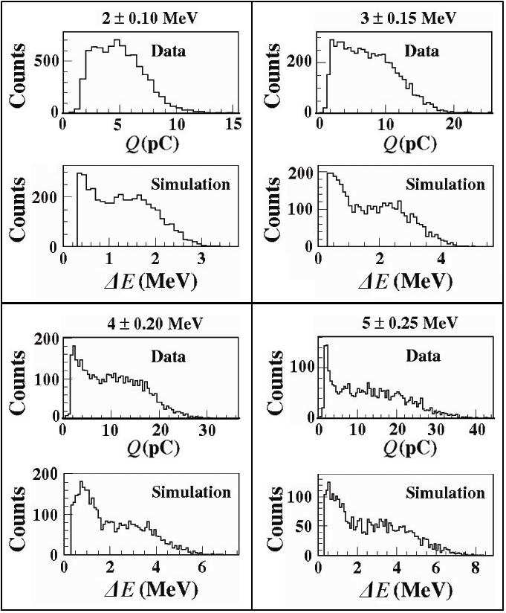
GEANT4 simulation
Deposit energies of the fast neutrons and the comparisons to the pulse spectra
Simulation’s peak becomes narrower in data
Origin of discrepancies between the data and the simulations
Difference in the light yields between p and ¹²C.
The difference becomes larger at the lower neutron energies, because of the threshold effect.
Case Ⅱ

Slide 15
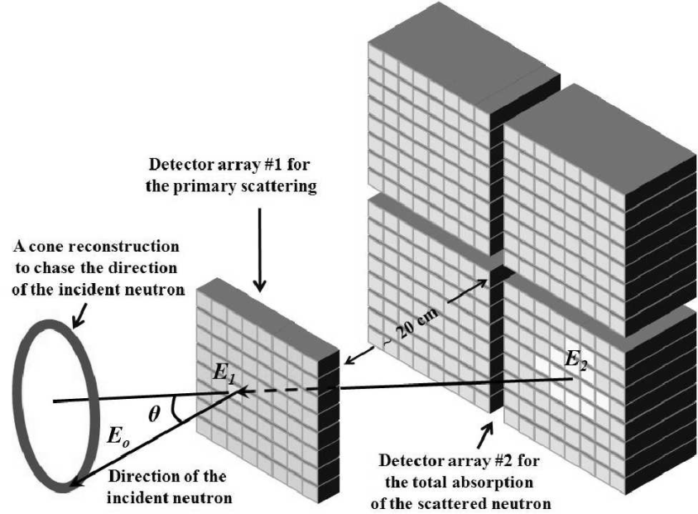
Potential application to the neutron camera
Neutron camera system with PSPMT
The neutron camera is a useful detector to search for any hidden fast-neutron sources.
The energy of recoil nucleus by neutron - nucleus elastic scattering
Proton takes a half of neutron’s energy (A=1) → ,
The angle of the neutron track is
We are developing the practical neutron camera as an application of the neutron detector.
Notes:
양성자와 중성자의 질량이 근사적으로 같으므로 고전적인 산란 모형을 이용하면 중성자와의 탄성 산란에 의한 되튀김핵(recoil nucleus)의 에너지는 다음과 같이 주어진다.
유기검출기를 구성하는 주성분은 H와 C이다. 탄소의 경우 무겁기 때문에 탄성산란에 의한 되튀김 에너지가 작고 검출기 내에서의 탄성산란 신호가 매우 작다. 그러나 수소원자의 핵인 양성자의 경우 A = 1이므로 평균적으로 중성자 에너지의 절반을 가져가게 된다.

Slide 16
Conclusions
We have measurement of the light yields and the pulse (energy) resolutions as a function of the neutron energy by the TOF method.
The data have been compared with the GEANT4 simulations : The pulse resolution increased with the neutron energy.
The spatial range for the absorption via the multiple scatterings increases as the neutron energy.
The relative strength of n-¹²C to n-p in the elastic scattering accounts for the worse resolutions at higher energies.
We are developing the neutron camera as a potential application.

Slide 17
Back up

Slide 18
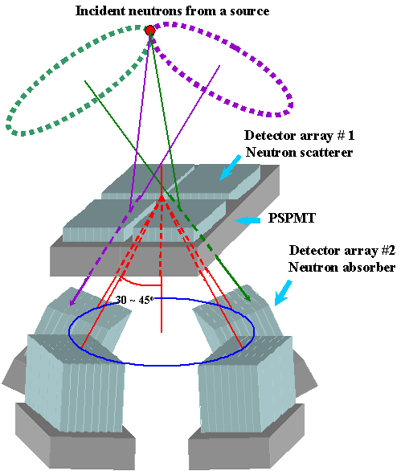
Potential application to the neutron camera
The resolution for the scattering angle to determine the neutron direction
For example,
2m from neutron source material
FWHM of scintillation fiber pixel is 0.35 →
is 60 mrad → the diameter of a cone is 24㎝
If area of neutron scatter is 200 ㎠, with 0.2 ㎐ detection, neutron source material weighs about 100 kg.

Slide 19
References
Page 3 : www.symmetrymagazine.org/cms/?pid=1000102
Page 4 : http://www.ati.ac.at/~neutropt/experiments/Radiography/radiography.html
Original paper : JKPS 2009 54:586-591

