Slide 1
Development of the Scintillation-fiber Detector
for the Neutron-Beam Profile Measurement
C. Kim,* B. Hong, R. J. Hu, M. Jo, K. S. Lee, S. Park, and K. S. Sim
Department of Physics and Korea Detector Laboratory,
Korea University, Seoul 136-701
HIM 2009 spring

Slide 2
Contents
Motivation
Detector Characteristics
  Scintillation fiber
  Si-photodiode array and Electronics
  Protection system
  Control device for scan operations
Test
  Calibration by X-ray
  Neutron-beam profile measurement at KIRAMS
Beam-profile images in absorbed dose rates
Detector modification
Conclusions and Prospects

Slide 3
1/19
1. Motivation
1.
2.
a.
b.
c.
d.
3.
a.
b.
4.
5.
6.
High LET (linear energy transfer) radiations:
  - Fast neutrons, protons, heavy-ions…
  - significantly large energy deposit in tissue per unit length
Fast-neutron radiotherapy:
  Very effective treatment for soft-tissue cancer
Necessity of precise neutron beam-profile
measurement device
We designed, built, and tested scintillation fiber detector based on a current-mode
electronics.

Slide 4
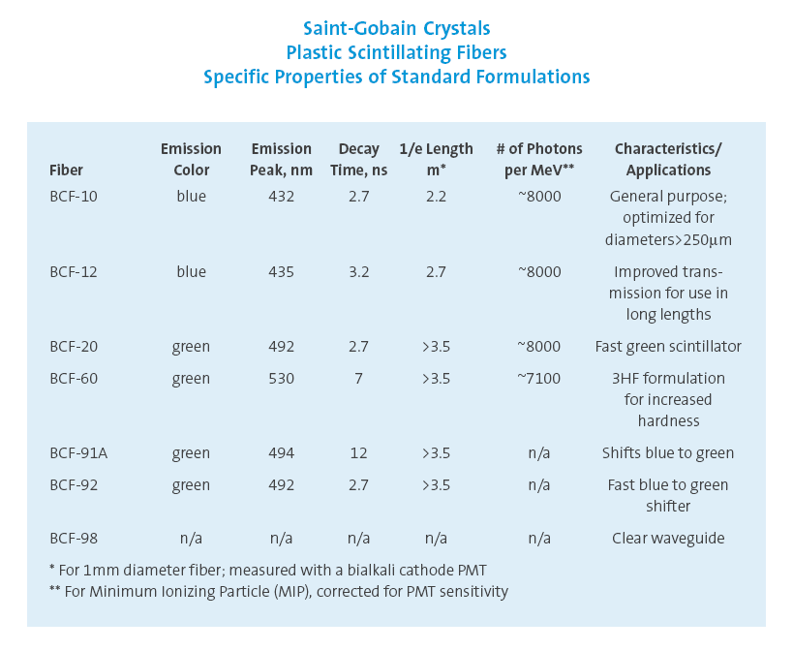
2/19
2. Detector characteristics - a. Scintillation fiber
46.2 mm × 3.0 mm
(46 × 3 pieces)
Neutron
Neutron
1.
2.
a.
b.
c.
d.
3.
a.
b.
4.
5.
6.
1.0 × 1.0 mm²
Energetic
proton
9.0 mm
9.0 mm
59.7 mm
Energetic
proton
Emitted photon
(Green, 530 nm)
11.8 mm
Line scan detector with 46 × 3 pixels
Single-clad scintillation fiber (Bicron BCF-60)
9 mm fiber length:
  - Compromised between neutron sensitivity enhancement &
  multiple scattering probability suppression
Three-layer structure for maximized light yield produced
by the scattered protons

Slide 5
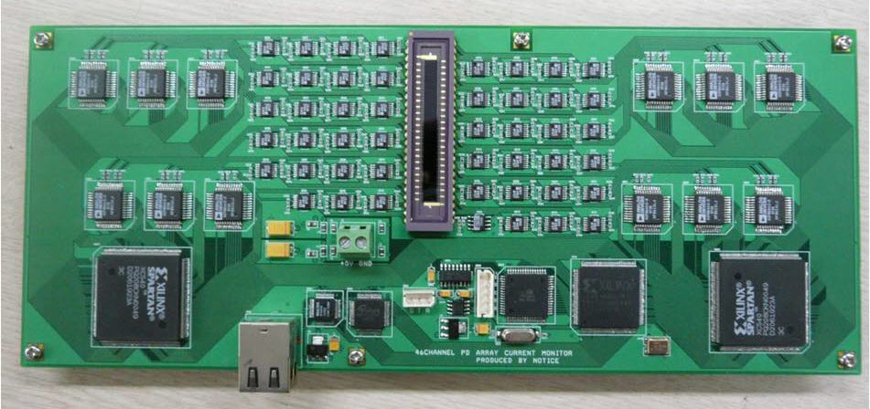
3/14
2. Detector characteristics - b. Si-photodiode array and Electronics
3/19
1.
2.
a.
b.
c.
d.
3.
a.
b.
4.
5.
6.
Scintillation fibers
Electronics board
46 channel Si-photodiode array
(Hamamatsu S4111-46Q)
Electronics board
46 channel Si-photodiode array
(Hamamatsu S4111-46Q)
46 channel Si-photodiode (Hamamatsu S4111-46Q)
  - Dark current: ~ 10 pA
Current-integration-mode electronics
  - Designed for high-intensity fast neutron-beams
  (neutron beams for typical radiotherapies, 10⁸ ~ 10¹⁰ Hz/cm² )

Slide 6
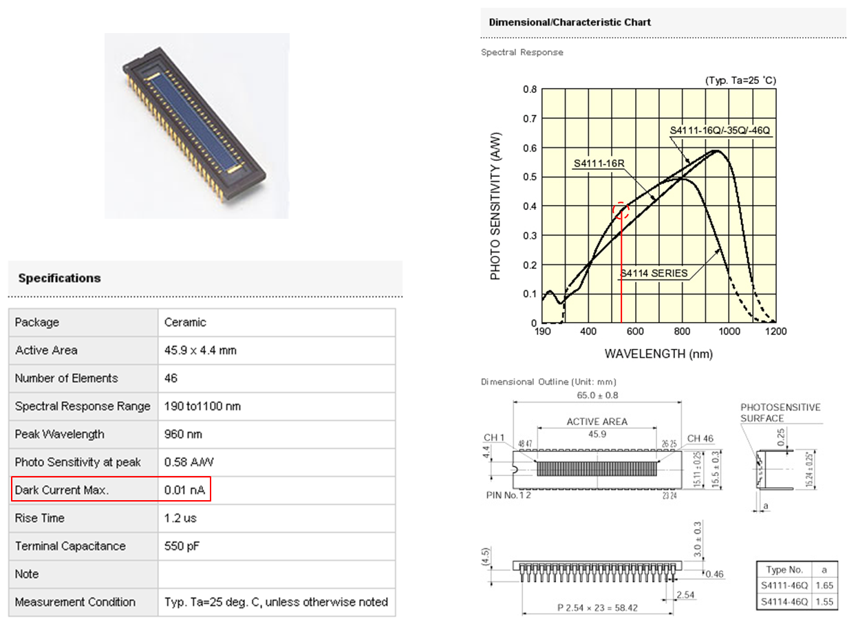
4/19
2. Detector characteristics - b. Si-photodiode array and Electronics
1.
2.
a.
b.
c.
d.
3.
a.
b.
4.
5.
6.

Slide 7
5/19
2. Detector characteristics - b. Si-photodiode array and Electronics
1.
2.
a.
b.
c.
d.
3.
a.
b.
4.
5.
6.
LV bias
(+5V)
Data
buffer
Silicon
photo -
diode
Preamp
ADC
Digital
processor
MCU
Ethernet
link
Data
control
in PC
Output pulses fed into preamp (preamp sensitivity: 10⁻¹⁰ ~ 10⁻² A)
Preamp converts output pulses to voltage-sensitive pulses
Preamp outputs are multiplexed to four ADCs
ADCs convert the voltage-sensitive analog inputs into 12-bit digital signals (in every 7.8 μs) and feed them to a digital processor
Input signals transferred from the ADCs are summed over 1 ms and fed into a data buffer area
Data from digital processor are transferred to PC by MCU via Ethernet link

Slide 8
6/19
  2. Detector characteristics - c. Protection system
1.
2.
a.
b.
c.
d.
3.
a.
b.
4.
5.
6.
Upper collimator
(Gd₂O₃ + epoxy mixture)
Glass plate
(2 mm thickness)
V shape collimator
(Gd₂O₃ + epoxy mixture)
Acryl plate
(1 cm thickness)
Gd₂O₃ powder
(1 mm thickness)
Two-step collimation for the fast neutrons
  - Collimators made of natural Gd₂O₃ powder and epoxy
  - Slit width of V-shape collimator: 1 mm
Gd layers for fast/thermal neutron shielding

Slide 9
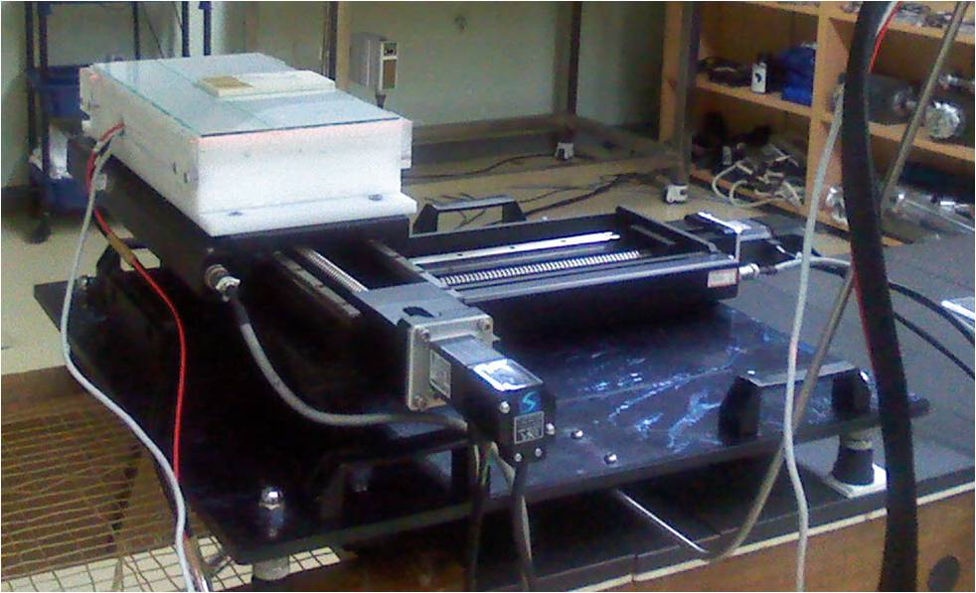
7/19
  2. Detector characteristics - d. Control device for scan operations
1.
2.
a.
b.
c.
d.
3.
a.
b.
4.
5.
6.
Transverse movement (red line):
  - continuous with adjustable speed (1~5 cm/s)
Vertical movement (yellow line): 46 mm per step
Total possible scan area: 30 × 32 cm²

Slide 10
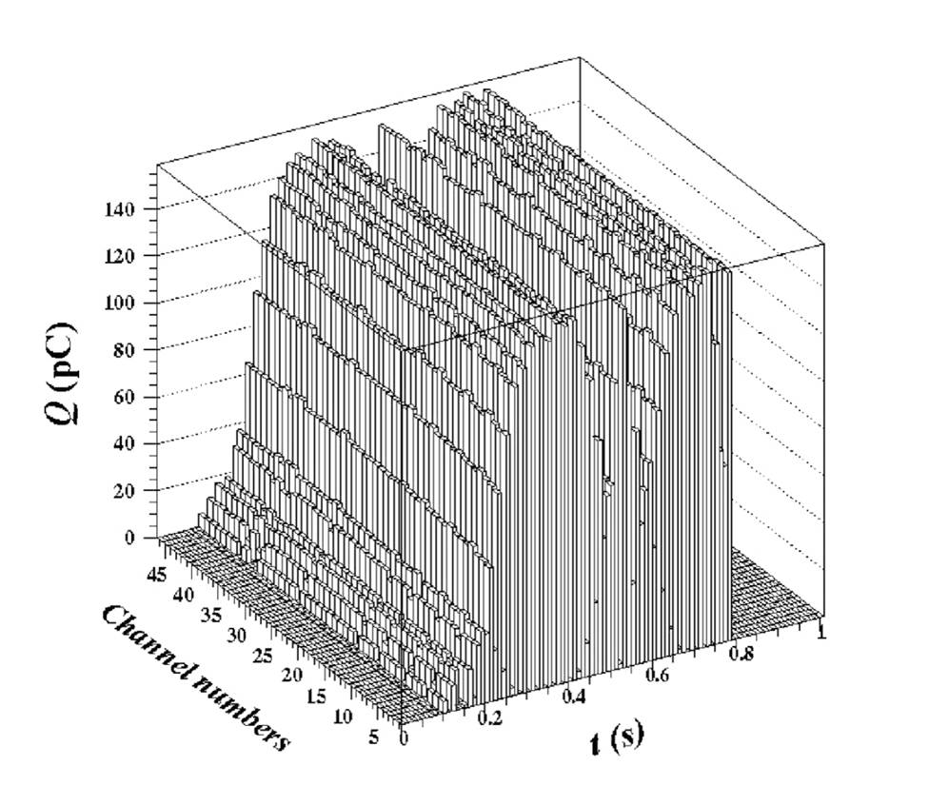
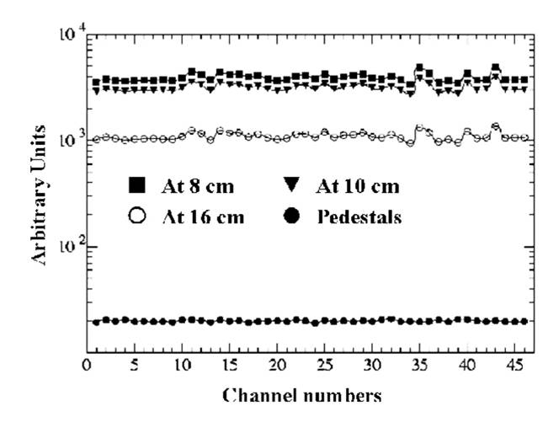
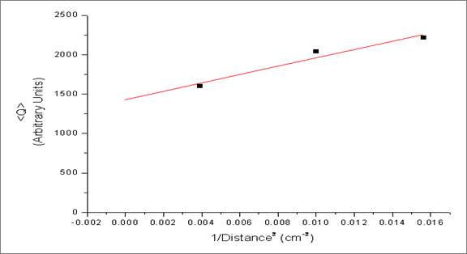
8/19
  3. Test - a. Calibration by X-ray
1.
2.
a.
b.
c.
d.
3.
a.
b.
4.
5.
6.
Calibration test for the sensitivity of each channel
Test was performed by the X-ray generator (8 mA, 70 kV)
  - The portable X-ray gun was placed at three different distances
  (8, 10, and 16 cm) from the detector
Results:
- Sensitivity varies at the level of a few %
- Channel responses were measured precisely.
- Calibration factors were obtained for the channel responses.

Slide 11
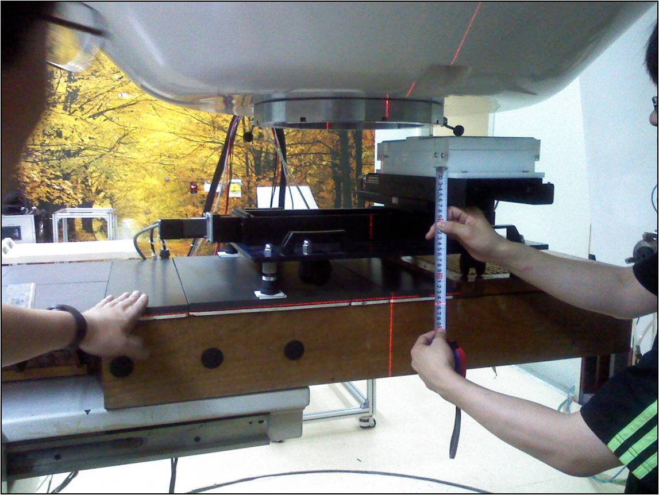
9/19
  3. Test - b. Neutron-beam profile measurement at KIRAMS
1.
2.
a.
b.
c.
d.
3.
a.
b.
4.
5.
6.
Fast-neutron beam was provided by MC50 cyclotron at KIRAMS
Distance from Be target to the scan detector: 123 cm
Incident proton energy: 45 MeV
Be target thickness: 10.5 mm
Test was performed with two beam currents: 10 μA and 20 μA

Slide 12
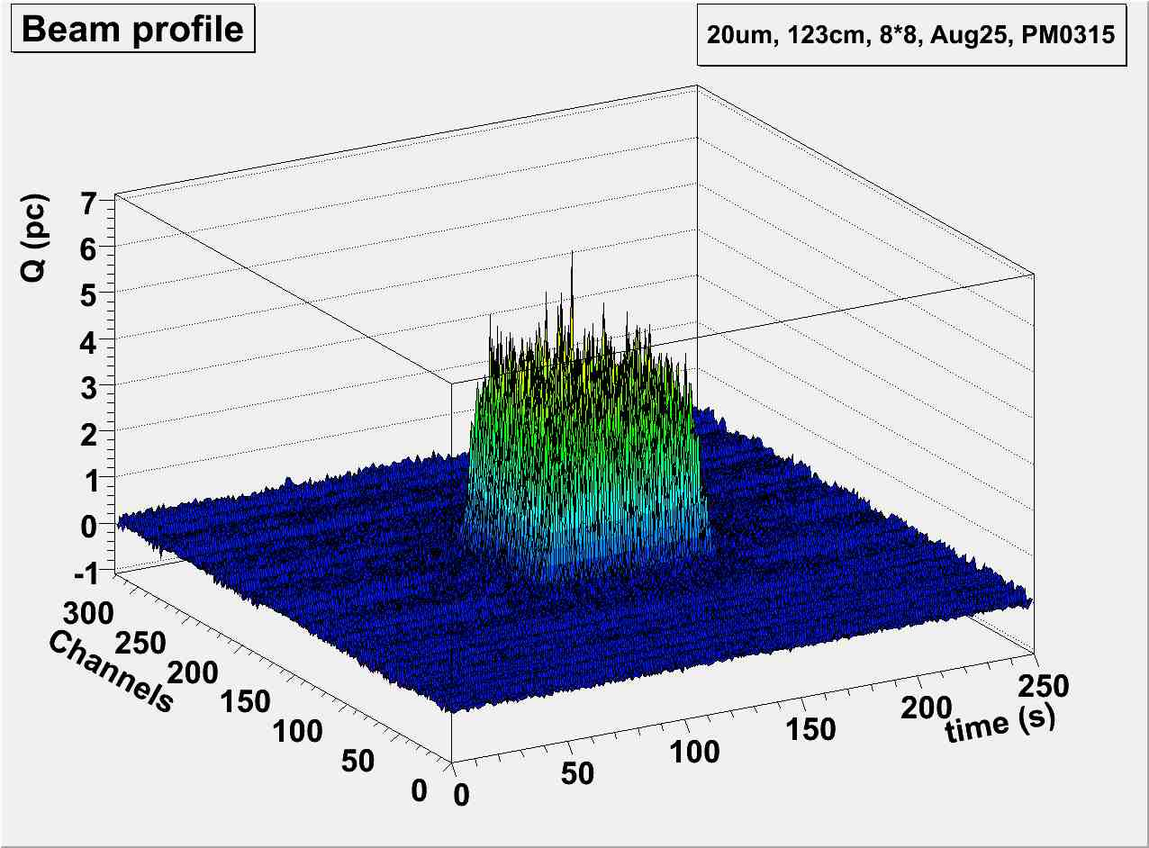
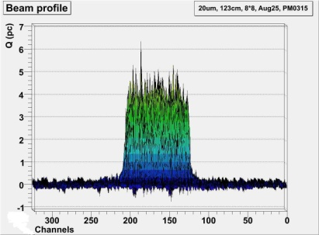
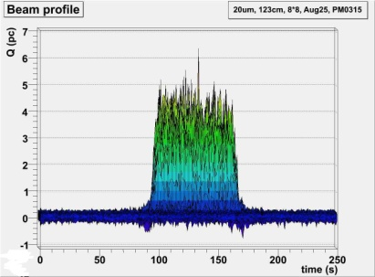
10/19
  3. Test - b. Neutron-beam profile measurement at KIRAMS
20 μA, 123 cm, 8×8 cm², Aug25, PM0315
1.
2.
a.
b.
c.
d.
3.
a.
b.
4.
5.
6.
Q (pC)
Q (pC)
Channels
time (s)

Slide 13
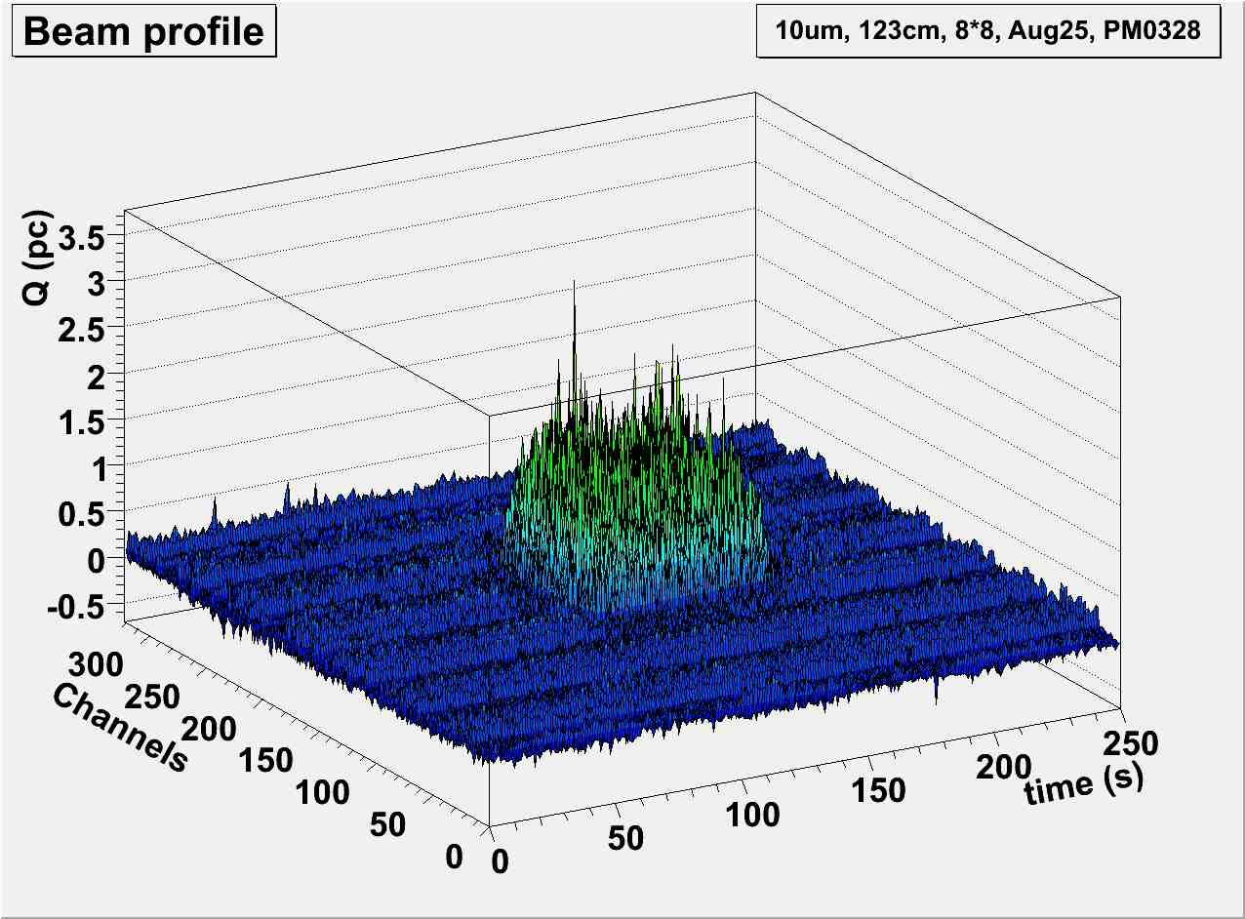
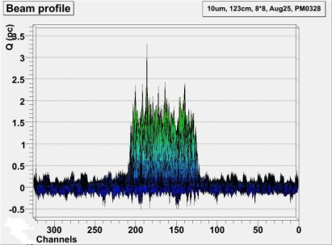
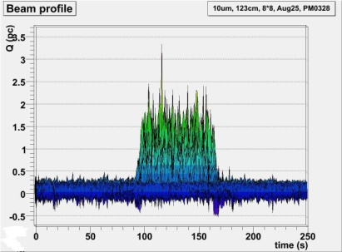
11/19
  3. Test - b. Neutron-beam profile measurement at KIRAMS
10 μA, 123 cm, 8×8 cm², Aug25, PM0328
1.
2.
a.
b.
c.
d.
3.
a.
b.
4.
5.
6.
Q (pC)
Q (pC)
Channels
time (s)

Slide 14

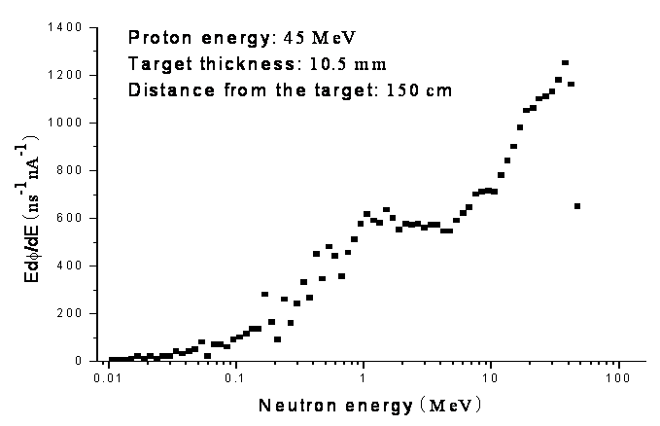
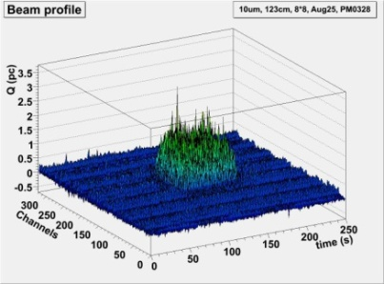
12/19
  3. Test - b. Neutron-beam profile measurement at KIRAMS
1.
2.
a.
b.
c.
d.
3.
a.
b.
4.
5.
6.
Measured beam profiles at KIRAMS (left) and Unfolded neutron flounce spectrum
(lethargy spectrum) measured by Boner sphere system (KAERI/RR-2442/2003) (right)
Beam-profile measurement conditions:
- Corresponding mean charge value to neutron beam intensities:
~ 4.0 pC ↔ ~ 4.8 × 10⁷ Hz/cm² (20 μA beam current)
~ 1.8 pC ↔ ~ 2.4 × 10⁷ Hz/cm² (10 μA beam current)
- Test performed under the beam intensities lower than operational intensity
(10⁸ ~ 10¹⁰ Hz/cm²)

Slide 15
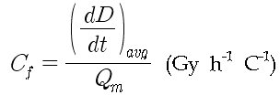

13/19
  4. Beam-profile images in absorbed dose rates
1) Beam-profile image (charge distribution)
- Detector signal is roughly proportional to the deposited energy in the detector
- Beam-profile images ≈ distribution of expose dose rate induced in the
detector
1.
2.
a.
b.
c.
d.
3.
a.
b.
4.
5.
6.
2) Conversion by using Geant4 simulations
Where,
A_{p} : area of each image pixel (cm²)
i_{p} : proton beam current (nA)
E_{i} : neutron energy (MeV)
E_{i} ΔФ_{i} /ΔE_{i} : differential neutron flux (n/s/nA)
δE_{i} : energy deposited in the detector (GEANT4)
є_{i} : interaction sensitivity (GEANT4)
Q_{m} : mean charge induced in the beam area
→ The conversion factor
∴ Distribution of the beam profile in Gy :
Neutron spectrum measured at 1.5 m (n/s/nA) (KAERI/RR-2442/2003)

Slide 16
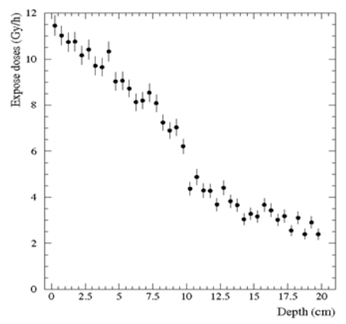
14/19
  4. Beam-profile images in absorbed dose rates
3) Applying to human-body:
- Proton beam status: 45 MeV, 20 μA
- Be target thickness: 10.5 mm
- Distance: 123 cm
- Beam area : 8 × 8 cm²
- Human body phantom : 30 × 30 × 20 (depth) cm³
- Size of a voxel : 1 cm³
1.
2.
a.
b.
c.
d.
3.
a.
b.
4.
5.
6.

Slide 17
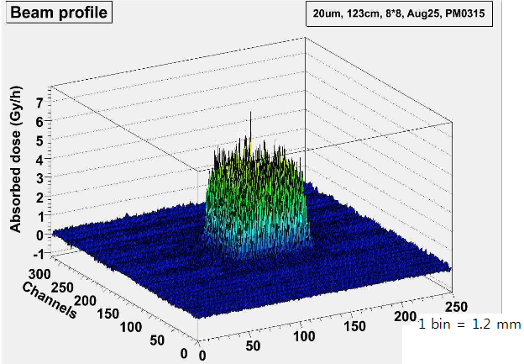
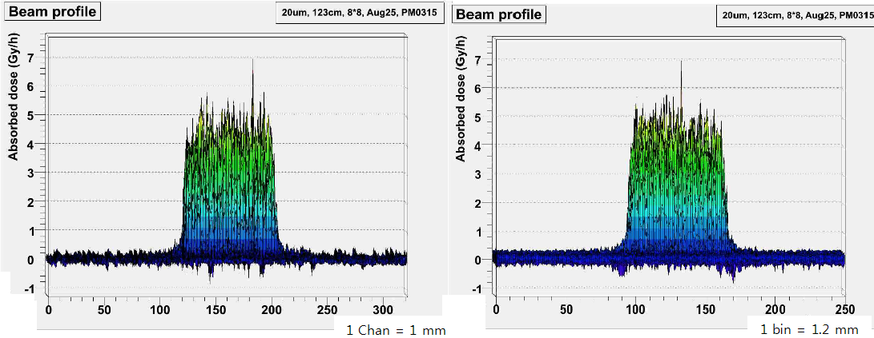
15/19
  4. Beam-profile images in absorbed dose rates
1.
2.
a.
b.
c.
d.
3.
a.
b.
4.
5.
6.

Slide 18
16/19
  5. Detector modification
Neutron
1.
2.
a.
b.
c.
d.
3.
a.
b.
4.
5.
6.
10.0 mm
Energetic
proton
60.0 mm
15.0 mm
10.0 mm
Emitted photon
(Green, 530 nm)
10.0 mm
55 mm
~70 mm
Bended scintillation fibers
(46 × 2 pieces)
47.0 mm × 2.0 mm
1.0 × 1.0 mm²
41 mm
Bended structure to avoid direct beam-exposure
Improvement in statistics: {(10⁸ → 10⁷) ~ 10¹⁰} (Hz/cm²)
- Increased fiber length (9 mm → ~ 20 mm)
- Collimator slit removed (open width: 1 mm → 2 mm)
- * movement speed will also be adjusted

Slide 19
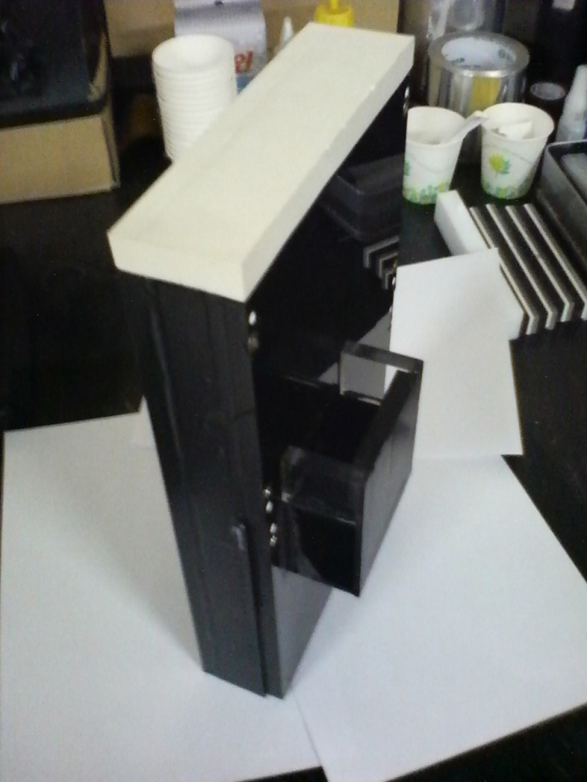
17/19
  5. Detector modification
1.
2.
a.
b.
c.
d.
3.
a.
b.
4.
5.
6.
30~40 mm thickness
acryl plate
~ 15 mm thickness
Gd + Epoxy mixture
10 mm thickness
acryl plate
2 mm thickness
Gd + Epoxy mixture
5 mm thickness
acryl plate
mounted Electronics

Slide 20
18/19
  6. Conclusions and Prospects
Conclusions
Fast-neutron beam profile was successfully measured.
The detector composed of scintillation fiber and current-integration mode electronics was proved as a reliable
instrument for the beam-profile measurement.
High-precision data measurement:
not only beam area but also beam-halo were observed.
Stable beam-profile measurement is possible
Direct result (charge distribution) can be converted to absorbed dose rates by Geant4 simulation
1.
2.
a.
b.
c.
d.
3.
a.
b.
4.
5.
6.

Slide 21
19/19
  6. Conclusions and Prospects
Prospects
Second neutron-beam test arranged at KIRAMS: March 16
Further, and deeper simulations by Geant4 are required for precise absorbed/equivalent dose rates calculation
1.
2.
a.
b.
c.
d.
3.
a.
b.
4.
5.
6.

Slide 22
Thank you!

Slide 23
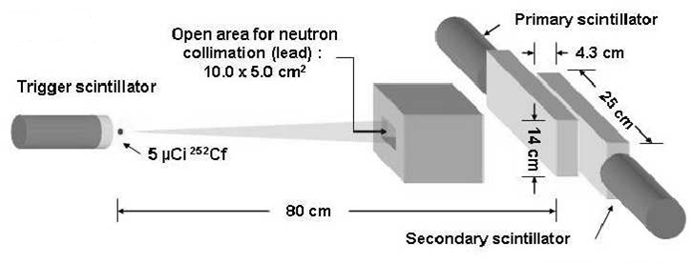
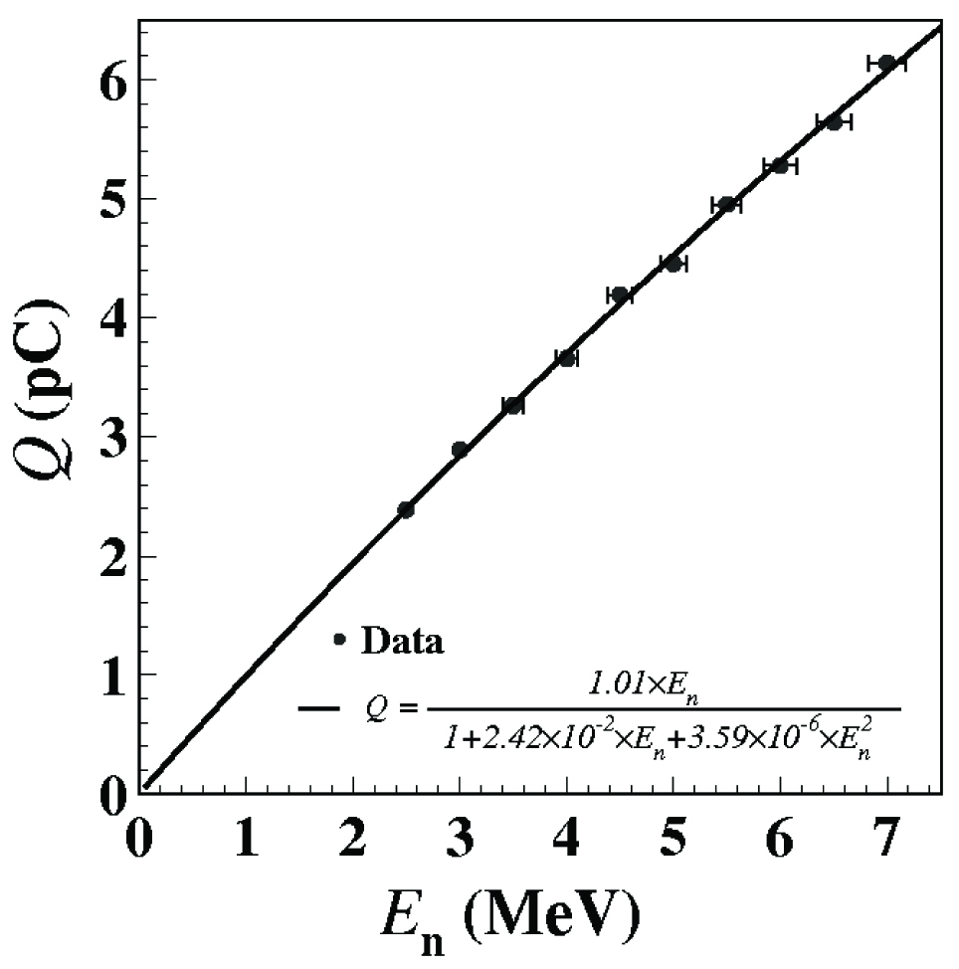
  Backup Slides - Signal produce
Elastic scatterings
  n-p elastic scattering: deposited energy by recoiled proton
  (dominant)
  n-¹²C elastic scattering: deposited energy by recoiled ¹²C
  Neutron signal is proportional to deposited energy
  The beam-profile images directly reflects the distribution of
  absorbed doses
Inelastic scatterings
  p(n , γ)d → signals by secondary deuteron
  n + ¹²C → 3 α’s

Slide 24
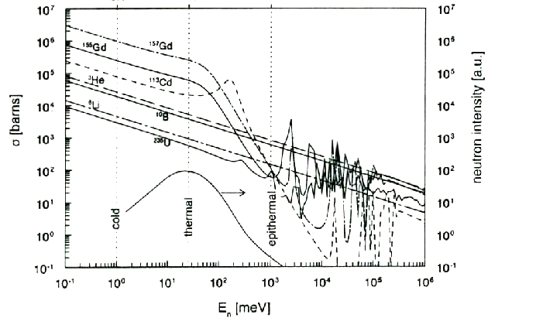
  Backup Slides - Gadolinium
동위원소 질량비 |  | 내부전환에 의해 발생하는 전자의 에너지
질량수 | 존재비 (%) | Energy (KeV) | 내부전환 확률 (%)
152 | 0.2 | 29 | 9.82
154 | 2.2 | 39 | 4.19
155 | 14.8 | 71 | 26.80
156 | 20.5 | 78 | 6.17
157 | 15.7 | 81 | 4.97
158 | 24.8 | 88 | 1.16
160 | 21.8 | 131 | 3.41
여백 |  | 150 이상 | ~2
¹⁵⁷Gd: 6.3 × 10⁶ barn
¹⁵⁵Gd: 3.6 × 10⁵ barn

Slide 25
  Backup Slides – Detector arm
Beam Area
Scan Device
Detector arm
Detector

Slide 26
  Backup Slides – (tagging efficiency × deposited energy) / neutron

Slide 27
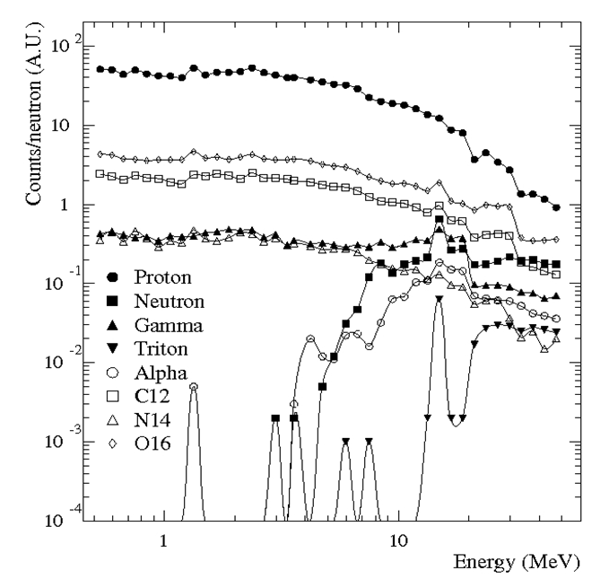
  Backup Slides – Counts of secondary particles / neutron

Slide 28

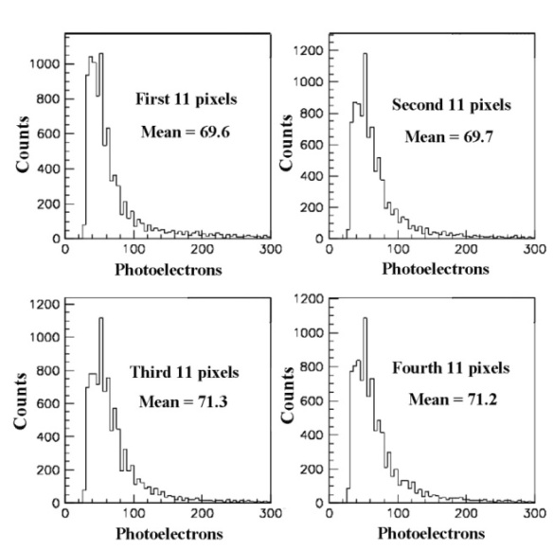
  Backup Slides - Position sensitivity test
50 mm
~10 mm
Pb Brick
γ rays
PMT
~ 46 mm
Pb Brick
Co60 (~1.25 MeV)
pixel detector (side view)
60 mm
Schematic diagram of position sensitivity test. The width of γ-ray pass (open space
between lead bricks) adjusted to overcome low irradiation rate of γ-source.
4 points (by 1 cm interval) of detector
checked to examine position-sensitivity
of detector.
γ-ray distribution of each points were
all uniform.

Slide 29
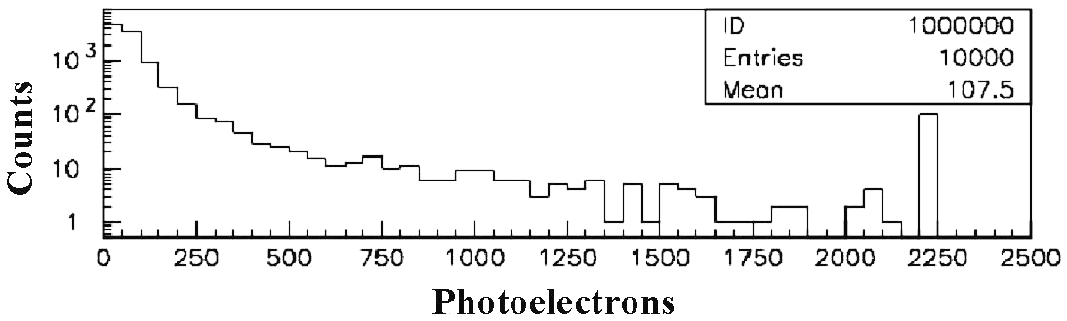
  Backup Slides - LED Test
low-brightness LED (green, ~550 nm)
Si-photodiode array
~3 cm
2 pieces of obscure glasses
Electronics
power supply
PMT
~7 cm
Simple circuit for LED power
paper cup
taped paper cylinder
Schematic diagram of LED test
Amounts of photon correspondent to LED power measured by PMT
Same experiment repeated by designed electronics

