Slide 1


Low Energy Heavy-Ion Beam Facility at Korea Basic Science Institute
Presentation
전자 맴돌이 공명(ECR) 이온원 개발 연구
박진용, 안정근
이효상, 이병섭, 원미숙, 김종필, 윤장희
(Pusan National University
&
Korea Basic Science Institute)
Heavy Ion Meeting 2008-11

Slide 2
Low Energy Heavy-Ion Beam Facility for fast neutron production
Fast Neutron Radiography & Applications
Superconducting ECR Ion Source and Prototype ECR Ion Source Project at KBSI
Current Status and Prospects

Slide 3
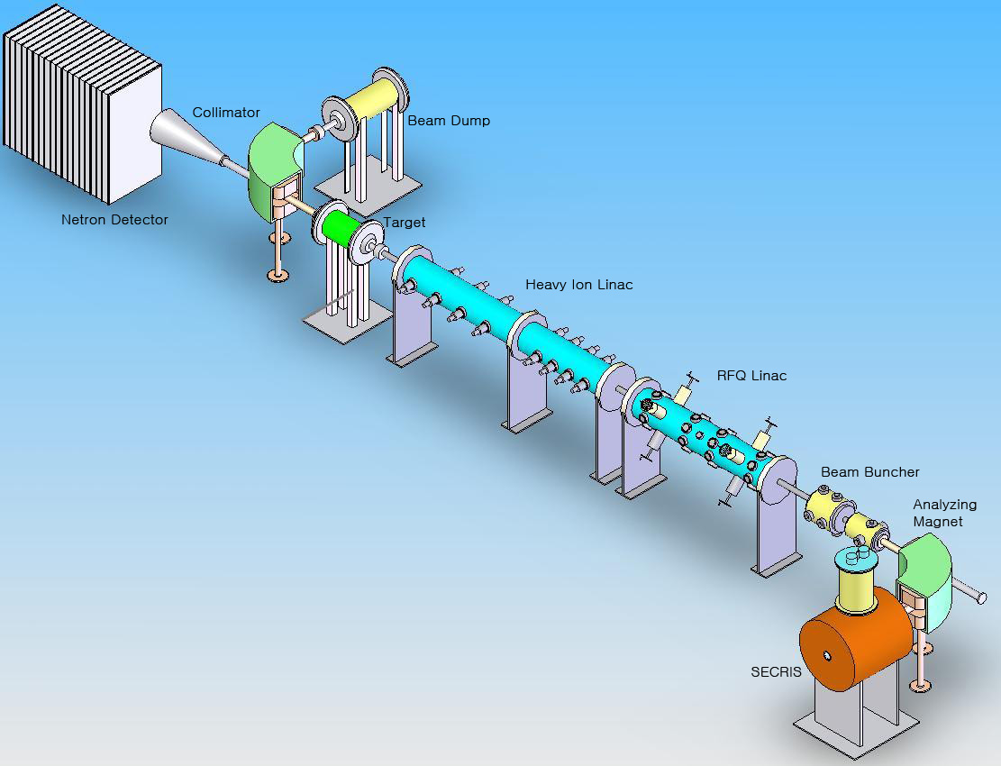
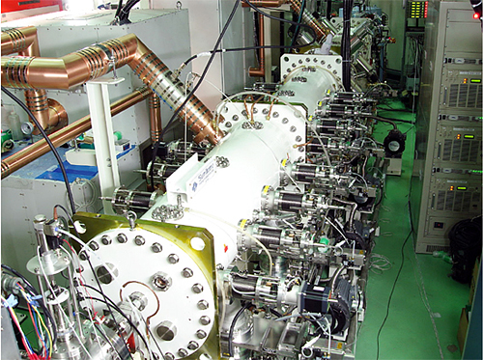
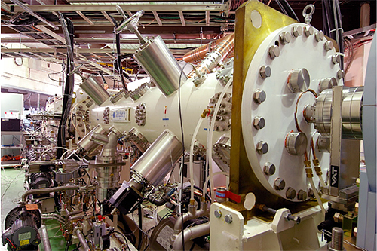
Schematic view of the Heavy-Ion Beam Facility

Slide 4
Featured Specifications
ECRIS | S-ECR : 10kW, 28GHz, 3W G-M cooler (4K) PM-ECR: 1kW, 2.45GHz
RFQ | 8 keV/u → 0.6 MeV/u 200MHz, Q/M=1/2, Length ~2m, Diameter 35cm
HI-DTL | 0.6 MeV/u →4 MeV/u 200MHz, Q/M=1/2, Length ~3.2m Diameter 35cm
Production Target | Hydrogen Gas Target at 500Torr
Beam Current | Li ³⁺ 5mA / Ar ⁸⁺ 2mA / Kr ¹³⁺ 0.6 mA / Xe ²⁰⁺ 0.3 mA, Fast neutron 10¹²/s with Li ³⁺ 1mA

Slide 5
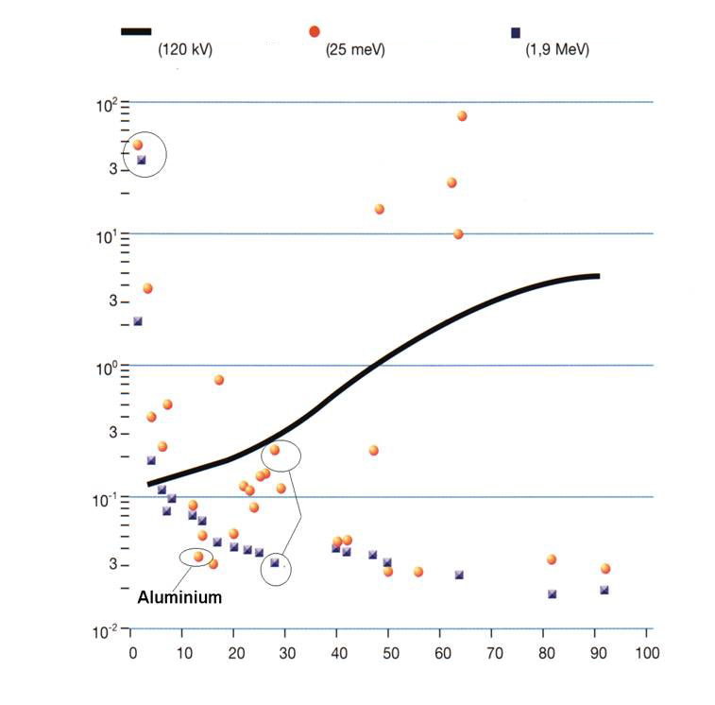
Fast Neutron Radiography
Neutron radiography
Neutron absorption
Penetration thru high-Z material
Sensitive to Low-Z material
X-Rays
Thermal neutron
Fast neutron
Fast Neutron
mass attenuation coefficient [cm^{2/}g]
atomic number [Z]

Slide 6
Fast Neutron Radiography
Neutron radiography
Neutron absorption
Penetration thru high-Z material
Sensitive to Low-Z material
X-Rays
Thermal neutron
Fast neutron
Fast Neutron
mass attenuation coefficient [cm^{2/}g]
atomic number [Z]

Slide 7
Fast Neutron Radiography
Neutron radiography
Neutron absorption
Penetration thru high-Z material
Sensitive to Low-Z material
X-Rays
Thermal neutron
Fast neutron
Fast Neutron
mass attenuation coefficient [cm^{2/}g]
atomic number [Z]

Slide 8
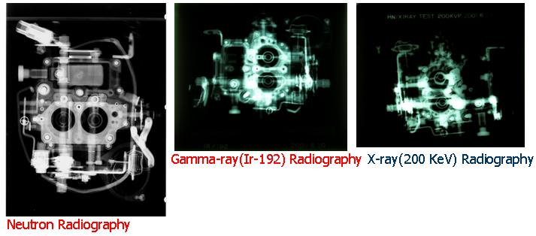
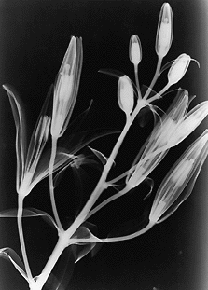
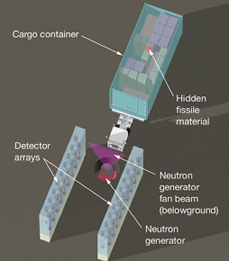
Fast Neutron Radiography
Neutron radiography
Neutron absorption
Penetration thru high-Z material
Sensitive to Low-Z material
X-Rays
Thermal neutron
Fast neutron
Fast Neutron
mass attenuation coefficient [cm^{2/}g]
atomic number [Z]

Slide 9
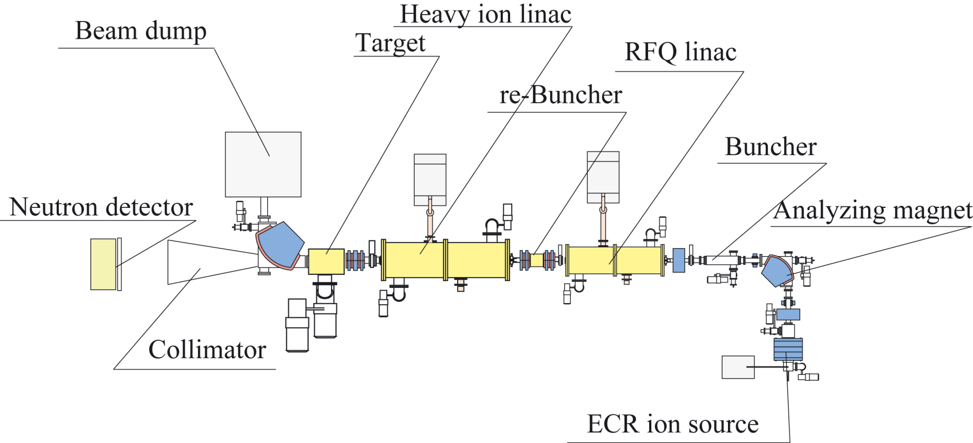
Fast Neutron Beam Facility
Neutron production
2.5MeV ~10¹²/sec
Acceleration
~2.5MeV/u
(Li^{2~3+} production
>1pmA)
H(⁷Li, n)⁷Be Inverse kinematics

Slide 10
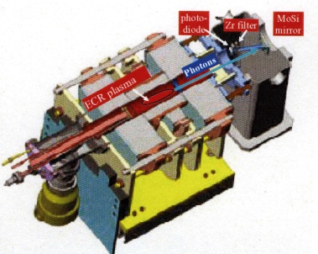
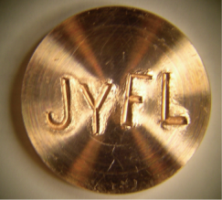
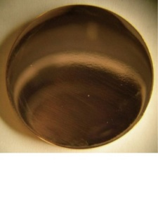
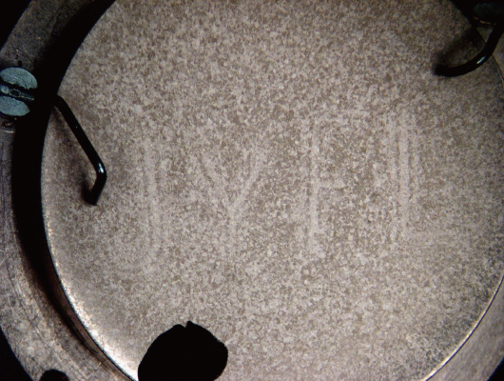
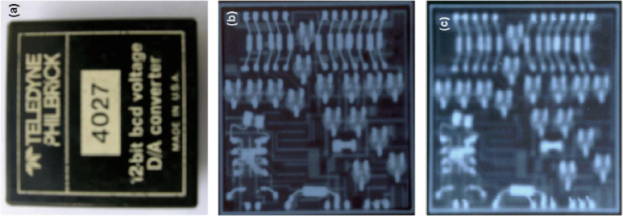
Application of the ECR Ion Source
Imaging of Deformed metal surfaces
EUV source
Polishing
Ar ion (~10keV) 10¹⁸/cm²
X-ray source
PECRIS
beam intensity Xe¹⁰⁺ 70μA
EUV power 100mW/2π sr
Hospital X-ray
machine
ECR X-ray
machine
18 GHz ECRIS
beam intensity Xe²⁰⁺ 300μA
Xe¹⁰⁺ ~3mA
EUV power 4W/2π sr
High energetic X-ray (~100 keV) without High voltage
Easily change the X-ray energy
High x-ray flux (~ 10R/h ~ 100msr/h)
28GHz ECRIS ~ 100W/2π sr

Slide 11
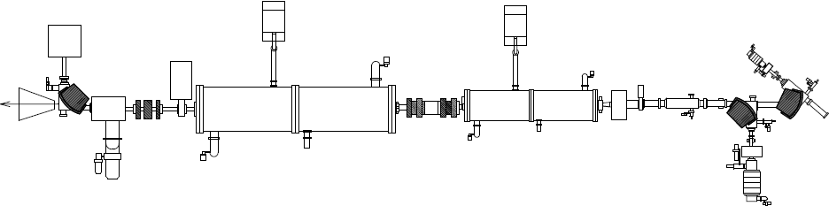
Current Trends in Development of
the ECR Ion Source
Low cost and Compact ECRIS
-> Permanent magnet ECRIS
High current and multiply charged Ion Source
-> Superconducting ECRIS
Beam dump
DTL
RFQ
Target
Buncher
neutron
collimator

Slide 12
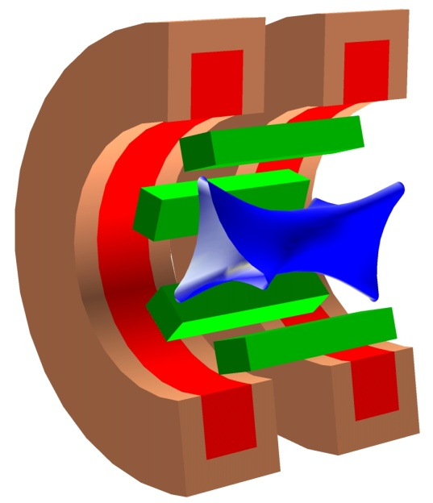
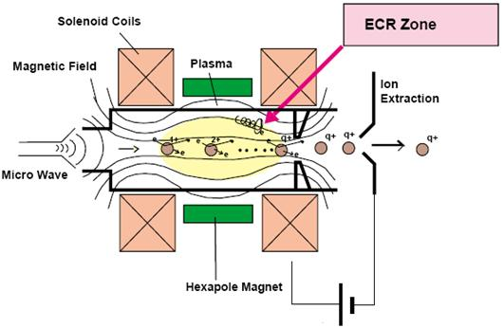
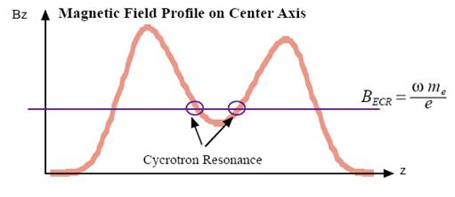
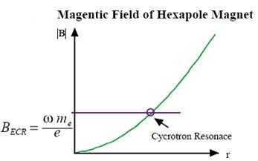
Principle of the ECR Ion Source
Solenoid magnet
Plasma
Microwaves
Beam
Sextupole

Slide 13
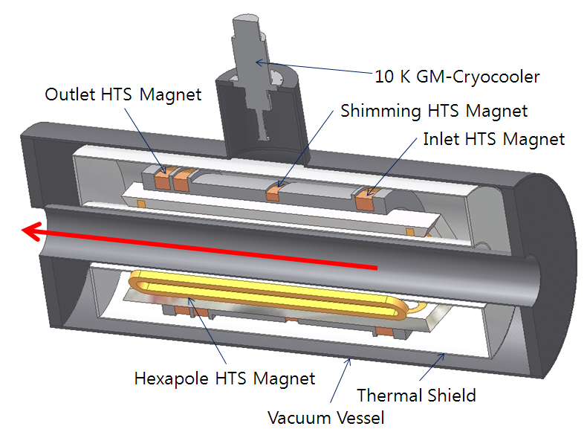
28GHz 10kW Superconducting ECR Ion Source with B_{max} = 4T
전도 냉각형 고온 초전도 자석
(높은 안정성, 저렴한 유지 비용)
Volume Type ECR Zone 설계
(에너지 전달 효율 증대)
Hexapole 자석을 위한
고강도 구조 설계
High-B mode 운영을 위해
설계 수정 중
(High intensity beam 산출)
28 GHz Gyrotron 설계 진행중
Extraction Side
Injetion Side
Target Ion
- Li ³⁺ 5mA / Ar ⁸⁺ 2mA
- Kr ¹³⁺ 0.6 mA / Xe ²⁰⁺ 0.3 mA

Slide 14
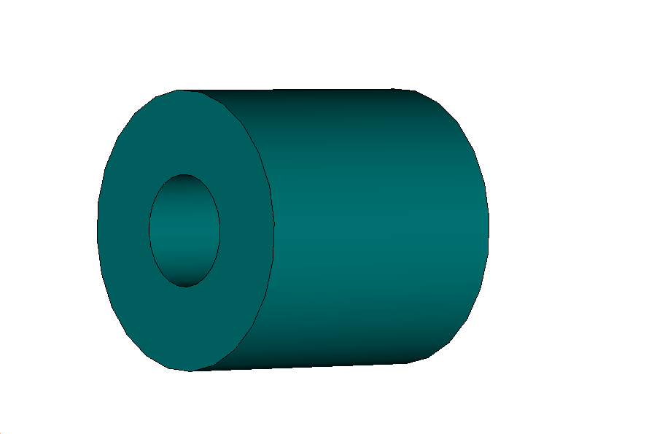
Optimized configuration of permanent magnets
Annular Magnet
d

Slide 15
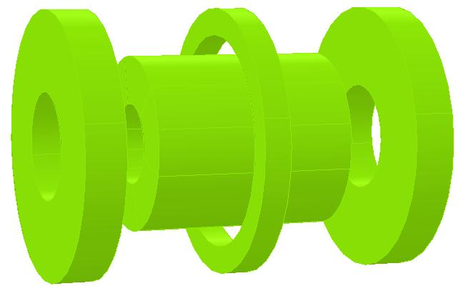
Geometry of Prototype ECRIS
Notes:
15

Slide 16
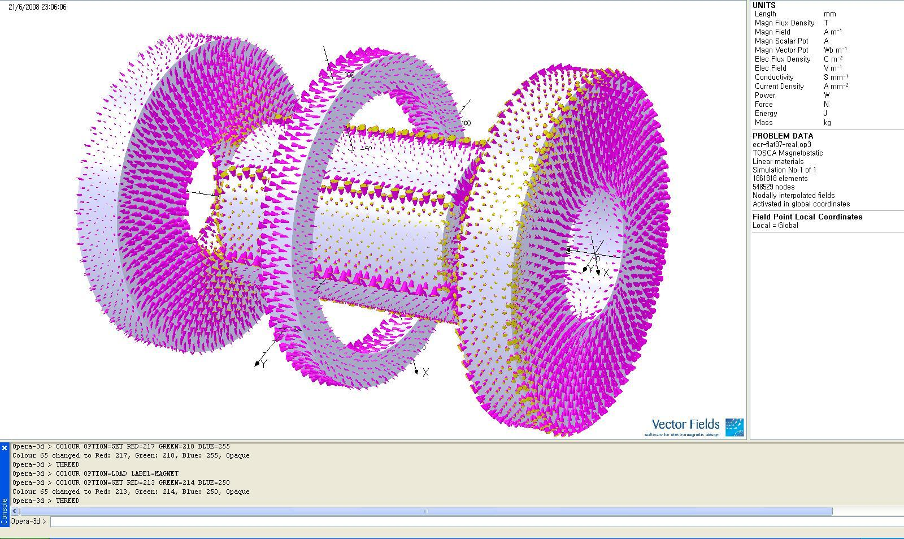
Opera-3D Simulation Results
Notes:
16

Slide 17
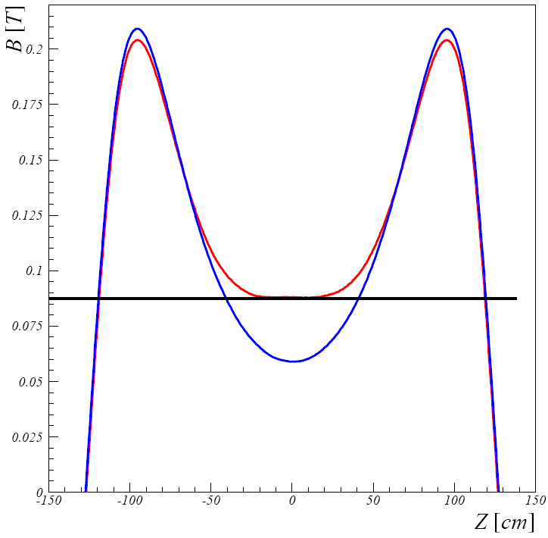
Opera-3D Simulation Results
Magnet Field Profile on Center Axis
Magnet Field Hexapole Magnet
Cycrotron Resonance
Notes:
17

Slide 18
Schematic view of Prototype ECR ion source
Notes:
18

Slide 19
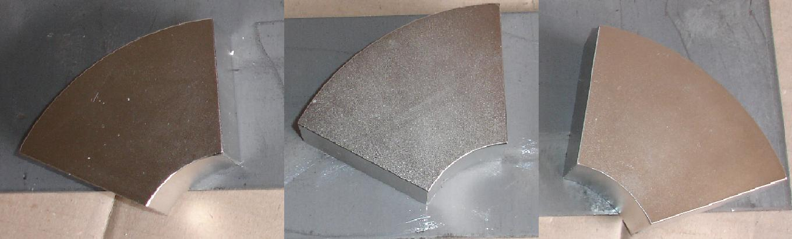
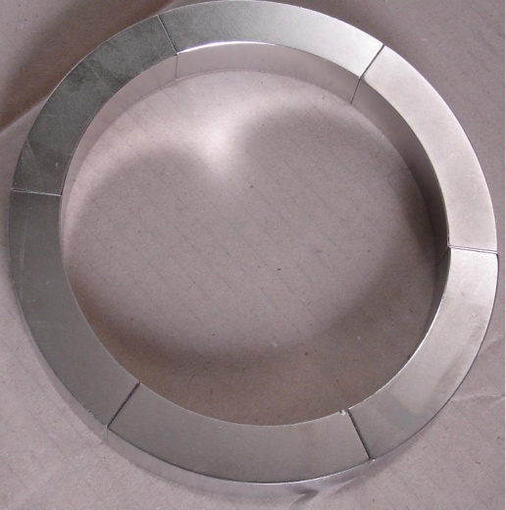
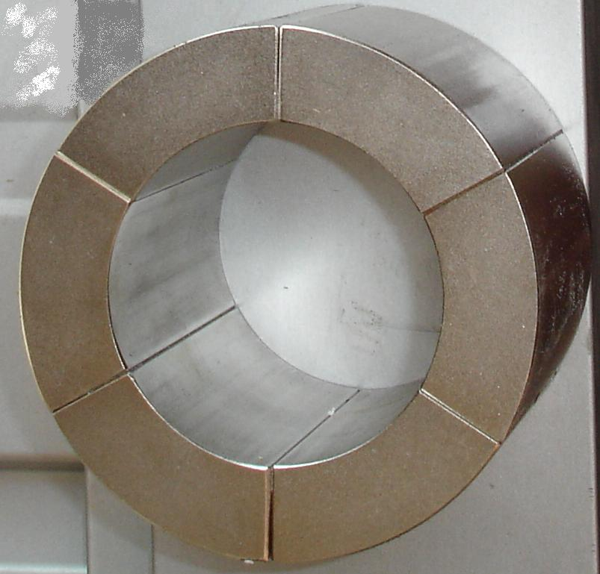
Permanent Magnet
Notes:
19

Slide 20
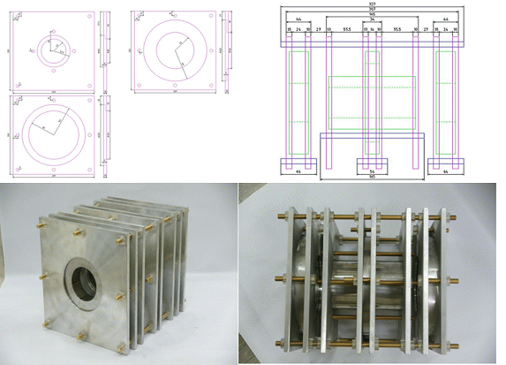
Permanent Magnet & Structure

Slide 21
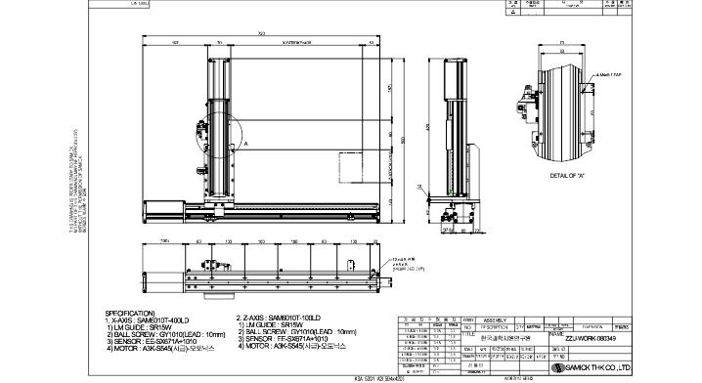
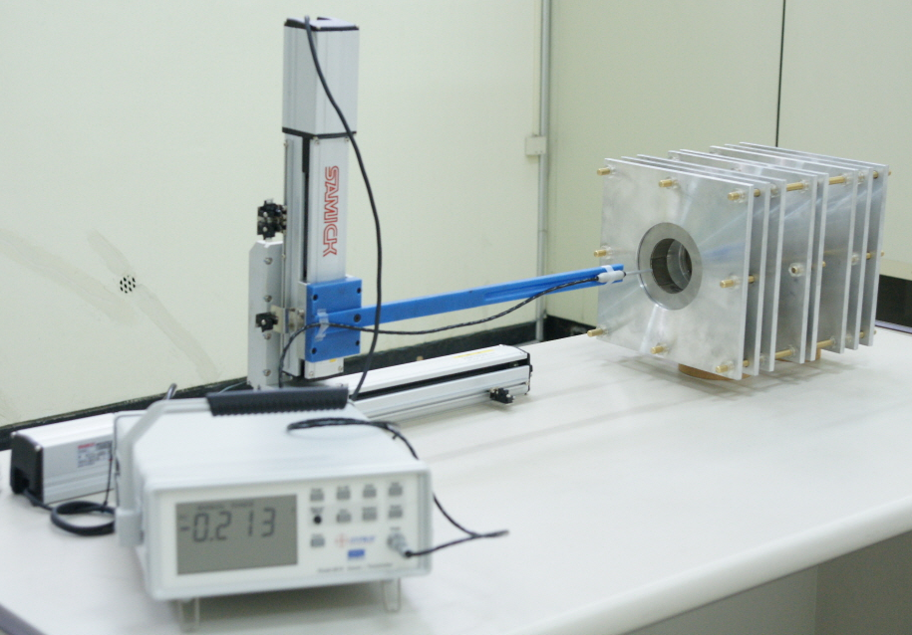
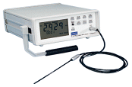
테스트 벤치 구축
테스트 벤치 구축 완료
2.45 GHz Proteptype ECR 이온원 자기장 측정
Movement System
Hall Probe
Gauss Meter

Slide 22
측정결과
Notes:
22

Slide 23
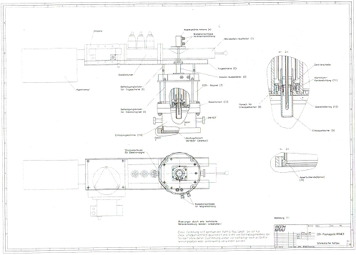
2.45GHz 안테나 마이크로웨이브

Slide 24
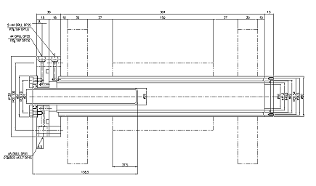
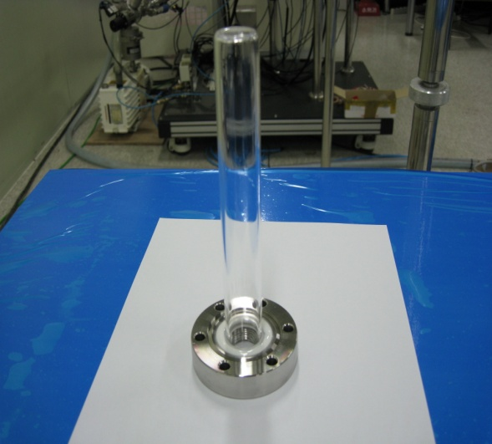
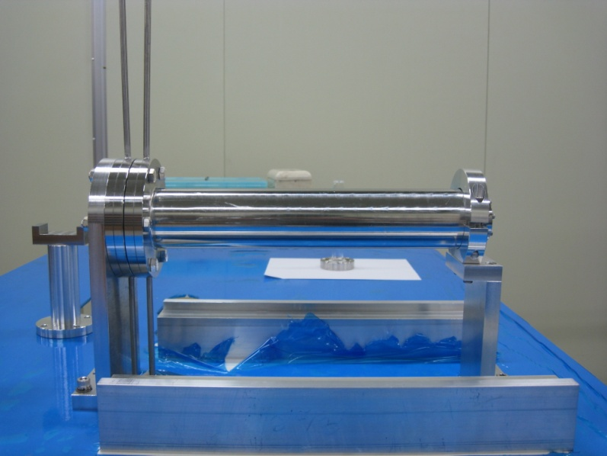
Chamber

Slide 25
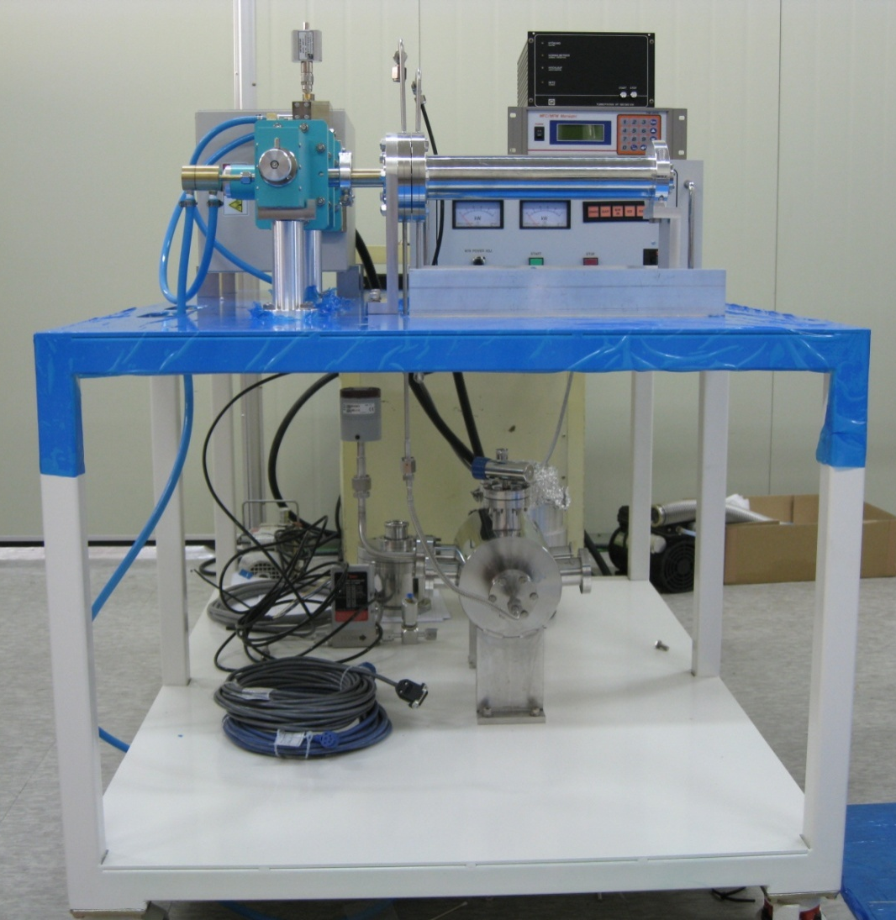
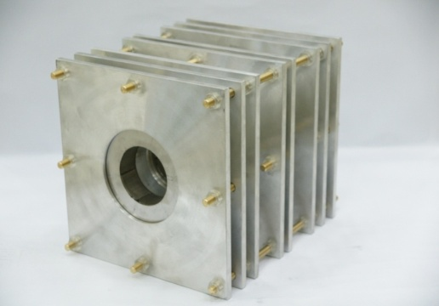
Prototype ECR 이온원
이온화 챔버 하우징
가스 공급/조절 장치
ECR용 영구자석 시스템
고주파 발생기
고주파 발생
측정/조절 장치
Prototype ECR용 영구자석 제작
- 고주파 발생기 제작
이온화 챔버 하우징 제작
진공 및 가스 조절 장치 제작
플라즈마 실험 다음 주 진행

Slide 26
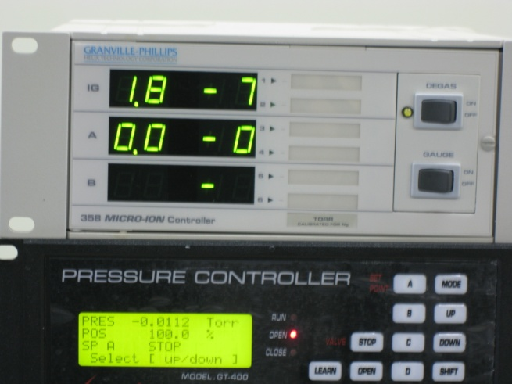
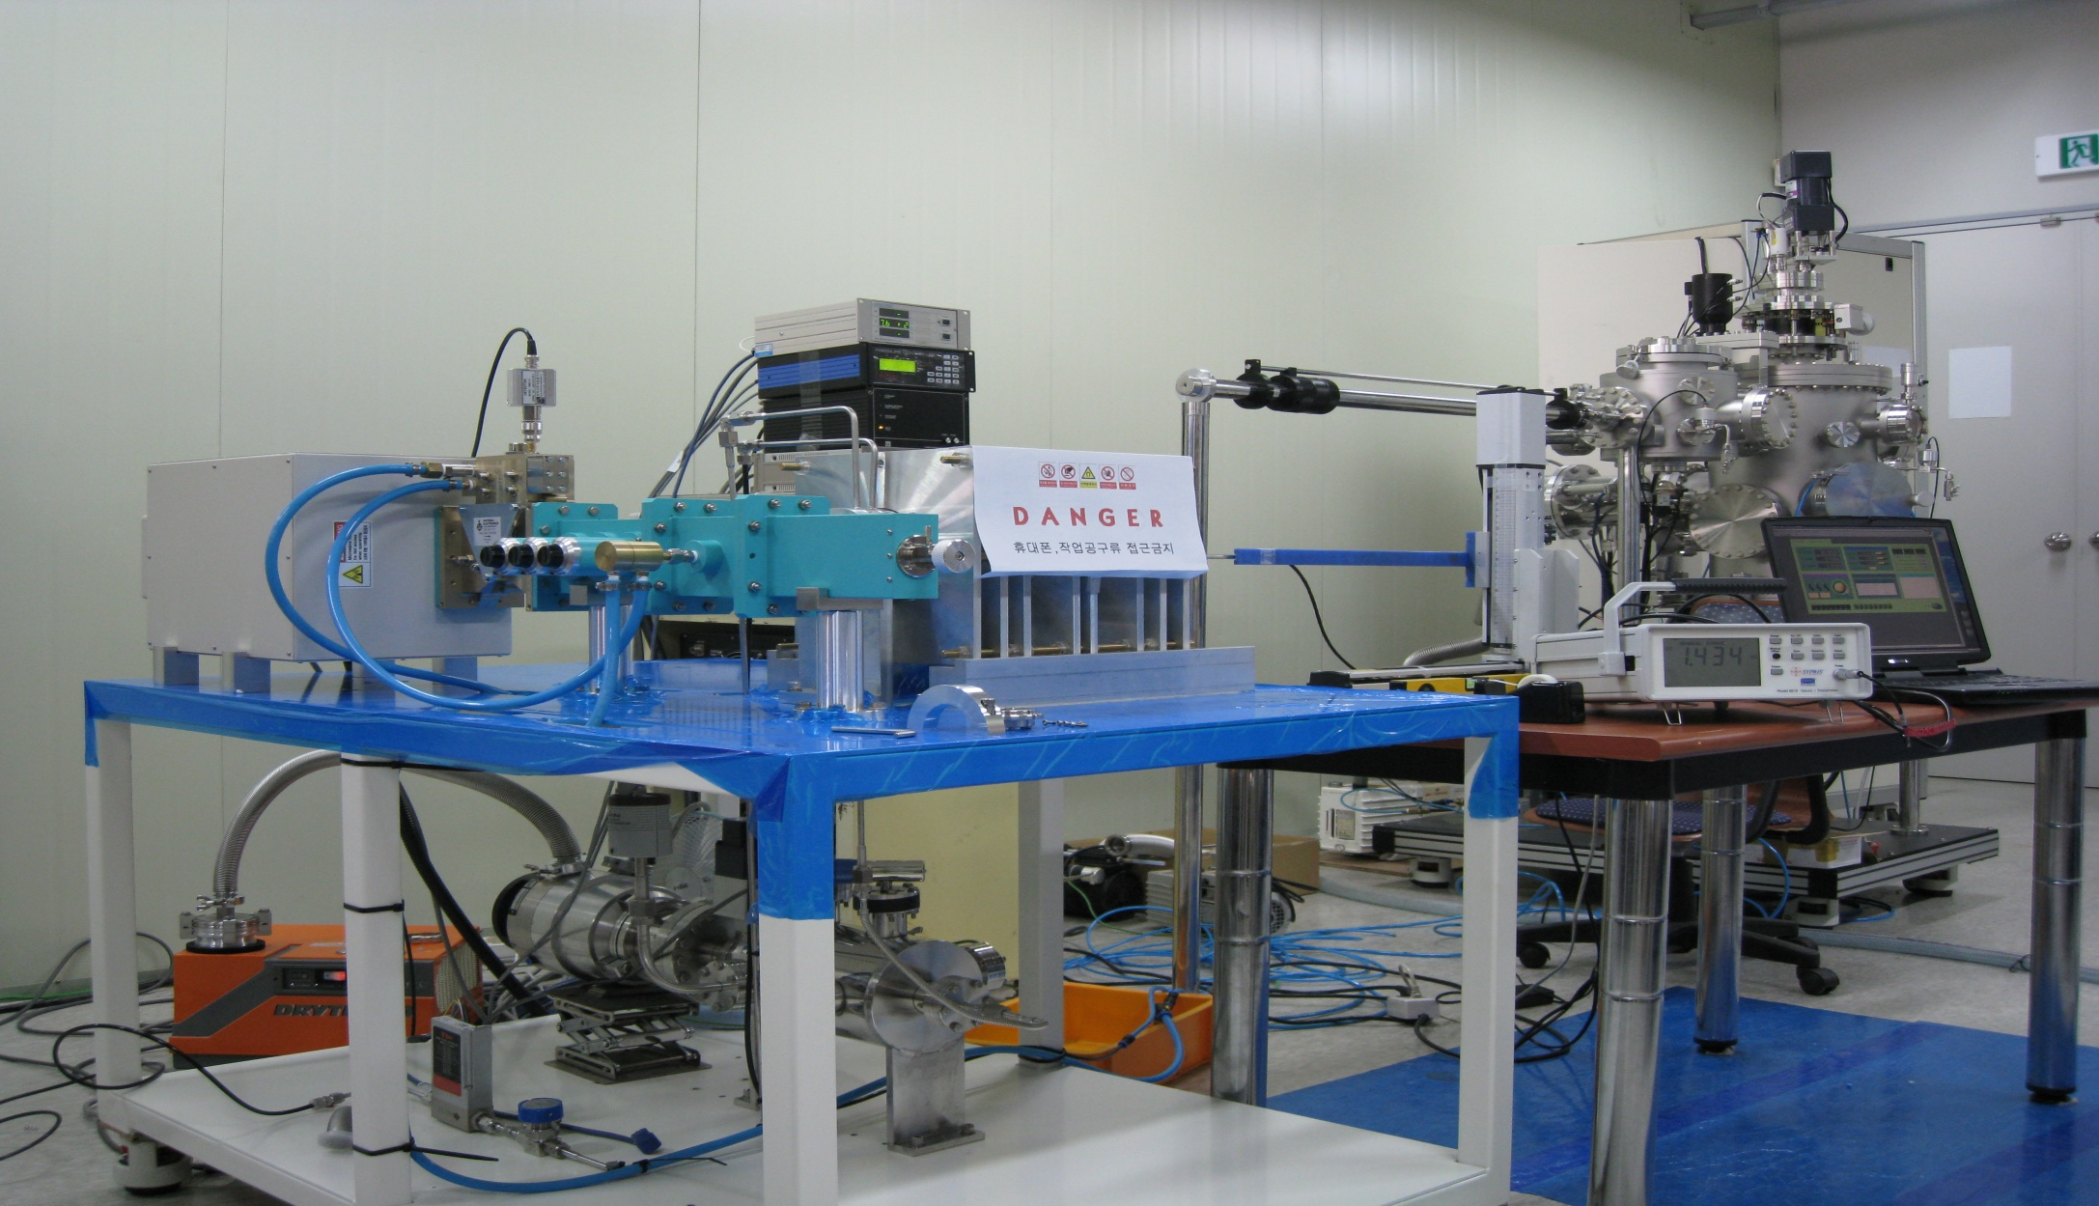
Prototype ECR 이온원 진공 테스트

Slide 27
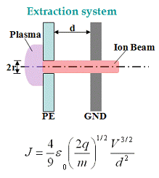
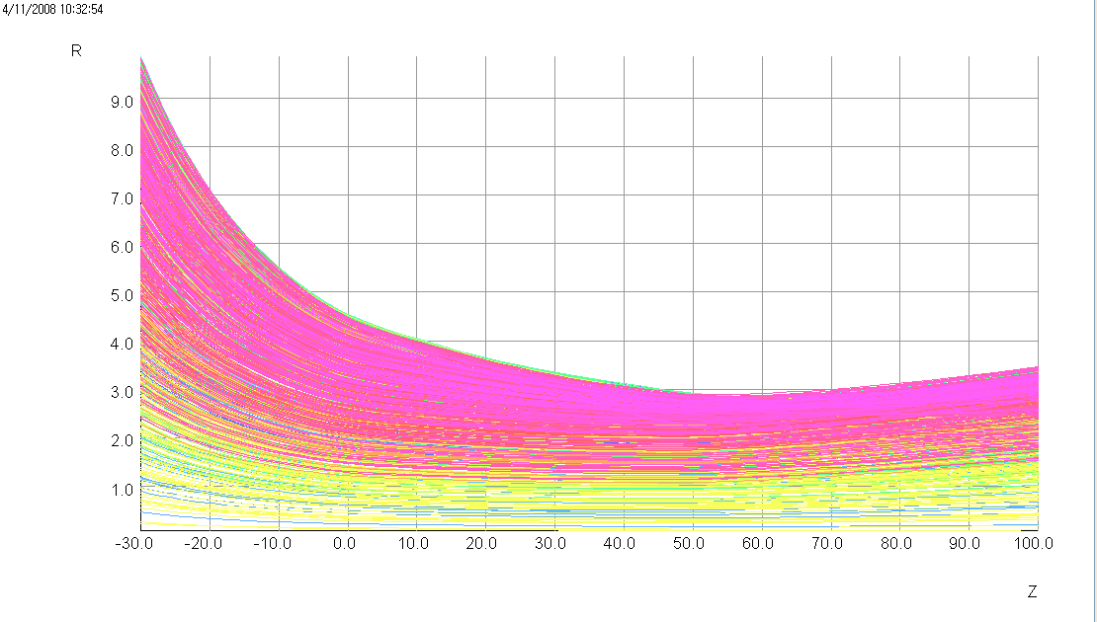
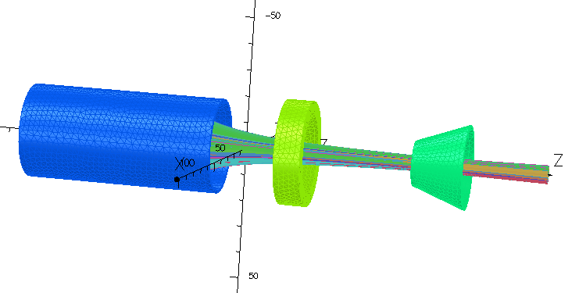
Ion Beam Extraction
이온 빔 Extraction 결과 (인가 전압 10kV)
- 참조 가스로 Ar을 이용하여 2.45GHz ECR 이온원의 성능 평가
Faradaycup을 이용하여 출력이온의 전하량 측정

Slide 28
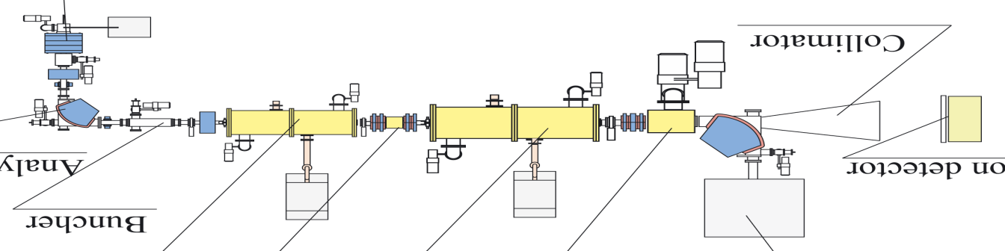
Roadmap
2008
2009
2010
2011
2012
ECR IS
Beam collimator
Analyzing
Magnet
Beam
Buncher
NeutronDetector
ECRIS 설계 및 영구자석 ECRIS 제작
RFQ
re-buncher
Heavy-ion
Linac
Gas Target
Beam dump
ECRIS의 초전도자석 제작 및 2kW RF 제작
수소표적 개발
가속기 설치
차폐설계 및 설치
10kW RF 제작
이온빔 인출 및 이용시설
빔번처제작
중이온선형가속기 도입
중성자 검출기 개발 및 설치
시험가동

Slide 29
감사합니다.

Slide 30
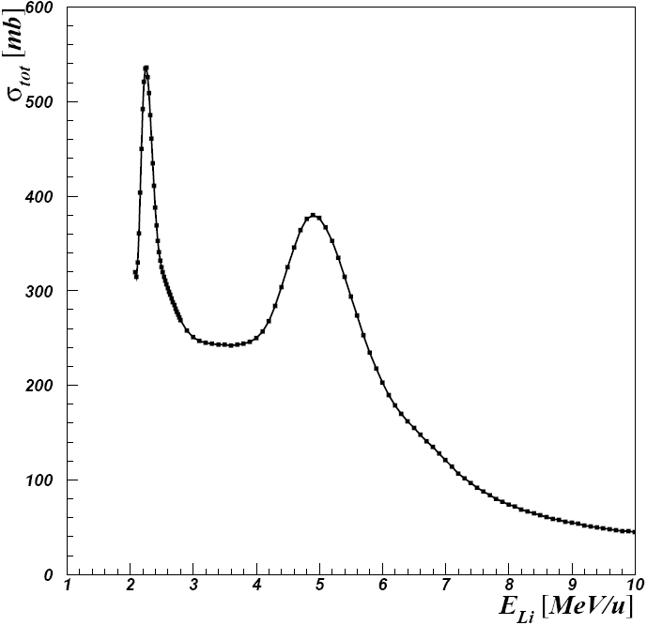
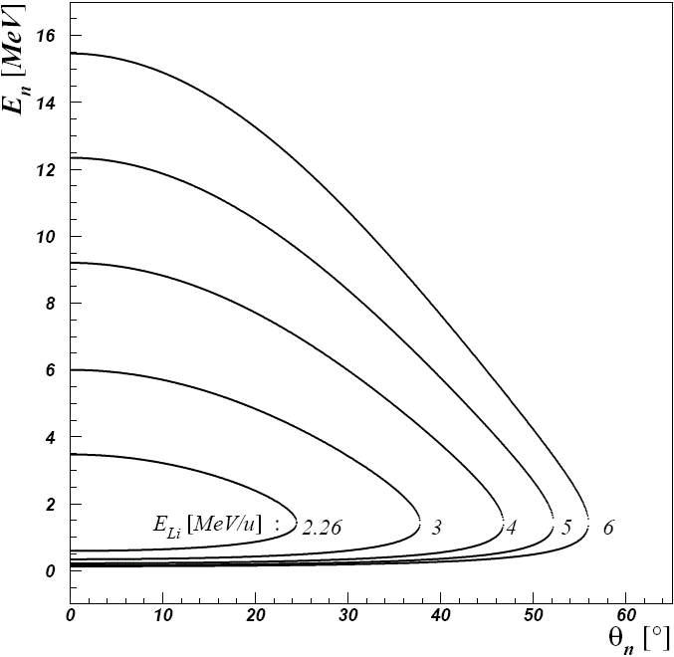
Requirements for Neutron Radiography
Beam flux: Production of 10¹²/s (fast neutrons)
beam intensity: Li^{2~3+} higher than 2pmA
Beam energy : ~2 MeV/u
Gas target : >350 Torr
Neutron detection : High efficiency for fast neutron
Y : neutron Yield
F_{Li} : Beam Flux
ρ : Density
N_{A} : Avogadro constant
A : Atomic Number
L : Target Length
σ : Cross section
Fast neutron flux is
at a ⁷Li⁺³
Beam current of 1mA

